Slide 1

Consult Management Practices:
Consult Setup and Notifications
Dr. David M. Douglas

Slide 2

The Problem with Consults
CPRS Consult Set Up
Notifications
  Renew in CPRS
  Run report in Vista
  VSSC as a backup
Consult Default View
The prompt to complete a progress note
What should be in place at your site?
Q&A

Slide 3

Poll Question
Do staff at your site get prompted to link a CPRS progress note to a consult at the time a New note is created?
    Yes
    No
    Not sure, but I don’t recall seeing it.
Notes:
Now I’d like to ask a poll question.
(usually presenters read the poll question and acknowledge that the possible answers are on the screen)
To answer this question, use the blue polling icon above my head. We’ll move on and come back to your results in just a moment.
[erase these notes and add your own!]

Slide 4

The Problem with Consults
Notes:
Delinquent consults appeared as soon as CPRS was launched
Labor-intensive set-up and maintenance
Difficulty accessing and using data for clean-up
Linked to VA access and scheduling difficulties

Slide 5

VA Consult
> 250,000,000 consults since launch of CPRS
Consults used for clinical and non-clinical purposes
76 cases of Institutional Disclosure of an adverse event related to consults
S
http://cdn2.vox-cdn.com/assets/4492093/VA_FactSheet.pdf

Slide 6
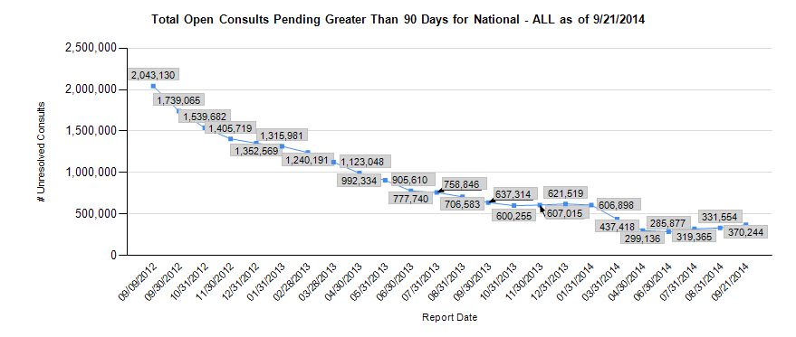
¼ of a Billion Consults since 1999

Slide 7

Needles in a Haystack
Notes:
Needle in a hay stack

Slide 8
Poll Results
Do staff at your site get prompted to link a CPRS progress note to a consult at the time a New note is created?
    Yes
    No
    Not sure, but I don’t recall seeing it.
Notes:
Now let’s pause for a moment and take a look at your poll results.
(Copy and paste the questions and answers here so you can easily remember what the poll question and answers were)
To answer this question, use the blue polling icon above my head. We’ll move on and come back to your results in just a moment.
Ad-lib to the audience results, then advance to move on.

Slide 9
Poll Results
Do staff at your site get prompted to link a CPRS progress note to a consult at the time a New note is created?
    Yes
    No
    Not sure, but I don’t recall seeing it.
Notes:
(Cue to Tech Team that you’re moving on) “Click” again to move on

Slide 10
Consult Set-Up determines who gets consult notifications and who can complete a consult
Set up Consult Services
Select Service/Specialty: Diabetic Retinopathy Surveillance (VANC) Outpt
SERVICE NAME: Diabetic Retinopathy Surveillance (VANC) Outpt
SERVICE INDIVIDUAL TO NOTIFY:
Select SERVICE TEAM TO NOTIFY: DIAB RETINOP SURVEIL CONSULTS
//
Select NOTIFICATION BY PT LOCATION:
PROCESS PARENTS FOR NOTIFS: NO//
Select UPDATE USERS W/O NOTIFICATIONS: DOUGLAS,DAVID M
//
Select UPDATE TEAMS W/O NOTIFICATIONS: TEAMCAC//
Select UPDATE USER CLASS W/O NOTIFS: OPHTHALMOLOGIST
//
Select ADMINISTRATIVE UPDATE USER: DOUGLAS,DAVID M
//
ADMINISTRATIVE UPDATE USER: DOUGLAS,DAVID M//
NOTIFICATION RECIPIENT: YES//

Slide 11
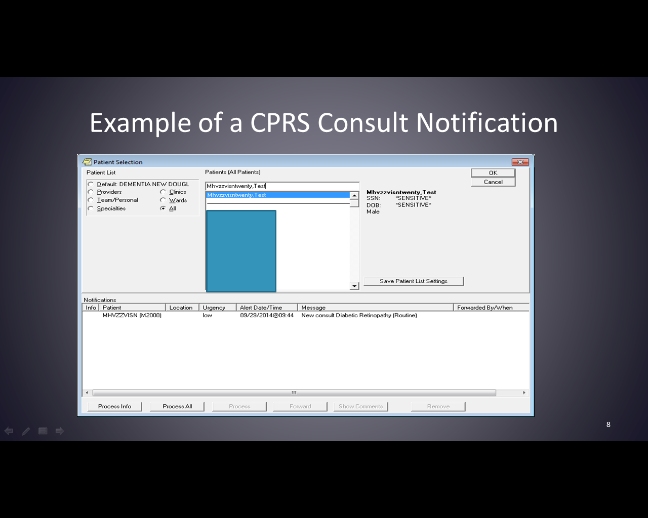
Example of a CPRS Consult Notification

Slide 12
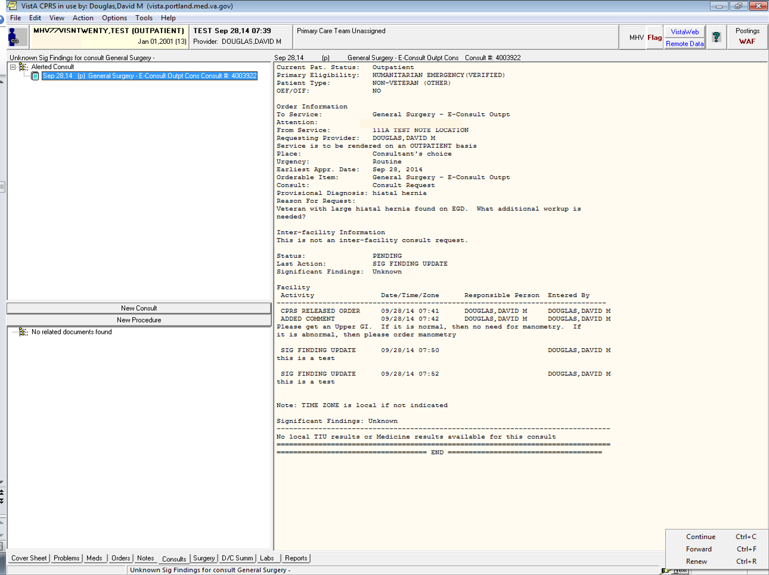
You can RENEW or FORWARD a notification

Slide 13
You can reproduce a list of your notifications in VistA
Notification Listing by Recipient
DATE CREATED from Sep 18,2014 to Sep 24,2014@24:00
START WITH DATE CREATED: Sep 18,2014// (SEP 18, 2014)
GO TO DATE CREATED: Sep 24,2014// (SEP 24, 2014)
START WITH RECIPIENT: // DOUGLAS,DAVID M
GO TO RECIPIENT: // DOUGLAS,DAVID M

Slide 14
Here is the new consult notification you accidentally deleted
ZZZZ,ZZZZ (Z-SSN): New consult Diabetic Retinopathy (Routine) SEP 24,2014 12:54 DOUGLAS,DAVID M
AAAA,AAAA (A-SSN)): Comment Added to Consult PROSTHETICS REQUEST
SEP 24,2014 10:04 DOUGLAS,DAVID M
BBBBB,BBBB(B-SSN): Comment Added to Consult General Surgery Outp
SEP 24,2014 10:40 DOUGLAS,DAVID M
CCCC,CCCC (C-SSN): Labs resulted - [HEMOGLOBIN A1C]
SEP 24,2014 09:38 DOUGLAS,DAVID M

Slide 15
Consult Status Lifecycle
Pending
Active
Scheduled
Partial Results
Complete
Notes:
Pending: A consult order has been placed but has not yet scheduled or otherwise acted upon by the receiving service. Consults should NEVER remain in a Pending status for more than 7 days.
Active: A consult has been accepted by the receiving service but appointment has not yet been scheduled.
Scheduled: An appointment with the consulting service has been made.
Partial Results: A consult note has been initiated, but not yet signed by the consultant.
Complete: A clinical note or administrative action has completed the consult process.
Cancelled: A consult order has been cancelled by the consult service without being acted upon.
Discontinued: An order to discontinue a previously requested consult order.

Slide 16
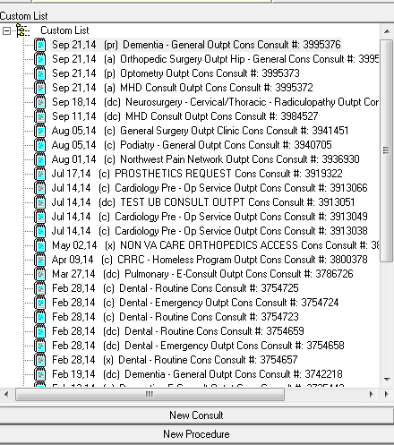
CPRS Default View:
Easy to miss an open consult

Slide 17
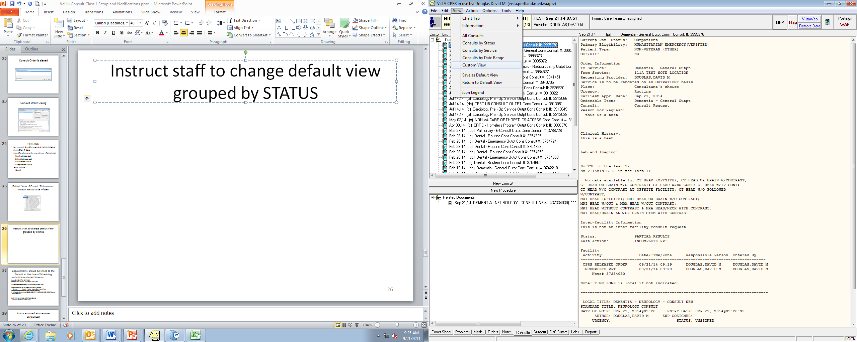
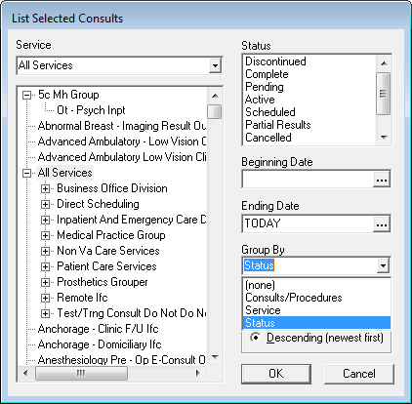
Instruct staff to change default view grouped by STATUS

Slide 18
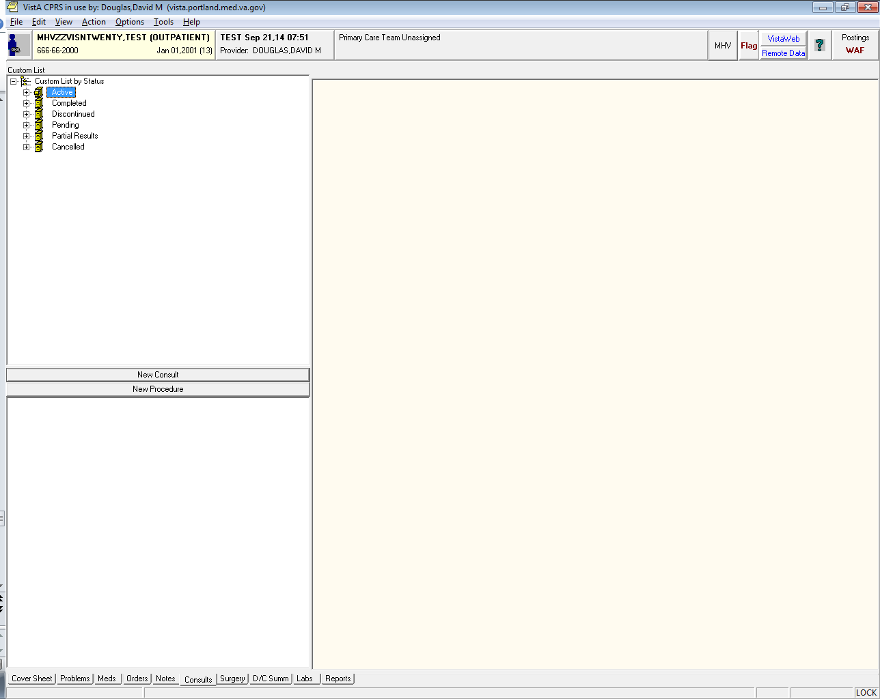

Now it’s easy to spot an open consult!

Slide 19
Appointments should be linked to the Consult at the time of Scheduling
Select Non-MAS Scheduling Menu Option: Make Appointment
Select CLINIC: ORTHO NEW PA-8C --
Select PATIENT NAME: MHVZZVISNTWENTY,TEST
Will this appointment be for a CONSULT/PROCEDURE? YES//
Please select from the list of consult(s), press 0 for none.
# Service Sending Provider Request Date Cons # Reqst
------------------------------------------------------------------------------
1. Orthopedic Surgery Outp DOUGLAS,DAVID M 09/21/14@09:09 3995374 Consult
Select Consult: 1
DATE/TIME: 10-7@130 (OCT 07, 2014@13:30)
30-MINUTE APPOINTMENT MADE

Slide 20
Status automatically becomes SCHEDULED
CPRS RELEASED ORDER 09/21/14 09:09 DOUGLAS,DAVID M
RECEIVED 09/21/14 09:12 DOUGLAS,DAVID M schedule appt
SCHEDULED 09/21/14 09:12 DOUGLAS,DAVID M ORTHO NEW PA-8C Consult Appt. on 10/07/14 @ 13:30

Slide 21
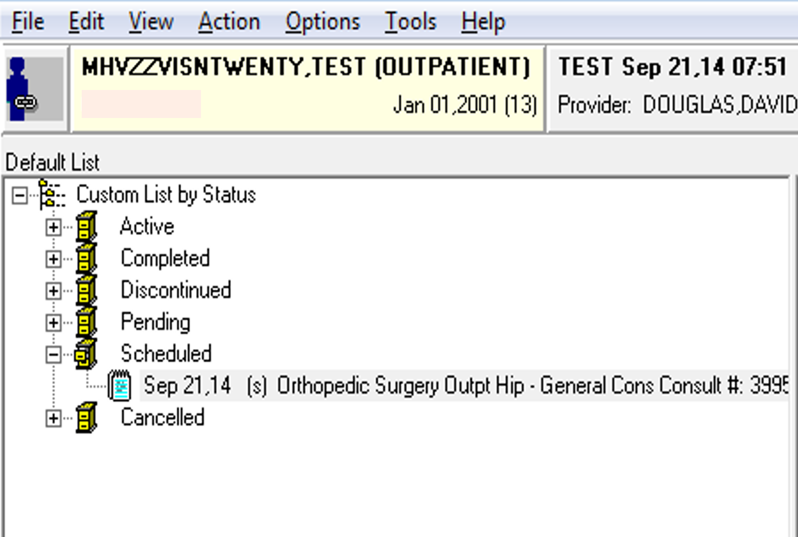
Consult status is now SCHEDULED
Notes:
Consult is now teed up for the consultant to easily see it and then use one of 2 ways to link the note to the consult

Slide 22
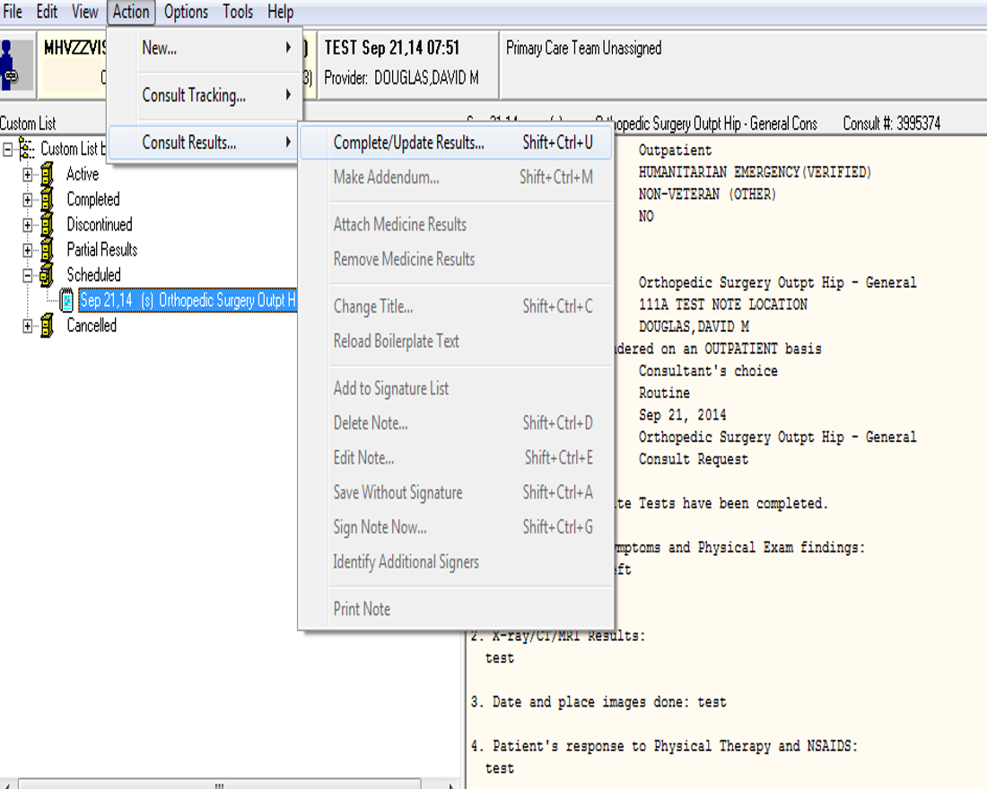
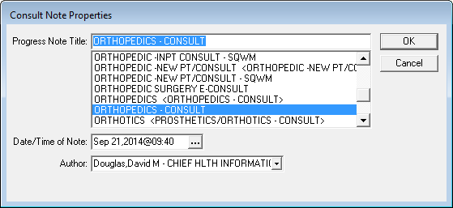
Consult Tab Method to link your note to the consult

Slide 23
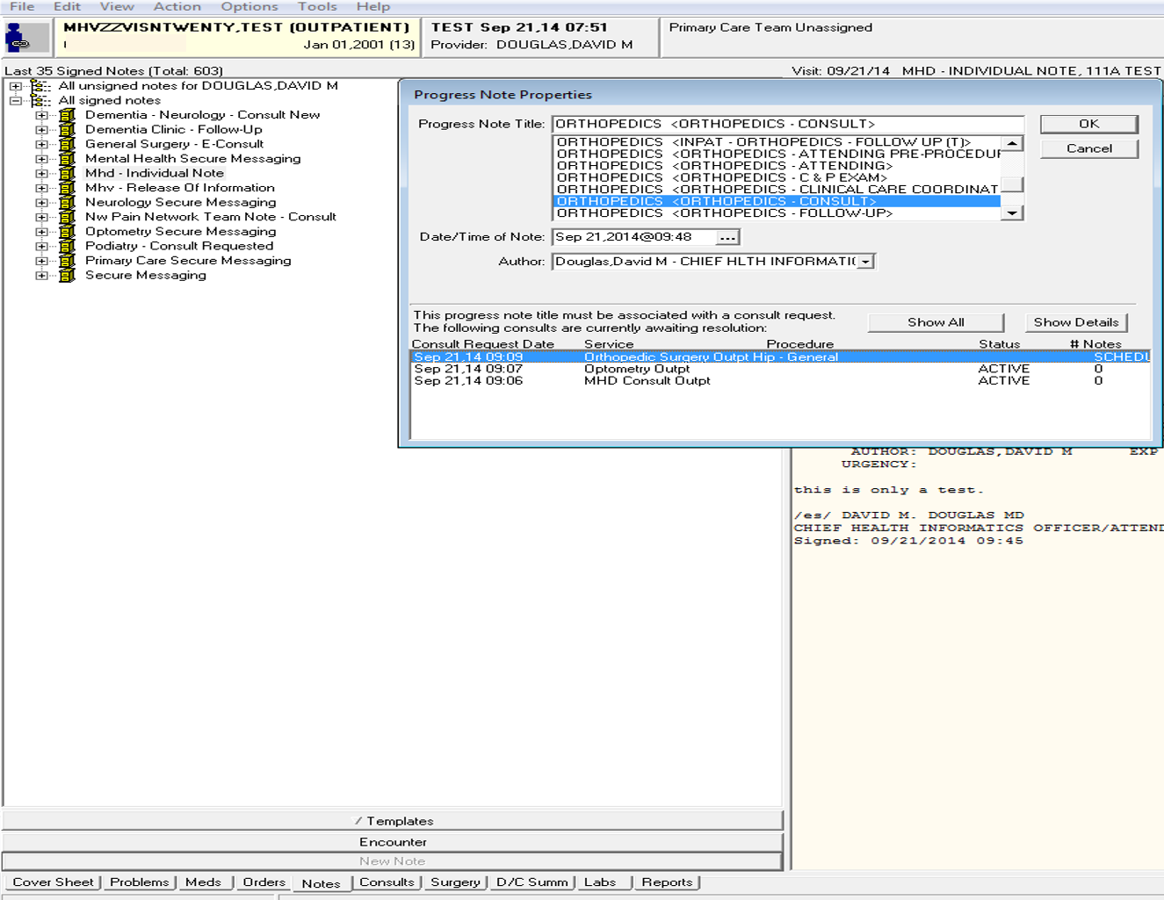
Notes Tab method

Slide 24
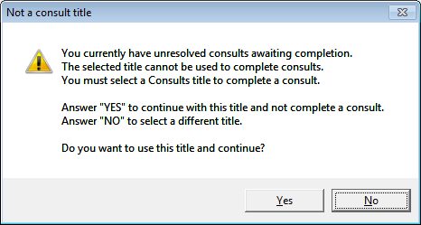
Warning: You are choosing a note title that will not complete the consult

Slide 25
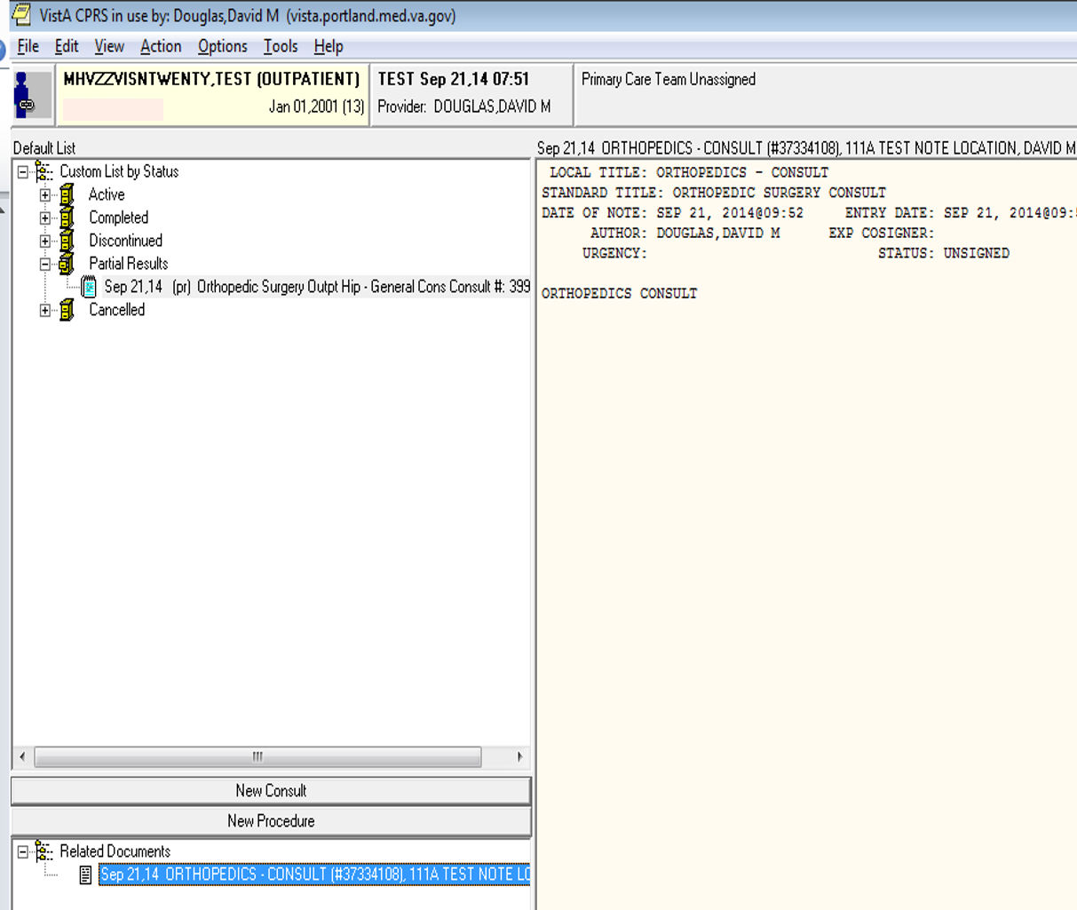
When this note is signed, the status will change to COMPLETED

Slide 26
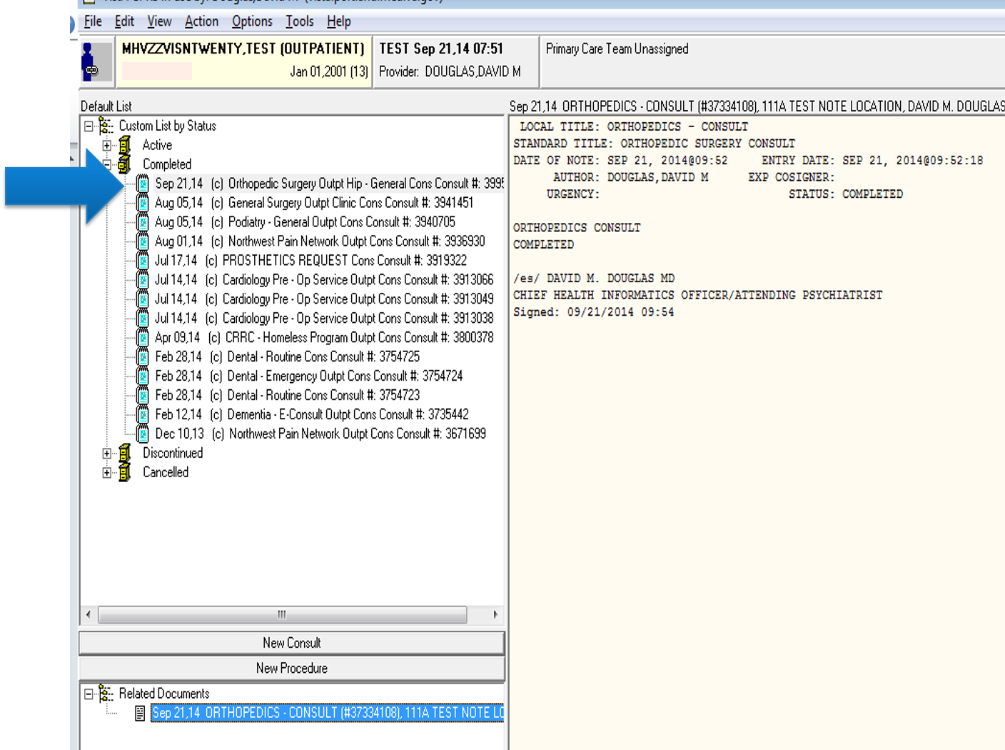
Completed Ortho Consult

Slide 27

How could this process
Consultant is not set up to be able to complete the consult

Slide 28
How could this process
Consultant is not set up to be able to complete the consult
No prompt has been set up

Slide 29
How could this process
Consultant is not set up to be able to complete the consult
No prompt has been set up
Consultant bypasses the prompt

Slide 30
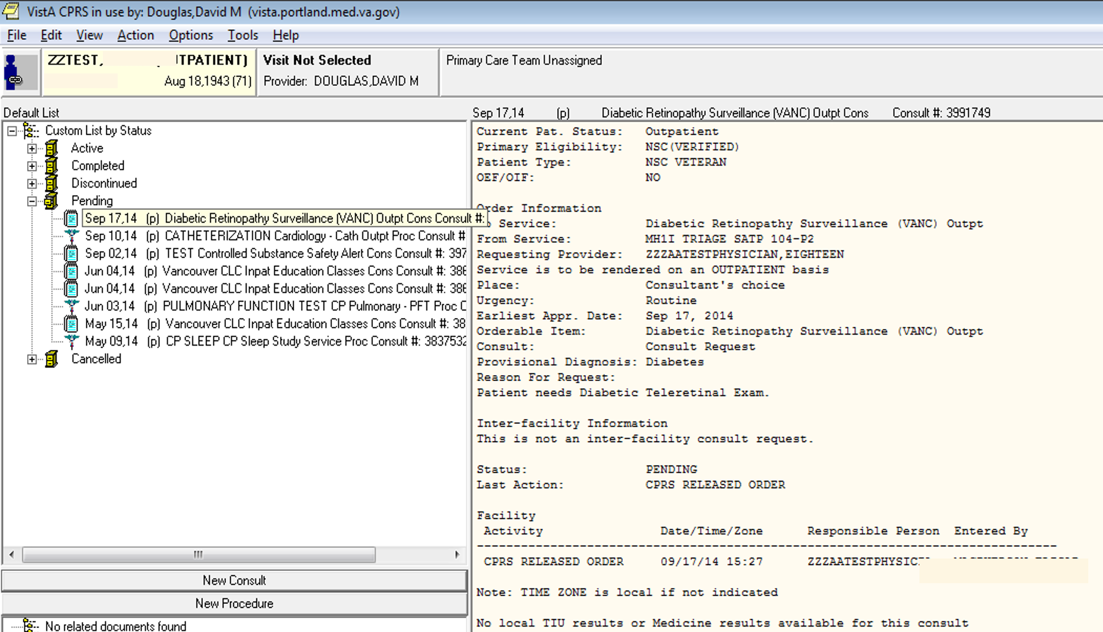
Notes:
For this example, we have an open (pending status) Diabetic Retinopathy Surveillance that we wish to complete.

Slide 31
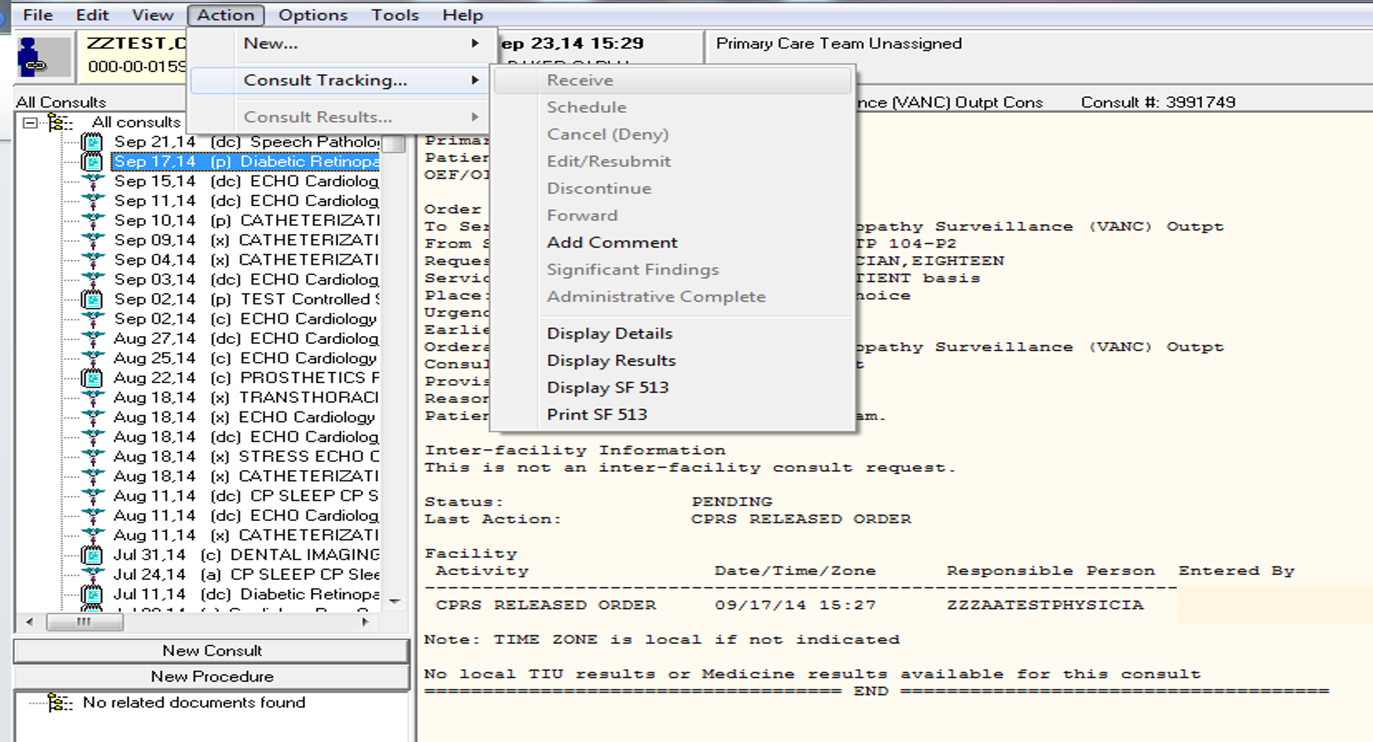
Notes:
The user then moves to the consult tab and clicks on that consult. The user then goes to the Action Tab and views the actions available in the drop down menu. This user does not have access to take any action on this consult except that of adding a comment.

Slide 32
Check the consult update status in Vista
Select Consult Management Option: ua Determine users' update authority
This option will allow you to check a user's update authority for any given
service in the consults hierarchy. If the PROCESS PARENTS FOR UPDATES field
is set to YES, all ancestors of the selected service will be checked.
The type of update authority and the service to which they are assigned will
be displayed.
Select Consult Service: Diabetic Retinopathy Surveillance (VANC)
Choose user to check for update status: DOUGLAS,DAVID M
This user has no update authority
(Now we know why the user was not linking his notes to the consult and we have to fix it!)

Slide 33
Select Consult Management Option: ss Set up Consult Services
Select Service/Specialty: Diabetic Retinopathy Surveillance (VANC)
Select UPDATE USERS W/O NOTIFICATIONS: (We add the user needing access at this prompt. An UPDATE USER can complete a consult with a consult note)DOUGLAS,DAVID M CHIEF HLTH INFORMATICS OFFICER
Are you adding 'DOUGLAS,DAVID M' as
a new UPDATE USERS W/O NOTIFICATIONS (the 11TH for this REQUEST SERVICES)? N (the default is No so we type Y for Yes) o// Y

Slide 34
Check your work
Select Consult Management Option: ua Determine users' update authority
Select Consult Service: Diabetic Retinopathy Surveillance (VANC) Outpt
Choose user to check for update status: DOUGLAS,DAVID M
CHIEF HLTH INFORMATICS OFFICER
This user is an update user for:
Diabetic Retinopathy Surveillance (VANC) Outpt

Slide 35
What should be in place at your site?
Post Consult service staff contact info on your intranet
Train staff in careful management of consult notifications
Instruct staff to change Consults Default View to Grouped by Status
Use CPRS Prog Note prompt to train existing and new staff to link notes to the consult

Slide 36

What Every Clinician Should Know About Common Consult Problems & Using VSSC Data to Fix
What Every Clinical Leader Should Know About Consults, No Shows & Cancellations
What Every VA Clinician & Resident Needs to Know About Consults
Consults and Non VA Care
Notes:
Thank you for joining us this morning. If you have questions, please feel free to use the ask the presenter icon and I will answer them via email.
I will see you back here today for several upcoming sessions.

