Slide 1

Usability as a Health IT Development Requirement
William Plew
Ross Speir

Slide 2

“Usability is one of the major factors – possibly the most important factor – hindering widespread adoption of EMRs.”
“Improving EHR usability… is an important goal for our nation’s health care system.”
“…98% of software designed for the US government was ‘‘unusable as delivered.
Notes:
Ross
The importance of usability for VA health IT systems cannot be overstated. There have been a number of articles about usability -- published in journals and by medial associations such as AMIA and HIMMS – and they’ll describe
- the effects that poor usability in HIT system have on the clinicians and patients.
- and they’ll call for developers of next-generation HIT systems, to put usability at the forefront of the design process. To make usability a priority; a requirement.
And this is what our talk is about… strategies you can apply to VA HIT development projects that can make usability a measureable outcome of a deployed system.
The strategies we will be discussing can be applied to VA HIT development projects (or even procurement projects). And the presentation is geared toward VA Stakeholders or Business owners, Project managers and Business analysts , and even SMEs or user advocates who are part of a project team.
So before we get started, let’s see who we have in attendance today.

Slide 3

Poll Question
What role do you have or would you likely have in a VA health IT project?
Stakeholder
Project Manager
Development Team Member
Subject Matter Expert
Usability Specialist
Health IT User
Notes:
Bill
Now I’d like to ask a poll question.
What role do you have or would you likely have in a VA health IT project?
Stakeholder
Project Manager
Development Team Member
Subject Matter Expert
Usability Specialist
Health IT User
To answer this question, use the blue polling icon above my head. We’ll move on and come back to your results in just a moment.

Slide 4

Objectives
Notes:
Ross
As you are responding, let’s talk about what we want to achieve in out time together.
The purpose of this presentation is to help YOU:
Understand how usability is defined and operationalized
Understand causes of usability problems in VA HIT systems, and understand how these problems negatively impact VA business objectives of HIT systems (being developed or procured)
Understand how usability, when ‘engineered’ into the HIT design, will enable end users to carry out their work more effectively, more efficiently, and with fewer errors and fewer workarounds.
Understand 3 types of non-functional ‘usability’ requirements that can be applied to VA HIT projects;
in-house development
contractor development
COTS (Commercial Off-the-shelf) procurement

Slide 5
Poll Results
What role do you have or would you likely have in a VA health IT project?
Stakeholder
Project Manager
Development Team Member
Subject Matter Expert
Usability Specialist
Health IT User
Notes:
Bill
Now let’s pause for a moment and take a look at your poll results.
What role do you have or would you likely have in a VA health IT project?
Stakeholder
Project Manager
Development Team Member
Subject Matter Expert
Usability Specialist
Health IT User
Ad-lib to the audience results, then advance to move on.

Slide 6

Poll Results
What role do you have or would you likely have in a VA health IT project?
Stakeholder
Project Manager
Development Team Member
Subject Matter Expert
Usability Specialist
Health IT User
Notes:
Click again…

Slide 7
Usability is NOT…
Notes:
Ross
To begin the talk, we need to have a shared understanding of ‘usability.’
And I find it helpful to begin by first addressing some common misconceptions about usability.
So what is usability NOT?

Slide 8
Usability is NOT…
Intuition or common sense
Notes:
Ross

Slide 9
Usability is NOT…
Intuition or common sense
Graphic or visual design
Notes:
Bill

Slide 10
Usability is NOT…
Intuition or common sense
Graphic or visual design
User or stakeholder opinion
Notes:
Ross

Slide 11
Usability is NOT…
Intuition or common sense
Graphic or visual design
User or stakeholder opinion
Tacked on at the end
Notes:
Bill

Slide 12
Usability is…
extent to which a system, product or service can be used by specified users to achieve specified goals with effectiveness, efficiency and satisfaction in a specified context of use
ISO 9241-210
Notes:
Ross
[Read definition]
“This make makes usability a goal (a requirement) for interactive systems.
So, usability requirements provide a systematic approach to designing and testing HIT systems, to ensure that intended users can carry out their intended tasks within a specified context of use.

Slide 13
Usability IS…
Notes:
Bill
So now let’s talk about how good ‘usability’ is achieved

Slide 14
Usability IS…
Addressed early in design
Notes:
Bill

Slide 15
Usability IS…
Addressed early in design
Based on science and evidence
Notes:
Ross
by applying evidence-based UI standards,
by applying human factors engineering to design systems around how people think, work, collaborate, make decisions
by utilizing human factors methods to engage users throughout HIT design, development, and testing.

Slide 16
Usability IS…
Addressed early in design
Based on science and evidence
Testable
Notes:
Bill
[talk about the ability to test a system against specified users carrying out specified tasks in specified contexts]

Slide 17
Usability IS…
Addressed early in design
Based on science and evidence
Testable
Critical to business success
Notes:
Ross
“To the extent that the business objectives of a HIT system
are dependent on intended users being able to carry out their tasks efficiently, effectively, and safely –
usability is critical to business success.”
Conversely, poor usability can compromise business success.
Segue: causes of poor usability with Health IT systems

Slide 18

Design
Conventions
Wording and
Labels
Page Layout
Affordances
Notes:
Bill
“Designing Usable systems involves following basic principles of good design.“
When these principles are not followed, some common issues with usability include the following:
The UI deviates from design conventions and standards
Page layout is cluttered and not well organized
Labels are unintuitive
System affordances are not apparent, leaving user uncertain about what actions they can take

Slide 19
System Task-Flow
System Navigation
Information Display
Notes:
Ross
“Designing Usable systems involves designing the user interface to ‘fit’ with the way users think;
they way they can best visualize and understand information,
and supports good decision-making.”
Usability problems occur when
System navigation inconsistent with user mental representation
Disconnect between system task-flow and user thought-flow
Information display not designed to augment understanding and decision-making

Slide 20
macro-usability
Notes:
Bill
“Highly-usable systems are designed to work within the intended context of use.”
System fails to interoperate seamlessly with other HIT systems
System design does not account for environmental factors
System is not designed to promote care-team coordination
System does not align with clinical workflow
“Designing highly-usable health IT applications requires thinking about usability from a ‘systems’ perspective.”

Slide 21
Tasks
Organization
Systems Engineering Initiative for Patient Safety: framework for work system elements
Processes
Outcome
People
Tools
Technologies
Physical Environment
Notes:
Ross
[discuss model]
Points:
- the context of use is critical for designing and testing for usability
- changes to a complex system → unintended consequences
Bill
To surmise, usability involves a “systems” style of approach that includes everything.
But what about when a system isn’t properly evaluated? Well let’s take a look at a few impacts of poor usability.

Slide 22

Impacts of poor usability
Notes:
Bill
Frustration → low morale

Slide 23

Impacts of poor usability
User frustration
Notes:
Bill

Slide 24

Impacts of poor usability
User frustration
Increased task time
Notes:
Ross

Slide 25

Impacts of poor usability
User frustration
Increased task time
Work-arounds
Notes:
Bill

Slide 26

Impacts of poor usability
User frustration
Increased task time
Work-arounds
User error
Notes:
Ross

Slide 27

Impacts of poor usability
User frustration
Increased task time
Work-arounds
User error
Training costs
Notes:
Bill

Slide 28

Impacts of poor usability
User frustration
Increased task time
Work-arounds
User error
Training costs
HIT system re-work
Notes:
Ross
Lastly,
“Post-deployment usability assessment.”

Slide 29
Poll Question
What is the biggest impact of usability problems with some of the health IT systems that you have used?
User frustration
Increased task time
Work-arounds
User error
Notes:
Bill
Now I’d like to ask a poll question.
What is the biggest impact of usability problems with some of the health IT systems that you have used?
User frustration
Increased task time
Work-arounds
User error
To answer this question, use the blue polling icon above my head. We’ll move on and come back to your results in just a moment.

Slide 30

Engineering usability into
Health IT system
development and procurement
Notes:
Ross
“The costs of poor usability of a HIT system can be significant.”
[financial, employee morale, care quality]
“So the VA has invested in establishing a program office to help engineer usability into VA HIT systems.” This program office is part of Health Informatics, it’s call the Human Factors Engineering office,
- Bill and I
What is Human Factors Engineering?
Bill
Human Factors Engineering (the engineering discipline):
Is based on the science of human abilities, human limitations, and other human characteristics that are relevant to design. And Human factors engineers apply this information to the design of tools, tasks, environments, and systems – to optimize safe, comfortable, and effective human use.
Role of HFE program office is to
1) Help understand which factors in a clinical system could effect safe and effective human use
2) Help design user interfaces the capitalize on human abilities, and compensate for human limitations
3) Uncover sources of usability problems in VA HIT systems (before a project begins or as part of system implementation

Slide 31
Poll Results
What is the biggest impact of usability problems with health IT systems you have used?
User frustration
Increased task time
Work-arounds
User error
Notes:
Bill
Now let’s look at your poll results. The question was:
What is the biggest impact of usability problems with health IT systems you have used?
Ad lib to the audience results

Slide 32

Poll Results
What is the biggest impact of usability problems with health IT systems you have used?
User frustration
Increased task time
Work-arounds
User error
Notes:
Click again…

Slide 33

usability engineering
Notes:
Ross
We are going to talk about some of the costs of investing in usability. But first, I’d like to talk about the return an investment in engineering usability into HIT systems.
Numerous research studies quantifying and estimating ROI,
Every $1 investment yields a $10-100 return
Cost to fix a usability problem:
$1 early in design
$10 late in development
$100 after release
Important to note:
Costs of poor usability are costs to the organization / business (task efficiency, system rework)
Costs of engineering usability into HIT development are costs primarily to the team

Slide 34
Investing in usability
Notes:
Bill
Let talk about some of the costs associated with engineering usability into HIT system development:

Slide 35
Investing in usability
Additional project work
$
Notes:
Bill

Slide 36

Investing in usability
Additional project work
Extended project time
Notes:
Ross

Slide 37

Investing in usability
Additional project work
Extended project time
Additional technical skills
Notes:
Bill
- UI designers
- usability specialists
- human factors engineers

Slide 38

Investing in usability
Additional project work
Extended project time
Additional technical skills
Modified process
Notes:
Ross

Slide 39

Investing in usability
Additional project work
Extended project time
Additional technical skills
Modified process
Access to intended users
Notes:
Bill
<challenges in the VA getting clinicians’ time >

Slide 40

Finding the right level of effort
  Costs of usability investment
  Costs of poor system usability
Notes:
Ross
Let’s talk for a moment about how to weigh these investment costs against the costs of poor usability.
Every VA HIT project is unique: must weigh investment costs against
- risks and impact of poor usability on business goals
Bill
1) A sophisticated, safety-critical application that needs to integrate into a complex clinical environment
VS. an informational website
→ Risk of problems
2) A system-wide application intended for large number of users (high salaried)
VS. a specialized application for a small number of users
→ Cost of task inefficiencies (time) to organization
3) Design or purchase of an application that’s never been used in the VA
VS. deployment of an application to a VISN that’s already in use at a neighboring VISN
→ Lower risk
Ross
To determine the appropriate level of usability investment in your project…
- business objectives ← risks and impacts of poor usability
- HF Engineer → engineer usability into HIT design and development
(plan a process that will minimize costs to the project team and maximize the return on your investment)

Slide 41



Non-functional requirements supporting Health IT usability
User Interface Standards
User Performance Objectives
User-Centered Design Process
Notes:
Bill
“There are basically 3 ways you can engineer usability in your HIT system; in other words, 3 types of usability requirements for HIT projects.
“For the remainder of this presentation, we will describe each type of requirements in more detail and talk about implementation strategies

Slide 42

VA project
STAKEHOLDERS must take responsibility for
HIT system usability
Notes:
Ross
“In my experiences, every member of the project team cares deeply about system usability. Everyone wants to deliver a product that helps users do work more efficiently and effectively.
It is also my experiences –
Usability is achieved when the HIT system’s stakeholders take ownership of system usability.
Why?
Understand the business objectives, best able to identify risks of sub-optimal usability
Represent the people (end users) who will benefit from highly usable systems
must make decisions about the appropriate level of usability investment required for their HIT project
Usability engineering requires access to end users

Slide 43

Requirements for HIT System Usability:
User Interface Standards
Notes:
Bill
The FIRST type of usability requirement is the User Interface Standard.
[Define User Interface Standards]
Benefits
Good design
Consistency within and across applications
Easier for developers

Slide 44


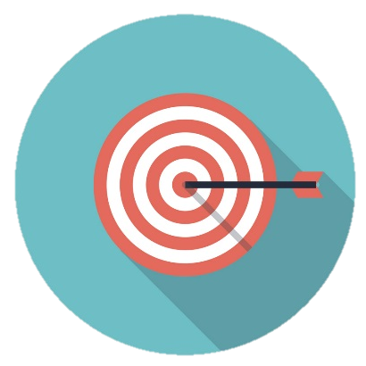
User Interface Standards
  Published Standards
  Usability Heuristics
  Compliance Regulations
Notes:
Ross
Discuss various types of UI Standards
Segue: 1st

Slide 45
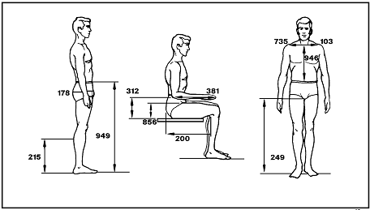
HFS 300 Guidelines for Using Anthropometric Data in Product Design (2004)
Notes:
Bill
Standards are based on measurements of the human population
[Data about human body dimensions…

Slide 46
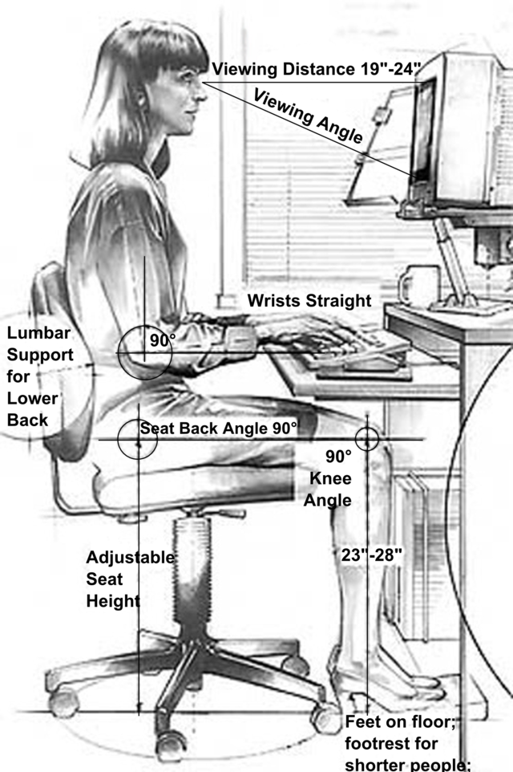
American National Standard for Human Factors Engineering of Visual Display Terminal Workstations (1988)
Notes:
Bill
… inform standards for designing the physical environment.
Benefits of standards-based workstations: the physical environment is designed to ‘fit’ the physical body
Benefits to the organization:
Minimize fatigue
increase satisfaction and productivity
configurable for a range of body types

Slide 47

vision
hearing
Notes:
Ross
Likewise, measurements of the human perception and cognition provide standards for designing interactive systems

Slide 48

Notes:
Bill
Luminance and background contrast ratios
Icon designs
Auditory signals
Menu designs
Form designs
Standards for mobile apps
Ross
Discuss how to implement into HIT system requirements

Slide 49

Usability Heuristics
Notes:
Bill
Define usability heuristics
Examples
Aesthetic and minimalist design
Visibility of system status
Help users diagnose and recover from errors
Ross
Discuss how to get these implemented as system requirements for VA HIT
i.e. Heuristic Evaluation

Slide 50

Compliance Regulations
Notes:
Bill
Discuss HFE Compliance Regulations for Mobile Devices
- Discuss Compliance Regulations (Usability Heuristics and UI standards)
- Discuss reviews process: HE and UI inspection
HEs are based around 10 usability heuristics which are considered an industry standard
UI Certs are based on VA established standards in which the following categories are evaluated: Consistency, Errors, Frequent Interactions, Modal Tasks, Readability, Sound, User Input, and Testing

Slide 51


integrating UI Standards into VA HIT development or procurement projects
Guidance for
Notes:
Bill
Clicking the green download button will give you access to references to:
User Interface Standards
Usability Heuristics
Method description for evaluating violations of usability heuristics (Heuristic Evaluation)

Slide 52
Requirements for HIT System Usability:
User Performance Objectives
Notes:
Ross
The SECOND type of usability requirement is the User Performance Objective.
[describe]
Scenarios of use (common, critical, complex) for business success
Types of user performance objectives:
1. Criteria based on specific user performance measures (X% of a sample of the intended users should accomplish Y% of the benchmark tasks within M minutes and with no more than E errors.” requires independent SUT; pro: cut and dry; con: limitation: expensive to test and
- from baseline measures
2. Criteria based on issues severity (“no critical usability issues” works well with Agile dev because lower priority but easily addressed issues can be addressed if schedule permits)

Slide 53

Specifying User Performance Criteria
Notes:
Bill
Measures must be based on something: baseline data from legacy system or concept designs of new system
MHV example of performance criteria

Slide 54

Validation through Usability Testing
Notes:
Bill
Representative users carry out representative tasks in the context of use
Purpose of the test
Identify usability problems
Get user recommendations on usability improvements
Assess measures of efficiency, effectiveness, and satisfaction
- By effectiveness we mean task completion, errors, recovery from errors
- By efficiency: task time, keystrokes
- By satisfaction: well, the users satisfaction with (or experience with) carrying out those specified tasks

Slide 55
Formative and Summative Testing
Notes:
Ross
[similarities: users, tasks, context]
[contrasts:
Purpose (diagnose and understand vs. validate)
Execution (think aloud vs. measure)

Slide 56

Specifying Issue-Severity Criteria
Notes:
Bill
Discuss Usability Issue severity
- Serious
- Moderate
- Minor

Slide 57
Validating User Performance Objectives
Stakeholder Acceptance
Stakeholder Requirements
Scenarios of Use
Design
Assess
Understand
User Performance Objectives
User Personas
Usability Testing Objectives
Usability Test Measures
Notes:
Ross

Slide 58
integrating User Performance requirements into VA HIT development or procurement projects
Guidance for
Notes:
Bill
Clicking the green download button will give you access to references to:
Method descriptions for planning and conducting Formative Usability Tests and Summative Usability Tests
Ranking system for usability findings
Publication details the various roles of clinicians in eHR Usability testing

Slide 59
Requirements for HIT System Usability:
User-centered Design Process
Notes:
Ross
The THIRD type of usability requirement is the process for engineering usability into HIT systems is called UCD (HCD)
UCD is a user interface design process that focuses on
- usability goals
- characteristics of intended users
- tasks and workflow
- work environment (context of use)
UCD follows a series of well-defined methods and techniques for
- user analysis
- UI design
- usability evaluation
- and integration into the clinical socio-technical environment
Bill
ISO standards
best practices for user-centered design of interaction systems
Usability testing methods
Practices for the design for mental workload
6 principles of engineering usability into the system development from ISO Standards

Slide 60
Principle 1: Apply evidence-based UI standards
Notes:
Bill
As we’ve discussed…
ISO 18036:2003 provides a consistent set of icons applying to function such as Back, Forward, Refresh, Home, Search, Print, & Stop
ISO 9241-303:2011 establishes image-quality requirements, as well as providing guidelines for electronic visual displays.

Slide 61

Principle 2: Plan a UCD process that supports business objectives
Notes:
Ross
For interactive HIT Systems: Business objectives <<- usability
In my experience at the VA,
All members of the project team (PMs, analysts, developers) are very committed to designing usable HIT systems.
But the project team also values (and is held accountable to) project scope, costs, and deadlines.
And therefore, a successful integration of usability requires that UCD be factored into the project scope, costs, and deadlines. The usability requirements must be specified up front!
[discuss UCD methods]

Slide 62

Principle 3:
Understand users and the context of use
Notes:
Bill
Discuss in the context of user requirements

Slide 63

Principle 4:
Iterate the user interface design
Notes:
Ross
Importance of design, test, and re-design
To achieve optimal design:
- get feedback through rapid assessments of low-fidelity designs
- move towards rigorous usability testing of high-fidelity, interactive designs.
Interactive designs don’t have to be coded (can be visual models)

Slide 64
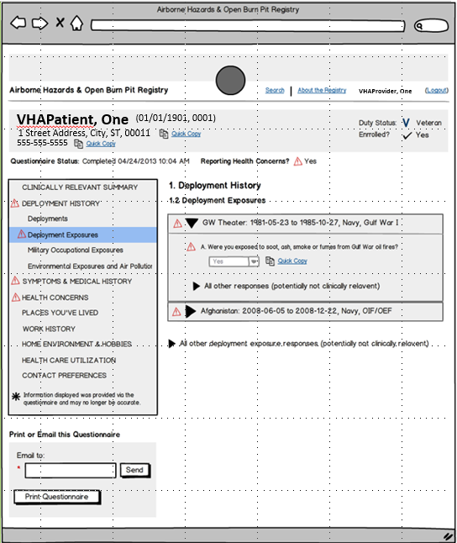
Specification
/ Mockup
1
Notes:
Bill

Slide 65
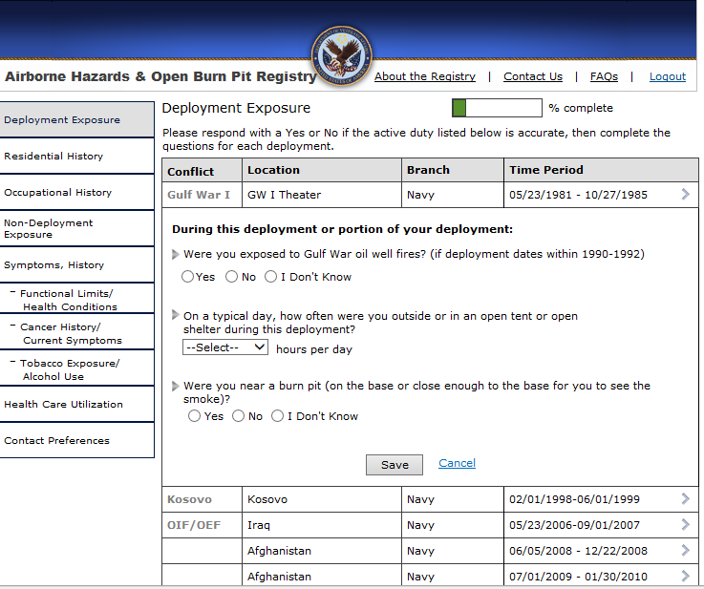
2
Wireframe
Notes:
Bill

Slide 66
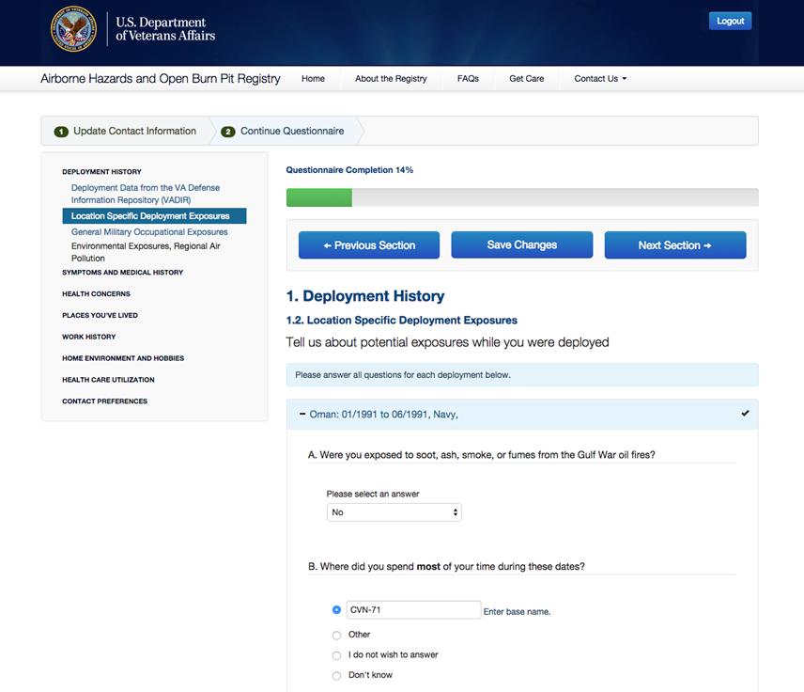
3
Interactive Model
Notes:
Bill

Slide 67
Roles
Notes:
Ross
Roles in the UI design process

Slide 68
Roles
Stakeholders are not Users
Notes:
Ross

Slide 69
Roles
Stakeholders are not Users
Developers are not Designers
Notes:
Ross

Slide 70
Roles
Stakeholders are not Users
Developers are not Designers
Designers are not Users
Notes:
Ross

Slide 71
Roles
Stakeholders are not Users
Developers are not Designers
Designers are not Users
Users are not Designers
Notes:
Ross

Slide 72
Poll Question
Which one of these roles is NOT performing their responsibilities?
The Stakeholder drafts up a rough UI sketch of what they’d want.
The Usability Professional suggests a particular test based on what they feel will work best for the project.
The Developer begins to make changes to the HIT system based on feedback from a Doctor who’s a friend of his.
The Project Manager forwards UI design principles to the Development team.
Notes:
So to review what Ross just went over, it’s time for another Poll Question!
Which one of these roles is NOT performing their responsibilities?
The Stakeholder drafts up a rough UI sketch of what they’d want.
The Usability Professional suggests a particular test based on what they feel will work best for the project.
The Developer begins to make changes to the HIT system based on feedback from a Doctor who’s a friend of his.
The Project Manager forwards UI design principles to the Development team.
Click on the blue polling icon above my head to answer the question. We’ll move on and come back to your results in just a moment.

Slide 73

Principle 5: Assess HIT system usability
Notes:
Bill
Evaluate
- Intended Users
- Intended Tasks
- Intended context of use

Slide 74
Usability Assessment and Testing
Pilot / Field test
Summative testing
Confidence
Formative testing
Usability Assessment
Effort
Notes:
Ross
Iterative process of design, test, and re-design
Goal: make this iterative process rapid and efficient (minimize the cost of achieving that optimal design)
Just as you implement a design process that begins with low-effort, low-fidelity prototypes –
you also implement a usability testing process that begins with low-effort usability assessments.
But there’s a trade-off with a low-effort usability assessment – and that’s low level of confidence that you have discovered all of the design problems that are preventing effectiveness, efficiency, and satisfaction.
Best practice is to start with easy, low-effort assessments and then progress to high-fidelity designs and high-confidence tests.
Why? This enables you to solve user interface design problems and optimize system usability early in the development process – at the point when solutions are easiest to implement and least disruptive to development teams.

Slide 75
Poll Results
Which one of these roles is NOT performing their responsibilities?
The Stakeholder drafts up a rough UI sketch.
The Usability Professional suggests a particular test.
The Developer begins to make changes to the HIT system.
The Project Manager forwards UI design principles to the Development team.
Notes:
Bill
discuss
[Click again…]

Slide 76
Poll Results
Which one of these roles is NOT performing their responsibilities?
The Stakeholder drafts up a rough UI sketch.
The Usability Professional suggests a particular test.
The Developer begins to make changes to the HIT system.
The Project Manager forwards UI design principles to the Development team.
Notes:
Click again…

Slide 77
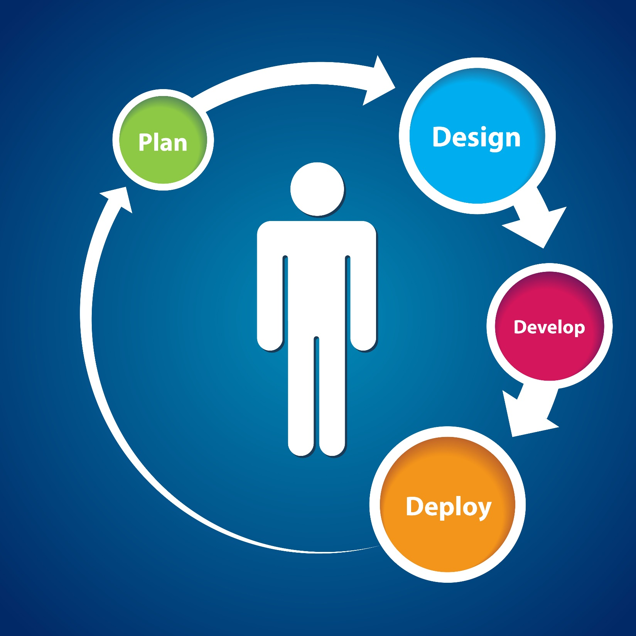
Principle 6:
Involve users throughout HIT system design, development, and testing
Test
Notes:
Bill
Involve users in all phases of the development process:
- Requirements specification
- UI design
- Development
- Testing
- Implementation / deployment

Slide 78
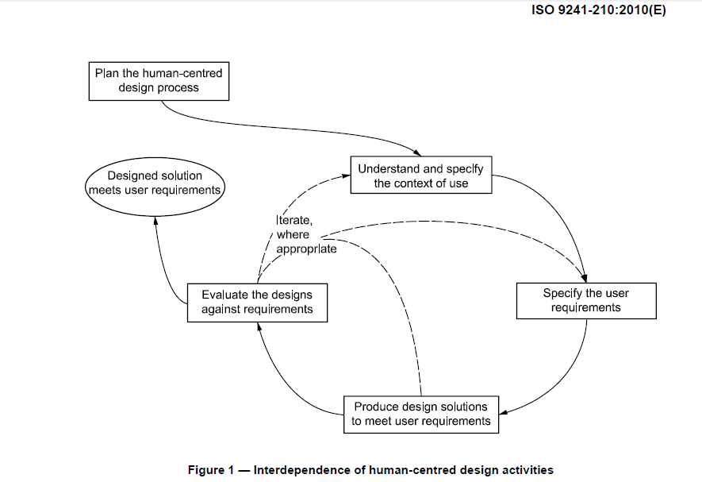
Notes:
Ross
- hard to see, but they can see it clearer if they download the presentation by clicking on the green download icon

Slide 79
integrating UCD into VA HIT development or procurement projects
Guidance for
Notes:
Bill
Clicking the green download button will give you access to references to:
UCD Standards
ISO Standard
Standard for eHRs (required for Meaningful Use Certification)
Various Human Factors methods for to support UCD throughout the lifecycle
Publication outlines the application of a systems engineering framework for an eHR

Slide 80

Case Studies
Ross to provide case study examples soon
Slide notes and talking points
Notes:
Ross
This concludes our presentation on usability as a HIT requirement.
Usability is critical to business success
Bill
Good design is based on evidence-based user interface standards
Ross
Usability is achieved through a user-centered design process that
focuses on users and the context of use
follows an iterative process of design, test, and redesign
Bill
Usability can be empirically tested
Ross
Health IT business stakeholders must take ownership of system usability
User Interface Standards
User Performance Objectives
UCD process requirements

Slide 81

Ask the Presenter
Notes:
Bill
If you haven’t submitted your questions yet, there is still time to do so by clicking on the orange “Ask The Presenter” icon. We’re going to show a brief announcement and be right back to answer your questions.
(Stand still and smile until you see the video come up full screen)

Slide 82
Slides Removed

Slide 83
Notes:
Ross
Talk about how findings from usability testing require you to revisit
Design solutions
User requirements
Understanding of the usage context

Slide 84
Notes:
Ross
Talk about involving users in each phase…

Slide 85
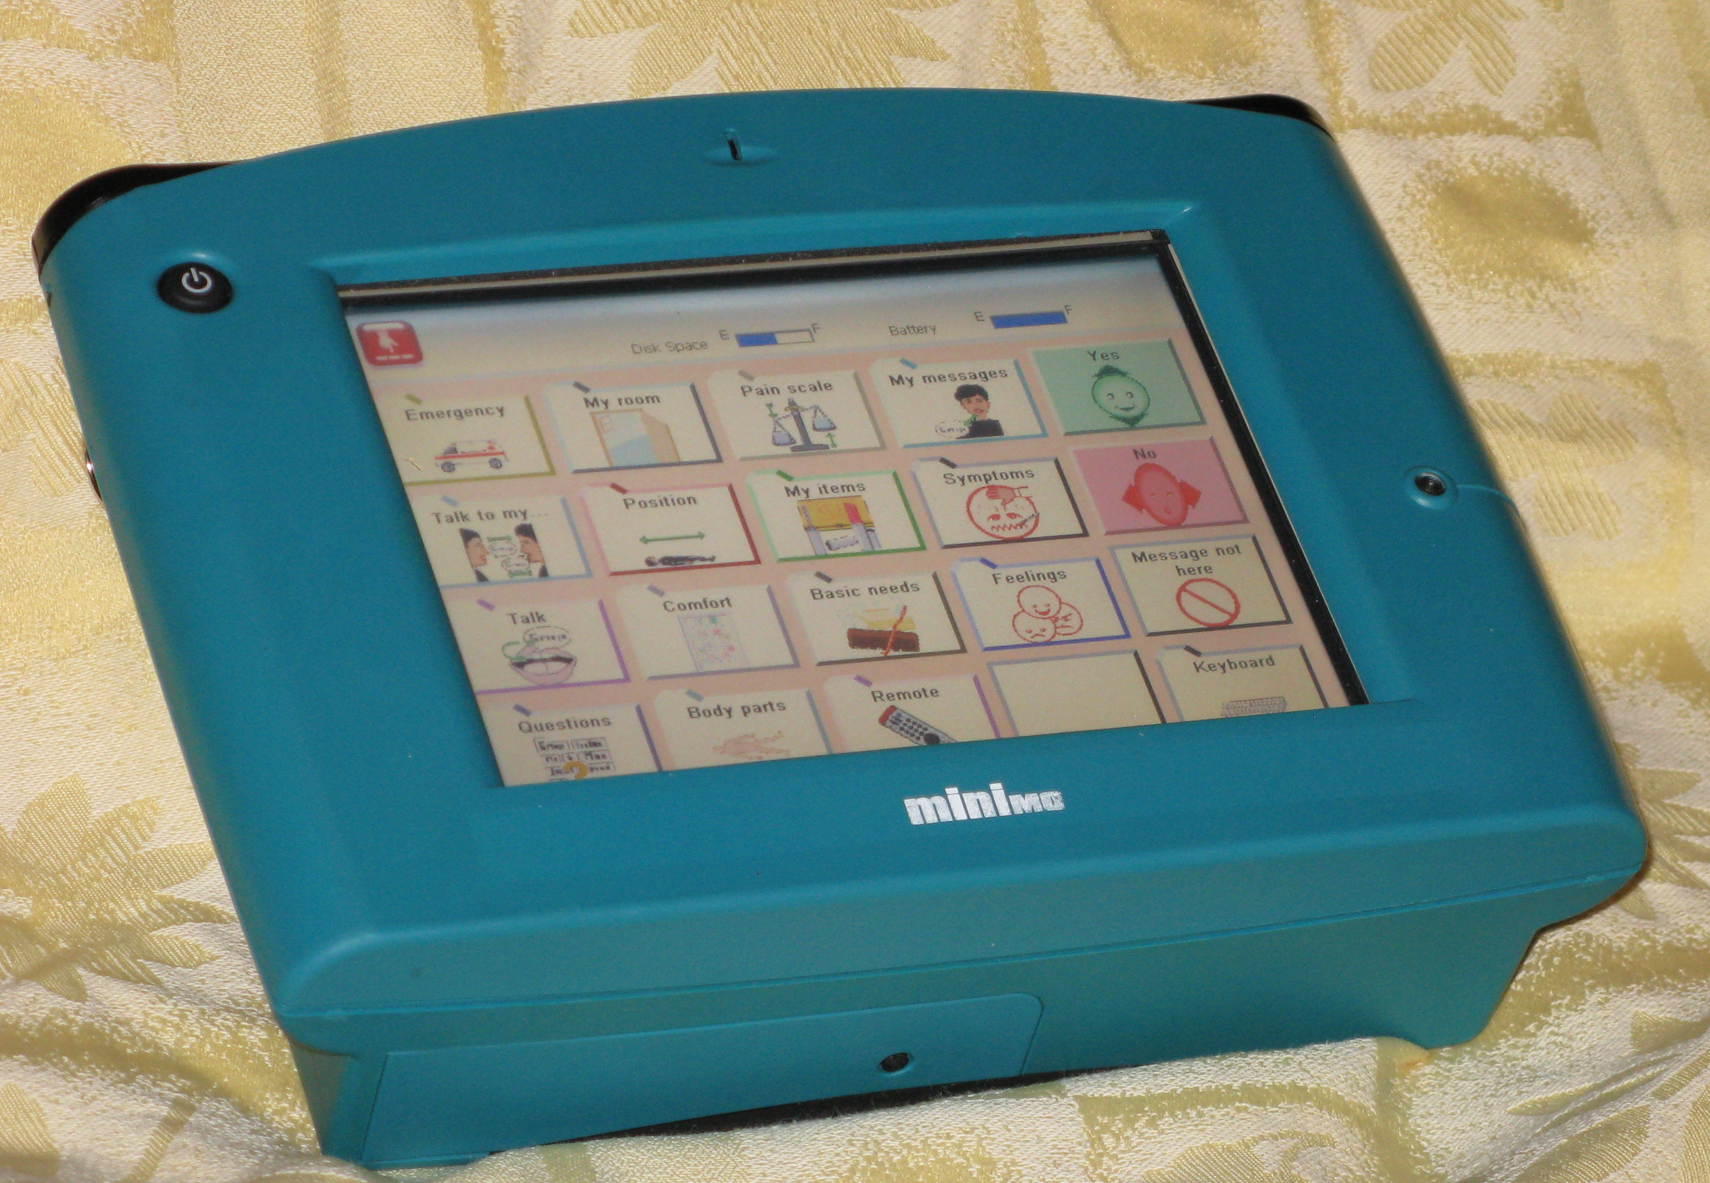
ANSI/HFS 200 Human Factors Engineering of Software User Interfaces (2008)
Notes:
Where is this picture from?
http://en.wikipedia.org/wiki/Speech-generating_device
Published Standards

Slide 86

Usability requirements are
universally applicable
Notes:
===============
Ross
[The point is that there are 3 categories of usability requirements, and each requirement category has different levels of rigor – they can be customized depending on the goals, characteristics, and constraints of the project. The VA needs to figure out how to apply them to different type of HIT projects.]
[Consider discussing these factors in the context of VA projects that have adopted one or more of these usability requirements
Perhaps making this presentation / resources a collection of VA good practices]
Is it a safety critical HIT system?
Intended User
Veteran or Caregiver
Clinician
Type of HIT project
Enhancement
Application
System re-engineering
Development process
Waterfall / Fixed-price contracts
Incremental
Agile
Who performs HIT design / development
VA ‘in-house’ development projects
Contract development
COTS procurement
[resources and guidance to apply the requirements appropriate for your project]
[At the end of the presentation, give examples of projects that have implemented usability requirements (model or case studies)]
======================
-- applicable to various types of HIT system development projects

Slide 87


Roles and Responsibilities
Stakeholder
Usability Specialist
Development
Team
Notes:
Ross
Stakeholders determine which class of UI standards are appropriate for the project. These become NFRs.
The development team will meet these requirements by designing the HIT user interface in accordance with these standards.
But applying these standards is not always cut and dry –
Design tradeoffs
The Usability Specialist will support the development team

Slide 88

Human Factors Research
Notes:
Discuss the need for ‘requirements’ related to Advanced Usability Objectives
- Supporting cognitive efficiency (reducing cognitive workload)
- Supporting clinical decision-making
- Clinician HIT: Designs to support team-based care (situational awareness)
- Veteran HIT: Designs to support the achievement of health goals
Describe how to implement: UCD (impacts requirements, UI design, usability testing)

