Slide 1
Protecting Privacy and Security
Using Apps from the Public App Store
Neil C. Evans, MD Co-Director (Clinical Lead) Connected Health Office Office of Informatics and Analytics
D.J. Kachman Security Assurance Division Director Enterprise Systems Engineering Office of Information & Technology

Slide 2
KNOW before you SHOP
Notes:
Speaker: Dr. Evans
Why are you here?
You've attending this training today because you were recently issued, or will be issued, a VA-furnished mobile device. The purpose of this training is to discuss some of the security implications, risks, and to identify ways to mitigate privacy and security-related risks. This course will provide guidance for protecting privacy and Information Security Awareness when using mobile devices in VA.
We'll also discus how we can safely use mobile apps on the new devices.
But, first, let's discuss the increasing use of mobile technologies in health care.

Slide 3
Course Objectives
How VA Protects Device Security
Best Practices for Personal Security
Public App Store Privacy and Security
Recap and Resources
Overview
Notes:
Speaker: Moderator
Introductions….Bio slides
Section 1: Overview – COVERING (a) Mobility in Healthcare and (b) VA Mobile Provider Program.
Section 2: Best Practices for Personal Security
Section 3: How VA Protects Device Security
Section 4: Public App Store Privacy and Security
Section 5: Recap and Resources

Slide 4
4 out of 5
clinicians use smartphones
everyday
Notes:
Speaker: Dr. Evans
We all know that there is a lot of interest in using mobile devices in health care.
By 2018 mHealth is forecasted to increase by 61% to be a $26 billion market
- A report from 2012 told us that about 4 out of 5 clinicians use smartphones everyday, a rate which they expected to increase to 9 in 10 by 2014. (epocrates.com)

Slide 5
69%
use a mobile device to view patient information
36%
use mobile technologies to collect data at the bedside
Notes:
Speaker: Dr. Evans
We‘ve also learned that 69% of providers are using a mobile device to view patient information, and 36% use mobile technologies to collect data at the bedside, according to a HIMSS survey of 170 individuals who held a variety of positions in the health care industry.
- We know that there is a lot of interest in using mobile devices in health care, particularly at the point of care.
We also know that providers often use their own devices.

Slide 6
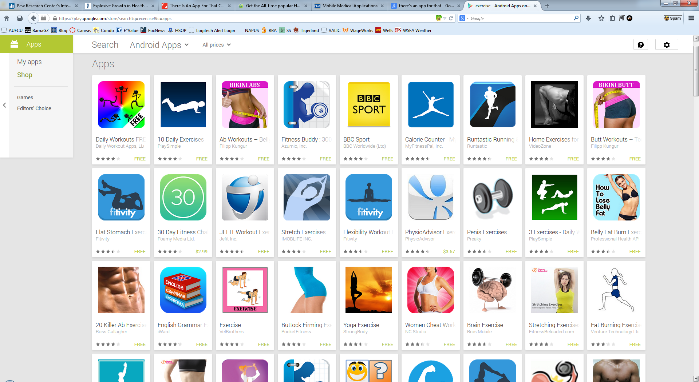
69%
use a mobile device to view patient information
There are more than
40,000 apps
categorized as
“health and fitness” or “medical”
in Apple’s app store
Notes:
Speaker: Dr. Evans
There are more than 40,000 apps categorized as "health and fitness" or "medical" in Apple's app store alone.
Additionally, the number of health-focused mobile apps on the market tell us that the demand and interest by providers for these technologies are extremely high.
Insert some statistics about number of provider-focused apps on the market

Slide 7
Mobility of patient information
Easy access 24/7
Secure communication
Notes:
Speaker: Dr. Evans
As many of you have likely already experienced, having a connected device 24/7 has enabled you to incorporate it into your existing workflows, and even improve them
Convenient access to real-time clinical information
 Mobility of patient information throughout the medical center
 Easy access to medical tools at work, home or on-the-go, 24/7
 Secure communication between patients and providers
Improved access to patient generated data (need to rethink this bullet)

Slide 8
VA Mobile Health Provider Program
Phase 1: Feb – Sept 2014
Phase 2: Fall 2014 (Target Date)
Devices will include:
VA email
Access to commercially available mobile health Apps that have passed VA security reviews
Access to other capabilities to assist providers with accessing information in the medical center as well as off-site
Devices will be loaded with VA-developed Apps that will:
Allow for quick access to real-time information to inform clinical decisions
Assist Veterans and Caregivers with self-management
Allow providers to write progress notes, enter a subset of orders, and complete other clinical tasks.
Notes:
Speaker: Dr. Evans
You've received this device as part of VA's Mobile Health Provider Program.
From your involvement in this program, YOU are helping us shape how VA will implement and use mobile technologies into our healthcare delivery.
- The VA Mobile Health Provider Program aims to issue mobile devices to clinicians in advance of releasing VA-developed apps in order to allow clinicians to familiarize themselves with the mobile devices
(examples in downloadable handout if you want to read more)
***********
Phase 1: Feb – Sept 2014
Devices will include:
VA email
Access to commercially available mobile health Apps that have passed VA security reviews
Access to other capabilities to assist providers with accessing information in the medical center as well as off-site
Phase 2: Fall 2014 (Target Date)
Devices will be loaded with VA-developed Apps that will:
Allow for quick access to real-time information to inform clinical decisions
Assist Veterans and Caregivers with self-management
Allow providers to write progress notes, enter a subset of orders, and complete other clinical tasks.

Slide 9
Dr. Frank Liu
Dr. Leslee Davis
Stacy Washington
DC VAMC
Orlando VAMC
OIT Field
Implementation Manager
used his iPad to read an emergency scan from the side of the road. Patient had life-threatening blood clots. Dr. Liu was able to order immediate care.
uses her iPad at the point of care to enhance patient education with apps such as Visual Diagnosis App
manages deployment of iPads and offers on-going assistance to providers through FaceTime and other technologies available through iPad.
Notes:
Speaker: Dr. Evans
Your peers are already using their iPads in countless ways to deliver improved health care to our Veterans, here are a few examples

Slide 10
Mobile Initiatives at VA
Notes:
Speaker: Dr. Evans
We'll mostly be talking about the Apple products and the iOS platform today, because the provider program has distributed iPads. In the future, though, VA is looking to incorporate the use of Androids, Microsoft Surfaces, and others.
Many of the things we'll discuss today can be applied across devices and across mobile platforms (including Androids, Microsoft Surfaces, and others).

Slide 11
Why is this course required ?
Notes:
Speaker: Dr. Evans
Many laws require VA staff to take privacy and information security training.
If you use a VA Government Furnished Mobile Device and have access to VA information systems or VA Sensitive information through that mobile device, VA requires you to take this course so you know what to do to keep information safe and help VA comply with these laws.
VA must comply with federal laws about privacy and information security.
We developed this course to help you understand your roles and responsibilities for keeping information safe while using the mobile device and any App loaded onto that device.
You must complete this training module each year to maintain access.
This course must be completed in addition to VA Privacy and Information Security Awareness and Rules of Behavior (VA TMS 10176) [or VA Privacy and Information Security Awareness and Rules of Behavior (VA TMS ID: 31167)] and Privacy and Health Insurance Portability and Accountability (HIPPA) Training (VA TMS ID: 10203) are required training for all Veterans Health Administration (VHA) and Veterans Benefits Administration (VBA) employees who have access to Protected Health Information (PHI) AND who have been issued a government furnished mobile device (GFE iPad).
We will be referencing some of the same guidelines found in these trainings.
If you would like to find more detail about policies and guidance, we provided with you with a handout detailing where you can find more information and course.

Slide 12
Course Objectives
How VA Protects Device Security
Best Practices for Personal Security
Public App Store Privacy and Security
Recap and Resources
Overview
Notes:
Speaker: Dr. Evans
We will begin the main content of this training by discussing about a couple ways that you can keep your device safe.
The next section will talk more about how VA is working to keep your device safe. However, security is everyone's responsibility, so let's discuss a few ways that you can help keep Veteran data safe while using your iPad.

Slide 13
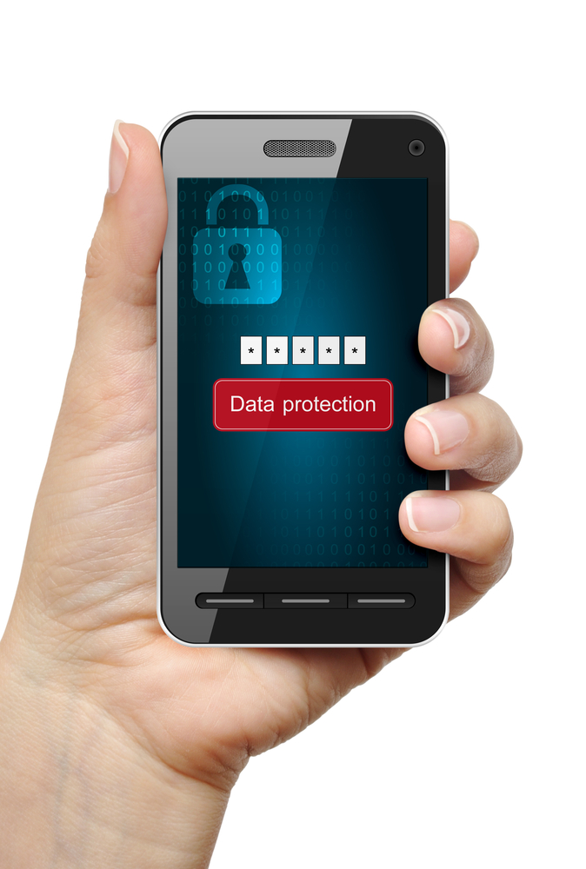
54% of U.S. smartphone users do not set up password security on mobile devices
Notes:
Speaker: Dr. Evans
Pin Code
Recent research tells us that 54% of smartphone users in the US do note set up password security on mobile devices. If a phone without a passcode is left unattended, anyone that picks it up may have access to restricted information.
When you picked up your device, or when you do pick up your device, you will configure your device to include a passcode. Remember, passcodes that are easy to guess is less secure, so avoid passcodes like 1-2-3-4. Your device includes a passcode lock timer, so you're device will lock after XX minutes.
Apple ID
You've also set up an Apple ID. Include information about how Apple IDs/passwords should be kept safe.

Slide 14
Tips to Prevent Loss and Theft
Notes:
Speaker: Dr. Evans
VA tracks incidents of loss and stolen devices.
This year, we've had about 12 devices that were lost and stolen--that's less than 1%.
We know that the more devices deployed will likely increase the number of devices that are lost and stolen. However, there are some ways we can mitigate that:
Don’t leave the device unattended
Don’t share your device, which we will discuss in more detail in the next slide
Since you are on the go and can carry these everywhere, but extra careful about where you set it down in public places

Slide 15
VA’s
GFE mobile device should never be shared with another person.
Unauthorized access by another user prohibited
Device to be used in accordance with VA policy only
Rules of Behavior
Notes:
Speaker: Dr. Evans
VA’s National Rules of Behavior do not allow you to share your VA device, please keep this in mind since this is another best practice for ensuring against loss or theft
The GFE mobile device should never be shared with another person.
The device is issued to a single person and PIN protected for single person use only.
The VA National Rules of Behavior prohibit unauthorized access by another user by logging off or locking any VA computer device or console.
Should the user no longer need that device for official duty, the device should be turned into the OI&T office for repurpose.

Slide 16
Notes:
Speaker: Dr. Evans
Although all apps available through the VA App Catalogue have been vetted by VA, it's very important for users to know what types of information their apps have access to.
Emphasize providers have choices when downloading apps
For example, when you download an app even as simple as Angry Bird you are asked a bunch of questions via pop ups about access and need to keep in mind not to auto click “OK” in order to get to the app more quickly
Instead, take a step back and make a choice about how this app might be able to access your information
Question where the data is being stored, on the cloud. Do not automatically accept access request to
Location
Contacts
Calendar, etc.
Accepting these parameters when downloading, installing or using Apps may open your device to potential tracing capabilities for additional information sharing.
For example, EverNote is a very valuable and useful app for many people, however in 2013 it was hacked and all passwords were stolen

Slide 17
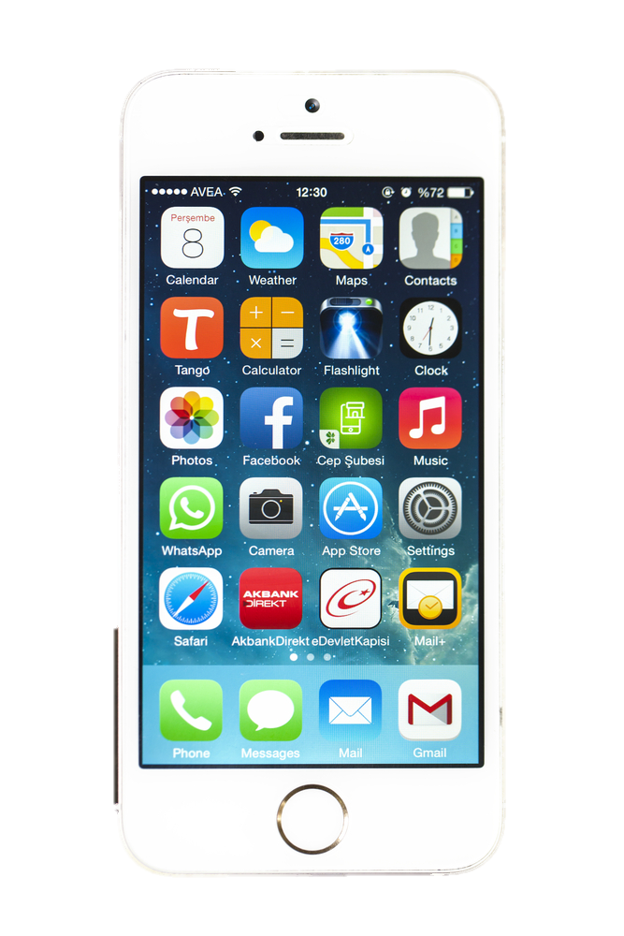
Tailor Individual Apps’ Privacy Settings
Notes:
Speaker: Dr. Evans
In the privacy section of the settings tab, you have the ability to see which apps are accessing your data and can make a decision about which ones may or may not put your data, or your patient’s data, at risk
Android and Microsoft platforms are also pursuing environments to include security settings similar to the ones that exist on Apple
The decisions made about risks will be present across all platforms
For example with Android, it is all or nothing where iOS can access certain items and gives the user a choice app by app
Note that on the Android side their apps are not pre-vetted at all

Slide 18
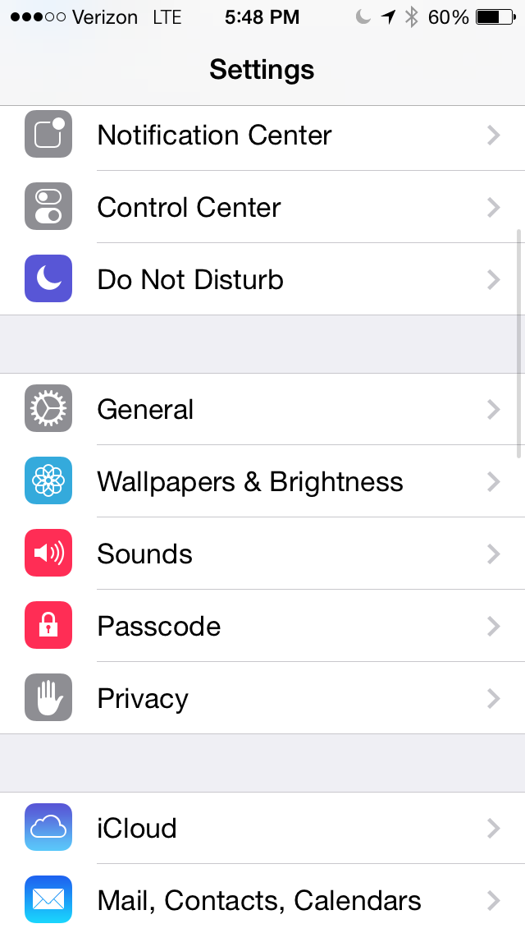
Notes:
Speaker: Dr. Evans
In the privacy section of the settings tab, you have the ability to see which apps are accessing your data and can make a decision about which ones may or may not put your data, or your patient’s data, at risk
Android and Microsoft platforms are also pursuing environments to include security settings similar to the ones that exist on Apple
The decisions made about risks will be present across all platforms
For example with Android, it is all or nothing where iOS can access certain items and gives the user a choice app by app
Note that on the Android side their apps are not pre-vetted at all

Slide 19
Collaboration
OI&T
VHA
Notes:
Speaker: Dr. Evans
The program you are participating in is a great example of how OI&T and VHA are collaborating to enable secure 21st century health care for Veterans
DJ will now go into more specifics about how we can all work together to keep your information, and our Veteran’s information, safe

Slide 20
Course Objectives
How VA Protects Device Security
Best Practices for Personal Security
Public App Store Privacy and Security
Recap and Resources
Overview

Slide 21
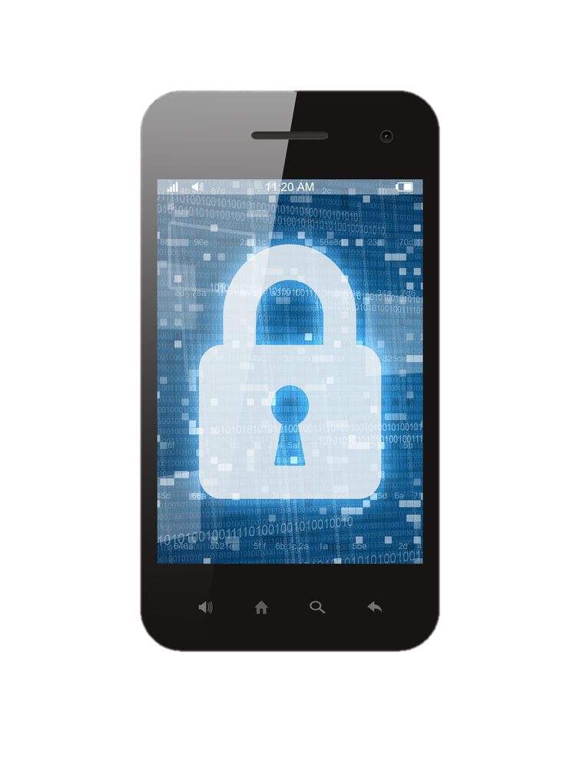
Existing Privacy and Security Measures: Software and Testing
Remotely lock/wipe device
Track downloaded apps
Configure content and web browsing restrictions
Email alerts
Automated threat analysis
Wipe the device clean
Track downloaded apps
Restrict device features, content, and browsing
Mobile Device Management Solution
Secure Remote Access
Commercial App Security Testing
Notes:
Speaker: DJ Kachman
Protect, not prevent – these are some examples of the measures we have already taken to protect you and ensure the mobile devices and apps are secure
MDM can….
Wipe the device clean
Track what apps are downloaded
Restrictions can be configured for device features, content and web browsing, and continuous monitoring keeps devices compliant.
If a device is lost or stolen, we can remotely lock or wipe the device.
We can also automatically disable access and wipe content if a device is compromised, non-compliant or the user leaves the company.
-----------------
Block cloud storage native to the device via MDM
Set compliance rules based on VA requirements for device baseline
Ability to wipe enterprise application and data
E-mail reminders and push notifications when issues arise
Deliver an approved application list for VA “interactive” applications
Automated threat analysis of applications on device
Detect “root” or “jailbreaking” of device

Slide 22
Existing Privacy and Security Measures: Software and Testing
Easily manage the security risks of borderless networks
Mobile Device Management Solution
Secure Remote Access
Commercial App Security Testing
Notes:
Speaker: DJ Kachman
Cisco AnyConnect is….
Another way in which VA is secures the mobile devices is through Cisco AnyConnect, a secure mobility solution which provides security to the mobile devices.
It combines Cisco web security with remote access technology to help organizations easily manage the security risks of borderless networks.

Slide 23
Existing Privacy and Security Measures: Software and Testing
Standardized testing approach for commercial apps
AirWatch Mobile Device Management Solution
Cisco AnyConnect
Commercial App Security Testing
Notes:
Speaker: DJ Kachman
App Security Testing
As difficult as keeping security problems out of in-house software can be, it becomes even more difficult with third-party applications, which is why we have implemented a standardized testing approach for commercial apps

Slide 24
Course Objectives
How VA Protects Device Security
Best Practices for Personal Security
Public App Store Privacy and Security
Recap and Resources
Overview

Slide 25
VA 6500 Handbook, Appendix D: National Rules of Behavior (ROB)
Required when downloading, installing, and utilizing public Apps
Address inherent risks when downloading Apps
“Gold Standard” in Data Security
Authorized users must use “Due Diligence”
Notes:
Speaker: DJ Kachman
All VA Rules of Behavior (ROB) must be followed when downloading, installing, and utilizing any App from a public App Store
There are inherent risks when downloading an app from a public app store.
Remember the Gold Standard is required in VA Data Security and users are asked to go beyond the stated rules, using “due diligence” and the highest ethical standard to guide their actions.
Apply the Gold Standard and “due diligence” not only when downloading from the public app store, but also when updating existing public apps. Make sure you understand the updates and ensure there is no privacy or security risk associated with the update.
ROB Background (c) & (d)
c. VA must achieve the Gold Standard in data security which requires that VA information and information system users protect VA information and information systems, especially the personal data of Veterans, their family members, and employees. Users must maintain a heightened and constant awareness of their responsibilities regarding the protection of VA information. The Golden Rule with respect to this aspect of VA employees’ responsibilities is to treat the personal information of others the same as they would their own.
d. Since written guidance cannot cover every contingency, authorized users are asked to go beyond the stated rules, using “due diligence” and highest ethical standards to guide their actions. Users must understand that these rules are based on Federal laws, regulations, and VA directives.

Slide 26
Public App Store: Policies & Guidance
Notes:
Speaker: DJ Kachman
And now we will do a deeper dive into the policies and guidance for this course, “Protecting Privacy and Security Using Apps from the Public App Store”
Reinforce the VA National Rules of Behavior
Provide awareness of the risks associated with downloading and installing an App from a public App Store
Provide awareness of the risks associated with utilizing Apps from a public App Store

Slide 27
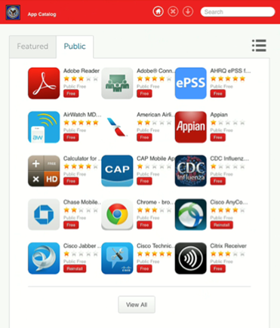
What Is the Difference?
VA App Catalog
Public App Stores
Generic
Public App Store
Image
Notes:
Speaker: DJ Kachman
If you are receiving VA information on the app, you need to download via the App catalog
But if you are not receiving or inputting any information related to the VA, then you can download from other public app stores

Slide 28
What Is the Difference?
VA App Catalog
Public App Stores
May use if NOT receiving or inputting VA information
Must use if receiving VA information on the app
Notes:
Speaker: DJ Kachman
If you are receiving VA information on the app, you need to download via the App catalog
But if you are not receiving or inputting any information related to the VA, then you can download from other public app stores

Slide 29
Poll Question
Which of the following information is considered PHI?
A) Social Security Number
B) Last 4
C) Medical Records
D) Birth Date
E) All of the above
F) Both A and C
Notes:
Speaker: DJ Kachman

Slide 30
Public App Store Apps: ROBs and Responsibilities
No public store apps should contain PHI/PII regardless of the security implied by the manufacturer or developer
You must protect VA Sensitive information when you use any type of electronic device or communication to store, transport or dispose of information
You are required to report any incidents
Notes:
Speaker: DJ Kachman
You have a responsibility to protect privacy and ensure information security.
You are legally required to uphold these responsibilities and follow the law.
If you do not, you may lose your job, have to pay fines, or face prison.
Complying with the ROB will ensure you are following the law.
Remember: It's in your hands to protect VA and Veterans every day!
Applicable ROB: 1a, 2b(13)

Slide 31
Poll Results
Which of the following information is considered PHI?
A) Social Security Number
B) Last 4
C) Medical Records
D) Birth Date
E) All of the above
F) Both A and C
Notes:
Speaker: DJ Kachman

Slide 32
Name | Type
Social Security Number | PII
Last 4 | PII
Medical Records | PHI
Birth Date | PII
Medical Diagnosis | PHI

Slide 33
“Data Hogging” Apps…
…are apps requiring a large storage or operating capacity
VA Directive 6001
“Limited Personal Use of Government Office Equipment (GFE) including Information Technology”
states that use of GFE is limited to include "minimal additional expense to the Government“
Notes:
Speaker: DJ Kachman
Again, keep in mind that any public store app should be used for non-work only, even if the work is non-sensitive.
Data “hog” apps should not be used on the VA data plan.
These are Apps that require a large storage capacity or operating capacity and they should be avoided.
VA Directive 6001 “Limited Personal Use of Government Office Equipment (GFE) including Information Technology” states that use of GFE is limited to include "minimal additional expense to the Government“
Use of the equipment must result in only minimal additional expense to the Government in areas such as:
Communications infrastructure costs, e.g., telephone charges, telecommunications traffic;
Use of consumables, e.g., paper, ink, or toner, in limited amounts;
General wear and tear on equipment;
Data Storage on storage devices; or
Transmission impacts, e.g., moderate electronic mail message sizes with only small attachments.

Slide 34
Inappropriate App Types
VA Directive 6001 prohibits "the use of GFE for activities that are illegal, inappropriate, or offensive to fellow employees or the public…”
Notes:
Speaker: DJ Kachman
VA policy applies to the device, i.e., no porn, gambling, illegal activity, etc.
VA Directive 6001 prohibits "the use of GFE for activities that are illegal, inappropriate, or offensive to fellow employees or the public. Such activities include hate speech, or material that ridicules others on the basis of race, creed, religion, color, sex, disability, national origin, or sexual orientation. The creation, downloading, viewing, storage, copying, or transmission of sexually explicit or sexually oriented materials is also prohibited.
The creation, downloading, viewing, storage, copying, or transmission of materials related to gambling, illegal weapons, terrorist activities, and any illegal activities, or activities otherwise prohibited must be avoided when using GFE mobile devices."

Slide 35
“I understand that when I use any government information system, I have NO expectation of privacy in any records that I create or in my activities while accessing or using such information system…”
Subject to Monitoring
-VA National Rules of Behavior
Notes:
Speaker: DJ Kachman
VA National Rules of Behavior states that "I understand that when I use any government information system, I have NO expectation of privacy in any records that I create or in my activities while accessing or using such information system"
Any attempt to change, circumvent or modify the GFE device system to prevent VA from accessing this information is prohibited
This statement demonstrates that you as users of the GFE devices accept the fact that all Apps downloaded, installed, and utilized on GFE mobile devices
i.e., iPads, will be subject to monitoring and appropriate actions may be taken upon discovery of misuse in any manner, to include restricting access, blocking, tracking, and disclosing information to authorized OIG, VA and law enforcement personnel.

Slide 36
Poll Question
There’s an app I want to use to keep track of follow-up items for my clinic patients. It is only available on the Apple App Store. What should I do?
Download it through the public app store and start using it
Check Yammer to find out if any of my other colleagues are using it
Ask my local IT department
Do not download it. Submit a ticket for the app to be tested and hopefully added to the VA App Store
Notes:
Speaker: DJ
There’s an app I want to use to keep track of follow-up items for my clinic patients. It is only available on the Apple App Store. What should I do?
Download it through the public app store and start using it
Check Yammer to find out if any of my other colleagues are using it
Ask my local IT department.
Do not download it. Submit a ticket for the app to be tested and hopefully added to the VA App Store – (855) 500 2025.

Slide 37
Course Objectives
How VA Protects Device Security
Best Practices for Personal Security
Public App Store Privacy and Security
Recap and Resources
Overview
Notes:
60 seconds please ☺

Slide 38
Poll Results
There’s an app I want to use to keep track of follow-up items for my clinic patients. It is only available on the Apple App Store. What should I do?
Do not download it. Submit a ticket for the app to be tested and hopefully added to the VA App Store
Notes:
Speaker: Neil
There’s an app I want to use to keep track of follow-up items for my clinic patients. It is only available on the Apple App Store. What should I do?
Download it through the public app store and start using it
Check Yammer to find out if any of my other colleagues are using it
Ask my local IT department.
Do not download it. Submit a ticket for the app to be tested and hopefully added to the VA App Store – (855) 500 2025.
ANSWER: D. -- Do not download it. Submit a ticket for the app to be tested and hopefully added to the VA App Store – (855) 500 2025
You should not download from a public app store any app for work purposes that access or stores VA data.
However, Connected Health is constantly testing third party apps to upload to the VA App Catalog. Continue to check the VA App Catalog, as new ones are added often.

Slide 39
To submit a request for an app to be included on the VA App store…
Technical Support
Online support/web, 24/7:
http://help.vamobile.us
Telephone support
Weekdays 8 a.m.-8 p.m. (EST): 1 (855) 500 2025
Notes:
Furthermore, if there is an app that you are really interested in using, you can submit a request to Connected Health for us to review the app for inclusion on the VA App store. You can submit that request via the VA Mobile Provider Program Help Desk at 855-500-2025 or at http://help.vamobile.us.

Slide 40
Public App Store
Before you shop …
Protect privacy and ensure information security
Understand how apps are accessing other data 0n your device
VA aims to protects your device, but this doesn’t diminish your role
Apps accessing, storing, or receiving VA information MUST be downloaded through the VA App Catalog
Notes:
Speaker: Dr. Neil Evans
We’ve listened to your feedback and your requests to open the public App Store to increase functionality and productivity of these devices. In order to do so, we must make sure VA staff understand how to mitigate privacy and security risks. This training was developed to enable providers to have access to thousands of commercial apps on the public app store so that you have the tools you need to deliver better health care to our nation’s Veterans. Let’s recap:
You have a responsibility to protect privacy and ensure information security. You are legally required to uphold these responsibilities, and you must comply with VA’s Rules of Behavior.
There are steps you can take to protect you own device. Users should understand how they apps they download access information. Go to the privacy section of the settings tab to see which apps are accessing your data, and make informed decisions about which ones may or may not put your data, or your patient’s data, at risk.
VA recognizes that security incidents cannot be prevented entirely. Instead, VA aims to protect your device so that patient data is still kept safe, even if the device is lost or stolen. VA protects your device through the use of the MDM, secure remote access, and by testing third party apps to ensure they are safe for use.
If you are accessing or receiving VA information through an app, it must be downloaded through the VA App Catalog.

Slide 41
Ask the Presenter

