Slide 1


TAMING THE DRAGON
Strategies for Successful Implementation of
Speech Recognition Software
Michelle Strong
Don Leben
Notes:
Don:
Thank you Rosie. Michelle and I are happy to be here with you today and to share our experiences implementing Dragon Voice Recognition Software within VISN 2, specifically in Bath, NY. We hope that sharing some of our insights and experiences will prove valuable to you as you embark on your Dragon journey.

Slide 2

Veteran
Integrated
Service
Network:
VISN 2
Notes:
Michelle:
I’d like to begin by giving you some background/demographic data on VISN 2 and Bath, NY. VISN 2 is located in the Upstate NY area, in the heart of the Finger Lakes region. It is comprised of 5 Medical centers and 31 CBOC’s and serves roughly 130,000 Veterans. We are an integrated VISN, which means that we have a shared database.
Bath is a level 3 facility within VISN 2, and is comprised of 2 CBOC’s, a large Domiciliary, Community Living Center, a small acute care unit, and Urgent Care Center.
VISN 2 implemented Dragon Medical (version 10.1) more than 3 years ago. It was a coordinated implementation for our Network, and currently we have over 500 Dragon Users.

Slide 3

Poll Question
What is your role within VA?
    Health Information Management
    Clinical Provider/Staff
    Informatics
    Leadership
    Information Technology
    Other
Notes:
Michelle:
Before we get started we’d like to get an idea of who is in the audience by asking our first poll question. Please let us know what your role within VA is by using the blue polling icon above my head. Choose A if you work in Health Information Management, B if you are a clinical Provider or staff, C if you work in Informatics, D if you are part of your facilities Leadership team, E if you work in Information Technology, or choose F if you work somewhere else. Before we move on I’d also like to remind you that if you think of a question at any time during the presentation you can click on the orange (ask the presenter) icon above to pose your question. We will answer questions at the end of the session. Now, let’s get started.

Slide 4
Roles & Responsibilities
Planning & Implementation
Avoiding Pitfalls
Tips & Tricks
Notes:
Michelle:
Our objectives for today’s session are to describe for you the various roles involved with the Dragon implementation process and identify the responsibilities associated with each role.
We will Discuss phases of implementation, including planning, implementation and post-implementation, and will examine the steps necessary to ensure success at each phase.
We’ll also share with you potential pitfalls or areas of concern related to Dragon Implementation, and identify strategies you can use to mitigate these potential pitfalls, and share some tips and tricks that we learned along the way that will, hopefully, make your transition a smooth one.

Slide 5

What is
Dragon®?
Notes:
Don:
So before we get into the actual process of implementing Dragon at the Medical Center, let’s take a minute to talk about what Dragon is? At its most basic Dragon is Speech Recognition software, in other words, “You talk, it types!” Think of it as an automated transcriptionist. And, Dragon is not just for users who can’t type. Even good typists can increase the speed and efficiency of their documentation with Dragon.

Slide 6
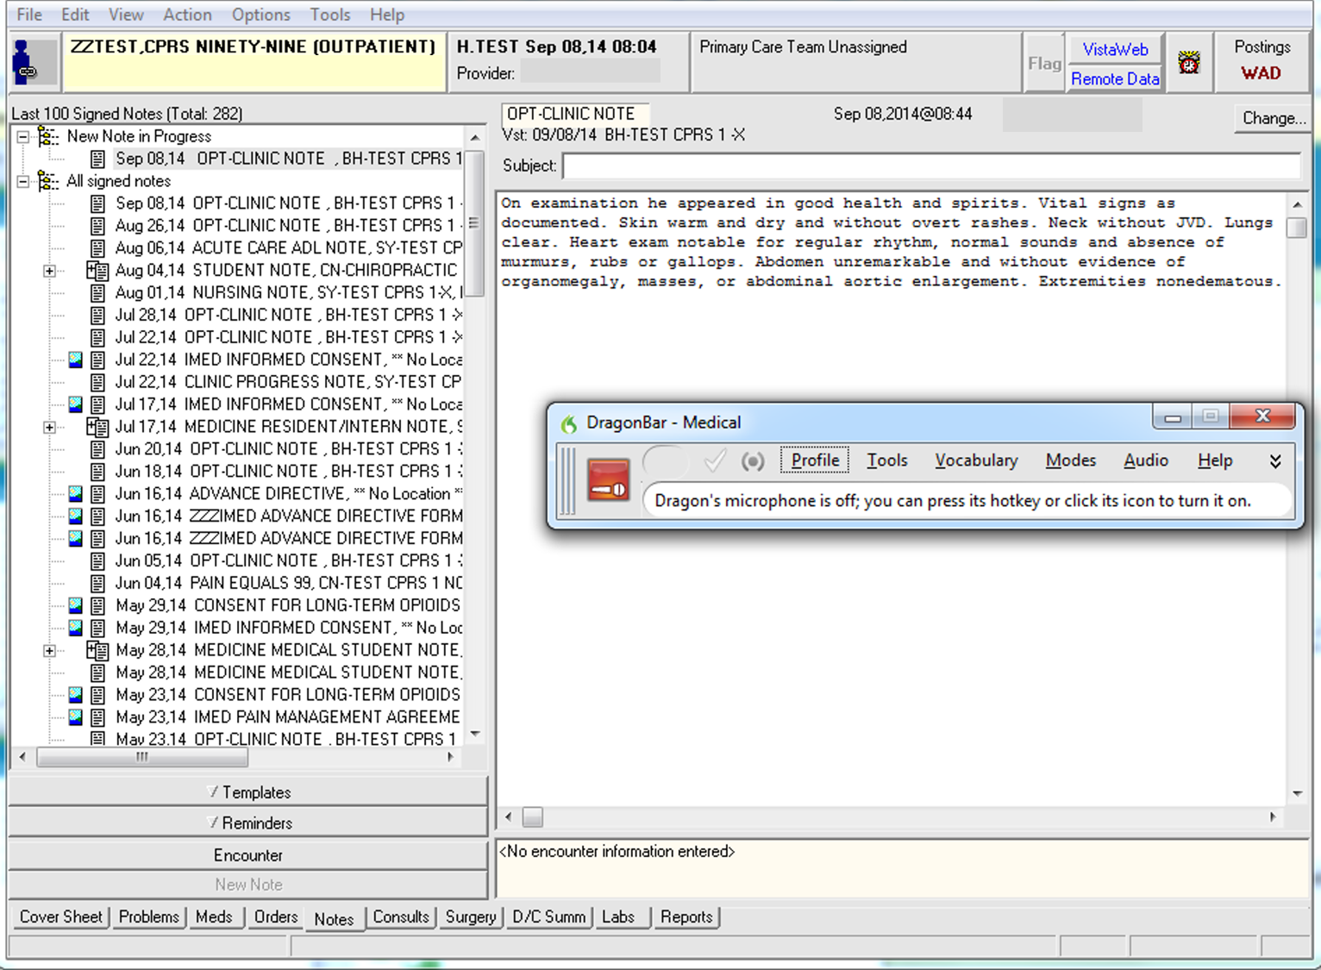
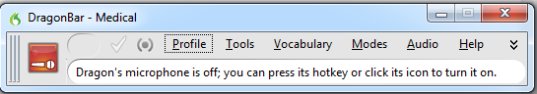
Notes:
Don:
Consider this, the typing speed for an average typist is considered to be around 40 words per minute without error. However, the average rate of speech is between 120 and 200 words per minute. Dragon works at the rate of speech. Also with Dragon, there’s a reduced chance for spelling errors, because the words that Dragon recognizes will all be spelled correctly. But, Dragon goes beyond this because it gives you the ability to add new words to the vocabulary, for example physicians names or new drugs that come to market. This gives Dragon a virtually unlimited vocabulary.
Dragon is also very flexible. While our primary use for Dragon is to document progress notes in CPRS, it can be used with other software to dictate documents such as letters, policies and emails.

Slide 7
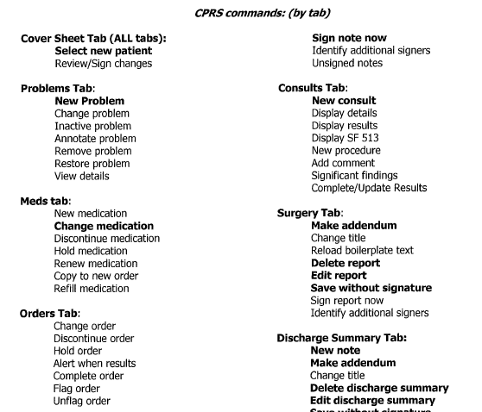
Built-In CPRS
Commands
Notes:
Don:
Dragon comes to us in VA with over 60 pre-built commands specifically for CPRS already installed. For example, you can navigate to the Notes tab in CPRS by simply saying “Notes Tab”. Some other commonly used CPRS commands that are built into Dragon are the New Note, Sign Note Now, and Save Without Signature. But, Dragon is very flexible and it also gives you the ability to make your own additional CPRS commands. For example, I’ve created commands to run the spellchecker and the grammar checker that are built into CPRS. Commands can be shared amongst Dragon users and can even be shared with all of a VISN’s Dragon users.
While these commands seem simple, they allow for an uninterrupted workflow while dictating in CPRS. As providers gain proficiency with Dragon they no longer have to reach for the mouse or the keyboard to access functions within CPRS.

Slide 8
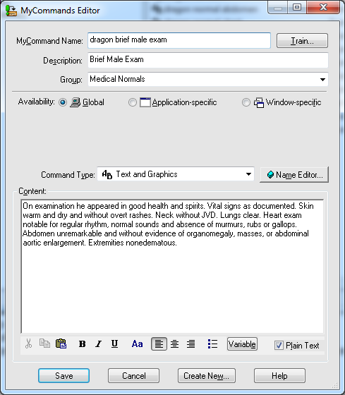
Create Custom Commands
Notes:
Don:
The simplest form of command is the Auto-Text. An Auto-Text command works like a simple template in CPRS. A provider can say a voice command, such as “Normal MSE” and their templated text for a normal mental status exam is inserted into their progress note where it can be edited if necessary. Using Auto-Text commands can significantly reduce documentation time and result in more thorough and consistent medical record documentation.
Because Auto-Texts commands are so easy to create, I normally include this in my Dragon training. To create a new Auto-Text command a user simply clicks on the word “Tools” on the Dragon toolbar, then clicks Add New Command, or they can just say “Add New Command”.
When the Command Editor window appears, you simply give the command a name, train the name with your voice and then add the text into the content field. Then after the command is saved, it’s ready to be tested and used.
More sophisticated Step-by-Step and Advance Scripting commands that can automate routine tasks, such as running the spellchecker or opening a website are usually built by our trainers or administrators. Although I have had a few Dragon Users who are excited about building commands and have wanted to learn how to build these.
Now that I’ve explained a little bit about what Dragon is, the next question is “Why Dragon?” So, Michelle, tell us, why use Dragon?

Slide 9
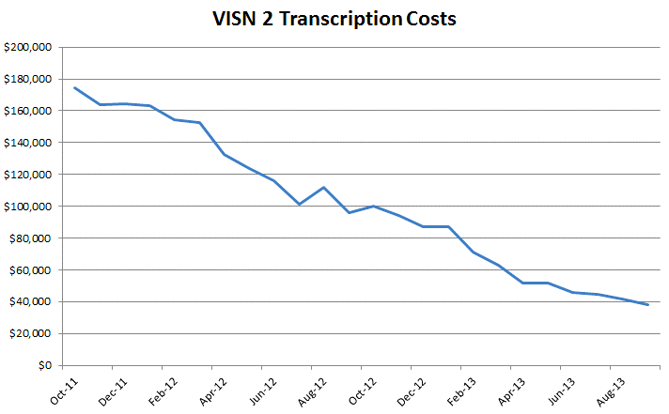
VISN 2 Transcription Costs
Notes:
Michelle:
That’s a great question, one that we actually hear quite a bit from our providers. There are several benefits to utilizing Dragon Voice Recognition Software, one of the most obvious being the reduction of costs related to traditional transcription services. This slide demonstrates the dramatic reduction we saw in VISN 2 since we started using Dragon back in 2012. To date, we have seen our costs go from almost $180,000/month, down to less than $30,000/month.
Equally as important as the reduction in costs, has been the time efficiencies that our providers have recognized. We’ve had users tell us that Dragon has cut their documentation time in half. On average, we find that providers using Dragon save at least 5 minutes/patient in their documentation, which equates to roughly an extra hour in their day that we are able to give them back. This has been a huge selling point for us as we look to roll this out to more of our providers.
Don: “You know, Michelle, that 5 minutes savings is for providers who are good typists. Those that aren’t, really save much more time.”
Michelle: “Great point, Don. Thanks for sharing that. Now let’s pause for a moment and take a look at the poll results.”

Slide 10
Poll Results
What is your role within VA?
    Health Information Management
    Clinical Provider/Staff
    Informatics
    Leadership
    Information Technology
    Other
Notes:
Michelle:
We asked: What is your role within the VA?
Health Information Management
Clinical Provider/Staff
Informatics
Leadership
Information Technology
Other
It looks like most of you work within HIM, followed by ……….and a few providers….. We have a variety of staff represented here today – we hope that you’ll find this presentation helpful.

Slide 11
Poll Results
What is your role within VA?
    Health Information Management
    Clinical Provider/Staff
    Informatics
    Leadership
    Information Technology
    Other
Notes:
[Pause for a second, then click again.]

Slide 12

VISN 2 JOURNEY
2011
500+
2014
Dragon 10.1
Active Users
Dragon 360
Notes:
Michelle:
By way of introduction we’d like to share our Dragon journey within VISN 2 and give you a little bit of our background and experiences with Dragon. In the fall of 2011, VISN 2 made the decision to purchase Dragon Medical version 10.1. Primarily this was seen as a way to reduce transcription costs, but also the hope was that utilizing Speech Recognition technology would help providers complete their documentation more efficiently and reduce the time spent documenting, freeing them up to spend more time taking care of Veterans.
As a VISN we now have well over 500 active Dragon Users in 5 medical centers and CBOC’s. While our journey began as primarily a cost savings measure, the biggest advantage we have seen is the time that it is actually saving our providers. In some cases, we have given them back upwards of an hour in their day, which, to a provider, is even more beneficial, or meaningful, than the cost savings.
We are currently in the process of migrating to Dragon Medical Edition 360 – Network Edition, which we are extremely excited about and expect to be fully implemented by the end of this year.

Slide 13
Poll Question
What experience do you have with speech recognition software?
      Very experienced (expert)
      Limited experience (familiar with functionality)
      No experience
      Have it on my smartphone
Notes:
Don:
Now we’d like to ask another poll question. You’re probably not aware that speech recognition software was first developed over 60 years ago at the Bell laboratories with a system called “Audrey”. “Audrey” was only able to recognize numbers that were spoken by a single voice. Ten years later, IBM demonstrated its “Shoebox” machine at the 1962 world’s fair which could only understand 16 words spoken in English. Clearly, speech recognition software has come a long way with Dragon having a virtually unlimited vocabulary and the ability to recognize speech at over 150 words per minute. That said, a lot of people have had no experience with voice recognition software. So, we like to get a sense of your experience using voice recognition technology. Our question to you is, “what experience do you have with speech recognition software?”
You’re very experienced or even an expert
You have limited experience but you’re familiar with the functionality of speech recognition
You have no experience with speech recognition
You have it on your smart phone, perhaps through the Dragon app or an application such as Siri.
To answer this question, use the blue polling icon above my head. We’ll move on and come back to your results in just a moment.

Slide 14

How do we get there from here?
PLANNING
IMPLEMENTATION
POST-IMPLEMENTATION
DRAGON
Notes:
Michelle:
How do we get there from here? Just like mapping out a route when taking a trip, in order to successfully reach your goal of full Dragon implementation you will need a roadmap. This presentation is designed to equip you with the map that you‘ll need to guide you on your journey.
So let’s begin plotting our course.

Slide 15

PLANNING
IMPLEMENTATION
POST-
IMPLEMENTATION
Notes:
Michelle:
The first phase of the Dragon journey that we will discuss is the Planning Phase. There are many decisions that will need to be made in this phase and they require extensive coordination within the VISN and across the medical centers. So the first step we recommend, is to create a workgroup to help with these decisions. Various roles will need to be assigned, and depending on how you are structured locally, these roles may differ from one medical center to another. In VISN 2, we are integrated, which means that our database is shared. However, we all operate independently, and in many cases, the roles assigned for implementation vary from site to site.
Now let’s pause for a moment and take a look at your poll results.

Slide 16
Poll Results
What experience do you have with speech recognition software?
  Very experienced (expert)
  Limited experience (familiar with functionality)
  No experience
  Have it on my smartphone
Notes:
Don:
We asked -
What experience do you have with Speech Recognition Software?
Very experienced (Expert)
Limited experience
No experience
Have it on my Smartphone
It looks like the majority of you have limited experience………
Once again, I’d like to remind you that if you think of a question at any time during the presentation you can click on the orange (ask the presenter) icon above to pose your question. We will answer questions at the end of the session.

Slide 17
Poll Results
What experience do you have with speech recognition software?
  Very experienced (expert)
  Limited experience (familiar with functionality)
  No experience
  Have it on my smartphone
Notes:
[Pause for a second, then click again.]

Slide 18
ROLES
PLANNING
  VISN POCs
  Administrators
  IT Support
  HIMS
  Trainers
  Dragon Users
IMPLEMENTATION
POST-
IMPLEMENTATION
Notes:
Michelle:
This slide demonstrates the various roles that are involved in a Dragon implementation. Roles include Administrators, Trainers, VISN Point of Contact, IT Support, and, of course, Dragon Users; Thoughtful planning and consideration should be given as you decide who at your facility will fill each role. A little later on we will review each of these roles more in depth, and share our experiences and break down how we determined who was assigned to each role.

Slide 19

ROLE
VISN POC
PLANNING
IMPLEMENTATION
POST-
IMPLEMENTATION
Notes:
Michelle:
As you may know, Dragon is being rolled out at the VISN level, so the first role we will discuss is that of VISN Point of Contact. This role involves high level coordination with not only the Medical Centers, but Regional IT and Nuance as well. Duties include developing training schedules, both at the Network and site level, facilitating travel for training, acting as a “go between” between Nuance and the VISN, coordinating and ensuring the functionality of pc’s, software, and access to the Active Directory. Attributes important for this role include good organizational skills, team building skills, versatility, flexibility, and the ability to rally others around a common goal or cause. Conversely, you would not want to assign this role to someone who was a procrastinator, or with poor organizational skills. In VISN 2, the role of the VISN POC was assigned to the VISN 2 HIMS Manager.

Slide 20
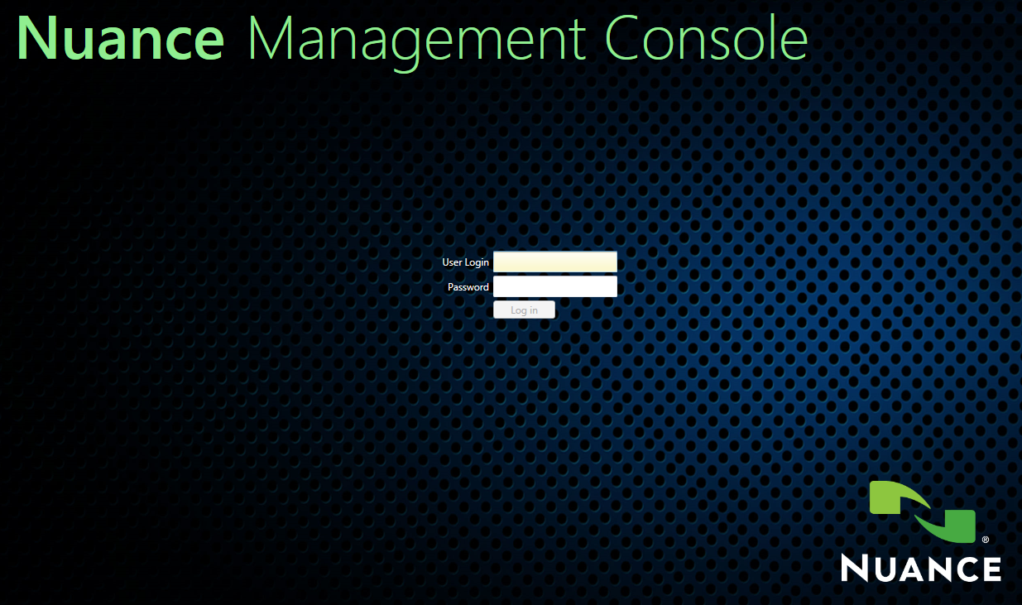
ROLE
PLANNING
Administrator
IMPLEMENTATION
POST-
IMPLEMENTATION
Notes:
Don:
The next role is that of Administrator. Administrators play a crucial role in the use of Dragon throughout your medical Center. In a sense, they are the gatekeepers who actually enable users to access the software.
Administrators do a lot of their work in a web-based software application called the Nuance Management Console or the NMC. There are two requirements that need to be in place before users are able to access and use Dragon. First, users need to be added to the management console in order to log into Dragon with their Windows user name and password. Secondly, Dragon users need to be added to a VISN specific Active Directory which establishes where their speech profile will be stored on the network. In VISN 2 these processes are split up. The Dragon administrators add new users to the Nuance Management Console, but their access to the Active Directory is accomplished through an electronic system access request called ECAR which is processed through their work unit or Care Line. OI&T staff facilitate adding users to the Active Directory.
Site Administrators may also be responsible for coordinating with OI&T staff to arrange installing the Dragon client software on users computers through SCCM, managing equipment such as PowerMics and headset microphones and for troubleshooting problems. SCCM stands for System Center Configuration Manager and it’s the software that IT uses to update our computers in VA.
At Bath we chose to have our Clinical Informatics staff as our Administrators. Primarily, this was because these staff were already familiar with Dragon and its functionality in CPRS as a result of our prior experience with Dragon over the past 3 years.

Slide 21
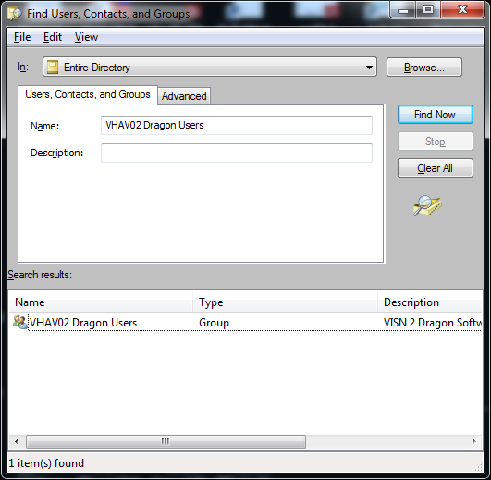

Active Directory
Notes:
Don:
Administrators and Trainers can easily check to see if their users are in the appropriate Active Directory by using the Microsoft Windows Explorer. For most users there is an icon on the taskbar at the bottom of their desktop that looks like a folder. Windows Explorer can also be accessed by clicking on the start button, clicking on “All Programs” then on “Accessories”. You then click on the Network selection in the left panel and click on the “Search Active Directory” button. You then type in the Active Directory name for your VISN in the Name field and Click the “Find Now” button. In our case the Active Directory is named, “VHAV02 Dragon Users”. When you select this, a window opens listing all of the users in this directory.
I’ve created a brief PowerPoint that walks you through the steps for searching the Active Directory to ensure that your users have been added. The PowerPoint shows you how you can save the search as a desktop icon so it is always readily accessible. You can download these instructions using the Download icon above my head.

Slide 22
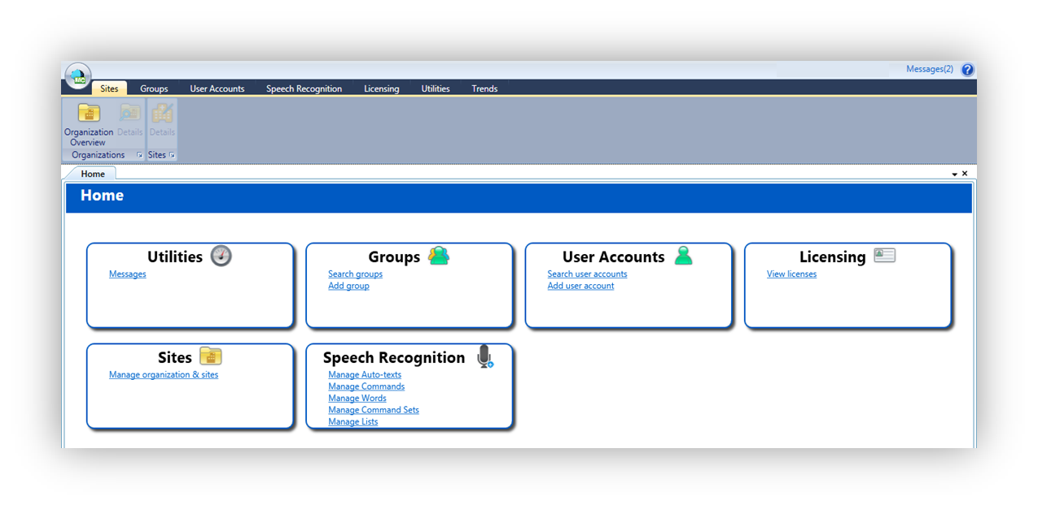
Nuance
Management
Console
(NMC)
Notes:
Don:
A few key points to keep in mind for Administrators are:
You need to ensure that you have an adequate number of Administrators for number of Users you have. For example, you probably can't be successful if you have only 1 Administrator for say 500 Users. At a minimum you should have at least two Administrators to ensure back up coverage. At Bath, we have two Administrators, myself and Michelle, and we will be training a third.
Administrators also need to develop competence with the Nuance Management Console. Administrators receive both on-line and in-person training on the Management Console as part of the initial training with Nuance. By the time this training is complete, Administrators should be reasonably proficient with the Console and comfortable with navigating the software.

Slide 23
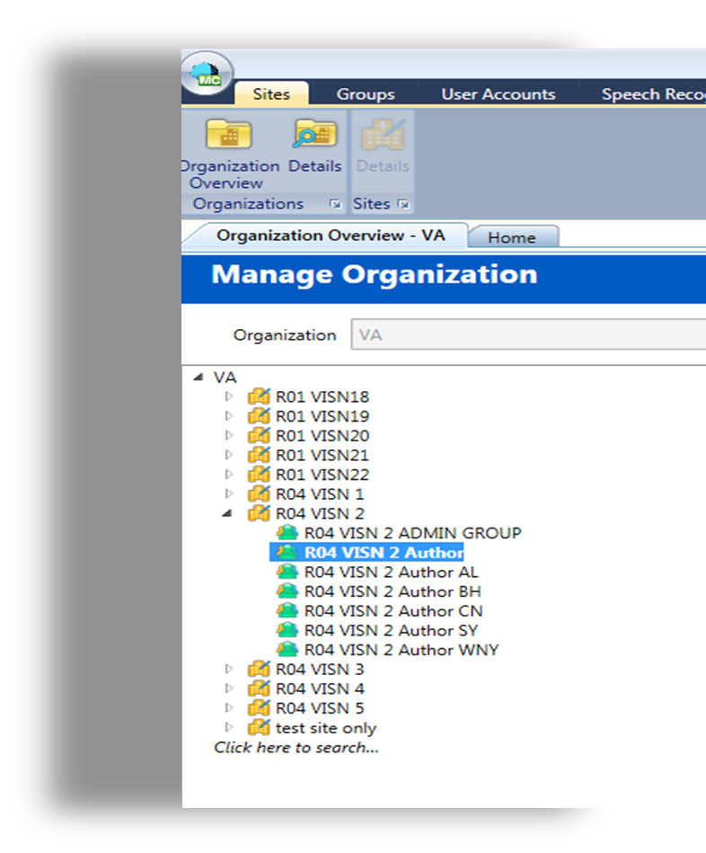
Managing
Groups
Notes:
Michelle
Within the Management Console, Administrators can manage groups, which determine the level of access authors and administrators have. In Bath, we give our users both a Region 4 VISN 2 Author Group as well as a Region 4 VISN 2 Author – BH group. This allows for us to give certain commands or access to just our local Bath users if we want, or we can assign things to all VISN 2 authors, if appropriate. Each site within our Network has the flexibility to do this based on the assignment of their users to not only the VISN group, but a group defined by their local site as well.

Slide 24
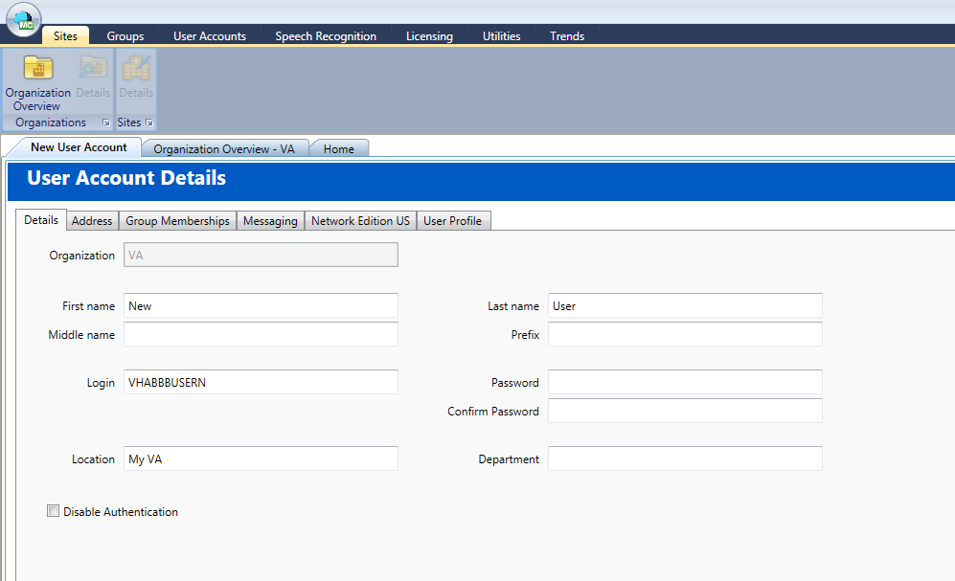
Adding
New Users
Notes:
Michelle
Administrators are also responsible for adding new users to the Nuance Management Console. There are a number of fields that need to be completed that establish a user’s ability to log into Dragon, and determine what level of access they will have to the system. At sites where the Administrators are not Dragon Trainers, Administrators will need to coordinate with the trainers to ensure access to Dragon is complete before training begins.

Slide 25





Importing Commands & Words
Notes:
Don:
Administrators are also responsible for adding new words, commands and lists to the Console so that they can be shared by all of the users within a group. This functionality makes it easy to share useful commands with all of the Dragon Users in your VISN or depending on how you have your groups set-up, by facility or other groupings, such as by department.

Slide 26
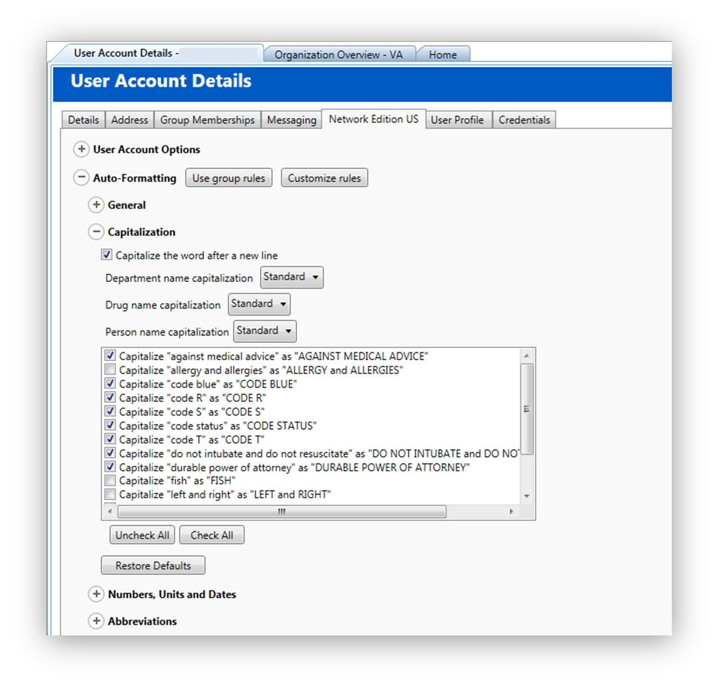
Direct
User
Support
Notes:
Don:
Additionally, Administrators provide direct user support such as customizing user settings, restoring profiles, and requesting Dragon Logs for troubleshooting support from Nuance. They need to coordinate with OI&T regarding installation of software, deployment of equipment and in troubleshooting problems.

Slide 27
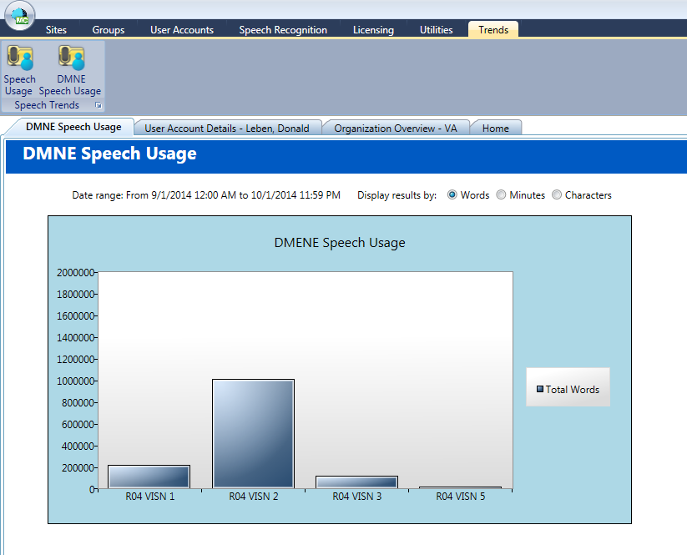
Reports
&
Graphs
Notes:
Don:
Lastly, Administrators are able to run Dragon usage reports and graphs from within the Nuance Management Console.
As you can see, Administrators play a large and crucial role within Dragon. So, I just want to mention three personal qualities that we feel help to make a good Administrator: First, they need to be very comfortable working with computer technology; they should have good organizational and coordination skills; and they need to have an exceptional “customer service” mindset.

Slide 28

ROLE
IT Support
PLANNING
IMPLEMENTATION
POST-
IMPLEMENTATION
Notes:
Michelle:
The next role we will be discussing is the Information Technology Role. Information Technology involves many important functions which are integral to a successful Dragon implementation. These include managing the SCCM process, as well as the Active Directory, ensuring that equipment (pc’s) meet minimum specifications (i.e. 4GB of memory) making sure that Dragon is loaded on any new equipment as it’s deployed, and responding to service calls related to the software. Decisions will need to be made with regard to how equipment resources are going to be managed? (i.e. microphones and headsets), and who will be responsible for tracking them. You will also need to work with IT to decide how you will manage the process of adding/removing users from Active Directory? Ideally, all of this will be a seamless process to the end user.
Since Information Technology plays such a key role in the Dragon implementation process, the sooner you involve them in the planning phase, the better.

Slide 29

ROLE
HIMS
PLANNING
IMPLEMENTATION
POST-
IMPLEMENTATION
Notes:
Michelle:
Health Information Management also plays a key role in any successful Dragon deployment. HIMS is responsible for oversight and ensuring that the integrity of the record is maintained. This means that providers must edit their work appropriately, and correct errors before signing documents. It’s our job to perform audits or focused reviews on all Dragon Users and provide timely feedback to the providers and medical staff as issues are identified. In VISN 2, overall Program responsibility for Dragon lies with the HIM Department.

Slide 30

ROLE
HIMS
PLANNING
IMPLEMENTATION
STEPS
FOR
SUCCESS
POST-
IMPLEMENTATION
Notes:
Michelle
There are pre-emptive steps you can take to ensure success down the road. We recommend attending Medical Staff and Departmental Meetings well before your Dragon deployment begins, so you can start to educate your providers on their roles and responsibilities, well ahead of time. If you have in-house transcription you will also want to include them and begin educating your staff early on, so they feel included in the transition to Dragon. Coders can also assist with maintaining the integrity of documentation, by bringing to your attention any errors in notes or work that did not get edited properly. It is imperative that you have a mechanism in place for identifying errors or issues, a process to communicate your findings, and a means to ensure that corrections have occurred. This will ensure the integrity of the medical record is maintained.

Slide 31

HIMS Transition
Notes:
Michelle
Before you begin to transition to Dragon, you will want to evaluate your existing practices regarding the utilization of dictation at your facility, and determine what your goal is. The goal needs to be clearly understood and supported by your facility Leadership as well, so that collectively you are all on the same page and working towards the same goal. For example, will you continue to allow dictation, or only for certain providers? Or is your goal as a facility to eliminate the use of transcription entirely? In VISN 2 we had sites with different goals and expectations. Here in Bath, our goal was to reduce and eliminate the use of dictation, with the exception of our fee basis providers. We took the approach that we would wean our providers off slowly and made the decision to not offer traditional dictation as an option to any new providers as they came on board, and slowly transitioned the rest of our staff to Dragon. Other sites within our Network took an entirely different approach. One site went “cold turkey” and wouldn’t allow the use of dictation after a certain date. They were not prepared, however, to handle all of the issues and fall out from that decision, so they eventually returned to a more gradual, transitional approach. One of the most successful ways we saw this handled within our VISN was to get the Departmental Leads on board as Champions, who could then facilitate the transition within their department. This approach was so successful in a few areas that they took it a step further and the Leads are now doing all of their own Dragon training within their department. The key to any successful transition, however, is ensuring that you have adequate staff available to train the users that require training. In some cases it may mean getting creative and looking outside of the HIM or Clinical Informatics Department for trainers.

Slide 32

ROLE
PLANNING
Trainers
IMPLEMENTATION
POST-
IMPLEMENTATION
Notes:
Don:
The next role we’re going to discuss is that of the trainer, which is a pretty straight forward role. It’s to train users on how to properly use Dragon, provide ongoing support, and provide initial troubleshooting support for user who run into problems.
Trainers are also able to help Dragon users build basic Auto-Text commands, integrate Dragon fields into CPRS templates and build more sophisticated step-by-step and advance scripting commands.
Sites will need to determine who will serve in this role. At Bath, our Clinical Informatics staff took on this role because of their familiarity with CPRS and medical record documentation requirements. Other sites in our VISN used HIMS staff or transitioned their transcription staff into this role. As Michelle mentioned, some medical centers in our VISN have taken a true “train-the-trainer” approach in which clinical department leads have been trained to train their staff.
Regardless of who serves in this role, you need to ensure that there are sufficient numbers of trainers to support your user base. As with the Administrator role, we feel that there are some qualities of a good Dragon trainer that you might want to consider. First, your trainers need to be good, effective teachers. It not enough to be proficient and knowledgeable about Dragon, your trainers need to be effective at transferring their competence to the staff they are training. It’s helpful for your trainers to have good interpersonal skills, patience, and experience with documenting in CPRS. They should have enough technical background with CPRS to know how to incorporate Dragon commands into templates and to be able to build useful commands for your Dragon users.

Slide 33

ROLE
PLANNING
Dragon Users
IMPLEMENTATION
POST-
IMPLEMENTATION
Notes:
Don:
And finally, the last role that we’ll be discussing is that of the Dragon User. The key requirement for Dragon users is a willingness to learn to use the software. We always stress with our users the need to use Dragon correctly so their speech recognition improves over time. For example, I constantly remind users to correct mistakes with their voice and not the keyboard so Dragon can associate the right words with their speech.
We require all Dragon Users to sign a “Rules of Behavior” agreement, in which they acknowledge that they will follow VA rules and specifically that they will not build commands to automatically enter they’re user name or passwords. I’ve had a number of providers ask about doing this and I simply reiterate to them that using a command or your voice to enter access codes is not secure and that I can not do that for them. If you would like a copy of our Rules of Behavior form, you can download it using the Download icon above.
Another responsibility for Dragon users is to ensure the accuracy of their documentation. While Dragon is very good, it’s not perfect, so users are responsible for proofreading their documentation before signing it.
A final consideration for sites to make is who will be allowed to use Dragon. We’ve made it available to all medical providers and to a number of other clinical staff such as psychologists and social workers. We’ve also made it available to some administrative staff, such as employees with carpal tunnel, as part of a “reasonable accommodation”.
Michelle: Don, you know with the new Network version of Dragon, we have unlimited licenses, so the only limitations will be the number of microphones we have available. We may want to consider making Dragon available to even more staff.

Slide 34

Facility Culture
Notes:
Michelle:
In addition to determining who at your site will be performing all of these roles, we recommend that you spend time examining what the culture is like at your facility with regard to documentation, as part of your planning process. By culture, I am talking about the method that your providers utilize to complete their documentation. Do they dictate their notes, or enter them manually? Other questions to ask are, “Is sloppy documentation currently acceptable, or are issues identified and the expectation is that they are corrected? Current dictation practices and utilization reports should be run to identify who your heavy dictation users are. These may be the staff that you target first, as a cost savings measure. In our review, we identified one of our Optometrists as a heavy user of dictation. We enlisted him as an early adopter of Dragon, and today he is one of our strongest Champions, utilizing Dragon for all of his documentation. Set the expectation early and let everyone know that they are required to review their notes for potential errors (i.e. hypertension vs hypotension). Dragon will make mistakes – end users need to review and correct these mistakes prior to completing their documentation.

Slide 35
Poll Question
Which function is the most crucial for successful Dragon deployment?
      Training Providers
      Developing a comprehensive implementation plan
      Post-Deployment maintenance and support
      Software installation
Notes:
Don:
Now, it’s time for another poll question. With this question we would like to get a sense of your impression of the importance of some of the key tasks involved in deploying Dragon at your Medical Centers.
Which of these functions do you think is most crucial for a successful Dragon deployment?
Training Providers
Developing a comprehensive implementation plan
Post-Deployment maintenance and support
Software installation
To answer this question, use the blue polling icon above my head. We’ll move on and come back to your results in just a moment.

Slide 36
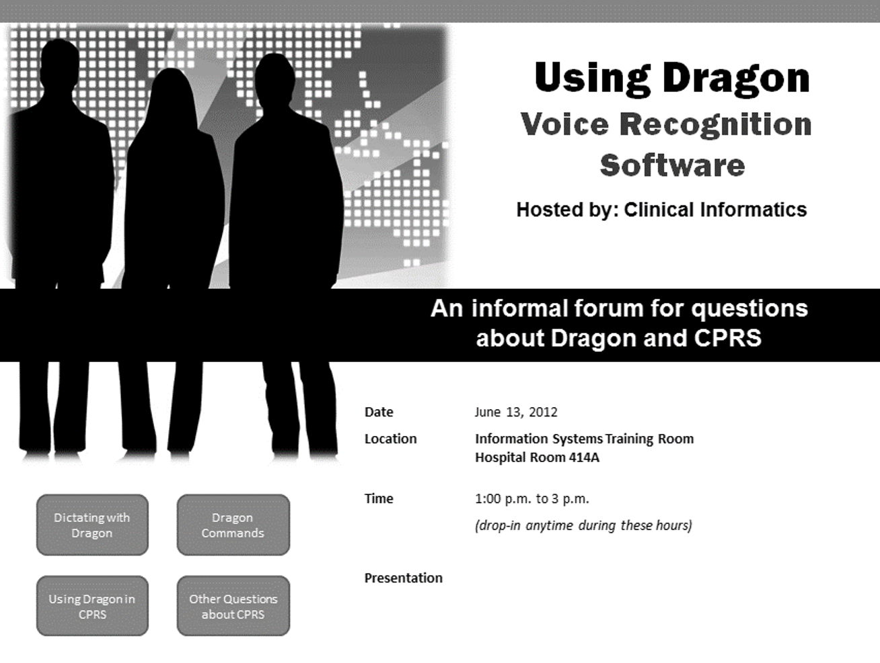
Marketing
Notes:
Don:
Next we want to talk a little about marketing your Dragon implementation. Having a successful Dragon deployment requires an effective marketing strategy. You have to get the word out. We used a number of strategies as part of our initial marketing. We began with some brief discussions about the benefits of Dragon with our Medical Center and Clinical leadership. Securing leadership buy in helps to “sell” the benefits of Dragon and it’s absolutely crucial if you run into resistance as we did when weaning providers off of the transcription service.
We also distributed emails and flyers explaining the benefits of Dragon and who to contact for more information or a demonstration.
A particularly effective event we conducted was a live demonstration of Dragon at a meeting of all of the Medical Staff. We had a “physician champion” who had been trained by Nuance put Dragon through its paces. I followed this up with a demonstration of some of the additional features such as ability to add commands. I would say that at least half of those in attendance signed up for Dragon training on the spot.
We followed-up our Medical Staff presentation with a number of “drop-in” demonstrations open to everyone. These sessions gave potential users more time to ask questions and become comfortable with the capabilities of Dragon.
We continue to market Dragon to all new medical providers and we’ve been able to stop offering the transcription service as an option to them.

Slide 37
Nuance & VISN POC
Medical Center Leadership
Effective Communication
Dragon Users (Providers)
Notes:
Michelle:
Communication, at all levels of your organization, will be an integral factor in your success. As Don mentioned, it will be important to meet with your Medical Center Leadership and get their support and buy-in prior to marketing this to the Medical Staff. During these meetings you will want to not only orient them to the functionality of Dragon, but relay the benefits and cost savings to the organization as well. Do your homework and share the data. Leadership support will be important as you begin a facility wide implementation, as no doubt you will meet with some resistance along the way. Having your leadership team on board and supportive will help to minimize the resistance.
Additionally, communicating and demonstrating Dragon to your providers ahead of time will allow you to share its positive features and benefits. The more you communicate with them ahead of time, the better your chances for a successful deployment. Targeting users who are tech savvy, and excited about the technology will help sell Dragon by positive “word of mouth” advertisement for initial users.
Having regular communication with Nuance has also been extremely important. Early on in our deployment we established weekly calls with them, which helped us to establish a rapport with their team, and to set some mutually agreed upon timelines and benchmarks for training and implementation. We also met as a VISN on a weekly basis to follow-up on any internal issues we needed to address or come to consensus on as well. There are many different resources available through Nuance that we also share with our users, such as a Newsletter that highlights new features and tips, as well as the iSupport website. Working together as a team, we resolve issues as they present themselves.
Now let’s pause for a moment and take a look at your poll results.

Slide 38
Poll Results
What function is the most crucial for successful Dragon deployment?
  Training providers
  Developing a comprehensive implementation plan
  Post-deployment maintenance and support
  Software installation
Notes:
Michelle:
We asked you “Which function was the most crucial for successful Dragon deployment?
Training Providers
Developing a comprehensive implementation plan
Post-Deployment maintenance/ support
Software installation
It looks like most of you felt that Developing a comprehensive implementation plan was the most crucial. I would agree that having a plan is absolutely essential, it’s worth mentioning that all of these functions play an integral role in a successful Dragon deployment.

Slide 39
Poll Results
What function is the most crucial for successful Dragon deployment?
  Training providers
  Developing a comprehensive implementation plan
  Post-deployment maintenance and support
  Software installation
Notes:
[Pause, then click again]

Slide 40



PLANNING
PEOPLE
IMPLEMENTATION
RESOURCES
POST-
IMPLEMENTATION
TIME
Notes:
Don:
When planning your actual implementation of Dragon, the most important thing to keep in mind is to “be flexible.” With a project of this scope and size, it’s almost inevitable that problems will arise and timelines will slip. In our case we had a difficult time coordinating training schedules with Nuance and because we have an integrated database a lot of the processes we needed to establish had to be coordinated across all 5 Medical Centers and with Regional OI&T to make it work. Then after we completed training with Nuance and were just beginning to role the new version of Dragon out to our Providers, a problem was discovered with the SCCM routine for installing the Dragon Client, resulting in another delay in the implementation process. So keep in mind that you need to be flexible and adaptable as you go through the process of implementing Dragon.
Some of the key implementation tasks that will need to be planned for are:
Establishing your train-the-trainers schedule with Nuance which involves two in-person 3 day sessions.
Planning 3 separate virtual Administrator trainings.
Working with OI&T to identify computers that will need the Dragon client software and ensure that those computers meet the hardware requirements and specifications for Dragon.
Develop a flexible deployment schedule. For example, will it be rolled-out by department or across all identified departments.
Identify your initial Dragon users and have them entered into the Active Directory and the Nuance Management Console
Develop training schedule for users (this may involve training at their work site or perhaps a consolidated training site)
Determine how you will manage resources such as your microphones. For example will you physically secure the microphones to specific computers? This works well in areas where computers are shared such as your Emergency Department. Or, you may choose to actually issue microphones to users. We did this for users who don’t share computers and we have them sign Property cards. If you choose to do this, you’ll need to determine a process for tracking the microphones.
Finally, another part of your plan should be considering how you will provide support Post-Deployment.

Slide 41
PLANNING
IMPLEMENTATION
POST-
IMPLEMENTATION
Notes:
Michelle:
Now it’s time to move on to the actual Implementation. This entails installing the Dragon Client onto the users’ computers, ensuring that the users have access through the Management Console and the Active Directory, and scheduling and initiating training.
Some things that we found useful during our initial implementation were starting with just a couple of users initially, which allowed us to work out the bugs before a full blown deployment.
Now Don’s going to talk a little bit about how he trains Dragon users.

Slide 42
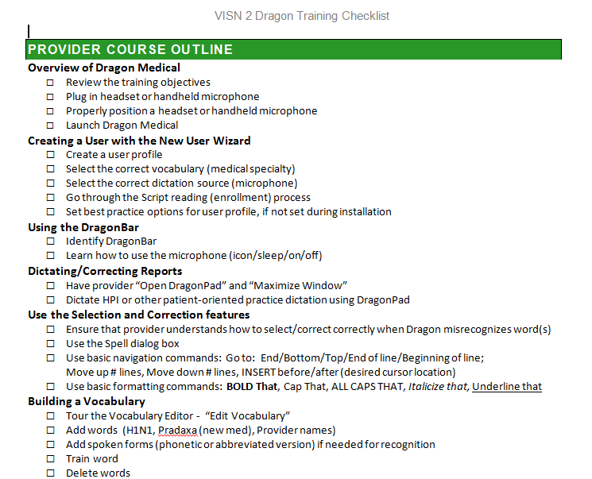
Provider
Training
Notes:
Don:
After your users have the Dragon Client installed on their computer and they’ve been added to the Active Directory and the Nuance Management Console, you’re ready to start training them. So, I want to start by discussing a few things to consider in planning user training and then provide a brief explanation of how I usually train a new Dragon User.
After this, we’re going to take a little closer look at how a Dragon Profile is set-up, talk a little about the types of microphones typically used with Dragon and then give you a look at the Dragon Toolbar.
Normally, we recommend individual training over group training. Many times, new users need one-to-one support during the learning process and this can be difficult in a group setting. Also, I have handouts provided by Nuance available for new users. These include a “cheat sheet” of the common Dragon Commands and the CPRS specific commands. At Bath, we had these laminated, front and back so our Dragon users could have it close by as they are dictating.
I try to schedule the Dragon training around the Provider’s schedule, whenever possible. I’ve found that a full training session takes about 2 hours, however, some providers are not comfortable blocking that much time at one setting. So, I tend to be flexible and will schedule multiple sessions with a new user if that fits better with their schedule or learning preference.

Slide 43
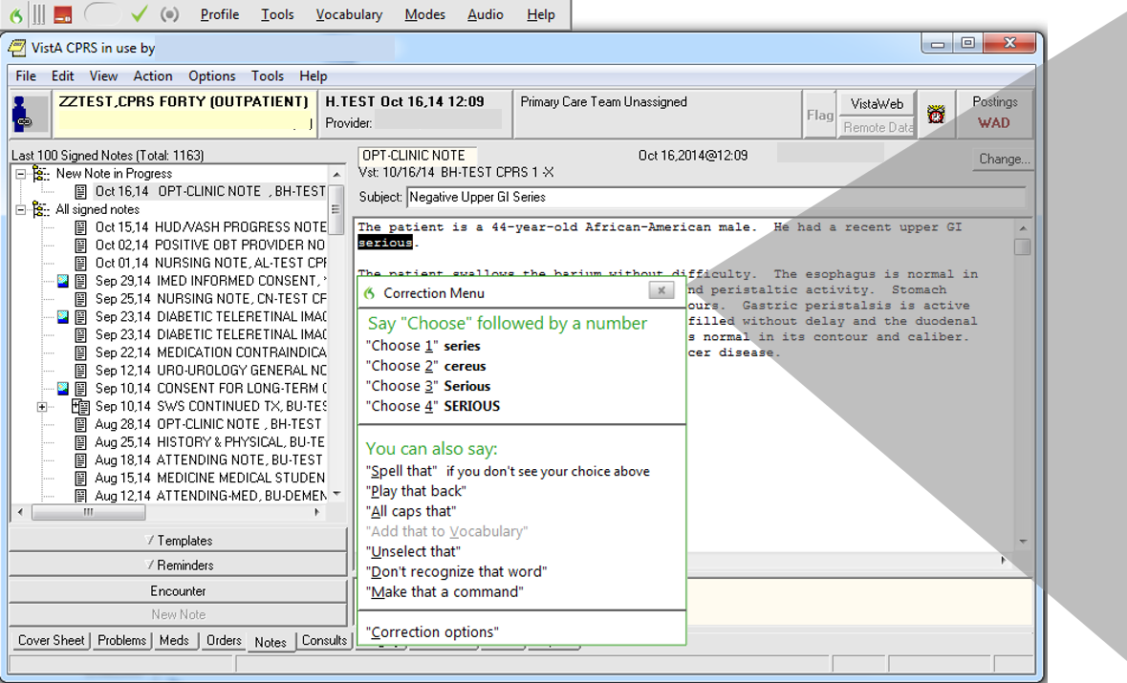
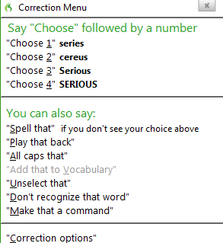
T I P S and T R I C K S
Provider Training
Notes:
Don:
When I begin training a new user, we go through the initial profile set-up which takes 5-10 minutes. Then I orient them to the PowerMic or the Headset microphone and I explain the Dragon toolbar to them. After this, I will explain a few basic requirements of using Dragon such as the need to dictate punctuation and how to start a new line or paragraph. I have them open CPRS and start a new progress note and then I turn them loose. I have them dictate for awhile and I tell them to just ignore any mistakes that Dragon makes. After they’ve dictated for awhile and there are some mistakes in the text, I’ll have them stop and we go back and review the note. I use what they’ve dictated to demonstrate how to use their voice to navigate in the note and, most importantly, the proper way to correct mistakes. I stress with the users the need to correct mistakes with their voice and not with the keyboard. This is how Dragon learns the user’s pronunciation of words and how those words are used in dictation. I also use their dictation to show them how to add words to the Dragon vocabulary and how to use the other built in Dragon and CPRS commands. After this, I have them practice dictating and correcting some more. Then, once they are comfortable with the dictation process, we move on to learning some more of the features of Dragon including the Dictation Box, Auto-Text commands, and using Dragon fields in commands and templates. I usually finish up by demonstrating how they can create their own Auto-Text commands and how to properly close Dragon so their voice profile is saved.
During the training with Nuance, trainers go through this process themselves, as well as having the opportunity to train actual providers with Dragon.

Slide 44
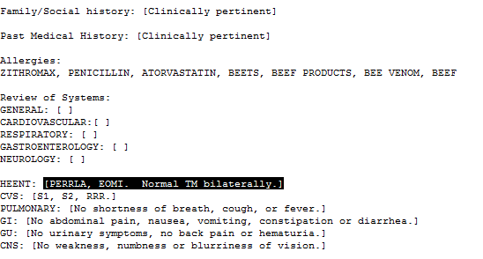
Dragon
Fields
Notes:
Don:
Another great feature of Dragon that I always train new Users on, is what’s referred to as Dragon “Fields” or “Variables”. Fields in Dragon act as a placeholder that are entered in either a Dragon Auto-Text command or in a CPRS Template. With Dragon, Users are able to easily navigate to these placeholders with a simple voice command. By default Dragon Fields are designated by an open square bracket and a close square bracket. Whenever these are present in a document that’s being edited, Dragon will automatically recognize them as a Field. A User can easily navigate through their template by using the voice command, “Next Field”. This command will automatically move the cursor to the next set of brackets, which will be highlighted and ready for dictation. The User simply dictates the text they want included and the brackets are replaced by this text. Brackets can be skipped by repeating the command “Next Field” and can be returned to with the command “Previous Field”.
To make Dragon Fields even more useful, default text can be added between the brackets. If this default text is appropriate for the patient, the User can simply leave it by saying “Next Field”. Or, if they want to change it, they just need to dictate the replacement text. Before the User signs the progress note, they can use the Dragon command, “Accept Defaults” to remove any left over brackets that remain in their document.
Dragon Fields can greatly enhance a provider’s efficiency and result in more consistent and thorough documentation while reducing the amount of time required to complete progress notes. And, because Fields can be easily customized, they offer a tremendous amount of flexibility in the design of templates.
An advantage for Dragon Users who use the PowerMic is that there are already buttons that are pre-programmed with the “Next Field”, “Previous Field” and “Accept Defaults” commands. With just a little bit of practice, providers are able to fly through their progress notes, in many cases without having to type a single word. Finally, as an added bonus, the provider isn’t waiting for their dictated note to come back from the transcription service. When they’re finished dictating and reviewing their note, they can sign it and be done.

Slide 45
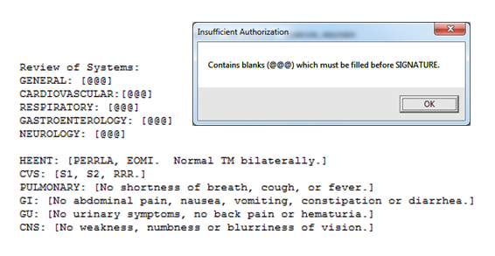
T I P S and T R I C K S
Dragon Fields
Notes:
Don:
As a last note on Dragon Fields, I want to share a nice tip that’s been promoted by one of my colleagues in Syracuse. This trick lets you simulate a “mandatory or required field” in a CPRS template. He uses a little known feature of CPRS that was designed for use by transcription services. When a transcriptionist can’t understand a word recorded by a provider, they place 3 @ signs in the note where the word belongs. When the provider receives the note back from transcription they have to review it to correct any of these types of errors. CPRS will not let the provider sign the note until all of these @ signs are removed. By placing 3 @ signs inside of the square brackets in a CPRS template that’s been designed for Dragon, you in essence have created mandatory fields in your template that work great with Dragon.

Slide 46
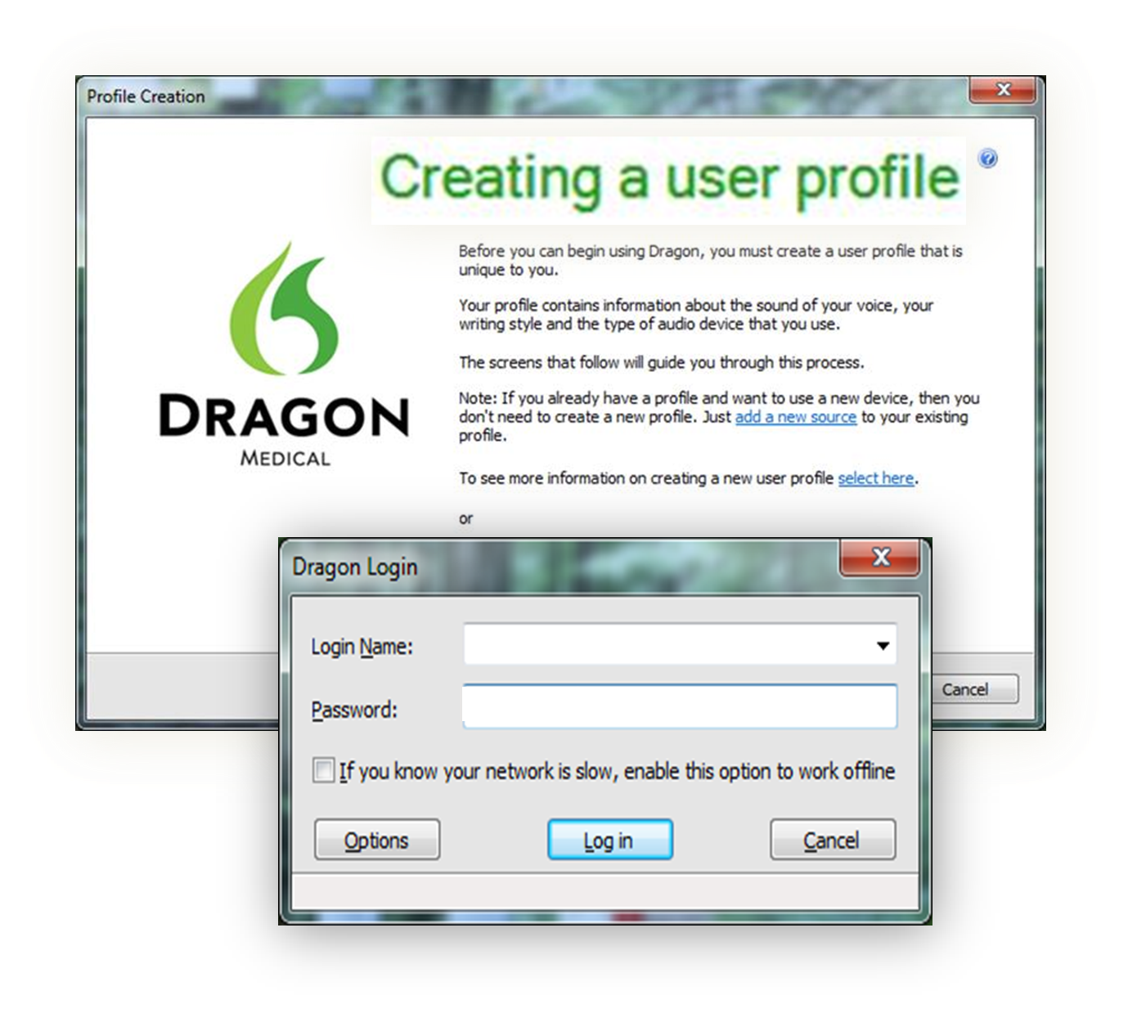
Dragon
Profile
Notes:
Michelle:
Next we’re going to take a closer look at the process for creating a new Dragon profile. If the new user is set-up properly in the Management Console and the Active Directory, when they log-in to Dragon for the first time, they’ll be prompted to create a new profile.

Slide 47
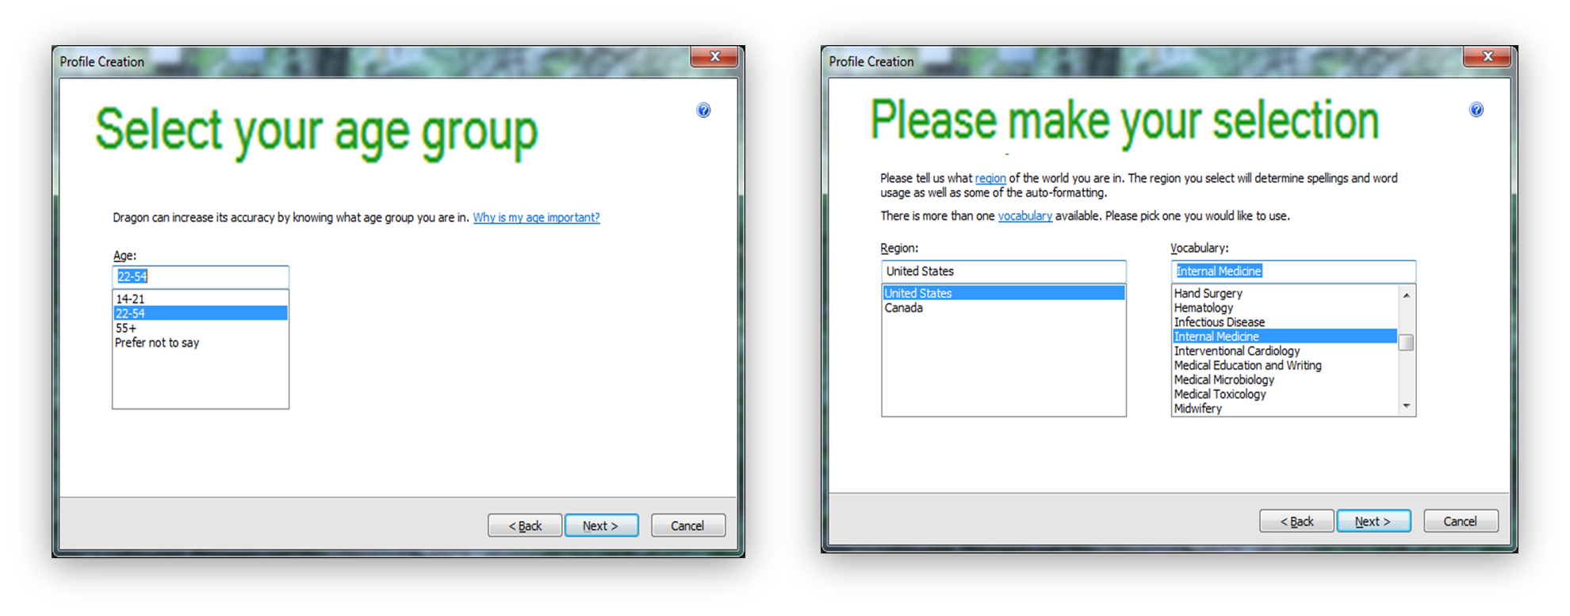
T I P S and T R I C K S
Dragon Profile
Notes:
Michelle:
The user is then prompted to select an age range and a vocabulary based on their medical discipline. Both of these settings help to optimize Dragon’s speech recognition capability. Dragon Users can later add additional vocabularies to their profile and have the option of which to choose when they log-on to Dragon.

Slide 48
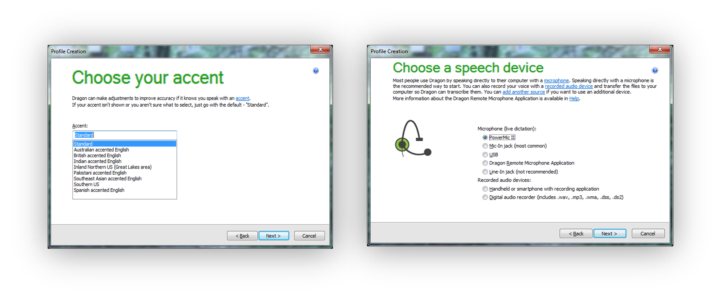
T I P S and T R I C K S
Dragon Profile
Notes:
Michelle:
Dragon can be optimized to adjust for users’ accents and it will recognize speech conventions from other locations. For example, Don was training a physician from Pakistan who had his medical training in London. Instead of saying “period” at the end of sentences, he used the term “full stop”. Dragon had no problem with this and entered the punctuation correctly.
Next in the profile set-up process, the user selects the type of microphone they will be using. As with the vocabulary selected, a user can add an additional speech device to their profile at a later time.

Slide 49
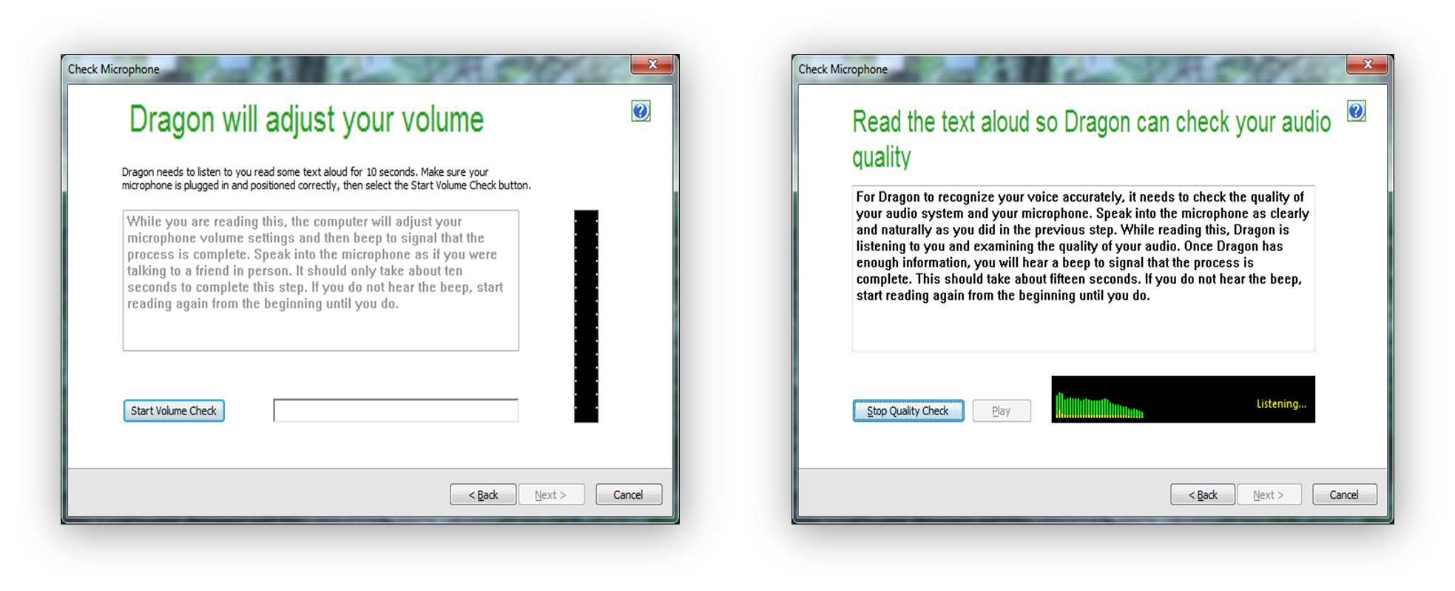
T I P S and T R I C K S
Dragon Profile
Notes:
Michelle:
After reviewing your settings, Dragon begins to build your profile. The user is then prompted to read two brief paragraphs that are used to adjust the volume settings of the microphone and to adapt for the audio quality of the computer’s sound system. These steps take about 1-2 minutes to complete and once they are done, the user gets a confirmation that their Dragon profile is complete and ready to use. The entire profile set-up takes 5-10 minutes. This is a significant improvement over Dragon version 10.1, which takes 20-30 minutes.

Slide 50
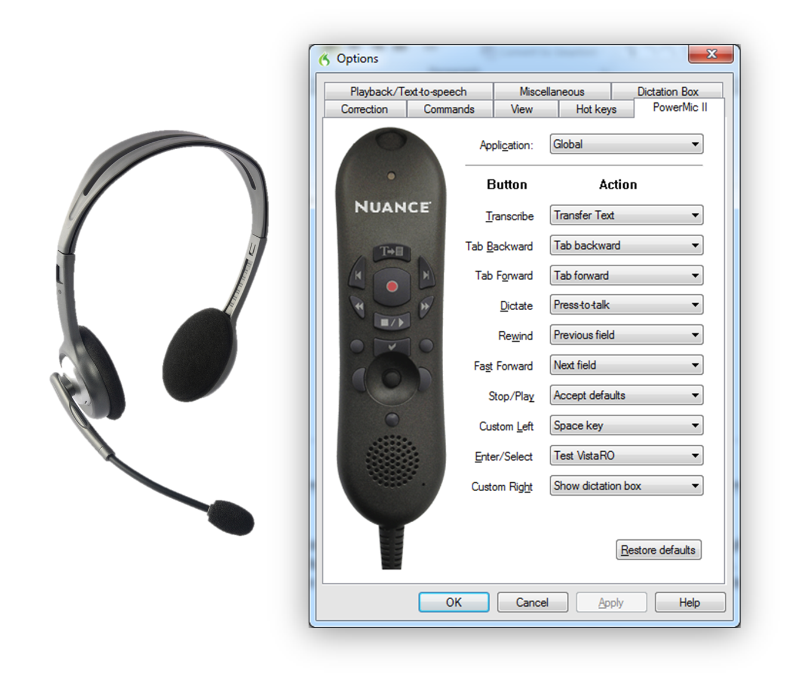
Microphone
Notes:
Don:
After helping a user set-up their Dragon Profile, I go over the use of and positioning of the microphone they are going to be using.
Typically, there are two types of microphones that are used with Dragon. The standard headset microphone that is worn on the user’s head with a speaker over one ear and a small microphone that can be adjusted to rest in front of the user’s mouth. There are no buttons on this type of microphone and it’s controlled by Dragon voice commands. A voice commands such as “Go to Sleep” is used to have Dragon stop entering text and “Wake up” is used to have it start listening again. Typically, we’ve issued the headsets to users who have medical conditions that make holding a handheld microphone too difficult.
The second type of microphone, and by far the most commonly used in VISN 2, is the PowerMic. The PowerMic is a handheld microphone that has a built-in mouse and a number of buttons that can be programmed by the user to complete different tasks. The button in the middle with the red dot is the “hold to talk” button and is held down by the user whenever they’re dictating into Dragon. Being able to program these buttons gives Dragon Users a lot of flexibility in how they want to use this microphone. For example, I built a command called “Test VistaRO” for my own use that I’ve programmed to the Enter/Select button. User’s can program buttons to open specific websites or programs such as Vista Imaging that they use frequently. During training with Nuance, all of the features of the PowerMic and the how it’s programmed are thoroughly explained.

Slide 51

Dragon
Toolbar
Menu
options
Microphone button
Status window
Notes:
Michelle
Let’s take a few minutes now and review the Toolbar in more detail. The red microphone button changes to green when the microphone is active, which is a good visual indicator for the user. The status window displays text that tells you what’s going on with Dragon right then. The text changes when you are loading/saving your profile, when the microphone is active, etc. Above the status area are the menu options, along with a checkmark that turns green when you are in a window that accepts Dragon dictation.

Slide 52
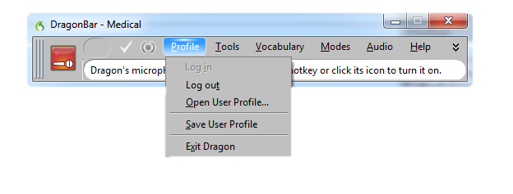
PROFILE
Dragon Toolbar
Notes:
Michelle
If you hover over the word “Profile,” it allows you to open your profile , as well as save it when you are done. You may also exit Dragon from here as well.

Slide 53
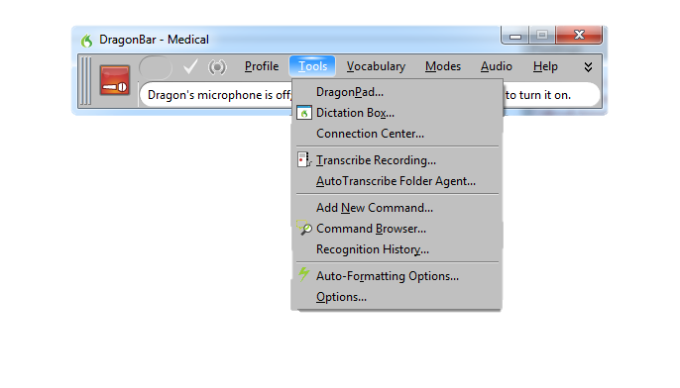
TOOLS
Dragon Toolbar
Notes:
Don:
There are a number of useful tools on the Tools menu and I’m not going to discuss them all, but I do want to address a few of the more useful options. Dragon has a built-in basic word processing program called DragonPad which is similar to Microsoft Word. And, as with many options in Dragon, can be accessed from the menu or with your voice by saying “Open DragonPad.” Another really useful tool is the Dictation Box. This tool opens a window on the screen into which any dictated text is entered. So for example, a provider could switch from tab to tab in CPRS, dictating text from different parts of the record into the Dictation Box. When finished, they can go to their progress note, say “Transfer Text” and their dictation will be pasted into their note.
Also, on the Tools menu is the Command Browser where users can add, edit, and import commands for Dragon. And finally, users have the ability to customize Dragon using the Auto-Formatting Options and the Options selections on this menu. Trainers are taught how to use these tools during their training with Nuance and we typically go through most of these options when training new Dragon users.

Slide 54
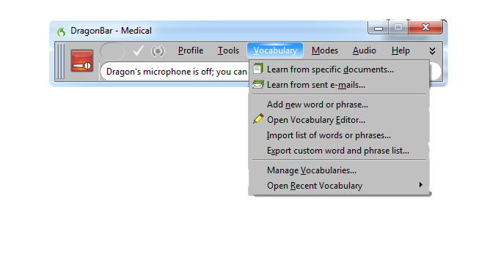
VOCABULARY
Dragon Toolbar
Notes:
Don:
The Vocabulary menu has a number options for helping a user add, edit, import and export words and lists into their vocabulary. In training, I normally will show these options to the new user, with just a brief explanation of what they do, and then I train them by using the Dragon voice command, “Edit Vocabulary” which is the same as clicking on the “Open Vocabulary Editor” option.

Slide 55
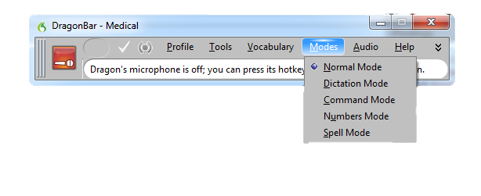
MODES
Dragon Toolbar
Notes:
Don:
For most Dragon Users, we leave Dragon in the Normal Mode. In this mode, Dragon is listening for both dictation and for commands and it will respond based on what the user says. There are options here to place Dragon into Dictation Mode in which commands are ignored. In Command Mode, Dragon will only respond to commands and not type dictation. Numbers Mode can be useful when dictating numbers, such as in a spreadsheet and Spell Mode allows you to enter text by spelling words.

Slide 56
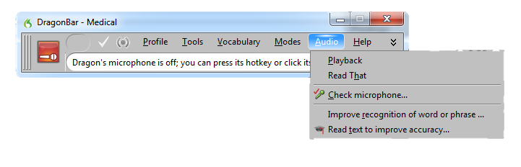
AUDIO
Dragon Toolbar
Notes:
Michelle
The “Audio” button allows you to playback recent dictation. “Read That” will read you text that you have highlighted from a specific area. “Check microphone” gives you some helpful hints with regard to using the microphone and allows you to perform a volume check. The “Improve recognition of word or phrase” option allows you to train Dragon by entering the word or phrase here, versus entering it via a command, and will add it to the Vocabulary. And, finally, “Read text to improve accuracy” allows you to train Dragon by reading a passage for better recognition.

Slide 57
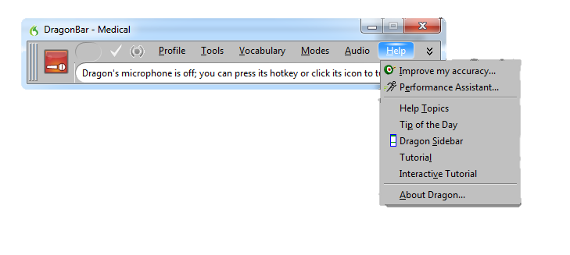
HELP
Dragon Toolbar
Notes:
Michelle
The Help menu has options to help a user improve the accuracy of Dragon’s speech recognition, Tutorials, Tip of the Day suggestions, and Help topics that can be used to learn more about Dragon features and functions.

Slide 58
Training Tips
PLANNING
IMPLEMENTATION
POST-
IMPLEMENTATION
Notes:
Michelle
Now we’d like to share some tips that we give to our Dragon Users to assist them with accuracy and improve their efficiency.
The first recommendation is to speak in full sentences so Dragon picks up the context of your words. This will help when a word you are dictating sounds the same as another word with a different meaning. Dragon is smart, and if you dictate in full sentences it will know to select the word that is most appropriate based on the context of your sentence. The second tip is to correct Dragon with your voice versus the keyboard, which may take some getting used to. While it may be faster to correct with the keyboard, we stress to our users that if you take the extra minute or so to correct Dragon with your voice, every time you dictate that word it will recognize it and you should never have to correct it again. We encourage users to add new words through the edit vocabulary command. Once again, taking the extra time in the beginning to add words to the vocab will save you a lot of time down the road, and make you a proficient Dragon User. Most of the time when we hear complaints about Dragon not saving a user time, it’s because they haven’t taken the time to train Dragon with their voice, and are, therefore, continuously having to edit the same words or phrases over and over again.
Lastly, we always remind users to close Dragon before logging off of the computer so the user’s Dragon Profile is saved. Dragon learns a lot about a user during every session including how words are pronounced, which words are used more frequently, new words added to the vocabulary and new commands that a user might add. We want to be certain that all of this information is saved in the user profile.

Slide 59

PLANNING
IMPLEMENTATION
POST-
IMPLEMENTATION
Notes:
Michelle:
Once you’ve adequately trained your users it’s important to ensure that what you’ve taught them is being utilized and they are following your guidance. As I mentioned earlier, reviewing notes for accuracy and providing feedback to your users with regard to their Dragon utilization is crucial. Timely reviews should be completed for all new Dragon Users to address any errors identified (i.e. providers not editing their work, spellcheck not selecting the correct word, etc), and assist them with any issues they may encounter. This is also a great time to reinforce with them how to add commands/Vocabulary through the console and assist them with building commands. We created a local mail group for our Dragon Users as a means of communicating general information that would be beneficial to all users (such as tips, updates, and notification when a server is down.)

Slide 60
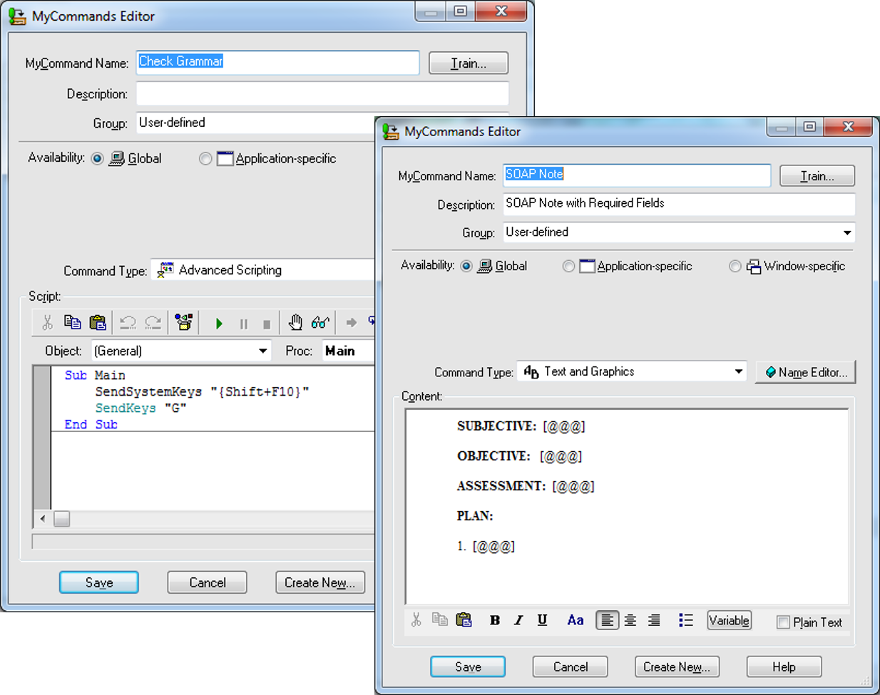
Ongoing Support &
Maintenance
Notes:
Don:
Once you’ve deployed Dragon and you’ve built up you user base, you want to make sure that you have good on-going support. I can guarantee you that most of your Dragon users will become very dependent on this software and you will get panic calls when something isn’t working right. Administrators and Trainers need to know how to respond to these calls and when an issue needs to be reported to the National Help Desk for support from Nuance.
Some other ways to support Dragon Users are to:
Continue to Develop useful commands and templates for your Dragon users.
Work with OI&T to ensure that Dragon is properly installed on new replacement computers for Dragon users.
Make sure you keep track of your microphones and headsets and if one fails, get a replacement issued as quickly as possible.
Offer additional basic and advance training to your users.
Finally, ensure there is ongoing collaborating and communication between Administrators, trainers, OI&T, and when necessary, Nuance.

Slide 61

Ask the Presenter
Notes:
Michelle
That’s it for our formal presentation. If you haven’t submitted your questions yet, there is still time to do so by clicking on the orange “Ask The Presenter” icon. We’re going to show a brief announcement and be right back to answer your questions.

