Slide 1

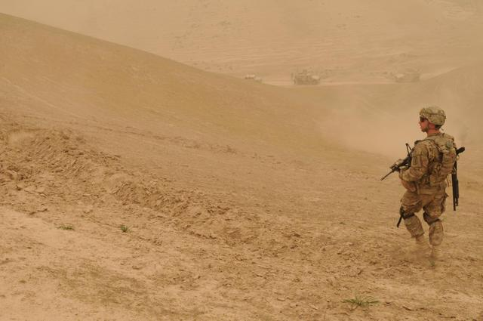
The Airborne Hazards Registry
Evaluating Veterans’ Exposure and Respiratory Concerns
Omowunmi Osinubi, MD
Michael Falvo, PhD
Anays Sotolongo, MD
Mehrdad Arjomandi, MD
Michael Morris, MD (Guest)
Notes:
==============
Photo Credit:
U.S. Army Sgt. Christopher W. Kane, a squad leader with Alpha Company, 3rd Platoon, 2nd Battalion, 18th Infantry Regiment, 170th Infantry Brigade Combat Team, surveys an area during a sandstorm near Gerdab, Nangarhar province, Afghanistan, April 14, 2011. (U.S. Army photo by Private 1st Class Nathan Goodall/Released)
Photographer's Name: PFC Nathan GoodallLocation: Gerdab
Date Shot: 4/14/2011Date Posted: 4/22/2011VIRIN: 110414-A-PX654-094

Slide 2

1 in 3
report “definite or probable exposure to environmental hazards”
1 in 4
report “persistent major health concerns due to deployment exposures”
Notes:
Many Veterans are concerned about exposure to airborne hazards after deployment to the Persian Gulf region (aka Southwest Asia) and Afghanistan.
1/3rd of soldiers report “Definite or Probable Exposure to Environmental Hazards” during military service
[2010 National Survey of Veterans].
In another study for example, >25% of soldiers deployed to Joint Base Balad (JBB) report “Persistent major health concerns due to deployment exposures” on their post-deployment health reassessments
[Epi Studies of Health Outcomes Among Troops Deployed to Burn Pit Sites”, AFHSC May 2010].
Possible Health effects of concern expressed by Veterans include:
Respiratory, Cardiovascular, Gastrointestinal, Dermatologic conditions as well as Cancers.
====================
References:
National survey of Veterans, active duty service members, demobilized national guard and reserve members, family members, and surviving spouses. Department of Veterans Affairs. 2010. http://www.va.gov/SURVIVORS/docs/NVSSurveyFinalWeightedReport.pdf
Epidemiological Studies of Health Outcomes Among Troops Deployed to Burn Pit Sites Report. Armed Forces Health Surveillance Center (AFHSC) and the DoD Center for Deployment Health Research. 2010. http://fhp.osd.mil/pdfs/AFHSC_Report_FACT_SHEET_FINAL_2010_10_13.pdf
2

Slide 3
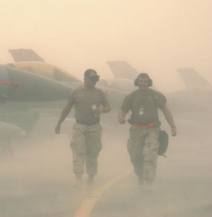
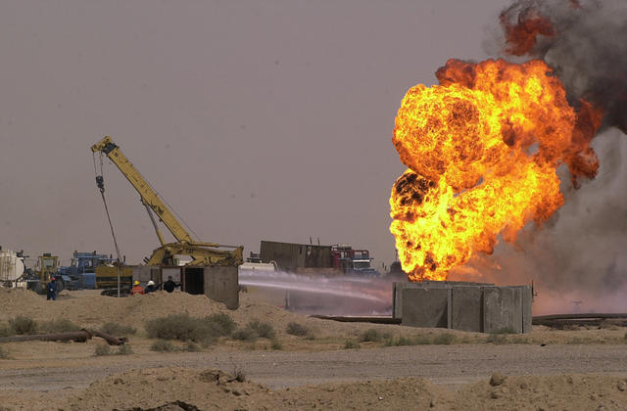
Airborne Hazards &
Post Deployment Health
Burn Pit Smoke
Sand and Dust
Oil Well Fires
Notes:
So what are the air borne hazards?
Particulate matter (PM) is comprised of combustion particles, gases, organic chemicals, metals, and soil and dust particles and we encounter these pollutants in a variety of settings. These particulates have very small aerodynamic diameters in the 2.5 micron range that can be deposited into the lungs and transported to other parts of the body causing health effects.
So, what are the sources of these PMs in Iraq & Afghanistan?
BURN PIT SMOKE
Open air waste incineration (burn pit) was utilized extensively. Most camps used burn pits to dispose of trash until the burn pits were replaced by incinerators. There were 273 burn pits in operation in Iraq & Afghanistan as of August 2010.
SAND & DUST STORMS
What is this substance?
Extremely fine (talc-like) sand. Wind blowing across large areas of flat terrain picks up the sand and creates sandstorms which can irritate the respiratory tract.
Oil well fires
At the end of the 1st Gulf War, >600 Kuwaiti oil wells & several pools of spilled oil were ignited & left burning by Iraqi troops
Huge dramatic plumes of billowing smoke and PM rose high into the atmosphere, “super-plumes” partially obstructed the sun at times
Other Sources of Airborne Hazards
Industrial & ambient air pollution
Air craft and automobile engine exhaust
Aerosolized particles from blasts, explosions and structural fires
To summarize, these airborne hazards are diverse, complex and there is significant concern that they may be associated with adverse respiratory outcomes.
==================
Photo Credits:
U.S. Marine Corps Lance Cpl. Justin Rose, with Bravo Company, 1st Battalion, 5th Marine Regiment, throws trash into a burn pit at Forward Operating Base Blue Falcons Nest, Afghanistan, Sept. 9, 2009. The Marines are deployed with Regimental Combat Team 3 to conduct counterinsurgency operations with Afghan National Security Forces in southern Afghanistan. (U.S. Marine Corps photo by Cpl. Artur Shvartsberg/Released)
Photographer's Name: Cpl. Artur ShvartsbergLocation: FOB Blue Falcons Nest
Date Shot: 9/9/2009Date Posted: 9/15/2009VIRIN: 090909-M-VO695-006
Severe sand and wind storm hits this forward deployed location in Southwest Asia. Conditions make it almost impossible to work outside. Sandstorms often make work difficult for Airmen in the region. Despite the challenge, aircraft from the base still flew combat sorties in support of Operation Iraqi Freedom. Operation Operation Iraqi Freedom is the multi-national coalition effort to liberate the Iraqi people, eliminate Iraqi's weapons of mass destruction and end the regime of Saddam Hussein..(U.S. Air Force photo by Master Sgt Terry L. Blevins).(RELEASED)
Photographer's Name: MASTER SGT TERRY L. BLEVINSLocation: 379 AEW
Date Shot: 3/26/2003Date Posted: unknownVIRIN: 030326-F-AF536-035
Kuwaiti oil well control specialists try to put out a well fire using fire shelters at the AR Rumalia Oil Field in southern Iraq, March 27, 2003. (U.S. Army photo by Spc. James P. Johnson) (Released)
Photographer's Name: SPC. JAMES P. JOHNSONLocation: AR RUMALIA OIL FIELD
Date Shot: 3/27/2003Date Posted: unknownVIRIN: 030327-A-JA359-002
3

Slide 4
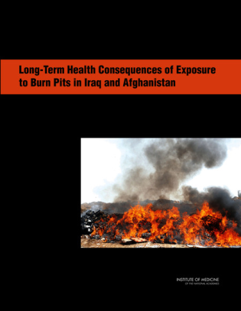
IOM Report 2011
“…service in Iraq or Afghanistan –– might be associated with long-term health effects, in highly exposed ..or susceptible populations..”
Notes:
Particular controversy surrounds the burn pit used to dispose of solid waste at Joint Base Balad in Iraq. The Department of Veterans Affairs asked the IOM to form a committee to determine the long-term health effects from exposure to these burn pits. The IOM relied on research studies that have been published in surrogate populations.
Findings of the IOM Report “Long-Term Health Consequences of Exposure to Burn Pits in Iraq and Afghanistan”
“a broader consideration of air pollution than exposure only to burn pit emissions-might be associated with long-term health effects”, in highly exposed ..or susceptible populations..”
Insufficient evidence prevented the IOM committee from developing firm conclusions.
==============
References:
-National Research Council. Long-Term Health Consequences of Exposure to Burn Pits in Iraq and Afghanistan. Washington, DC: The National Academies Press, 2011. http://www.nap.edu/catalog.php?record_id=13209 . Pages 7-8.
Link to IOM Report:
http://www.iom.edu/Reports/2011/Long-Term-Health-Consequences-of-Exposure-to-Burn-Pits-in-Iraq-and-Afghanistan.aspx

Slide 5

Airborne Hazards
& Open Burn Pit
Registry
Monitor and ascertain health effects from exposures
Monitor the health care of Veterans with concerns
Provide high quality health services
Public Law 112-260
Notes:
In response to stakeholder concerns Congress enacted Public Law 112-260 which mandated that the VA to establish the AH&OBP Registry
Purpose
Monitor and ascertain health effects from exposures
Monitor the health care of Veterans with concerns
Provide high quality health services
==========================

Slide 6

1
2
On-line self-assessment questionnaire (SAQ)
Optional in-person clinical evaluation
Notes:
There are two components to the registry evaluation
Self-administered questionnaire – went national in June 2014
An optional in-person medical evaluation
To date, over 20,000 veterans have completed the on-line SAQ, and many of these Veterans will be seeking in-person evaluations from their VA primary care physicians or environmental health clinicians.
As a VA pulmonologist, you will likely get referral for specialty level evaluation of veterans with AH exposure concerns.
For more specific and detailed information about the airborne hazard registry, you can access a webinar on this topic via the link PROVIDED IN THE DOWNLOADS.
Dr. Falvo will now discuss the deployment-related factors that may increase the susceptibility and vulnerability of the soldiers to airborne hazards in the course of deployment.
============================
Link to webinar: http://www.audio.va.gov/warrelatedillness/MP4/2014_03_04_OOsinubi_Airborne_Hazards_and_Ope_%20Burn_Pit_Registry-What_Providers_Need_to_Know.mp4

Slide 7
Respiratory Health
Airborne Hazards
Exercise and Physical Activity
Preexisting Factors
Tobacco Smoke
Stress and Violence
Military Living Conditions
Notes:
Thanks Dr. Osinubi – As you mentioned, there a variety of diverse and unique airborne hazards present in the deployment environment. Even just geographically, Southwest Asia is well-known to have air pollution levels that far exceed those observed in the United States. From a robust body of literature, we know there is a clear association and even causal relationship between air pollution exposure and cardiopulmonary morbidity and mortality.
But what I wanted to touch on now are some additional factors that may predispose our military to greater exposure risks and therefore greater health effects. In other words, I want to identify factors that could increase their VULNERABILITY and SUSCEPTIBILITY to airborne hazards.
=============
Reference:
Brook RD et al. Particulate Matter Air Pollution and Cardiovascular Disease: An Update to the Scientific Statement From the American Heart Association. Circulation 2010;121(21):2331-2378. http://www.nejm.org/doi/full/10.1056/NEJMp1405976

Slide 8
Respiratory Health
Airborne Hazards
Exercise and Physical Activity
Preexisting Factors
Tobacco Smoke
Stress and Violence
Military Living Conditions
Notes:
Many of these factors relate to military deployment. For example, military personnel deployed to a conflict are under considerable physical and mental stress in environments that are violent and chaotic. Numerous controlled studies and natural experiments have observed that if animals and humans are put in a stressful environments or exposed to violence – the adverse health effects associated with air pollution are enhanced.
=============

Slide 9
Respiratory Health
Airborne Hazards
Exercise and Physical Activity
Preexisting Factors
Tobacco Smoke
Stress and Violence
Military Living Conditions
Notes:
‘Military Living Conditions’ may also not be the most hygienic of settings, especially during the initial periods of the conflict. This has been suggested to contribute to respiratory infections and illnesses being one of the most common non-combat injuries and leading causes of missed service days. In fact, during the early portion of the conflicts in Iraq and Afghanistan – approximately 70% of deployed military personnel reported an acute respiratory illness during service. This rate declined to 40% during later periods of the conflicts with one of the reasons suggested for this decline was improved living conditions and facilities. As an example, access to flush toilets and facilities dramatically increased from 13% to 69% over a 2 year period.
=================
References:
Soltis, B. W., J. W. Sanders, et al. (2009). "Self reported incidence and morbidity of acute respiratory illness among deployed U.S. military in Iraq and Afghanistan." PLoS.One. 4(7): e6177.
Rose, C. S. (2012). "Military service and lung disease." Clin Chest Med 33(4): 705-714.

Slide 10
Respiratory Health
Airborne Hazards
Exercise and Physical Activity
Preexisting Factors
Tobacco Smoke
Stress and Violence
Military Living Conditions
Notes:
Military service in and of itself is physically active by nature. And while exercise is generally always a good thing, exercise in a polluted environment may carry some additional risks. For example, simply walking down a busy street with high-traffic has been shown to result in acute decrements in pulmonary function. I’ll describe this in more detail in an upcoming slide.
===============

Slide 11
Respiratory Health
Airborne Hazards
Exercise and Physical Activity
Preexisting Factors
Tobacco Smoke
Stress and Violence
Military Living Conditions
Notes:
Earlier this year, the New England Journal of Medicine published a perspective piece calling for a “tobacco-free military” recognizing not only the harms, but the high rates of tobacco use and exposure in this population. Therefore, when considering the respiratory health of Veterans – we must acknowledge the important role of tobacco.
==============
Reference:
Smith, E. A., S. A. Jahnke, et al. (2014). "Is it time for a tobacco-free military?" New England Journal of Medicine 371(7): 589-591.

Slide 12
Airborne Hazards
Exercise and Physical Activity
Preexisting Factors
Tobacco Smoke
Stress and Violence
Military Living Conditions
Respiratory Health
Notes:
Finally, the role of non-military factors must not be dismissed. These may include pre-existing medical conditions such as asthma, which is important as asthmatics demonstrate greater airway inflammation following particulate matter exposure as compared to non-asthmatics. In addition, non-military exposures – such as potential inhalational exposures from hobbies and civilian occupations – must also be considered when evaluating the respiratory health of Veterans.
====================
I’m going to briefly touch on 3 of these factors that are perhaps deserving of a bit more detail.

Slide 13
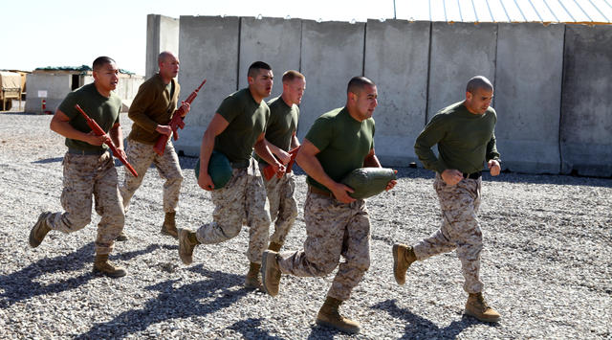
Why PM ‘Matters’ For Military
Exercise and Physical Activity
Notes:
So let’s consider exercise for a minute. Each day we breathe in ~10,000 – 20,000 liters of air. When we exercise, the amount of air we breathe increases dramatically, even with low-intensity exercise like walking. Not just exercise but any physical work like carrying military armor and gear increases pulmonary ventilation. Therefore, if the ambient air we breath during exercise and/or physical work contains a lot of particles, there is a greater chance for these particles to make it into the lung.
Additionally, as exercise intensity increases such as from walking to jogging – like these soldiers in the picture - there is a shift from nasal to oral breathing. This shift enables larger particles to bypass the protective filtering of the upper airways, further increasing exposure to pollutants. Controlled studies have demonstrated that, in comparison to rest, exercise can result in a 10-fold increase in particles deposition into the lung.
Therefore, the physically active nature of military service itself may enhance a soldier's vulnerability to airborne hazards.
==============
References:
Patton JF et al. Physiological responses to prolonged treadmill walking with external loads. Eur J Appl Physiol 1991;63:89-93.
Niinimaa V et al. The switching point from nasal to oronasal breathing. Respir Physiol 1980;42:61-71.
Chalupa DC et al. Ultrafine particle deposition in subjects with asthma. Environ Health Perspect 2004;112:879-82.
Daigle CC et al. Ultrafine particle deposition in humans during rest and exercise. Inhal.Toxicol. 2003;15:539-52.
Photo Credit:
This work, Any clime or any place, Marines stay fit [Image 3 of 11], by GySgt Robert Storm, identified by DVIDS, is free of known copyright restrictions under U.S. copyright law.

Slide 14
Tobacco Smoke
>50%
of active duty in Iraq smoke
(Hamlett-Berry et al. 2008)
 | Any Smoking | Heavy Smoking
All Branches | 31.7% | 10.6%
Army | 38.1% | 15.6%
Navy | 32.3% | 9.6%
Marine Corps | 30.8% | 9.5%
Air Force | 25.5% | 7.7%
Notes:
Let’s take a look at one other important factor in deployed military - which is smoking:
Approximately 40% of active duty military personnel smoke and tobacco use is 2 times greater in deployed versus nondeployed military personnel. In comparison, approximately 18% of U.S. adults smoke cigarettes. A recent study also found that about half of all military personnel deployed to Iraq and Afghanistan began or restarted smoking while deployed and almost 40% smoked ½ pack of cigarettes or more per day. These high rates of tobacco use are not restricted to U.S. military personnel either, as 40-60% of coalition forces are reported to smoke as well. Although tobacco smoke differs in many respects from the other airborne hazards, the contribution of active and passive tobacco smoke exposure to soldiers’ cumulative exposures cannot be completely discounted.
Heavy smoking = > 1 pack per day
Smoking rates are adjusted to account for differences in demographics
General US population ~ 23%
============
References:
IOM (Institute of Medicine). Combating Tobacco Use in Military and Veteran Populations. The National Academies Press, 2009.
2. Sanders JW et al. Impact of illness and non-combat injury during Operations Iraqi Freedom and Enduring Freedom (Afghanistan). Am.J.Trop.Med.Hyg. 2005;73:713-9.
3. Boos CJ, Croft AM. Smoking rates in the staff of a military field hospital before and after wartime deployment. J R Soc Med 2004;97:20-2.
4. Bray I, Richardson P, Harrison K. Smoking prevalence amongst UK Armed Forces recruits: changes in behaviour after 3 years follow-up and factors affecting smoking behaviour. J R Army Med Corps 2013;159:44-50.
5. Hamlett-Berry, KW, as cited in Beckham, JC et al. Preliminary findings from a clinical demonstration project for veterans returning from Iraq or Afghanistan. Military Medicine. May 2008;173(5):448-51.
****

Slide 15
Stress and Violence
Lung Health
Violence
Socio-Economic
Verbal Abuse
Notes:
Finally, both cross-sectional and prospective studies have demonstrated that certain stress factors enhance an individual’s susceptibility to air pollution exposure. These factors include domestic violence, low socioeconomic status, as well as verbal abuse and racism. Experimentally, this is referred to as a “double-hit” paradigm whereby environmental and psychosocial stressors act synergistically to exacerbate the effects of air pollution exposure.
Ultimately, what I hope to have illustrated is that beyond high levels of air pollution – military personnel may be uniquely vulnerable and susceptible to airborne hazards exposure.
===========
References:
Clougherty JE, Kubzansky LD. A framework for examining social stress and susceptibility to air pollution in respiratory health. Environ Health Perspect 2009;117:1351-8.
Chen E et al. Chronic traffic-related air pollution and stress interact to predict biologic and clinical outcomes in asthma. Environ Health Perspect 2008;116:970-5.
Clougherty JE et al. A longitudinal analysis of the efficacy of environmental interventions on asthma-related quality of life and symptoms among children in urban public housing. Journal of Asthma 2006;43:335-43.
Clougherty JE et al. Synergistic effects of traffic-related air pollution and exposure to violence on urban asthma etiology. Environ.Health Perspect. 2007;115:1140-6.
Clougherty JE et al. Chronic social stress and susceptibility to concentrated ambient fine particles in rats. Environ Health Perspect 2010;118:769-75.

Slide 16

Airborne Hazards Referral
Case Study #1
48 Year Old OIF Veteran Non-Smoker
Notes:
Thank you (Dr. Falvo)! Now that we have heard about the factors that may make military personnel susceptible to airborne hazards during their deployments, we will discuss some cases with you. This is going to be an interactive session with the audience and the panelists
The first case I am going to present is 48 year old African American female referred to a VA pulmonologist for evaluation of her respiratory complaints.
=============

Slide 17

Clinical History
“Breathing problems” & “Hoarseness”
Started in 2005 in Iraq
Worsening over time
Limiting work activities
Diagnostic work-up to date (normal)
  Spirometry, Chest x-ray, cardiac stress test/echo
  Chest CT – “small hiatal hernia”
Trial of inhalers – “Not helpful”
Psychiatry - “Severe PTSD”
Notes:
The veteran presents with chief complaints of “Breathing problems and Hoarseness.
She was fine until around 2005 when she started to notice what she thought was a "wheezing-like sensation" that felt and sounded like something was at the base of her throat – she described it as “constricting her breathing”. She sounded raspy and muffled to herself; her husband noticed she was hoarse. She could not identify any specific triggers as this sensation would occur at any time and last for hours.
She had shortness of breath with exercise and occasional non-productive dry cough. There was no associated chest pain or tightness. Symptoms have worsened over time and are now limiting her vocational and social activities.
On review of systems she has poor sleep and intermittent episodes of heart burn, associated with “stress”, and takes “Tums” for relief .
She remembers seeing a doctor in 2005 because she was having similar symptoms; she recalls having some kind of breathing test that was reported to her as normal. She had chest x-ray, cardiac stress test and echo that were all normal per her recollection. Chest CT only showed a small hiatal hernia.
She was on inhaler medicine for a period of time, didn’t do much for her. She has severe PTSD, and her breathing problems were presumed to be related to “anxiety”.
By the time she presents to clinic, she is frustrated as her breathing difficulties are interfering with her ability to work and exercise. She is starting a new job as a customer service representative, and is embarrassed about her hoarse voice as she has to speak and interact with members of the public for several hours a day.
==================

Slide 18

Notes:
She is at her wits end.. She states:” I’m in limbo….My breathing problems are changing my life..I don’t understand what is going on…I’m going through a tough time…But that doesn’t mean that I am crazy”.
============

Slide 19

“VA Burn-pit Registry”
“I was at Balad,…. I was next to the burn pit…..I breathed in the smoke, now I can’t breathe!
Notes:
She was at Joint Base Balad and had concerns about the burn pit smoke. She heard about the new “VA burn-pit registry” and wonders if her breathing problems might be related to her deployment . She has completed the on-line survey and has seen her VA PCP who is not familiar with “burn-pit issues”. Since the Veteran has breathing problems, and a brief trial of inhalers did not work, she is referred to the pulmonary specialist for further evaluation and management.
================

Slide 20

Poll Question
Have you seen patients like this with concerns about AH exposures?
A. Yes
    B. No
    C. Unsure
Notes:
Now I’d like to poll the audience:
In your clinical practice within the VA, have you seen patients who present with similar symptoms as this Veteran and express concern about their deployment-related exposures to airborne hazards?
To answer this question, use the blue polling icon above my head. We’ll move on and come back to your results in just a moment.

Slide 21

Exposure History
Military Exposures
  Military occupation specialty
  Deployment-related exposures
Non Military Exposures
  Civilian occupational exposures
  Civilian non-occupational exposures
Notes:
So how do we obtain information about the relevant exposures of concern for this Veteran?
It is important to take an exposure history to get a sense about what might be contributing to the Vet’s respiratory symptoms. Key sections of exposure history will include military and civilian exposures.
===================

Slide 22
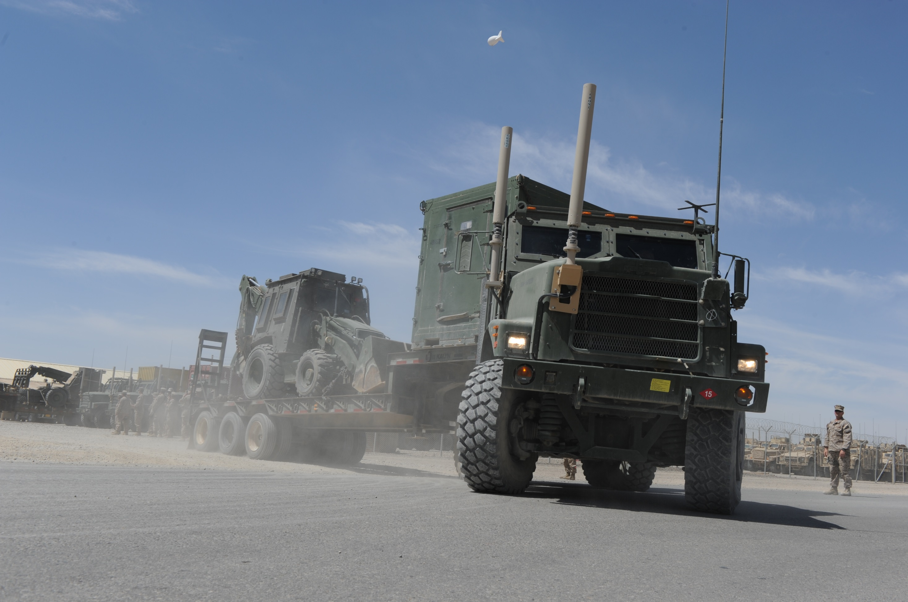

Military Exposure History
Army Corps of Engineers (10 years)
  Motor pool construction trucks
    Diesel exhaust fumes
    Construction dusts
Notes:
So what might be relevant in terms of her exposure? Lets look at her military history:
Military History:
She joined the Army National Guard in 1995 and for about 10 years
she was attached to the Army Corps of Engineers, and mostly worked in motor pool driving construction trucks.
As a “weekend warrior” She was exposed diesel exhaust fumes and construction dusts during building and road paving projects.
================
Photo Credit: Petty Officer 2nd Class Daniel Garas
Seabees assigned to Naval Mobile Construction Battalion (NMCB) 15, prepare for a logistical movement mission. NMCB 15 is currently mobilized in support of Operation Enduring Freedom and is an expeditionary element of U.S. Naval Forces that act as combat engineers and support various units worldwide through national force readiness, humanitarian assistance, and building and maintaining infrastructure. (U.S. Navy photo by Mass Communication Specialist 2nd Class Daniel Garas)

Slide 23
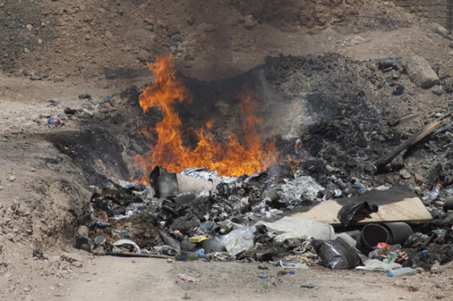
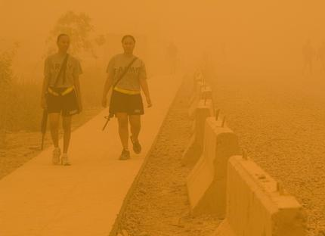
Military Exposure History
Deployment-related exposures (1/04-6/05)
  Kuwait: “monster sand and dust storms”
  Iraq: “Balad burn pit- burned 24/7”
  Sick often – “Iraqi crud”
Military Exposure History
Notes:
What about her Deployment-related exposure history? (Dr. Sotolongo):
She was deployed to Iraq from January 2004 to June 2005 – she spent a few months in Kuwait where they experienced “monster sand and dust storms”. She tried to cover her mouth and nose with a cravat, but the dust “got in everywhere”.
She was then at Joint Base Balad (JBB) for the remainder of her deployment. She did motor pool and convoys for some months. She was involved in a roll-over MVA that killed a number of her comrades, but she escaped unscathed. She later did security patrols and guard duty at JBB. She stood guard for 10-12 hour shifts, she was stationed 300-500 yards down-wind from the burn pit which burned 24/7. She experienced burning of her eyes, cough, and frequent respiratory infections (a.k.a. Iraqi crud) during that deployment .
=============
Photo Credit:
A fire burns in a burn pit at Village Stabilization Platform Hyderabad, Helmand province, Afghanistan, June 2, 2011. (U.S. Marine Corps photo by Lance Cpl. Justin Williams/Released)
Photographer's Name: Lance Cpl. Justin WilliamsLocation: VSP Hyderabad
Date Shot: 6/2/2011Date Posted: 7/25/2011VIRIN: 110602-M-LQ522-067
Photo Credit:
U.S. Soldiers walk from the dining facility during a sandstorm, at Forward Operating Base Warhorse, Iraq, July 4, 2009. (U.S. Navy photo by Mass Communications Specialist 1st Class Kirk Worley/Released)
Photographer's Name: MC1 Kirk WorleyLocation: Forward Operating Base Warhorse
Date Shot: 7/10/2009Date Posted: 8/3/2009VIRIN: 090710-N-QJ684-043

Slide 24
Poll Results
Have you seen patients like this with concerns about AH exposures?
    Yes
    No
    Unsure
Notes:
Now, Let’s review the results of the poll
In your clinical practice within the VA, have you seen patients who present with similar symptoms as this Veteran and express concern about their deployment related exposures?
? of the attendees have seen these types of patients
? have not seen these types of clinical presentation
? are not certain
[Say something about why the results matter!]
We’ll now move onto discuss the Veteran’s deployment-related exposure concerns in more detail.
==============

Slide 25
Items Burned at Joint Base Balad
GAO 2010; IOM 2011
Notes:
Dr. Falvo, the Vet has mentioned her concerns about being at Joint Base Balad a number of times – what is unique about JBB that is relevant to this veteran’s presentation?
JBB is unique for a few reasons, but primarily the size of the base and the size of the burn pit. JBB had a population of over 25,000 during some portions of the war and generated approximately 100-200 tons of waste per day. This is in comparison to smaller bases that produced an estimated 30-42 tons of solid waste a day.
In the earlier periods of the conflicts, the majority of the waste at JBB was eliminated via open burn pits. The burn pit at Joint Base Balad has received the greatest attention as it was nearly 10 acres in size and burned a variety of items including plastics, metals, rubber, paints, solvents, petroleum, munitions and other wastes (2003 – 2009). This burn pit was closed in 2009, therefore – the timing of when a Veteran was deployed is important during the evaluation.
=============
References:
GAO Report October 2010: Afghanistan and Iraq. DoD Should Improve Adherence to Its Guidance on Open Burn Pit Burning and Solid Waste Management. http://www.gao.gov/new.items/d1163.pdf
Institute of Medicine, National Research Council. Long-Term Health Consequences of Exposure to Burn Pits in Iraq and Afghanistan. Washington, DC: The National Academies Press, 2011. http://www.nap.edu/catalog.php?record_id=13209

Slide 26
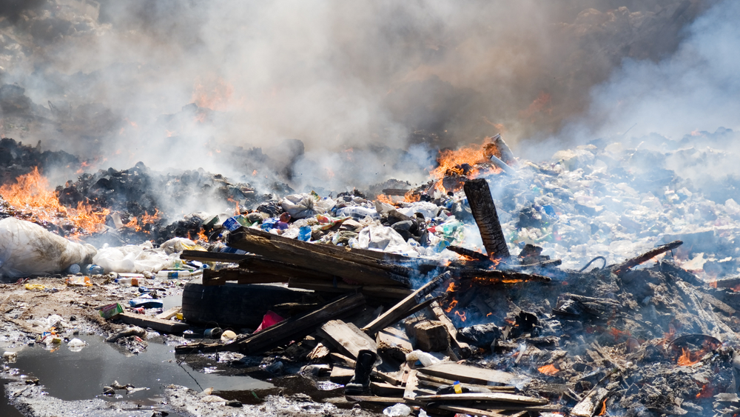
Burn Pit Emissions
Burn Pit Emissions
Combustion by-products
Environmental Pollutants
PM; PACs; VOCs; CO;
Acute,
Long-Term, Latent Health Effects?
PM; PACs; VOCs;
CO; dioxins, lead, mercury, etc.
Notes:
A range of possible pollutants emitted from burn pits have been identified – including combustion by-products, volatile organic compounds and particulate matter. It is possible that emissions from burn pits combined with local environmental pollutants may contribute to acute, long-term and/or latent health effects. However, our current level of evidence is strongest for acute health effects – which some Veterans refer to as the “Iraqi Crud”.
Additional information on burn pits are provided through the web-links in the notes of this presentation, which is available to you for download after this session.
===========
References:
U.S. Army Public Health Command. Joint Base Balad Burn Pit. Fact Sheet 47-002-0214. http://phc.amedd.army.mil/PHC%20Resource%20Library/Balad_Burn_Pit_JBB_FS_47-002-0214.pdf
Institute of Medicine, National Research Council. Long-Term Health Consequences of Exposure to Burn Pits in Iraq and Afghanistan. Washington, DC: The National Academies Press, 2011. http://www.nap.edu/catalog.php?record_id=13209

Slide 27

Civilian Exposures
Works in waste management
  Grain dusts
  Temperature extremes (-40 to 100+ degree F)
  Heavy physical job demand (> 50 Ibs. frequently)
Non-vocational exposures/social history
  Non-significant
Notes:
Thank you Dr. Falvo
So what about her Non–military exposure history? (Dr. Sotolongo)
As a civilian, she has been employed by a waste management company in Iowa for the past 15 years.
Her job entailed picking up and dumping garbage cans, and she was exposed to grain dusts, working in extremes of weather (ranging from -40 degrees to 100+ degree weather), and the physical exertion, all made her breathing difficulties worse. She is preparing to transfer to office work for the same company doing customer service for their accounts and clientele.
Social History:
She is a lifelong non-smoker and she uses alcohol occasionally. She has no pets, no hobbies, no personal or family history of asthma, allergies or atopy,
=============

Slide 28
Summary of Exposures
Burn pit smoke
Sand & dust storms
Construction dusts
Diesel exhaust
Grain dusts
Temperature extremes
Heavy physical work
Psychological trauma
Notes:
To summarize, this Veteran has a number of military and civilian exposures, one or more of which could be contributory to her current symptoms-
========

Slide 29
Poll Question
Which exposures may be contributory?
    Military exposures only
    Civilian exposures only
    Military & Civilian exposures
    Anxiety & PTSD only
Notes:
Now I’d like to ask a poll question, which of the exposures we have discussed so far could be contributory to her respiratory symptoms
To answer this question, use the blue polling icon above my head.
We’ll move on and come back to your results in just a moment.
So that brings us to what are the likely differential diagnoses in this Veteran given the context of her exposure history.
==============

Slide 30
Differential Diagnosis
Signs & Symptoms:
Diseases:
  Dyspnea
  Wheezing
  Intermittent
  Asthma Syndromes
  ? HP
  Vocal Cord Dysfunction
  ? Stridor
  Hoarseness
  Reflux
  GERD
  Poor Sleep
  Sleep Breathing d/o
  Anxiety & PTSD
  ? Psychogenic Dyspnea
Notes:
So Dr. Arjomandi, we have discussed her symptoms and exposures. What are the possible differential diagnoses in this Veteran?
The story of this patient is very intriguing. The main complaints of “breathing problems”, “wheezing-like sensation”, and “constricting of her breathing” are all consistent with obstructive lung diseases. Additionally, the history that “the sensation would occur at any time and last for hours” reveals the intermittent nature of the patient’s problem.
These symptoms are suggestive of some sort of asthma syndromes. Another possibility is hypersensitivity pneumonitis but the only reported significant exposure was to grain dust which had occurred in the past and is not a current concern.
In addition, it would be important to better characterize the patient’s complaint of “wheezing” and establish whether it is wheezing or stridor. If the patient does have stridor, vocal cord dysfunction as a possible etiology should also be entertained.
Interestingly, the patient’s complaint of “hoarseness” along with the history of “reflux” and “GI problems” implicates GERD as a possible pathology. GERD may also contribute to vocal cord dysfunction or asthma syndromes.
The patient also complains about poor sleep, and may suffer from sleep disordered breathing. Sleep apnea may contribute to pre-existing reflux, but should not cause intermittent dyspnea during the awake times.
Anxiety and PTSD may manifest themselves by producing the sensation of dyspnea; however, dyspnea on its own can cause anxiety and the question always is what is the cause and what is effect, and thus, anxiety and PTSD would be be diagnoses of exclusion.
Finally, non-pulmonary causes of of her symptoms, including cardiovascular causes, should be investigated.
Which of her exposures may contribute to any one or more of these conditions?
=================

Slide 31
Contributory Exposures
Burn Pits
Diesel Exhaust
Airborne
Exposures
Construction
& Grain Dust
Sand & Dust Storms
Temperature Extremes
Notes:
So Which of her exposures may contribute to any one or more of these conditions?
While the patient is a lifelong non-smoker, has no concerning hobbies, and denies any allergies or atopy, she reports multiple significant exposures including exposure to:
Burn pits
Diesel exhaust fumes
Construction dust
Sand and dust storms
Temperature extremes
============

Slide 32
Contributory Exposures
Burn Pits
RADS
Diesel Exhaust
Jess- could you please make the asthma and RADS to appear at the same time and then vocal cords dysfunction later?
Airborne
Exposures
Irritant-induced Asthma
Construction
& Grain Dust
Sand & Dust Storms
Temperature Extremes
Notes:
With these exposures, she reported experiencing “burning of her eyes, coughing, and frequent respiratory infections”, which, along with the rest of her history and work up, is strongly suggestive of Irritant-induced Asthma (IrIA) or Reactive Airways Dysfunction Syndrome (RADS).
=============

Slide 33
Contributory Exposures
Burn Pits
RADS
Jess- could you please make the asthma and RADS to appear at the same time and then vocal cords dysfunction later?
Diesel Exhaust
Airborne
Exposures
Irritant-induced Asthma
Construction
& Grain Dust
Vocal Cord Dysfunction
Sand & Dust Storms
Temperature Extremes
Notes:
In addition, vocal cord dysfunction may also be triggered with these exposures and could be present in association with asthma.
==============

Slide 34
Poll Results
Which exposures may be contributory?
    Military exposures only
    Civilian exposures only
    Military & Civilian exposures
    Anxiety & PTSD only
Notes:
Thank you Dr. Arjomandi…now, Let’s review the results of the poll….
Yes most (??%) of you answered correctly – both military and non-military exposures may be contributory to the Vet’s respiratory symptoms

Slide 35
Diagnostic Work-Up
Work up:
Diseases:
  Cardiac Stress Test
  Echocardiography
  Cardiovascular dz
  Spirometry
  Imaging Studies
  Obstructive Lung dz
  Interstitial Lung dz
  Inhaler Ineffectiveness
  ? Vocal Cord Dysfunction
Notes:
So that brings us to the next step in her care, are there any diagnostic assessments that we can offer to this veteran? After all, she has normal spirometry, and normal chest imaging other than a small hiatal hernia on chest CT.
She was also seen by cardiology and she had a normal cardiac stress test and echocardiogram. The challenge for this Vet is that the inhalers were tried for a period, and did not work for her.
Dr. Arjomandi, what are your thoughts about her work up thus far?
Her normal cardiac stress test -- rules out significant ischemic heart disease
Her normal echo-- rules out significant cardiomyopathy, valvular heart dz, pulmonary HTN
While normal spirometry rules out COPD and argues against restrictive lung diseases, it does not rule out asthma since asthma has an intermittent nature. Peak flow measurements over a period of time would be much more useful in assessing presence of asthma.
Her normal CXR and CT scan -- rules out major infection or structural and parenchymal lung diseases as a pathology, although the hiatal hernia seen on CT may contribute to GERD.
Another thing to consider in the diagnostic evaluation of this veteran is the lack of effectiveness of a trial of inhalers. This favors possibility of vocal cord dysfunction, but it is important to determine whether the patient was treated adequately.
Dr. Falvo, this Veteran was referred to the WRIISC Cardiorespiratory Laboratory – what tests did she have and what is the rationale for these types of tests?
==================

Slide 36

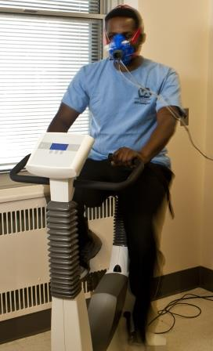
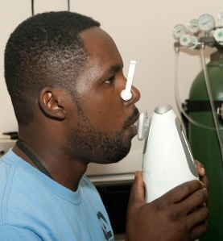
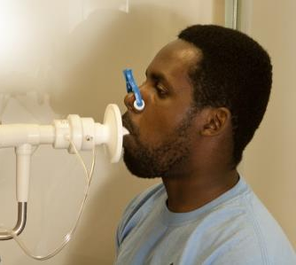
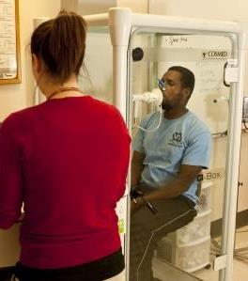
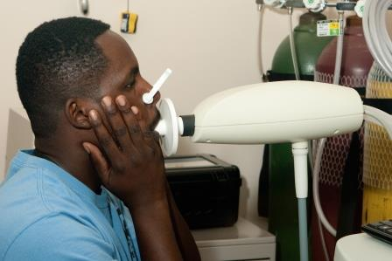
Diagnostic Evaluation
Spirometry (Pre/Post BD)
Body Box
DLCO
CPET w/ ABGs and 12-lead ECG
FOT
(Pre/Post BD)
FeNO
Notes:
We perform a comprehensive standardized evaluation for every Veteran referred to our lab that includes full pulmonary function studies as well as cardiopulmonary exercise testing when clinically indicated.
Our findings and those reported in the literature have reported higher rates of airway obstruction in deployed Veterans with airborne hazards exposure. Therefore, in our evaluations we pay close attention to changes in spirometry post-bronchodilator, but also add some additional tests such as the forced oscillation technique or FOT. Some folks may be more familiar with a type of FOT called impulse oscillometry or IOS.
Regardless of the type, this test is not available in most pulmonary labs, but is unique in that it uses sound waves to measure central and peripheral airways resistance. Similar to bronchodilator spirometry, FOT is generally performed before/after a bronchodilator and can provide evidence of airway hyperresponsiveness that are not always evident with spirometry.
In addition, we supplement these tests with evaluation of exhaled nitric oxide to determine whether airway inflammation is also present.
Another common finding from our lab and reported by others is an isolated reduction in diffusing capacity – or DLCO. To further detect impairments in gas exchange, we also perform cardiopulmonary exercise testing with expired gas analysis.
Exercise testing combined with arterial blood gases and 12-lead ECG allows us to objectively assess dyspnea, rule out non-pulmonary causes of symptoms, and mimic reported symptoms.
For this particular Veteran, Dr. Sotolongo will focus on some of the more relevant findings…
==================

Slide 37
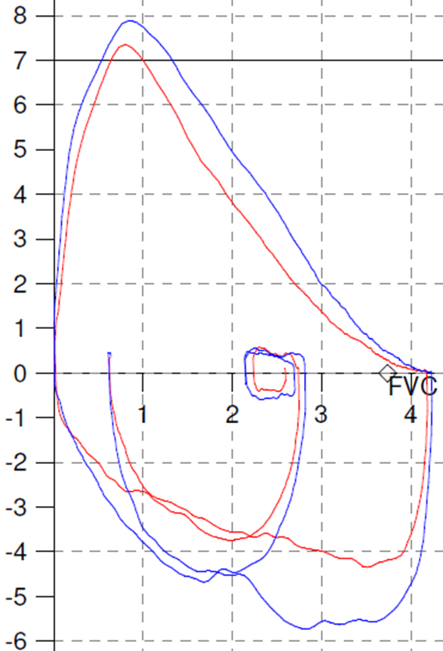

Diagnostic Test Results
PFT & DLCO
  FEV1 85.4%; FVC 96.9% FEV1/FVC 75%.
  FEF 25-75% (55%), +20% bronchodilator
  RV 134% predicted
  DLCO 114% predicted
CPET
  VO2 max: 88% predicted
  VE/MVV: 61% at peak
  Appropriate ↓deadspace
  Throat tightness/discomfort at peak exercise
Notes:
Dr. Sotolongo, where there any new findings from the WRIISC work-up that helped shed more light on this case?
I think we can start with looking at the flow volume loops. They are grossly normal. There is no scooping that you might expect with obstructive lung disease or diminution of the tracing that you might see in restrictive lung disease. There is also no cut off sign in either the expiratory or inspiratory limbs that might make you think of a lesion in the airway or in vocal cord dysfunction
However when you look in the mid range area :she did demonstrate a decrease in FEF 25-75% with a positive bronchodilator response in the small airways region. She also demonstrated some evidence of air trapping with an increase in residual volume. So this might be small airways disease.
Her CPET was normal with a VO2 max of 88% predicted with adequate ventilator reserve but she experienced some throat tightness at peak exercise, so possibly vocal cord dysfunction
PULMONARY FUNCTION TEST
PROCEDURE DATE/TIME: XXXXXXXXXX
- - - - - - - - - - - - - - - - - - - - - - - - - - - - - - - - - - - - - - - -
SEX: F AGE:XX 66 in/126 lb AMBIENT: 22C/763T
RACE: XXX TECH:
NON-SMOKER EFFORT: GOOD
CONSULT DX: R/O COPD
................................................................................
UNITS PRED ACTUAL %PRED PREV1 PREV2 CI
VOLUMES.........................................................................
INERT GAS DILUTION
TLC L 5.35 5.50 102.7 4.28
VC L 3.91 3.42 87.4
FRC L 2.75 3.22 117.1 U 3.81
RV L 1.54 2.08 134.6 U 2.32
RV/TLC % 38
UNITS PRED ACTUAL %PRED PREV1 PREV2 CI
FLOWS...........................................................................
MACHINE: DRY WATER SEAL
STANDARD STUDY
FVC L 3.91 3.79 96.9
FEV1 L 3.31 2.83 85.4 2.75
PF L/SEC 1.304 5.300 406.3 -5.21
FEF25-75 L/SEC 3.747 2.350 62.7 2.38
MVV L/MIN 117.14 88.00 75.1 113.67
FEV1/FVC % 75
AFTER BRONCHODILATOR
(NOTES): 3 Puffs of Proventil HFA given.
FVC L 3.91 3.80 97.1
FEV1 L 3.31 3.10 93.5 2.75
PF L/SEC 1.304 5.710 437.7 -5.21
FEF25-75 L/SEC 3.747 3.140 83.8 2.38
FEV1/FVC % 82
DIFFUSION.......................................................................
METHOD: SINGLE BREATH
DLCO-SB L 25.39 29.00 114.2 18.88
INTERPRETATION..................................................................
INTERPRETATION: May have early obstructive dysfunction. Some bronchodilator
response. Mild hyperinflation indicated by elevated RV. Normal
diffusing capacity.
- - - - - - - - - - - - - - - - - - - - - - - - - - - - - - - - - - - - - - - -
PREDICTED VALUE FORMULAS USED
TLC .0590*HT-4.537 CRAPO '82
VC .049*HT-(.0216*AGE)-3.59 CRAPO '81
FRC .0360*HT-(.0031*AGE)-3.182 CRAPO '82
RV .0197*HT+(.0201*AGE)-2.421 CRAPO '82
FVC .049*HT-(.0216*AGE)-3.59 CRAPO '81
FEV1 .0342*HT-(.0255*AGE)-1.578 CRAPO '81
PF 2.2382-(.1111*AGE)+(.0163*HT)MILLER '83
FEF25-75 .0154*HT-(.046*AGE)+2.683 CRAPO '81
MVV .924*HT-(.82*AGE)-10.7 LINDALL '67
DLCO-SB 2.2382-(.1111*AGE)+(.160*HT) MILLER '83
COHB CORR. ACT*(1+COHB) MORRIS '85
HB CORR. HB+10.22/(1.7*HB)*ACT COTES '72
NOTE: HT=height,WT=weight,ACT=actual measurement value

Slide 38
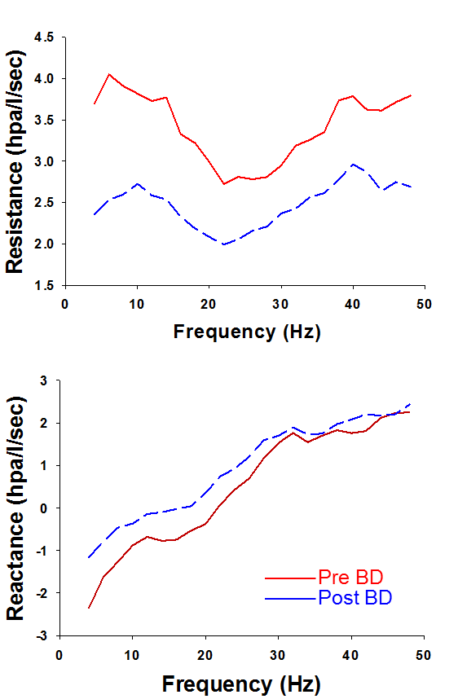
Diagnostic Test Results
Forced oscillometry (FOT)
  ↓airways resistance & ↓reactance post bronchodilator
Expired nitric oxide (FeNO)
↑121 ppb
(normal <50 ppb)
Notes:
When we look at subtler findings of airway dysfunction as with Forced oscillometry or FOT (a.k.a. IOS) we see that the absolute numbers are not that elevated; we usually expect to see numbers in the 6-7 range to call it an abnormal, however when you compare pre and post bronchodilator tracings there is a significant change in both resistance and reactance in both the low and the high frequencies demonstrated by a shift downward of the resistance tracing and a shift to the left of the reactance tracing of at least 20%
R4 = 3.82 (pre), 2.58 (post) → -32%
R20 = 2.52 (pre), 1.98 (post) → -21%
X4 = -2.35 (pre), -1.16 (post) → +51%
She also demonstrates a fairly high level of expired NO which can be a marker for increased inflammation.

Slide 39
(-) airway disease
Cardiopulmonary exercise
normal FEV1/FVC
(+) airway disease
FeNO
Resistance FOT
(+) Response in small airways
Notes:
I think the best way to look at these data is to assess the best fit by the preponderance of the evidence.
The patient has a normal FEV1/FVC ratio , however there was a bronchodilator response in the FEF 25-75% which is usually and indicator of small airways disease, air trapping, the cardiopulmonary exercise test was normal but there was increase resistance in the FOT and a significant increase in FeNO both can be seen in airways disease.
So by the evidence this would lead me to think that this patient may have obstructive airways small airways disease.
Thank you Dr. Sotolongo.
Dr. Arjomandi, what about the possibility of upper airways disease such as vocal cord dysfunction in this Veteran?

Slide 40
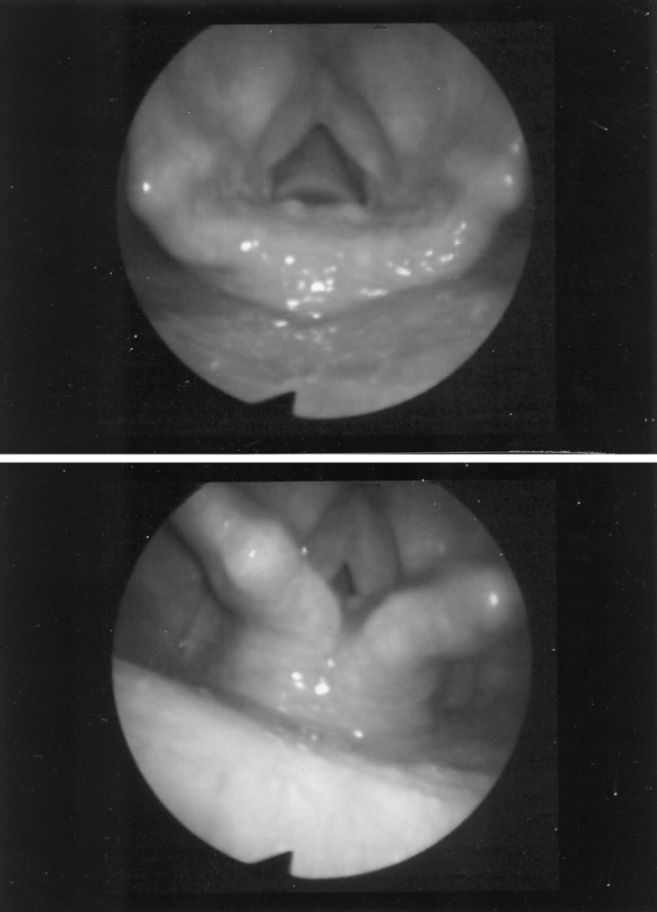
Vocal Cords Dysfunction
(Paradoxical Vocal Fold Motion)
Inspiration
Presentation
  Stridor/Dyspnea
  Asthma Tx ineffective
Work up
  PFT
  Laryngoscopy
Management
  Acute:
    Reassurance/panting
  Chronic:
    Speech/behavioral therapy
Normal
VCD
Vlahakis et al. Chest. 2002
Notes:
Vocal cord dysfunction refers to inappropriate motion of vocal cords with closure of vocal cords during respiration. Normally, there is abduction of vocal cords during inspiration and no more than 40% adduction or closure during expiration. Vocal cords dysfunction is considered to be present if there is any closure of vocal cords during inspiration, or more than 40% closure during expiration. The patient with this problem presents with dyspnea and stridor.
Etiology is often multifactorial and may not be identified, but VCD is associated with asthma, exercise, inhalation of irritants, reflux, neurologic injuries, post-intubation, and psychosocial disorders and stress. Delay in diagnosis is common and patients are often misdiagnosed with asthma.
Work up should include PFTs and radiographic imaging to assess for other causes as indicated, but visualization of the larynx using a flexible laryngoscope is imperative to confirm the diagnosis. Laryngoscopy may be only diagnostic after exposure to the precipitous stimulus such as exercise and irritants.
Management in acute cases involves reassurance and “panting” maneuvers.
Chronic management involves treatment of possible underlying causes, and speech therapy consultation for respiratory training to regain laryngeal control.

Slide 41

ENT Evaluation
Flexible laryngoscopy
  Bilateral vocal cord nodules
  Vocal cords normal movement
  Pharynx is hyperemic
  Posterior pharyngeal wall cobble stoning
  Evidence acid reflux
Notes:
The patient underwent an ENT evaluation, and laryngoscopy showed some vocal cord nodules, and some evidence of acid reflux, but the vocal cords showed normal movement at the evaluation.
Dr. Falvo, this veteran complained of symptoms suggestive of VCD during exercise as seen during her CPET, can you discuss the role of exercise laryngoscopy as a diagnostic tool in this type of situation?
Work from Dr. Mike Morris at Brooke Army Medical Center has demonstrated exercise-induced VCD in approximately 10% of active duty military personnel referred for evaluation of exertional dyspnea. Their lab generally performs laryngoscopy before and after exercise and recommends this test particularly in the presence of normal spirometry and negative bronchoprovocation tests.
============

Slide 42

Exercise Laryngoscopy
Dr. Michael Morris
???
?????
Notes:
Thanks Dr. Falvo, I actually have Dr. Morris joining us as a guest and he is available to briefly comment on exercise induced vocal cord dysfunction in returning soldiers.
DR. MORRIS, over to you!
(wait until you see him up on screen and he has started talking, then click to next slide to bring up data)
========

Slide 43

Exercise Laryngoscopy
Exercise Laryngoscopy
Post-deployment dyspnea in active duty military
10% with exertional dyspnea
48 diagnosed with VCD at LRMC
  39% related to exercise
10% w/ VCD (STAMPEDE III - ongoing)
Pre/post exercise laryngoscopy indications (BAMC)
  Normal PFTS with negative bronchoprovocation testing
  Abnormal flow volume loop
  Upper respiratory symptoms during exercise
Notes:
Flexible laryngoscopy has an important role in the evaluation of post-deployment respiratory symptoms for both active duty military and veterans.
It provides important information on the role of the upper airway on respiratory symptoms. First, it will rule out anatomic lesions as a causative factors. Secondly, if performed both pre and post exercise, may identify functional laryngeal disorders such as vocal cord dysfunction and finally identify evidence of aggravating factors such as GERD.
Our previous studies of active duty military identified vocal cord dysfunction as a significant factor. The 2002 Military Medicine study of 105 AD patients with exertional dyspnea noted a 10% incidence of VCD. A recent retrospective study of 48 redeployed military at Landstuhl Regional Medical Center (LRM) Cnoted 39% had symptoms related primarily to exercise. Finally, our ongoing prospective study of post-deployment dyspnea called STAMPEDE III has similarly identified 10% with VCD.
Exercise laryngoscopy is routinely performed at the Brooke Army Medical Center (BAMC) in the evaluation of AD military with exertional dyspnea. It should especially be considered for those with normal PFTS and negative bronchoprovocation testing, presence of an abnormal flow volume loop or those who describe upper airway symptoms such as hoarseness, voice changes or upper airway wheezing/stridor.
Dr. Falvo: Thank you Dr. Morris. We’re going to go ahead and let you go but perhaps we’ll see you again during Q&A
(wait until his picture goes away then click to next slide)
=============
References:
Morris MJ, Grbach VX, Deal LE, Boyd SY, Morgan JA, Johnson JE. Evaluation of exertional dyspnea in the active duty patient: the diagnostic approach and the utility of clinical testing. Mil Med. 2002 Apr;167(4):281-8.
Morris MJ, Oleszewski RT, Sterner JB, Allan PF. Vocal cord dysfunction related to combat deployment. Mil Med. 2013;178(11):1208-12. doi: 10.7205/MILMED-D-13-00155.
Post-deployment dyspnea in active duty (AD) military
10% with exertional dyspnea (Mil. Med, 2002)
48 diagnosed with VCD at LRMC (Mil. Med, 2013)
39% related to exercise
10% with VCD (STAMPEDE III - ongoing)
Pre/post exercise laryngoscopy indications (BAMC)
Normal PFTS with negative bronchoprovocation testing
Abnormal flow volume loop
Upper respiratory symptoms during exercise

Slide 44
What about her poor sleep?
Aero Digestive Inflammation
Rhinitis
Chronic Cough
GERD
Sleep Apnea
Polysomnography
  obstructive sleep apnea-hypopnea syndrome & frequent upper airway resistance
Notes:
so for this vet we can conclude that an exercise laryngoscopy would be indicated to further evaluate her symptoms of VCD.
Dr. Sotolongo, the Veteran reported poor sleep as one of her complaints. How would one evaluate that objectively and what were the findings?
Yes, the Veteran had polysomnography which demonstrated moderate to very loud snoring throughout the study. Frequent arousals were also noted. The patient appeared to go in and out of REM at times. Assessment - Supine predominant obstructive sleep apnea-hypopnea syndrome with frequent upper airway resistance.
BMI 22, no OSA Habitus – OSA, airborne irritants – aerodigestive inflammation – nasal congestion, chronic cough, and GERD – upper airway is inflamed
There is some interesting data coming out about World Trade Center First Responders and volunteers. We know in general there is a high correlation between BMI or weight and severity of OSA. But a few studies are showing that this may not be true in WTC.
One study by de la Hoz looked at WTC responders with rhinitis and upper airway disease, which is highly prevalent in this group; he noted that there was significant increase in new onset snoring and a trend toward higher apnea-hypopnea index with longer WTC dust exposure but it did not reach statistical significance.
Another study by Sunderram noted that when you include those with rhinitis, UAD (upper airway dysfunction) and GERD or what we call aero-digestive disorders that the correlation with BMI and weight goes away. Leading him to conclude that there is something else that is driving the sleep apnea in at least some in this population.
And most recently, presented at the American Heart Association scientific session : researchers studied more than 800 WTC participants between January 2011 to September 2013 with varying exposure to particulate matter, taking into account each first responder's time of arrival, proximity, duration and level of exposure at Ground Zero. They concluded that high levels of exposure were linked to OSA.
Now these were all retrospective studies but I think there is beginning to be a growing body of evidence that indicates there is an association between high levels of particulate matter exposure and obstructive sleep apnea
While there are no studies to date linking inhalation exposure in OIF/OEF veterans, Dr. Morris did note in his paper that in his cohort of 50 soldiers that 22% had obstructive sleep apnea.
=======================
References:
Snoring and obstructive sleep apnea among former World Trade Center rescue workers and volunteers.
de la Hoz RE¹ et al. J Occup Environ Med. 2010 Jan;52(1):29-32
Unique features of obstructive sleep apnea in World Trade Center responders with aerodigestive disorders.
Sunderram J¹, et al. J Occup Environ Med. 2011 Sep;53(9):975-80.
The two separate studies were both presented on March 20 at the American Heart Association's EPI/NPAM 2014 Scientific Sessions in San Francisco, California by cardiologist Mary Ann McLaughlin, MD, MPH, principal investigator for the WTC-CHEST Program at Mount Sinai, (Epidemiology and Prevention/Nutrition, Physical Activity and Metabolism Scientific Sessions
Study of Active Duty Military for Pulmonary Disease Related to Environmental Deployment Exposures (STAMPEDE)
Michael J. Morris, et al. American Journal of Respiratory and Critical Care Medicine, Vol. 190, No. 1 (2014), pp. 77-84.

Slide 45
Summary/Takeaways Case #1
IrIA /RADS:
VCD:
  Exposure assessment
  Symptom onset
  Stridor vs. wheezing
  Awareness of VCD
  Radiographic Imaging
  Identify potential cause(s)/trigger(s)
  Flexible laryngoscopy
  Reversible airflow obstruction
    PFT, FOT, CPET
  Functional impairment
Notes:
Dr. Arjomandi, what are the salient points that VA pulmonologists and related specialists should bear in mind when they see a Veteran with similar health and exposure concerns?
The most important point in assessment of Irritant-induced asthma and Reactive Airway Dysfunction Syndrome is to investigate the index exposure(s). The type, intensity, and duration of exposure, and the temporal relationship between the exposure and onset of symptoms are important to identify.
Radiographic imaging and lung function assessment with PFT along with longitudinal peak flow measurement, airway hyperreactivity assessment, forced oscillometry, and cardiopulmonary exercise testing are all helpful in determining the presence of these diseases.
For assessment of Vocal Cord Dysfunction differentiation between stridor and wheezing along with an awareness of how common this problem is among some of the veterans are important.
Work up should include identification of potential causes and triggers and flexible laryngoscopy with or without use of potential trigger.
Finally, it should be noted that VCD is a functional impairment and not a psychogenic disorder.
==============

Slide 46

Airborne Hazards Referral
Case Study #2
35 year old OIF/OEF Veteran
Severe shortness of breath
Notes:
Thank you Dr. Arjomandi. Now I am going to present our second case who is a 35 year old OIF/OEF Marine Corps Veteran who joined the military in 2004 at the age of 20.

Slide 47

Chief Concerns
Severe shortness of breath since Iraq
Decreased exercise capacity
Multiple episodes of acute respiratory distress
.
Notes:
He reports that his SOB started in 2006 while he was still in Iraq He states that previously he could run 2 miles in 12 minutes and it progressed to 2 miles in 17 minutes. His symptoms stayed at a fairly constant level for a few years and they began getting worse in early 2011. He reports that he can now only go up 1~2 flights of stairs before getting extremely SOB and needing to rest. He also reports several hospital visits due to his dyspnea.
He was most concerned about the sand and dust storms. He described that there was “dust every where” got in his mouth, ears, and he was coughing up discolored sputum.
Throughout his deployment he experienced frequent episodes of respiratory tract infections which he described as “Iraqi Crud”, for which he was given antibiotics frequently and for most of the time he was deployed.

Slide 48
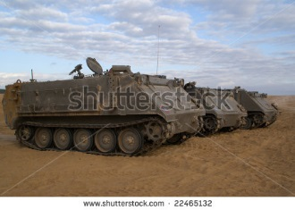
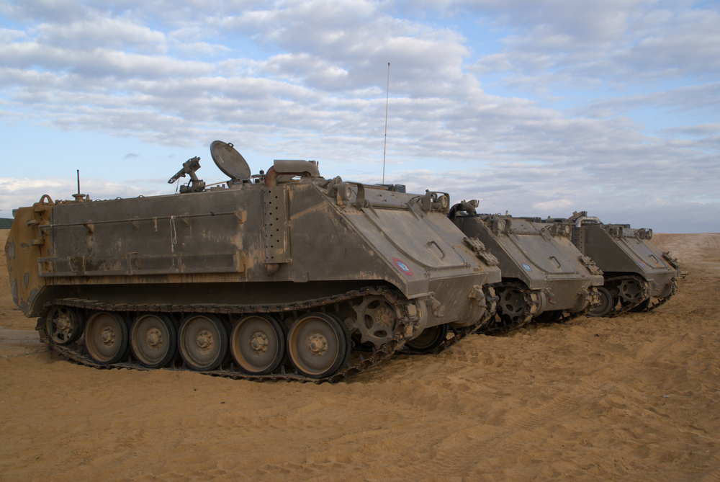
Military Exposure History
Combat truck convoys
Sand and dust storms
Burn pit
Notes:
He was deployed to Joint Base Balad (JBB) from May 2005 to April 2006. At the outset he was a combat truck driver and did a lot of convoy missions, where he was a gunner and was exposed to dusts from the land terrain.
While doing convoy missions, he was often exposed to sand and dust storms. He recalled 4 specific episodes when he was caught in dust storms with one particularly intense episode that lasted for about 24 hours - he was outside in the dust storms performing guard duty activities using a bandana as a face kerchief.
He was later re-assigned to do military police and guard duty where he worked 12 hour shifts 6 days a week. He stood guard approximately 200 yards from the large burn pit at JBB, and he frequently inhaled the smoke from the burn pit.

Slide 49
Poll Question
Is airborne hazard exposure a valid concern for this Veteran?
    Yes
    No
    Unsure
Notes:
Is airborne hazard exposure a valid concern with respect to this Veteran’s respiratory symptoms?
To answer this question, use the blue polling icon above my head. We’ll move on and come back to your results in just a moment.

Slide 50
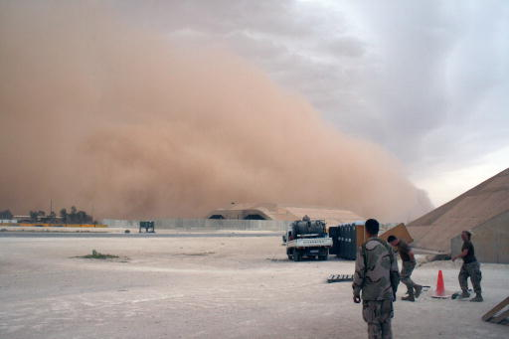
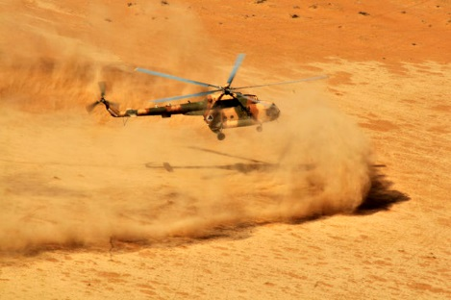
Sand and Dust
Notes:
Dr. Falvo, we’ve discussed the concerns about burn pit smoke. This Veteran was also exposed to burn pit smoke, but he was particularly concerned about sand and dust storms. Can you comment more on what type of data we have about PM pollution in the deployed environment?
There has been some limited air sampling surveillance performed by the Department of Defense in Iraq and Afghanistan which indicated PM levels that exceeded occupational and military exposure guidelines – levels that are approximately 10 times those observed in the United States. One of the primary contributors to this elevated PM are the sand and dust storms characteristic of the region. In fact, dust storm events – which are periods of significantly elevated PM levels – occur approximately 1 out of every 3 days in the region.
Although there have been conflicting reports and limited analyses, one study has suggested that chemical and mineralogical compositions of the sand/dust particles in the region are unique and are characterized as angular, having sharp edges and containing trace metals including titanium. The long-term respiratory outcome of such exposures are still being evaluated.
============
Refs:
Engelbrecht JP et al. Characterizing mineral dusts and other aerosols from the Middle East--Part 1: ambient sampling. Inhal.Toxicol. 2009;21(4):297-326.
Thalib L, Al-Taiar A. Dust storms and the risk of asthma admissions to hospitals in Kuwait. Science of The Total Environment 2012;433(0):347-51.
Szema AM et al. Iraq Dust Is Respirable, Sharp, and Metal-Laden and Induces Lung Inflammation With Fibrosis in Mice via IL-2 Upregulation and Depletion of Regulatory T Cells. J Occup Environ Med 2014;56(3):243-51.
Photo Credits:
U.S. Navy Sailors prepare to take cover as a sandstorm engulfs the hardened aircraft shelter at Al Asad Air Base, Iraq, May 21, 2007. Pilots stationed at Al Asad use the base to fly missions in support of the war on terror. (U.S. Navy photo by Senior Chief Aviation Structural Mechanic Andrew Stack) (Released).
Photographer's Name: AMCS ANDREW STACKLocation: AL ASAD
Date Shot: 6/15/2007Date Posted: unknownVIRIN: 070521-N-TW583-021
Pilots of Mi-17 helicopters, assigned to Kandahar Air Wing, come in for a dust landing during an air assault training mission, enabled by air crews from the 25th Combat Aviation Brigade in Kandahar province, Afghanistan, Feb. 29, 2012. (U.S. Army photo by Sgt. Daniel Schroeder/Released)
Photographer's Name: SGT Daniel SchroederLocation:
Date Shot: 2/29/2012Date Posted: 3/5/2012VIRIN: 120229-A-UG106735

Slide 51

“Iraqi Crud”
Cough
Dyspnea
Allergy symptoms
Fatigue
Constrictive Bronchiolitis
Acute Eosinophilic Pneumonia
Obstructive Lung Disease
?
Aero Digestive inflammation
GERD/Sinusitis
Notes:
Dr. Sotolongo, this Vet had frequent respiratory infections while in Iraq, this is the second time that we have heard the term “Iraqi Crud”, what is this condition?
Thank you Dr. Osinubi,
“Iraqi Crud” is a general term coined by Iraqi war veterans to describe the constellation of symptoms that they experienced during their deployment. While it was initially used to describe an acute experience suffered while they were deployed it is now being used by them to describe more of their chronic symptoms. These symptoms are usually cough productive of dark or black sputum, rhinitis, sinusitis, and shortness of breath . It has sometimes be used to described digestive problems such as diarrhea.
So, what are the types of respiratory conditions that have been reported in deployed settings or as a consequence of deployments to this region?
We know that Morris looked at a cohort of 50 soldiers and found that 21% complained or were treated for rhinitis, or other allergy symptoms, and 4% complained of GERD
We know that Szema and his group found that 14% of the over 1800 troops deployed to Iraq and Afghanistan reported respiratory symptoms compared to less than 2% deployed elsewhere. Of those 14%, 6% demonstrated obstructive lung disease either reversible or fixed.
We know that Shorr and his group noted 18 cases of Acute Eosinophilic pneumonia during 13 month period in Iraq
And we know that King and his group at Vanderbilt looked at cases of 80 soldiers evaluated for dyspnea on exertion of those 49 underwent lung biopsy and of those 38 cases of constrictive bronchiolitis were identified
At this point, what we as physicians don’t know is whether “Iraqi Crud” is one disease or several diseases.
Is it an infectious process or is it an inflammatory process or auto-immune process?
Is the acute “Iraqi Crud” the same as the chronic “Iraqi Crud”
As you can see there is a lot we still don’t know and are trying to find out and we may identify other diseases in the future.
=================
Ref.
Study of Active Duty Military for Pulmonary Disease Related to Environmental Deployment Exposures
Morris, M et al . Am J Respe Crit Care Med Vol 190, July 2914 pp77-84
New onset asthma among soldiers serving in Iraq and Afghanistan.
Szema, AM et al. Allergy Asthma Proc 2010:31:67-71.
Acute eosinophilic Pneumonia Among U.S. Military Personnel deployed in or near Iraq.
Shorr et al. JAMA 292:2997-3005
Constrictive bronchiolitis in soldiers returning from Iraq and Afghanistan.
King et al. NEJM 365:222-230

Slide 52
Poll Results
Is airborne hazard exposure a valid concern for this Veteran?
    Yes
    No
    Unsure
Notes:
Thank you Dr. Sotolongo. Now, Let’s review the results of the poll
Is airborne hazard exposure a valid concern with respect to this Veteran’s respiratory symptoms?
-XX% of the attendees agree that AH exposures warrant due consideration for this veteran
We’ll now move onto discuss the Vet’s clinical course with respect to his airborne hazard exposures and respiratory symptoms.
=============

Slide 53

Post Deployment History
Progressive SOB & DOE, Orthopnea
  Current smoker 15 pack-year to date
  Cardiac work-up (echo) was reported as “normal”
Comorbid conditions
  HTN
  GERD
  PTSD
  Divorced /distressed
Unable to work due to respiratory impairment
  No other occupational exposures
Notes:
Post deployment veteran had frequent episodes of bronchitis, he remains short of breath and he complains of orthopnea. He continues to smoke up to 1 PPD.
He is currently unemployed because he is too sick to work, but previous occupations included : car dealership, sheriff’s department, and pizza delivery.
This is clearly a relatively young man who is clearly not doing well and complaining of worsening respiratory symptoms exacerbated by multiple medical and social problems.
He continued to be symptomatic and given his smoking history, he had cardiac work up. His Echo was a technically difficult study as the pulmonary artery systolic pressure could not be adequately addressed. The LV systolic function appears normal with a visually estimated ejection fraction (EF) around 55%.
================
2-D ECHO MEASUREMENTS
CALCULATED EF: 0% ESV: EDV:
CARDIAC OUTPUT:
ESTIMATED EF:
EF DESCRIPTOR:
REGIONAL WALL MOTION:
DOPPLER MEASUREMENTS
AORTIC MAX GRAD: 0.0 mm Hg MITRAL MAX GRAD: 0.0 mm Hg
AORTIC MEAN GRAD: MITRAL MEAN GRAD:
AORTIC VALVE AREA: MITRAL VALVE AREA(Dopp): 0.0 cm-sq
PA SYSTOLIC: MITRAL VALVE AREA(Echo):
FINDINGS:
DIAGNOSIS:
OTHER CONCLUSION:
1. Technically suboptimal study
2. Normal right atrial (RA) size and right ventricular (RV)
dimensions subjectively.
3. Mild tricuspid regurgitation (TR).
4. Estimated pulmonary artery systolic (PAsys) pressure cannot be
adequately assessed.
5. Normal left atrial (LA) size by 2-dimensional imaging
subjectively.
6. Normal mitral valve (MV) apparatus and valve excursion.
7. There is trace mitral regurgitation (MR).
8. The left ventricle (LV) appears normal size by 2-dimensional
imaging subjectively. The LV systolic function appears normal with a
visually estimated ejection fraction (EF) around 55%.
9. The aortic valve is tricuspid. There is no aortic insufficiency.
10. No pericardial effusion seen.

Slide 54
Poll Question
What would you do next?
    Still smoking - so do nothing
    Increase dose of inhaler medications
    Additional non-invasive work up
    Proceed straight to “lung biopsy”
Notes:
The patient was initially managed by a primary care provider, he was treated with Advair and Singulair with minimal improvement. His symptoms progressed to the point that he was unable to manage 1-2 flights of stairs.
In light of his respiratory symptoms, his PCP recommended that the patient quit smoking, but his life stressors are overwhelming at this point. He is not ready (or able) to quit smoking.
He reports worsening symptoms yet his PFTs and imaging to date do not show substantial impairment/pathology. He is frustrated at this point and he is seeking answers. He has read about constrictive bronchiolitis in some Iraq deployer’s he wants to know if he has this disease.
His PCP referred him to you for a pulmonary consult, and at his first visit with you, he is asking for a “lung biopsy”.
What will you do next?
To answer this question, use the blue polling icon above my head.
We’ll move on and come back to your results in just a moment.
================

Slide 55

“It was when I was under the care of a pulmonologist ... that my condition … received a more thorough workup”
What types of additional work-up would be appropriate for this Veteran?
Notes:
The Veteran reported that it was when he was under the care of a VA pulmonologist..that his condition…received a more thorough workup. So let’s review the types of additional work-up that would be appropriate for this Veteran.
=============

Slide 56
Diagnostic Work-up
Chest x-ray:
  R costophrenic angle blunting
    Chronic & Stable
  Mild hyperaeration
  No acute process
PFT:
  Diffusion:
    DLCO= 29.5 (101%)
  Spirometry:
    FV loops-curvilinear
    FEV₁/FVC= 0.70
    FEV₁= 3.85L (77%)
    No BD response
    MVV ↓60 l/min
  Lung Volumes:
    TLC= 7.90L (96%)
    VA= 5.13 L (67%)
    RV/TLC= 35%
Notes:
So now lets review some of the diagnostic work-up that his PCP did for his pulmonary complaints:
His chest x-ray was largely unremarkable except for some blunting of the right costophrenic angle and mild hyperaeration.
He had PFTs done in 3/2014 and these were reported as: “Normal spirometry, no bronchodialtor response, normal DLCO.
The Maximum Voluntary Ventilation (MVV) is reduced. The reduced MVV is inconsistent with the otherwise normal PFTs.
Dr. Arjomandi, what are your thoughts about these PFTs?
The PFT data are very interesting. While the spirometry is normal, the expiratory portion of flow-volume loop is curvilinear and the difference between total lung capacity measured by plethysmography and by single breath diffusion measurement is very high at almost 3 L, which indicates severe air trapping and hyperinflation, which may be the cause of reduced MVV as forced, rapid breathing maneuvers as it happens during exertion, may precipitate in dynamic hyperinflation.
Together, this data imply presence of an obstructive lung disease.

Slide 57
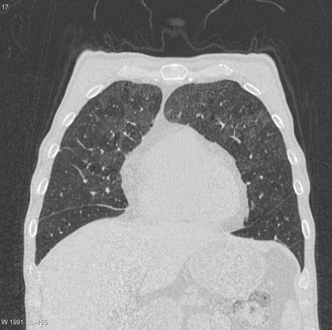
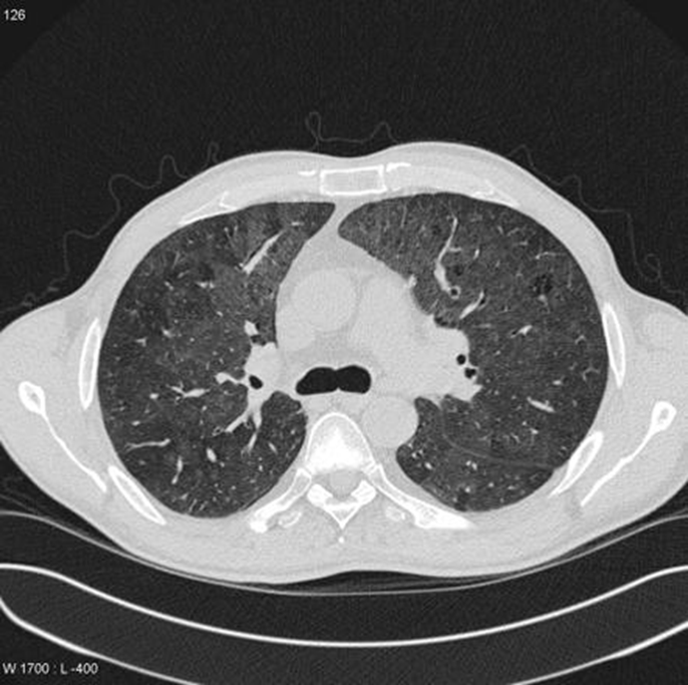
High Resolution Chest CT Imaging
ILD Evaluation by HRCT:
Patient’s HRCT Findings:
Axial Scans:
  Supine & Prone
Full inspiration
1-1.5 mm collimation at 1 to 2 cm intervals
Dynamic, during forced expiration views:
  Aortic arch
  Carina
  Above diaphragm
CT 4/2013 & 7/2013:
  Mild emphysema
  Mosaic perfusion
  Mild bronchiolitis
  RUL minor ground glass
  No ILD/effusion/LAD
Findings unchanged
  (CT 4/2013 vs. 7/2013)
Notes:
Dr. Arjomandi, lets talk about chest imaging studies – he had a chest x-ray which was read as “normal”. Should we be doing any thing more for this Vet?
Although CXR remains the initial imaging tool for assessment of the lung parenchyma, its sensitivity and specificity are only about 80%. For example, CXR has been reported to be normal in 10-15% of symptomatic patients with parenchymal lung disease, and about 60% percent of patients with emphysema. On the other hand, HRCT has a sensitivity of 95% and a specificity approaching 100% in parenchymal lung disease, and it is the best tool for diagnosis and characterization of parenchymal lung diseases such as ILD and emphysema.
To achieve these high sensitivity and specificity, the proper imaging protocol should be obtained. A recommended protocol, used in some of the ILD programs nationwide, is to obtain axial views with full inspiration in both supine and prone positions, along with dynamic expiratory views at 3 levels of aortic arch, carina, and above diaphragm.
This patient had two CT scans done about 3 months apart. The CT scans were read as be not different from each other and showed:
Mild emphysema
Mosaic perfusion suggestive of small airway disease
Some centrilobular nodules suggestive of bronchiolitis, and
Minor ground glass in RUL which is suggestive of some focal inflammatory process
In addition, there was no:
Interstitial thickening suggestive of fibrotic disease
Lymphadenopathy, or
Effusion
===============

Slide 58
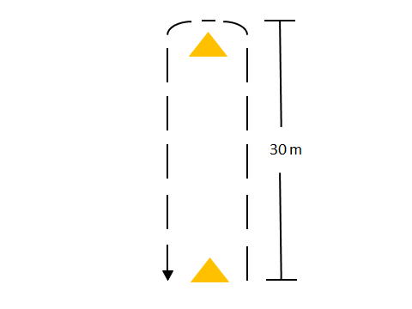
Six-minute Walk Test
BMI:
WHR:
Baseline SpO₂:
6MWD:
Peak HR:
HR @2min post:
Post exertion SpO₂:
Other:
26.8 (overweight)
0.96
94%
350m (51% pred)
134/min
108/min
-11% (84%)
Requires 2 LPM oxygen to stay above 90%
Notes:
Dr. Falvo, this Vet reports significant dyspnea on exertion, his VA facility does not have CPET. Is there a way to objectively assess his physical activity tolerance? Would a six minute walk test be of value here?
Sure, the 6MWT has been around a long time and provides a quick, simple, and inexpensive method to evaluate a patient’s functional capacity – including patients with mild to severe lung disease. There are numerous studies that have examined a relationship between 6MWT and CPET, but the strength of this relationship varies between studies for several reasons. Still, the 6MWT affords a great opportunity to evaluate a patient’s exercise tolerance and when combined with pulse oximetry and measurement of heart rate – a good deal of information can be obtained.
In the present case, the Veteran is only able to cover about 51% of their predicted 6MW distance which can be interpreted as poor exercise tolerance. This may be due in part to deconditioning as evidenced by a high waist-to-hip ratio and body mass index. However, the data obtained from the pulse oximeter suggests exercise-induced desaturation as hemoglobin saturation dropped 11%.
In addition, a delayed heart rate recovery is also observed in this Veteran which may suggest autonomic dysfunction. Given these findings, a follow-up CPET would be warranted to more accurately characterize this Veteran’s limitations.
==============
References:
Robert M Ross, Jayasimha N Murthy, Istvan D Wollak and Andrew S Jackson. The six minute walk test accurately estimates mean peak oxygen uptake
BMC Pulmonary Medicine 2010, 10:31 doi:10.1186/1471-2466-10-31
http://www.biomedcentral.com/1471-2466/10/31
Swigris et al. Heart Rate Recovery After 6-Min Walk Test Predicts Survival in Patients With Idiopathic Pulmonary Fibrosis
Chest 2009, 136:841 doi:doi:10.1378/chest.09-0211
http://www.ncbi.nlm.nih.gov/pmc/articles/PMC2775995/
Enright PL, Sherrill DLReference equations for the six-minute walk in healthy adults.
Am J Respir Crit Care Med. 1998 Nov;158(5 Pt 1):1384-7.
http://www.ncbi.nlm.nih.gov/pubmed/9817683

Slide 59
Poll Results
What would you do next?
    Still smoking –so do nothing
    Change pulmonary medications
    Additional pulmonary work-up
    Proceed straight to “lung biopsy”
Notes:
Okay let’s get back to the question we posed earlier:
The question was: PCP recommended that the patient quit smoking, but his life stressors are overwhelming at this point. He is not ready to quit smoking.
He reports worsening symptoms yet his PFTs and imaging to date do not show substantial impairment/pathology. He is frustrated at this point and he is seeking answers. He has read about constrictive bronchiolitis in some deployer’s he wants to know if he has this disease. He is seeing you for a pulmonary consult and he is asking for “lung biopsy”.
What will you do next?
Now let’s review the results of the Poll
Still smoking –so do nothing (XX%)
Change pulmonary medications (XX%)
Additional non-invasive work-up (XX%)
Proceed straight to “lung biopsy” (XX%)

Slide 60



What about lung biopsy?
When is lung biopsy indicated?
What type of biopsy is indicated?
  Bronchoscopy with biopsy
  Surgical lung biopsy (VATs)
What are the limitations of each type?
What are the possible complications?
Notes:
Now let’s talk about the issue of lung biopsy in this Vet. He has some abnormalities on his chest CT, and he desaturates on physical exertion. He wants to know if he has constrictive bronchiolitis from his AH exposures in Iraq.
Dr. Sotolongo: When is lung biopsy indicated? And what type of lung biopsy we would consider?
Can you also discuss the potential risks versus the benefit of getting a lung biopsy at this point.
Well a bronchoscopy has a sensitivity of 81-90% for diagnosing infection, centrally located malignancies and sarcoidosis. After that, the sensitivity goes down for diagnosing other diseases.
If you are thinking about interstitial lung disease which is a possibility in this patient then a surgical lung biopsy either as a Video Assisted Thoracotomy or VAT or an open thoracotomy.
A surgical lung biopsy gives the pathologist a larger lung specimen where he or she can see a broader landscape of the lung so the chance of establishing a firm clinicopathologic diagnosis is greater.
This is important because some of the treatments for interstitial lung disease can be toxic, require a long treatment regimen, there might be clinical trials for the disease or there might not be any treatment at all. So you want as definitive a diagnosis as possible so the patient and the physician can make an informed decision about goals of treatment.
Lastly there is “the greater good” , as we get more information and correlate surgical lung biopsies, clinical symptoms, CT scans, and PFTs we can begin to understand certain diseases and how they manifest.
Now all of this must be weighed against the risk to the individual. The patient will be under general anesthesia for the procedure and one lung must be deflated in order to get the biopsy. If a patient already has respiratory compromise then the biopsy could exacerbate it. There is also the possibility that for whatever reason the VATs procedure which creates a relatively small incision turned into an open thoracotomy which creates a much larger incision and has a longer recovery time.
Finally there are complications such as pneumothorax, bronchopleurofistulas, poor healing of the incision, nerve damage from the incision and anesthetic complications just to name a few.
That is why most clinicians try to exhaust all other less invasive possibilities to diagnose a problem before proceeding with a surgical biopsy.
So what would you tell the veteran at this point about his request for a lung biopsy?
Given all the information I would say a surgical biopsy is indicated one could argue for a bronchoscopy to rule out infection first but given the desaturation on exercise I think this is some form of interstitial lung disease that will require surgical biopsy for definitive diagnosis.
===========
Ref.
Surgical Biopsy for Diagnosis of Interstitial Lung Disease Is Superior to High Resolution CT Imaging
Kayatta M. et al Chest. 2012;142(4_MeetingAbstracts):434A
An Official ATS/ERS/JRS/ALAT Statement: Idiopathic Pulmonary Fibrosis: evidence –based Guidelines for Diagnosis and Management
Am J Respir Crit Care Med Vol 183. pp 788-824, 2011
ATS/ERS International Multidisciplinary Consensus Classification of the Idiopathic Interstitial Pnemonias
Am J Respir Crit Care Med Vol 165. pp 277-304, 2002
An Official ATS/ERS Statement: Update of the International Multidisciplinary Classification of the Idiopathic Interstitial Pneumonias
Am J respire Crit Care Med Vol 188, pp 733-748 2013

Slide 61

Hospitalized in 2013
Presented with acute respiratory distress
Bronchoscopy:
  Early granulomatous reaction
  Consistent with silicosis
  Larger tissues sample was recommended
Notes:
Patient had been switched to Symbicort and Spiriva but his symptoms progressed, and he presented in acute respiratory distress for which he was hospitalized in the course of which he had a bronchoscopy.
Pathology report of bronchoscopic biopsy suggested early granulomatous reaction that may be consistent with silicosis, but a larger tissues sample was recommended.
The patient subsequently had VATs biopsy, but before we find out the results of the open lung biopsy, lets talk for a few minutes about the issue of possible constrictive bronchiolitis or interstitial lung diseases in OEF/OIF deployers.
Dr. Falvo, have there been any studies in this regard?
============

Slide 62



Constrictive Bronchiolitis in OEF/OIF
NEJM: CB in soldiers exertional dyspnea
  38 of 49 (78%) diagnosed with CB
    PFTs, CPET within normal limits
    Moderate reduction in DLCO
ATS Research abstract: National Jewish Hospital
US Army Public Health Command (USAPHC):
  Epidemiologic evidence to date is inadequate to support or refute an association between deployment and chronic respiratory conditions
Notes:
Currently, only 1 published case series is available describing constrictive bronchiolitis (CB) in OEF/OIF soldiers who were referred for evaluation of exertional dyspnea. PFTs and CPETs were mostly within normal limits with the exception of reduced diffusing capacity of carbon monoxide. And the majority of chest CT findings were unremarkable. 49 of these solders underwent lung biopsy and 38 received a diagnosis of CB. Although a large percentage of these soldiers were exposed to a sulfur fire during deployment, 10 reported exposure to the airborne hazards we previously discussed.
Although it’s unclear whether exposure to airborne hazards during deployment is causally related to findings of CB, work presented at the American Thoracic Society Conference from Dr. Cecile Rose’s group at National Jewish in Denver has also observed that lung biopsies in deployers returning from Iraq and Afghanistan with unexplained exertional dyspnea are significantly more likely to show constrictive/obliterative bronchiolitis and emphysema than biopsies in normal controls and in persons with autoimmune lung disease. While these findings have been presented at scientific meetings, but are not yet in press.
The US Army Public Health Command has reviewed the literature and concluded that the epidemiologic evidence to date does not clearly support the inference of a specific association between deployment and chronic respiratory conditions among deployed personnel, or the absence of such an association. This is consistent with the IOM 2011 report that we mentioned earlier.
=============
References:
King et al. Constrictive Bronchiolitis in Soldiers Returning from Iraq and Afghanistan. N Engl J Med 2011; 365:222-230. http://www.nejm.org/doi/pdf/10.1056/NEJMoa1101388
Rose et al. Emphysema And Constrictive Bronchiolitis Are More Likely In Lung Biopsies Of Symptomatic Deployers To Iraq And Afghanistan Compared To Normal And Autoimmune Lung Disease Controls
http://www.atsjournals.org/doi/pdf/10.1164/ajrccm-conference.2014.189.1_MeetingAbstracts.A6501
USAPHC. Epidemiologic evidence summary statement. Military deployment and chronic respiratory conditions. Fact Sheet 64-023-0414.
http://phc.amedd.army.mil/PHC%20Resource%20Library/Chronic_Respiratory_Conditions_and_Military_Deployment.pdf

Slide 63
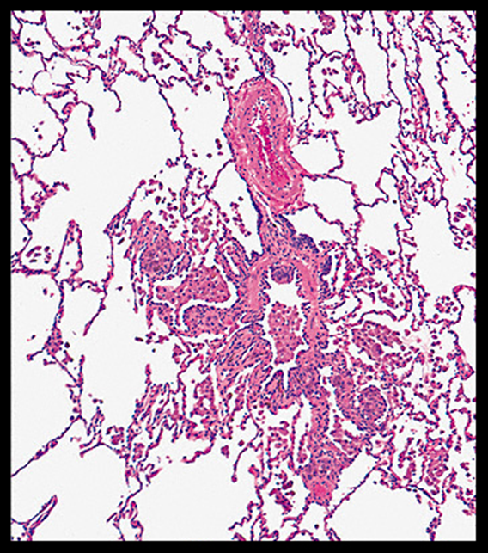
Right Upper & Lower Lobe Open Biopsies
Preliminary Pathology report:
  Mild anthracosilicotic deposits
  Hemosiderin-laden intra-alveolar macrophages
  Dx: Smoking-related interstitial lung disease
Addendum to pathology report (SEM/EDXA)
  Particles contain Si, Al, & O; K & Na (environmental silicates)
  Rare particles Ti, Fe & Cr (possibly steel)
Notes:
Thank you Dr. Falvo. Now, lets review pathology report from our Veteran’s open lung biopsy:
Hematoxylin and eosin (H & E) stained sections showed collections of intra-alveolar pigmented macrophages, a portion of which stain with Iron stain consistent with hemosiderin. Mild anthracosilicotic deposits are noted in sub-pleural locations and adjacent to airways. No asbestos bodies are identified.
Diagnosis: Smoking-related interstitial lung disease –
The veteran’s actual pathology slide had more widespread disease than what is shown on this image.
ADDENDUM to Pathology report:
Scanning electron microscopy with energy dispersive x-ray analysis (SEM/EDXA) showed that the majority of the particles examined contained silicon (Si), aluminum (Al), and oxygen (O) with potassium (K) and Sodium (Na) consistent with silicates/silica which may be from environmental sources.
Rare particles containing titanium (Ti), Iron (Fe) & chromium (Cr), (possibly steel) are also identified. The former is present in many products such as paint. The latter may be a processing artifact. The clinical significance of these findings is undetermined
Anthra-silicotic deposits are frequently present in adult lung specimens, and may not be etiologically related to the pathology changes seen
Clinical and radiological correlations are suggested
==============
Pathology Slide Used with Permission:
Respiratory bronchiolitis in patient with respiratory bronchiolitis-associated interstitial lung disease
Faintly pigmented alveolar macrophages fill the lumen of this respiratory bronchiole and the surrounding airspaces. There is a mild thickening of the wall of the respiratory bronchiole.
Source:“Cool CD. Idiopathic interstitial pneumonias: Clinical manifestations and pathology. In: UpToDate, Post TW (Ed), UpToDate, Waltham, MA. (Accessed on 10/16/2014.) Copyright © 2014 UpToDate, Inc. For more information visit www.uptodate.com.”

Slide 64
Differential Diagnosis
  Progressive DOE
  Environmental exposures
Emphysema
Alveolar damage
Sx
    Air trapping
    Hypoxia w exertion
PFT
Smoking-related ILD:
RB-ILD
DIP
PLCH
    Emphysema
    Air trapping
    Bronchiolitis
HRCT
ILD/Exposure Lung Disease:
Pneumoconiosis
CB
    Smoking-related ILD
    Hemosiderin-laden AM
    Particles w Si/TiO2/Cr
Bx
Notes:
Thank you Dr. Osinubi.
I think the pathology report should be interpreted in the context of patients history, PFTs, and HRCT findings. The patient’s respiratory disease is quite remarkable. He was able to jog a 6 minute mile, and now could only climb 1 flight of stairs and is hypoxic with minimal exertion.
While his spirometry had normal FEV1 and FVC, he had large amount of air trapping, which is consistent with obstructive lung diseases. In this setting, as I mentioned, the low MVV may be indicative of presence of dynamic hyperinflation, which in turn could result in reduced exercise capacity. Given these findings, it would be interesting to perform a cardiopulmonary exercise test along with inspiratory capacity loop measurements to asses the role of dynamic hyperinflation in his exercise limitation.
In addition, the patient’s HRCT showed mild emphysema as well as mosaic perfusion. Mosaic perfusion is suggestive of small airway disease, and could be due to obstructive lung diseases with air trapping as it was also observed on his PFT. At the same time, other diseases such as bronchiolitis obliterans(BO) or constrictive bronchiolitis (CB) may also cause such a pattern on HRCT. Interestingly, there was evidence of bronchiolitis along with some minor amount of ground glass opacities in RUL. Together, these findings suggest the presence of smoking-related lung diseases such as RB-ILD and DIP. Pulmonary Langerhans Cell Histiocytsis (PLCH), which is another smoking-related ILD, is less likely given the lack of cystic structures on CT scan.
Finally, the lung biopsy showed mild emphysema, but extensive smoking-related interstitial lung disease including presence of intraluminal macrophages along with a patchy submucosal and peribronchiolar infiltrate of lymphocytes and histiocytes, which are hallmark of RB-ILD. DIP also remains a possibility. Of note, there was no evidence for BO or CB.
(Chest pathologist that reviewed the slides stated that “there are no findings on the biopsy that could not be explained by smoking)
The electron microscopy evaluation of the lung biopsy showed the presence of particles containing silicon, titanium, iron, chromium, and steel, all of which suggest various inhalational exposures, and are concerning for presence of possible pneumoconiosis. While this could be early disease and thus not manifesting the complete histopathology or radiographic appearance associated with these pneumoconiosis, the severity of the patient’s symptoms suggest that the pneumoconiosis are less likely to be the main pathogenesis of his condition.
============

Slide 65

What is the Diagnosis?
RB-ILD
CB
DIP
Notes:
Dr. Arjomandi, how would we differentiate DIP from RB-ILD?
How do those present differently from Constrictive Bronchiolitis?
The main feature that distinguishes DIP from RB-ILD is that DIP affects the lung in a more uniform and diffuse manner and lacks the bronchiolocentric distribution seen in RB-ILD. However, there is considerable clinical, radiologic, and histologic overlap between these entities. It is also important to note that RB-ILD and DIP should be diagnosed only when other forms of interstitial lung disease have been vigorously excluded, a process that requires correlation of biopsy findings with clinical and radiographic features. This is where obtaining adequate number and size of lung biopsy specimens become important. Inadequate biopsy specimen may cause sampling bias and result in incorrect or spurious diagnoses.
It is important to note that patients with RBILD and DIP may be relatively asymptomatic, but their symptoms may progress to include severe dyspnea, hypoxemia, and clubbing as has been described in the literature
=============
Reference:
Sadikot RT1, Johnson J, Loyd JE, Christman JW. Respiratory bronchiolitis associated with severe dyspnea, exertional hypoxemia, and clubbing. Chest. 2000 Jan;117(1):282-5.

Slide 66

What is the Management?
RB-ILD
CB
steroids, macrolides
DIP
+ steroids
Notes:
Dr. Sotolongo, how would the management of smoking related ILD, differ from that of DIP? Please touch on management of CB as well.
What would be the best-practices for managing each of these conditions?
Really the primary and first line management for smoking related-ILD is to stop smoking
Most patients improve with cessation of smoking and in the case of DIP adding corticosteroids such as prednisone has been shown to help as well
That being said there is still a lot we don’t know about these two diseases and their relationship to the other idiopathic interstitial pneumonia.
We don’t know how other potential inhalation injuries in addition to smoking affect the natural course of the disease
We don’t know why in some people the disease progresses despite smoking cessation
Constrictive bronchiolitis unfortunately does not have good outcome and is felt to be an irreversible disease. The disease has two components an inflammatory one and a fibrotic one with the assumption that the former progresses to the latter. We try to deal with the inflammatory component with high dose steroids about 1mg/kg other things that have been tried are macrolides like azithromycin and immunomodulaters have been tried. In severe cases lung transplant is a possibility but unfortunately one of the major complications of lung transplant is constrictive bronchiolitis
The clinical course of those OEF/OIF soldiers that were diagnosed with CB is still evolving..we will have more data over time.
=============
References:
An Official ATS/ERS/JRS/ALAT Statement: Idiopathic Pulmonary Fibrosis: evidence –based Guidelines for Diagnosis and Management. Am J Respir Crit Care Med Vol 183. pp 788-824, 2011
ATS/ERS International Multidisciplinary Consensus Classification of the Idiopathic Interstitial Pnemonias
Am J Respir Crit Care Med Vol 165. pp 277-304, 2002
An Official ATS/ERS Statement: Update of the International Multidisciplinary Classification of the Idiopathic Interstitial Pneumonias. Am J respire Crit Care Med Vol 188, pp 733-748 2013
Epler, G. et al. Constrictive Bronchiolitis Obliterans: What Do We Know About This Fibrotic Airway Disease? Chest PCCSU Article | 02.01.08
Devakonda, A. et al. Bronchiolar Disorders:A Clinical-Radiological Diagnostic Algorithm Chest. 2010;137(4):938-951

Slide 67
Summary/Takeaways Case #2
High Resolution CT
  Assess lung parenchyma for fibrosis
Lung Biopsy
  Gold standard for interstitial lung disease
  ? Benefit/Risk ratio
Constrictive Bronchiolitis
  Rare disease
  Irreversible (steroids may help)
  ? Clinical course in diagnosed soldiers
B-ILD and DIP
  Related to smoking
  Rx: STOP SMOKING
Notes:
Dr. Sotolongo, to summarize this case, what are the key takeaways for pulmonologists as they encounter veterans with similar clinical presentation?
HRCT:
Is useful when patient’s symptoms seem to be out of proportion to findings on chest xray or regular CT scan
HRCT can pick up more subtle findings of fibrosis
You can also consider inspiratory and expiratory views to pick up any air trapping that might be present.
Lung Biopsy:
Remains the gold standard for diagnosing interstitial lung disease, however it is not without risk therefore should be considered carefully. Specifically will this change your management; will the patient end up in worse shape after the procedure?
Smoking related ILD:
Smoking is quite prevalent in this population. We don’t know whether these smoking related ILDs are exacerbated by inhalation injury but we know that continued smoking doesn’t help. So I can’t emphasize enough smoking cessation
Constrictive Bronchiolitis:
Remains a rare disease. We are aware of the study by King and his group in Vanderbilt. We still are not sure how prevalent it is in the OIF/OEF population as a whole, nor do we know the natural course in this population. It is certainly worth thinking about when presented with someone with severe unexplained dyspnea. Sometimes steroids may help if primarily in inflammatory phase, but in general it is felt to be an irreversible disease.
So, Dr. Sotolongo just that I am clear about this, should we be really be doing lung biopsy on every one who has shortness of breath and was deployed?
One of the questions that may come up for pulmonologists is whether or not they have to make a determination about the relationship between airborne hazard exposures and the veteran’s pulmonary disease or diagnosis – what should one do if faced with that scenario?
=============

Slide 68

Ask the Presenter
Notes:
We have been taking questions through out this presentation, and we are now going to have our panelists answer those questions.
If you haven’t submitted your questions yet, there is still time to do so by clicking on the orange “Ask The Presenter” icon. We’re going to show a brief announcement and be right back to answer your questions.

