Slide 1

Notes:
Thank you (Joe)! I’m happy to be back here today to talk about ePharmacy. The picture on your screens was taken from the front of our house last Halloween. Every year our family and friends get together to carve jack-o-lanterns and these are a few from last year. If you like this picture or want to learn more about Halloween at our house then please download the handout. Use the green download button located above my right shoulder and grab the handout with Halloween Pic in the title.

Slide 2
ePharmacy Billing for Pharmacy Staff
Greg Laird
ePharmacy Implementation Team Manager
Notes:
So moving on I just want to thank the VeHU staff for allowing me to present again on ePharmacy and to thank them for all the help they provided with the presentation. Just a note before I get started, if you have questions during the presentation feel free to enter them using the orange ‘ask the presenter’ button. I will try to answer all of them at the end of the session.
========================================================
VeHU - 2014

Slide 3

Agenda
ePharmacy
Basics
Roles
Rules
Behind the Scenes
Prescription Processing
Notes:
Today we will take a look at some basic aspects of the ePharmacy process
like terminology used,
the way claims transmit to the payer,
and who is responsible for reject resolution,
we will also cover a couple of statistics that may be of interest to you
We will discuss roles & responsibilities of the staff involved
Review some basic ePharmacy Billing Rules
And we will take a behind the scenes look at how ePharmacy functions
We will then get into some aspects of processing ePharmacy Prescriptions,
for example how staff pharmacists interface with ePharmacy, including a detailed review of the different Reject Notification screens that may be encountered
We will conclude by listing how you can get additional information about ePharmacy.
********************

Slide 4

Poll Question
How long have you been a VA pharmacy staff person?
    Less than 1 year
    1-5 years
    Over 5 years
    I am not a VA pharmacy staff person
Notes:
Before we get started I would like to get a feel for the experience of the audience, so I can keep that in mind when presenting.
So our first poll question is how long have you been a VA pharmacy staff person? Your choices as shown on the slide are
Less than 1 year
1-5 years
Over 5 years
I am not a VA pharmacy staff person
To answer the question, click the blue polling icon above my head. We will come back later and present the results.
In the meantime I would like to go over some of those ePharmacy basics I mentioned, so let’s get back to the presentation.
********************

Slide 5
ePharmacy Basics
Notes:
So to start with some basics. As you may already know, ePharmacy bills prescriptions in real time, as prescriptions are being processed, for VA patients with third party prescription coverage. So lets start with some terminology involved with the process.
***************

Slide 6
ePharmacy Terminology
PBM
NCPDP
NPI
OPECC
ECME
ECME# (don’t really need this one
ePharmacy Site Manager
ECME User Screen
Pharmacy Worklist
CPAC
Notes:
Of course a VA project would not be possible without acronyms, so here are some acronyms and terminology you may see or hear when working with ePharmacy. The handout for this slide lists all the acronyms you see list here and includes their expansions. Once again to download a handout, click the green download icon.
Starting in the upper left hand corner of the slide and working across:
PBM refers to the Pharmacy Benefit Managers that adjudicate third party claims. Express Scripts and Caremark are examples of PBMs.
NCPDP is the National Council for Prescription Drug Programs. That entity sets the standards used in electronic pharmacy claims processing
A National Provider Identifier or NPI, is used in the ePharmacy process to identify both the pharmacy as well as the prescriber.
ECME is the VistA ePharmacy software, it stands for Electronic Claims Management Engine
You may encounter the ECME#. It refers to the prescription number we transmit on claims. For example if a PBM help desk is ever contacted regarding a reject, the ECME# is used rather than the Outpatient Pharmacy prescription number.
Going down from ECME, the ePharmacy Site Manager is the pharmacy person at a facility responsible for resolving ePharmacy related issues.
The Pharmacy Worklist stands for the Third Party Payer Rejects – Worklist, the ePharmacy menu option that rejects are sent to, to be resolved by the ePharmacy Site Manager.
The OPECC, the Outpatient Pharmacy Electronic Claims Coordinator, is the revenue person that coordinates claims processing. We will discuss the OPECC in more detail later
The ECME User Screen is the work screen used by the OPECC for reject resolution.
CPAC stands for Consolidated Patient Account Center. Most OPECCs are now located at one of the five CPACs where billing is coordinated. However if your site processes TRICARE or CHAMPVA prescriptions, a local revenue staff person is the OPECC for those claims.
***************

Slide 7
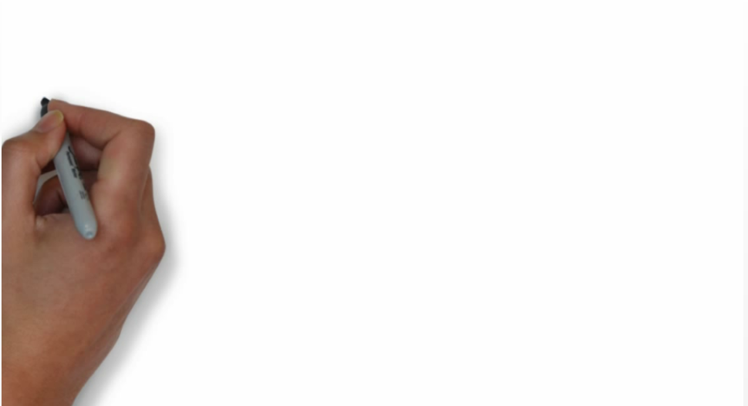
ePharmacy Claims Routing
?
?
?
?
Notes:
Now I would like to provide an overview of the routing for our ePharmacy claims.
If the patient has third party insurance and the drug is billable, claims are transmitted as the result of different actions taken with regard to a prescription, for example when prescriptions are finished, or refilled, or pulled from suspense.
Let’s take a look at this process (wait for video, then click)

Slide 8

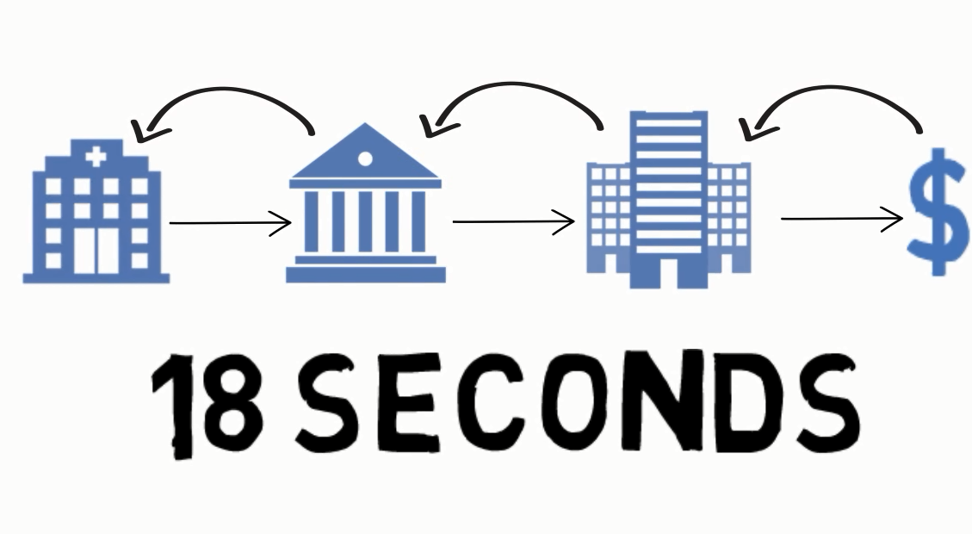
Notes:
The claims are sent from the facility through our intermediary, the Austin Financial Services Center, then through Emdeon, our clearinghouse, and are then routed to the payer, for example Caremark, for adjudication.
The claim then follows the same process in reverse: the payer sends the adjudicated response back through the clearinghouse, the FSC and then to the VA facility.
On average the transmission process is completed in 18 seconds.
Most claims are returned as payable, but others return rejected.

Slide 9
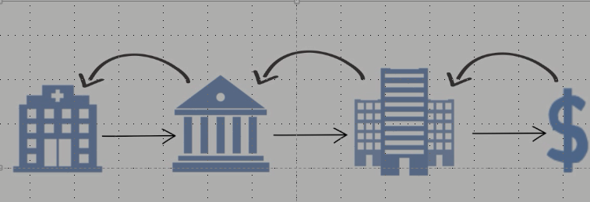
Pharmacy to Resolve:
Drug Utilization Review rejects
Refill Too Soon rejects
Rejects requiring edits to prescription
Reject Resolution Required rejects
Rejected
Pharmacy and OPECC to Resolve:
Product Package Size rejects
OPECC to Resolve All Other Rejects
Notes:
So if the claim rejects someone needs to resolve the reject to hopefully get a payable claim. This slide summarizes who is responsible for resolving selected rejects.
The main responsibility pharmacy has is to resolve the 88 Drug Utilization Review and 79 Refill Too Soon rejects, because those rejects can have clinical and patient safety implications. However pharmacy also needs to resolve rejects that require an edit to the prescription, like reject 22, Dispense As Written, and rejects related to product package size.
Pharmacy can also designate rejects as Reject Resolution Required, which are also sent to the Pharmacy Worklist for resolution. I will have more on those later.
Some rejects, like the product related rejects, require coordination between the OPECC and Pharmacy.
All other rejects are resolved by the OPECC.

Slide 10
ePharmacy by the Numbers
Notes:
Since a pharmacy presentation would not be complete with graphs, here is the first of two statistic slides I wanted to share. The line represents the numbers of ePharmacy prescription fills for each calendar year since 2004, when we first started. Calendar year 2013 was the first year ePharmacy fills decreased. The actual number of ePharmacy prescriptions for 2013 was almost 9 million (8,987,805).

Slide 11
ePharmacy by the Slice
Notes:
The dark blue portion of this pie diagram depicts the relatively small slice of the total prescription pie represented by ePharmacy prescriptions. In calendar year 2013 the percentage was 6.27%.

Slide 12
Poll Results
How long have you been a VA Pharmacy staff person?
    Less than 1 year
    1-5 years
    Over 5 years
    I am not a pharmacy staff person
Notes:
Now let’s pause for a moment and take a look at your poll results.
OK so they show that the majority of you are VA Pharmacy staff that have been with the VA for .
Thanks for the feedback. I will keep that in mind when presenting.
I’m sure you are eager to hear about ePharmacy roles so let’s get back to the presentation.

Slide 13
Poll Results
How long have you been a VA Pharmacy staff person?
    Less than 1 year
    1-5 years
    Over 5 years
    I am not a pharmacy staff person
Notes:
Click again…

Slide 14

ePharmacy Roles
Notes:
The next slides recap the roles different VA staff members play in the ePharmacy process. As I alluded to earlier, the ePharmacy process requires that revenue staff and pharmacy staff work together.

Slide 15

Outpatient Pharmacy Staff Role
Handle ePharmacy process elements that interface with day to day activities
Notes:
Outpatient Pharmacy staff have some basic responsibilities for the ePharmacy process as it relates to their normal activities.
For example staff pharmacists are presented Reject Notification screens when finishing prescriptions
Prescription finishing staff can also follow up to make sure there is not an ePharmacy issue keeping a local prescription from being filled
Technicians and pharmacists can help ensure that NDCs sent with claims match the NDC of the product used for the prescription fill
Staff handing out prescriptions at the outpatient window obtain patient signatures for ePharmacy prescriptions

Slide 16

ePharmacy Site Manager Role
Coordinates all pharmacy-specific aspects of the ePharmacy process
Notes:
The ePharmacy Site Managers have the greatest number of duties.
The majority of their work involves resolving rejects from the Pharmacy Worklist
They often need to consult with the OPECC to resolve ePharmacy related issues
The Site Manager needs to keep updated on changes with regard to the ePharmacy process, and are responsible for keeping other pharmacy staff updated on ePharmacy changes
They also update the VistA ePharmacy Site Parameters used for the ePharmacy process when needed
The Site Manager needs to review and take action on ePharmacy related VistA bulletins on a daily basis, and ePharmacy reports are often run for monitoring purposes.
Finally, they will assist when a site undergoes a third party prescription audit

Slide 17

Pharmacy ADPAC Role
Manages the behind the scenes pharmacy aspects of the ePharmacy process
Notes:
The Pharmacy ADPAC is usually the person that manages the ePharmacy related information for the local Drug File entries
They also ensure the system is set-up correctly to transmit third party claims, which is important as facilities add new CBOCs and new pharmacies.
ADPACs will also work with Information Resource Management Service to ensure ePharmacy-related patches are loaded and functioning correctly.
At many facilities the Pharmacy ADPAC is the back-up to the ePharmacy Site Manager.

Slide 18

OPECC Role
Revenue staff member that coordinates the entire ePharmacy process
Notes:
The Outpatient Pharmacy Claims Coordinator is the revenue staff member that interacts with pharmacy and other staff, like insurance verification and accounts receivable staff, to coordinate the ePharmacy process across the organization and ensure ePharmacy claims are processed timely and paid properly.
The OPECC monitors and resolves rejects from the ECME User Screen on a daily basis

Slide 19
Poll Question
  Staff Pharmacists are responsible for updating the ePharmacy Site Parameters.
    True
    False
Notes:
OK time for another Poll question. As before, to answer this poll question, click the blue icon above my head.
True or False: Staff Pharmacists are responsible for updating the ePharmacy Site parameters. Select A for True or B for False.
True
False
We will give you some time to reflect on that and show the answers a few slides from now.
Now I would like to review some rules used by the ePharmacy process so let’s get back to the presentation.

Slide 20

ePharmacy Rules
Notes:
The VA Pharmacy business model and prescription billing is much different than the private sector’s. We will now look at some of the rules that govern the VA ePharmacy process and claims transmissions.

Slide 21

Non-Billable Prescriptions
Service Connected Prescriptions
Partial Fills
Prescriptions Processed for Inpatients
Sensitive Dx Medications w/o Patient Consent
Most OTC Products
For Patients w/ Medicare Part D Policies
Notes:
This slide lists prescriptions we do not bill for, even when the patient has third party prescription insurance.
For example we do not bill for service connected prescriptions
Prescriptions processed as VistA Outpatient Pharmacy partials are not billed either
Any medication order processed thorough Outpatient Pharmacy software for an inpatient, for example pass meds or self-meds, may transmit a claim, however payable claims for Inpatients are auto-reversed after 5 days.
A signed Release Of Information needs to be obtained from the patient to bill for medications used exclusively to treat a sensitive diagnosis, and information from the form has to be entered into VistA to enable claims generation. The local drug file entries for sensitive drugs need to be marked in the DEA, SPECIAL HDLG with a U to make this process work, and I will have more on this later.
Even though the VA provides Over The Counter products to their patients, and in many cases assigns VA copays for those prescriptions, the majority of those OTC prescriptions are not billed. Insulin and some diabetic supplies are exceptions and are billed.
Finally, there are certain insurance plans that are not billed, e.g. Medicare Part D plans and Insurance Discount Cards.

Slide 22
Veterans | TRICARE | CHAMPVA
Drug Cost + Admin Fee (currently $13.07) | Drug Cost + Dispensing Fee (currently $11.56) | Drug Cost + Dispensing Fee (currently $5)
Prescription Billing Differences
Notes:
In addition to Veterans, some of your facilities may treat TRICARE and /or CHAMPVA patients and bill for their prescriptions. Different business rules govern how prescriptions for the three types of patients are processed. The rules are based on the fact that VAs are funded to treat Veteran patients, which is our primary responsibility. The treatment of TRICARE and CHAMPVA patients is discretionary, and prescription processing follows their respective benefit plans. If payable claims are not obtained for TRICARE or CHAMPVA prescriptions, the facility is not reimbursed.
The tables on the next three slides summarize the differences between billing for Veteran prescriptions versus TRICARE prescriptions versus CHAMPVA prescriptions.
For Veteran claims the current administration fee per prescription is $13.07.
For TRICARE claims the dispensing fee is $11.56 and CHAMPVA has a $5 dispensing fee.
The drug costs used for claims are derived from your facilities drug file.

Slide 23
Veterans | TRICARE | CHAMPVA
Prescriptions processed even if claim rejects (except for RTS, DUR or RRR reject) | Reject must be: Resolved to a payable status, or Ignored before prescription can be filled | Reject must be: Resolved to a payable status, or Ignored before prescription can be filled
Prescription Billing Differences
Notes:
For Veteran claims, labels will print and the prescriptions can be filled unless the claim rejects for Refill Too Soon, Drug Utilization Review or any reject you may have marked as Reject Resolution Required. Any of those rejects have to be resolved before prescriptions are allowed to be filled. Any other rejected prescription is allowed to be filled.
TRICARE and CHAMPVA prescriptions that reject for any reason, cannot be filled until the reject is resolved.
These billing rules also determine how and when staff pharmacists are notified via Reject Notification screens about ePharmacy rejected claims.

Slide 24
Veterans | TRICARE | CHAMPVA
Pharmacy staff only notified of DUR, RTS and RRR rejects | Pharmacy staff notified of all rejects | Pharmacy staff notified of all rejects
Reject Notification Rules
Notes:
For Veteran prescriptions, pharmacy staff are only notified when claims reject for Refill Too Soon, Drug Utilization Review or Reject Resolution Required reasons. This is because prescriptions for claims that reject for other reasons are filled.
Since payable claims should be obtained for TRICARE and CHAMPVA prescriptions, staff are notified for any reject.

Slide 25
Poll Results
Staff Pharmacists are responsible for updating the ePharmacy Site Parameters.
    True
    False
Notes:
Now let’s pause for a moment and take a look at your poll results.
OK so it looks like ___ of you knew the right answer, which is False.
The ePharmacy Site Manager, and in some cases the Pharmacy ADPAC are responsible for updating the ePharmacy Site Parameters, not staff pharmacists.
Nice job! Since I have a few more billing rules to cover let’s get back to the presentation.

Slide 26
Poll Results
Staff Pharmacists are responsible for updating the ePharmacy Site Parameters.
    True
    False
Notes:
Click to next slide

Slide 27
Over-the-counter medications are subject to co-pays
Supply products are not charged a copay
VA Co-Payments
Priority Group | Co-pay Amount
 | 1-30 days | 31-60 days | 61-90 days
2-6 | $8 | $16 | $24
7 and 8 | $9 | $18 | $27
Notes:
The ePharmacy process is not responsible for VA copayments, however I have two slides on the issue because ePharmacy and VA first party copay are related.
The table in this slide lists the current copayment rates for Veteran prescriptions.
As you probably already know, Veterans are charged either $8 or $9 for each 30 day supply or less, depending on their Priority Group. Priority Groups are based on Eligibility.
Priority Groups 2 through 6 are charged $8 for every 30 day supply
Priority Groups 7 and 8 are charged $9 for every 30 day supply
So for example, a 7 day prescription copayment would be either $8 or $9, depending on the patient’s Priority Group. Copayments for a 90 days supply would be $24 or $27.
The VA charges prescription copayments for OTC medications but not supply products.
A patient’s VA copayment is reduced by amounts received by third parties for prescriptions, as can be seen in the next slide.

Slide 28
A patient’s VA copayment is offset dollar-for-dollar, up to the amount of the copay
VA Co-pay | Insurance Payment | Amount Co-pay Decreased | Balance to Patient
$24 | $21 | $21 | $3
$24 | $0 | $0 | $24
$18 | $3 | $3 | $15
$16 | $31 | $16 | $0
$8 | $41 | $8 | $0
$9 | $15 | $9 | $0
Notes:
When VA receives reimbursement from a third party payer, VA offsets the first party co-pay dollar-for-dollar, up to the amount of the copay.
As long as a payment equaling a Veteran’s co-pay is received, the Veteran is not charged. The Veteran will only receive a VA bill if the payer reimburses VA an amount less than the VA co-pay. I have included some examples on this slide.
Reimbursement that exceeds the Veteran’s copayment is kept by the facility.
So you can see that billing prescriptions to third parties can be advantageous to the Veteran as well as the VA facility.

Slide 29
Poll Question
  Claims for pass med or self-medication prescriptions should auto-reverse because ePharmacy does not bill for prescriptions filled as part of an inpatient stay.
    True
    False
Notes:
OK time for another Poll. Once again, to answer this poll question, click the blue icon above my head.
This time lets review a topic I presented a few slides ago. If a pass med or self-medication prescription is entered through the Outpatient pharmacy package, the claim auto-reverses because VA does not bill for prescriptions filled as part of a patient’s inpatient stay.
Select A for True or B if you think the statement is False.
True
False
We will give you some time to reflect on that and show the answers a few slides from now. Now I would like to review some behind the scenes functionality that play a role in the ePharmacy process, so let’s get back to the presentation.

Slide 30

ePharmacy
Behind the Scenes
Notes:
Since VA prescription processing is unique, and the NCPDP standards are tailored to a typical retail model, software had to be designed to accommodate the VA business model. Let’s look at some of these background factors that facilitate ePharmacy. Hopefully this look will provide you with a clearer understanding of why ePharmacy functions the way it does. Just a reminder not to hesitate to submit your questions using the ‘ask the presenter’ icon.

Slide 31
“Last Local NDC” Process Flow
Local ePharmacy Rx is finished
Claim generated using last local NDC
Label is printed but Rx is filled with different NDC
Automation sends new NDC to VistA via OPAI or prescription has payable claim
Last local NDC field is updated
New NDC used for next local Rx
Notes:
I would like to start with a discussion on the NDC used for ePharmacy claims.
Before we get to the flow diagram I need to provide some preliminary information on the process.
First of all a third party claim needs to be sent to the payer prior to the prescription actually being filled, so we can receive information like DUR and RTS reject information back from the payer before actually processing the prescription.
For these reasons VA sends claims when prescriptions are finished, refilled and pulled from suspense etc.
Every third party claim needs an NDC number to identify the product to the payer.
VA is unlike a retail pharmacy, in that the particular NDC of product that will be used to fill the prescription is not known when the order is being input or finished etc. To account for this business model, we built logic into our software to predict which NDC will be used for the fill and we use that NDC for the claim.
The NDC by Outpatient Site field is a multiple field in the Drug file that stores the Last Local NDC and the Last CMOP NDC for an outpatient site.
The NDC selected for the claim is also the one that appears in the Pharmacy Fill Card section of the Outpatient prescription laser label.
So looking at the flow diagram:
Claims generation starts when ePharmacy prescriptions are finished or refilled etc.
The LAST LOCAL NDC is transmitted on the initial claim for those local fills.
When an ePharmacy prescription is processed, if the NDC is changed at release, then another claim with the new information is transmitted to the third party.
If the NDC the claim was changed to is provided back to VISTA through the Outpatient Pharmacy Automation Interface by an automation system, or if the NDC change via the Release Medication option results in a payable claim, then the ‘Last Local NDC’ subfield is changed to the new NDC, to be used for the next local prescription.

Slide 32
“Last CMOP NDC” Process Flow
Last CMOP NDC field is updated and new NDC used for next CMOP Rx
CMOP ePharmacy Rx is pulled from suspense
Rx is filled with different NDC
New NDC returned with CMOP release
Claim is generated using Last CMOP NDC
Notes:
Here is a NDC flow diagram for a CMOP prescription fill.
The LAST CMOP NDC is the NDC that is transmitted when a CMOP ePharmacy prescription is pulled from suspense.
If CMOP fills the prescription with a different NDC, the LAST CMOP NDC field is updated as part of the CMOP release process.
As always, if the NDC is changed when an ePharmacy prescription is released, another claim with the new information is transmitted to the third party.

Slide 33


NDC
Claim NDC needs to be updated if a different NDC of product is used
NDC verification is done when prescriptions are released
NDC Validation option allows NDC update when filling, but only in a non-automated setting
An NDC change generates a new claim
NDC
Notes:
Because the NDC actually used to fill the prescription may change from what was chosen when the prescription was finished, we require the NDC for ePharmacy prescriptions be verified when the prescription is released.
For local fills, this is done either manually using the Release Medication option, or in the background through the Outpatient Pharmacy Automation Interface when an outpatient automation system is used.
For non-automated pharmacies staff can change the NDC during the filling process using the ePharmacy NDC Validation option.
Anytime an NDC is changed, a new claim is generated.

Slide 34
Poll Results
  Claims for pass med or self-medication prescriptions should auto-reverse because ePharmacy does not bill for prescriptions filled as part of an inpatient stay.
    True
    False
Notes:
Now let’s pause for a moment and take a look at your poll results.
OK so it looks like ___ of you knew the right answer, which is True, the claim would reverse because ePharmacy does not bill for meds provided to inpatients. Great job!
There are still some behind the scenes topics I want to cover so let’s get back to the presentation.

Slide 35
Poll Results
  Claims for pass med or self-medication prescriptions should auto-reverse because ePharmacy does not bill for prescriptions filled as part of an inpatient stay.
    True
    False
Notes:
Click to next slide

Slide 36
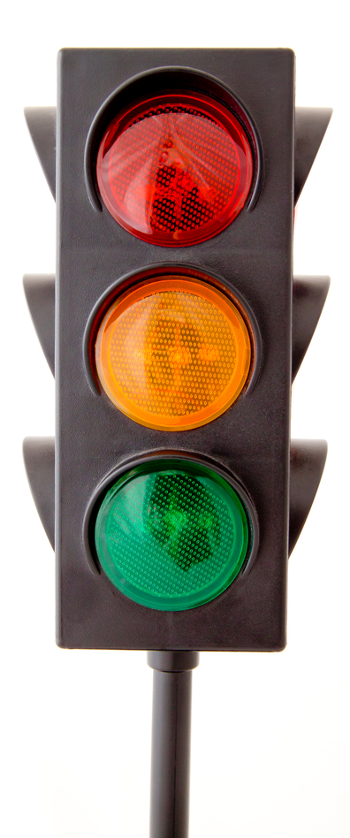
DEA, SPECIAL HDLG Codes
I S N 9
M 0
Null
Not Billable
Billable if ROI
on file in VistA
U
IE SE
NE 9E
All Others
Billable
Notes:
I mentioned the DEA SPECIAL HDLG field a few slides ago when I discussed prescriptions we do not bill for. The DEA SPECIAL HDLG is a field in the Drug file that is used to indicate different aspects associated with a drug.
ePharmacy uses the DEA SPECIAL HDLG field to determine if a prescription for a drug can be billed to a third party payer
Pharmacy ADPACs usually make changes to this field, so don’t worry about remembering all the details of this conversation.
Using this traffic light analogy and looking at the red light, if the DEA, SPECIAL HDLG field contains an “I” (which means the drug is an Investigational drug), an “S” (for Supply product), an “N” (designating a Nutritional Supplement), or a “9” (which stands for OTC item), prescriptions for the drug are NOT billable.
However, looking at the green light below, if the same drug also contains the “E” (which means electronically billable), as shown by the IE, SE, NE or 9E, then prescriptions for those drugs become BILLABLE.
Back to the red light, if the DEA, SPECIAL HDLG field contains an “M” or “0”, prescriptions for the drug are NOT Billable, and this holds true even if the “M” or “0” are appended with the “E”. This is because the “M and “0” denote compounded items which the VA does not bill for.
Finally, if the DEA, SPECIAL HDLG field is blank, (or null), the drug is also NOT Billable.
Looking at the orange light, if the DEA, SPECIAL HDLG field contains a “U” (which indicates a drug used for a sensitive diagnosis), the drug is NOT billable unless the appropriate signed Release of Information from the patient is on file in VistA. Obtaining the release of information and entering it into VistA are business or revenue staff functions.
Drugs marked with any other code are billable and any combination of billable codes will remain billable.
The advantage to using the DEA, SPECIAL HDLG field to flag drugs like this is that it reduces the number of claims that would reject for non-covered items.

Slide 37
DEA, SPECIAL HDLG Codes
I S N 9
M 0
Null
AIDS
Drug and Alcohol Abuse
Sickle Cell Anemia
Not Billable
Billable if ROI
on file in VistA
U
IE SE
NE 9E
All Others
Billable
Notes:
Now I would like to provide a little more information on billing for prescriptions for sensitive drugs.
The US Code of Federal Regulations prevents VA from informing third parties that patients have certain conditions such as AIDS, Sickle Cell Anemia, Drug Abuse, or Alcohol Abuse, without the patients permission. Information on this rule can be found in VHA Handbook 1605.1, Subpart 14).
By submitting electronic claims submissions for medications exclusively used to treat those conditions we may be violating privacy regulations. The word exclusively is important here. Drugs like methadone, which can treat other conditions beside one of the sensitive diagnoses, do not require a release of information to bill.
As I mentioned previously, the letter U in the DEA Special HDLG field is used to identify drugs used solely to treat sensitive diagnoses.
Sensitive Drugs marked with a U are not billable through ePharmacy or on paper until a signed Release of Information form is recorded using the VistA ‘Patient Release of Information (ROI)’ option.
A list of drugs requiring the ‘U’ designator can be found in the ePharmacy section of the Pharmacy Informatics SharePoint site.
You will notice that Hepatitis is not one of the sensitive diagnoses so drugs used exclusively for hepatitis do not need to be marked.
My notes and the links to the documents mentioned above are in the handout for this slide, so use the green icon to download if interested.

Slide 38


NCPDP Field Specifications
VA quantity chosen for a prescription is not always
the quantity needed
for a third party
prescription
claim
Must ensure the correct quantity of product is transmitted for ePharmacy prescriptions
Notes:
Another background process has to do with ensuring the correct quantity of product is transmitted for ePharmacy prescriptions.
We need to do this because the VA quantity chosen for a prescription is not always the quantity needed for a third party prescription claim.

Slide 39
NCPDP Field Specifications
NCPDP Dispense Unit
NCPDP Quantity Multiplier
Drug File Field 82
Drug File Field 83
do NOT affect:
Drug Accountability
Drug File pricing
Any other Pharmacy process
Notes:
Two Drug file fields are helpful in assuring the correct quantity is used for a prescription, and they only do this for ePharmacy prescription claims.
Drug File Field 82 is the NCPDP Dispense Unit
Drug File Field 83 is the NCPDP Quantity Multiplier
These fields do not affect Drug Accountability, Drug File pricing, or any other Pharmacy process
The person responsible for your facility’s drug file, for example the Pharmacy ADPAC, updates these fields.

Slide 40
NCPDP Field Specifications
NCPDP Dispense Unit
EA = Each, GM = Grams,
ML = Milliliters
Setting for Insulin vial = ML
NCPDP Quantity Multiplier
Type a number
between 0.001 and 99999.999
Setting for Insulin vial = 10
Drug File Field 82
Drug File Field 83
Notes:
The diagram in this slide shows the parameters used for the two fields.
The NCPDP DISPENSE UNIT can be expressed in EACH, GRAMS or MILLILITERS.
The NCPDP QUANTITY MULTIPLIER is a number that can currently be set to three decimal places.
An example for how these are used would be a prescription for a vial of insulin. When VA prescription orders are finished, the number of vials is chosen. The third party billing standard however requires the number of MLs dispensed. So the NCPDP DISPENSE UNIT field should be set to ML, and the NCPDP QUANTITY MULTIPLIER field set to 10, since there are 10 ml per vial. This will result in the number of vials dispensed being multiplied by 10, for ePharmacy prescriptions only, resulting in the correct number of MLs transmitted on the claim.
Having the correct NCPDP QUANTITY MULTIPLIER is very important, as claims may not be paid, or paid incorrectly if the wrong quantity is transmitted.

Slide 41
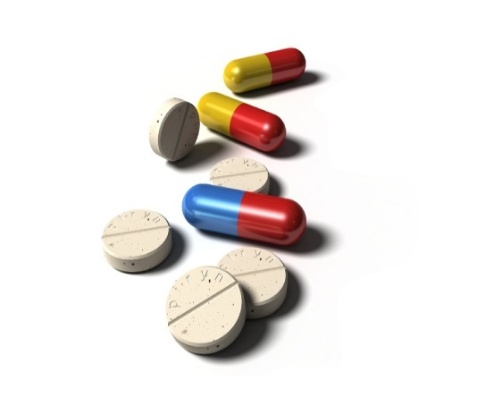
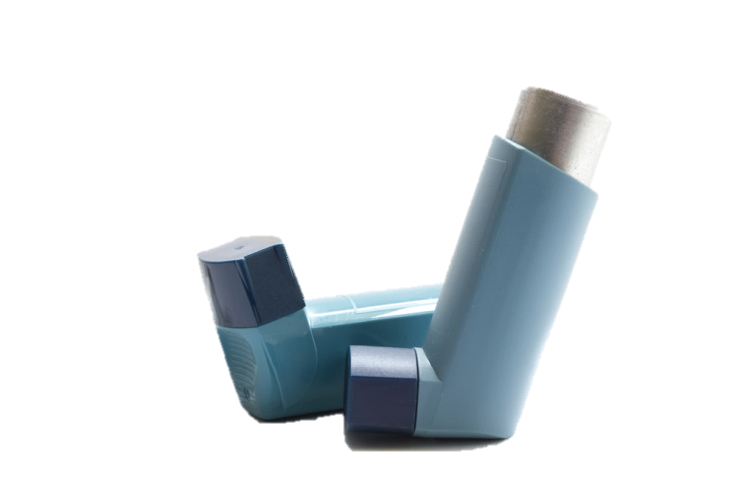
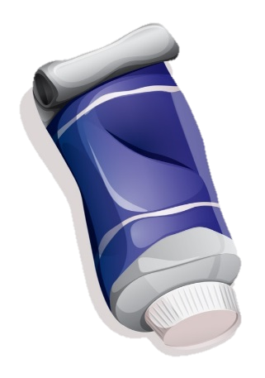
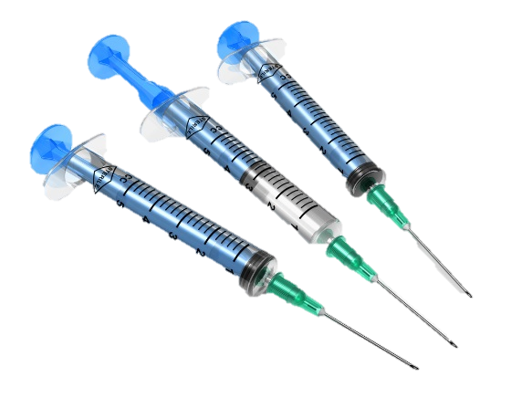
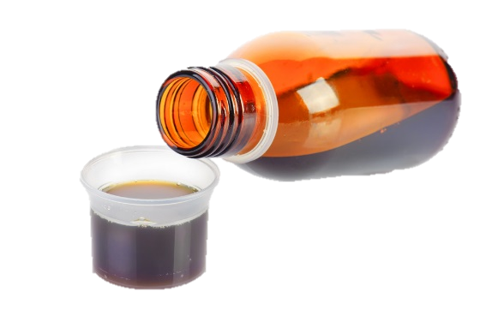
Typical Billing Units
Each
Grams
Milliliters
Notes:
Here are some examples of the dispense unit used for certain types of products.
EACH is used for dosage forms like tablets, capsules and injection kits.
GRAMS are used for inhalers, creams, ointments gels and powders.
And MILLILITERS are used as the dispense unit for oral liquids, lotions and most injections.
The dispense unit value of Each, Grams or Milliliters is not transmitted on electronic prescription claims, only the quantity is transmitted. Nevertheless we recommend the NCPDP DISPENSE UNIT field be set to the respective unit of measure to be consistent.
Like the sensitive drug lists I mentioned earlier, the NCPDP Quantity Multiplier and Dispense Unit values to use are located on the Pharmacy Informatics SharePoint site.

Slide 42
Billing Quantity
Rx Activity Log Mar 22, 2011@16:11:24 Page: 3 of 4
PATIENT, VA ONE
PID: ###-##-#### Ht(cm): ###.34 (03/14/2011)
DOB: MMM #,#### (##) Wt(kg): ###.36 (03/14/2011)
+
ECME Log:
# Date/Time Rx Ref Initiator Of Activity
===============================================================================
1 3/15/11@19:55:10 ORIGINAL PHARMACIST, ONE
Comments: ECME:CMOP TRANSMISSION(NDC:59310-0579-20)-pCAREMARK CLAIMS
3/15/11@19:55:10 ORIGINAL PHARMACIST, ONE
Comments: BILLING QUANTITY submitted: 8.5 (GM)
CMOP Event Log:
Date/Time Rx Ref TRN-Order Stat Comments
===========================================================================
03/17/11@0636 Orig #####-280 DISP NDC: 59310057920
Carrier: USPS Pkg ID: ##########
CMOP Lot#/Expiration Date Log:
+ Enter ?? for more actions
Select Action: Next Screen//
Comments: BILLING QUANTITY submitted: 8.5 (GM)
Notes:
Here is a View Prescription screen shot showing the ECME Log for a prescription.
When the Quantity transmitted on the ePharmacy claim is different from the VA Product Quantity entered for the prescription, the ‘Billing Quantity’ will display in the ECME Log of the View Prescription. This is the quantity calculated when the VA Quantity chosen for the prescription is multiplied by the NCPDP Quantity Multiplier. This example is for a ProAir albuterol inhaler prescription where the VA quantity entered for the prescription was 1. You can see from this screen shot the Billing Quantity that was sent to the third party was 8.5, the number of grams in one inhaler.

Slide 43
¾ Days Supply Hold
Rx Activity Log May 30, 2014@16:11:24 Page: 3 of 4
PATIENT, VA ONE
PID: ###-##-#### Ht(cm): ###.34 (08/10/2012) DOB: MMM #,#### (##) Wt(kg): ###.36 (04/28/2014)
+
Activity Log:
# Date Reason Rx Ref Initiator Of Activity
===============================================================================
1 03/01/14 SUSPENSE ORIGINAL USER,ONE
Comments: RX Placed on Suspense for CMOP until 03-01-14
2 03/02/14 PROCESSED ORIGINAL POSTMASTER
Comments: Transmitted to CMOP NATIONAL CMOP
3 03/06/14 SUSPENSE REFILL 1 USER,TWO
Comments: RX Placed on Suspense for CMOP until 03-21-14
4 03/14/14 SUSPENSE REFILL 1 POSTMASTER
Comments: 3/4 of Days Supply SUSPENSE HOLD until 3/25/14.
5 03/14/14 SUSPENSE REFILL 1 POSTMASTER
Comments: Change Refill Date 03/21/14 to 03/25/14
6 03/25/14 PROCESSED REFILL 1 POSTMASTER
Comments: Transmitted to CMOP NATIONAL CMOP
05/05/14 SUSPENSE REFILL 2 USER,TWO
+ Enter ?? for more actions
Select Action: Next Screen//
3/4 of Days Supply SUSPENSE HOLD until 3/25/14
Notes:
Here is the final behind-the–scenes look I have to share.
Have you ever wondered what the ¾ Days Supply SUSPENSE HOLD comment in the Activity Log for a prescription means?
Here is a View Prescription screen shot showing the Activity Log showing the ¾ days Supply SUSPENSE HOLD comment.
Most third parties allow prescriptions to be refilled after three-fourths, or 75% of the previous days supply has elapsed. Our Outpatient Pharmacy software has similar functionality that holds prescriptions on suspense until what it feels is an appropriate date of next fill, however many sites have Pull Ahead parameters that pull prescriptions earlier than that date. So ePharmacy software controls the date of filling for ePharmacy prescriptions only. When an ePharmacy prescription is scheduled to be pulled from suspense to be filled, if 75% of the previous days supply has not elapsed, the prescription will be placed back into suspense to be filled at the appropriate time. This enhancement has significantly reduced the number of Refill Too Soon rejects facilities receive.

Slide 44
Poll Question
  The Last Local NDC field is updated as a result of prescription processing.
    True
    False
Notes:
OK time for another poll question. As before, to answer this poll question click the blue icon above my head. I presented this topic a few slides ago. The question is ‘The Last Local NDC field is updated as a result of prescription processing’. Is that statement True or False? Select A for True or B for False.
True
False
We will give you some time to reflect on that and show the answers a few slides from now. Next I would like to review some situations you may encounter when processing ePharmacy prescriptions so let’s get back to the presentation.

Slide 45
ePharmacy Prescription Processing
Notes:
Now lets touch on some hands-on processes involved with ePharmacy and claims transmissions. We’ll review some practical scenarios that hopefully will help you choose the correct action when encountered.

Slide 46
ePharmacy Claim Submission
Rx # ###1111 04/06/11
TEST,PSOUSER #90
TAKE ONE TABLET BY MOUTH EVERY DAY
LISINOPRIL 40MG TAB
USER,PSOTEST USER,PSOTEST
# of Refills: 3
SC Percent: 100%
Disabilities: NONE STATED
Was treatment for a Service Connected condition? NO
Is this correct? YES// YES
Prescription ###1111 successfully submitted to ECME for claim generation.
Claim Status:
IN PROGRESS-Waiting to start
IN PROGRESS-Waiting for packet build
IN PROGRESS-Waiting for transmit
IN PROGRESS-Transmitting
E PAYABLE
Prescription 383404 successfully submitted to ECME for claim generation.
Claim Status:
IN PROGRESS-Waiting to start
IN PROGRESS-Waiting for packet build
IN PROGRESS-Waiting for transmit
IN PROGRESS-Transmitting
E PAYABLE
Notes:
Here is a screen shot showing the ePharmacy transmission messaging seen directly after finishing an ePharmacy prescription. As mentioned earlier, claims are also generated when refilling, pulling a prescription from suspense, or editing a prescription.
If the prescription is ePharmacy billable, the ECME messaging will display. In this example the claim came back as PAYABLE, but you may also see E REJECTED at the end of transmission messaging.
At the end of transmission messaging is where Reject Notification screens are generated to the pharmacist, and there are three basic reasons why they are generated
The first is when a Veteran prescription claim rejects for 79 - Refill Too Soon or 88 - Drug Utilization Review.
The second is if a reject for a Veteran prescription is one the site has designated as being Reject Resolution Required
The third is when a CHAMPVA or TRICARE prescription rejects for any reason
Those rejects I just mentioned will not allow the prescription to be filled until the rejects are resolved, and the Reject Notification screen provides the user with options to take regarding the prescription.
If any other reject code is returned for a Veteran prescription, you will see E REJECTED at the end of the transmission messaging – but no Reject Notification screen is presented and the pharmacist takes no action. The reject goes on the ECME User Screen and the OPECC will resolve it.

Slide 47
Reject Notification (RTS)
*** REJECT RECEIVED FROM THIRD PARTY PAYER ***
------------------------------------------------------------------
Division: ECME TEST NCPDP#: 1098981
Patient : ECMEPATIENT,FOUR Sex: M DOB: JAN 1, 19XX
Prescription : ###44/0 AMOXICILLIN 500MG C ECME#: 00000####444
Reject Type : 79 – REFILL TOO SOON received on JAN 2,2012
Payer Message: Refill Payable on or after 01-4-12
Insurance : CAREMARK Contact: 555-555-5555
Group Name : XXXXX Group Number: XXXXX
Cardholder ID: XXXXXXXXX
------------------------------------------------------------------
Select one of the following:
I (I)GNORE – FILL Rx WITHOUT CLAIM SUBMISSION
Q (Q)UIT – SEND TO WORKLIST (REQUIRES INTERVENTION)
(I)gnore,(Q)uit: //
Reject Type : 79 – REFILL TOO SOON received on JAN 2,2012
Payer Message: Refill Payable on or after 01-4-12
I (I)GNORE – FILL Rx WITHOUT CLAIM SUBMISSION
Q (Q)UIT – SEND TO WORKLIST (REQUIRES INTERVENTION)
Notes:
I indicated that users are presented Reject Notifications screens for rejects that do not allow the prescription to be filled until they are resolved. The Reject Notification screen provides the staff pharmacist with an opportunity to take additional action regarding those prescriptions, and to process those prescriptions immediately if warranted.
This is a sample of the Reject Notification screen that is seen while finishing, refilling, or updating a prescription that rejects for Refill Too Soon.
This screen has information about the patient, his prescription and insurance company, and the reject type that says… ‘Refill Too Soon’.
You can also see from the Payer Message that this prescription can filled in 2 days
Below the dotted line are the options available when this screen is encountered.
In most cases, the correct action will be to Quit, which sends the reject to the Third Party Payer Rejects – Worklist for the ePharmacy Site Manager to resolve. The prescription will not be allowed to be filled until the RTS reject is resolved.
If Ignore is chosen, the prescription will be allowed to be processed, but the claim will be bypassed and the facility will not be reimbursed for the prescription, and the patient’s copay will not be able to be reduced.
In most cases the patient will have enough medication to get them by until the third party will approve a refill. When the early refill is due to an increase in dose for a new prescription, the ePharmacy Site Manager can override the reject and get a payable claim.

Slide 48
Poll Results
  The Last Local NDC field is updated as a result of prescription processing.
    True
    False
Notes:
Now let’s pause for a moment and take a look at the results of your last poll.
OK so it looks like ___ of you knew the right answer, which is True. The Last Local NDC is updated as a result of prescription processing. Once again great job!
Now for more Reject Notification screens, so let’s get back to the presentation.

Slide 49
Poll Results
  The Last Local NDC field is updated as a result of prescription processing.
    True
    False
Notes:
Click to next slide

Slide 50
Reject Notification
(DUR)
*** REJECT RECEIVED FROM THIRD PARTY PAYER ***
---------------------------------------------------------------------
Division: ECME TEST NCPDP#: 1098981
Patient : ECMEPATIENT,ONE Sex: M DOB: JAN 1, 19XX (XX)
Prescription : ####23/0 HCTZ 50/TRIAMTERENE ECME#: 00000####936
Reject Type : 88 – DUR REJECT received on JAN 2,2012@13:14:34
Payer Message: LISINOPRIL/HCTZ, TRIAMTERINE, DUR REJECT ERROR
Insurance : HUMANA Contact: 1-555-555-5555
Group Name : XXXXX Group Number: XXXXX
Cardholder ID: XXXXXXXXX
---------------------------------------------------------------------
Select one of the following:
O (O)VERRIDE – RESUBMIT WITH OVERRRIDE CODES
I (I)GNORE – FILL Rx WITHOUT CLAIM SUBMISSION
Q (Q)UIT – SEND TO WORKLIST (REQUIRES INTERVENTION)
(O)verride, (I)gnore,(Q)uit: //
Reject Type : 88 – DUR REJECT received on JAN 2,2012@13:14:34
Payer Message: LISINOPRIL/HCTZ, TRIAMTERINE, DUR REJECT ERROR
O (O) VERRIDE – RESUBMIT WITH OVERRIDE CODES
Notes:
This is a sample of the Reject Notification screen that is seen for a Drug Utilization Review reject. You can see it is similar to the Refill Too Soon screen for a Veteran prescription, but the reject type in the middle says DUR Reject. In this case the payer message indicates the DUR reject is due to an interaction between the Lisinopril/HCTZ prescription being processed, and the fact the patient appears to also be on Triamterene.
Notice the additional action of Override. In some cases override codes can be used to resolve DUR rejects. The common override codes to be used can be found in the ePharmacy Reference Cards, and in our ePharmacy Helpful Hints, both of which can be found on our ePharmacy training site. The Quick Reference card used by Pharmacy Finishing Staff is included in a handout for this slide.
Please do not guess on override codes, as this causes other rejects and can result in non-payable claims.
For the same reasons as described for Refill Too Soon rejects, the action taken the majority of the time will be to Quit.

Slide 51
Reject Notification (RRR)
*** REJECT RECEIVED FROM THIRD PARTY PAYER ***
-------------------------------------------------------------------------
Division : XXXXXX NPI#: XXXXXXXXXX
Patient : OPPATIENT,ONE (999-XX-XXXX) Sex: F DOB: OCT XX,19XX(XX)
Rx/Drug : 2718XXX/0 - EZETIMIBE 10MG TAB ECME#: 431XXXXXXXXX
Reject(s): Days Supply Exceeds Plan Limitation (7X). Received on SEP
28, 2013@15:35:16.
Insurance : ABC Insurance Contact:
Group Name : ABC Group Name Group Number: 12312312
Cardholder ID: XXXXXXXX
Reject Resolution Required Reject
Gross Amount due ($229.15) is greater than or equal to
Threshold Dollar Amount ($50.00)
Please select Quit to resolve this reject on the Reject Worklist.
-------------------------------------------------------------------------
Select one of the following:
I (I)GNORE - FILL Rx WITHOUT CLAIM SUBMISSION
Q (Q)UIT - SEND TO WORKLIST (REQUIRES INTERVENTION)
(I)gnore,(Q)uit: Q// (Q)UIT - SEND TO WORKLIST (REQUIRES INTERVENTION)
Reject Resolution Required Reject
Gross Amount due ($229.15) is greater than or equal to
Threshold Dollar Amount ($50.00)
Please select Quit to resolve this reject on the Reject Worklist.
Notes:
Here is a screen shot of the Reject Notification screen that is returned for a Reject Resolution Required reject. RRR rejects only happen for new prescriptions for Veterans.
RRR rejects are reject codes your site has designated that should be resolved prior to the prescription being filled. A threshold dollar amount is usually associated with these codes. Since this functionality is used mainly to change prescriptions that reject for 60 or 90 days supplies, to days supplies covered by the third party, additional information is provided in these notifications.
The middle of the screen shot shows the Gross Amount Due, Threshold Amount, and a statement encouraging Quit as a choice. The Gross Amount Due and Threshold Amounts are reimbursement figures used to determine if the prescription will be worth changing from a 90 days supply to a 30 days supply. Notice the default action is also to Quit.
You can download a handout for this slide if you want to learn more about the Reject Resolution Required process.

Slide 52
Reject Notification - TRICARE or CHAMPVA RTS/DUR
88 - DUR Reject Error
*** TRICARE - REJECT RECEIVED FROM THIRD PARTY PAYER
------------------------------------------------------------
Division : XXXXXX NPI#: XXXXXXXXXX
Patient : TRICARE,ONE (XXX-XX-XXXX) Sex: F DOB: JAN 1,19XX(XX)
Rx/Drug : 2718XXX/0 - LISINOPRIL 10MG TAB ECME#: 00000431XXXX
Reject(s): DUR REJECT (88). Received on FEB 01, 2014@07:08:44.
Insurance : EXPRESS SCRIPTS Contact:
Group Name : TRICARE Group Number: DODA
------------------------------------------------------------
Select one of the following:
O (O)VERRIDE - RESUBMIT WITH OVERRIDE CODES
I (I)GNORE - FILL Rx WITHOUT CLAIM SUBMISSION
D (D)iscontinue - DO NOT FILL PRESCRIPTION
Q (Q)UIT - SEND TO WORKLIST (REQUIRES INTERVENTION)
(O)verride,(I)gnore,(D)iscontinue,(Q)uit: Q//
TRICARE
**If CHAMPVA, will say CHAMPVA**
I (I)GNORE – FILL Rx WITHOUT CLAIM SUBMISSION
**Only displays if user has TRICARE/CHAMPVA key**
Notes:
Here is a screen shot of the Reject Notification screen staff will get when a TRICARE or CHAMPVA prescription rejects for DUR or RTS. CHAMPVA prescriptions will indicate CHAMPVA rather than TRICARE.
The actions listed are similar to what is seen for Veteran claims that reject and once one of these actions is selected the process is similar to what it is for Veteran claims. However, if the user does not have the PSO TRICARE/CHAMPVA security key, the Ignore action will not display.
The ability to Override the reject, as well as Discontinue the prescription, are also available.
For most situations, the user would choose Quit to send the reject to the Pharmacy Worklist. Once on the worklist, the reject can be resolved and the prescription processed if needed.

Slide 53
Reject Notification– TRICARE or CHAMPVA non-RTS/DUR
IN PROGRESS-Transmitting
IN PROGRESS-Parsing response
E REJECTED
21 - M/I Product/Service ID
*** TRICARE - REJECT RECEIVED FROM THIRD PARTY PAYER ***
--------------------------------------------------------------------------
Division : XXXX DIVISION NPI#: XXXXXXXXXX
Patient : OPPATIENT,TRI(XXX-XX-XXXX) Sex: M DOB: JAN 1,19XX(XX)
Rx/Drug : XXX5341/0 - AMOXICILLIN 250MG CA ECME#: 00000234XXXX
Reject(s): M/I Product/Service ID (21) Received on FEB 01, 2014@09:30:03.
Insurance : EXPRESS SCRIPT TRICARE Contact:
Group Name : TRICARE Group Number: DODA
--------------------------------------------------------------------------
Select one of the following:
I (I)GNORE – FILL Rx WITHOUT CLAIM SUBMISSION
D (D)iscontinue - DO NOT FILL PRESCRIPTION
Q (Q)UIT - SEND TO WORKLIST (REQUIRES INTERVENTION)
(I)gnore,(D)iscontinue,(Q)uit: Q//
All “other” rejects will display and require staff to take action
Most times, the correct action is to select “Quit” to send the reject to the Pharmacy Worklist
Notes:
This is a screen shot of the Reject Notification screen that pharmacy staff will see for a TRICARE or CHAMPVA prescription that rejects for a reason other than DUR or RTS. Once again the screens for CHAMPVA prescriptions will indicate CHAMPVA rather than TRICARE. In these cases the Override action does not show because it is only used for DUR rejects.
As in the previous example, the Ignore action will not be seen if the TRICARE/CHAMPVA key is not held. Discontinuing the prescription is also a choice, and could be appropriate if the prescription is for a non-covered item, and it is your local policy not to provide non-covered items to TRICARE and CHAMPVA patients.
For most situations the user would choose Quit to send the reject to the Pharmacy Worklist for resolution.

Slide 54
Poll Question
  In most cases, the best action to choose from a Reject Notification screen is ‘Quit’.
    True
    False
Notes:
OK time for one last poll question. As before, to answer this poll question click the blue icon above my head. This is another True/False question: In most cases, the best action to take from a Reject Notification screen is ‘Quit’. Select A for True or B for False.
True
False
We will give you some time to reflect on that and show the answers a few slides from now.
Now I would like to review additional situations you may encounter when processing ePharmacy prescriptions so let’s get back to the presentation.

Slide 55
REJ View REJECT Action
OP Medications (SUSPENDED) May 28, 2014@11:36:58 Page: 1 of 4
PATIENT, ONE
PID: ###-##-#### Ht(cm): 185.42 (09/26/2008)
DOB: MMM #,#### (##) Wt(kg): 94.55 (03/12/2014)
SEX: MFMF Non-VA Meds on File Last entry on 01/24/12
CrCL: 54.6(est.) (CREAT:1.30mg/dL 3/12/14) BSA (m2): 2.19
Rx #: ####5685$e
(1) *Orderable Item: INSULIN ASPART HUMAN (PEN) INJ <DIN>
(2) CMOP Drug: INSULIN,ASPART 100UN/ML NOVO FLEXPEN 3ML
Verb: INJECT
(3) *Dosage: 12 UNITS
*Route: SUBCUTANEOUS
*Schedule: AC BREAKFAST
*Conjunction: AND
Verb: INJECT
*Dosage: 18 UNITS
*Route: SUBCUTANEOUS
*Schedule: AC LUNCH
+ Enter ?? for more actions
DC Discontinue PR Partial RL Release
ED Edit RF (Refill) RN Renew
Select Action: Next Screen// REJ
1
Select a prescription from the Patient Prescription Processing screen
2
Select the hidden action: REJ View REJECT
Notes:
I think we covered all the Reject Notifications screens and will move on.
I want to make sure you are aware of another action that may be helpful. It is the View Reject action.
If you want additional information about a rejected prescription, the Reject Information screen for a current reject can be accessed from the Patient Prescription Processing screen.
Select a prescription with a current reject from the Patient Prescription Processing screen as shown in this screen shot.
Then select the hidden action: REJ View REJECT
Note, if a prescription without a current reject is selected, an ‘Invalid Selection!’ error will display when you use the View REJECT action. I have more on the next slide.

Slide 56
Reject Information(UNRESOLVED)May 28, 2014@11:38:01 Page: 1 of 1
Division : VAMC -ONE NPI: ########## NCPDP: #######
Patient : PATIENT, ONE (####) Sex: M DOB: MMM #,####(##)
Rx# : ########/0 ECME#: 0000######## Date of Service: May 27, 2014
CMOP Drug: INSULIN,ASPART 100UN/ML NOVO FLEXPEN 3ML NDC Code: 00169-6339-10
REJECT Information
Reject Type : 79 - REFILL TOO SOON received on MAY 27, 2014@19:19:14
Reject Status : OPEN/UNRESOLVED - E REJECTED
Payer Addl Msg : NEXT AVAILABLE FILL DATE 20140605
Reason Code : ER (OVERUSE )
+DUR Text : ER2: 25 DS 1 20140517
INSURANCE Information
Insurance : CAREMARK (610029)
Contact : (800)421-2342
BIN : 610029
Group Number : ####
Cardholder ID : ######
Enter ?? for more actions
VW View Rx IGN Ignore Reject OVR Submit Override Codes
MP Medication Profile RES Resubmit Claim CSD Change Suspense Date
Select: Quit//
3
A Reject Information screen will display
Additional actions to help the ePharmacy Site Manager resolve reject
REJ View REJECT Action
Notes:
Once entered, the Reject Information screen will display.
This is the same screen that is accessed from the Pharmacy Worklist.
It provides information and additional tools to assist in resolving the reject.
The Reject Information screen is used by the ePharmacy Site manager to resolve rejects.
I just wanted you to know about the action in case you want to know more about a reject than is shown on the Reject Notification screen.

Slide 57

Importance of Release Medication
NDCs verified
DUR/RTS reject resolution
ePharmacy claims will reverse if not released
VA Copay assigned
Critical from a revenue generation standpoint
RELEASE
Notes:
I touched on the medication release process when discussing NDC verification, but would now like to address the reasons the medication release process is important to ePharmacy and to billing in general.
As you are all aware, releasing a prescription is the final sign off in Outpatient Pharmacy, that indicates the prescription is checked and filled and ready for pick-up or delivery etc.
For ePharmacy claims,
The release step is where NDCs are verified
It is when additional DUR or RTS reject resolution may occur
If prescriptions are not released, ePharmacy claims will reverse, and this is a feature facilities sometimes use to avoid processing to third parties, for example for prescriptions given in clinic
Another reason is that both a payable response and a prescription release are needed to create a bill on the revenue side.
Lastly, release triggers the First Party prescription Copay charge for eligible patients and a copay will not be assigned if the prescription is not released

Slide 58

Release Medication Option
OP Medications(ACTIVE) Aug 6, 2010@11:10:38 Page: 1 of 1
TEST,ECMEPATIENT
PID: 000-00-0000 Ht(cm): _______ (______)
DOB: JAN 1,1950 (XX) Wt(kg): _______ (______)
---------------------------------------------------------------------------------
(9) Days Supply: 30 (10) QTY ( ): 1
(11) # of Refills: 5 Remaining: 4
(12) Provider: PROVIDER,PSOTEST
(13) Routing: WINDOW (14) Copies: 1
Method of Pickup:
(15) Clinic: Not on File
(16) Division: TEST CBOC (XXX)
(17) Pharmacist:
(18) Remarks:
(19) Counseling: NO
(20) Refill Data
(21) DAW Code: 0 - NO PRODUCT SELECTION INDICATED
Finished By: PHARMACIST,PSOTEST
Entry By: ECME,PHARMACIST Entry Date: 08/06/10 10:16:47
Enter ?? for more actions s
DC Discontinue PR Partial RL Release
ED Edit RF Refill RN Renew Select
Select Action: Next Screen// RL Release
RELEASE
RL Release
Notes:
Prescription release at most sites is now done in the background as a result of an automation system working with the Outpatient Pharmacy Automation Interface, however release can also be a manual process.
This is a typical screen shot of one way the ‘Release Medication’ option can be accessed when in a non-automated setting.
All existing methods of releasing prescriptions will work with ePharmacy.
In this case the prescription number is either scanned, or is manually entered and RL is chosen. I have more on the next slide.

Slide 59
Validate NDC
** This NDC has not been validated.
PID: ###-##-####
MED: CIPROFLOXACIN HCL 250MG T/
NDC: 00026-8512-50// 00026-8512-50
Enter PHARMACIST: PHARMACIST,PSOTEST
Enter/Wand PRESCRIPTION number: 2719764
** This NDC has not been validated.
PID: ###-##-####/
MED: CIPROFLOXACIN HCL 250MG T/
NDC: 00026-8512-50// 00026-8512-50
Prescription Number ####764 Released
ePharmacy Rx - Obtain Signature
ePharmacy Rx - Obtain Signature
Notes:
When the prescription is brought up, ePharmacy prescriptions have an additional stop, prompting the user to compare the NDC transmitted to the third party with the NDC of the product being used to fill the order.
The releasing person therefore needs to know which NDC was used to fill the prescription. Some sites place the original stock container in the prescriptions tote, while other have the filling technicians action in the NDC used on the prescription fill section or other place of the laser label.
If the NDC from the claim is the same one used to fill the prescription, as shown in the top box of this screenshot, the Releasing pharmacist chooses the default.
The software then reminds the releasing pharmacist that this is an ePharmacy Rx and to obtain a signature upon window pick-up.

Slide 60
Validate NDC cont.
Enter PHARMACIST: PHARMACIST,PSOTEST
Enter/Wand PRESCRIPTION number: ####222
** This NDC has not been validated.
NDC: 50474-0001-48// ?
Select one of the following valid NDC code(s) below:
1 - 50474-0001-48
2 - 50474-0001-33
NDC: 50474-0001-48// 2 50474-0001-33
Prescription ####222 successfully submitted to ECME for claim generation.
Claim Status:
Reversing and Rebilling a previously submitted claim...
Reversing...
IN PROGRESS-Waiting to start
IN PROGRESS-Waiting for transmit
IN PROGRESS-Transmitting
IN PROGRESS-Waiting to process response
Resubmitting...
IN PROGRESS-Waiting to start
IN PROGRESS-Waiting for packet build
IN PROGRESS-Waiting for transmit
IN PROGRESS-Transmitting
IN PROGRESS-Waiting to process response
E PAYABLE
Prescription Number 2222222 Released
ePharmacy Rx - Obtain Signature
NDC: 50474-0001-48// ?
Select one of the following valid NDC code(s) below:
1 - 50474-0001-48
2 - 50474-0001-33
NDC: 50474-0001-48// 2 50474-0001-33
ePharmacy Rx - Obtain Signature
Notes:
If the NDC is different, the user inserts a ? at the NDC prompt and they will be provided with a list of available NDCs. The correct one is chosen from the list, then the prescription released. The user will see transmission messaging if the NDC is changed.
If you are using an automated system that performs an automated release through OPAI, then the last two slides do not apply since the NDC validation is being done in the background.
Once again, the software reminds the releasing pharmacist that this is an ePharmacy Rx and to obtain a signature.
The reminder to obtain a signature is also presented during controlled substance prescription release, and when removing names from the Bingo Board display.

Slide 61
Poll Results
  In most cases, the best action to choose from a Reject Notification screen is ‘Quit’.
    True
    False
Notes:
Now let’s pause and take a look at your poll results.
OK so it looks like ___ of you knew the right answer, which is True.
Since you want to ensure the prescription is billed, may not be sure of the correct override to use, and the prescription usually does not need to be discontinued, in most cases the best action to take from a Reject Notification screen is ‘Quit’, which sends the reject to the Pharmacy Worklist where the ePharmacy Site manager can resolve it. Great job!
I still have some processing slides to present, so let’s get back to the presentation.

Slide 62
Poll Results
  In most cases, the best action to choose from a Reject Notification screen is ‘Quit’.
    True
    False
Notes:
Click to next slide

Slide 63


Signature Logs
Documents prescriptions were received by patients
Signature lines on trailing document of laser labels
ePharmacy prescriptions also print the third party name
Signatures only needed for window prescriptions
Notes:
In the next few slides I would like to address the process for obtaining signatures for ePharmacy prescriptions.
We do this because third parties require documentation that prescriptions were received by patients.
The trailing document of the outpatient VistA laser labels will display signature lines for all prescriptions filled within an outpatient batch
If it is an e-Pharmacy prescription, the third party name will also print on the signature form.
Signatures are only needed for window prescriptions. The standard documentation methods we have for mail-out prescriptions meets the mail-out requirements of third parties.
Signature Logs may be reprinted if lost or not available when the prescription is picked up.
Some sites have patients sign the signature log for all prescriptions picked-up, not just ePharmacy prescriptions.

Slide 64

Signature Logs
Logs need to be readily available for 3rd party audits for 6 years
Electronic signature devices can be used in lieu of paper signature logs
The maintenance of log books requires special approval, see handout
Eventual goal is to have VA-wide electronic signature log process
Notes:
Once signatures are obtained they can be pasted into a notebook to be used as a log.
Signature Logs need to be available for 3rd party audits for 6 years.
Electronic signature devices can be used in lieu of paper signature logs.
An Outpatient Pharmacy Automation Interface indicator is now available for automation vendors to use to target only ePharmacy Rxs for signature. If you only want patients to sign for ePharmacy prescriptions, get with your automation vendor.
Maintaining log books is generally not acceptable, but exceptions can be made for applications like this. There is additional information about log books in the handout for this slide. Click the green icon to download.
The eventual goal is to have a VA-wide electronic signature log process

Slide 65

Signature Log Sample
VAMC ECME TEST, ST 00011
XXXA5 Ph. 555-555-5555 APR 7,2011
By signing below
you acknowledge receipt of the following Rx’s
####0591 (0) 04/07/11 AMOXICILLIN 500MG CA
####0592 (0) 04/07/11 NAPROXEN 250MG TAB
Pt. Sig. ____________________________________________
Caremark
Relation________________ Counseling Refused __ Accepted__
ECMEpatient, One 0000
Note – each Rx from batch will print on sig. log label
Notes:
Here is an example of the VA Manual Signature Log form that prints on the trailing documents of each batch of patient prescriptions.
If all prescriptions in a batch are local mail, the sig log will not print, since it will not be needed.

Slide 66
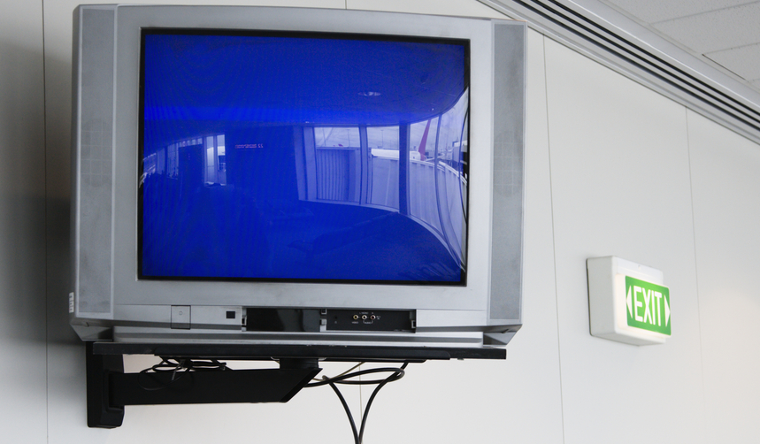
Bingo Board Removal - ePharmacy Rx
Bingo Board Option
Select Bingo Board User Option:
Remove Patient's Name from Monitor
Enter/Wand Rx # or Enter PATIENT NAME: ####567B
*** This ePharmacy Rx requires a patient signature! ***
Press RETURN to continue:
Notes:
As already alluded to, special reminders are provided to ensure signatures are obtained for ePharmacy prescriptions.
For ECME billable prescriptions, an alert will display and a beep will sound when the patient’s name is removed from the Bingo Board via the “Remove Patient’s Name from Monitor” option.
The user must press return to continue after the prompt seen in this screen shot displays.

Slide 67

Medication Profile April 6, 2012@11:10:38 Page: 1 of 1
TEST,PSOPATIENT
PID: 000-00-XXXX Ht(cm): _______ (______)
DOB: JAN 1,1700 (XX) Wt(kg): _______ (______)
ISSUE LAST REF DAY
# RX # DRUG QTY ST DATE FILL REM SUP
-------------------------------------ACTIVE-------------------------------------
1 ####03470$ ALBUMIN 25% 50ML 1 A 02-04 11-04 5 31
2 ####03461 KETAMINE 50MG/ML 10ML INJ 10 A> 01-04 11-04 1 10
3 ####404$e LISINOPRIL 40MG TAB 45 A> 08-22 03-27 1 90
4 ####03185 TERFENADINE 60MG TAB 2 A 04-01 08-01 5 5
-----------------------------------DISCONTINUED---------------------------------
5 ####03530$ BENZTROPINE 2MG TAB 1 A 10-08 01-08 3 90
6 ####03400 MAGNESIUM SULFATE 1G/ML (50%) 2ML 10 A 09-23 09-23 5 31
Enter ?? for more actions
PU Patient Record Update NO New Order
PI Patient Information SO Select Order
Select Action: Next Screen//
How do I know a claim was sent for an Rx via ePharmacy?
3 # # # # 4 0 4 $ e
Lowercase “e” after Rx # indicates this is an ePharmacy prescription
Notes:
That completes the Sig Log and prescription pick-up information.
I would like to show you just a few more screenshots.
This screen shows one way to tell if a prescription is an ePharmacy prescription
The lower case ‘e’ at the end of the Rx number indicates an e-Pharmacy Rx and appears after ePharmacy prescription numbers in Medication Profiles, View Prescription screens, and in other places
This ‘e’ indicates that the last fill of a prescription was e-billable. In other words if the first fill of a prescription was e-billable, but subsequent refills were not e-billable, then the ‘e’ will no longer display after the Rx number on the medication profile. The ‘e’ will show for renewed prescriptions, but only if the previous fill was e-billable.
Also, the ‘e’ flag will appear regardless of whether the claim was returned Payable or Rejected.

Slide 68
ePharmacy Menu
Select <V15 West> ePharmacy Menu Option:
IR Ignored Rejects Report
MP ePharmacy Medication Profile (View Only)
NV NDC Validation
PF ePharmacy Medication Profile Division Preferences
SP ePharmacy Site Parameters
VP Third Party Payer Rejects - View/Process
WL Third Party Payer Rejects - Worklist
TC TRICARE CHAMPVA Bypass/Override Report
VER View ePharmacy Rx
Select ePharmacy Menu Option: WL Third Party Payer Rejects - Worklist
You may select a single or multiple DIVISIONS,
or enter ^ALL to select all DIVISIONS.
DIVISION: ECME TEST VA HSRO 111X ECME TEST VA ← (Enter a Division)
ANOTHER ONE: ← More than one division may be selected
Please wait...
WL Third Party Payer Rejects - Worklist
More than one division may be selected
Notes:
I am almost finished, but I just want to show a couple of ePharmacy menu options in case you are interested
This screen shot shows the ePharmacy menu, located in the Rx (Prescriptions) Menu
The Third Party Payer Rejects Worklist is the most used menu option, and as we covered earlier, is used by the ePharmacy site manager to resolve RTS, DUR and other rejects. It is important the rejects on this worklist are worked on a daily basis. As we previously covered, prescriptions associated with certain rejects cannot be filled until the rejects are resolved.
If you have multiple divisions or outpatient sites, you can choose to have your worklist print for a single division, selected divisions or all divisions. This is especially useful for ePharmacy Site managers who work at integrated sites that share VistA systems.
Please don’t take any action from the menu option unless you have cleared it with the ePharmacy Site Manager.

Slide 69
View ePharmacy Rx Option
Select <V15 West> ePharmacy Menu Option:
IR Ignored Rejects Report
MP ePharmacy Medication Profile (View Only)
NV NDC Validation
PF ePharmacy Medication Profile Division Preferences
SP ePharmacy Site Parameters
VP Third Party Payer Rejects - View/Process
WL Third Party Payer Rejects - Worklist
TC TRICARE CHAMPVA Bypass/Override Report
VER View ePharmacy Rx
Select <Visn15 West> ePharmacy Menu Option: VER View ePharmacy Rx
Select Prescription:
53500495A BUDESONIDE 160/FORMOTER 4.5MCG 120D INH
Patient Rx# Drug Name Rx Status
PATIENT, ONE 53500495A BUDESONIDE 160/FORMOTER 4 ACTIVE
OK to continue? Yes//
VER View ePharmacy Rx
Notes:
As shown in this slide another option that can be very helpful is the View ePharmacy Rx option. It provides additional information about ePharmacy prescriptions. The next slide lists the information the option provides.

Slide 70
View ePharmacy Rx
Output
View Prescriptions ...
ECME Claim Log ...
ECME Billing Events Report ...
ECME Claims-Response Inquiry (CRI) Report ...
View Insurance Policies
TPJI bills ...
TPJI Claim Information ...
TPJI AR Account Profile ...
TPJI AR Comment History ...
TPJI ECME Rx Response ...
View Registration Eligibility Status ...
View Registration Eligibility Verification ...
Notes:
These are the different reports and information sources displayed for ePharmacy prescriptions.
As listed on this slide, the VER provides about anything you would ever need to know about an ePharmacy prescription.

Slide 71

Ask the Presenter
Notes:
I would to share one last piece of information and that is the link to our ePharmacy training site.
To get the link download the handout for this slide.
Please visit the Pharmacy section of our ePharmacy training site for additional education.
If you haven’t submitted your questions yet, there is still time to do so by clicking on the orange “Ask The Presenter” icon. We’re going to show a brief announcement and be right back to answer your questions.
****************************************
Link:
http://vaww.vistau.med.va.gov/VistaU/e-bp/e-pharmacy.htm

