Slide 1
Clinic Orders Reloaded
Dan Papell, Pharmacist CAC
Cleveland VA Medical Center
Notes:
It’s my pleasure to be here today to talk with you about Clinic Orders. Let’s rewind for a moment and go back a decade to 2004.
*****

Slide 2
Inpatient vs. Outpatient
Two patients are lying in reclining treatment chairs in a VA Chemo clinic…
Notes:
Two patients are lying in reclining treatment chairs in a Chemo clinic. One patient an inpatient status patient. The other an outpatient status patient. The inpatient status patient gets the full Bar Code Medication Administration (BCMA) Treatment. The nurse scans the barcode on the patient’s wrist band, then scans the barcode on the IV bag with the scary looking warning stickers on it. BCMA tells the nurse that it is okay to give this patient, this medication, at this dose, by this route at this time, all with a satisfying beep. But all the outpatient status patient gets is trust me. Now nurses are not used car salesmen. They go through the five basic medication administrations rights for both patients. Right patient. Right drug. Right dose. Right route. Right time. But it’s not lost on the outpatient status patient, nor on any observer, that the guy in the gown gets special treatment.
*****

Slide 3
2004 Special Focus Group Initial Request Analysis Recommendation:
BCMA application be expanded to include outpatient status patients
Notes:
It wasn’t lost on the Special Focus Group Initial Request Analysis Folks either, who put out a report in 2004 that medication administration safety in the VA was not consistent across the continuum of care from inpatient status patients (that is patients assigned a bed) to outpatient status patients (that is patients seen in clinic). Their recommendation was that the Bar Code Medication Administration (BCMA) application be expanded to include outpatient status patients.
*****

Slide 4
Inpatient Medications for Outpatients (IMO)
Clinic Orders
Notes:
Long about that time I was a new Clinical Applications Coordinator on my very first Test Site call. We were testing the Computerized Patient Record System (CPRS) software and Pharmacy software. The software developers kept talking about IMO, IMO. I don’t know, what’s IMO? So I asked, What’s IMO? A developer piped back, “Inpatient Medications for Outpatients”. And what’s that? And what’s that is what was rebranded Clinic Orders and will be Reloaded in CPRS Version 30b.
*****

Slide 5
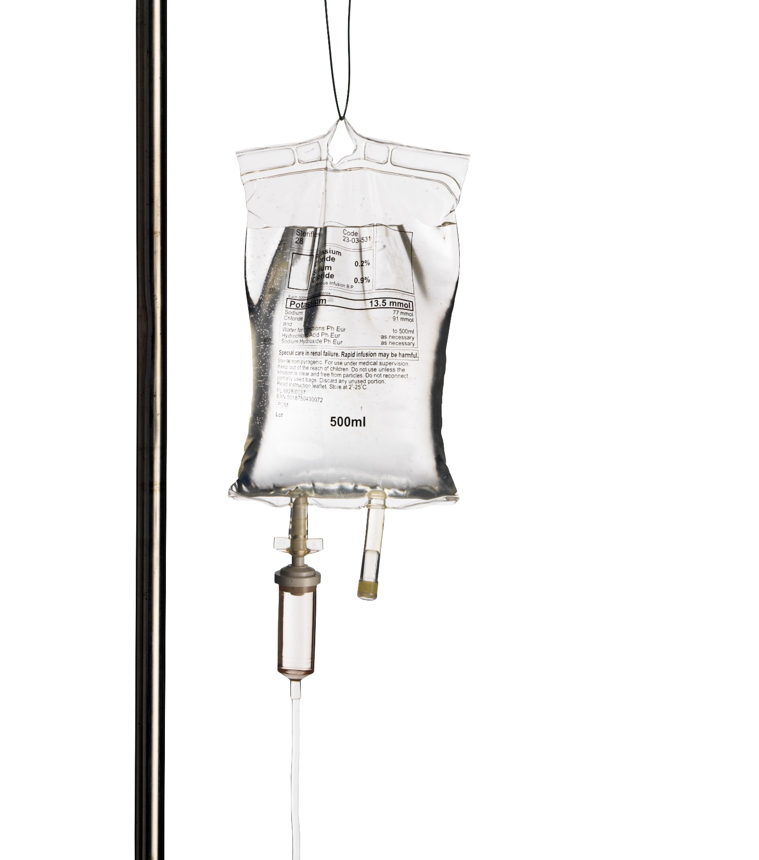
1999 Inpatient unit dose medications can be ordered for outpatient status patients at Portland VA
2005 CPRS Version 25 allows National ordering of inpatient unit dose medications for outpatient status patients
2005 “Administer Inpatient Meds?” parameter added to Hospital Location file
2005 Clinic Definition parameters
2006 CPRS Version 26 groups unit dose, IV and nursing text orders for outpatient status patients in Clinic Medications display group
Notes:
First a brief history. The first time at the VA that inpatient unit dose medications could be ordered for outpatient status patients was with a local modification done to the National software back in 1999 at the Portland VA. By early 2005 in CPRS Version 25 came the first ability in the National software for providers to order inpatient unit dose medications for outpatient status patients. Only inpatient unit dose orders could be ordered for outpatient status patients not inpatient infusions. The outpatient IV functionality which was there from the beginning of CPRS was kept and relied upon for ordering Infusions for outpatient status patients. Also introduced in early 2005 was the Administer Inpatient Meds? Parameter in the Hospital Location file. In mid 2005 came the Clinic Definition parameters. In mid 2006 CPRS Version 26 was released which grouped unit dose, IV and nursing text orders written from Clinic locations on outpatient status patients in the Clinic Medications display group.
*****

Slide 6
BCMA for outpatients delayed due to problems with BCMA for inpatients
Notes:
But along the way in 2005, the BCMA folks backed out of their commitment to BCMA for outpatients. They were having a lot of problems with the BCMA application for inpatients. They wanted to get BCMA for inpatients right before they took on BCMA for outpatients.
*****

Slide 7
CPRS, Pharmacy Inpatient Medications software, and BCMA for Clinic Orders come together on both outpatient and inpatient status patients
2010
Pharmacy Inpatient Medications software changes
2013
BCMA GUI with Clinic Orders Changes
2014
CPRS Version 30b contains Clinic Orders Changes
2015+
Notes:
Inpatient Medications for Outpatient functionality languished until rebranded Clinic Orders in 2010. That year planning and funding came through to bring CPRS, Pharmacy Inpatient Medications software and BCMA for Clinic Orders together to work for Clinic Orders on both outpatient status patients and inpatient status patients. In late 2013 came the Pharmacy Inpatient Medications software changes. In early 2014 came the new BCMA GUI with the Clinic Orders Changes. But the Clinic Orders changes to CPRS won’t come until at least early 2015 in CPRS Version 30b. That’s the history of Clinic Orders in a nutshell.
*****

Slide 8
Before Clinic Orders
Clinic Orders current functionality
CPRS Version 30b Clinic Orders
Notes:
Dates are not important for this class. What’s important is that Clinic Order functionality came to us in piecemeal. For the purposes of understanding Clinic Orders in more detail, I will refer to three time periods. Before Clinic Orders, Clinic Orders current functionality. Clinic Orders changes after CPRS Version 30b.
|
Lets start with before Clinic Orders, how did a provider write an order for a medication to be administered in clinic?
*****

Slide 9
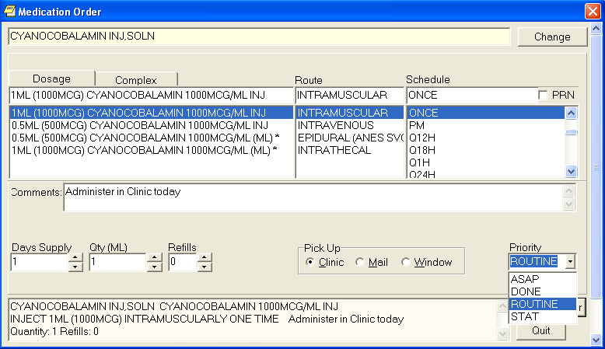
Notes:
They used outpatient medication orders with a pick up route of window, mail or clinic. The provider would enter an outpatient medication order in CPRS for example Cyanocobalamin injection commonly know as Vitamin B12 injection. The Vitamin B12 injection outpatient medication order goes to the pharmacist in the Outpatient Medications software package. The pharmacist finishes and verifies the Vitamin B12 injection outpatient medication order. If the pick up route is window, the patient will pick up the Vitamin B12 injection at the Outpatient pharmacy. If the pick up route is mail, the Vitamin B12 injection gets mailed to the patients home. Either way the patient brings the Vitamin B12 injection with them to their next clinic appointment. The nurse then administers the Vitamin B12 injection brought in by the patient to said patient in clinic. The authority for administering the Vitamin B12 injection is based on the Vitamin B12 injection outpatient medication order.
*****

Slide 10
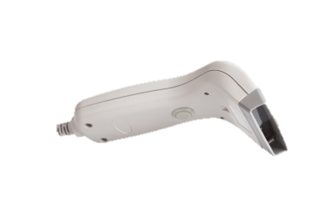
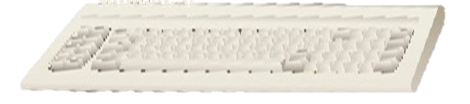
The authority for administering the Vitamin B12 injection is based on the outpatient medication order with a pick up route of
CLINIC.
Notes:
If the Vitamin B12 injection is available as clinic stock in Automated Dispensing Cabinets such as Pyxis or Omnicell, then the provider enters a Vitamin B12 injection outpatient medication order with a pick up route of clinic. The pharmacist finishes and verifies the Vitamin B12 injection outpatient medication order with a pick up route of clinic but does not print a label. The nurse withdraws the Vitamin B12 injection from the clinic stock. Then administers the Vitamin B12 injection to the patient. The authority for administering the Vitamin B12 injection is based on the outpatient medication order with a pick up route of Clinic.
*****

Slide 11
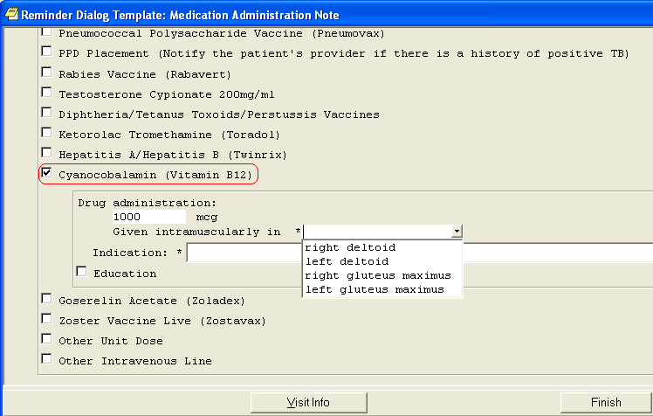
Notes:
The nurse documents administration of the Vitamin B12 injection to an outpatient status patient in a progress note. Here is an example of a quick documentation template for a Vitamin B12 injection administration. The nurse enters the dosage given, in this case 1000 MCG. Then chooses the location administered in, from the drop down list.
*****

Slide 12
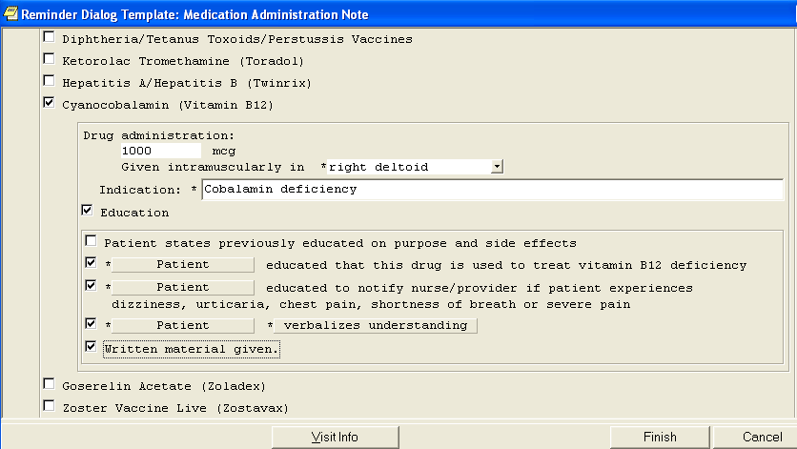
Notes:
In this case, given intramuscularly in the right deltoid as opposed to the wrong deltoid. Adds the indication, cobalamin deficiency. And completes the education fields. The nurse left-clicks on Finish which drops the completed template into the progress note.
*****

Slide 13
Before Clinic Orders …
… CPRS progress note text available only for a manual chart review
Notes:
The nurse signs the progress note documenting administration of the Vitamin B12 injection in clinic. Though text in a CPRS progress note is not computable, that is retrievable in a report, it’s at least there for a manual chart review. A nurse could also document on a paper Medication Administration Record (MAR) or for vaccines and some injections they could document on the encounter form. That’s it for our look at before Clinic Orders.
*****

Slide 14
Poll Question
What is your level of familiarity with Clinic Orders?
Never heard of Clinic Orders prior to this Class
Heard of them but can’t tell a Clinic Order from an Inpatient Medication Order
Amateur Clinic Orders Enthusiast
Clinic Orders Pro – tell me something I didn’t know
Notes:
Now I’d like to ask a poll question.
How many times did Dan say, Vitamin B12 injection? Or better yet, “What is your level of familiarity with Clinic Orders?
Never Heard of Clinic Orders, prior to this Class.
Heard of them, but can’t tell a Clinic Order from an Inpatient Medication Order.
Amateur Clinic Orders Enthusiast.
D. Clinic Orders Pro - tell me something I didn’t know.
To answer this question, use the blue polling icon above my head, not to be confused with the blue button in MyHealtheVet. We’ll move on and come back to your results in just a few moments, while I count up the Vitamin B12 injection references thus far. Eighteen.
*****

Slide 15
Defining
Clinic Orders
“Inpatient-like”
Replace Outpatient Orders
Notes:
For a working definition of Clinic Orders, let’s try this. Clinic Orders are “Inpatient-like” unit dose orders that replace Outpatient Medication orders with a pick up route of window, mail or clinic. And “Inpatient-like” infusion orders that replace Outpatient IV Orders. Clinic Orders better represent medication orders to be administered in BCMA workflow clinics. Clinic Orders have a start and stop time and can be active for up to a year.
|
But you just mentioned BCMA workflow. What’s that?
*****

Slide 16
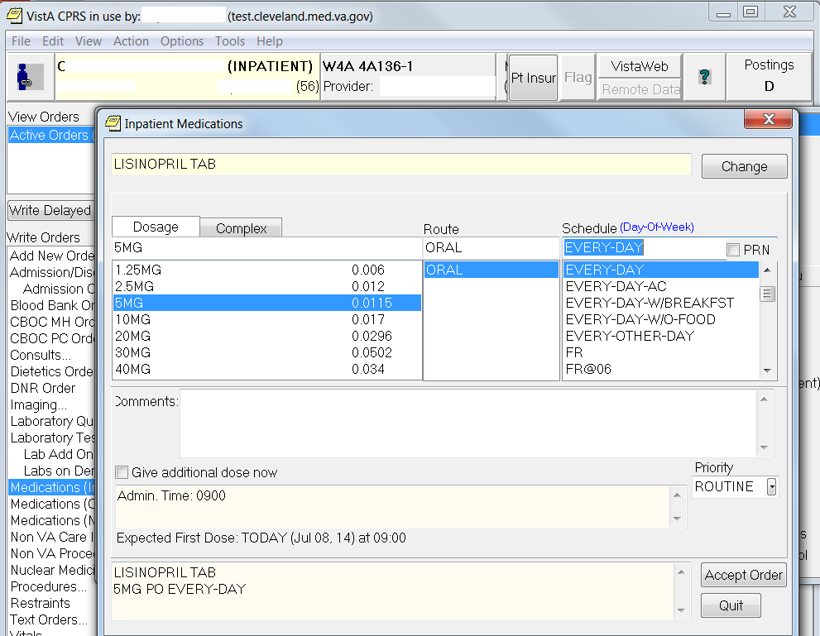
Notes:
To illustrate the BCMA workflow, take for example an inpatient status patient on a medicine ward. The provider wants the patient to get Lisinopril 5mg every day to control blood pressure. With the chart open to the ward, the provider uses the inpatient medication order dialog to enter a Lisinopril 5mg inpatient medication order to be given on the ward. The provider accepts and signs the Lisinopril 5mg inpatient medication order.
*****

Slide 17
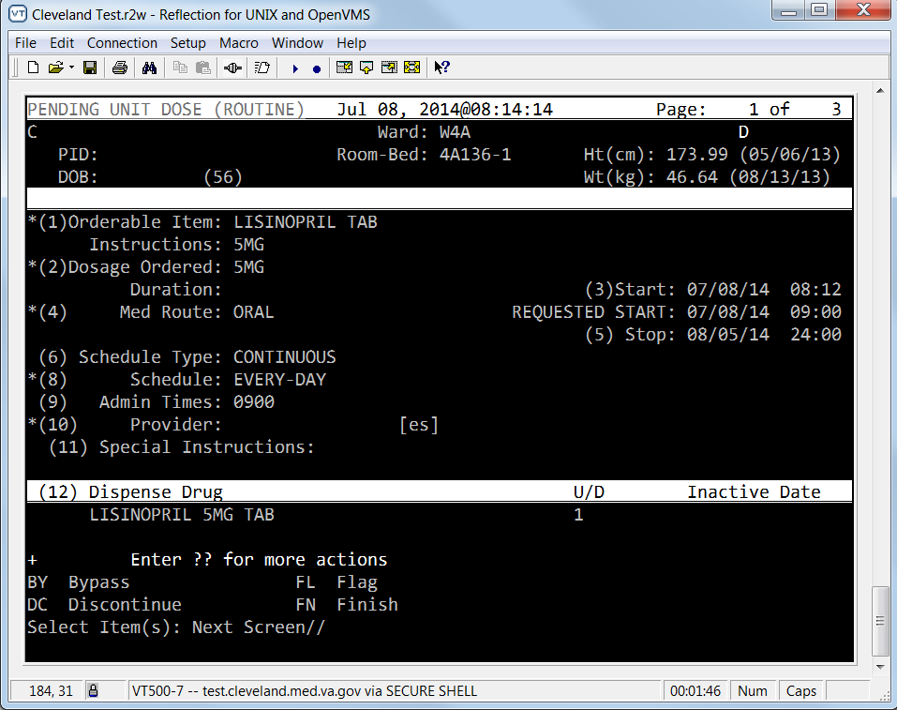
Pharmacist finishes
and verifies
the order
Notes:
Then the pharmacist, in the Inpatient Medications package, finishes and verifies the Lisinopril 5mg inpatient medication order.
*****

Slide 18
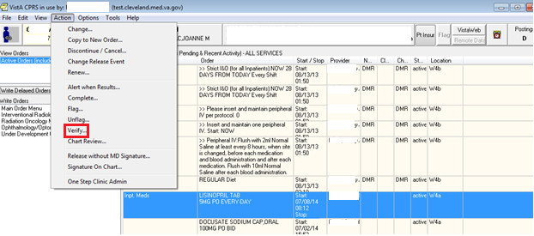
Verify…
Notes:
The Nurse in CPRS, on the CPRS Orders tab verifies the newly active Lisinopril inpatient medication order -
*****

Slide 19
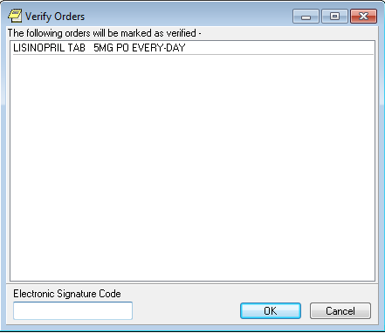
Nurse verifies newly active order
Notes:
using the Verify Orders screen.
*****

Slide 20
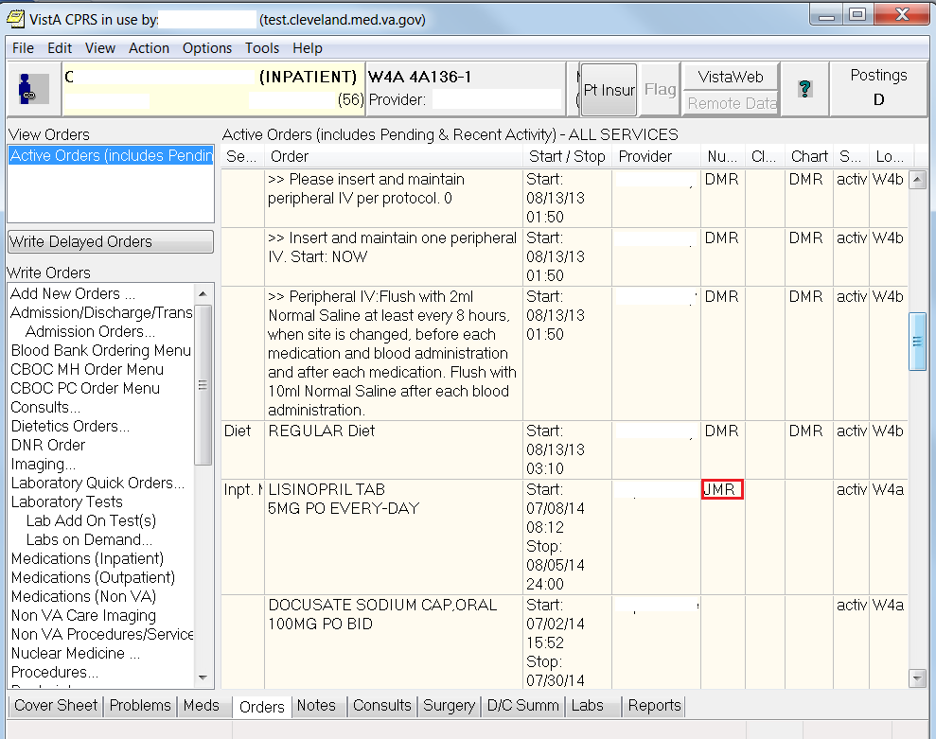
Notes:
The initials of the nurse appear in the Nurse column on the CPRS Orders tab.
*****

Slide 21
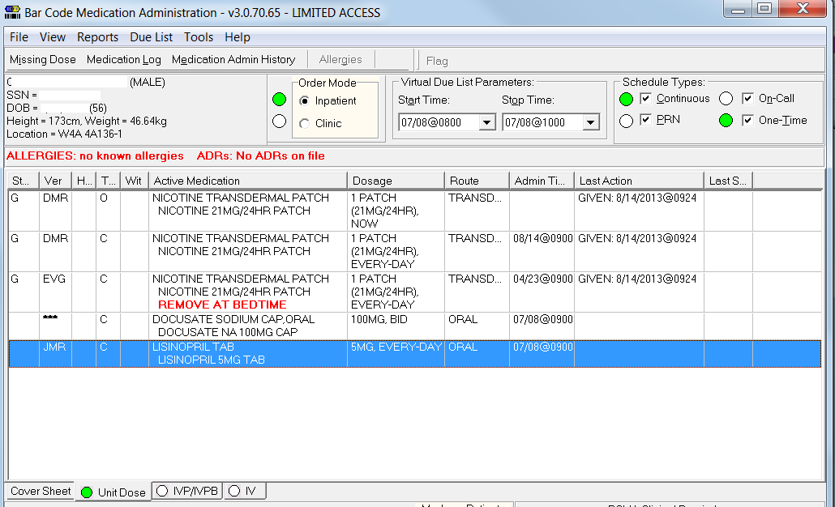
Clinic Orders only work for outpatient status patients in clinics that follow the BCMA workflow
Notes:
Then at the appropriate time a Nurse administers the Lisinopril 5mg Tablet using BCMA. Of note, the provider will not be present when the Lisinopril 5mg Tablet is administered. The provider will be seeing other patients. This is the BCMA workflow on a ward or unit for an inpatient status patient. Clinic Orders only work for outpatient status patients in clinics that follow the BCMA workflow. Examples of clinics that follow the BCMA workflow include Emergency Department, Hemodialysis Unit, Injection Clinic, Same Day Unit, Chemo Clinic.
*****

Slide 22
Poll Results
What is your level of familiarity with Clinic Orders?
Never heard of Clinic Orders prior to this Class
Heard of them but can’t tell a Clinic Order from an Inpatient Medication Order
Amateur Clinic Orders Enthusiast
Clinic Orders Pro – tell me something I didn’t know
Notes:
Now let’s pause for a moment and take a look at your poll results.
The question: What is your level of familiarity with Clinic Orders?
|
Let’s move on.
*****

Slide 23
Poll Results
What is your level of familiarity with Clinic Orders?
Never heard of Clinic Orders prior to this Class
Heard of them but can’t tell a Clinic Order from an Inpatient Medication Order
Amateur Clinic Orders Enthusiast
Clinic Orders Pro – tell me something I didn’t know

Slide 24
Clinic
Order
vs
Inpatient Medication Order
Notes:
As promised, the question: How can you tell the difference between an inpatient medication order and a Clinic Order? The answer: Location, Location, location.
*****

Slide 25
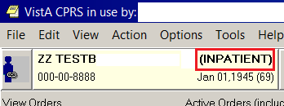
VEHU PATIENT ONE
VEHU PATIENT ONE
Notes:
Location is so important when writing Clinic Orders that prior to CPRS Version 30b, the provider is not even in the game unless they start with an outpatient status patient. Just looking at a patient, the provider has almost no clue whether the patient in their clinic has an outpatient status or an inpatient status. Dom patients and Community Living Center (CLC) Residents wear street clothes but are inpatient status patients because they have been assigned a bed. Fortunately a version or so ago of CPRS brought the patient status of inpatient or outpatient to the CPRS patient demographics box. Providers have no excuse for not knowing the inpatient status or outpatient status of their patient.
*****

Slide 26
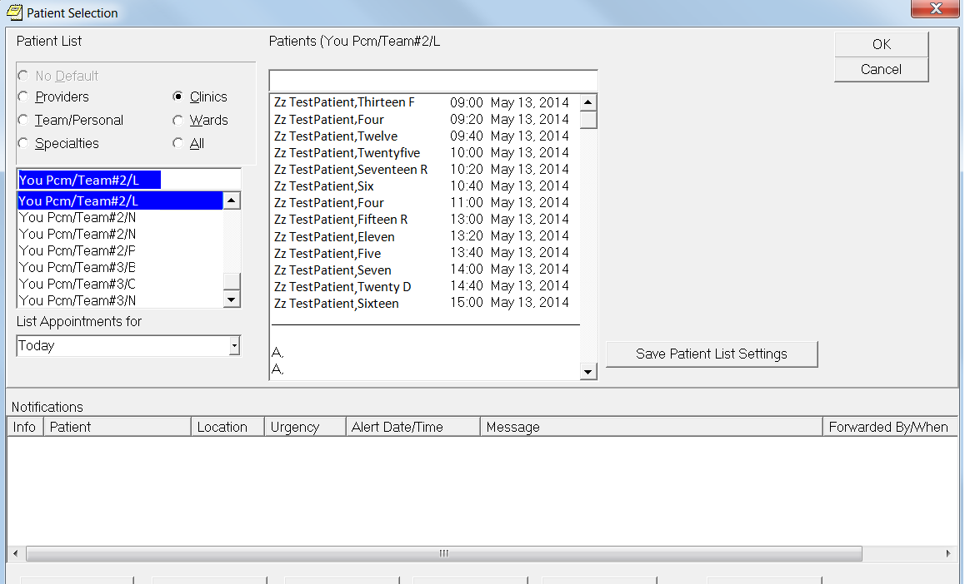
Limit the patient list to patients with appointments in the provider clinic TODAY
Notes:
Lets start our trip through the current Clinic Orders ordering process (pre CPRS Version 30b) from the providers point of view. First the easy way, then the hard way. If the patient is physically in the provider’s clinic, limiting the patient list to patients with appointments in the provider’s clinic today makes it easier for the provider to choose the correct patient’s electronic health record.
|
Also choosing the patient’s electronic health record from the list of patients with appointments in the provider’s clinic today automatically lines up the clinical electronic paper with the business electronic paper. So when the provider is going to document on or put orders in their patient’s electronic health record, the provider must have the chart open to a visit for current activities or a visit, for short. The visit links the clinical electronic paper (progress note or order) with the business electronic paper (encounter form for billing and workload credit).
*****

Slide 27
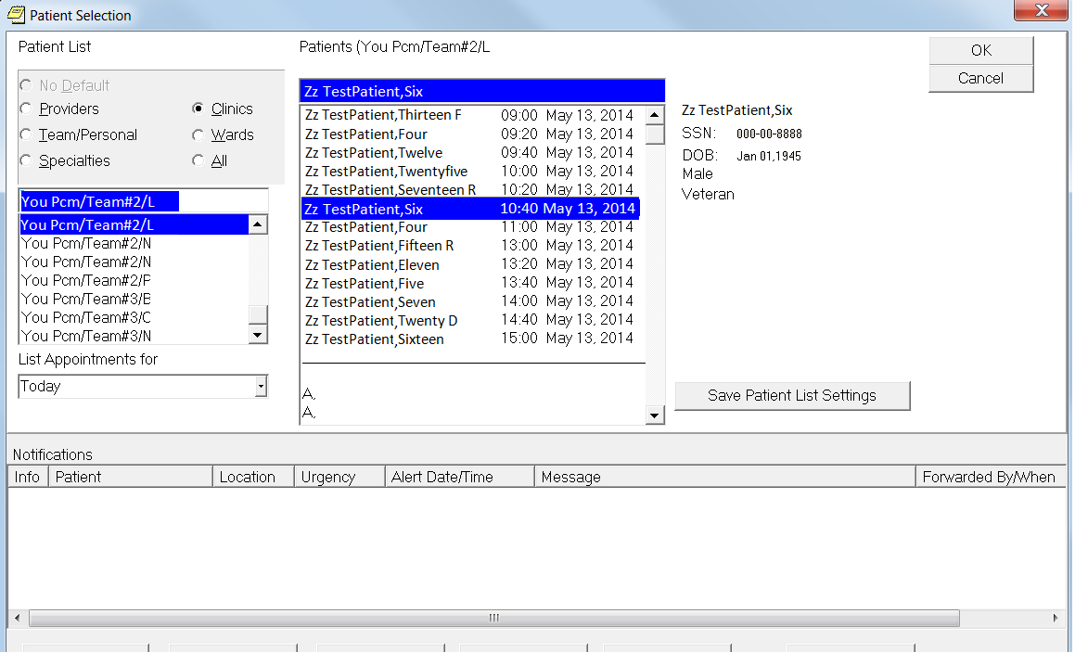
Left-click on their patient’s to pull up full name, full Social Security number and birth date
Notes:
When the provider Left-clicks on their patient’s name in the appointment book from today. The patient’s full name, full Social Security number and birth date will appear to the right.
|
Of course if the provider wants to do it the hard way…
*****

Slide 28
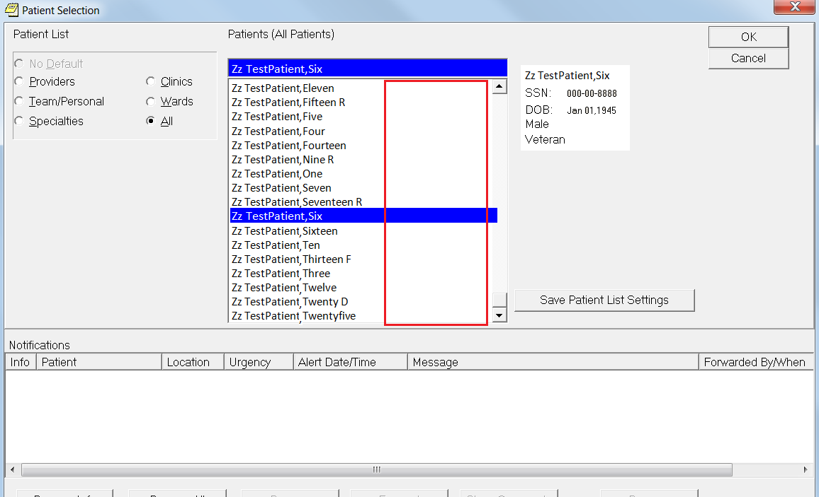
“All Patients” list does not link visit to current appointment
Notes:
They can select their patient’s electronic health record from the All Patients list sort, where the visit is not linked to the current appointment. See there are no clinic visit date times next to the patient names. When the provider left-clicks on their patient’s name –
*****

Slide 29
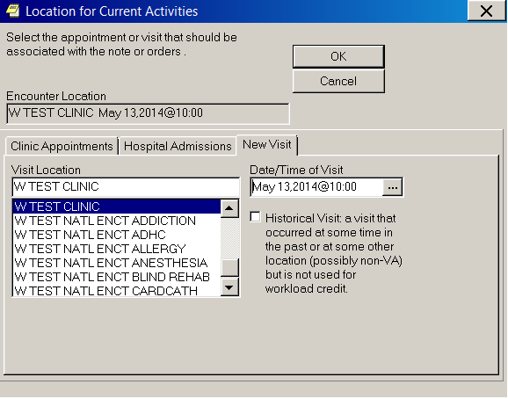
This time when you left-click on patient name …
…Location for Current Activities
dialog
comes up
Notes:
the location for Current Activities dialog comes up. Here the provider will have to manually link the appointment to the current visit, so the clinical electronic paper (progress note or order) and the business electronic paper (encounter for billing and workload credit) will be linked.
|
Now, Clinic Order creation is touchy. Specific criteria has to be met to result in a Clinic Order.
*****

Slide 30
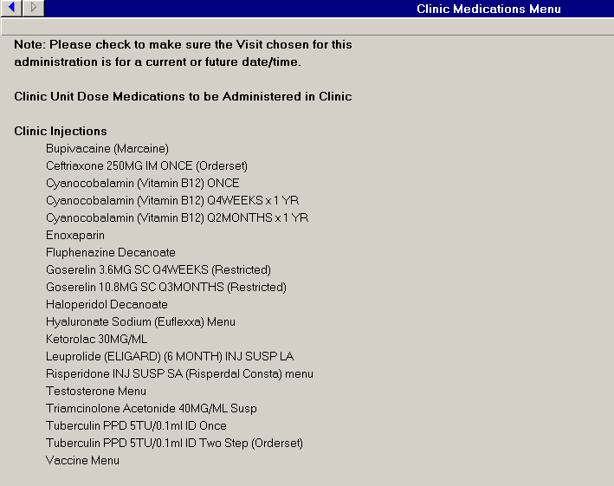
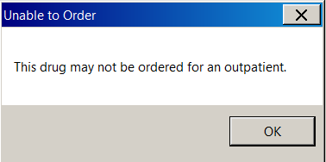
Notes:
This criteria for Clinic Order creation may seem strange until you realize that Clinic Orders were designed to work with BCMA for Outpatients. From the standard Inpatient Medications order dialog and inpatient infusions order dialog and related quick orders, Clinic Orders can only be written on outpatient status patients for a current or future clinic appointment. If for a current appointment the patient cannot be checked out or 24 hours pass since check in. The criteria is in place because a nurse cannot administer medications to a patient who has left the building. If the provider tries to write a Clinic Order that does not met these criteria using the standard Inpatient Medications order dialog…
[CLICK FOR ANIMATION]
…the provider will get the dreaded. This drug may not be ordered for an outpatient, error. Unless the medication is marked for the IV pharmacy package, then the provider will get a standard Outpatient IV order, not a Clinic Order. CPRS and the Inpatient Pharmacy IV package since the beginning of CPRS have allowed IV orders to be entered for outpatient status patients and dispensed from the pharmacy. Medications marked for the IV Pharmacy package will fail over to Outpatient IV orders when the criteria for Clinic Order creation is not met. This will drive your pharmacists and providers mad. An Outpatient IV order cannot be converted to a Clinic Order by Pharmacy. The provider must re-enter. The chances that provider will meet the criteria for Clinic Order creation the second time around is less than ideal.
*****

Slide 31
Illustration of a star chart with planetary rotation
If the provider is able to enter a Clinic Order on an outpatient status patient…
Notes:
Let’s say everything lines up and the provider is able to enter a Clinic order on an outpatient status patient…
*****

Slide 32
Rewritten as Clinic Order
Notes:
The Pre Clinic Orders Vitamin B12 injection outpatient medication order with a pick up route of clinic can now be rewritten as a Clinic Order. The provider can choose a schedule of Q4WEEKS and using the complex tab on the Clinic Orders Medication dialog, choose a duration of 12 months.
|
After the provider signs the Vitamin B12 injection Clinic Order in CPRS…
*****

Slide 33
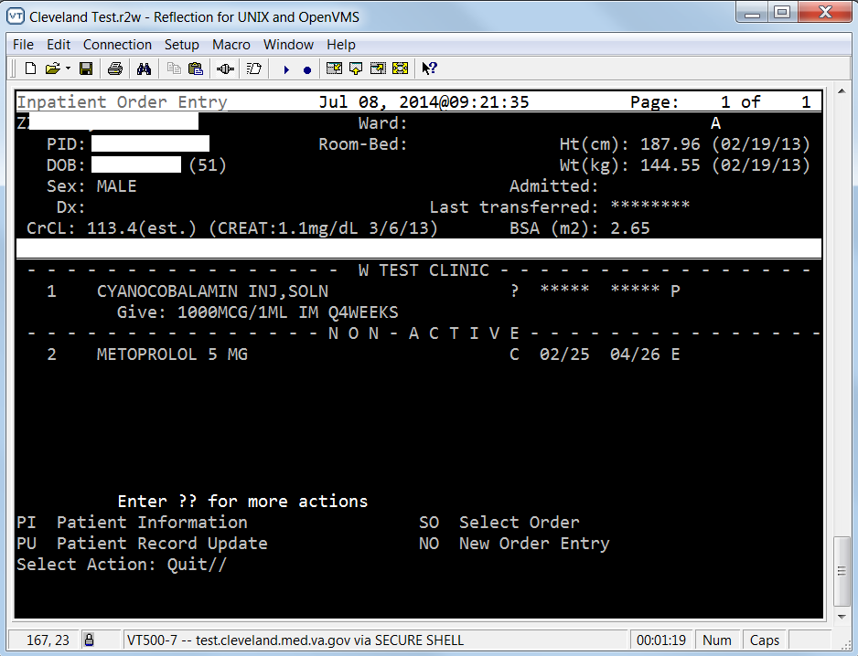
Clinic Order appears in Inpatient Medications
Notes:
the pending Clinic Order appears in the Inpatient Medications software package. Note the pending Clinic Orders are grouped by clinic. In this case W Test Clinic.
*****

Slide 34
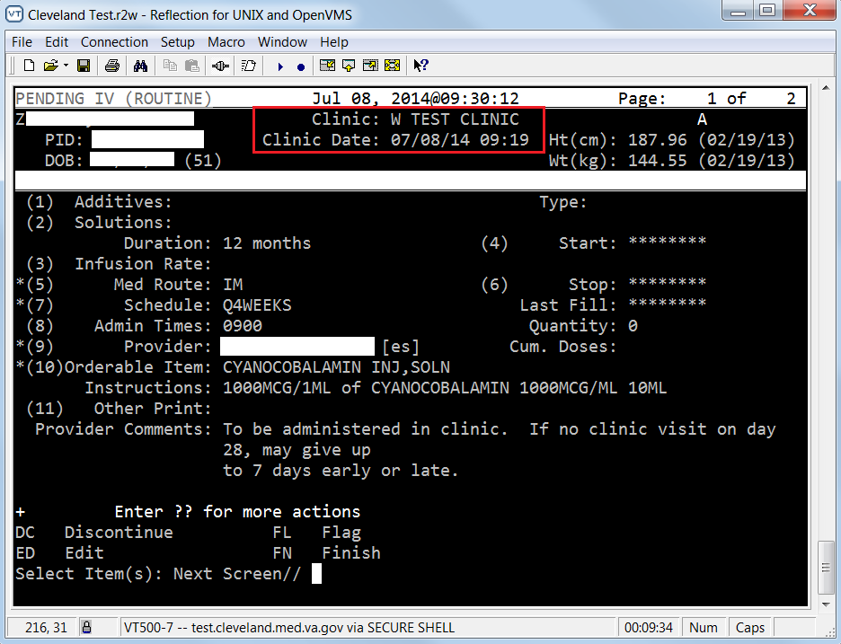
Clinic Order or Inpatient Medication Order?
Location!
Location!
Location!
Notes:
In the inpatient medications software package what distinguishes a Clinic Order from an inpatient medications order is location. The Clinic order will have a clinic location instead of a ward. And a Clinic Appointment date/time. The pharmacist finishes and verifies the Clinic Order.
*****

Slide 35
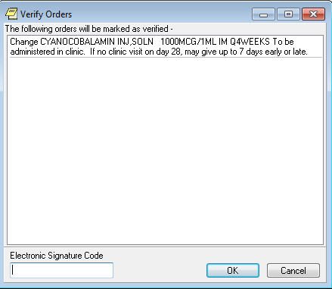
Nurse verifies newly active
Clinic Order
Notes:
The nurse in CPRS will verify the newly active Clinic Order in the Nurse column.
*****

Slide 36
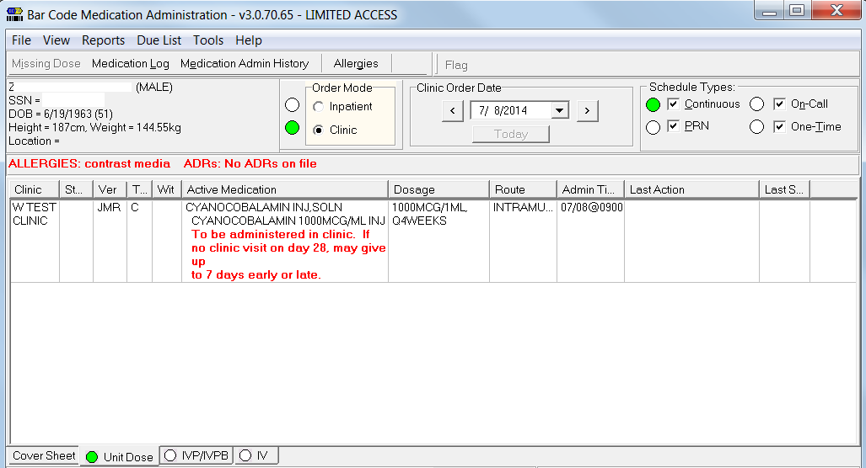
Notes:
When the time comes to administer the medication in clinic, if the clinic is using BCMA, the nurse will look on the BCMA Clinic Order mode view for the Clinic Order. Scan the barcode on the patient’s wrist band or the barcode on the patient’s Veterans Health Identification (VHIC) card and the bar code on the medication. BCMA will let the nurse know it’s okay to give this patient, this medication, at this dose, by this route, at this time.
*****

Slide 37
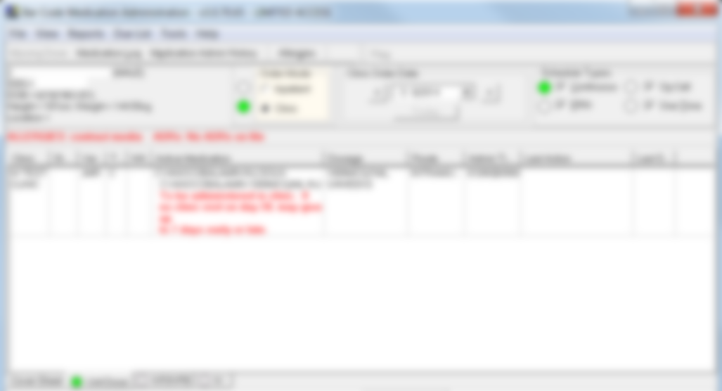
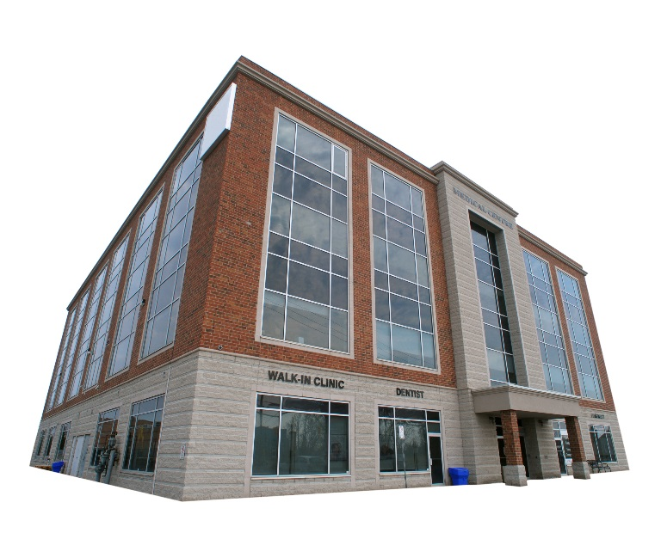
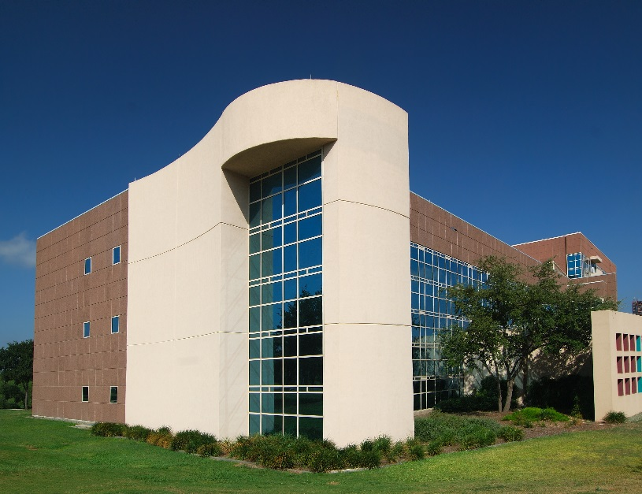
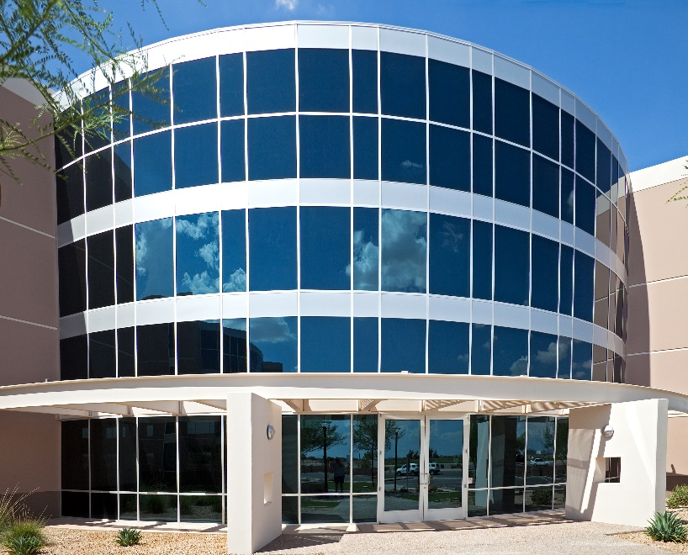
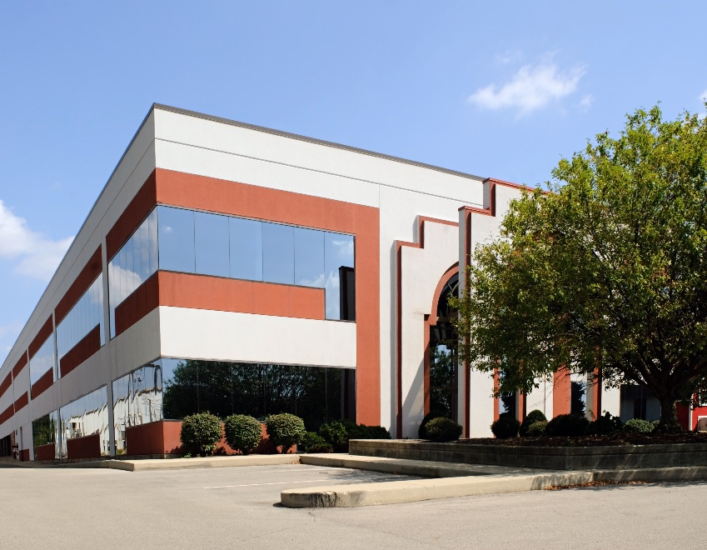
Notes:
Did you know that Clinic Orders act differently based on the clinic location they are written from?
*****

Slide 38
Notes:
The parameters for each clinic location are controlled from the dark side, the backdoor VistA roll and scroll. There are two important VistA options for setting up clinics for Clinic Orders – the Inpatient Medications to Clinic option, and the Inpatient Pharmacy Supervisor’s Parameters Edit menu Clinic Definition option. Let’s take a look at each of these in turn...
|
The first one is the Inpatient Medications to Clinic option, SD IMO EDIT. Pharmacy ADPACs and Informaticists; you must beg, borrow or steal this option. SD is a PCAS namespace but, you need this option.
*****

Slide 39
Notes:
Without it, you will not be able to set up a clinic to Administer Inpatient Meds.
|
A simple yes at the prompt is all you need. Now I had over Five-thousand Clinics to set up in Cleveland, so I had to use a Macro to save my fingers.
*****

Slide 40
Notes:
The other VistA option required to set up a clinic for Clinic Orders is the Clinic Definition option under the Inpatient Pharmacy Supervisor’s Parameters Edit menu. Pharmacy ADPACs and Informaticists should already have the Pharmacy Supervisor’s Menu, Parameters Edit Menu and Clinic Definition option. I will go through each Clinic Definition parameter and their ramifications one by one. Again I had to set these for over five thousand clinics in Cleveland using a Macro.
*****

Slide 41
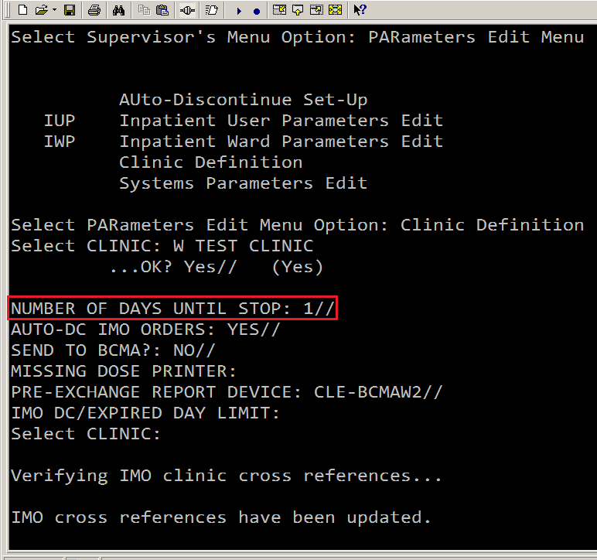
Inpatient Medications software package looks at duration of order from CPRS before “Number of Days Until Stop” parameter to determine what the stop date of the Clinic Order will be
Notes:
Number of Days Until Stop may be the first Clinic Definition parameter but is the absolute last parameter that the Inpatient Medications software package looks at to determine what the stop date of the Clinic Order will be. The first thing that the Inpatient Medications software package looks at is the duration of the order from CPRS if a provider uses the complex tab on the Clinic Orders Medication dialog.
*****

Slide 42
1
Provider-entered duration of order from CPRS
2
Pharmacy orderable item dose limit
Determining Stop Date
3
Clinic Definition Number of Days Until Stop
4
If null, defaults to stop date of 14 days
Notes:
Provider specified duration trumps everything. If the provider specifies a duration of 12 months, then the Inpatient Medications software package determines the stop date of the Clinic order to be 12 months from now. If the provider does not specify a duration, then the pharmacy orderable item dose limit will be used to determine the stop date. If there is no duration specified by the provider and no dose limit on the pharmacy orderable item, then the Clinic Definition Number of Days Until stop will determine the stop date. If the Clinic Definition Number of Days Until Stop is null then the Inpatient Medications software package defaults the stop date to 14 days.
*****

Slide 43
Notes:
The Number of Days until Stop parameter for each clinic can be set from 1 to 365 days. I set all the clinics in Cleveland to 1 day because if the provider is not using a quick order for a commonly ordered Clinic Order, they probably only want the Clinic Order for one day. The quick orders for common Clinic Orders contain a duration, even the one time vaccines have a duration of 30 days, so the Clinic Order will stick around long enough for the nurse to give.
*****

Slide 44
Notes:
The next parameter in the Clinic Definition file is Auto-DC IMO Orders. Yes or No.
*****

Slide 45
Notes:
Yes allows Clinic Orders from that clinic to be subject to the standard patient movement rules effectively auto-discontinuing all Clinic Orders upon admission. No will permit survival of Clinic Orders through the patient movements of admission, transfer and discharge. From the very beginning in to 2006, I have had the Auto-DC IMO orders parameter for all clinics set to yes. Until Early 2014, BCMA only had one view, the inpatient view. If a Clinic Order survived admission and was sent to BCMA. It was possible for a nurse to give the Clinic Order on the ward before a provider had a chance to do a medication reconciliation and write inpatient orders. Clinic Orders are ok to give at a clinic appointment, but if a patient is admitted, their health status has changed. Maybe the Clinic Order is no longer appropriate to give. So it was a patient safety hazard to allow Clinic Orders to survive admission and to be sent to BCMA.
*****

Slide 46
Notes:
After early 2014 with the new BCMA GUI, the view was split into two: Inpatient Order Mode and Clinic Order Mode.
*****

Slide 47
Inpatient Order Mode View
Notes:
Inpatient medication orders and inpatient infusion orders show up on the Inpatient Order Mode View and –
*****

Slide 48
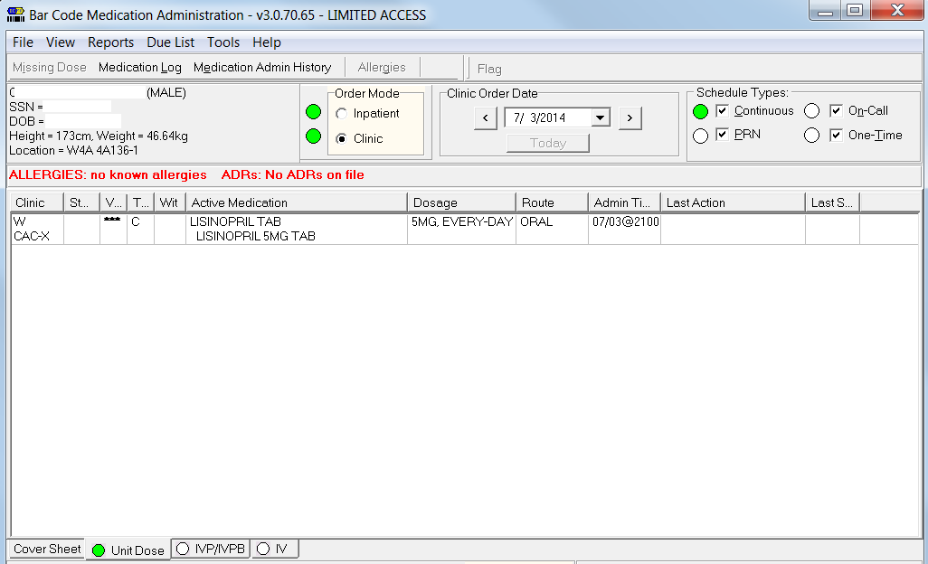
Clinic Order Mode View
Notes:
Clinic Orders show up on the Clinic Order Mode view. Since the nurses on the wards and units only use the Inpatient Order Mode, there is little chance that a Clinic Order which survives admission and is sent to BCMA could be given on the ward or unit. With the new BCMA GUI with the two order mode views, we no longer have to auto discontinue Clinic Orders to be safe.
*****

Slide 49
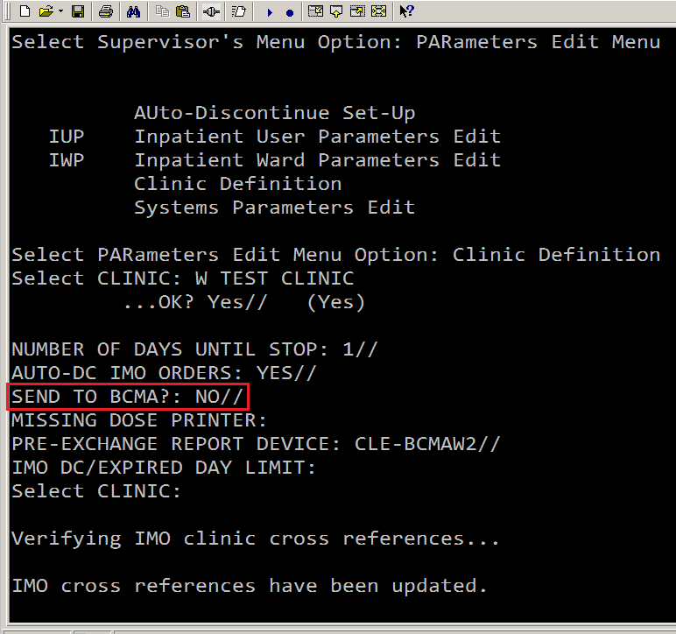
Until CPRS Version 30b is released, all intended Clinic Orders entered on inpatient status patients will appear as inpatient medication orders in the BCMA inpatient order mode view
Notes:
Before getting too enthusiastic about implementing BCMA in Clinics before CPRS Version 30b, listen to this. The Bar Code Resource Office in early 2014 set about testing BCMA for Clinic Orders in a controlled implementation of one clinic each at six test sites. Only four of the six test sites implemented BCMA for Clinic Orders in one clinic during the allotted time frame. The test sites found problems most of which can be summed up in one sentence: Until CPRS Version 30b is released, all intended Clinic Orders entered on inpatient status patients will appear as inpatient medication orders in the BCMA inpatient order mode view.
*****

Slide 50
Notes:
And yes this is a showstopper. In Cleveland we are waiting until CPRS Version 30b comes to our Live account before implementing BCMA in any clinic with a chance of an inpatient status patient being seen there. To understand this better, lets do an armchair thought experiment. First one that plays to the sweet spot of the current functionality of Clinic Orders and BCMA for Clinic Orders, then one that plays on the wrong side of the Bridge Out sign over the abyss.
*****

Slide 51
When it goes right …
Patient comes to the Emergency Department from home
Provider places and signs Clinic Orders
Pharmacist verifies orders in Inpatient Medications software package
Nurse verifies newly activated orders
Orders would appear on BMCA Clinic Order Mode view
Notes:
First the sweet spot. A VA patient comes in from home to the Emergency Department, so the patient is an outpatient status patient. The Emergency Department provider examines the patient then wants the patient to get the average three to five meds per Emergency Department visit. The Emergency Department provider opens the chart to the Emergency Department location, the current visit. Then uses the inpatient medication order dialog, inpatient infusion order dialog and related quick orders that the provider has always used since 2006 to place the Clinic Orders. Clinic Orders result. The provider signs the Clinic Orders. The pharmacist finishes and verifies the Clinic Orders in the Inpatient Medications software package. The nurse in CPRS verifies the newly activated Clinic Orders. If the Emergency Department was up on BCMA for Clinic Orders, the Emergency Department nurse would see the Clinic Orders on the BCMA Clinic Order Mode view and document administration in BCMA. Otherwise the nurse documents administration in a progress note. The VA patient, mended, goes back home.
*****

Slide 52
When it goes wrong…
Patient comes to the Emergency Department from Community Living Center where they are “inpatient” status
Provider places and signs Clinic Orders
Pre-CPRS Version 30b, inpatient medication orders result
Provider places and signs inpatient medication orders
Pharmacist verifies inpatient medication order in Inpatient Medications software package
Nurse verifies newly activated orders
Inpatient medications appear on BCMA Inpatient Order Mode View
Incorrect medication administration could result
Notes:
But wait, unfortunately there’s more. Let’s take a patient who is a guest in the Community Living Center (CLC). Though they wear street clothes, they have been assigned a bed so they are an inpatient status patient. The CLC patient goes bad in the middle of the night and is brought down to the Emergency Department. The Emergency Department provider examines the patient then wants the patient to get the average three to five meds per Emergency Department visit. The Emergency Department provider opens the chart to the Emergency Department location, the current visit. Then uses the inpatient medication order dialog, inpatient infusion order dialog and related quick orders that the provider has always used since 2006 to place the Clinic Orders. Unfortunately, pre CPRS Version 30b, inpatient medication orders result. The provider signs the inpatient medication orders. The pharmacist finishes and verifies the inpatient medication orders in the Inpatient Medications software package. The nurse in CPRS verifies the newly activated inpatient medication orders. If the Emergency Department was up on BCMA for Clinic Orders, the Emergency Department nurse would not see the Clinic Orders on the BCMA Clinic Order Mode view. These inpatient medications would appear on the BCMA Inpatient Order Mode View. I suppose best case scenario is that the Emergency Department nurse would document administration of the meds under the BCMA Inpatient Order Mode View. But if the Emergency Department nurse didn’t give all the ordered medications or the Emergency Department is not up on BCMA for Clinic Orders, when the patient returns to the CLC that morning, the CLC nurse gives the usual 15 medications and may give some of the medications ordered in the Emergency Department again, especially if available as ward stock in the Automated Dispensing Cabinets. Even with profiling on, the CLC patient does have active inpatient medication orders for the meds given in the Emergency Department after all. There is nothing to stop the CLC nurse from giving these meds again.
*****

Slide 53
After months of deliberation, multi-disciplinary committee recommended paper clinic medication orders on all inpatient status patients
Notes:
In Cleveland we actually had a multi-disciplinary committee meet for months trying to figure out how to use electronic clinic medication orders safely on inpatient status patients in the Emergency Department. Their final recommendation was to use paper clinic medication orders on all inpatient status patients. In Cleveland the Emergency Department does not use BCMA for Clinic Orders for any patients, so the nurse documents the medication administration in a progress note. This committee is going to have a party once CPRS Version 30b comes to our live account.
*****

Slide 54
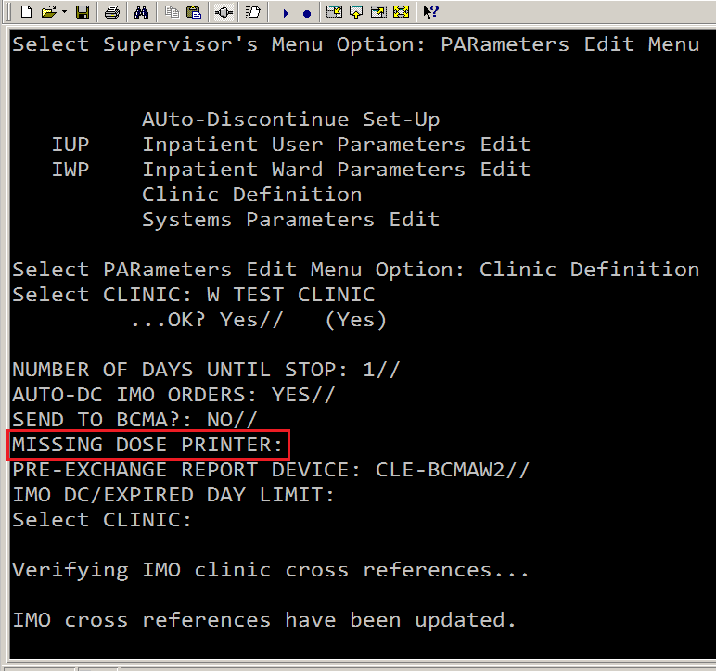
Notes:
The fourth parameter in the Clinic Definition file is Missing Dose Printer. In the BCMA Clinic Order Mode view, if the nurse does not have the medication as clinic stock in the Automated Dispensing Cabinets nor has the medication been timely delivered to the Clinic, the nurse can click the Missing Dose button. And send a missing dose request to the pharmacy.
*****

Slide 55
Notes:
Which missing dose printer to choose for each clinic depends on who is taking care of the clinic. Ideally there should be a Clinic Pharmacy that timely finishes and verifies Clinic Orders. They would know what is stocked in the Automated Dispensing Cabinets, even what is stocked in a Community Based Outpatient Clinic (CBOC) halfway across the State. When a provider orders a medication that is not commonly stocked, they would know to send the medication to the clinic. When a nurse calls that a patient’s clinic appointment was changed, they could go into the pharmacy option that changes all the start dates for Clinic Orders for that patient. Or if an entire Clinic was rescheduled, they could use the pharmacy option to change the start dates on all the clinic Orders for that clinic. But pharmacy management looks at me like I just fell off the turnip truck. We have an outpatient pharmacy. We have an inpatient pharmacy. We have no clinic pharmacy. So the outpatient pharmacy and inpatient pharmacy have to split up the Clinic Orders workload.
*****

Slide 56
Inpatient pharmacy takes care of clinics with emergent or acute Clinic Orders, Clinics with 24 hour coverage and complicated Clinic Infusion Orders
Outpatient pharmacy takes care of
clinics with maintenance medications
and injections that follow regular business hours
Notes:
A good split would be to have the inpatient pharmacy take care of clinics with emergent or acute Clinic Orders, Clinics with 24 hours coverage and complicated Clinic Infusion Orders. Like the Emergency Department, Same Day Surgery, Chemo Clinic. The outpatient pharmacy would take care of clinics with maintenance medications and injections that follow regular business hours. Like Psych Injection Clinics, Regular Injection Clinics, Traveler’s Clinics. Since Clinic Orders are processed using the inpatient medications software package, the inpatient pharmacists have an easy time learning how to finish and verify them. The outpatient pharmacists, not used to using the Inpatient Medications software package, have a steeper learning curve, but they learn. If the Missing Dose Printer Parameter in the Clinic Definition file is not populated for a clinic then it defaults to the Missing Dose Printer Parameter for the Division in the BCMA Parameters GUI.
*****

Slide 57
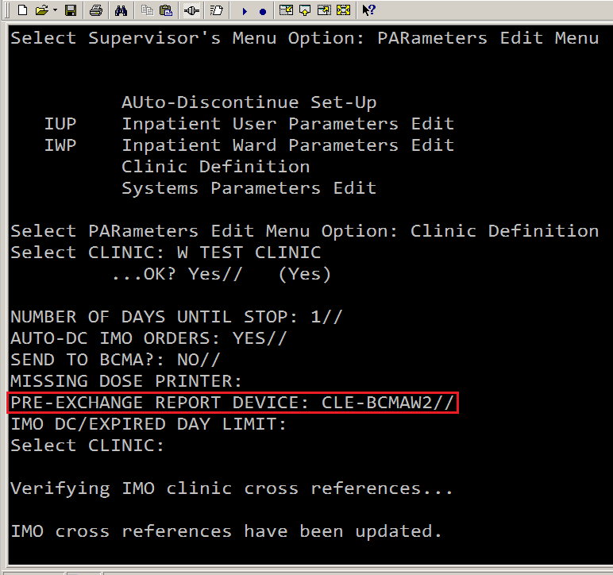
Notes:
The fifth parameter in the Clinic Definition file is the Pre-Exchange Report Device. When the pharmacist is finishing and verifying a Clinic Order, this default printer is presented to them as the Pre-Exchange Report Device. If the medication is not stocked in the clinic in the Automated Dispensing Cabinets, the pharmacist can print a pre-exchange report so the medication can be sent to the clinic from the pharmacy.
*****

Slide 58
Notes:
Unfortunately the pharmacist has to know what’s not stocked in that clinic’s Automated Dispensing Cabinet. That’s why the pharmacy most familiar with the clinic should process the Clinic Orders from those clinics. Before Clinic Orders most medications to be administered in clinic came from outpatient medication orders. But with Clinic Orders, pharmacy stock comes from the pharmacy that finishes and verifies the Clinic Orders for that clinic, if not available in Automated Dispensing Cabinets. There may be some VA sites that are still using plain clinic stock without Automated Dispensing Cabinets. One advantage of having Automated Dispensing Cabinets is that the pharmacist can look remotely to see what’s stocked in the Automated Dispensing Cabinets. If the pharmacist has access to view what’s stocked in Automated Dispensing Cabinets, they don’t have to guess what to send on the pre-exchange reports.
*****

Slide 59
Poll Question
Downsides of Clinic Orders current functionality (Pre CPRS Version 30b) include:
The provider can only enter Clinic Orders for outpatient status patients not inpatient status patients.
Providers have to choose a current or future Visit date/time, if current, patient cannot be checked out nor 24 hours pass, to successfully enter Clinic Orders.
Intended Clinic Orders for inpatient status patients go to the BCMA inpatient order mode view instead of clinic order mode view.
All of the above.
Notes:
Now I’d like to ask another poll question.
Downsides of Clinic Orders current functionality (Pre CPRS Version 30b) include?
The provider can only enter Clinic Orders for outpatient status patients not inpatient status patients.
Providers have to choose a current or future Visit date/time, if current, patient cannot be checked out nor 24 hours pass, to successfully enter Clinic Orders.
Intended Clinic Orders for inpatient status patients go to the BCMA inpatient order mode view instead of clinic order mode view.
D. All of the above.
To answer this question, use the blue polling icon above my head.
We’ll move on and come back to your results in just a moment
*****

Slide 60
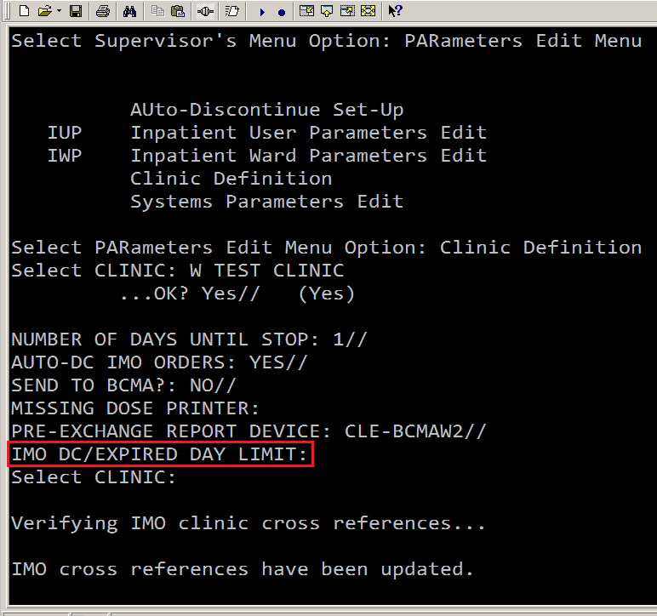
Notes:
The sixth and final parameter in the Clinic Definition file is the IMO DC/Expired Day Limit. This parameter controls how long an expired or discontinued Clinic Order remains available for drug-drug order checking for each clinic.
*****

Slide 61
Notes:
The choices are 1 to 120 days. If not populated the default is 30 days that expired or discontinued Clinic Orders remain available for drug-drug order checking. Clinics from which there is a high likelihood that patients will be admitted, might conceivably be a candidate for a low IMO DC/Expired Day Limit. This might avoid excess duplicate drug-drug order checks several days into the admission. And perhaps a clinic which often has a Clinic Order administered where the medication stays in the patient’s system for months might be a good candidate for a high IMO DC/Expired Day Limit. But in Cleveland I left the IMO DC/Expired Day Limit blank for the default of 30 days for all clinics with no complaints.
*****

Slide 62
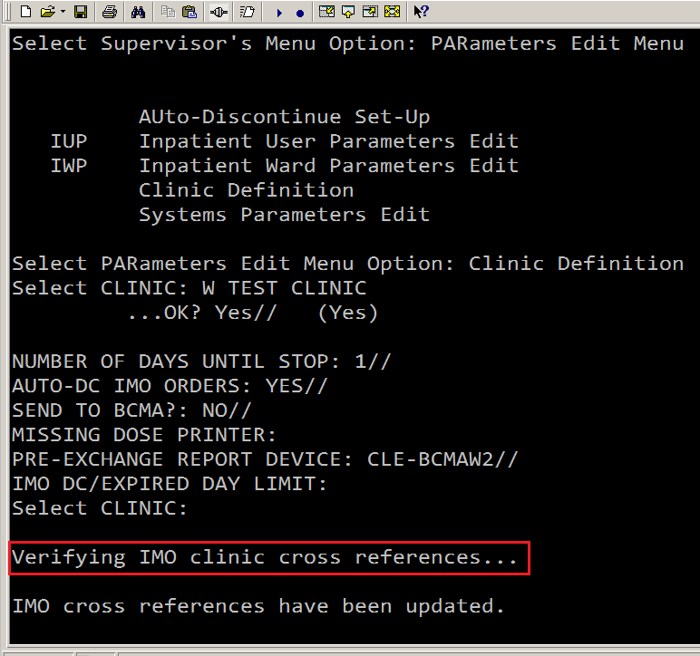
“Send to BCMA” parameter updates immediately upon exiting the clinic definition parameters
Notes:
The Send to BCMA parameter updates immediately upon exiting the clinic definition parameters. They aren’t kidding when they say Verifying IMO clinic cross references. If you put a yes in the Send to BCMA field, Clinic Orders for that clinic immediately appear in the BCMA Clinic Mode view. If you put a no in the Send to BCMA field, Clinic Orders for that clinic immediately disappear from the BCMA Clinic Mode view. Freaky.
*****

Slide 63
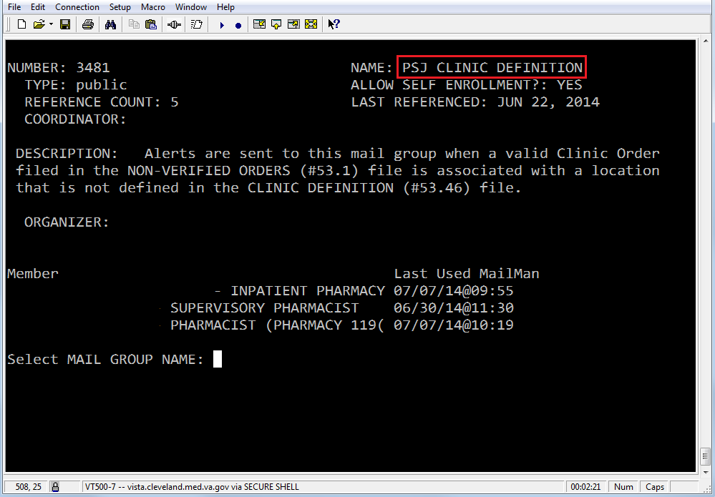
What if the Clinic Definition file parameters have not been populated?
Notes:
If a provider writes a Clinic Order for a Clinic where the Clinic Definition file parameters have not been populated, an email goes out to a VistA email group called PSJ CLINIC DEFINITION, warning of incomplete clinic definition setup.
*****

Slide 64
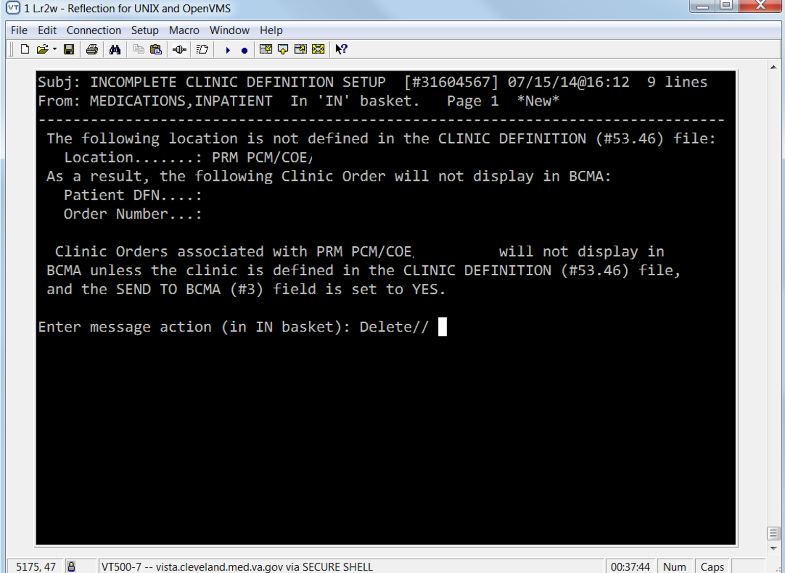
Notes:
You will want to put several people in that email group so the Clinic Definition File parameters for that clinic can be populated quickly.
|
Let’s give you another moment to complete the poll…
*****

Slide 65
Poll Results
Downsides of Clinic Orders current functionality (Pre CPRS Version 30b) include?
The provider can only enter Clinic Orders for outpatient status patients not inpatient status patients.
Providers have to choose a current or future Visit date/time, if current, patient cannot be checked out nor 24 hours pass, to successfully enter Clinic Orders.
Intended Clinic Orders for inpatient status patients go to the BCMA inpatient order mode view instead of clinic order mode view.
All of the above.
Notes:
Now, let’s view your poll results.
The question: Downsides of Clinic Orders current functionality (Pre CPRS Version 30b) include?
|
The provider can only enter Clinic Orders for outpatient status patients not inpatient status patients. That’s the true root of the problem.
Providers have to choose a current or future Visit date/time, if current, patient cannot be checked out nor 24 hours pass, to successfully enter Clinic Orders. That’s also true and the biggest annoyance to providers.
Intended Clinic Orders for inpatient status patients go to the BCMA inpatient order mode view instead of clinic order mode view. That’s true and a showstopper for clinics that have any chance of an inpatient status patient being seen there.
|
That’s it for our look at Clinic Orders current functionality. Now it’s time to move on to the question, does CPRS Version 30b tame Clinic Orders or just add more gasoline to the fire?
*****

Slide 66
Poll Results
Downsides of Clinic Orders current functionality (Pre CPRS Version 30b) include?
The provider can only enter Clinic Orders for outpatient status patients not inpatient status patients.
Providers have to choose a current or future Visit date/time, if current, patient cannot be checked out nor 24 hours pass, to successfully enter Clinic Orders.
Intended Clinic Orders for inpatient status patients go to the BCMA inpatient order mode view instead of clinic order mode view.
All of the above.
Notes:
Click to next slide

Slide 67
CPRS Version 30b
will tame Clinic Orders
Notes:
CPRS Version 30b tames Clinic Orders. The biggest change that CPRS Version 30b brings is allowing providers to write Clinic Orders on inpatient status patients. This is huge. It mitigates most of the current patient safety issues with Clinic Orders. CPRS Version 30b also makes it easier for providers to write Clinic Orders. I have been hammering providers in training videos for years about location, location, location. They seem to get that. If the chart is open to a clinic location for an outpatient status patient when using the inpatient medication order dialog, inpatient infusion order dialog and related quick orders they get Clinic Orders.
*****

Slide 68
CPRS Version 30b removes the visit date/time requirement
Treats outpatient status and inpatient status patients the same
Notes:
But that thing about a current or future appointment. If a current appointment, the patient cannot be checked out or 24 hours pass since check in, keeps slipping them up. CPRS Version 30b removes the visit date/time requirement and treats both outpatient status and inpatient status patients the same. If the chart is open to a clinic location, regardless of outpatient status or inpatient status, no matter what the visit date/time, past, present or future, when using the inpatient medication orders dialog, inpatient infusion order dialog and related quick orders they will get Clinic Orders. If a past visit date/time is chosen, the pending Clinic Orders default to now. If the provider has the chart open to a ward location for an inpatient status patient, when using the inpatient medications order dialog, inpatient infusion order dialog and related quick orders they will get an inpatient order.
*****

Slide 69
Use the same quick orders and menus you have always used for Clinic Orders
Notes:
Let’s follow a Clinic order in CPRS Version 30b written on an inpatient status patient. For all the pharmacy ADPACs, Informaticists, Clinical Applications Coordinators out there, you can use the same quick orders and menus you have always used for Clinic Orders. You don’t have to change them.
*****

Slide 70
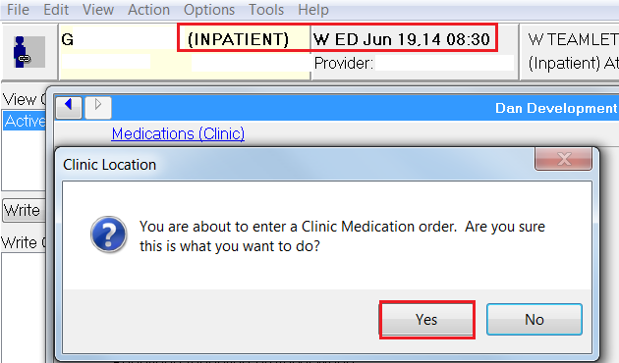
Notes:
Here we have our CLC patient, an inpatient status patient, down in the Emergency Department. The Emergency Department provider has the chart open to the Emergency Department location. When the provider clicks on the first quick order, the Clinic Location dialog appears. You are about to enter a Clinic Medication Order. Are you sure this is what you want to do? The Emergency Department provider left-clicks on Yes.
*****

Slide 71
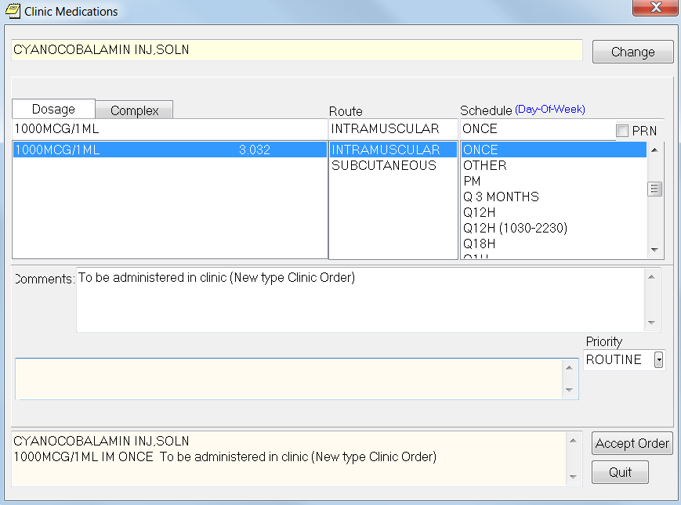
Clinic Medications dialog
Notes:
The cyanocobalamin Vitamin B12 injection once Clinic Order comes up in the Clinic Medications dialog. Before CPRS Version 30b, the Inpatient Medications dialog would have come up dooming this intended Clinic Order to become an inpatient medication order. Since this is CPRS Version 30b, the Clinic Medications dialog comes up. The Emergency Department provider accepts this Clinic Order.
*****

Slide 72
Notes:
For this inpatient status patient, the Emergency Department provider gets a Clinic Order with a clinic location of W Emergency Department. Just what the doctor ordered. The Emergency Department provider right clicks to sign the unreleased Clinic Order.
*****

Slide 73
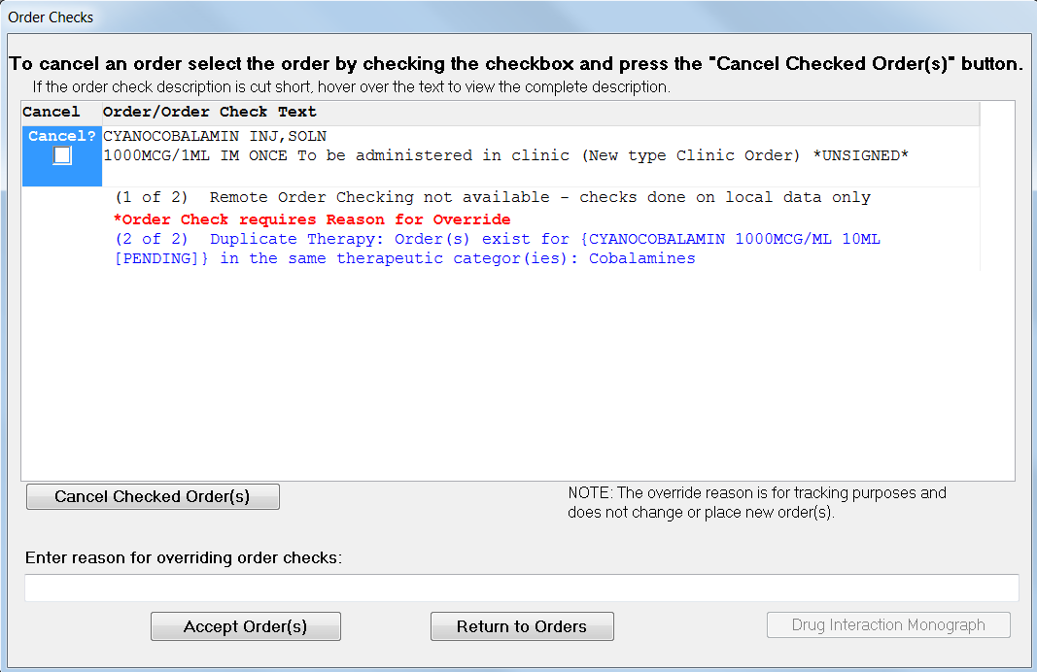
Order Check dialog
Notes:
The Order Check dialog comes up. After the Emergency Department provider takes care of the order checks.
*****

Slide 74
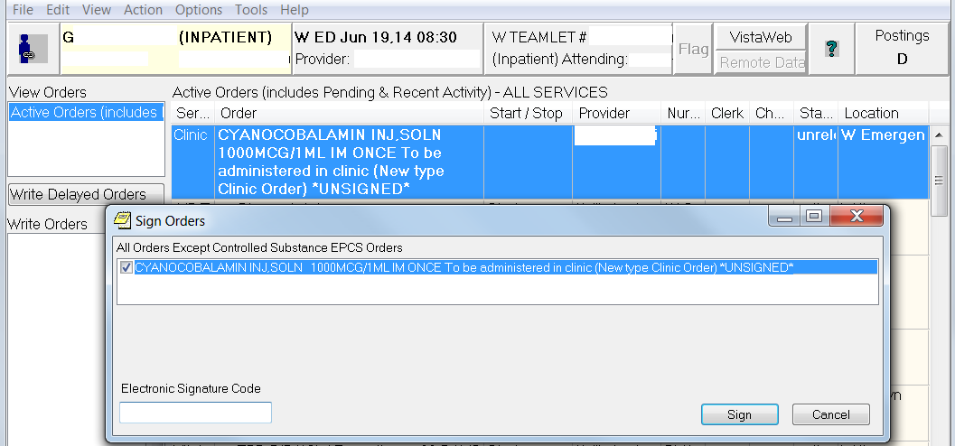
Emergency Department Provider can now sign the Clinic Order
Notes:
They can sign the Clinic Order.
|
And the pending Clinic Order goes to the pharmacy Inpatient Medications software package to be finished and verified.
*****

Slide 75
Inpatient Medications Order dialog, Inpatient Infusion Order dialog
and related quick orders
Inpatient Medication orders
Clinic
orders
Notes:
CPRS Version 30b works with all your existing inpatient medication and inpatient infusion quick orders and order sets to result in clinic orders if the chart is open to a clinic location, thanks to the Inpatient Medications Workgroup. The suggestion that was brought forward to the Inpatient Medications Workgroup was that instead, the inpatient medications order dialog, inpatient infusion order dialog and related quick orders should only result in Inpatient Medication orders, not Clinic Orders. And that the new Clinic Medications Order dialog, Clinic Infusions Order dialog that ships with CPRS Version 30b should only result in Clinic Orders. All 30 members of the Inpatient Medication Workgroup shot down the idea that the Inpatient Medication order dialog, Inpatient infusions order dialog and related quick orders will only result in inpatient medication orders. They shot it down in favor of keeping faith with the traditional Clinic Orders functionality while providing the new option of Clinic Only order dialogs. You owe these folks a debt of gratitude that you don’t have to copy existing inpatient medications quick orders created in the past 8 years to the new Clinic only quick orders in just 8 weeks. Not happening, thanks to the Inpatient Medication Workgroup.
*****

Slide 76
Testing new software
Create an outcome matrix
Notes:
But CPRS Version 30b still ships with the new clinic only medications order dialog and clinic only infusion order dialog which brings me to this outcome matrix. Testing new software is like a cross between being on a jury and a kid on Christmas morning. The project manager tells you what they think you need to know to make the decision, does a particular software function pass or fail the test script. Like a jury you are sometimes denied need to know information. And like a kid on Christmas morning, sometimes the toy breaks the first time you play with it. CPRS Version 30b Clinic Order functionality in the then current test version was broke pretty good in my estimation when I asked for a conference call with two of the lead software developers. We had an earnest discussion for about 25 minutes. We go along way back and trust each other. I knew something was wrong with the logic, but they were kind of thinking that maybe I just had it in for Clinic Only medication order dialog. Then one of the software developers suggested, let’s go old school and create an outcome matrix with all the scenarios.
*****

Slide 77
A CLC patient, an inpatient status patient, is brought down to the Emergency Department…
Notes:
Turned out it was easy to identify the broken scenario. And here it is, a CLC patient, an inpatient status patient, goes bad in the middle of the night and is brought down to the Emergency Department. In the matrix, patient status is inpatient. The Emergency Department provider has the chart open to the Emergency Department location (in the matrix, CPRS encounter location is clinic) and attempts to enter a Clinic Order using the inpatient medications order dialog, inpatient infusion order dialog and related quick orders (in the matrix, dialog selected by user is Inpatient medications) but they get inpatient medication orders, not clinic orders which is a logic violation (in the matrix, result should be clinic medication orders). The Inpatient Workgroup wanted to keep faith with traditional Clinic Orders functionality. The developers fixed this in one of the next couple of test versions of CPRS Version 30b, so the Emergency Department provider gets Clinic Orders with the location of the Emergency Department.
|
Well Morpheus, what else is in the matrix? Let’s jack in and find out.
*****

Slide 78
Patient Status
Inpatient or Outpatient
Notes:
There are two types of patient status, inpatient or outpatient.
*****

Slide 79
CPRS Encounter Location
Ward or Clinic
Notes:
There are two types of CPRS encounter locations the chart can be opened to, ward or clinic.
*****

Slide 80
Dialog Selected By User
Inpatient Med. or Clinic Med.
Notes:
There are two types of order dialogs, Inpatient Medications or Clinic Medications.
*****

Slide 81
Results
8?
2 x 2 x 2 =
8?
6
X
Notes:
Two times two times two gives you eight possible outcomes.
[CLICK FOR ANIMATION]
We can throw out two outcomes. You can not have the chart open to the ward for an outpatient status patient. That would mean you were trying to write orders for a past hospital admission. Not only has the patient left the building, if you were successful it would create a catastrophic edit. Sounds nasty. Don’t do it.
|
First lets start with the Inpatient Medication Order dialog, Inpatient Infusion Order dialog and related quick orders, providers have always used for Clinic Orders since 2006. The new twist is that regardless of the patient status, inpatient or outpatient, what determines if the provider gets an inpatient medication order or a Clinic Order is what location the chart is open to.
*****

Slide 82
Pat Status | CPRS Encounter Location | Dialog Selected By User | Results
Inpatient | Clinic | Inpatient Medication | Clinic Medication
Notes:
Lets say we have a Community Living Center (CLC) patient, who is an inpatient status patient (in the matrix patient status is inpatient), who comes down to the Dental clinic for a dental appointment. The Dentist wants the CLC patient to have a one time antibiotic in the Dental clinic and 3 more doses of the antibiotic on the CLC. Since the CLC patient is an inpatient status patient the chart opens up by default to the CLC location. The Dentist changes the location the chart is open to, to the Dental Clinic. In the matrix, CPRS encounter location is clinic. The Dentist uses the same Inpatient Medication Order dialog, Inpatient Infusion Order dialog and related quick orders they have always used since 2006. In the matrix, dialog selected by user is inpatient medications. But with CPRS Version 30b the Clinic Location dialog appears. You are about to enter a Clinic Medication Order. Are you sure this is what you want to do? The Dentist left-clicks on yes and is able to enter a one time antibiotic Clinic Order for this CLC patient to be given in the Dental Clinic. In the matrix, result is clinic medication orders. Pharmacy finishes and verifies the Clinic Order. The nurse, in CPRS, verifies the newly active Clinic Order. If the Dental Clinic has implemented BCMA, the one time antibiotic appears on the BCMA Clinic Mode View for the Dental Clinic nurse to administer in BCMA.
*****

Slide 83
Pat Status | CPRS Encounter Location | Dialog Selected By User | Results
Inpatient | Ward | Inpatient Medication | Inpatient Medication
Notes:
Assuming the one time antibiotic administration in the Dental Clinic went well. Before the CLC patient leaves the Dental Clinic. In the matrix, patient status is inpatient. The Dentist changes the location the chart is open to, to the CLC location. In the matrix, CPRS encounter location is ward. The Dentist uses the same Inpatient Medication Order dialog, Inpatient Infusion Order dialog and related quick orders, they have always used since 2006 (in the matrix, dialog selected by user is inpatient medications) to enter inpatient medication orders for the CLC patient to get three more doses of the antibiotic on the CLC. In the matrix, result is inpatient medication orders. You can see that the Dentist determines what kind of orders they are entering, clinic or inpatient, based on the location the chart is open to. Again very elegant.
*****

Slide 84
Pat Status | CPRS Encounter Location | Dialog Selected By User | Results
Outpatient | Clinic | Inpatient Medication | Clinic Medication
Notes:
Same Dentist but this time an outpatient status patient comes in from home for a Dental appointment. In the matrix, patient status is outpatient. The Dentist wants this outpatient status patient to have a one time antibiotic in the Dental clinic. The Dentist opens the chart to the Dental Clinic location. In the matrix, CPRS encounter location is clinic. The Dentist uses the same Inpatient Medication Order dialog, Inpatient Infusion Order dialog and related quick orders they have always used since 2006. In the matrix, dialog selected by user is inpatient medications. The Clinic Location dialog appears. You are about to enter a Clinic Medication Order. Are you sure this is what you want to do? The Dentist left-clicks on yes and is able to enter a one time antibiotic Clinic Order for this outpatient status patient to be given in the Dental Clinic. In the matrix, result is Clinic medication orders. Pharmacy finishes and verifies the Clinic Order. The nurse, in CPRS, verifies the newly active Clinic Order. If the Dental Clinic has implemented BCMA, the one time antibiotic appears on the BCMA Clinic Mode View for the Dental Clinic nurse to administer in BCMA.
*****

Slide 85
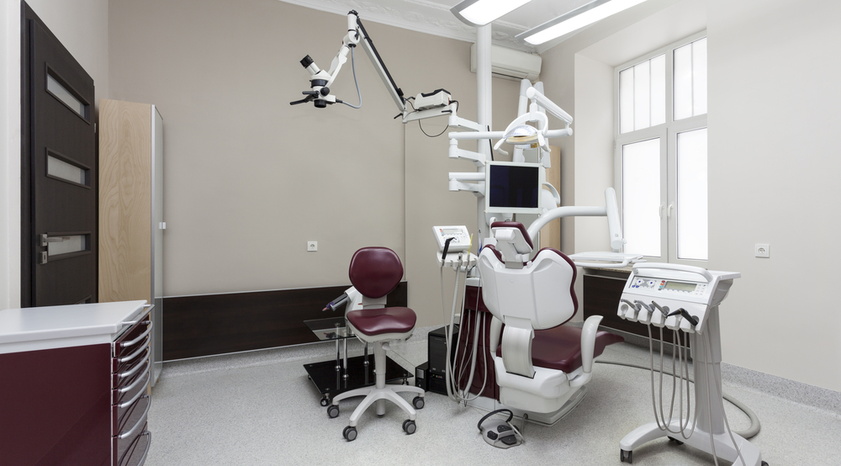
Pat Status | CPRS Encounter Location | Dialog Selected By User | Results
Inpatient | Ward | Inpatient Medication | Inpatient Medication
Inpatient | Clinic | Inpatient Medication | Clinic Medication
Outpatient | Clinic | Inpatient Medication | Clinic Medication
Notes:
At this point you’ve seen all three scenarios with the Inpatient Medications type order dialog. The location the chart is open to, ward or clinic, determines the type of order that results, inpatient medication order or clinic order, regardless of patient status.
*****

Slide 86
Pat Status | CPRS Encounter Location | Dialog Selected By User | Results
Inpatient | Ward | Clinic Medication
Forces a clinic location to be chosen and result in a Clinic Medication
Notes:
As an additional or alternate patient safety strategy CPRS Version 30b ships with the new Clinic Medication Order dialog, Clinic Infusion Order dialog and related quick orders. The plan behind these new Clinic Only order dialogs and related quick orders is that no matter what the inpatient or outpatient status of the patient, no matter whether the chart is initially open to a ward or clinic, these Clinic Only order dialogs and related quick orders will always result in Clinic Orders.
|
Same CLC patient. Different Dentist. Same plan for a one time antibiotic to be given in the Dental Clinic and 3 more doses of the antibiotic to be given on the CLC. Since the CLC patient is an inpatient status patient (in the matrix, patient status is inpatient) the chart opens up by default to the CLC location. The new Dentist leaves the chart open to the default CLC inpatient location (in the matrix, CPRS encounter location is ward) but goes to use the new Clinic Only Dental menu (in the matrix, dialog selected by user is clinic medications) and starts to order a one-time antibiotic. The Clinic Location dialog appears. You are about to enter a Clinic Medication Order. Are you sure this is what you want to do? The new Dentist left-clicks on yes, and CPRS forces the Location for Current Activities dialog.
*****

Slide 87
Pat Status | CPRS Encounter Location | Dialog Selected By User | Results
Inpatient | Clinic | Clinic Medication | Clinic Medication
Dentist changes the location the chart is open to the dental clinic
Notes:
The new Dentist, after asking another Dentist What’s this? changes the location the chart is open to, to the Dental Clinic. And is able to enter a one time antibiotic Clinic Order for this CLC patient to be given in the Dental Clinic. In the matrix, the result is clinic medication orders. Pharmacy finishes and verifies the Clinic Order. The nurse, in CPRS, verifies the newly active Clinic Order. If the Dental Clinic has implemented BCMA, the one time antibiotic appears on the BCMA Clinic Mode View for the Dental Clinic nurse to administer in BCMA.
*****

Slide 88
Pat Status | CPRS Encounter Location | Dialog Selected By User | Results
Inpatient | Ward | Inpatient Medication | Inpatient Medication
Notes:
Assuming the one time antibiotic administration in the Dental Clinic went well. Before the CLC patient leaves the Dental Clinic. In the matrix, patient status is inpatient. The new Dentist will have to change the location the chart is open to, to the CLC location. In the matrix, CPRS encounter location is ward. And find the Dental Menu with the inpatient Medication Order dialog, Inpatient Infusion Order dialog and related quick orders that have been in use since 2006 (in the matrix, dialog selected by user is inpatient medications) to enter the inpatient medication orders for the CLC patient to get three more doses of the antibiotic on the CLC. In the matrix, results in inpatient medication orders.
|
Two sets of menus, Clinic and Inpatient, especially for a VA that has never implemented Clinic Orders might work. But using the same menu and quick orders but having the location the chart is open to determine whether the provider orders Clinic Orders or Inpatient Medication Orders is much more elegant. Tell us how you really feel, Dan.
*****

Slide 89
Pat Status | CPRS Encounter Location | Dialog Selected By User | Results
Inpatient | Clinic | Clinic Medication | Clinic Medication
Notes:
Here are the rest of the scenarios for the new Clinic Medication Order dialog, Clinic Infusion Order dialog and related quick orders. Back to the experienced Dentist. Same CLC patient, who is an inpatient status patient, who comes down to the Dental clinic for a dental appointment. The Dentist wants the CLC patient to have a one time antibiotic in the Dental clinic. Since the CLC patient is an inpatient status patient (in the matrix, patient status is inpatient) the chart opens up by default to the CLC location. The Dentist changes the location the chart is open to, to the Dental Clinic. In the matrix, CPRS encounter location is clinic. And uses the new Clinic Only Dental menu (in the matrix, dialog selected by user is clinic medications) and starts to order a one-time antibiotic. The Clinic Location dialog appears. You are about to enter a Clinic Medication Order. Are you sure this is what you want to do? The Dentist left-clicks on yes and is able to enter a one time antibiotic Clinic Order for this CLC patient to be given in the Dental Clinic. In the matrix, result is clinic medication orders. Pharmacy finishes and verifies the Clinic Order. The nurse, in CPRS, verifies the newly active Clinic Order. If the Dental Clinic has implemented BCMA, the one time antibiotic appears on the BCMA Clinic Mode View for the Dental Clinic nurse to administer in BCMA.
*****

Slide 90
Pat Status | CPRS Encounter Location | Dialog Selected By User | Results
Outpatient | Clinic | Clinic Medication | Clinic Medication
Notes:
Last scenario. Same Dentist but this time an outpatient status patient comes in from home for a Dental appointment. In the matrix, patient status is outpatient. The Dentist wants this outpatient status patient to have a one time antibiotic in the Dental clinic. The Dentist opens the chart to the Dental Clinic location. In the matrix, CPRS encounter location is clinic. The Dentist uses the new Clinic Only Dental menu (dialog selected by user is clinic medications) and starts to order a one-time antibiotic. The Clinic Location dialog appears. You are about to enter a Clinic Medication Order. Are you sure this is what you want to do? The Dentist left-clicks on yes and is able to enter a one time antibiotic Clinic Order for this outpatient status patient to be given in the Dental Clinic.
In the matrix, result is clinic medication orders. Pharmacy finishes and verifies the Clinic Order. The nurse, in CPRS, verifies the newly active Clinic Order. If the Dental Clinic has implemented BCMA, the one time antibiotic appears on the BCMA Clinic Mode View for the Dental Clinic nurse to administer in BCMA.
*****

Slide 91
Pat Status | CPRS Encounter Location | Dialog Selected By User | Results
Inpatient | Ward | Clinic Medication | Clinic Medication
Inpatient | Clinic | Clinic Medication | Clinic Medication
Outpatient | Clinic | Clinic Medication | Clinic Medication
Notes:
At this point you’ve now seen all three scenarios for the new Clinic Only Medications type order dialog. The Clinic Only Medications type order dialog always results in Clinic orders no matter what the patient status, inpatient or outpatient and no matter what location the chart is open to initially. It does this by force. An additional patient safety strategy if you decide to use it.
*****

Slide 92
CPRS Version 30b allows providers to write Clinic Orders on inpatient status patients
Notes:
CPRS Version 30b tames Clinic Orders. The biggest change that CPRS Version 30b brings is allowing providers to write Clinic Orders on inpatient status patients. This is huge. It mitigates most of the current patient safety issues with Clinic Orders especially with BCMA. CPRS Version 30b also makes it easier for providers to write Clinic Orders. Gone is the thing about having to have a current or future appointment. If a current appointment, the patient cannot be checked out or 24 hours pass. Any Clinic appointment visit date/time whether past present or future will work. Remember, location, location, location is the key to Clinic Orders.
*****

Slide 93
Outpatient vs. Inpatient
Two patients are lying in reclining treatment chairs in a VA Chemo clinic…
Notes:
Fast forward to early 2015, after CPRS Version 30b is released Nationally. Two patients are lying in reclining treatment chairs in a Chemo clinic. One patient an inpatient status patient. The other an outpatient status patient. Both patients gets the full Bar Code Medication Administration (BCMA) Treatment, with a satisfying beep. Medication administration safety in the VA can be consistent across the continuum of care from inpatient status patients to outpatient status patients. Thank you.
*****

Slide 94
Ask the Presenter
Notes:
If you haven’t submitted your questions yet, there is still time to do so by clicking on the orange “Ask The Presenter” icon. We’re going to show a brief announcement and be right back to answer your questions.
|
[Stand still and smile until you see the video come up full screen]

