Slide 1
Back to Basics: CPRS Templating 101
David A Brown, RRT
Clinical Applications Coordinator
Clinical Systems Business Office
Notes:
Thank you Joe!
It is wonderful to be here In MyVeHU Campus today. I would like to begin by thanking ALL Veterans for their service to our country. My career with the VA has been a very rewarding experience as I have been given the opportunity to serve those who have served us so well. Before becoming a Clinical Applications Coordinator, I was a Respiratory Therapist and enjoyed working directly with the Veterans. Now my role is to support those who work directly with the veteran.
<Next Slide>

Slide 2

Notes:
One of the most important ways I serve those caring for the Veteran is through building templates. Creating templates that suit the needs and requirements of the clinical and administrative staff will be the focus of our session today. We’ll explore the functionality available in the CPRS template editor and learn it’s capabilities and it’s limitations..
Now let’s look at our specific objectives for this session:
<Next Slide>

Slide 3
Objectives
How to Build A TXML progress note template
Build and modify template fields
Optimize templates for form and function
Importing and exporting templates within CPRS
Known issues with CPRS template editor
Notes:
Our Specific Objectives are
Learn how to build a TXML template from start to finish.
Learn how to build and modify template fields.
Importing and Exporting TXML Templates
Optimize templates for form and function.
5. Known issues with the CPRS Template Editor
To begin, let’s take a brief look at CPRS and VistA.
<Next>

Slide 4
Background
Veterans Health Information Systems and Technology Architecture (VistA)
Text Integrated Utilities (TIU)
Computerized Patient Record System (CPRS)
GUI--Gooey
Notes:
VistA or Veterans Health Information Systems and Technology Architecture –
-The original electronic medical record.
It is an amalgamation of many different packages
Well over 100 different packages
For our topic today we are concerned primarily with the notes package, or in VistA terms the Text Integrated Utilities package aka TIU.
This package allows us to create note titles and store note content as text.
Now let’s talk about CPRS.
Computerized Patient Record System (CPRS)
***It is important to realize and remember that CPRS IS VistA.
CPRS is a point an click interface vs. the “type and enter” interface that is VistA
This presentation will detail a type of template used in CPRS called a TXML template. TXML is the file format for our templates. It is similar to Word documents being denoted with “doc”.
<Next slide>

Slide 5

Poll Question
How would you rate your experience with building templates?
    Beginner – have built few to no templates.
    Intermediate – have built some.
    Experienced – have built numerous templates. Too many to count!
Notes:
Now for a poll question:
To help understand who’s out there in Virtual VA land I’d like you to answer the following question:
How would you rate your experience with building templates?
Beginner-Have built few to no templates
Intermediate-Have built some.
Experienced-Have built numerous templates. Too many to count!
Please click the blue Polling icon in the upper left of your screen and make your selection now.
We will review your answers in a few minutes. Now, let’s get back to the presentation.
<Next slide><Navigate>

Slide 6
Notes:
Now, that we have a foundational understanding of VistA, CPRS and TIU, lets get started with templating.
In order to build templates, we need to navigate to the CPRS Template Editor in CPRS.
<Next slide>

Slide 7
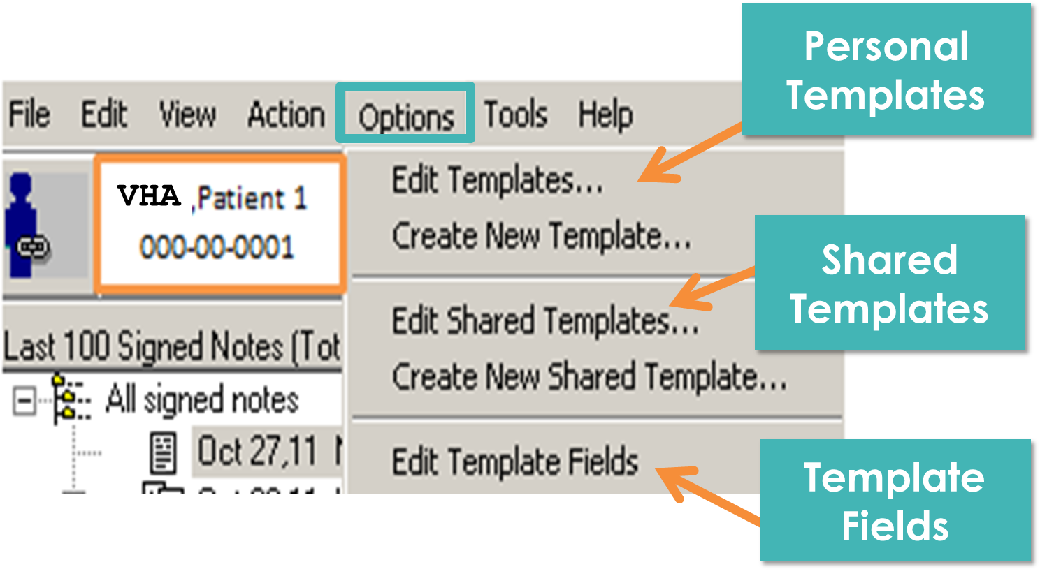
Notes:
The CPRS Template Editor can be accessed using the “Options” menu on either the Notes Tab or the Consults Tab in CPRS.
Option Menu has 3 Sections:
Personal Template Section—Allows users to create templates for their own personal use. They are not accessible by anyone except that user, unless that user exports them and sends them to another user.
Shared Template Section—Allows the user to create templates and make those templates available to all users as Shared Templates, or associate them with Note Titles or Consult and Procedure Orders.
Edit Template Field Section—Allows the user access to the Template Field Editor.
Access to each of these sections is determined by VistA Parameters which we will discuss next.
If a user does not have access to a particular section, the selection items in the Options Menu will be greyed out and not selectable.
A Clinical Applications Coordinator should have access to all 3 sections. If they do not, they will not be able to create new templates, create Shared Templates or create Template Fields.
<Next slide><Parameters/User Class>

Slide 8
Template editor access
TIU PERSONAL TEMPLATE ACCESS
ASU USER CLASS—Clinical Coordinator
TIU FIELD EDITOR CLASSES
Notes:
There are 3 items that determine the users ability to access the template Editor.
Personal Templates: access is set via the TIU PERSONAL TEMPLATE ACCESS parameter . When a user has access they will have a “My Templates” folder in the Template Drawer on the Notes Tab. This parameter can be used by sites to restrict access to personal templates.
There are several reasons to restrict personal template access. 2 main reasons are:
Users can save templates in a Favorites type list. These are copies of the original template in the Shared Templates Root.
When the original template is updated, it does not automatically update the copy.
Secondly, there is nothing controlling what the user can put into their template.
Shared Templates: can only be accessed when the user has a “User Class” of Clinical Coordinator set in the Authorization /Subscription Utilities (ASU) Package.
Edit Template Fields: access is set via the TIU FIELD EDITOR CLASSES parameter. This parameter works in conjunction with the ASU User Class.
If you have sections of the Options menu greyed out, ask your supervisor or preceptor to review these parameter settings and ASU User Class.
<Next slide><Poll results>

Slide 9
Poll Results
How would you rate your experience with building templates?
  Beginner
  Intermediate
  Experienced
Notes:
So it looks like we have ………..
Ad-lib results, transition to next topic
<Next slide><Best Practice for entering the Template Editor>

Slide 10

Poll Results
How would you rate your experience with building templates?
  Beginner
  Intermediate
  Experienced
Notes:
Click again

Slide 11
What option should I choose?
Edit
Personal
Create
Shared
vs.
Notes:
When entering the CPRS Template Editor it’s BEST PRACTICE to use: Edit Templates
-Opens with Personal Templates highlighted
--This is Safest
---will not alter anything accessible to all users
---will not alter anything in Shared Templates
Accessing shared templates can be done by selecting “Edit Shared Templates” in the lower left corner of the Template Editor.
<Next slide><Explore Template Editor>

Slide 12
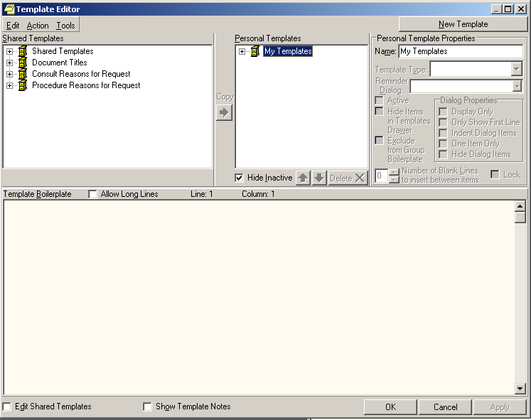

Notes:
When using the “Edit Templates” option previously mentioned the Template Editor opens with My Templates highlighted.
<Note that it’s highlighted>
This is the section where you will be building templates.
Note the “Edit Shared Templates” check box in the lower left. Clicking here will allow you to edit shared templates.
The Template Editor has several other sections to note.
Let’s start in the Upper Left Hand Corner:
<Next slide>

Slide 13
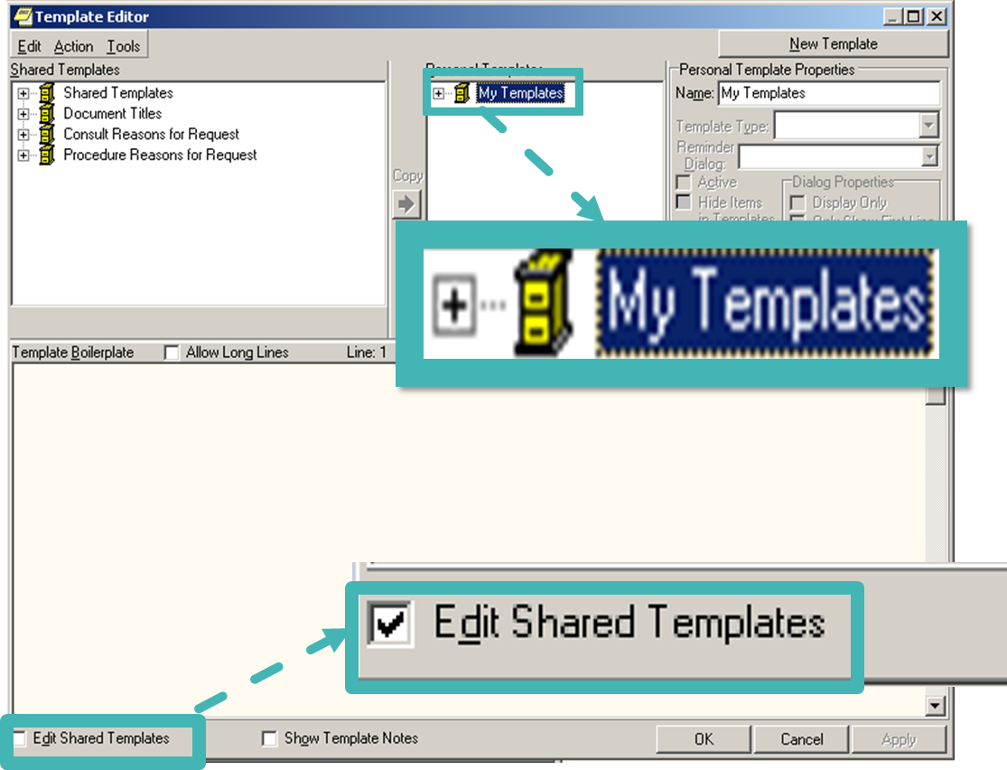
Notes:
Below the menu bar we have the Shared Templates window.
4 Template Root Drawers
<Next Slide>

Slide 14
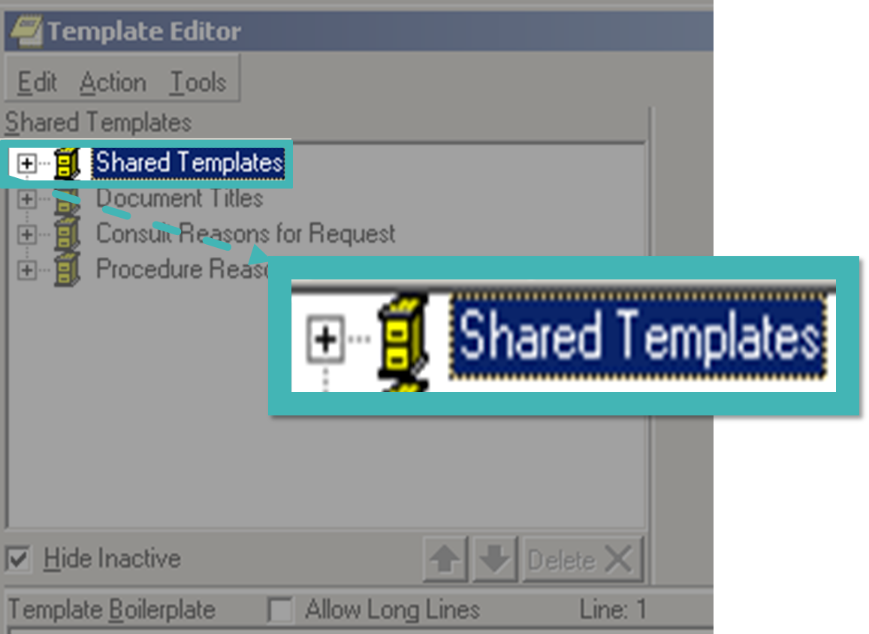
Notes:
First is Shared Templates
-Contains standalone progress note Templates that all users can access and use.
-Standalone means not associated to a note title.
-Can be used in any note by any user.
<Next slide>

Slide 15
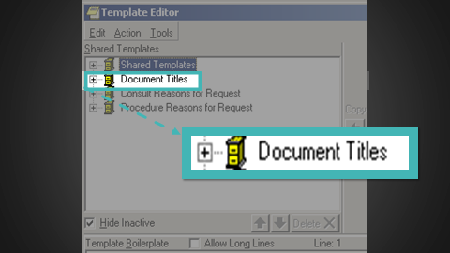
Notes:
Document Titles:
-Templates Associated with Note titles
-The Template will open automatically when note title selected.
-Later in the presentation, we will learn how to associate a template to a note title in the Document Title Root Folder..
<Next slide>

Slide 16
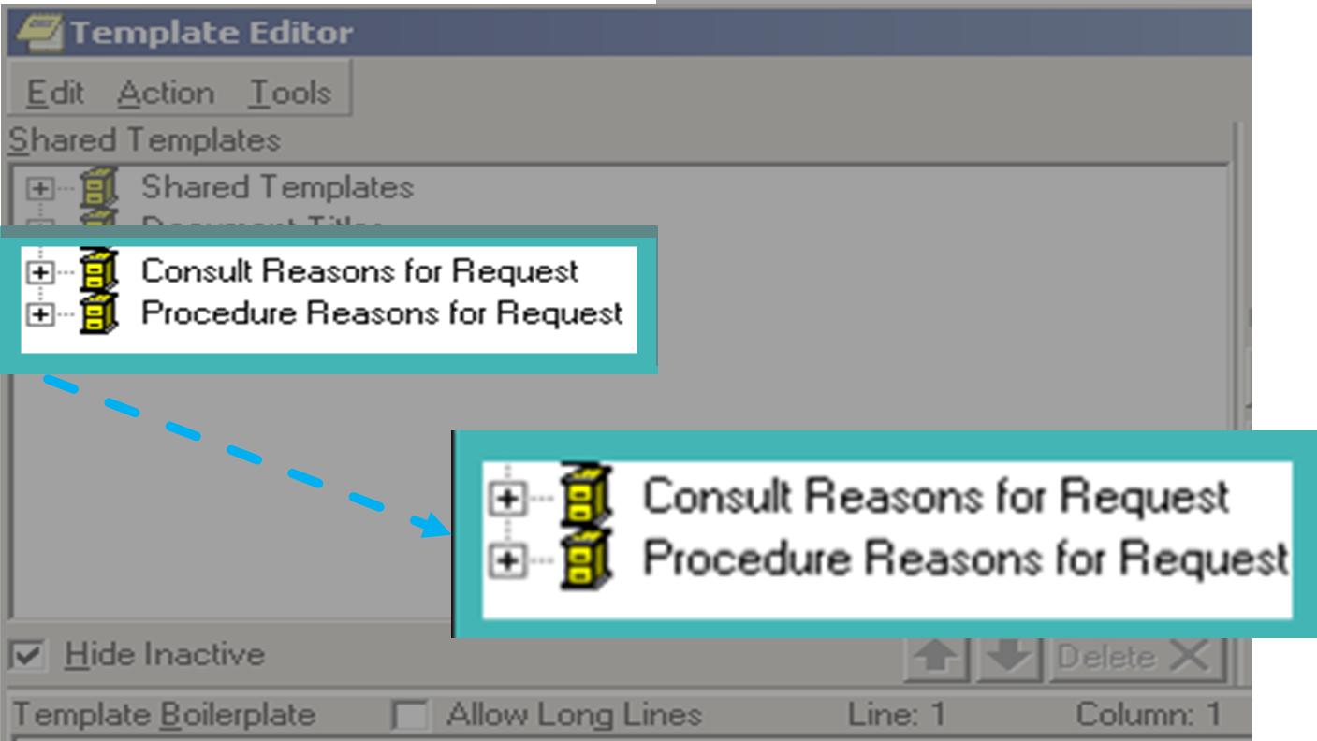
Notes:
Consult and Procedure Reasons for Request-
-Function like Document Titles
-Templates associated with Consult and Procedure services
-Template will open automatically when order for Consult or Procedure is accessed
-Template OUTPUT is entered into the Reason for Request field for that order.
<Next slide>

Slide 17
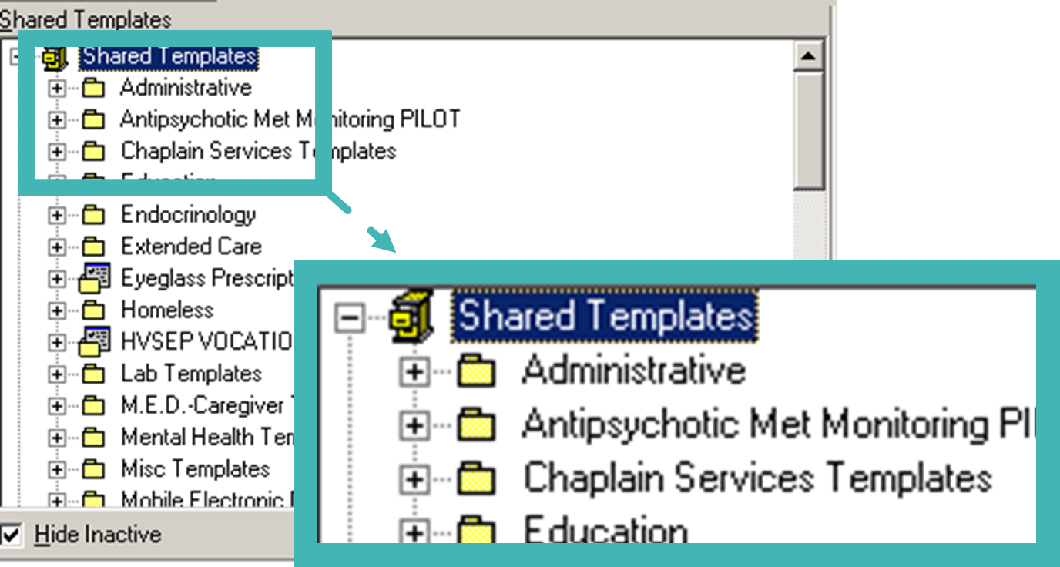
Notes:
As we talked about earlier, the Shared Template Root contains standalone templates for users to add to their notes.
The Shared Template should be organized by using folders designated by specialty. All nursing templates can be placed in a folder titled Nursing Templates and so on.
<Next slide>

Slide 18
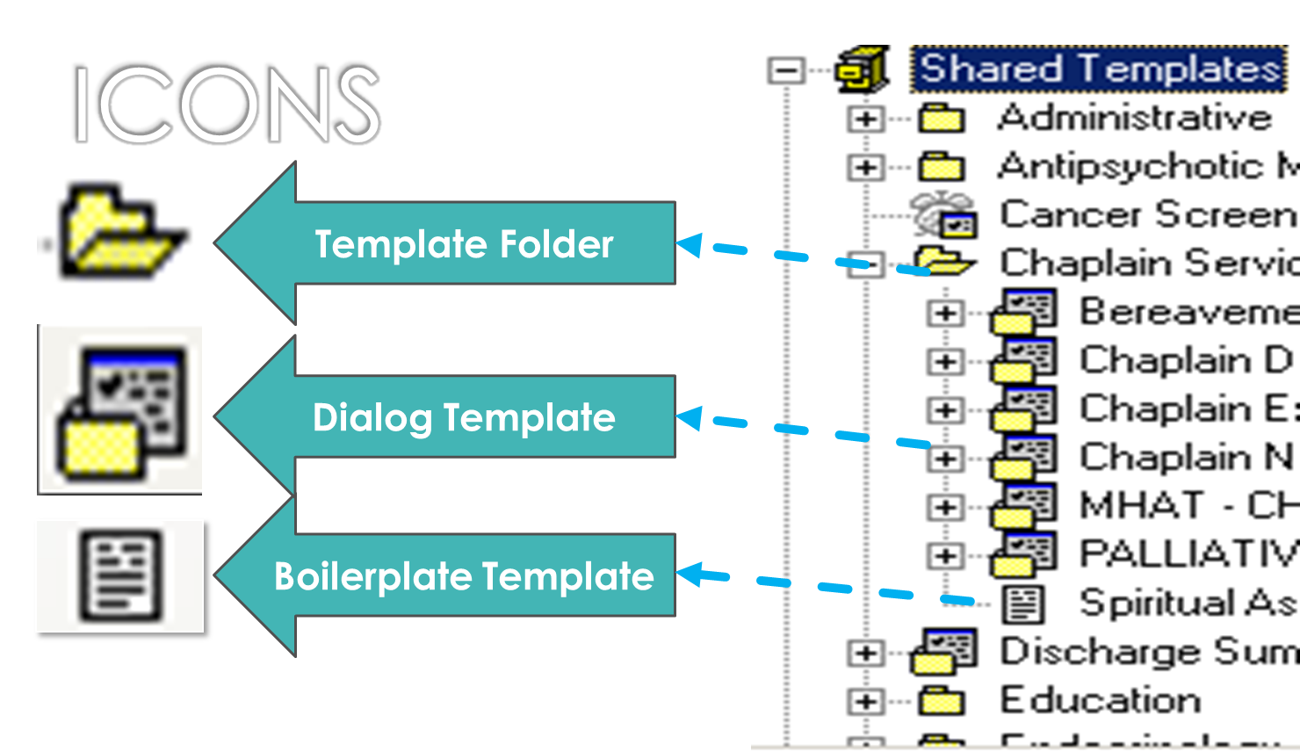
Notes:
Here is an expanded view of the Shared Templates Root. We can see that there a several icons present here.
The main three Icons we will be dealing with today are:
-Template Folder
-Dialog Template
-Boilerplate Template
There are other icons that you will see when working with the CPRS Template Editor, but for today, we will be working mainly with these 3.
<Next slide><Poll Question>

Slide 19
Poll Question
In order to for a user to have the ability to create and edit Shared Templates they need:
    An ASU user class of Template Builder
    An ASU user class of Clinical Coordinator
    An ASU user class of Template Master
    An ASU user class of IT Specialist
Notes:
This is a knowledge check question to see if you were paying attention.
In order to for a user to have the ability to create and edit Shared Templates they need
An ASU user class of Template Builder
An ASU user class of Clinical Coordinator
An ASU user class of Template Master
An ASU user class of IT Specialist
Please click the blue Polling icon in the upper left of your screen and make your selection now.
We will review your answers in a few minutes. Now, let’s get back to exploring the CPRS Template Editor
<Next slide><Personal Templates Window>

Slide 20
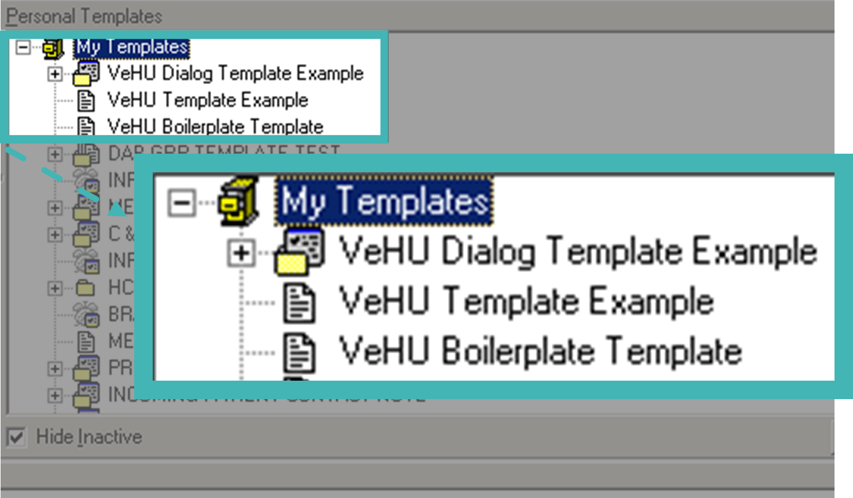
Notes:
Personal Templates Window
The Personal Template window contains the “My Templates Root”
As a CAC/HIS, this is where you will build your templates. I do not advocate building templates in the Shared Templates Root or any of it’s subfolders. It’s much safer to build it here in My Templates for many reasons. The main reason is that if something goes wrong, it only effects you not ALL users.
When your template is built, tested, and reviewed for errors you can move it to the Shared Templates Root by Exporting from your My Templates Root, saving it to a location on your computer or personal drive and then importing it into the Shared Templates Root.
Now let’s take a look at the Menu Bar
<Next slide>

Slide 21
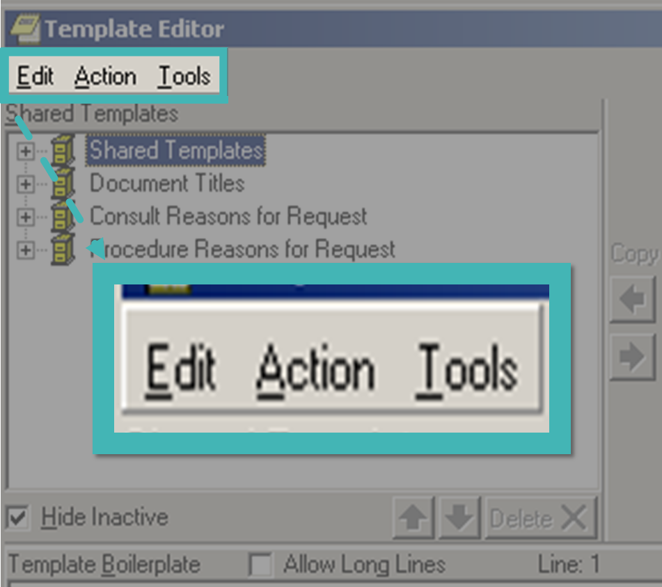
Notes:
Far in the upper left we have the Menu Bar that contains the
-Edit Menu,
-the Action Menu
-and the Tools Menu.
<Next slide>

Slide 22
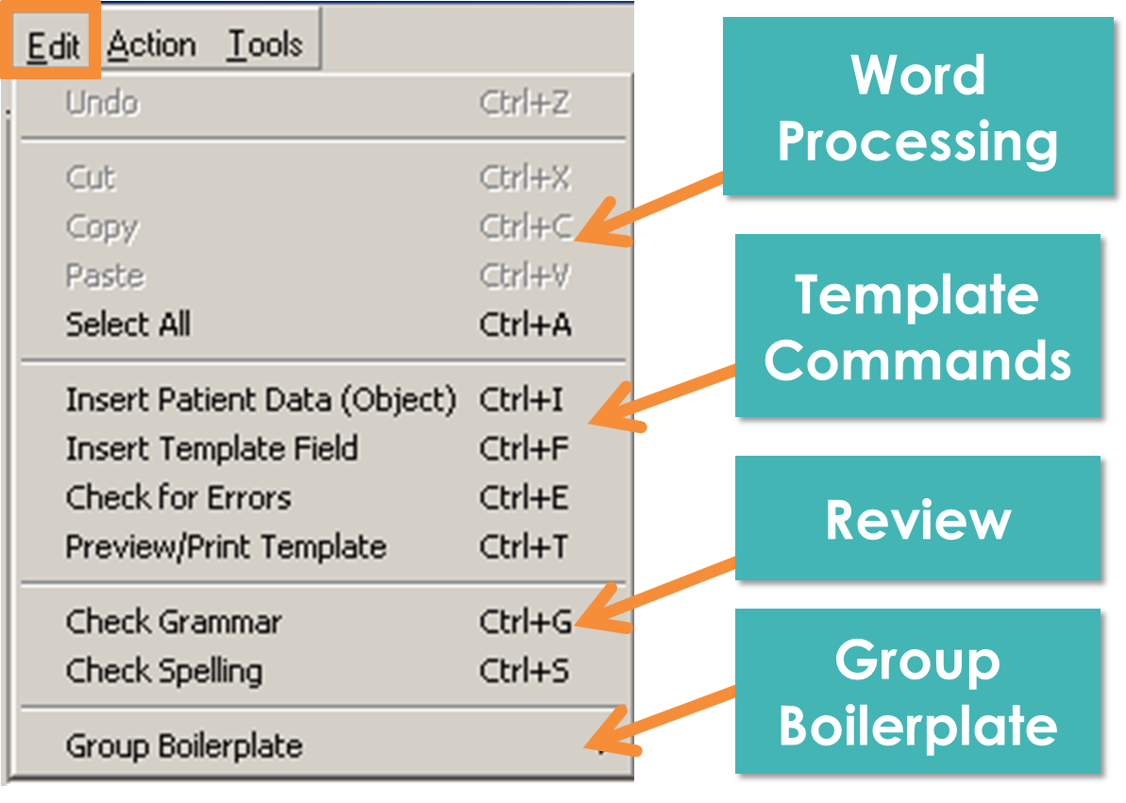
Notes:
The Edit menu, which can also be accessed by Right Clicking in the main body of the template, has many important options.
The first 5 I believe should be self explanatory for anyone familiar with Microsoft Word, Internet Explorer, Power Point etc. They are grayed out here as one need to be working in the template display window for them to become active. The “Undo” feature is handy when you are first starting out or are experimenting with text additions.
The Template Commands section you will use most often:
---Patient Data Objects: are objects that pull actual patient data into the template such as lab results, demographics, Vitals sign values and so on.
----They are built at 3 levels, Nationally, VISN and locally
----There is thus variability in naming conventions, time limits and other parameters.
----Creating Patient Data objects is beyond the scope of this class, but the VeHU Class library has several classes on what they are and how to build them.
----Insert Template Fields: allows us to insert template fields into our template to simplify the documenting process such as free text boxes, checkboxes, date fields and so on. We will explore Template fields at length later in the presentation.
----Check for Errors: option is useful for checking for errors with Template Fields and Patient Data Objects.
-----Preview/Print Template: Option you will use MOST frequently. It displays the template as the user would see it. The different template types will have different template displays.
-----Group Boilerplate have not found a use for this option. It appears to let you select all and copy text from a group of templates.

Slide 23
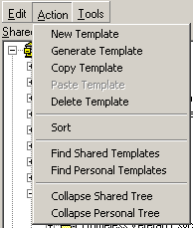
Template
Options
Sort
Search
And
Collapse
Notes:
The next menu is the Action Menu.
It can also be accessed by Right Clicking the Template Root, Template Folder or Individual Template.
In my experience, I don’t use this menu extensively.
The Template Editor window has buttons for New Template and Delete Template that are clearly visible and accessible.
The Generate Template and Copy Template options are a little beyond the scope of this class.
I do use the Sort option. Sort will alphabetize a Template Root or Template Folder, which is helpful in keeping them organized.
The Search or Find features are helpful to search Root Drawers and Template folders that contain larger numbers of templates. These options function very much like searching a Word document or PDF.
The Collapse function is handy to close all the large templates and folders that you have expanded with one click.
<Next slide> <Poll results>

Slide 24
Poll Results
For a user to create and edit Shared Templates they need:
    An ASU user class of Template Builder
    An ASU user class of Clinical Coordinator
    An ASU user class of Template Master
    An ASU user class of IT Specialist
Notes:
The user needs “B” the ASU user class of Clinical Coordinator to be able to create and edit Shared Templates.
It looks like the majority……..AD LIB
<Next slide><

Slide 25
Poll Results
For a user to create and edit Shared Templates they need:
    An ASU user class of Template Builder
    An ASU user class of Clinical Coordinator
    An ASU user class of Template Master
    An ASU user class of IT Specialist
Notes:
Click again

Slide 26
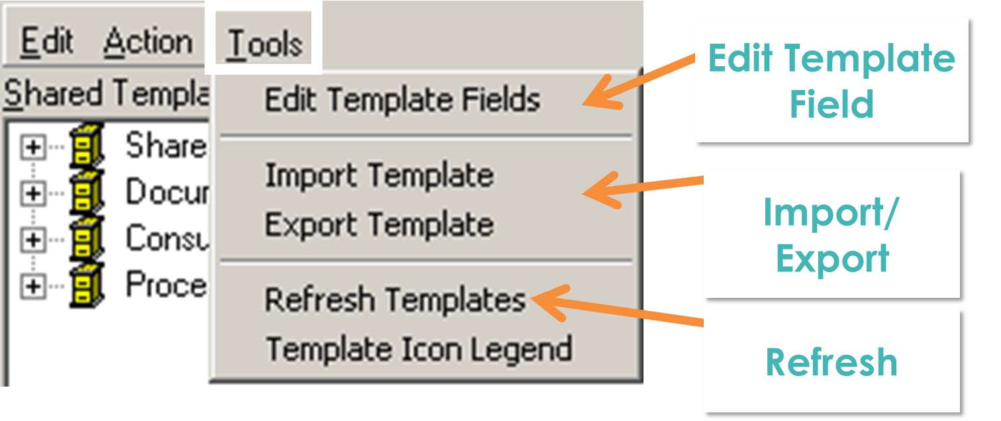
Notes:
The Tools menu has several important options.
First is the Edit Template Fields. This is the only place to access the Template Field Editor once inside the Template Editor. We will discuss Template fields in depth, later in the presentation.
The next section contains the Import and Export Template commands. These you will use often. They are preferred way to bring templates out of your Personal Templates and place them in the various Roots Folders in the Shared Templates Window. We will cover this, step by step near the end of the presentation.
Refresh Templates is similar to the Refresh Patient Information option in CPRS.
<Next Slide><Building a template>

Slide 27

BUILDING A NEW TEMPLATE
Notes:
Now that we know our way around the Template Editor let’s use these tools and build a template.

Slide 28
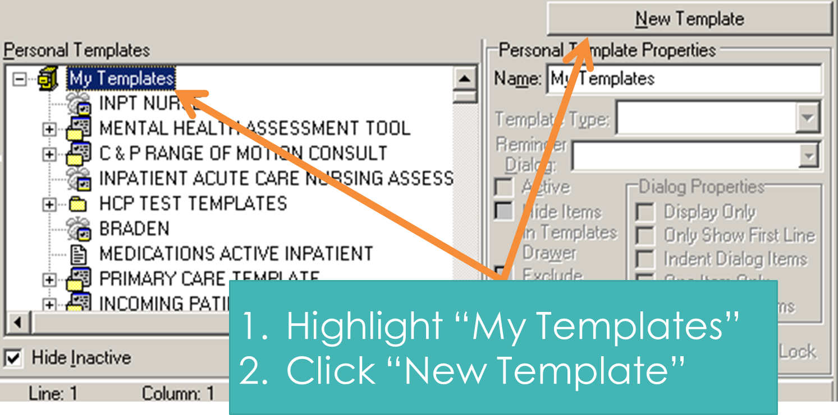
Notes:
The First Step is to Highlight the My Templates Root and then click new Template.
<Next slide> <Naming>

Slide 29
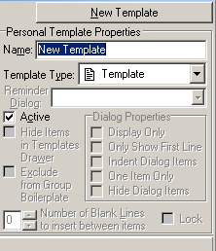
Name the Template
Notes:
Once you click “New Template” a new template is created.
You must change the name from New Template at this point.
You can name it anything you want, except…… “New Template”
-You can have templates with the same name, although this may add confusion.
-You can add numerals to help differentiate the templates if the have the same name (e.g. Test 1, Test 2, Test 3 etc)
-Has to be a minimum of 3 characters. A stroke of the space bar counts as a character. So if you are making template named Yes and another No. To create a No template type N then O and then hit the space bar.
-Work with your peers to determine proper naming conventions.
-Consider using All caps as it will help it stand out as CPRS default font is a very small 8 point—SITE YOUR TEMPLATE FOLDER AS AN EXAMPLE
-Once you give it a name you are free to start adding text and other items.
<Next slide> <Adding Text>

Slide 30
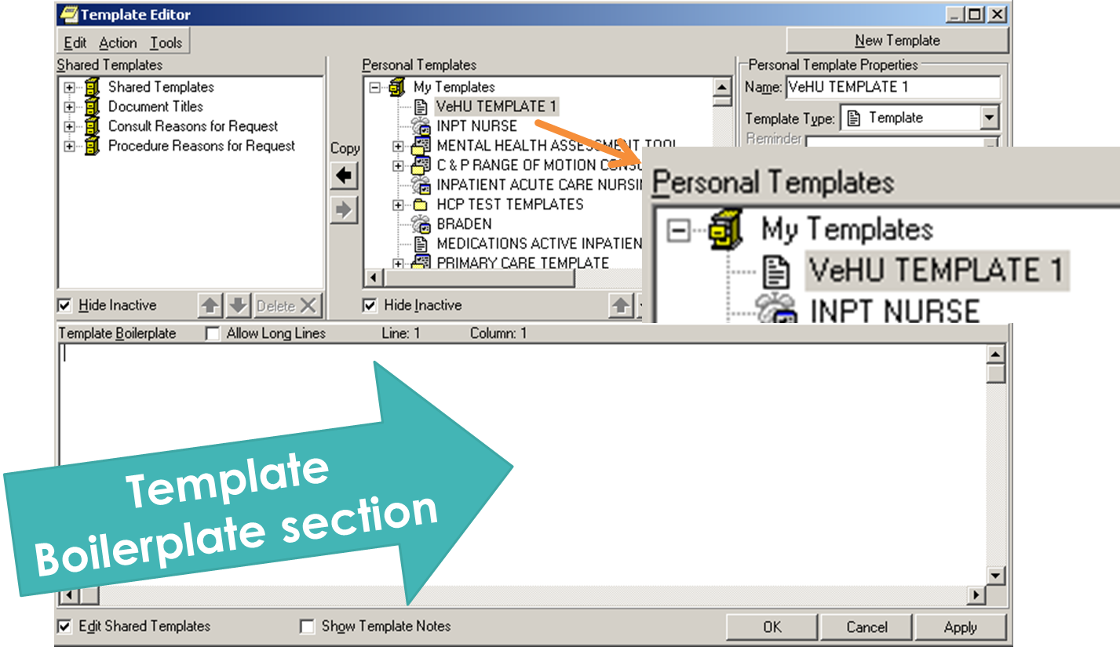
Notes:
Here we have our new template which is named “VeHU Template 1.
Now that we have named the template we have a blank canvas on which to create our template aka the Template Boilerplate section.
Lets enter some text and learn how to preview what we added.
The preview option will allow us to see the template as the clinician or end user will, once it is available in the Chart.

Slide 31
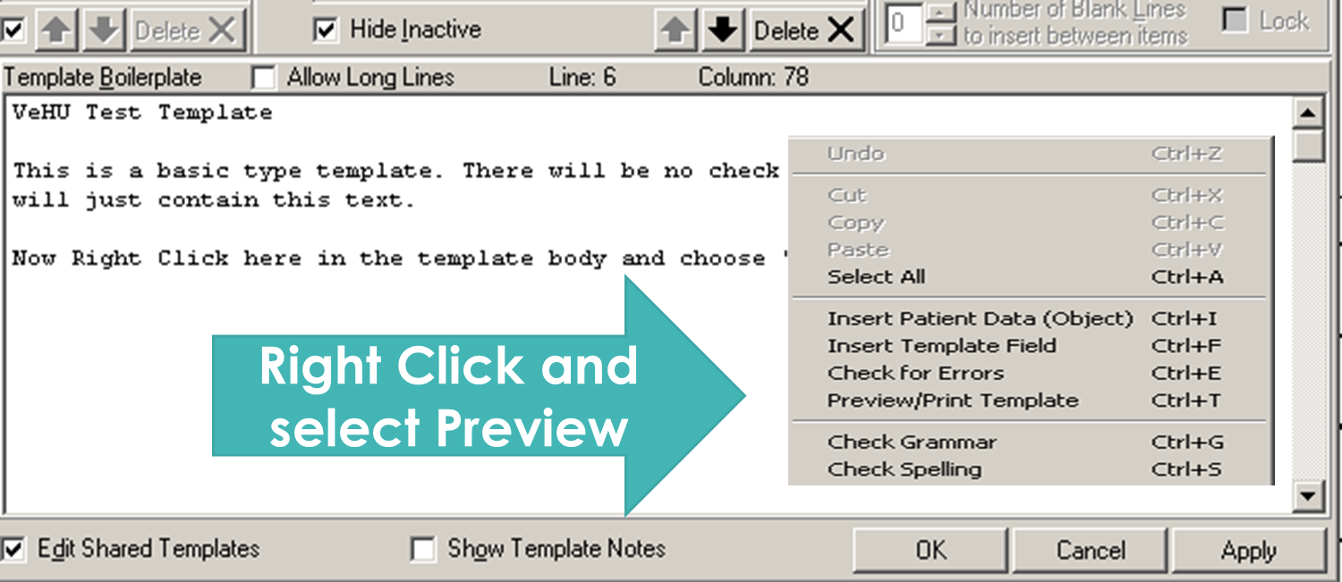
Notes:
Once you have added text, Right Click in the template body and select Preview
<next slide> <Preview>

Slide 32
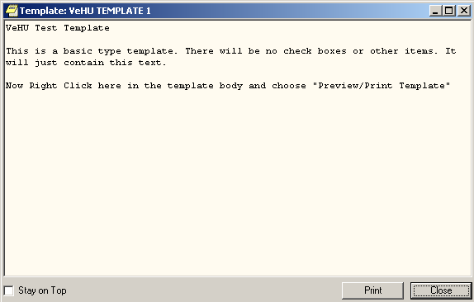
Basic Template Preview
Notes:
This is a preview of a Boilerplate Template.
The boilerplate templates just dump text into our note, there is no template that appears as a popup window,
so the preview we see here then is how the text looks in the note.
This is were we review for typos, spacing issues and so on.
If we like what we see then we:
<Next Slide>

Slide 33
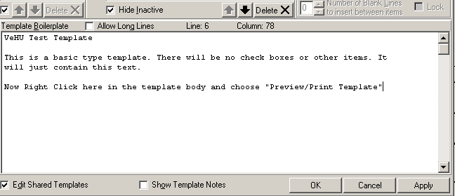

Apply
Apply
Apply
Notes:
After previewing and if we are satisfied with the content.
APPLY APPLY APPLY!!!!
Can’t stress this enough!
If you exit the Template Editor without clicking APPLY your changes WILL NOT be saved!
The template Editor DOES NOT prompt you to save changes like Word or Excel!
It DOES NOT AUTOMATICALLY save your work!
Clicking OK and Cancel WILL NOT save your work.
You can use this apparent flaw to your advantage though.
Say you start playing around in an existing template and you really messing things up, just click cancel and it’s like it never happened.
<Next Slide><Poll Question>

Slide 34
Poll Question
What is the safest way to open the CPRS Template Editor?
    Clicking Create Shared Templates
    Clicking Edit Shared Templates
    Clicking Edit Templates
    With universal precautions
Notes:
Let’s see if you were paying attention.
What is the safest way to open the CPRS Template Editor?
Clicking Create Shared Templates
Clicking Edit Shared Templates
Clicking Edit Templates
With universal precautions
Please click the blue Polling icon in the upper left of your screen and make your selection now.
We will review your answers in a few minutes.

Slide 35
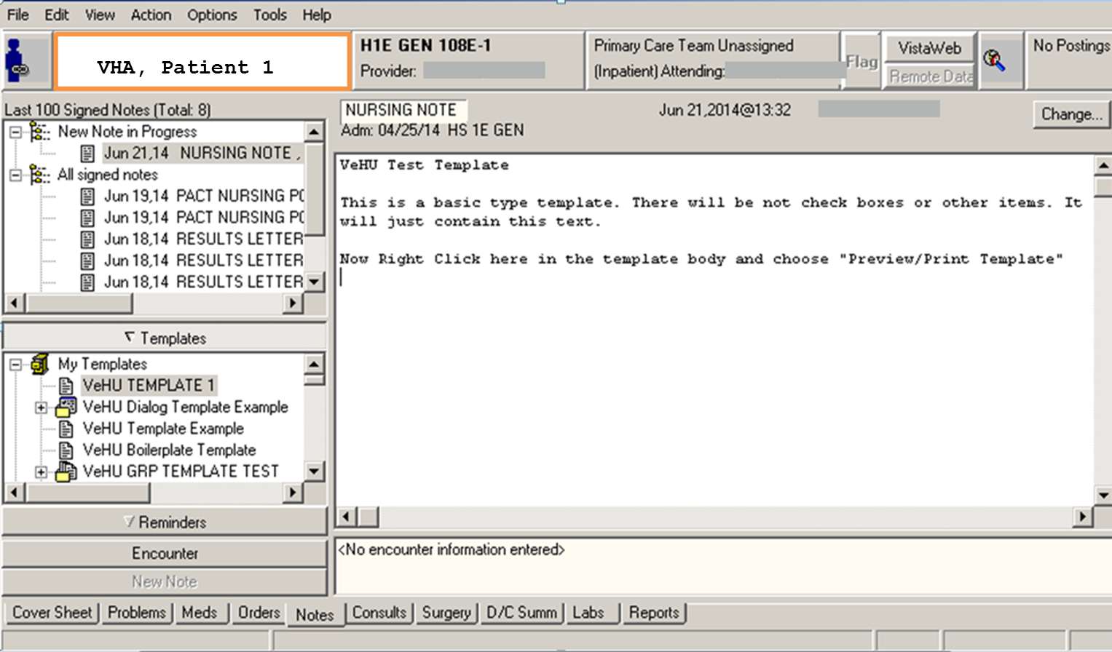
Notes:
Here is an actual note view from CPRS.
The text on the right side is the template OUTPUT.
Boilerplate templates work by just dumping the text into the note body.
-User can then edit the text in the note like a Word document
-2 benefits for Boilerplate templates
-Chart not locked
-Text saved with time out
So, what’s makes a popup template?
<Next slide> <Popup via template filed>

Slide 36
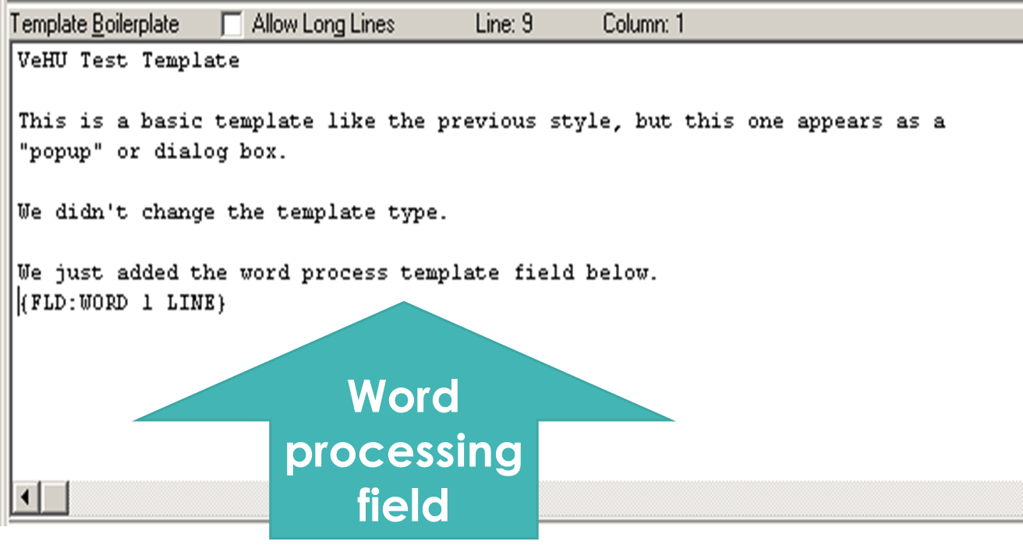
Notes:
A popup template will occur with a boilerplate template that has a template field added or when using a dialog template type.
Here is our boilerplate template with a template field added. This will make the template a popup dialog box for the user to fill in.
Let’s now look at template types and build a dialog template.
<Next Slide> <Template Type>

Slide 37
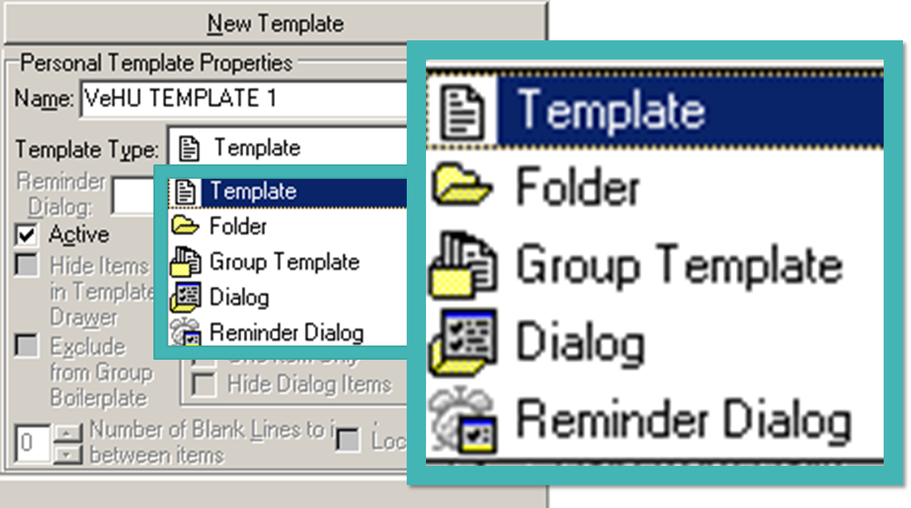
Notes:
The Template Editor gives 5 options for template type.
<Briefly explain the options>
Template: This is the type we have now.
Folder: explain-we’ve already seen these
Group Template-Works like a folder. Has a contains a list of templates.
Dialog-Makes a popup style template, this type we will pick next.
Reminder Dialog-Built in VistA. Not for the scope of this class.
<Next Slide><Change Type>

Slide 38
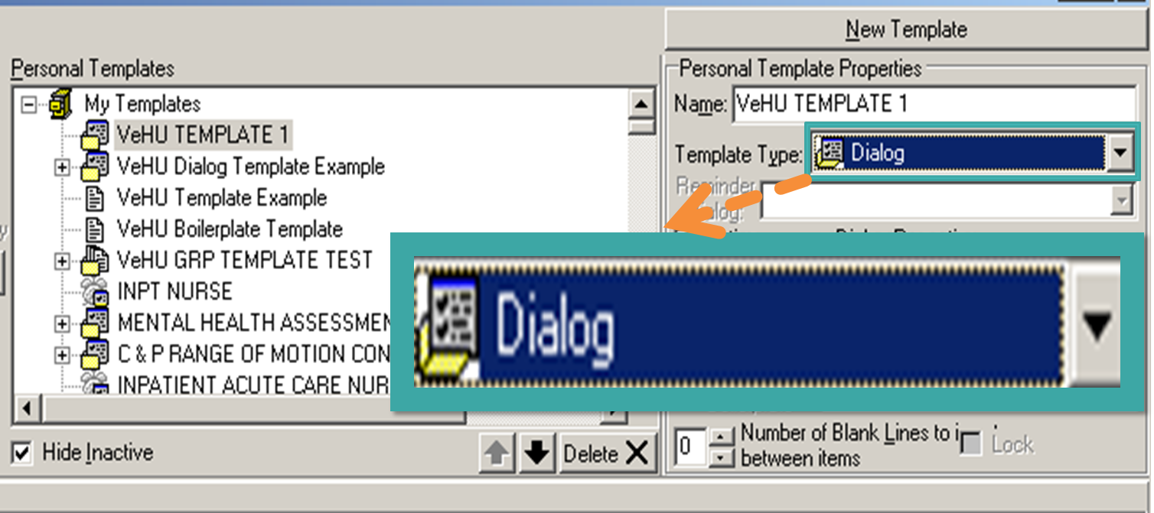
Notes:
Here we have changed our template type to Dialog
Note: Dialog Properties now active:
Only first two are active—apply to single template
Remaining three active when Child Templates are added.
So why Dialog and not dialogue?
Dialogue is a conversation between two people:
Dialog is short for Dialog Box which is
-a box that appears on a computer screen with a question inside asking the user to make a choice or give information
So when we speak of templates, dialog is the proper term. It’s not a conversation, it is a box that appears to the user requesting information.
In CPRS we have many types of Dialog Boxes, templates of course, but others such as Order Dialogs, Allergy Dialog and Encounter Dialogs to name just a few.
<Next Slide>

Slide 39
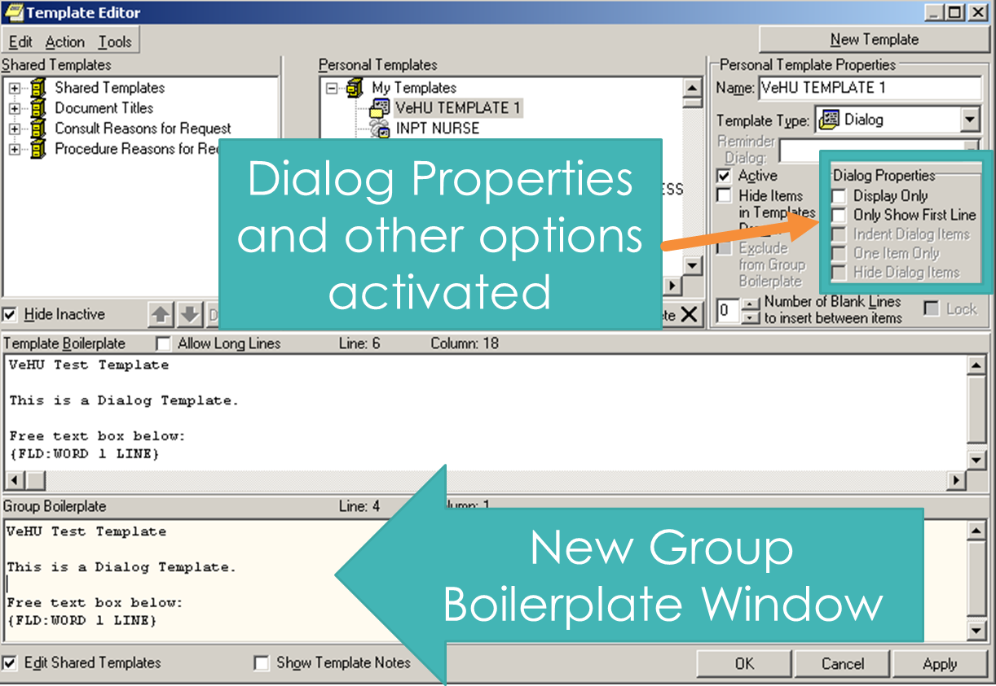
Notes:
Changing the template type to Dialog adds the Boiler Plate Group Window at the bottom of the editor.
can’t type here
Preview of the templates above
Preview of all the text in the group of templates.
Now let’s preview our template and see what it looks like:
<Next Slide><Preview>

Slide 40
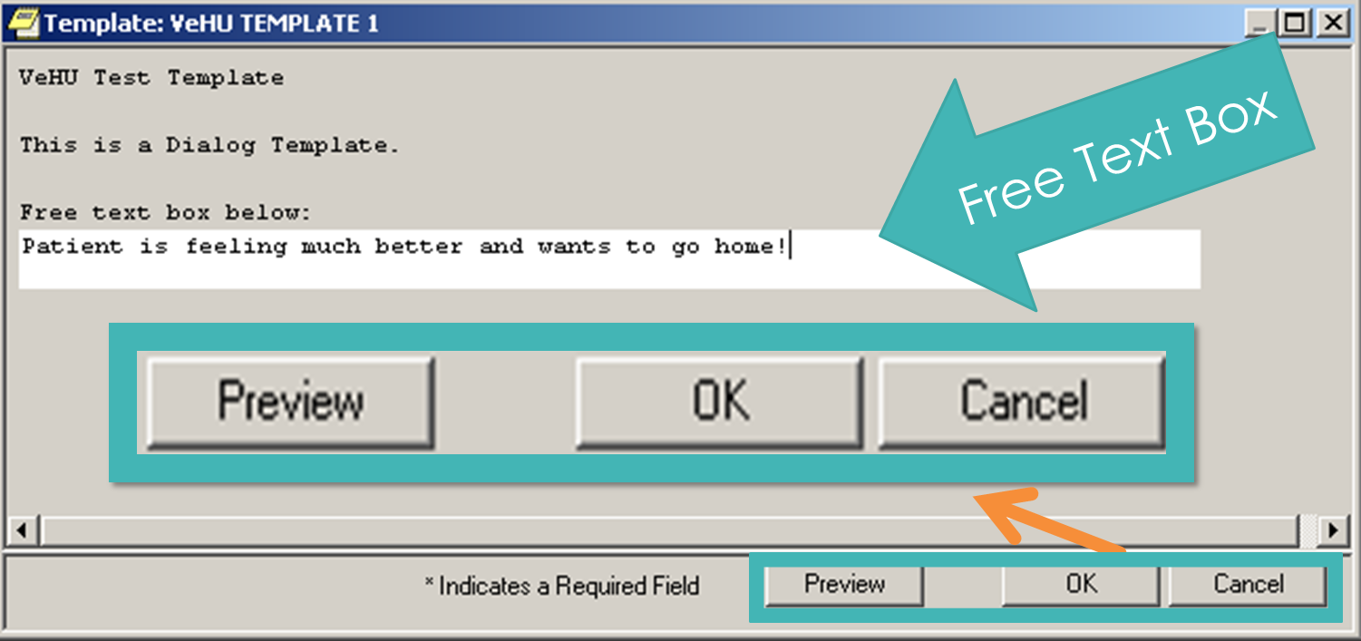
Notes:
Here is our Dialog Template.
We have “Preview”, OK and Cancel” buttons on the bottoms
--Preview button
-Shows template OUTPUT
This is a basic Dialog template. These templates can do so much more.
Before we see what these puppies can do let’s take a look at our poll results.
<Next Slide><Poll Results>

Slide 41
Poll Results
What is the safest way to open the CPRS Template Editor?
    Clicking Create Shared Templates
    Clicking Edit Shared Templates
    Clicking Edit Templates
    With universal precautions
Notes:
The safest way to enter the Template Editor is by C: Clicking Edit Templates.
This opens the template Editor to the Personal Template Section and without creating a New Template.
Looks like most of you……..AD LIB
<Next Slide> <Poll Results>

Slide 42
Poll Results
What is the safest way to open the CPRS Template Editor?
    Clicking Create Shared Templates
    Clicking Edit Shared Templates
    Clicking Edit Templates
    With universal precautions
Notes:
Click again

Slide 43
Dialog Template Benefits
Allows Child or Sub-templates
Dialog Properties
Notes:
Allows Child or Sub-templates
Create different sections
Decision trees
Dialog Properties
Display only
Only Show First Line
Indent Dialog Items
One Item Only
Hide Dialog items
Now let’s explore these benefits. We’ll start with adding a Child template.
<Next Slide> <Adding a Child>

Slide 44
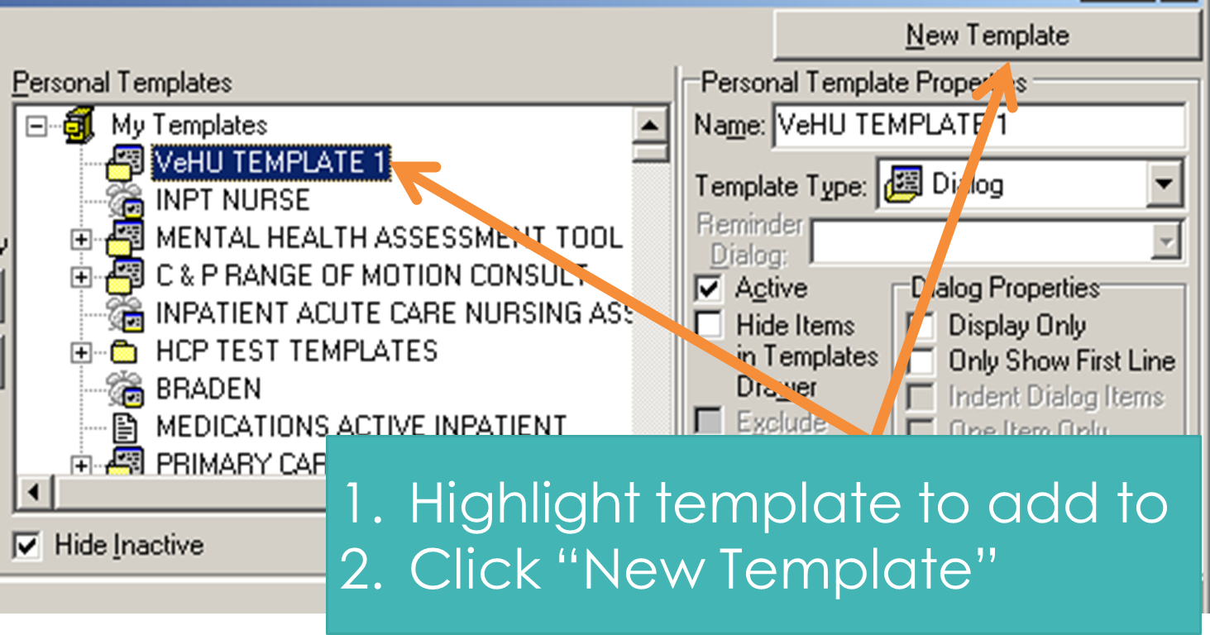
Notes:
Adding a child template
Using the same steps as before. We highlight where we want the Template Editor to put our new template.
Then we name our template. Remember we have to choose something other than “New Template”
<Next Slide> <Dialog Properties Open Up>

Slide 45
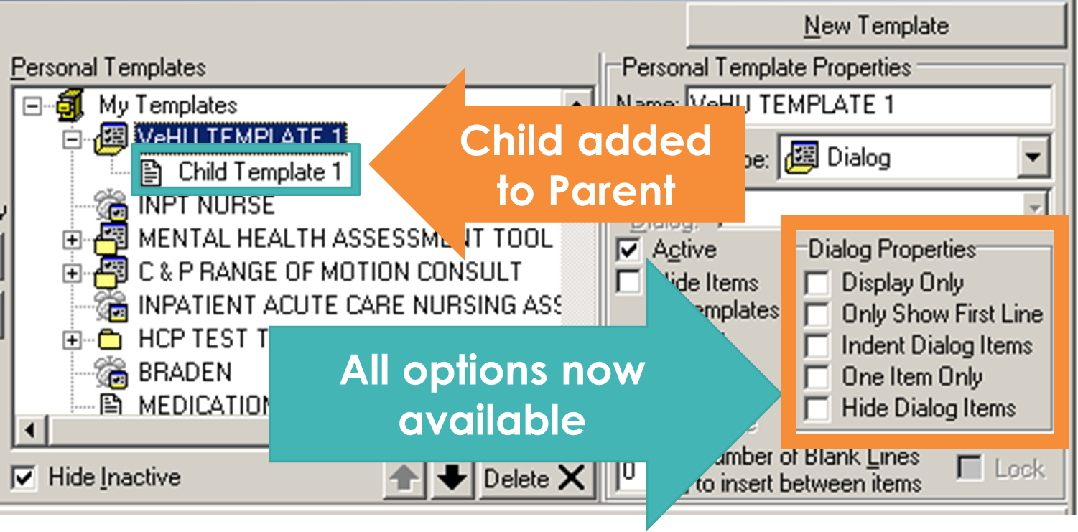
Notes:
Now we have a REAL Dialog Template
A main or Parent template with a Child template underneath.
Now we have the full array of Dialog Properties available---As the parent is highlighted, the properties apply to the Parent and it’s contents at this point. If we select the Child templates, the properties will apply to the Child template and it’s contents.
You can repeat this process to add more Child templates to the Parent.
You can also add sub templates to the child template. To do this, change the Template Type of the Child template to Dialog
Select the Child template and then click New Template.
THIS sequence>>>> “Select to highlight>> Click New Template” process will become second nature to you. You will be repeating that again and again as you build templates and build more and more complex templates.
Let’s preview this and see what it looks like:
<Nex Slide> <Preview Child>

Slide 46
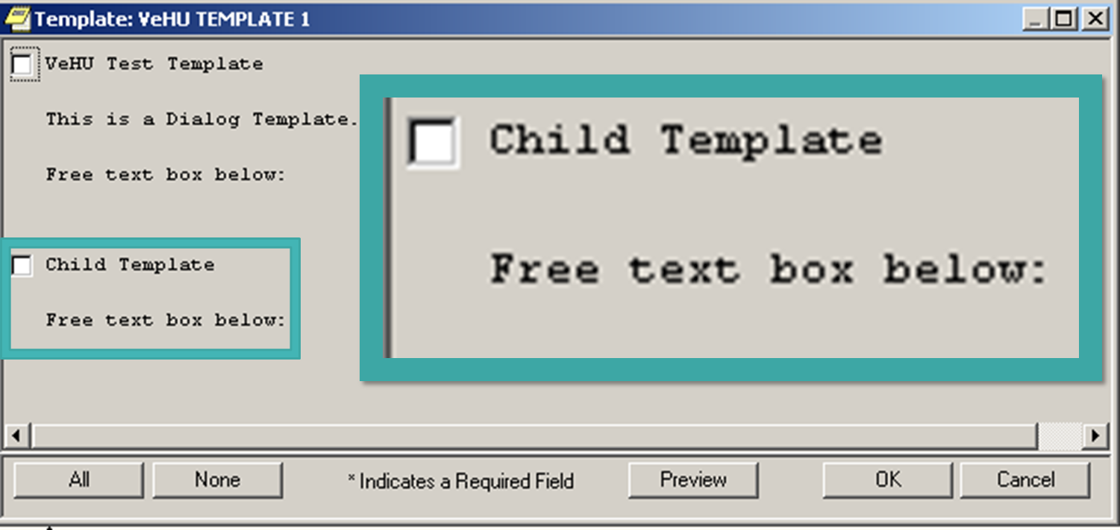
Notes:
Now our example is starting to look very different from our previous examples.
Not just because of the added text,
But we now have Check boxes.
When a Dialog Template has a child template added to it, it adds a Check Box at the beginning of the template AND
For the child template you added.
This allows you to create subsections to a template.
What happened to our free text boxes though?
They are still there. In order for them to show you have to Activate the template by selecting the Check box;
<Next Slide> <Dialog/Group of Templates>

Slide 47
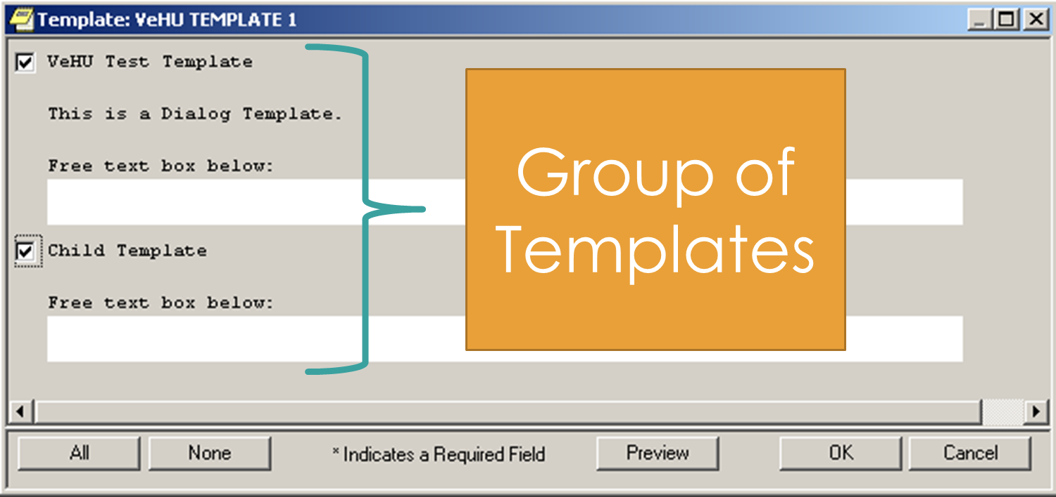
Notes:
Now that we have put checks in the boxes by left clicking on them, the sub-template is active.
So what we are looking at now is a template that is a Group of Templates.
<Next Slide> <Extra Template Buttons>

Slide 48
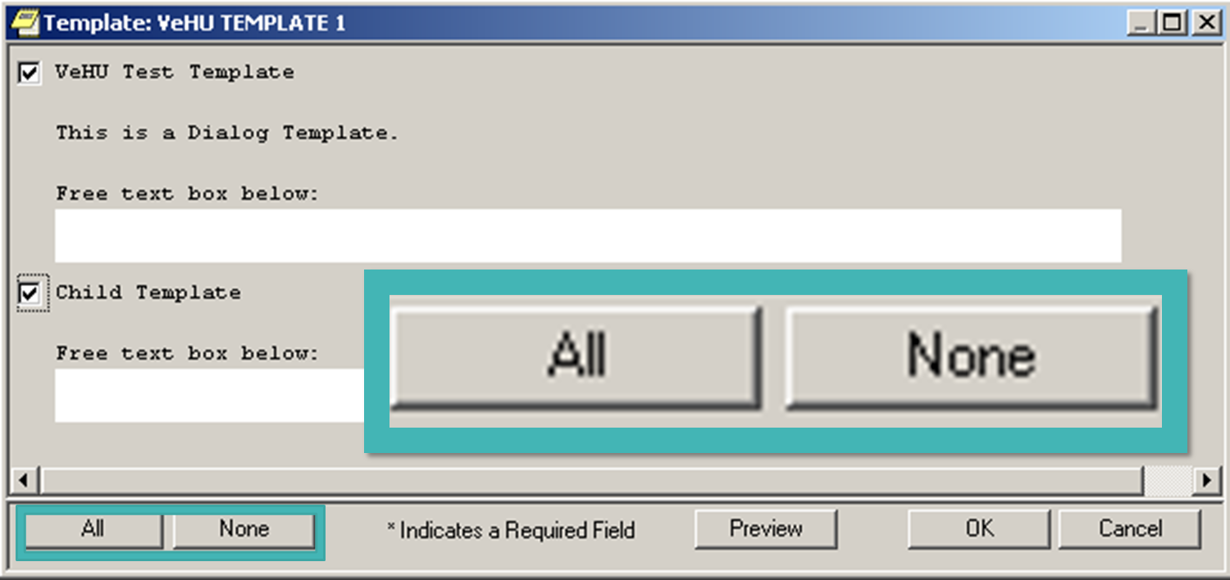
Notes:
Note also that we now have 2 new buttons at the bottom of the screen: the ALL button and the NONE Button
Clicking the ALL button activates ALL the Templates in the Group. If there are sub templates added to the child templates, you have to click ALL again to activate them and so on.
NONE simply deactivates all the templates.
Some users like to see all the sub sections when they start charting and so will use the ALL button to open the entire template. Some templates are very long and clinicians will often want to see everything that they must fill in to gauge how much time they will be spending.
<Next Slide><Tailoring for form and function>

Slide 49

Notes:
Template Formatting:
Now that we have explored the template functionality, let’s tailor our template for form and function.

Slide 50
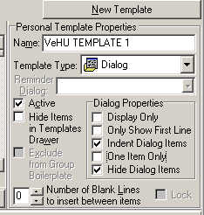
Notes:
Let’s start with 2 Dialog Properties:
Indent Dialog Items and Hide Dialog Items
Indent Dialog Items
-Indents the Child template
-Useful for subsections or hierarchical display.
Hide Dialog Items
Hides the Child templates until template activated.
Useful for Decision Trees.
Now let’s take a look at how these two properties have changed our template.
<Next Slide> <Dialog Property Review>

Slide 51
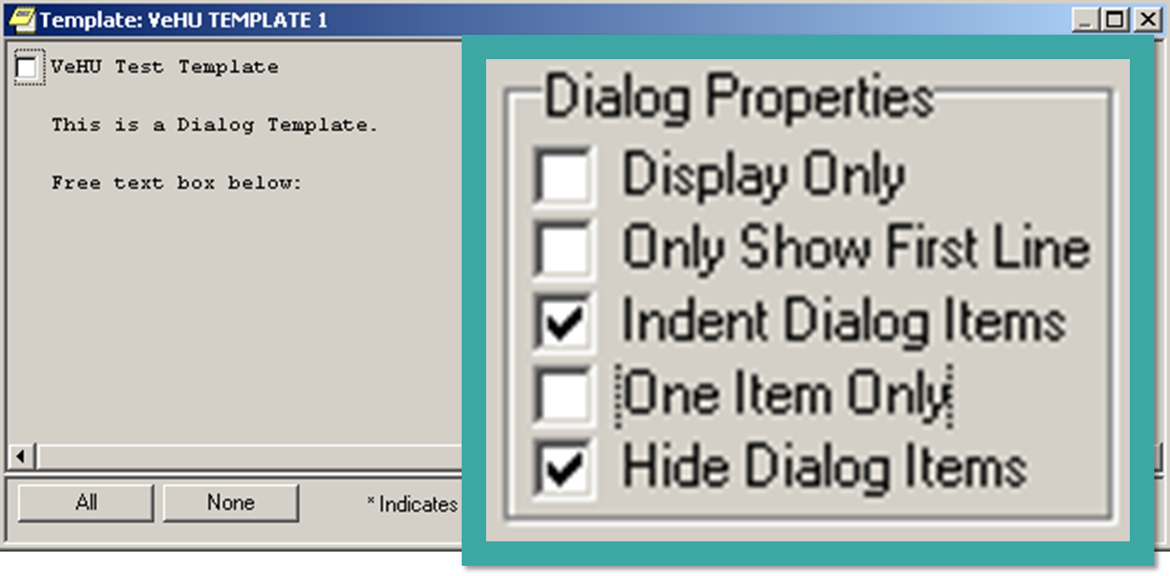
Notes:
OK….So what happened to our Child Template? It’s gone!
No, it’s not really gone. Remember in the last slide we told it to “Hide Dialog Items”. Well it did what we told it to do. It hid the Child template.
Also, it indented the Child template and we will see that in just a moment.

Slide 52
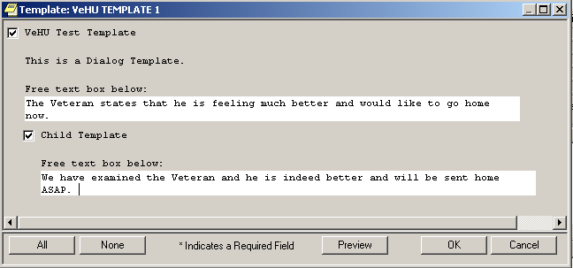
Notes:
When we clicked on the first check box to the left of VeHU Test Template the Child template appeared.
We also put a check in the Child template so we could type some text in the free text box.
So that’s how Hide items works.
We’ll look at the Indent Property in a few moments.
Now, why would I want to use this Hide Dialog Items?
<Next Slide> <Hide dialog answers>

Slide 53


Hide Dialog Items Benefits
Cleaner look
User focused on items displayed at that step
Useful for Decision Trees
Notes:
Hide Dialog Items has numerous benefits.
Cleaner look
Not As Cluttered or Busy Looking
User focused on items displayed at that step
User not overwhelmed by a big long template.
Useful for Decision Trees
As the user answers questions, more specific questions are displayed
Now lets looks at Indent Dialog Items
<Next Slide> <Indenting Dialog Items>

Slide 54
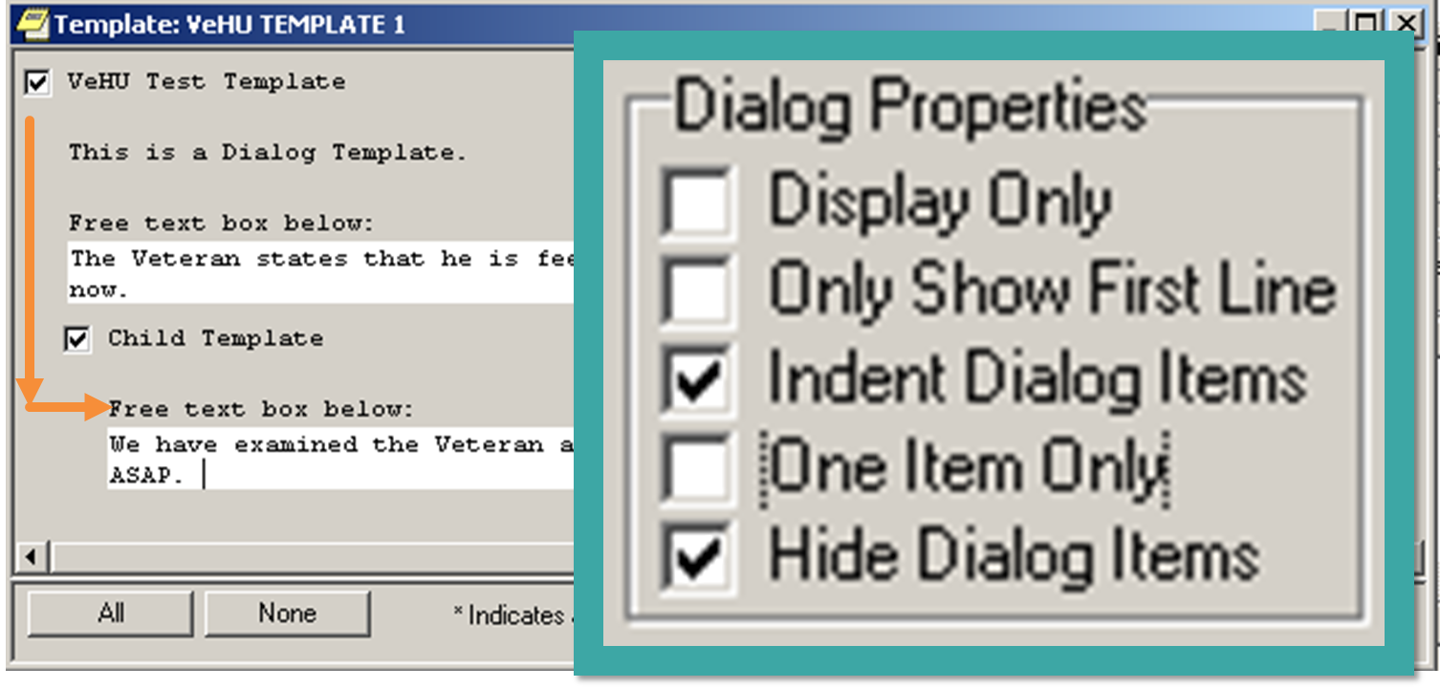
Notes:
Now let’s talk about our Indent Dialog Items
The Indent of the Child Template is obvious. It’s not left justified under the Parent. It’s farther over to the right.
It is important to note here that the Indent Dialog Items ONLY affects the template display and it DOES NOT indent the text that will appear in the note.
Let’s preview the template output again to confirm that statement.
To see how the “Output” of the template or how it will look in the note, Click the PREVIEW button at the bottom of the template.
<Next Slide> <Output preview>

Slide 55
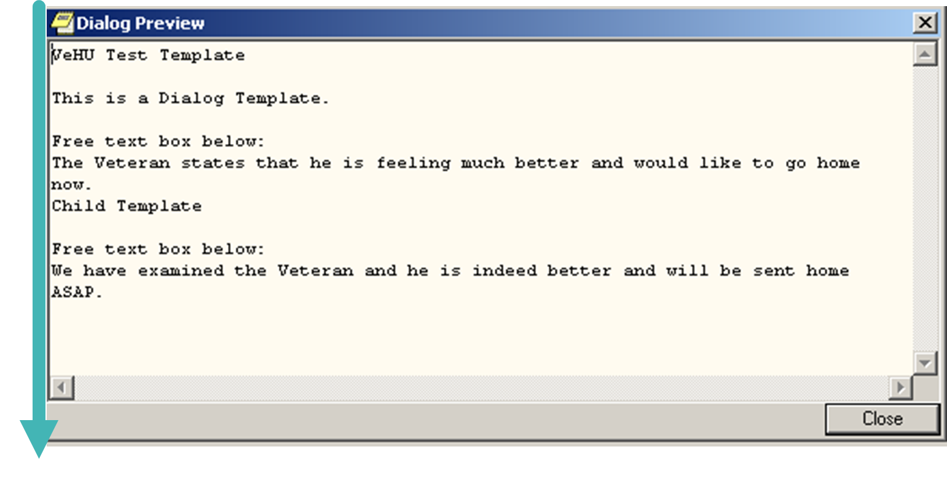
Notes:
We can see that everything is left justified.
So how do we indent the note text?

Slide 56
“Indent Dialog Items”
only indents in the template display.
To indent the Note text
add spaces before boilerplate text and/or template fields.
Notes:
To indent the Template Output text add spaces before boilerplate text and/or template fields.
Let put some spaces before our lines in the Boilerplate text.
<Next Slide> <Added Lines Preview>

Slide 57
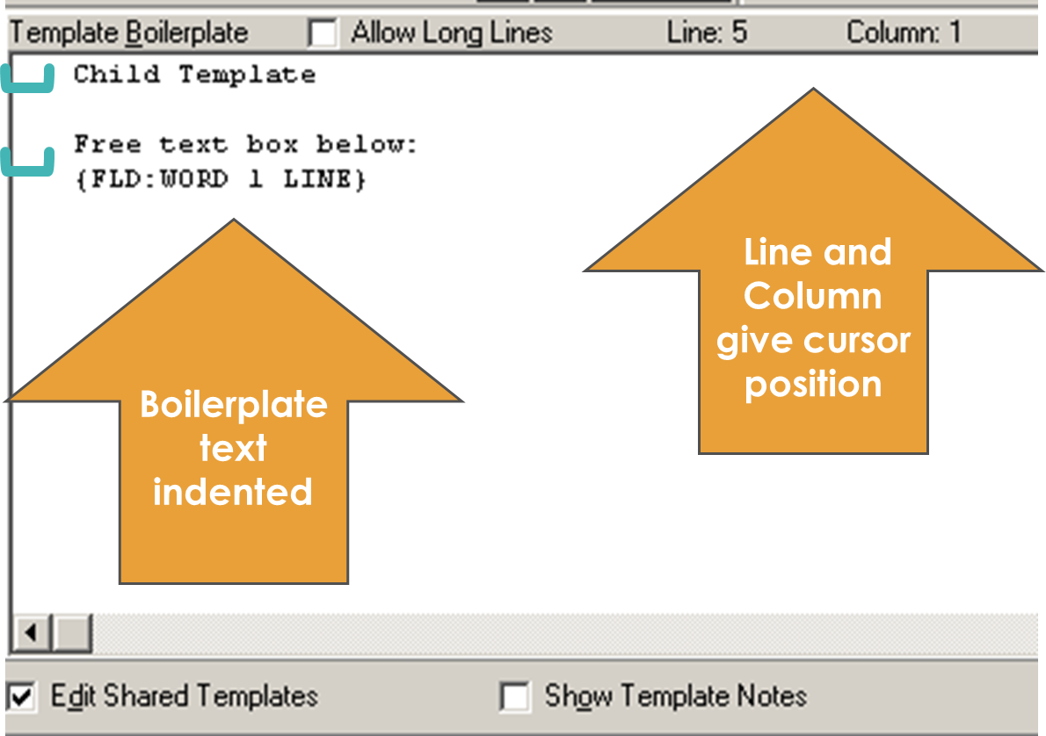
Notes:
This is the Boilerplate text in our Child template.
Spaces have been added before each line of text and before the template field.
Now we have added spaces before each line of text and have also moved the template field over the same number of spaces.
Line and Column Markers are useful for formatting.
-Line = horizontal line
- Column = number of spaces on a given line.
Let’s preview again to see how these changes look.

Slide 58
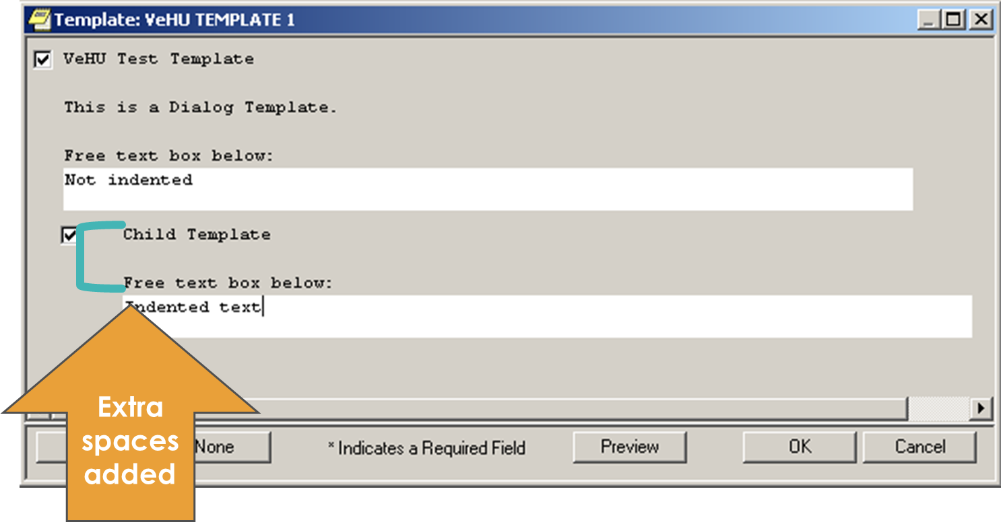
Notes:
We can see that the Child Check box is still indented. That is the dictated by the Dialog Properties we selected several steps ago.
What’s different now is that there are several spaces between the Child Template Check box and the Text “Child Template”
The same number of spaces are present before the “Free text box” statement and before the template field.
Now lets preview the template Output:
<Next Slide> <Line Spaces>

Slide 59
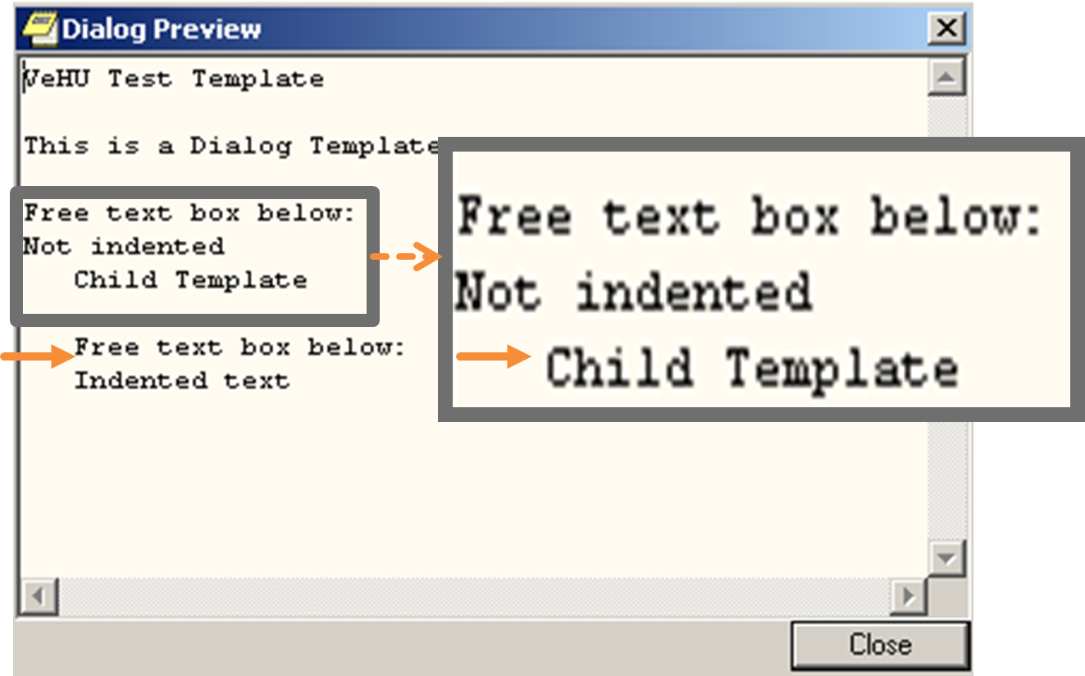
Notes:
OK, now we are getting somewhere.
The note text for the Child template is indented in the template output now.
But I’m not really liking that the “Not Indented” is right on top of the “Child Template”
How do we get some space in there?
Recall that the text “Child Template” is in a separate template.
To add line spaces between lines and between templates use the enter button.
<Next Slide> <Enter Key>

Slide 60
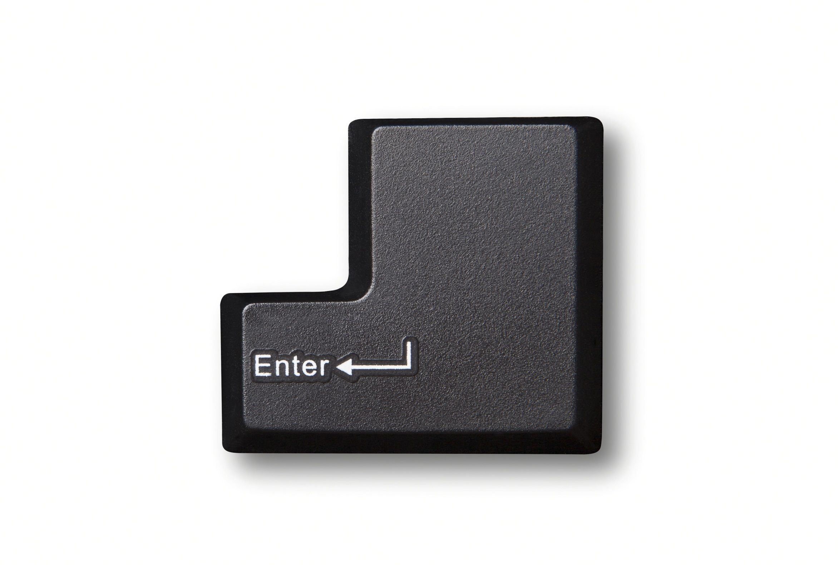
Text Spacing-Hit The Enter Key
Notes:
To add spaces between lines of text hit the enter key.
To add spaces between the lines of the template output text of adjacent templates hit the enter key.
OK, on this first one, many of you are probably saying “Duh Dave, we know that”.
But what do I mean with the second statement.
To add spaces between the lines of output text of adjacent templates hit the enter key.
To put spaces between lines of text generated by adjacent templates, you must put blank lines at the end of the preceding template.
Let’s take a look:

Slide 61
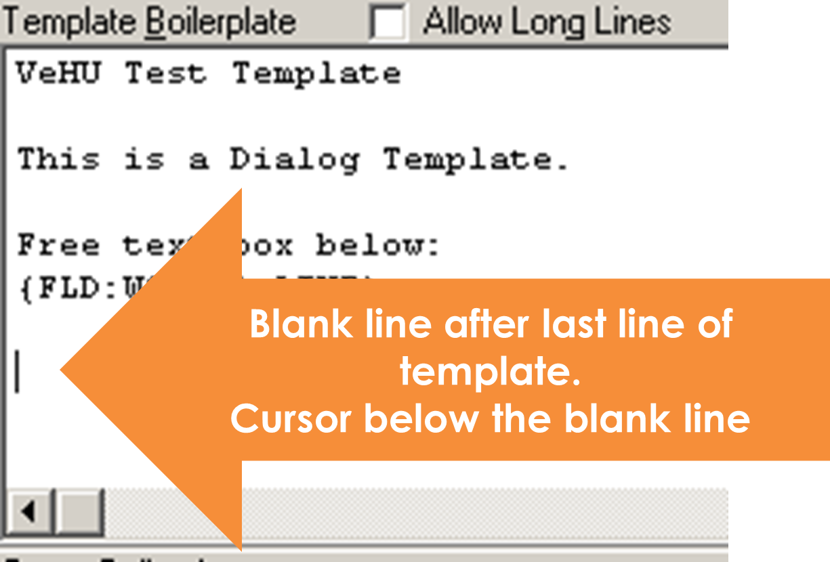
Notes:
Here’s the Parent template we’ve been working with.
We are adding a blank line after the last line of Text.
This will add a blank line in the template output.
However it will not add a blank line in the template display.
Now lets see a preview
<Next Slide><Blank Line Preview>

Slide 62
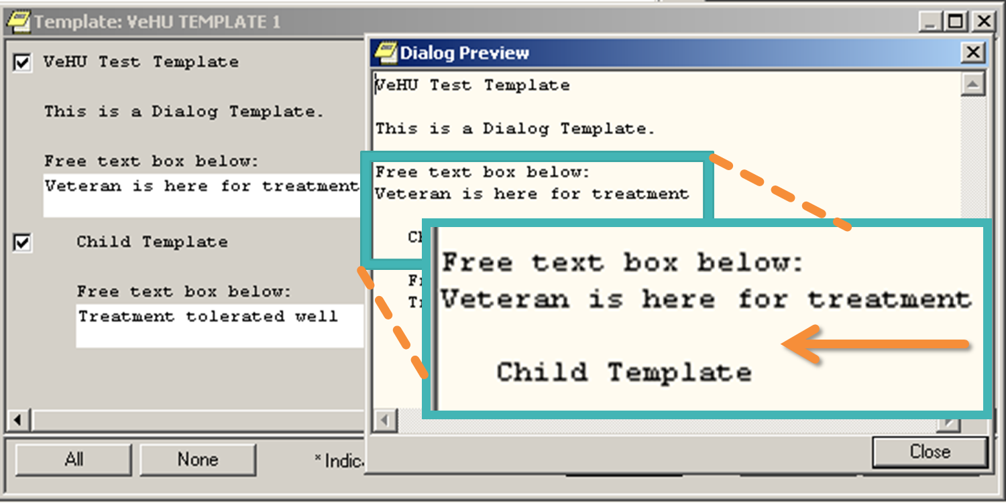
Notes:
Here we have 2 dialog boxes superimposed on each other.
We can see that there is a blank line in the template output text between “Veteran is here for treatment” and
“Child Template”. The words “Veteran is here for treatment” is from the Word Processing field.
Look at the template itself. We can see that an extra line was not inserted in the template display between the Parent Template and the Child Template.
A simple tap of the enter key can add a blank line in the Template Output.
Now let’s look at Display Only
<Next Slide><Display Only>

Slide 63
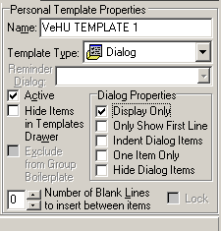
Dialog Properties Display Only
Notes:
This Dialog Property is quite helpful for a number of reasons:
-Can add instructional information to the template that the user needs to guide them in filling out the template, but is not needed in the note.
-Suppresses the Initial Checkbox for that template.
-Many CAC’s will use a Display Only dialog template as the Parent template as it will suppress the check box. This is mostly for aesthetics. It does not suppress checkboxes for other templates.
Let’s make our Parent template Display Only to see how this works.
<Next Slide> <Display Only>

Slide 64
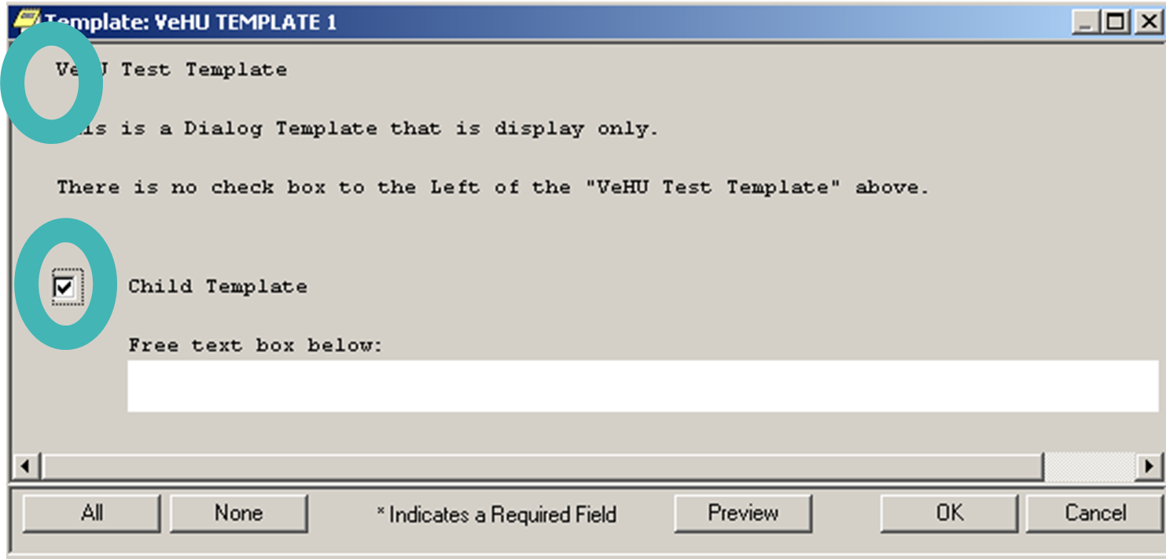
Notes:
Display only example
Note the initial Check Box is gone.
The word Processing field was removed also and the text changed for the example.
Let’s look at the template output.
<Next Slide> <Display Only w/child Output>

Slide 65
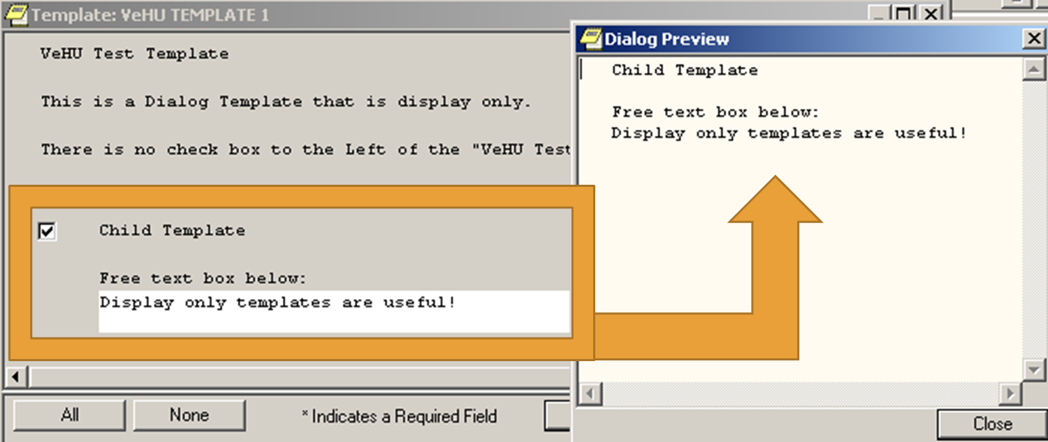
Notes:
Display only template
Note that the text from our Parent Template is NOT in the template Output.
The only output is from the Child Template section.
Now let’s look at “Only Show First Line”
<Next Slide>

Slide 66
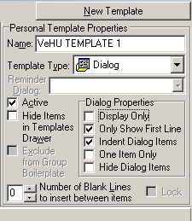
Dialog Properties: Only Show First Line
Notes:
This property Only shows the first line of template text in template display.
Useful for entering large amounts of text into the template output that does not need to be in the template.
The remainder of the template text does not display, but the text will be in the template output.
<Next Slide><One Item Only>

Slide 67
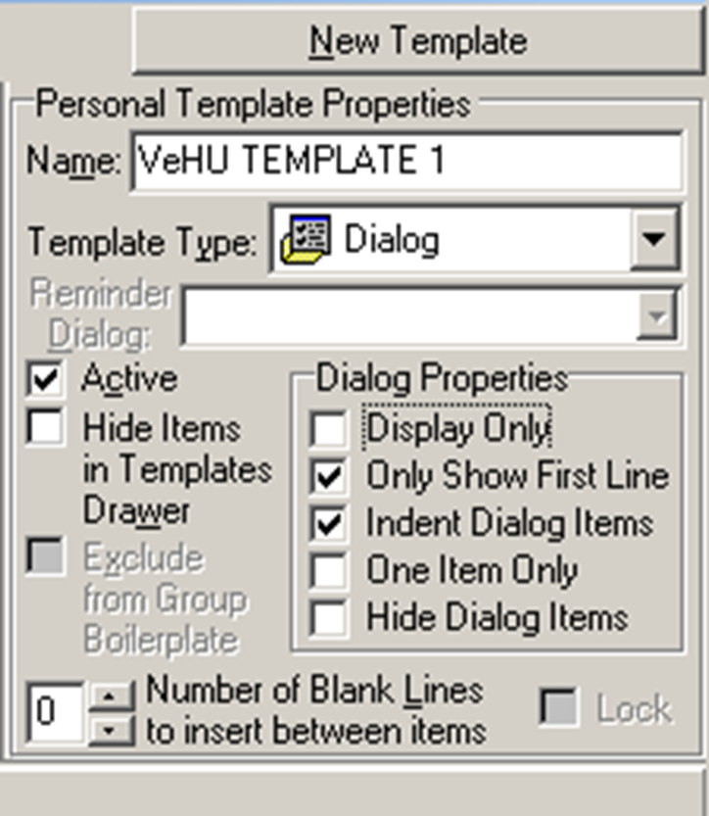
Dialog Properties: ONE ITEM ONLY
Notes:
One Item Only
Forces user to select only one of a list of two or more child templates
Useful when contrasting selections are available, but only one is appropriate. (E.G. Male patient vs. Female patient)
There must be multiple Child templates for this to work. The checkboxes we saw in the previous examples are replaced with “Radio Buttons”.
<Next Slide>

Slide 68
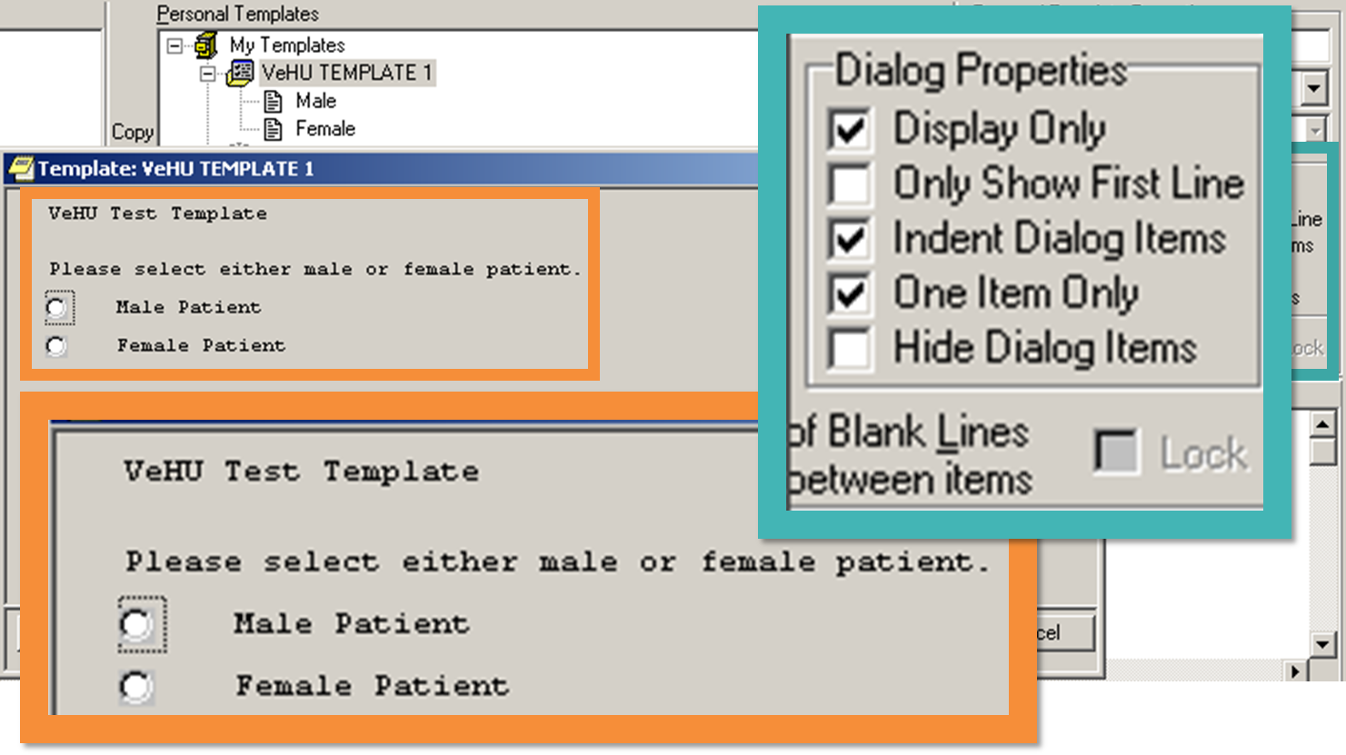
Notes:
Again we have the template superimposed over the Template Editor so we can see how our Dialog Properties selections affect our template display.
<Next Slide>

Slide 69
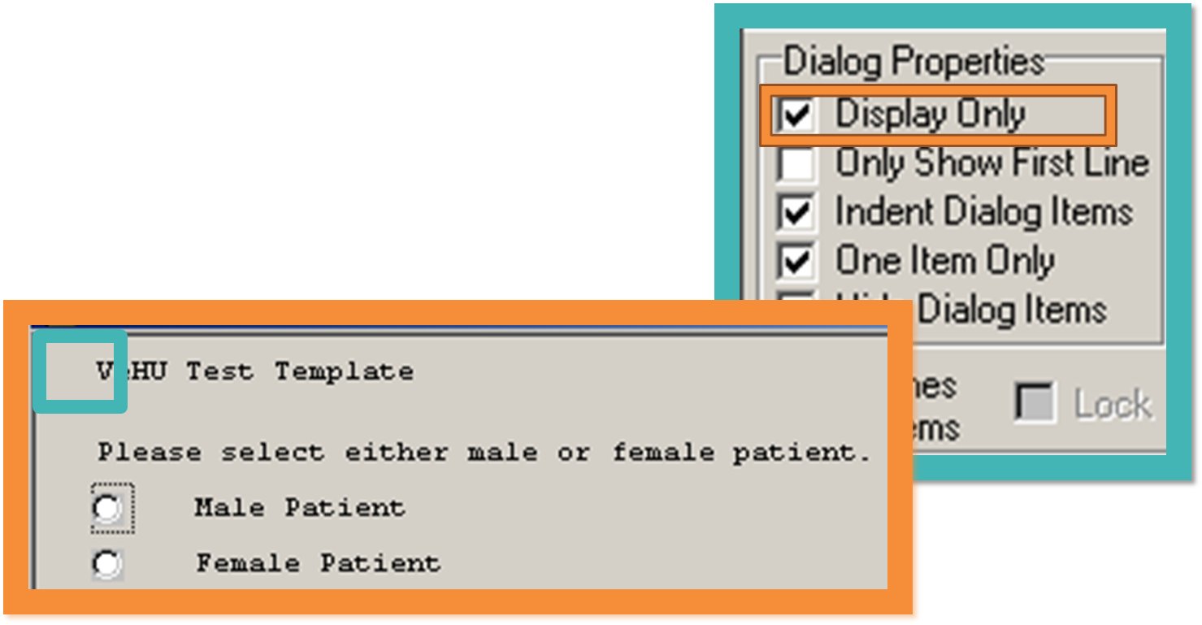
Notes:
The Parent Template is Display Only”
-The ”Please select male or female patient” statement will not show in note
-Instructions for the user to make a choice.
<Next Slide>

Slide 70
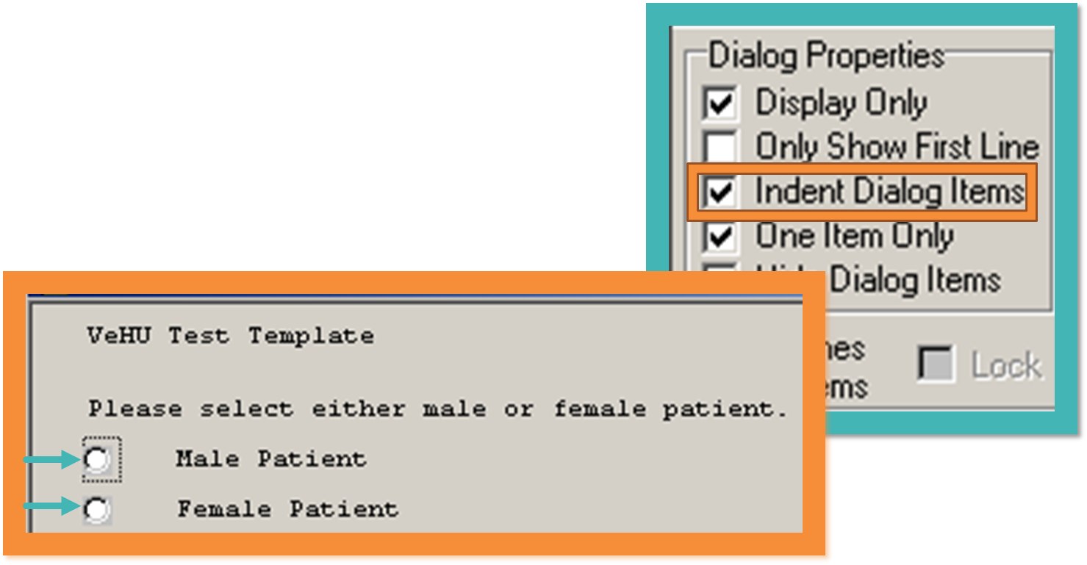
Notes:
Indent Dialog property has indented the Male and Female Child Templates in the template display.
<Next slide>

Slide 71
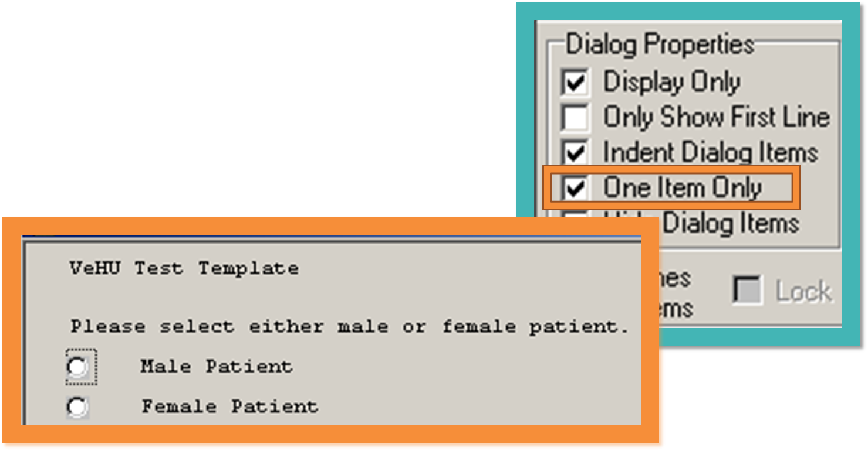
Notes:
One Item Only –The user can select either Male or Female.
This is useful as documentation can differ greatly for male and female.
Now let’s look at items to place in our templates other than text:
Patient Data Objects
And
Template Fields

Slide 72

Patient Data Objects
Pulls patient data into the note
Built using Health Summary Components
Can be built with specific data range
2 yrs
Notes:
-Pulls actual patient data into the note. (Demographics, Vitals, Lab Results, Advance Directives).
-Built using Health Summary Components
-Can be built with specific data ranges. (Most recent lab result, LDL Last 2 yrs).
Vary from site to site
-To access the Patient Data Object list we Right click in the template body and chose “Insert Patient Data Object”
Let’s look at the list.
<Next Slide>

Slide 73

Notes:
The PDO list has many objects.
As most are built locally, the will vary greatly from site to site.
-Naming conventions vary from site to site.
-In the template with double bars ||
-Bars are command characters and one on either end is needed for object to work.
-You can’t use Bars in the template text as they are associated with PDO’s. Using them will generate errors in your template.
-Can’t preview PDO’s. have to insert into the template and then preview.
<Next Slide>

Slide 74

Active Problem List
Notes:
Patient Data Object Example
This PDO will pull in the list of Active Problems from the Veteran’s record.
<Next Slide>

Slide 75

Notes:
Template fields
Template Fields are POWERFUL tools to help you create templates to meet the needs of your customers.
They can be used to supplement the dialog properties we just explored and they can be used to do what the dialog properties cannot.
They can optimize the template for ease of documentation.
They can be used to create items that are mandatory or required to be addressed by the user.
There are a multitude of uses and applications for Template fields. They are indispensable for optimizing templates for form and function.
Let’s explore template fields
<Next Slide>

Slide 76

Notes:
To Insert Template Fields
Right Click in the “Template Boilerplate” and select Insert Template Field as we did with Patient Data Objects
The Insert Template Field dialog opens and there are a MYRIAD of templates fields available for your to choose from.
As with PDO’s there are National, VISN, and local Template Fields.
Local naming conventions vary.
Let’s take a closer look at the list
<Next Slide>

Slide 77

Notes:
The list contains thousands of template fields of variety of types.
A really useful feature here is the “Preview” button. You can select any Template Field and get a working example of the template field.
<Next Slide>

Slide 78
Template Field Types
Edit Box
Combo Box
Button
Check Boxes
Radio Buttons
Date
Number
Hyperlink
Word Processing
Text
Notes:
These are the types of template fields.
We will look at some of these and build a few to get our feet wet.
<Next Slide>

Slide 79

Notes:
The template field list has 2 columns.
On the Left is the Name of the field. Most of the time this is self-explanatory, although naming conventions vary from site to site.
The other column displays the type of template field.
When a template is imported into your system any new template fields contained in the template will be installed and made available on this list.
<Next Slide>

Slide 80

Notes:
Date template field
Let’s look a commonly used field, the Date Field.
Type Date in the top search bar.
A list of all fields with Date are listed and there are MANY!
Select a field from the list.
Then select preview to see the field.
<Next Slide>

Slide 81

Notes:
This is how the Date field displays.
In order for the calendar to appear the user must click the box with the 3 dots.
The calendar feature is very commonly used. Some of the fields have date and time as well.
Let’s add this to our template to see how that’s done.
<Next Slide>

Slide 82

Notes:
We insert a template field by highlighting the template field and click Insert Field.
<Next Slide>

Slide 83

Notes:
Here we have our Date field inserted in our template.
Template fields have a specific structure in the template. If there is a variation of this structure, the field will not work.
Lets look at the structure.
Template fields all start with a CURLY BRACE,
<Next Slide>

Slide 84

Notes:
Then have the letters in caps FLD a colon
<Next Slide>

Slide 85

Notes:
and then the template name
<Next Slide>

Slide 86

Notes:
Then a closing curly brace.
This format must match the Template field name from the template field list other wise it will not work.
Curly brace needs to be on either end AND on the same line.
Can’t use curly braces in your template text or it will generate errors.
Let’s see how this field looks in our template.
<Next Slide>

Slide 87

Notes:
Here we have 3 template fields:
A Date field
A required Yes/No Radio button
And a required Word Processing field.
There many ways to incorporate template fields into your templates. The best way to learn what to use and when really is through practice. Explore the existing template fields. Insert them into a test template and test them out. See how they display. Preview the template to see what their output is like. There is no substitute for hands on learning.
Now that we know how to Find template fields, lets build one.
<Next Slide>

Slide 88

Notes:
This is the Template Field Editor. We access this from the Tools Menu in the Template Editor.
We will use this to create new template fields.
Some advice before we start.
<Next Slide>

Slide 89
Template Field Building
Notes:
<Comment on each:>
-Start building template fields in the Test Account and not Production!
-Use local naming conventions. (prefix etc)
-DO NOT alter the names of existing template fields unless you know EVERY template that field is used in. You will need to change the name of the template field in EVERY template or they will not work.
-Use CAUTION when altering content of existing template fields.
<Next Slide>

Slide 90

Notes:
Check boxes are frequently used in templates.
They contain text with a check box near each item to select it for inclusion in the template output.
This example is for Barriers to Learning.
Let’s build a check box template field of our own.
<Next Slide>

Slide 91

Notes:
In the Template Field Editor
Click New
<Next Slide>

Slide 92

Notes:
Type a name, 3 plus characters. Try to name it so that it’s name indicates what it does.
In our example we are creating checkboxes with family history selections.
<Next Slide>

Slide 93

Notes:
Click the drop down arrow and select Check Boxes
<Next Slide>

Slide 94

Notes:
Enter the text you want for each selection and hit enter at the end of each line.
Be careful not to hit enter after the last line of text. This will create a check box with no text.
Our previous example was with check boxes on the same line.
Let’s select Separate Lines, which will put the check boxes in a column.
Let’s also make this required.
Special note:
-Beware of blank lines.
-Stretch window with long lines.
-Caution with reviewing existing fields with long lines—Click cancel
Now we can select Preview to check our work.
<Next Slide>

Slide 95

Notes:
This is how it will appear in the template.
Now let’s put it in our template to see how it will look:
This looks good. Let’s keep it!
One last step!
<Next Slide>

Slide 96

Notes:
Here’s how the template field will appear in our VeHU template body.
Note I also added a Edit Field. This will allow the user a free text space if they select the “Other:”

Slide 97

Notes:
Here is how our Check Boxes template field will look in the template display.
Not the Edit Box is right next to the “Other” field. The Edit Box is not part of the Check Box field, but it appears there next to other because we put it on the same line as the Check Boxes template field. Also the Edit Box is small enough to fit on the same line.
Now since this looks good and we want to include it in our template.
What’s our next step?

Slide 98
Apply
Apply
Apply
Notes:
Everybody say!!! APPLY APPLY APPLY
Click that Apply button!

Slide 99

Combo Box Pros & Cons
Notes:
The Combo Box is just a like a drop down menu. The user clicks the down arrow which opens a list of options.
Combo Box Pros
-Cleaner template
-Checkboxes take up real estate
Combo Box Cons
-Extra step to click the down arrow then the item.
-Easy to pick the wrong item
<Next Slide>

Slide 100

Radio Buttons Pros & Cons
Notes:
Radio Buttons are just like the “One Item Only” Dialog Properties
They are useful for making the user select one or the other vs. check boxes where the user can select several options.
They are used a lot as answers to questions.
Does the Veteran get meds from Outside the facility “Yes/No”
One of the major Cons is that they don’t open a field if the user selects one or the other.
So if they select ‘Yes” to the Does a Veteran Get Meds From Outside the VA?” Another window doesn’t pop open stating something like “Specify which pharmacy”.
Many CAC’s will get around that with use of creating a “Display Only” Text Template field That will state “If Yes, please explain”.
Now let’s look at an example of that.
<Next Slide>

Slide 101

Text Field
Notes:
Here we have a display only text field.
Instructs the user to specify any Yes responses.
The Statement is in template display, but not in template output.
Let’s look at how this template field looks in the Template Editor:
<Next Slide>

Slide 102

Notes:
Here is how the text template field is setup.
We have Text selected for type
We have the text we want to display
We have Exclude From Note checked. This makes it viewable only in the template.
<Next Slide><Import/Export>

Slide 103
Importing and Exporting Templates
Notes:
Until now we have been working in our “Personal Templates” section.
Now we want to share this nifty template we have built with users.
We will use the Import/Export functionality of the Template Editor to get our templates into the Share Folder and also associated with a Note Title.
Let’s begin
<Next Slide>

Slide 104

2
1
Notes:
In the Template Editor
Highlight the template in our Personal Templates to Export
Open the Tools Menu
Click On Export
Export to a folder destination of your choice.
<Next Slide>

Slide 105

Notes:
Select Share Templates
Select Import
Navigate to the location you just saved it to.
<Next Slide>

Slide 106

Notes:
Template is now in the Shared Folder.
Let’s change some settings to ensure that this template is used properly.
<Next Slide>

Slide 107

Notes:
I’ve compacted the Template Editor to bring the Properties Closer to the Shared Template Window.
See how the template is expanded out? We can see the Child templates.
We don’t want the user to select one of the Child templates on it’s own, but rather we want them to open ONLY the parent and then access the Child templates that way.
We do this by selecting “Hide Items in Templates Drawer”. The templates drawer is accessed via the Notes tab in CPRS.
Locking the template prevents the template from being Edited while in the Shared Templates Root.
In order to Edit a locked template you must Export it as before and Import it to your Personal Templates.
This creates a new copy of the Template.
<Next Slide>

Slide 108


vs.
Notes:
Here are two examples of Shared Templates.
On the top is Shared Templates from the Templates Drawer on the Notes Tab in CPRS.
One the bottom is the Shared Templates Window and the Shared Templates Root Folder
Note the view on the left. There is no + sign next to the template like there is on the right view in the template editor.
It is locked in the Template drawer.
This will prevent users selecting a sub-template.
Now let’s take our template and associate it with a note title.
<Next Slide>

Slide 109
Associating A Template
With a Note Title
Benefits
Do’s and Don’ts
Notes:
Benefits
Allows the template to Automatically open when note title is selected.
User does not have to find the template in Shared Templates.
Users don’t have to save the template to My Templates
Do’s and Don’ts
DO import the template into the Document Titles Root.
DON’T copy the template from Personal Templates to Document Titles Root
-If the template is deleted from your Personal Templates it will disassociate the template from it’s Note Tile.
-Users won’t see the template when opening the Note title.
<Next Slide>

Slide 110

Notes:
The template has been Imported into the Document Titles Root, we see that there is now a
“Associated Title” Bar.
Type our title name in the Associated Title Bar. VEHU PROGRESS….
The bar will bring up titles after just typing a few letters.
Choose the drop down to see the whole list.
Click on the Note Title from the list.
***I always click in the Body of the template to make sure the APPLY button becomes active.
Confirm the correct title and then>>>>
<Next Slide>

Slide 111
Apply
Apply
Apply
Notes:
Everybody say!!! APPLY APPLY APPLY
Click that Apply button!
<Next Slide>

Slide 112

Notes:
There are 2 types of templates we have not yet discussed, Reminder Dialog Templates and Group Templates.
-Reminder Dialog Templates are built entirely in VistA and are beyond the scope of this class. I encourage you to attend David Carter’s Session 14101 Back to Basics: High Performance Reminder Dialogs.
-Group Templates are a type of TXML template very similar to Dialog Templates.
1. Allows you to have sub or child templates
2. Parent template controls the child templates.
-Benefits
1. Suppresses check boxes for child templates
2. Displays a list of child templates in shared templates.
-user can pick the parent and access all the templates
-Or can select the children individually.
****These can be achieved with other template types
-Basic template with template fields added is the same as a template with a suppressed check box. Not many of tho
-Dialog template in Template drawer w/out Hide Items in Template Drawer selected.
Major Cons:
-Lose Dialog Properties functionality
<Next slide> <Functionality Limitations>

Slide 113
Functionality Limitations
Notes:
As we have seen, the Template Editor has a lot of very nice features and options for creating very functional templates.
However there are some functionality limitations that are note worthy. There are workarounds for some of these, other do not have workarounds.
This is by no means an exhaustive list.
VISTA FORMATTING LIMITATIONS;
-As CPRS is VistA, we can’t change fonts, bold, underline, use italics, add color or any other text formatting.
-be creative through the use of CAPS, special characters such as asterisks, ><, +, = etc.
DIAGRAMS/PICTURES
-No diagrams or pictures in the template such as anatomical figures for charting.<<<<No Work around.
LARGE TEMPLATE LAG
-Large templates with many child templates impedes performance.<<<Minimize the size of templates as much as possible.
NO MANDATORY TEMPLATES;
-Dialog Templates with Child templates require checking the box to make the template and the mandatory fields in the template active.
-Thus if they don’t check the box, it’s they can bypass.
-The solution I used was to build template trees. Through using One Item Only and Hide Dialog Items, I was able to build these trees in such a way that the user has to move through the template tree and answer the questions, before moving on to later sections of the template. This prevented bypassing the questions and placed the questions into the tree for the appropriate patient type. After the women’s health questions, the trees are identical. This is a workable solution, but there is a drawback. This is a LARGE template. There are lag times when the template is opened.
<Next Slide>

Slide 114

Known Issues
Chart Locked When Template Open
Text Wrapping Issues
Notes:
There are a fair amount of know issues with the CRPS Template Editor
We will be discussing 2 major issues here today: For a more detailed discussion on CPRS Template issues I encourage you to attended session14104 The Templates of Today and The Needs of Tomorrow with David Carter and I where we will compare and contrast TXML templates and Reminder Dialog Templates.
The first issue is:
-The Chart Locked When Template Open-Describe
>>>Known issue. Several remedy tickets exist
The second issue:
-Text Wrapping
>>>Maximum text length for a TIU note is 80. There are issues with Word Processing type template fields
that have long text length, typically a text length >70
>>>>Let’s look at an example.
<Next Slide>

Slide 115

Notes:
Here is an example of the Word wrapping Issue that occurs when a Word processing template field has a long text length.
<Describe wrapping issue>
This can be maddening of you don’t know what’s causing it.
The cause is that the Word processing field has a default field length of 74.
Word processing fields with long field length, generally >70 can cause this issue.
The issue can be further aggravated by sites reducing the field length parameter setting for a TIU note.
As a rule of thumb, avoid Word Processing Fields with a Text Length >70.
Let’s take a look at how the Word Processing field is setup.
<Next slide>

Slide 116

Notes:
When creating a Word Processing field, set the Field Length to <70
And/or find existing Word Processing Fields with 70 or less.
<Next Slide> <Conclusion>

Slide 117
Conclusion

Slide 118

Ask the Presenter
Notes:
In closing I would like to thank you for spending time with me today to explore Templating in CPRS. I sincerely hope that you now have a better understanding of the functionality available to you in the CPRS Template Editor and are ready to apply these skills. We by no means covered every detail and aspect of this powerful tool. Through practice and trial and error you will acquire the skills need to build templates that suit the needs of your customers. Use your knowledge of what is available to help them achieve their goals.
All of us started out as new CAC’s. We all have learned through trial and error to some degree. Don’t be afraid to try new things. Experiment and push the boundaries, then share your knowledge. Doing so will strengthen our organization and keep the VA the leader in Health Care as we move into the future!
If you haven’t submitted your questions yet, there is still time to do so by clicking on the orange “Ask The Presenter” icon. We’re going to show a brief announcement and be right back to answer your questions.
(Stand still and smile until you see the video come up full screen)

Slide 119
Helpful Links
CPRS Home Page : http://vista.med.va.gov/cprs/index.html
CPRS Icons: http://vista.med.va.gov/cprs/html/306_icon.html
CAC WIKI: https://vaww.wiki.webdev.va.gov/index.php?title=Portal%3AClinical_Applications_Coordinators

Slide 120
Helpful Links
CPRS WIKI: https://vaww.wiki.webdev.va.gov/index.php?title=CPRS_Tips_and_Tricks
VA Software Document Library (VDL) http://www.va.gov/vdl/
Clinical Applications SharePoint: http://vaww.esm.infoshare.va.gov/sites/hps/CACs/default.aspx

