Slide 1


VistA Evolution
VA’s Next Generation Clinical Information Systems
Theresa A. Cullen, MD, MS
Chief Medical Information Officer
Director, Health Informatics, OIA, VHA
W. Paul Nichol, MD
Deputy Chief Medical Information Officer
Director, Health Solutions Management, HI, OIA, VHA
Notes:
Terry – Wing it
______________________________________________________________--
Overview of current major HIT projects that effect VA that CHI staff may be called upon to inform leadership of status or potential impact and/or support deployment.
Overview of VE
What the role of the CHI is in the deployment
Expectations when project comes to site or VISN
How best to prepare for deployment and if there is an available timeline to be shared
Any challenges or outcomes that can be shared

Slide 2

Poll Question
Who do we have in the audience today?
Healthcare Team Member
Healthcare Administration
Health Informatics
Healthcare Association Affiliation (OSEHRA, AMIA, etc.)
Other

Slide 3

VistA Evolution Background
Patient Benefits
Improving the Quality of Healthcare
Program Principles/Goals/Management
Product Roadmap
Product Sets
Interoperability
Community Engagement
Notes:
106480619

Slide 4

How did we get here?
Notes:
Background on VistA Evolution
Need to Modernize
2010 joint iEHR
2013 Focus Interoperability
Vista Evolution
-VistA Core
-Adherence to standards
-Data –scope + interop
-faster
________________________________________________________________
Both VA and DoD have recognized a need to modernize their current clinical information systems.
The VA Health Informatics Initiative and DoD EHR Way Ahead were the initial programs focused on this change
The iEHR initiative established in 2010 was an attempt to have both Departments adopt a common system
In 2013 this decision was revised to have iEHR focus on interoperability of data and have both Departments pursue system modernization independently.
The VistA Evolution is the VA Initiative to modernize our clinical information systems based on the VistA core while increasing adherence to national open standards, improving data scope and interoperability, integrating modern technologies, and decreasing development/acquisition cycle time.
Our mission and goals have not changed.
115562752 – dark pic with scrolls and books

Slide 5

History of VistA
V1
Decentralized Hospital Computer Program (DHCP)
VA Information Systems and Technology Architecture (VistA) / Computerized Patient Record System (CPRS)
“Gold Disk” version of VistA/ Open Source Electronic Record Alliance (OSEHRA)
VistA 4 is the next evolution of open-standards-based, extensible VistA
V2
V3
Au
V4
4
Notes:
History of VistA
DHCP
VISTA CPRS
Gold Disk
VistA 4
---------------------------------------------------------------------------------------------
Local applications based on the Massachusetts General Hospital Utility Multi-Programming System (MUMPS), eventually lead to the Decentralized Hospital Computer Program (DHCP).
Computerized Patient Record System (CPRS), a graphical user interface (GUI) that interacts with the VistA kernel. In the following two decades, VistA has been enhanced and upgraded through development and national release of new capabilities and significant enhancements and modernization of existing capabilities.
In 2012, VA announced the creation of the “Gold Disk” version of VistA establishing a homogenous enterprise-wide VistA to foster rapid and efficient deployment of new capabilities while optimizing sustainment.
VistA 4 is the next evolution of VistA that will harness the powerful core of software and business processes embedded within VistA and apply a modern computing architecture that is modular and extensible, fully leveraging VA’s investment in VistA, and allowing for an interoperable EHR that provides patient-centered care to Veterans, Service members, and their dependents.
(delete this paragraph if you keep previous slide)
Vista Evolution is a VA Program lead jointly by the Office of Information and Technology (OIT) and the Veterans Health Administration (VHA).
The VistA Evolution program will modernize VistA to serve business needs and to support clinical and infrastructure content to fulfill the objective to deploy an EHR, with seamless electronic sharing of medical health data with DoD and private providers, and an integrated data display
The first VistA Evolution product, VistA 4 provides the infrastructure and open, extensible platform on which tools and services can be integrated in support of Veterans’ evolving needs, in pace with the technological landscape

Slide 6



What is Driving the Need For
VistA Evolution?
Notes:
Factors Driving the Need for VistA Evolution
Data
Workflow \ productivity
Cycle time
Team care
ONC
Technology
OS and Class III
Analytics, Safety, QM
Performance, reliability, BU
________________________________________________________
Limited data interoperability and scope
Need for workflow and productivity enhancements
Long development cycle time
Changes in practice, e.g. more team based care
Focus on patient centered care
Desire to meet Office of National Coordinator EHR Certification Criteria (AKA Meaningful use)
Demands of advances in technology
Need to better integrate contributions from field, open source, communities of practice
Need for enhanced data analytics, quality and performance measurement, patient safety, and reporting
Improve system performance, reliability, redundancy/back-up
Windmills: 43841323

Slide 7




The VistA Evolution program will modernize VistA to serve business needs and to support clinical and infrastructure content to fulfill the objective to deploy an EHR, with seamless electronic sharing of medical health data with DoD and private providers, and an integrated data display
Notes:
History of VistA Evolution
Joint VHA OIT
Modernize Vista
Infrastructure
Interoperability
Integrated data display
Vista 4
-extensible platform
___________________________________________________________
Vista Evolution is a VA Program lead jointly by the Office of Information and Technology (OIT) and the Veterans Health Administration (VHA).
The VistA Evolution program will modernize VistA to serve business needs and to support clinical and infrastructure content to fulfill the objective to deploy an EHR, with seamless electronic sharing of medical health data with DoD and private providers, and an integrated data display
The first VistA Evolution product, VistA 4 provides the infrastructure and open, extensible platform on which tools and services can be integrated in support of Veterans’ evolving needs, in pace with the technological landscape

Slide 8
Poll Results
Healthcare Team Member
Healthcare Administration
Health Informatics
Healthcare Association Affiliation (OSEHRA, AMIA, etc.)
Other
Who do we have in the audience today?

Slide 9
Poll Results
Healthcare Team Member
Healthcare Administration
Health Informatics
Healthcare Association Affiliation (OSEHRA, AMIA, etc.)
Other
Who do we have in the audience today?
Notes:
This is not a duplicate slide

Slide 10










We Are Here For The Patient
Notes:
Patients as partners
Tools to participate
-decision making
-informed choices
-self management
-continuity
Healthcare Team
-communication
-shared knowledge-multiple sources
______________________________________________________________________-
VistA Evolution will support the need for health professionals and patients to work as partners, facilitated by electronic tools.
The integration of electronic tools will enable patients to actively participate as a member of their care team, receive support for health decision-making, exercise informed choices about sharing their data, manage their personal health record and communicate with their care team in safe and convenient ways.
VistA Evolution will support patients having a healthcare team using electronic tools that optimize health care delivery, that ensure they receive health care that is informed by shared knowledge of diagnostic studies, diagnoses made, and treatments delivered from multiple sources.
Patients will experience a health care system that devotes the right kind and right amount of resources to their care.
We are here for the patients.

Slide 11



  VistA Evolution
  ALSO
  supports the clinician
  in care coordination…
  …patient-centric, team-based care with capabilities for quality improvement
Notes:
Care coordination
Patient Centric, Team based
Quality improvement
New UX
Pharm, Rad, Lab
MU
Increased teroperability
Support for care coordination: patient-centric, team-based care with capabilities for quality improvement
New user experience with multifaceted support for understanding and decisions that speed use of EHR and improve quality of clinical reasoning
Pharmacy management, laboratory information systems and radiology enhancements
Meaningful Use demonstration & EHR certification
Capability for technical, semantic and process interoperability
Structured Data Capture
Medication Reconciliation
Annotation
Patient Lists
Radiology GUI
Patient Secure Messaging
Provider Secure Messaging
ePrescribing

Slide 12
Poll Question
What is your primary reason for attending the presentation today?
  Gain a better understanding of VistA Evolution Program
  Better understand your role and opportunities to support VistA Evolution
  Understand how you will benefit from the implementation of VistA Evolution

Slide 13
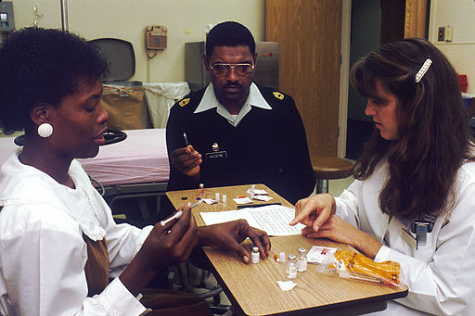


…to Improve Value of Healthcare and Promote Health Equity
Vision
Team-Based
Patient-Centered
Quality-Driven
Notes:
VistA Evolution Vision: Improve Value of Healthcare and Promote Health Equity
Team-based
One shared care plan
Task- and goal-based communication
Distributed decision making
Population management
Patient-Centered
Explicit link to patient goals and preferences
Plans tailored to patient goals
Shared decision making and management
Quality-Driven
Transactional data collection
links resources to activities and goals to outcomes
Support “Lean-type” management
Support
-Care Coordination
-Patient Aligned Care Teams

Slide 14

VistA 4
The
VistA
Federal Partners (DOD, IHS)
Integrated Architecture and Services
User Experience
VLER and IPO – defined interoperability standards
Care Coordination Framework
VBA
Standard Data Model
Open Source/
Community Partners
Notes:
Beginning with delivery of new features by September 2014, we will analyze and begin to synthesize existing features into a new platform
A single viewer will become the starting point for a new user experience to support Patient Aligned Care Teams
By 2017, we will have an architecture and framework that supports interoperability, care coordination, meaningful use and partnership.

Slide 15

FOCUS on Service members, Veterans, their families and Caregivers
PROTECT the safety of our patients
ENABLE health care that provides the highest quality care
UTILIZE a cohesive, forward-looking architecture
Notes:
Principles
Focus
Protect safety
Enable health care
Modern architecture and technology
___________________________________________________________
This VistA Evolution Program is based on the following principles to ensure the highest standards of program execution:
Focus on our Service members, Veterans, their families and Caregivers
Protect the safety of our patients
Enable health care that applies the appropriate and most efficient resource to the task of providing the highest quality care while maintaining a focus on prudent custodianship of taxpayer resources
A cohesive, forward-looking architecture that maintains affordability while enabling a steady and reliable evolution forward: incorporates state-of-the-art-technology while leveraging the knowledge base and processes that create a patient-centric health care environment

Slide 16
Poll Results
What is your primary reason for attending the presentation today?
  Gain a better understanding of VistA Evolution Program
  Better understand your role and opportunities to support VistA Evolution
  Understand how you will benefit from the implementation of VistA Evolution

Slide 17
Poll Results
What is your primary reason for attending the presentation today?
  Gain a better understanding of VistA Evolution Program
  Better understand your role and opportunities to support VistA Evolution
  Understand how you will benefit from the implementation of VistA Evolution
Notes:
This is not a duplicate slide

Slide 18

continual investment and delivery of scalable and modular EHR and health IT products
improving the quality, safety, efficiency and satisfaction in health care for Veterans
Notes:
Program goals:
Open, extensible, non proprietary
Interoperability
Re-engineering
____________________________________________________________________________
The VistA Evolution Program will support VA strategic plans through continual investment and delivery of scalable and modular EHR and health IT products to:
Improve the quality, safety, efficiency and satisfaction in health care for Veterans through:
Implementation of an open-architected, non-proprietary in design, and extensible EHR system
Establishment of interoperability between VA and DoD EHR systems
Re-engineering of business processes in collaboration with users of health IT

Slide 19

Organizing framework must be detailed enough to practice Value
  Work breakdown structure
  must align to EHR
Management
  capabilities & business functions
yet ‘light’ enough to enable agile
management and development
Organization of scope, schedule and cost must
include business, technical & program functions
Notes:
Program Management:
The importance, size and complexity of VistA Evolution requires adoption of ROBUST constructs for organization and governance structure.
The organization of scope, schedule and cost must include the business, technical and program functions.
The organizing framework must be detailed enough to practice Value Management yet ‘light’ enough to enable agile management and development when appropriate.
The work breakdown structure must align to EHR capabilities and to business functions

Slide 20
…improving the
experience of care
…improving the
health of populations
…reducing per capita
costs of health care
Notes:
_______________________________________________________________________________
Note: Presenters need to review text below:
The roadmap for the VistA Evolution Program includes delivering to the field:
VistA patient-safety goals (V-PSGs), modeled after the Joint Commission's National Patient Safety Goals, will be developed to positively impact patient safety.
A new, ONC certified, EHR platform that replaces legacy applications and provides an improved user experience to the patient centered healthcare teams.
New User Interface (UI) displays that support better reasoning for both patient and provider by integrating the appropriate information into single, but flexible views.
Sharable Clinical Decision Support to promote best clinical practices tailored to the patient's clinical condition and health-related goals;
Capabilities for clinicians, managers, and researchers to define and manage patient populations;
Planning tools that support both resource (human and material) management and interdisciplinary, interoperable m patient-centered care plans.
Explicit incorporation of patient goals in the care plan, to support patient-defined terms of success, and;
Enterprise-wide deployment (beginning in 2017 and complete in 2021).
This pathway supports the triple goals of improving the experience of care, improving the health of populations, and reducing per capita costs of health care.
Map: 9269587

Slide 21
Poll Question
What is the pain point that you want HIT to help solve for you?
Clinical information access from DoD
Clinical information access from external non DoD providers
Better way to look at notes
Improved clinical decision support within CPRS
A new graphical user interface

Slide 22
VistA 4 Product Roadmap
2014
2015
2016
2017
2018
Colleague EHR
(Gartner Gen 4)
Care Coordination
Interoperability and Improved Care Management
Core Care Management and ONC Certification
Initial Care Management Capabilities
Notes:
________________________________________________________________________-
2014
Initial Care Management Capabilities
Advanced UI Tools
VA/DoD Information
Sharing (via Joint Legacy Viewer)
Back-end Immunization Modules
VistA Standardization
2015
Core Care Management and ONC Certification
Integration of DoD and external provider data
Clinical Improvements for Patient-safety , Decision Support, Communication, and Population Health
A new, ONC certified, EHR platform at alpha sites
Enterprise deployment of view-only enterprise Health Management Platform (eHMP)
2016
Interoperability and Improved Care Management
Meaningful, real-time exchange of information with DoD and external providers
Broad deployment of eHMP (ONC Certified)
Initial deployment of Laboratory Information System (LIS) to 2 sites
Additional clinical improvements to include patient goals, enhancements to pharmacy and Radiology
2017
Care Coordination
Full scale deployment of Laboratory Information System (50 VAMC/year)
Enterprise-wide deployment of eHMP
Additional clinical improvements including
planning tools that support patient-centered care plans and improved communication tools
2018
Colleague EHR (Gartner Gen 4)
Delivery of all new VistA 4 capabilities throughout the enterprise
Laboratory Information System (50 VAMC/year
Completion of care coordination and quality management capabilities consistent with Gartner Gen4

Slide 23
Major Clinical Outcomes
Better support for medication ordering and integrated views of VA and DoD data.
New data for family history and women’s health
Enabling robust team-based coordination
Improved workflow and decision support
New laboratory functionality
Measure effectiveness of care in relationship to Veteran-defined goals and preferences
Enable care-process capture to support lean-style quality improvement and cost control
FY14
FY15
FY17
FY18
Notes:
Keep this slide or add to speaker notes on previous slide?

Slide 24

Product Set #1 September 30, 2014
  Advanced UI Tools (eHMP)
  VA/DoD Information Sharing (via Joint Legacy Viewer)
  Immunizations
  Laboratory Information System Acquisition
  VistA Standardization
Notes:
______________________________________________________________________
Product Set #1
Capabilities enabled at two sites: Hampton Roads and San Antonio
Advanced UI Tools
‘Google-like’ search across database
HL7 context-aware ‘InfoButtons’ integrated into UI
Medication review tool
VA/DoD Information Sharing (via Joint Legacy Viewer)
Immunizations
Modernize VistA immunization files, incorporate required ‘CVX’ format
Facilitates enabling of read/write/exchange plus advanced clinical decision support in FY15
Enables new sources of adoption: VA Innovations, Open CDS, Indian Health Service Resource and Patient Management System
Laboratory Information System Acquisition
Modernization and automation of ‘back-end’ lab processes
Facilitates data exchange, business process interoperability and enhanced clinical decision support
VistA Standardization
Certification of 74 standardized VistA application routines in production

Slide 25
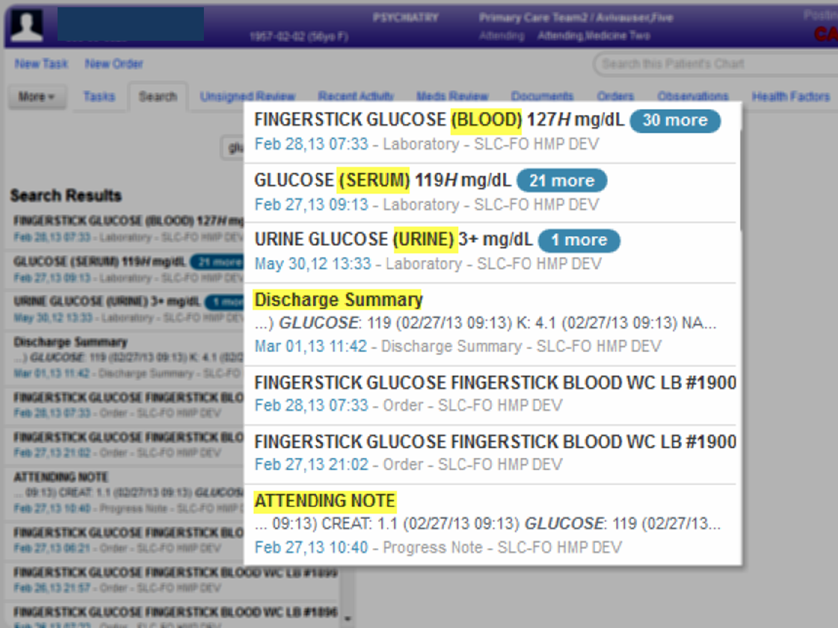

Search
Notes:
______________________________________________________________________
Multiple data forms are returned for users detailing different types of data available

Slide 26
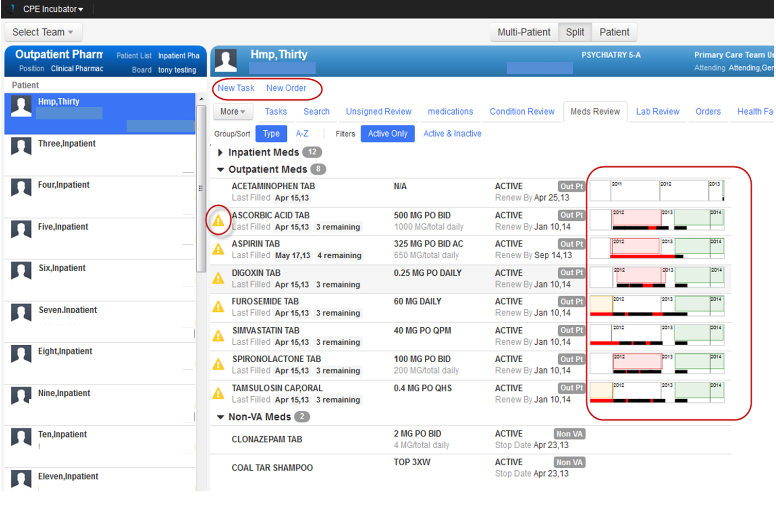
Medication Review
Notes:
___________________________________________________________________________
The Medication Review tab displays patient medication orders from all VistA instances and stored in the VPR. This first step creates the comprehensive medication list. The VPR also has the capacity to capture data from other systems Such as the DOD and non VA medications data as the connectivity becomes available.
The time lines, New order link, warnings are circled in this screen capture

Slide 27
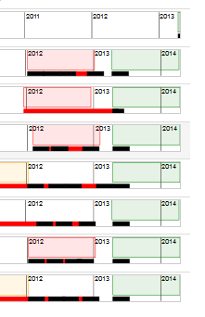
Medication Review
Notes:
__________________________________________________________________________-
The Medication Review tab displays patient medication orders from all VistA instances and stored in the VPR. This first step creates the comprehensive medication list. The VPR also has the capacity to capture data from other systems Such as the DOD and non VA medications data as the connectivity becomes available.
The time lines, New order link, warnings are circled in this screen capture

Slide 28
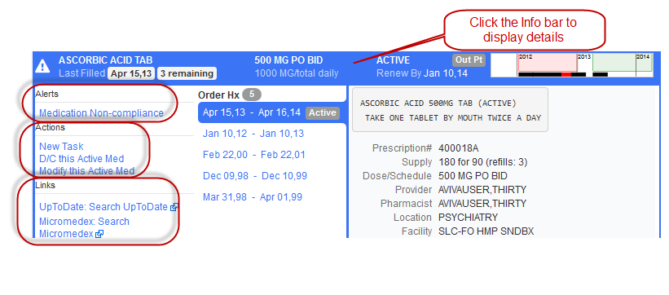
i
Click the Info bar to display details
nfo button
Notes:
____________________________________________________________________________
Clicking on the order header opens and closes the details window. Displaying order history,
The left portion of this details window includes Alerts, Actions for order modification and Infobutton for Up to Date, Micromedex, Medline Plus

Slide 29
i
Click the Info bar to display details
nfo button
Notes:
___________________________________________________________________________-
Clicking on the order header opens and closes the details window. Displaying order history,
The left portion of this details window includes Alerts, Actions for order modification and Infobutton for Up to Date, Micromedex, Medline Plus

Slide 30

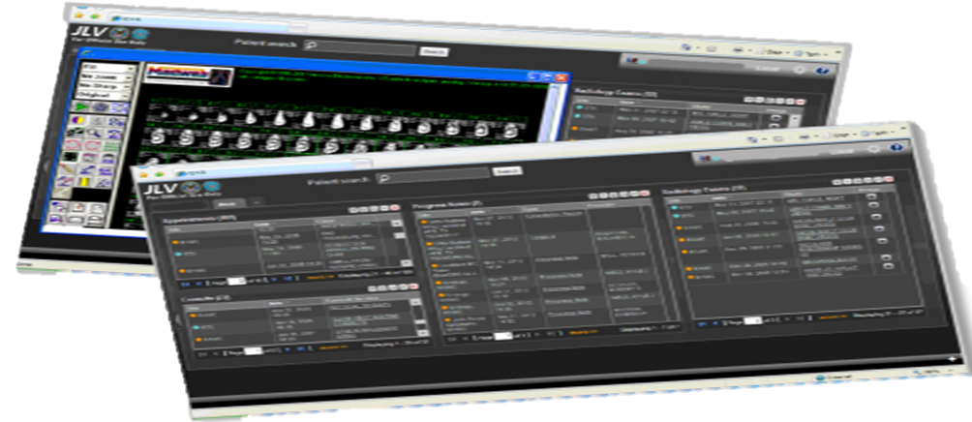
Joint Legacy Viewer (JLV)
Notes:
____________________________________________________________________________
JLV is a read only, graphical user interface (GUI) that provides an integrated read-only, near real-time view of health data from DoD and VA EHR systems in a common viewer.
Key Benefits:
In production and successfully deployed to DoD, VHA and VBA providers ahead of schedule
Proven high levels of provider satisfaction over current HIE tools
Simplifies review of patient records, returning valuable time to care providers
Increases efficiency and decreases cost of healthcare delivery
Reduced need for duplicate diagnostics
Allows for more rapid throughput in Benefits claims

Slide 31

Product Set #2
September 30, 2015
Core Health Management Capabilities on an Office of the National Coordinator (ONC) certified Technology (2014 Edition Certification Criteria)
Notes:
__________________________________________________________________________-
Product Set #2
Core Health Management Capabilities on an ONC certified Technology (2014 Edition Certification Criteria)
VA intends to certify by September 30, 2015

Slide 32
ONC Certification Criteria Relevant to eHMP
Patient Engagement
View, Display, Transmit to 3rd Parties
Clinical Summary
Secure Messaging
Clinical
Computerized Provider Order
Entry (CPOE)
Drug-Drug/Drug-Allergy Interaction
Checks
Demographics
Vital Signs
Problem List
Medication List
Medication Allergy List
Clinical Decision Support
Electronic Notes
Drug Formulary Checks
Smoking Status
Image Results
Family Health History
Patient List Creation
Patient-Specific Education Resources
Electronic Medication Administration
Record (BCMA)
Advanced Directives
Care Coordination
Transition of Care/Referral Summary
Receive-Display-Incorporate
Create-Transmit
Electronic Transmission
Outbound Electronic Prescribing
Clinical Information Reconciliation
Incorporate Lab Tests & Results
Transmission of Lab Tests & Results
Data Portability
Clinical Quality Measures
Capture & Export
Import & Calculate
Electronic Submission
Public Health
Immunization Information
Transmit to Immunization Registries
Transmit to Public Health Agencies
Syndromic Surveillance
Reportable Lab Results
Privacy/Security
Authentication, Access Control
& Authorization
Auditable Events & Tamper-resistance
Audit Reports
Amendments
Auto Log-Off
Emergency Access
End-user Device Encryption
Integrity
Accounting of Disclosures
Utilization
Automated Measure Calculation
Safety-enhanced Design
Quality Management System

Slide 33

ONC Certification Criteria Relevant to eHMP
Patient Engagement
View, Display, Transmit to 3rd Parties
Clinical Summary
Secure Messaging
Clinical
Computerized Provider Order
Entry (CPOE)
Drug-Drug/Drug-Allergy Interaction
Checks
Demographics
Vital Signs
Problem List
Medication List
Medication Allergy List
Clinical Decision Support
Electronic Notes
Drug Formulary Checks
Smoking Status
Image Results
Family Health History
Patient List Creation
Patient-Specific Education Resources
Electronic Medication Administration
Record (BCMA)
Advanced Directives
Care Coordination
Transition of Care/Referral Summary
Receive-Display-Incorporate
Create-Transmit
Electronic Transmission
Outbound Electronic Prescribing
Clinical Information Reconciliation
Incorporate Lab Tests & Results
Transmission of Lab Tests & Results
Data Portability
Clinical
Clinical Quality Measures
Capture & Export
Import & Calculate
Electronic Submission
Family Health History
Public Health
Immunization Information
Transmit to Immunization Registries
Transmit to Public Health Agencies
Syndromic Surveillance
Reportable Lab Results
Privacy/Security
Authentication, Access Control
& Authorization
Auditable Events & Tamper-resistance
Audit Reports
Amendments
Auto Log-Off
Emergency Access
End-user Device Encryption
Integrity
Accounting of Disclosures
Utilization
Automated Measure Calculation
Safety-enhanced Design
Quality Management System

Slide 34

ONC Certification Criteria Relevant to eHMP
Patient Engagement
View, Display, Transmit to 3rd Parties
Clinical Summary
Secure Messaging
Clinical
Computerized Provider Order
Entry (CPOE)
Drug-Drug/Drug-Allergy Interaction
Checks
Demographics
Vital Signs
Problem List
Medication List
Medication Allergy List
Clinical Decision Support
Electronic Notes
Drug Formulary Checks
Smoking Status
Image Results
Family Health History
Patient List Creation
Patient-Specific Education Resources
Electronic Medication Administration
Record (BCMA)
Advanced Directives
Care Coordination
Transition of Care/Referral Summary
Receive-Display-Incorporate
Create-Transmit
Electronic Transmission
Outbound Electronic Prescribing
Clinical Information Reconciliation
Incorporate Lab Tests & Results
Transmission of Lab Tests & Results
Data Portability
Clinical
Clinical Quality Measures
Capture & Export
Import & Calculate
Electronic Submission
Patient-Specific Education Resources
Public Health
Immunization Information
Transmit to Immunization Registries
Transmit to Public Health Agencies
Syndromic Surveillance
Reportable Lab Results
Privacy/Security
Authentication, Access Control
& Authorization
Auditable Events & Tamper-resistance
Audit Reports
Amendments
Auto Log-Off
Emergency Access
End-user Device Encryption
Integrity
Accounting of Disclosures
Utilization
Automated Measure Calculation
Safety-enhanced Design
Quality Management System

Slide 35



ONC Certification Criteria Relevant to eHMP
Patient Engagement
View, Display, Transmit to 3rd Parties
Clinical Summary
Secure Messaging
Clinical
Computerized Provider Order
Entry (CPOE)
Drug-Drug/Drug-Allergy Interaction
Checks
Demographics
Vital Signs
Problem List
Medication List
Medication Allergy List
Clinical Decision Support
Electronic Notes
Drug Formulary Checks
Smoking Status
Image Results
Family Health History
Patient List Creation
Patient-Specific Education Resources
Electronic Medication Administration
Record (BCMA)
Advanced Directives
Care Coordination
Transition of Care/Referral Summary
Receive-Display-Incorporate
Create-Transmit
Electronic Transmission
Outbound Electronic Prescribing
Clinical Information Reconciliation
Incorporate Lab Tests & Results
Transmission of Lab Tests & Results
Data Portability
Care Coordination
Clinical Quality Measures
Capture & Export
Import & Calculate
Electronic Submission
Public Health
Immunization Information
Transmit to Immunization Registries
Transmit to Public Health Agencies
Syndromic Surveillance
Reportable Lab Results
Privacy/Security
Authentication, Access Control
& Authorization
Auditable Events & Tamper-resistance
Audit Reports
Amendments
Auto Log-Off
Emergency Access
End-user Device Encryption
Integrity
Accounting of Disclosures
Outbound Electronic Prescribing
Utilization
Automated Measure Calculation
Safety-enhanced Design
Quality Management System

Slide 36
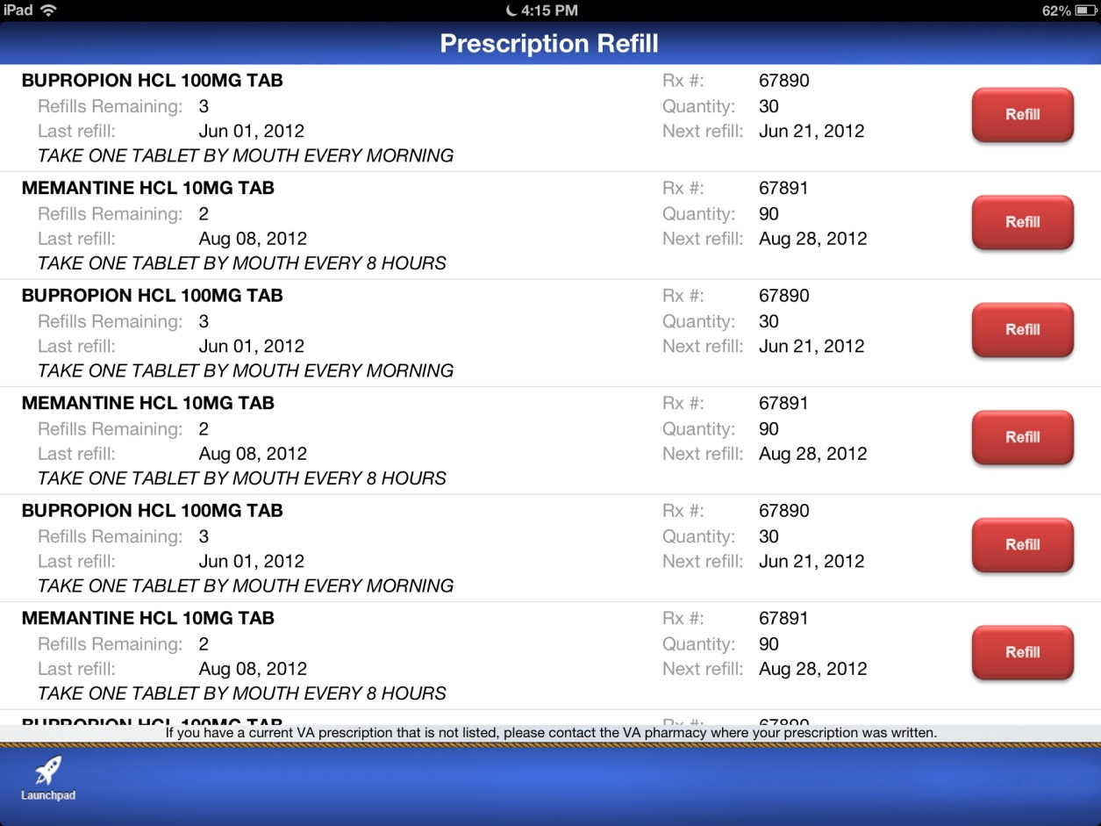
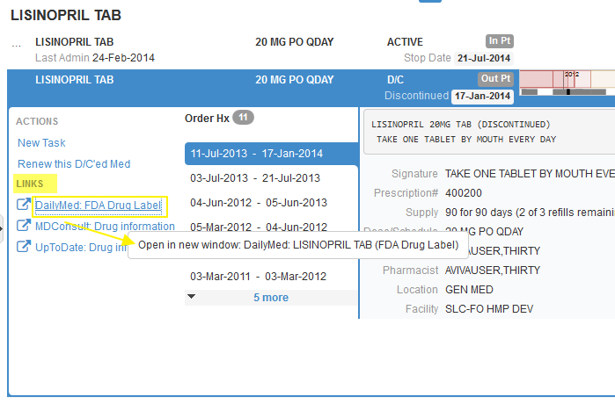
ONC Certification Criteria Relevant to eHMP
Patient Engagement
View, Display, Transmit to 3rd Parties
Clinical Summary
Secure Messaging
Clinical
Computerized Provider Order
Entry (CPOE)
Drug-Drug/Drug-Allergy Interaction
Checks
Demographics
Vital Signs
Problem List
Medication List
Medication Allergy List
Clinical Decision Support
Electronic Notes
Drug Formulary Checks
Smoking Status
Image Results
Family Health History
Patient List Creation
Patient-Specific Education Resources
Electronic Medication Administration
Record (BCMA)
Advanced Directives
Care Coordination
Transition of Care/Referral Summary
Receive-Display-Incorporate
Create-Transmit
Electronic Transmission
Outbound Electronic Prescribing
Clinical Information Reconciliation
Incorporate Lab Tests & Results
Transmission of Lab Tests & Results
Data Portability
Care Coordination
Clinical Quality Measures
Capture & Export
Import & Calculate
Electronic Submission
Public Health
Immunization Information
Transmit to Immunization Registries
Transmit to Public Health Agencies
Syndromic Surveillance
Reportable Lab Results
Privacy/Security
Authentication, Access Control
& Authorization
Auditable Events & Tamper-resistance
Audit Reports
Amendments
Auto Log-Off
Emergency Access
End-user Device Encryption
Integrity
Accounting of Disclosures
Utilization
Automated Measure Calculation
Safety-enhanced Design
Quality Management System
Clinical Information Reconciliation

Slide 37


ONC Certification Criteria Relevant to eHMP
Patient Engagement
View, Display, Transmit to 3rd Parties
Clinical Summary
Secure Messaging
Clinical
Computerized Provider Order
Entry (CPOE)
Drug-Drug/Drug-Allergy Interaction
Checks
Demographics
Vital Signs
Problem List
Medication List
Medication Allergy List
Clinical Decision Support
Electronic Notes
Drug Formulary Checks
Smoking Status
Image Results
Family Health History
Patient List Creation
Patient-Specific Education Resources
Electronic Medication Administration
Record (BCMA)
Advanced Directives
Care Coordination
Transition of Care/Referral Summary
Receive-Display-Incorporate
Create-Transmit
Electronic Transmission
Outbound Electronic Prescribing
Clinical Information Reconciliation
Incorporate Lab Tests & Results
Transmission of Lab Tests & Results
Data Portability
Care Coordination
Clinical Quality Measures
Capture & Export
Import & Calculate
Electronic Submission
Transition of Care/Referral Summary
Public Health
Immunization Information
Transmit to Immunization Registries
Transmit to Public Health Agencies
Syndromic Surveillance
Reportable Lab Results
Privacy/Security
Authentication, Access Control
& Authorization
Auditable Events & Tamper-resistance
Audit Reports
Amendments
Auto Log-Off
Emergency Access
End-user Device Encryption
Integrity
Accounting of Disclosures
Utilization
Automated Measure Calculation
Safety-enhanced Design
Quality Management System

Slide 38


ONC Certification Criteria Relevant to eHMP
Patient Engagement
Patient Engagement
View, Display, Transmit to 3rd Parties
Clinical Summary
Secure Messaging
Clinical
Computerized Provider Order
Entry (CPOE)
Drug-Drug/Drug-Allergy Interaction
Checks
Demographics
Vital Signs
Problem List
Medication List
Medication Allergy List
Clinical Decision Support
Electronic Notes
Drug Formulary Checks
Smoking Status
Image Results
Family Health History
Patient List Creation
Patient-Specific Education Resources
Electronic Medication Administration
Record (BCMA)
Advanced Directives
Care Coordination
Transition of Care/Referral Summary
Receive-Display-Incorporate
Create-Transmit
Electronic Transmission
Outbound Electronic Prescribing
Clinical Information Reconciliation
Incorporate Lab Tests & Results
Transmission of Lab Tests & Results
Data Portability
Clinical Summary
Clinical Quality Measures
Capture & Export
Import & Calculate
Electronic Submission
Privacy/Security
Authentication, Access Control
& Authorization
Auditable Events & Tamper-resistance
Audit Reports
Amendments
Auto Log-Off
Emergency Access
End-user Device Encryption
Integrity
Accounting of Disclosures
HR: 77
BP: 137/82
Public Health
Immunization Information
Transmit to Immunization Registries
Transmit to Public Health Agencies
Syndromic Surveillance
Reportable Lab Results
Utilization
Automated Measure Calculation
Safety-enhanced Design
Quality Management System
Notes:
Clinical Summary – summary of care after visit

Slide 39



Care
Coordination
Care Management
Care Planning
Notes:
Care Planning
Care Management
Care Coordination
______________________________________________________________________
Care Planning:
Individual Patient Focus
Problem-specific
Interdisciplinary
Identify care needs, treatment goals & plan to meet goals
Criteria for terminating interventions
Documentation of progress
Care Management:
Population and Panel Focus
Holistic
Identification/Stratification/Prioritization of At-Risk Patients
Evaluation
Care Coordination:
Healthcare System Focus
More developed approaches to Health Care Home, Proactive Plan of Care, Communication, Information Systems, Transitions/Handoffs

Slide 40
Poll Results
What is the pain point that you want HIT to help solve for you?
Clinical information access from DoD
Clinical information access from external non DoD providers
Better way to look at notes
Improved clinical decision support within CPRS
A new graphical user interface

Slide 41

Poll Results
What is the pain point that you want HIT to help solve for you?
Clinical information access from DoD
Clinical information access from external non DoD providers
Better way to look at notes
Improved clinical decision support within CPRS
A new graphical user interface

Slide 42





Interoperability
Product Set #3
September 30, 2017
Notes:
_________________________________________________________________________
Map of US with lines and dots connecting
iEHR IS interoperability? – will this raise too many questions?
Soldier to Veteran, records moved seamlessly from DoD to VA
Individual in center, with bubbles representing military tx facility, clinic, etc.

Slide 43

National Defense Authorization Act (NDAA) defines “interoperability” as:
the ability of different electronic health records systems or software to meaningfully exchange information in real time and provide useful results to one or more systems.

Slide 44
Technical (syntactic) Interoperability
Information must be reliably exchanged between multiple Systems so People in different places and organizations can see it, use it and add to it
Semantic Interoperability
Information exchanged between Systems must have shared meaning in order for People (assisted by computers) to use it for making care and benefits decisions
Process Interoperability
People (assisted by computers) must be able to make use of shared Information in their local workflows and processes for providing and receiving care and benefits

Slide 45



Interoperability Principles
Notes:
Principles of Interoperability
-Mapping to standards
-First do no Harm
-100% Mediation not expected
_______________________________________________________________
Mapping to National Standards is the correct approach
VA investment will improve interoperability with DoD and other Health Care Partners
“First No Harm”
VA must balance permitted uses of shared data with our level of confidence in coding and content accuracy
The possibility and degree of harm
100% mediation is NOT to be expected
Mediation rates in Clinical/Health Data Repository are ~80 percent
This is still an improvement over No Data

Slide 46









&
DoD
VA
Responsibilities
Provide seamless, integrated sharing of standardized health data among DoD, VA, and private sector providers
  Modernize their respective EHR systems that support clinicians’ operations

Slide 47












Interagency Program Office (IPO) Responsibilities
Seamless integration of health data between DoD and VA EHR Systems
Represent and lead interoperability efforts with ONC
Collaborate with HARB and ICIB
Notes:
HARB – Health Architecture Review Board (VA and DoD representation)
ICIB – Interagency Clinical Informatics Board (VA and DoD representation)

Slide 48
VistA Evolution, IPO and DHMSM Operating Model
Joint Executive Committee
Resources
Coordination and Collaboration
Health Executive Committee (Requirements)
DoD / VA Senior Stakeholders Group
Chaired by: VA CIO and USD (AT&L)
VistA Evolution Program Office
PEO DHMS
VistA Evolution
Interoperability
IPO
Facilitates Interoperability
IPO
Facilitate Interoperability
Coordinate selection, adoption of, and mapping to health data standards
Coordinate collaboration with health standards organizations
Monitoring and reporting on standards compliance
Technical authority for interoperability
Coordinate data governance
VistA Evolution
Interoperability
Interoperability
DHMSM
DHMSM
Interoperability
Technical Architecture
Requirements
Service Level Agreements
Outputs
Data Exchange Guidance
Interface
Control Documents
Execute and Implement
VistA Evolution Product VLER Health: External Health Information Sharing Partnerships | Legacy Data Sharing between VA/DoD Enhancements Data Mapping and Exchange
Common Services
Execute and Implement
Legacy Data Sharing between DoD/VA Data Mapping and Exchange | Next Generation EHR System Acquisition VLER Health:
Network & Hosting
Standards Implement.
Identity Mgmt
Access Control
Private Sector Exch
Notes:
DHMSM – Defense Healthcare Management Systems Modernization

Slide 49


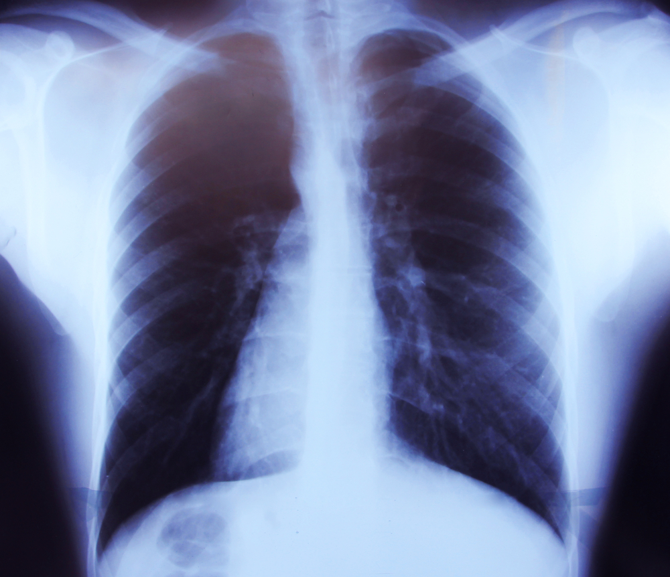



Product Set #4
September 30, 2018
Further Evolution of
Clinical Systems
Notes:
Product Set #4
“Further Evolution of Clinical Systems”
Pharmacy
-enhancements
-PHIS
Radiology
-protocols
-dashboards
-communication
LIS
-25% of sites by 2017
-incremental deployment
_________________________________________________________________________
The Pharmacy business owners and users will benefit from the continued incremental enhancements to the existing VistA pharmacy system. These continued enhanced ancillary services capabilities will also enable more robust clinical decision support for clinicians, allowing them to provide improved quality, safety, efficiency and satisfaction in healthcare for Veterans, Service members, and their dependents.
Radiology enhancement will include best practices functionality, such as support for electronic protocols and a dashboard display of the patient’s status facilitating communication between radiologists and technologists
Upgrades to the pharmacy system will come in two distinct phases:
Enhancements to the existing system
Followed by acquisition of a comprehensive Pharmacy Hospital information System (PHIS)
New Laboratory Information System (LIS)
Deployed at 25% of VA Medical Centers (VAMCs) by the end of 2017
Planned incremental deployments scheduled to take place at 13-16 VAMC sites every 6 months
Enterprise wide deployment (152 sites) of the new LIS will be complete March 2021
Pharmacy Hospital Information System offers improved:
Checks for drug-drug, drug-food, drug-allergy interactions
Validation of drug dosage based on patient’s age, weight, frequency and route of administration, dosing interval and duration of therapy
Patient safety through advanced clinical intervention tools
Alerts and notifications to users by using rules to decrease patient injury or use of non-standard practices
Streamlined Pharmacy Medication Order Workflow to allow clinicians to focus on patient safety when reviewing profiles and orders

Slide 50

Community Involvement

Slide 51


DoD
Community
CITE Team
VHA
VA
VBA
VA OIT
Notes:
Community IT Engagement (CITE)
Industry Innovators
Health Systems
Researchers
OSEHRA
National Health Informatics Organizations
Universities
Open Source Community
Health Standards Groups

Slide 52
Get Involved!
Integration across programs and projects
Community
IT Engagement
Portfolio
Capability Prioritization and Roadmap Planning
Program
Product Design and Testing
Project
Notes:
PORTFOLIO
Coordination with IHP → Integration with other Programs and Projects
Touchpoints and support for bi-directional communication
Integrated Product Roadmap planning for FY15 and beyond
Community IT Engagement
Governance
Industry and VHA Informatics Brain Trust
Standards Development
PROGRAM
Capability Prioritization and Roadmap Planning
ONC 2014 Criteria
iEHR Clinical Capabilities
IHP Capabilities
Gartner Gen 3 CPR
Community IT Engagement
Support solution intake
Promote VistA Evolution value and engagement to industry
Participate in OSHERA for VistA VA Next-Gen Planning
PROJECT
Product Design and Testing
Business requirements
Prototype Design and Testing
Field Support
Community IT Engagement
Review Community Developed Pilots

Slide 53
Organizational Awareness
Resources and Informatics Structure
User Acceptance Testing
What can you do?
Benefits
Workflow Assessment
Support
Training
Communication
Notes:
Begin Preparing for VistA Evolution
Organizational Awareness
Promote project awareness & understanding across the organization
Engage leadership buy-in and involvement
Define how Vista Evolution aligns with the clinical and business goals of your organization
Resources and Informatics Structure
Fill all open CAC and ADPAC positions . Do all departments/ services have informatics representation?
Make sure IT governance committees are established and operational
Engage in the project planning process to ensure organizational relevance
User Acceptance Testing
Identify key groups and individuals to test and evaluate the software & planned functionality to ensure its readiness for your organization
Workflow Assessment
Identify the key people and processes that will be impacted
Engage your organization’s Process Redesign department
Communication
Define your communication hierarchy and identify best methods/ modalities to inform and engage all stakeholders
Training
Identify any training resources and best practices
Are training classrooms established and sufficient?
How will scheduling be managed?
Support
Define how best to support new software implementations
Identify and develop super-users per service to provide support at go live
Define communication processes for reporting and problem-solving issues
Benefits
Define the benefits and goals of the implementation for your organization
How will they be measured?
How will clinical adoption be achieved?
How will patient care be improved?

Slide 54

Ask the Presenter
Notes:
If you haven’t submitted your questions yet, it’s not too late. Just click on that orange ask the presenter icon above my head. We are going to go to a brief announcement and then we’ll be back to answer your questions.

Slide 55
BACK UP

Slide 56
VLER Health
Connected Health
JLV
VistA Web
VistA
EHR
CPRS
RDVs
CAPRI
VistA Standardization
HMP
‘
Notes:
Over the past several years, various products have been developed across the VA landscape, creating a complex suite of applications
‘Conceptual’ representation of current EHR/Health IT Landscape
Acronyms:
CAPRI – Compensation and Pension Record Interchange
HMP – Health Management Platform
iEHR – integrated Electronic Health Record
JLV – Joint Legacy Viewer
RDV – Remote Data Views
VLER – Virtual Lifetime Electronic Record

Slide 57
History of VA’s EHR
1977 - Organizational tension erupts: Central Control vs. Decentralized Clinical Innovation
1979 - Underground Railroad
1982 - Decentralized development strategy endorsed
  1983: 25 sites: Outpatient pharmacy, ADT*/scheduling
  1984: 120 sites
  1985: 120 sites: Add lab, inpatient pharmacy, radiology
  1989: 120 sites: Add eight additional packages
* Admission/Discharge/Transfer (registration)

Slide 58
History of VA’s EHR (continued)
1990 – VistA Imaging
1994 – Order Entry/Results Reporting
1997 – VistA Radiology
1998 – Computerized Patient Record System (CPRS) Graphical User Interface (GUI)
2000 – Bar Code Medication Administration
2007 – Indian Health Service deploys VistA Imaging
2000+ – Open source code used by others with multiple international deployments
  Ongoing development within VA and open source community

Slide 59


VistA Evolution Background
In 2013, VA and Department of Defense (DoD) Secretaries made decisions that require a change in EHR strategy
The VA EHR core will be VistA-based
Our mission has not changed:
“…to care for him who shall have borne the battle, and for his widow, and his orphan”
-Abraham Lincoln

Slide 60
Fiscal Year 2014 National Defense Authorization Act (NDAA) Requirements
  Data Domain Standards
    “Not later than October 1, 2014, all health care data contained in … AHLTA and … VistA systems shall be computable in real time and comply with the existing national data standards ….”
    “…if such national standards do not exist … [adopt] the articulation of data of the Health Data Dictionary until such national standards are established.”
  Integrated View
    “Ensure that the electronic health record systems … are interoperable with an integrated display of data, or a single electronic health record, by complying with the national standards and architectural requirements identified by the Interagency Program Office of the Departments ….”
  Executive Committee
    “No later than 60 days of enactment both Secretaries should jointly establish an Executive Committee to support the development. It will also annually certify to congress that the platform and the standards are meeting the definition of integrated.”
    “The Executive Committee shall consist of 1) two co-chairs appointed by each secretary 2) one member of the technical community appointed by Secretary of VA 3) one member of the clinical community appointed by Secretary of Defense 4) one member of the clinical community appointed by Secretary of VA 4) one member of the technical community appointed by Secretary of Defense.”

Slide 61
NDAA Interoperability Requirements
Functional Perspective
ICIB identified a Data Domain Prioritization in November 2013 and specified high value targets in February 2014
The ICIB established an initial INTEGRATED user requirement of ~12,500
  VA: Includes all current requests by VA Clinical users and VBA claims administrators (with a goal of reaching all clinical users by 2016)
  DoD requirements were largely unchanged (less than 1000) and focused on Joint Venture sites
  Focus on understanding where integrated record view is needed to support workflows and use cases
  Expand data sets to include: Provide an integrated display of: Radiographic Images, Scanned Documents, Inpatient Documents, eHealth Exchange Data, Audiograms, Flags, and Clinical Warnings
  Enhancing semantic interoperability through the identification and targeting data sets of high clinical value that are technically achievable
DoD and VA both plan to continue to use existing data viewers that support current workflows
  NDAA does not specify migration to a single viewer
  DoD and VA both have long term plans to modernize viewing capabilities as part of their program modernizations

Slide 62
Preliminary Courses Of Action to address NDAA
Developing 4 courses of action:
  Baseline: Continue efforts to develop Data Management Service (DMS) for all domains
  Baseline Plus BHIE DoD Adaptor: Use DMS for majority of domains and DoD Adapter for remaining domains
  Baseline Minus DMS: Continue to develop core infrastructure (MED COI and ESB) but utilize DoD Adapter
  Current with additional maps: Continue to add additional domains to DoD Adapter
Currently performing detailed analysis to determine cost, schedule, and performance
Requires:
  Software development to achieve necessary scalability and sustainability
  Requires DoD, VA, and IPO mapping efforts to add terminology maps for additional data domains and to close identified data gaps
  Continued close coordination across IPO, DoD, and VA

Slide 63
National Data Standards
IPO
  Will actively engage with ONC, DoD, VA and Standards Development Organizations (SDO) to identify, define, and facilitate the development of data interoperability standards to enable efficient health care data sharing and increased computability of the data
  Will incorporate standards covering both terminology standards and technical standards governing the interoperability of health record data between DoD and VA
DHMSM
  In collaboration with IPO, actively engage the Office of the National Coordinator (ONC) to ensure the DHMSM Request for Proposal (RFP) contains technical, gate, and source selection criteria necessary to ensure that proposed Electronic Health Record software meets all appropriate National Data Standards
    Currently soliciting feedback from VA, ONC representative, and industry on draft RFP language including language addressing compliance with National Data Standards
VistA Evolution
  Natively and consistently implement a coherent suite of National Terminology standards
  Provide health care data and information in a computable form, using national terminology data standards
  Implement nationally standardized message exchange specifications
  Establish, monitor and approve, in collaboration with the HARB, ICIB, and IPO, clinical, and technical standards profiles supporting interoperability

Slide 64
Summary of Achievements
Joint DoD and VA Achievements
  Joint Executive Committee approved the new IPO Charter
  Signed a new DoD/VA IPO Charter December 2013
  VLER Health Program Plan updated
DoD Achievements
  Conducted two Industry Days for solicitation of input in developing RFP with third to be held February 19, 2014
  Prepared to release first Draft RFP by January 31, 2014
  Acquisition Decision Memorandum signed September 12, 2013 by Undersecretary Kendall defining Mr. Christopher Miller as the Program Executive Office of DoD Healthcare Management Systems
  Acquisition Decision Memorandum signed January 2, 2014 by Undersecretary Kendall providing program direction for DHMS
  Established Functional Advisory Council (FAC) Advisory Board
  Internally approved DHMSM Acquisition Strategy and awaits Undersecretary Kendall’s signature
VA Achievements
  Established VistA Evolution Program with the first enhancements scheduled for 2014, followed by the roll-out of full capabilities in 2017
  Development of VistA Evolution draft Program Charter
  VistA Evolution Program Plan: IOC Plan completed on December 16, 2013
  VistA Evolution Program Plan planned for completion by January 31, 2014
Notes:
**put in SSG

Slide 65
VistA Evolution Management Approach
Continuous feedback and improvement
Engaged customers and stakeholders
Just in time requirements
Agile Principles
Feature Driven Design
An agile User Experience (UX)-Value Management approach allows high-level, very broad modeling and planning at the beginning of the project to address the majority usability, User Interface (UI), and project risks facing the team.
Value Management
Requires some system modeling and design upfront.
Focuses on system behavior and usability
Plan the program before starting work

Slide 66
VistA 4
The VistA 4 will provide an enabling infrastructure, and open & extensible platform on which tools and services can be integrated in support of Veterans’ evolving needs, in pace with the technological landscape. The VistA 4 will be incrementally developed and deployed through Fiscal Year (FY) 17.
The VistA 4 will:
Deliver on the VA and DoD Secretaries’ commitments to accelerate full health data interoperability between VA and DoD
Tie together disparate threads of clinical data into one care coordination plan available to the entire clinical care team
Will enable improved care that supports the health status goals of Service Members, Veterans and the family members
Will be incrementally delivered through FY17

Slide 67
Technical Objectives and Design Principles
Technical objectives:
  Seamless interoperability between DoD and VA EHR systems
  Modernize and maintain EHR and ancillary Health Information Technology (HIT) systems
  Re-engineer legacy HIT systems to align with evolving healthcare business practices
Core design principles:
  Service oriented architecture (SOA) – Software applications will use common enterprise services
  Open architecture – A key enabler of interoperability and the sharing of computable health data between VA, DoD, and external providers
  ONC-approved standards – Essential for fostering effective and openly available healthcare solutions and prevent solution “lock-in”
  Agile Development – An incremental delivery approach is responsive to end users’ needs
  Robust IT Infrastructure – IT infrastructure will comply with data center consolidation, virtualization, and “cloud first” guidelines
Notes:
**cut down at all? Without compromising content

Slide 68
High Level Milestones
 | FY14 |  |  |  | FY15 |  |  |  | FY16 |  |  |  | FY17
 | 1Q | 2Q | 3Q | 4Q | 1Q | 2Q | 3Q | 4Q | 1Q | 2Q | 3Q | 4Q | 1Q | 2Q | 3Q | 4Q
Program Management Activities
Product Set 1 Capability Target: VistA 4 Initial Operating Capability
Product Set 2 Capability Target: ONC 2014 Edition EHR Certification
Product Set 3 Capability Target: Interoperability
Product Set 4 Capability Target: Clinical Transformation
FOC Program Plan Delivered
Product Set 1 Complete (IOC)
Product Set 2 Complete
Product Set 3 Complete
Product Set 4 Complete
Governance Established
Interoperability Development
Clinical Capabilities Development
Integration Testing
Testing, Deployment
User Adoption and Training
2014 Edition EHR Certification
Standardization of 74 VistA Application Routines Complete
Legend:
Upcoming Event:
Completed Event:
Major Milestones:
Architecture Review
Product Plan
Review
Product Plan Complete
IOC Program Plan Delivered
Interoperability Development
Clinical Capabilities Development
Integration Testing
Testing, Deployment
User Adoption and Training
Architecture Review
Product Plan Review
Product Plan Complete
Interoperability Development
Clinical Capabilities Development
Integration Testing
Testing, Deployment
User Adoption and Training
Architecture Review
Product Plan Review
Product Plan Complete
Interoperability Development
Clinical Capabilities Development
Integration Testing
Testing, Deployment
User Adoption and Training
Architecture Review
Product Plan Review
Product Plan Complete
Notes:
67

Slide 69
Product Management: Feature Driven Design Process
Envision
Identify Vision
Speculate
Explore
Adapt
Close
Pass along key lessons
Celebrate
Write code and implement specs
Determine user needs from real, actual users
Deliver product
Create Models
Identify Projects and Teams
Organize user needs into Features and Feature Groups
Develop user personas and scenarios
Investigate pain points in current system
Investigate options for meeting user needs
Investigate process tooling
Develop multiple designs for Features
Design and test Throw Away prototypes with real users
Create lightweight Real prototypes of the best designs
Adds/Cuts on selected designs
Create lightweight specs for development
Test features for code quality
Test features against scenarios with real users
Integrate with other Feature Groups and System
Allows for substantial upfront design and iteration and evolution in development
This is needed to deliver features requiring highly refined design for UI and UX controls, layout and interaction

Slide 70
VistA Evolution Metrics
  Measurable metrics will be established and delivered in Third Quarter of Fiscal Year (FY) 2014 to evaluate Program effectiveness and specific benefits, such as:
Improved patient safety
Upgraded applications to reduce patient safety events
Improved operational efficiency
Increase throughput by reducing inefficiencies in workflow and improving care coordination
Better care quality
A comprehensive care plan designed for each patient will enhance health outcomes
Enhanced functionality with technical applications/capabilities
Allow the care team to more efficiently assess and diagnose each patient, proactively identifying care options through population analytics
Improved cost savings
Reduce duplicative tests and administrative overhead
Improved customer satisfaction
Effective preventative care will result in an enhanced patient experience, with not only better outcomes but also less time spent in a care facility

Slide 71
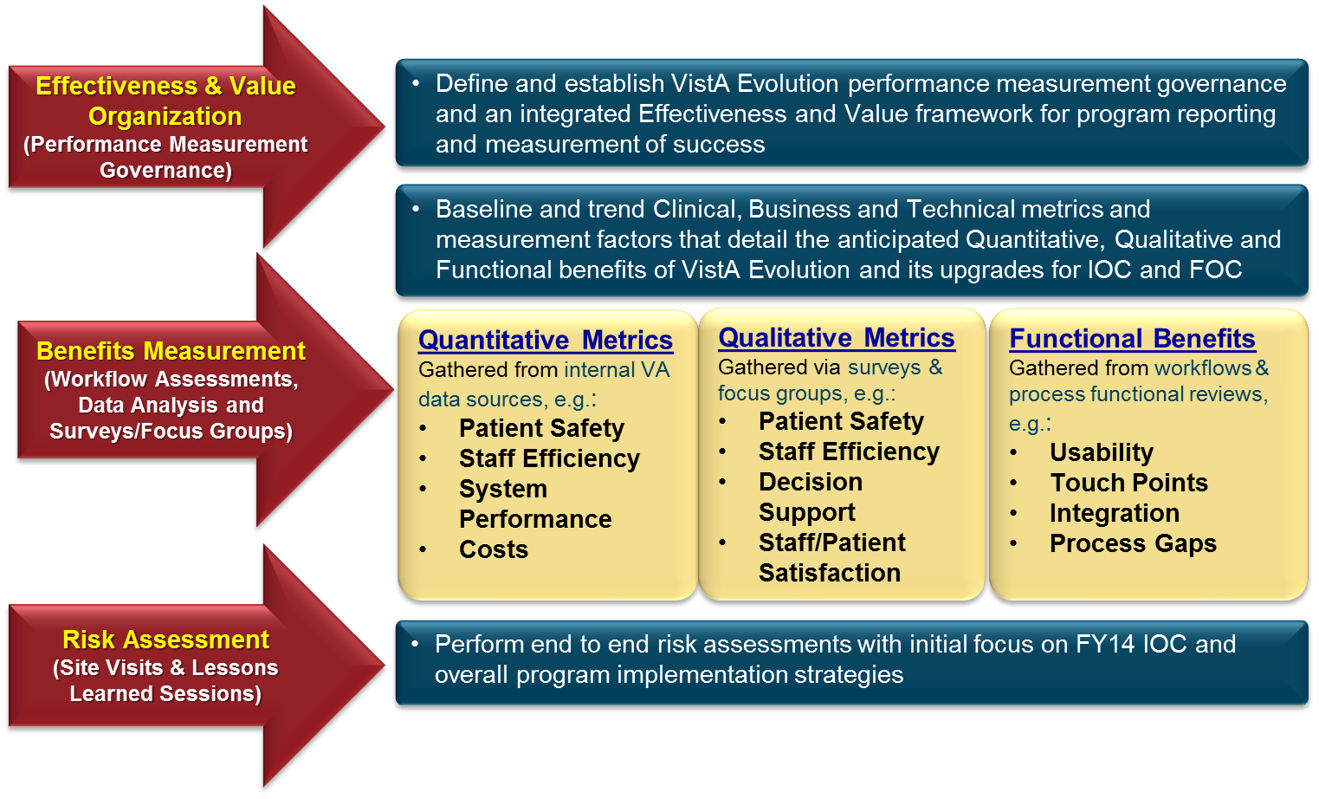
Measuring VistA Evolution’s Success through Effectiveness & Value: Consistency between VA and DoD Metrics
Notes:
The VistA Evolution program will leverage the Effectiveness and Value Organization (EVO) to work hand in hand with program and VA leadership to:
Define and implement an integrated Effectiveness and Value framework and governance model for VA to establish, measure and monitor benefits of VistA Evolution and its implemented capabilities
Establish and maintain a consistent benefits measurement framework to address clinical, business, and technical/functional capabilities from the top down
Perform independent assessment and analyses of VistA Evolution’s program, product and process improvements to ensure they are effective, efficient and valuable to the clinician and ultimately to the veteran
Provide the VistA Evolution program office and leadership with evidence-based information for decision support, validation, and justification of investment
Establish governance that enables an effective and consistent measurement reporting mechanism to program stakeholders and Congress

Slide 72
JLV Integrated Viewer Capacity Testing
System of systems for operational capability
Initial scope limited to JLV capacity testing
  Load represented through patient search and get patient record message traffic
Reviewing additional steps to include:
  Increasing test boundary to include DoD adaptor
  Potential software fixes on JLV
  Load balancer to increase capacity
  Refine user operational load profile and associated behavior
Joint VA and DoD coordinated testing effort
Initial testing completed 21 Feb; currently analyzing results to determine next steps
JLV initially broken out as the system under test

Slide 73
Requests for JLV Integrated Viewer
Requestor | Users | Purpose of JLV/Use Case(s)
ARMY Physical Disability Agency | Pending | Washington DC HQ & Physical Evaluation Boards (PEBs) at Walter Reed, San Antonio, and Seattle
Fort Belvoir | 8 | ARMY MEB process for Reservists and Guardsmen; iDES evaluations; Outpatient clinics
Federal Recovery Coordination Program | 22 | Coordination of care for severely injured, ill or wounded Service members and Veterans
Pensacola Naval Hospital | 25 | NAVY clinician access to support shared care
VA Loma Linda Health Care System | 25 | Clinical care (VistA Evolution)
VA San Diego Health Care System | 25 | Clinical care (VistA Evolution)
Richard L. Roudebush VA Med Ctr, Indianapolis | 25 | Clinical care (VistA Evolution)
Walter Reed National Military Medical Center | 50 | Clinical care/Polytrauma care and disability exams.
Hampton VA Medical Center | 50 | Clinical care (VistA Evolution Capability)
Travis Air Force Base - VA Northern California Health Care System Joint Venture | 100 | USAF and VA clinician access to support shared care
William Beaumont Army Medical Center – El Paso VA Joint Venture (Fort Bliss) | 100 | ARMY and VA clinician access to support shared care
Keesler Air Force Base – Gulf Coast Veterans Health Care System Joint Venture | 100 | USAF and VA clinician access to support shared care
ARMY National Guard | 400 | State/Deputy Surgeons and Nurse Case Managers for pre-discharge and disability claims processing
Tripler Army Medical Center – VA Pacific Islands Health Care System Joint Venture | 500 | ARMY and VA clinician access to support shared care
VA Polytrauma System of Care | 750 | VA Polytrauma teams access to DoD records
Veterans Benefits Administration | 10,000 | VBA staff throughout the claims adjudication process
Notes:
If audience asks

Slide 74
Open Source and External Community
Open Source Electronic Record Alliance
  Partner with open source community to enable accelerated adoption of technologies
  OSEHRA workspace to collaborate with open source developers: “VistA VA Next-Gen Planning”
  Codify and streamline intake process for code into VA
Other community Engagements
  Voice of industry (VOI) brain trust
  Continued evaluation of service delivery oriented health services platform consortium
  vendor inquiry vetting process

Slide 75
VistA Evolution Program Support
The Community IT Engagement (CITE) team will act as Subject Matter Experts, contributing to other VE work streams.
Governance
Defined an engagement protocol for approaching the Community based on guidance from the Office of General Counsel. Ensures compliance with the Federal Acquisition Regulation (FAR), Corporation Control Act (CCA) and Federal Advisory Committee Act (FACA).
VOI Resource / Brain Trust
Developed the Resource Trust concept, a collaboration workgroup where industry informatics thought leaders provide best practice domain insight and share industry lessons learned with the VA VEPEO leaders. Ensures Community innovation efforts are evaluated as part of the VE program.
RFI / RFP - Open Standards
Language for Open API and Open Architecture

Slide 76
Community Involvement
Communications
Create internal and external messaging to promote awareness
Participate in speaking engagements
Standards Development
SDO Community Outreach
OSEHRA
Promote the use of OSEHRA to its full capacity
Increase clinician focus
Promote VE value and engagement to industry
Participate in consortiums around standards
HL-7 FHIR, Boston Sharp Group, OHT, OTHERS

Slide 77
Community Involvement
Solution Intake
Find the shortest pathway through VHA – OIT – PD for each product, solution, or service, thus optimizing C3>C1
Community Developed Solutions
Create a reference guide to the Community for utilizing Cooperative Research and Development Agreements. Will encourage Community to engage in the VA’s pilot and proofs-of-concept process.
Run POC Pilots i.e. Review Community developed meds reconciliation
External Communication
Host an Industry Day for members of the outside community to learn about the VistA Evolution Program. Will inspire the Community to bring solutions and services to the VA.
Webinars & Social Media
Use Case under development - Fileman 22.2

Slide 78
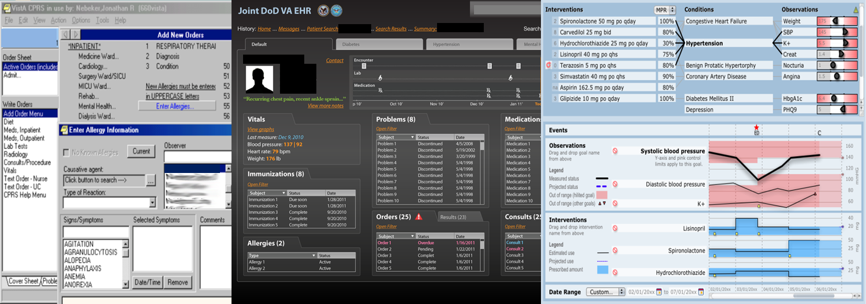
New User Experience
Data Silos
Data Juxtaposition
Data + Workflow Integration

Slide 79
Levels of Data Interoperability
Level | Description | DoD/VA Example
Level 4 Machine -Interpretable | Computable Electronic Data: Structured messages containing standardized and coded data; transfer from one system to another without need for translation or interpretation | Data Federation Accelerators CHDR (Pharmacy only) VLER Health (some content)
Level 3 Machine -Organizable | Structured, Viewable Electronic Data: Indexed Documents and images; transmission of structured messages containing non-standardized data, requires interfaces that can translate incoming data from the sending organization | BHIE FHIE VLER Health (some content) Typical HL7 2.x messaging
Level 2 Machine Transportable | Unstructured, viewable electronic data: fax, email, scanned documents, pictures, pdf files | AHLTA“Chart Print” PDF files (available to VBA via HAIMS)
Level 1 Non-Electronic | Non-electronic Data: Paper-based, mailed, or phone calls | Historical paper records
Target over time
NDAA TARGET LEVEL
Notes:
______________________________________________________________
NDAA Language Definition of Interoperable: The term ‘‘interoperable’’ refers to the ability of different electronic health records systems or software to meaningfully exchange information in real time and provide useful results to one or more systems.
PM DMIX Interpretation of Computable and Interoperable for the PueImplementation:
Definition of Computable = Data provided in national standard terminology or agreement by the Departments upon a standard with which to share data.
HDD: Mechanism to do the translation between the maps provided by the two departments.
CTS : Open HDD is the nucleus for CTS operation. CTS is a wrapper of web services around the HDD that allow the application to be placed on the bus for use by the DMS.
Map: Product delivered by the Departments after each takes data in local terminology and maps it to terminology defined in the national standard.
*Center for Information Technology Leadership
Reference: https://www.ncoic.org/apps/group_public/download.php/19487/CITL%20HIEI%20Levels.pdf

