Slide 1
Back to Basics
CPRS High Performance reminder dialogs
David carter
Notes:
Thank you Joe! I am happy to be here today to talk about (subject).
Thank the Veterans.
Disclaimer – Explain to the audience that the presentation isn’t about only one way of doing things or me and that there are several solutions in different scenarios and processes vary at sites. Also this presentation is not about clinical coversheet reminders and we will only be covering reminder dialogs used as templates today.
Explain that what I am sharing today is from what I have learned from others and it is not a step-by-step point and click course.
Please note the icons above my head. The green is for downloading documents, blue polling, red chat, Facebook/twitter, orange ask the presenter which you can use any time throughout the presentation.
Now I’d like to ask a poll question.
*****

Slide 2

POLL QUESTION
Who is in the audience today?
    CAC – reminder builder
    CAC – not reminder builder
    CPRS user
    Data Analyst
    Other
Notes:
Who is in the audience today?
CAC – reminder builder
CAC – not reminder builder
CPRS user
Data Analyst
Other
To answer this question, use the blue polling icon above my head. We’ll move on and come back to your results in just a moment.
*****

Slide 3

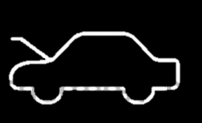
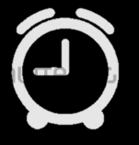

OUTLINE
Why reminder dialogs?
Best practices
The 5 Cs
Under the hood
End product
Troubleshooting & Tips
5
Notes:
Speak to slide
Now let’s take a look at your poll results.
*****

Slide 4
Poll Results
Who is in the audience today?
    CAC – reminder builder
    CAC – not reminder builder
    CPRS user
    Data Analyst
    Other
Notes:
I asked: Who is in the audience today?
Ad-lib to the audience results.
Now, before you get too comfortable, I want to go through a short exercise…
*****

Slide 5

Poll Results
Who is in the audience today?
    CAC – reminder builder
    CAC – not reminder builder
    CPRS user
    Data Analyst
    Other
Notes:
Click again…

Slide 6

Notes:
Ask the audience to write down how many green lights and red lights they had on their way to work and for home workers the names of all the people they have talked with in the last 2 weeks.
*****

Slide 7

A Brief history
Notes:
1968 MUMPS was created
1996 Reminders were built into PCE
2002 Reminders were added to CPRS
*****

Slide 8
Why do you want your users to use Reminder dialogs?
Notes:
To decide you must first ask your users questions and analyze the feedback
*****

Slide 9
Unique documentation or clinical process
Notes:
Is it for a unique documentation or clinical process?
*****

Slide 10
Unique documentation or clinical process
Performance Measure Involved
Notes:
Is there a performance measure involved that needs to be monitored?
*****

Slide 11

Unique documentation or clinical process
Performance Measure Involved
to get data in chart
Notes:
Does the user need to get data in the chart that isn’t already existing data?
*****

Slide 12

Content Flow
Notes:
Do they need a decision tree within the content flow?
Unique documentation or clinical process
Performance Measure Involved
To get data in chart
Decision tree within the content flow
*****

Slide 13
Explanations
Big Data
Notes:
Data Flow with Big Data
The biggest and most common reason is because we are in the Big Data era and the users need to gather data
The reasons are endless, but these are most common reasons the reminder dialog templates are the best tool to meet their needs
*****

Slide 14

Best Habits & Building practices
Rules of Thumb
Notes:
Rules of Thumb
To start off our discussion of best practices, I’d like to ask a poll question.
*****

Slide 15
POLL QUESTION
For what purpose do you most frequently use reminder dialogs?
    Standardizing content
    Gathering data
    Ensuring screenings are completed
    Other
Notes:
For what purpose do you most frequently use reminder dialogs?
A. Standardizing content
B. Gathering data
C. Ensuring screenings are completed
D. Other
To answer this question, use the blue polling icon above my head. We’ll move on and come back to your results in just a moment.
*****

Slide 16

Word Document
Notes:
Ask the user/service to put together the in a word document first before starting.
The word document will help with visualizing the dialog and will also help determine which layout they will need to use i.e.. Decision Tree, One Stop Shop, first level selects only, or Optional Groupings.
*****

Slide 17
Flow Mapping
Notes:
Make use Flow Mapping Charts to help align the documentation process, clinical processes and the different roles of the users.
*****

Slide 18
Capitalization
Abbreviations
Greater than/less than
Naming Conventions
AA aa
amt
> <
EL
GRP
Notes:
For headings the case should be consistent through the whole template. Whether starting out with Upper and Lower case or all UPPER CASE, continue with the rest likewise.
Never use unapproved abbreviations and spell out all other abbreviations as much as possible. Refer to the JCAHO Unapproved Abbreviations list
Spell out “greater than” and “less than” instead of using the symbols “>” and “<”.
When naming elements or groups in the dialogs use a naming convention that helps identify the dialog component such as using “EL” for an element or “GRP” for a group.
*****

Slide 19
Main group
Spaced Sequence numbers
Notes:
Use a main group at the top of the hierarchy of groups or sections within a dialog.
When adding a sequence space the numbers out so that you will have room later to add additional groups or elements. Most builders space them by 5’s but the amount of spacing is up to the you, but keep in mind single digit spacing is frowned upon.
Before we move on to some more best practices, let’s check on the results of the poll question I asked earlier.
*****

Slide 20
Poll Results
For what purpose do you most frequently use reminder dialogs?
    Standardizing content
    Gathering data
    Ensuring screenings are completed
    Other
Notes:
I asked: For what purpose do you most frequently use reminder dialogs?
Ad Lib to results
If you chose “other” let us know how you use reminder dialogs by clicking on the red chat icon above my head!
*****

Slide 21
Poll Results
For what purpose do you most frequently use reminder dialogs?
    Standardizing content
    Gathering data
    Ensuring screenings are completed
    Other
Notes:
Click again

Slide 22
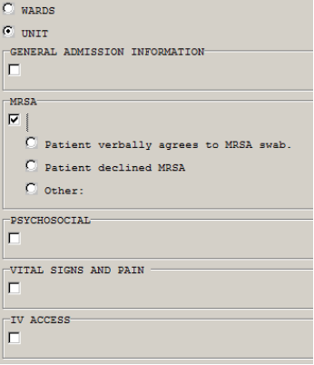
Reduce scrolling
Notes:
Reduce scrolling by setting groups to not show content within the group until it is clicked on. If there are several grouped sections make them optional since a user may not get to complete all sections during a session. Otherwise they will be forced to do the whole dialog or they will resort to other creative methods to document due to time constraints.
Save on real estate in the dialog by using branching logic that is patient centered/specific to the patient. If a particular section would not apply to the patient then it would not be included into the template when it is opened reducing more roll and scrolling.
*****

Slide 23
Read only text
Web Links
(Read Only text)
Notes:
Use read only text to help guide the user through the dialog or provide more information. Ie. Including web links to helpful references or “please explain below” for a required comment field.
*****

Slide 24

Smaller to larger parts
Notes:
As a beginning build smaller parts first such as elements then include them in the larger group parts because once a dialog starts filling up it is harder to navigate or find specific areas that you need to work in.
*****

Slide 25
Previous Clinical History
Notes:
Create previous history sections that are read only at the top of the dialog which includes health summaries. This will help the provider by reducing they have to look in other tabs or areas of CPRS to gather additional information before making a clinical decision. Ie. Lab results, previous family history etc.
*****

Slide 26
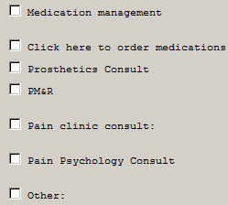

Clinical process
Finish
Notes:
Create groups for orders related to clinical process that open when they click finish. This will save time they would spend searching for orders through the Orders tab. It makes them handy and available if they need them at just the right time.
*****

Slide 27
BOX
Health Factors
Exam
Names
Notes:
Use the box feature to visually separate sections and groups, which helps with navigating the form more easily.
Never use Health Factors for something that already exists in the system unless it is an absolute last resort. For example a Health Factor should not be used for a type of Exam. A new exam should be created or an existing exam should be used.
*****

Slide 28
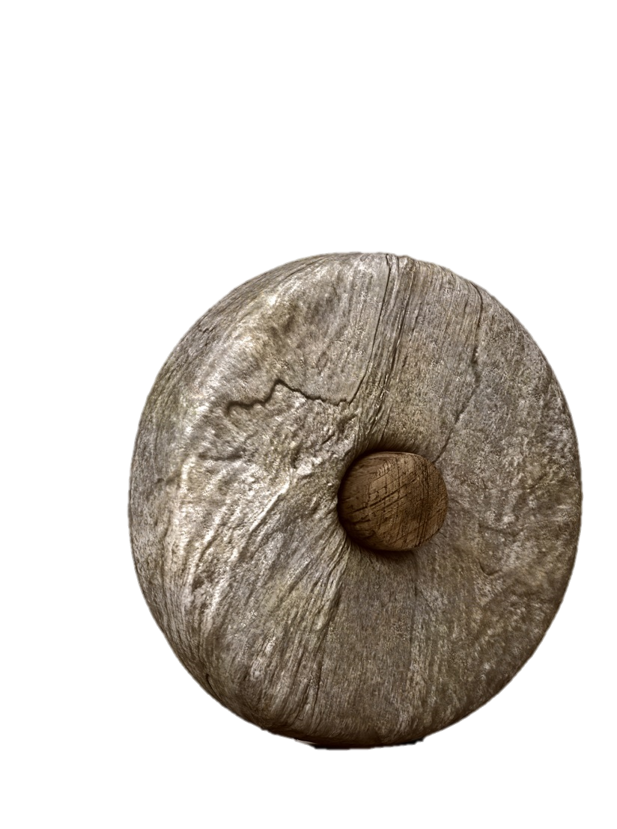
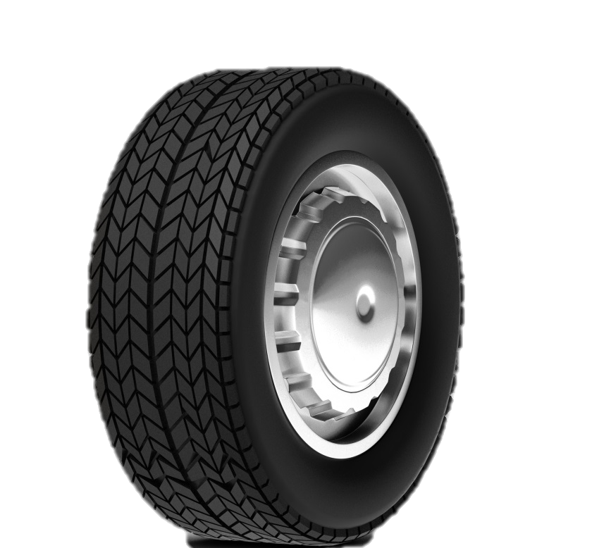
Test
production
Notes:
Halfway point
The hardest rule not to break, but wisest, is to always build or exchange new dialogs in a test environment first then send it to production once it is ready. This will reduce clutter and also help you find trouble spots you can fix before moving it into production.
*****

Slide 29
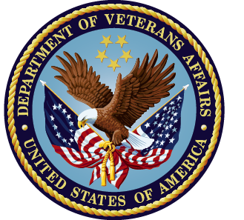
Always use VA national components
Notes:
Whenever possible always use National components. This will reduce workload later since they are automatically updated with patches and will help keep components standardized.
This concludes the rules of thumb… Of the rules of thumb the word document and flowchart are the greatest value. Learning the menus and layout will come with time, but aligning the processes are the more challenging part.
Now let’s start our 5 Cs discussion with a poll question.
*****

Slide 30
POLL QUESTION
Which of the following is most important when working with reminder dialogs?
    Collaboration
    Communication
    Consistency
    Conformity
    Coordination
Notes:
Which of the following is most important when working with reminder dialogs?
A. Collaboration
B. Communication
C. Consistency
D. Conformity
E. Coordination
To answer this question, use the blue polling icon above my head. We’ll move on and come back to your results in just a moment.
*****

Slide 31
5 Cs
Needed during the development lifecycle

Slide 32

Collaboration
Notes:
Collaboration: All of the stakeholders must chip in including leadership.
Having all the stake holders will create diversity in group by having members from various backgrounds and roles. This is when they will create new innovations by connecting their ideas and experiences together.
Leadership is an important stakeholder must support the implementation to let the users know that the process is the expected standard.
Without collaboration the process will fall to the wayside and be viewed as not having buy-in.
*****

Slide 33
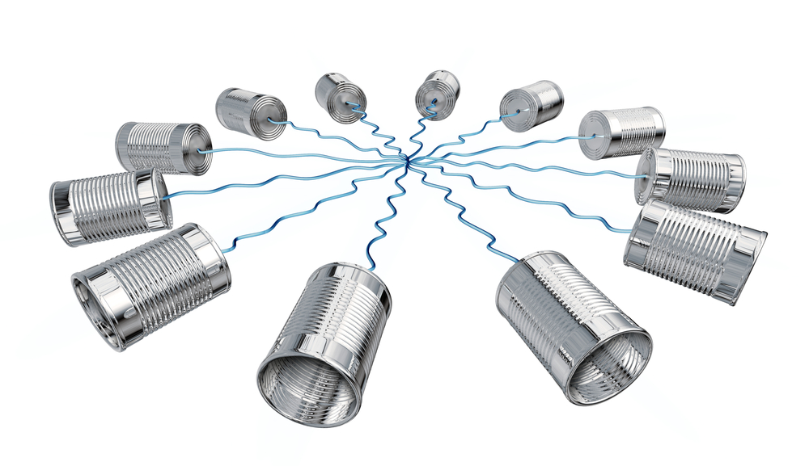
Communication
Notes:
Communication: The group must take full advantage of all social applications and meet frequently via conference calls.
This will break down the work in silos and bubbles.
Without communication the goal will become unclear.
Also without communication stakeholders will not be able to contribute to the process or add new innovative ideas.
*****

Slide 34
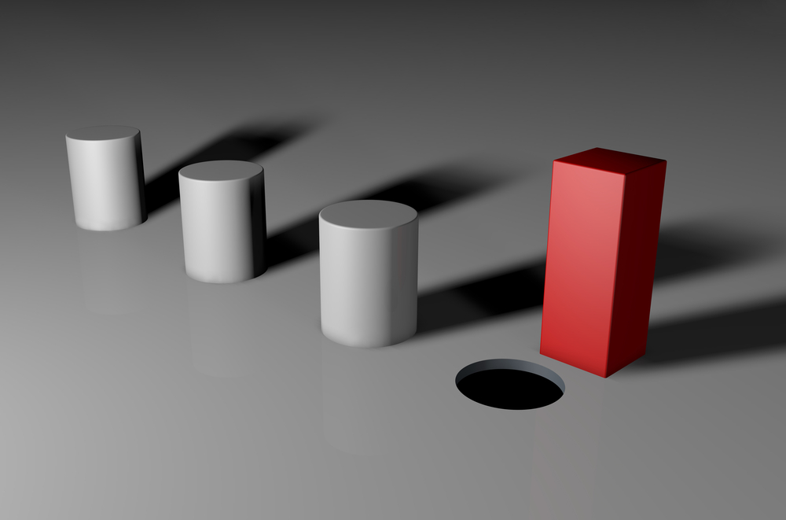
consistency
Notes:
Consistency: At first there can be resistance to change, but the group will have to be consistent about encouraging the process.
At times user will try to continue to use previous methods and or techniques to bypass the new process.
So without consistent reinforcement the new process will default back to the previous ways. Everyone has to be on board.
*****

Slide 35
Conformity
Notes:
Conformity: Here again the group and leadership must reinforce conformity in the areas involved and create the follow the herd movement from point A the previous to point B the objective/goal.
This will reinforce to the users that the new process is supported and accepted.
*****

Slide 36

coordination
Notes:
Coordination: Coordinating the efforts combines the other 4 C’s.
This is where the Health Informatics Specialists are the most valuable resource to all of the other stakeholders.
Without coordination the process will not be able to transition from the old to the new.
*****

Slide 37
Recap
Notes:
Collaboration
Communication
Consistency
Conformity
Coordination
Let’s take a break and look at those poll results
*****

Slide 38
Poll Results
Which of the following is most important when working with reminder dialogs?
    Collaboration
    Communication
    Consistency
    Conformity
    Coordination
Notes:
I asked: Which of the following is most important when working with reminder dialogs?
Ad-lib to the audience results. Transition.
*****

Slide 39
Poll Results
Which of the following is most important when working with reminder dialogs?
    Collaboration
    Communication
    Consistency
    Conformity
    Coordination
Notes:
Click again

Slide 40
Under the Hood
  How reminder functionality provides solutions for dialogs
Notes:
The reminder dialog template functionality provide solutions for dialogs by
Providing data at just the right time saving the user time from having to search by hand.
Providing patient centered/specific data within the dialogs templates.
Allowing users to enter process specific orders directly from the dialog templates.
Providing a means of transparent entry of data markers to be entered into the record during the documentation process such as Health Factors, Education Topics and Immunization.
Requiring needed documentation input.
Let’s ask another poll question
*****

Slide 41
POLL QUESTION
How do you most often use reminder dialogs?
    Consult responses
    Templates linked to titles
    Cover sheet reminders
    Templates used as shared templates
Notes:
How do you most often use reminder dialogs?
A. Consult responses
B. Note templates
C. Shared templates
To answer this question, use the blue polling icon above my head. We’ll move on and come back to your results in just a moment.
*****

Slide 42
End Product
Reminder Due Report
Reminder Extract
FileMan
VISN Data Warehouse
Notes:
The value added from the end product happens when the dialogs are used. This results from the various types of reports that can be developed for leadership to analyze best practices, identify areas within clinical processes that need improvement and the ability to make more informed decisions for future needs.
Additionally and most importantly the results help our providers support evidence based medicine for our high level of patient care.
When everything comes together the dialogs become a meaningful multipurpose documentation tool that will save them time with less typing or searching for information in the chart and allow data entry into the encounter while documenting, which reduces the time for coding.
The results will then show in the various types of reports that can be developed.
Reminder Due Reports – Used to pull patient lists by specific locations, for example patients due for a particular screening.
Extracts- Used to pull data lists based on data definition rules that filter specific data. An example of this is the quarterly CHF report that gets pulled automatically at all sites.
FileMan Reports- Used to create reports which can be turned into a menu option in VistA for the user. Many sites use this method to quickly pull Health Factor reports such as a report to find pressure ulcer Health Factors to identify changes quickly in the patient’s condition to pass the information to the next shift so that severe cases are prevented early.
VISN Data Warehouse Reports – These reports are created and query data that is shadowed nightly from every site. They allow us to pull data on larger geographical patient populations or allow management to compare sites processes for best practices. Though it is also possible to use them to link directly to a patient’s specific data straight from CPRS via a web link, if needed by the user.
Now that you know the end products of reminder dialogs, let’s see how you said you use reminder dialogs.
*****

Slide 43
Poll Results
How do you most often use reminder dialogs?
    Consult responses
    Templates linked to titles
    Cover sheet reminders
    Templates used as shared templates
Notes:
I asked: How do you most often use reminder dialogs at your site?
Ad lib/discuss results and transition.
*****

Slide 44
Poll Results
How do you most often use reminder dialogs?
    Consult responses
    Templates linked to titles
    Cover sheet reminders
    Templates used as shared templates
Notes:
Click again

Slide 45
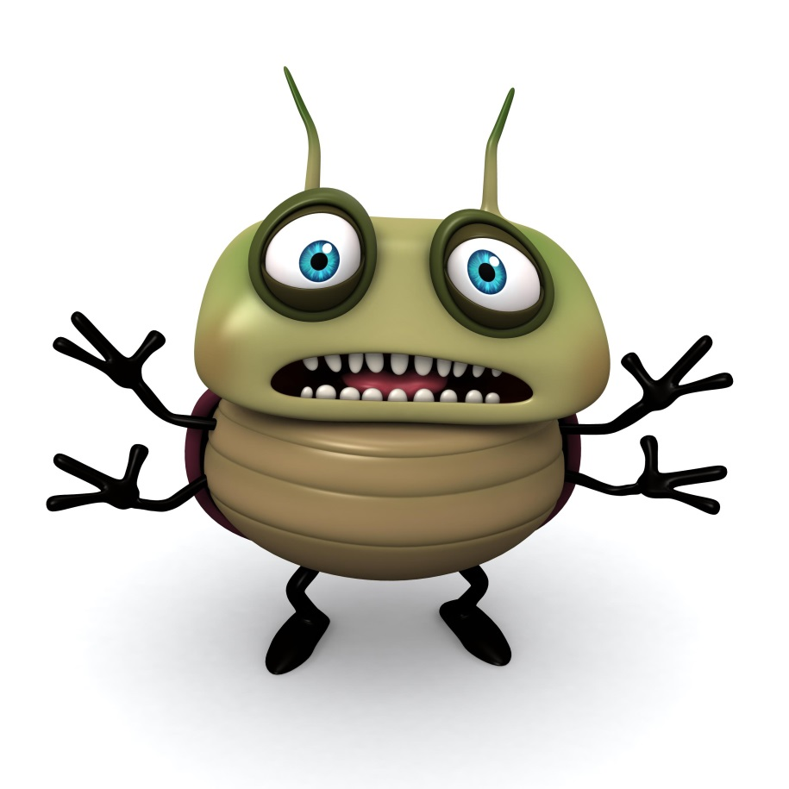
Troubleshooting & Tips
Notes:
Dialogs are not perfect and here are a few common quirks or questions a new builder may run into:
*****

Slide 46
“Note template isn’t opening when I start”
Notes:
User complaint/question: The note template isn’t opening when I start my note, but it was working fine and coming up earlier.
What to ask the user: Ask if they have been on a dual monitor system prior to the system they are currently on. If yes, ask them to close all CPRS sessions they have open (very important step). Once they have use the menu option Clear Gui Settings to reset their windows to show on the main monitor again. They will just need to resize the window once it opens.
*****

Slide 47
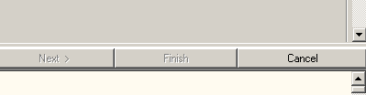
“Finish button grayed out”
Notes:
User complaint/question: My Finish button is grayed out and I can’t finish the template.
Ask the user: Do you have another note highlighted in blue in the notes list other than the note that you are using the dialog in? If yes, direct them to reselect the original note and the Finish button will become enabled again.
*****

Slide 48
“Can dialogs calculate totals like a calculator?”
Notes:
User complaint/question: Can dialogs calculate totals for me like a calculator.
Response: Unfortunately, the functionality doesn’t exist in reminder dialogs.
*****

Slide 49

“Can I highlight or bold text?”
Notes:
User complaint/question: Can I highlight text or make it bold.
Response: This again is a functionality that doesn’t exist in reminder dialogs.
*****

Slide 50
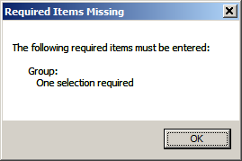
“I can’t see anything I missed”
Notes:
User complaint/question: I can’t finish my template. It says there is something required, but not saying what it is. I can’t see anything I missed.
Response: Check the dialogs for a dialog group that has one or more selection or higher, but doesn’t have dialog progress note text. Also check for any TIU Fields that they may have overlooked. Sometimes a small asterisk is elusive when staring at notes at the end of the day.
*****

Slide 51
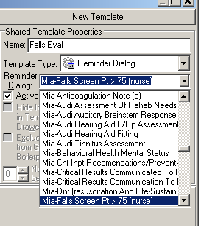
“Why isn’t my dialog showing in tiu editor?”
?
Notes:
New reminder builder question: Why isn’t my dialog showing in the TIU editor drop down list so that I can link it to my note title.
Response: Add a new sequence in the TIU REMINDER DIALOG PARAMETER with the name of your dialog.
*****

Slide 52
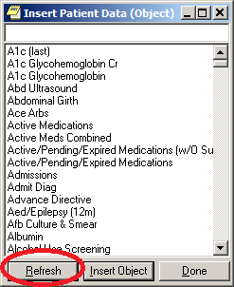
“tiu patient data object doesn’t exist”
Refresh
Notes:
New reminder builder question: I just created a TIU PATIENT DATA OBJECT and put it in the text, but it is saying it doesn’t exist.
Response: Short route is to open the TIU EDITOR and right click in a scratch template to add a patient object then when the list opens click refresh at the bottom. The long route is to close out of CPRS and reopen it.
*****

Slide 53
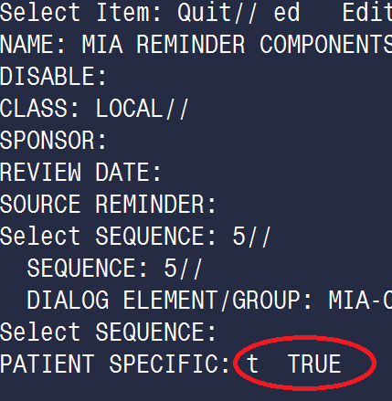
“Why isn’t the branching working?”
Notes:
New reminder builder question: Why isn’t the branching working in my dialog for my patient.
Response: Check to see if the patient specific filed for the dialog is set to true. This is the most commonly missed.
*****

Slide 54
A few more tips…
Start an addendum
Click on clock
Notes:
Other Miscellaneous Tips [next to last slide]
When you are pressed for time to open a reminder quickly starting with an addendum is much quicker than starting a new note to get the reminder button to show in the lower left of CPRS
Clicking on the clock in the upper right of CPRS then going to Action then Refresh Dialogs is much faster than File then Refresh Patient information.
If working on a template tied to a title using Action, Reload boilerplate is faster than deleting the new note and starting over.
*****

Slide 55

Ask the Presenter
Notes:
If you haven’t submitted your questions yet, there is still time to do so by clicking on the orange “Ask The Presenter” icon. We’re going to show a brief announcement and be right back to answer your questions.
(Stand still and smile until you see the video come up full screen)

