Slide 1
I-10 and Clinical Reminders!
Kathy Corrigan, MD
Elizabeth Griffith
Jennifer Teal
Notes:
Jen:
Thank you Rosie! Kathy and I are happy to be here today to kick off the discussion on ICD-10 and Clinical Reminders. We will discuss the impact of ICD-10 on the clinical reminders and walk through the steps of updating existing local clinical reminders using ICD-10 codes. We will have Elizabeth on in a few minutes to discuss the changes and modifications made to the existing reminder software due to the ICD-10 code changes. She will walk through the reminder updating process and tools used to ensure that all aspects of the reminder are complete and accurate. With the implementation of the ICD-10 code set, all national as well as any local taxonomies must be updated to reflect equivalent ICD-10 codes and in turn, each clinical reminder must reference individual codes from the taxonomy appropriate for the reminder clinical context.
*******************

Slide 2
Poll Question
We would like to know who is in our audience today.
Health Informatics Specialist (formerly CAC)
Clinician
HIM
Other
Notes:
Jen
Before we get started, how about we pause for a moment and ask our first poll question. We would like to know who is in our audience today. Select A if you work in Health Informatics, B if you are a Clinician, select C if you work in Health Information Management, or D for Other.
To answer this question, use the blue polling icon above my head. We’ll move on and get back to your results in just a moment.
*******************

Slide 3
VA’s Transition to ICD-10 is a Huge Undertaking
ICD-9
ICD-10
Notes:
Jen:
Transitioning from ICD-9 to ICD-10 is not as simple as flipping a switch and using the new code set beginning October 1st 2015. There is a lot of prep work that must occur long before then. VA’s transition to ICD-10 is a huge undertaking. There are major software updates that are needed. Not only must the applications be updated to recognize and accept ICD-10 codes, but they must also be date aware to know when to start utilizing the new code set versus continuing to use ICD-9 codes for dates of service prior to October 1st, 2015. 36 software packages have been remediated and extensive testing in test accounts has occurred.
So you’ve heard me say October 1st 2015 a couple of times now. You are probably aware that the implementation deadline that was previously set for October 1, 2014 was recently pushed back . The Protecting Access to Medicare Act of 2014 has a provision in the statute that states: “The Secretary of Health and Human Services may not, prior to October 1, 2015, adopt ICD-10 code sets as the standard for codes sets ...”
As a result of that language, we are expecting the U.S. Department of Health and Human Services to release an interim final rule here in the very near future that would include a new compliance date requiring the use of ICD-10 beginning on October 1, 2015.
*******************

Slide 4
Why ICD-10 ?
Notes:
Jen:
There are many reasons why the transition to ICD-10 is important. One reason is to align the US with coding systems worldwide. In addition, the use of ICD-10 offers greater coding accuracy and specificity as well as higher quality information for measuring healthcare service quality, safety and security. The biggest change is in the sheer volume of codes, going from approximately 13,000 codes in ICD-9-CM to approximately 68,000 codes in ICD-10-CM. That’s for the diagnosis codes. For the procedure codes, the codes increase from approximately 4,000 ICD-9 procedure codes to over 70,000 ICD-10-PCS codes.
Kathy: Wow, that really is a HUGE increase in codes.
Jen:
It sure is, but this expansion provides the ability to offer codes that have a great deal more detail than what is currently available in ICD-9.
There was a previous vVeHU Session 313 - ICD-10 and the Clinician, which discussed differences between ICD-9 to ICD-10 and how the differences will affect the clinical business process. That is a great session to review on demand if you missed it.
Kathy, would you like to discuss some of the clinical implications of the transition to ICD-10?
*******************

Slide 5
Why ICD-10 ?
Notes:
Kathy:
As Jen mentioned, ICD-10 has a greatly expanded number of codes with increased specificity and accuracy.
For the clinician ICD-10 offers the ability as well as the responsibility to more accurately define the individual patient’s condition or diagnosis. Additionally the provider has a responsibility to provide the clinical detail in the health record documentation that supports the code selection. This is important for claims and revenue streams but additionally will become increasingly important to analysis of VHA healthcare quality and utilization as well as to research.
Examples of increased specificity of ICD-10 codes include the ability to describe the laterality of a condition or which side is affected. For example a fracture of the hip can be the right hip or the left hip or both hips. Additionally the location of the fracture within the femur needs to be specified.
Is the care for the fracture acute care or is the visit a follow-up visit.
For other ICD-10 codes increased specificity may relate to indicating:
The etiology of the condition. An example is a fall from a ladder.
The causative organisms. An example is the organism which caused the patient’s pneumonia
Accompanying conditions. Probably the most familiar example is diabetes mellitus and the many conditions that may accompany diabetes
The degree of severity of the condition
*******************

Slide 6
Poll Results
We would like to know who is in our audience today.
Health Informatics Specialist (formerly CAC)
Clinician
HIM
Other
Notes:
Jen:
Let’s pause for a moment and take a look at your poll results. We wanted to know who was in our audience today. It looks like most of our audience is….
It looks like we have a fairly diverse group in our audience today. It is important to have a multidisciplinary team involved in the update process. You are going to need folks with knowledge and access to Clinical Reminder criteria, an understanding of the Clinical Context, and coders familiar with ICD-10.
Just a quick reminder before we get back to our presentation. If you have any questions, just click on the Orange ‘Ask the Presenter’ icon located above my head. We will answer your questions at the end of the presentation.
Back to you Kathy.
*******************

Slide 7
Poll Results
We would like to know who is in our audience today.
Health Informatics Specialist (formerly CAC)
Clinician
HIM
Other

Slide 8
Taxonomies
Notes:
Kathy:
Now let’s talk about how the ICD-10 transition relates to Clinical Reminders.
Currently, the clinical reminders software is widely used as throughout VHA to provide clinical decision support which is used to assist clinicians in providing the right care to the right patient at the right time. A few examples include assisting the clinician to know when and if a specific immunization is due for a patient or when a mental health or cancer screening is due. Many sites use reminders to alert the clinician when an intervention is due to monitor or treat a chronic disease such as diabetes.
Taxonomies are sets of codes. These codes are used within the Clinical Reminders software to define the “right” patient. The right patient to be included in the reminder or the right patient to be excluded.
One of the most commonly used examples of a taxonomy is one used to define which patient have diabetes.
Currently: ICD-9, ICDO, CPT codes can be used to define a taxonomy
Upcoming software releases will ensure that taxonomies will have the functionality to include ICD-10 and other coding system such as SNOMED
Taxonomies can be defined on the National level, or they can be defined by VISN or by Local facilities. Taxonomies may also be shared by importing them from other VA sites.
All taxonomies that contain ICD-9 will need to be updated with ICD-10 codes. Jen has some first hand experience with updating the national taxonomies with the ICD-10 codes.
Jen: It has been a great learning opportunity and I will get into some examples in a moment.
Kathy: Taxonomies can also be used in reminder dialogs to collect encounter information. The most frequently used example of this is local flu shot dialogs that capture the appropriate ICD-9 and the CPT codes.
Taxonomies can also be used in reminder dialogs to define pick lists that allow selection of a problem be added to the problem list.
*******************

Slide 9
Minimize impact on clinical care
Notes:
Kathy:
The ability to add ICD-10 codes to existing clinical reminder taxonomies represents a major transition.
Jen:
Updating existing taxonomies prior to the projected 10-1-15 deadline will require a major amount of work and will impact clinical application coordinators as well as HIMS staff and subject mater experts. Some taxonomies did need to have A LOT of codes, such as high risk for pneumococcal pneumonia that added a few thousand codes.
Kathy:
The overall Goal of the ICD-10 Transition is to *** Minimize impact on clinical care ***
Minimizing impact on clinical care is critical since Clinical Reminders are a major Clinical Decision Support (CDS) tool in CPRS and their display in CPRS supports quality of care.
Reminder Reports play an important role a local VA’s in supporting performance improvement and feedback in VHA especially in outpatient clinics
*******************

Slide 10
National Clinical Reminder Committee ICD-10 Update Project
Notes:
Kathy:
The National Clinical Reminder Committee recognizes the importance of clinical reminders and taxonomies to clinical care in VHA. The committee is sponsoring the ICD-9 Update Project to review and update taxonomies used in national reminders.
Clinical Reminder Developers will be releasing the clinical reminders software patch 26 in the near future. This will allow local sites to begin the work update local taxonomies to include ICD-10 codes well in advance of 10-1-15.
In Patch 26, the Reminder Taxonomy data dictionary (file #811.2) is a being restructured to be Lexicon-based instead of pointer-based. This allows use of any coding system supported by the Lexicon package.
A New taxonomy management system will be used and taxonomy evaluation has been changed to accommodate the new structure.
For Reminder Dialogs, users will no longer be able to add ICD-9-CM and/or CPT-4 codes directly to a Reminder Dialog, they will need to create a Taxonomy, assign codes, and then add the Taxonomy to the Reminder Dialog. Elizabeth will go into more detail during her part of this presentation.
Jen: And remember, any time adding or editing codes, please consult your local HIM/coding staff for input!
*******************

Slide 11
N
W
Start
Notes:
Kathy:
How to Prepare General Approach
Start NOW
Review Taxonomy List
Identify reminders with taxonomies
Substitute national taxonomies for local taxonomies when possible
Identify and rename inactive taxonomies
*******************

Slide 12
Identify Reminders with Taxonomies
RP Reminder Reports
FUR Finding Usage Report
Select from the following reminder findings: 19 TAXONOMY
Enter your list for the report: (1-24): 16
Search for all or selected REMINDER TAXONOMYS?
Select one of the following:
1 ALL
2 SELECTED
Enter response: SELECTED// 1 ALL
Deliver the report as a MailMan message? N// YES
Notes:
Kathy:
Use the Finding Usage Report menu option to find your local taxonomies.
This menu options can be found under the Reminder Reports Menu Option
*******************

Slide 13
Review CR Finding Usage Report
The following REMINDER TAXONOMYs are used as Clinical Reminder findings:
================================================
REMINDER TAXONOMY - CHF-OLD (IEN=53)
CHF-OLD is used in the following Definitions:
----------------------------
report count - CHF 428 (IEN=206)
Finding number 1
----------------------------
report count - ER CHF 2 (IEN=769)
Finding number 1
Notes:
Kathy:
This is a screen shot of a portion of the Finding Usage Report. Note that the report provides information not only on the taxonomies but also which reminders they are used in.
*******************

Slide 14
Identify local taxonomies that need updating to ICD-10
Notes:
Kathy:
After you have substituted national taxonomies for local taxonomies and have
identified and renamed inactive taxonomies, you may find that your site had a considerable number of taxonomies that will need to be updated to ICD-10.
Is that Taxonomy available elsewhere? If taxonomy imported from another site – contact that site to share updated taxonomy.
Discuss how to share workload within your VISN at your VISN clinical reminder group.
Involve HIM Chief early and identify which subject matter expert you will need to work with. Jen, Can you provide your valuable input on this part of the process?
Jen:
Ok, so now you have identified a set of local taxonomies used at your facility that need to be updated for ICD-10, so what next. This is really a task that will be a group effort, coordinated with your local ICD-10 workgroup and your HIM Chief. You are definitely going to need coding staff that are trained on ICD-10.
Also be sure to work with your local subject matter experts to help define the purpose of the specific taxonomy. Knowing this piece of information will be helpful to coding staff as they are trying to determine the equivalent ICD-10 codes for the previously used ICD-9 codes in the taxonomy. Remember, there is rarely a one-to-one mapping between ICD-9 and ICD-10, so knowing the clinical context is important.
*******************

Slide 15
VA Tobacco Use
ICD-9-CM
ICD-10-CM
305.1 Tobacco use disorder
F17.200 Nicotine dependence, unspecified, uncomplicated
Notes:
Jen:
Here is just one example of some of what you will need to look at when updating your local taxonomies with ICD-10 codes. ICD-9 code 305.1 is used in the VA Tobacco Use taxonomy. If we were to use the ICD-9 to ICD-10 mapping to find the equivalent ICD-10 code, you would end up with ICD-10 code F17.200. Now, one thing to look at is whether this meets the intent of the ICD-9 code. Notice these are not exact matches. The ICD-9 code title is Tobacco Use Disorder while the ICD-10 code title is Nicotine dependence, unspecified, uncomplicated.
*******************

Slide 16
But what about…
F17.201 Nicotine dependence, unspecified, in remission
F17.210 Nicotine dependence, cigarettes, uncomplicated
F17.211 Nicotine dependence, cigarettes, in remission
F17.220 Nicotine dependence, chewing tobacco, uncomplicated
F17.221 Nicotine dependence, chewing tobacco, in remission
F17.290 Nicotine dependence, other tobacco product, uncomplicated
F17.291 Nicotine dependence, other tobacco product, in remission
F17.203 Nicotine dependence, unspecified, with withdrawal
F17.208 Nicotine dependence, unspecified, with other nicotine-induced disorders
F17.209 Nicotine dependence, unspecified, with unspecified nicotine-induced disorders
F17.213 Nicotine dependence, cigarettes, with withdrawal
F17.218 Nicotine dependence, cigarettes, with other nicotine-induced disorders
F17.219 Nicotine dependence, cigarettes, with unspecified nicotine-induced disorders
F17.223 Nicotine dependence, chewing tobacco, with withdrawal
F17.228 Nicotine dependence, chewing tobacco, with other nicotine-induced disorders
F17.229 Nicotine dependence, chewing tobacco, with unspecified nicotine-induced disorders
F17.293 Nicotine dependence, other tobacco product, with withdrawal
F17.298 Nicotine dependence, other tobacco product, with other nicotine-induced disorders
F17.299 Nicotine dependence, other tobacco product, with unspecified nicotine-induced diso
Notes:
Jen:
And what about all of these ICD-10 codes that also reflect nicotine dependence? Forward mapping goes from ICD-9-CM to ICD-10-CM. But you must also consider backward mapping which goes from ICD-10-CM to ICD-9-CM. Backward mapping may help identify how some of the new ICD-10 concepts relate to the ICD-9 code set. Mapping is rarely one-to-one. We had a previous vVeHU Session 13045 - ICD-10 General Equivalence Maps – What They Are and How to Use Them. If you would like more information on the use of the GEMs, be sure to review that session On Demand in MyVeHU Campus.
*******************

Slide 17
Notes:
Jen:
Again, when converting ICD-9 codes to ICD-10 codes for your local taxonomies, it will be important that this effort is coordinated with your local ICD-10 Workgroup and ICD-10 coding experts. Work with local subject matter experts to help define purpose of the taxonomy. Determine what type of patients you are trying include or exclude in a cohort. Having coders involved in the process will be critical in to identifying the correct ICD-10 codes to include or exclude. Let’s take a look at an example on the next slide.
*******************

Slide 18
256.31 | Premature menopause | E28.310 | Symptomatic premature menopause | keep
 |  | E28.319 | Asymptomatic premature menopause | remove
256.39 | Other ovarian failure | E28.39 | Other primary ovarian failure | remove
 | Other options to consider: | E89.40 | Asymptomatic postprocedural ovarian failure | remove
 |  | E89.41 | Symptomatic postprocedural ovarian failure | keep
 |  | N97.0 | Female infertility associated with anovulation | remove
 |  | N97.1 | Female infertility of tubal origin | remove
 |  | N97.2 | Female infertility of uterine origin | remove
 |  | N97.8 | Female infertility of other origin | remove
 |  | N97.9 | Female infertility, unspecified | remove
 |  | Q50.02 | Congenital absence of ovary, bilateral | remove
Notes:
Jen:
We formed a workgroup to work through the process of updating all of the national clinical reminders for ICD-10. First there was an initial review of the taxonomies that each reminder references. During the initial review, it was determined that some should be inactivated. If you have some that are inactive, outdated, or not being used, you don’t want to spend the time converting all of the codes only to have them not needed so that was an important step in the process.
Here is an example from the VA-TERATOGENIC MEDICATIONS ORDER CHECK TAXONOMIES. The intent for this taxonomy is that if there is no chance that a woman is pregnant, then this excludes them from the need for an order check for dangerous medications during pregnancy.
Next, we identified the current ICD-9 codes used by the reminder and had two separate coders determine the best equivalent ICD-10 codes. Part of the determination was based on the description of the taxonomy provided by the clinical reminder experts. We needed to know how the taxonomy was used, and what the context was. After independent coding by the two coders, we came together and reviewed the proposed equivalencies that we each came up with and reached a consensus on the superset of ICD-10 codes to put forward to the workgroup for the clinical staff to determine which ones were appropriate to keep or not. This slide shows the original ICD-9 codes, the ICD-10 codes that come up as general equivalencies if mapping is used, and additional ICD-10 codes that we thought might also fit the scenario. The clinical experts decided which ones to ultimately keep or remove. This is just one example. The same process must be followed for each of the local taxonomies that need to be updated for ICD-10.
*******************

Slide 19
Poll Question
In what capacity do you work with clinical reminders?
Create/modify clinical reminders
Provide codes
Do not work with clinical reminders
What are clinical reminders?
Notes:
Kathy:
How about another poll question. In what capacity do you work with clinical reminders?
Select A if you Create/Modify clinical reminders
Select B if you provide codes for clinical reminders
Select C if you do not work with clinical reminders
Or Select D if you are wondering, What are clinical reminders?
To answer this question, use the blue polling icon above my head. While you are responding to the poll, we’ll move on with the presentation and get back your answers a little later.
Now I would like to introduce Elizabeth Griffith, she is a clinical application coordinator from the Marion Il VAMC, she is going to go over in more detail the new taxonomy interface.
*******************

Slide 20
Describe the new Taxonomy interface in VistA
How to prepare for ICD-10 implementation
How to create and edit Taxonomies for use in Reminder Definitions, terms and dialogs
Notes:
Thank you to Jennifer and Kathy. You have done a great job describing the Why and What of ICD10 and clinical reminders.
Now lets get to the How or the more fun technical piece.
I am not the technical expert. I am a clinical application coordinator and I have been involved in testing these new changes for the last year.
There are several positive things to report!
This should not affect the providers
The changes increase functionality within the reminder dialog and I really liked the new changes – explain this
We have until October 2015 now to make sure all of our local taxonomies that contain ICD9 codes are updated to include ICD10
I am going to talk about what the differences are in the new taxonomy structure, how you can prepare for ICD 10 and then show you how you create and edit taxonomies.
*******************

Slide 21
Coding Systems Supported By Clinical Reminders
Abbreviation | Nomenclature
10D | ICD-10-CM
10P | ICD-10-Proc
CPT | CPT-4
CPC | HCPCS
ICD | ICD-9-CM
ICP | ICD-9-Proc
SCT | SNOMED CT
Notes:
Although we are talking about taxonomy changes because of the addition of the ICD10 codes, you can see there are many different coding systems available for use within clinical reminders.
Each coding system has a 3 character abbreviation. You will see later how this is used in creating/editing your taxonomies
*******************

Slide 22
Taxonomy DD (file structure) Changes
Notes:
As Dr. Corrigan referenced earlier, the entire file structure for taxonomies will change with the conversion
The old pointer system where when you created taxonomies , you entered a range of codes that pointed to a file, has been replaced by a new selected codes multiple file system where many different types of codes can be stored for one taxonomy.
The field in your taxonomy for Brief Description has been replaced by Description
Brief Description was limited to 80 characters – before you would sometimes need to be creative to fit your descriptions into 80 characters.
Description uses word processing functionality. Text not limited
Selectable Diagnosis and Selectable Procedures multiples are no longer used for dialogs, instead codes are marked as Use In Dialog (UID). I will show you later in the presentation how you designate codes within the taxonomy that are to be used in your reminder dialog.
*******************

Slide 23
What it
IS
What it
IS NOT
Notes:
How do we define “Conversion”
What the Conversion IS:
Converting the file structure in VistA from pointer-based structure to a new structure that will accept the multiple coding systems that I showed you earlier
It keeps your local taxonomies and preserves the codes that are in them
What the Conversion is NOT:
And you probably wish it was –
Will not add ICD-10 codes to your current local taxonomies
Will not convert current ICD-9 codes in your local taxonomies to ICD-10 codes
Will not delete current taxonomies with ICD-9 codes
Will not update national taxonomies yet – that will come in later patches
As Kathy talked about, the Finding Usage report will give you the information needed to work with your local HIMS staff and ICD10 workgroup to identify ICD-10 codes that mean the same thing as the ICD-9 codes contained within their local taxonomies. Your Clinical Application Coordinator will update the appropriate local taxonomies and add the ICD10 codes.
This “identifying” of ICD-10/SNOMED codes needs to be started now so your local taxonomies will be ready for use by 10/1/2015
*******************

Slide 24
Dialogs Will Now Use Taxonomies Exclusively
Individual codes no longer used as findings or additional findings
Individual codes in use as a Finding Item or Additional Finding will have a taxonomy created for replacement
Notes:
Dialogs will now use taxonomies exclusively
Before you could have an individual code as a finding item or additional finding in your reminder dialog,
Individual codes in use as a Finding Item or Additional Finding will have a taxonomy created for replacement during the conversion process
Within the Description of the new taxonomy the system will show that the taxonomy was automatically generated from a Reminder Dialog
*******************

Slide 25
GMPL*2.0*44
DG*5.3*862
PXRM*2.0*26
Requires:
LEX*2.0*80
ICD*18*57
Notes:
Install is a multi-package build DG*5.3*862 GMPL*2.0*44 PXRM*2.0*26
Requires
LEX*2.0*80 ICD*18*57
The Lex star 2 star 80 patch contains the ICD10 codes that will be loaded into your system, these codes wont add automatically to your existing taxonomies but they will be available for you to add into your local taxonomies.
Should have a day between Lex/ICD installs and the PXRM star two star 26 bundle install to let all background jobs associated with LEX to complete
*******************

Slide 26
PXRM*2.0*26
Notes:
Although this is a multipackage build as shown, most of what I will show you with reminders and taxonomies will be in the PXRM 26 bundle.
Once the install starts, all reminder evaluations will be disabled during the install. Depending on the size of your database this installation could take a few hours. I encourage you to install into production during non clinic hours so that disabling the reminder evaluations will not affect patient care.
*******************

Slide 27
Poll Results
In what capacity do you work with clinical reminders?
Create/modify clinical reminders
Provide codes
Do not work with clinical reminders
What are clinical reminders?
Notes:
Let’s pause for a moment and take a look at your poll results. It looks like most of our audience today is….
Either Do not create clinical reminders/ Are folks that work with clinical reminders. For those that create and modify reminders you will be using the new taxonomy editor that I am going to show you. For those of you that don’t work directly with clinical reminders, this is a good reference for you to see what your Clinical Application Coordinators will need to do to get your existing reminders ready for ICD10. It really will be a team effort to identify the appropriate codes. If you answered D, this part of the presentation may be a little boring for you.
Thank you all for joining us today!
*******************

Slide 28
Poll Results
In what capacity do you work with clinical reminders?
Create/modify clinical reminders
Provide codes
Do not work with clinical reminders
What are clinical reminders?

Slide 29
Are you ready to install?
Have you:
Run “Check all active reminder dialogs for invalid items” report?
Run the Finding Usage Report?
Backed up file 801.41?
Yes – install
No
Notes:
Before I talk about the install and getting ready, I want to tell you, “don’t panic”, you will get the information including a pre-install guide as it gets closer to the installation time for your facility.
Some things you can do now though are :
Check active reminder dialogs for invalid items – identify those items that need “cleaning up” or things you need to fix. Shows your dirt! There is a one page document outlining items you will find on this report available in the downloads, click the green button above my head. Not everything on the report needs to be corrected for the installation and that document will outline that. For our facility, we had several elements and groups within reminder dialogs that had incomplete sequences that I had to clean up.
Run Finding usage report
Backup file 801.41 (this is your reminder dialog file) – work with your local OIT
*******************

Slide 30
VistA Mail
1
What dialogs looked like pre-install
2
What dialogs look like now
3
Possible errors
4
Problem List Index rebuild
5
PTF Index rebuild
Notes:
Pre install you will run a report of what your dialogs with ICD/CPT or Taxonomies looked like
Post install you will run a report of what your dialogs look like now. You should use this for a side by side comparison to make sure all items are there
After installation you may get several mailman messages in your Vista mail, these are the types of messages you may receive:
Possible message about errors. You may need to get with OIT about these messages or you can contact the national help disk and have a remedy ticket entered and the team will be able to help you sort through these.
You will get two separate messages about the Problem List and PTF Index rebuild
If there are entries that can’t be indexed, you will receive separate messages about this – you will again want to put in a remedy ticket and get help.
*******************

Slide 31
What happens to my elements and groups that contain
ICD9, CPT, Taxonomies
as finding items or additional findings?
Notes:
Are you wondering what happens to your existing elements and groups that contain ICD9, CPT and Taxonomies as finding items or additional findings?
If a single ICD or CPT code is the Finding Item or Additional Finding of a dialog element/group:
Taxonomy is created during conversion
Taxonomy is given the name of the element/group it is in
If a taxonomy is the finding item of a dialog element/group
Current name of taxonomy remains – still the same codes
You can edit your available PXRM prompts
*******************

Slide 32
‘Pick List’
ALL
Displays 2 pick lists for choosing codes
One for ICD and one for CPT
Displays ‘pick list’ for ICD only
All CPT codes in taxonomy are entered into PCE
Displays ‘pick list’ for CPT only
All ICD codes in taxonomy are entered into PCE
No ‘pick list’ for either ICD or CPT
All codes in taxonomy are entered into PCE
DX ONLY
CPT ONLY
NONE
Notes:
Kathy referenced earlier the “pick list of codes” in a reminder dialog.
These ‘pick lists’ are only relevant for the Finding Type field (not Additional Findings field)
There are up to four choices for your finding item in how that list might display. The options you will see are dependent on what type of codes are contained in your taxonomy.
This slide references a Taxonomy that contains both icd and CPT codes to show all four possibilities
If All is chosen then you would actually have two separate pick lists within the dialog – one for the cpt code and one for the icd code
If dx only – the pick list will be displayed for the icd code only and the cpt codes would automatically file to PCE
If CPT only, the pick list will be displayed for the cpt code and the icd codes will automatically file to PCE
If you choose none then NO pick list will be displayed and all the codes in the taxonomy will file to PCE
The default is ALL
Have to have a choice selected
*******************

Slide 33
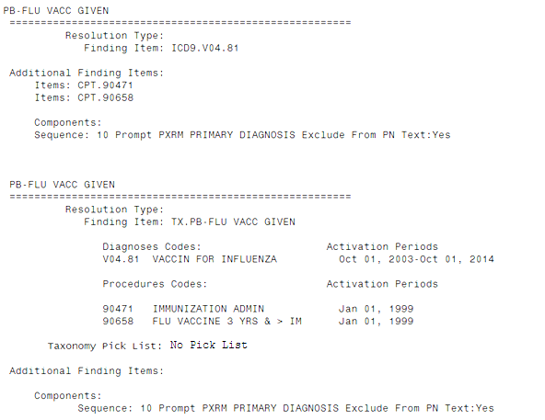
ICD9 and CPT codes
Name of new taxonomy
Notes:
When taxonomies are created during conversion, the name of the dialog element/group they are contained in is the new name of the taxonomy
In this example there is a ICD code as a finding item and two cpt codes as additional findings pre-conversion on an element named PB-FLU VACC GIVEN
Note that post-conversion there has been ONE taxonomy created that contains both the diagnosis and procedure codes, it has been added as the finding item and the name of the taxonomy is the same as the name of the element that those findings were contained in PB-FLU VACC GIVEN
*******************

Slide 34
Pre-Conversion
Post-Conversion
Notes:
Another example where a CPT code was an additional finding item and a health factor was the finding item.
Notice post conversion, the HF is still the finding item and the new taxonomy is the additional finding, that taxonomy has the name of the element HF LIPID LDL 120-129
*******************

Slide 35
What happens if two elements/groups have the same ICD/CPT codes?
Notes:
If more than one element or group have the same code or codes as a finding or additional finding, then the taxonomy will be named for the first element that it is contained in
All other elements that contain those same codes will have the name of the first taxonomy name.
No new taxonomy created – no redundancy
Lets look at an example of this
*******************

Slide 36
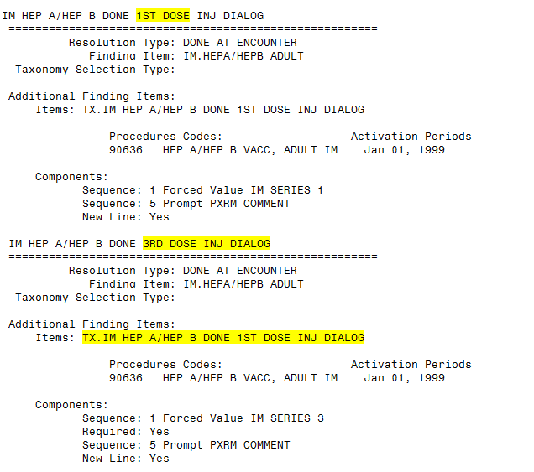
Notes:
In this example the first element that contained the code was named IM HEP A/HEP B DONE 1ST DOSE INJ DIALOG
There was more than one element that that had the single code as a finding item, in this example another element IM HEP A/HEP B DONE 3rd dose INJ Dialog used the same code, therefore every element after that first one now uses the initial taxonomy name you can see both elements use the taxonomy name with 1st dose– even though it DOES NOT MATCH the other element name.
You can rename the taxonomy that is contained in multiple elements/groups to a generic name if you like.
*******************

Slide 37
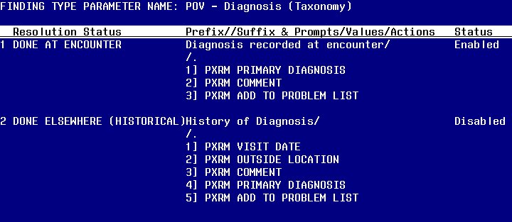
Resolution Type for Taxonomy
Notes:
In your current system pre-patch installation, this is the parameter where the default prompts are set for your dialogs that contain icd9 or cpt codes The prompts you see by default will be dependent on the resolution type of the element/group (Done at Encounter or Done Elsewhere/Historical)
After the installation of PXRM 26, this functionality is so much better in that you can set these prompts within your dialog when you are adding the finding item.
I really liked this feature and found it much easier to add the prompts I wanted like “add to problem list” or “set as primary diagnosis.”
*******************

Slide 38
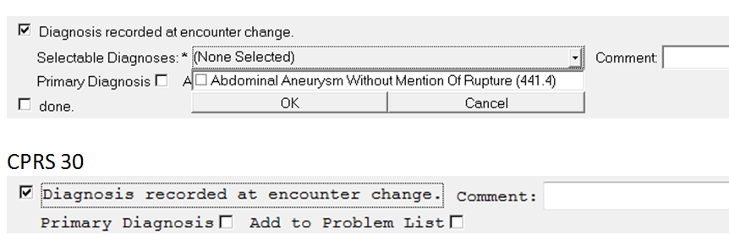
If there is 1 ACTIVE CODE in pick list, will file to PCE and will NOT display pick list
Notes:
Lets look at how the reminder dialog with a taxonomy finding looks in cprs and show some differences between cprs 29 and cprs 30.
There have been some improvements made that you will see when cprs 30 is installed
If there is one active code for an encounter, with v29 it will display a pick list and the provider has to choose the code, with v30 it will automatically file to PCE and will not display a pick list
*******************

Slide 39
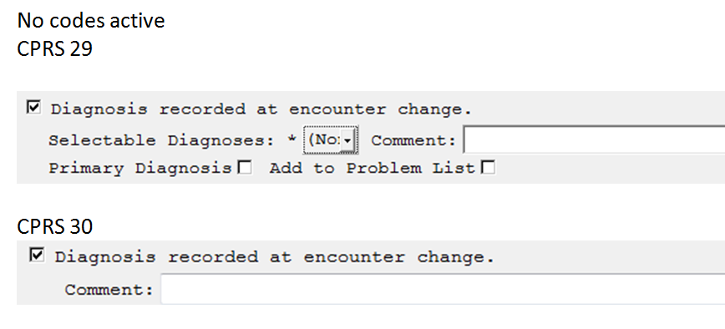
Notes:
Another example of a future improvement is that with v29, if no code in the taxonomy is active or valid at the time of entry, a pick list will still be displayed that indicates there are no codes, with v30 it will not display a pick list if there are no valid codes
*******************

Slide 40
No more navigating menus…
List Manager
ScreenMan
Browser
Notes:
Before I show you the new taxonomy editor, I want to explain some key differences.
Almost everything is done from a main screen, No more navigating menus
This application uses
List Manager
ScreenMan
Browser
We have Screen Man and Browser help documentation available for you in downloads.
Takes getting used to☺. I think you will like it once you get used to it. The biggest challenge I faced when I first started creating taxonomies using the new editor was remembering to Save.
If your reflections screen is set with a WHITE background, it will make it more difficult to see and navigate. I recommend you change to another color scheme.
*******************

Slide 41
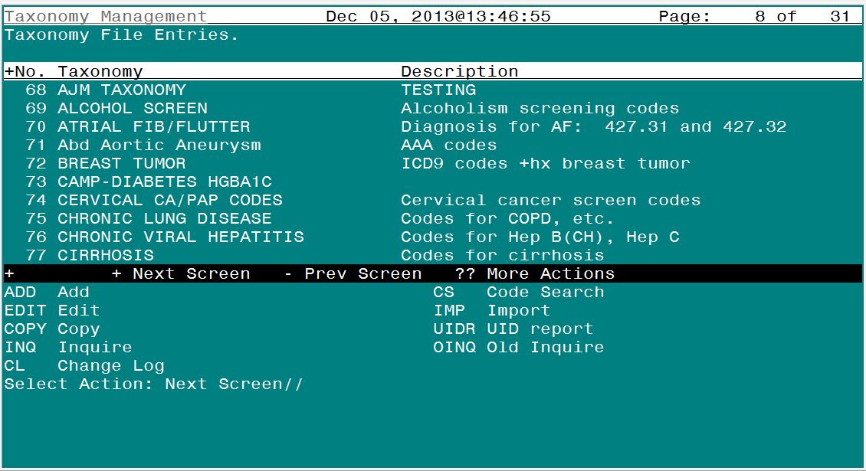
Notes:
This is the main viewer for taxonomy add/edit.
We are going to discuss several of the available options.
From this screen we can ADD a new taxonomy, we can
Edit an existing one (this is where you might add/remove codes or rename)
Some of the other options I will discuss are the INQ Inquire to see information about existing codes and the IMP option to Import codes.
*******************

Slide 42
Add/Edit a Taxonomy
The list manager interface is only used to give the taxonomy a name and class
Notes:
I am going to walk you though how you add a new taxonomy:
This is the only place you will see the list manager interface, when you give a taxonomy a name and class. After that, all editing is done in screenman.
When I first heard about this change, I remember thinking “what is screenman?” well for those of you like me that don’t know, screenman is the same format that is used when you enter leave request in Vista. So you may not have know that was the name for it, but you have probably used it before.
As we go thought the process of adding a new taxonomy, you will see that all the fields you are used to seeing are available, just in a different format
*******************

Slide 43
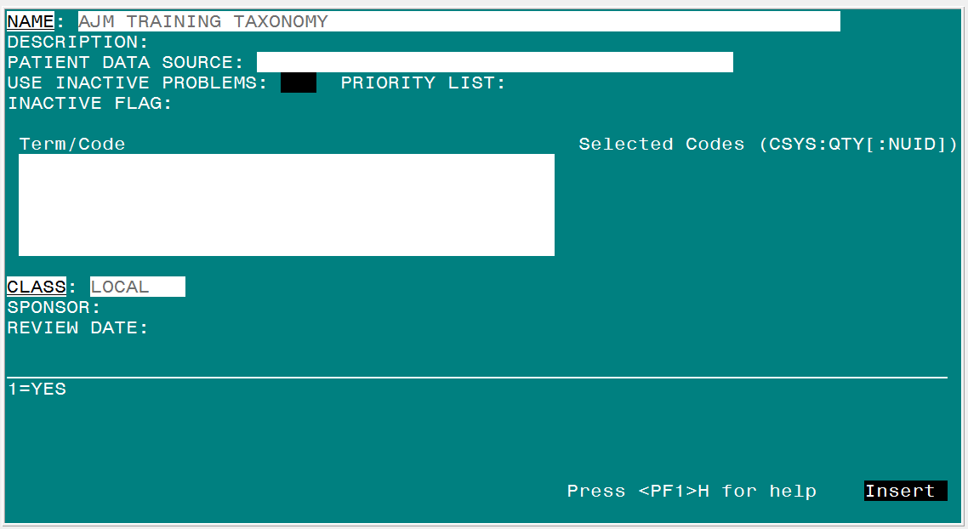
Add/Edit a Taxonomy
Lexicon search is invoked here
Notes:
Here is the screen man interface.
You can see the fields look very familiar, you can use your arrow key or tab to navigate from field to field.
You can type a ? In any field to get more information.
When you get to the field for term/code this is where you will start the lexicon search.
*******************

Slide 44
Add/Edit a Taxonomy
Type in a search term (Diabetes)
Notes:
One of the main differences between how you used to do this and how you do it now is that you used to have to know the specific code or range of codes, now you can still use a specific code if you know it but you can also use a name like I have for diabetes or you can use a common abbreviation like DM.
Even though you can use the lexicon search to look up codes, continue working with your HIM and clinical staff to identify what codes you should use. This is very important with ICD10 because of all the different code options available for each diagnosis.
Hit the enter key after entering your search term.
*******************

Slide 45
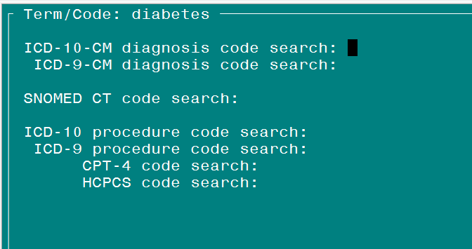
Add/Edit a Taxonomy
Choose a coding system to search with
Notes:
In this demonstration, we will only be adding ICD9 codes to our taxonomy. Do know that this will work for all coding systems maintained in VistA
You are now able to choose which coding system you want to use to search for your search term, in our case Diabetes.
Any of the coding systems maintained in the Lexicon will be available for search.
Use the directional arrows on your keyboard or the Tab key to navigate to the coding system you want to search The black cursor box lets you know where you are at
Hit the enter key when you want to invoke the search. All matches for your search term are returned for the coding system you are looking in…
*******************

Slide 46
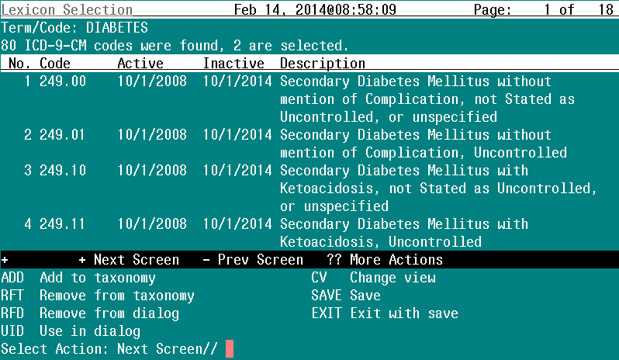
Add/Edit a Taxonomy
All ICD-9 codes returned
Notes:
For this demonstration, we decided to look for Diabetes (search term) in the ICD9 coding system
All codes having to do with diabetes are returned
Talk about the items on this screen,
page on the upper right side
number of codes returned above the yellow circle on left side
There are several actions available we are going to discuss adding codes.
*******************

Slide 47
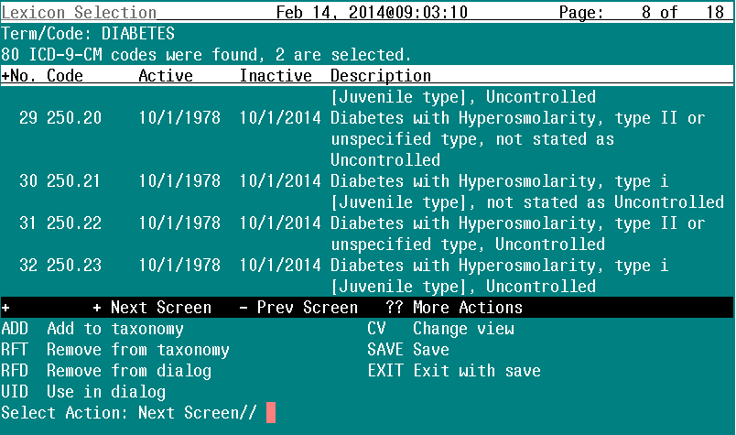
Add/Edit a Taxonomy
Items 29-32 of search results
Notes:
we have navigated to the screen where items 29-32 are displayed.
We will be selecting items 29 and 31 for addition to our taxonomy. Talk about the different ways you can go about this. (choosing the items first, then the action or choosing the action first, then the items)
If I wanted to I could add a range of codes and add 1-10
*******************

Slide 48
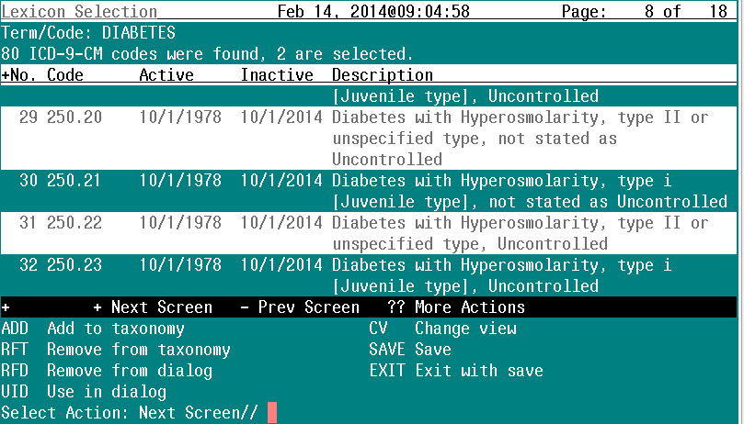
Add/Edit a Taxonomy
Selected
Selected
Save and Exit
Notes:
Codes 29 and 31 were chosen. You can see the highlighting shows that they are selected for our taxonomy. – here is one of the reasons why you would not want to have a white background with your Vista session.
You must save or EXIT with “save” to save the codes in your taxonomy
*******************

Slide 49
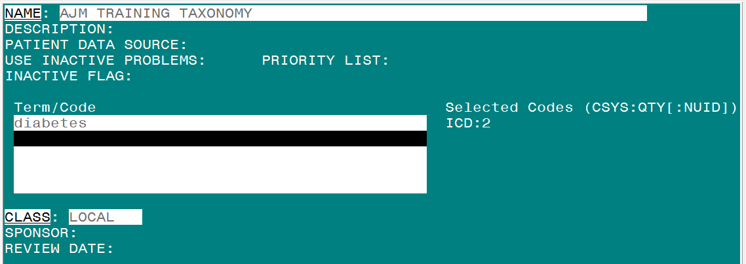
Add/Edit a Taxonomy
Notes:
Once you have saved the codes to your taxonomy, you will be taken back to the screen where you can do another term search if you desire. You can have more than one term or code search in a single taxonomy
Notice the box contains a “map” of what we selected from the search term Diabetes. It shows Coding system, this is that three character abbreviation from one of the earlier slides, number of codes selected
So now we have a taxonomy with two icd9 codes but we cant use this in a reminder dialog yet, so lets go back into that diabetes term and make one of these codes available for use in a dialog
*******************

Slide 50
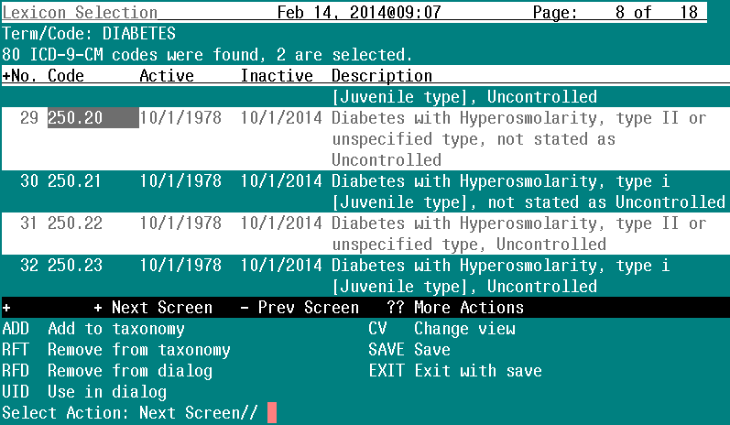
Add/Edit a Taxonomy
Mark for use
Notes:
I can see the two codes that are highlighted are part of my taxonomy, now I must explicitly mark them for use by using the UID action.
Find the codes you want marked for UID and select them. This is similar to how we added the codes but instead of using the ADD action, we will use the UID action.
I am choosing number 29
I could also choose a new code like 32 and add it to my taxonomy and mark it used in dialog at the same time with the UID option.
Be sure to SAVE or EXIT to save these changes!
*******************

Slide 51
Add/Edit a Taxonomy
Notes:
You should be familiar with this screen we showed earlier. Now look at that “map” box and you can see that you now have 2 ICD9 codes signified by the ICD 3 character abbreviation and you also now see you have 1 code marked for UID.
If we needed to remove a code from the taxonomy or remove it for use in the dialog, we would go back into that term again
*******************

Slide 52
Add/Edit a Taxonomy
RFT – removes from taxonomy AND UID
RFD – removes from UID only
Notes:
And choose the actions of either RFT and RFD to remove items from your taxonomy.
RFT will remove from taxonomy AND UID. Using RFD will only remove item from UID. *******************

Slide 53
Extra Features: TE Dialog Taxonomy Edit
Notes:
There is more than one place that you can make changes to a taxonomy that is used in a reminder dialog.
I have been showing you the new taxonomy editor now I am going to show you some Extra Features. You will notice that now I am in the reminder dialog editor. The dialog editor should look familiar to those of you that create clinical reminders. Note that there is a new optioned called TE for taxonomy editor.
*******************

Slide 54
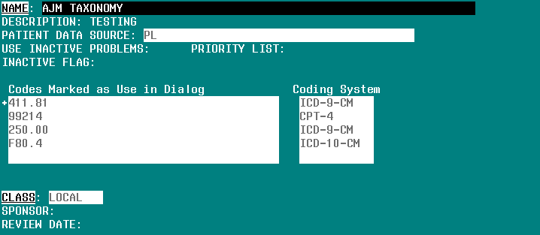
Extra Features: TE Dialog Taxonomy Edit
Must know exact code
Notes:
There are some key differences as noted in this slide
No Lexicon search function, You must know the exact code to use this functionality.
Only UID codes can be added or deleted, The codes you select will automatically be marked as UID.
You can edit existing taxonomies or create new ones.
Although you can edit your taxonomies for use in a reminder dialog here, I recommend you use the new taxonomy editor for most of your taxonomy additions and changes, the functionality and options are more robust as I have demonstrated.
*******************

Slide 55
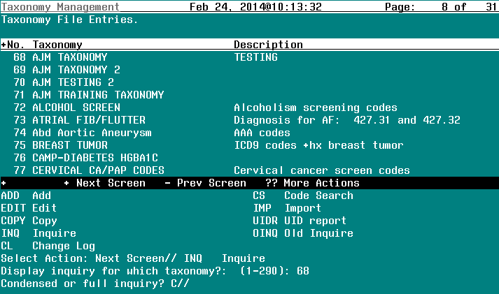
Extra Features: INQ Inquire
Notes:
I am going back to our taxonomy editor now and want to show you some of the other options.
Lets look at Inquiry. I would encourage you to use the INQ option over the OINQ option. The OINQ option will be removed in a subsequent patch.
New inquiry much nicer anyway ☺
I chose the option of INQ and then picked the taxonomy I want to inquire on, number 68, I now have the choice for what view I would like, either a condensed or full inquiry. The default is condensed.
I will show you both views.
You will be using a browser, so you will need to use the keystrokes in the handout we attached to navigate around the screen.
*******************

Slide 56
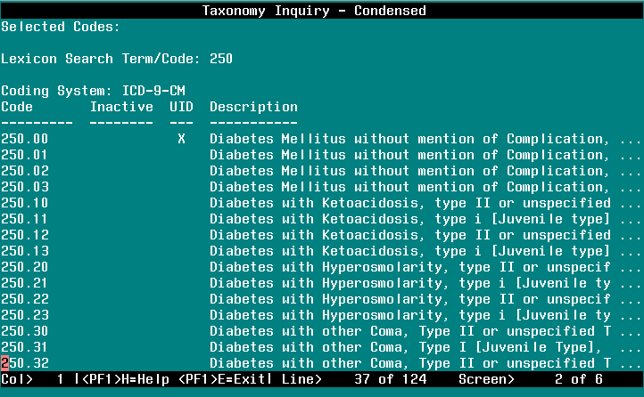
1 line per entry
Notes:
This is the condensed display, again, note 1 line per entry. This is a good way to get a quick glance of the codes contained in the taxonomy
*******************

Slide 57
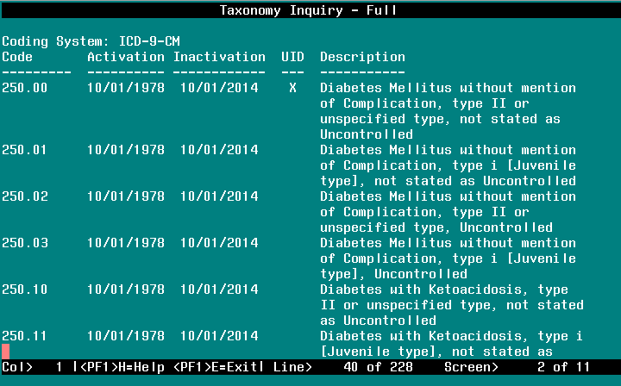
More than 1 line per entry
Notes:
Full version will show all information about each entry. Note some entries will have more than 1 line associated with the entry. Also has the Activation and Inactivation dates. This taxonomy has ICD 9 codes that are active but have inactivation dates in the future, as you add ICD10 codes to your local taxonomies you will see their activation date will be in the future. After this patch is installed into your system, you will be able to start adding those codes as your ICD10 group provides them to you and they can remain in your taxonomy but wont be active or available for the user to see until after their activation date.
Reiterate browser actions to navigate
*******************

Slide 58
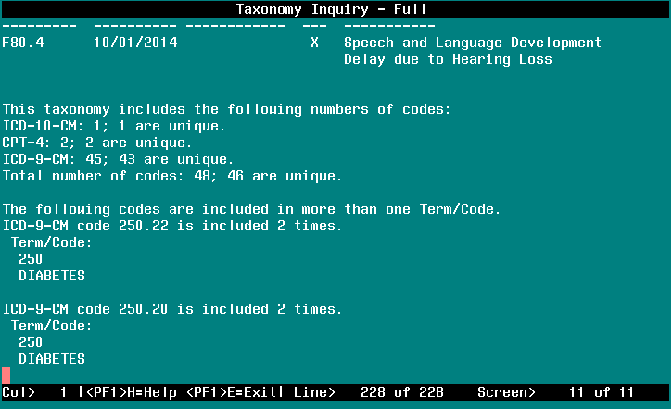
Details about taxonomy
Notes:
For both versions of the INQ, the full and condensed, you will see a summary at the end
Gives details about the taxonomy
*******************

Slide 59
HF CSV host file
PA CSV file paste
TAX Another taxonomy
WEB CSV file from a web site
Notes:
The last topic I want to talk about is the Import feature
Here are the four import options.
HF host File
PA CSV (Comma Separated Value) file paste
TAX from another taxonomy
WEB CSV file from a web site
Use of any one of these options will require an existing taxonomy to be available to import into.
You will mainly use the PA option, so we will spend more time on this option
This is something that sounds harder than it is, I learned by doing it.
*******************

Slide 60
IMPORT
HF CSV host file
Notes:
HF – The first option allows a user add codes to an existing taxonomy by means of a host file. To do this, you must have access to a directory on your host Vista system
And the file must be a .CSV or comma separated value file created from Microsoft Excel, I will show you in a minute what a .CSV file format looks like.
Clinical Application Coordinators will rarely use this as you normally don’t have access to a directory on your host Vista system
*******************

Slide 61
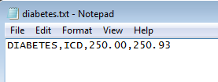
IMPORT: PA CSV File Paste
Notes:
PA – This is the option you will use most often, you are not actually going to import a file but you will use this action to paste in the information found in the CSV file
You must copy text from notepad, word, etc in comma separated format
You can see in this example the csv format, first column is our search term diabetes, the second column is our coding system three character abbreviation for ICD9 and after that are the codes separated by a comma
At my facility this is how we are going to add the ICD10 codes that our HIMS staff and ICD10 work group is providing us to our existing local taxonomies that contain ICD9. They are providing us with an excel document with the new codes and I am creating a CSV file from that spreadsheet.
I will walk you though pasting the info
*******************

Slide 62
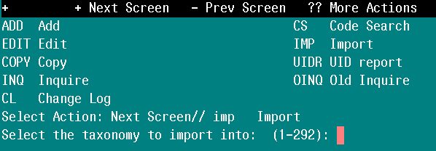
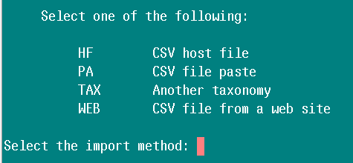
IMPORT: PA CSV File Paste
Notes:
After selecting IMP action, then choose your taxonomy to import into.
Next you will choose the PA option…
*******************

Slide 63
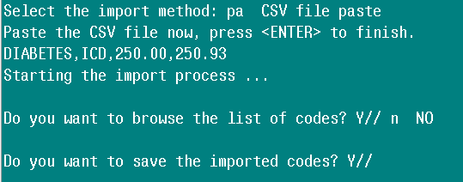
IMPORT: PA CSV File Paste
Notes:
Now you will paste your file, you Have about 10 seconds to complete this action – if you don’t paste by then, then will take you back to previous menu – already have your file copied
Copy and paste comma separated text and press ENTER
Can choose to browse the codes and save the imported codes
*******************

Slide 64
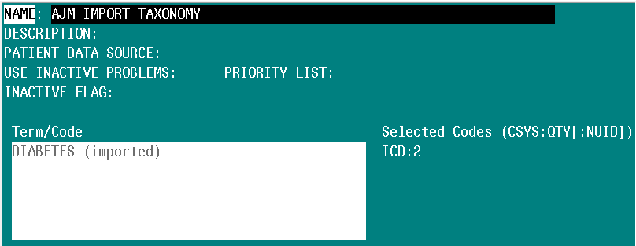
IMPORT: PA CSV File Paste
Notes:
The taxonomy now contains the imported codes from the CSV entry
You can see our search term is the same as what we pasted from the .csv file.
These codes cannot be used in a dialog, If you want the codes for UID, you will have to go into the term and mark them as such.
Notice in the Term/Code box, it signifies IMPORTED
*******************

Slide 65
IMPORT: TAX Another taxonomy
Select another taxonomy to import codes from
Once selected, you can import all the codes or selects sets of codes
Notes:
This option copies different codes from one taxonomy to another.
*******************

Slide 66
IMPORT: WEB CSV file from a web site
import codes from a web site using a specific URL
.CSV
http://
Notes:
The last option that you can use when importing into a taxonomy is from a web site.
The web site must contain a .csv file and should not have a https protocol
This wont be used that often but it could be used as a way for a VISN or program office to distribute a taxonomy to different sites, a .CSV file could be added to a SharePoint and each facility could come and import that file.
But remember you can always use reminder exchange to send a taxonomy between sites, so if one site in your VISN is really ahead of the game on updating taxonomies, they can share taxonomies this way as well.
*******************

Slide 67
Identify local taxonomies that contain ICD9 codes
Work with your ICD10 team to get the appropriate ICD10/SNOMED codes
Clean up your reminder dialogs in preparation for the new taxonomy
Learn the new Taxonomy interface
Notes:
Here are some things you can take away from today’s presentation:
Look at your local taxonomies and identify those that contain ICD9 codes, remember national taxonomies will be updated so if you can be using them, please do.
Work with your team now to identify those appropriate ICD10 codes so that when you get these patches installed, as your team identifies the new codes, you will be ready to add in the appropriate ICD10 codes to your local taxonomies.
You can clean up your reminder dialogs now – remember to review that attached document.
You can also be learning this new interface- It is different but not more difficult. I really like the way it works and I hope you do also.
*******************

Slide 68
Site | URL | Description
National Clinical Reminders site | http://vista.med.va.gov/reminders | Contains manuals, PowerPoint presentations, and other information about Clinical Reminders
National Clinical Reminders Committee | http://vaww.portal.va.gov/sites/ncrcpublic/default.aspx | This committee directs the development of new and revised national reminders
VistA Document Library | http://www.va.gov/vdl/ | Contains manuals for Clinical Reminders and related applications.
HIM ICD-10 Implementation | http://vaww.vhaco.va.gov/him/icd10.html | Contains general information, training resources, and other tools for VA’s transition to ICD-10.
Notes:
Here are some additional resources.
This is where you will find out more information about the National taxonomies and which ones will be updated as well as which ones will be inactivated. As the new national taxonomies are updates, they will be posted to the Sharepoint.
*******************

Slide 69
Ask the Presenter
Notes:
Thank you for joining us today. As we are wrapping up, if you haven’t submitted your questions yet, there is still time to do so by clicking on the orange “Ask The Presenter” icon. We’re going to show a brief announcement and then we’ll be right back to answer your questions.
(Stand still and smile until you see the video come up full screen)

