Slide 1
Benefits of Open Source and VistA Standardization
Guy Esten
Christine Rhodes

Slide 2

VistA Standardization
Notes:
After over 3 decades of VistA use at 130 VA Medical Centers and site by site variance over that time, the senior leadership of the VA has directed that we standardize VistA across the enterprise.
Today we will go over:
What is VistA Standardization.
How is Standardization achieved.
Challenges and benefits of Standardization.
Hopefully this will allow you to assess the impact of Standardization on you.
Chris Rhodes will address:
The purpose of Waivers
How waivers are submitted and processed
The end result of waiver requests and the waiver process.

Slide 3
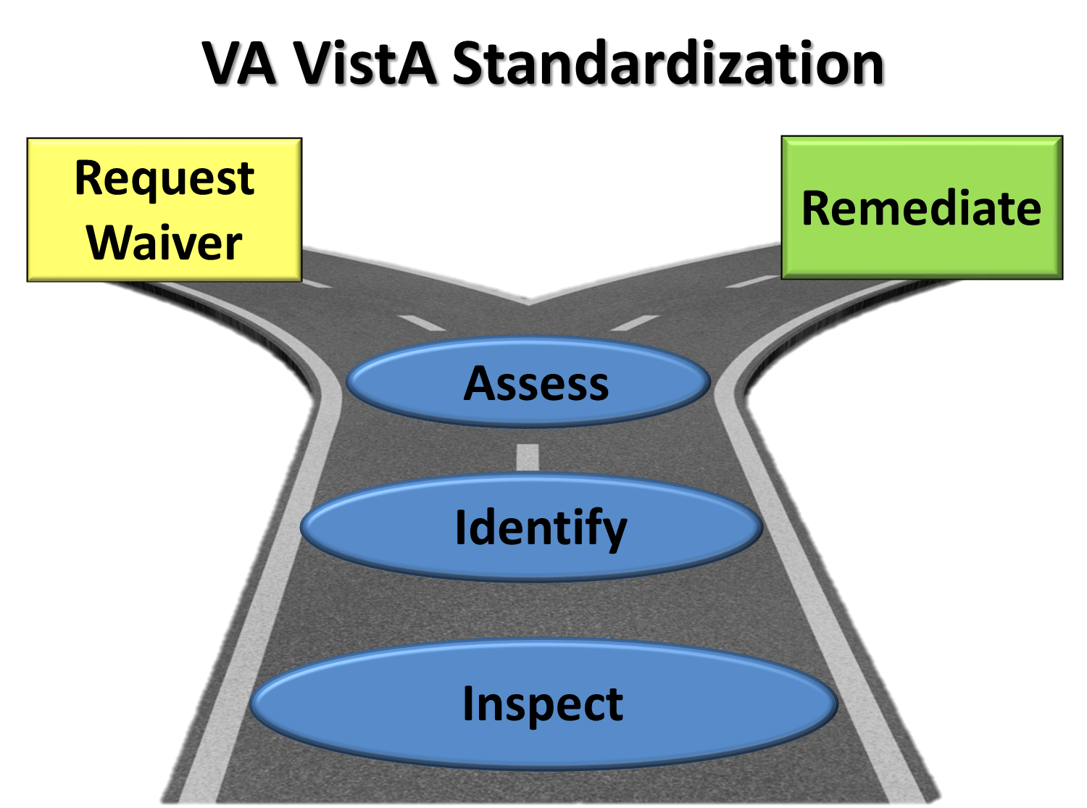
Notes:
What is VA VistA Standardization?
The Standard:
The VA has established an Enterprise VistA Version as the standard version of VistA for Class 1 (nationally released and supported SW). This version has been publicly released as the Freedom Of Information Act (FOIA) version, that is currently published on the OSEHRA website. http://www.osehra.org/content/va-enterprise-vista-standard
Standardization – gaining enterprise wide compliance:
Inspection of all VA VistA instances.
Identifying variance from the standard.
Assess impact of variance and:
Remediate, or
Request waiver, resulting in:
Waiver granted and catalogued.
Waiver denied and variance remediated.

Slide 4

Poll Question
Do you feel VistA Standardization will:
    Enhance the functionality I get from VistA in the long run
    Cause me to lose site specific features I need
    A little of both A and B
Notes:
Now I’d like to ask a poll question.
(ASK QUESTION)
To answer this question, use the blue polling icon above my head. We’ll move on and come back to your results in just a moment.
[erase these notes and add your own!]

Slide 5

133
VistA Instances
133 VistA Instances
133 VA Medical Centers
800 associated clinics
133
133
800
12 to 2000
27,400
180
3.64 million
133
VAMCs
800
clinics
Notes:
Scope of VistA Standardization
The magnitude of inspecting, remediation where needed, and certifying all VA sites is significant:
VA VistA is deployed at 133 VistA Instances, supporting 133 VA Medical Centers and over 800 associated clinics.

Slide 6
133
133
800
12 to 2000
27,400
180
3.64 million
180
Active Components
Notes:
Scope of VistA Standardization
Each VA VistA Instance is comprised of 180 active components or ‘packages’ of specific functionality.

Slide 7
133
133
800
12 to 2000 Routines
27,400 Routines
180
12 to 2000
3.64 million
Routines per Package
27,400
Routines per
VistA Instance
Notes:
Scope of VistA Standardization
Each package is comprised of 12 to 2000 Routines (modules of executable code). A VistA instance is comprised of 27,400 Routines.

Slide 8
133
133
800
12 to 2000
27,400
180
3.64 million
3.64 million site/routine
comparisons
Notes:
Scope of Vista Standardization
3.64 million site/Routine comparisons to the VA Standard are needed to certify VA wide.
Use of automated tools to identify character by character code variance.
Human inspection of the variance detected to determine corrective action.

Slide 9
Inspect
Using automated tools
Analyze
Manually
90% of variance benign
Remediate
Certify
With no adverse effect on clinical care
Compliant routines and remediated variance
Notes:
Inspect sites:
Use automated tools to compare tens of thousands of Routines against the VA Enterprise Standard and detect variance.
Analyze Variance:
SW Developers manually analyze variance.
Typically 500 to 2000 variance points per site.
90% of variance usually benign (does not impact executable code), such as notes, blank character spaces, etc.
Results in 40 to 400 variances per site for remediation.
Remediation of variance:
Sites determine if remediation to the standard can be done with no adverse impact on clinical care, and then remediate through normal ‘break/fix’ local test and release processes.
Waivers sought for those essential items for clinical care.
Certification and Waiver Catalogue:
All compliant routines and remediated variance is certified, and remaining variance that is waivered is catalogued.

Slide 10
Increments
Piloted concept
Small number of production sites
1-2
Completed
Changed to iEHR Core Product set
21 sites per increment
3-5
Work underway
Will complete FOC milestone in CY14
CY 14
6-10
Will address products outside of iEHR Core set
About 40% of VistA remains for this.
CY 15
Other
Notes:
Standardization Methodology
Increments 1 and 2 (complete)
Selected ~14 VistA Products Sets each
Inspect all 133 VistaS
Identify site variance from the Standard using CATS tool.
Increments 3, 4, and 5 completed
74 VistA products that support iEHR Core Capabilities, at 20 sites per increment.
Increment 6 through 10 planned for CY14, to complete iEHR Core product set nationally.
Other VistA products to be completed in CY15

Slide 11
Open Source Processes

Slide 12
Open Source Processes
VistA Standardization
Compare OSEHRA Certified VA Enterprise Vista Instance with Sites.
Remediate or Waiver.
Certify in Forum.

Slide 13

Standardization
Notes:
Challenge: Natural trade off between site specific needs/preference and Enterprise need for interoperability.
Solution: Joint VHA/OIT Waiver Committee
Challenge: VistA product bounds not absolute, and nomenclature and product/capabilities lists vary across the myriad of organizations involved.
Solution: Defining ‘Products’ for VistA Standardization by sets of Routines that are primarily namespace centric.
Challenge: Site/Regional resources and expertise for remediation.
Solution: Prioritization of Standardization relative to other tasks.

Slide 14

Enterprise
Wide VistA
Standardization
Value
Notes:
Standardizing across the VA’s 133 VistA Instances will:
Provide interoperability across the 133 VA sites by providing commonality.
Position the VA to more readily deploy iEHR solutions enterprise wide.
Enhance the VA’s ability to utilize Open Source code for enterprise wide solutions.
Minimize or eliminate site by site accommodations required for enterprise wide releases.
Reduce sustainment costs by reducing site specific technical support needs that do not enjoy an economy of scale provided by nationally released and supported product.

Slide 15
Poll Results
Do you feel VistA Standardization will:
    Enhance the functionality I get from VistA in the long run
    Cause me to lose site specific features I need
    A little of both A and B
Notes:
Now let’s pause for a minute and take a look at our poll results
INTERPRET RESULTS
Okay, let’s go ahead and get back to the presentation

Slide 16
Poll Results
    Enhance the functionality I get from VistA in the long run
    Cause me to lose site specific features I need
    A little of both A and B
Notes:
(This is not a duplicate slide, do not delete)
(Cue to Tech Team that you’re moving on) “Click” again to move on once results have come down

Slide 17
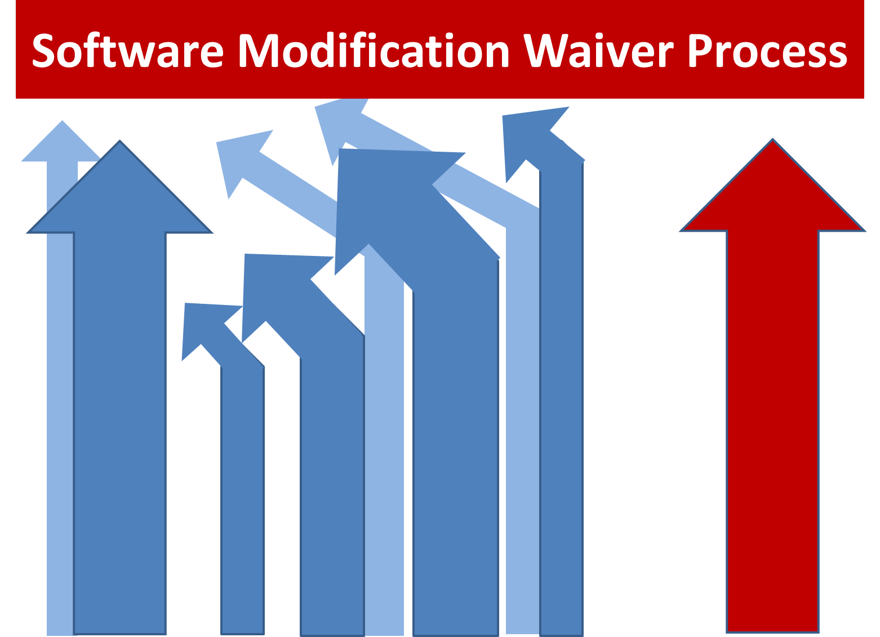
Notes:
Thank you Guy for providing us with an understanding of the VistA Standardization effort.
My name is Chris Rhodes, and I am the chair of the Software Modification Waiver Committee.
I want to talk to you today about the Software Modification Waiver Process.

Slide 18
Poll Question
Have you submitted a software modification waiver request before?
    Yes
    No
Notes:
I’d like to start by asking the audience a question.
I want to know how familiar you are with the Software Modification Waiver Process.
Read question.
To answer this question, use the blue polling icon above my head. We’ll move on and come back to your results in just a moment.

Slide 19
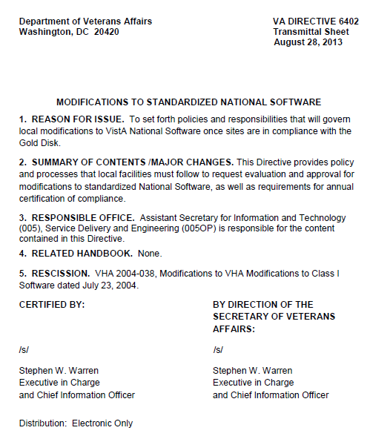
VA Directive 6402
MODIFICATIONS TO STANDARDIZED NATIONAL SOFTWARE
Establishes waiver request process
Establishes waiver request committee
Notes:
VA Directive 6402
Establishes the Software Modification Waiver process
Signed by Steph Warren, Chief Information Officer for OIT
Released in 2013
Lays out the Waiver Committee and the Waiver process
Directive 6402 is in the handouts for this session and can also be found on the VA Directives page
I would encourage you to obtain a copy and familiarize yourself with its contents.
http://vaww1.va.gov/vapubs/search_action.cfm?dType=1

Slide 20

VistA Standardization
Software Modification Waiver Request
Local Modifications
Gold VistA
Notes:
Many sites are running local software modifications that modify the national VistA software
Modifications supports clinical and administrative functions not provided in the national software
Running local software may seem to be at odds with desire to standardize VistA nationally
This is exactly the reason the Waiver Process was put into place
Provides sites an opportunity to request to keep their important local modifications
Local innovation is important to VA and as such, the waiver request process was developed to support the promotion of local enhancements nationally.
Background - 141165271

Slide 21

Local Modification Collaboration
Notes:
After IT cleanup that Guy just discussed, any remaining code deviations from the national standard need to be assessed.
Remember we’re only looking at code changes to the National VistA routines.
Locally namespaced code that does NOT modify the National VistA routines is out of scope for VistA Standardization!
For example, if you have written a module that supports a local need, but you have written it entirely using local namespacing, that is ok.
Not only is it ok, but it will not be looked at for standardization. In other words, you will not be asked to remove those items locally.
These are what I’m going to call ‘Legal CIII’
Legal CIII is not intrusive to the CI software.
The only approval you need to ensure you have for legal CIII is from the regional FD staff prior to placement into a production account.
But – no software modification waiver is needed.
To assess remaining code deviations to the national software, both local IT and clinical/administrative staff need to collaborate
Discuss functional enhancements put into place
Business community determines criticality of their local modifications
Collectively determine what local modifications the site needs to retain

Slide 22
1=1
Functional Enhancements
Waiver
Requests
Notes:
Once sites determine which local enhancements they want to retain they need to submit waiver requests.
But how many waiver requests should a site submit?
You may be tempted to submit 1 waiver request for all your local changes.
Not good because each separate piece of functionality may render a different decision.
With 1 waiver request, we are forced to render 1 decision. That means all are approved or all are denied.
You also don’t want to take the opposite extreme of submitting one waiver request for each routine.
That would not allow us to see what routines work together to support a unique piece of functionality.
To avoid that situation1 waiver request should be submitted for each separate piece of functionality.
Example - Let’s say you have a functional modification that supports your sites ability to interface with a piece of medical equipment.
In order to accomplish that function, you had to modify 5 routines.
You would submit one waiver request, and identify all 5 routines within the request.
Remember – 1 functional enhancement equals one waiver request!

Slide 23
Poll Results
Have you submitted a software modification waiver request before?
    Yes
    No
Notes:
Now before we go further, let’s take a look at the results of our poll.
Previously I asked how familiar you were with submitting a waiver request
Let’s see how you responded.
It looks like most of you have / have not submitted a waiver request before.
For those of you who are familiar with this, hopefully the rest of the session will offer you some helpful tips on how to make your waiver requests even stronger.
And for those of you who have not submitted a waiver request previously this session will give you an overview on how to submit a strong waiver request.

Slide 24
Poll Results
    Yes
    No
Notes:
Do not speak
Click to next slide

Slide 25
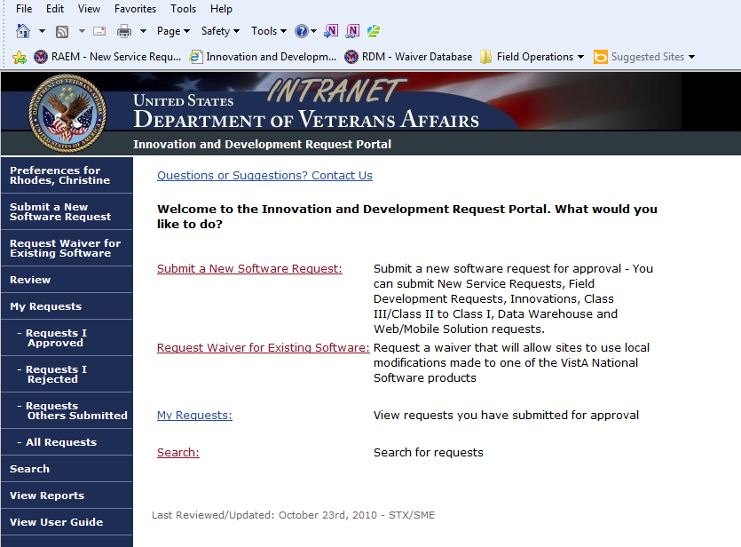
https://epas.r02.med.va.gov/apps/idrp/
Notes:
You’re done collaborating and now want to enter a waiver request. So who submits it?
Either IT or non-IT staff can submit a waiver – no rule – you decide
Waiver requests are submitted on the Informatics & Development Request Portal site (IDRP)
Link is provided in handouts – don’t write it down – available in handouts.
When entering IDRP, you will see this screen with several options.
For this purpose, you will choose the ‘Request Waiver for Existing Software’ link.
This link is used to request permission to continue using a local modification. The key is that you already have a software solution.
Do not choose the ‘Submit a New Software Request’ link, as that request is used when you want to have software written to satisfy a business need. In other words, there is no software product built yet.
You will also see two additional choices on the bottom of the IDRP screen – My Requests and Search
My requests – see list of all requests you have submitted to date. Will show both new software solution requests and waiver requests.
Search – Allows you to search for a particular waiver request, or for all requests that might pertain to a particular key word.
Remember, IDRP is not only used to enter a waiver request, but you can always come back and see the status of your request and its progress.
https://epas.r02.med.va.gov/apps/idrp/

Slide 26
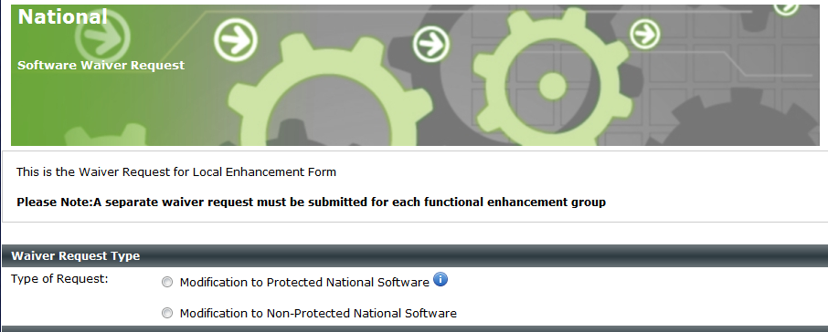
i
Notes:
Next you will be asked to select the type of request?
Does your local enhancement modify nationally protected software or not?
Directive 6402 defines protected software as a subset of the National Software that represents its core. These products are restricted from local modifications of any type.
Select the appropriate type based on your local modifications
You’ll notice the BLUE “INFO” icon. Click on that to view list of Protected National Software

Slide 27
Accounts Receivable
Bar Code Medication Administration
Computerized Patient Record System (CPRS) Order Entry Modules
Fee Basis
Health Level Seven (HL7)
VA FileMan
VistA Imaging
…
i
Notes:
Here is an example of SOME of the Protected National Software.
You can see that critical or foundational VistA applications such as FileMan, CPRS and AR are on this list.
A complete list is available in
Downloads of this presentation
Within VA Directive 6402
OR by clicking on the blue information icon when submitting a waiver request

Slide 28
Integrated Billing
Kernel
Personnel and Accounting Integrated Data (PAID) Time and Attendance
Remote Procedure Call (RPC) Broker
VA FileMan
VistA Data Extraction Framework (VDEF)
VistA Imaging
VistALink
Accounts Receivable
Bar Code Medication Administration
Computerized Patient Record System (CPRS) Order Entry Modules
Fee Basis
Health Level Seven (HL7)
VA FileMan
VistA Imaging
Notes:
THIS SLIDE WILL BE DELETED FROM PRESENTATION, BUT WILL BE LEFT IN DOWNLOADS VERSION IN PLACE OF SLIDE 27

Slide 29
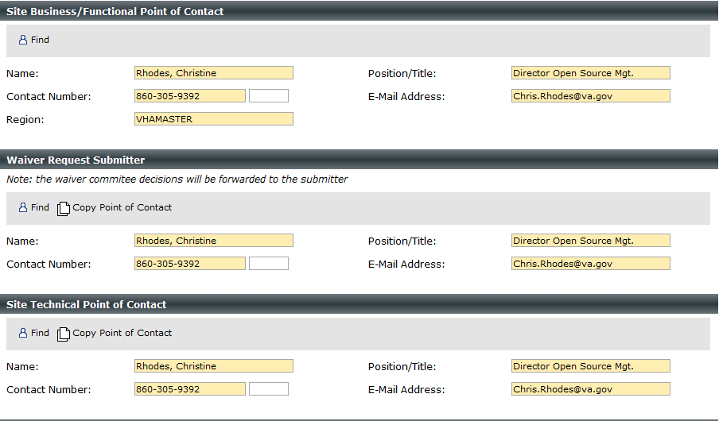
Site Business/Functional Point of Contact
Should be 3 different POCs
Waiver Request Submitter
Site Technical Point of Contact
Notes:
Next you will be asked to enter Points of Contact for your waiver request.
3 different POC’s needed
Functional POC – knowledge of how the local enhancement works
Submitter – Person who will receive all waiver decisions
Site Technical POC – Person familiar with the code
Find – allows you to select someone from GAL. When selected, all fields within that POC will be populated fro information within the GAL.
Copy – allows you to copy POC information from a previous POC.
Example – Your Technical POC is the same as your Submitter. Choose Copy within Tech POC and information will be copied from the submitter information.
Use judiciously. Minimally, you should have at least 2 different POCs – Technical and Functional.
This is also important because if your waiver request is approved, the technical and functional POCs will be called upon for more information as the software moves forward for national implementation.

Slide 30
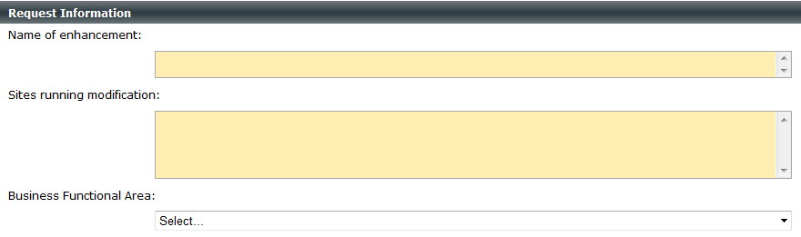
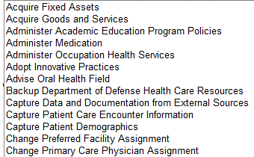
Request Information
Name of enhancement:
Sites running modification:
Drop down menu for Business Functional Area
Notes:
Name – brief – will become title of waiver request
Sites Running – list all known
If multiple sites are running the same enhancement, no need to submit multiple waivers – all sites simply need to be listed
Helpful when all sites within a VISN are running the same enhancement – 1 waiver can apply to all of them
Also, if there is an existing waiver that your site is using, but you are not listed as a user, you can request to be added to it instead of submitting a separate waiver. E-mail message to Chris.Rhodes@va.gov will suffice.
Business Functional Area – Choose best functional area that represents your functional enhancement from drop down list
Example – waiver requests for pharmacy medication administration would likely choose the 4th function on this list titled ‘Administer Medication’

Slide 31
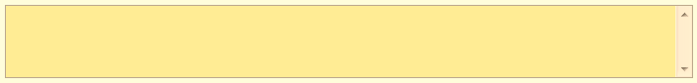
Modification Description
“We have a modification running in one of our routines. It has been here forever. We don’t know exactly what it does, but we don’t want to rock the boat by removing it.”
Notes:
Modification Description is your opportunity to provide a narrative explaining the functional change you have implemented.
It is meant to be more detailed than the Name of the waiver.
Should be written from a functional perspective.
Let’s look at some examples.
Here you see a less than desirable example. Surprisingly, we have received some of these. It lacks any information on what the functionality does. Remember that these waivers will be reviewed by a committee. If you don’t know what your local modification does, we won’t know either.

Slide 32
Modification Description
“K DIC S LREND=0,LRACC="",LRSS="MI",DIC=62.4,DIC("S")="I +Y<999",DIC(0)="AQEZ"
Notes:
This is another less than desirable example of a Waiver Description.
As you can see, it simply presents the code.
Description should not contain any code.
Description should be text and explain the functionality
Many of the waiver reviewers do not read code, so this would not mean anything to them.

Slide 33

Modification Description
This modification allows for longer drugs names to be displayed on the XXXX report, which is invoked using the YYYY option. Currently, drug names are limited to 25 characters. This change assists the pharmacist in distinguishing between two or more drugs names when the first 25 characters are the same.
Notes:
Now here’s an example of a much better waiver description.
It identifies where the change has been made – on the xxxx report
It identifies what option is used that invokes the change – the yyyy option
It tells us who the change impacts – pharmacists
It tells us what the current restriction was – drug names limited to 25 characters
It tells us what the problem was that prompted the change – inability to distinguish drugs with same initial 25 characters
Finally, it tells us what the change was – increasing the drug name display to longer than 25 characters.
Writing your descriptions with these characteristics in mind will reduce the review time associated with your waiver request

Slide 34
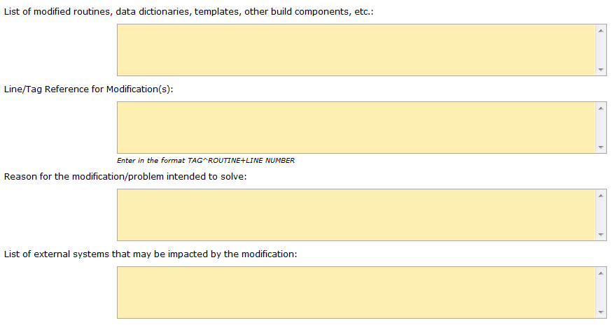
List of modified routines, data dictionaries, templates, other build components, etc…
Line/Tag Reference for Modification(s):
Enter in the format TAG^ROUTINE+LINE NUMBER
Reason for the modification/problem intended to solve:
List of external systems that may be impacted by the modification:
Notes:
Now for the technical folks, the first two fields on this slide are for you!
List of modified routines – list all national routines that were modified to support your local enhancement.
Line/Tag Reference - List the line tag within the routine for the location of your changes
Often, sites list the compare they received from the technical assessment.
It clearly indicates what is in the gold version vs. what the site has running
This allows us to see exactly what you have changed within the code
Reason for modification should list what the problem was initially that prompted you to make a change to the software.
External systems

Slide 35
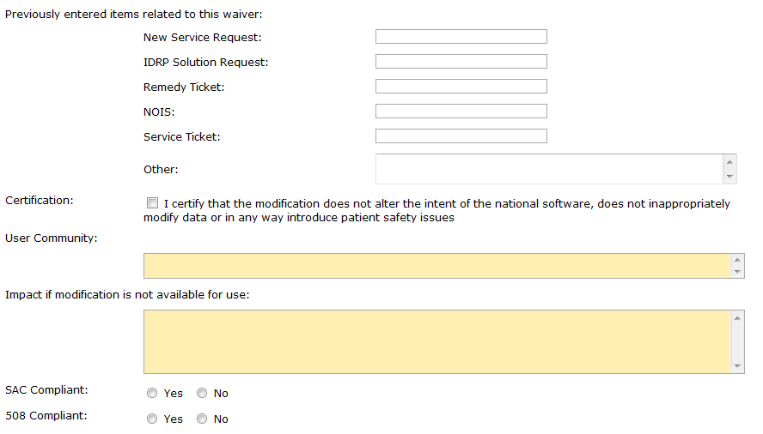
Previously entered items related to this waiver
Certification
User Community
Impact if modification is not available for use
Notes:
If you have ever sought to have someone review your local modification before, please tell us about them.
NSRs – Remedy Tickets, etc.
Enter numbers associated with those items
Helps us research further
Certification – check the box to certify that your change does not inappropriately modify national data or introduce patient safety issues
If due diligence testing was done prior to promoting your modification into production, you should have no problem certifying this
User Community – who uses this local modification? Pharmacists? Nurses? Ward clerks? Etc.
Impact – tell us how your site would be impacted if this modification wasn’t available for your use
Last 2 are for the technical staff again – Does your software adhere to the Standards and Conventions and is your product 508 compliant

Slide 36
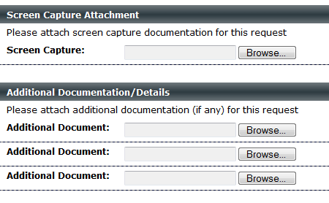
Attachments
Notes:
Here’s your chance to enter attachments that will help us review your waiver request.
Screen Capture – Whatever your enhancement is, try to capture it.
If you add fields to an input screen, take a screen shot.
If you modify a report, capture it
Submit a visualization of your functionality in action. This helps us see what exactly has been changed.
Additional Documentation
Often, sites use this section to share copies of their modified routines.
Also, where a modified national routine calls a local routine, it is useful if you attach a copy of your local routine as well.
Share any other documentation that you feel would be useful for us to see when reviewing your request

Slide 37
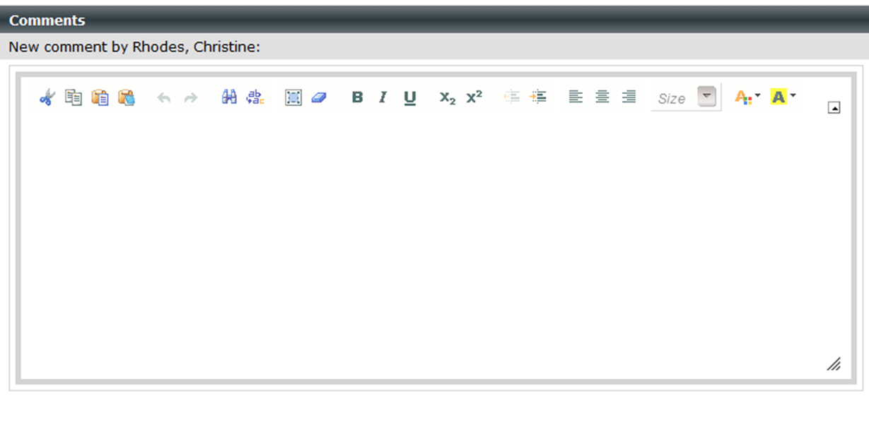
Comments
Notes:
And finally – here’s your chance to enter any comments. Enter anything you want us to know that you haven’t already informed us of.
Comments will also be used by the reviewers
To describe the details of your waiver decision
To indicate that other sites have been added to the waiver request.
All comments are stored in the waiver request, and can be viewed when looking at the IDRP entry.

Slide 38



Waiver Submission
Submitter
Software Modification Waiver Committee
Notes:
So you’re done entering all your important waiver information – now what?
You have to remember to click on the Save and Submit button.
Submitting enters your waiver request formally into the IDRP system.
A Waiver Request # is generated for your request.
You will be notified that your waiver was submitted via e-mail.
Notification goes to the waiver submitter – identified as Submitter POC.
Message is also sent to waiver committee notifying them that there is a new waiver request ready for their review.

Slide 39

Waiver Committee
  VHA Business Representation
  OIT Technical Representation
Notes:
So who is the waiver committee?
10 voting members
Balanced representation between business community and technical staff in OIT (5 voting members each)
Chaired by VHA
VHA Business Representation
Clinical Operations – clinicians in the field
Business Operations – administrative staff in the field
VHA Program Office (3 slots) – representing national application perspective
OIT Technical Representation
Product Support -
Product Development
Service Delivery & Engineering
Architecture Strategy & Design
Field Development

Slide 40

  Waiver requester / POCs
  VHA Program Offices
  VHA Workgroups
  COLLABORATION
  Others
  Product Support
  Product Development
Notes:
In order to process a waiver request – committee needs lots of information from many people
Vague waivers may even need additional feedback from the site – well written waivers will require less back and forth
VHA assessment looks at the functionality being requested
OIT assessment looks at code and technical approach of solution
Let’s look at each.

Slide 41
Functional Assessment
Functionality
National Policy
Patient Safety
National applicability
Criticality
Availability
Notes:
As part of the functional assessment, the waiver committee reaches out to the Program Office – Business Owner
What does local mod do?
Is functionality available in current national apps?
Does local mod go against national policy or directive?
Does local mod introduce patient safety issue?
Is local mod of benefit to more than just one site?
Is local mod desired nationally?
Is it critical or nice to have?
How are other sites handling this without a local modification?
May also reach out to Patient Safety and other clinical workgroups for further information.

Slide 42
Technical Assessment
Support
Protection
Code Violations
Technical Availability
Notes:
Tech assessment looks more at the code for things such as:
Ensuring local Mod uses supported Kernel Utilities
Doesn’t modify ‘Protected’ software
Doesn’t violate VISTA Standards and Conventions
Assesses device interfacing to ensure use of any nationally released, generic, interfaces as opposed to use of proprietary interfaces
Is there any other way using the existing software to accomplish the desired local functionality

Slide 43

Functional Feedback
Technical Feedback
Waiver Committee
Notes:
Once both functional and technical assessments are complete, the results are brought to the Waiver Committee for review
Committee meets weekly
Meetings can only be held if a quorum of voting members is in attendance.
Other interested staff may join the call as well.
Members review feedback – ask questions – experts are part of committee
Often, MC POCs join and can offer answers on their waiver requests
Where questions cannot be answered, waiver deferred to gather additional information
Not an easy decision, committee tasked with achieving standardization while doing no harm to facilities.
*There are only 2 ways to achieve standardization
Remove local software
Include local software in the national standard by disseminating it nationally.

Slide 44
Waiver Committee Decisions
X | Returned – duplicate waiver request
X | Returned – functionality must be resubmitted separately
X | Returned – not a waiver request
X | Returned – waiver not needed
X | Disapproved
X | Rescinded
✓ | Exempt
✓ | Approved
Notes:
So let’s look at some of the decisions the waiver committee can make.
First, let’s look at the red X’s which indicate decisions in which a waiver was not approved.
A request can be returned for many reasons
Duplicate – many waivers submitted for same purpose. Close duplicates and add sites to primary waiver request.
Returned functionality must be resubmitted separately –
Returned not a waiver request – Submitted request for a software solution you want built
Returned waiver not needed – submitted for legal CIII
Disapproved
Rescinded – when previously approved and the waiver is no longer needed or supported.
In any of these scenarios, the site must take steps to remove the local modification and restore the routines to their national, gold standard
Alternatively, the committee may allow the site to continue using their local modification by making one of two decisions indicated by the green checkmarks:
Exempt – in essence removes the routine from the VistA standardization process.
Example – Interim Management Solution – no longer supported nationally.
Sites may continue using their local modifications and will not be required to standardize exempt routines.
Approved
Approved waivers allow sites to continue using their local modifications for a temporary period of time ONLY until the enhancement can be released nationally as part of the CI product.

Slide 45
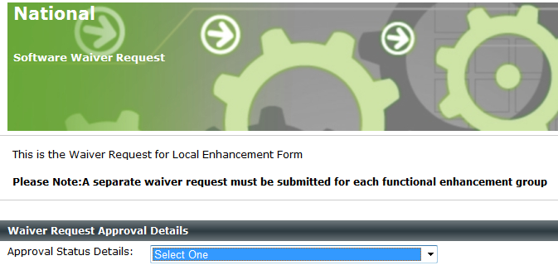


Insert example of decision e-mail sent to waiver submitter.
Submitter
Notes:
When a decision is reached, the chair returns to the IDRP system to enter comments and the approval decision.
When the decision is saved, an e-mail message is generated to the submitter of the waiver request.
E-mail informs them of the decision, and provides a link to the waiver request.

Slide 46

National Implementation
Notes:
Remember our goal is standardization.
There are 2 ways to achieve standardization
Sites remove the local modification
The local modification becomes part of the national software standard
Therefore, every approved waiver MUST have a path to national release
Upon national release, the approved waiver will be rescinded, and sites will be expected to utilize the functionality within the national product at that point.
This is why local mods that do not have national applicability will not be approved
VA is looking at how to streamline adoption of local code into national app
VistA Intake Workgroup has been established to identify issues and make recommendations
One recommendation is the creation of a Small Product Intake Group
Will offer a quick release for products that already exist and simply need testing and minor code tweaking
Final recommendations will be completed by the end of April.

Slide 47

OSEHRA
Notes:
One thing we have not covered is how OSEHRA can help support the VistA Standardization effort.
OSEHRA is the Open Source Electronic Health Record Alliance.
They were established to be the custodial agent of VistA software.
OSEHRA provides an opportunity for anyone in the community to contribute locally developed software that can be shared within the VistA Open Source Community.
OSEHRA also provides a code certification that will test any local software and provide a certification that the code is safe.
Sites can submit their local software to OSEHRA, but may only do so after
Having the code redacted
Redaction removes any proprietary code, or code that contains security or privacy components that must be removed before being shared with anyone outside VA.
All of the VistA software is redacted every time it is submitted to OSEHRA or as a result of any FOIA request
Local code is no different – it must be redacted before being published to OSEHRA.
3 groups are authorized within VA to redact code:
Open Source, Configuration & Tools Management Office within OIT
Field Development staff who support the regions
Innovations staff supporting the Innovations program
You must also be aware that if you submit to OSEHRA for certification, you will be required to submit documentation and test scripts with your code
OSEHRA will certify your code if it passes all of the necessary checks and balances
The value to certifying through OSEHRA is twofold:
CIII code that is certified and well tested will be easier for the VA to adopt – take less time to release
Open Source Community can engage to use your code; help test your code; and potentially even enhance your code.
VA can elect to adopt code once certified
Testing and release within the VA is still needed

Slide 48

Ask the Presenter
Notes:
If you haven’t submitted your questions yet, there is still time to do so by clicking on the orange “Ask The Presenter” icon. We’re going to show a brief announcement and be right back to answer your questions.
(Stand still and smile until you see the video come up full screen)

