Slide 1
VA Mobile Development 101
Shawn Hardenbrook, MSW
Director VHA Web & Mobile Solutions
Brian Olinger
Lifecycle Manager, VHA Web & Mobile Solutions
Notes:
Thank you [DAWNELL].
Excited to be here today.
Get asked frequently: “Tell me about mobile.”
Taken 3 years to get here. Will talk about the things that’ve taken place to get us here. History.
Brian Olinger will talk about tools, resources, and processes involved.
*********************************************************************

Slide 2

Poll Question
Have you used your mobile device specifically for health care?
    Yes
    No
Notes:
Now I’d like to ask a poll question.
Keep it simple
“Have you ever used your mobile device specifically for healthcare?”
Could be your own, a family member, or a patient.

Slide 3

500 million
Smartphone users will be using health apps by 2015¹
Notes:
500 million is a huge
2015 isn’t far away.
VA sees value
Investing in the mobile space
Are doing groundbreaking things.
Through technology, have chance to change the way healthcare is delivered
Patient will become more a part of their care team
More ways to access VA.
More ways to interact with providers.
*********************************************************************

Slide 4


The mobile phone has become the biggest platform in the history of mankind
3G Countries
Non 3G Countries
Over 5 Billion total Subscribers
>1B 3G Subscribers Today
Expected to be ~2.8B by 2014
Notes:
Talk about some stats:
2012: 6 billion subscribers to cellphone plans world-wide.
Mobile is the largest single platform ever created
Bigger, more reach than the PC or television
End of 2014: 90% of subscribers will have access to high speed connectivity
3 years ago: 20% of phones had high speed connectivity.
1 billion new phones are now being shipped every year. Apple just passed the 500 million mark for iPhones. They’ll deliver 100 million more before the end of this year.
All of this has happened in just a few short years.
*******************************************************

Slide 5
More Cell Phone Devices Than Any Other Computing or Consumer Electronics Device Globally
Billions
5.0*
MORE THAN 3 BILLION MORE DEVICES
1.3
0.7
0.3
Cell Phone Users
TV Households
Desktop PC Users
Mobile PC Users
Notes:
Graph puts it in perspective.
The number of television and PC users, combined worldwide - less than half that of Smartphones.
Mobile technology is now familiar.
People do everything on it from checking in at the airport to ordering pizza to trading stocks.
Easy. Always with you.
Should be investing in healthcare tools that are on the platform people like to use.
*********************************************************************

Slide 6

  Leverages wireless/mobile technologies to improve the health of Veterans
  Expands care for Veterans beyond the traditional office visits
  Helps Veterans, Caregivers and VA health care team securely coordinate all aspects of care
  Provides Veterans and their Caregivers with tools to help lead healthier lives
Notes:
VA Began moving toward mobile about 3 years ago
Talk about history of first just brainstorming, forming 2 years ago, Brent Dalton Kathy Frisbee
T21 major initiative under New Models of Healthcare, initiative 7
T21 provided initial access to funding
VA is willing to invest because important
Goal is to provide a pathway for mobile app development.
Here to support program offices.
Develop a strategy for VA’s mobile direction for VA apps and staff apps.
Mobile is all about improving lives
making services more accessible,
making the Veteran an active part of their healthcare team.
*********************************************************************

Slide 7

The Potential of Mobile Health Technology
Decision support tools
Increased access
Self reporting
Range of media
Tailored information
Quality face-to-face visits
Notes:
The door is wide open for what VA can do
This is a new space in general in healthcare, whether government run or private sector.
Our current active list of initiatives and apps in development focus on some key areas:
We plan on increasing access to healthcare teams through digital communications- secure messaging with myhealth-e-vet
Variety of media to meet individual communication styles
audio, video presentations or video chat.
Feature phones still common – SMS text messaging capability.
Appointment reminders, coaching, lab results, computer assisted frequently asked questons
Primary goals: integration of the Veteran into their Care Team.
Data collected in apps will be shared – Patient Generated Database.
Solves: better, more accurate recording of information. Facilitates face-to-face visits.
Renal - diet log
Hypertension – blood pressure monitoring
Pain Management – Record pain scores in Pain Coach.
Will begin developing real time decision support tools and provider subscription services……. Information overload…… Subscribe to what you want to see.
*********************************************************************

Slide 8
Poll Results
Have you used your mobile device specifically for health care?
    Yes
    No
Notes:
Okay, let’s take a moment to look at the results of that poll.
.
.
.
And now let’s return to the presentation
*********************************************************************

Slide 9
Poll Results
    Yes
    No
Notes:
Do not speak to this slide
CLICK TO NEXT SLIDE

Slide 10
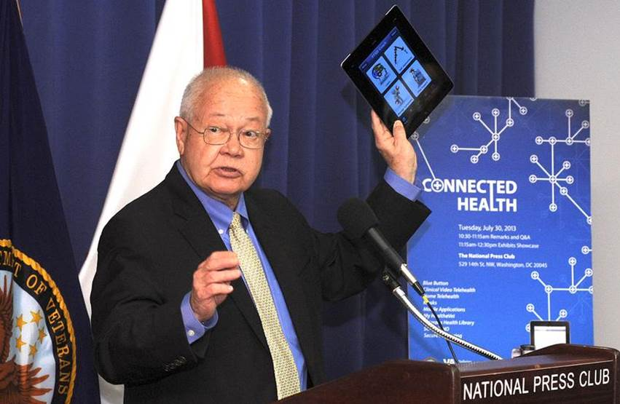
VHA Web & Mobile Solutions Origins
Notes:
Dr. Petzel, the VA Undersecretary of Health
PTSD Coach application – Julia Hoffman.
Support for mobile is all the way at the top.
Veterans Groups, Veterans, Private Sector all watching
Start up.
Year 1: Hiring initial staff, Forming OIT relationships, kick-starting development,
Year 2: Formed the Governance Board and workgroups. MAGB: Executives
Workgroups: Mobile Application Management Team – Business and technical folks doing work, making recommendations. Finding really cool ideas.
Year 3: Zoning in on contracting, Propath/PMAS and MAE expansion.
*********************************************************************

Slide 11

Origin November 2011
OIT
VHA
Notes:
Envisioned as partnership since day 1
OIT obtained funding through T21
Here are some of the ways OIT is contributing:
OIT is providing App Development and Architecture Support through PD, their Product Development section. 12 Developers.
Enterprise Systems Engineering, or ESE, is leading the Mobile Device Management effort, focusing on physical hardware and integration of mobile devices into the VA network.
Joint VHA/OIT Program Management initiative referred to as MHED. MHED stands for “Mobile Health External Development.” Official sanctioned PMAS-compliant project.
PMAS = Program Management Accountability System
Pathway for apps to reach class I, supported enterprise app, from field, from off the shelf
Governance boards OIT participates in.
*********************************************************************

Slide 12

VA Mobile Health: Expanding Care for Veterans
Personalized, Convenient, Coordinated & Accessible
Increase Patient Engagement
Expand Care for Veterans
Governance
Notes:
Focus is on 4 major areas:
Veteran Experience should be be Personalized, Convenient, Coordinated, and more Accessible.
In addition, we have 3 larger strategic goals that drive our work. We’ll talk about the goals in a minute.
In the area of…
Personalization…
Communication between visits
eCoaching provides personalized prompting…. Stop smoking….manage weight.
Patient entered data reconciles patient’s world with clinical EMR – Health Data Reconciliation
Convenience….
EMR data securely shared - same technology as banking – Secure Socket Layer (SSL)
eTools provide patients with information to actively participate in disease self-management
Coordination of care…
Patient centered team care driven by shared care plans & patient goals
MY GOALS app pilot
Patient self-entered data is key
Patient decision support creates SELF-CORRECTING feedback loops
Provider decision support tools
Apps designed to support clinical workflow – IMMUNIZATION CAMPAIGN APP
Accessibility…
Apps are available anywhere
Apps are 508 compatible – government regulation defining accessibility features – colorblind, image tagging for visually impaired
*********************************************************************

Slide 13
Increase Patient Engagement
Personal Inventory App
Goal Setting App
Care Plan App
Patient Self-Entered Data to Health Team
Patient Decision Support (eCoaching)
SMS Messaging
Notes:
Now let’s look at our strategic goals and how we’re trying to meet them.
I’ll run through some apps and how we’re meeting our goals with them.
Goal #1 is to Increase Patient Engagement
Screen lists apps that meet the goal
TALK ABOUT BARRIERS – New technology, unfamiliar to some, a few in Caregiver pilot nervous or scared to use the technology
*********************************************************************

Slide 14
Expand Care for Veterans
Increased Coordination & Communication
Video Conferencing
Secure Messaging
Coaching Notifications from Health Team
Display Clinical EHR Data
Notes:
Goal #2 is to Expand Care for Veterans
First goal was about patient driving data to VA.
This goal is about sharing data back with the Veteran.
Why do this when we have MHV secure messaging?
Mobile apps are small, lightweight, fast to get into.
Leverage existing infrastructure
Data entered in one app is shared with other apps
All are important
If had to pick one, sharing of EMR data live is the real game changer.
Data will be live or under 4 hour delay.
Vet with Traumatic Brain Injury discharged – can’t remember instructions. Now can look them up.
*********************************************************************

Slide 15
Governance
Mobile Device Management
Cloud Hosting
Mobile Application Environment (MAE)
Data Standardization
App Certification
Notes:
Goal #3 is in the area of Governance
About encouraging innovation and building the VA’s mobile infrastructure
Provide a way for field sites and individuals to get apps created and into production through MHED. Some we develop, some OIT develop, some field will develop
Complement to innovation.
Mobile Device Management
Cloud Hosting
Mobile Application Environment (MAE)
Data Standardization
App Certification
*********************************************************************

Slide 16

Enterprise Apps
In Development
Notes:
Contracts awarded for FY14
Download to see the full list
Mention device rollout at 3 – 18 pilot sites – Nashville, DC, Orlando
DISA review process to get app into VA
Mobile radiology – FDA approved for diagostic quality
Text Messaging for Disease Management Support
Mobile Radiology Imaging
Mobile Devices (10,000) and Mobile Device Support Service
Mobile App Deployment
Mobile App Sustainment
Analytics/PMO Support
Analyze PGD for 5 apps and create provider displays
Workflow analysis before mobile apps deployed
Communications
PMO support
DISA reviews of outside apps
Nursing & Miscellaneous Apps
*********************************************************************

Slide 17

Nursing & Miscellaneous Apps
Notes:
Nursing and Miscellaneous Apps
Download to see list.
Nursing pilot consist of 4 apps
Formed workgroup last year – nurses helped define the requirements.
1,000 devices in the contract but is not just limited to that number.
Nursing Applications
To-Do List
Safety Checks
Nursing Action Tracking
Interactive Patient information
Cardiac Rehabilitation App
Chronic Kidney Disease App
Antibiogram Expansion
Stroke Pathway App
Emergency Department App Expansion
Teledematology
Conversion of iOS apps to HTML5
**************************************************************

Slide 18

New Health Care Team-Facing
Mobile Apps
Notes:
New Health Care Team-Facing Mobile Apps
Goal is to integrate apps into clinical workflow
Not asking providers to change what they do
Want to enhance clinical work, offer better ways to make decisions, more information
Patient viewer app has been around 2 years on iPad
Will be working on apps to enter orders on the fly
Enter progress notes
Mobile VistA imaging – not diagnostic quality
Health data reconciliation – allergies, problem list, VA and non-VA meds, with images
***** Stop here *********************
The below is for reference:
PatientViewer (expansion)
Antibiotic Drug Resistance
Mobile Vista Imaging
Surgical Pathology/Cytology
Progress Notes (enter)
Wound Care
Immunization Campaign
Secure Messaging
Consult Orders Management
Coumadin Clinic
Mobile Radiology Imaging
Radiology Orders Management
Laboratory Orders Management
Medication Orders Management
Patient Consent
Health Data Reconciliation
ICU
Facility and Bed Locator
Safe Woman Prescribing
Nursing Apps
*********************************************************************

Slide 19
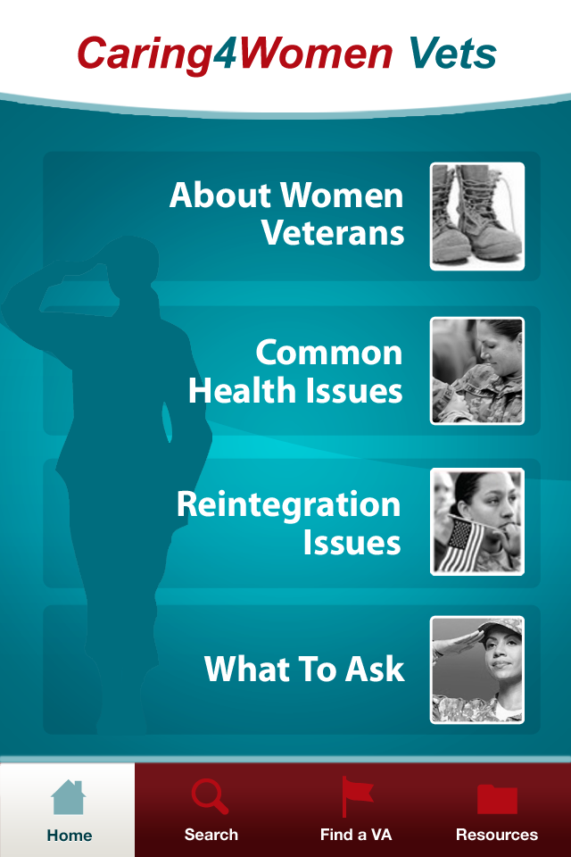
New Patient-Facing Mobile Apps
Texting for Health
Patient Health Inventory
Caring for Women Veterans
Preconception/Prenatal
Maternity Tracking
Veteran Health Competition
Biosurveillance Reporting
Subscription Service for Biometric Monitoring
Notes:
New Patient-Facing Mobile Apps
Women’s health has been very active partner
National Center for PTSD, Dr. Julia Hoffman has been active –
Stay Quit Coach, PTSD Coach, Sleep Coach
Apps are available now Google Play, Apple App Store
VA App store coming soon
*********************************************************************

Slide 20

Mobile Pilots and Field Tests
Notes:
We’re learning and sometimes having to create the rules as we go.
Starting cautiously – new to patients, new to VA
What is PGD, for example… Who owns it? Where do we put it? If patients read from the record, why not integrate with the record?
We’ve never done this before.
Sometimes pilots may fail. We’ll learn and adjust. Pilots that are successful will be pushed to production.
Let’s talk about some of our recent pilots.
*********************************************************************

Slide 21
VA’s Mobile Health Pilots
Clinician Pilot
Mobile Health Browser Pilot
Veteran Patient/ Family Caregiver Pilot
June 2013
April 2013
January 2012
Notes:
January 2011: Decision to launch mobile health provider at the DC VAMC
Pilot 30 mobile devices (15 iPads & 15 iPhones)
January 2012: Clinician Pilot
30 Mobile Devices at Washington DC VAMC – phones and iPads
First apps to access data from VistA on a mobile platform
Test viability of mobile as a clinical tool
April 2013: Mobile Health Browser Pilot
Mobile Blue Button Interface for Veterans which allows selecting specific elements from the medical record for download
Form Factor Evaluation at San Francisco VAMC
Size of screen – mini vs. full size
June 2013: Veteran Patient/Family Caregiver Pilot
1,000 Family Caregivers – Started face to face, now online training
Pre-loaded iPads with VA Mobile Health Apps
Secure, two-way exchange of data
Develop a limited number of Apps that display data from VistA System
Login Screen
Patient Search
Patient Summary (demographics, labs)
Medication List/Detail
*********************************************************************

Slide 22

Family Caregiver Pilot Apps
Suite of 11 apps pre-loaded on iPads and
distributed to 1,120 Family Caregivers
and their post 9/11 seriously injured Veterans
Notes:
Family Caregiver Pilot Apps (10)
Launchpad
Pain Coach
Care4Caregiver
eJournal
RxRefill
Mobile Secure Messaging
PTSD Coach
Health Advocate
Notifications
Summary of Care
If you would like more detailed information that what’s being presented here, Dr. Neil Evans, co-Director of Connected Health, along with Becky Monroe and Harold Bonds in OIA Training Strategy have recorded an on-demand MyVEHU sessions on this topic.
The session is broken down into 4 sections:
Support of Disease Management
Support of Family Caregivers
Improving Coordination of Care
Facilitating Communication & Interaction
*********************************************************************

Slide 23
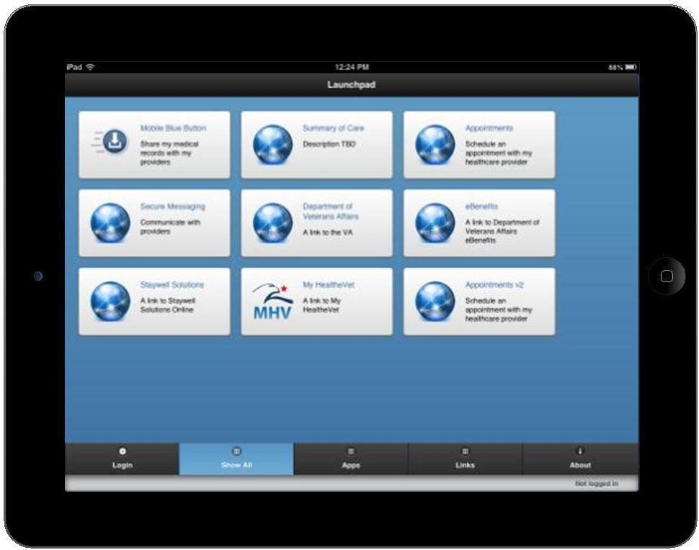
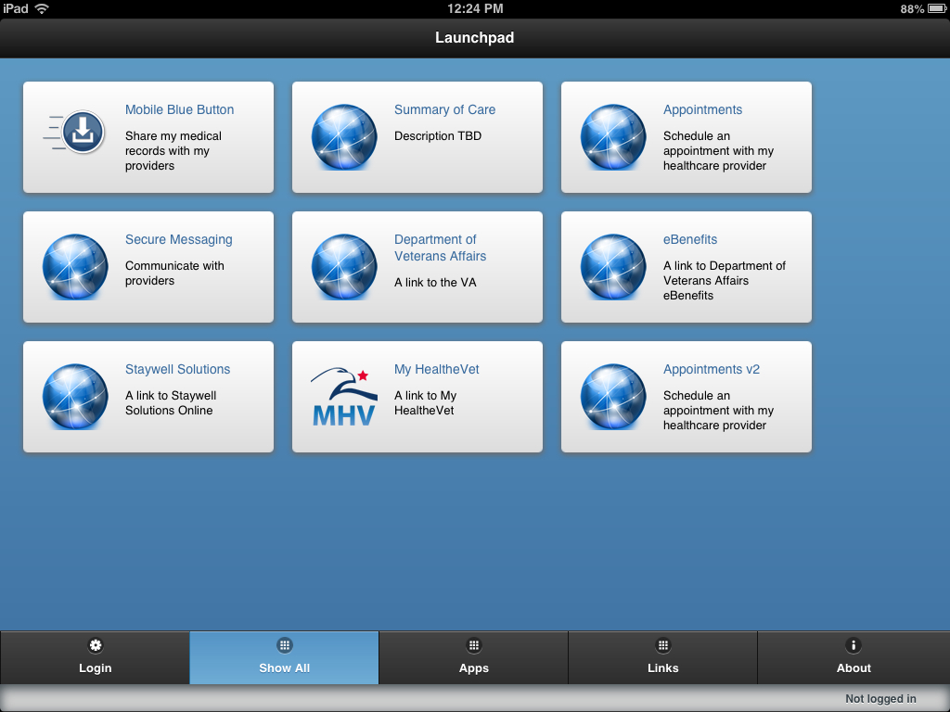
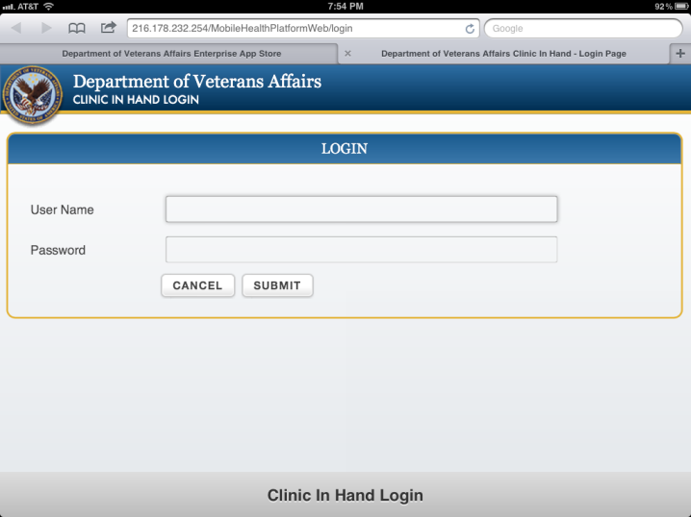
Notes:
Here we see the typical web-based login screen for a VA mobile app.
Mobile Apps will be using the DoD DS Log On credentials for authentication.
At a later date, we’ll probably change the credentials to something more encompassing, such as the Access VA portal that’s being established by Identity Access Management.
Through our pilots, we’ve seen that DoD Logon has some challenges.
A lot of this has to do with the fact that the process for establishing this credential is managed by DoD.
On our mobile health website, which is available at the end of this presentation, there are user guides and instructions developed for Veterans that explain the steps involved with setting up a DS Logon. We also plan on releasing a new App that will help a Veteran set up a DS Logon as well as test their current logon with the VA mobile infrastructure, to be sure that it’s working.
*********************************************************************

Slide 24
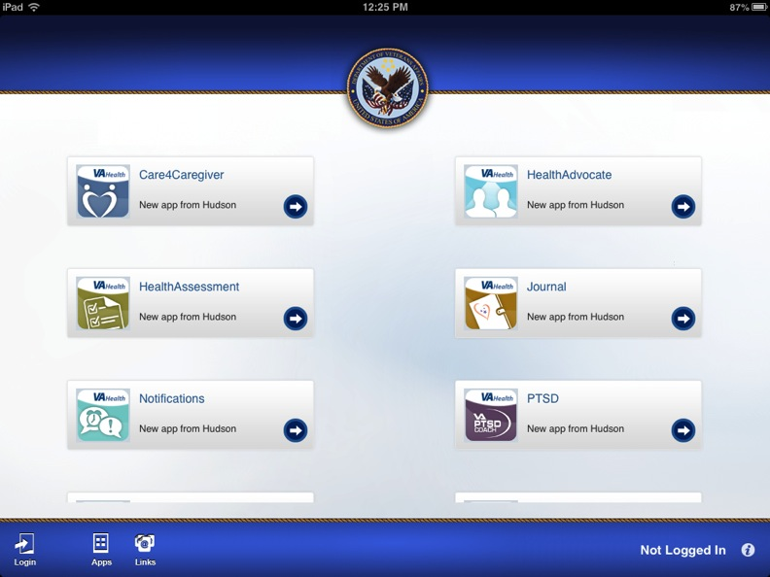
VA Mobile Launchpad
Notes:
Launchpad is the central hub for all Veteran mobile apps.
We have versions for both iOS and HTML5, which will run on almost any internet-enabled mobile device.
In Launchpad, the user will be able to see all applications available for download as well as applications they’ve already installed or accessed. By swiping the screen, there’s also a page of links to other content which may be relevant to them.
Apps come in a variety of flavors. Some apps may be what’s referred to a as a “native” app, which means it gets downloaded and installed on a device. These apps sometimes will work off-line if they’re informational only or don’t connect to a VA database. Then we also have HTML5 apps, which can either be installed or can be hosted as a traditional web-app.
Our strategic direction is to build apps in HTML5, unless there’s some reason it won’t work for a specific app. For example, there may be some special piece of hardware on a specific mobile device which can’t be access in HTML5. But by building apps in HTML5, we can ensure they’ll run on the majority of mobile devices such as all popular version of Android, iPhone, iOS, and Windows Phone or tablet platforms. HTML5 apps will also run on traditional desktops.
**************************************************************************************

Slide 25
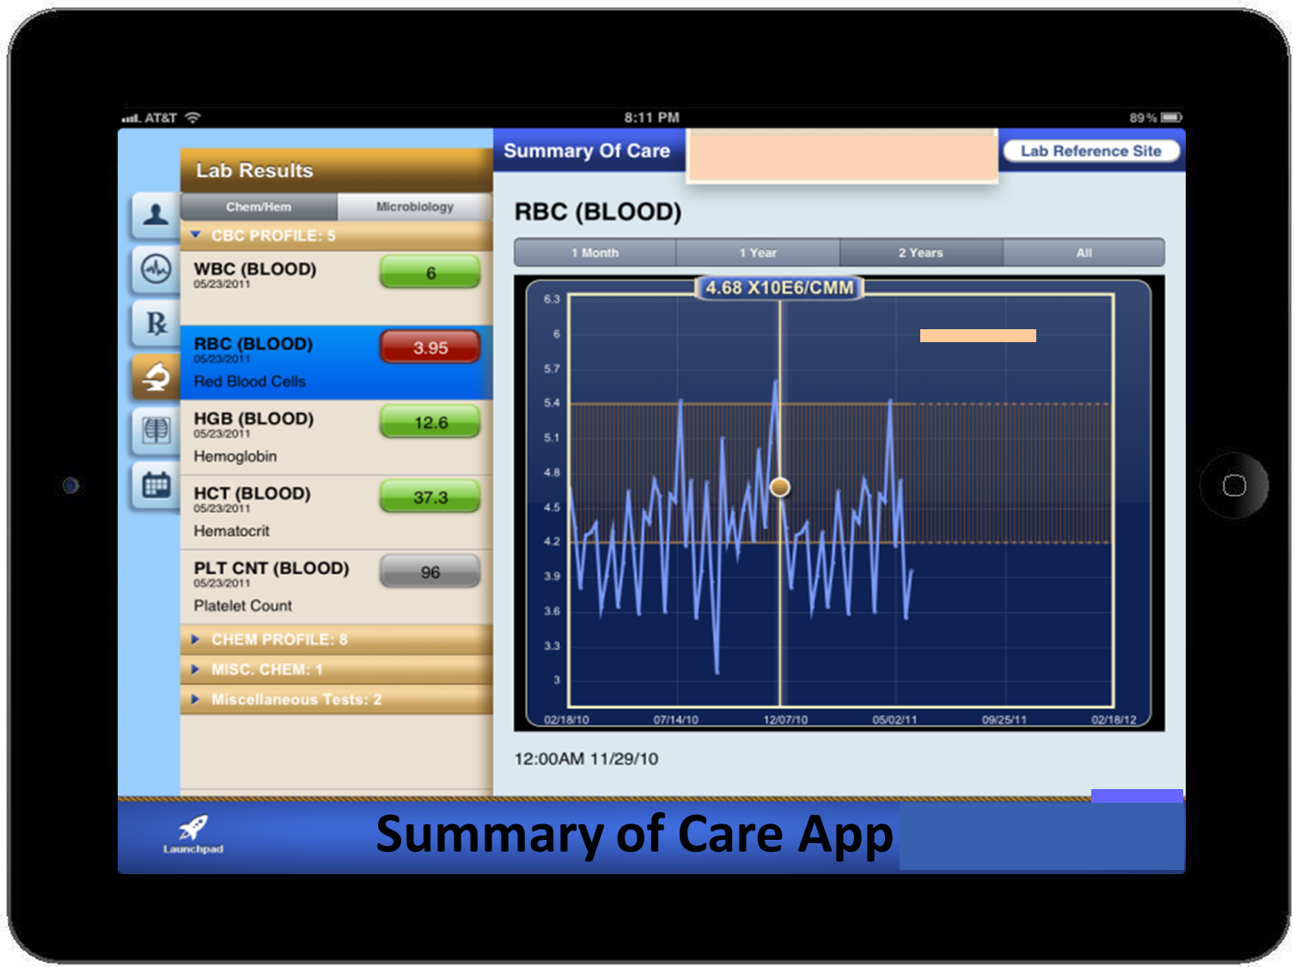
Notes:
Summary of Care App Displays EHR Data
Medications
Labs
Problem List
Radiology Reports
Progress Notes
Demographics
Vitals
*********************************************************************

Slide 26
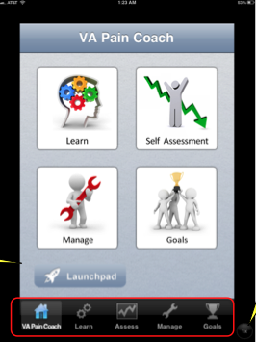
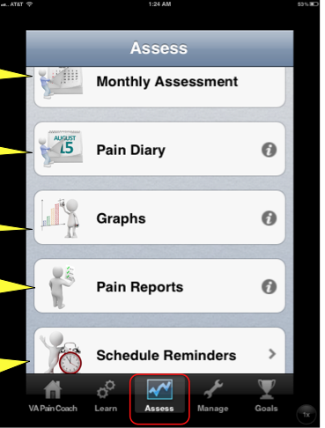
Notes:
Pain coach – large buttons with familiar look and feel – looks like other apps
NAVIGATION panel at bottom
Try to keep apps consistent – VA mobile style guide and certification
LAUNCHPAD button
*********************************************************************

Slide 27
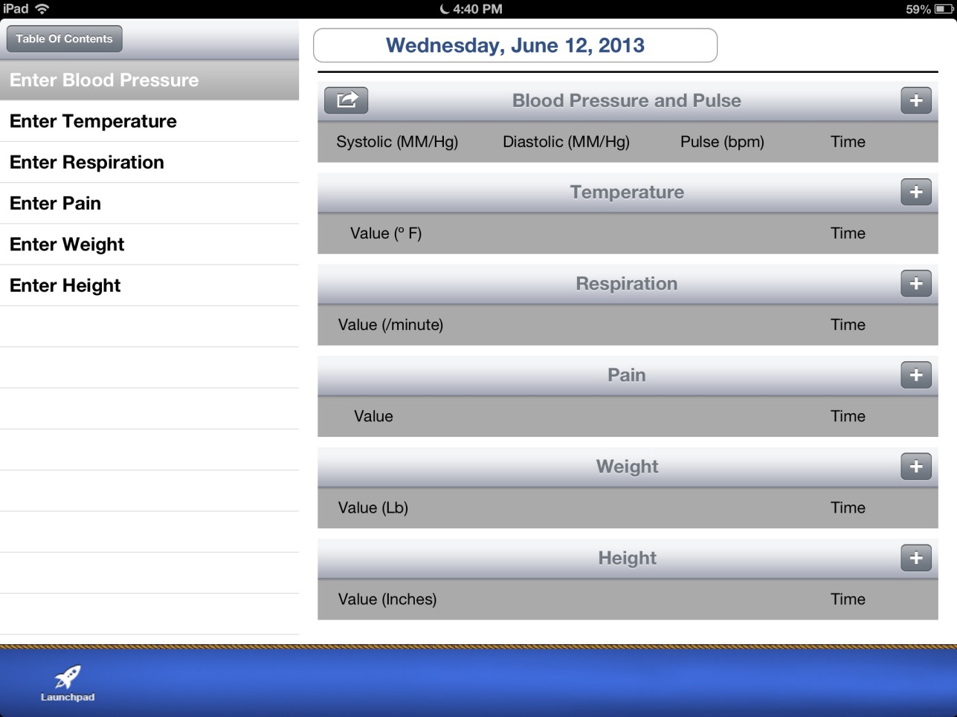
eJournal App
Notes:
eJournal App
Vitals
Exercise
Diet
Mood
Communications
*********************************************************************

Slide 28
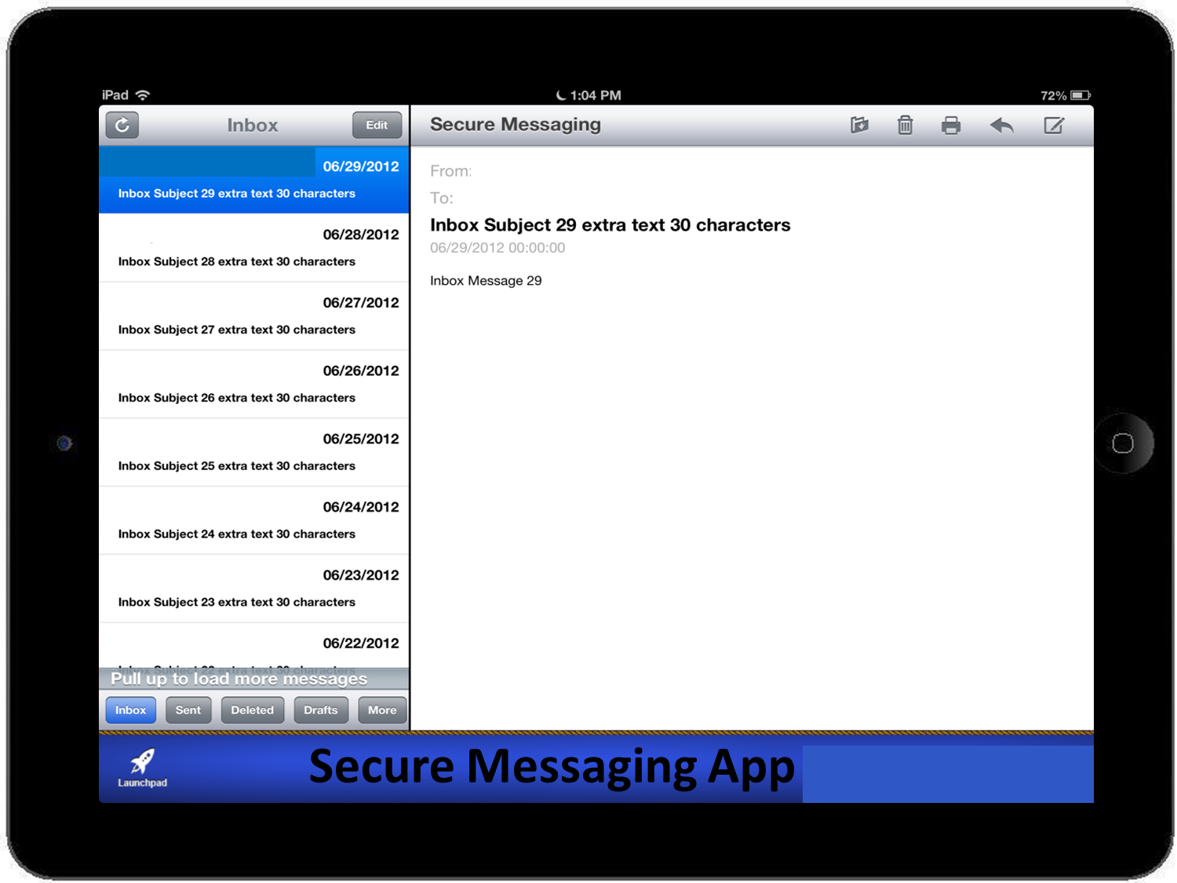
Notes:
Secure Messaging App
Only Mobile App that requires MHV credentials to use
*********************************************************************

Slide 29
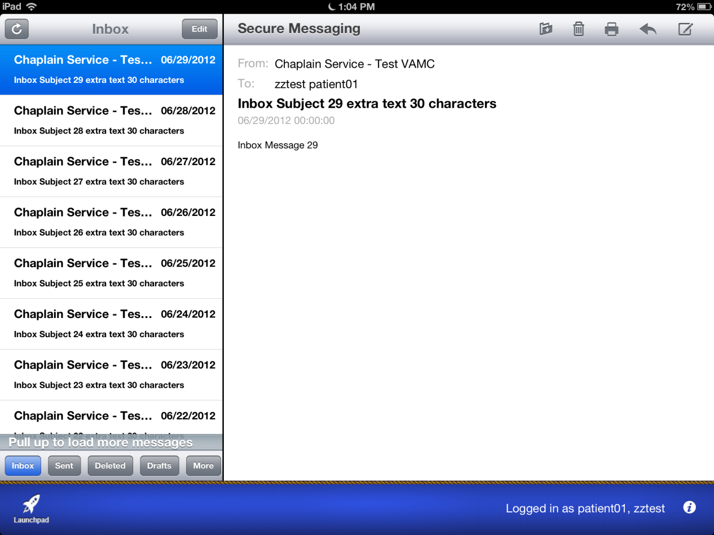
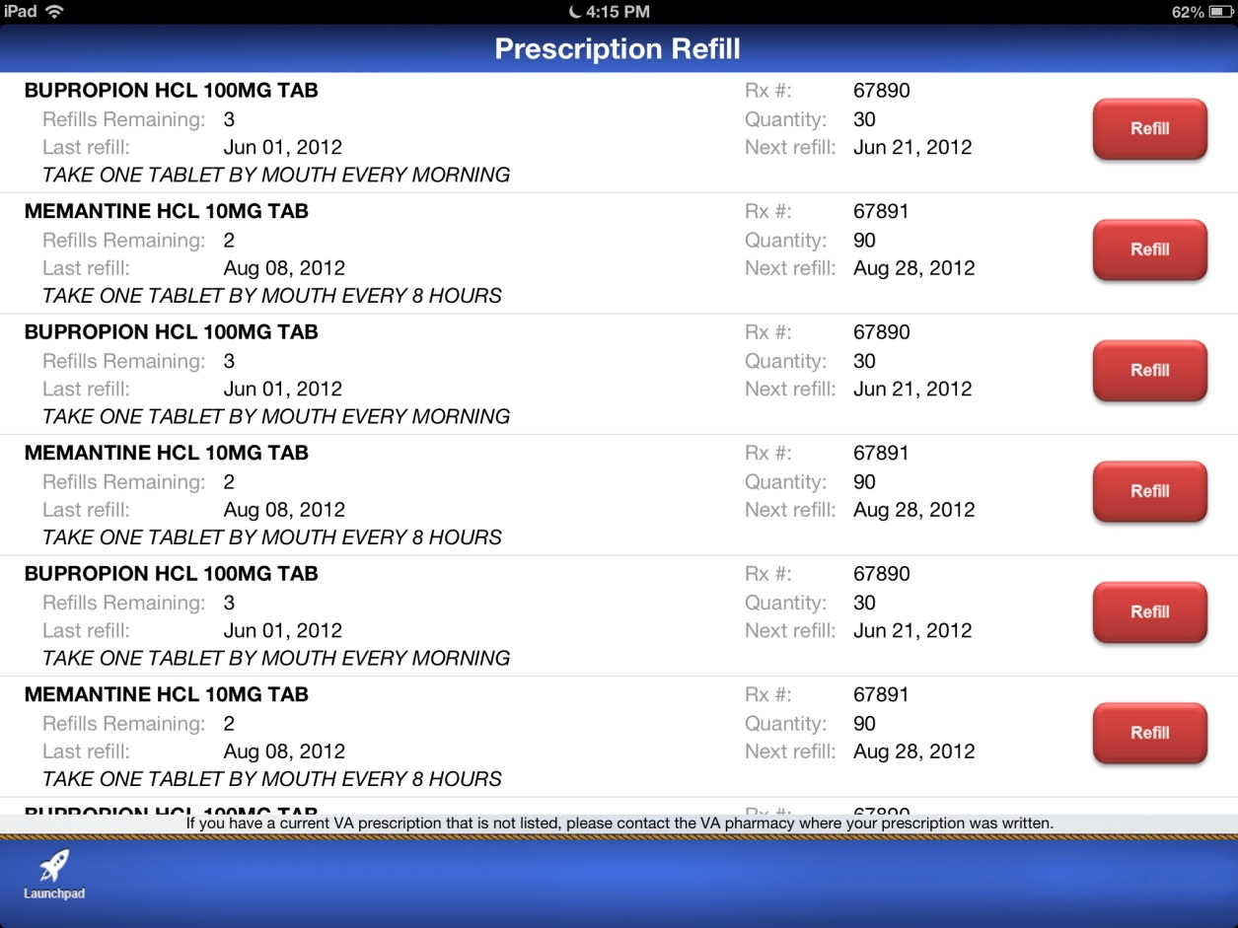
Rx Refill App
Notes:
Rx Refill App
Allows Veterans to request prescription refills
*********************************************************************

Slide 30
Apps for Everyone!
HTML5
IOS?
Android?
Wrapped?
Windows Modern?
Native?
Hosted?
Notes:
*********************************************************************

Slide 31

Technologies Utilized for UI Development
Notes:
Native iOS
Native Android
Embarcadero XE (i.e. Delphi)
Focus is HTML5
Why?
Easier to sustain one code base
Platform agnostic
No specialized hardware (Macs needed for iOS)
Downsides
Access limited to some custom device API’s
Speed, look-and-feel (Sometimes)
*********************************************************************

Slide 32


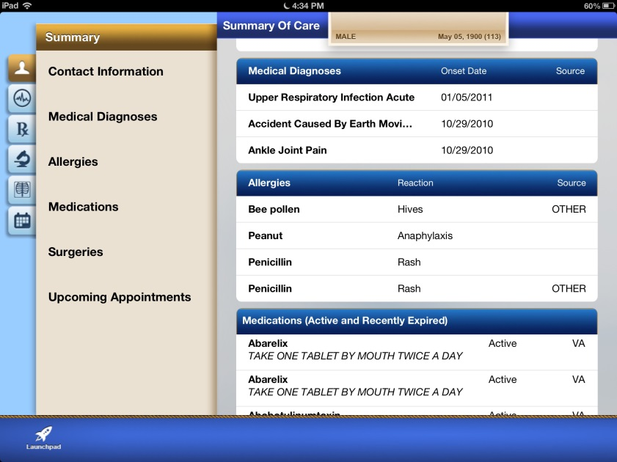
Veteran-Facing Apps
Summary of Care
Mobile Blue Button
Veteran Appointment Request
Notes:
Veteran-Facing Mobile Browser Apps (HTML5)
Mobile Blue Button: download healthcare data to mobile device
Summary of Care: summarize healthcare data graphically over time
Veteran Appointment Request: Request VA Appointments from mobile device
LET’S LOOK AT MOBILE BLUE BUTTON
*********************************************************************

Slide 33
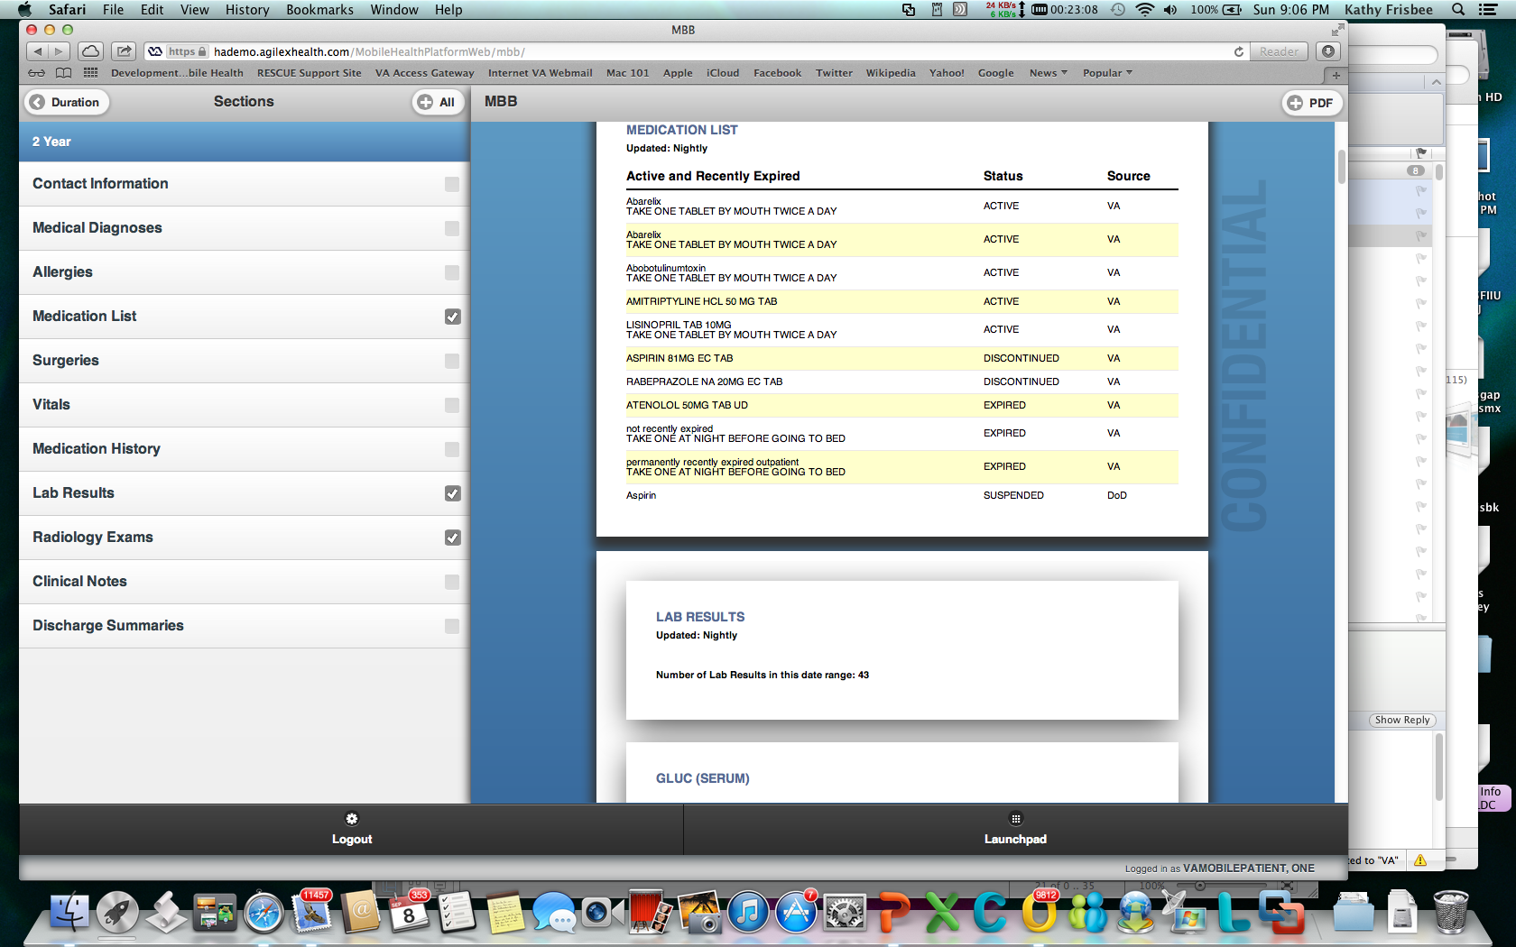
Mobile Blue Button
Notes:
*********************************************************************

Slide 34

Mobile Blue Button
Allergies
Medication List
Surgeries
Vitals
Medication Hist
Lab Results
Notes:
*********************************************************************

Slide 35
Mobile Blue Button
Notes:
*********************************************************************

Slide 36

Mobile Application Environment (MAE)
Notes:
Anyone can request access here:
https://mobilehealth.va.gov/initiation
Cloud based
Contains:
Atlassian Tools
Development, Test, Pre-Production, Integration & Production Environments
MDM Solution – Airwatch
Public App Store
Middle-tier services
*********************************************************************

Slide 37


Who is Building Mobile Apps?
Notes:
OIT PD mobile development team
VHA WMS mobile development team
VHA WMS contracted resources
VBA contracted resources
DoD
National Center for PTSD (NCPTSD)
VHA Innovation
VBA Innovation
And others…
*********************************************************************

Slide 38

Agile Development Methodology
Strengths and Weaknesses
Notes:
Agile Development Methodology
Strengths:
Easy to begin with basic requirements
High business owner/user engagement
Rapid time to working prototypes
Responsive to changes throughout the process
Weaknesses
Planning and documentation can sometimes be overlooked
Requires high business owner/user engagement
Requires alignment with OIT PMAS
*********************************************************************

Slide 39
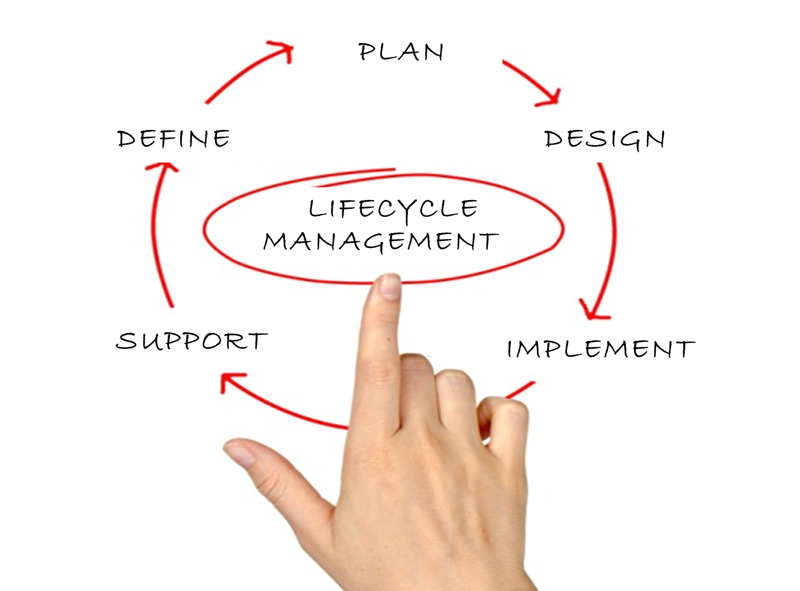

PLAN
DEFINE
DESIGN
LIFECYCLE
MANAGEMENT
SUPPORT
IMPLEMENT
Notes:
Lifecycle Management.
Introduction Brian Olinger Web and Mobile solutions supervisor
LifeCycle Mangement – Were going to discuss how and Idea becomes a Mobile App and released to Providers, Medical center staff, Veterans.
*********************************************************************

Slide 40
Poll Question
If you were going to develop a mobile app, and could only choose one, which platform would you choose?
    IOS (Apple)
    Android
    HTML5 (Web)
    Other
Notes:
Now I’d like to ask a poll question.
Please take a moment and let us know what you think.
To answer this question, use the blue polling icon above my head. We’ll move on and come back to your results in just a moment.
*********************************************************************

Slide 41


Mobile Development
CONCEPT DEFINITION
PLANNING
DEVELOPMENT
O&M
MS0
MS1
ORR/IOC Entry
MS2
Multiple Apps
Multiple Apps
IMPLEMENTATION
IOC Exit
7.8 SQA
7.13 VA Branding
7.9 Enterprise Security
7.10 Data Security
7.11Privacy
7.12 Independent V&V
MAGB
1 Request New App
2
Approve Request
3 Business Requirements Document (BRD)
4
Fund Effort
5
Assign/ Contract Agile Team
6
Concept Paper Scope
7
Agile Development
8
Field Testing
9
Release
10 Product Support
Sprint 0
Sprint 1
Sprint 2
Sprint 3
Sprint 4
Sprint 5
WMS PM
VA OI&T PM
7.4 508
7.3 Data & Terminology
7.2 Enterprise Architecture
7.5 Clinical Assessment
7.7 OAP/ Sustainment Plan
7.1 Human Factors
7.6 Patient Safety
Notes:
This is our evolving process or lifecycle of a mobile app. Today will review key components of this process from Request a New App to Product Support.
For those interested please visit the download section in the MyVehu Campus to get a better view of this slide and anything else in the presentation that Shawn or I presented.
*********************************************************************

Slide 42
Mobile Development
CONCEPT DEFINITION
PLANNING
DEVELOPMENT
O&M
MS0
MS1
ORR/IOC Entry
MS2
Multiple Apps
Multiple Apps
IMPLEMENTATION
IOC Exit
7.8 SQA
7.13 VA Branding
7.9 Enterprise Security
7.10 Data Security
7.11Privacy
7.12 Independent V&V
MAGB
1 Request New App
2
Approve Request
3 Business Requirements Document (BRD)
4
Fund Effort
5
Assign/ Contract Agile Team
6
Concept Paper Scope
7
Agile Development
8
Field Testing
9
Release
10 Product Support
Sprint 0
Sprint 1
Sprint 2
Sprint 3
Sprint 4
Sprint 5
Request
Prepare
Approve
WMS PM
VA OI&T PM
7.4 508
7.3 Data & Terminology
7.2 Enterprise Architecture
7.5 Clinical Assessment
7.7 OAP/ Sustainment Plan
7.1 Human Factors
7.6 Patient Safety
App Intake and Request Process
Notes:
“Lets jump right in to the First section of the Mobile development Process the Request and Approval process. This will cover the Concept Definition and Planning Phases of the process.
*********************************************************************

Slide 43
App Intake Process
Request
Prepare
Approve
1
  Register with VA by completing the forms that are specific to your request
Notes:
To develop and or brand a VA Veteran or clinical provider mobile app, using VA resources, you must first register with VA by completing the forms that are specific to your request.
You will need to provide information on your idea, project, or proposal.
Once submitted a member of the WMS team will discuss steps to prepare the request for the Mobile Governance board. Request can be made at http://mobilehealth.va.gov/initiation. This link is available in the download.
There are 3 primary type of app request will discuss.
*********************************************************************

Slide 44
App Intake Process
Request
Prepare
Approve
Forms
    Have VA build an app
    Certify an app you are building to carry the VA brand
    Start building a VA-branded app for which you have funds and resources
    Request a VA mobile app development environment (Tools setup)
    Request server resources for your VA mobile app development project
    Request a user account to participate in an existing VA mobile app development project
Notes:
Ok the first type of App request is:
Have the VA Build an App
Use this form if you have an idea for an App that you would like the VA to develop.
I would like to point out this is different from innovations, if you do have an Idea prior to submitting the request there are a few key components, you as the requestor will need to bring to the table, we will review those requirements in a bit.
*********************************************************************

Slide 45
App Intake Process
Request
Prepare
Approve
Forms
    Have VA build an app
    Certify an app you are building to carry the VA brand
    Start building a VA-branded app for which you have funds and resources
    Request a VA mobile app development environment (Tools setup)
    Request server resources for your VA mobile app development project
    Request a user account to participate in an existing VA mobile app development project
Notes:
The second type of Mobile app request is:
Certify an app you have already built to carry the VA brand
Use this form to request VA compliance resources to review your completed App for compliance with VA requirements. Example of this, we have had several apps that were built by local staff and or tech staff.
If you want an app that was built to carry the VA brand, A passing evaluation from all of the compliance reviewers will allow your App to be published in the VA App Library. Later on we will talk about the different compliance groups.
*********************************************************************

Slide 46
Request
Prepare
Approve
Forms
    Have VA build an app
    Certify an app you are building to carry the VA brand
    Start building a VA-branded app for which you have funds and resources
    Request a VA mobile app development environment (Tools setup)
    Request server resources for your VA mobile app development project
    Request a user account to participate in an existing VA mobile app development project
App Intake Process
Notes:
Third and Final type of app request we currently have is:
Start building a VA-branded app for which you have funds and resources
Use this form if you have a contract or funds and or you have resources to build a mobile app using the VA's mobile App processes and policies. Again, A passing evaluation from all of the compliance reviewers will allow your App to be published in the VA App Library
*********************************************************************

Slide 47
App Intake Process
Request
Prepare
Approve
Forms
    Have VA build an app
    Certify an app you are building to carry the VA brand
    Start building a VA-branded app for which you have funds and resources
    Request a VA mobile app development environment (Tools setup)
    Request server resources for your VA mobile app development project
    Request a user account to participate in an existing VA mobile app development project
Notes:
Now we have talked about the three type of app request, lets review some of the other request types to support mobile projects.
Request a VA Mobile App Environment (MAE) for Development
Use this form if your app development requires connectivity to the VA network and/or VA test databases in the MAE.
*********************************************************************

Slide 48
App Intake Process
Request
Prepare
Approve
Forms
    Have VA build an app
    Certify an app you are building to carry the VA brand
    Start building a VA-branded app for which you have funds and resources
    Request a VA mobile app development environment (Tools setup)
    Request server resources for your VA mobile app development project
    Request a user account to participate in an existing VA mobile app development project
Notes:
Request server resources for your VA mobile app development project
Use this form if your project needs its own dedicated server resources.
Projects typically only need the VA Mobile Framework server resources already available in the MAE. Just a note that additional servers dedicated solely to the project, may require special funding arrangements.
*********************************************************************

Slide 49
Request
Prepare
Approve
Forms
    Have VA build an app
    Certify an app you are building to carry the VA brand
    Start building a VA-branded app for which you have funds and resources
    Request a VA mobile app development environment (Tools setup)
    Request server resources for your VA mobile app development project
    Request a user account to participate in an existing VA mobile app development project
App Intake Process
Notes:
Request User Account
If you needs access to the available tools in the MAE, you will need to fill out a user account request. In addition if you to be added as a team member of a project you will need to fill out this request.
Use this form to join an existing development project in the Mobile Applications Environment (MAE) that has been approved by the Mobile Applications Governance Board.
*********************************************************************

Slide 50
App Intake Process
Request
Prepare
Approve
2
  You will be contacted by Web and Mobile solutions to prepare request for Mobile Apps Governance Board (MAGB)
  MAGB is responsible for reviewing and approving request
Notes:
Now your team has submitted the required request, App request need to prepare a submission for the Mobile Apps Governance Board.
The Mobile Apps Governance board is the group that will review the APP request and approve it to move forward. In order to present to the Board there is basic information that needs to be collected and presented for the board to make a decision.
*********************************************************************

Slide 51
App Intake Process
IMPORTANT!!!
!!!
In order to obtain approval by the Governance Board the request must answer 3 questions:
  Meets the VA Mission
  Has a Business Sponsor
  Business Sponsor Commitment to Sustain
Notes:
Lets look at the basic requirements for the MAGB.
In order for the MAGB to approve they will ask 3 pesky questions
1) Does the App Meets the VA Mission, is their something else out there that duplicates this functionality
2) Does the App have an approved Business Sponsor. For example, If you were building an app for Scheduling you would need approval from VHA leadership who oversee that particular area.
3) Sustainment – When the app is released how will it be supported and sustained. Who will update the app. Sustainment can be up to 80% of cost of a software application.
*********************************************************************

Slide 52
App Intake Process
Request
Prepare
Approve
3
  Once MAGB approves your request, if applicable a JIRA project will be created
Notes:
Approval.
When all goes as planed, the Project team will receive an Approval from the MAGB. Once approval is received a project will be created in the Mobile Apps environment. Depending on the type of request teams can begin finalizing requirements, preparing for compliance review, or begin development.
Once a project is approved it is the Projects responsibility to provide Project Mangers, coordinated business owner support, and keep the project active and up to date in the Project tool JIRA in the MAE. We will take a closer look at the tools in a bit.
*********************************************************************

Slide 53
Poll Results
If you were going to develop a mobile app, and could only choose one, which platform would you choose?
    IOS (Apple)
    Android
    HTML5 (Web)
    Other
Notes:
Lets look at the results.
It appears that most people would want to develop an ##### app. As Shawn stated Web and Mobile solutions is currently focusing on HTML5 apps in order to maximize the access to multiple devices, however we have several other groups in the VA leveraging the mobile process who are building **IOS and Android apps**.
*********************************************************************

Slide 54
Poll Results
    IOS (Apple)
    Android
    HTML5 (Web)
    Other
Notes:
CLICK TO NEXT SLIDE

Slide 55

Business Requirements Document (BRD)
Captures and describes epics or business needs
Captures and describes User Stories or business requirements
Identifies capabilities needed by stakeholders and target users
Created by Requirements Development and Management (RDM) or agile development team
Notes:
If the App was approved to be built by the VA a Business Requirements Document (BRD) will be required.
The BRD can be developed by Requirements Development and Management (RDM) who works with business owner and/or designated subject matter experts (SMEs), and other stakeholders or by an agile development team.
The BRD is a high-level document that captures and describes business needs or epics and business requirements or user stories.
Example of business requirement: Provide the ability for a user to generate a report
Example of user story: As a user, I want to print a report from my home screen so that I can review the workload of my staff.
*********************************************************************

Slide 56

Mobile Development
Agile Methodology
Sprint meeting every 1-3 weeks
Review work completed and planned
Business Owner attendance
Notes:
VA mobile is currently utilizing the Agile methodology to develop mobile apps, at a high level this means. :
Approx. every 1-3 weeks the software development team will host a sprint meeting for all apps currently under development
For each app, the development team will review the work completed during the previous two weeks and work planned for the next two weeks
It is expected that the Business Owner (BO) attend and participate at these meetings
It is also the BO’s responsibility to review the functionality that has been delivered and accept or reject it at the sprint meeting
*********************************************************************

Slide 57
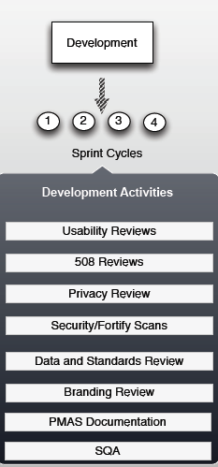
Mobile Development
IMPORTANT!!!
Development teams are required to engage the compliance teams to ensure the App will pass the final compliance reviews.
Notes:
I wanted to talk about an important point. Development teams must engage with Compliance bodies through the development process. If development wait till the end to determine if their app is meeting the VA requirements it will most likely fail the final review. This will require the team to be removed from the Compliance and Release process. Lets now take a closer look at the compliance process.
*********************************************************************

Slide 58
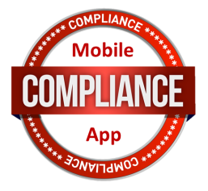
Mobile App Compliance
Mobile Application Classification | 1 - Very Low | 2 - Low | 3 - Medium | 4 - High
Certifying Body | Does not utilize VA resource | Read only access to VA resources | Write access to VA resources | Read and/or write access to VA sensitive resources
Software Quality Assurance | Assessment | Assessment | Testing | Testing
Patient Safety Assessment (OIA) | REQUIRED | REQUIRED | REQUIRED | REQUIRED
508 Accessibility (OIT) | REQUIRED | REQUIRED | REQUIRED | REQUIRED
Code Review | REQUIRED | REQUIRED | REQUIRED | REQUIRED
Usability Testing (OIA) | REQUIRED | REQUIRED | REQUIRED | REQUIRED
User Interface (OIA) | REQUIRED | REQUIRED | REQUIRED | REQUIRED
VA Branding (OPIA) | REQUIRED | REQUIRED | REQUIRED | REQUIRED
Sustainment Plan | REQUIRED | REQUIRED | REQUIRED | REQUIRED
System Performance Impact Assessment (OIT) |  | REQUIRED | REQUIRED | REQUIRED
IV&V | REQUIRED | REQUIRED | REQUIRED | REQUIRED
Data and Terminology Standards Compliance |  |  | REQUIRED | REQUIRED
Privacy and Application Data Security (OIA) |  |  |  | REQUIRED
Enterprise Security |  |  |  | REQUIRED
Certifying Bodies
Notes:
This chart is difficult to see, it’s available in the handout in the Downloads section. But I want to call your attention to the PURPOSE/USE of the chart. The left hand column has list of key certifying bodes. The remaining columns are different “categories” that apps falls into. And so depending on the level of access the app requires, this chart tells you WHICH certifying bodes are required to complete a compliance review. And so now we’re going to take a closer look at each of these certifying bodies and talk about what they each are responsible for assessing/reviewing
*********************************************************************

Slide 59
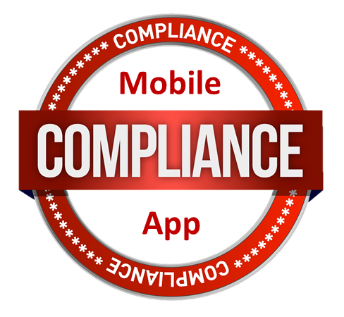

Patient Safety
  Key Certifying Body
Notes:
Patient Safety
Purpose
Reviews documentation of development and testing processes that have already been conducted or are planned to ensure there is appropriate and sufficient consideration of patient safety. They review the functionality of the App to ensure the app does not have the potential to harm patients.
*********************************************************************
When to Engage
During requirements gathering
POC: Jeanie Scott and Pamela Wright
Contact Info:
Jeanie Scott: Jeannie.Scott@va.gov; 518-449-0692
Pamela Wright: Pamela.Wright5@va.gov; 518-449-0285
Documentation
https://mobilehealth.va.gov/sites/default/files/files/PatientSafety.docx

Slide 60
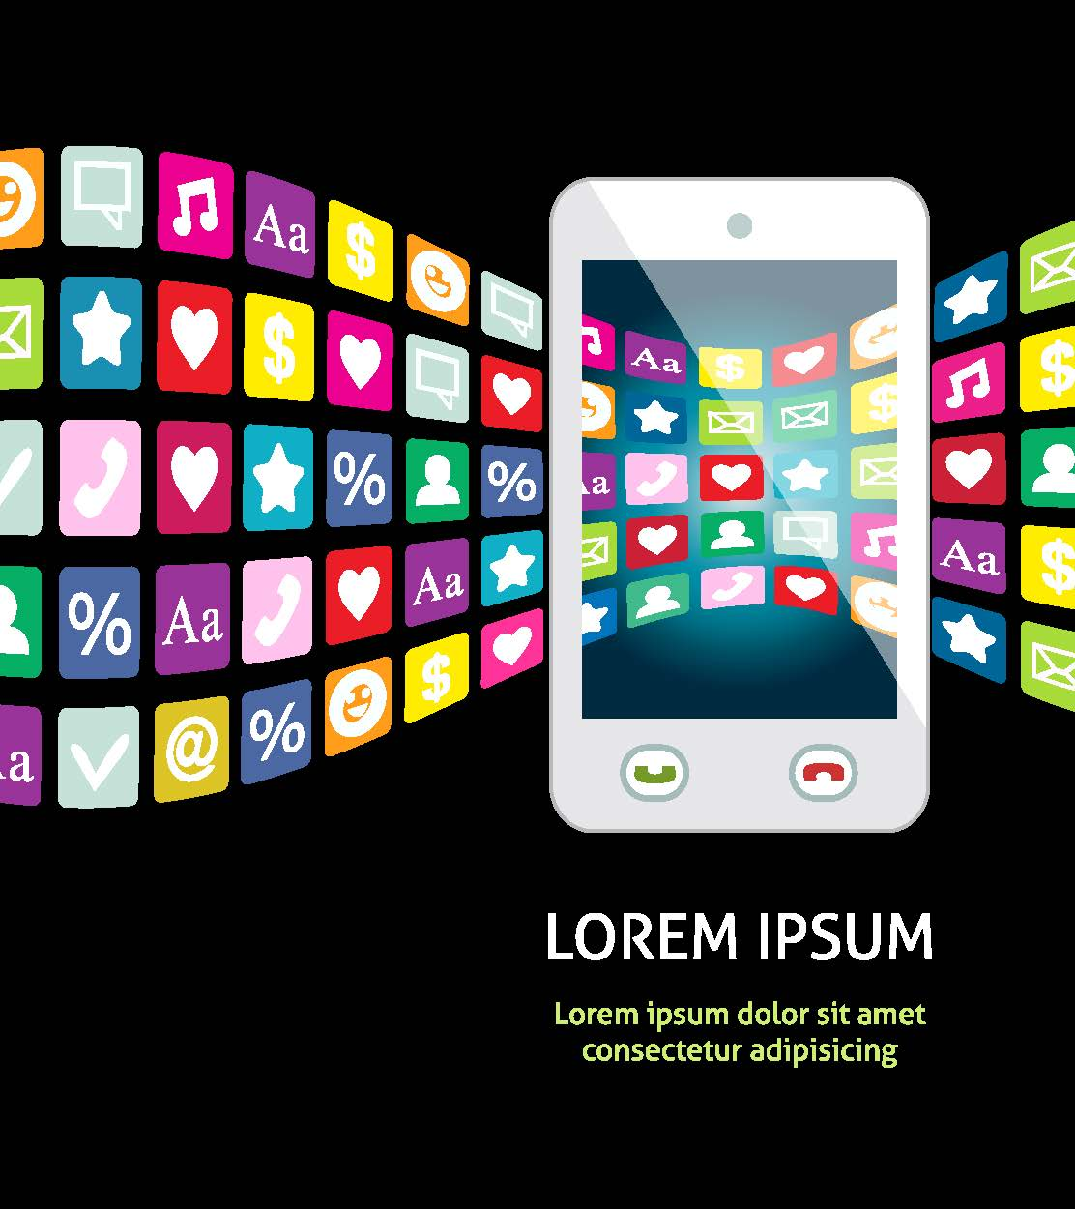
Usability
  Key Certifying Body
Notes:
Usability
Purpose
Ensures a positive user experience through App flow and navigation, including features such as language, graphics, and areas for input. At a minimum, this must include a heuristic evaluation.
*********************************************************************
When to Engage
During requirements gathering
POC: Nancy Wilck and Margo Kabel
Contact Info:
Nancy Wilck: Nancy.Wilck@va.gov; 202-330-1818
Margo Kabel: Margo.Kabel@va.gov; 202-443-5402
Documentation
https://mobilehealth.va.gov/sites/default/files/files/UsabilityHeuristics.pdf

Slide 61

508 Accessibility
  Key Certifying Body
Notes:
508 Accessibility
Purpose
Tests application for Section 508 conformance. Software must be accessible to people with disabilities.
*********************************************************************
When to Engage
During requirements gathering
POC: Mia Lipner
Contact Info: Mia.Lipner@va.gov; 415-400-4122
Documentation
https://mobilehealth.va.gov/sites/default/files/files/Consolidated508ComplianceMobileChecklist.doc
https://mobilehealth.va.gov/sites/default/files/files/CVS_fillable.pdf

Slide 62
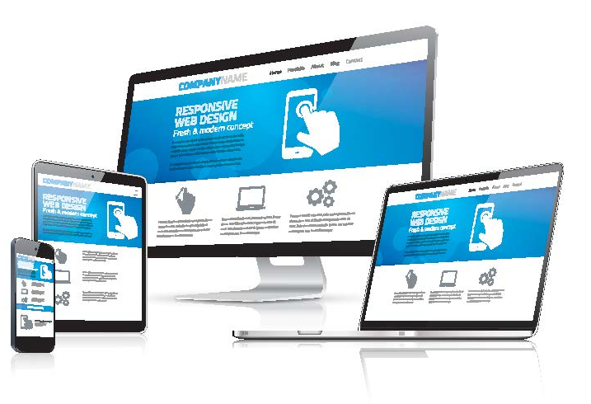
User Interface
  Key Certifying Body
Notes:
User Interface
Purpose
Verifies that the Application meets all required User Interface standards for mobile devices.
*********************************************************************
When to Engage
During requirements gathering
POC: Nancy Wilck
Contact Info: Nancy.Wilck@va.gov; 202-330-1818
Documentation
https://mobilehealth.va.gov/sites/default/files/files/UITemplate.xls

Slide 63

Data and Terminology Standards
  Key Certifying Body
Notes:
Data and Terminology Standards Compliance
Purpose
This certification is designed to ensure that data elements that pass from one system to another are consistent and follow established standards. For Example if you build an App that collects Vitals information, Data and Terminology will ensure you are collecting in a meaningful way that can be used in the future.
*********************************************************************
When to Engage
During requirements gathering
POC: Marisol Navas
Contact Info: Marisol.Navas@va.gov; 813-644-2171
Documentation
https://mobilehealth.va.gov/sites/default/files/files/Data%20and%20Terminology%20Standards%20Compliance%20Certification%20Pre-Cert%20Elements.xls

Slide 64

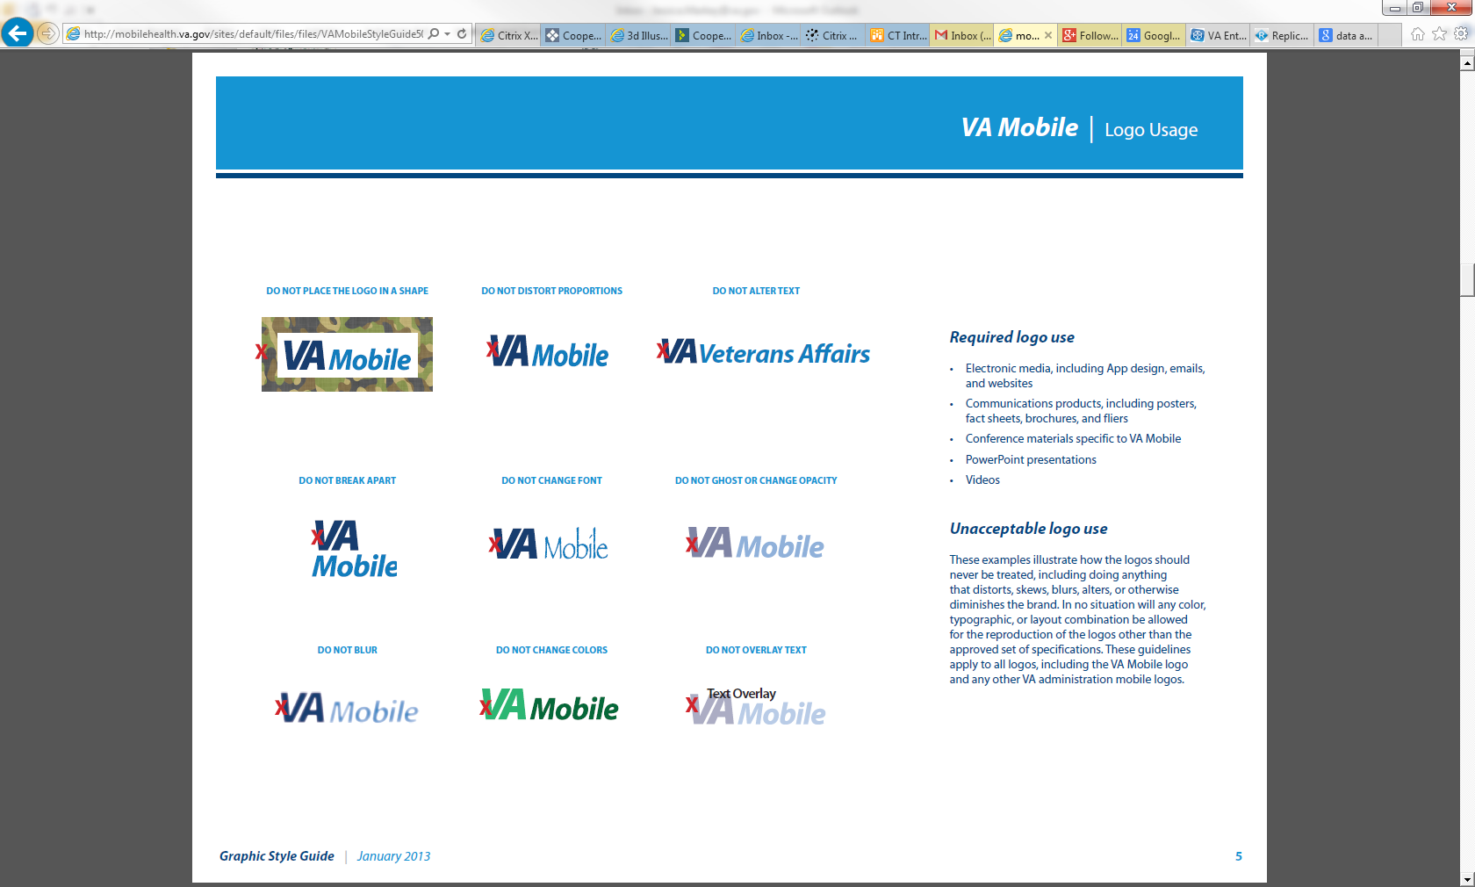
VA Branding
  Key Certifying Body
Notes:
VA Branding
Purpose
Ensures that the use of logos and trademarks associated with the Department of Veterans Affairs and VA Mobile are used consistently and appropriately within an application.
*********************************************************************
POC: Joshua Tuscher
Contact Info: Joshua.Tuscher@va.gov; 202-461-7494
When to Engage
After software design, prior to development
Documentation
https://mobilehealth.va.gov/content/va-mobile-branding-requirements-resources#overlay-context=content/va-mobile-branding-requirements-resources

Slide 65

Privacy and Application Data Security
  Key Certifying Body
Notes:
Privacy and Application Data Security
Purpose
Ensures that Personal Health Information (PHI) and Personal Identification Information (PII) are appropriately protected in the application and ensures that the data entered into the mobile device is appropriately secured.
*************************************************************
POC: Andrea Wilson and Christopher Shawn
Contact Info:
Andrea Wilson: Andrea.Wilson3@va.gov; 321-205-4305
Christopher Shawn: Christopher.Shawn2@va.gov; 518-449-0264
When to Engage
After requirements gathering, before development begins
Documentation
https://mobilehealth.va.gov/sites/default/files/files/PrivacyApplicationDataSecurityChecklist.docx

Slide 66

Data Security for GFE Devices
  Key Certifying Body
Notes:
Data Security for GFE Devices
Purpose
Ensures that the WMS apps on VA Government Furnished Equipment (GFE) and the information/data that may reside on the device are secure.
*********************************************************************
When to Engage
After development is complete
POC:DJ Kachman
Contact Info: Donald.Kachman@va.gov; 269-317-5481
Documentation
No link available

Slide 67
Poll Question
What do you think is the most difficult compliance requirement to meet when developing a Mobile App?
    Privacy and Security
    Data and Terminology
    Usability/User Interface
    Branding
    508 Accessibility
    Patient Safety
Notes:
Now I’d like to ask a poll question.
(usually presenters read the poll question and acknowledge that the possible answers are on the screen)
To answer this question, use the blue polling icon above my head. We’ll move on and come back to your results in just a moment.

Slide 68
Mobile Project Management Accountability System (PMAS)
MHED
Base PMAS Docs
Covers All Mobile Apps
& Created Once
32 Individual PMAS Documents
12 PMAS Docs
Covers each App
Notes:
Externally developed Apps are associated with the Mobile Health External App Development (MHED) Project.
In traditional PMAS Applications require their own PMAS project as you can see require 32 individual documents, with Mobile there is one overarching mobile project MHEAD, each App will be required to add to the MHED project and provide the 12 app level documents throughout the lifecycle of the project.
Each Project will be responsible for providing the development and project documents associated with their effort.
*********************************************************************

Slide 69

PMAS Documents
Business Requirements Document
Concept Paper/Scope Statement
Requirements Specification Plan
Requirements Specification Addendum
Software Design Document
Notes:
Lets quickly review some of the PMAS documents that project teams will need to complete.
Business Requirements Document – Specific requirements for a project
Concept Paper/Scope Statement – This is an Agreement on the scope of the first release or phase of the application; responsibility of Agile Team in collaboration with the business owner
Requirements Specification Plan – Overarching document that lists enterprise wide Non-functional requirements and managed centrally; teams adding or changing requirements will need to update this documentation
Requirements Specification Addendum – required for each Mobile Application; User stories and acceptance criteria will meet this requirement
Software Design Document – Overarching design documentation for VAMF managed centrally; developers adding services or changing services will need to update this documentation
*********************************************************************

Slide 70
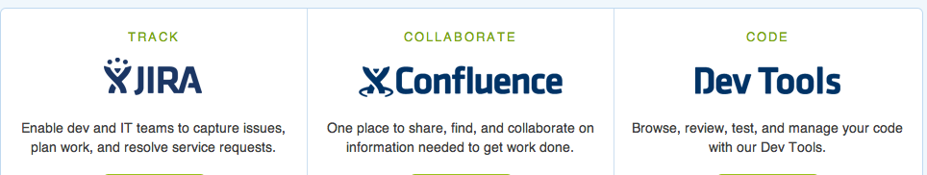
Mobile Development Tools
Notes:
Ok Lets talk a bit about the Mobile environment in the cloud, especially the tools available to assist development teams.
In the VA mobile App Environment there is a set of Mobile Development tools. These tools will assist project teams building apps using the Agile process.
JIRA is the primary project tracking tool. As you can see from the slide it has the ability to track issues, build Sprints, document User stories, and track Compliance.
It is not currently a requirement that teams use this to manage their development, however they must update project information and required documents in this system.
Confluence is the second tool we will discuss.
Confluence is a wiki tool that allows for collaboration or a project along with templates for the required documentation.
Example you can log into your project wiki and fill out the template of the BRD associated with the project.
There are also multiple developer tools provided in the mobile apps environment, for example Stash is the code repository provided to the teams to assist in keeping their source code cataloged and in sync with the rest of the developers.
*********************************************************************

Slide 71
Poll Results
What do you think is the most difficult compliance requirement to meet when developing a Mobile App?
    Privacy and Security
    Data and Terminology
    Usability/User Interface
    Branding
    508 Accessibility
    Patient Safety
Notes:
Speak to results

Slide 72
Poll Results
    Privacy and Security
    Data and Terminology
    Usability/User Interface
    Branding
    508 Accessibility
    Patient Safety
Notes:
CLICK TO NEXT SLIDE

Slide 73

OIT MHED Release Process
Notes:
VHA & OIT have partnered to create a process for externally developed apps that adhere to PMAS standards. OIT is overseeing the release process of Apps under the MHED project in conjunction with VHA and all the compliance groups that we discussed earlier.
*********************************************************************

Slide 74

Step 1: Validation and Verification (V&V)
Step 2: Final Compliance Review
Step 3: Review of Operation Readiness Report (ORR) and Initial operating Capability
Notes:
Lets look at the Release steps of a mobile development project.
Step 1: Validation and Verification
Once you development team is complete, you app has undergone Software quality analysis with your team, you have completed the approrate documentation, and you are ready to release you will submit a request form to initiate the Validation and verification review.
Once reviewed by V&V you will be provided a list of defects to be addressed, or given the green light to undergo final certification review.
Step 2: Final Compliance Review
At this time your app will undergo final compliance review from the teams you engaged with during development.
Step 3: Review of Operation Readiness ORR and IOC review
Once Signoff is complete you will have an operation readiness review. If approved you will enter IOC entry and your app will be available for field testing.
Apps should undergo field testing and track and compile results. Once these results are presented to the ORR group and your app can be published and released nationally.
*********************************************************************

Slide 75

Lessons Learned So Far
Notes:
Let’s take a minute to review some of the Mobile lessons learned so far
Building a small mobile app doesn’t necessarily mean that it’s easy. This can still entail complicated issues and problems that require architecture discussions, compliance issues, and leadership engagement.
Ensure when your building a mobile app you engage with the compliance groups and mobile staff early in development.
Apps need to have a master test plan. How are you or the project team going to validate the app will work in the systems its intended to run in. A testable version of an app will need to be provided to V&V and compliance groups in order to certify your app.
Mobile is an evolving space in the VA, project teams must remain flexible as best practices are still be defined. In addition the mobile environment itself is changing. It seems ever quarter new devices and new operating systems are released which has the potential to disrupt or break active development projects.
***************************************************************************************************

Slide 76

Ask the Presenter
Notes:
If you haven’t submitted your questions yet, there is still time to do so by clicking on the orange “Ask The Presenter” icon. We’re going to show a brief announcement and then Shawn will join me back onstage to answer your questions.
(Stand still and smile until you see the video come up full screen)

