Slide 1
Vista Pharmacy Outpatient Training Module
HANDOUTS

Slide 2
PATIENT RECORD UPDATE: How to Add to an Existing Narrative
NARRATIVE: **PT reqUestS MedS Sent to PO Box, 10-27-13,lmg** Replace
Replace lmg** With lmg **need correct AddreSS,meds rtd USPS undeliverable,PO box closed, 11-6-13,ddd**
Replace
**PT reqUestS MedS Sent to PO Box, 10-27-13,lmg; **need correct AddreSS,meds rtd USPS undeliverable,PO box closed, 11-6-13,ddd**
Notes:
NOTE: Using mixed case and special characters can make the narrative stand out more so pharmacy staff will be alerted to the important information.
1.To add to a string of an already existing narrative string.
Pick the last word or characters that you want to add to. When Vista prompts for Replace, I type lmg** and then I begin typing my new message (need correct AddreSS,meds rtd USPS undeliverable,PO box closed, 11-6-13,ddd**
Here is the completed, updated narrative.

Slide 3
PATIENT RECORD UPDATE:
Replacing an Entire Narrative
NARRATIVE: **PT reqUestS MedS Sent to PO Box, 10-27-13,lmg; **need correct AddreSS,meds rtd USPS undeliverable,PO box closed, 11-6-13,ddd** Replace
Replace … With By doing dot dot dot I can replace the whole string of text with something new! 11-8-13,lmg**
Replace
By doing dot dot dot I can replace the whole string of text with something new! 11-8-13,lmg**
Notes:
Replacing an entire narrative string. The narrative now is **PT reqUestS MedS Sent to PO Box, 10-27-13,lmg**need correct AddreSS,meds rtd USPS undeliverable,PO box closed, 11-6-13,ddd**
Vista responds with the word Replace. Type …(3 periods) enter and Vista returns the word, WITH. Then type your message (By doing dot dot dot I can replace the whole string of text with something new!11-8-13,lmg**) and vista returns with the word Replace
Hit Enter and you will view the finished narrative (By doing dot dot dot I can replace the whole string of text with something new! 11-8-13,lmg

Slide 4
PATIENT RECORD UPDATE: Deleting a Narrative
NARRATIVE: **WATCH FOR REFILLS LOCALLY** 2. Replace ... With
Replace
SURE YOU WANT TO DELETE?
Notes:
1. If you completely want to delete the entire string of text, **WATCH FOR REFILLS LOCALLY**,
2. After the Vista prompt Replace, do the dot dot dot (3 periods) after replace, and Vista replies with the word With. Type nothing and hit enter. Vista replies Replace, hit enter and then Vista replies with the question, SURE YOU WANT TO DELETE? Type Yes and the narrative is deleted.

Slide 5
SPECIAL FUNCTION KEYS
The Shift-6 (^)
// Double backslashes
The Shift-2 (@)
Space bar, return
Notes:
Special Function Keys:
Let’s talk about a few keys that will make life easier when navigating/using Vista.
-The up-carat or shift 6 will move you on the menu tree. If you find you are in a menu or at an option that you want to leave, enter an up-carat by itself and you will return to the previous menu.
-The at sign or shift 2 is used to delete data entered into a field.
-The // Two slashes simply means that the value is our system default – and it also means you can still activate the help feature by entering ?? for more guidance →
Oone more function that may be helpful is using the space bar. Vista also remembers previous entries when you only hit the Space Bar, then the return or (enter) key. For example, if you were performing a second function in the computer for a patient, when the prompt asked for the patient’s name, drug name, you would only need to do Space Bar Return and the computer would automatically fill in the patient’s name.
Shutterstock 59797750

Slide 6
SPECIAL FUNCTION KEYS: Shift-6 (^)
Return to Previous Menu
Inventory Sheet Print
Single AOU Inventory
Delete Inventory Date/Time
Input AOU Inventory
Pick List
Enter/Edit Quantity Dispensed
On-Demand Requests ...
Backorder Requests ...
Return Items for AOU
Crash Cart Menu ...
Auto Replenishment Reports
Select Production Menu Option:
Notes:
If you find you are in a menu or at an option that you want to leave, enter ^ by itself and you will return to the previous menu. Here I am in a menu option that I am not familiar with and I am totally lost.

Slide 7
SPECIAL FUNCTION KEYS: Shift-6 (^) Return to Previous Menu
Select Production Menu Option: ^
Production Menu ...
Supervisor's Menu ...
Select Automatic Replenishment Option: ^
Pharmacy Technician's Menu ...
2 IV Menu ...
3 Unit Dose Medications ...
Notes:
At the Menu Option prompt, type shift ^. It will take you back one menu screen. At that menu prompt, type shift^, and you are at a familiar menu.

Slide 8
SPECIAL FUNCTION KEYS: Shift-6 (^)
Jump to Another Menu
Select Unit Dose Medications Option: 5 PIck List Menu
ENter Units Dispensed
EXtra Units Dispensed
Pick List
RRS Report Returns
RPL Reprint Pick List
Send Pick List to ATC
Update Pick List
Select PIck List Menu Option: ^PROC
1 Process Internet Refills [PSO INTERNET REFILLS]
2 Process Telephone Refills [A3A PHONE REFILLS]
Notes:
If you know the menu option name, you can “jump” to that other menu using the shift ^ key. At a menu prompt, type shift ^ and the first few letters of the Known menu name. In our example, we are at the Select Pick List Menu Option. If we type shift ^ PROC, 2 options appear, Process Internet Refills and Process Telephone Refills. This jumping can be a timesaver.

Slide 9
SPECIAL FUNCTION KEYS: Shift-2 (@)
Deleting Data in a Field
0000 RAMSEY ST
APT 000
Anytown
NORTH CAROLINA 00001
STREET ADDRESS [LINE 1]: 0000 RAMSEY ST//
STREET ADDRESS [LINE 2]: APT 000// @
ZIP+4: 00000// 00000
0000 RAMSEY ST
Anytown
NORTH CAROLINA 00000
Notes:
In the first address example above, we want to remove the apartment number from the street address [line 2]. When we get to the Street Address [line 2], we are shown the APT 103 followed by 2 backslashes. This is the data we want to delete, so we use the @ sign to delete the information. The last example shows the address with the data removed.

Slide 10
SPECIAL FUNCTION KEYS: Double backslashes //
Select ITEM: NS500 SODIUM CHLORIDE 0.9% 500ML INJ
...OK? Yes// (Yes)
drawer 3
ON-DEMAND QUANTITY DISPENSED: 1
EXPIRATION DATE: FEB 2013//
FEB 2013//
Notes:
You may already know this but for those that don’t, two slashes simply means that the value is our system default – and it also means you can still activate the help feature by entering ?? (2 question marks) for more guidance. You can also change the default value.

Slide 11
SPECIAL FUNCTION KEYS: Double backslashes //
Select ITEM: NS500 SODIUM CHLORIDE 0.9% 500ML INJ
...OK? Yes// (Yes)
ON-DEMAND QUANTITY DISPENSED: 1
EXPIRATION DATE: FEB 2013// APR 2015
Notes:
In the above example for an on-demand request, you may have noticed that the prompts up until the date were blank fields and did not return any automatic value, such as the On-Demand quantity dispensed in the example above for the Sodium Chloride 0.9% 500ML INJ. We had to manually enter all of that information. But you noticed that the expiration date entry returned with a defaulted date of Feb 2013//. In our example, we want to change the default date so we typed in Apr 2015.

Slide 12
SPECIAL FUNCTION KEYS: Space bar, return
Select On-Demand Requests Option: enter/Edit On-Demand
AR/WS Inpatient Site Name: FAYETTEVILLE,NC
SELECT DATE/TIME FOR ON-DEMAND REQUEST: t (DEC 05, 2013)
Select AOU: 3A DEC 05, 2013@03:00
Select ITEM: lact
1 LACTULOSE 10GM/15ML ORAL SOLN GA202
2 LACTULOSE 10GRAM/15ML ORAL SOLN UD
CHOOSE 1-2: 2 LACTULOSE 10GRAM/15ML ORAL SOLN ...OK? Yes// (Yes)
ON-DEMAND QUANTITY DISPENSED: 1
Select AOU: 4A DEC 05, 2013@04:00 NHCU
Select ITEM:
Select ITEM: LACTULOSE 10GRAM/15ML ORAL SOLN UD ...OK? Yes//
Do the space bar then return to bring up the same item
Notes:
I am going to mention one more function that may be helpful using the space bar. Vista also remembers previous entries when you only hit the Space Bar, then the return or (enter) key. For example, if you were performing a second function in the computer for a patient, when the prompt asked for the patient’s name, you would only need to do Space Bar Return and the computer would automatically fill in the patient’s name. In the above example, we are in the On-Demand Requests Option: Enter/Edit On-Demand. On AOU Ward 3A, the last item we entered was Lactulose 10gram/15ml oral soln ud. When I go to my next AOU, 4A, the next item I need to type is the same, so I can use the space bar, and then hit return and Vista remembers my last entry and it populates the field with the Lactulose 10gram/15ml oral soln ud.

Slide 13

Select Pharmacy Technician's Menu Option:
1 Outpatient Pharmacy Menu ...
2 IV Menu ...
3 Unit Dose Medications ...
4 Technician (CS Pharmacy) Menu ...
5 Barcode Rx Menu ...
6 Suspense Functions ...
7 Inpatient Roster
8 Automatic Replenishment ...
9 Label/Profile Monitor Reprint
10 Special Label Printer
11 Drug View
12 Process Telephone Refills
13 Medication Administration Menu Pharmacy ...
14 Print a PMI Sheet
15 Copay Menu ...
Notes:
The Label/Profile Monitor Reprint option can be used when a large number of prescriptions need to be reprinted. An example of this would be if you were printing local mail and your toner ran out and half of the prescriptions were unreadable, or if a printer suddenly broke and there were many prescriptions that had been queued to the printer.

Slide 14
Select Pharmacy Technician's Menu Option: Label/Profile Monitor Reprint
Division: FAYETTEVILLE NC VAMC 565
You are logged on under the FAYETTEVILLE NC VAMC division.
Select LABEL PRINTER: HOME// HOME(CRT) Right Margin: 80//
OK to assume label alignment is correct? YES//
Notes:
You will go through a series of default prompts, your division, label printer, and alignment message.

Slide 15
Select Pharmacy Technician's Menu Option: Label/Profile Monitor Reprint
ENTER FAILED OUTPUT DEVICE NUMBER OR NAME:
Do you want to resend to Dispensing System Device? No// NO
Reprint the FDA Medication Guide? No// NO
Notes:
Then Vista will prompt you with a series of questions. Answer the prompts as you are instructed. Enter the failed output device number or name (the printer that is not working).

Slide 16
Select Pharmacy Technician's Menu Option: Label/Profile Monitor Reprint
ENTER NEXT USABLE LABEL/PROFILE ('RETURN' FOR REMAINDER OF THE QUEUE):
FILPHARM RM 0077-1 PHARMACY
ENTER LAST USABLE LABEL/PROFILE: 5761747
Notes:
Vista answers with detailed info about printer: filphARM RM 0077-1 PHARMACY Then you must have the number or profile of the last usable label. In our example we entered the prescription number 5761747 as the last readable/usable label. Then you will enter the next usable label/profile if that is available. If the next usable label is not available, hit return for the remainder of the lost queue.

Slide 17
Select Pharmacy Technician's Menu Option: Label/Profile Monitor Reprint
PRINT ON DEVICE: FILPHARM//
aaa123 RM 0077-1 PHARMACY (AAA123)
OK to assume label alignment is correct? YES//
Notes:
Then you can select the same printer, if the problem is corrected, or enter a new printer as in our example. Enter through the alignment prompt, and Vista responds that your Task Queued #4700219 !! On the reprinted labels, you will see that they say “GROUP REPRINT.”

Slide 18
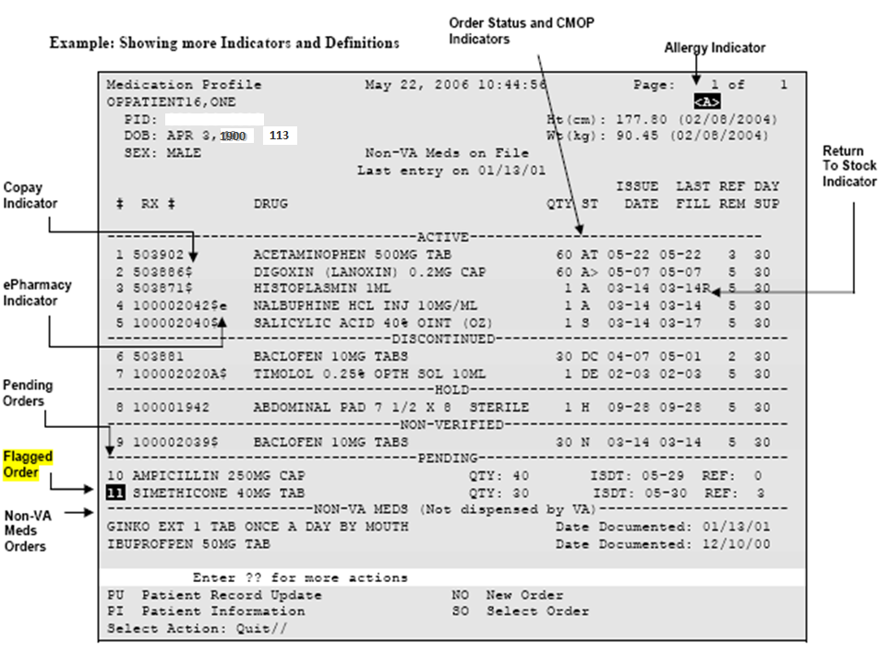
Outpatient List Manager
Medication Profile
Notes:
18
Print this slide as a handy reference. After the patient information screen, you come to the patient’s medication profile. Let’s start at the top with the order status and CMOP (or consolidated mail out pharmacy) indicators. The order status can be A for active; S for suspended; E for expired; DC or DE for discontinued; H for hold; N for non-verified. When a drug is marked for CMOP it will either have a greater than sign after the status (as it does on the status for digoxin in this example), or it will have a letter T displayed when the prescription is in a transmitted state to CMOP. (You will see an example of that after the status of acetaminophen.) The return to stock indicator (which will be a capital R) will be displayed to the right of the last fill date of a prescription if it has been returned to stock in vista. A dollar sign next to the prescription number indicates the prescription is copay eligible. A lowercase E displayed to the right of the prescription number indicates that the prescription is electronic third party billable. Pending orders are those that have been entered by a provider but not yet processed by the outpatient pharmacy. A flagged order (which has a dark box around the number) is a prescription that can’t be finished for one reason or another without clarification from the provider. Flagging an order sends the provider a notice with a message as to why we need more information. An example of that might be a prn order without an indication. Finally, there are the non-va meds. This is where any prescription, otc or herbal medication, purchased by the patient at an outside pharmacy are listed.

