Slide 1
and the Impact on Clinical Workflow
ICD-10
Doug McKee, MD Shelley Weems, MS, RHIA, CCS
Notes:
(S) Thank you! We are happy to be here today to talk about ICD-10 and the Clinical Workflow.
I’m Shelley Weems, lead for the VA’s National ICD-10 project.
(D) And I’m Dr. Doug McKee, primary care doctor and informaticist at the Viera VA OPC in Viera Florida.

Slide 2
Objectives
Notes:
(S) The objectives of the session today are familiarity and better understanding with the
Major differences between ICD9 and ICD10
CPRS problem list and encounter completion with ICD10
Documentation specifics and why they are important
Search functionality in a little more detail
Ways to prepare for ICD10 in order to minimize impact on change

Slide 3
69,101
14,025
ICD-9
ICD-10
Diagnosis Codes
Notes:
(D) So first, I am sure this is a review for most of you, but no talk about ICD10 is complete without discussing the number of codes. The number of diagnosis codes in ICD9 to ICD10 will increase from 14,025 to 69,101. While this number is more than a little daunting, it is always good to keep in mind that you will never touch many of those 69,000 codes in your day-to-day routine.

Slide 4
71,957
3,824
ICD-9
ICD-10
Procedure Codes
Notes:
(S) The ICD 9 procedure codes will see a major overhaul as well. While the code increase of approximately 4000 to over 70,000 is an enormous change, this piece of the ICD10 pie will only be used by the coders. So, we can say that these changes do not impact the providers except for the fact that there are some terminology changes.
(D) So, let’s talk about structure of ICD10 next. First, let me show you an example of a REAL ICD10 code next: X90.27XA.

Slide 5
X90.27XA
Drowning and submersion due to falling and jumping from burning water skis
Notes:
(D) Sounds very foreign with all of the letters and numbers mixed together, doesn’t it? However, this is a real ICD10 code. This is the code for drowning and submersion due to falling and jumping from burning water skis.
And yes, this is a real code, one of my personal favorites.

Slide 6
7th digit = visit encounter or sequelae for injuries...
Format Differences
Notes:
(S) This leads perfectly, though, to examining the format changes in ICD10.
An ICD10 code will require at least 3 digits, but can consist of up to seven digits, with the 7th digit extension representing visit encounter or sequelae for injuries and external causes.
The first 3 possible places in the code represent the general category, while the next three represent the etiology, anatomic site, and severity.
(D) Certainly, many codes do not use every possible position in the code structure. A prime example is also one ICD10 code that I already have memorized: I10. Ironically, this is the code for HTN, something that is a sequalae of ICD10 for many people.
So let’s next look at another real example of an ICD10 code that DOES use all 7 places.

Slide 7
Example: Laceration with foreign body of abdominal wall, right lower quadrant with penetration into peritoneal cavity, initial encounter
Notes:
(S) This is S31.623A = LACERATION WITH FOREIGN BODY OF ABDOMINAL WALL, RIGHT LOWER QUADRANT WITH PENETRATION INTO PERITONEAL CAVITY, INITIAL ENCOUNTER. (As opposed to the less-specific ICD9 code for: laceration, trunk). As you can see, ICD10 allows for much more specific coding.
One question that does come up often is what the “initial encounter” refers to. This refers to the initial encounter with this patient for this problem. The follow-up visit for this problem would change to “subsequent encounter”.
This is as opposed to a subsequent repeat laceration with foreign body of the abdominal wall etc . . .
I will discuss documentation specifics with ICD10 later in the talk. But for now, let’s discuss the main focus of our talk: clinical workflow changes with the problem list and encounter forms completion in CPRS.

Slide 8
Problem List
Encounter Form
Notes:
Probably the most important thing to know about workflow changes for the clinician with ICD10 is how the way we work with the problem list will change.
Now, I believe for most providers, the main way we manage the problem list is through the encounter form. Obviously, I still go to the problem list tab at times to update things and clean the list up, but I mainly add to the problem list now from the encounter form as I am completing a visit.

Slide 9
Old Workflow
Open encounter form
Choose problem from the problem list
SNOMED & ICD9
Finish encounter
ICD9
Search for a new problem
ICD9
Add to the problem list
SNOMED & ICD9
Notes:
(D) The current workflow generally flows like this:
Open the encounter form
Choose current problems from the carried over problem list in the encounter form and/or
Search for a new problem/choose a new problem from a national encounter form
Click the “add to problem list” button to add the coded ICD9 problem to the list
Finish the encounter

Slide 10
New Workflow
?
Notes:
(D) To show you the new workflow, I need to explain first the “WHY” behind this.

Slide 11
“Meaningful Use 2”
MANDATORY
Notes:
(D) Those of you who have had any recent experience in the private sector probably have heard of Meaningful Use. The current phase, Meaningful Use 2, is now mandatory. In fact, many providers are now having their Medicare reimbursement penalized for not meeting Meaningful Use 2 criteria. Part of the many requirements in MU2 is that clinical concepts are reported with SNOMED terminology.

Slide 12
SNOMED
SNOMED
Notes:
(D) Those of you already using version 29 or 30 of CPRS should already be familiar with SNOMED to a point at least. SNOMED is generally a little friendlier to clinicians and can produce a lot of linked synonyms to make our problem lists more clinically meaningful. The other good thing about SNOMED is that there is a direct translation from SNOMED to ICD9 billing codes and vice versa.
Currently, my bet is that most of you still have problems lists populated mostly with ICD9 codes and not SNOMED terms. However, when you have tried to add a new problem to the problem list via the problem list tab, you will have noticed that you can ONLY search SNOMED now through that tab. When you go to the encounter form, though, you can click the SNOMED code in the problem list and it will code an ICD9 code as HIPAA requires, all in the background, without requiring you to do anything different.

Slide 13
SNOMED-CT
ICD-9
SNOMED
SNOMED
Notes:
(D) Again, though, it is important to point out that SNOMED and ICD9 have a translation that can be done automatically through the computer which is why choosing an ICD9 code in the encounter form is still possible.

Slide 14
ICD-10 codes are required for encounter diagnoses
?
Notes:
(D) OK, back to the why of our new workflow.
With ICD10 required by HIPAA as of 10/1/2015, an ICD10 code is REQUIRED for encounter diagnosis and reason for visit. The ICD9 and ICD10 data required by HIPAA is utilized by all healthcare organizations and the World Health Organization. This data is used for many purpose: research, analytics, performance improvements, revenue, just to name a few.

Slide 15
Meaningful Use 2 requires SNOMED
AND
…
ICD-10
Oct. 1, 2015
Notes:
(S) This is really the crux of the matter, then:
Meaningful Use 2 requires SNOMED codes
HIPAA will require all encounter diagnosis ICD-10 codes starting 10/1/2015
And . . . .

Slide 16
SNOMED-CT
ICD-10
… yet there is no direct translation -
Notes:
(S) There is no direct translation between SNOMED and ICD-10.
(D) This may not seem like a big deal at first, but through our talk, you will see its implications.

Slide 17
Encounter form problem List
Notes:
(D) The first thing to know is that all of the problems on the problem list will remain there on and after 10/1/2015. However, any that are ICD9 will have the pound/hashtag symbol in the encounter form indicating that they are out of date and cannot be used for billing.
Within the problem list tab itself, you will not see a pound symbol before these inactivated codes in version 30, but in the details there will be a message that these are inactive codes. This is as of version 30.12 anyway.
However, again, please remember: all ICD9 codes will become inactive as of 10/1/2015.

Slide 18
Problem List Tab
Notes:
(D) Here is what I meant by the pound sign in the problem list tab. This screenshot is an ICD9 problem list as of 10/1/2015. Note, the pound sign is missing here (although it will be present in the encounter form).

Slide 19
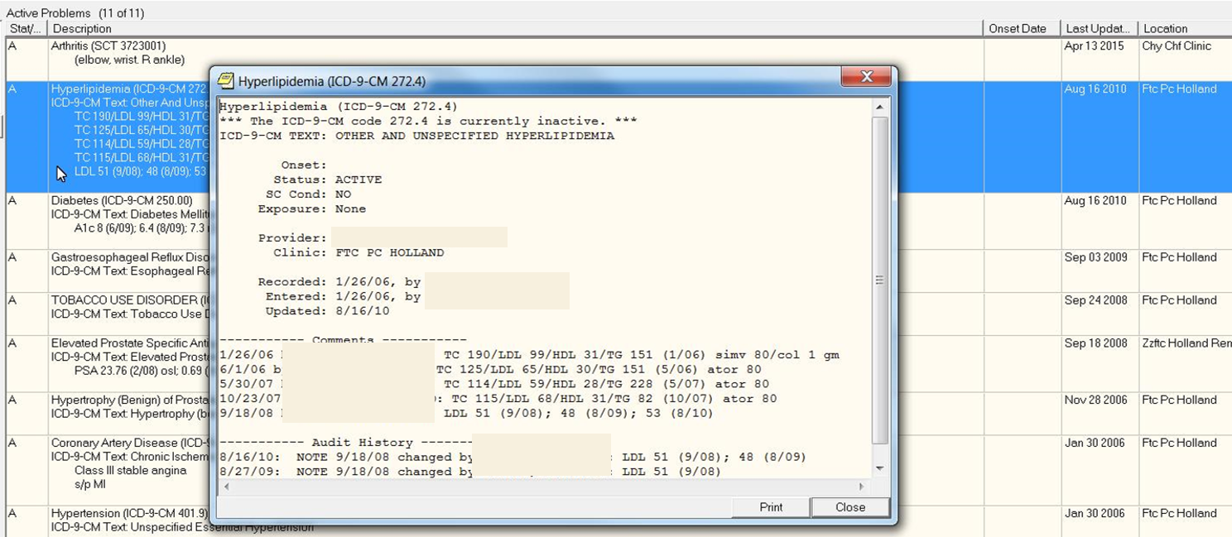
Problem Detailed View
Notes:
(S) And this is the example of the detail view of the ICD9 problem in that list as of 10/1/2015. Note the indication that this is an inactive code associated with the problem at the top

Slide 20
POLL QUESTION
What happens to problems in the problem list coded with ICD-9 codes as of 10/1/2015?
They disappear from the problem list
They are automatically converted to SNOMED codes
They are automatically converted to ICD-10 codes
They remain on the list but are no longer valid and cannot be used for encounter completion
Notes:
(S) Ok, Dr. McKee, I think it is time to pause for a second to let some of this sink in. Let’s have our first poll of the talk!
(D) Our first question is this: What happens to problems in the problem list coded with ICD9 codes as of 10/1/2015?
A. They disappear from the problem list
B. They are automatically converted to SNOMED codes
C. They are automatically converted to ICD10 codes
D. They remain on the list but are no longer valid and cannot be used for encounter completion
(S) To answer this poll question, click on the blue polling icon above our heads and submit your answer. We’ll move on and look at your results in just a moment.
(D) This is starting to get a little stressful. Let’s have a brief I10-lowering break (remember, I10 is the ICD10 code for HTN):

Slide 21
Notes:
(D) These are my 2 puppies, Hank and Ollie on the day we brought them home 10 months ago. I don’t care who you are, this just makes you say “Ahhhhh”!
Why don’t we think of a couple of ICD10 diagnoses to go along with this picture?
(S) How about “L23.81, allergic contact dermatitis due to animal dander”?
(D) Nice! I was thinking more “R40.0, Somnolence” for Hank and “Z73.811, Behavioral insomnia of childhood” for Ollie.

Slide 22
Notes:
And one more: “T43.616A”.
What is that code?
(D) Something I tend to encounter frequently: “underdosing of caffeine, initial encounter”.

Slide 23
S C E N A R I O S Search New Problem: Other Diagnosis Button Choose New Problem in Encounter Form Choose ICD-9 Code from the problem list in the Encounter Form Choose SNOMED Term from the problem list in Encounter Form Choose New Problem from Encounter Form after adding to Problem List
Notes:
(D) OK, we have many different scenarios to examine with how we can interact with the problem list in ICD10 in the encounter form and the problem list tab itself. We will cover each one. They are:
1. Searching a new problem from the “other problem” button in the encounter form with the option of adding it to the problem list or not.
2. Choosing a new problem in the encounter form through a collection of ICD10 terms, such as the primary care encounter form.
3. Choosing an ICD9 code from the problem list in the encounter form.
4. Choosing a SNOMED code from the problem list in the encounter form.
5. Adding a new problem to the problem list from the problem list tab THEN choosing it from the problem list in the encounter form.

Slide 24
POLL RESULTS
What happens to problems in the problem list coded with ICD-9 codes as of 10/1/2015?
They disappear from the problem list
They are automatically converted to SNOMED codes
They are automatically converted to ICD-10 codes
They remain on the list but are no longer valid and cannot be used for encounter completion
Notes:
(S) OK, the results are in.
Looks like most of you got the correct answer, D. It is important to know what is going to happen to the problem list on 10/1/2015 as we discussed.
Dr. McKee, now that everyone’s blood pressure is lowered, let’s take it back up with looking at encounter form completion.

Slide 25
POLL RESULTS
What happens to problems in the problem list coded with ICD-9 codes as of 10/1/2015?
They disappear from the problem list
They are automatically converted to SNOMED codes
They are automatically converted to ICD-10 codes
They remain on the list but are no longer valid and cannot be used for encounter completion
Notes:
CLICK THROUGH HERE NO PAUSING

Slide 26
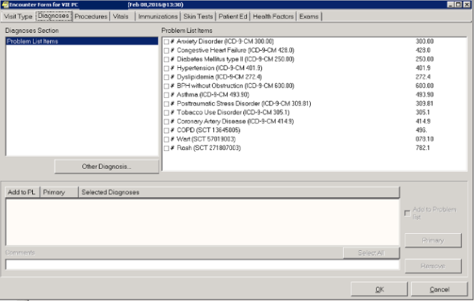
Search New Problem Using Other Diagnosis Button
SCENARIO #1:
ICD-9 & SNOMED
Notes:
(D) OK, so let’s look at all of these different scenarios for finishing the encounter form after 10/1/2015, one by one.
First, you will have your problem list showing up in the “problem list items” tab of the encounter form. This will include #ICD9 codes and SNOMED codes.
Let’s say at this juncture, our problem is a new one.
For this example, let’s hit the “other diagnosis” button and search for the code for the new problem.

Slide 27
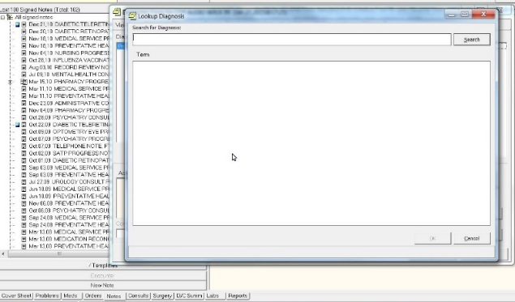
Search New Problem Using Other Diagnosis Button
SCENARIO #1:
Search Box #1: ICD-10
Notes:
(D) The search box will appear as illustrated. This search will be for an ICD10 code, because at this point, we are searching for a billing code. Type in your search term and you will get a result like so:

Slide 28
Search New Problem Using Other Diagnosis Button
SCENARIO #1:
Choose Correct ICD-10
Notes:
(D) You will then choose the appropriate ICD10 code (if you get lucky).
Now is the big decision: do you want to add this to the problem list?

Slide 29
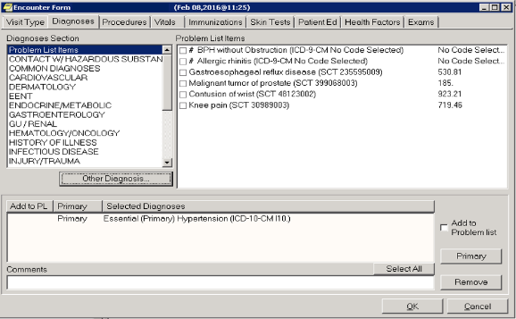
Search New Problem Using Other Diagnosis Button
SCENARIO #1:
Select
checkbox
Notes:
(D) As discussed earlier, I think most providers currently use this little checkbox as the main way of adding problems to the problem list.

Slide 30
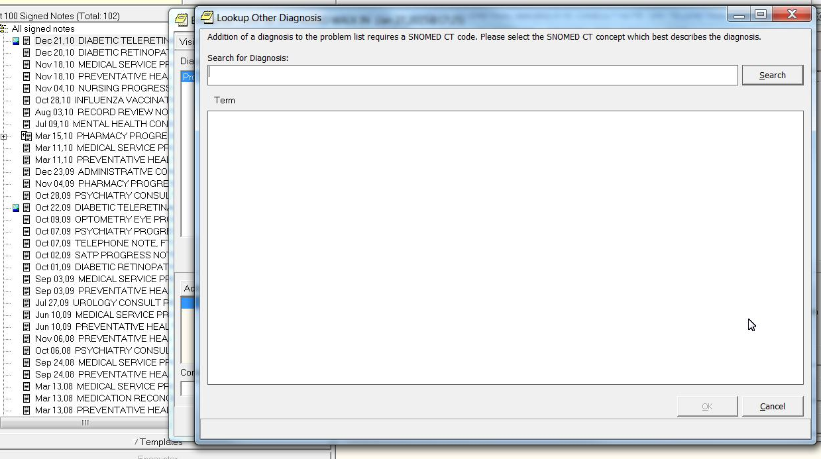
Search New Problem Using Other Diagnosis Button
SCENARIO #1:
Add to Problem List
Search Box #2: SNOMED
Notes:
(D) Clicking the “add to problem list” button will bring up a second searchbox, which is a searchbox for a SNOMED code. Now, the question you might have right now is “Why doesn’t it just add the ICD10 code to the problem list?”
The answer goes back to our earlier discussion: ICD10 and SNOMED don’t mix! We need SNOMED codes in the problem list, but ICD10 codes in the encounter form. So, we can NEVER add an ICD10 code to the problem list by itself, including from the problem list tab in CPRS.
Therefore, when you want to add an ICD10 code to the problem list from the encounter form, you are really just adding a SNOMED code. At this point in time as well, the search box will come up empty and you will have to retype the search. There is a reason for this as well. Because of big search lexicon differences, we found in testing that most of the time, carrying over the search term from ICD10 to a SNOMED search resulted in no results. This led to having to erase the carried over search term 90% of the time. The user functionality testers recommended just leaving it blank then because of that. I tell you this because you are going to ask why this isn’t carried over when you start using this, but I guarantee you, it is for a very good reason and will save you time NOT to have that filled in.

Slide 31
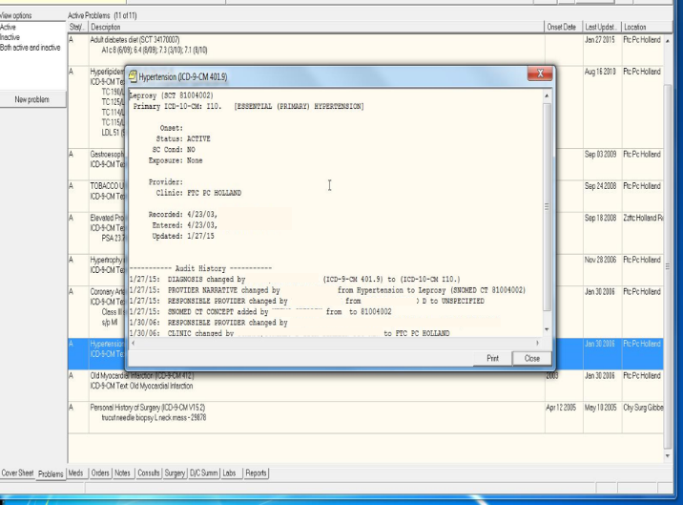
Search New Problem Using Other Diagnosis Button
SCENARIO #1:
Be careful when linking ICD-10 & SNOMED!
Notes:
(D) So, now once you choose your SNOMED term, it will now link to the ICD10 code you just added. Essentially, you will have an ICD10 code in the problem list then, but it will only show up in the detail view from within the problem list. One issue with this, though, is that there is no verification that the codes you have just linked are truly equivalent codes.
For example, you can link the ICD10 code for HTN (I10) to the SNOMED term for leprosy. From then on, unless you notice the linkage isn’t correct yourself, these 2 terms are forever linked. SO, you will have to be very careful when linking an ICD10 code and a SNOMED code.
At any rate, that covers just one scenario with interacting with the encounter form and the problem list. If you remember, this was an example of searching for a new diagnosis from within the encounter form and adding it to the problem list.
Within this example, you could just stop at choosing the ICD10 code as well if you didn’t want to add it to the problem list.

Slide 32
S C E N A R I O S Search New Problem: Other Diagnosis Button Choose New Problem in Encounter Form Choose ICD-9 Code from Encounter Form Choose SNOMED Term from Encounter Form Choose New Problem from Encounter Form after adding to Problem List
Notes:
(D) At any rate, that covers just one scenario with interacting with the encounter form and the problem list. If you remember, this was an example of searching for a new diagnosis from within the encounter form and adding it to the problem list.
Within that example, you could just stop at choosing the ICD10 code as well if you didn’t want to add it to the problem list.
(S) Our next scenario is choosing an ICD10 code from an encounter form pick list, such as the primary care encounter form. Now, a lot of work went into creating these encounter forms, and in fact, Dr. McKee was part of the national primary care encounter form workgroup. The problem with any of the encounter forms is that you are trying to narrow these down from large amounts to manageable choices, but you are still left with many. For example, there are 13,000 codes for fractures . . .how do you narrow that down?

Slide 33
Choose New Problem from an Encounter Form
SCENARIO #2:
Choose Correct
ICD-10
Add to Problem List
Search Box #2: SNOMED
Similar process, more choices
Notes:
(D) So, choosing an ICD10 code from the encounter form pick lists is no different than choosing it from the encounter form lists now except that there will be many more choices. You will find your ICD10 code and check the box, which will add it to the coding box of the encounter. You can stop there OR you can click the “add to problem list” tab, which will again bring up a blank search box for you to search for a SNOMED term.
Remember, doing this will LINK the chosen ICD10 code with the SNOMED term that you choose.

Slide 34
POLL QUESTION
When you choose an ICD10 problem from the primary care encounter form then add it to the problem list, how will the problem appear in the problem list tab?
SNOMED TERM
ICD10 term
ICD9 term
Nothing will transfer to the problem list
Notes:
(S) So let’s see if any of this is making sense. With this last scenario, where you chose an ICD10 problem from the primary care encounter form then added it to the problem list, how will the problem appear in the problem list tab? Is the answer:
SNOMED TERM
ICD10 term
ICD9 term
Nothing will transfer to the problem list
Again, to answer this poll question, click on the blue polling icon above our heads and submit your answer. We’ll move on and look at your results in just a moment.

Slide 35
S C E N A R I O S Search New Problem: Other Diagnosis Button Choose New Problem in Encounter Form Choose ICD-9 Code from Encounter Form Choose SNOMED Term from Encounter Form Choose New Problem from Encounter Form after adding to Problem List
Notes:
(S) Alright, let’s look at the next scenario

Slide 36
Choose ICD-9 problem from encounter form problem list
SCENARIO #3:
Invalid ICD-9 Codes
Notes:
(D) Alright, our next scenario will emulate 10/1/2015: you finish an encounter, go to the encounter form and see this: a problem list of almost all # symbols! These are ICD9 codes or SNOMED terms linked to ICD9 codes, none of which are valid anymore. So, let’s choose an ICD9 code and see what happens:

Slide 37
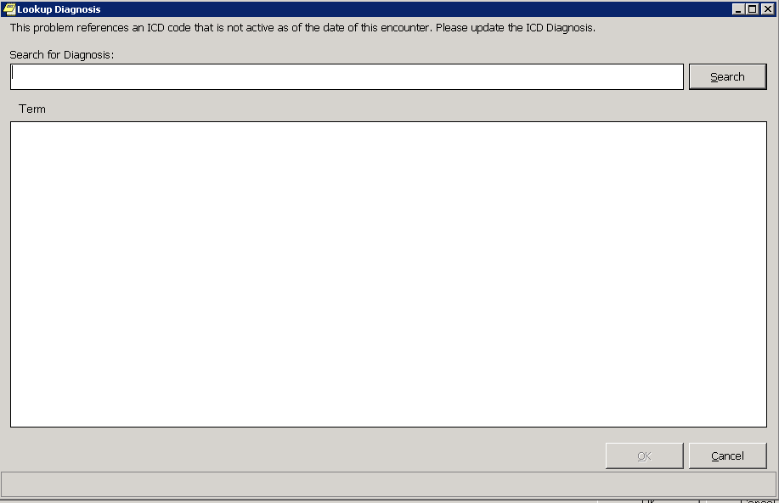
Choose ICD-9 Code from encounter form problem list
SCENARIO #3:
Select ICD-9 Code
Empty Search Box (ESB)
Notes:
(D) That’s right! Our good friend, the empty search box comes up again. We are going to be seeing this so often, I think we will give it a name . . .what do you think we should call it, Shelley?
Since we are part of the government and the government loves its abbreviations, let’s call it the ESB, for empty search box.
(D) I love it! OK, the empty search box will now be referred to as the ESB in the slides to come. So for me, I would be looking at an ESB in CPRS at an OPC in the VA . . . .love those abbreviations!
(S) So, back to the scenario. The ESB comes up and you will type in your search term. In this example, we will choose wrist contusion. The result that the ESB gives us is the ICD10 code for wrist contusion.

Slide 38
Choose ICD-9 Code from encounter form problem list
SCENARIO #3:
ICD-10 = Increased Specificity
Notes:
(S) Note that you have to choose which wrist for the ICD10 code. Again, this shows the degree of specificity required for ICD10 coding.

Slide 39
Choose ICD-9 Code from encounter form problem list
SCENARIO #3:
Select ICD-10
Empty Search Box (ESB)
Notes:
(D) Exactly. Ok, so after you choose the ICD10 code, just like a bad penny, the ESB turns up again, and this time, when you type wrist contusion, here’s what you get:

Slide 40
Choose ICD-9 Code from encounter form problem list
SCENARIO #3:
SNOMED Linked to ICD-10
Empty Search Box (ESB)
Notes:
(D) A search result for SNOMED terminology. Note that with SNOMED, you can’t code for laterality.
Now, with this result, you have just linked your SNOMED term to your ICD10 term. This will now be a part of the problem list since you chose the problem from the problem list to begin with.
So, to recap, in this scenario you choose an invalid ICD9 code from the problem list, converted it to ICD10, then linked that ICD10 code to a SNOMED term which is now the new term in the problem list.

Slide 41
POLL RESULTS
When you choose an ICD10 problem from the primary care encounter form then add it to the problem list, how will the problem appear in the problem list tab?
SNOMED TERM
ICD10 term
ICD9 term
Nothing will transfer to the problem list
Notes:
S) So let’s go back to the poll results. . . . .
Great! It looks like most of you got the correct answer.
This is all very confusing, but I can see that this is starting to make a little sense for some of you anyway!
Let’s take this one step further with another question:
(Next poll question)

Slide 42
POLL RESULTS
When you choose an ICD10 problem from the primary care encounter form then add it to the problem list, how will the problem appear in the problem list tab?
SNOMED TERM
ICD10 term
ICD9 term
Nothing will transfer to the problem list
Notes:
CLICK THROUGH HERE

Slide 43
POLL QUESTION
What will you see when you pull up the “details” view of the SNOMED code you just added to the problem list tab from the encounter form?
Only a SNOMED term
SNOMED term with the linked ICD10 code in the detail
SNOMED term with a linked ICD9 code in the detail
Empty search box
Notes:
(S) For our previous poll question, the correct answer was a SNOMED term would show up in the problem list tab.
(D) The next poll question is this:
What will you see when you pull up the “details” view of the SNOMED code you just added to the problem list tab from the encounter form?
Only a SNOMED term
SNOMED term with the linked ICD10 code in the detail
SNOMED term with a linked ICD9 code in the detail
Empty search box
Once again, select the blue polling icon above our heads to submit your answer. We’ll take a look at how you responded in just a minute

Slide 44
S C E N A R I O S Search New Problem: Other Diagnosis Button Choose New Problem in Encounter Form Choose ICD-9 Code from Encounter Form Choose SNOMED Term from Encounter Form Choose New Problem from Encounter Form after adding to Problem List
Notes:
(S) Wow, that’s a tougher one! I hope we see a lot of correct answers with this!
Ok, moving on, let’s look at another scenario. We are still within the encounter form and we chose a SNOMED term from the problem list.

Slide 45
Choose SNOMED Term from encounter form problem list
SCENARIO #4:
SNOMED Term linked to ICD-9
Notes:
(S) Remember, the SNOMED term is linked in the background to an ICD9 code, and ICD9 codes are no longer valid as of 10/1/2015.
So, what pops up when we choose this? What do you think Dr. McKee?
(D) I think the ESB is coming back.

Slide 46
Choose SNOMED Term from encounter form problem list
SCENARIO #4:
Empty Search Box (ESB)
Type SNOMED Term
ICD-10 Code
SNOMED + ICD-10 = Problem List
Notes:
(S) Yep, you got it! The ESB is back!
(D) That’s right, so you will type in the problem list/SNOMED term and this time will get an ICD10 code. Again, this will link the ICD10 code to the SNOMED term and will automatically add it to the problem list since it was in the problem list to begin with, just linked to an invalid ICD9 code.
So to recap, in this example, we choose a SNOMED term from the problem list, linked it to an ICD10 code, and it automatically added this linked SNOMED/ICD10 combination to the problem list.

Slide 47
S C E N A R I O S Search New Problem: Other Diagnosis Button Choose New Problem in Encounter Form Choose ICD-9 Code from Encounter Form Choose SNOMED Term from Encounter Form Choose New Problem from Encounter Form after adding to Problem List
Notes:
So, that pretty much covers the encounter form and all of the possible scenarios. While most of us tend to use this to add problems to the problem list while coding the encounter, you can see this will now be much more complicated.
Now I am picturing much of the audience looking at the screen with kind of lost looks like these guys. We’re not done yet, though.
Let’s switch gears and venture back to the problem list. Our next scenario will be adding a problem to the problem list from the problem list tab.

Slide 48
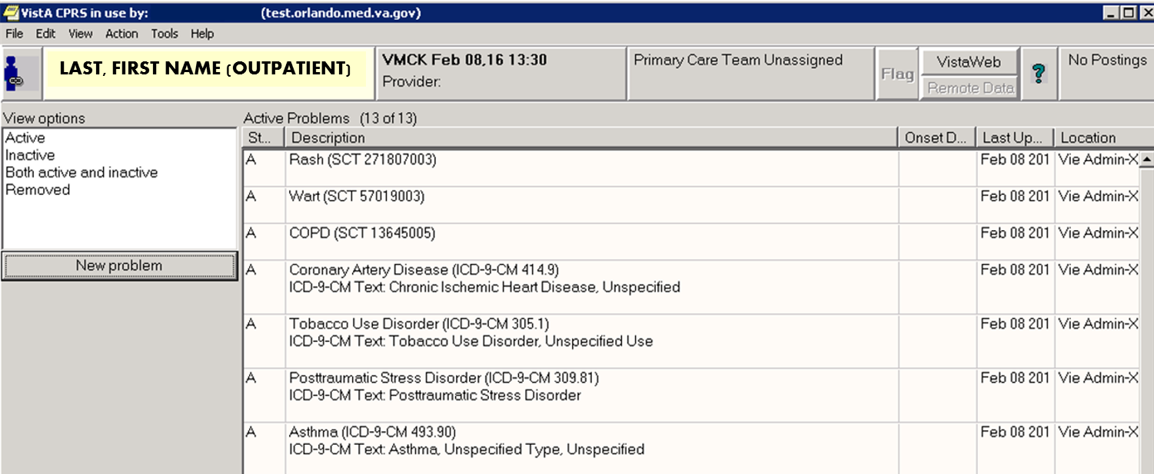
SCENARIO #5:
Choose New Problem from Encounter Form after adding to Problem List Tab
Notes:
(D) Here is the tab you are all far too familiar with. You should already be comfortable with adding a SNOMED code to the problem list since you have been doing that in version 29 and up for over a year now.
With version 30 and ICD10 active, this workflow does not change . . .in the foreground anyway. There is a subtle difference in the background, however.

Slide 49
SCENARIO #5:
Choose New Problem from Encounter Form after adding to Problem List tab
Empty Search Box (ESB)
Notes:
(D) Let’s look at adding the code for leprosy to the problem list from the problem list tab. Interesting factoid: there have been multiple cases of leprosy in Florida over the last couple of years, mostly in gardeners. You can use that for your next board exam.
OK, so when you hit the new problem button, what is going to happen?? That’s right, the ESB is back!

Slide 50
SCENARIO #5:
Choose New Problem from Encounter Form after adding to Problem List tab
SNOMED Term
Notes:
(D) This time, you will get a SNOMED term when you type in your search. It will populate the problem list like so . . . .

Slide 51
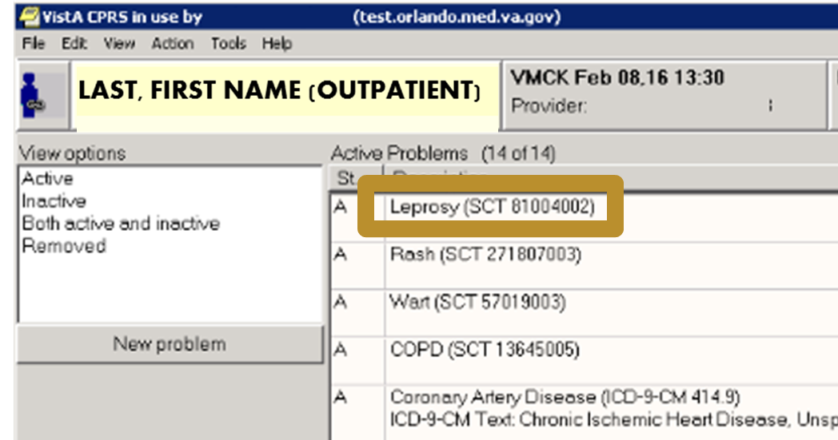
SCENARIO #5:
Choose New Problem from Encounter Form after adding to Problem List tab
Leprosy (SCT 81004002)
Notes:
(D) This is the SNOMED term for leprosy. Looks the same as with ICD9, right? Let’s look a little closer though . . . .

Slide 52
SCENARIO #5:
Choose New Problem from Encounter Form after adding to Problem List tab
Leprosy (SCT 81004002) Primary ICD-10-CM: R69 (Illness unspecified)
Notes:
(D) When you hit the details view, here is what you will see: the SNOMED term and number and an ICD10 term! So, you finally were able to add an ICD10 problem to the problem list, right?
(S) Yes and no!
This ICD10 code, R69, is the equivalent to the ICD9 code 799.9, both of which are essentially placeholders. R69 is not a code that you will be able to select for billing, just like a 799.9 problem was never selectable in the encounter form.
This goes back to some programming details in CPRS, which basically create a requirement that an ICD code must be linked to any problem in the problem list, even if it is just a placeholder.
OK, all this being said, let’s go back to our poll for a moment:

Slide 53
POLL RESULTS
What will you see when you pull up the “details” view of the SNOMED code you added to the problem list tab from the encounter form?
Only a SNOMED term
SNOMED term with the linked ICD10 code in the detail
SNOMED term with a linked ICD9 code in the detail
Empty search box
Notes:
(S) Let’s see what you chose:
The correct answer was B.
In this case, you linked a searched for ICD10 code to a SNOMED term, and the details view will show that background linkage

Slide 54
POLL RESULTS
What will you see when you pull up the “details” view of the SNOMED code you added to the problem list tab from the encounter form?
Only a SNOMED term
SNOMED term with the linked ICD10 code in the detail
SNOMED term with a linked ICD9 code in the detail
Empty search box
Notes:
CLICK THROUGH HERE

Slide 55
SCENARIO #5:
Choose New Problem from Encounter Form after adding to Problem List tab
Primary ICD-10-CM: R69 = Placeholder code
Notes:
(D) OK, going back to our most recent scenario in the problem list tab, we will have the R69 placeholder code rather than the correct ICD10 code because:
There is no translation between SNOMED and ICD10, even though it existed for SNOMED and ICD9 and happened automatically in the background
An ICD code is REQUIRED by CPRS to add a problem to the problem list, even when adding SNOMED terms
So let’s take this problem list tab scenario one step further: let’s code the visit with the problem list you just created.

Slide 56
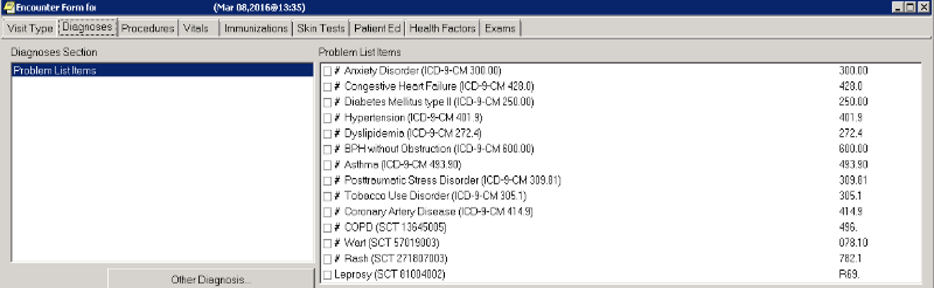
SCENARIO #5:
Choose New Problem from Encounter Form after adding to Problem List tab
Leprosy (SCT 81004002)
Notes:
(D) Here is the encounter form with the SNOMED term we added from the problem list tab.
Can you tell me what is going to happen when we choose the SNOMED term from the encounter form, keeping in mind that there is now an ICD10 code associated with it? I’ll tell you, this is almost a trick question. What do you think Shelley?
(S) The ESB is back?

Slide 57
SCENARIO #5:
Choose New Problem from Encounter Form after adding to Problem List tab
Selecting valid ICD-10 code will link to SNOMED term and get rid of R69
Empty Search Box (ESB)
Notes:
(D) That is correct!
OK, this gets down to the details. Remember, the R69 code that will be linked to EVERY problem you add from the problem list tab is purely a placeholder and is not a code you can use in billing. So, choosing this SNOMED term from the problem list in the encounter form will out of necessity lead to a search for a VALID ICD10 code for billing. After you choose the correct term, it will keep it in the problem list linked to that SNOMED term, getting rid of the R69 code.

Slide 58
!
ICD-10 codes cannot be added to Problem List from Problem List Tab
Only SNOMED codes can be added directly to the problem list
ICD- Codes cannot be typed into Problem List tab Search Box
REMEMBER
Notes:
(S) So, the key things to remember as a recap about the problem list are:
1. You cannot add an ICD10 code to the problem list from the problem list tab
2. You can only add a SNOMED code directly to the problem list
3. Just like now, you cannot type in an ICD code in the problem list tab search box

Slide 59
CPRS ICD-10 Workflow
Notes:
(D) So that was a pretty exhaustive look at the change in the workflow with problem list and the encounter form. This is my oldest daughter celebrating at the end of a 5 mile hike in Rocky Mountain National Park. Just like her climbing the mountain, you can now celebrate climbing the ICD10 mountain and learning about the ICD10 workflow with CPRS!
In summary, the problem list and the encounter form are now going to be very separate, unlike before ICD10.
You will need to adjust your workflow and get used to all of the times the ESB will be appearing (in other words, the blank searchbox).
A key thing to remember is that you CANNOT add an ICD10 code directly to the problem list from the problem list tab, and you can only do it through the encounter form by linking it to a SNOMED term.

Slide 60
Change takes time…
Notes:
(S) Whew! This is all very confusing and time-consuming!!
One of the main reasons we are showing you this is emphasize that YOU WILL NEED MORE TIME when this is first implemented! Every medical center will have it’s own approach with this, but it is very much recommended that your centers plan for giving more time for chart/encounter completion with ICD10.
(D) Now keep in mind, it will be a long time before you see everyone in your panel, so you will be encountering the out of date problem list for some time. Like anything else, though, the learning curve will will be steep and you will adapt to the new codes and methods of coding fairly quickly. Plus, after you see someone once, you will be able to choose the past ICD10 codes you used and the SNOMED terms linked to ICD10 terms that you have populated your new problem list with. This will be much quicker then when seeing the patient for a second time.

Slide 61
Lexicon Search Functionality
Notes:
(D) This is a nice transition to the next topic of our talk. One of the functions in CPRS that is going to help tremendously is having a good search functionality.
(S) You’re probably thinking to yourself, why do I care how it functions. “I want a short list of codes to pick from that are accurate that I can get through quickly”.
So explaining how the search functionality work will help you better understand what you might need to enter into a search prompt to get a shorter list and prevent getting no choices.
(D) Can you tell me the bottom line here?
(S) Yes, all of the applications is going to use a ‘free text search, looking for begins with’ each individual word you enter in the search box. And this really isn’t any different than it works today, so if you pay attention to the list returned closely you should be able to find the specific text in each result returned in any given search.

Slide 62
Crosswalk/Mappings
THINGS TO KNOW: ICD-10-CM
Notes:
(D) Crosswalk/Mapping…..so I have heard and I’m sure many of our audience has probably heard about the GEMs; why can’t we just use those?
(S) That is a very good question. The two code set are very different and there really isn’t a crosswalk/mapping between them. HHS developed the General Equivalence Maps to be used for general purposed to determine close equivalents. Because the equivalents are determine as close but not necessary same meaning match we shouldn’t and don’t use them to suggest ICD10 codes based on ICD9 code entries. After all it really makes sense when you think about it, ICD9 is non-specific in many cases where ICD10 is very specific.

Slide 63
Initial Encounter: first time treatment for this condition with this provider
Subsequent Encounter: second or more treatment for condition with this provider
Sequela: treatment for residual conditions after the healing or acute phase is over
DEFINITIONS: ICD-10-CM
Notes:
(S) Initial encounter is defined within ICD10 as the period when the patient is receiving active treatment for the injury, poisoning, or other consequences of an external cause.
Subsequent encounter is defined within ICD10 as an encounter after the active phase of treatment and when the patient is receiving routine care for the injury during the period of healing or recovery.
(D) Example: Traumatic Brain Injury
-Initial Treatment by Medical Physician: initial encounter
- Consultation by Neurologist: initial encounter
-Follow up visit by same medical physician: Subsequent
-Outpatient visits with speech and audiology for treatment of hemiphagia, hemiparesis, etc. : Sequela

Slide 64
Documentation
Where: CPRS Notes Tab
Why: Not just for billing
Notes:
(S) VHA is no different than any other healthcare organization when it comes to what is required about documentation. The old adage if it wasn’t document it wasn’t done applies to all providers.
Code assignment is based on the provider documentation. The ICD-10-CM Official Guidelines for Coding and Reporting use the term "provider" to mean physician or any qualified health care practitioner who is legally accountable for establishing the patient's diagnosis. “

Slide 65
SPECIFICITY
Notes:
(D) So Shelley what do you consider ‘good’ documentation?
(S) First we want documentation that is complete and reflects the services provided. You wouldn’t treat the patient without finding out some things right: things like first their chief compliant or reason why the patient is there, family history, social history, review of systems, and physical exam.
(D) So these are things that I already document, is there anything else that I should keep in mind?
(S) yes, also keep in my those things that provide the detail about a specific diagnosis or reason for visit in the documentation. Such as: Acuity of condition; Site/Location of condition or symptom; Laterality; manifestations or causal relationships, and any contributing factors for the conditions treated.

Slide 66
IMPACT OF
Operational Budget
Performance Measures
Patient Satisfaction
Documentation and Encounter Code Selection
Notes:
(D) Quality of documentation and encounter code information is utilized for many things.
(S) That’s right, the coded data that should be fully supported by the documentation is used for many things. As a matter of fact there was a session in the campus that aired just a couple of days ago entitled “Encounter data and How it is used in physician productivity, VERA, and third party billing” which will be available on demand in about a week or so that outlines how this data is used.
(D) Just remember, much of what we use in the healthcare industry is coded data because it supports analytics, research, comparison which is used for so many things, VHA is no different.
(S) Just to name a few, VERA which impact facility budgets, 3rd Party Payer reimbursement which also can assist patient copayments, performance measurement and research which is largely used for clinical practice guideline updates., as well as other uses just not enough time to mention them all.

Slide 67
CHANGE TAKES TIME…
and
PREPARATION
Notes:
(D) So what can we do to prepare?
(S) That is a good question and there are many things that have already been done in preparation for this transition, mostly out of sight of the providers .
However, there are many things you can do to prepare your providers for this transition and change of workflow.

Slide 68
PREPARATION
Documentation Improvement Process
My VeHU Campus Sessions
National ICD-10 HIM Intranet Site
Test Accounts
Problem List Conversions
Notes:
(S) So lets talk about some of things you can do. While we have already discussed a few things: We cannot emphasize enough, though, that documentation improvement is key.
Next, your providers can watch wonderful talks like these from VeHU on demand as wells as the ICD10 Intranet site which both have a wealth of information available to provide education with various levels of detail about ICD10.
(D) Another thing that can greatly help providers is to allow them to play around in test accounts. This is probably one of the best ways for providers to get a good feel for this new workflow. For me, playing around in an account was the only way I got a true understanding of how this new workflow works.
In the live CPRS accounts, the other potential to help would be to start having your providers convert their current problem lists to SNOMED codes. If you think about it, that will take one step out of the multi-step equation in the future workflow. Rather than choosing an ICD9 code, then converting to ICD10 then linking a SNOMED term on 10/1/2015, you would only have to choose a SNOMED term then find an ICD10 term to link.
(S) While this is, in the long run, the same amount of work, doing the SNOMED conversion now will at least split the work up. The only caveat is to make sure at a center-level that the reminders are set up to accommodate SNOMED terms, which they already should be.

Slide 69
and the Impact on Clinical Workflow
ICD-10
SUMMARY
Notes:
(S) So, in summary, we hope that after today’s talk you are now familiar with:
Major differences between ICD9 and ICD10
ICD10 code structure
CPRS problem list changes
CPRS encounter completion with ICD10
Documentation specifics with ICD10
Search functionality for ICD10 codes
Ways to prepare for ICD10

Slide 70
ASK THE
PRESENTER
Notes:
We hope this session was informative for you.
Remember this is a national change, not just a VA change, so all of your colleagues will be going through this with you in private and government settings. There is not doubt this is a challenging transition, but the VA has been working on this for years now and is one of the most well-prepared clinical entities for ICD10 because of this. You have many resources at your fingertips because of the Shelley’s leadership and your local leadership, so remember to take this a step at a time but to get prepared for this important change.
(S) If you haven’t submitted your questions yet, there is still time to do so by clicking on the orange “Ask The Presenter” icon. We’re going to show a brief announcement and be right back to answer your questions.

