Slide 1
ICD-10-CM
Chapter Review 15-21
Pamela Heller, RHIA, CCS-P
Director, Health Information Management
Jennifer Teal, MS, RHIA, CCS, CPC
Health Information Management Specialist
AHIMA Approved ICD-10-CM/PCS Trainers
Notes:
Pam:
Thank you Becky! I am happy to be here today as we conclude our Chapter-by-Chapter walk through of ICD-10-CM. Today we will cover Chapters 15-21 of ICD-10-CM. Facilities should have received AHIMA ICD-10-CM Coder Training Manuals which were provided as a one-time purchase for select staff at each of the VA Medical Centers. Much of the material corresponds to the content in these training manuals. Facilities that wish to purchase additional copies or updated versions of the AHIMA ICD-10-CM Coder Training Manuals may order them directly through AHIMA Press.
As a reminder, we had a vVeHU presentation on ICD-10-CM Coding Conventions and Guidelines last year in session 13044 which is now available on demand. We also covered Chapters 1-14 of ICD-10-CM in two previous sessions earlier this week, so if you missed either of those presentations, be sure to go back and review them on Demand.
A couple of housekeeping items before we get started: Our presentation is available for download using the green download button. We have also added the ordering instructions for the training manual and some additional resources as an additional handout in the download area above. Also, if you have any questions during our presentation, please submit them using the orange “Ask the Presenter” icon above my head.
Now, lets pick up where we left off from the last presentation, on chapter 15 of ICD-10.

Slide 2

Poll Question
The first character of an ICD-10-CM code is:
    Always a number
    Always a letter
    Either a letter or a number
Notes:
Pam:
Before we get started, I’d like to test your memory from some of the previous sessions that we have had. Our first poll question is:
The first character of an ICD-10-CM code is: A, Always a number; B, Always a letter; or C, Either a letter or a number
To answer this question, use the blue polling icon above my head. We’ll move on and come back to your results in just a moment.

Slide 3
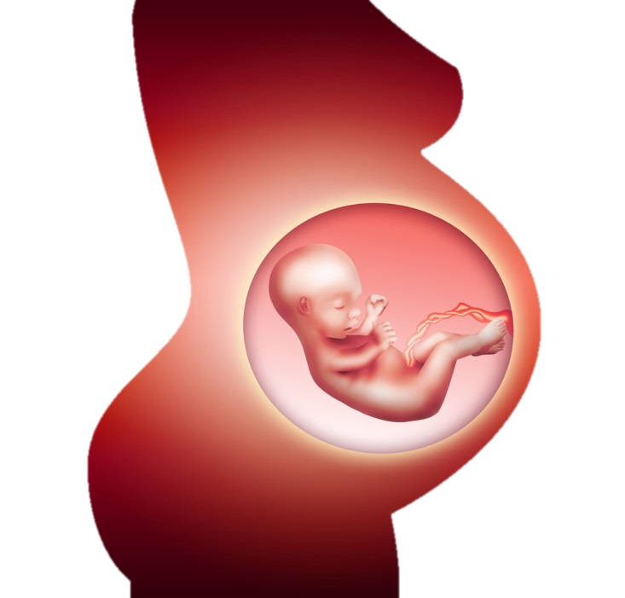
Chapter 15:
Pregnancy, Childbirth, and the Puerperium
(O00-O9A)
Notes:
Jen:
Now I know that many of you probably don’t do a lot of pregnancy and delivery coding, so we will just highlight a few of the major differences between ICD-9 and ICD-10 for this chapter. Codes from this chapter are for use for conditions related to or aggravated by the pregnancy, childbirth, or by the puerperium (maternal causes or obstetric causes). The final character for most codes within this chapter identify the trimester of pregnancy. The episode of care, that is delivered, antepartum, or postpartum, is no longer the axis of classification as was the case with ICD-9.

Slide 4

Use of Trimesters
less than 14 weeks
14 weeks to less than 28 week
28 weeks until delivery
Notes:
Jen:
You will find the definition for the trimesters at the beginning of the chapter in the tabular list. Trimesters are counted from the first day of the last menstrual period. They are defined as follows:
1st trimester- less than 14 weeks
2nd trimester- 14 weeks to less than 28 weeks
3rd trimester- 28 weeks until delivery
You will also find the addition of a seventh character to identify the fetus in a multiple gestation that is affected by the condition being coded. 7th character zero is used for single gestation or where the affected fetus is unspecified.

Slide 5
Patient presents with pregnancy induced hypertension at 32 weeks, she is treated and sent home.
ICD-9
642.33
Transient hypertension of pregnancy, antepartum condition or complication
O13.3
Gestational hypertension without significant proteinuria, third trimester
ICD-10
Notes:
Jen:
Here is a comparison between ICD-9 and ICD-10 coding, noting our use of trimester versus an antepartum condition. In this example, we have a patient with pregnancy induced hypertension who is at 32 weeks in her pregnancy. You can see the difference in the ICD-9 code and the ICD-10 code. ICD-9 classifies this as an antepartum condition while ICD-10 instead specifies the third trimester.
Slide reference:
ICD-9-CM Coding: Theory and Practice with ICD-10, 2013/2014 Edition
By Karla R. Lovaasen, RHIA, CCS, CCS-P and Jennifer Schwerdtfeger, BS, RHIT, CCS, CPC, CPC-H
Elsevier Saunders

Slide 6
Poll Results
The first character of an ICD-10-CM code is:
    Always a number
    Always a letter
    Either a letter or a number
Notes:
Pam:
Now let’s pause for a moment and take a look at your poll results. We asked what the first character of an ICD-10-CM code is.
(Respond with what the audience selected.)
The correct answer is B, always a letter. In ICD-10-CM, the first character of a code is always an alphabetic character. Let’s get back to our presentation and show you an example of the ICD-10 code formatting on the next slide.

Slide 7
Poll Results
    Always a number
    Always a letter
    Either a letter or a number
Notes:
(Cue to Tech Team that you’re moving on) “Click” again to move on

Slide 8


ICD-9-CM
Category
Etiology, Anatomic
Site, Manifestation
ICD-10-CM
Category
Etiology, Anatomic
Site, Severity
Extensions
Notes:
Jen:
So here is a little refresher on the structure of the ICD-10-CM code. As you can see, the format is very similar to ICD-9, but longer in length. The first character of an ICD-10-CM code is always a letter. All the letters of the alphabet are utilized with the exception of the letter “U”.
The second character is numeric, and characters 3-7 can be alpha or numeric. As with ICD-9, a decimal is placed after the first three characters or the code category. A valid code may be as few as 3 characters long, or may be up to 7 characters.
Just a quick reminder, if you have any questions during our presentation, you can submit them using the orange “Ask the Presenter” icon above my head. Now let’s move on to our first coding case. Pam, would you like to walk us through the first coding scenario?
Citation:
Barta, Ann; et al.. "ICD-10-CM Primer." Journal of AHIMA 79, no.5 (May 2008): 64-66.
http://library.ahima.org/xpedio/groups/public/documents/ahima/bok1_038084.hcsp?dDocName=bok1_038084

Slide 9

Patient presented 3 weeks after undergoing a cesarean section. The patient has a temp of 102 °F and the cesarean section wound is red with minimal drainage of the incision. A wound culture grew Streptococcus group B. Discharge dx: Postop obstetric cesarean surgical wound infection, Streptococcus, group B.
Coding Case 1.116
AHIMA ICD-10-CM Coder Training Manual, page 133
Notes:
Pam:
Sure Jennifer. Just so everyone knows, these coding cases are in the AHIMA training manual and we have indicated the case number as well as the page number on each slide so that you can go back and review, or follow along.
In our first case, we have a patient who presented 3 weeks after undergoing a cesarean section. The patient has a temperature of 102 °F and the cesarean section wound is red with minimal drainage of the incision. A wound culture was obtained and grew Streptococcus group B. The discharge diagnosis states Postoperative obstetric cesarean surgical wound infection, Streptococcus, group B. Jennifer, what are the correct diagnosis codes for this scenario?
You can also find the page numbers in our slide deck, which you can access by downloading our presentation from the green icon above my head.
Reference:
DeVault, K., Barta, A., & Endicott, M. (2013). ICD-10-CM Coder Training Manual, 2013 Edition. Chicago: AHIMA Press.

Slide 10

Answer/Rationale
O86.0 – Infection of obstetric surgical wound
B95.1 – Streptococcus, group B, as the cause of diseases classified elsewhere
Notes:
Jen:
The correct coding for this scenario is O86.0 for the Infection of obstetric surgical wound, and B95.1 for Streptococcus, group B, as the cause of diseases classified elsewhere.
ICD-10 Guidelines state that any complication occurring within the first six weeks (42 days) following delivery are considered to be a postpartum complication. In the Tabular, under subcategory O86, a note instructs the coder to use an additional code (B95-B97) to identify the infectious agent.
One thing to remember with the ICD-10 codes, and this case is a good example, since both letters and numbers are used you will have to be cautious in differentiating between the letter OH and the number ZERO. Since all codes start with a letter, we know the first character in this case should be an OH and not a Zero.
Reference:
DeVault, K., Barta, A., & Endicott, M. (2013). ICD-10-CM Coder Training Manual, 2013 Edition. Chicago: AHIMA Press.

Slide 11
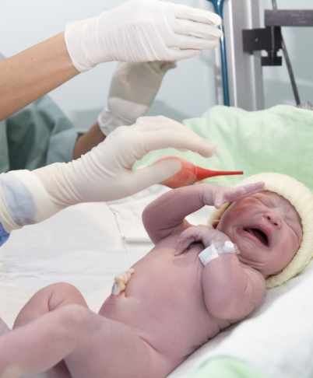
Chapter 16: Certain Conditions
Originating in the Perinatal Period (P00-P96)
“fetus or newborn”
Notes:
Pam:
Next, we move on to chapter 16 covering conditions originating in the perinatal period. According to ICD-10, the perinatal period is defined as before birth through the 28th day following birth. The conditions may be coded throughout the life of the patient if the condition is still present as long as the condition originated in the perinatal period. You will find this clarified as an introductory note at the beginning of the chapter in the tabular list.
The phrase “fetus or newborn” that was used in many of the ICD-9 codes is not used in ICD-10. Instead, the term newborn is consistently used to clarify that these codes are to be used only on the newborn record and never on the mother’s record. Since we don’t code many newborn records, other than non-VA purchased care, we won’t spend a lot of time on this chapter either.

Slide 12

Coding Case 1.120
Full-term newborn delivered 4 days ago and was discharged with no problems. After going home she was noticed to be somewhat jaundiced, and her mother brought her to the pediatrician's office. She was diagnosed with hyperbilirubinemia and will have phototherapy provided at home.
AHIMA ICD-10-CM Coder Training Manual, page 136
What is the correct diagnosis code(s)?
Notes:
Pam:
Here is another coding scenario from the AHIMA training manual.
In this case, we have a full-term newborn delivered 4 days ago and discharged with no problems. After going home she was noticed to be somewhat jaundiced, and her mother brought her to the pediatrician's office where she was diagnosed with hyperbilirubinemia. Now let’s take a closer look at how we would code this one.
Reference:
DeVault, K., Barta, A., & Endicott, M. (2013). ICD-10-CM Coder Training Manual, 2013 Edition. Chicago: AHIMA Press.

Slide 13
Answer/Rationale
P59.9 – Neonatal jaundice, unspecified
Notes:
Pam:
The birth did not occur at this encounter, so the Z38 category for Liveborn Infant is not assigned. Hyperbilirubinemia without mention of prematurity or specified cause is coded to P59.9. If prematurity was documented, there is a specific code to identify that condition (P59.0).
Reference:
DeVault, K., Barta, A., & Endicott, M. (2013). ICD-10-CM Coder Training Manual, 2013 Edition. Chicago: AHIMA Press.

Slide 14
Chapter 17: Congenital Malformations, Deformations & Chromosomal Abnormalities (Q00-Q99)
New Arrangement
Updated Terminology
Greater Specificity
Notes:
Jen:
Now on to our next chapter. The arrangement of the congenital malformations, deformations, and chromosomal abnormalities have been grouped into subchapters or blocks making it easier to identify the type of conditions classified in this chapter. As we know, that is certainly not true of the ICD 9 structure. ICD-10 organizes the congenital conditions by body system.
Modifications have also been made to specific categories that bring the terminology up-to-date with current medical practice. For example, Q61, cystic kidney disease contains options for congenital renal cyst, polycystic kidney, infantile type or polycystic kidney, adult type. The autosomal dominant and autosomal recessive terminology that was used in ICD-9 is not part of the code description in ICD-10.
AND there are classification changes that provide greater specificity than found in ICD-9 for conditions such as cleft hard palate, cleft soft palate, cleft hard palate with cleft soft palate, cleft uvula.
Many of the codes for congenital conditions and chromosomal abnormalities have been expanded. For example, the category for chromosomal anomalies are classified to a single category in ICD-9 while there are now nine categories for chromosomal abnormalities in ICD-10.

Slide 15
Coding Case 1.124
Cleft palate involving both the soft and hard palate, with bilateral cleft lip. What is the correct diagnosis code(s)?
AHIMA ICD-10-CM Coder Training Manual, page 139
Notes:
Pam:
Here we have another coding scenario. This case illustrates the greater specificity that was mentioned on the previous slide. The patient in this scenario has a cleft palate involving both the soft and hard palate with a bilateral cleft lip. Jennifer, can you walk us through how to code this one?
Reference:
DeVault, K., Barta, A., & Endicott, M. (2013). ICD-10-CM Coder Training Manual, 2013 Edition. Chicago: AHIMA Press.

Slide 16
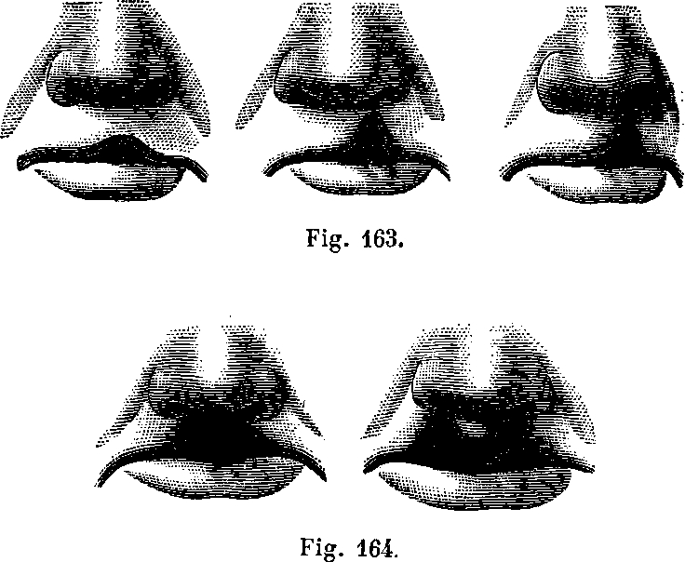
Q37.4 – Cleft hard and soft palate with bilateral cleft lip
Notes:
Jen:
Sure. For this scenario, careful review of the documentation is needed to select the one code that combines these conditions. Our patient has a cleft palate involving both the soft and hard palate with a bilateral cleft lip. ICD-10 code Q37.4 reflects a cleft hard and soft palate combined with a bilateral cleft lip.
Cleft lip and palate are congenital defects caused when the bones and tissues don’t fuse together in utero. The palate is the roof of the mouth, and consists of the soft palate which is the back part near the throat, and the hard palate which is the front part behind the teeth. Frequently cleft lip and cleft palate are both present. A cleft lip can be either unilateral or bilateral as you can see from the images on this slide. The unilateral cleft lip has a gap on one side of the lip under either the left or right nostril, whereas in a bilateral cleft lip, the gap is on both sides of the lip.
Reference:
DeVault, K., Barta, A., & Endicott, M. (2013). ICD-10-CM Coder Training Manual, 2013 Edition. Chicago: AHIMA Press.

Slide 17
Chapter 18: Symptoms, signs, and abnormal clinical and laboratory findings, not elsewhere classified (R00-R99)
Organizational changes
Classification changes
New chapter specific guidelines
Notes:
Pam:
The chapter for signs and symptoms in ICD-10 is arranged in blocks with those related specifically to a body system being grouped together followed by general signs and symptoms. For example, block R30-R39 contains symptoms and signs involving the genitourinary system, while block R70-R79 includes abnormal findings on examination of blood, without diagnosis. You will also notice more Exludes1 notes within this chapter to help clarify if a symptom should or should not be coded separately. For example, under the code for wheezing you will find an Excludes1 note for asthma. In that scenario, you would only code the asthma and not assign a separate code for the wheezing.
Some codes have also been moved from one chapter to another. For example, Bradycardia was located in Chapter 7 in ICD-9, Diseases of the Circulatory System. It has been relocated to Chapter 18 in ICD-10 under the block for Symptoms and signs involving the circulatory and respiratory systems.
Additionally, where ICD-9 had general coding guidelines for signs and symptoms, ICD-10 provides chapter specific guidelines.

Slide 18
SIRS
Hematuria
More Changes!
Notes:
Pam:
Another significant change in this chapter was made pertaining to hematuria coding. Various types of hematuria will be coded here unless included with the underlying condition such as acute cystitis with hematuria. Where ICD-9 provided a single code for acute cystitis, you will find that ICD-10 has choices for acute cystitis with hematuria, or acute cystitis without hematuria. Just another example where you are going to find an increased use of combination codes in ICD-10.
Another change in this chapter is with Systemic Inflammatory Response Syndrome, or SIRS. SIRS due to a noninfectious process such as trauma or malignant neoplasm, has been moved to this chapter rather than the chapter on Injury and Poisonings where it was located in ICD-9.

Slide 19

More Changes!
Coma scale
Notes:
Pam:
The Glasgow coma scale has been incorporated into ICD-10 coding in subcategory R40.2.
The coma scale codes can be used in conjunction with traumatic brain injury codes, acute cerebrovascular disease or sequelae of cerebrovascular disease codes. The coma scale codes should be sequenced after the diagnosis code(s). These codes, one from each subcategory (eyes open, verbal response, and motor response), are needed to complete the scale. The 7th character indicates when the scale was recorded.

Slide 20
Glasgow Coma Scale
Eyes open
Verbal response
Motor response
0 - Unspecified time
1 - In the field [EMT or ambulance]
2 - At arrival to emergency department
3 - At hospital admission
4 - 24 hours or more after hospital admission
Notes:
Pam:
Since this is new, let’s take a closer look at using the coma scale. One code from each subcategory is needed to complete the scale.
Subcategory R40.21- represents eyes open, subcategory R40.22- represents the verbal response, and subcategory R40.23- represents the motor response. The appropriate 7th character is to be added to each code from these subcategories to reflect when the coma scale was recorded. The 7th character options are
0 - unspecified time
1 - in the field [EMT or ambulance]
2 - at arrival to emergency department
3 - at hospital admission
4 - 24 hours or more after hospital admission
The 7th character should match for all three codes. At a minimum, report the initial score documented on presentation at your facility. This may be a score from the EMT or in the emergency department. If desired, a facility may choose to capture multiple coma scale scores.
Jennifer, how about you walk us through an example?

Slide 21
Coma scale codes when the following is documented by the EMT: Eyes do not open, no verbal response, no motor response. On day 2 of admission, the neurologist documented eyes open to sound, verbal response produced inappropriate words, and motor response with flexion withdrawal.
EMT
R40.2111, Coma scale, eyes open, never
R40.2211, Coma scale, best verbal response, none
R40.2311, Coma scale, best motor response, none
Neurologist
R40.2134, Coma scale, eyes open, to sound
R40.2234, Coma scale, best verbal response, inappropriate words
R40.2344, Coma scale, best motor response, flexion withdrawal
AHIMA ICD-10-CM Coder Training Manual, page 141
Notes:
Jen:
Sure Pam. Here is an example of a case scenario from the AHIMA Coder Training Manual. We have the coma score documented by the EMT, and additional coma scores documented by the neurologist on day 2 of admission. One code from each subcategory is needed to complete the scale; eyes open, best verbal response, and best motor response. The seventh character indicates when the scale was recorded and it should match for all three codes. So on the left side of the slide you can see all three categories that were assigned by the EMT, with a 7th character of 1 for each of those codes. Then on the right side of the slide you can see all three categories with a 7th character of 4 to reflect what was recorded on day two of the admission by the neurologist.
Slide reference:
DeVault, K., Barta, A., & Endicott, M. (2013). ICD-10-CM Coder Training Manual, 2013 Edition. Chicago: AHIMA Press. Page 141.

Slide 22
Poll Question
In ICD-10-CM, what does the final character represent for most codes from Chapter 15: Pregnancy, Childbirth, and the Puerperium?
    Episode of care
    Trimester
    Number of previous pregnancies
    None of the above
Notes:
Jen:
Now I’d like to ask a poll question. In ICD-10, what does the final character represent for most codes from Chapter 15: Pregnancy, Childbirth, and the Puerperium?
Select A for episode of care, B for Trimester, C for the number of previous pregnancies, or D for none of the above
To answer this question, use the blue polling icon above my head. We’ll move on and come back to your results in just a moment.

Slide 23

Coding Case 1.133
Patient is seen complaining of right upper quadrant abdominal pain. In addition, the patient is having nausea and vomited several times. Patient also has elevated blood pressure readings but a diagnosis of hypertension is not made at this visit. The patient was given an order for an outpatient sonogram.
AHIMA ICD-10-CM Coder Training Manual, page 142
What is the correct diagnosis code(s)?
Notes:
Jen:
While folks are answering the polling question, we have another coding scenario to look at. This patient is seen complaining of right upper quadrant abdominal pain. In addition, the patient is having nausea and vomited several times. Patient also has elevated blood pressure readings but a diagnosis of hypertension is not made at this visit. The patient was given an order for an outpatient sonogram. Pam, how would we code this scenario.
Reference:
DeVault, K., Barta, A., & Endicott, M. (2013). ICD-10-CM Coder Training Manual, 2013 Edition. Chicago: AHIMA Press.

Slide 24
Answer/Rationale
R10.11 – Right upper quadrant pain
R11.2 – Nausea with vomiting, unspecified
R03.0 – Elevated blood-pressure reading, without diagnosis of hypertension
Notes:
Pam:
In this scenario, no conclusive diagnosis was documented, therefore the symptoms are coded. You would code R10.11 for the right upper quadrant pain, R11.2 for the nausea with vomiting, and R03.0 for the elevated blood pressure reading.
Reference:
DeVault, K., Barta, A., & Endicott, M. (2013). ICD-10-CM Coder Training Manual, 2013 Edition. Chicago: AHIMA Press.

Slide 25
Chapter 19: Injury, poisoning & certain other consequences of external causes (S00-T88)
Injuries
Burns
Poisoning
Other external causes
Notes:
Jen:
Our next chapter covers Injuries, Burns, Poisonings, and certain other consequences of external causes. This is a fairly large chapter and you will find that this chapter encompasses two alpha characters; the S section covers various types of injuries related to a single body region while the T section covers injuries to unspecified body regions as well as poisonings and certain other consequences of external causes.
At the beginning of this chapter in the tabular list, there is an instructional note to Use secondary code(s) from Chapter 20, which are the codes for external causes of morbidity, to indicate the cause of an injury. So this provides you with a good sequencing guideline. The code from Chapter 19 comes first, followed by any secondary codes from Chapter 20. There are some codes within the T section of this chapter that include the external cause and therefore do not require an additional external cause code from Chapter 20.
Most of the categories within this chapter require the use of a 7th character. The 7th character values for most categories, with the exception of fractures, will be: A for initial encounter, D for subsequent encounter and S for sequela. Categories for traumatic fractures have additional options for the 7th character values, and we will take a look at an example of that on one of our upcoming slides.

Slide 26

Corrosions and Burns
Notes:
Jen:
I also want to point out that ICD-10 makes a distinction between burns and corrosions. Corrosive burns are those due to a chemical substance rather than a heat source.

Slide 27
Poll Results
In ICD-10-CM, what does the final character represent for most codes from Chapter 15: Pregnancy, Childbirth, and the Puerperium?
    Episode of care
    Trimester
    Number of previous pregnancies
    None of the above
Notes:
Pam:
Now let’s pause for a moment and take a look at your poll results. We asked, In ICD-10, what does the final character represent for most codes from Chapter 15: Pregnancy, Childbirth, and the Puerperium?
(The poll results show )
The correct answer is B for Trimester.
The final character for most codes within this chapter identify the trimester of pregnancy. The episode of care (delivered, antepartum, postpartum) is no longer the axis of classification as was the case with ICD-9. You will find the definition for the trimesters at the beginning of the chapter in the tabular list. Trimesters are counted from the first day of the last menstrual period.
Now let’s get back to Chapter 19. Jennifer back to you.

Slide 28
Poll Results
    Episode of care
    Trimester
    Number of previous pregnancies
    None of the above
Notes:
(Cue to Tech Team that you’re moving on) “Click” again to move on

Slide 29
S00-S09 Injuries to the head
S10-S19 Injuries to the neck
S20-S29 Injuries to the thorax
S30-S39 Injuries to the abdomen, lower back, lumbar spine, pelvis and external genitals
S40-S49 Injuries to the shoulder and upper arm
S50-S59 Injuries to the elbow and forearm
S60-S69 Injuries to the wrist, hand and fingers
Injuries
Notes:
Jen:
Thanks Pam. Now we are in the injuries section of Chapter 19. A significant change was made to the coding of injuries with ICD-10. As you will notice on this slide, in ICD-10 injuries are grouped in categories by body part rather than the nature of the injury. Following the site, injuries are further subdivided based on the type of injury, such as superficial injury, open wound, fracture, etc.
New for ICD-10 is that you will code the injury not just during the initial treatment, but you code it the entire time the patient is receiving care. Remember, the 7th character will specify whether it is an initial encounter, subsequent encounter, or an encounter for a late effect, or sequela. Recall that sequela is used in ICD-10 code descriptions rather than the term late effect which was used in ICD-9.

Slide 30

S82.001 Unspecified fracture of right patella
S82.002 Unspecified fracture of left patella
S82.009 Unspecified fracture of unspecified patella
The appropriate 7th character is to be added to all codes from category S82
Notes:
Jen:
Here we are showing an example of a fracture category, S82.0, Fracture of the patella. We have choices for laterality, either right, left or unspecified. We also need to add a 7th character before we have our final code, and I’ll show you the 7th character options for this category on the next slide.
Before I go to the next slide, I also want to mention some new guidelines for fractures in ICD-10 with regards to some of the default coding scenarios. The guidelines state that a fracture not indicated as open or closed should be coded to closed, that is the default. The guidelines also state that a fracture not indicated whether displaced or not displaced should be coded to displaced, that is the default. So again, when the documentation does not indicate open or closed, you code it as closed, and when the documentation does not indicate displaced or not displaced, you code it as displaced.
Ok, now that we have cleared that up, lets move to the next slide and take a look at the options that we have for our 7th character in this scenario.

Slide 31
The appropriate 7th character is to be added to all codes from category S82 - Fracture of lower leg, including ankle
A – initial enc. for closed fracture
B – initial enc. for open fracture type I or II, initial enc. for open fracture NOS
C – initial enc. for open fracture type IIIA, IIIB, or IIIC
D – sub. enc. for closed fracture w/routine healing
E – sub. enc. for open fracture type I or II w/routine healing
F – sub. enc. for open fracture type IIIA, IIIB, or IIIC w/routine healing
G – sub. enc. for closed fracture w/delayed healing
H – sub. enc. for open fracture type I or II w/delayed healing
J – sub. enc. for open fracture type IIIA, IIIB, or IIIC w/delayed healing
K – sub. enc. for closed fracture w/nonunion
M – sub. enc. for open fracture type I or II w/nonunion
N – sub. enc. for open fracture type IIIA, IIIB, or IIIC w/nonunion
P – sub. enc. for closed fracture w/malunion
Q – sub. enc. for open fracture type I or II w/malunion
R – sub. enc. for open fracture type IIIA, IIIB, or IIIC w/malunion
S – sequela
Notes:
Jen:
These are the 7th character choices for the Fracture of the patella subcategory that I showed on the previous slide. These choices actually apply to the entire S82 category which is for fractures of the lower leg including the ankle. So we are in the right category for our patella fracture.
Now I know this is a busy slide, but since we have mostly talked about only three choices for the 7th character, I wanted to give you another example of the 7th character choices that you might have in some categories. While most of the time you will find only three choices for either initial, subsequent, or sequela, in this example here with fractures, you will notice that there are many more options for the 7th character than what we have seen in other categories. Here the 7th character represents not only the episode of care being initial, subsequent, or sequela; but also notice that the 7th character provides the detail on the type of fracture, whether the fracture is open or closed, and routine healing versus malunion or nonunion.
Care of complications of fractures, such as malunion and nonunion, should be reported with the appropriate 7th character for subsequent care with nonunion (either K, M, N,) or subsequent care with malunion (using either P, Q, R). For example, a 7th character of ‘M’ reflects a subsequent encounter for an open fracture type I or II, with nonunion.

Slide 32
Episode of Care
Initial encounter
The patient is receiving active treatment for the condition
Subsequent encounter
After patient received active treatment for the condition and receiving routine care during healing or recovery phase
Sequela
Complications or conditions that arise as a direct result of a condition
Notes:
Pam:
Jennifer, we have mentioned the 7th character a few times now. How about we pause for a moment and review the definitions applicable to the episode of care? Initial encounter is assigned when the patient is receiving active treatment for the condition. Examples of active treatment include surgical treatment, emergency department encounter, or evaluation and treatment by a new physician.
Subsequent encounter is assigned after the patient received active treatment for the condition and is receiving routine care during healing or recovery phase. Examples of routine care include cast change or removal, removal of external or internal fixation device, medication adjustment, or other aftercare and follow-up visits following injury treatment.
Sequela is used in place of late effect. This is used when complications or conditions arise as a direct result of a condition.
One thing to keep in mind, which is different from ICD-9, is that the aftercare Z codes (what were the V codes in ICD-9) should not be used for aftercare for conditions such as injuries or poisonings, where seventh characters are provided to identify subsequent care.

Slide 33
Subsequent encounter for malunion fracture of right tibia from motor vehicle accident
ICD-9
733.81, Malunion of fracture
905.4, Late effect of fracture of lower extremities
E929.0, Late effects of motor vehicle accident
ICD-10
S82.201P, Unspecified fracture of shaft of right tibia, subsequent encounter for fracture with malunion
V89.2XXS, Person injured in unspecified motor-vehicle accident, traffic, sequela
Notes:
Jen:
Thanks Pam, that was a great refresher. Now let’s look at another ICD-9 and ICD-10 comparison. This scenario is for a subsequent encounter for malunion fracture of the right tibia caused by a motor vehicle accident. In ICD-9, this requires 3 codes; 733.81 for the malunion of the fracture. Notice that that code does not tell us where the fracture is located. 905.4 is used to reflect the late effect of a fracture of the lower extremity. That provides some general information of where the fracture is, but not exactly. Next you would add an E code, E929.0 to capture that this was a late effect of a motor vehicle accident.
In ICD-10, code S82.201P tells us that this was a fracture of the right tibia specifically, and that it is a subsequent encounter for the fracture with a malunion. All that in a single code. Then we would assign V89.2XXS to represent the initial cause of the injury, motor vehicle accident, with the seventh character representing sequela so that we know this is not the encounter for the initial injury, but rather a late effect.
Slide reference:
ICD-9-CM Coding: Theory and Practice with ICD-10, 2013/2014 Edition
By Karla R. Lovaasen, RHIA, CCS, CCS-P and Jennifer Schwerdtfeger, BS, RHIT, CCS, CPC, CPC-H
Elsevier Saunders

Slide 34

Coding Case 1.139
Patient is seen emergently for a frontal skull fracture with a subsequent subdural hemorrhage. There was a 45-minute loss of consciousness at the time of the accident.
What is the correct diagnosis code(s)?
AHIMA ICD-10-CM Coder Training Manual, page 146
Notes:
Pam:
Now for another coding scenario. In this case, we’ll assign just the injury codes, not the external cause codes. A patient was seen emergently for a frontal skull fracture with a subsequent subdural hemorrhage. There was a 45 minute loss of consciousness at the time of the accident. Jennifer, can you walk us through how to code this one?
Reference:
DeVault, K., Barta, A., & Endicott, M. (2013). ICD-10-CM Coder Training Manual, 2013 Edition. Chicago: AHIMA Press.

Slide 35
Answer/Rationale
S02.0XXA – Fracture of vault of skull, initial encounter for closed fracture
S06.5X2A – Traumatic subdural hemorrhage with loss of consciousness of 31 minutes to 59 minutes, initial encounter
Notes:
Jen:
In ICD-10, there is not a combination code for intracranial hemorrhage associated with skull fracture. Both conditions must be identified with separate codes. There
is a “code also” note directing the coding professional to code also any associated intracranial injury, referring you to category (S06.-) You’ll notice that the code for the subdural hemorrhage also includes the details about the loss of consciousness. So we end up with S02.0XXA for the skull fracture, initial encounter, and S06.5X2A for the traumatic subdural hemorrhage with loss of consciousness of 31 minutes to 59 minutes, initial encounter.
Reference:
DeVault, K., Barta, A., & Endicott, M. (2013). ICD-10-CM Coder Training Manual, 2013 Edition. Chicago: AHIMA Press.

Slide 36
Poll Question
Which of the following are subcategories of the Glasgow coma scale?
    Eyes open
    Verbal response
    Motor response
    All of the above
    None of the above
Notes:
Pam:
Now I’d like to ask another poll question. Which of the following are subcategories of the Glasgow coma scale?
Select A for eyes open; B for verbal response; C for motor response; D for all of the above; or E for none of the above
To answer this question, use the blue polling icon above my head. We’ll move on and come back to your results in just a moment.

Slide 37
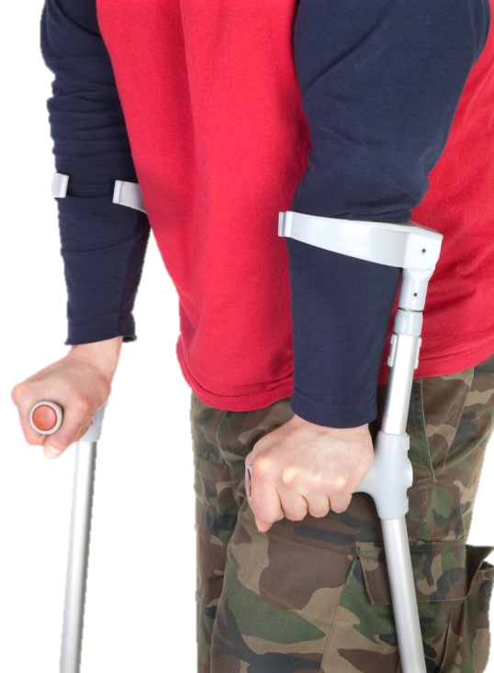
Coding Case 1.169
Patient was seen in primary care concerning the traumatic fracture of the anterior wall of the acetabulum of the right pelvis. The patient was hit by a car, knocked down, and the car ran over his pelvis. The pelvic fracture is healing appropriately.
What is the correct diagnosis code(s)?
AHIMA ICD-10-CM Coder Training Manual, page 157
Notes:
Pam:
Let’s take a look at another case. This one involves aftercare, which we mentioned a bit earlier. In this scenario, a patient was seen by his primary care provider concerning the traumatic fracture of the anterior wall of the acetabulum of the right pelvis. The patient was hit by a car, knocked down, and the car ran over his pelvis. The pelvic fracture is healing appropriately. Jennifer, how would we code this scenario?
Reference:
DeVault, K., Barta, A., & Endicott, M. (2013). ICD-10-CM Coder Training Manual, 2013 Edition. Chicago: AHIMA Press.

Slide 38
Answer/Rationale
S32.411D – Displaced fracture of anterior wall of right acetabulum, subsequent encounter for fracture with routine healing
V03.90XD – Pedestrian on foot injured in collision with car, pick-up truck or van, unspecified whether traffic or nontraffic accident, subsequent encounter
Notes:
Jen:
As mentioned previously, aftercare encounters in ICD-10 are coded to the appropriate fracture code with a seventh character D to reflect subsequent encounter rather than using an aftercare V code like we were used to in ICD-9. In the Alphabetic Index of ICD-10, under the main term Aftercare, subterm Fractures, it directs the coder to “code to the fracture with seventh character D.” With our scenario here, the sixth character of the fracture code specifies the laterality of the fracture, right side and the seventh character indicates that this is a subsequent encounter for fracture with routine healing. The accident external cause code is also assigned to reflect how the injury occurred, once again with seventh character D.
Now for the correct codes: With the fracture code, S32.411D displaced is the default when not specified as not nondisplaced. This is in accordance with the Official Guidelines pertaining to traumatic fractures which states, “A fracture not indicated as open or closed should be coded to closed. A fracture not indicated whether displaced or not displaced should be coded to displaced.”
We also assign code V03.90XD to represent the cause of the injury, Pedestrian on foot injured in collision with car, pick-up truck or van, unspecified whether traffic or nontraffic accident, subsequent encounter. No place of occurrence or activity code should be assigned because they are only to be used on the initial encounter.
Reference:
DeVault, K., Barta, A., & Endicott, M. (2013). ICD-10-CM Coder Training Manual, 2013 Edition. Chicago: AHIMA Press.

Slide 39
Poll Results
Which of the following are subcategories of the Glasgow coma scale?
    Eyes open
    Verbal response
    Motor response
    All of the above
    None of the above
Notes:
Pam:
Now let’s pause for a moment and take a look at your poll results. We asked what were the subcategories of the Glasgow coma scale?
(Respond to the results, explain to the audience why their participation was helpful, or why it was a good learning point before moving on.)
The correct answer is D. All of the above. Remember, the coma scale codes can be used in conjunction with traumatic brain injury codes, acute cerebrovascular disease or sequelae of cerebrovascular disease codes. The coma scale codes should be sequenced after the diagnosis code(s). These codes, one from each subcategory (eyes open, verbal response, and motor response), are needed to complete the scale. The 7th character of the coma scale code indicates when the scale was recorded.

Slide 40
Poll Results
    Eyes open
    Verbal response
    Motor response
    All of the above
    None of the above
Notes:
(Cue to Tech Team that you’re moving on) “Click” again to move on

Slide 41
Burns, Poisonings, Adverse Effects
T20-T32 Burns and corrosions
T20-T25 Burns and corrosions of external body surface, specified by site
T33-T34 Frostbite
T51-T65 Toxic effects of substances chiefly nonmedicinal as to source
T66-T78 Other and unspecified effects of external causes
T36-T50 Poisoning by, adverse effect of & underdosing of drugs, medicaments & biological substances
T15-T19 Effects of foreign body entering through natural orifice
Notes:
Jen:
Next we move on to burns, poisonings, and adverse effects. Shown here is a sample of some of the blocks that reflect burns, poisonings, adverse effects, and other external causes. We didn’t include them all on this slide, we just wanted to give you a snapshot here. You will need to refer to the tabular list for a complete listing of the blocks for Chapter 19 as they don’t all fit here on this slide, but we wanted to give you some sense of the arrangement and what is included here in these categories.

Slide 42
T36-T50
Poisoning by, adverse effect of and underdosing of drugs, medicaments and biological substances
T51-T65
Toxic effects of substances chiefly nonmedicinal as to source
Notes:
Jen:
One point that I want to make with some of the codes in this chapter is that the codes found in categories T36-T65 are combination codes that include both the substance that was taken, such as penicillin, as well as the intent, such as adverse effect. No additional external cause code is required for poisonings, toxic effects, adverse effects and underdosing codes.

Slide 43
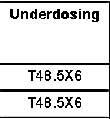

Table of Drugs
Notes:
Jen:
Also included in this chapter are poisonings and certain other consequences of external causes. As previously mentioned, many of these codes are combination codes that include the drug as well as a description of intent in a single code.
Another major change is that ICD-10 includes the concept of underdosing which was not part of the ICD-9 classification for poisonings, adverse effects, and toxic effects. Notice on this slide in the Table of Drugs we have a new column labeled “Underdosing” Underdosing is defined as taking less of a medication than is prescribed by a provider or the manufacturer's instructions, either inadvertently or deliberately, with a resulting negative health consequence. So, when utilizing the table of Drugs and Chemicals, you will now find options for:
-- Poisoning, Accidental (unintentional)
-- Poisoning, Intentional self-harm
-- Poisoning, Assault
-- Poisoning, Undetermined
-- Adverse effect, and
-- Underdosing

Slide 44
2-year-old accidentally drank lye, causing burns to the mouth and throat
ICD-9
983.2, Toxic effect of caustic alkalis
947.0, Burn of mouth and pharynx
E864.2, Accidental poisoning by caustic alkalis not elsewhere classified
ICD-10
T54.3X1A, Toxic effect of corrosive alkalis and alkali-like substances, accidental, initial encounter
T28.5XXA, Corrosion of mouth and pharynx, initial encounter
Notes:
Jen:
Here is another ICD-9 to ICD-10 comparison. This scenario is for a child that accidentally drank lye, causing burns to the mouth and throat. In ICD-9 we would code this as 983.2, Toxic effect of caustic alkalis; 947.0, Burn of mouth and pharynx; and E864.2, Accidental poisoning by caustic alkalis not elsewhere classified.
In ICD-10 we would code this as T54.3X1A, Toxic effect of corrosive alkalis and alkali-like substances, accidental, initial encounter; and T28.5XXA, Corrosion of mouth and pharynx, initial encounter.
Notice that the toxic effect and the intent being accidental are combined into a single code represented by T54.3X1A in ICD-10. Two codes were required in ICD-9.
Although we don’t do much coding on pediatric charts, this one is a good example used to demonstrate where ICD-9 uses the term “burn,” ICD-10 specifies this as corrosion since the burn was caused by a chemical. The provider documentation may still use the term burn as the example here does, but when you refer to Burn, Chemical in the Alphabetic Index, it will give you a cross reference to See Corrosion, by site.
Slide reference:
ICD-9-CM Coding: Theory and Practice with ICD-10, 2013/2014 Edition
By Karla R. Lovaasen, RHIA, CCS, CCS-P and Jennifer Schwerdtfeger, BS, RHIT, CCS, CPC, CPC-H
Elsevier Saunders

Slide 45
Coding Case 1.32
Patient is being seen for ongoing management of steroid-induced DM which was due to the prolonged use of corticosteroids, which have been discontinued. The patient’s DM is managed with insulin which he as been taking for the last two years. What is the correct diagnosis code(s)?
AHIMA ICD-10-CM Coder Training Manual, page 102
Notes:
Pam:
Let’s look at another coding scenario. This one involves a patient being seen for ongoing management of steroid-induced diabetes which was due to prolonged use of corticosteroids, which have since been discontinued. The patient’s diabetes is managed with insulin which he as been taking for the last two years. Jennifer, how would we code this one?
Reference:
DeVault, K., Barta, A., & Endicott, M. (2013). ICD-10-CM Coder Training Manual, 2013 Edition. Chicago: AHIMA Press.

Slide 46
Answer/Rationale
E09.9 – Drug or chemical induced diabetes mellitus without complications
T38.0X5S – Adverse effect of glucocorticoids and synthetic analogues, sequela
Z79.4 – Long term (current) use of insulin
Notes:
Jen:
The reason for this encounter is the steroid-induced diabetes. E09.9, drug or chemical induced diabetes, is sequenced first according to a Coding Guideline (I.C.19.e.5.a) which states that the nature of the adverse effect is assigned first followed by the appropriate code for the adverse effect. There is also a “use additional code” note under category E09 regarding the sequencing of adverse effect codes. The seventh character of S is assigned to code T38.0X5 as this is the sequela of the corticosteroid use. Additionally, under category E09 there is another instructional note to “use additional code to identify any insulin use (Z79.4).” So we end up with 3 codes to fully capture the scenario: E09.9 for the secondary diabetes, T38.0X5S for the adverse effect of the corticosteroids, and Z79.4 for the insulin use.
Reference:
DeVault, K., Barta, A., & Endicott, M. (2013). ICD-10-CM Coder Training Manual, 2013 Edition. Chicago: AHIMA Press.

Slide 47
Chapter 20: External Causes of Morbidity (V01-Y99)
Classification of environmental events and circumstances as the cause of injury, and other adverse effects.
No longer a supplemental classification
Always used secondary to a code from another chapter
Assigned for every encounter where injury is being treated
Notes:
Pam:
Codes in Chapter 20 capture the cause of an injury or health condition, the intent (whether unintentional or accidental; or intentional, such as suicide or assault), the place where the event occurred, the activity of the patient at the time of the event, and the person’s status (that is, civilian, military) at the time of the event.
A significant change with ICD-10 is that the codes for external causes are no longer located in a supplemental classification as they were in ICD-9 as the “E” codes. They are now part of the main classification located here in chapter 20. Many of the categories have been expanded to provider greater specificity. For example, a Fall from playground equipment represented in ICD-9 is now reflected by several code choices in ICD-10 to specify whether the fall was from a playground slide, a playground swing, a jungle gym…you get the idea right? One point to remember, these codes are always used as secondary codes after the code for the type of injury such as fracture, burn, open wound, and so on.
Another change with ICD-10 is that you will assign the external cause code, with the appropriate 7th character (initial encounter, subsequent encounter or sequela) for every encounter for which the injury or condition is being treated, not just on the initial encounter as was the guideline for ICD-9. The place of occurrence, activity, and external cause status codes on the other hand are still only assigned during the initial encounter for treatment.

Slide 48
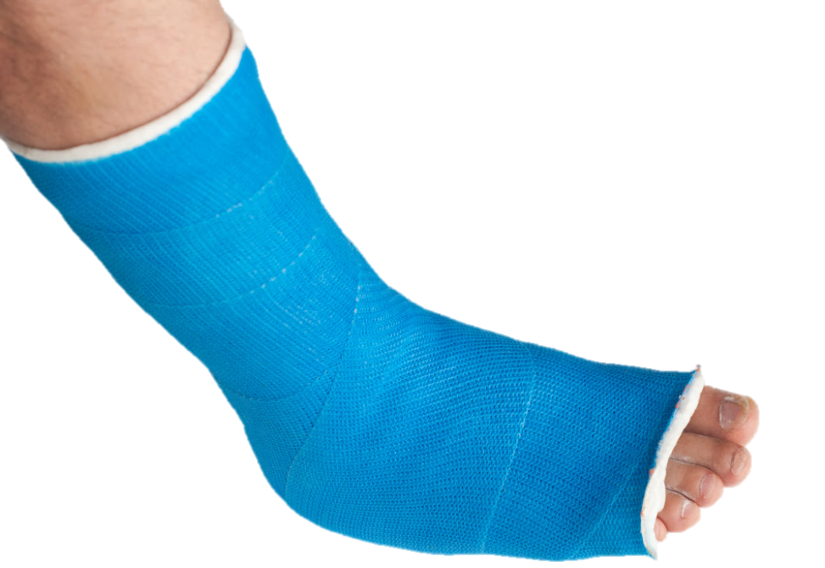
Here’s an Example - Crush injury of left foot with metatarsal fractures due to dropping car battery on foot at industrial factory
S97.82XA – Crushing injury of left foot, initial encounter
S92.302A – Fracture of unspecified metatarsal bone(s), left foot, initial encounter
W20.8XXA – Other cause of strike by thrown, projected or falling object, initial encounter
Y92.63 – Factory as the place of occurrence of the external cause
Y99.0 – Civilian activity done for income or pay
Notes:
Pam:
Here is another coding scenario. This patient sustained a crush injury of his left foot with metatarsal fractures due to dropping a car battery on his foot at an industrial factory (which is his place of employment). We are going to assign codes for the crush injury, the fracture, the cause, place of occurrence, and status. What we end up with is:
S97.82XA – Crushing injury of left foot, initial encounter
S92.302A – Fracture of unspecified metatarsal bone(s), left foot, initial encounter
W20.8XXA – Other cause of strike by thrown, projected or falling object, initial encounter
Y92.63 – Factory as the place of occurrence of the external cause
Y99.0 – Civilian activity done for income or pay
Slide reference:
ICD-9-CM Coding: Theory and Practice with ICD-10, 2013/2014 Edition
By Karla R. Lovaasen, RHIA, CCS, CCS-P and Jennifer Schwerdtfeger, BS, RHIT, CCS, CPC, CPC-H
Elsevier Saunders

Slide 49
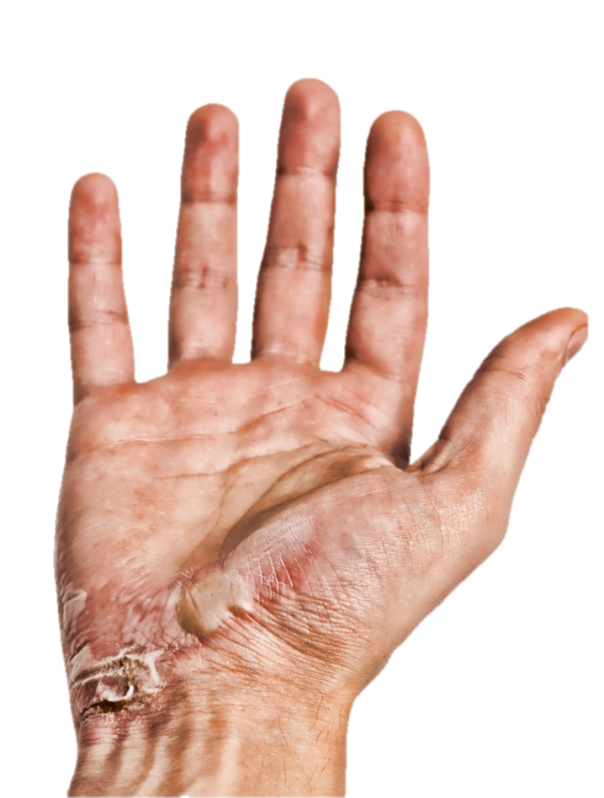
Another Example
Left wrist with keloid scar due to previous burns from fire (accidental)
L91.0 – Hypertrophic scar
T23.072S – Burn of unspecified degree of left wrist, sequela
X08.8XXS – Exposure to other specified smoke, fire and flames, sequela
Notes:
Pam:
Our next scenario is for a patient seen for a left wrist with keloid scar due to previous burns from fire (accidental). In this example, notice that you are still coding the burn and the exposure to fire, but for both you will assign a 7th character to reflect that the encounter is for a sequela of the initial injury. Our codes for this scenario are:
L91.0 – Hypertrophic scar
T23.072S – Burn of unspecified degree of left wrist, sequela
X08.8XXS – Exposure to other specified smoke, fire and flames, sequela
Slide reference:
ICD-9-CM Coding: Theory and Practice with ICD-10, 2013/2014 Edition
By Karla R. Lovaasen, RHIA, CCS, CCS-P and Jennifer Schwerdtfeger, BS, RHIT, CCS, CPC, CPC-H
Elsevier Saunders

Slide 50
Poll Question
True or False: A fracture not indicated whether displaced or not displaced should be coded to not displaced.
    True
    False
Notes:
Jen:
Now before we get to the next coding case, I’d like to ask another poll question. True or False, A fracture not indicated whether displaced or not displaced should be coded to not displaced. Select A if you think this statement is True, or select B if you think this statement is false.
To answer this question, use the blue polling icon above my head. In the meantime, we’ll move on and come back to your results in just a moment.

Slide 51
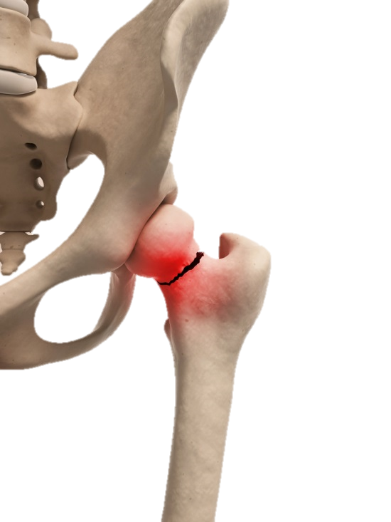
Coding Case 1.153
46-year-old male, working on his own home improvement projects, fell from a ladder outside of his single family home. After evaluation, it was determined that he had a non-displaced femoral neck fracture on the left side.
What is the correct diagnosis code(s)?
AHIMA ICD-10-CM Coder Training Manual, page 152
Notes:
Jen:
Now on to our next scenario. This one is for a 46-year-old male, who fell from a ladder outside of his single family home while working on his own home improvement projects. As a result, he sustained a non-displaced femoral neck fracture on the left side. Pam, I suspect there are lot of components to this one. Can you walk us through how we would code this scenario?
Reference:
DeVault, K., Barta, A., & Endicott, M. (2013). ICD-10-CM Coder Training Manual, 2013 Edition. Chicago: AHIMA Press.

Slide 52
Answer/Rationale
S72.002A – Fracture of unspecified part of neck of left femur, initial encounter for closed fracture
W11.XXXA – Fall on and from ladder, initial encounter
Y92.018 – Other place in single-family (private) house as the place of occurrence of the external cause
Y93.H9 – Activity, other involving exterior property and land maintenance, building and construction
Y99.8 – Other external cause status
Notes:
Pam:
Yes Jennifer, there are several components to this one. Our first two codes are going to be S72.002A – Fracture of unspecified part of neck of left femur, initial encounter for closed fracture, and W11.XXXA – Fall on and from ladder, initial encounter. The seventh character A is used to indicate the initial encounter for the fracture and the initial encounter for the fall. You may have noticed that we are also using the X placeholder in the fall code because the seventh character is required. W11 is only three characters, so in order to add the seventh character of A for the initial encounter, we need to add the placeholder X in positions 4, 5, and 6. That’s how we end up with W11.XXXA as the final code for the fall on and from ladder, initial encounter.
Next, we must also assign a code from categories Y92 for place of occurrence, Y93 for the Activity, and Y99 for status which are used to provide additional information about the event.
Injuring coding can be a bit of a challenge. As you can see from this scenario, we ended up with 5 separate codes to fully capture everything including the injury, the cause of the injury, the place of occurrence, activity, and status.
Reference:
DeVault, K., Barta, A., & Endicott, M. (2013). ICD-10-CM Coder Training Manual, 2013 Edition. Chicago: AHIMA Press.

Slide 53
Poll Results
True or False: A fracture not indicated whether displaced or not displaced should be coded to not displaced.
    True
    False
Notes:
Pam:
Now let’s pause for a moment and take a look at your poll results. We asked, True or False, A fracture not indicated whether displaced or not displaced should be coded to not displaced.
(Results of the poll showed .)
The correct answer is False. According to the official guidelines, a fracture not indicated whether displaced or not displaced should be coded to displaced.
Remember, if you have any questions during our presentation, you can submit them using the orange “Ask the Presenter” icon above my head. Jennifer, back to you for our next chapter.

Slide 54
Poll Results
    True
    False
Notes:
(Cue to Tech Team that you’re moving on) “Click” again to move on

Slide 55
Chapter 21: Factors influencing health status and contact with health services (Z00-Z99)
V Codes
Z Codes
Notes:
Jen:
Thanks Pam. We finally made it to our final chapter, Chapter 21! Codes from this chapter contain what we were familiar with as the V codes in ICD-9. These codes are to be used for circumstances other than a disease, injury or external cause classifiable elsewhere in ICD-10.

Slide 56
No category for care involving use of rehab procedures (V57)
Z Codes
Z14-Z15 Genetic carrier and genetic susceptibility to disease
Z16 Resistance to antimicrobial drugs
Z17 Estrogen receptor status
Z18 Retained foreign body fragments
Z20-Z28 Persons with potential health hazards related to communicable diseases
Z30-Z39 Persons encountering health services in circumstances related to reproduction
Z40-Z53 Encounters for other specific health care
Z55-Z65 Persons with potential health hazards related to socioeconomic and psychosocial circumstances
Z66 Do not resuscitate status
Z67 Blood type
Z68 Body mass index (BMI)
Z69-Z76 Persons encountering health services in other circumstances
Z77-Z99 Persons with potential health hazards related to family and personal history and certain conditions influencing health status
Z00-Z13 Persons encountering health services for examinations
Z67 Blood type
Notes:
Jen:
On the slide you will see the specific blocks covered in this chapter. That should give you a sense of the categories available in this chapter. Remember, the block are somewhat like a chapter outline.
One change in this chapter is that codes for personal and family history have been expanded. We also have a new category for blood type, Z67 as the call out box on this slide points out.
Another change is that there isn’t a category for Care involving use of rehabilitation procedures, what was V57 in ICD-9. Remember, in ICD-10 you will report the underlying condition for which the therapy is being provided, such as an injury, with the appropriate 7th character representing a subsequent encounter. This is a significant change for those of you that code a lot of aftercare, so it is something that you will need to get used to.

Slide 57
Vaccination for influenza
ICD-9
V04.81, Need for prophylactic vaccination and inoculation against influenza
ICD-10
Z23, Encounter for immunization
Notes:
Jen:
Here is another ICD-9 to ICD-10 comparison. In this example we can see that there is actually less specificity in the ICD-10 code. ICD-10 has a single code for encounter for immunization, Z23. In contrast, ICD-9 provided separate sub classifications for the specific type of immunization such as influenza, measles, smallpox, and many others. So while we keep saying that ICD-10 offers much more specificity than ICD-9, in this example we actually lose a little bit of specificity. According to the instruction note under Z23, procedure codes are required to identify the types of immunizations given.
Slide reference:
ICD-9-CM Coding: Theory and Practice with ICD-10, 2013/2014 Edition
By Karla R. Lovaasen, RHIA, CCS, CCS-P and Jennifer Schwerdtfeger, BS, RHIT, CCS, CPC, CPC-H
Elsevier Saunders

Slide 58

Coding Case 1.168
The patient who has had his bladder removed due to carcinoma without recurrence is scheduled for a radiology procedure to evaluate the patency of his ileal conduit, including ureteropyelography using contrast media. The entire procedure is performed in the radiology suite with the radiologists’ impression of “normal functioning ileal conduit.”
AHIMA ICD-10-CM Coder Training Manual, page 157
What is the correct diagnosis code(s)?
Notes:
Pam:
Let’s look at one final coding scenario as we are wrapping up. This one is for a patient who has had his bladder removed due to carcinoma without recurrence is scheduled for a radiology procedure to evaluate the patency of his ileal conduit, including ureteropyelography using contrast media. The entire procedure is performed in the radiology suite with the radiologists’ impression of “normal functioning ileal conduit.” Jennifer, can you explain the coding for this scenario?
Reference:
DeVault, K., Barta, A., & Endicott, M. (2013). ICD-10-CM Coder Training Manual, 2013 Edition. Chicago: AHIMA Press.

Slide 59
Answer/Rationale
Z43.6 – Encounter for attention to other artificial openings of urinary tract
Z90.6 – Acquired absence of other parts of urinary tract
Z85.51 – Personal history of malignant neoplasm of bladder
Notes:
Jen:
Sure Pam. The reason for the encounter was to check on the patency of the ileal conduit. An ileal conduit is an artificial opening for the urinary tract, not the digestive tract, although the urine is diverted into an isolated segment of the ileum following cystectomy. To create the ileal conduit, the ureters are resected from the bladder, and the ureteroenteric anastomosis is made to drain the urine into a detached section of ileum. The end of the ileum is brought out through a stoma in the abdominal wall. Based on that, this would be coded as:
Z43.6 – Encounter for attention to other artificial openings of urinary tract
Z90.6 – Acquired absence of other parts of urinary tract, and
Z85.51 – Personal history of malignant neoplasm of bladder
And now back to you Pam!
Reference:
DeVault, K., Barta, A., & Endicott, M. (2013). ICD-10-CM Coder Training Manual, 2013 Edition. Chicago: AHIMA Press.

Slide 60
ICD-9-CM
~ 13,000 Codes
Alpha (except V&E codes)
3-5 Digits
17 Chapters with 2 Supplements
3 Tables: Hypertension, Drugs & Chemicals, Neoplasms
ICD-10-CM
~ 68,000 Codes
Alphanumeric
3-7 Characters
21 Chapters
2 Tables: Drugs & Chemicals, Neoplasms
Notes:
Pam:
Now that we have covered all 21 chapters, let’s do a little re-cap of the differences between ICD-9 and ICD-10 diagnoses codes. ICD-10 represents a significant improvement over ICD-9. The biggest change is the sheer volume of codes, going from approximately 13,000 codes in ICD-9 to approximately 68,000 codes in ICD-10. The expansion provides the ability to offer codes that have a great deal more detail than was available in ICD-9. We have provided some great examples of the additional detail provided in ICD-10 throughout all of our presentations.
ICD-10 consists of 21 chapters compared to 17 chapters in ICD-9, and all codes are now alphanumeric. Diagnosis coding under ICD-10 uses 3 to 7 characters instead of the 3 to 5 digits used with ICD-9, but the format of the codes is similar.
There are no supplemental classifications in ICD-10 , instead what were ICD-9’s V and E code supplemental classifications are incorporated into the main classification in ICD-10.
And finally, in ICD-10 the type of hypertension is no longer required (benign, malignant, unspecified). As a result, the hypertension table has been eliminated. So while ICD-9 had three tables, ICD-10 has only two tables; the table of Drugs and Chemicals, and the Neoplasm table.

Slide 61
Coding Roundtable Topics
ICD-10-CM Coding Guidelines and Conventions
ICD-10-PCS Medical and Surgical Procedure Coding
Date and Time, Session 1
Tues. January 21, 2014 10:00 – 11:30am ET
Date and Time, Session 2
Thurs. January 23, 2014 1:00 – 2:30pm ET
Thurs. June 19, 2014 1:00 – 2:30pm ET
ICD-10-CM Chapters 1-7
ICD-10-CM Chapters 8-14
ICD-10-CM Chapters 15-21
ICD-10-PCS Coding Guidelines and Conventions
ICD-10-PCS Root Operations and Operative Approaches
ICD-10-CM/PCS Follow-up
Tues. March 18, 2014 10:00 – 11:30am ET
Tues. April 15, 2014 10:00 – 11:30am ET
Tues. May 13, 2014 10:00 – 11:30am ET
Tues. June 17, 2014 10:00 – 11:30am ET
Tues. July 15, 2014 10:00 – 11:30am ET
Tues. August 19, 2014 10:00 – 11:30am ET
September TBA
Thurs. March 20, 2014 1:00 – 2:30pm ET
Thurs. April 17, 2014 1:00 – 2:30pm ET
Thurs. May 15, 2014 1:00 – 2:30pm ET
Thurs. July 17, 2014 1:00 – 2:30pm ET
Thurs. August 21, 2014 1:00 – 2:30pm ET
September TBA
Notes:
Pam:
Thank you for joining us today and we hope that we have provided a good overview of some of the significant differences between ICD-9 and ICD-10 coding. Hopefully you noticed that there are many similarities as well. Remember, as long as you know the basic coding conventions and guidelines, you will be successful in ICD-10-CM coding. We have now covered all 21 chapters of ICD-10-CM, so if you missed our first two sessions, be sure to review them on Demand. We will also be holding some Coding Roundtable sessions in the future. The first session has already taken place. The tentative schedule has been provided on this slide, so be sure to save the dates. We will be offering each roundtable at two different times, but you only need to attend one session. The repeat session is for those unable to attend the first. In addition, we will be back here at the vVeHU Campus during the week of May 19th for some more ICD-10 session. Be sure to come back and join us!

Slide 62
References
ICD-10-CM Coder Training Manual, 2013 Edition
AHIMA Press
ICD-9-CM Coding: Theory and Practice with ICD-10, 2013/2014 Edition, Elsevier Saunders
ICD-10-CM Official Guidelines for Coding and Reporting, 2013
Notes:
Jen:
Remember, much of the material that we covered today coincides with the AHIMA ICD-10-CM Coder Training Manual. <hold up the training guide> The manual contains many more examples and coding cases covering each of the chapters than what we have covered here today. In addition, the training manual provides some site specific cases such as hospital inpatient cases, long term care cases, outpatient cases, and so on. Be sure to go back and work through the exercises to check your understanding. The training manual provides an answer key at the back so that you can monitor your progress and see how you are doing.
Later today, we will have our first ICD-10-PCS session, back here at 3pm ET, covering ICD-10-PCS Coding Conventions and Guidelines. We hope you all will join us back here for that presentation.

Slide 63

Ask the Presenter
Notes:
Jen:
One final reminder, if you haven’t submitted your questions yet, there is still time to do so by clicking on the orange “Ask The Presenter” icon. We’re going to show a brief announcement and be right back to answer your questions.
(Stand still and smile until you see the video come up full screen)

