Slide 1
Introduction to
Progress Note Templates by the Tips and Timesavers Guys
Don Weinshenker, MD (Denver, CO)
Neil Evans, MD (Washington, DC)

Slide 2
Today’s Goal
Walk away with ONE new timesaving tip!

Slide 3
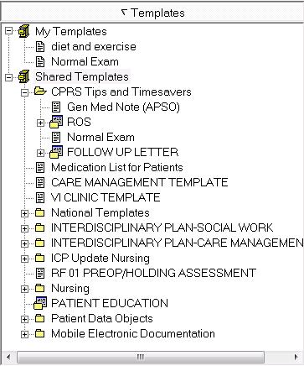
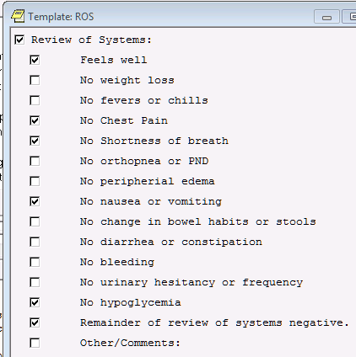
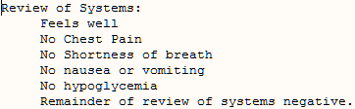
CPRS TEmplates

Slide 4

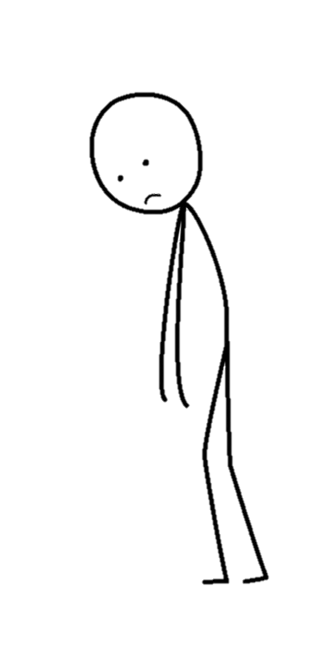

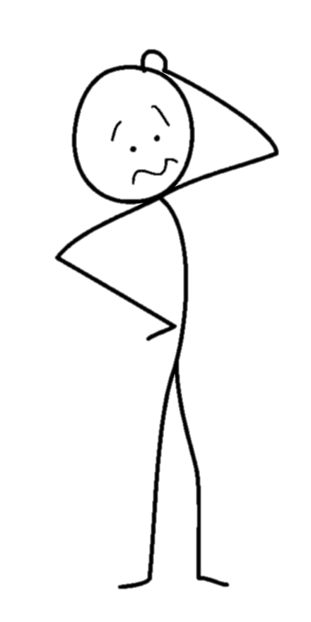
CPRS TEmplates
Notes:
Makes smoke come out your ears
Puzzles you (but you still have hope)
Wears you out – Is there hope?
You love templates

Slide 5

Poll Question
Who are you?
CPRS Templates make smoke come out my ears
The Template Editor puzzles me (but I still have hope)
Documentation wears me out – Is there hope?
I love templates and I want to learn more!

Slide 6


Slide 7


Slide 8


Slide 9
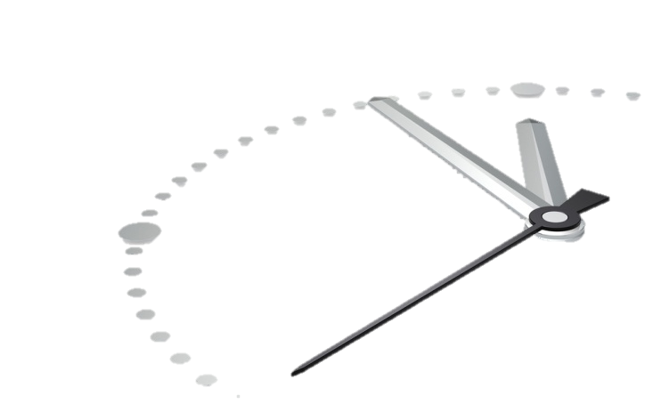
Saving Time with CPRS
Templates

Slide 10
Saving Time with CPRS
Templates
Custom Views

Slide 11
Saving Time with CPRS
Templates
Settings
Custom Views

Slide 12
Saving Time with CPRS
Templates
Settings
Keyboard Shortcuts
Custom Views

Slide 13
Saving Time with CPRS
Templates
Settings
Keyboard Shortcuts
Organization of Visit
Custom Views

Slide 14
Saving Time with CPRS
Templates
Settings
Keyboard Shortcuts
Organization of Visit
Speech Recognition
Custom Views

Slide 15
Templates
Settings
Keyboard Shortcuts
Organization of Visit
Speech Recognition
Custom Views
And more…
Saving Time with CPRS

Slide 16
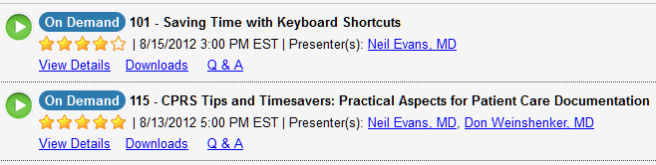
Additional CPRS Training classes available On-Demand!

Slide 17
Poll Results
Who are you?
CPRS Templates make smoke come out my ears
The Template Editor puzzles me (but I still have hope)
Documentation wears me out – Is there hope?
I love templates and I want to learn more!

Slide 18
Poll Question
How do you currently use templates?
I never use them (unless forced to because template is attached to progress note title permanently)
I’ve used them, but only from the Shared Templates Drawer
I have my own personal templates, but borrowed all those from someone else
I create and use my own templates

Slide 19

Notes:
Let’s dive in

Slide 20

How can templates save you time?
Less Typing
Meaningful Notes (built piece by piece)
Quick access to patient data in your notes
Cognitive support
during the visit
Notes:
Less Typing – STOP typing the same thing over and over.
Meaningful notes – Build notes piece by piece with only the important parts.
Quick Access to Patient Data in your notes – Drop in patient data objects – save time searching the record for key data elements.
Cognitive Support – for example, being able to quickly remember the elements of the review of systems you want to ask and document.

Slide 21

How can templates cause problems?
At worst, templates can:
Conflict with your workflow
Prevent you from looking elsewhere in CPRS
Decrease the value of documentation
Propagate errors

Slide 22

Notes:
Saving Time

Slide 23

Notes:
Improving the quality of your documentation

Slide 24
Poll Results
How do you currently use templates?
I never use them (unless forced to because template is attached to progress note title permanently)
I’ve used them, but only from the Shared Templates Drawer
I have my own personal templates, but borrowed all those from someone else
I create and use my own templates

Slide 25


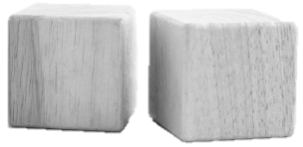
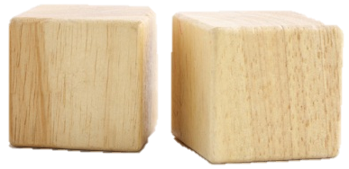
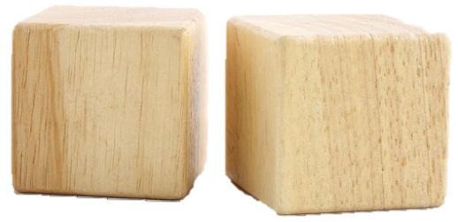
Saving time with CPRS
Template Fundamentals
Creating Templates
Using Templates

Slide 26

TEMPLATE FUNDAMENTALS
Template Drawer
Shared Templates
Personal Templates
Types of Templates
Template Editor
Patient Data Objects
Template Fields
CPRS Help

Slide 27
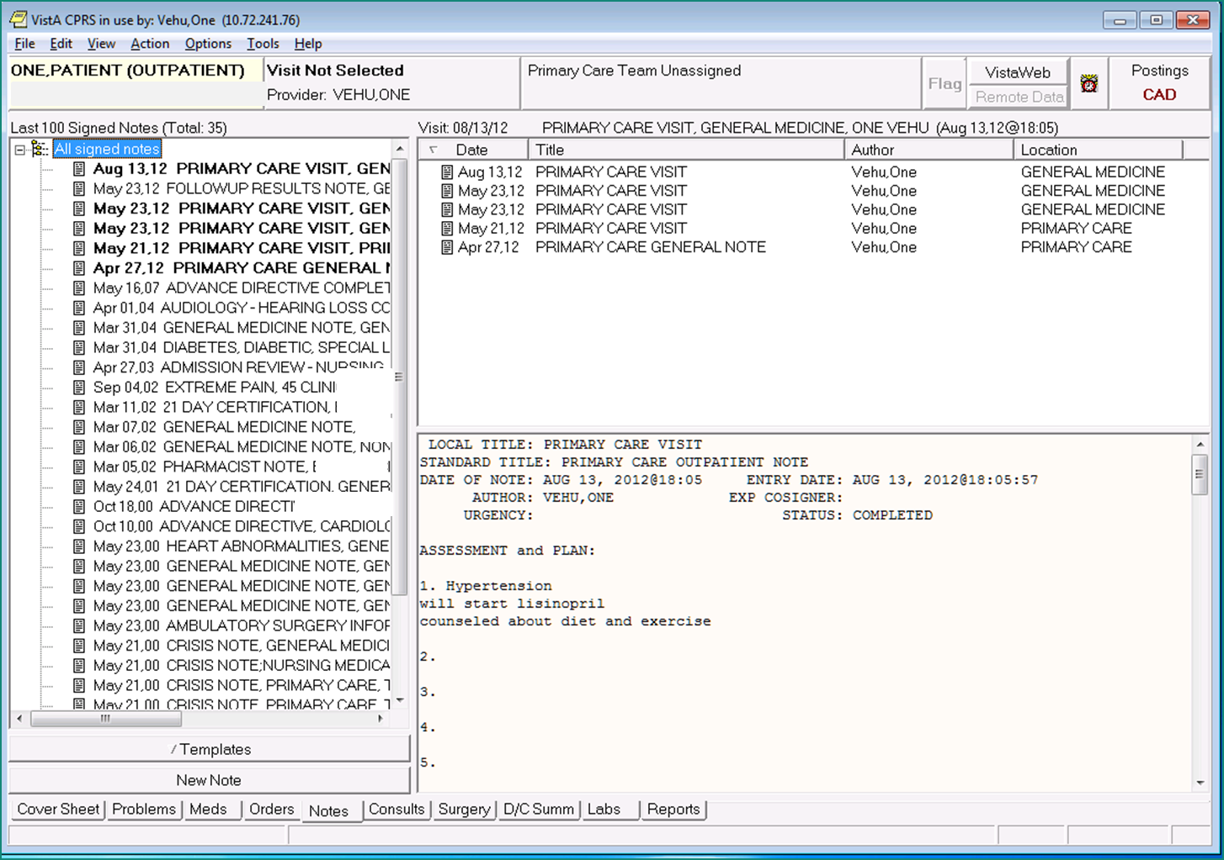

Slide 28
“Templates Drawer”

Slide 29
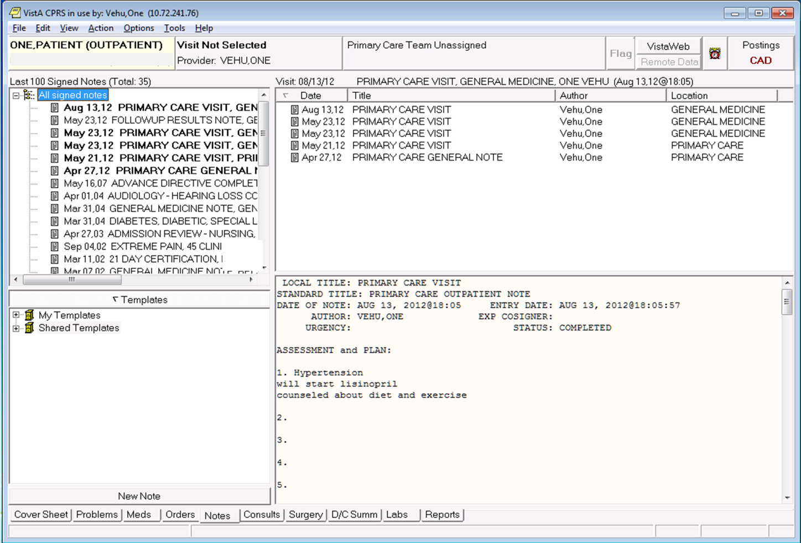
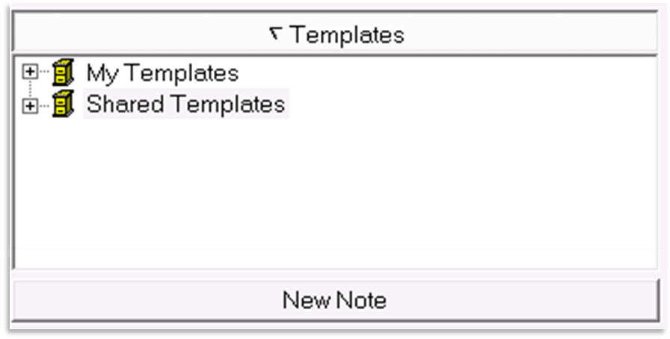

Slide 30


Slide 31
Personal Templates (My Templates)
  Templates you’ve created yourself
  Templates you’ve imported from a friend
  Templates you’ve imported from Shared Templates
Shared Templates
  Templates shared across your medical center
  Provided graciously by your Clinical Applications Coordinators (CACs)!

Slide 32
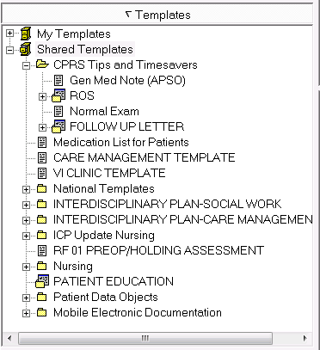

Slide 34


Slide 35
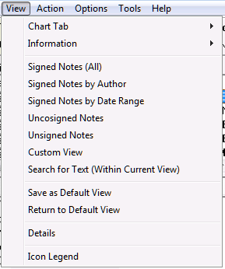
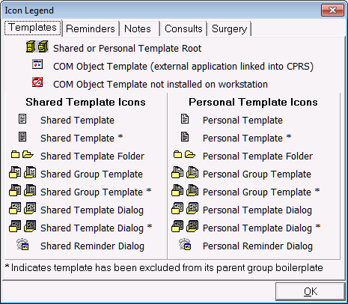

Slide 36
Template Types

Slide 38
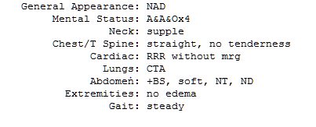
“Boilerplate” or Text Templates
Simple and easy to create
Entire template always entered into note
Can include patient data objects (example lab results, vitals, patient name, etc.)
Template fields can be included, but this changes the behavior of the template

Slide 39
Template Types

Slide 41
Dialog Templates
Pick and choose template components to include in your note
When processing, you are stuck in the template (gray box) until you complete it
Can include Patient Data Objects and Template Fields

Slide 42
Template Types

Slide 44
Reminder Dialog Templates
Can do lots of fancy stuff
  generate orders
  enter encounter information
  enter vital signs
  etc.
Usually permanently associated with a note title
Beyond the scope of this class
Talk to your Clinical Applications Coordinator (CAC)

Slide 45
Template Types

Slide 47

Template Folders – Get organized!
Useful for organizing templates
  by Category
  by Task
  by Portion of the Clinic Visit
  Etc.
Keep your template list under control

Slide 48
Templates Drawer
No longer a mystery!
But how do you create templates?
How do you organize this drawer?

Slide 49

You need the Template Editor!

Slide 50
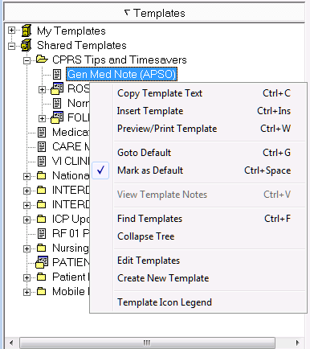
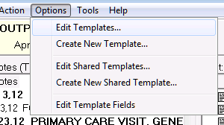
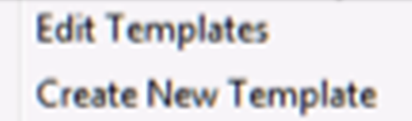
Template Editor
Right Click –OR– “Options”

Slide 51
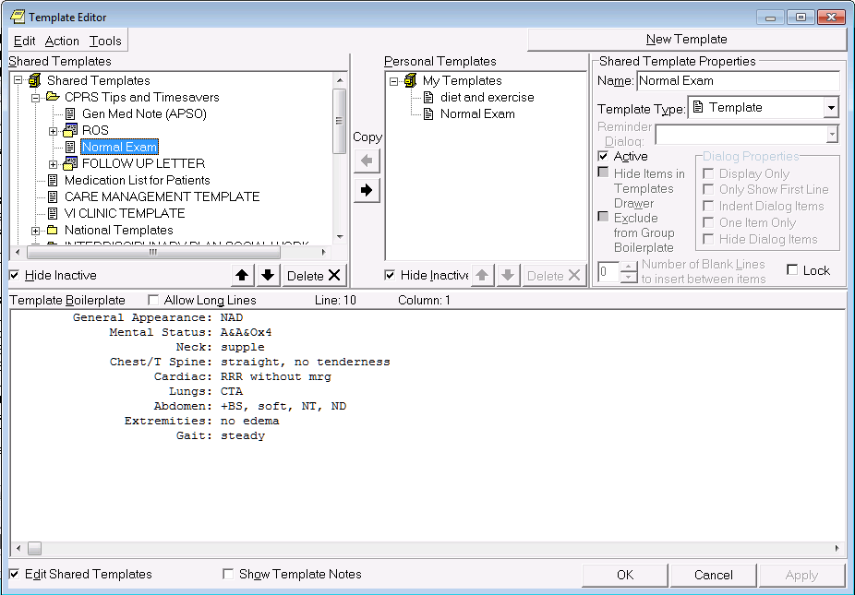
Template Editor
Notes:
The Template Editor! Here we are.

Slide 52

Create New Templates
Edit Existing Templates
Organize Personal Templates
Transfer from Shared -> Personal
Import & Export (for Sharing)
Template Fields/Patient Data Objects
Template Editor
Key Features
Notes:
Create New Personal Templates
Edit Existing Personal Templates
Organize Personal Templates
Transfer Shared Templates to Personal Templates
Import/Export Templates (for sharing)
Access Patient Data Objects
Access or Edit Template Fields
(Note: most sites restrict template field editing)

Slide 53
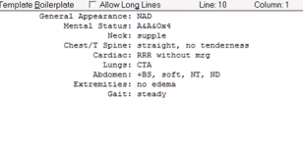
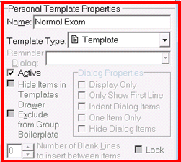
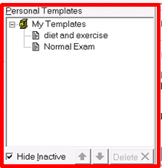

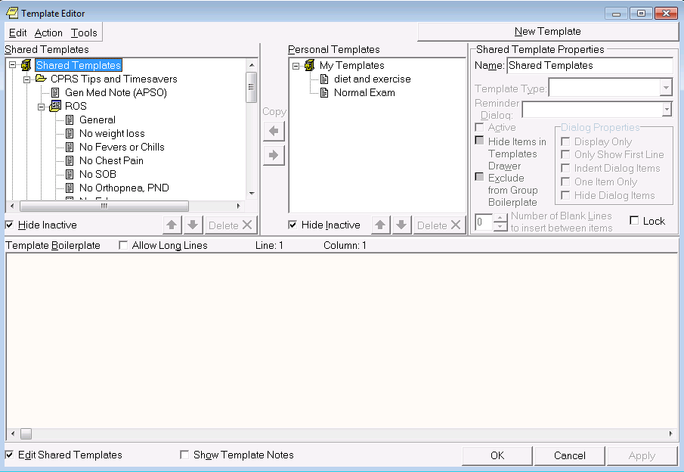
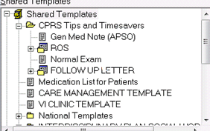
Let’s take a tour!
Notes:
Ok, Let’s take a TOUR of the Template Editor – one part at a time!

Slide 54
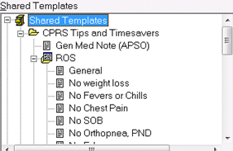
Template Editor
c

Slide 55
Template Editor
c

Slide 56
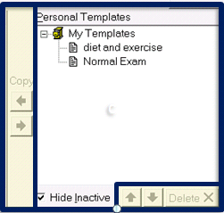
Template Editor
c

Slide 57
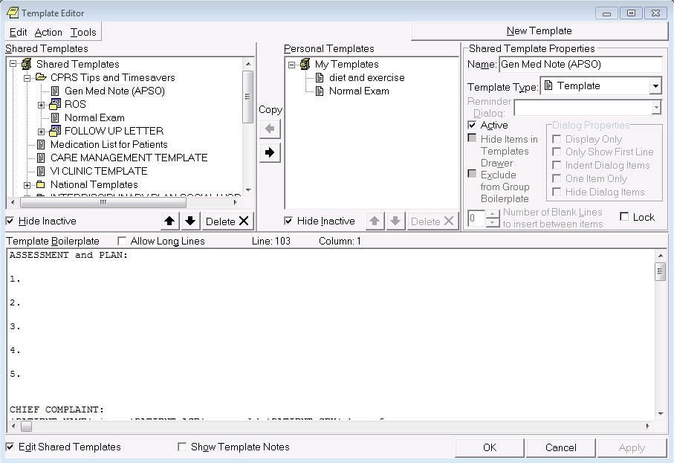
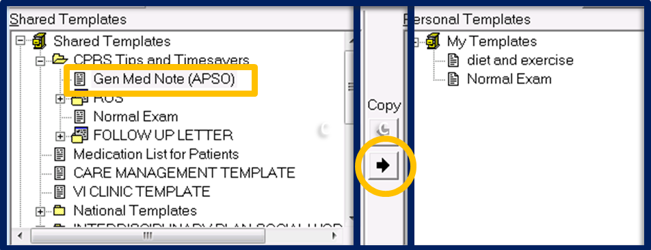
Template Editor
c
c

Slide 58
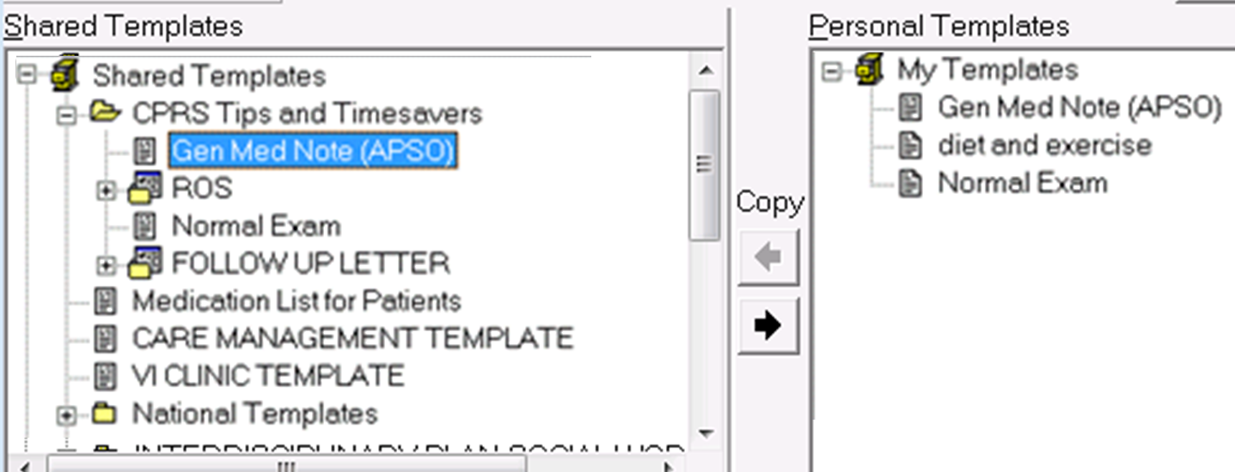
Template Editor

Slide 59
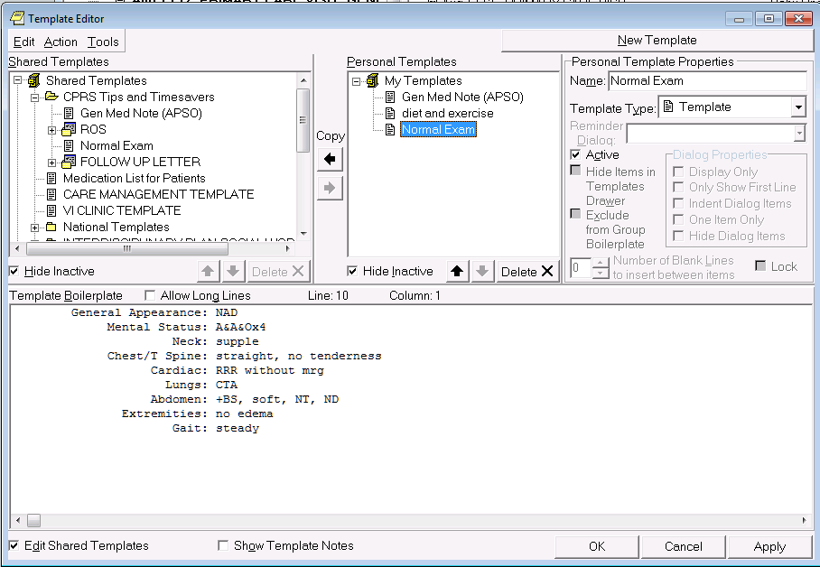

Template Editor

Slide 60
Template Editor

Slide 61
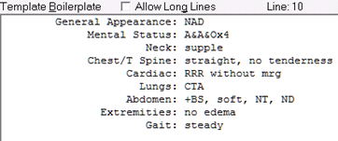
Template Editor

Slide 62
Template Editor
Edit Action Tools

Slide 63
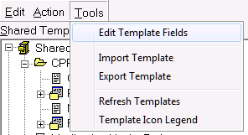
Template Editor
Edit Action Tools

Slide 64
Template Editor
Import Template
Export Template

Slide 65

Select Template to Export
Exporting Templates

Slide 66
Select Template to Export
Choose “Export Template” on Tools Menu
Exporting Templates

Slide 67
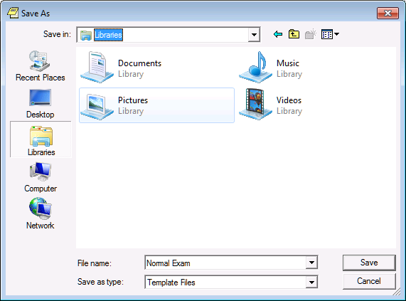
3. Choose Save As Location and Name
Exporting Templates

Slide 68
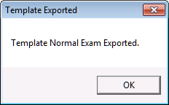
Choose Save As Location and Name
Click Save – template file is exported
Exporting Templates

Slide 69

5. Template saved in .txml file
Exporting Templates

Slide 70
Template saved in .txml file
E-mail the .txml file to your colleague
Exporting Templates

Slide 71
Template saved in .txml file
E-mail the .txml file to your colleague
Import .txml files
Importing Templates

Slide 72
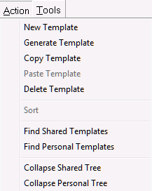
Template Editor
Edit Action Tools

Slide 73
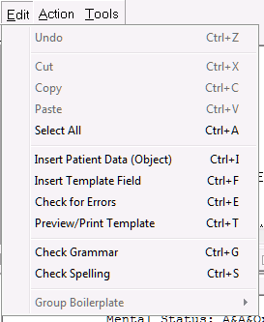
Template Editor
Patient Data Objects
Template Fields
Preview Templates
And More..
Edit Action Tools

Slide 74
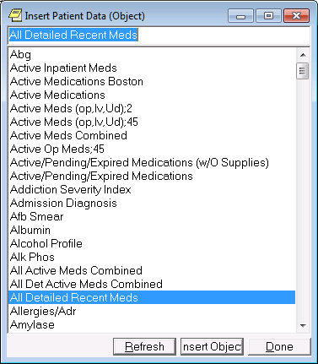
Template Editor

Slide 75
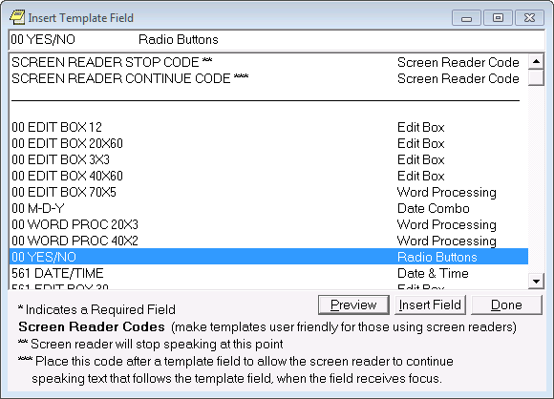
Template Editor

Slide 76

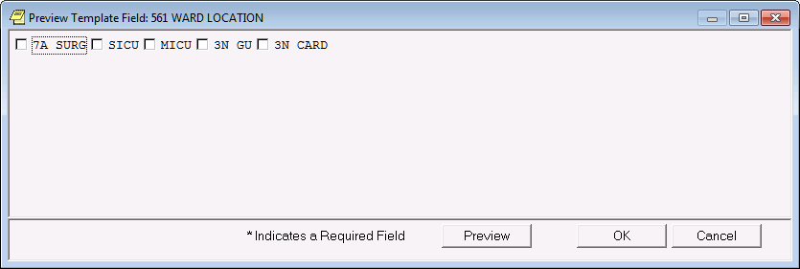
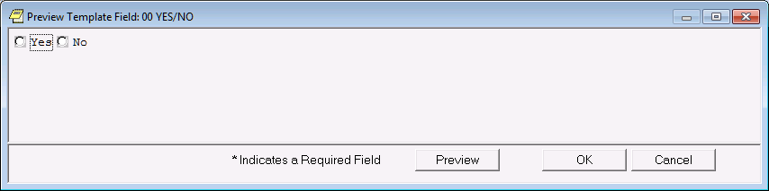
Edit Box
Combo Box
Button
Check Boxes
Radio Button
Date
Number
Hyperlink
Word Processing
Types of Template Fields
Notes:
9 different types of template fields

Slide 77
Template Editor

Slide 78
Template Editor

Slide 79
Template Editor
Notes:
Neil – Summarize – Template Drawer. Template Editor. // Template types, and the extras (PDO, Template Fields)

Slide 80
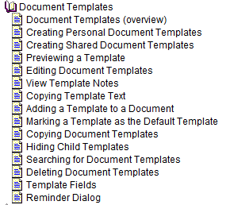

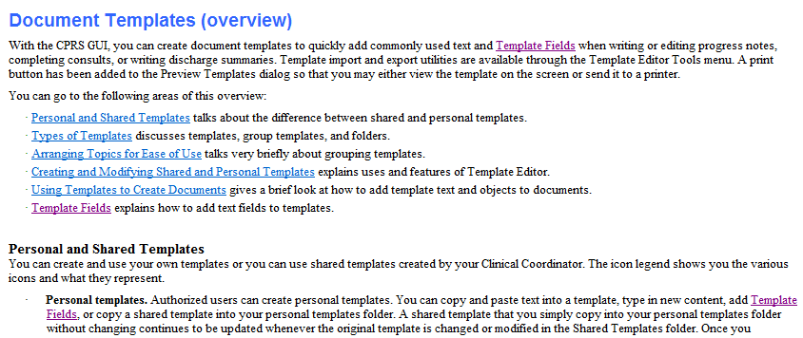
CPRS Help Menu

Slide 81

Text Templates “On the Fly”
Text Templates
Text Templates with Patient Data Objects
Text Templates with Template Field
Dialog Templates

Slide 82
Poll Question
How familiar are you with making templates?
A. I consider myself to be an expert in templates.
B. I am comfortable making templates but felt I could learn more by taking this class.
C. I have occasionally made my own templates but don’t really know what I am doing.
D. I have only rarely been in the Template Editor.
E. I have never even opened the Template Editor.

Slide 83
Text Templates “On the Fly”
Text Templates
Text Templates with Patient Data Objects
Text Templates with Template Field
Dialog Templates

Slide 84
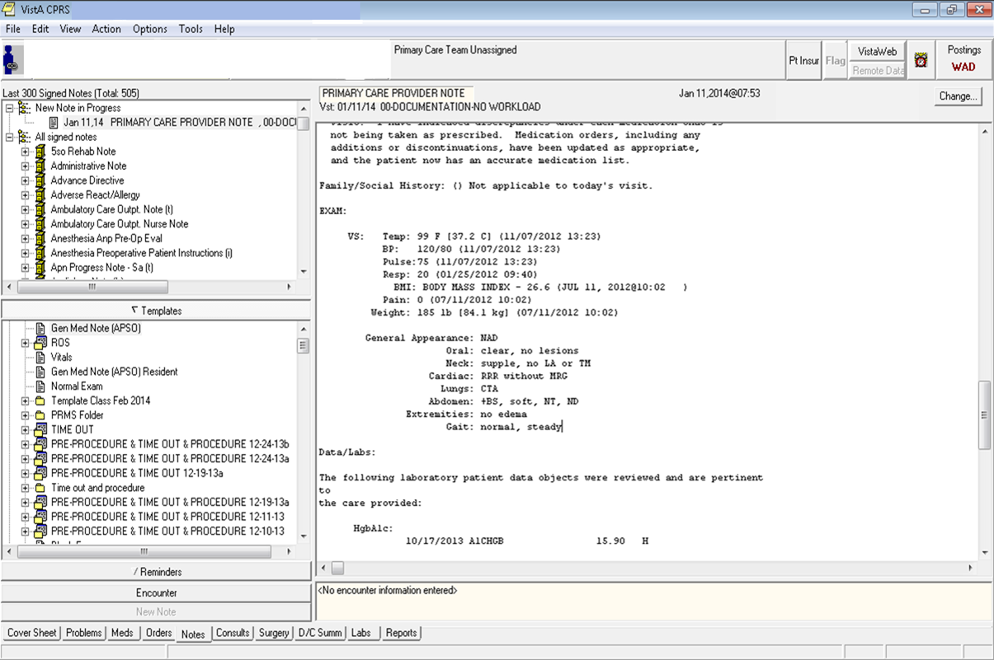
Create Text Template “On the Fly”
Notes:
Let’s say that you are writing a note and you type in a normal exam. You think to yourself that I would like to have this available to me to put in my notes as I always do the same thing when I create a normal exam. This is just a screen shot of CPRS and a note that I am editing.

Slide 85
To copy text into a new template…
Create Text Template “On the Fly”
General Appearance: NAD
Oral: clear, no lesions
Neck: supple, no LA or TM
Cardiac: RRR without MRG
Lungs: CTA
Abdomen: +BS, soft, NT, ND
Extremities: no edema
Gait: normal, steady

Slide 86
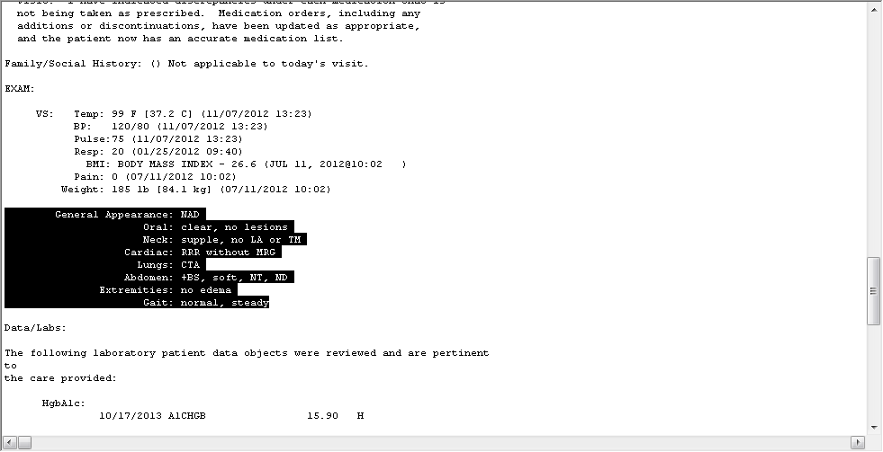
Create Text Template “On the Fly”
Highlight text

Slide 87
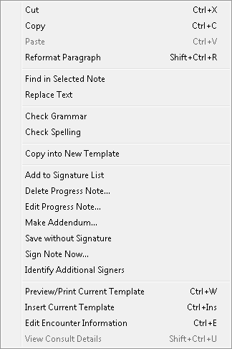
Create Text Template “On the Fly”
Highlight text
Right Click

Slide 88
Create Text Template “On the Fly”
Highlight text
Right Click
Select “Copy into New Template”

Slide 89
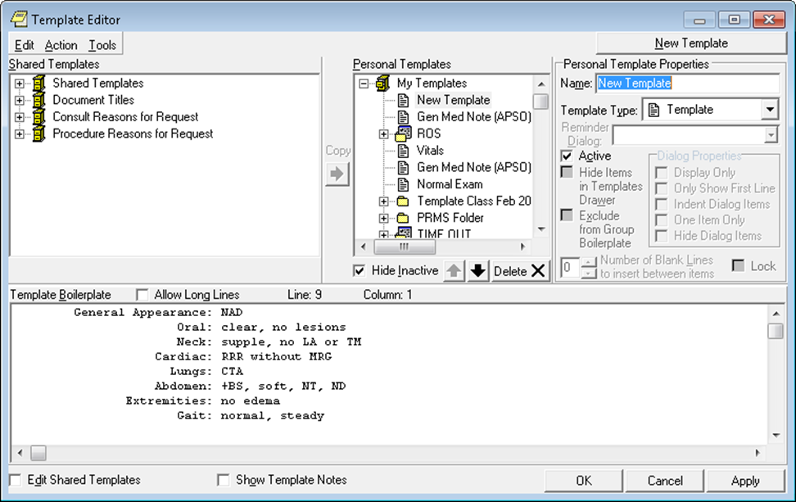
Create Text Template “On the Fly”
Template Editor will open
Notes:
.

Slide 90
Create Text Template “On the Fly”
Template Editor will open
…with text you copied

Slide 91
Create Text Template “On the Fly”
Name the new template

Slide 92

Create Text Template “On the Fly”
Name the new template
E.g., “Normal Exam”
-Personal Template Properties--
Name:
Normal Exam

Slide 93
Create Text Template “On the Fly”
To preview template:

Slide 94
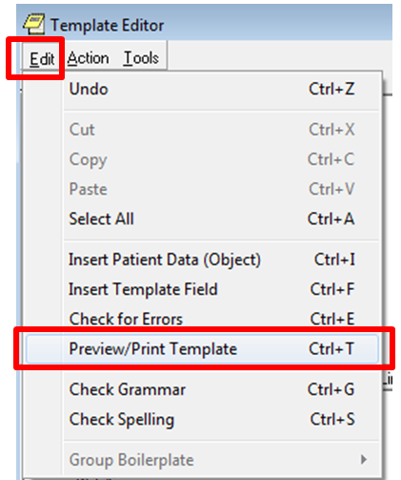
Create Text Template “On the Fly”
To preview template:
Select “Edit”

Slide 95
Create Text Template “On the Fly”
To preview template:
Select “Edit”
Select “Preview/Print Template”

Slide 96
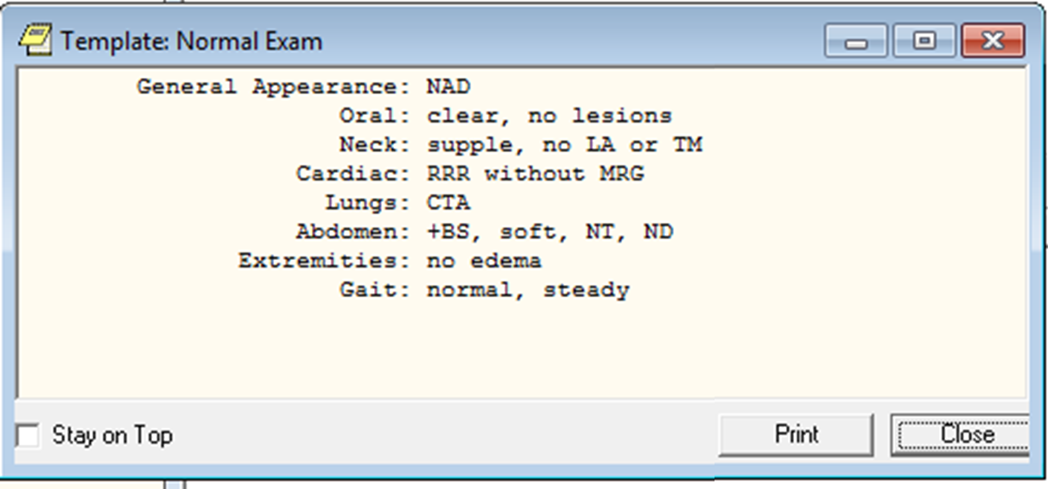
Create Text Template “On the Fly”
Preview/Print Template

Slide 97
Create Text Template “On the Fly”
Preview/Print Template
Looks good?
Click “Close” …

Slide 98
Create Text Template “On the Fly”
Template Editor
Looks good?
Click “Close” …
…to return to the Template Editor
…to return to the Template Editor

Slide 99
Create Text Template “On the Fly”
Template Editor
Click “OK” …

Slide 100

Create Text Template “On the Fly”
Click “OK” …
…to save and exit the Template Editor

Slide 101
Create Text Template “On the Fly”
Open the “Templates” Drawer

Slide 102

Create Text Template “On the Fly”
Open the “Templates” Drawer
to locate your template

Slide 103
Poll Results
A. I consider myself to be an expert in templates.
B. I am comfortable making templates but felt I could learn more by taking this class.
How familiar are you with making templates?
C. I have occasionally made my own templates but don’t really know what I am doing.
D. I have rarely been in the Template Editor.
E. I have never even opened the Template Editor

Slide 104
Text Templates “On the Fly”
Text Templates
Text Templates with Patient Data Objects
Text Templates with Template Field
Dialog Templates

Slide 105

Create Text Template
Click on the “Notes” tab

Slide 106

Create Text Template
Click on the “Notes” tab
Select “Options” menu

Slide 107
Create Text Template
Click on the “Notes” tab
Select “Options” menu
Select “Edit Templates…”

Slide 108

Create Text Template
Template Editor will open

Slide 109
Create Text Template
Select “New Template”

Slide 110
Create Text Template
Select “New Template”
Name the new template

Slide 111
Create Text Template
Select “New Template”
Name the new template
E.g., “Gen Med Note (APSO)”
Gen Med Note (APSO)
-Personal Template Properties--
Name:
Normal Exam
Gen Med Note (APSO)

Slide 112
Create Text Template
Select “New Template”
Name the new template
E.g., “Gen Med Note (APSO)”
3. Set the Template Type to “Template”
Gen Med Note (APSO)

Slide 113

Create Text Template
1. Enter desired text

Slide 114

Create Text Template
1. Enter desired text

Slide 115


Create Text Template
Enter desired text
Right-align text using spaces

Slide 116

Create Text Template
Enter desired text
Right-align text using spaces
Select “Edit”
Template Type:
General:
Oral:
Neck:
Cardiac:
Lungs:
Abd:
GU:
Ext:

Slide 117
Create Text Template
Enter desired text
Right-align text using spaces
Select “Edit”
Select “Preview/ Print Template”
Template Type:
General:
Oral:
Neck:
Cardiac:
Lungs:
Abd:
GU:
Ext:

Slide 118

Preview/Print Template
Create Text Template
Notes:
This is the preview

Slide 119

To set a template as “Default”:
Set as Default Template
Notes:
I am going to give you a bonus tip to help save you time. I want to set this template as my default so that I can more easily use it in the future using a keyboard short cut. I am in the template drawer and I have opened it.

Slide 120
To set a template as “Default”:
Right click on template
Set as Default Template

Slide 121

To set a template as “Default”:
1. Right click on template
2. Menu will
appear
3. Choose
“Mark as Default”
Set as Default Template
Notes:
This is my gen med note template. I want to set this template as my default

Slide 122


To set a template as “Default”:
4. Check mark will appear
Set as Default Template

Slide 123
Notice “Insert Template” option and keyboard shortcut. We will use this later.
Set as Default Template
Notes:
You will also see the choice “Insert Template” which is the second choice in the menu. You will also notice that there is a key board short cut next to it, Crtl + Ins keys. We will use this keyboard shortcut later in the presentation.

Slide 124
Text Templates “On the Fly”
Text Templates
Text Templates with Patient Data Objects
Text Templates with Template Field
Dialog Templates

Slide 125
Create Text Template w/ Pt Data Object
Notes:
I have created a simple review of systems text template related to CHF. I have not put in any template fields at this time. You could use this template as is.

Slide 126
Select “New Template”
Create Text Template w/ Pt Data Object

Slide 127
Select “New Template”
Name the new template
Create Text Template w/ Pt Data Object

Slide 128
Select “New Template”
Name the new template
E.g., “Creatinine”
Creatinine
Create Text Template w/ Pt Data Object
-Personal Template Properties--
Name:
Normal Exam
Creatinine

Slide 129
4. Place cursor in Template Boilerplate
Creatinine
Create Text Template w/ Pt Data Object

Slide 130

4. Place cursor in Template Boilerplate
5. Select “Edit”
Creatinine
Create Text Template w/ Pt Data Object

Slide 131
4. Place cursor in Template Boilerplate
Select “Edit”
Select “Insert Patient Data (Object)”
Creatinine
Create Text Template w/ Pt Data Object

Slide 132

“Insert Patient Data (Object)” will open
Create Text Template w/ Pt Data Object

Slide 133
“Insert Patient Data (Object)” will open
Type in “Lab Creatinine”
Create Text Template w/ Pt Data Object
Notes:
The insert patient data (Object) box will open. Type in lab and then creatinine as that is how things are set up here in Denver.

Slide 134
“Insert Patient Data (Object)” will open
Type in “Lab Creatinine”
Click “Insert Object”
Create Text Template w/ Pt Data Object
Notes:
The insert patient data (Object) box will open. Type in lab and then creatinine as that is how things are set up here in Denver.

Slide 135

Create Text Template w/ Pt Data Object
Notes:
This is what it will look like in the boilerplate area
Notice the straight bars on either side of the data object.
Let’s see what it looks like when we preview it. Edit menu, preview template.

Slide 136

Preview/Print Template
Create Text Template w/ Pt Data Object
Notes:
This is what it will look like in the boilerplate area
Notice the straight bars on either side of the data object.
Let’s see what it looks like when we preview it. Edit menu, preview template.

Slide 137


Create Text Template w/ Pt Data Object
Notes:
Let’s create another one for a hemoglobin A1c.
Create a new text template and name it Hemoglobin A1c.
Repeat the process I just showed you - Put your cursor in the Template Boilerplate area. Choose edit and then insert patient data object:

Slide 138

“Insert Patient Data (Object)” will open
Type in “Lab A1c”
Create Text Template w/ Pt Data Object
Notes:
Choose Lab A1c. You will need to become familiar with the naming conventions at your facility.

Slide 139


Create Text Template w/ Pt Data Object
Notes:
This is what it will look like in the template boilerplate.

Slide 140

Select “Edit”
Create Text Template w/ Pt Data Object
Notes:
Let’s preview what this template looks like so far. Go to the Edit Menu and choose Preview in the Template editor.

Slide 141
Select “Edit”
Select “Preview /Print Template”
Create Text Template w/ Pt Data Object
Notes:
Let’s preview what this template looks like so far. Go to the Edit Menu and choose Preview in the Template editor.

Slide 142

Preview/Print Template
Create Text Template w/ Pt Data Object
Notes:
Let’s see what it looks like when we preview it. Edit menu, preview template.
Notice that some of these objects don’t appear in a particular pleasing way.
One way to improve that is to add some basic text to these patient data objects. I am going to just show you a screen shot of a lab template that combines several patient data objects.

Slide 143

Create Text Template w/ Pt Data Object
Notes:
I have used to space bar to move the values to the right and I have used some text to better organize the types of labs. I won’t go through making this template but it should be pretty clear from what we have done before. I create a text template, type some text and then insert the various patient data objects.
Anything with straight bars are patient data objects and anything without the bars is just plain text.

Slide 144
Basic Text
Create Text Template w/ Pt Data Object
Notes:
I have used to space bar to move the values to the right and I have used some text to better organize the types of labs. I won’t go through making this template but it should be pretty clear from what we have done before. I create a text template, type some text and then insert the various patient data objects.
Anything with straight bars are patient data objects and anything without the bars is just plain text.

Slide 145
Basic Text
Create Text Template w/ Pt Data Object
Patient Data Objects
Notes:
I have used to space bar to move the values to the right and I have used some text to better organize the types of labs. I won’t go through making this template but it should be pretty clear from what we have done before. I create a text template, type some text and then insert the various patient data objects.
Anything with straight bars are patient data objects and anything without the bars is just plain text.

Slide 146
Create Text Template w/ Pt Data Object
Notes:
I have used to space bar to move the values to the right and I have used some text to better organize the types of labs. I won’t go through making this template but it should be pretty clear from what we have done before. I create a text template, type some text and then insert the various patient data objects.
Anything with straight bars are patient data objects and anything without the bars is just plain text.

Slide 147

Preview/Print Template
Create Text Template w/ Pt Data Object
Notes:
And again this is what it looks like when we preview it.

Slide 148
Text Templates “On the Fly”
Text Templates
Text Templates with Patient Data Objects
Text Templates with Template Field
Dialog Templates
Notes:
By using template field in text template, it changes how the template behaves

Slide 149
Create Text Template w/ Template Field
Notes:
I have created a simple review of systems text template related to CHF. I have not put in any template fields at this time. You could use this template as is.

Slide 150
-Personal Template Properties--------
Name:
ROS (with template field)
Create Text Template w/ Template Field
CHF Review of Systems:
SOB:
PND:
Edema:
Chest discomfort:
Daily Weights:
Med Compliance:
Notes:
I have created a simple review of systems text template related to CHF. I have not put in any template fields at this time. You could use this template as is.

Slide 151
-Personal Template Properties--------
Name:
ROS (with template field)
Create Text Template w/ Template Field
CHF Review of Systems:
SOB:
PND:
Edema:
Chest discomfort:
Daily Weights:
Med Compliance:
Notes:
I am going to be sure to put my cursor next to SOB: In fact, it is one space to the right of the colon.

Slide 152
Select “Edit”
Create Text Template w/ Template Field
Notes:
I have created a simple review of systems text template related to CHF. I have not put in any template fields at this time. You could use this template as is.

Slide 153
Select “Edit”
Select “Insert Template Field”
Create Text Template w/ Template Field
Notes:
I have created a simple review of systems text template related to CHF. I have not put in any template fields at this time. You could use this template as is.

Slide 154

“Insert Template Field” menu will open
Create Text Template w/ Template Field
Notes:
Don – do you want to delete this slide and skip straight to the next one which has the first prompt “Select template field”?
Choose the template field you want. In this case, I am just choosing a simple yes and no. Note that I choose radio button option.

Slide 155
Insert Template Field menu
Create Text Template w/ Template Field
Select template field
Notes:
Choose the template field you want. In this case, I am just choosing a simple yes and now. Note that I choose radio button option.

Slide 156
Insert Template Field menu
Create Text Template w/ Template Field
Select template field
Click “Insert Field”
Notes:
Choose the template field you want. In this case, I am just choosing a simple yes and now. Note that I choose radio button option.

Slide 157
CHF Review of Systems:
SOB:
PND:
Edema:
Chest discomfort:
Daily Weights:
Med Compliance:
{FLD:YES –OR- NO}
Create Text Template w/ Template Field
{FLD:YES –OR- NO}
Field will be inserted at cursor
Notes:
When you choose insert, it will go where your cursor is. In this case, I had my cursor next to the SOB option.

Slide 158

Preview/Print Template
Create Text Template w/ Template Field

Slide 159
Create Text Template w/ Template Field
CHF Review of Systems:
SOB:
PND:
Edema:
Chest discomfort:
Daily Weights:
Med Compliance:
Notes:
I will get out of the preview mode and we are now back to our template. I will put my cursor next to PND and then insert another Template Field.

Slide 160
Select “Edit”
Create Text Template w/ Template Field
Notes:
Again, I’m going to select Edit

Slide 161
Select “Edit”
Select “Insert Template Field”
Create Text Template w/ Template Field

Slide 162

“Insert Template Field” menu will open
Create Text Template w/ Template Field
Notes:
Insert Template Field will open

Slide 163
Insert Template Field menu
Select template field
Click “Insert Field”
Create Text Template w/ Template Field
Notes:
Click Insert Field

Slide 164

CHF Review of Systems:
SOB: {FLD:YES –OR- NO}
PND: {FLD:YES/NO}
Edema:
Chest discomfort:
Daily Weights:
Med Compliance:
Create Text Template w/ Template Field
Field will be inserted at cursor
Notes:
This is what that new template field looks like in the Template Boilerplate. Again, this is the “under the hood” view.
Let’s preview the template…you know what to do by now so let’s jump ahead to what it looks like.

Slide 165

Preview/Print Template
Create Text Template w/ Template Field

Slide 166

Preview/Print Template
Create Text Template w/ Template Field
Notes:
This is the preview of the template so far. I clicked on the little down arrow to see what options (yes/no) is available in this particular template field.

Slide 167
CHF Review of Systems:
SOB: {FLD:YES –OR- NO}
PND: {FLD:YES/NO}
Edema: {FLD:YES –OR- NO}
Chest discomfort: {FLD:YES –OR- NO}
Daily Weights: {FLD:YES –OR- NO}
Med Compliance: {FLD:YES –OR- NO}
Create Text Template w/ Template Field
Completed Template
Notes:
Here, I finished entering the rest of the yes/no template fields. I made all of them, except the second one, radio buttons. Again this is the under the hood view of the template in the Template Boilerplate.

Slide 168
Preview/Print Template
Create Text Template w/ Template Field
Notes:
This is what it looks like when you preview how it is going to look like when you go to use it.

Slide 169
Text Templates “On the Fly”
Text Templates
Text Templates with Patient Data Objects
Text Templates with Template Field
Dialog Templates

Slide 170

Dialog Templates
Notes:
Let’s start a new dialog template

Slide 171
Create a new template and name it “ROS (Dialog)”
Dialog Templates
Notes:
Let’s start a new dialog template

Slide 172
Create a new template and name it “ROS (Dialog)”
Set the Template Type to “Dialog”
Dialog Templates
Notes:
Create a new text template and name it ROS (Dialog)

Slide 173
Create a new template and name it “ROS (Dialog)”
Set the Template Type to “Dialog”
Dialog Templates
3. Type “Review of Systems” into template boilerplate
Notes:
Type in Review of Systems in the template boilerplate part.

Slide 174
Dialog Templates
Notes:
So, we now have a new template that is a dialog template with the text “Review of Systems” typed in. Functionally, this is exactly like a regular text template.

Slide 175
Select “New Template” again to create a new child template
Dialog Templates
Notes:
Click on New Template to start a new child template.

Slide 176

Select “New Template” again to create a new child template
Dialog Templates
Note how it displays under “ROS (Dialog)”
Notes:
Click on New Template to start a new child template.

Slide 177

Select “New Template” again to create a new child template
Name the template, in this case we will name it “General”
Dialog Templates
Notes:
Type in a name for the child template, in this case “General.”

Slide 178

Select “New Template” again to create a new child template
Name the template, in this case we will name it “General”
Dialog Templates
Note how it changes to “General”
Notes:
Type in a name for the child template, in this case “General.”

Slide 179
Select “New Template” again to create a new child template
Name the template, in this case we will name it “General”
Dialog Templates
Parent Template
Child Template
Notes:
Type in a name for the child template, in this case “General.”

Slide 180
In the child template:
Dialog Templates
Notes:
Make sure you are in child template

Slide 181
In the child template:
1. Type in text, in this case “Feels well.”
Dialog Templates
Notes:
Next, type in what you want in the child template. Notice the two spaces at the front of the “Feels well.”

Slide 182
Dialog Templates
Click back to parent template
Notes:
Click back on parent template “ROS (Dialog)”

Slide 183

Dialog Templates
Click back to parent template
Several options have now become available
Notes:
I repeat, you need to click back on the parent template.
Because this dialog template now has a child template, several options become available. Click on Indent dialog items as well as hide dialog items to make the template more useful. I have also typed in “Review of Systems” in the parent template.

Slide 184
Dialog Templates
Create additional Child Templates by repeating the process
Notes:
Click on New Template to start another child template.

Slide 185
Dialog Templates
Create additional Child Templates by repeating the process
Notes:
Click on New Template to start another child template.
I will name this one No Weight loss. I will type in the Template Boilerplate “No weight loss.”

Slide 186

Dialog Templates
Create additional Child Templates by repeating the process

Slide 187


Dialog Templates
Parent Template
Child Templates

Slide 188


Dialog Templates
Add as many child templates as needed
Notes:
Keep adding the various child items. For example, in the “No Fevers or Chills” template, I simply typed No Fevers or Chills with two spaces in front of the words.

Slide 189

Preview/Print Template
Dialog Templates
Notes:
Because we clicked on Hidden when we created the parent template, all the child templates are hidden until you click in the box next to Review of Systems. If you remember, we typed Review of Systems in our parent template.

Slide 190

Preview/Print Template
Check the box to display the child templates
Dialog Templates
Notes:
Everything is hidden until I click on box next to Review of Systems. Everything now is unhidden.
Do you remember that we clicked on indent? Note that the various elements have the boxes indented to make them easier to see and differentiate.

Slide 191

Preview/Print Template
Check the box to display the child templates
Select all child templates you want to appear in your note
Dialog Templates
Notes:
Click what you want to appear in your note. The unchecked items do not appear in your note.

Slide 192

Preview/Print Template
Dialog Templates
Notes:
This is what it will look like after you have chosen what you clicked on and then clicked OK. This will go into your progress note where your cursor is.
Also note that I put two spaces in front of each of the items which will make it easier to read.

Slide 193
Text Template “On the Fly”
“Normal Exam”
Text or “Boilerplate” Template
“Gen Med Note (APSO)”
Text Template with Patient Data Object
Text Template with Template Field
Dialog Template
“Creatinine,” “A1C,” “Lab Template”
“CHF ROS (with template field)”
“ROS”

Slide 194
Using Templates to Build Progress Notes
Notes:
Will give a brief example.
Generally prefer text templates as dialog templates lock you into the template.
Can build progress using multiple templates

Slide 195

Notes:
First, let’s assume we are sitting in front of the patient. We have CPRS open and we start with a blank progress note. In this case, I am using the progress note title “primary care provider.”

Slide 196


OR
Ctrl + Insert
Create additional Child Templates by repeating the process
Notes:
I have the template drawer open and I either use the keyboard short cut Ctrl and Ins or a drag my Gen Med Note (APSO) over to the progress note. I can use the key board short cut as I had set this template to be my default earlier.

Slide 197
Create additional Child Templates by repeating the process
Notes:
Here is my basic building block for my progress note.

Slide 198
Create additional Child Templates by repeating the process

Slide 199
S
O
A
P
Create additional Child Templates by repeating the process
Notes:
Everyone is familiar with the SOAP format to progress notes.

Slide 200
A
P
S
O
Create additional Child Templates by repeating the process
Notes:
I turn this around and use the APSO format.

Slide 201
A/P
S
O
Create additional Child Templates by repeating the process
Notes:
I combine my assessment and plans so I use A/P SO.

Slide 202
Create additional Child Templates by repeating the process

Slide 203
Create additional Child Templates by repeating the process

Slide 204
A/P
S
O
Create additional Child Templates by repeating the process

Slide 205

Drag general ROS Template into HPI/ROS section of template
Notes:
I then start to write my note with the patient in the room. Usually I would start typing. For this example, let’s start with the templates. Under the HPI/ROS, I want to do a general ROS. I will use my ROS dialog template I created earlier and drag it over to the HPI section. (Please note that this ROS template is the same as the ROS (Dialog) template I created. It just has a different name.

Slide 206
Drag general ROS Template into HPI/ROS section of template
ROS Template opens. Click on the questions you asked the patient
Notes:
The ROS template opens and I click on the questions I asked.

Slide 207


Drag general ROS Template into HPI/ROS section of template
ROS Template opens. Click on the questions you asked the patient
The text from ROS Template is dropped into template where cursor is (here it is under “HPI/ROS”)
Notes:
The text from the ROS template is dropped right where my cursor was.

Slide 208
4. Now drag and drop “CHF ROS” template
Notes:
Now, let’s use our more specific CHF ROS template – you will recall that we created this one using template fields. It will have a similar feel to a dialog template.
Drag CHF ROS under the under the text we created with the ROS template and it will open.

Slide 209

Now drag and drop “CHF ROS” template
CHF ROS Template will open

Slide 210

My Progress Note so far
Notes:
This is what the progress note now looks like so far after using two templates.

Slide 211

6. Highlight existing blank exam and delete it
Notes:
Now, let’s assume that we did an exam on this patient and it was completely normal. However, we already have a blank exam in our note. We need to highlight the existing blank exam and then delete it.

Slide 212

Highlight existing blank exam and delete it
7. Now drag and drop “Normal Exam” template
Notes:
Drag over the normal exam template into your note under Exam.

Slide 213


8. Now drag and drop “Lab Template”
Notes:
Now let’s drag over some lab tests. In this case, I am going to drag over the larger Lab Template I created. You could drag over individual lab templates such as the one I created for the creatinine or hgbA1c. But in this case, I want to see all the labs that are on the template.
You continue to write your note using free text and perhaps other templates that you have created.

Slide 214
My
Progress Note
so far
Notes:
And, again, this is the note I have created so far. I used main template and then used four more templates (two ROS templates, one exam template, and one lab template) to create what I have here. You can see parts of the lab section but not all of it.

Slide 215
You would complete the note from now on with free text
Notes:
Just continue your note.

Slide 216
Text Templates “On the Fly”
Text Templates
Text Templates with Patient Data Objects
Text Templates with Template Field
Dialog Templates

Slide 217

Ask the Presenter
Notes:
If you haven’t submitted your questions yet, it’s not too late. Just click on the “Ask The Presenter” icon above my head. We’re going to a brief commercial and then Neil and I will be back to answer your questions.

