Slide 1
ICD10 General Equivalence Maps (GEM): What are they and how are they used?
Jennifer Teal, MS, RHIA, CCS, CPC
Shelley Weems, RHIA, CCS
Notes:
Jen: Good afternoon everyone, and thank you for joining us. Today Shelley and I are going to discuss an overview of the ICD-9 and ICD-10 code sets and delve into the workings of the ICD-10 General Equivalence Maps or GEMS.

Slide 2
Objectives
Notes:
Doctor working on a digital tablet with copy space :90266317 from Shutterstock.com
Course Objectives: The attendee will be able to:
Identify the major differences between the ICD-9 and the ICD-10 code sets
Identify the different types of General Equivalent Maps (GEMs) that are available
Outline the appropriate use of the GEMs
Identify methods to avoid errors when using the maps
Outline generable principle to identify GEM which should be used to fit the code mapping scenario
How to apply guidelines provided in order to use the GEMs

Slide 3

Poll Question
What is your primary interest in using General Equivalent Maps?
    Gain familiarity with ICD10
    Minimize learning impact of ICD10
    Comparison of ICD9 and ICD10 data
    Use as an additional reference tool for ICD10
Notes:
Jen: Before we get started, I’d like to ask our first poll question.
We would like some insight into what your primary interest is in using GEMs?
Is it: A. Familiarize yourself with ICD10
B. To minimize the learning impacts of I10
C. For comparison of I9 and I10 data, or
D. As a reference Tool for I10
To answer this question, use the blue polling icon above my head. We’ll move on and come back to your results in just a moment.

Slide 4
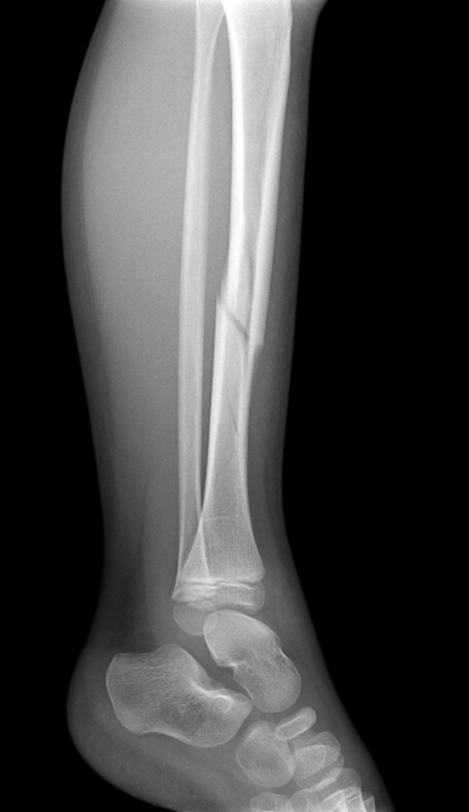
English
I fell and broke my leg
Spanish
Me caí y me rompí la pierna
French
Je suis tombé et cassé mon ma jambe
Russian
Я упал и сломал мою ногу
German
Ich fiel und brach mein Bein
Notes:
Jen: Shelley, can you give us a description of the GEMs, who developed them, and what they are used for.
What are gems: general purpose equivalents of two code sets, in this case ICD9 and ICD10
Who developed them: CMS
Purpose: serve as a reference tool to aid in finding all of the closest equivalent meaning to a value without consideration of a specific use.
What they are not: Crosswalk, for most part there is not one to one match in meaning, nor do they have a one to many match in meaning.
Why can’t we use them as a crosswalk: If the two code sets had values that meant the same thing we would really need a new code set.
-A sentence translated from English to spanish may not be able to capture the full meaning of the original because of fundamental differences in the structure of the language. Likewise, a code set may not be able to seamlessly link the codes in one set to identical counterparts in the other code set. Put simply, the GEM is a bi-directional translational dictionary.

Slide 5
Lessons Learned
GEMs should not be utilized as a replacement for native coding based on documentation
Backward Mapping or I10 to I9 GEM can and should be used for the majority of uses
Reimbursement Mappings should be used as a last resort, contain generic and unspecified codes
GEMs can be utilized to identify specificity or additional codes that might have otherwise gone unnoticed
Notes:
Jen: So Shelley, who uses the GEMs and what is the benefit of using them?
Lessons learned from attempting to use GEMs
-GEMs were developed to aid or reference tool. They are not meant to serve as a replacement for learning the new ICD10-CM and PCS code set.
-As a general rule the best GEMs to use is the I10 GEM as default.
-Reimbursement Mappings should be avoided, created to support payment consistency between I9 and I10. CMS after study determined GEMs were more accurate in meeting their objectives related to creation of MS-DRGs. Published by CMS at the 2011 ICD9 Coordination and Maintenance committee meeting on the CMS website, just look for Medical Severity DRG conversion project.
-Last but not least, a positive lesson is that the GEMs can be useful to identify specificity, additional codes that possibly need to be included or considered for a specific purpose, and one resource to familiarize yourself with specific section or category of codes.
Jen: Really, use of the GEMS does not replace learning the new code set.

Slide 6
Poll Results
Notes:
Jen: Now let’s pause for a moment and take a look at your poll results. We asked what is your primary interest in using General Equivalent Maps?
(Respond to the results, explain to the audience why their participation was helpful, or why it was a good learning point before moving on.)
[erase these notes and add your own!]
No matter your primary reason any of these reasons can be valid and you may have more than one.

Slide 7
Appropriate Uses of GEMS
To create applied Mappings – CMS Outlined Use
Research
Claims adjudication
Analyzing coding patterns
Historical Data for comparison – CMS Outlined Use
Test records – CMS Outlined Use
General Reference Tool – CMS Outlined Use
One “best” for specific use
All possibilities
Desired Outcome
Notes:
Applied mapping: what is it and why you would create one. The terminology ‘applied mappings’ has been used by CMS to define a mapping that is created for a specific purpose. An example of that is a specific research study or specific category of diagnostic conditions coding and documentation pattern.
CMS in developing the GEMs as general purpose believed that they could serve some usefulness for quick historical data comparison, such as single report analysis.
The GEMs are being utilized by many organizations for purposes of planning and analysis in advance to determine impacts.
Jen: I’ve also heard that professional organizations are also using GEMs to identify areas in the code set that need to be corrected or improved, and as an aid during training. Because we are dealing with an new code “language”, it will be necessary to translate back and forth between I9 and I10 code systems for specific purposes.
Context is everything, and the specific purpose of an applied mapping must be identified before the most appropriate methodology and plan for tools that can be used can be determined. The GEMs were really designed to provide the ‘best’ not always ‘fully’ equivalent considering all possible uses.

Slide 8
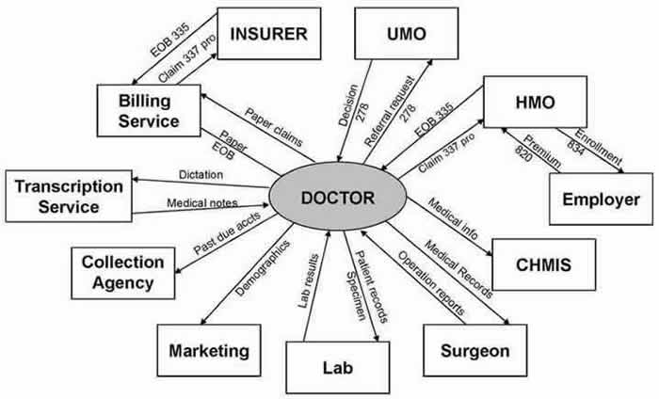
HTN
DM
CHF
Notes:
Obtained from: http://www.batuta.org/hipaa-trans1.jpg via Google images search HIPAA
U.S. is implementing two modifications for two of the code set standards adopted in the Transactions and Code Sets pursuant to HIPAA.
Adopts the International Classification of Diseases, 10th Revision, Clinical Modification (ICD-10-CM) for diagnosis coding and Official ICD-10-CM Guidelines for Coding and Reporting.
Adopts the International Classification of Diseases, 10th Revision, Procedure Coding System (ICD-10-PCS) for inpatient hospital procedure coding and Official ICD-10-PCS Guidelines for Coding and Reporting.
Jen: CPT coding is not affected since only those folks that use Volume 3 of ICD-9 for the inpatient procedure codes will use ICD-10-PCS. As a result, we will not be covering the PCS GEMS in detail.

Slide 9
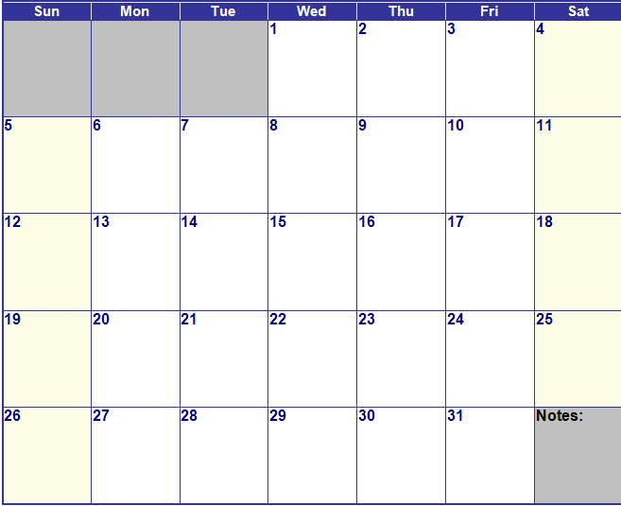
October 2014
X
ICD-9-CM
ICD-10-CM & PCS
Visit Date
Notes:
Code Set is date of service driven. Outpatient Encounters occurring on 10/1/2014 and after will be coded using ICD10-CM. CPT will continue to be used to capture procedure and services for outpatients. HIM coding staff will utilize ICD-10-CM and PCS will be used for all inpatient discharges occurring on or after 10/1/2014.
Jen: So let me see if I understand this correctly, if I am entering codes on October 2, 2014 for an encounter that took place on September 30, 2014 , I am going to continue to utilize ICD-9-CM codes right?
YES that is correct. This change is very similar to code set versioning that happens each year for ICD in Oct when code set is updated to include new codes, deleted codes, or modified codes. The biggest difference is this will be code set versioning ‘on steroids’.

Slide 10


ICD9
ICD10
Notes:
Paint dripping 46035352 from shutterstock.com
Paint pots in assorted colors 85315798 from shutterstock.com
Shelley: Jennifer, can you explain to our audience a little bit about the differences between ICD-9 and ICD-10.
Jen: Sure Shelley. The biggest difference is the sheer volume of codes available. Using the image on the slide as an example, ICD-9 uses only a few colors. You can see here that we have a great deal more color choices with ICD-10.
Not only is there an increase in the volume of codes from approximately 13,000 codes in ICD-9, to approximately 68,000 codes in ICD-10-CM, but ICD-10 often provides a higher level of specificity in the codes.
ICD-10-CM codes are comprised of seven alphanumeric characters, compared to five digits in ICD-9. We move from 17 chapters in ICD-9, to 21 chapters in ICD-10.
ICD-10 has significantly increased specificity and allows for expandability. It incorporates advances in medicine and technology, provides more detail on socioeconomic and family factors, problems related to lifestyle, and outcomes of screening.
And finally, ICD-10-CM provides added detail on etiology, anatomy, severity, laterality, and post-procedural disorders.

Slide 11
ICD9: 038.12 Methicilin Resistant Staphlococcus Aureus Septicemia
ICD10: A41.02 Sepsis due to Methicillin resistant Staphylococcus Aureus
Notes:
Let’s talk for a minute about the code format in ICD-10-CM.
In this example, the ICD-10 code is virtually identical to the old ICD-9 code. The only difference is an updated terminology. Where ICD-9 uses the term septicemia, ICD-10 uses Sepsis instead.
Jen: Let’s also point out the difference in the format of the code itself. I mentioned that ICD-10 codes were alphanumeric. The first character always starts with a letter. Valid codes in ICD-10 can be anywhere from 3-7 characters long. But you see, the category is still 3 characters, followed by a decimal. So in the example here with A41.02, this ICD-10 code looks very similar to an ICD-9 code.

Slide 12
ICD9: 402.91 Hypertensive heart disease, unspecified with heart failure
ICD10: I11.0 Hypertensive heart disease with heart failure
Notes:
Jen: Here is another example where the two codes have slightly different descriptors. In ICD-10, the type of hypertension is no longer required (benign, malignant, unspecified), so that descriptor was removed from the code description.

Slide 13
ICD9: 854.05 Intracranial injury of other and unspecified nature, without mention of open intracranial wound, with prolonged unconsciousness, no return to normal
ICD10: S06.2X6S Diffuse traumatic brain injury with loss of consciousness greater than 24 hours without return to pre-existing conscious level with patient surviving, sequela
Notes:
In this example, we see the full scope of specificity available in ICD-10. In this example, ICD-10 allows for description of diffuse TBI, which was not possible in ICD-9. The code also shows a placeholder (X) in the 5th character position. This placeholder will be used for future expansion. The placeholder must be coded for a valid code. The code also includes a 7th character, called an extension. This extension indicates the type of encounter, in this case a sequela or late effect associated with TBI.

Slide 14
General Equivalence Maps
GEM
Notes:
Jen: Now, before we get into the detail about using the GEMS, just a quick reminder to use the “Ask the presenter” if you have any questions, which is the orange button above my head. We will answer your questions at the end of the presentation.

Slide 15
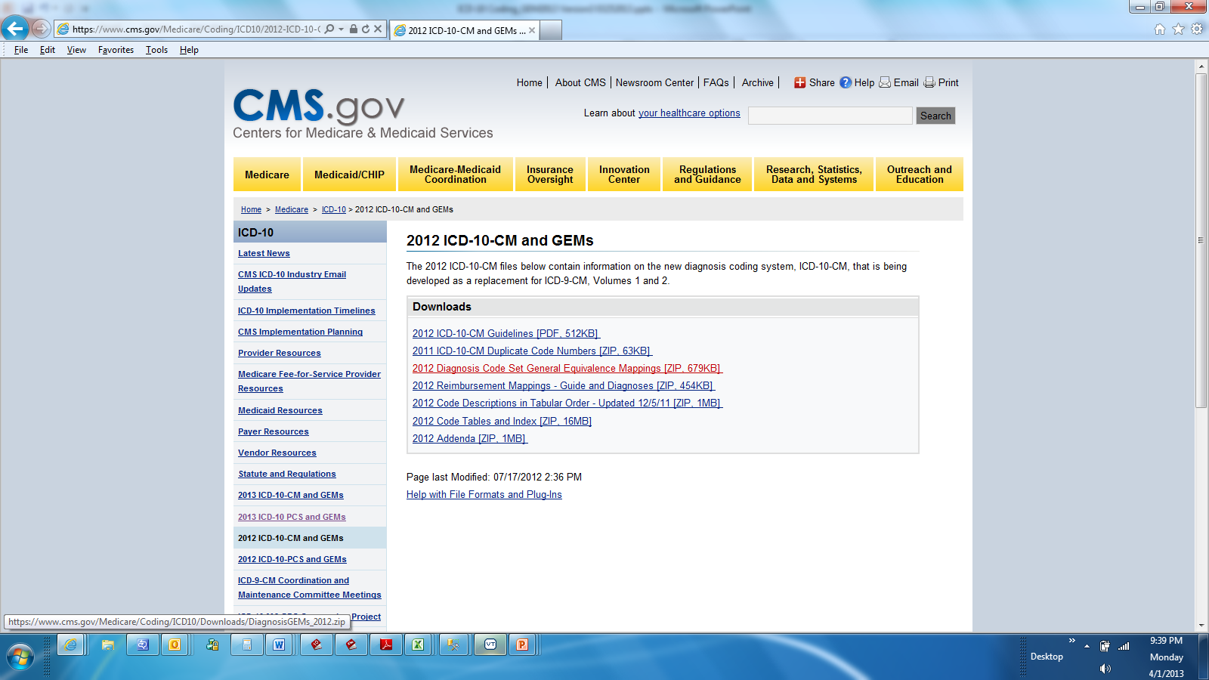
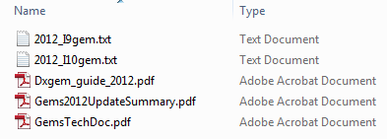
Notes:
Jen: There two sets of diagnosis GEMS, one for mapping ICD-10-CM to ICD-9-CM (backward map) and one for mapping ICD-9-CM to ICD-10-CM (forward map). There are also two sets for PCS mapping.
Additionally, There are Diagnosis GEM Guide that covers general introduction to GEMs, explanation on the contents of the GEM files, and how they should be utilized. It also provides key terms and their definitions.
The GEM Update Summary outlines the changes to the GEM files as a result of Diagnosis changes in the version of the code set for which the Gems are applicable.
The GEM Technical Document outlines structure of the files, detailed explanation of content such as flags, provides information on many appropriate uses and highlights other uses which should not be considered appropriate.
It is important to note: users should utilize the instructions.

Slide 16
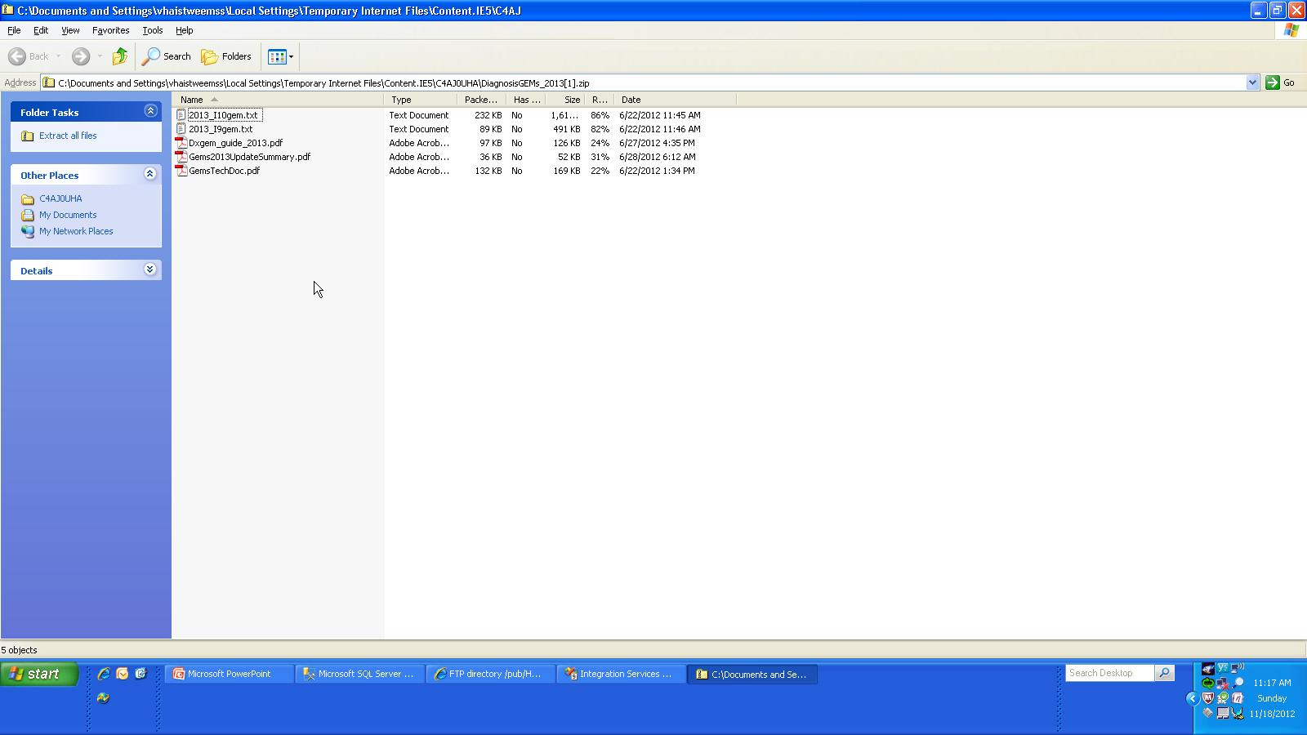
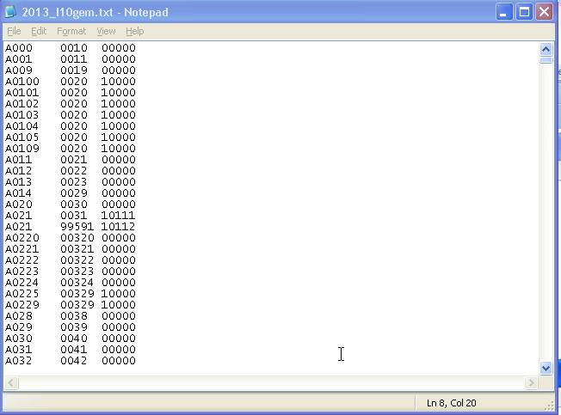
Contents of
Text Files
Notes:
Jen: When you enter the GEM file, this is what you will see. It is just a text file with a list of characters in columns. It looks like a bunch of gobbly gook, how can I make sense of this?
Let’s take a closer look at the GEM. This an example of the I10 GEM. Remember, this map contains all ICD-10-CM codes and their mapping to ICD-9-CM codes.
Notice the text file contains no column delineation, no headers, no decimals, no descriptions. To make the file usable you likely will have to import the file into another file type.

Slide 17
Using the Content
Source | Target | F1 | F2 | F3 | F4 | F5
E10311 | 25051 | 1 | 0 | 1 | 1 | 1
E10311 | 36201 | 1 | 0 | 1 | 1 | 2
E10311 | 36207 | 1 | 0 | 1 | 1 | 3
E10319 | 25051 | 1 | 0 | 1 | 1 | 1
E10319 | 36201 | 1 | 0 | 1 | 1 | 2
E10321 | 25051 | 1 | 0 | 1 | 1 | 1
E10321 | 36204 | 1 | 0 | 1 | 1 | 2
E10321 | 36207 | 1 | 0 | 1 | 1 | 3
E10329 | 25051 | 1 | 0 | 1 | 1 | 1
E10329 | 36204 | 1 | 0 | 1 | 1 | 2
E11311 | 25050 | 1 | 0 | 1 | 1 | 1
E11311 | 36201 | 1 | 0 | 1 | 1 | 2
E11311 | 36207 | 1 | 0 | 1 | 1 | 3
E11319 | 25050 | 1 | 0 | 1 | 1 | 1
E11319 | 36201 | 1 | 0 | 1 | 1 | 2
Notes:
The text file has been imported in Microsoft Excel, headers have been added. Be careful when doing that that you make sure you import as “text” as you know if you don’t you may drop leading or training zeros which then can make a code value unknown. Is that a little clearer, now?
Let’s look at each column of the GEM structure in more detail on the next slide...

Slide 18
Source
Source | Target | F1 | F2 | F3 | F4 | F5
E10311 | 25051 | 1 | 0 | 1 | 1 | 1
E10311 | 36201 | 1 | 0 | 1 | 1 | 2
E10311 | 36207 | 1 | 0 | 1 | 1 | 3
E10319 | 25051 | 1 | 0 | 1 | 1 | 1
E10319 | 36201 | 1 | 0 | 1 | 1 | 2
E10321 | 25051 | 1 | 0 | 1 | 1 | 1
E10321 | 36204 | 1 | 0 | 1 | 1 | 2
E10321 | 36207 | 1 | 0 | 1 | 1 | 3
E10329 | 25051 | 1 | 0 | 1 | 1 | 1
E10329 | 36204 | 1 | 0 | 1 | 1 | 2
E11311 | 25050 | 1 | 0 | 1 | 1 | 1
E11311 | 36201 | 1 | 0 | 1 | 1 | 2
E11311 | 36207 | 1 | 0 | 1 | 1 | 3
E11319 | 25050 | 1 | 0 | 1 | 1 | 1
E11319 | 36201 | 1 | 0 | 1 | 1 | 2
Source Code
Notes:
The first column is called the source code. The values in this column represents the values from the entire code set.
Jen: So the source is your starting point. This is the code that you are trying to translate right?
The source is the value that you have that you are trying to find a match in meaning or close equivalent to.

Slide 19
Source | Target | F1 | F2 | F3 | F4 | F5
E10311 | 25051 | 1 | 0 | 1 | 1 | 1
E10311 | 36201 | 1 | 0 | 1 | 1 | 2
E10311 | 36207 | 1 | 0 | 1 | 1 | 3
E10319 | 25051 | 1 | 0 | 1 | 1 | 1
E10319 | 36201 | 1 | 0 | 1 | 1 | 2
E10321 | 25051 | 1 | 0 | 1 | 1 | 1
E10321 | 36204 | 1 | 0 | 1 | 1 | 2
E10321 | 36207 | 1 | 0 | 1 | 1 | 3
E10329 | 25051 | 1 | 0 | 1 | 1 | 1
E10329 | 36204 | 1 | 0 | 1 | 1 | 2
E11311 | 25050 | 1 | 0 | 1 | 1 | 1
E11311 | 36201 | 1 | 0 | 1 | 1 | 2
E11311 | 36207 | 1 | 0 | 1 | 1 | 3
E11319 | 25050 | 1 | 0 | 1 | 1 | 1
E11319 | 36201 | 1 | 0 | 1 | 1 | 2
Target
Target Code
Notes:
Contains the closest match in meaning to the target code set from source.
Jen: Using this map, can I just use the code in the target column as the match to what I was looking for in the source code? That’s my translation so I don’t have to do anything else right?
No, You have a couple more things to consider.

Slide 20
Source | Target | F1 | F2 | F3 | F4 | F5
E10311 | 25051 | 1 | 0 | 1 | 1 | 1
E10311 | 36201 | 1 | 0 | 1 | 1 | 2
E10311 | 36207 | 1 | 0 | 1 | 1 | 3
E10319 | 25051 | 1 | 0 | 1 | 1 | 1
E10319 | 36201 | 1 | 0 | 1 | 1 | 2
E10321 | 25051 | 1 | 0 | 1 | 1 | 1
E10321 | 36204 | 1 | 0 | 1 | 1 | 2
E10321 | 36207 | 1 | 0 | 1 | 1 | 3
E10329 | 25051 | 1 | 0 | 1 | 1 | 1
E10329 | 36204 | 1 | 0 | 1 | 1 | 2
E11311 | 25050 | 1 | 0 | 1 | 1 | 1
E11311 | 36201 | 1 | 0 | 1 | 1 | 2
E11311 | 36207 | 1 | 0 | 1 | 1 | 3
E11319 | 25050 | 1 | 0 | 1 | 1 | 1
E11319 | 36201 | 1 | 0 | 1 | 1 | 2
F1
F2
F3
F4
F5
Equivalence Flags
Notes:
Equivalence Flags provide information about the entries and the equivalence of the target as a meaning match to the value in source that is represented.
These flags must be utilized in order to derive an accurate or appropriate applied mapping equivalent.

Slide 21
Poll Question
How many GEM files are there?
    1
    2
    3
    4
Notes:
Jen: Let’s pause for a moment and ask another poll question.
How many GEM files are there? Is your answer:
1
2
3
4
To answer this question, use the blue polling icon above my head. We’ll move on and come back to your results in just a moment.
[erase these notes and add your own!]

Slide 22

Source | Target | F1 | F2 | F3 | F4 | F5
E10311 | 25051 | 1 | 0 | 1 | 1 | 1
E10311 | 36201 | 1 | 0 | 1 | 1 | 2
E10311 | 36207 | 1 | 0 | 1 | 1 | 3
E10319 | 25051 | 1 | 0 | 1 | 1 | 1
E10319 | 36201 | 1 | 0 | 1 | 1 | 2
E10321 | 25051 | 1 | 0 | 1 | 1 | 1
E10321 | 36204 | 1 | 0 | 1 | 1 | 2
E10321 | 36207 | 1 | 0 | 1 | 1 | 3
E10329 | 25051 | 1 | 0 | 1 | 1 | 1
E10329 | 36204 | 1 | 0 | 1 | 1 | 2
E11311 | 25050 | 1 | 0 | 1 | 1 | 1
E11311 | 36201 | 1 | 0 | 1 | 1 | 2
E11311 | 36207 | 1 | 0 | 1 | 1 | 3
E11319 | 25050 | 1 | 0 | 1 | 1 | 1
E11319 | 36201 | 1 | 0 | 1 | 1 | 2
F1
Approximate Flag
Exact Match OR Approximate
Notes:
The entries in the next columns are referred to as flags.
The first flag, Approximate Flag. Describes the equivalent in meaning of the source code to the target code.
1= (yes)approximate match represents a close equivalent for the source code in the target code set
0=(no) identical match exists
Jen: Are we really asking, does the target code set value partially match in meaning to a value in the source code set or is there an exact match in meaning?
Yes, A value of 1 would indicate be a partial match, and 0 means we actually have an identical match in meaning.

Slide 23
ICD9: 042. Human Immunodeficiency Virus (HIV) Disease
ICD10: B20. Human Immunodeficiency Virus [HIV] Disease
I9 GEM | Source | Target | F1 | F2 | F3 | F4 | F5
 | 042 | B20 | 0 | 0 | 0 | 0 | 0
0 = indicates identical match
Notes:
In this example we are comparing a single diagnostic condition represented in both code sets. Reviewing an entry out of the I9 Gem, you can see that the approximate match flag column value is set to zero.
Jen: Okay, so since the flag is zero, that means that the code values have identical meaning.

Slide 24
ICD9: 297.1 Delusional Disorder
ICD10: F22. Delusional Disorders
I10 GEM | Source | Target | F1 | F2 | F3 | F4 | F5
 | F22 | 2970 | 1 | 0 | 0 | 0 | 0
 | F22 | 2971 | 1 | 0 | 0 | 0 | 0
 | F22 | 2972 | 1 | 0 | 0 | 0 | 0
1 = approximate meaning match
Notes:
Here is another example this time from the ICD10 Gem in which the approximate flag value is set to 1.
Jen: so even though the descriptions are almost identical, why can’t we interpret that as an exact match?
Let me explain……

Slide 25
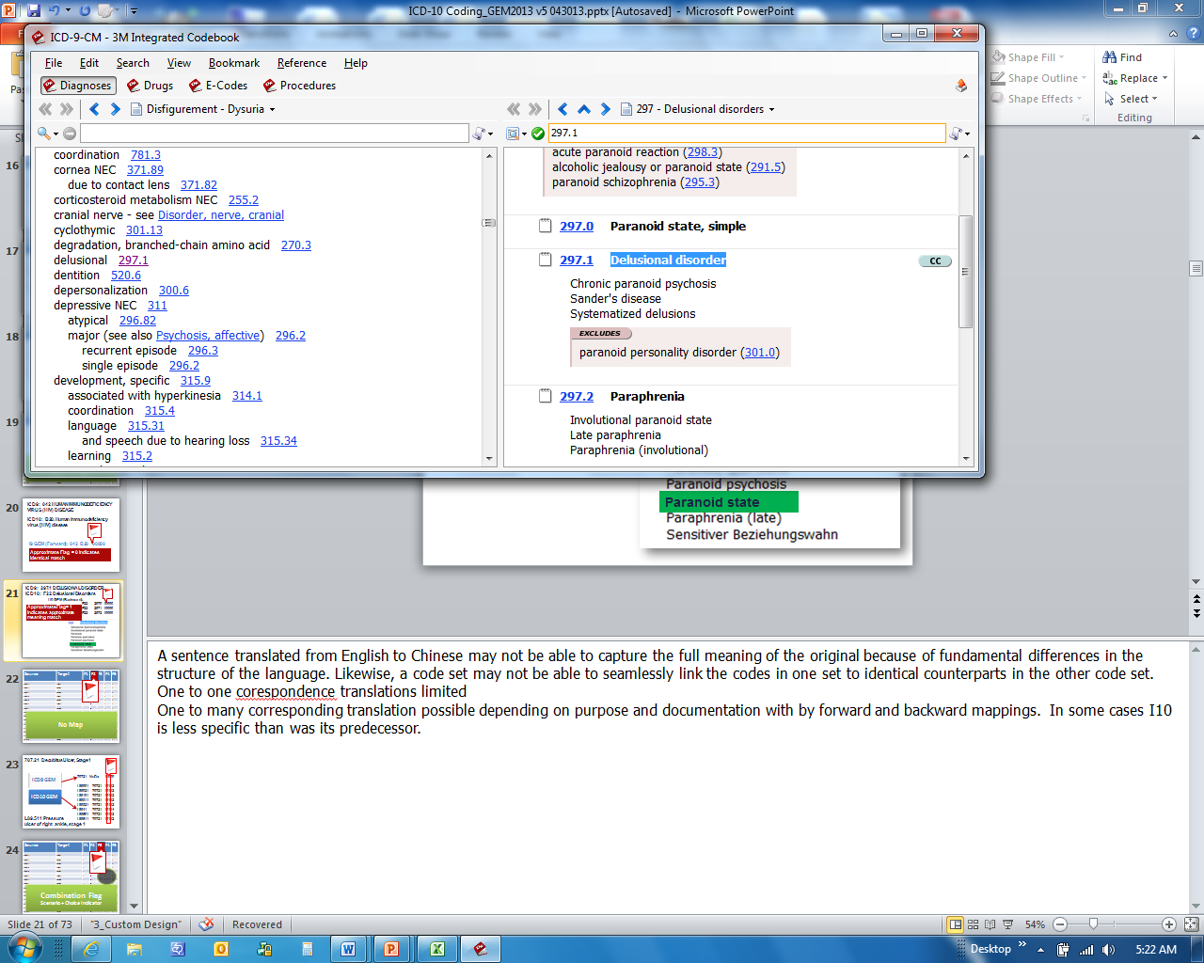
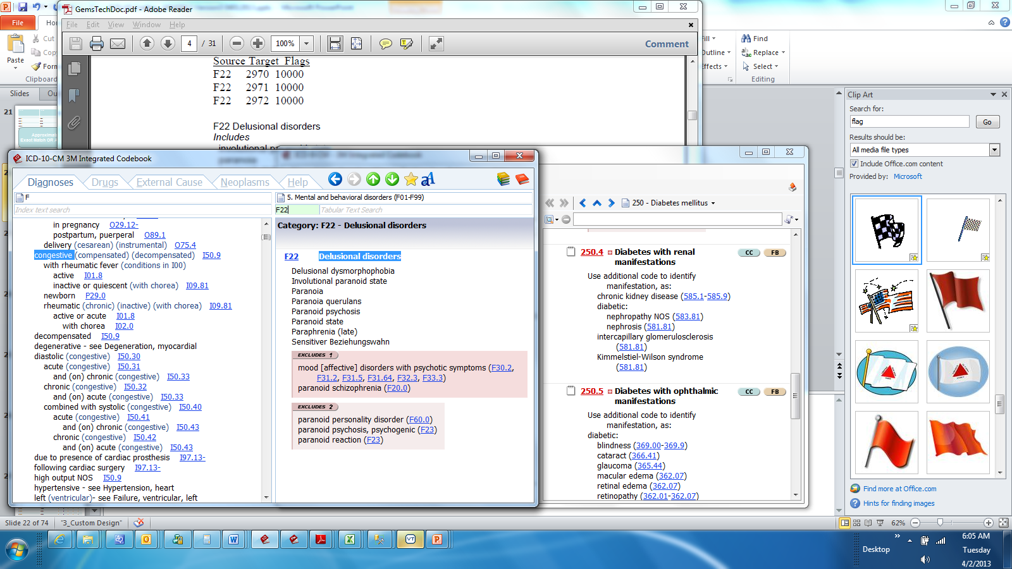
Approximate Flag =
1 indicates approximate meaning match
Notes:
Highlighted here are the tabular list showing ICD9 individual codes for Paranoid state and Paraphrenia while the ICD10 code for Delusional disorder contains all of these conditions represented as a single ICD10 category code.
Jen: Ok, I can see that in ICD-10, one code represents what was depicted by multiple codes in ICD-9. Although the description of 297.1 and F22 are almost identical, F22 also includes conditions that were represented by ICD-9 codes 297.0 and 297.2 as well.

Slide 26
Poll Results
Notes:
Jen: Now let’s pause for a moment and take a look at your poll results.
We asked: How many GEM files are there?
Answer: There are 4 GEM Files: 2 forward I19 GEMS and 2 backward I10 Gems for both CM and PCS.
Remember there are also 2 Reimbursement maps which we will briefly cover later.

Slide 27
Source | Target | F1 | F2 | F3 | F4 | F5
E10311 | 25051 | 1 | 0 | 1 | 1 | 1
E10311 | 36201 | 1 | 0 | 1 | 1 | 2
E10311 | 36207 | 1 | 0 | 1 | 1 | 3
E10319 | 25051 | 1 | 0 | 1 | 1 | 1
E10319 | 36201 | 1 | 0 | 1 | 1 | 2
E10321 | 25051 | 1 | 0 | 1 | 1 | 1
E10321 | 36204 | 1 | 0 | 1 | 1 | 2
E10321 | 36207 | 1 | 0 | 1 | 1 | 3
E10329 | 25051 | 1 | 0 | 1 | 1 | 1
E10329 | 36204 | 1 | 0 | 1 | 1 | 2
E11311 | 25050 | 1 | 0 | 1 | 1 | 1
E11311 | 36201 | 1 | 0 | 1 | 1 | 2
E11311 | 36207 | 1 | 0 | 1 | 1 | 3
E11319 | 25050 | 1 | 0 | 1 | 1 | 1
E11319 | 36201 | 1 | 0 | 1 | 1 | 2
F2
No Map
Notes:
The next column of flags represents No Map. Slight more than 1% have no mapping at all, the remaining entries from both GEMs have a GENERAL equivalent.
The values contains a 1 when no plausible translation for the source code value is available and a 0 when at least one plausible translation for the source code exists.
Jen: Well then, what do you do when there is no mapping?
Lets take a look at an example where no mapping is available….

Slide 28
707.21 Decubitus Ulcer, Stage 1
ICD9 GEM
70721 NoDx 11000
L89001 70721 10112
L89021 70721 10112
L89101 70721 10112
L89311 70721 10112
L89321 70721 10112
L8941 70721 10114
L89501 70721 10112
L89511 70721 10112
ICD10 GEM
L89.511 Pressure
ulcer of right ankle, stage 1
Notes:
In this example here is one entry from the I9 Gem or Forward Map which contains no mapping. For ICD9 code 707.21, you can see that not only does the flag value represent a 1, indicating no plausible translation but also “NoDX” in the target column value.
However in reviewing the I10 Gem or Backward Map using the ICD9 target data to find possible equivalents to meaning of Pressure Ulcer Stage 1 in the ICD10 code set you can see there are several possible equivalents in the L89 category.
Jen: Is that why the I10 GEM is the one that is most commonly used?
Yes, generally the ICD10 GEM will contain more possible meaning matches because the additional specificity in ICD10 is easier to translate to something more general, ICD9 codes.
Jen: Okay, since we know our ICD9 code but didn’t find translation in the ICD9 GEM we could utilize the ICD10 GEM by looking at the target column instead. We would search through the target column to find the I9 code we are looking for to determine the possible ICD10 equivalents.
Some of this content is a little confusing and I’ll bet folks have some question. Just a reminder, don’t forget to use the orange ask the presenter button above my head if you have questions.

Slide 29
F3
Source | Target | F1 | F2 | F3 | F4 | F5
E10311 | 25051 | 1 | 0 | 1 | 1 | 1
E10311 | 36201 | 1 | 0 | 1 | 1 | 2
E10311 | 36207 | 1 | 0 | 1 | 1 | 3
E10319 | 25051 | 1 | 0 | 1 | 1 | 1
E10319 | 36201 | 1 | 0 | 1 | 1 | 2
E10321 | 25051 | 1 | 0 | 1 | 1 | 1
E10321 | 36204 | 1 | 0 | 1 | 1 | 2
E10321 | 36207 | 1 | 0 | 1 | 1 | 3
E10329 | 25051 | 1 | 0 | 1 | 1 | 1
E10329 | 36204 | 1 | 0 | 1 | 1 | 2
E11311 | 25050 | 1 | 0 | 1 | 1 | 1
E11311 | 36201 | 1 | 0 | 1 | 1 | 2
E11311 | 36207 | 1 | 0 | 1 | 1 | 3
E11319 | 25050 | 1 | 0 | 1 | 1 | 1
E11319 | 36201 | 1 | 0 | 1 | 1 | 2
Combination Flag
Scenario + Choice Indicator
Notes:
Now lets focus on Flag 3 representing the Combination Flag (3rd) which indicates when more than one code in the target is needed to adequately provide meaning to the source code value. A one (1) indicates more than one code from the target code set is required to fully provide meaning match and a zero (0) indicates translation using only one code from the target code set is needed.
Jen: We talking potential multiple code entries, we are referring to is the fact that multiple codes are needed to reflect a particular condition. An example would be in the diabetes coding in ICD-9. Diabetic nephropathy for example requires one code to represent the diabetes with renal manifestations, and an additional code specifies the type of renal complication.
We will show an example in just a min that will help to provide clarity.

Slide 30

Combination Flags
Scenario
in a combination entry, a collection of codes from the target system containing the necessary codes that combined as directed will satisfy the equivalent meaning of a code in the source system
Choice List
in a combination entry, a list of one or more codes in the target system from which one code must be chosen to satisfy the equivalent meaning of a code in the source system
Notes:
Now lets look at the Fourth and Fifth flag column values which are directly associated to the combination flag as seen on last slide.
Scenario and Choice values provide further explanation to the combination flag.
Scenario—indicates a collection of codes from the target system containing the necessary codes that will satisfy the equivalent meaning in the source system
Choice—List of one or more codes in the target system from which one code must be chosen to satisfy the equivalent meaning in the source system (pick list)
Jen: Do you only have a scenario or choice flag when there is a combination flag? There seems to be a relationship.

Slide 31
F3
Source | Target | F1 | F2 | F3 | F4 | F5
E10311 | 25051 | 1 | 0 | 1 | 1 | 1
E10311 | 36201 | 1 | 0 | 1 | 1 | 2
E10311 | 36207 | 1 | 0 | 1 | 1 | 3
Type 1 diabetes mellitus with unspecified diabetic retinopathy with macular edema E10.311
Diabetes with ophthalmic manifestation 250.51
Background Diabetic Retinopathy 362.01
Diabetic Macular Edema 363.07
Notes:
ICD10 code set contains many codes that represent both the manifestation and the disease in a single code where ICD9 utilizes more than one code. The flag value in this example from the ICD10 GEM indicates more than one code is required from the target, since there is a 1 in the combination flag column which is F3 as shown here. Notice the red circle highlighting the associated scenario (F4) and choice (F5) values.
The combination value of one (1) indicates that more than one code in the target system is required to satisfy the full equivalent meaning of a code in the source system, while a value of zero (0) indicates a complete translation is represented with one code from the target code set.
Looking at this example the 3 ICD9 codes would be required to fully translate a single ICD10 code represented for the ICD10 code E10.311. The scenario flag, labeled here as F4, represents a grouping of target code values which provide possible matches, there may be more than one grouping. The choice flag, labeled here as F5, represents the sequence of codes within this grouping which are required.

Slide 32
GEMS in 3 Easy Steps
Step 1:
Step 2:
Step 3:
Extract
Analyze
Refine
Notes:
Jen: Shelley, based on what you have described, it sounds like the best plan of attack is to first extract all of the data, analyze the results and the flags, and refine based on the purpose. The maps might get you into the right general area, but it seems like sometimes you need to refer to the medical record documentation to find your exact match.
Just to quickly run through the process for using the GEMs….

Slide 33
1: Extract
I9 GEM
vs.
I10 GEM
Notes:
Once you have determined the GEM to utilize, step one is to extract entries or identify the rows containing the code value you are starting with. So remember if you are using the I9 GEM and trying to find I10 equivalents to 401.9 Essential hypertension for example. You will be utilizing the source code column as that is where the ICD9 codes are listed. Rather if you are using the ICD10 GEM you may be looking for 401.9 in the target column to identify all possible equivalents. No matter which GEM you are using, validate all rows that contain the search code has been selected.

Slide 34
2: Analyze
Review Flags
Notes:
The next step is to analyze or review the information outlined by the flag values. Note any flags applied to the code and understand what they convey about the entry.
Things to evaluate:
Is the “approximate” flag set to 1 or 0? If 1, remember the translation is not a precise equivalent.
Is the “no map” flag equal to 1 or 0? If 1, there is no corresponding code in the target system.
Is the “combination” flag set to 1 or 0? If 1, more than one code in the target system is required to satisfy the meaning of the code in the source system and don’t forget to consider the groupings and sequence represented by scenario and choice flags.

Slide 35
3: Refine
Notes:
Image: Smiling man wearing an apron and carrying a feather duster. (Source: http://office.microsoft.com/en-us/images/results.aspx?qu=housekeeping&ex=1#ai:MC900389112|)
Now that you have general entries identified and reasonable sense that it represents general equivalence its time to determine whether or not the results are meaningful for the specific purpose, applied mapping.
Things to consider or ask yourself would be:
What is the purpose of the applied mapping?
Does the applied mapping require that the code in the source system be mapped to only one “best” alternative in the target system?
Will the correct applied mapping vary depending on the documentation in the record?
Do you need to go through the process again or utilize different GEM, code book, other tools/references?

Slide 36
896.2 Traumatic amputation of foot (complete) (partial), bilateral, without mention of complication
S98.911A Complete traumatic amputation of right foot level unspecified, initial encounter
S98.912A Complete traumatic amputation of left foot level unspecified, initial encounter
S98.921A Partial traumatic amputation of right foot level unspecified, initial encounter
S98.922A Partial traumatic amputation of left foot level unspecified, initial encounter
Source | Target | F1 | F2 | F3 | F4 | F5
8962 | S98911A | 1 | 0 | 1 | 1 | 1
8962 | S98912A | 1 | 0 | 1 | 1 | 2
8962 | S98921A | 1 | 0 | 1 | 1 | 1
8962 | S98922A | 1 | 0 | 1 | 1 | 2
896.2 ONLY found in I9 GEM
Notes:
Look at an this example where the ICD9 code specifies that the traumatic amputation, which is bilateral but does not specify whether it is partial or complete. Since both types of information are specified in separate codes in I-10 representing left or right foot, and whether the amputation is partial or complete the entry in the ICD9 GEM with combination flag set to 1.
To refine this entry, decide whether or not the results fully represent the same intended meaning.
Jen: Are additional codes available in ICD10 that might be a potential match other than what is listed here as the Target code?
Yes there are, which is part of the refinement process. For example each one of the ICD10 codes listed here represent those codes that would only be assigned for initial encounters which was not reflected in the ICD9 code set. In this case you may want to review the I10 GEM or code set to identified all of the codes having 7th character representing subsequent or sequela as well. Use other tools such as official code set to ensure you have a complete listing for your specific purpose.

Slide 37

At GEMS!
Be Sure to Utilize Code Book
& Other Coding Resources
Notes:
businessman holding a don't stop sign 120452194
Open book with isolated on white. Vector illustration. 78753688
Jen: Really, the GEMs are just one tool. The lesson learned seem to be, DON’T STOP AT GEMS! In some cases, ICD-9 is more specific than ICD-10, but in most cases ICD-10 is more specific than its predecessor, ICD9.
You have many other resources available. Be sure that you utilize code books and other coding resources.

Slide 38
Poll Question
Once you have identified the rows in the GEMs, for the source code to target code map, you can stop looking and use the translation.
    True
    False
Notes:
Jen: Let’s ask one final poll question.
True or False: Once you have identified the rows in the GEMs, for the source code to target code map, you can stop looking and use the translation provided.
Select A if you think the answer is True
Or, Select B if you think the answer is False
To answer this question, use the blue polling icon above my head. We’ll come back to your results in just a moment.
[erase these notes and add your own!]

Slide 39

Notes:
bright gems isolated on a white background 95820505 from shutterstock.com
Picture of yellow road sign warning about risk ahead 98840174 from shutterstock.com
I can’t say this enough, there are many differences between I9 and I10, there are very few identical corresponding meanings due to the differences in specificity and terminology utilized in the two code sets. ICD10 is simply not just an expansion of ICD9, there are new concepts and terms that didn’t exist in ICD9. The GEMs are not a crosswalk.

Slide 40
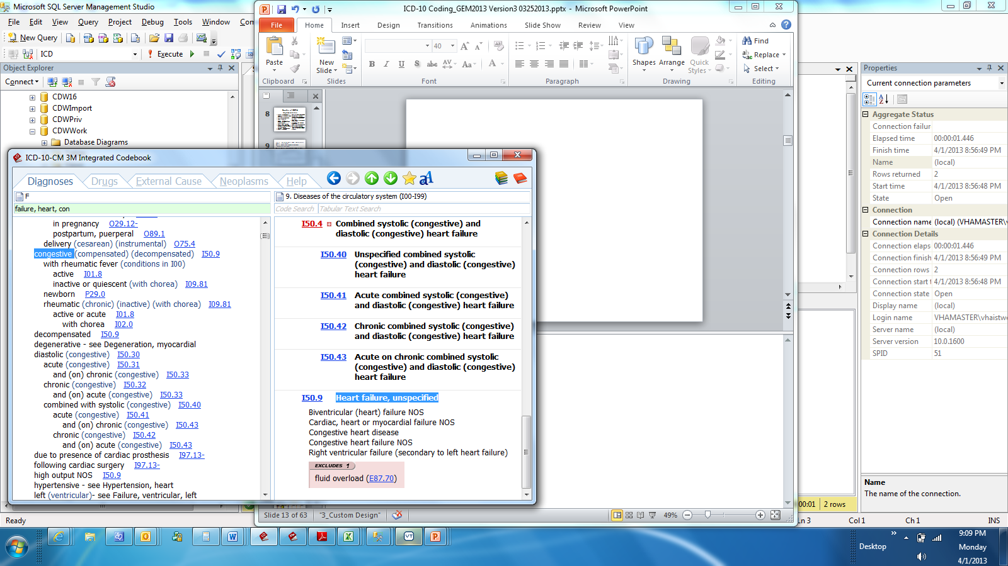

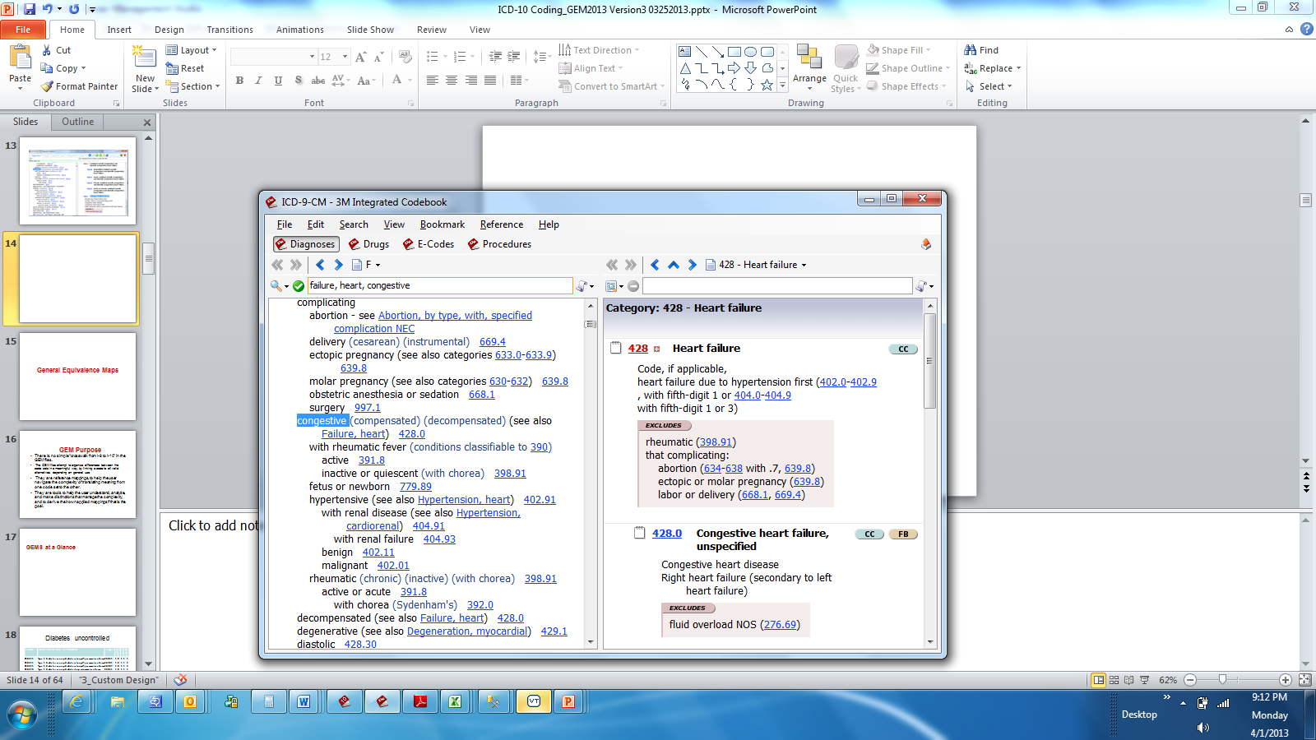
Notes:
Jen: So really, folks should not be using the GEMS as a replacement for learning the new code set. They do serve other purposes, but when you have the documentation in the health record you should really be applying the coding conventions and guidelines to come up with the accurate ICD-10 code for the scenario.
While many differences exist, if you are familiar with ICD9 coding you will notice many similarities in ICD10. The methods for obtaining the right codes are going to be the same, the difference will be how the values themselves will look and possibly mean something slightly different. We learned ICD9 and we can learn ICD10.
Jen: I can think of a good example of a scenario where it might be helpful to use the GEMs. We often have providers who want to look back at a select cohort of patients. Say the Dr. comes to me and asks for a list of all of his/her patients treated in the past 5 years with Diabetes. Once we transition to ICD-10, going back 5 years will require the use of both ICD-10 codes as well as ICD-9 codes to identify all of the patients. In this example we are not simply looking to translate code for code, we are looking for a range of potential matches. This would be a good example for use of GEM.

Slide 41
Poll Results
Notes:
Jen: Now let’s pause for a moment and take a look at your poll results.
Reminder the question was: Once you have identified the rows in the GEMs, for the source code to target code map, you can stop looking and use the translation provided.
Answer: False

Slide 42
Where Can I Find GEMs?
Available on NCHS website:
http://www.cdc.gov/nchs/icd/icd10cm.htm
Also available on CMS website:
http://www.cms.gov/ICD10/11b1_2011_ICD10CM_and_GEMs.asp#TopOfPage

Slide 43
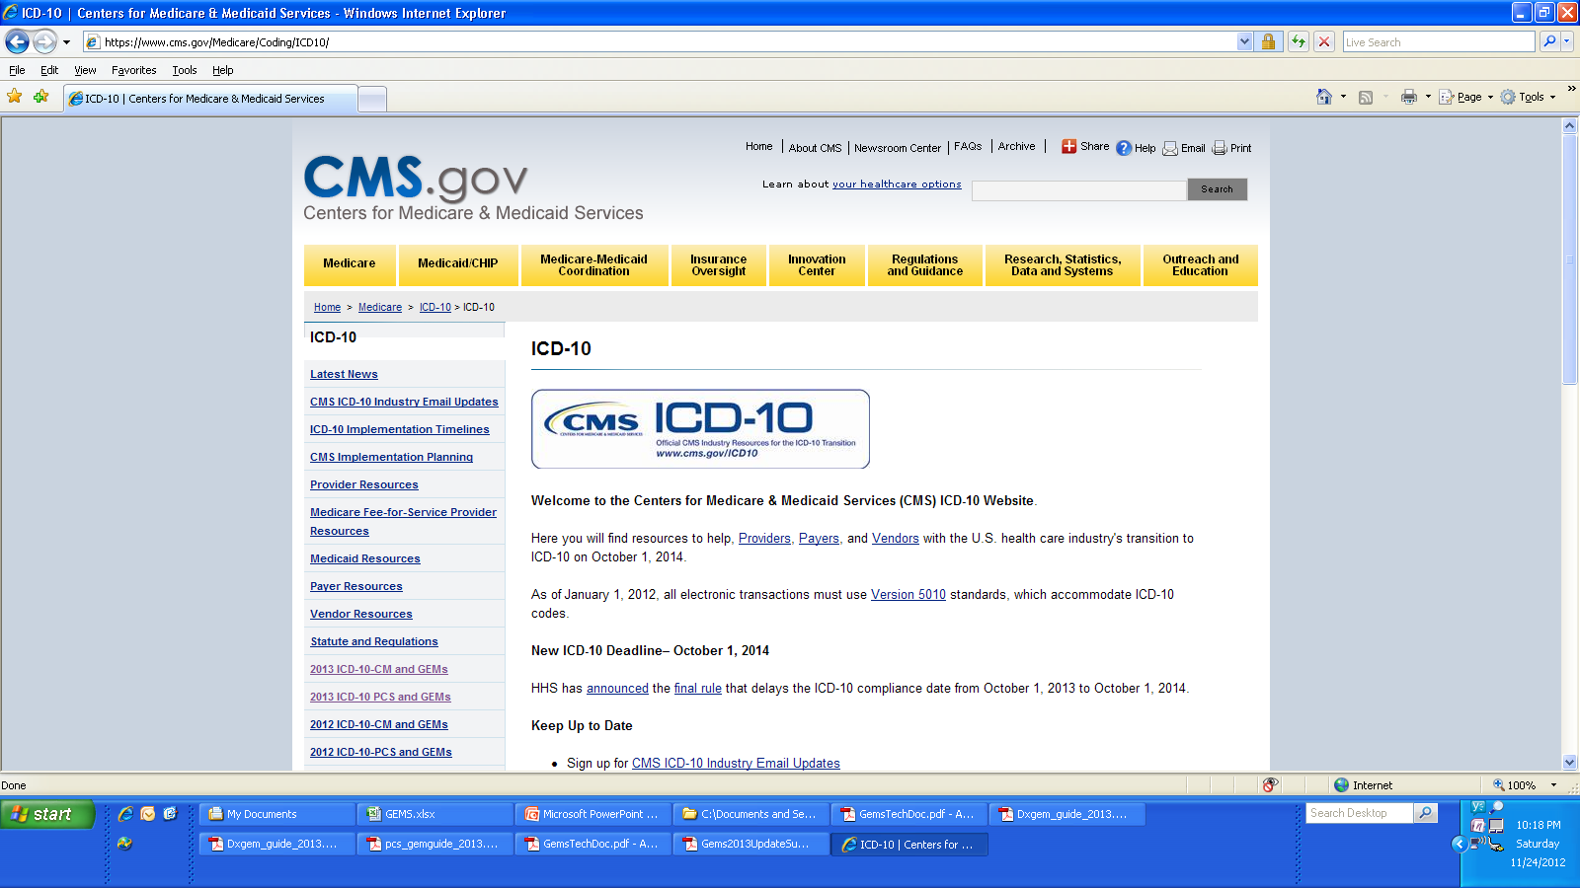
Center for Medicaid & Medicare Services
ICD-10-CM &
ICD-10-PCS www.cms.gov/Medicare/Coding/ICD10/
Notes:
If you go out to this the website, it can be a little overwhelming because there is a lot of information here. So I’m going to step through the links and provide a brief overview just so you are aware of what to expect.

Slide 44
Diagnosis & Procedure Files by YEAR

Slide 45
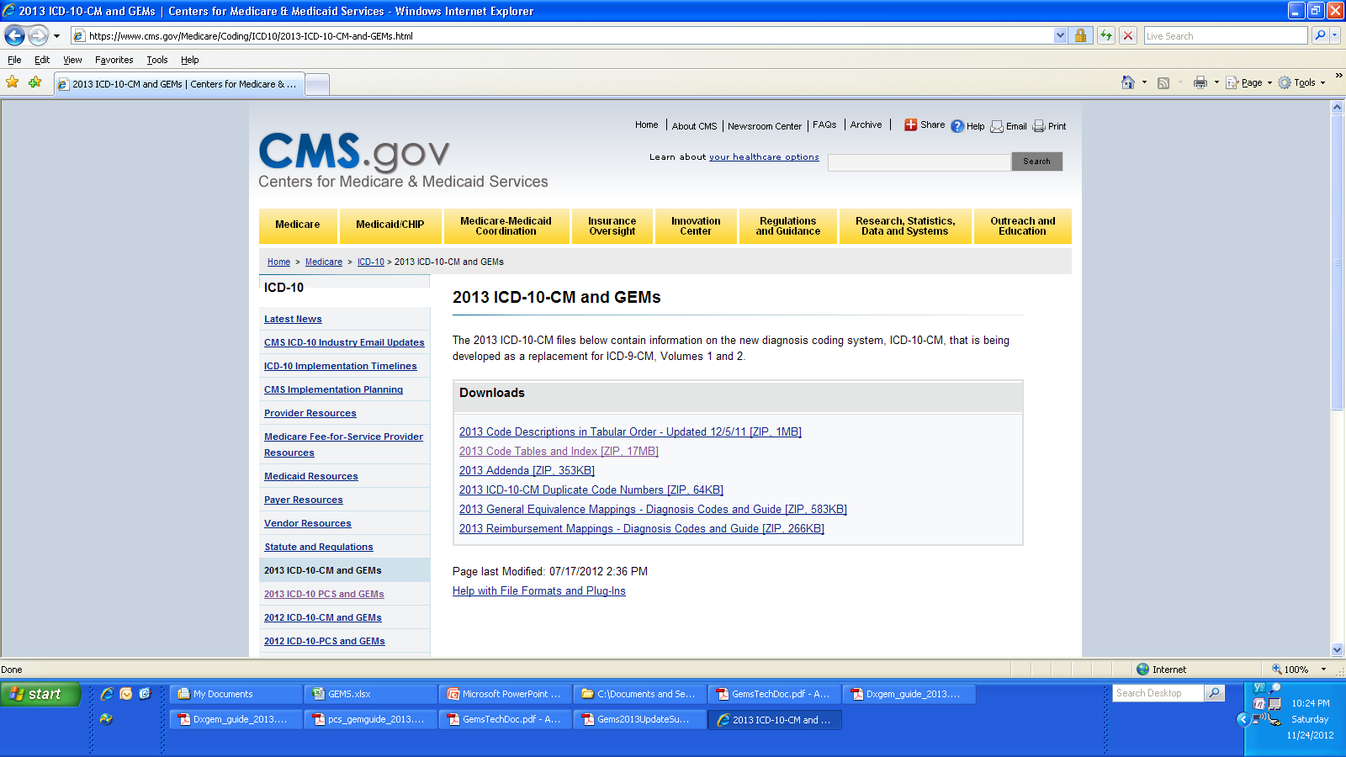
CMS Code & Gem Files:I10 CM
Gems for Diagnosis

Slide 46
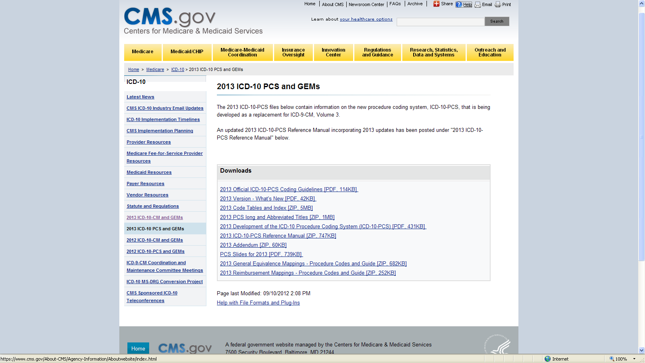
CMS - Gem Files: I10 PCS
Gems for Procedure Codes

Slide 47
CMS - Code &
Gem Files: I10 PCS
Reimbursement Mappings
Notes:
GEMs are translational aids.
Diagnosis Reimbursement Maps (DRMs) are “crosswalks” interposed between ICD-10-CM entry data and ICD-9-CM legacy applications.
DRMs are always “backward mapped” because they indicate which ICD-9 codes will be used to reimburse an ICD-10 code. Assumption: clinicians will enter 1CD-10-CM data in routine practice.
DRMs are not part of GEMs. They are separate files.
http://www.cms.gov/ICD10/11b1_2011_ICD10CM_and_GEMs.asp#TopOfPage
WHY DO WE NEED DRM?
On October 1, 2013, health care claims for services on or after that date will be submitted to payers with diagnoses coded in ICD-10-CM format.
Created to provide a temporary but reliable mechanism for mapping records containing ICD-10-CM diagnoses to “reimbursement equivalent” ICD-9-CM diagnoses.
While systems are being converted to process ICD-10-CM claims directly, the claims will be processed by the legacy systems.
The ICD-10-CM diagnoses submitted on the claim are mapped into ICD-9-CM and the claim may then be priced using the rules written for ICD-9-CM codes.
CMS is not using DRM for any purpose. CMS is converting systems and applications to accept ICD-10-CM codes directly.

Slide 48

Ask the Presenter
Notes:
The reason that we have done this presentation and main goals were to introduce you to the GEMs, instruct you on how to appropriate utilize them and to remind you that the GEMs shouldn’t be the only resource you use.
We have covered a lot of information today, if you haven’t submitted your questions yet, there is still time to do so by clicking on the orange “Ask The Presenter” icon. We’re going to show a brief announcement and we’ll be right back to answer your questions.
(Stand still and smile until you see the video come up full screen)

