Slide 1
VA Blue Button in 2014
(Including VA OpenNotes):
How a Simple Idea Spawned an Era of Change (and What it Means for You)
Kim M. Nazi, PhD
Notes:
Thank you Dawnell. I am so excited to be here today to talk with all of you about the VA Blue Button.
--Proud to say I’ve worked at VA for more than thirty years
--VA has made many important contributions to our nations healthcare system over those years
--But one that I’m MOST excited about has happened just in the last few years:
----opening up the vault of the medical record and enabling patients to ACCESS and DOWNLOAD their data

Slide 2

Medical Record Transformation
Notes:
--For decades, patient access to their personal health and medical information has been constrained BOTH culturally and technologically.
--Even though medical record keeping continues to transform from paper to electronic…..important data has still been LOCKED in the ‘vault’ of the medical record.

Slide 3

Why is it so important?
Notes:
--Why is this so important?
--One of the most important issues facing the future of health and medicine is changing the PARADIGM to effectively ENGAGE and EMPOWER people as active participants in their health.
--This change requires a critical shift from historically paternalistic medicine to patient-centered care in which the locus of control and decision-making is centered upon the patient and aligned with their individual needs and preferences.
--Providing people with easy access to their personal health information is a critical first step in building a foundation to inspire and support this change.

Slide 4

Web-based Portal System
Notes:
While a growing number of health care organizations provide patients with access to information via a web-based patient portal system, the idea of enabling all available personal health information to be combined into a single electronic file that can be viewed, printed, and/or downloaded by consumers was a novel solution. [a breakthrough idea]

Slide 5

Notes:
--The Blue Button concept was a simple idea that aimed to solve this critical problem of data liquidity. [allowing data to flow]
--The Blue Button places control of data and information in patient’s hands, enabling the idea of ‘consumer empowerment’ to take on real and practical meaning in people’s everyday lives.

Slide 6
Objectives for Today’s Session
1. Understand the Blue Button concept and how it relates to Meaningful Use
2. Describe the VA Blue Button and
VA OpenNotes, and how they relate to VA health care delivery
3. Describe Veteran feedback received to date, and the patient experience with VA OpenNotes.
Notes:
Here are the objectives for our session today…
--Gain an understanding of the Blue Button concept and how it relates to Meaningful Use criteria.
--Be able to describe the VA Blue Button and VA OpenNotes, and how they relate to the delivery of VA health care.
--Be able to describe Veteran feedback received to date, the refinements that have been made in response, and the patient experience with VA OpenNotes.

Slide 7

Poll Question
What is your role?
    Health care professional
    Administrative professional
    VA Researcher
    Other VA staff member
    Patient
    Family member or Caregiver
Notes:
Now I’d like to ask a poll question. The question I’d like each of you to answer is: what is your role?
Are you a…
--Health care professional
--Administrative professional
--VA Researcher
--Other VA staff member
--Patient
--Family member or Caregiver
Please use the blue polling icon above my head to respond to this question.
We’ll move on and come back to your results in just a moment.

Slide 8

January 2010
Notes:
--So how did we get here and where are we going?
--The Blue Button concept originated at a January 2010 meeting of the Markle Foundation Consumer Empowerment Workgroup in which representatives from government and private industry envisioned that adding a big “blue button” to PHR portals would enable patients to have more direct downloadable access to their clinical information.
-------give patients direct access to their DATA
-------incentivize industry to develop applications to transform data into actionable INFORMATION [data.gov]
--Support for the Blue Button concept was underscored in a Markle Foundation survey that found that 70% of patients and 65% of doctors agreed that patients should be able to download and keep copies of their own clinical information.
…a SIMPLE and TRANSFORMATIVE idea

Slide 9
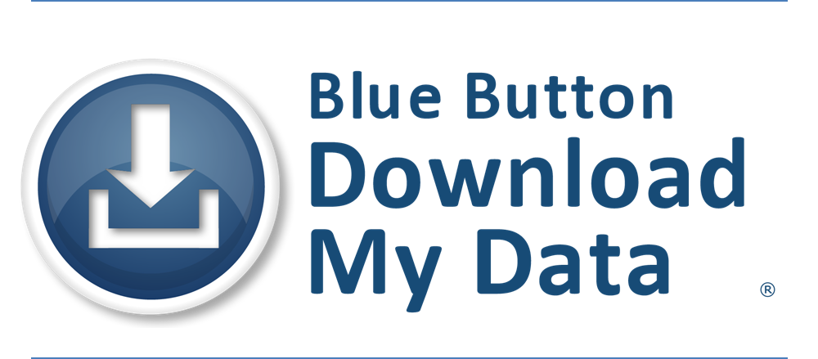
September 2010
VA: My HealtheVet
DoD: Tricare Online
CMS: MyMedicare.gov
Notes:
--VA partnered with the Department of Defense (DoD) and Centers for Medicare & Medicaid Services (CMS), mobilizing to release the first Blue Button on each agency’s beneficiary portal within the next eight months (unprecedented speed for federal agencies).
--By September of that same year, all three agencies had added the Blue Button to their beneficiary portals
--The idea was to begin with a simple solution and make incremental enhancements
…..and we did!

Slide 10
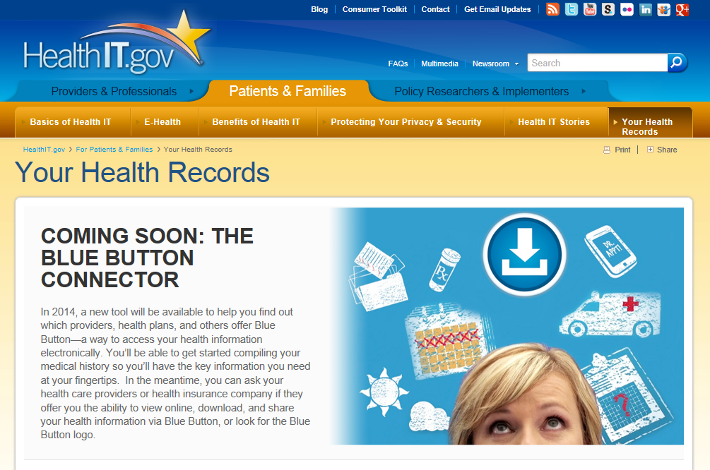
September 2013
Notes:
Meanwhile Beyond VA…
--From September 2010 to 2013, the Blue Button evolved from this simple idea to a ‘paradigm shift’
--ONC at DHHS embraced the concept, took the reins and set multiple initiatives in motion to spawn a ‘movement’
-----inspiring industry commitment with the Blue Button Pledge
-----hosting developer’s challenges and contests to optimize the presentation of information to effectively translate ‘data’ into ‘actionable information’ via the Blue Button Accelerator
-----also helping to create consumer awareness, incentivize vendor communities, and creating a vision for expansion (Blue Button Plus and Blue Button DIRECT)
--The “healthIT.gov” website is a great resource to stay abreast of the evolution of the Blue Button

Slide 11
Today
“Blue Button” - shorthand for a movement toward an improved healthcare system in which patients and providers use information technology to collaborate and improve health.
To “Blue Button” is a verb, meaning, for a consumer, “download my health data so I can use it.”
Notes:
---Here is how ONC now describes “Blue Button”
“Blue Button” is shorthand for a movement toward an improved healthcare system in which patients and providers use information technology to COLLABORATE and improve health.
“Blue Button” is not a noun , it’s a verb, meaning, for a consumer, “download my health data so I can use it.”

Slide 12

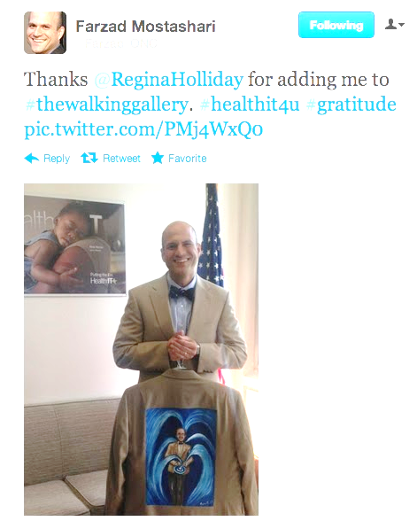
#bluebutton
Notes:
As evidence of the scope of this movement…
--seen on twitter [hashtag BlueButton]
--Dr. Farzad Mostashari [former National Coordinator for Health IT] with his walking gallery jacket painted by artist Regina Holliday
--Holding the Blue Button in his hands with 3 waves of Meaningful Use (representing the 3 stages of meaningful use)
--you can use Twitter to stay abreast of the rapidly evolving Blue Button movement

Slide 13

Meaningful Use
of Certified EHR Technology
· Improve quality, safety & efficiency
· Reduce health disparities
· Engage patients & families in their health care
· Improve care coordination
· Improve population & public health
· Maintain privacy & security across all areas
Notes:
--Meaningful Use of certified EHR Technology places focus on not just implementing technology, but using that technology in meaningful ways
--MU objectives
Improve healthcare quality, safety, and efficiency
Reduce health disparities
Fully ENGAGE patients and their families and caregivers in their health care
Improve care coordination
Improve the health of the population and public health
And of course maintain privacy and security across all areas

Slide 14

Meaningful Use
Stage 2 Core Measure
View/Download/Transmit
Provide patients the ability to view online, download and transmit their health information within four business days of the information being available to the Eligible Professional.
Notes:
--How does this relate to the Blue Button?
--Stage 2 of MU criteria now includes providing patients with access to View/Download and Transmit their personal health information
--Blue Button is the tool
--Why is this so important? Let me tell you a personal story

Slide 15

Notes:
In May of 2010 my brother was in the Emergency Room
--Need just-in-time access to critical information (e.g. meds, problem list, allergies, lab results, etc.)
--right information/right place/right time

Slide 16

Notes:
My experience with care coordination
--6 phone calls, 2 letters, and in desperation…one formal patient complaint later…
--Need just-in-time access to critical information (e.g. meds, problem list, allergies, lab results, etc.)

Slide 17

Accurate details are critical to patient safety
Notes:
--for example, an accurate details about current medications: critical to patient safety

Slide 18

Notes:
Healthcare pivots on INFORMATION
--right information/right place/right time…AND often Just In Time…
--patients play a role

Slide 19
Poll Results
What is your role?
  Health care professional
  Administrative professional
  VA Researcher
  Other VA staff member
  Patient
  Family member or Caregiver
Notes:
Now let’s pause for a moment and take a look at your poll results.
I asked you to answer the question: what is your role?
--This was a bit of a trick question.
--Family member or Caregiver ???
We have to get away from thinking that it’s US versus THEM. We ARE THEM.

Slide 20
Poll Results
  Health care professional
  Administrative professional
  VA Researcher
  Other VA staff member
  Patient
  Family member or Caregiver
Notes:
Click to cue studio to take down poll results

Slide 21

Notes:
We are all patients, family members of patients, or caregivers…if not today, then inevitably in future days
--Information is powerful medicine.

Slide 22

Information is Powerful Medicine
Notes:
--Many of you are also health care professionals, researchers or involved in some very important way in the delivery of healthcare services
--For all of us…Information is powerful medicine
--How will you utilize the Blue Button?

Slide 23

Notes:
--We’ve talked about the Blue Button concept and how it relates to Meaningful Use
--Now let’s take a closer look at My HealtheVet and the VA Blue Button
--My HealtheVet is VA’s Personal Health Record portal: a suite of tools to empower patients in their care
--Veterans can refill prescriptions, use Secure Messaging with their VA health care team, view VA Appointments, access the Veterans Health Library…and much more.

Slide 24
My HealtheVet Objectives
Provide
Easy to use Personal Health Record (PHR)
Easy access to data
Tools to understand
and manage information
Secure communication
Notes:
My HealtheVet objectives are aimed at engaging patients to be active participants in their care.
--Provide Veterans with an easy to use Personal Health Record (PHR), trusted health education resources, and tools
--Give VA patients easy access to data from the VA Electronic Health Record (EHR)
--Provide them with tools to understand and manage their information
--Support their need to communicate easily with their health care team(s) using Secure Messaging

Slide 25
My HealtheVet Objectives
Improve
Access
Satisfaction
Outcomes
Notes:
--and ultimately…to Improve access, satisfaction, outcomes

Slide 26
Use of My HealtheVet: November 2013
2.5 million
Registered users (37% of VA patients)
1.3 million
Users with a premium (authenticated ) account
47 million
Online prescription refill since August 2005
838,000
Users opted-in for Secure Messaging
Notes:
Use of My HealtheVet continues to grow

Slide 27

VA Blue Button
3
types of output
3
sources of data
2
ways to customize
Notes:
The VA Blue Button enables Veterans to View/Print and Download their available personal health information from My HealtheVet.
--3 types of output: .txt, .PDF. And .bluebutton
--3 sources of data: data self-entered into the MHV PHR, data from the VA Electronic Health Record, and Military Service Information from the DoD
--2 ways to customize: by selecting the date range and/or the types of information to include
Veterans can…View, print and download an electronic file that contains all available personal health information from My HealtheVet.

Slide 28
Poll Question
Have you ever shared information about the VA Blue Button with a Veteran?
    Yes
    No
Notes:
Now I’d like to ask another poll question. The question is: Have you ever shared information about the VA Blue Button with a Veteran?
Please use the blue polling icon above my head to respond “yes” or “no” to this question.
We’ll move on and come back to your results in just a moment.

Slide 29
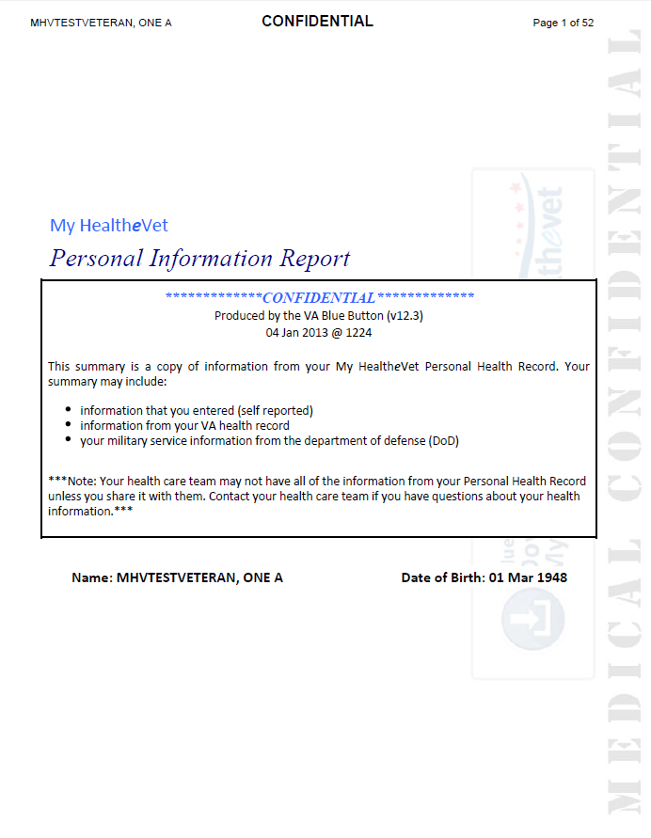
VA Blue Button
Self-reported data
Information from the VA EHR
Military Service Information
Notes:
So to summarize, the VA Blue Button can include:
--self reported or “patient generated data” (for example medications, herbals and supplements, health history, non-VA care)
--data from the VA EHR, (e.g., appointments, lab results, Wellness reminders, etc.)
--Military Service Information from DoD
In January 2013 we significantly expanded the types of information available for Premium users from the VA Electronic Health Record:
(problem list, allergies, immunizations, vitals and readings,
VA Notes, pathology and radiology reports, admissions and discharge summaries, etc.)*

Slide 30
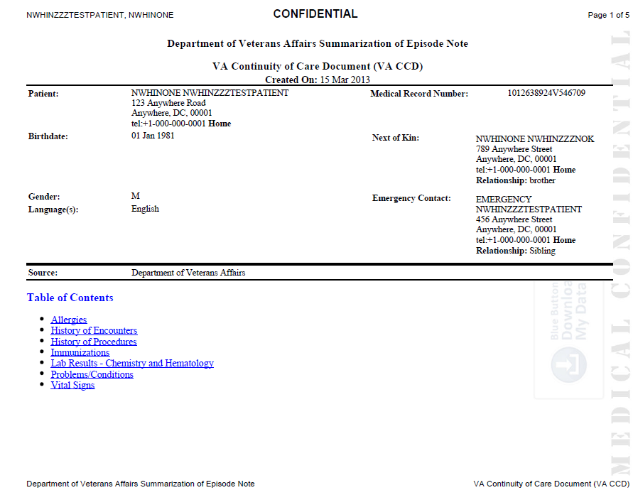
VA Continuity of Care Document (VA CCD)
Standards-based
health summary
Available in xml and PDF
Next iteration will:
Expand data (C-CDA)
Enable patients to share via DIRECT (Meaningful Use: View/Download/Transmit)
Notes:
In January 2013we also added a new information product: the VA CCD:
--health summary
--xml or PDF
--interoperable
…the next enhancements will
--expand the types of information that are included
--and enable patients to SHARE via a secure protocol called “DIRECT”
This will meet MU criteria for VDT

Slide 31
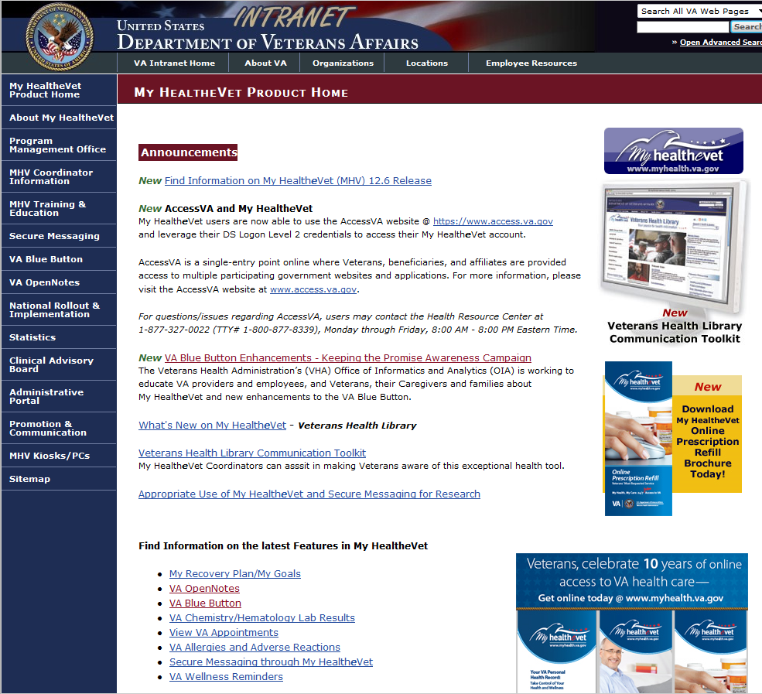
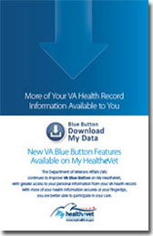
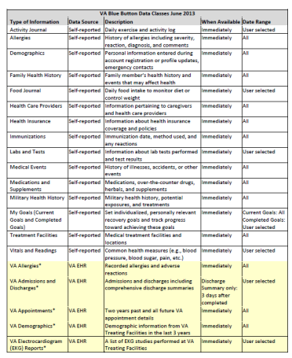
My HealtheVet Product Website
Notes:
--The My HealtheVet Product website is a great place on the VA Intranet to obtain information, products, and resources: http://vaww.va.gov/myhealthevet/
--For example, you can access a complete summary of all of the types of data that are available in both the Blue Button and the VA CCD, as well as the associated business rules for each

Slide 32
Use of VA Blue Button/VA CCD
918,000
Unique VA Blue Button users since August 2010
5.2 million
VA Blue Button file downloads since August 2010
73,000
Unique VA CCD users since January 2013
301,000
VA CCD file downloads since January 2013
Notes:
Use of the VA Blue Button and VA CCD

Slide 33
Poll Results
Have you ever shared information about the VA Blue Button with a Veteran?
  Yes
  No
Notes:
Now let’s pause for a moment and take a look at your poll results.
I asked you to answer the question: Have you ever shared information about the VA Blue Button with a Veteran?
It looks like…..
Clinician endorsement is a key driver in fostering patient adoption.

Slide 34
Poll Results
  Yes
  No
Notes:
Click to cue studio to take down poll results

Slide 35

Notes:
--Now let’s take a tour of how easy it is to use the VA Blue Button, and along the way I’ll point our some enhancements we’ve made based on direct Veteran feedback

Slide 36
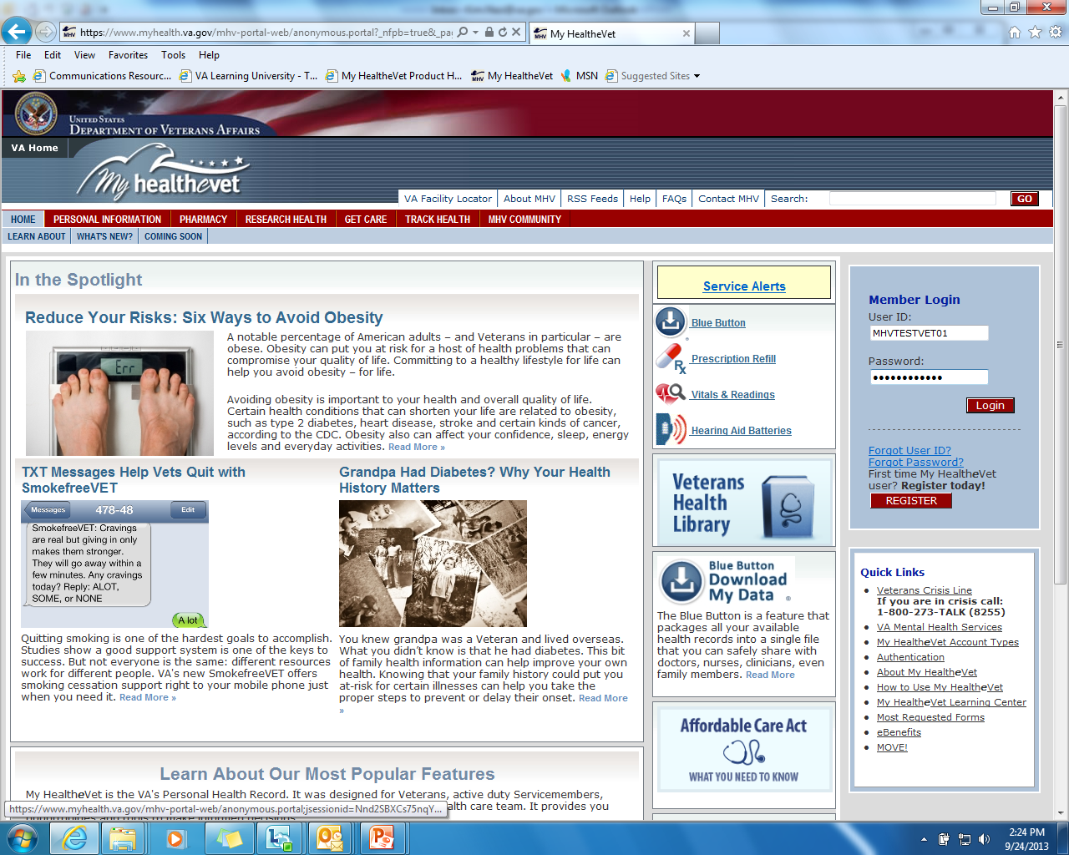
Log on to My HealtheVet

Slide 37
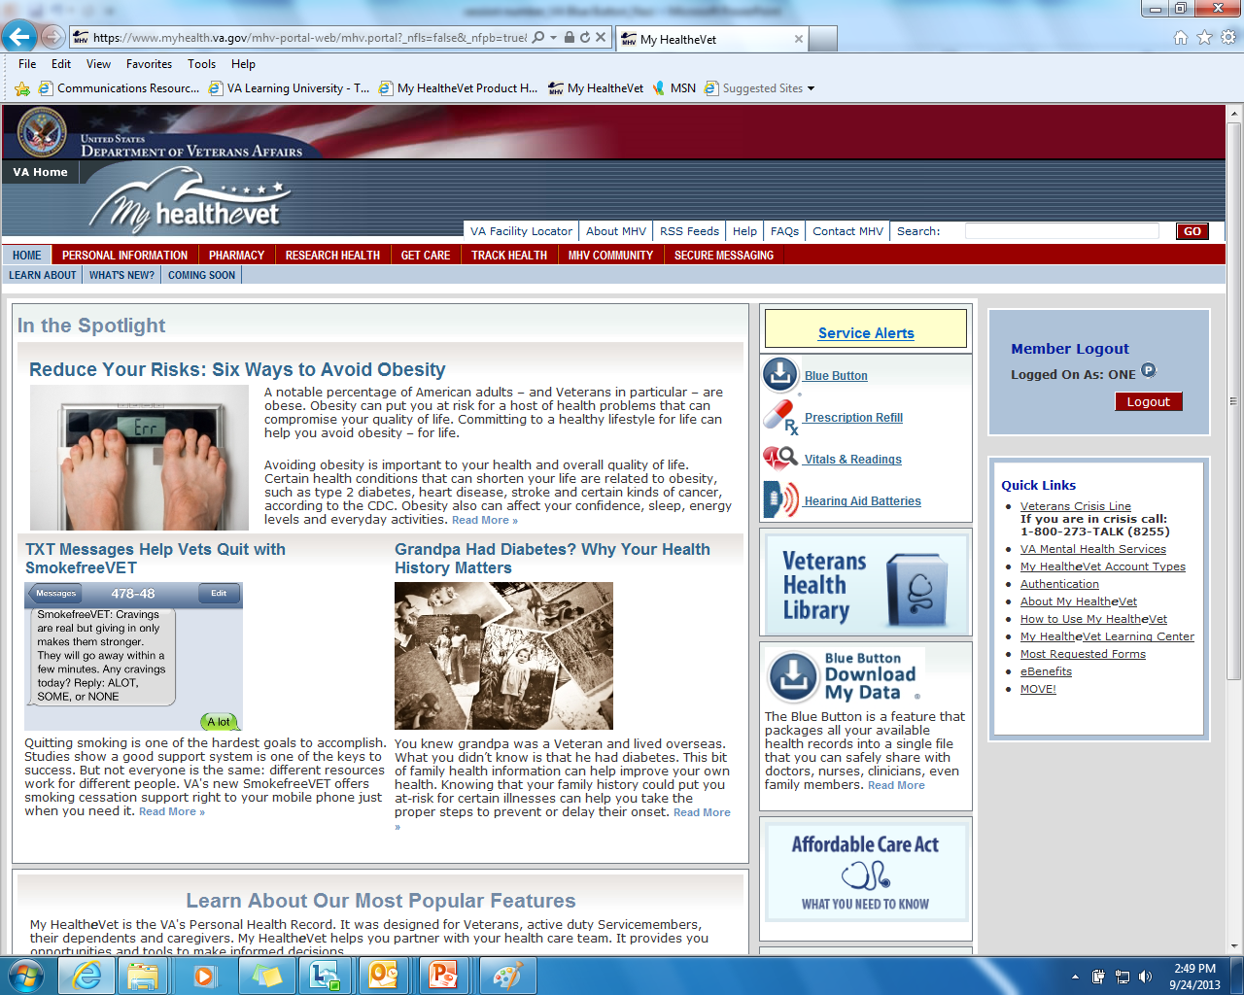
Easy Access to the VA Blue Button

Slide 38
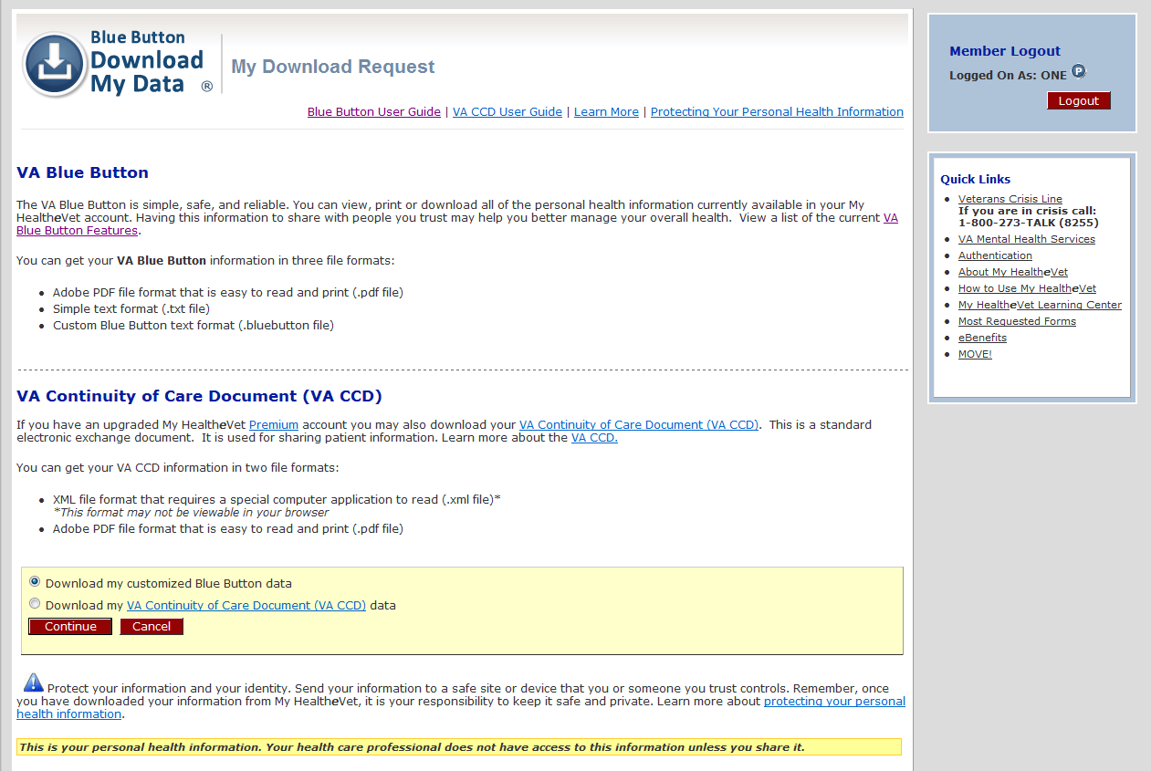
My Download Request Page

Slide 39
My Download Request Page: Blue Button User Guide
Notes:
I want to remind you that we have all of these screenshot available in a handout. You can access that by clicking the green download button above my head.

Slide 40
My Download Request Page: Blue Button Features

Slide 41
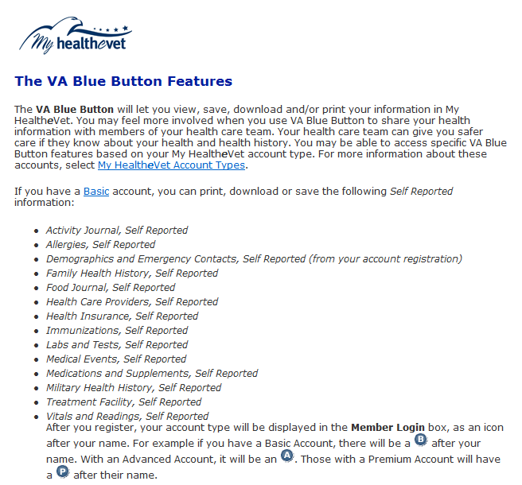
My Download Request Page: Blue Button Features

Slide 42
My Download Request Page: Select Blue Button or VA CCD

Slide 43
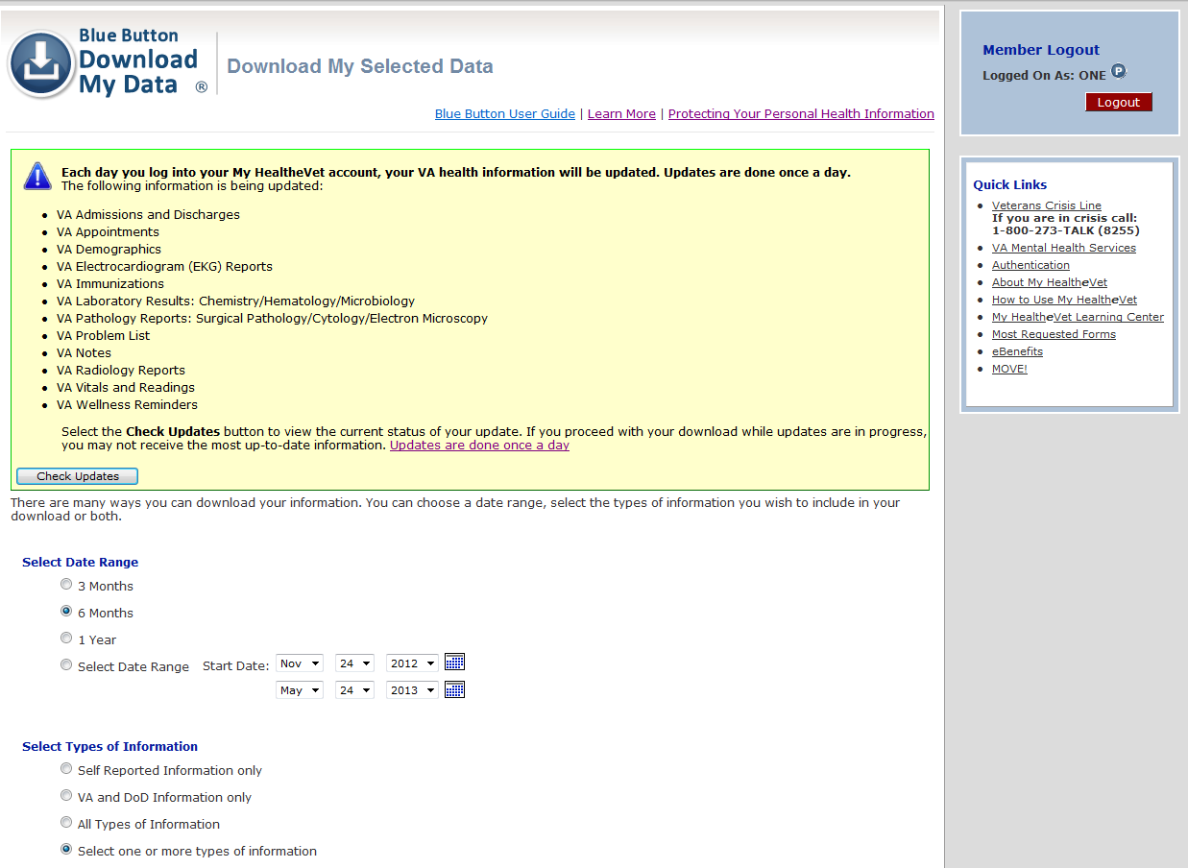
Download My Selected Data Page

Slide 44
Download My Selected Data Page: Data Refresh

Slide 45
Download My Selected Data Page: Data Refresh

Slide 46
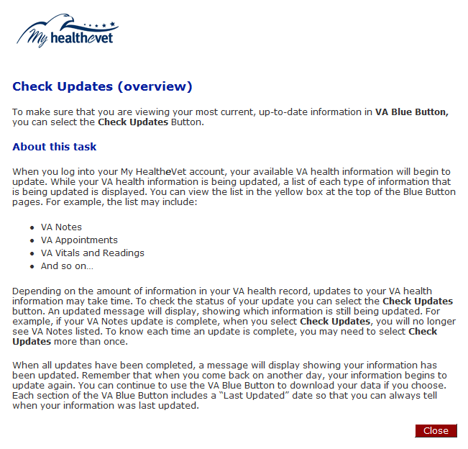
Download My Selected Data Page: Data Refresh

Slide 47
Download My Selected Data Page: Check Updates

Slide 48
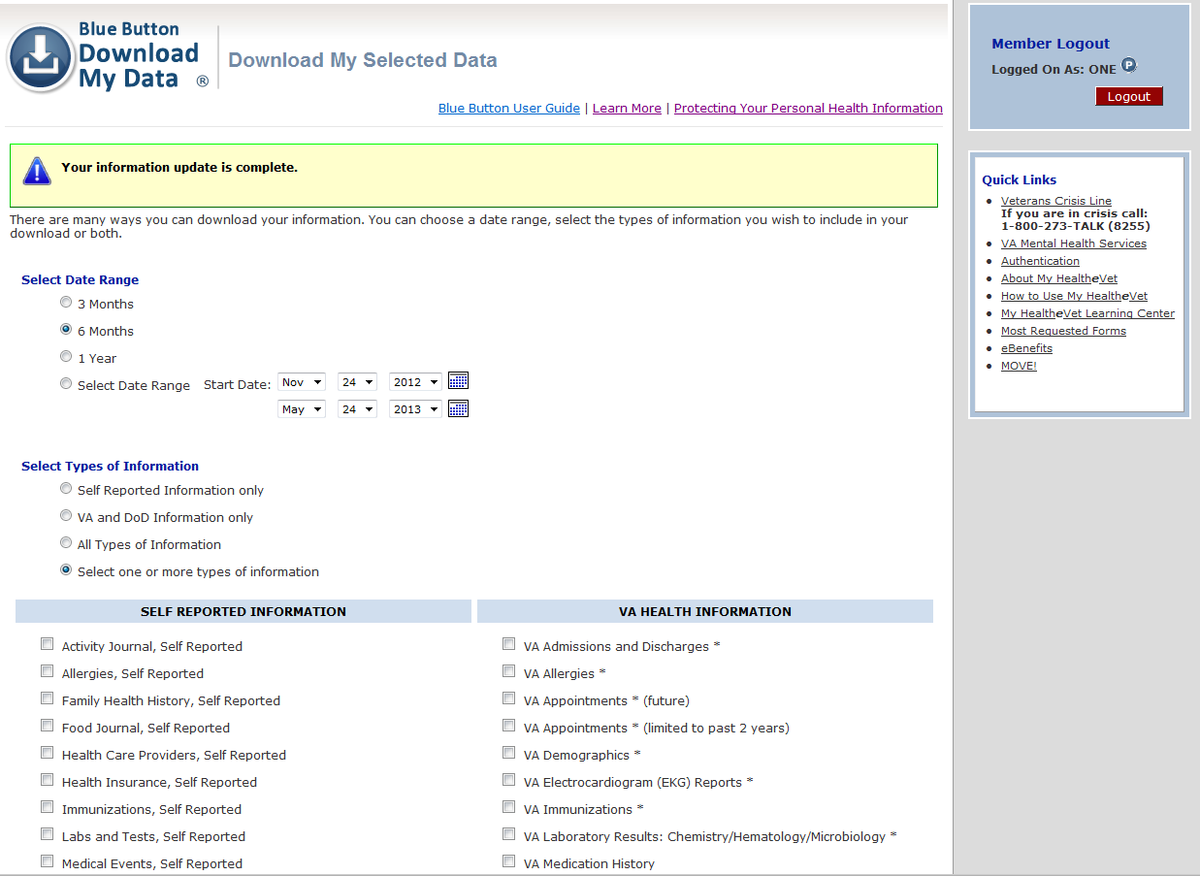
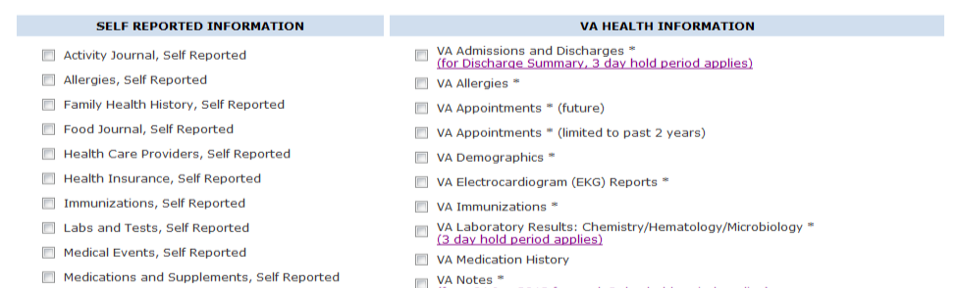
Download My Selected Data Page: Data Refresh Completed

Slide 49
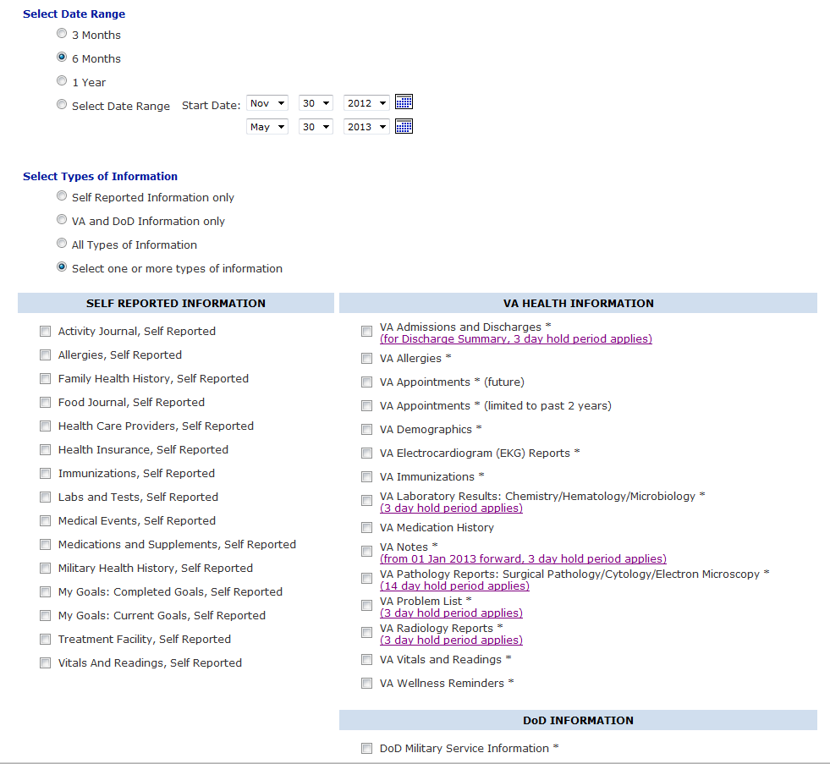
Download My Selected Data Page: Select Date Range

Slide 50
Download My Selected Data Page: Select Type of Information

Slide 51
Download My Selected Data Page: Select Type of Information

Slide 52
Download My Selected Data Page: Select Type of Information

Slide 53
Download My Selected Data Page: Select Type of Information

Slide 54
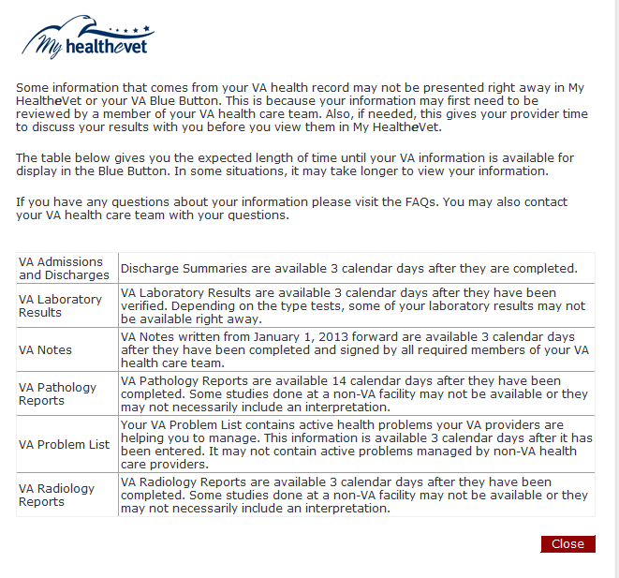
Download My Selected Data Page: Select Type of Information

Slide 55
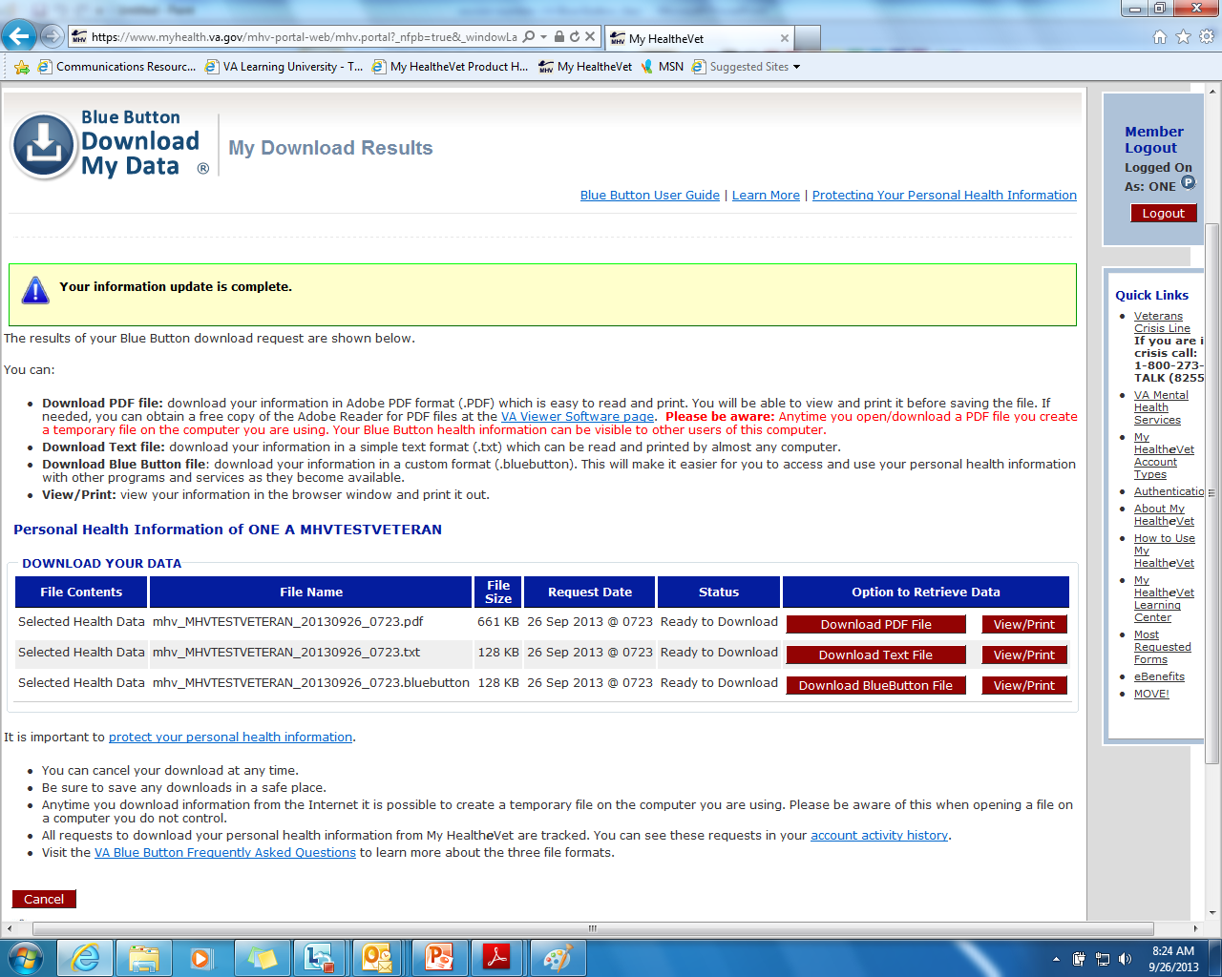
My Download Results Page

Slide 56
My Download Results Page: View/Print/Download

Slide 57
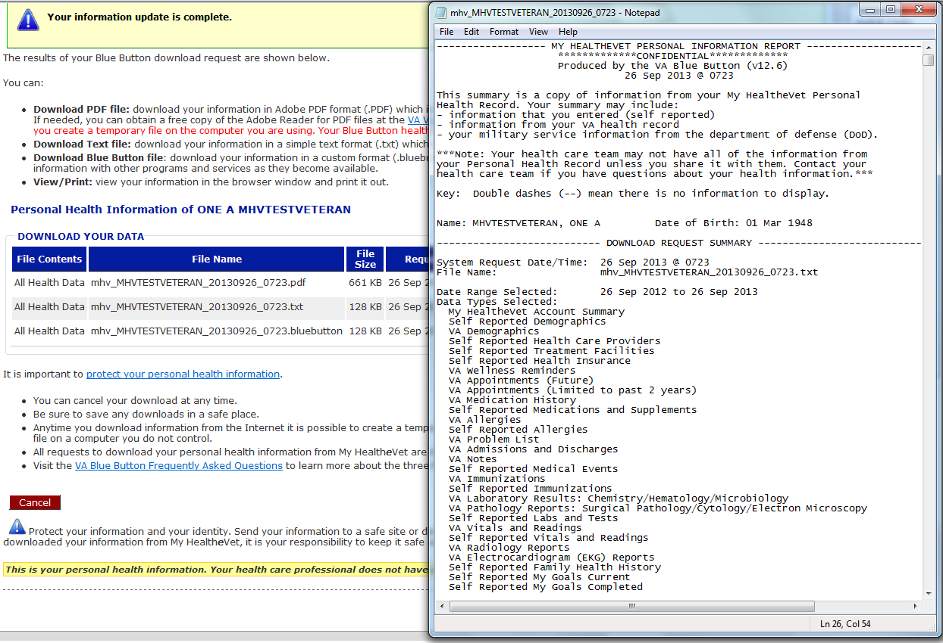
My Download Results Page: Text Output

Slide 58
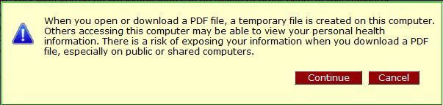
My Download Results Page: PDF Warning

Slide 59
My Download Results Page: Download PDF

Slide 60
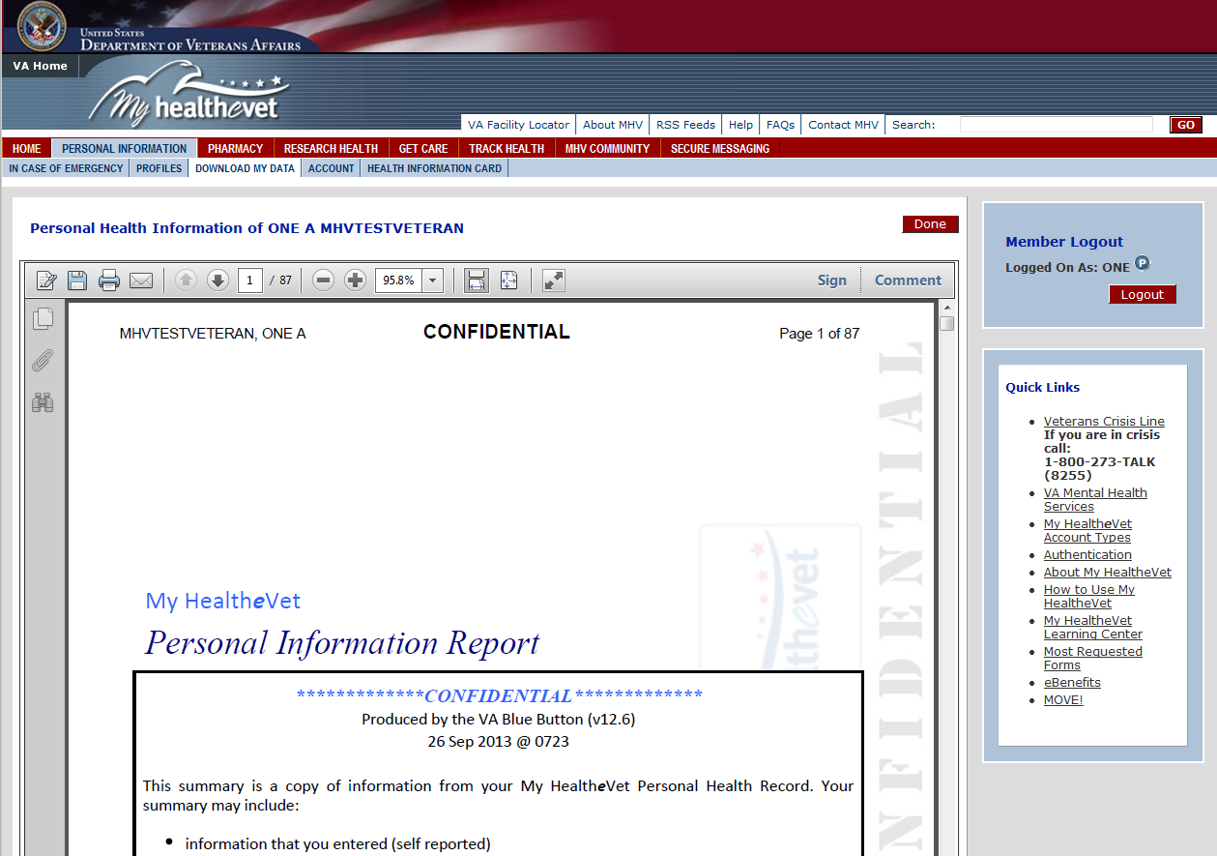
My Download Results Page: View/Print PDF

Slide 61
My Download Request Page: Select VA CCD

Slide 62
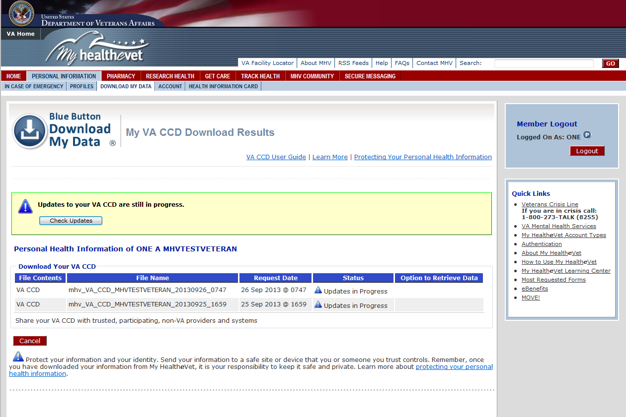
VA CCD My Download Results Page

Slide 63
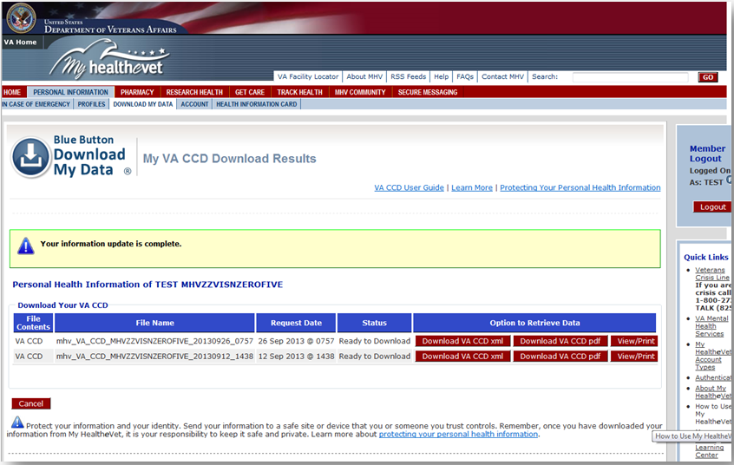
VA CCD My Download Results Page
Notes:
--data refresh complete
--download xml or PDF
--View/print in browser window

Slide 64
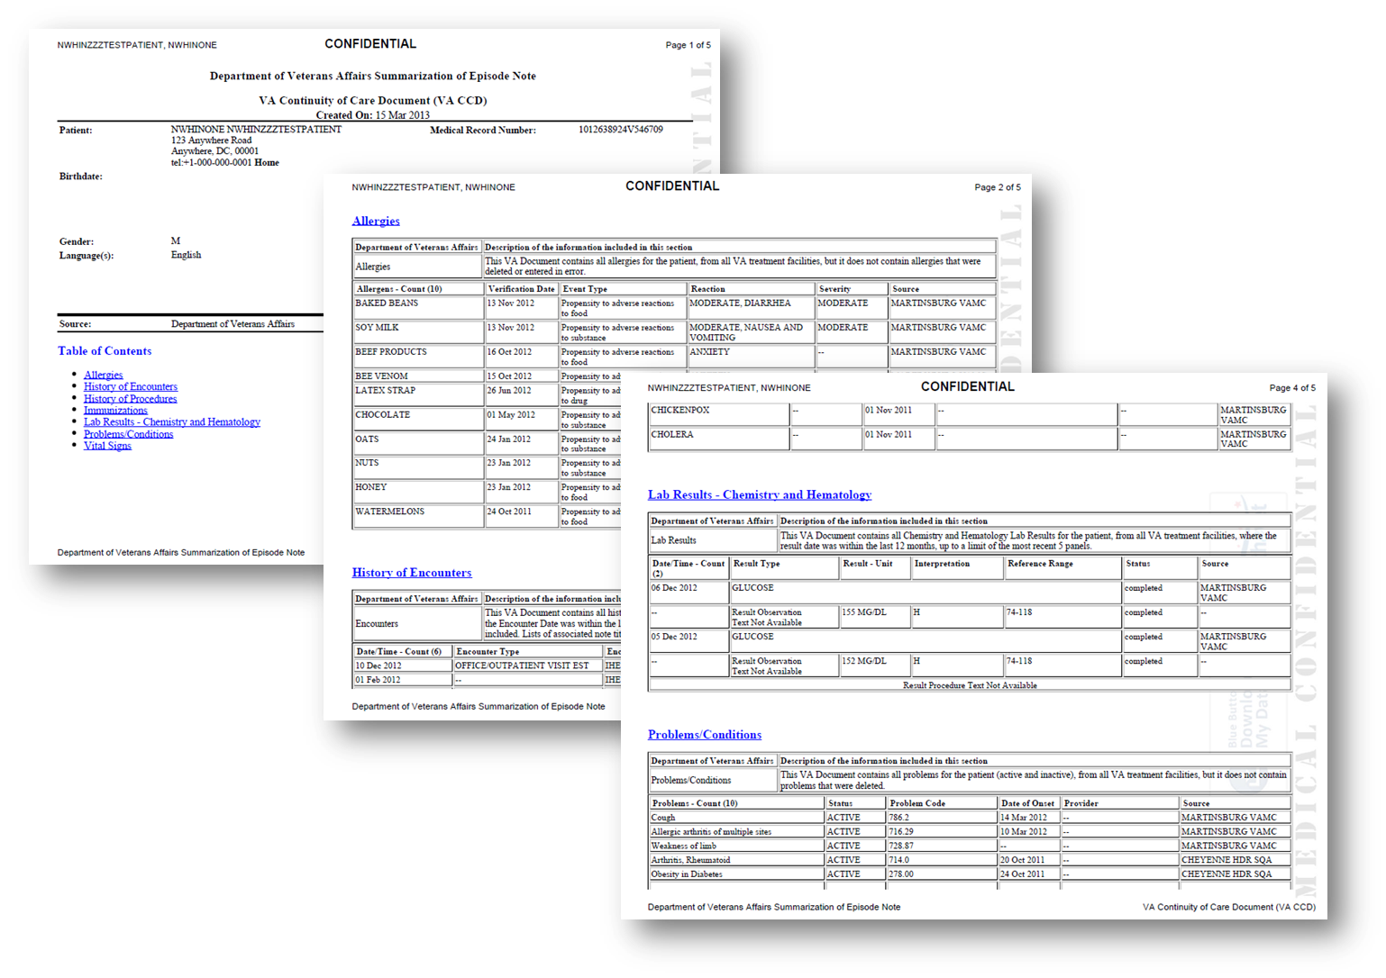
VA CCD PDF View

Slide 65

Next Steps
VA/DoD alignment
Patient-mediated exchange
DIRECT secure messaging
Expand CCD to C-CDA
Enhance usability
Support innovation
Notes:
--VA/DoD collaboration to support alignment, harmonization of data and business rules, and services
--Implement Blue Button DIRECT (Blue Button Plus)
DIRECT secure messaging protocol to enable secure patient mediated sharing of CCD to third party
Expand from CCD to C-CDA (more robust data set)
--Continue to enhance usability (Health Design Challenge)
--Continue to partner with industry to support innovation (e.g., Blue Button Co-Design Challenge)

Slide 66

Next Steps
  bi-directional data sharing
  push (publish updates automatically)
  pull (subscribe to automatic updates)
Notes:
--Future: enable bi-directional data sharing, push (publish updates automatically) and pull (subscribe to automatic updates)

Slide 67
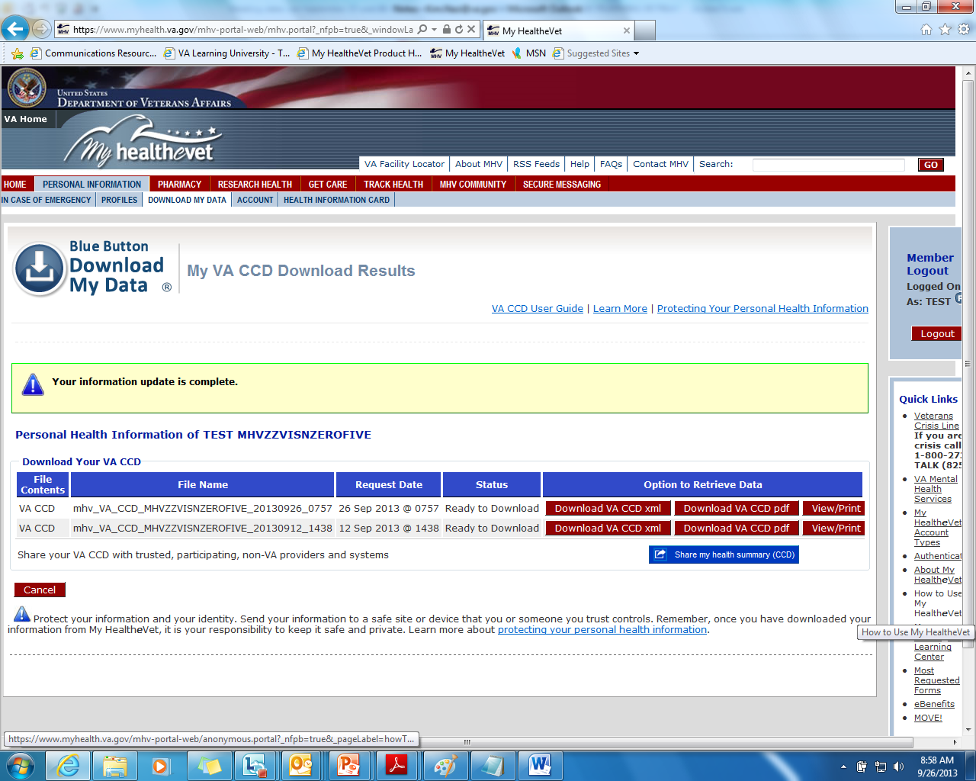
VA CCD My Download Results Page: Future
Notes:
--share my health summary (CCD)

Slide 68

Notes:
--Now I’d like to focus on one very important type of information that was added the to the VA Blue Button in January 2013
--VA joined the OpenNotes Initiative sponsored by the RWJF to provide patients with open access to their clinical notes

Slide 69
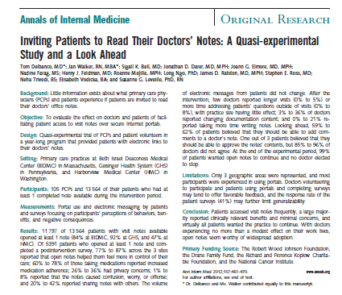
OpenNotes Evidence: For Patients
Better understanding of their health and medical conditions
Taking better care of themselves
Doing better with their medications
Did not feel overwhelmed
Notes:
--The OpenNotes study was a 1 year project with 100 providers who volunteered to share their visit notes with their patients
--20,000 patients participated at 3 major medical centers: Beth Israel Deaconess, Giesenger, and Harbor View Medical Center
--Study findings reveal important benefits for patients

Slide 70
OpenNotes Evidence: For Providers
Few reported significant impact
on workflow
Minority reported changing
their documentation
Concerns about potential harm
were not realized
Many described stronger relationships with their patients (trust, transparency, shared decisions)
All elected to continue
sharing their notes
“
I think it definitely helps patients take more ownership of their care and be more engaged in what’s happening.
This is a clear step towards: ‘this is about you, this is what we’re doing, and this is why it’s important.’
Primary care physician
“
Notes:
--Study findings also revealed important evidence for providers

Slide 71
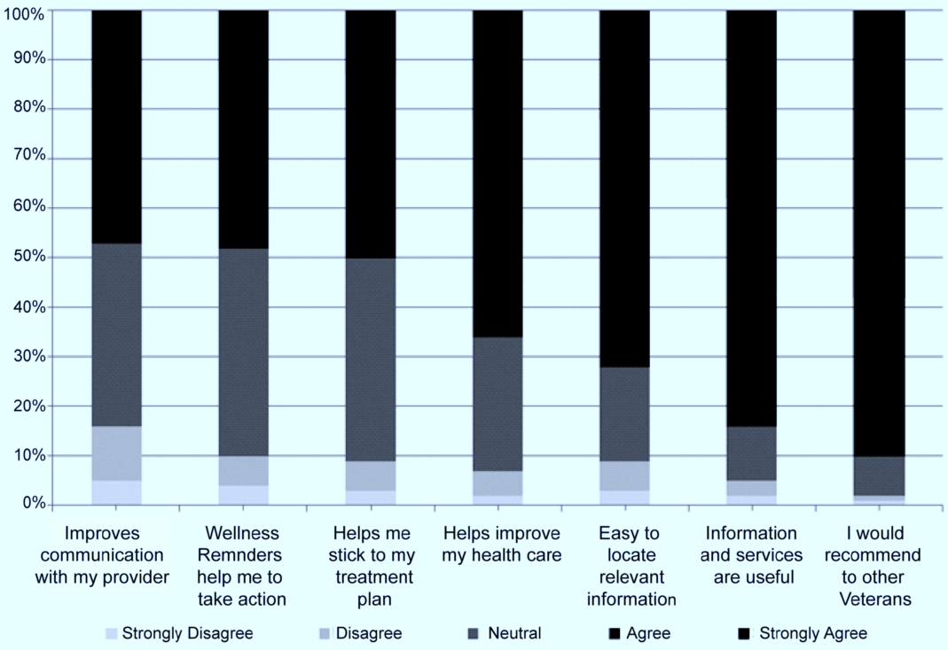
My HealtheVet Pilot Program
Notes:
Graph from published paper in 2013 in Medical Care:
--Within VA, the My HealtheVet Pilot Program (2000-2010) also demonstrated the value of providing patients with easier access to information contained in their VA health record
Reference: Nazi KM, Hogan TP, McInnes DK, Woods SS, and Graham G. Evaluating patient access to electronic health records: results from a survey of Veterans, Medical Care, 2013 Mar:51 Suppl:S52-S56.

Slide 72
VA OpenNotes: Basic Principles
Patients:
Have a legal right to access all information in their VA health record
Can request a copy of their information via their local Release of Information Office
But, VA patients have continuously requested easier access
Notes:
--Patients have a legal right to access all of the information in their VA health record
--VA patients currently exercise this right by requesting a copy of their information via their local Release of Information Office
--This right is guaranteed by the Office of Civil Rights (re-emphasized in September 2013 at the Consumer Health IT Summit)
--Veterans have continuously requested easier access to the information in their VA health record

Slide 73

VA OpenNotes
All signed Progress Notes
3 calendar day hold
for communication
Must be signed by all
required co-signers
VA Notes from January 1, 2013 forward
Note addendums
Notes:
What does VA OpenNotes include?
All signed Progress Notes
(primary care, specialty care, mental health, social work,
nursing, Secure Messaging, etc.)
Note addendums
3 calendar day hold
for communication
Must be signed by all
required co-signers
VA Notes from January 1, 2013 forward

Slide 74
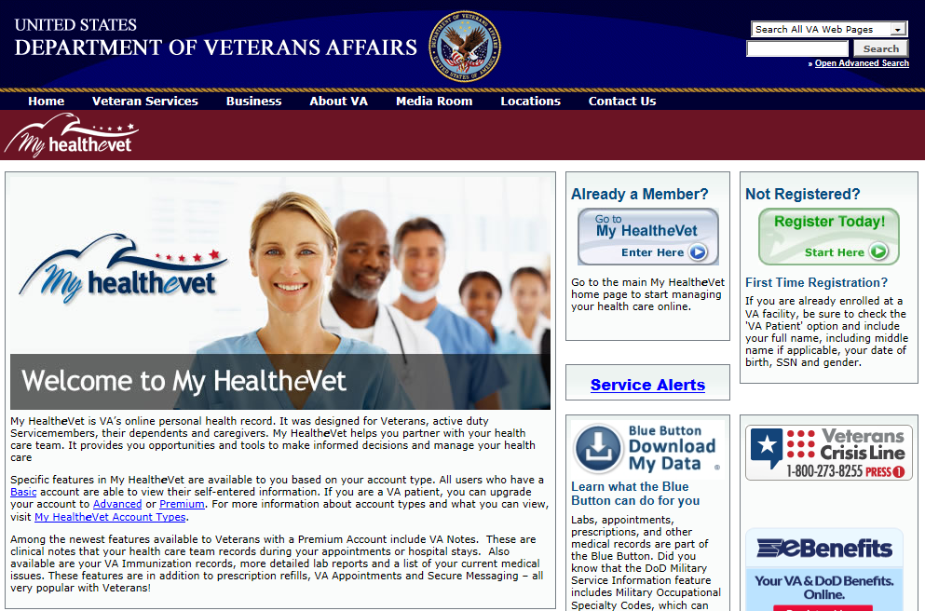
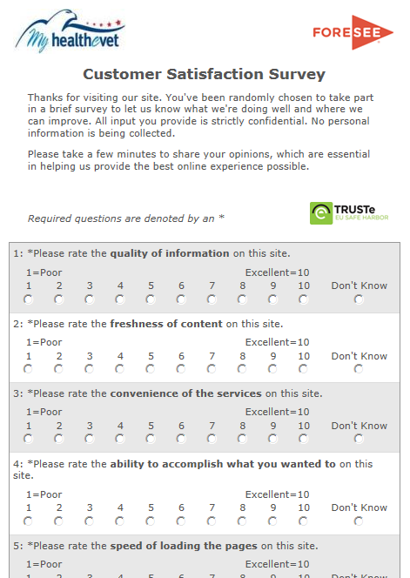
American Customer Satisfaction Index (ACSI) Survey
22 JUN 2013
to 15 SEP 2013
N=37,103
% Completed=62%
Random sample of 4% site visitors who’ve navigated 4 pages or more
Notes:
--To begin to understand the patient experience with VA OpenNotes we used the ACSI survey

Slide 75
VA OpenNotes Users
79%
Agree:
Visit notes will help me do a better job taking my
medications as prescribed
N=6,861

Slide 76
VA OpenNotes Users
89%
Agree:
Visit notes will help me be
better prepared for clinic visits
N=6,861

Slide 77
VA OpenNotes Users
91%
Agree:
Visit notes will help me take
better care of myself
N=6,861

Slide 78
VA OpenNotes Users
92%
Agree:
Visit notes (VA Notes) will help me understand my health and
medical conditions better
N=6,861

Slide 79
VA OpenNotes Users
88%
Disagree:
Visit notes will be more
confusing than helpful
N=6,861

Slide 80
VA OpenNotes Users
87%
Disagree:
Visit notes will make me
worry more
N=6,861

Slide 81

Clinical Applications
Blue Button is a tool to:
Engage patients in being active partners
Reinforce care/treatment plans
Coordinate care with non-VA providers
Enhance patient-centered care
Improve access, satisfaction, outcomes
Information is powerful medicine

Slide 82

“Time to
Leave the Island”
Regina Holliday
Notes:
--Regina Holliday painted this piece during the recent Consumer Health IT Summit in Washington DC in September
--In this painting a Blue Button doubles as the Island of Misfit Toys from the classic Rudolph the Red-nosed Reindeer.
The Text “All Misfits Welcome Here” is inscribed upon the button.
--Features Farzad Mostashari (ONC), Lean Rodriguez (OCR), ePatient Dave, and Lygiea Ricciardi (ONC)
http://reginaholliday.blogspot.com/2013/09/time-to-leave-island.html

Slide 83

Ask the Presenter
Notes:
If you haven’t submitted your questions yet, there is still time to do so by clicking on the orange “Ask The Presenter” icon. We’re going to show a brief announcement and be right back to answer your questions.

