Slide 1
Secure Messaging
Workload Credit
David M. Douglas, MD
Facility Chief Health Informatics Officer
Portland VAMC
Notes:
Thank you (moderator name)! I am happy to be here today to talk about (subject).

Slide 2

Secure Messaging
Workload Credit
Increments of Time

Slide 3

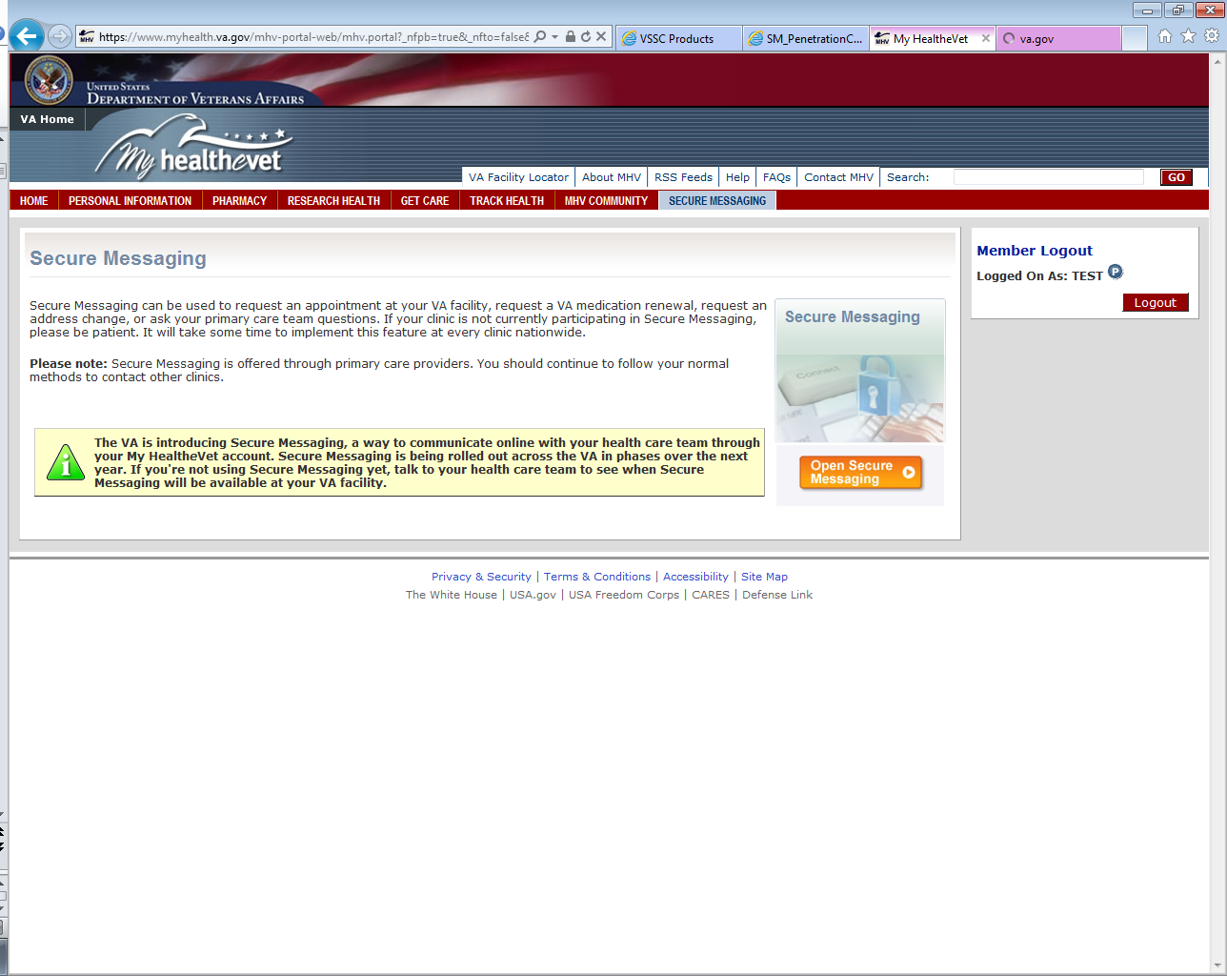
VA Secure Messaging
Notes:
Secure, approved mechanism for electronic communication between VA patients and their healthcare team.
More than 870,000 veterans have Opted In to Secure Messaging. In the last 30 days, VA providers have completed more than 300,000 secure messages and this speaks to the importance of creating a workload capture system.

Slide 4


Research: Consumers Eager to Use Online Health Care Tools, But Physicians Report Health IT Systems Lag
40%
Notes:
“Nearly two decades after email has become widespread, most patients say they want to – but still can’t – email their care provider,” said Simon Stevens, chairman of the Optum Institute.
Only 40 percent of physicians say they have the capability to engage with patients via email.
http://www.businesswire.com/news/home/20120920006234/en/Research-Consumers-Eager-Online-Health-Care-Tools

Slide 5
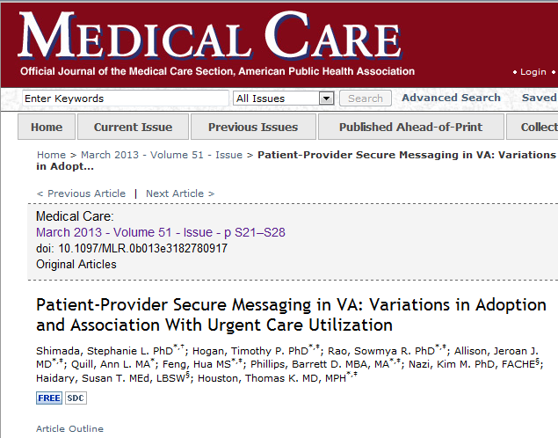
Notes:
In this exploratory analysis of early SM implementation in VA, we found a path of associations linking SM and reductions in Urgent Care utilization. These results suggest a need for further examination of the relationship between SM and its effects on health care utilization patterns.

Slide 6
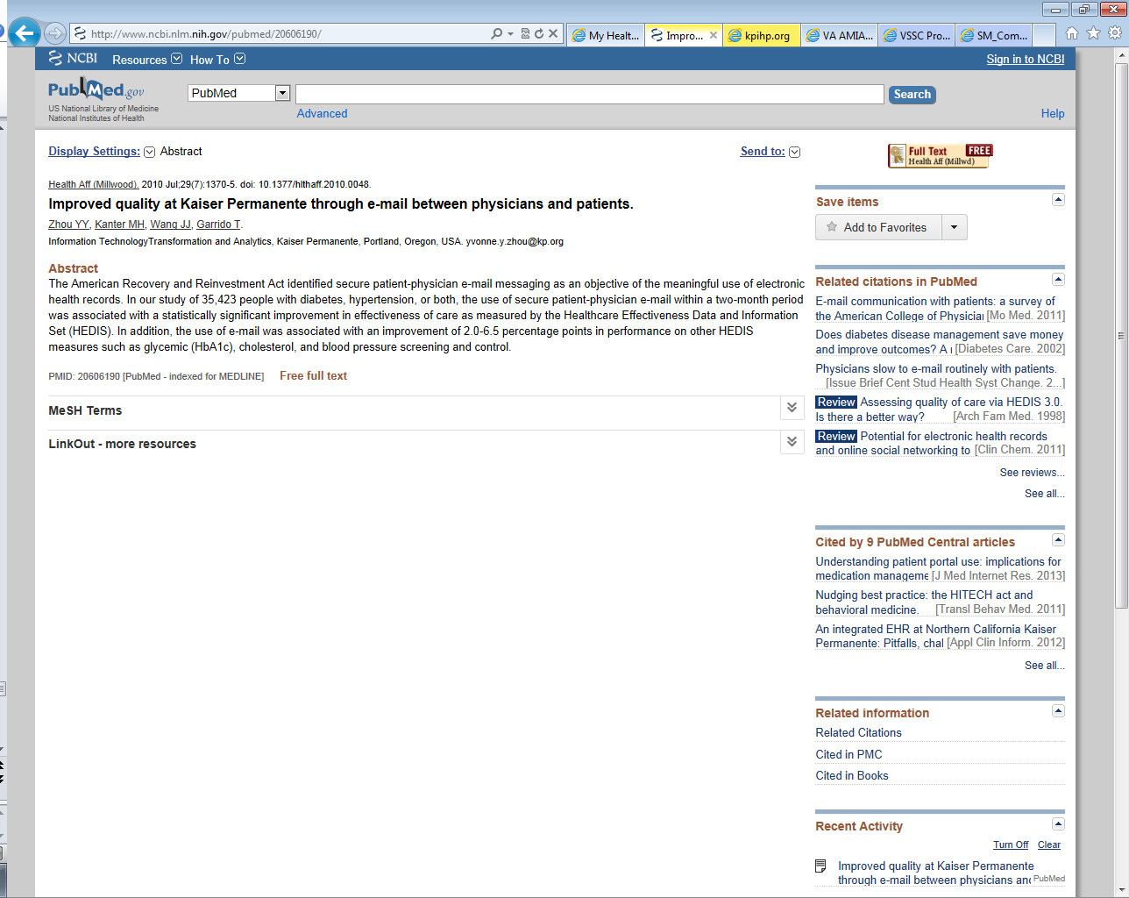
Notes:
Kaiser has reported that patients who use their version of Secure Messaging to communicate with their healthcare providers had a significant improvement in effectiveness of care as measured by the Healthcare Effectiveness Data and Information set commonly known as HEDIS. They also saw a 2-6.5 % improvement in other quality outcome measures like control of diabetes, cholesterol, and blood pressure.

Slide 7
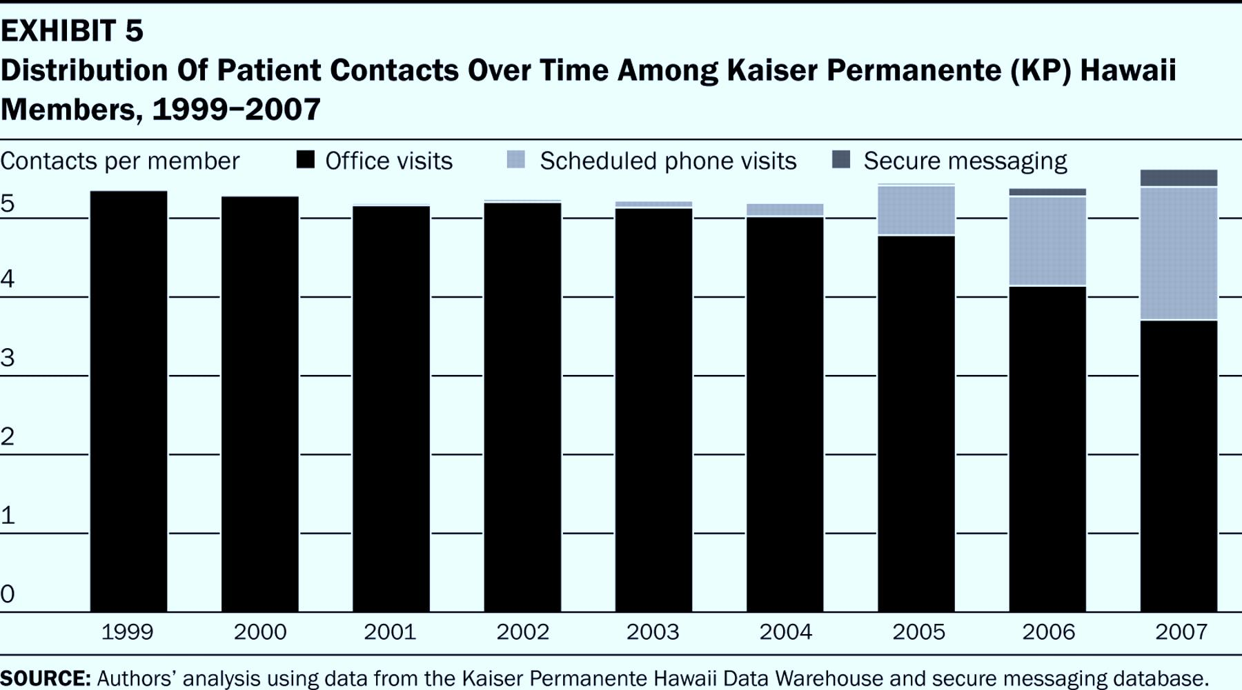

Distribution Of Patient Contacts Over Time Among Kaiser Permanente (KP) Hawaii Members, 1999–2007.
Notes:
Distribution Of Patient Contacts Over Time Among Kaiser Permanente (KP)
©2009 by Project HOPE - The People-to-People Health Foundation, Inc.
Hawaii Members, 1999–2007
Chen C et al. Health Aff 2009;28:323-333

Slide 8
Measure | Performance Numerator | Performance Denominator | % of Population
Virtual Care Modality (Across All Programs, Vrtl1) | 1,351,382 | 5,538,018 | 24.40 %
Telehealth Use (Tele1) | 551,185 | 5,538,018 | 9.95 %
Home Telehealth (Tele2) | 135,364 | 5,538,018 | 2.44 %
Clinical Video Telehealth (Tele3) | 185,790 | 5,538,018 | 3.35 %
Store and Forward Telehealth (Tele4) | 271,781 | 5,538,018 | 4.91 %
Secure Messaging (SM10) | 755,580 | 5,538,018 | 13.64 %
eConsult (SC10) | 234,711 | 5,538,018 | 4.24 %
SCAN ECHO (SC20) | 1,116 | 5,538,018 | 0.02 %

Slide 9
VISN | Avg Daily Outpt Visits | Secure Messages Sept 23, 2013
National | 205,662 | 14,120
V01 | 8,920 | 745
V02 | 5,171 | 208
V03 | 6,886 | 220
V04 | 9,506 | 529
V05 | 5,093 | 427
V06 | 10,841 | 1,100
V07 | 13,112 | 1,237
V08 | 20,858 | 1,291
V09 | 9,927 | 523
V10 | 8,669 | 476
V11 | 8,957 | 815
V12 | 9,085 | 340
V15 | 7,980 | 410
V16 | 15,739 | 1,202
V17 | 10,668 | 651
V18 | 8,523 | 774
V19 | 6,641 | 291
V20 | 9,080 | 926
V21 | 9,470 | 695
V22 | 11,490 | 881
V23 | 9,036 | 379
Notes:
This table shows the average daily outpatient visits at our 21 VISNs compared to the volume of secure messages on Sept 23. You can see that Secure Messaging volumes are between 4 and 10 % of the volume of face to face outpatient visits so you can already see that this is a significant activity and we need to track it.

Slide 10
Workload Credit in
Secure Messaging
David M. Douglas, MD
Mary Johnson RHIT, CCS-P
August 23 2012
Notes:
To view this past presentation you can go to MyVeHUCampus.com and click on the purple “on demand” button. Then type Workload Credit in Secure Messaging into the search line. It should pop right up.

Slide 11
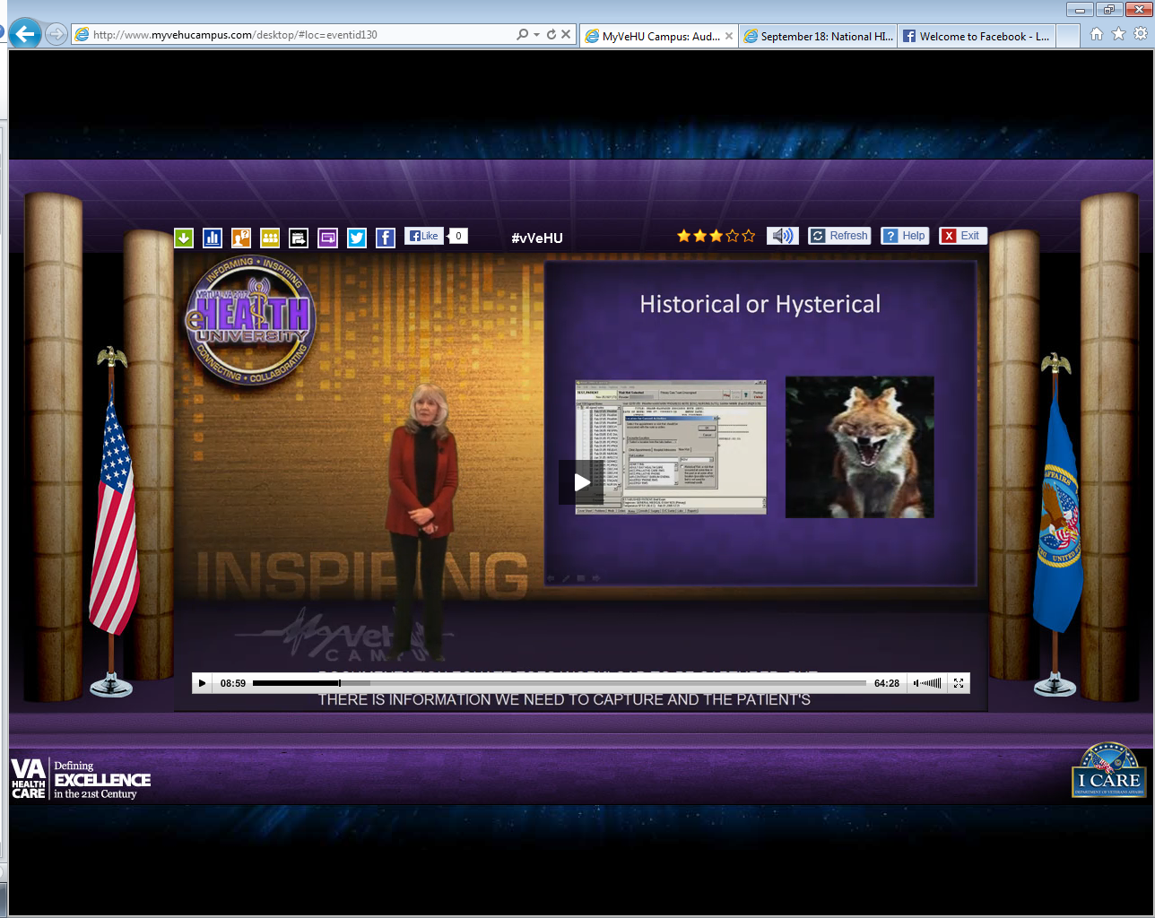
Notes:
Here’s Mary Johnson a brilliant HIMS and coding expert who helped us to understand the concepts underlying workload credit.

Slide 12
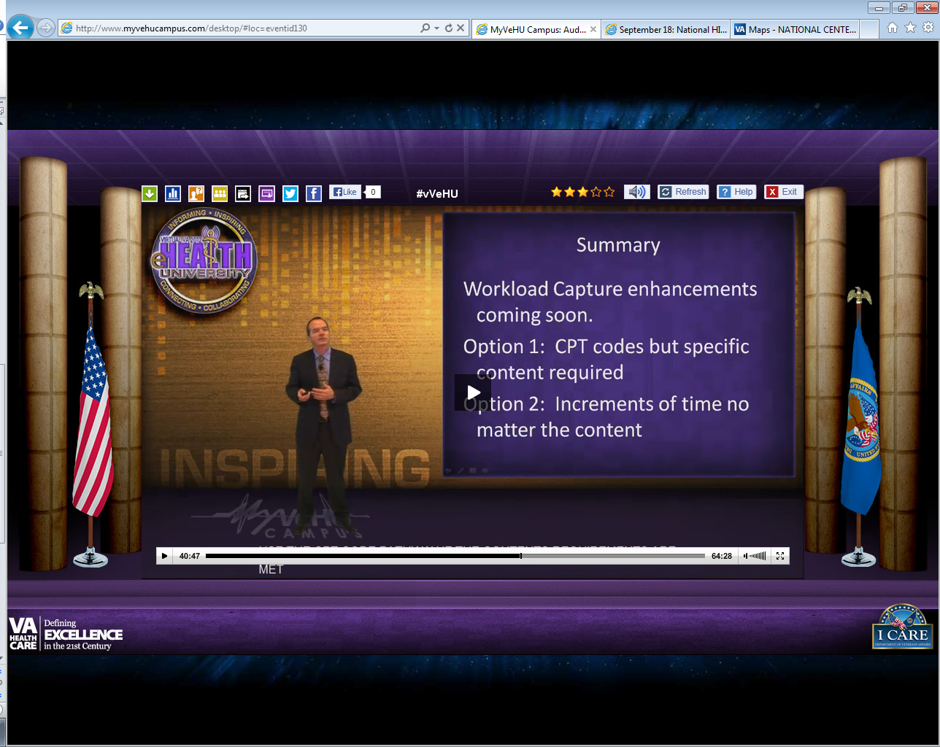

Slide 13

Encounter
Notes:
Professional contact between a patient and a practitioner
vested with responsibility:
diagnosing,
evaluating,
treating the patient’s condition
Outpatient
Inpatient
(M) The definition of encounter is evolving into a scenario of a trained clinical staff person and a Veteran interaction – be it phone, visit, email message. We have new programs expanding to provide some level of care remotely – from chart only consults to telemedicine. The secured messaging is the newest addition of care delivery models.

Slide 14
Online Evaluation and Management
99444
Notes:
to an established patient, guardian, or health care provider not originating from a related E/M service provided within the previous 7 days, using the Internet or similar electronic communications network
The authoritative source for CPT codes is the AMA. Their definition on the code for the physician specifically states evaluation and management services. This code should be used by clinical staff who have the credentials to provide evaluation and management services – MD, DO, PA, NP. Of note – there can be a nurse, social worker, psychologist involved in the response but the code selected is based on the clinician with the highest level of credentials. One encounter per day. . . . .
Online evaluation and management service provided by a physician

Slide 15

On-line Assessment and Management Service Provided by a Health Care Professional
98969
Notes:
to an established patient, guardian, or health care provider not originating from a related assessment and management service provided within the previous 7 days, using the Internet or similar electronic communications network
Assessment and management – qualified nonphysician. This code is used when the primary practitioner with the highest level of credentials are not MD, DO, PA or NP. Every person involved in the management of this patient should h
On-line assessment and management service provided by a qualified non-physician health care professional have their names added to the encounter form to assure everyone gets their workload captured.

Slide 16
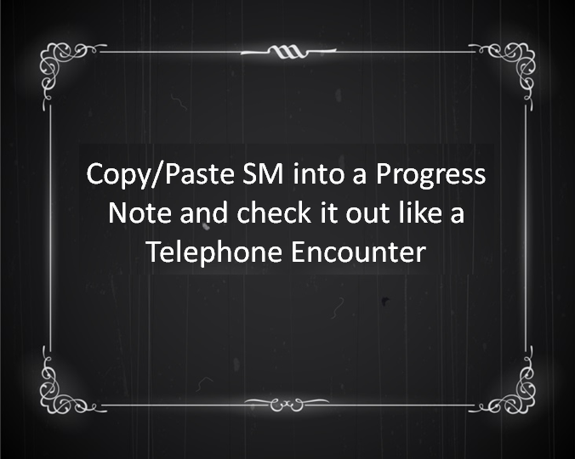
The Old Fashioned Way
Notes:
Copy/Paste SM into a Prog Note and check it out like a Telephone Encounter

Slide 17
SM CPT Codes in FY 13
98969 = 8,551
99444 = 4,242
Primary Care
5,159
Move
2,506
Clinical Pharmacy
351
Nutrition
184
Primary Care
3,385
Telephone
572
Clinical Pharmacy
101
Psychiatry
79

Slide 18

Poll Question
Have you Copy/Pasted SM threads into a Progress Note and checked it out an encounter to get workload credit?
    Yes
    No
    Unsure
Notes:
Now I’d like to ask a poll question.
Have you Copy/Pasted SM threads into a Progress Note and checked it out an encounter to get workload credit?
Yes
No
Unsure
To answer this question, use the blue polling icon above my head. We’ll move on and come back to your results in just a moment.

Slide 19

What does it take to capture workload?
Notes:
Provider
Patient
Hospital Location
Progress Note
Diagnosis Code
Procedure Code
Mandatory Questions: Service Connection, Agent Orange, etc

Slide 20

Notes:
Workload Credit- Documentation of Secure Messaging encounter meeting HIMS requirements for using CPT codes, ICD Diagnoses, provider and other data entry.
Increments of Time- Documentation of time spent working on a Secure Message using special Event Capture codes for online interaction with patient that does not meet requirements for a CPT code.

Slide 21
CPT Code Requirements
a problem focused history
straight forward med decision making
CPT Code Requirements
Notes:
That means we need at the minimum--
At least 1-3 elements of an hpi
At least 1 minor self-limited problem to be addressed that poses minimal risk. (for example, a self-limited minor problem that’s stable or improved for which perhaps further testing is required-- lab test or EKG or urinalysis or U/S)

Slide 22

Increments of Time
Notes:
Event Capture ECS allows special procedure codes to be created that will document time spent on Secure Messaging

Slide 23
Poll Results
Have you Copy/Pasted SM threads into a Progress Note and checked out an encounter to get workload credit?
    Yes
    No
    Unsure
Notes:
Now let’s pause for a moment and take a look at your poll results.
Have you Copy/Pasted SM threads into a Progress Note and checked it out an encounter to get workload credit?
Yes
No
Unsure
Ad-lib to the audience results, then advance to move on.

Slide 24
Poll Results
    Yes
    No
    Unsure
Notes:
(Click past this slide to cue the studio to take the poll results down)

Slide 25
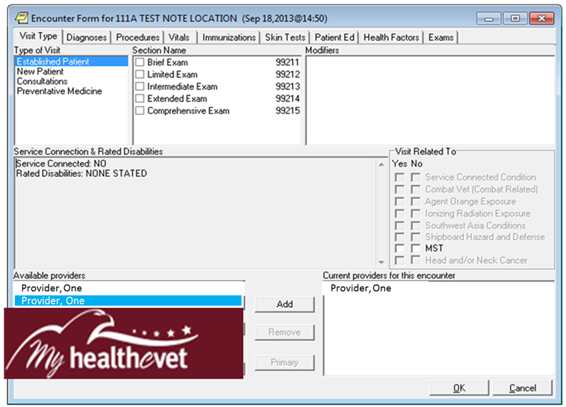
Patient Care Encounter PCE
Notes:
Patient Care Encounter PCE

Slide 26
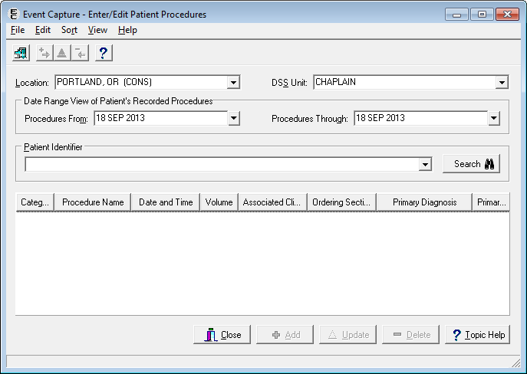
Event Capture ECS
Notes:
Here’s the Event Capture interface. Although it is not necessary for SM providers to launch Event Capture, we have used Event Capture software and processes to set up the SM workload credit and increments of time interface. One of several tasks has been for Event Capture administrators at each of our sites to work with MHV coordinators to get all the providers set up to send increments of time procedure codes into the right event capture buckets.

Slide 27
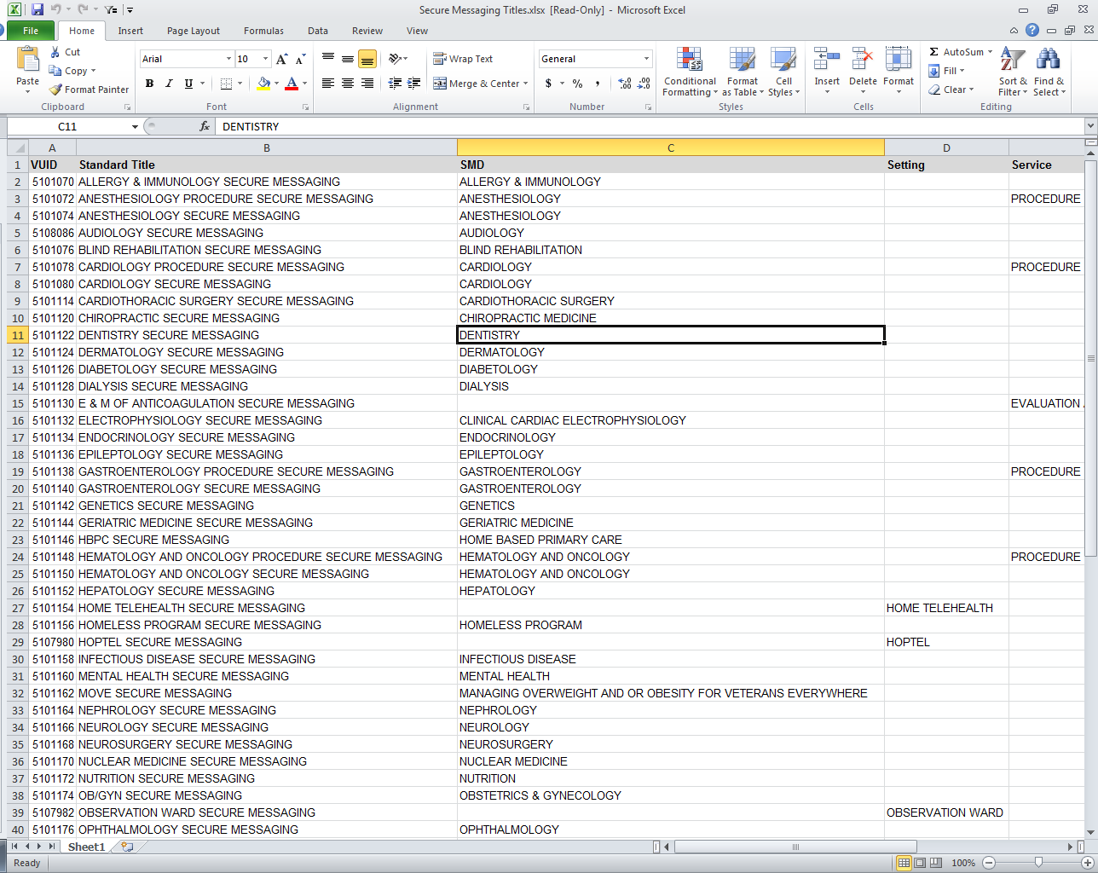
Special Secure Messaging Clinics

Slide 28
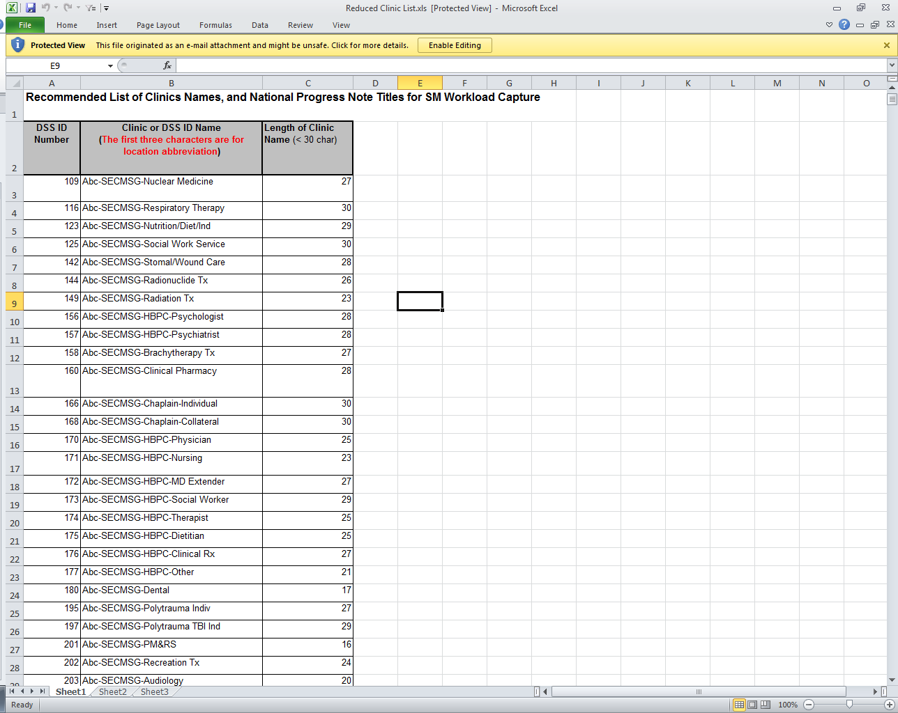
Special Secure Messaging Progress Notes

Slide 29
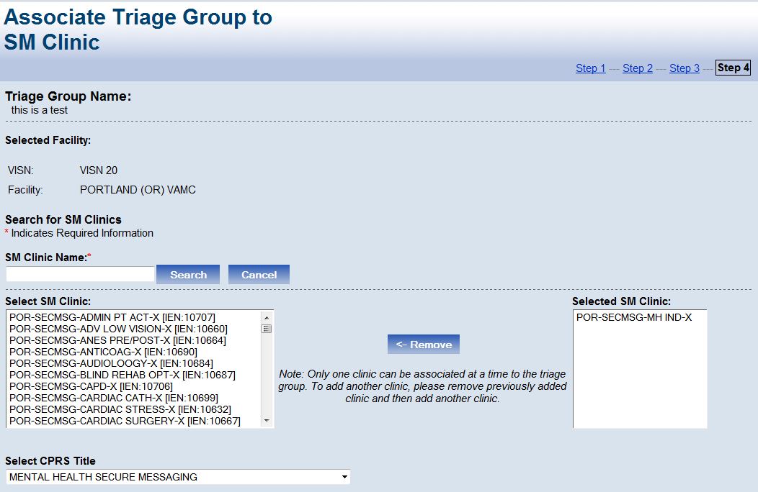
Under the Hood…

Slide 30
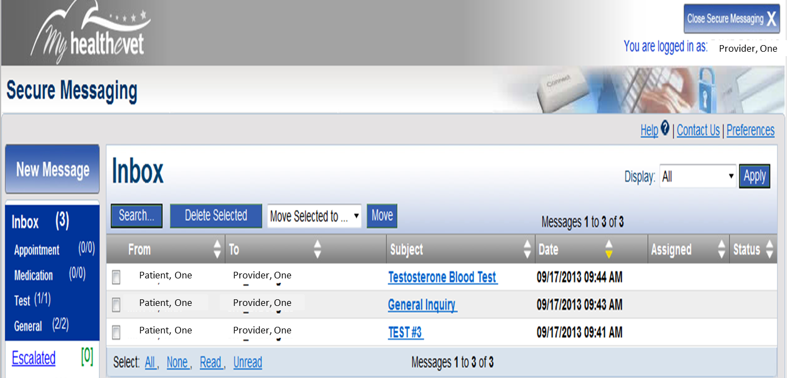
Veteran Sends Messages

Slide 31
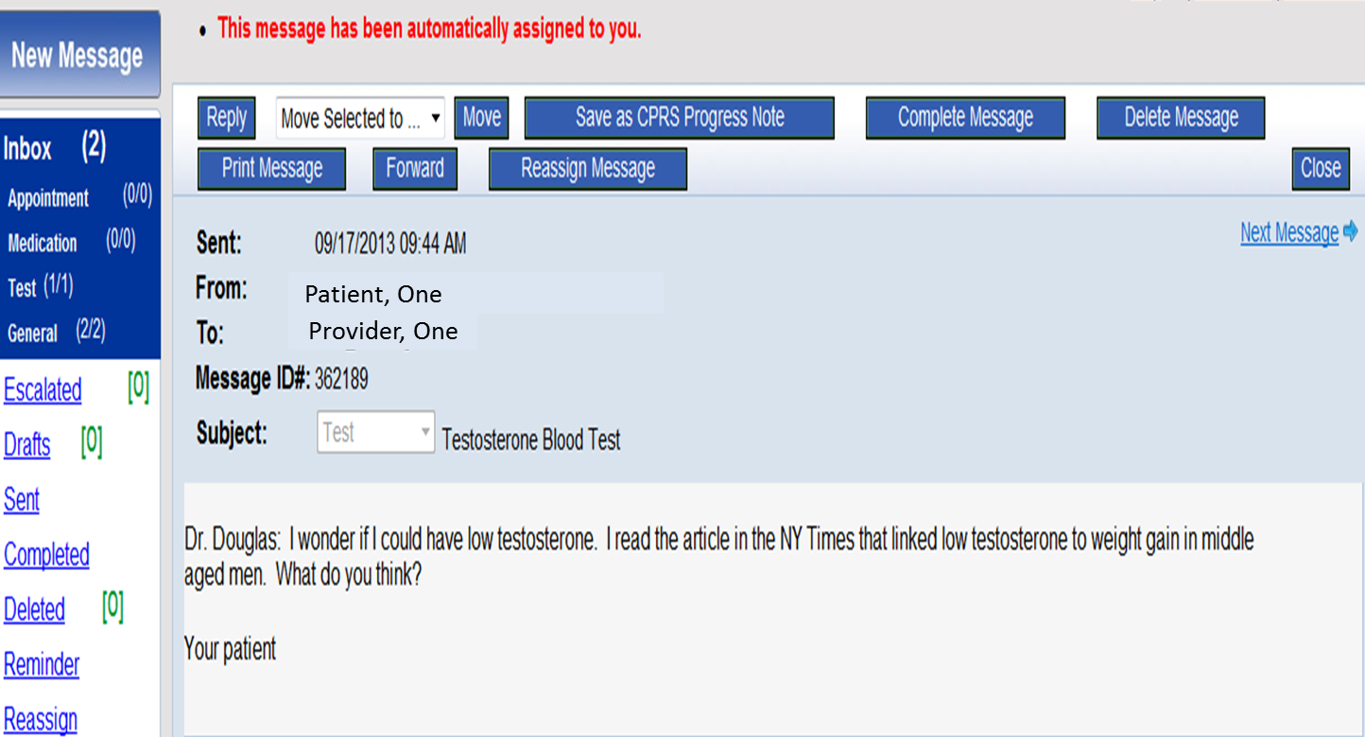
Could I Have Low T?
Notes:
Dr. Douglas: I wonder if I could have low testosterone. I read the article in the NY Times that linked low testosterone to weight gain in middle aged men. What do you think?
Your patient

Slide 32
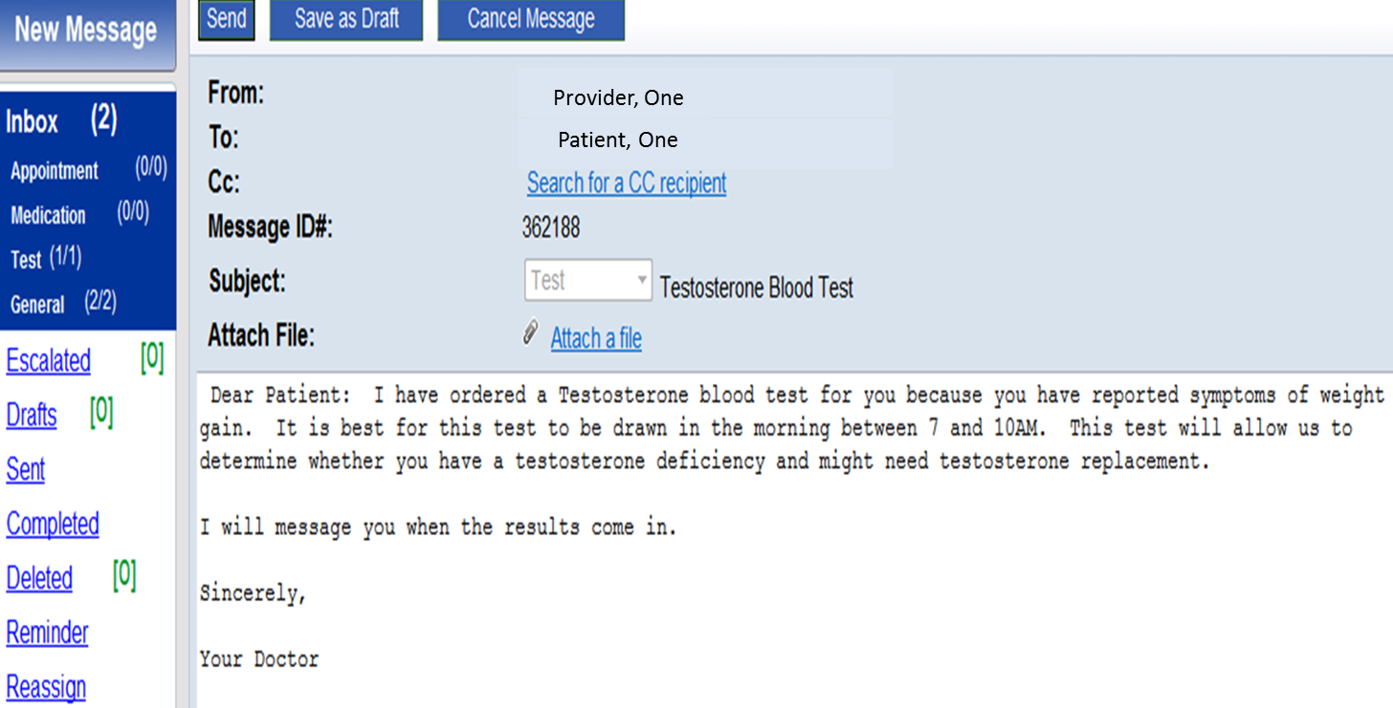
Diagnosis Based on the History
Notes:
The provider offers a diagnosis based on the history and orders a blood test.
Dear Patient: I have ordered a Testosterone blood test for you because you have reported symptoms of weight gain. It is best for this test to be drawn in the morning between 7 and 10 AM. The test will allow us to determine whether you have a testosterone deficiency and might need testosterone replacement.
I will message you when the results come in.
Sincerely, your patient

Slide 33
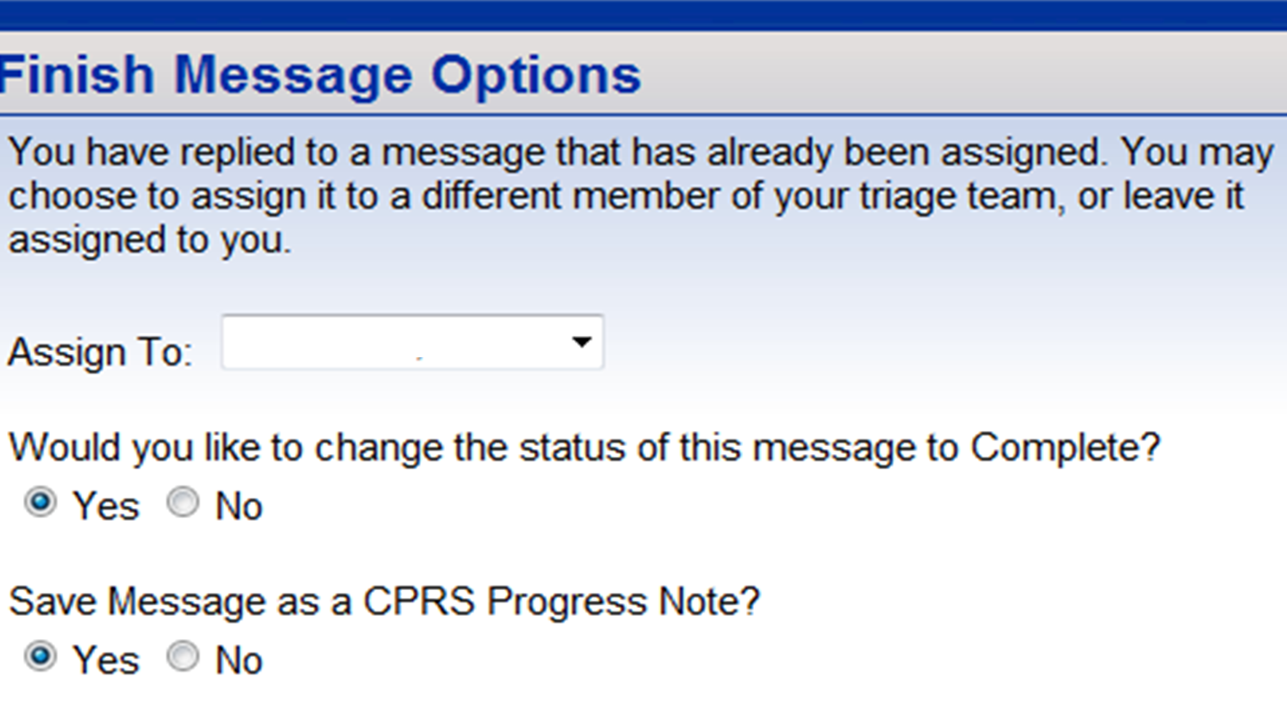
Workload Credit Option Follows
Save Message as a CPRS Progress Note

Slide 34
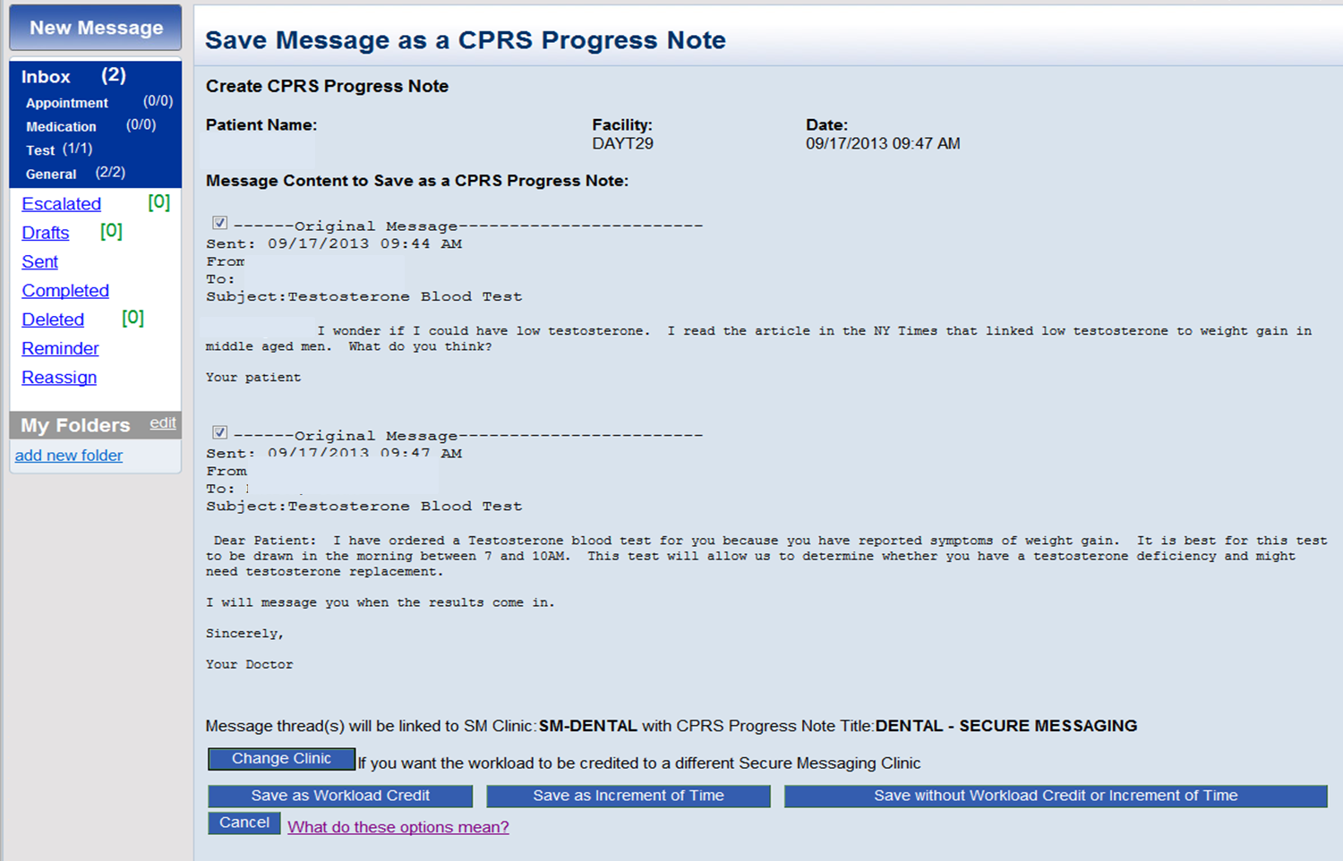
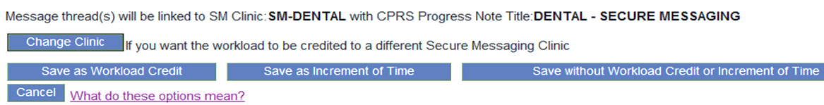
Three Options
Notes:
Save Message dialog gives you 3 choices

Slide 35
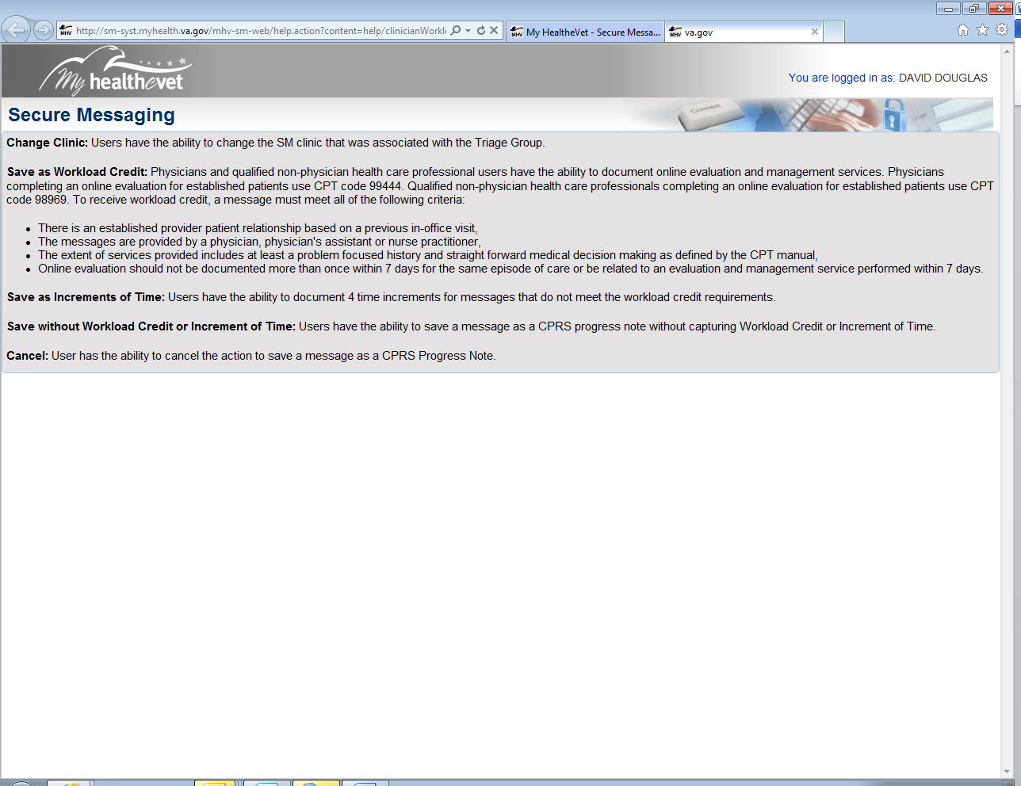
What do these options mean?
Change Clinic
Save as Workload Credit
Save as Increments of Time
Save without Workload Credit or Increments of Time
Cancel

Slide 36
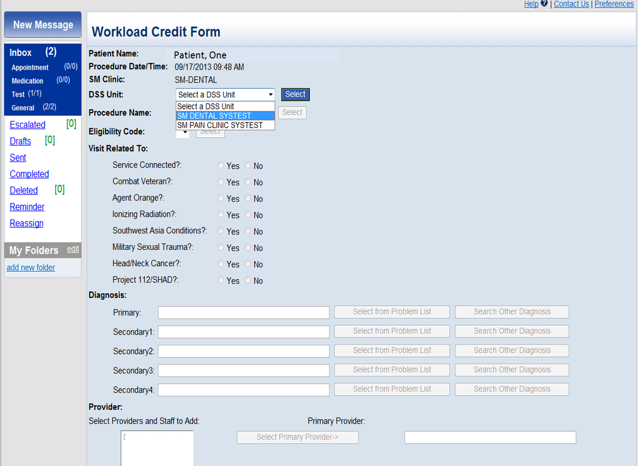
The Workload Credit Form

Slide 37
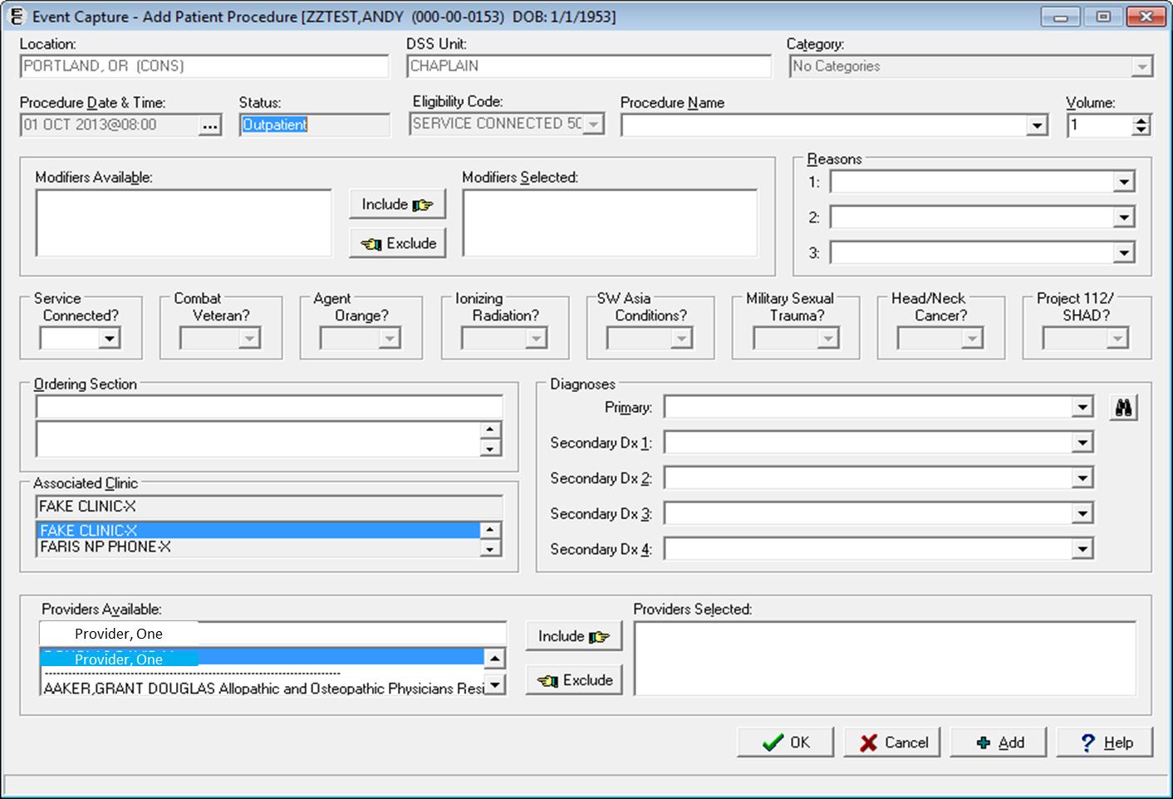
Analogous to Event Capture

Slide 38
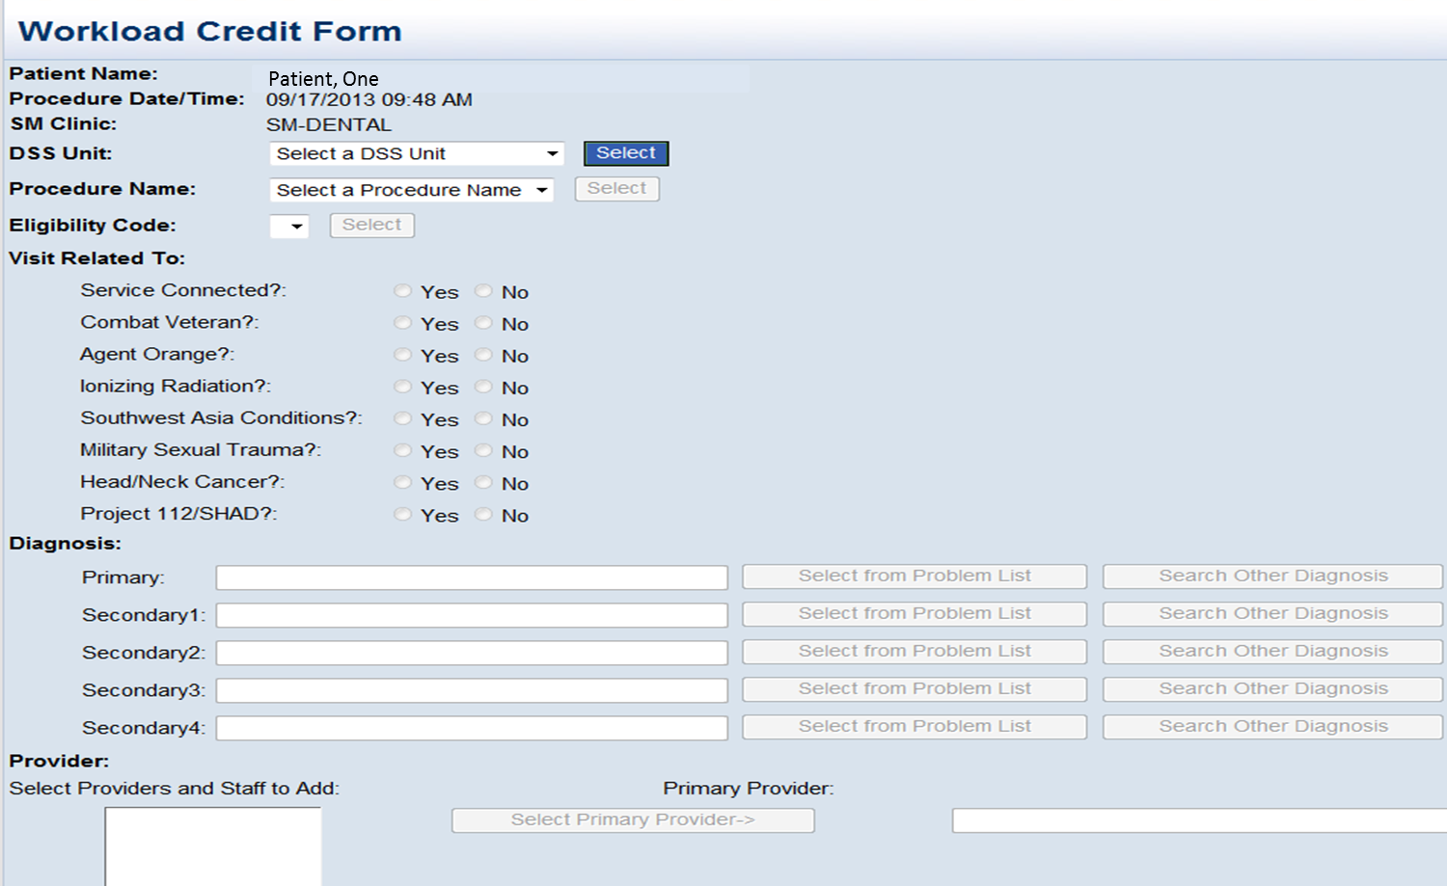
SM Clinic, DSS Unit, Eligibility, and
Applicable Visit Related to Questions
Notes:
SM clinic, DSS Unit, Eligibility, and
applicable Visit Related to Questions

Slide 39
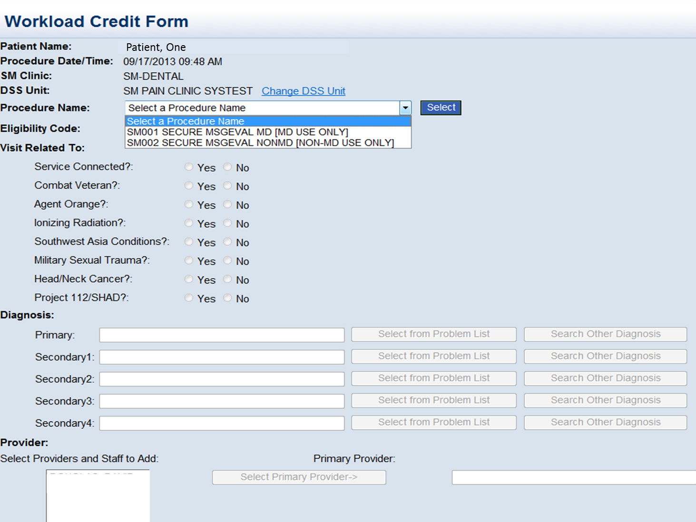

Slide 40
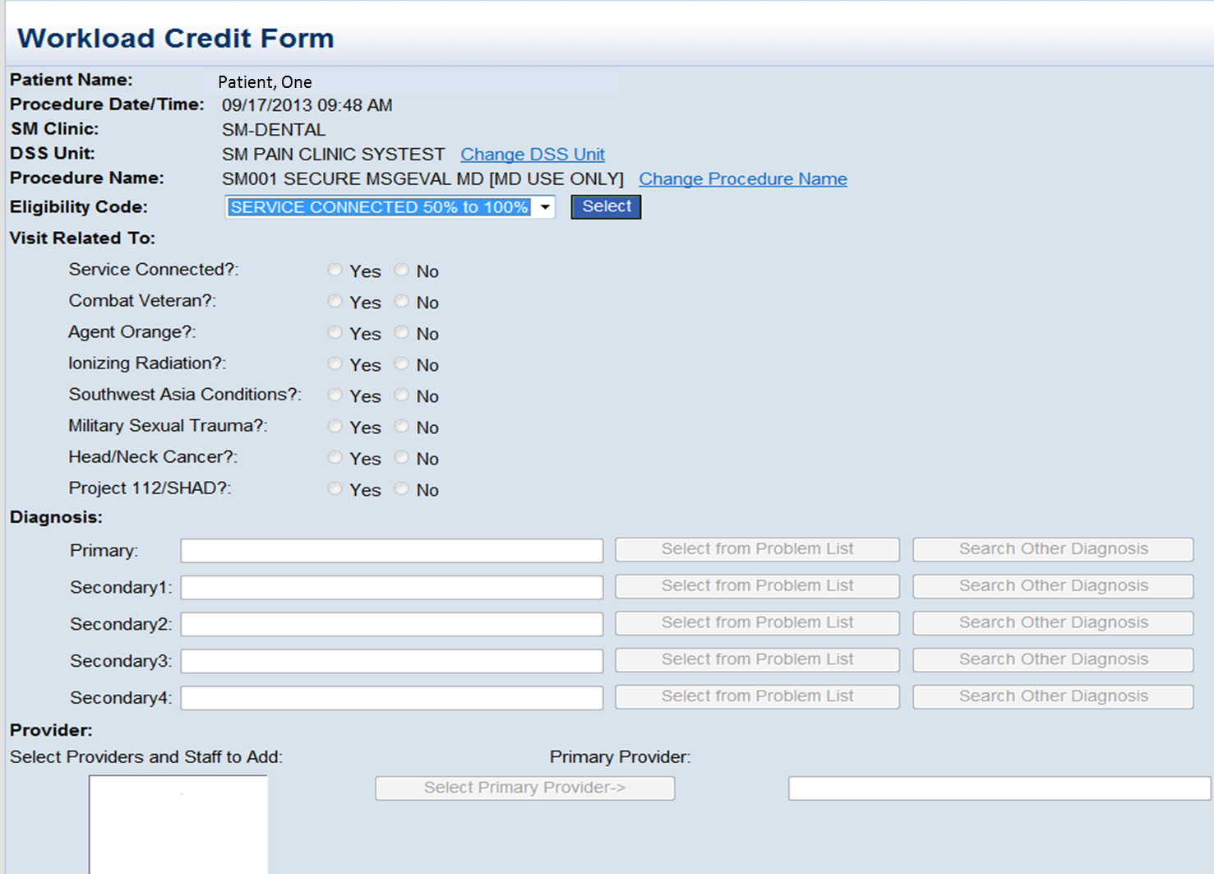

Slide 41
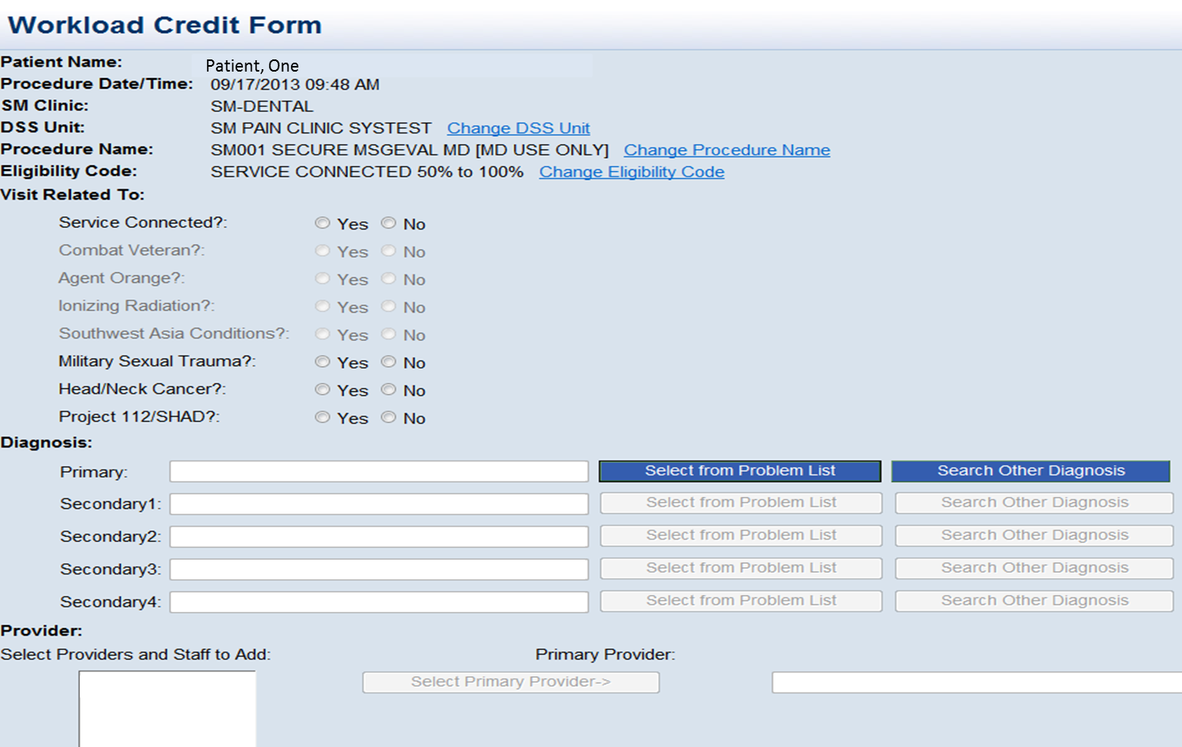
Conditions
Notes:
Conditions that don’t apply
(eg Agent Orange) are grayed out

Slide 42
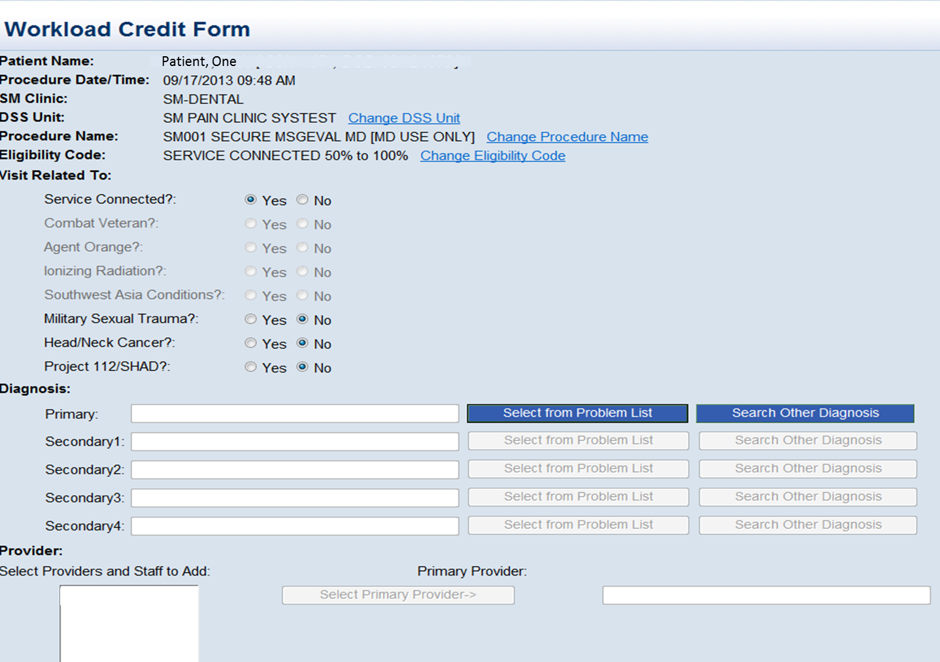
Diagnosis from Problem List or a Search Engine

Slide 43
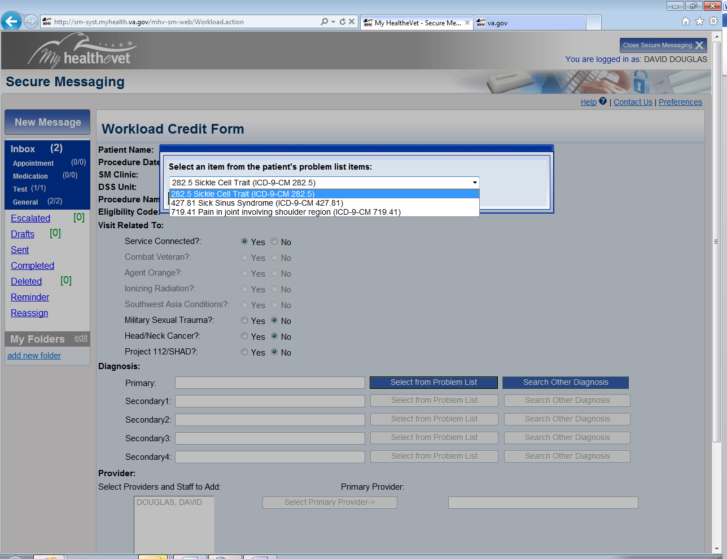
Diagnosis from the Problem List

Slide 44
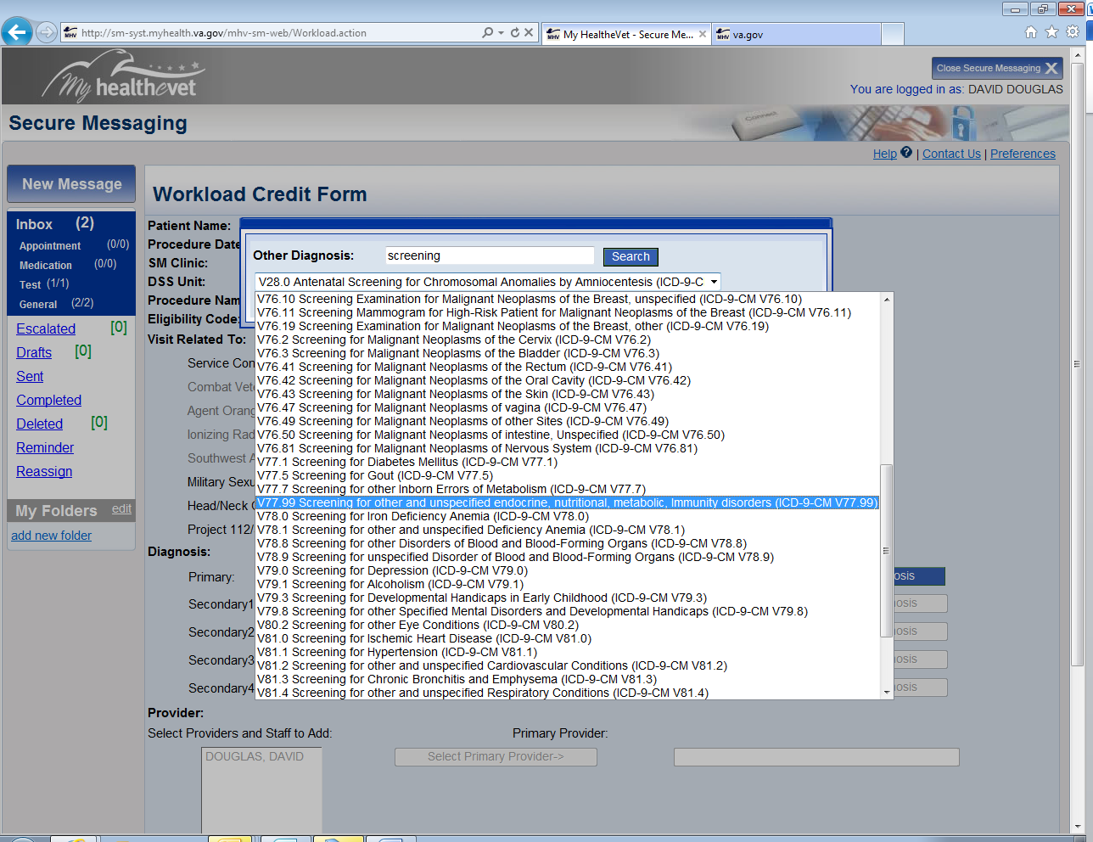
Diagnosis from a Search Engine

Slide 45
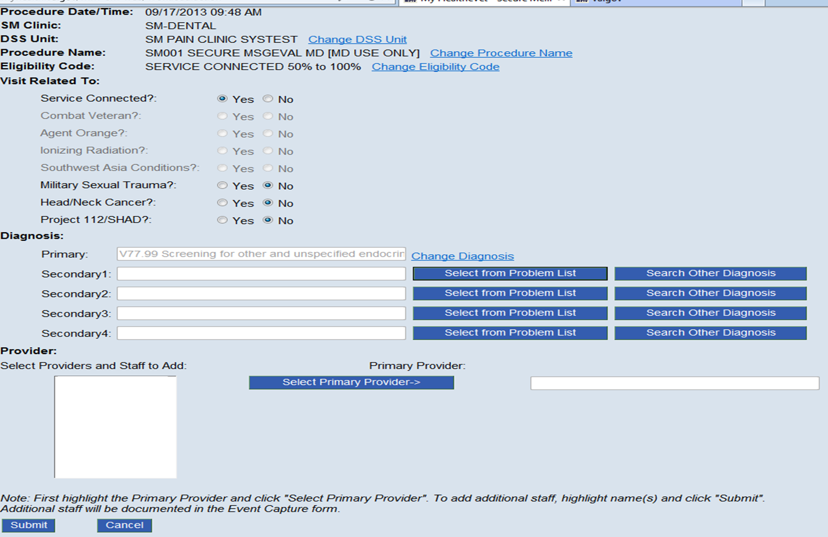
Add Provider(s)

Slide 46
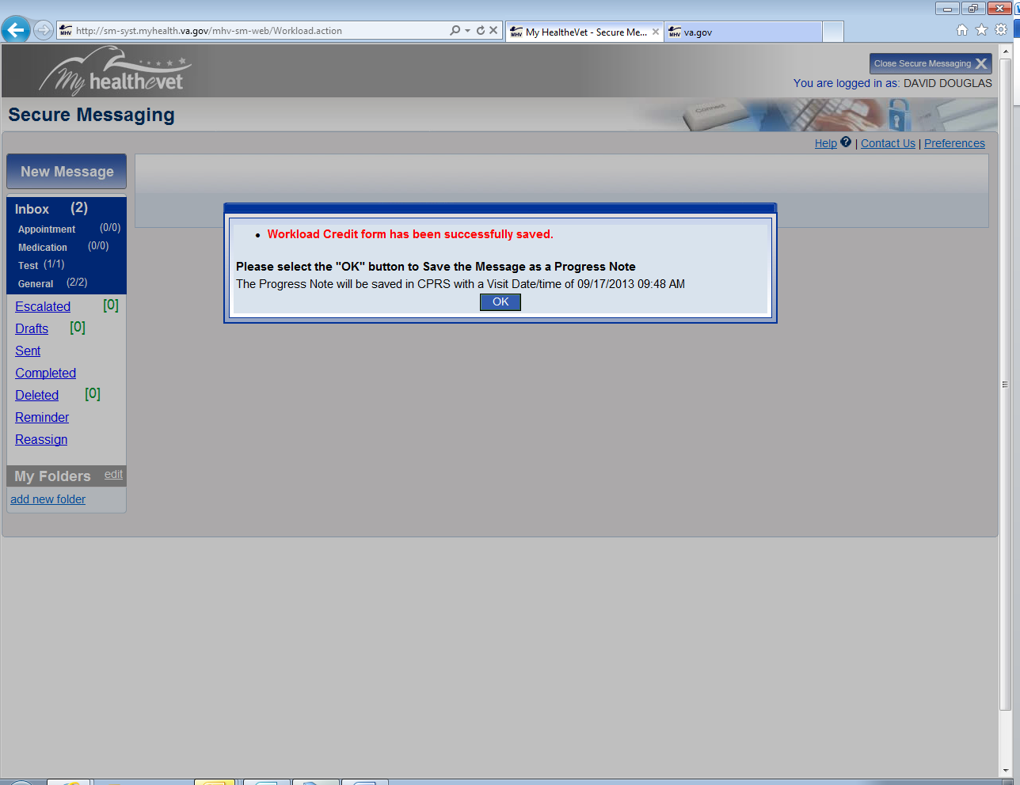
Submit and Workload is Captured

Slide 47
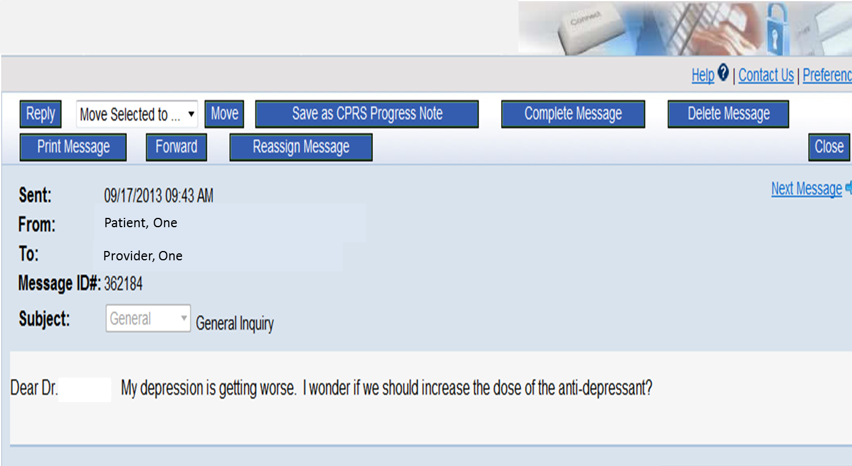
Take a History
Notes:
In this example, the clinician takes a history to make sure the thread qualifies for a CPT code

Slide 48
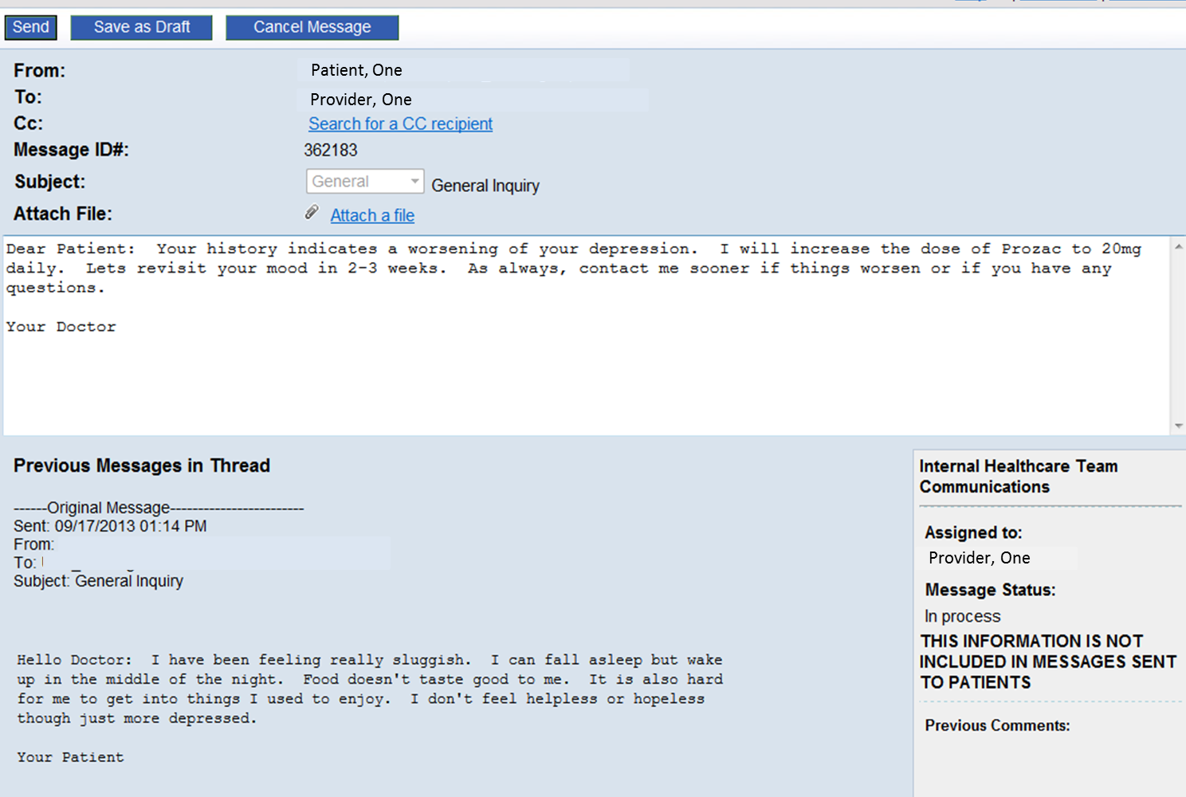
Diagnosis and Plan Based on History
Notes:
Doctor makes a diagnosis and plan based on the history

Slide 49
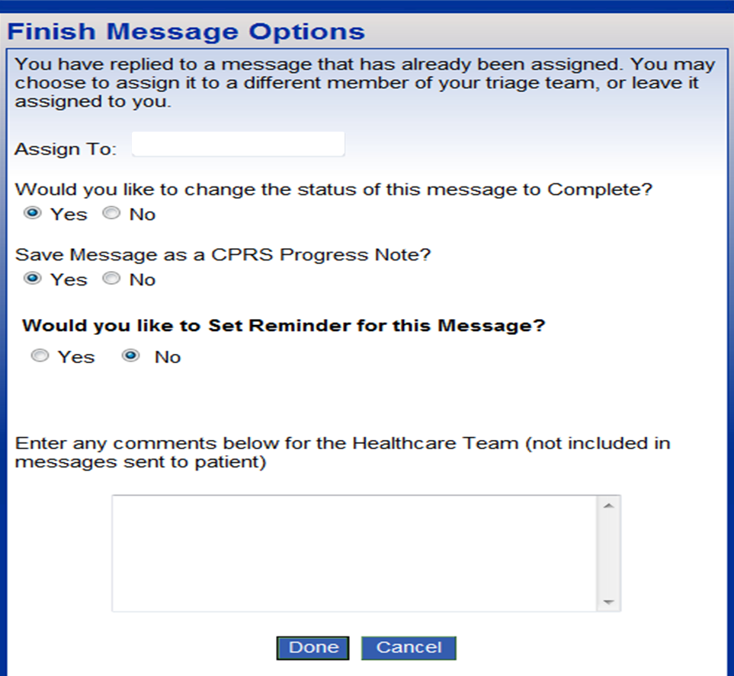
Save to CPRS Enables Workload Capture

Slide 50
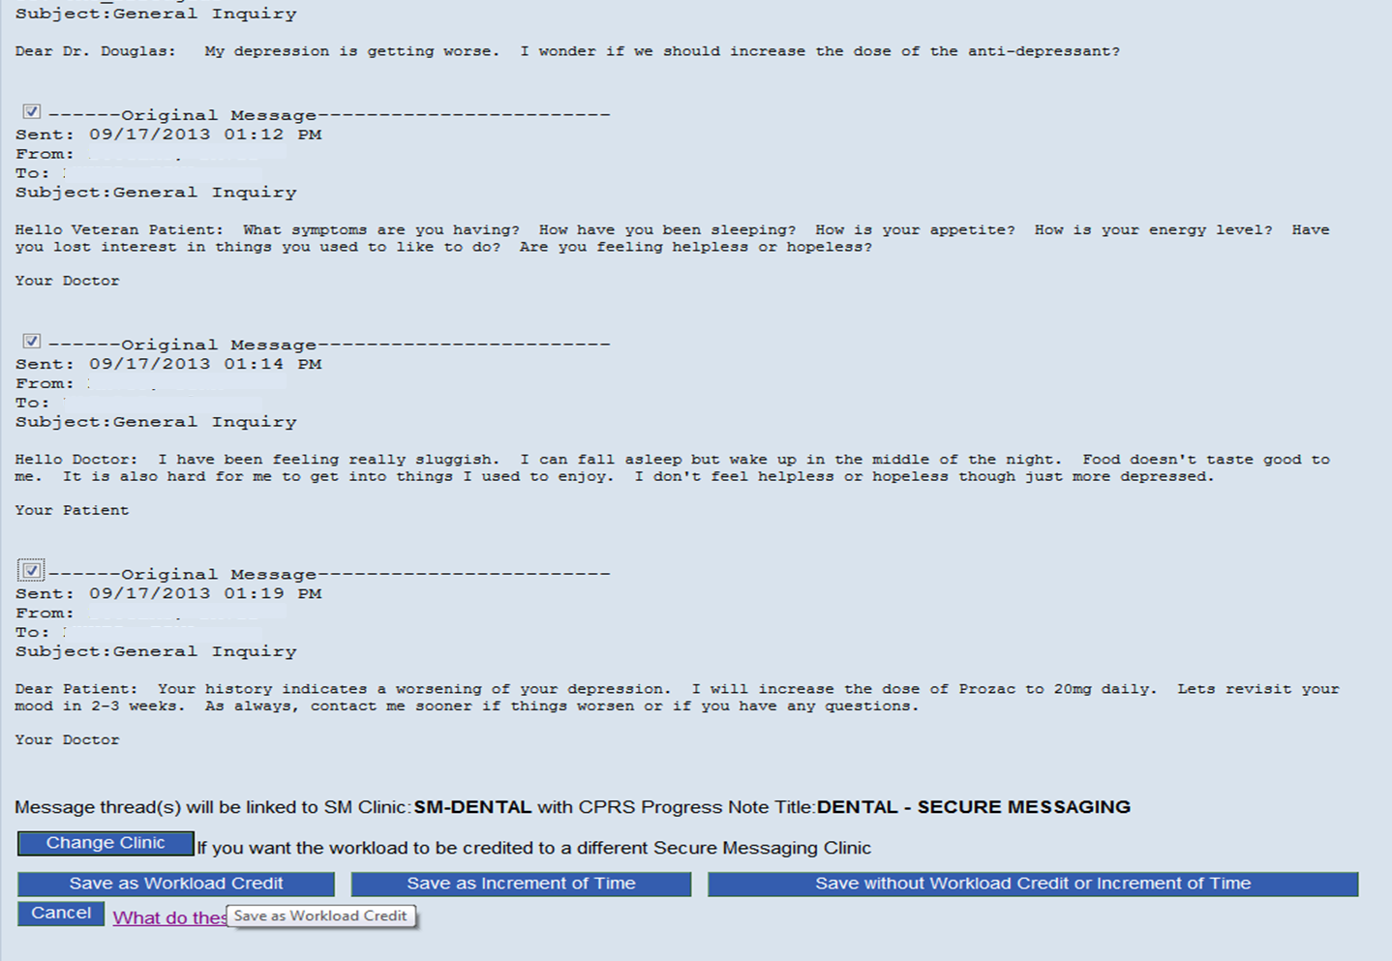
Saved Message Threads
Notes:
Message Threads Saved to CPRS qualify for a CPT code

Slide 51
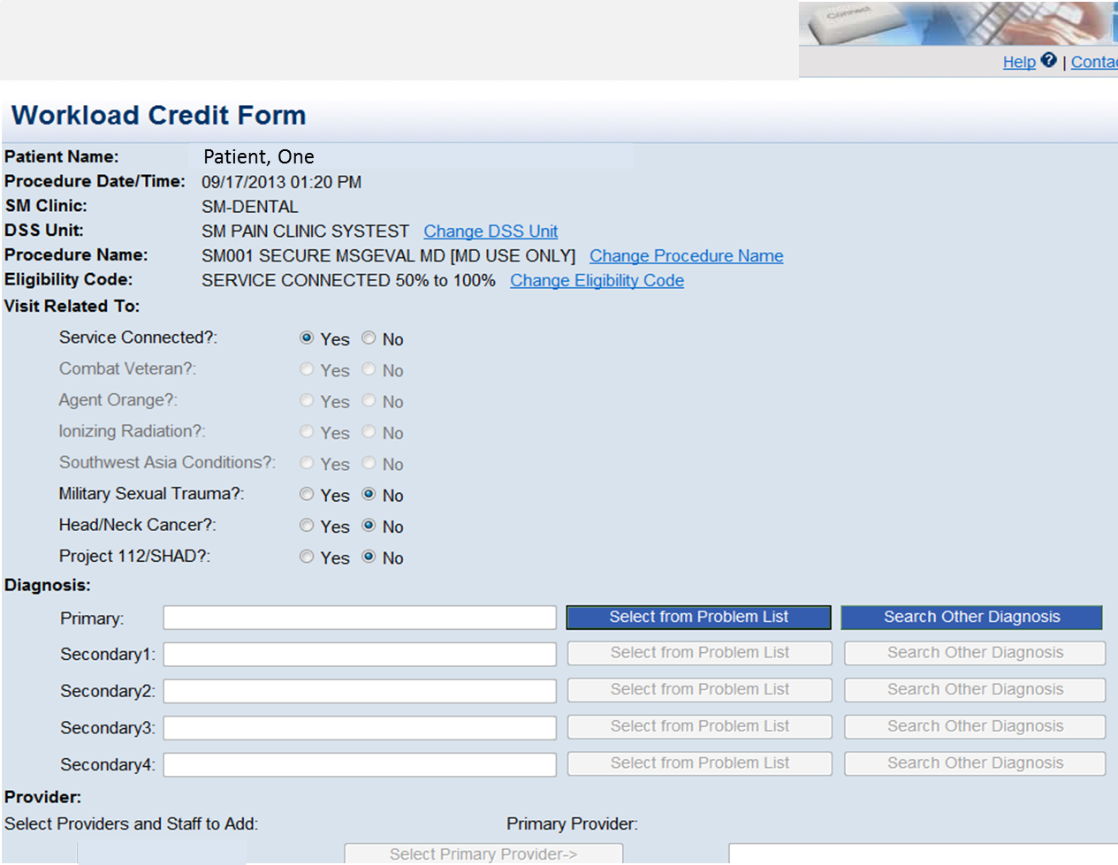
Workload Credit Form

Slide 52
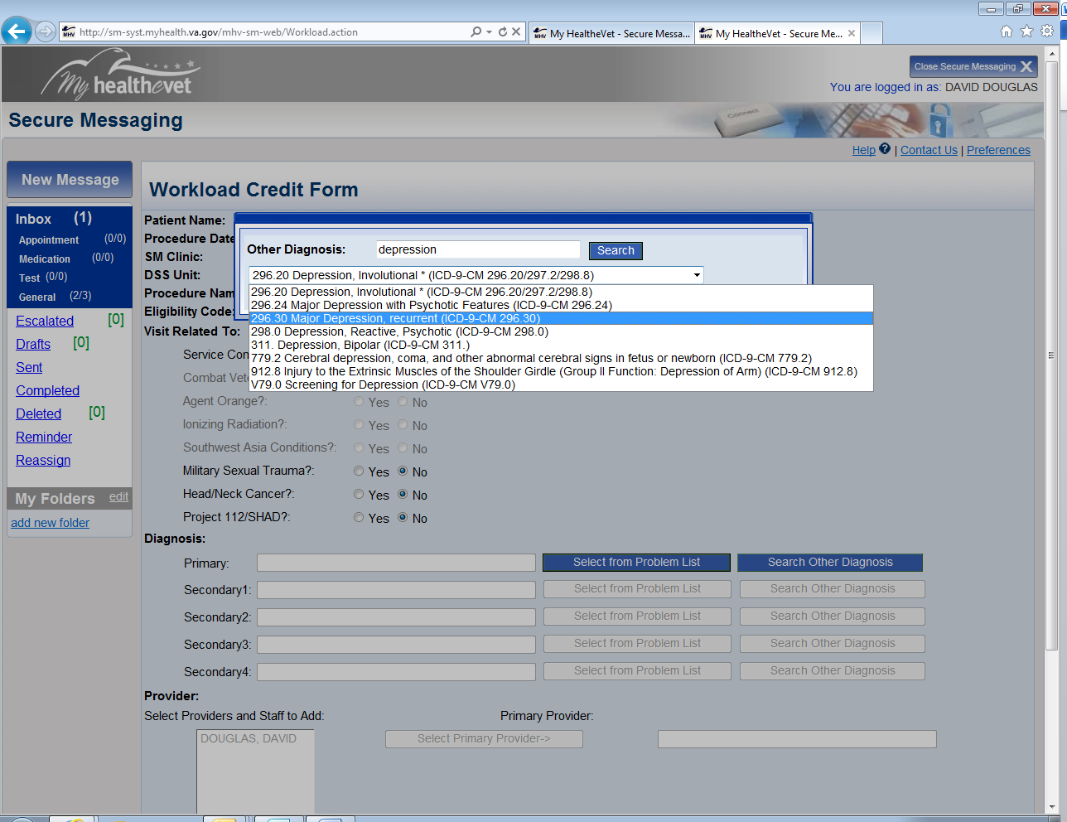
Chose the Primary Diagnosis
Notes:
Search Engine allows depression to be chosen as the Primary Diagnosis

Slide 53
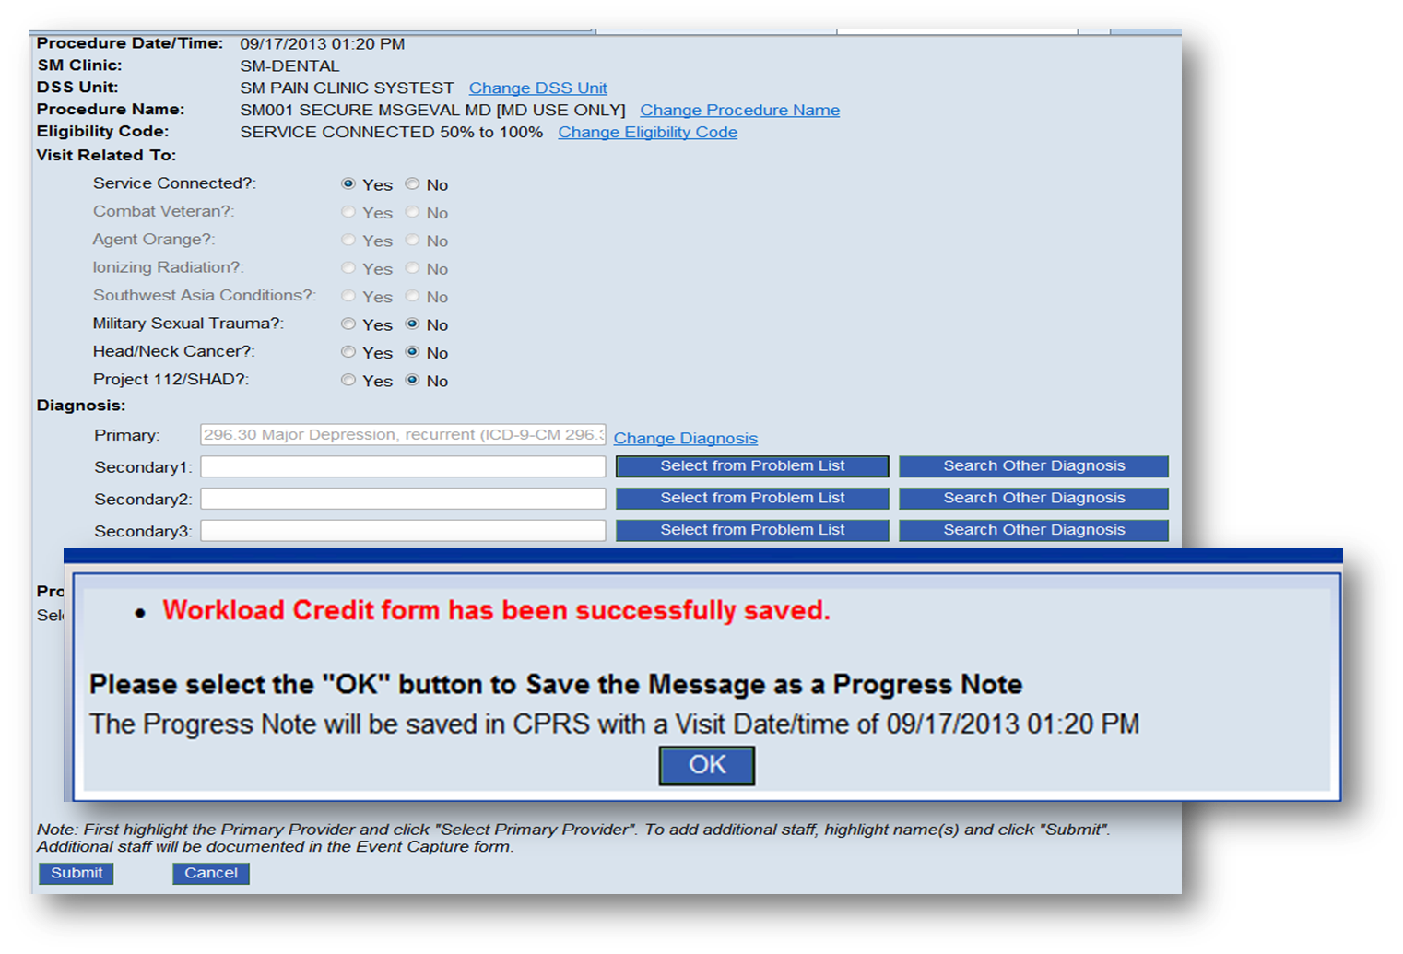
Add Provider and Submit

Slide 54
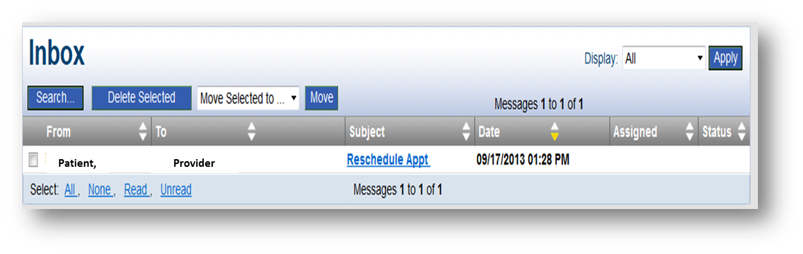
Increments of Time

Slide 55
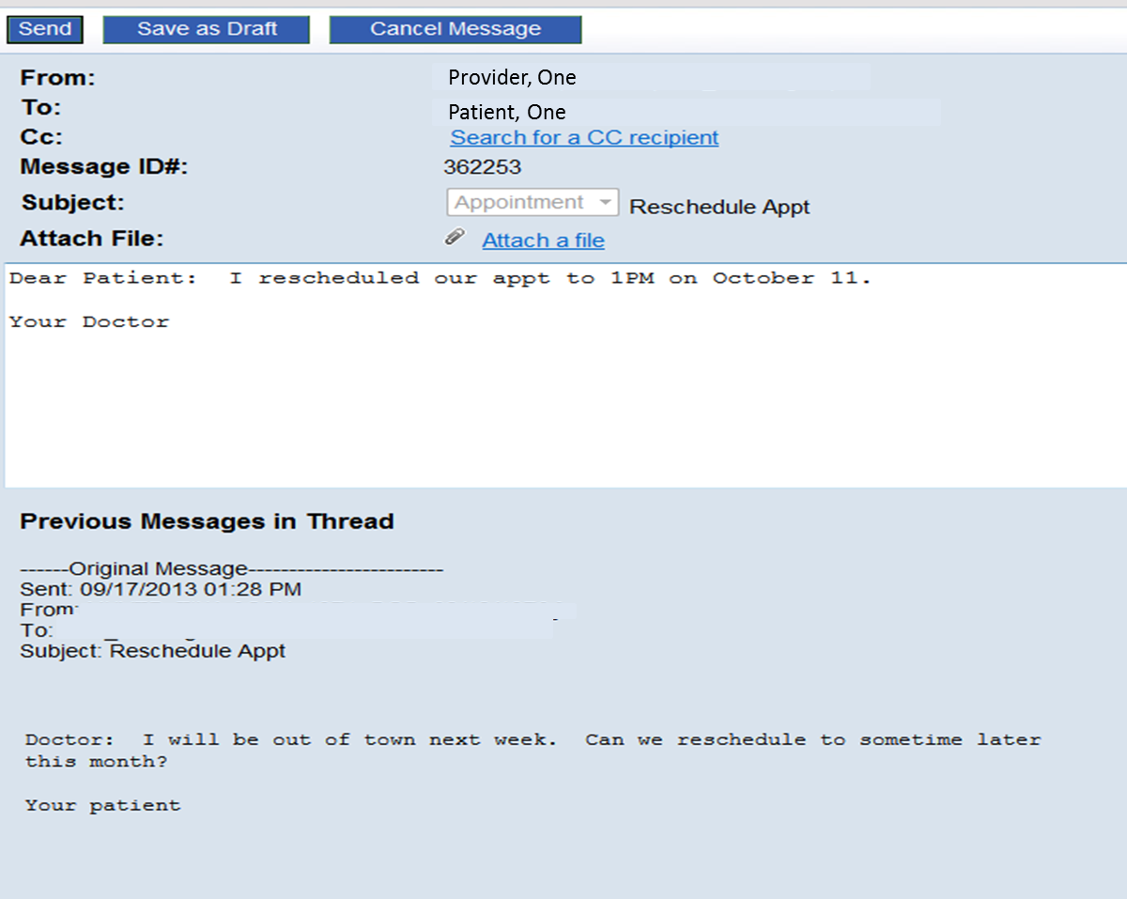
No Information = No CPT Code
Notes:
Dear Doctor: I will be out of town next week. Can we reschedule to sometime later in the month. Dear Patient: I rescheduled our appointment to 1PM on October 11. Your doctor

Slide 56
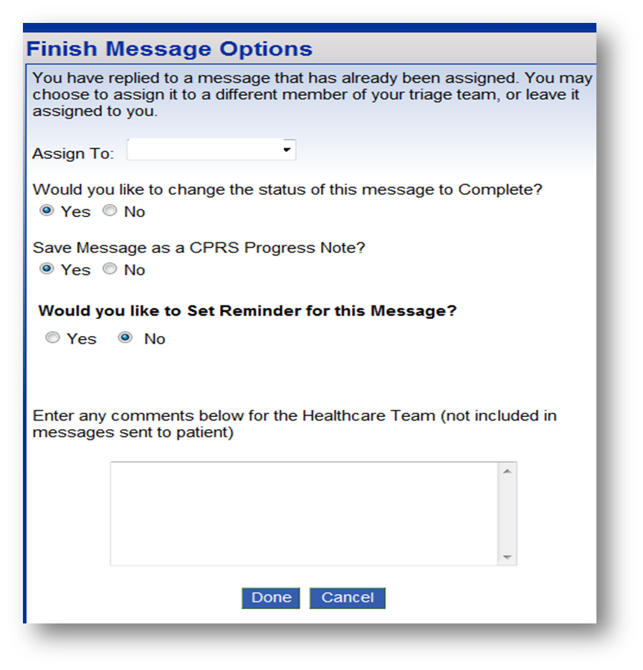
Increments of Time Captured
Notes:
Save to CPRS enables Increments of Time to be captured

Slide 57
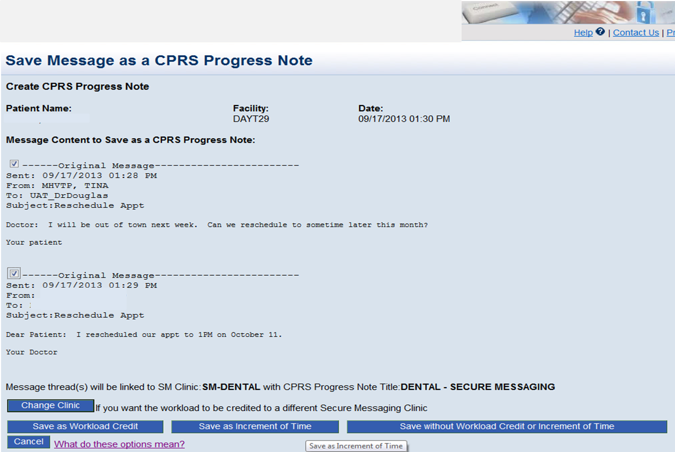
Save as Increments of Time

Slide 58
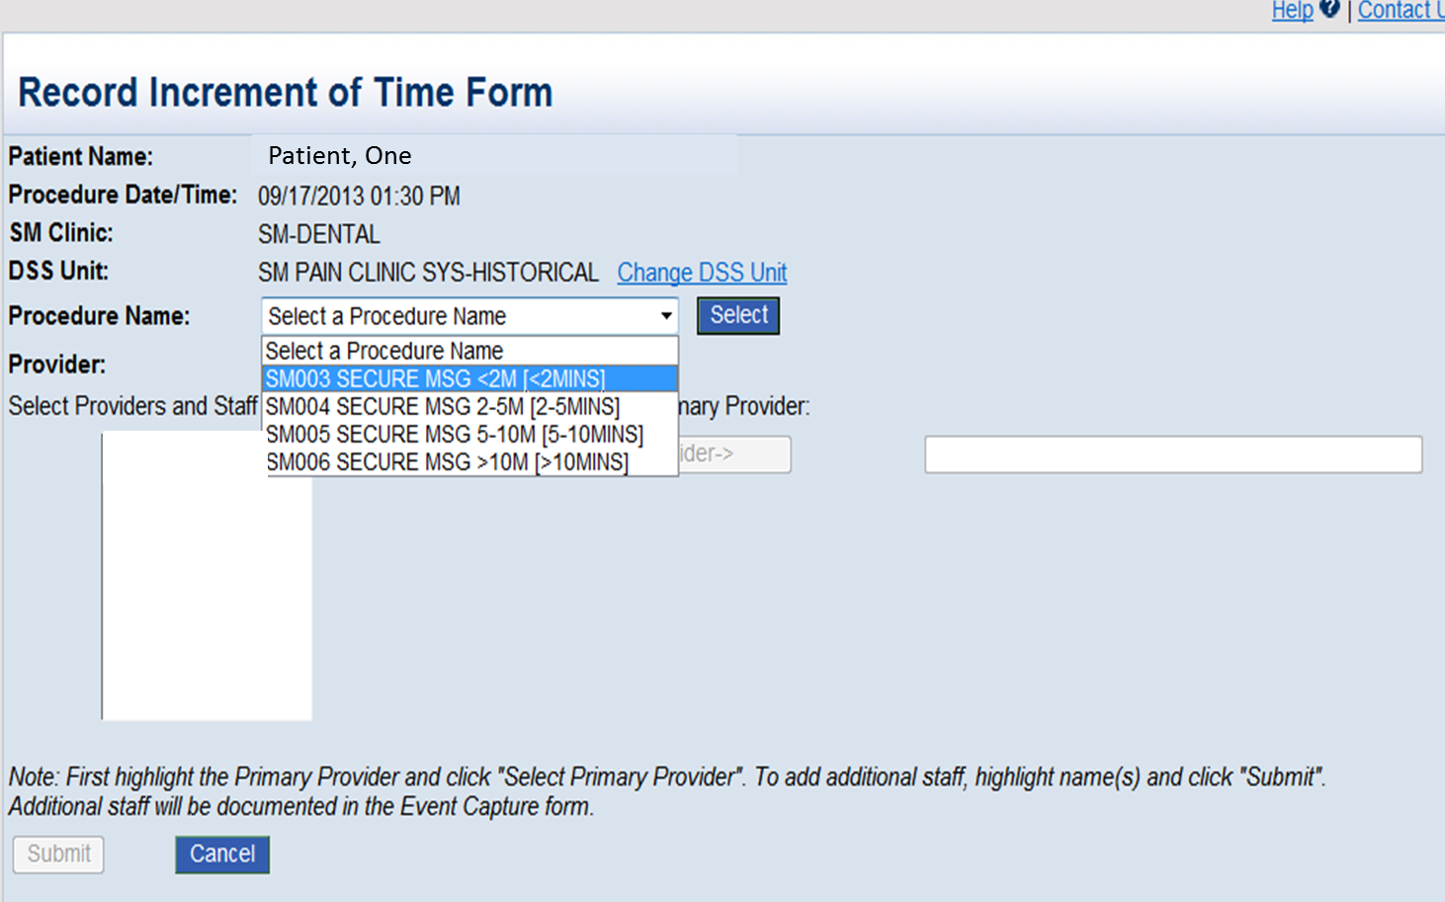
Select Clinic, DSS Unit, and
Increments of Time
Notes:
< 2M
2-5 M
5-10 M
> 10 M

Slide 59
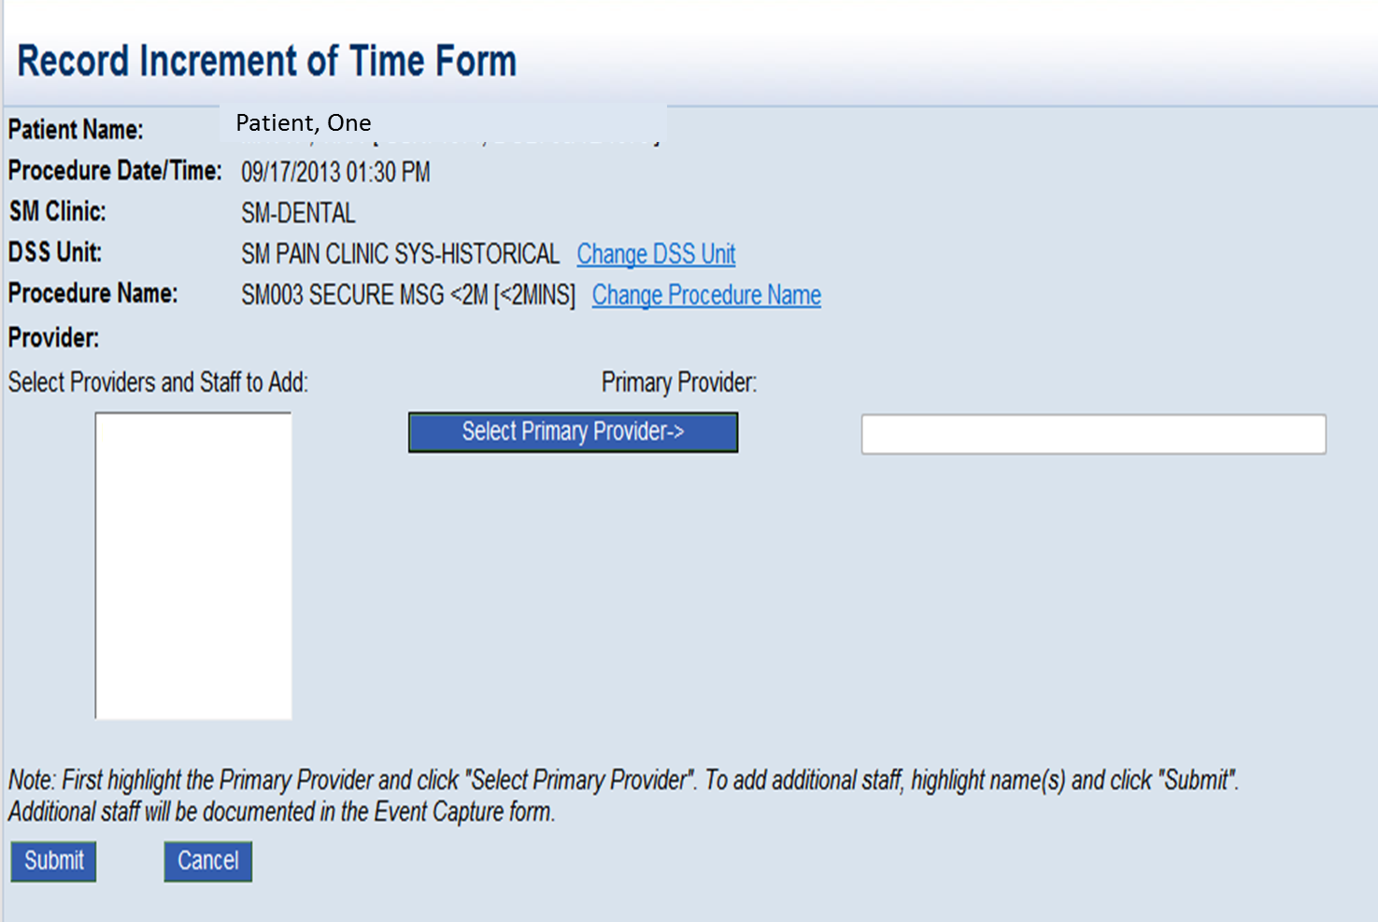
Add Provider

Slide 60
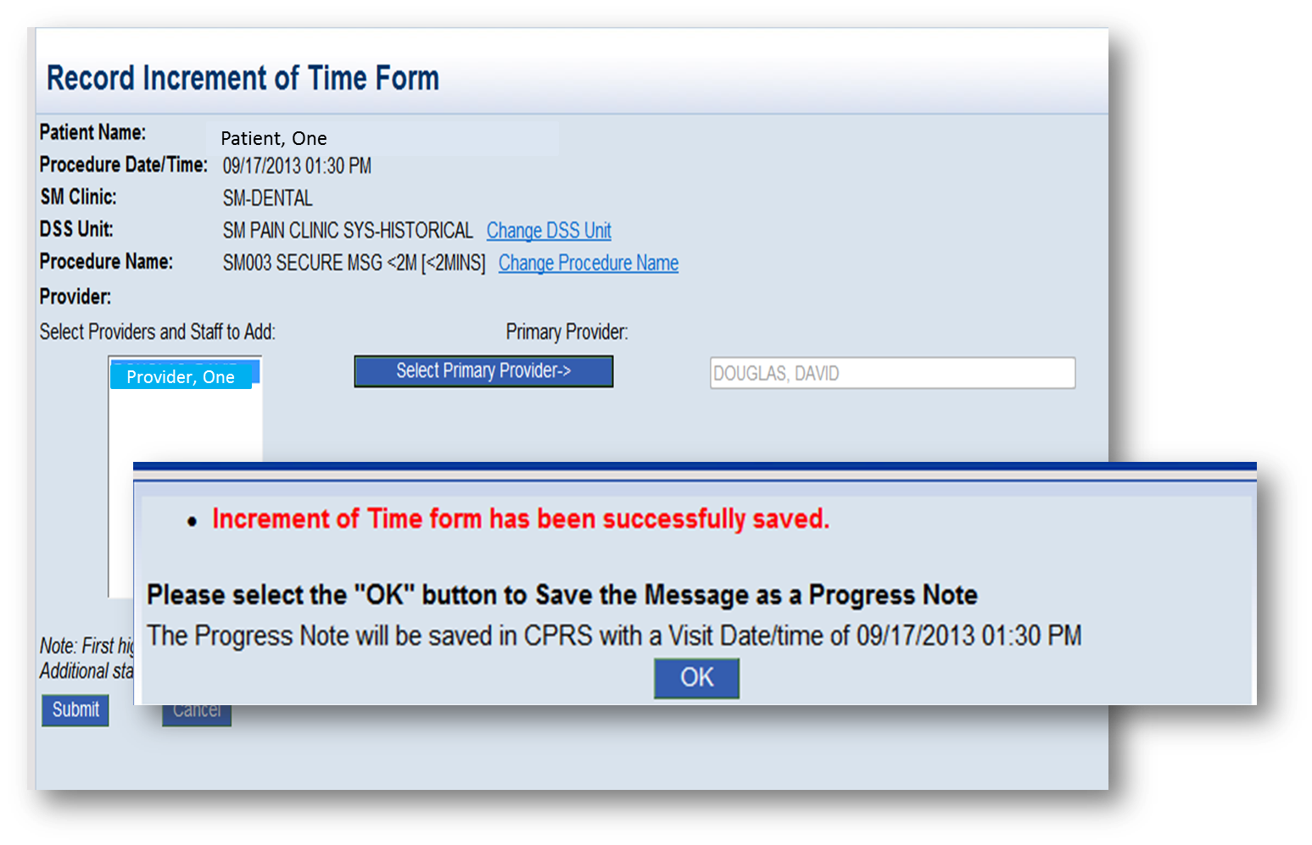
Submit and Your Time is Captured

Slide 61
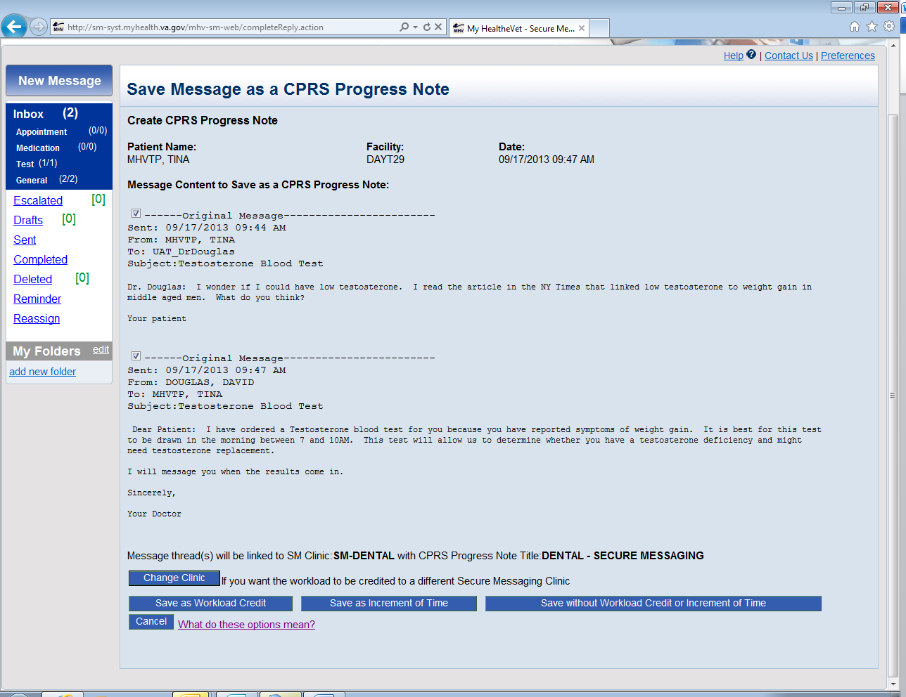

Change Clinic

Slide 62
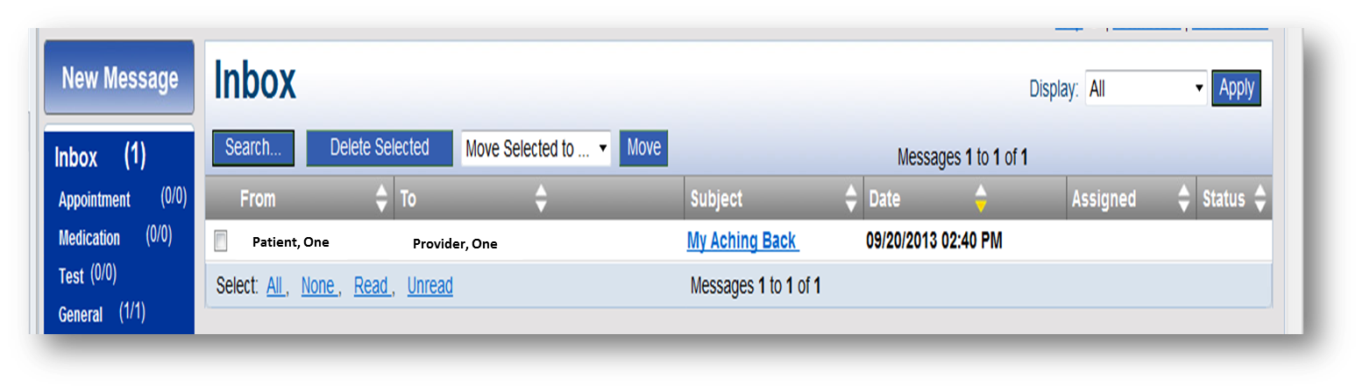
Workload Clinic and Progress Note can be Changed

Slide 63
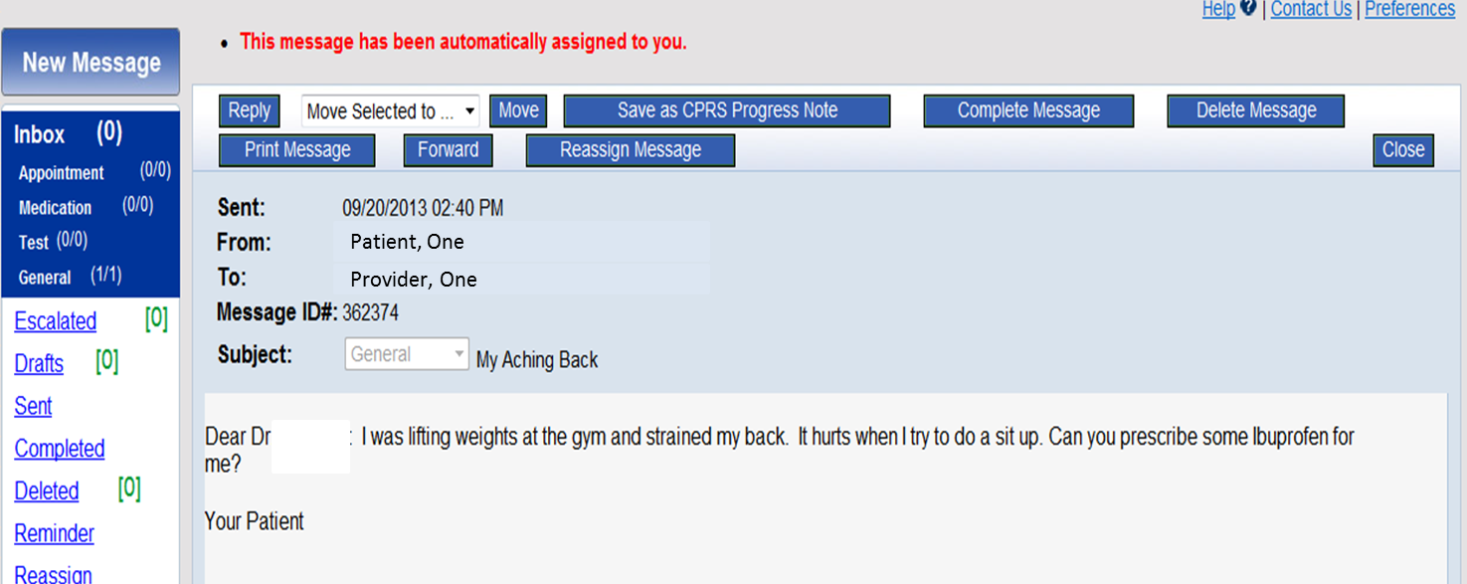
Automatic Assignment
Notes:
In this example, we will pretend a provider works in 2 different clinics who gets the message in one triage group but wants the workload to go to a clinic other than the one attached to the triage group.
Dear Dr: I was lifting weights at the gym and strained my back. Can you prescribe some ibuprofen for me.

Slide 64
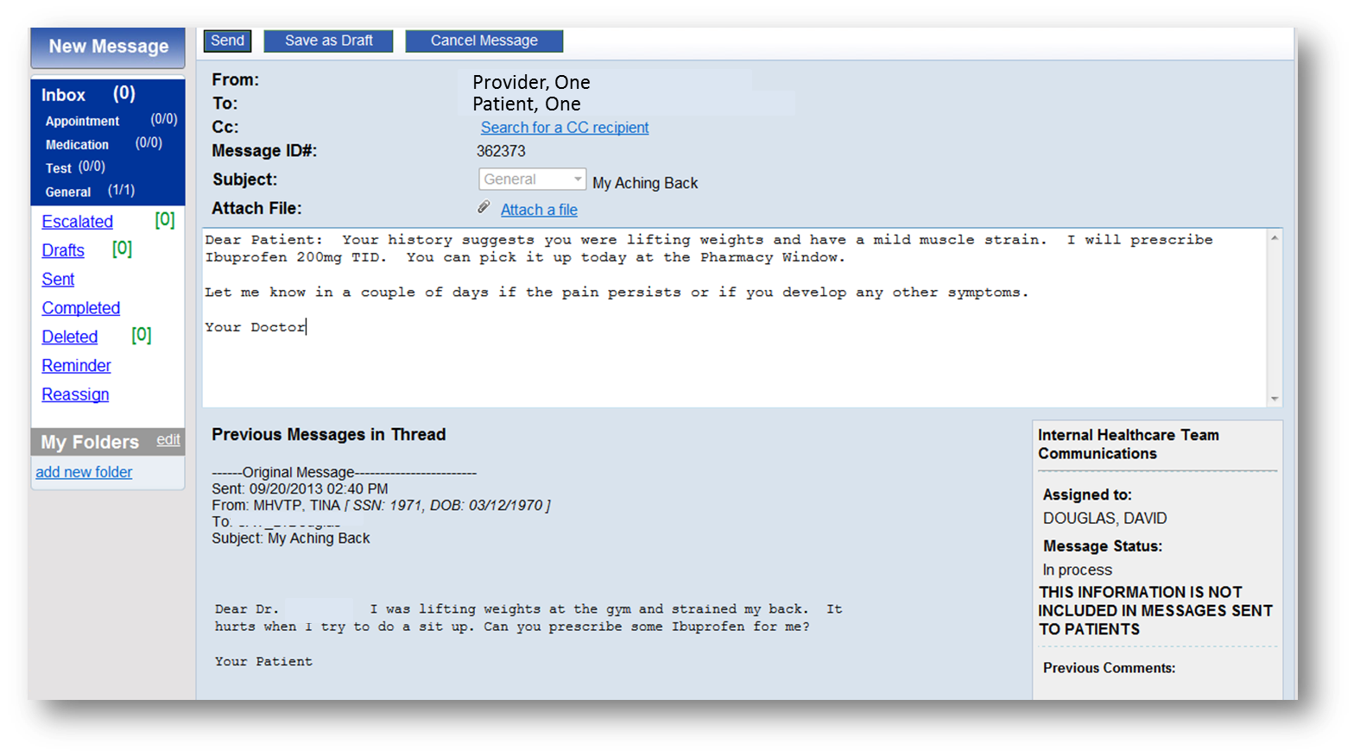
Notes:
Dear Patient: Your history suggests you were lifting weights and have a mild muscle strain. I will prescribe Ibuprogen 200mg TID. You can pick it up at the pharmacy window. Let me know in a couple of days if the pain persists or if you develop any other symptoms.

Slide 65
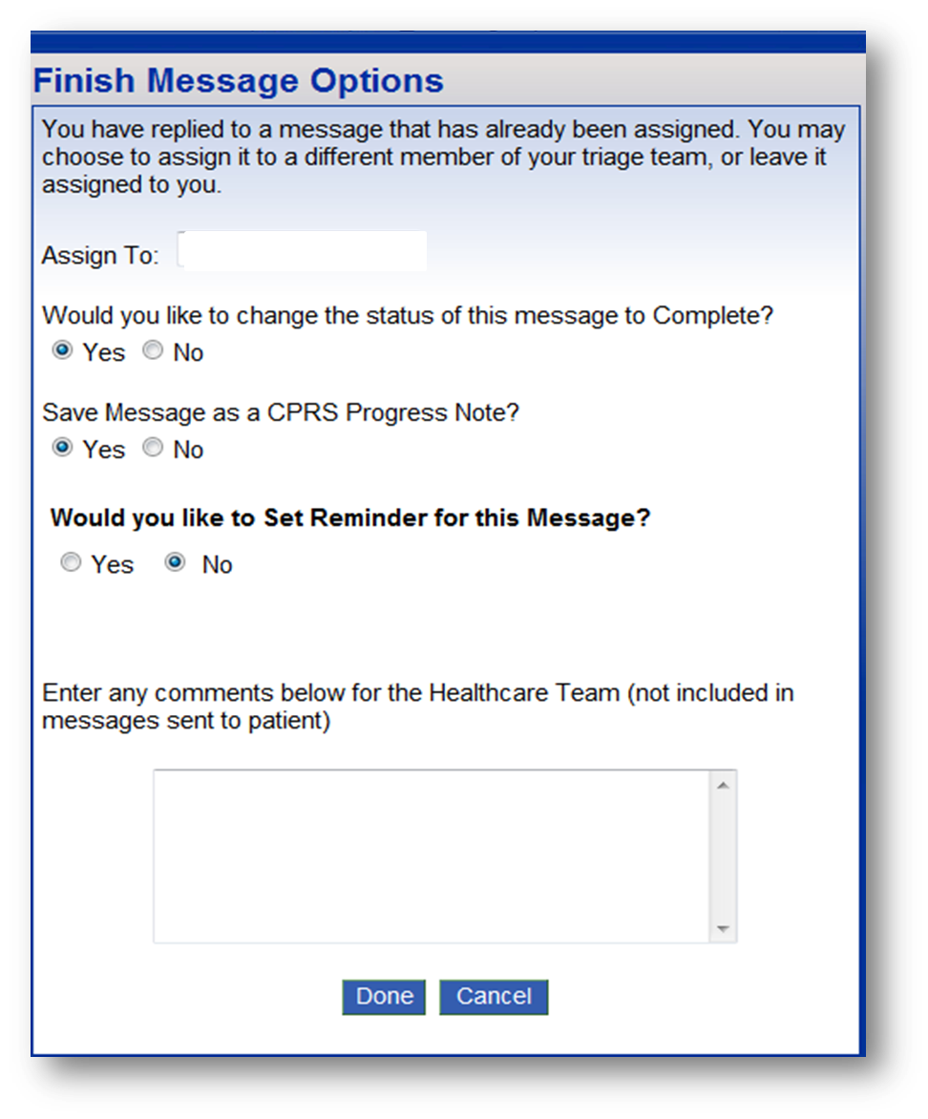

Slide 66

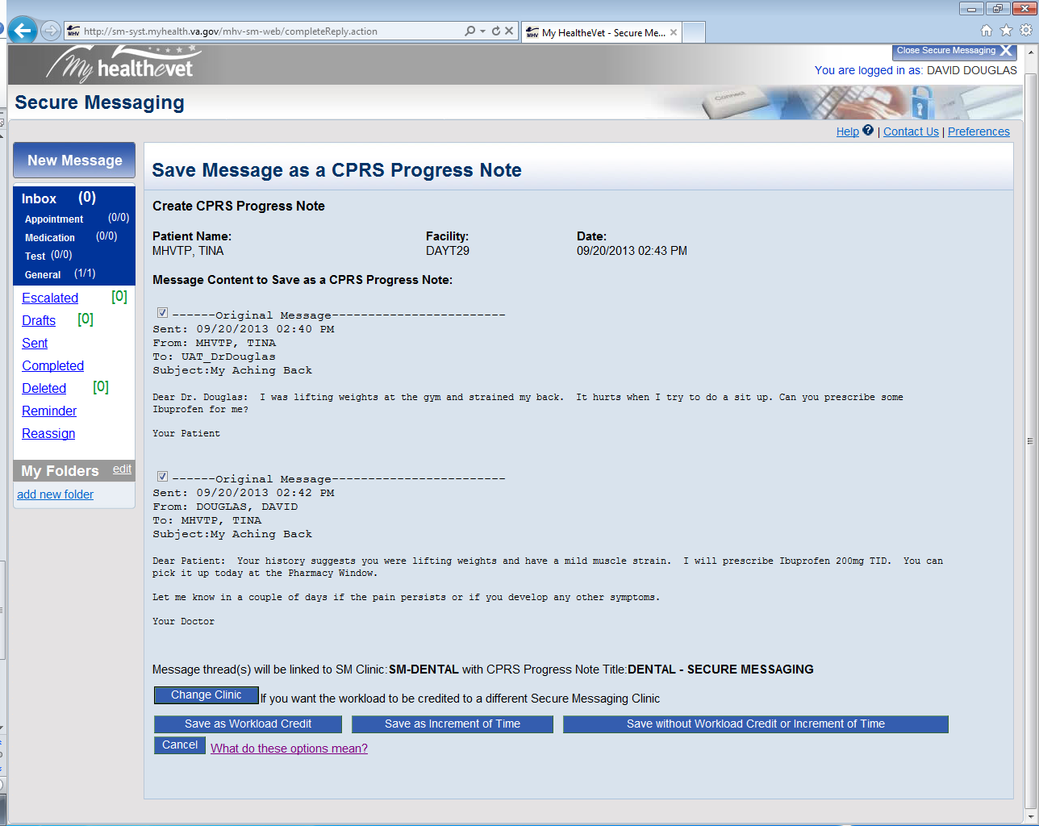

Linked Messages
Notes:
In this example the workload credit is headed for a Dental Clinic but the provider wants to redirect it to the Pain Clinic.

Slide 67

Secure Messaging
Pain Clinic
Notes:
The provider can attach the workload to a different clinic, in this case pain.

Slide 68

Secure Messaging
Pain Clinic

Slide 69



Slide 70

Vista Ad hoc reports
Fileman
Event Capture
National Web Sites

Slide 71
AAH
Select Provider Menu Option: ^AAH ACRP Ad Hoc Report
---- A C R P A d H o c R e p o r t -----------------
This report can be used to produce information from the ACRP databases in a variety of ways. Parameter selection will determine how to count and screen the information.

Slide 72
--------------------- R E P O R T L I M I T A T I O N S --------------------
Starting date: AUG 19,2013
Ending date: SEP 18,2013
Addl. limitation category: AMBULATORY PROCEDURE
Addl. limitation sub-category: ALL AMBULATORY PROCEDURE CODES
Include list: 99444 ONLINE E/M BY PHYS/QHP
Addl. limitation category: PROVIDER
Addl. limitation sub-category: ALL PROVIDERS
Include list: PROVIDER, ONE

Slide 73
How many Secure Messaging Encounters did I have last year?
For date range: SEP 19,2012 to SEP 19,2013
Date printed: SEP 19,2013@13:44 Page: 1
--------------------------------------------------------------------------------
ALL PROVIDERS: Encount. Visits Uniques
------------------------------------------ -------- -------- --------
PROVIDER, ONE 1 1 1
REPORT TOTAL: 1 1 1

Slide 74

Event Capture Reports

Slide 75

DSS Unit Activity Report

Slide 76
Poll Question
Do you use Event Capture?
  Yes
  No
  What’s Event Capture?
Notes:
Now I’d like to ask a poll question.
(usually presenters read the poll question and acknowledge that the possible answers are on the screen)
To answer this question, use the blue polling icon above my head. We’ll move on and come back to your results in just a moment.
[erase these notes and add your own!]

Slide 77

DSS Unit Activity Report

Slide 78


DSS Unit Activity Report

Slide 79

DSS Unit Activity Report

Slide 80

DSS Unit Activity Report

Slide 81
Event Capture Report

Slide 82


Activity Report from Export

Slide 83

Event Capture

Slide 84

Provider Summary Report

Slide 85

Report Preview

Slide 86
Poll Results
Do you use Event Capture?
  Yes
  No
  What’s Event Capture?
Notes:
Now let’s pause for a moment and take a look at your poll results.
(Copy and paste the questions and answers here so you can easily remember what the poll question and answers were)
To answer this question, use the blue polling icon above my head. We’ll move on and come back to your results in just a moment.
Ad-lib to the audience results, then advance to move on.

Slide 87
Poll Results
  Yes
  No
  What’s Event Capture?
Notes:
(Cue to Tech Team that you’re moving on) “Click” again to move on

Slide 88
Go Live Date for
WL Credit has slipped
Originally planned for January 2014
Now most likely dates are between March and June 2014.
Why the delay?
Blame it on Rube Goldberg!

Slide 89

Professor Butts and the Self-Operating Napkin
Notes:
A rube Goldberg machine is a contraption, invention, device, apparatus OR bureaucratic process (I added that one) that is deliberately over-engineered to perform a simple task in a very complex fashion usually involving a chain reaction.
In this famous example, our diner starts out wanting to wipe the soup off his chin. The solutin to this problem is the Self-Operating Napkin.
It starts with step A Professor Butts moves the spoon to his mouth which
pulls a handle B that activates a lever C that flips a cracker D that gets grabbed by the parrot E which elevates another lever F that dumps the sand G weighing down the bucket H that ignites the lighter J that launches the Roman Candle K that elevates the blade L that cuts the string M which frees the clock pendulum to swing back and forth wiping the soup off of Professor Butt’s Chin.

Slide 90
New Security Requirements due to Broker Security Enhancement
Federated User/Application Proxy user no longer allowed
Options
Access/Verify codes every time
HL7 solution
Notes:
The solution is to make the computer do the rube golberg work

Slide 91
Informatics Processes should be Rube Goldberg Test-Negative
RG Test +
RG Test -
Launch WC Form
Choose SM Clinic
Enter DSS unit
Enter Eligibility
Enter SC and other conditions
Enter Diagnoses
Enter Providers
Enter Access Code
Enter Verify Code
Save Note/Claim WL credit
Launch WC Form
Clinic, DSS Unit, Eligibility, SC etc auto-determined
Diagnosis from Prob List
Enter Provider(s)
Save Note/Claim WL Credit

Slide 92

HL7 solution

Slide 93
SM Workload Credit
HL7 Solution dependent on Vista Patch 11
Go live date likely to be sometime between March 22 and June 14
Blame it on Rube Goldberg!

Slide 94

Workload can now be captured from within SM
CPT codes set the stage for shifting face to face workload to virtual workload
Increments of time allow resource decisions to be made based on data
This is 21st century medicine

Slide 95

Ask the Presenter
Notes:
(This must be your last slide.)
If you haven’t submitted your questions yet, there is still time to do so by clicking on the orange “Ask The Presenter” icon. We’re going to show a brief announcement and be right back to answer your questions.
(Stand still and smile until you see the video come up full screen)
[erase these notes and add your own!]

