Slide 1
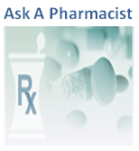


Utilizing Secure Messaging To
"Ask A Pharmacist"
Notes:
Healthcare literacy, medication adherence, adverse drug events, and access have contributed to a nationwide medication use crisis
Patients have limited “real time” access to comprehensive pharmacy services that mitigate this crisis by concentrating on safe, effective, patient-centered medication treatment management
Patients have questions about their medications at home, after hours, and seek answers on the internet or in the non VA health care settings
Adverse drug events (ADE)s are the most common of all healthcare-associated adverse events and can occur when multiple changes to medication regimens take place in the context of poor patient education, inadequate medication resources, and lack of concise communication between the patient and provider
Hello, my name is Eric Spahn. I am a pharmacist at the Veteran Healthcare System of the Ozarks in Fayetteville, AR, and today I’d like to inform you about a national initiative to incorporate an Ask A Pharmacist program into Secure Messaging and MyHealtheVet.

Slide 2

Access to Care
“Pharmacists are the most accessible health care professionals in the United States and have always been one of the most trusted professions.”
- 2011 USPHS Report to USSG
Notes:
I’d like to begin by focusing on the pharmacy profession and how it relates to access to care…“A 2000 estimate showed that the equivalent of the entire U.S. population (approximately 275 million people at the time of publication) visited pharmacies each week.”….Why is this? One of the reasons I became a pharmacists is that “Pharmacists are the most accessible health care professionals and have always been one of the most trusted professions” This trust is the result of a long standing communication between patients and pharmacists, established by their accessibility

Slide 3
Access to Care
“A significant contribution to health reform by the pharmacy profession may be to increase access to patient care services,”
- 2011 USPHS Report to USSG
Notes:
In order to meet the growing health care demands in the United States, pharmacists must continue to expand access to patient care services.

Slide 4
Access to Care
“Pharmacists may be in the best position of any health professional to effectively meet the demands and address the changing needs of the health care system.”
- 2011 USPHS Report to USSG
Notes:
Through our accessibility, expertise and experience, Pharmacists are uniquely positioned to play a much larger patient care role in the U.S. health care delivery system to meet these demands

Slide 5
Do you have a question for a Pharmacist..?
“VA pharmacists are dedicated to your health and well-being. You can search our archive for answers to general questions about health and medications any time, day or night. VA pharmacists have prepared hundreds of answers to commonly asked questions. In addition, Veterans who have completed the In-Person Authentication Process (IPA) can submit specific questions for a prompt, personal response through SECURE MESSAGING!”
Notes:
As VA Pharmacists, we have an opportunity to expand patient care services using an Ask A Pharmacist program which provides trusted medication resources and answers to frequently asked medication questions developed by VA pharmacists as well as links to Secure Messaging on MHV to ask questions directly to local VA pharmacists.
Do you have a question for a Pharmacist..?
“VA pharmacists are dedicated to your health and well-being. You can search our archive for answers to general questions about health and medications any time, day or night. VA pharmacists have prepared hundreds of answers to commonly asked questions. In addition, Veterans who have completed the In-Person Authentication Process (IPA) can submit specific questions for a prompt, personal response through SECURE MESSAGING!”

Slide 6

Poll Question
Do you know who the MyHealtheVet Coordinator is at your facility?
Yes
No
Notes:
Before I go into discussing the two components of Ask A Pharmacist, I need to ask you a question…
Do you know who the MyHealtheVet Coordinator is at your facility?
Don’t forget , in order to participate you must select the blue polling button above. We’ll show the results in just a few minutes

Slide 7
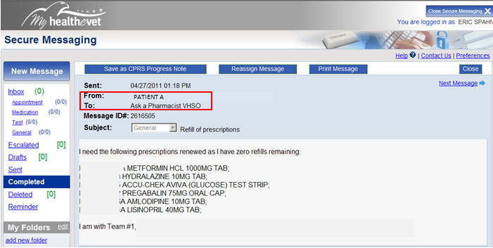
Key Components
  Ask A Pharmacist Secure Messaging Triage Group
Notes:
There are two components to Ask A Pharmacist.
One utilizes local triage group development within SM, which allows pharmacy staff to receive and triage messages from patients and providers, through a pharmacy triage group titled "Ask A Pharmacist (SITE ACRONYM),“ in the same manner a phone call to pharmacy is triaged.
A three day response window allows staff to respond in a secure, efficient, documented manner in CPRS.
In effect, this should provide less interruption to on-site patient care
At the Veteran Healthcare System of the Ozarks, we have created the SM triage group “Ask A Pharmacist VHSO,” which is currently being utilized by patients, providers, and pharmacy staff.
This component of Ask A Pharmacist is currently being incorporated at local sites across the nation

Slide 8
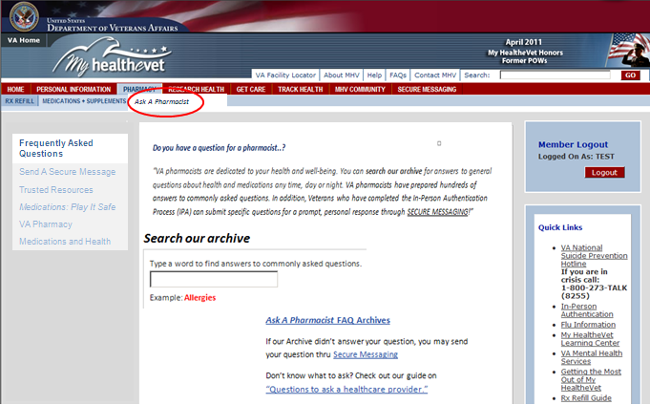
Key Components
  Ask A Pharmacist Clinical Content Addition to Pharmacy Section of MHV
Notes:
For the second component of Ask A Pharmacist, an Ask A Pharmacist website will be incorporated within the pharmacy section of MHV.
This will include a Frequently Ask Questions (FAQ) Archive on general medication topics developed by a National Pharmacy Workgroup, as well as links to internal and external medication resources, maintained by the workgroup and MHV.
Links to Secure Messaging will be available throughout the site for specific questions to Ask A Pharmacist Triage Groups (the first component from previous slide) thereby creating a local contact for Veterans visiting the site.
This component of Ask A Pharmacist is not yet available, but is currently being developed by various MHV and PBM representatives.

Slide 9
Description of Innovation
“Ask A Pharmacist” incorporated within the MyHealtheVet (MHV) Pharmacy Section will provide Veterans, families and their caregivers info on:
  Their VA Pharmacy
Notes:
“Ask A Pharmacist” incorporated within the MyHealtheVet (MHV) Pharmacy Section will provide Veterans, families and their caregivers info on:
Their VA Pharmacy. Information on CMOPs (Consolidated Mail outpatient Pharmacies), VA Formulary, and VA Pharmacy operations

Slide 10
Description of Innovation
“Ask A Pharmacist” incorporated within the MyHealtheVet (MHV) Pharmacy Section will provide Veterans, families and their caregivers info on:
  Their VA Pharmacy
  Their Medications
Notes:
Information on Their Medications: From trusted resources within MHV reviewed by VA healthcare providers

Slide 11
Description of Innovation
“Ask A Pharmacist” incorporated within the MyHealtheVet (MHV) Pharmacy Section will provide Veterans, families and their caregivers info on:
  Their VA Pharmacy
  Their Medications
  Connecting with Their Pharmacist
Notes:
Information on Connecting with their local pharmacists through a SM triage group called Ask A Pharmacist
This innovation is :
Veteran Centered - this program connects the patient to the healthcare team, thru the pharmacy
Benefits both Veterans and the VA. Ask A Pharmacist encourages Veterans to become “In-Person Authenticated” and promotes utilization of available resources within MHV while providing an additional route of communication that streamlines pharmacy workflow and increases patient satisfaction.
Lets take a look a the results from the previous polling question “Do you know who your MyHealtheVet Coordinator is?” It is important to get to know your local MyHealtheVet Coordinator for setting up Ask A Pharmacy triage groups in Secure Messaging

Slide 12

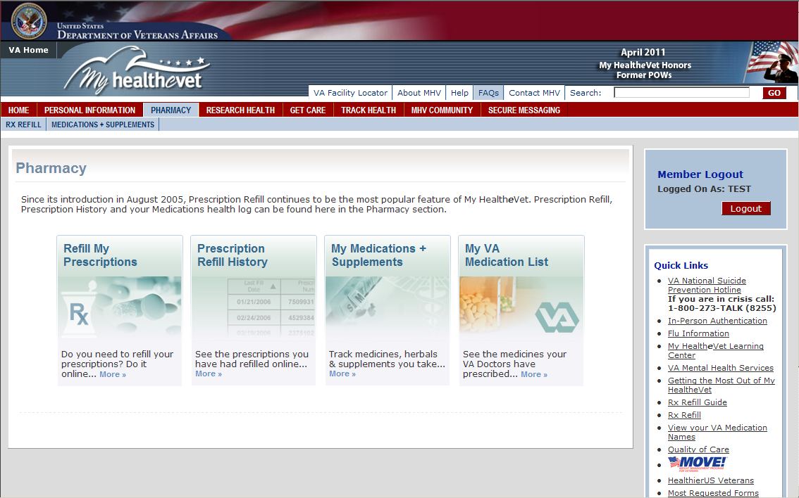
Location In MyHealtheVet
Notes:
Now, that you know what makes up Ask A Pharmacist, I’d like to show you how both components work together to provide better access to the care Veterans deserve and encourage their participation,
Prescription Refill is the number one electronic service that Veterans request, with January 2012 having over 730,000 Refills. Ask A Pharmacist would be located within the pharmacy section of MHV, where more Veterans visit than any other site on MHV

Slide 13
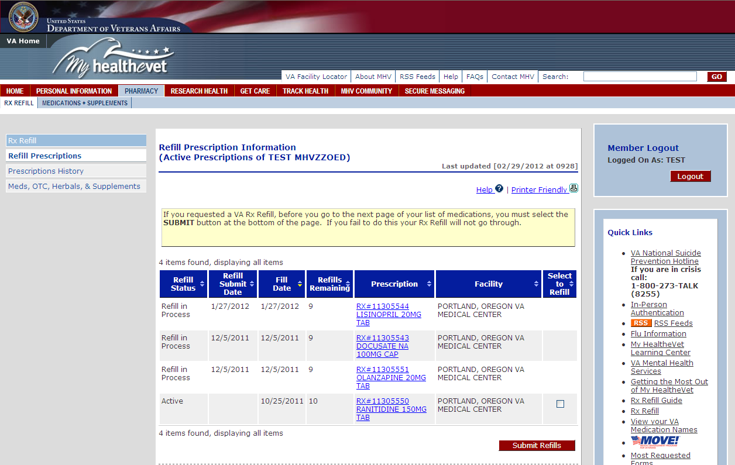
Location In MyHealtheVet
Ask A Pharmacist
Notes:
From my experience as a pharmacist, the most common time a patient has questions is when refilling a medication, especially after a visit with a provider.
Inserting Ask A Pharmacist alongside other functionalities of MHV Pharmacy, provides the easiest transition from self management to provider-assisted medication processing

Slide 14
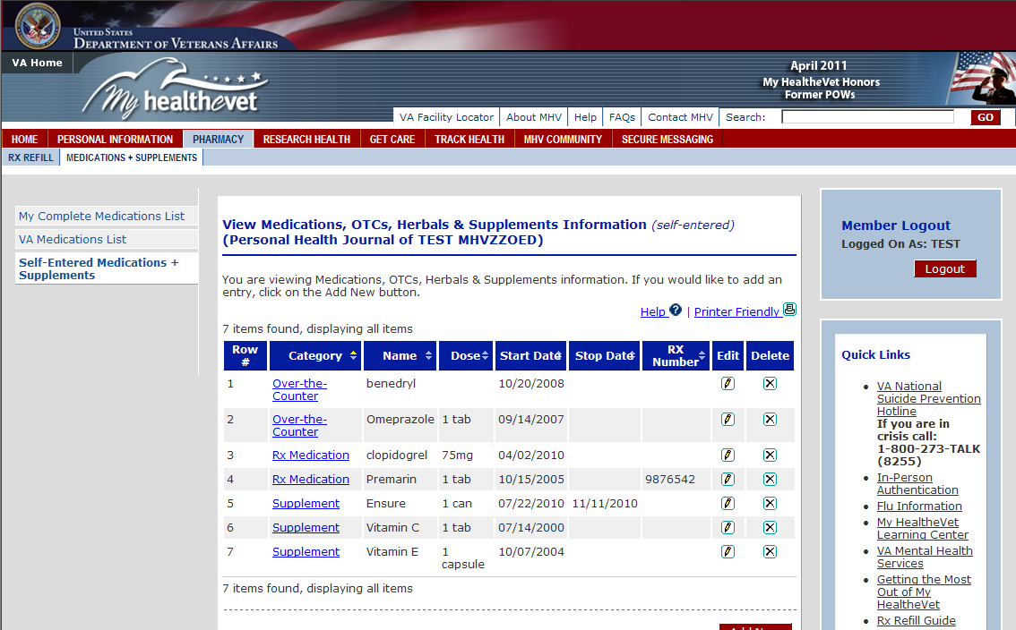
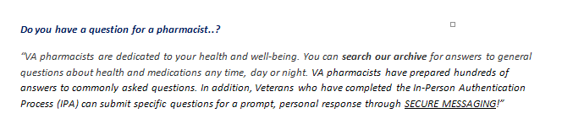
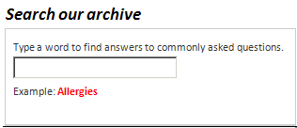
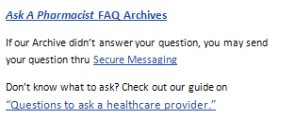
View In MyHealtheVet
Ask A Pharmacist
Frequently Asked Questions
Send A Secure Message
Trusted Resources
Medications: Play It Safe
VA Pharmacy
Medications and Health
Notes:
This is a view of what Ask A Pharmacist, the website, MIGHT look like if incorporated within the pharmacy section of MHV. Notice its placement as a subtab of the pharmacy section, next to Medications and supplements

Slide 15
Frequently Asked Questions
Ask A Pharmacist
Frequently Asked Questions
Send A Secure Message
Trusted Resources
Medications: Play It Safe
VA Pharmacy
Medications and Health
Notes:
A Frequently Ask Questions (FAQ) Archive developed by a National Pharmacy Workgroup will be viewable from the homepage of Ask A Pharmacist providing general questions and answers on medications and medication management.
These FAQs will be linked throughout the content of Ask A Pharmacist and the FAQ database on MHV.
Visitors to Ask A Pharmacist will be able to search FAQs using keywords or by clicking on the Ask A Pharmacist Archived list

Slide 16
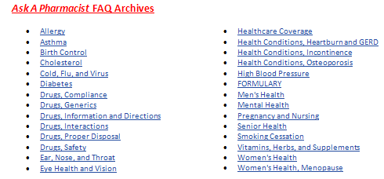
Frequently Asked Questions
Ask A Pharmacist
Frequently Asked Questions
Send A Secure Message
Trusted Resources
Medications: Play It Safe
VA Pharmacy
Medications and Health
Notes:
Once in the Ask A Pharmacist FAQ Archives, visitors will see a selection of topics on medication issues arranged alphabetically. In this example, “Drug, information and Directions” is chosen

Slide 17
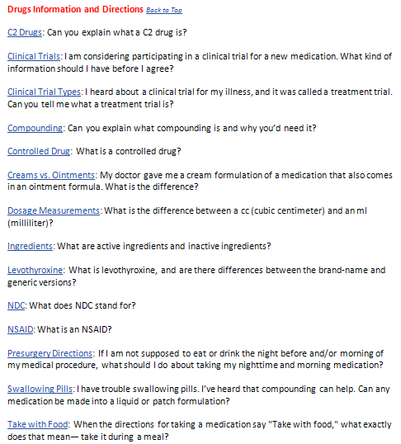
Frequently Asked Questions
Ask A Pharmacist
Frequently Asked Questions
Send A Secure Message
Trusted Resources
Medications: Play It Safe
VA Pharmacy
Medications and Health
Notes:
After selecting a topic, a list of subtopics and commonly asked questions appears. In this example, the subtopic under “Drug Information and Directions” titled “Take with food” is chosen, which asks the question “When the directions for taking a medication say “Take with food,” what exactly does that mean – take it during a meal? “

Slide 18
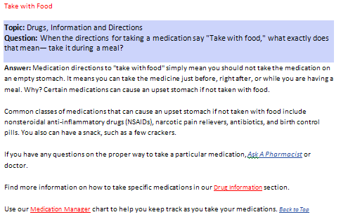
Frequently Asked Questions
Ask A Pharmacist
Frequently Asked Questions
Send A Secure Message
Trusted Resources
Medications: Play It Safe
VA Pharmacy
Medications and Health
Links to resources within content
Notes:
Once the subtopic is selected, the subtopic, topic, and question is restated along with a descriptive answer.
This also creates opportunities to link additional resources and content .
Notice the “Ask A Pharmacist” hyperlink within the paragraph. This is a link to Secure Messaging and can be found throughout the Ask A Pharmacist site as a constant reminder that answers to specific questions are available through local Ask A Pharmacist triage groups (as previously mentioned)

Slide 19
Frequently Asked Questions
Ask A Pharmacist
Frequently Asked Questions
Send A Secure Message
Trusted Resources
Medications: Play It Safe
VA Pharmacy
Medications and Health
Notes:
As in many encounters with healthcare providers, patients have trouble knowing what to ask. The home page of Ask A Pharmacist will have a link to “Questions to ask a healthcare provider,” a resource from “Medications: Play It Safe,” a healthy living center on MHV.
This provides helpful tools, previously developed by VA providers, on how to prepare for a doctor’s visit

Slide 20
Link(s) to Secure Messaging
Ask A Pharmacist
Frequently Asked Questions
Send A Secure Message
Trusted Resources
Medications: Play It Safe
VA Pharmacy
Medications and Health
Notes:
The ability to log into secure messaging from Ask A Pharmacist not only provides a convenient location for SM within the pharmacy section of MHV, but also provides an opportunity to promote secure messaging to those that have not yet opted-in.

Slide 21
Secure Messaging: Ask A Pharmacist
Ask A Pharmacist
Frequently Asked Questions
Send A Secure Message
Trusted Resources
Medications: Play It Safe
VA Pharmacy
Medications and Health
Notes:
For visitors that have opted into SM and are logged into MHV, patients with Ask A Pharmacist triage groups setup will have an Ask A Pharmacist contact for answers to specific questions and a prompt, personal response.

Slide 22
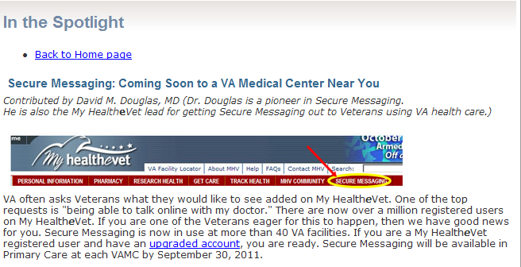
Secure Messaging: Ask A Pharmacist
Ask A Pharmacist
Frequently Asked Questions
Send A Secure Message
Trusted Resources
Medications: Play It Safe
VA Pharmacy
Medications and Health
Notes:
For visitors that have not yet opted into SM, the secure messaging home page will display informing them on its benefits and how to sign up.

Slide 23
Poll Question
Does anyone know the national drop dead date for Secure Messaging in Primary Care?
3/31/2012
10/31/2012
12/31/2012
3/31/2013
Notes:
Now would be a good time for a polling question.
Remember to use the blue polling button above to participate

Slide 24
Secure Messaging: Ask A Pharmacist Setup
Current Functionality
Activate Staff
Create a Triage Group
Reminders Due Report
Associate Group
OE/RR List
Notes:
Now that we’re on the topic of SM, lets go back to component 1 of Ask A Pharmacist, setting up an Ask A Pharmacist triage group. For Veterans to use Secure Messaging, they MUST have completed the In-Person Authentication Process (IPA) AND opted in to SM.
The way to setup Ask A Pharmacist Triage groups within current functionality would be as follows:
Have the MHV coordinator activate the Pharmacy Staff at a VAMC whose job it would be to respond to the Ask a Pharmacist messages. (pharmacy technicians, staff pharmacists, clinical pharmacists, administration)
Have MHV coordinator create a Triage Group called Ask a Pharmacist [SITE ACRONYM] such as Ask A Pharmacist - Portland or Ask a Pharmacist VHSO, etc. AND put the pharmacy staff on this Group. ***Using this will ensure VSSC reports catch all sites with Ask A Pharmacist triage groups
Have a Clinical Application Coordinator (CAC) run a Reminders Due Report on the patients at that site who have gone through In-Person Authentication and choose the Option to save this report as an Order Entry/Results Reporting (OE/RR List). Name the OE/RR list Ask A Pharmacist and be sure to make this list Public.
Associate the Ask a Pharmacist Triage Group with the Ask a Pharmacist OE/RR list, or you can associate by Patient Care Management Module (PCMM). ** VHSO associates patients by PCMM
Patients will now be able to select the Ask A Pharmacist triage group as a recipient of a New Message.
The CAC will have to periodically refresh this list as new patients go through In-Person Authentication. ** If associated by PCMM, no update is required

Slide 25
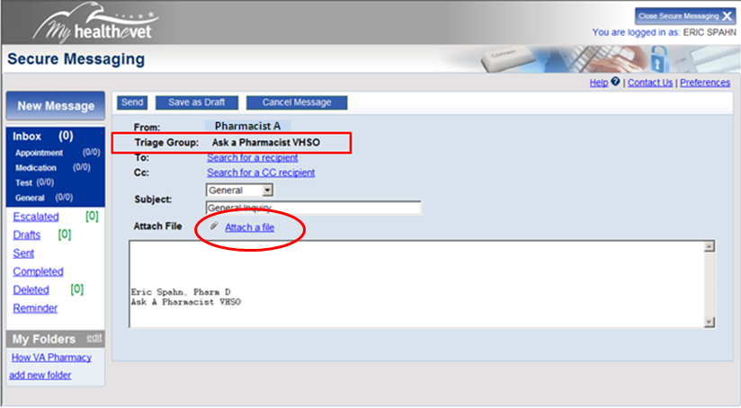
Secure Messaging: Ask A Pharmacist Rx view
Notes:
Once the MHV coordinator has setup the triage group (such as Ask a Pharmacist VHSO), it will display with each message that is sent.
As providers, we have the ability to send attachments such as medication profiles and tracking links.
We also have the ability to create distribution groups within SM to send alerts for CMOP rejects, shortages, conversions, etc to a specific list of patients.
This reduces cost of postage, printed paper ,and ink and provides a secure manner to alert individuals to changes in medication therapy by reducing opportunities for a patient identifiers to be lost in the mail.

Slide 26
Secure Messaging: Ask A Pharmacist Pt View
Notes:
In-Person-Authenticated Patients who have opted into Secure Messaging will now be able to select the Ask A Pharmacist triage group as a recipient of a New Message.
Again, this setup is part of a National Initiative for Local Implementation, which is currently being utilized at local VAMCs to streamline pharmacy workflow, and reduce interruption to on-site patient care.
Setting up Ask A Pharmacist triage groups will also create a local contact for Veterans visiting Ask A Pharmacist, the website on MHV.

Slide 27
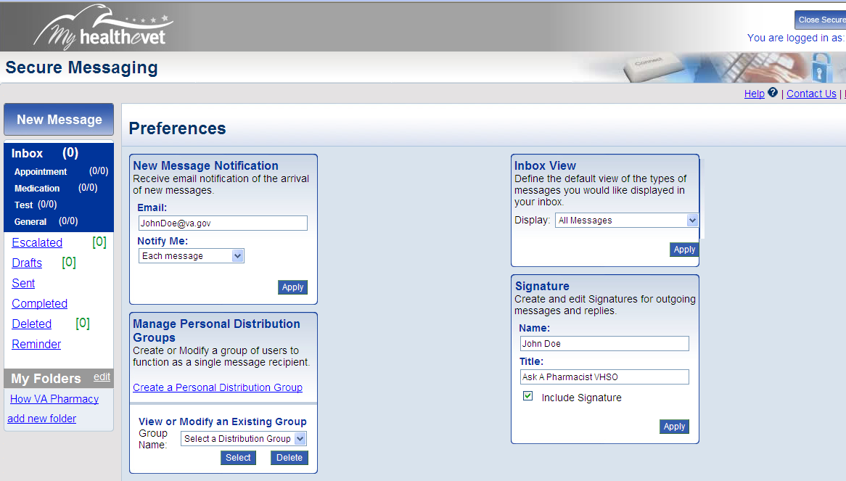
Secure Messaging: Pharmacy Tech Preferences
Notes:
Within the preferences section of SM, users have the ability to choose WHEN MESSAGE ALERTS are placed in their OUTLOOK INBOX and when messages in their SM INBOX appear.
Pharmacy technicians are NOTIFIED BY EACH MESSAGE sent to Ask A Pharmacist and ALL MESSAGES ARE DISPLAYED in their SM inbox.
Once a pharmacy technician opens a message, that message is automatically assigned to them.
A Pharmacy technician (aka triage staff) has “the responsibility of reviewing all messages being sent to triage group. He or she resolves the message or determines the appropriate hand-off, by assigning the message to another team member (pharmacist). Ideally, the pharmacy technician (triage staff )should be able to resolve and complete some messages without assignment.”
Messages can be forwarded to other members of the triage group or outside of the triage group for clarification without reassigning the message, so that ownership remains with the original contact (pharmacy technician).

Slide 28
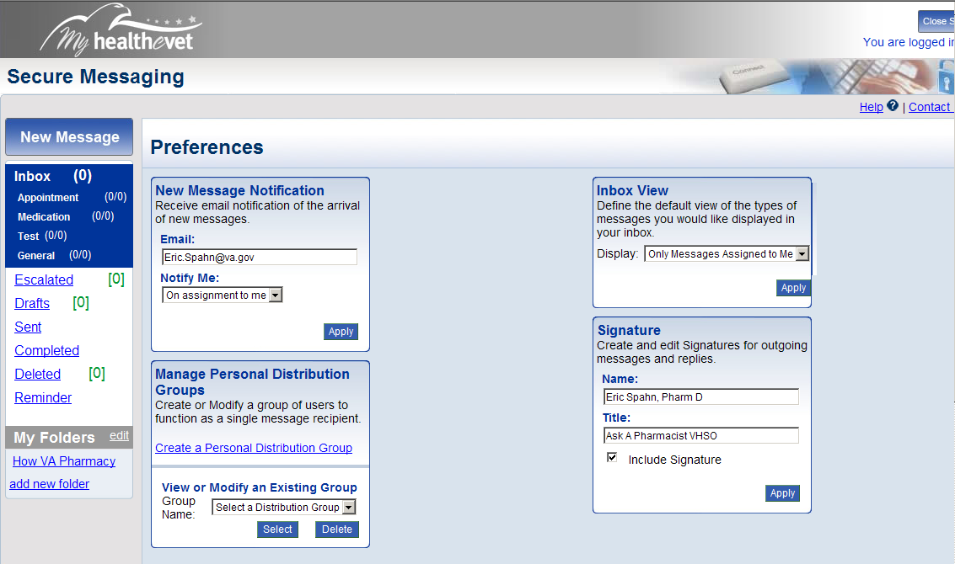
Secure Messaging: Pharmacist Preferences
Notes:
Pharmacist preferences are set to only alert their outlook inbox when messages have been assigned to them and only displays messages in SM that are assigned them
Since SM alerts come from MHV@va.gov, they can be forwarded to a designated “Secure Message” file by creating a “rule” in Microsoft Outlook.
This creates a triage of messages that streamlines the workflow of pharmacy in a documented, efficient manner versus pharmacists answering a blind phone call or returning a missed call or message only to recap the entire conversation over again and interrupt on-site care to Veterans visiting the pharmacy.

Slide 29
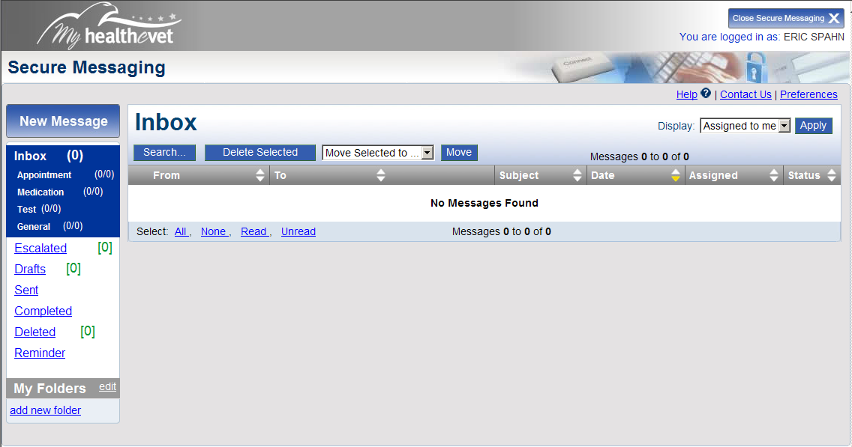
Secure Messaging: Pharmacist Inbox
Notes:
As you can see my inbox is empty since many of the messages sent to Ask A Pharmacist, such as refill requests and medication tracking, are answered by pharmacy technicians.
Also, since messages become escalated after 3 days, there is a constant reminder to complete messages, which removes them from your inbox.
Reminders can be placed for future dates on completed messages if there is need for follow-up.

Slide 30


Secure Messaging: Ask A Pharmacist Setup
Pharmacy
Prescribing Clinic
Veteran
COMMUNICATION
Notes:
Ask A Pharmacist triage group setup allows:
Veterans – an additional contact in SM to send medication inquires directly to local VA pharmacies via Ask A Pharmacist triage group, and actively participate in medication management
It allows… Pharmacy Technicians
To forward prescription renewal requests to prescribing clinic
To assign drug therapy or drug interaction questions to pharmacists
To process prescription refill requests directly from patients, including address verification prior to processing
To provide tracking numbers/links to medication orders for delivery conformation
To assign messages to the pharmacist associated with a specific provider or team (PACT) ** At VHSO, we have three pharmacists assigned to 15 PC teams (5 teams per pharmacist)
It allows…Pharmacists
To answer drug therapy questions from patient or provider that have already been triaged by pharmacy technician
To have less interruption to on-site patient care by ONLY receiving messages assigned to them
To communicate only the information relevant to a patient’s medical record in CPRS (Progress Note)
To send notification of drug alerts (CMOP delays, shortages, recalls, conversions, etc.) to multiple patients and/or providers using distribution groups within SM
To send attachments/links to patients/providers on medication education materials, including active medication lists
To forward questions needing administrative action to appropriate pharmacy staff
It allows….the Prescribing Clinic
– to send or forward medication questions to pharmacy via triage group
Less interruption to onsite care and decreased unscheduled appointments from medication issues
To make informed decisions from completed message threads of patient and pharmacy
Let’s revisit our poll now and see your responses, then we’ll take a look at the correct answer. (stay on this slide to view poll results!)

Slide 31
Poll Answer
Does anyone know the national drop dead date for Secure Messaging in Primary Care?
3/31/2012
Notes:
Here is the answer to the previous polling question “Does anyone know the national drop dead date for SM in all PC? “
(remark about whether or not they got it right)

Slide 32
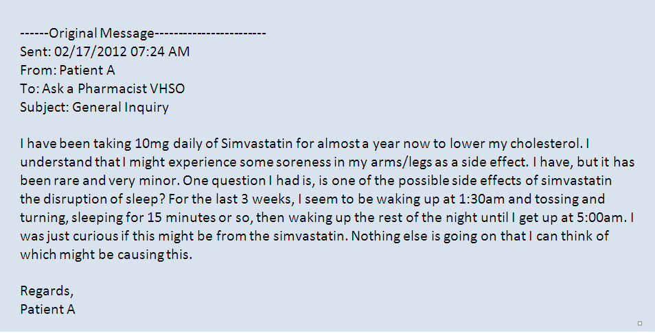
Secure Messaging: Ask A Pharmacist Thread
Notes:
Now lets look at a completed message thread that began with a patient sending a general inquiry to Ask A Pharmacist VHSO about a concern with a cholesterol medication, SIMVASTATIN

Slide 33
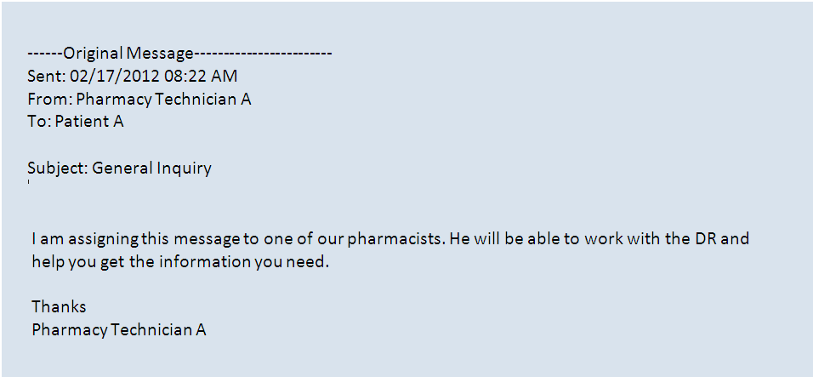
Secure Messaging: Ask A Pharmacist Thread

Slide 34
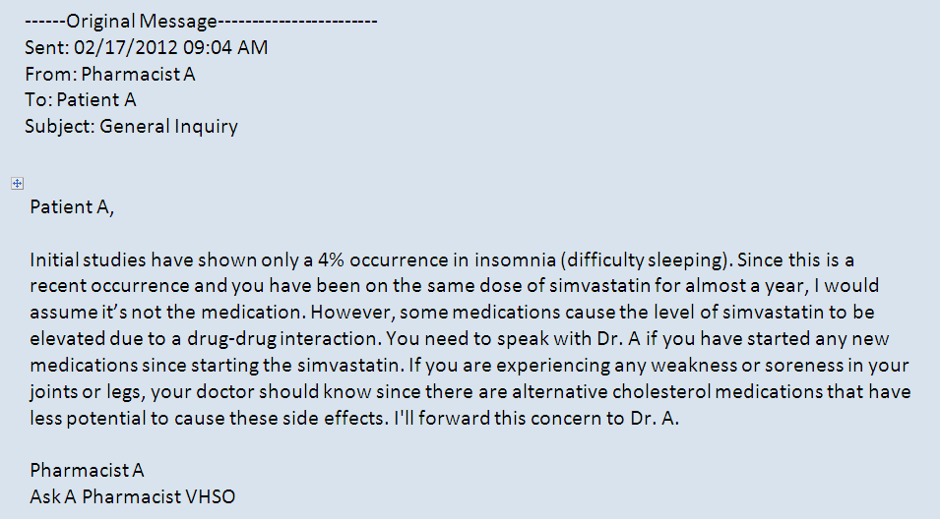
Secure Messaging: Ask A Pharmacist Thread

Slide 35
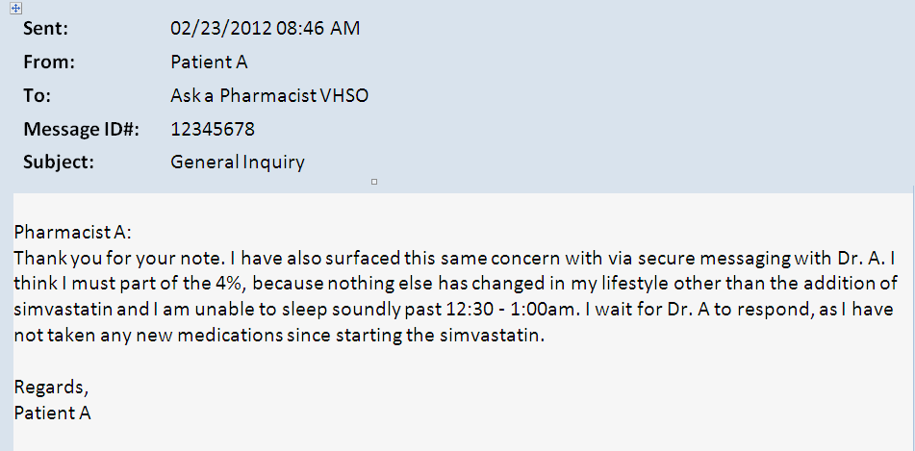
Secure Messaging: Ask A Pharmacist Thread

Slide 36
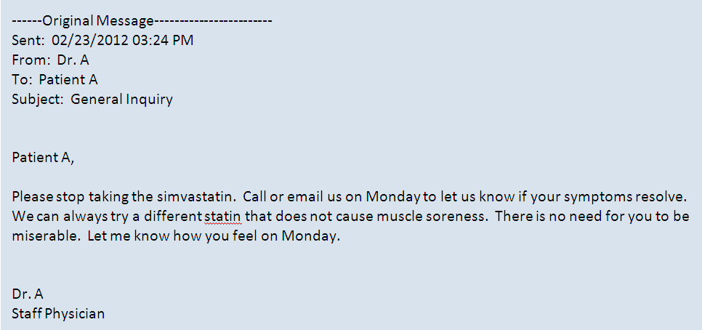
Secure Messaging: Ask A Pharmacist Thread
Notes:
Unlike most internet sites that can only provide general information, patients visiting Ask A Pharmacist can easily go from general medication information on MHV, to THEIR local VA pharmacy contact who can not only respond to the patient but also have access to the patient’s VA medication profile.
This simvastatin was placed on hold by the pharmacist just prior to being released and charging an additional 3 month supply of medication, that was eventually discontinued by the provider.

Slide 37
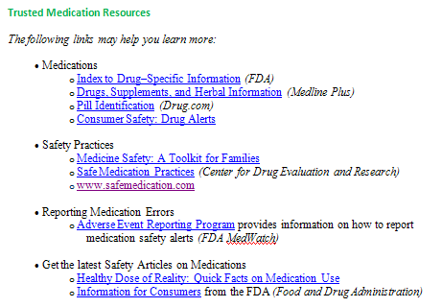
Trusted Resources
Ask A Pharmacist
Frequently Asked Questions
Send A Secure Message
Trusted Resources
Medications: Play It Safe
VA Pharmacy
Medications and Health
Notes:
Now lets get back to Ask A Pharmacist, the website.
Another valuable tool offered on Ask A Pharmacist, is Trusted Resources.
Patients have questions about their medications at home, after hours, and seek answers on the internet or in the non VA health care settings.
Ask A Pharmacist will provide trusted resources from internal and external sites on topics such as pill identification, safe medication practices, and Adverse Drug Reporting Programs, just to name a few
These resources will be developed and maintained by a National VA Pharmacy Workgroup and MHV

Slide 38
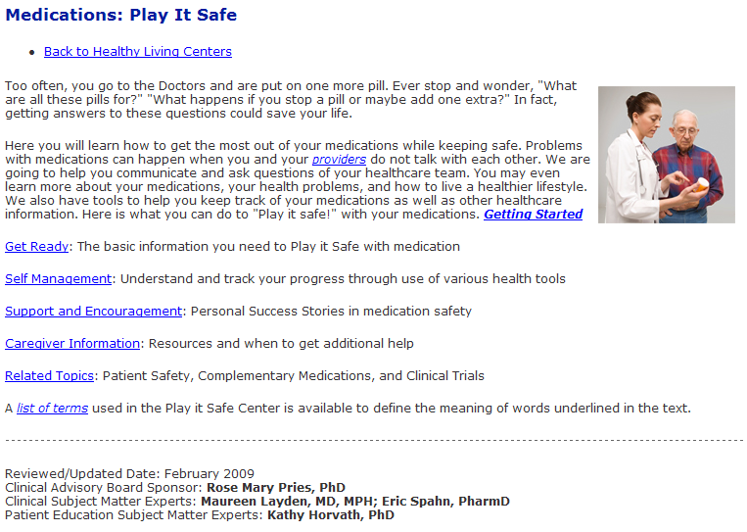
Medications: Play It Safe!
Ask A Pharmacist
Frequently Asked Questions
Send A Secure Message
Trusted Resources
Medications: Play It Safe
VA Pharmacy
Medications and Health
Notes:
Medications: Play It Safe is a healthy living center on MHV and is a valuable tool for patients and caregivers.
Bringing it to the pharmacy section of MHV within Ask A Pharmacist will make it more accessible and usable to Veterans and caregivers

Slide 39
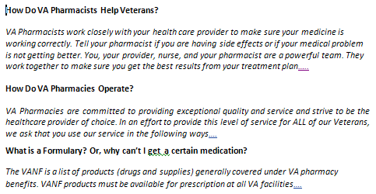
VA Pharmacy
Ask A Pharmacist
Frequently Asked Questions
Send A Secure Message
Trusted Resources
Medications: Play It Safe
VA Pharmacy
Medications and Health
Notes:
Many Veterans have questions about the day to day operations of VA Pharmacies, especially which medications are available on the VA formulary.
The VA Pharmacy section of Ask A Pharmacist will provide this information to open the lines of communication, and prepare Veterans before and after visits with VA AND non-VA providers.
This communication is important for establishing trust and preventing unintentional delays in therapy.
It should also reduce unscheduled visits to local VA pharmacies and clinics by educating visitors on how local VA pharmacies utilize consolidated mail outpatient pharmacies (CMOPs).

Slide 40
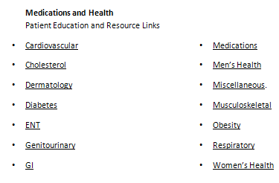
Medications and Health
Ask A Pharmacist
Frequently Asked Questions
Send A Secure Message
Trusted Resources
Medications: Play It Safe
VA Pharmacy
Medications and Health
Notes:
A section on Medications and Health will allow Veterans to obtain a general understanding of how disease states can determine which medication regimen they receive, including goals of therapy, and how disease states AND labs are monitored to assess how well a medication regimen is working.

Slide 41
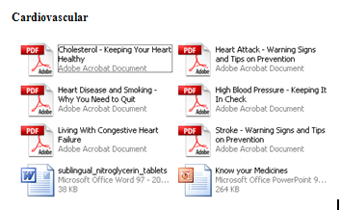
Medications and Health
Ask A Pharmacist
Frequently Asked Questions
Send A Secure Message
Trusted Resources
Medications: Play It Safe
VA Pharmacy
Medications and Health
Notes:
Content for the Medications and Health section is currently being discussed, including links to current resources within MHV such as the Health Library.
As mentioned on previous slides, content throughout the site will include hyperlinks to SM called “Ask A Pharmacist” which connects visitors to the Ask A Pharmacist triage groups at local facilities.

Slide 42
Poll Question
Before showing Ask A Pharmacist site locations, let me know were you’re located.
VISNs 1-7
VISNs 8-14
VISNs 15-23
Other
Notes:
Now would be a good time for another polling question. Before moving on to the next section, please let me know were you’re located…

Slide 43
Strategic Goals
    Improve patient care
      Safety
      Quality
      Access
    Increase satisfaction across many stakeholders
Improve Workflow
Notes:
Now, I will list important components of the business plan for Ask A Pharmacist, beginning with Strategic goals:
The first and utmost goal is to Improve patient care
- Safety: Communicating the right information from trusted resources as well as documentation to support adverse drug events
Quality: Activate patients to participate in shared and informed decisions about their medications
Access: Provide asynchronous communication determined by the Veteran, family, or caregiver – at home and after hours

Slide 44
Strategic Goals
    Improve patient care
      Safety
      Quality
      Access
    Increase satisfaction across many stakeholders
Improve Workflow
Notes:
Increase satisfaction across many stakeholders
Veteran, family, or caregiver and their healthcare team

Slide 45
Strategic Goals
    Improve patient care
      Safety
      Quality
      Access
    Increase satisfaction across many stakeholders
Improve Workflow
Notes:
Improve Workflow
Decreases phone calls, visits, and time waiting at the pharmacy window.
Assist in prescription processing questions as well as other medication related topics
Creates ownership and documentation of messages for better follow-up

Slide 46
Strategic Goals (cont)
    Address multiple unmet needs
    Help meet organizational requirements
Notes:
Address multiple unmet needs
Use MyHealtheVet (MHV) as a provider of an "Ask the Pharmacist" Program
Provides Veterans another communication device to “Ask Pharmacists” questions about medications and health
Provide both general and patient-specific drug information to our Veteran in one venue: MHV
In the 2011 Voice of the Veteran, one of the goals listed was to Augment technology to improve access to information including improving comprehensiveness of My HealtheVet

Slide 47
Strategic Goals (cont)
    Address multiple unmet needs
    Help meet organizational requirements
        VA Medication Reconciliation Directive
        Joint Commission
        Meaningful Use
        Patient Aligned Care Teams (PACT)
Notes:
Help meet organizational requirements
VA Medication Reconciliation Directive
Joint Commission
Meaningful Use
Patient Aligned Care Teams

Slide 48

Success Metrics
Process
Metrics
Outcome
Metrics
Satisfaction
Notes:
Success metrics are an important part of any project for implementation and continued improvement:
Process Metrics
Site usage statistics
Deployment across the VA – the National Initiative for Local Implementation
Outcome Metrics
Decrease calls and visits to clinic and pharmacy
Decrease adverse drug events and delays in therapy
Satisfaction
Patient, caregiver, and family
Staff

Slide 49
Stakeholders
  The Veteran, family, and caregiver
  Teams:
  Patient Aligned Care Teams(PACT)s, pharmacy, clinic, and support staff
  Organizations:
  Department of Veteran Affairs, MyHealtheVet, VA Pharmacy Benefits Management, National Medication Reconciliation Initiative
Notes:
Stakeholders of Ask A Pharmacist include:
The Veteran, family, and caregiver
Patient Aligned Care Teams(PACT)s, pharmacy, clinic, and support staff
MyHealtheVet, VA Pharmacy Benefits Management, National Medication Reconciliation Initiative

Slide 50

Current Support- VHSO
Notes:
It is important to recognize current support of Ask A Pharmacist, beginning with my home site - The Veteran Healthcare System of the Ozarks (VHSO),in VISN 16, and winner of the 2011 Carey Award. VHSO continues to exceed VISN and NATIONAL Patient Satisfaction Surveys (SHEP)
VISN 16 Veterans Rank 3rd in nation for online utilization of MHV
Ask a Pharmacist VHSO has approximately 1200 patients associated to Ask A Pharmacist, 1200 opted in, of which 829 are active users thanks to MHV Coordinators

Slide 51
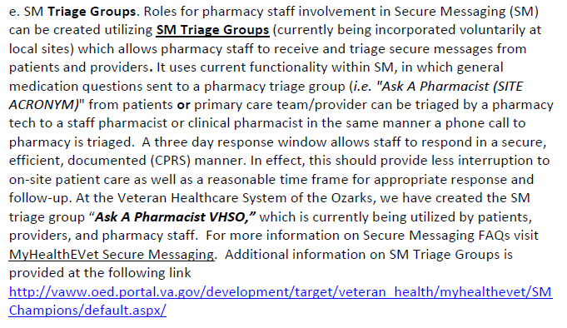
Current Support – MHV/PBM/PACT
VA PBM Field Guidance Pharmacy Business Rules for PACT – FEB 2012
Notes:
MHV and The Pharmacy Benefits Management group provided the initial interest in Ask A Pharmacist, the website, with a MHV content addition approval in 2008.
While working with representatives of the Pharmacy Benefits Management team, they asked for specific guidance on how VA Pharmacies could best utilize Secure Messaging and what the roles of pharmacy staff members might be.
The PBM recently released “Field Guidance for Pharmacy Business rules for PACT” just this February, including how SM should be utilized and incorporated using Ask A Pharmacist triage groups.
While working with representative of MHV and the National Medication Reconciliation workgroup, additional contacts such as the Daily Plan and My Recovery Plan have also provided support needed for collaboration and insight

Slide 52
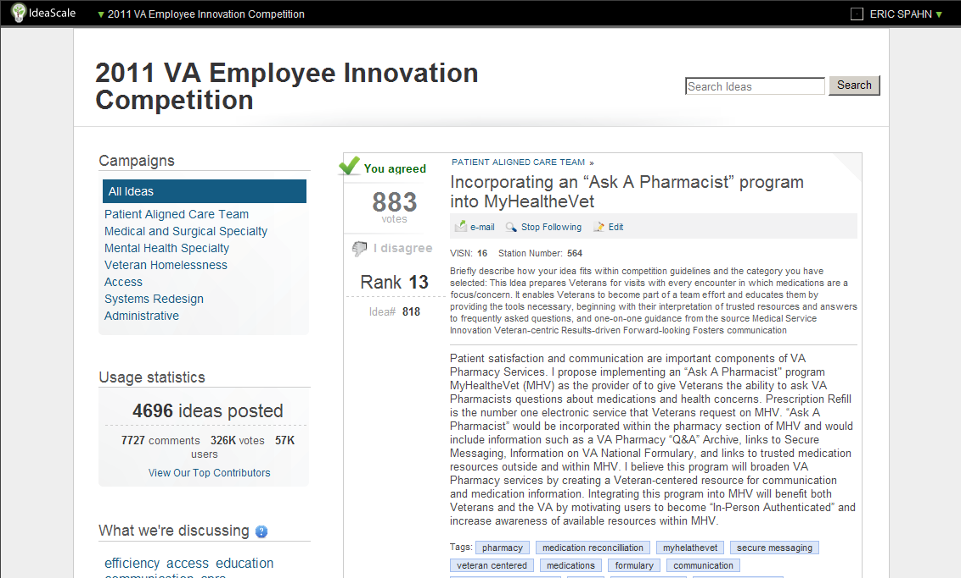
Our colleagues agreed!
Notes:
Though Ask A Pharmacist was not picked from the finalists of the 2011 Employee Innovation Competition, it did provide enough feedback to show how much our fellow employees and Veterans liked the idea.
This stage created much of the content needed to create a business plan and provided groundwork for local implementation of Ask A Pharmacist SM triage groups across the nation
Now would be a good time see results of the last polling question. Before showing Ask A Pharmacist site locations, please let me know were you’re located

Slide 53
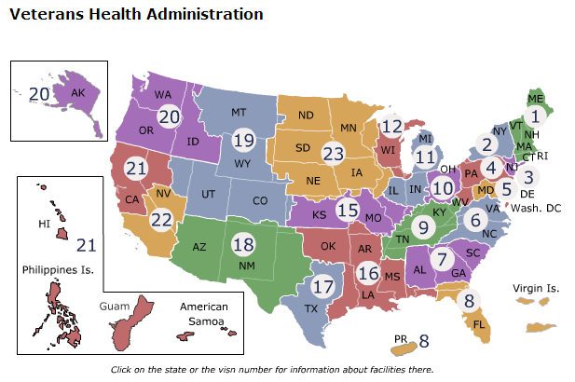
Current Support – Ask A Pharmacist Sites
Notes:
With the help from Ask A Pharmacist PORTLAND and MHV coordinators and pharmacy staff across the nation, the National Initiative for Local Implementation is already underway with “Ask A Pharmacist” Secure Messaging Triage Groups currently setup in 12 out of 21 VISNs

Slide 54
Current Stats– Ask A Pharmacist Patients
Notes:
Ask A pharmacist triage groups are not only utilized, but have also been used as a device for marketing and recruitment to get patients In-Person-Authenticated and opted into Secure Messaging.
Average use of Ask A Pharmacist triage groups by active users remains above 50% as of February 2012

Slide 55
Current Stats– Ask A Pharmacist
Notes:
Thanks to new reports, we can now begin looking at site utilization of triage groups in SM.
This is a list of Inbound messages from February 2012 for each station utilizing Ask A Pharmacist triage groups.
Most sites have reported an exponential clime towards the end of February and expect the numbers to continually grow
As previously mentioned, naming these triage groups “Ask A Pharmacist” followed by your site’s ACRONYM (“Ask A Pharmacist PORTLAND”) will make sure these reports catch every site

Slide 56
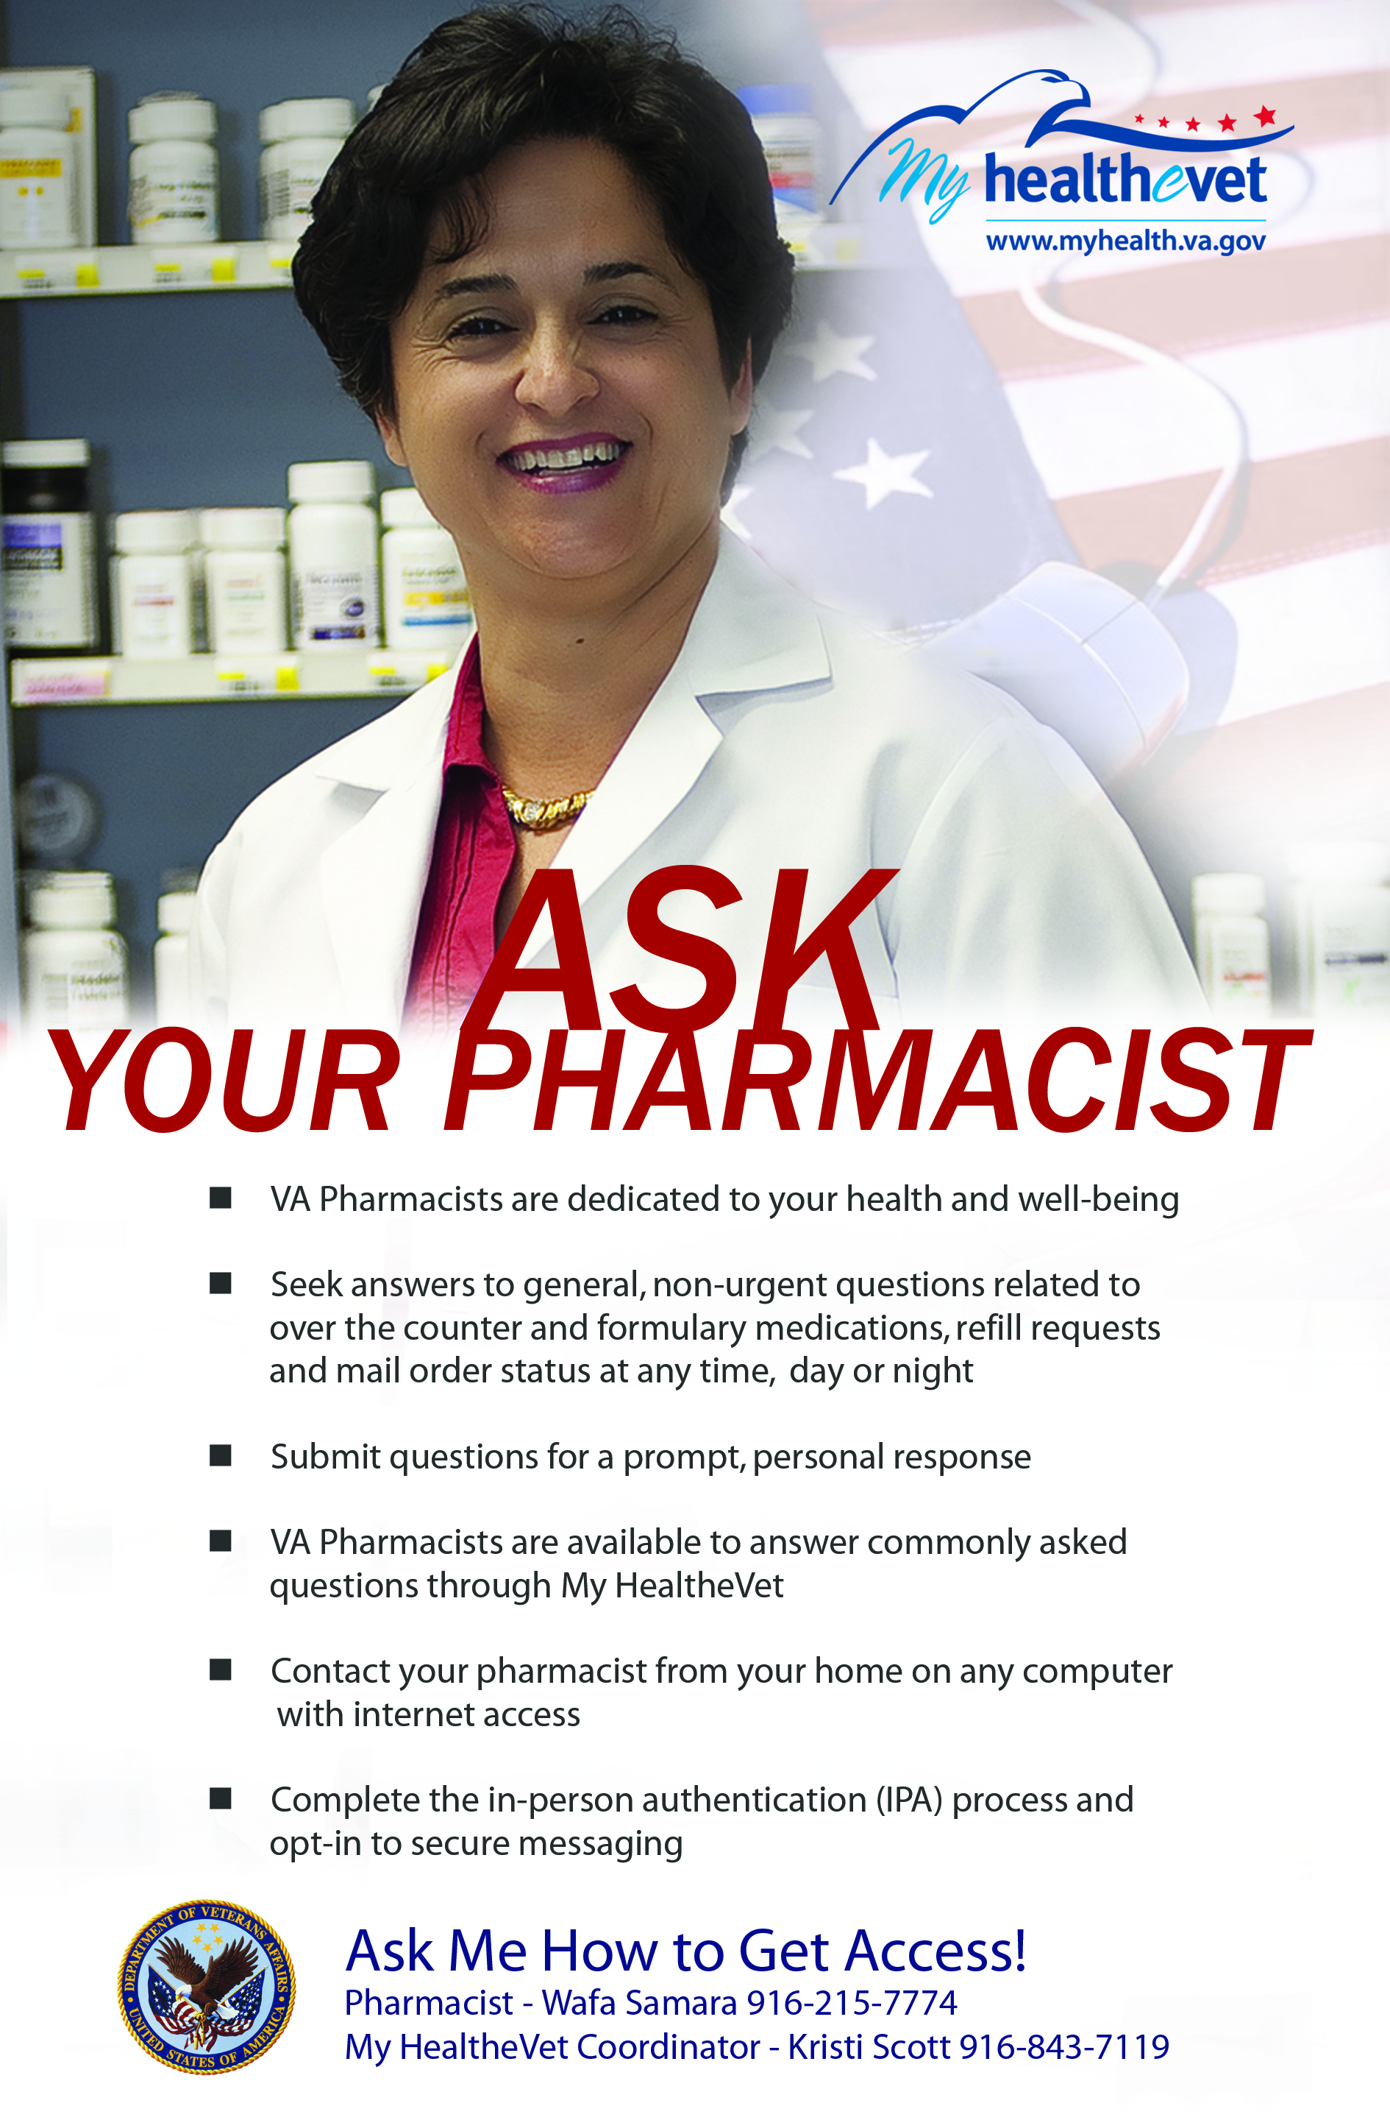
Marketing Tools – Ask A Pharmacist
Notes:
Marketing tools are key to any successful implementation.
Creative, personalized brochures and posters with local VA pharmacists have helped to get the word out and provide a message of communication and trust
Other forms used to inform patients and providers about Ask A Pharmacist.
Pre Appointment letters (VHSO)
Include phone technicians (VHSO)
Add to monitors in pharmacy waiting areas (VHSO) and pharmacy service section of VAMC internet (VHSO)
Have “On Hold” phone message includes Ask a Pharmacist (VHSO)
Add to VAMC Facebook page (VHSO)
Include a localized flyer with dispensed/mailed scripts (Station 442)
Have flyers and posters up around the facility (Station 442)
Place on facility telephone tree message system. (Station 442)
Posters in the Primary care waiting areas (VISN 21)
At PC appointments get Ask A Pharmacist pamphlet
(VISN 21)

Slide 57
Feedback – Ask A Pharmacist
“Your topic was really well received at our August conference and personally it helped our medical center improve our patient experience. We hope you will be able to help other Informatics Pharmacists implement Ask your pharmacist at their medical center”
“Great! We have dramatically decreased number of calls to the nurse case managers and improved PACT flow”
“Prevented same day pharmacy walk in for medication requests/concerns”
Notes:
Here are some of the many compliments received from VA employees

Slide 58

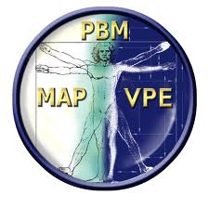
Subject Matter and Stakeholder Workgroup
Medication Reconciliation National VA Work Group > Shared Documents > Workgroups Meeting Minutes and Materials > Ask A Pharmacist
Notes:
A Subject Matter and Stakeholder Workgroup is needed to make sure content and resources remain consistent with the values and mission of VA Pharmacy and the Veteran Health Administration

Slide 59
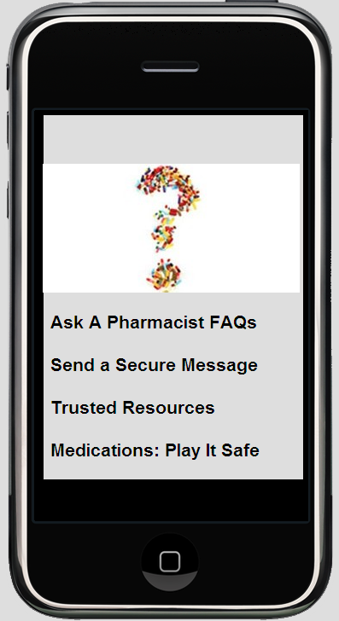
What’s Next?
Notes:
With the invention and popularity of phone apps, we cannot deny the need to involve Ask A Pharmacist with current development of MHV applications as another tool to expand access to patient care services

Slide 60

Measures of Success
Ask
A Pharmacist
On MHV
Notes:
What are our measures of success..?
Ask: Veterans deserve access to comprehensive pharmacy services to help promote full participation in the successful management of their medication treatment plans
A Pharmacist: The most accessible healthcare profession will participate and promote multidisciplinary team based care via their Pharmacist
On MHV: The most patient friendly platform in the VA: MHV promotes internal sites and services as well as In-Person-Authentication (IPA) while reducing patients waiting on the phone or at the pharmacy window

Slide 61
Measures of Success
“We’ll know we are successful when we hear one Veteran say to another, ‘Its easy, I just went on “Ask a Pharmacist” and found the answer I was looking for’.”
Maureen Layden, MD, MPH Director of the Medication Reconciliation Initiative, VACO PBM

Slide 62

Questions

