Slide 1
PHARMACY PRODUCTION MENU
LeeAnn Gadbaw
Notes:
Thank you (moderator name)! I am happy to be here today to talk about the Pharmacy Production Menu.
The Pharmacy Production Menu offers a wide variety of options for entering, tracking and trending drug stock on hand and medication usage in areas of use other than the pharmacy.
We will walk through the menu options, going step by step, and see what each option is used for. I’LL save the best for last as we go through the Auto-Replenishment Reports.
This menu option is shared by both pharmacists and pharmacy technicians. We will not be going through the setting up of the AOU Inventory Groups or locations. We assume those steps have been taken your informaticist/or other responsible pharmacy staff member.

Slide 2
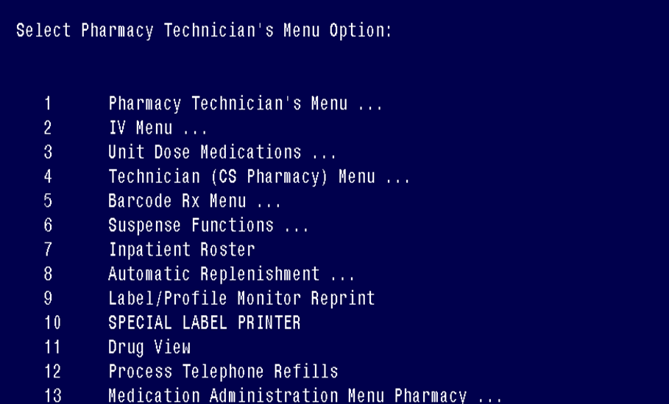
Automatic Replenishment (AR)/
Ward Stock (WS)
Notes:
To locate this menu, go to your main pharmacy technician or pharmacist menu. Select the Automatic Replenishment/Ward Stock menu option. Then we will be ready to choose the Production menu.

Slide 3
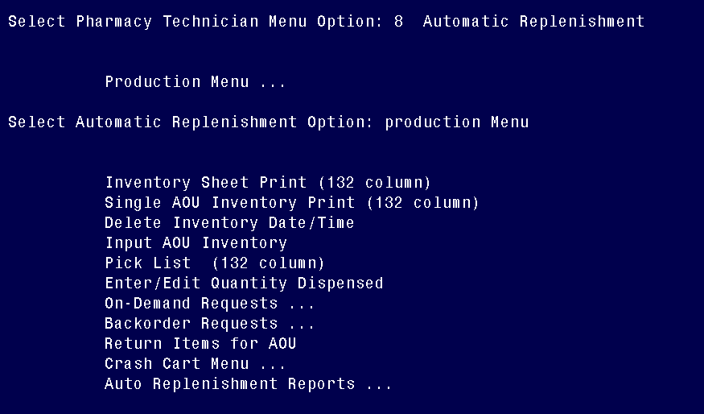
Production Menu
Notes:
The path to get to the production menu. And there are all our menu options.

Slide 4
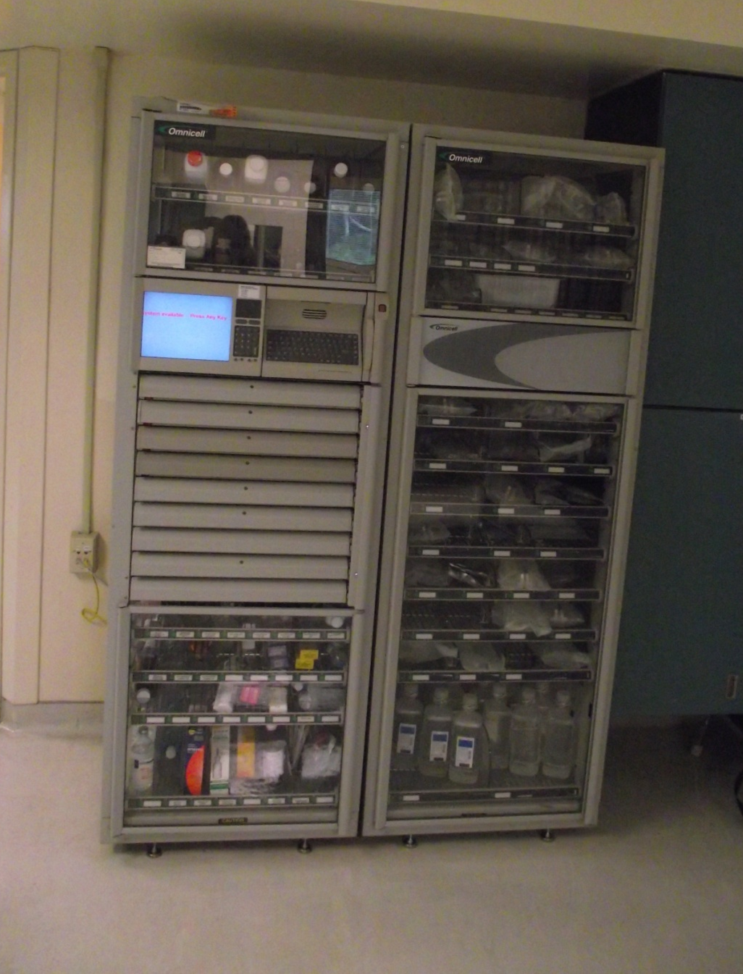
Automated Dispensing Cabinet
Notes:
Most VA Medical Centers use Automated Dispensing Cabinets to store ward stock items. Automated systems offer electronic tracking and reporting systems that mimic the Production Menu options; however, not all areas/sites have access to such equipment. The Production Menu Module is intended as a guide for those areas not served by automated dispensing units. As you will see, it is a manual process that will mirror the processing of your automated dispensing cabinets.

Slide 5
Objectives
Production Menu
Inventory Options
On-Demand Request
Crash Cart Locations
Auto Replenishment Reports
Notes:
The objectives of this module are:
Understand the purpose of the production menu.
Learn inventory options.
Know how to enter and return items for on-demand requests.
Be able to edit and print crash cart locations.
Know what Auto Replenishment reports are available and why you would use them.

Slide 6
Poll Question
How often do you use the Production Menu?
Daily
Weekly
Monthly
Seldom or never use
Notes:
Now I’d like to ask a poll question.
How often do you use the Production Menu?
Daily
Weekly
Monthly
Seldom or never use
To answer this question, use the blue polling icon above my head. We’ll move on and come back to your results in just a moment.

Slide 7
Production
Menu
Notes:
Our waiter has brought us our menu, so let’s take a look at the production menu. So what is this menu all about? Automatic Replenishment (AR)/Ward Stock (WS) is a method of drug distribution and inventory management within a hospital. Drug products can be automatically inventoried and delivered to an area of use (AOU). An area of use is the place where commonly stocked items/medications are stored. The area is potentially composed of wards, clinics, and specialties. A product could also be requested on-demand to a ward/clinic. The on-demand request is an Un-scheduled distribution of an item to an area of use. This would be automatic replenishment. The automatic replenishment/ward stock method is designed to allow each VAMC to adapt the system to its own needs.

Slide 8
Poll Results
How often do you use the Production Menu?
Daily
Weekly
Monthly
Seldom or never use
Notes:
Now let’s pause for a moment and take a look at your poll results.
How often do you use the Production Menu?
Daily
Weekly
Monthly
Seldom or never use
From the poll results, you can see ….many pharmacy personnel seldom or never use this menu option.
Ad-lib to the audience results, then advance to move on.

Slide 9
Production Menu
Inventory Sheet Print
Single AOU Inventory Print
Delete Inventory Date/Time
Input AOU Inventory
Pick List
Enter/Edit Quantity Dispensed
On-Demand Requests
Backorder Requests
Return Items for AOU
Crash Cart Menu
Auto Replenishment Reports
Notes:
Let’s open our menu to see what is here. To access the production menu, you will first sign into VistA . At the main pharmacy menu, type the option production menu or choose the number that corresponds with that option. Keep in mind the production menu you use may look different. Not all pharmacy staff at all sites will use every option that is listed, therefore, we will only review the most commonly used options that are available. Also the placement of this menu may be different since there was no standardization of menu placement in Vista.

Slide 10
Production Menu
Inventory Sheet Print
Single AOU Inventory Print
Delete Inventory Date/Time
Input AOU Inventory
Pick List
Enter/Edit Quantity Dispensed
On-Demand Requests
Backorder Requests
Return Items for AOU
Crash Cart Menu
Auto Replenishment Reports
Notes:
We will first review the menu option, Inventory Sheet Print. This option prints the AOU inventory sheet used to conduct a manual inventory. To print an Inventory Sheet for inventory or ward stock for a ward or clinic, you will select the option Inventory Sheet Print.

Slide 11
Notes:
Pharmacy staff will take the inventory sheet to the area of use to do the manual inventory of items. You will count what is on hand and then check the par level and write down the number needed to dispense.

Slide 12
Inventory Sheet Print
SELECT DATE/TIME FOR INVENTORY
PHARMACY AOU INVENTORY ID: 3054//
Are you adding MAY 11, 2010 as a new PHARMACY AOU INVENTORY?
Notes:
To start, you will choose your date and time for the inventory. You can use the letter T for today’s date or you may select a past or future date by entering T-1, T-2, T+1, T+2 etc.
You could also enter the word NOW as the date/time which may be beneficial, to create a unique inventory number which does not conflict with other inventories done on the same date. Remember that at any of these prompts, you can enter question marks for further information.
After choosing the date & time, the next selection is asking if this will be a new date added to the inventory. We will enter the letter Y for yes, that it is a new inventory and it will then be assigned an inventory ID.

Slide 13
Inventory Sheet Print
Select AOU INVENTORY GROUP: Mondays
PHARMACY AOU INVENTORY PERSON DOING INVENTORY:
Do you wish to print the AOU Inventory Sheet: YES/
Notes:
The next prompt will be asking for the name of the person doing the inventory. Enter through the prompt and your name will populate the field. At the next prompt you will select the AOU for the inventory group. You may enter more than one AOU by placing a comma between the selections. The inventory group selected is called Mondays and actually contains 3 areas of use, for example the Long Term Care ward, Dialysis, and the Cardiac Lab.
After selecting the inventory group, the next prompt will ask if you wish to print the AOU Inventory sheet. Type in a “Y” for yes and then select a printer at the device prompt.

Slide 14
Inventory Sheet Print
WARD STOCK INVENTORY FOR SEP 14,2010@13:44:39 INVENTORY # 3097 SEP 14,2010
PAGE 2
GROUP: LONG TERM CARE
ITEM STOCK QUICK ON REORDER MINIMUM QTY QUANTITY
LEVEL CODE HAND LEVEL TO DISPENSE DISPENSED
-----------------------------------------------------------------------------------------------------------------------------------
NH-3 MED ROOM
ACETAMINOPHEN 650MG RTL SUPP 100 APAP _____ ______
ALBUTEROL 3/IPRATROP 0.5MG/3ML INHL 3ML 30 34950267 _____ ______
ALBUTEROL SO4 INHAL SOL 2.5MG/3ML VIAL 30 34950269 _____ ______
DIMETHICONE 3% TOP LOTION 720 _____ ______
FUROSEMIDE INJ 10MG/ML 2ML 4 FUR-10
INFLUENZA SUBVIRON VACCINE,SYRINGE,0.5ML 30 INFLUENZ _____ ______
IPRATROPIUM BROMIDE 0.02% INH SOLN 2.5ML 30 34950268 _____ ______
LACTULOSE SOLN 10GM/15ML, 15ML UD 30 LACTULOS _____ ______
LIDOCAINE HCL 1% INJ MPF 2ML 5 LIDOCAIN _____ ______
SODIUM CHLORIDE 0.9% (PF) 3ML INJ 150 SALINE F _____ ______
Notes:
This is an example of what a printed inventory sheet will look like. This is just a small snapshot of the Long term care ward.
The columns shown on this report are directly affected by the way in which your site parameters are set. Your supervisor or pharmacy informaticist is responsible for establishing the site parameters.

Slide 15
Production Menu
Inventory Sheet Print
Single AOU Inventory Print
Delete Inventory Date/Time
Input AOU Inventory
Pick List
Enter/Edit Quantity Dispensed
On-Demand Requests
Backorder Requests
Return Items for AOU
Crash Cart Menu
Auto Replenishment Reports
Single AOU Inventory Print
Notes:
The single AOU inventory print option will print an inventory sheet for a single AOU that is included in the existing inventory date/time. This option is meant primarily to be used as a means of avoiding a reprint of a lengthy inventory sheet when there has been a problem such as a printer jam.

Slide 16
Single AOU Inventory Print
Notes:
As you can see, our pharmacy staff member has a major paper jam. She just printed the Inventory Group Mondays which normally contains 22 pages. We can use this option to print any one area of use that was unusable due to the paper jam.

Slide 17
SELECT DATE/TIME FOR INVENTORY: ??
1 8-11-2001@09:18:48 WARD-STOCK,SUPER WED
2 8-11-2001@09:47:49 WARD-STOCK,SUPER WED
3 8-11-2001@10:08:25 WARD-STOCK,SUPER WED
Notes:
To begin, select the Single AOU Inventory Print option. You will then be prompted to select the date and time for the inventory. As you can see, there were 3 inventories done on this day. Next, you will be prompted to select which date and time of the inventory to print. In our example, we have selected inventory number 2.

Slide 18
The following AOUs are included on this Inventory Sheet:
#1 MEDICATION ROOM
#2 MEDICATION ROOM
#3 MEDICATION ROOM
Notes:
Once you have selected the date and time for the inventory, you will be presented with the AOU’s that are included in this specific inventory sheet. Now, select the AOU. In our example, we have chosen the number one Medication Room. You will then choose a printer to which you will queue the report.

Slide 19
Production Menu
Inventory Sheet Print
Single AOU Inventory Print
Delete Inventory Date/Time
Input AOU Inventory
Pick List
Enter/Edit Quantity Dispensed
On-Demand Requests
Backorder Requests
Return Items for AOU
Crash Cart Menu
Auto Replenishment Reports
Delete Inventory Date/Time
Notes:
This option can be used to delete an Inventory Sheet that was created erroneously. Please note that the only inventory sheets that may be deleted are those that have not yet been printed.

Slide 20
Delete Inventory Date/Time
Select DATE/TIME for inventory to be deleted: 6-10-2010@ 1530 TECH, ONE FRI MED ROOM 1
First, let me check for existing entries in other files for this Inventory Date.
None
found
Notes:
Select the Delete Inventory Date/Time option. You will be prompted for the DATE/TIME FOR INVENTORY to be deleted. If you are unsure of the date and time, enter a single question mark to query the inventories available. In our example, we already knew the date and time of the inventory, so we entered it at the prompt. You will now see the date and time of the inventory, who requested the inventory (TECH, ONE), the inventory group which is F R I for Friday, and the AOU which is med room 1. There were no entries made to this inventory..

Slide 21
Delete Inventory Date/Time
Are you sure you want to delete this Inventory Sheet ? NO// YES
...Deleted
Notes:
It is now possible to delete it. Enter yes, that you are sure that you want to delete the inventory sheet and it is then deleted

Slide 22
Delete Inventory Date/Time
Select DATE/TIME FOR INVENTORY to be deleted:
6-17-2001@07:47:00 TECH, ONE THU MED ROOM 1
First, let me check for existing entries in other files for this Inventory Date.
There are entries in the PHARMACY AOU STOCK FILE (#58.1)
for this DATE/TIME FOR INVENTORY for MED ROOM(S):
------------------------------------------------------------------------------
MED ROOM 1
Because this Inventory Date is pointed to, it cannot be deleted at this time.
Notes:
Conversely, here is an example of an Inventory Date/Time which cannot be deleted. As in the previous example, pick the date and time for the inventory. When we choose this specific inventory, the message returned is that there are entries in the PHARMACY AOU STOCK FILE for this DATE/TIME FOR INVENTORY for MED ROOM 1. This inventory cannot be deleted because items have been logged for this Inventory Date that could affect other reports and files.

Slide 23
Production Menu
Inventory Sheet Print
Single AOU Inventory Print
Delete Inventory Date/Time
Input AOU Inventory
Pick List
Enter/Edit Quantity Dispensed
On-Demand Requests
Backorder Requests
Return Items for AOU
Crash Cart Menu
Auto Replenishment Reports
Input AOU Inventory
Notes:
Opening our menu back up , we see the Input AOU Inventory and this allows the user to enter current stock levels found in the AOU, creating data that will appear in the Pick List.

Slide 24
Input AOU Inventory
SELECT DATE/TIME FOR INVENTORY:
Select AREA OF USE:
SEP 24, 2012 PHARMACY, TECH FRI FRIDAY/NH TECH
MED ROOM 1//
Notes:
At the “Select DATE/TIME FOR INVENTORY” prompt, you may enter the inventory number from the top of the inventory sheet, or you may enter the actual date/time and then the AOU.
Here we have a technician entering the current stock levels into the computer. This information is obtained from the inventory sheet when the staff member did the manaul inventory of the area of use.

Slide 25
Input AOU Inventory
ITEM: SODIUM CHLORIDE 0.9% SYRINGE 3ML
ON-HAND: ^ASPIRIN 81MG EC
ITEM: BACLOFEN 10MG
ON-HAND: ^
Select AREA OF USE: MED ROOM 2//
ITEM: ASPIRIN 81MG EC
ON-HAND: 14
Notes:
You will then be prompted with items in the order as they appear on the inventory sheet. Items will appear alphabetically according to their location in the AOU. Once again, your informaticist will have these parameters already set up.
At the on-hand prompt, you may enter the amount on-hand, or you may press return and the system will enter the item stock level as the quantity on-hand. Also, at the on-hand prompt, you may enter an up-carat followed by an item name to jump to that particular item. For our inventory input for the AOU 138A, we entered the quantities for the first few items but then we wanted to jump to aspirin 81mg. To get there, we entered an up carat and then the name aspirin 81mg EC. That will bring us to that item where we can then enter the quantity and move to the next item. You can keep going through the list, or as we have done in our example, you can enter an up-carat by itself which will bring you to the next ward in your inventory group, if applicable.
As you may remember, we had Med Room 1, Med room 2 and Med room 3 in this particular inventory group.

Slide 26
Production Menu
Inventory Sheet Print
Single AOU Inventory Print
Delete Inventory Date/Time
Input AOU Inventory
Pick List
Enter/Edit Quantity Dispensed
On-Demand Requests
Backorder Requests
Return Items for AOU
Crash Cart Menu
Auto Replenishment Reports
Pick List
Notes:
The production menu Pick List option is not to be confused with the Pick List option on the pharmacy inpatient menu

Slide 27
PICK LIST EXAMPLE
TEAM: * TWO * WARD: WARD 1A
ROOM-BED:
ARIPIPRAZOLE 2.5MG DOSE (ABILIFY) NEEDED: 1 DISPENSED: 1//
AZITHROMYCIN 250MG CAP/TAB (ZITHROMAX) NEEDED: 1 DISPENSED: 1//
BUDESONIDE/FORMOTEROL INH 160/4.5mcg 120 NEEDED: 2 DISPENSED: 1//
CARBAMAZEPINE 200MG TAB NEEDED: 2 DISPENSED: 2//
CARBAMAZEPINE 200MG TAB NEEDED: 2 DISPENSED: 2//
FOLIC ACID 1MG TAB NEEDED: 1 DISPENSED: 1//
GUAIFENESIN ORAL AF/SF 100mg/5ml 10ml-UD NEEDED: 4 DISPENSED: 4//
THERAPEUTIC VITAMINS & MINS CAP/TAB NEEDED: 1 DISPENSED: 1//
QUETIAPINE 200MG TAB (SEROQUEL) NEEDED: 1 DISPENSED: 1
SIMVASTATIN 20MG TAB (ZOCOR) NEEDED: 1 DISPENSED:
THIAMINE 100MG TAB NEEDED:1 DISPENSED:1//
Notes:
Here is an example of the printed pick list: It lists the AOU, medications that need to be “Picked” and the quantity to be dispensed. If an item requires no action for this inventory (amount to be dispensed is zero), the item does not appear on the pick list.

Slide 28
Notes:
If you are conducting an actual physical count of the stock in an AOU, and entering the on hand amounts into the computer, the pick list indicates the quantities to dispense. If an item requires no action for this inventory (amount to be dispensed is zero), the item does not appear on the pick list. Since this option is rarely used, this training module will not cover this menu option. If you need further assistance with this menu option, please consult your supervisor or informatics specialist.

Slide 29
Inventory Sheet Print
Input AOU Inventory
Pick List
Notes:
So to recap what we have done so far, we have printed our Inventory sheet, gone to the AOU to record the on-hand stock levels
We came back to Input the AOU inventory
And then we ran our pick list that contained the medications that we need to fill to replenish the ward stock and we pulled those medications to send back to the areas of use for our inventory.

Slide 30
Production Menu
Inventory Sheet Print
Single AOU Inventory Print
Delete Inventory Date/Time
Input AOU Inventory
Pick List
Enter/Edit Quantity Dispe
On-Demand Requests
Backorder Requests
Return Items for AOU
Crash Cart Menu
Auto Replenishment Reports
Enter/Edit Quantity Dispensed
Notes:
From the production menu, choose enter/edit quantity dispensed.
The use of the Enter/Edit Quantity Dispensed option will depend on how your parameters are set up at a local level. Your site may use this option to input all quantities dispensed for an inventory group. It is also possible that you only use this option to edit the dispense quantities if there is a difference between the actual amount dispensed and the “to be dispensed” amount. A situation like this would happen when a medication is on backorder or is out of stock.

Slide 31
Enter/Edit Quantity Dispensed
SELECT DATE/TIME FOR INVENTORY
7-14-2010@07:58 TECH, PHARM FRI FIRST FLOOR
Select AREA OF USE:
MED ROOM TWO
Notes:
Select the date and time for the inventory on which you want to work. You will now select the area of use. In our example, we entered a date and accepted the prompted AOU of med room two.

Slide 32
Enter/Edit Quantity Dispensed
ITEM: SODIUM CHLORIDE 0.9% 1000ML DISPENSE QUANTITY: ^ACETAMIN
ITEM: ACETAMINOPHEN 160MG/5ML LIQ UNIT DOSE DISPENSE QUANTITY: 20
ITEM: ARTIFICIAL TEARS (15ML)DISPENSE QUANTITY: ^
Select AREA OF USE: Med Room 3
Notes:
You will be prompted for the dispensed quantity in the same order as the items appear on the inventory sheet. You will type the quantity dispensed, press enter and the next item will appear. Continue entering the dispensed quantities as listed on the inventory sheet. To bypass items on the list, you can type an up-carat and an item name, or an up-carat and the item’s quick code at the dispense quantity prompt. This action will jump you to that item. In our example, we did not need to enter a quantity for sodium chloride 0.9% 1000ml, but needed to enter the quantity for acetaminophen liquid. We typed an up-carat and started typing acetaminophen which bypassed any inventory items in between. This jumping can save time especially if there are not many items that have been dispensed for that particular inventory.
By typing an up-carat only and pressing enter at the dispense quantity prompt, you will jump to another AOU if there is more than one AOU on the inventory sheet. In our example, at the dispense quantity for artificial tears, we entered an up-carat and was brought to the next AOU, Med Room 3, for that inventory group.

Slide 33
Enter/Edit Quantity Dispensed
ITEM: SODIUM CHLORIDE 0.9% IRRIGATION,1000ML DISPENSE QUANTITY: 30
ITEM: BECLOMETHASONE ORAL INHALER DISPENSE QUANTITY: 2
Select AREA OF USE: Ward 2B
ITEM: DEXTROSE 5% IN WATER,1000ML DISPENSE QUANTITY: 12
Notes:
Now we are working on the list for our next AOU.
Continue entering the items dispensed until each inventory group is done. The system stores the quantities dispensed. When you are finished entering all quantities for the inventory groups, you will exit and be at the main production menu.

Slide 34
Production Menu
Inventory Sheet Print
Single AOU Inventory Print
Delete Inventory Date/Time
Input AOU Inventory
Pick List
Enter/Edit Quantity Dispensed
On-Demand Requests
Backorder Requests
Return Items for AOU
Crash Cart Menu
Auto Replenishment Reports
On-Demand Requests
Notes:
The On-Demand Requests menu gives access to all on-demand options. An on-demand request is the non-scheduled distribution of an item to an AOU. The scheduled distribution of an item is done through the inventory process which we have already discussed.
Items dispensed through the on-demand options are counted as Ward Stock on the AMIS Report (automated management information systems), not as automatic replenishment. For AMIS purposes, an on-demand request is reported in a different category than automatic replenishment. If regular stock items are frequently requested on-demand, then the automatic replenishment stock levels may need to be adjusted.

Slide 35
On-Demand Requests
PHARMACY DISPENSING SHEET
Notes:
Nursing comes to the pharmacy and immediately needs certain medications for a procedure they are doing In the clinic. This is an unscheduled “delivery” of a medication to this clinic. This would be an example of an on-demand request.

Slide 36
On-Demand Request
Enter/Edit On-Demand Request
Delete an On-Demand Request
Print an On-Demand Report by Date/AOU
Notes:
There are currently three sub-options on the on-demand requests menu. They are:
Enter/Edit On-Demand Request
Delete an On-Demand Request
Print an On-Demand Report by Date/AOU

Slide 37
Enter/Edit On-Demand Requests
Notes:
We are going to begin by reviewing the enter/edit on-demand requests option.
Here we have a pharmacy staff member with the Ward Stock/Clinic Sheets getting ready to enter all the data for the ON-DEMAND requests for that particular day.

Slide 38
Enter/Edit On-Demand Requests
Enter AR/WS Inpatient Site Name: Inpatient
SELECT DATE/TIME FOR ON-DEMAND REQUEST: NOW
Select AOU: MICU
Notes:
The first step to enter an On-Demand request is to select the inpatient location, which is specific to your site, and select the date and time for the request.
If you answer “NOW” as your date/time, a unique request is created which does not conflict with other requests, and your printout will include only those items you have requested. If you answer “today or T” as your date/time, then the request is batched with all other requests for today, and the printout shows all requests placed today, regardless of who entered the request. Future dates are not permitted. Items should be entered promptly into the On-Demand Requests for drug accountability purposes.
After you have selected the inpatient site and entered the date/time of the request, you will need to select the AOU for the on-demand request. We chose the MICU.

Slide 39
Enter/Edit On-Demand Requests
Select ITEM: ACETAMINOPHEN 325MG TAB U.D. ...OK? Yes// (Yes)
ON-DEMAND QUANTITY DISPENSED: 10
Notes:
Once you are at the item prompt, you can begin to enter in the items needed for the on-demand request. In the example above, acetaminophen is already an item on the AOU list; therefore, the system allows you to enter the needed quantity for the on-demand request. You may then continue entering additional items.

Slide 40
Enter/Edit On-Demand Requests
Select ITEM: FONDAPARINUX SODIUM PF 2.5MG/0.5ML SYR N/F
Are you adding 'FONDAPARINUX SODIUM PF 2.5MG/0.5ML SYR' as a new ITEM? No// Y
ON-DEMAND QUANTITY DISPENSED: 10
Notes:
What do you do if the item is not already on the item list for an AOU? The second item that we want to enter an on-demand request for is not an item on the AOU list; therefore, the system will want to know if you want to add it as a new item to the AOU list. This drug has never been dispensed to this AOU. For our example, we said yes. Once the item is added to the list, you can enter the quantity for the On-Demand request.

Slide 41
Enter/Edit On-Demand Requests
Notes:
Once you have entered all the items for the on-demand request, you will hit the return key until you are prompted to print a copy of this request.
At this point you need to decide if you want to print. This will be a local decision.

Slide 42
Enter/Edit On-Demand Requests
Do you wish to print a copy of this on-demand request? N//Y
You may select a single AOU, several AOUs, or enter "^ALL" to select all AOUs
-OR-You may select an Inventory Group
Notes:
If you would like to print a copy, enter “Yes” at the prompt. You will select either a single AOU, several AOUs, all AOUs, or an inventory group. To select by AOUs, enter the letter A and to select by Inventory Group, enter the letter I at the prompt.

Slide 43
Enter/Edit On-Demand Requests
Do you want to select AOU(s) or an Inventory Group? (Enter 'A' or 'I'): A
Select PHARMACY AOU STOCK AREA OF USE (AOU): MICU
Notes:
In the example, we only want to print a single AOU, so we selected “A” and entered the name of the AOU.
After you have selected the appropriate AOU or Inventory Group, you will enter the device information to print the report. We will review an on-demand requests report in the print report section.

Slide 44
Delete an On-Demand Request
Notes:
The delete an on-demand request allows you to delete either a single item on the request, or you may delete all items on the request. This option should be used when an on-demand request is canceled because the item or items are no longer needed; for example, a patient for whom an item was requested has been discharged, or a missing dose item was found on the ward and is no longer needed.

Slide 45
Delete an On-Demand Request
Enter AR/WS Inpatient Site Name: INPATIENT
SELECT DATE/TIME FOR ON-DEMAND REQUEST: 061510@ 1535
Do you wish to delete ALL items on this on-demand request? N//
Select PHARMACY AOU STOCK AREA OF USE (AOU): MICU
Notes:
The first step to delete an On-Demand request is to select the inpatient location, which is specific to your site. Then you will be asked for the request date and time. You must then answer the question, “Do you wish to delete all items on this on-demand request?”. If you answer yes, then all items on the request will be deleted. If you answer no, then you will be asked for the Area of Use. Again, realize that answering yes will cause the entire request to be deleted.
In our example, we selected NO and entered in the AOU so we can delete individual items.

Slide 46
Delete an On-Demand Request
Select ITEM: ?
Do you want the entire ITEM List? Y (Yes)
Choose from: ACETAMINOPHEN 325MG TAB U.D FONDAPARINUX SODIUM PF 2.5MG/0.5ML SYR
Select ITEM: ACETAMINOPHEN 325MG TAB U.D.
MICU ACETAMINOPHEN 325MG TAB U.D. On-demand request deleted
Notes:
After selecting the AOU, you can view the items by entering a question mark. Select the item that you want to delete from the list given. We are deleting the request for acetaminophen. It will then confirm that the selected item has been deleted. If necessary, you may then select more items following the same process.

Slide 47
Print an On-Demand Report by Date/AOU
Notes:
As we discussed, you can print this report after using the enter/edit option but you may also just need to print a copy to review. This option might be useful for tracking and analyzing on-demand requests.

Slide 48
Print an On-Demand Report by Date/AOU
BEGINNING date for report: 061510 (JUN 15, 2010)
ENDING date for report: 061610 (JUN 16, 2010)
You may select a single AOU, several AOUs, or enter "^ALL" to select all AOUs.
-OR-You may select an Inventory Group.
Do you want to select AOU(s) or an Inventory Group? (Enter 'A' or 'I'): A
Select PHARMACY AOU STOCK AOU: MICU
Notes:
The on-demand report shows the on-demand requests within a selected date range, and for one, several, or all Areas of Use.
To print this report, you will need to select a beginning and ending date. In the example, we only want to print the on-demand report for a single AOU, so we selected the letter A and entered the name of the AOU.
After you have selected the appropriate AOU or Inventory Group, you will enter the device information to print the report.

Slide 49
ON DEMAND REQUEST LIST BY DATE DATE: JUN 16,2010 PAGE: 1
REQUEST DATE: JUN 15,2010
ITEM DT/TIME ORDERED QTY BACK-ORDER
---------------------------------------------------------------------------------------------------------
==> AREA OF USE: MICU
ENTERED BY: PHARMACY USER, ONE
ACETAMINOPHEN 325MG TAB U.D.
JUN 15,2010@15:31 10 *Std. Stock
FONDAPARINUX SODIUM PF 2.5MG/0.5ML SYR
JUN 15,2010@15:35 10
Notes:
This is an example of an on-demand request report. The report prints the requested items, date and time ordered and quantities to be dispensed, as well as the name of the person who entered the request. If the item requested is a standard stock item, it will be flagged as such.

Slide 50
Poll Question
You entered an On-Demand Request for Dialysis Clinic for 5 items? Now the clinic calls and cancels the order. You delete the entire order using the Delete an ON-Demand Request option.
True/Yes
False/No
Notes:
Now I’d like to ask a poll question.
You entered an On-Demand Request for Dialysis Clinic for 5 items? Now the clinic calls and cancels the order. You delete the entire order using the Delete an ON-Demand Request option.
True/Yes
False/No
To answer this question, use the blue polling icon above my head. We’ll move on and come back to your results in just a moment.

Slide 51
Production Menu
Inventory Sheet Print
Single AOU Inventory Print
Delete Inventory Date/Time
Input AOU Inventory
Pick List
Enter/Edit Quantity Dispensed
On-Demand Requests
Backorder Requests
Return Items for AOU
Crash Cart Menu
Auto Replenishment Reports
Return Items for AOU
Notes:
At times, it is necessary to adjust stock items for an AOU. The quantities of medications stocked in an AOU may need to be altered to reflect current usage trends. Good management of the medication inventory will reduce the number of items that are out of stock and that expire before use.

Slide 52
Poll Results
True/Yes
False/No
Notes:
Now let’s pause for a moment and take a look at your poll results.
You entered an On-Demand Request for Dialysis Clinic for 5 items? Now the clinic calls and cancels the order. You delete the entire order using the Delete and ON-Demand Request
True/Yes
False/No
Most of you are correct. The answer is A, true.
Ad-lib to the audience results, then advance to move on.

Slide 53
Return Items for AOU
Select Production Menu Option: Return items for AOU
Enter AR/WS Inpatient Site Name: HOT SPRINGS VAMC
Select PHARMACY AOU STOCK AREA OF USE (AOU): 1E
1 1E MED ROOM 2 1E NARCS
CHOOSE 1-2: 1 1E MED ROOM
Notes:
To return an item for AOU, choose the Return items for AOU option from the production menu. You may be asked to enter the AR/WS inpatient site name which would normally be a synonym for your hospital. In this example, the letter H is entered, and expands into the name of the hospital. This is how a multi-divisional site entry would appear. A site that is a single division will only show the prompt “select pharmacy AOU stock area of use”. When you get to that prompt, enter the name of the AOU. We are going to return items to Med Room 1E.

Slide 54
Return Items for AOU
Select ITEM: iv: NS
1 IV: NS 1000ML
Select RETURNS DATE OF RETURN: SEP 04, 2010
Are you adding 'SEP 04, 2010' as a new RETURNS (the 3RD for this ITEM)? No// Y(yes)
Notes:
Once the AOU is entered, choose the name of the drug you would like to return from the AOU. In our example, we entered NS, which is a quick code for normal saline.
Enter the date of return for the medication. VistA will ask if you are adding the date as a new returns for this item. Note that if the item has been returned previously, that the option will note the number of times the item has been returned. This example shows that the medication has been returned three times.

Slide 55
Return Items for AOU
RETURN QUANTITY: 4
Select RETURN REASON: ? You may enter a new RETURN REASON, if you wish
Choose from: E EXPIRED O OVERSTOCK D DELETED ITEM C CHANGE IN STOCK LEVEL
Notes:
Enter the medication quantity that is being returned from the AOU. In our example, the returned quantity is 4 bags of normal saline. You will then be prompted to enter a return reason. The return reason field is not mandatory, but may be useful for tracking the usage on a item. The user can choose from four return reasons: Expired, Overstock, Deleted Item, or Change in Stock Level.
In this example we just presented, there were 3 returns for the same product. At this point, it would be prudent to either adjust stock levels or pull this product from the AOU inventory.

Slide 56
Production Menu
Inventory Sheet Print
Single AOU Inventory Print
Delete Inventory Date/Time
Input AOU Inventory
Pick List
Enter/Edit Quantity Dispensed
On-Demand Requests
Backorder Requests
Return Items for AOU
Crash Cart Menu
Auto Replenishment Reports
Crash Cart Menu
Notes:
The next menu option is the Crash Cart Menu.

Slide 57
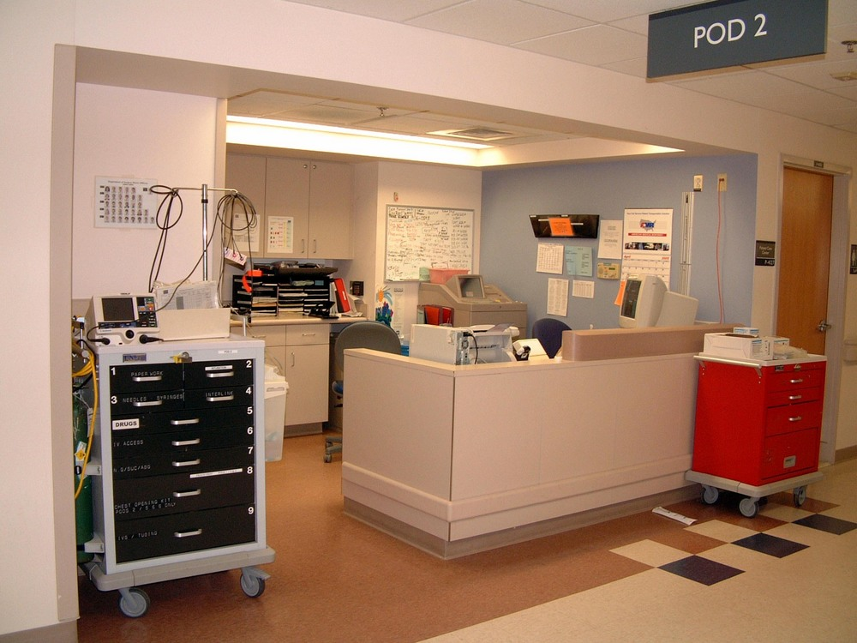
Crash Cart Menu
Notes:
There are 2 options under this menu. They are Enter/Edit Crash Cart Locations and Print Crash Cart Locations. Please note that this is not the option to use when replenishing a crash cart. You would use the On-Demand option to perform that task.

Slide 58
Select PHARMACY AOU STOCK AREA OF USE (AOU): ??
Crash Cart Menu
1 CRASH CART 2C SURGICAL CLINIC
3 CRASH CART DAYBED
4 CRASH CART DIABETIC CLINIC
5 CRASH CART ICU (MICU)
2 CRASH CART 3A
Notes:
Let’s start by choosing, enter/edit crash cart locations. This option allows users to enter or edit the location field for AOUs that are flagged as having crash carts. Entering two question marks will let you see the designated hospital locations that have already been set up at your site. We have 5 crash cart locations listed in our example.

Slide 59
Crash Cart Menu
CHOOSE 1-5: 5 CRASH CART ICU (MICU)
CRASH CART LOCATION: MICU// URGENT CARE
Notes:
After selecting a location, you have the opportunity to change the crash cart location after the two back slashes. We chose crash cart number 5 which then displays that it’s location is in the MICU. It is here where you could reassign the location. In our example, we changed the crash cart location from the MICU to URGENT CARE.
Use this to rename the cart if one ward/clinic no longer needs a crash cart and it needs to be reassigned to another area of use.

Slide 60
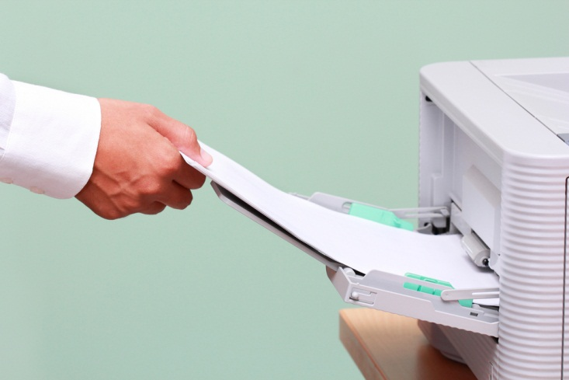
Crash Cart Menu
Notes:
The print crash cart locations selection will print a report listing all AOUs that have a crash cart assigned to their location.
Some sites may use this report when assigning crash cart inspections to staff members.

Slide 61
CRASH CART LOCATION LIST PAGE: 1 PRINTED: JUN 17,2010 CRASH CART LOCATION
------------------------------------------------------------- 3A NHCU 3A NHC 3C 3C MED-X 4A NHCU 4A NHCU-X
CRASH CART ICU 1 (MICU) MICU CRASH CART ICU 2 SICU
Notes:
Here is an example of the Print Crash Cart location list report. It lists the date printed, the crash cart name and the assigned hospital location.

Slide 62
Poll Question
The OR brings back a case of Lactated Ringers 1000ml that has expired. What menu option would you use to record this event?
Enter/Edit quantity dispensed
Delete Inventory Date/Time
Not possible to document
Return Items for AOU
Notes:
Now I’d like to ask a poll question.
The OR brings back a case of Lactated Ringers 1000ml that has expired. What menu option would you use to record this event?
Enter/Edit quantity dispensed
Delete Inventory Date/Time
Not possible to document
Return Items for AOU
(usually presenters read the poll question and acknowledge that the possible answers are on the screen)
To answer this question, use the blue polling icon above my head. We’ll move on and come back to your results in just a moment.
[erase these notes and add your own!]

Slide 63
Production Menu
Inventory Sheet Print
Single AOU Inventory Print
Delete Inventory Date/Time
Input AOU Inventory
Pick List
Enter/Edit Quantity Dispensed
On-Demand Requests
Backorder Requests
Return Items for AOU
Crash Cart Menu
Auto Replenishment Repots
Auto Replenishment Reports
Notes:
We will now review the auto replenishment reports. Please remember that not all reports are used at every site.
As we mentioned before, these reports may be printed for a single AOU, several AOUs, or you may enter up-carat A L L to print the report for all Areas of Use. You can also enter the letter I if you want to select an Inventory Group. Inventory groups are locally defined and typically include a group of 2 or more AOUs.

Slide 64
Poll Results
The OR brings back a case of Lactated Ringers 1000ml that has expired. What menu option would you use to record this event?
Enter/Edit quantity dispensed
Delete Inventory Date/Time
Not possible
Return Items for AOU
Notes:
Now let’s pause for a moment and take a look at your poll results.
The OR brings back a case of Lactated Ringers 1000ml that has expired. What menu option would you use to record this event?
A. Enter/Edit quantity dispensed
B. Delete Inventory Date/Time
C. Not possible using the ARWS menu
D. Return Items for AOU
The correct answer is Return Items for AOU. And I see that most of you had that correct.
Ad-lib to the audience results, then advance to move on.

Slide 65
Auto Replenishment Reports
List Stock Items
Expiration Date Report
Ward/AOU List for an Item
Item Activity Inquiry
Percentage Stock On Hand
Returns Analysis Report Usage Report for an Item
Zero Usage Report
Notes:
Let’s see. Here comes our waiter again and he has the dessert menu to offer us. Here we have all the Auto Replenishment Reports. This is what you have been waiting for, the sweetest part of the menu. This is where we get all that delectable data to track and trend.
The current options on the Auto Replenishment Reports menu are:
List Stock Items
Expiration Date Report
Inventory Outline
Ward/AOU List for an Item
Item Activity Inquiry
Percentage Stock On Hand
Returns Analysis Report
Usage Report for an Item
Zero Usage Report

Slide 66
List Stock Items
Notes:
The first report to review is List Stock Items. This report allows you to print the items listed as active stock for an AOU.
Here we have a lot of medications and we need to know where in our facilities we can find them.

Slide 67
List Stock Items
(Enter 'A' or 'I'): A
Select PHARMACY AOU STOCK AREA OF USE (AOU): 4C
Notes:
The list stock items report prints a list of all items currently available for inventory for an AOU or inventory group. In our example, we entered the letter A for Area of Use and then selected the AOU of 4C.

Slide 68
List Stock Items
You may print by either of these sorting methods:
Do you want to select AOU(s) or an Inventory Group?
(1)
By TYPE/
LOCATION /ITEM
(2) Alphabetical by ITEM
Notes:
The report may be printed by two different sort order methods. The first is sorting by TYPE/LOCATION/ITEM. This will generate an AOU stock list sorted by type, for example, oral or injection, and within type by location such as SHELF 1 or DRAWER 2. The second sort option is to generate the stock list in alphabetical order by item. This option generates a list of all items, in alphabetical order, for the selected AOUs.

Slide 69
List Stock Items
Select SORT ORDER for report (enter 1 or 2):
You may queue the report to print at a later time.
DEVICE:
Requested Start Time: NOW//T@1400
Notes:
After selecting the sort order for the report, enter the device number of the printer to which you are printing. The requested start time has a default of now. Hit enter for the report to print now or you can enter the time that you want the report to begin printing. In our example, we want to print the report today at 2PM so we entered T@1400.

Slide 70
List Stock Items
AOU STOCK LIST BY TYPE/LOCATION - DATE: Today PAGE: 1
AREA OF USE
TYPE MINIMUM QTY EXPIRATION
LOCATION ITEM STOCK LEVEL REORDER LEVEL TO DISPENSE DATE
---------------------------------------------------------------------------------------------4C MED ROOM 1 TYPE: EXTERNALS
MR,CA,S1 BACITRACIN 1OZ 3 1 2 Dec02,1993
MR,CA,S1 CLOTRIMAZOLE 1% CREAM 4 1 2 DEC 02,1993
MR,CA,S1 HYDROCORTISONE 1% CREAM 30G 4 2 2 AUG 13,1993
MR,CA,S2 DOMOL BATH & SHOWER OIL 8 2 6 DEC 02,1993
MR,CA,S2 HEXACHLOROPHENE DET. 5OZ 6 1 6 NOT LISTED
MR,CA,S2 HYDROGEN PEROXIDE SOLN 480ML 2 1 1 NOV 05,1993
MR,CA,S2 ISOPROPYL ALCOHOL 70% 480ML 6 1 6 DEC 02,1993
MR,CD,S3 BENZOIN COMP TINCT 1 NOT LISTED NOT LISTED
MED ROOM 1 TYPE: EXTERNALS
MR, CA, 91 BACITRACIN 1oz 3 1 2 Dec 2, 1993
Notes:
This is an example of the report that will be generated when sorted By TYPE/LOCATION/ITEM. You can see that the list starts with the type of medication which, here, is externals. Then the locations are listed and within those locations the meds are listed alphabetically. The information displayed for each stock item includes: AOU 4C
Item TYPE (for the report sorted by TYPE/LOCATION/ITEM) Externals, Location MR,CA, S1, item: bacitracin oint
Current Stock Level 3
Current Reorder Level 1
Current Minimum Quantity to Dispense 2
and Expiration Date Dec 02, 1993

Slide 71
List Stock Items
PHABETICAL LISTING OF AOU STOCK - DATE: TODAY PAGE: 1
AREA OF USE
MINIMUM QTY EXPIRATION
ITEM TYPE LOCATION STOCK LEVEL REORDER LEVEL TO DISPENSE DATE
---------------------------------------------------------------------------------------------------------------------
==>4C MED ROOM 1
ACETAMINOPHEN 500MG/15CC ELIX. MR,CC,S2 2 1 1 DEC 02,1993
ACETAMINOPHEN SUPP 650MG MR,REF,S2 12 1 6 DNOT LISTED
ACETAMINOPHEN MR,CC,S4 50 10 25 DEC 02,1993
ACETONE NOT LISTED 10 5 5 DEC 02,1993
ALUM.& MAG. HYDROXIDE GEL MR,CC,S3 6 2 6 DEC 02,1993
ASPIRIN SUPP 650MG MR,REF,S2 12 1 6 NOT LISTED
ATROPINE SULFATE INJ 0.4MG/ML,20ML MR,CC,S1 3 2 1
BACITRACIN OINTMENT 1OZ MR,CA,S1 3 1 2 DEC 02,1993
BECLOMETHASONE ORAL.INHALER 16.8GM MR,CC,S5 6 1 5
BENZOIN COMP TINC MR,CD,S3 1 NOT LISTED NOT LISTED
BLEOMYCIN INJ 15 UNIT NOT LISTED 3 1 2
BUSULFAN TAB 2M MR,B2,S1 10 5 5
CASTOR OIL 60ML U.D. MR,CC,S2 2 1
CHLORAMBUCIL TAB 2MG MR,CA,S3 5 1
ACETAMINOPHEN MR, CC, 94 50 10 25 Dec 2, 1993
Notes:
Here is the same example of the list stock item report, but it is generated for an alphabetical sort by item.
The same information is displayed just in a different view.

Slide 72
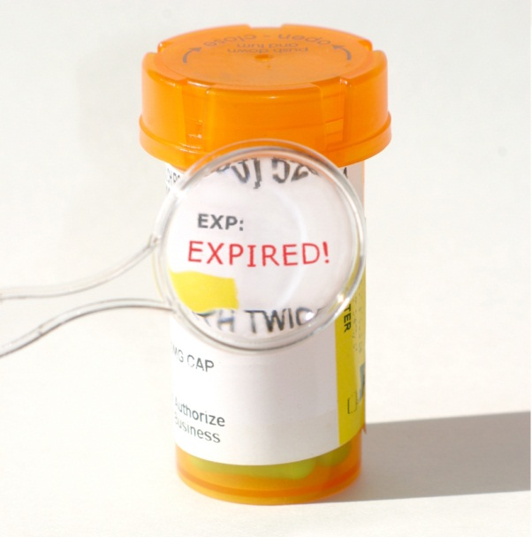
Expiration Date Report
Notes:
The next report we will look at will be the Expiration Date Report. You would run this report to track expiration dates for a given time, a particular AOU or for an inventory group. For this report to run correctly, expiration dates must be entered and kept updated for the AOU or inventory groups involved. Since many sites use Automated Dispensing Cabinets to manage ward stock on the wards and clinics, you may not use this report very often.

Slide 73
Expiration Date Report
BEGINNING date for report: t-90
(MAR 18, 2010)
ENDING date for report: t+90
(SEP 14, 2010)
Notes:
The first thing you need to do is set the date range for the report. In the example shown, we went back 90 days from our current date by entering the letter T for today minus 90. We did this just in case there was an expired medication that may have been missed or the correct date was not entered. We chose an ending date of 90 days from our current date by entering T plus 90. Our site routinely runs this report for our crash carts. Since it is not always the same staff member updating a returned crash cart, running the report monthly will ensure timely replacement of expired medications.

Slide 74
Select PHARMACY AOU STOCK AREA OF USE (AOU): ??
Expiration Date Report
BRAVO CLINIC
ALPHA CLINIC
CRASH CART 3A
CRASH CART 3C
Notes:
We entered two question marks so we would get a display of all the AOUs at our example facility.
Choose from:

Slide 75
Select AOU INVENTORY GROUP NAME:??
Expiration Date Report
MONDAY
WEDNESDAY
FRIDAY
Notes:
We have entered 2 question marks to see all the inventory groups. Your site may have inventory groups set up that could include several AOU’s grouped together into a single inventory group. For example, the Monday inventory group could be set up to contain multiple wards.

Slide 76
Expiration Date Report
Select PHARMACY AOU STOCK AREA OF USE (AOU):CRASH CART 3A
Select PHARMACY AOU STOCK AREA OF USE (AOU):
DEVICE:
You may queue the report to print at a later time.
Notes:
In this example, we picked the crash cart 3A as our AOU. Notice that at this point, you can select more than one AOU. If you have chosen multiple AOUs, you will be prompted to select a sort order for the report in one of the two formats:
Date/Drug/AOU or (2) Date/AOU/Drug
For easier review of expiration dates, it is recommended that you run the report for a single AOU.

Slide 77
Expiration Date Report
DRUG EXPIRATION DATE REPORT PAGE 1
FOR CRASH CART 3A
FOR PERIOD MAR 18,2010 TO SEP 14,2010
PRINTED JUN 16,2010@13:12
=> DATE
ITEM
---------------
=> JUN 30,2010
PROCAINAMIDE 100MG/ML (10ML) INJ
=> JUL 30,2010
ATROPINE 0.1MG/ML, 10ML SYRINGE
NALOXONE 0.4MG/ML INJ
=> AUG 30,2010
AMIODARONE HCL 50MG/ML INJ,AMP,3ML
DEXTRAN 40 10%/DEXTROSE 5% 500ML
DEXTROSE 5% 250ML (PLASTIC) INJ
DOPAMINE 40MG/ML (5ML) INJ
=> JUN 30,2010
PROCAINAMIDE 100MG/ML (10ML) INJ
Notes:
This is an example of an expiration date report. As you can see, on this crash cart there is one medication that expires at the end of June, two medications at the end of July, and four medications that expire at the end of August. You can use this report to pull and replace the medications as per your site’s policies.

Slide 78
Ward/AOU List for Item
Notes:
The ward/AOU list for an item report is primarily used to locate the wards and areas of use that stock a selected item. This report could be useful in the event of a medication recall. You want to find out all locations where a particular medication is located, rather than physically going to every location.

Slide 79
Ward/AOU List for Item
Select Auto Replenishment Reports Option: WARD/AOU List for an Item
Select ITEM Name: ACETAMINOPHEN 325MG TAB
DEVICE:
Notes:
After selecting Ward/AOU list for an item, select the item name. We want to check where acetaminophen 325mg unit dose tablets are stocked. We typed in the item’s name and then will choose a printer device for our report.
If not found anywhere in an AOU or ward, replies this.
__________is not a Ward Stock/Auto Replenishment item

Slide 80
Ward/AOU List for Item
WARD/AOU LIST FOR AN ITEM DATE: JUN 14,2010
ITEM NAME
STOCK
WARD AREA OF USE LOCATION LEVEL
-------------------------------------------------------------------------------------------------------
==>ACETAMINOPHEN 325MG TAB U/D
N/A MOBILE CLINIC NOT LISTED 10
58A 58A OMNICELL NOT LISTED 200
59B 59B OMNICELL NOT LISTED 150
Notes:
The report prints out the item name, the ward, Area of Use, location, and stock level of the item. If an area of use stocks the item, but the AOU is not associated with a ward, for example, the mobile clinic, then these areas will be printed at the top of the report. This will be followed by those AOUs which are associated with a ward.

Slide 81
Item Activity Inquiry
Notes:
The Item Activity Inquiry option will display all activity, such as, inventories, on-demands, and returns for a specified item in a specified AOU for a specified date range. This can be used for many reasons, one being to track and trend an item or items activity for drug accountability. Sometimes we need to put on the investigator hat to figure out where items are going. This report is very helpful to see what, when, and where the medications are being dispensed.

Slide 82
Item Activity Inquiry
Select Auto Replenishment Reports Option: Item Activity Inquiry (80 column)
This option will list all activity for a specified item, in a specified area of use, for a specified date range.
Notes:
The nice thing about using these reports, as soon as you pick your report, you will get a message that tells you exactly what the specific report will do.

Slide 83
Item Activity Inquiry
BEGINNING date for report: T-30 (JUL 10, 2010)
ENDING date for report: T (AUG 09, 2010)
Select AOU: ER
Notes:
To begin running the item activity inquiry, select the beginning and ending dates for the report. We want to look at the last 30 days.
Next, select the AOU for which you want to see the item activity.

Slide 84
Item Activity Inquiry
Select ITEM: KETOR
You may queue the report to print at a later time.
DEVICE:
KETOROLAC TROMETHAMINE 30MG/ML
Notes:
Choose the item. In our example, we have chosen to view the activity of the drug ketorolac in the ER for the last 30 days. Finally, select your printer at the device prompt.

Slide 85
Item Activity Inquiry
ITEM ACTIVITY INQUIRY for period JUL 10,2010 to AUG 9,2010 Page: 1
Printed AUG 9,2010@13:17
AOU : ER
ITEM: KETOROLAC TROMETHAMINE 30MG/ML
-------------------------------------------------------------------------------
INVENTORIES:
ID # - DATE/TIME FOR INVENTORY QUANTITY DISPENSED
RANGE **
** THERE IS NO INVENTORY DATA FOR THIS DATE
Notes:
The item activity inquiry report is broken down into 3 sections. The first activity shown is for any scheduled inventories that may have occurred. In our example, there is no inventory data for this date range since an automated dispensing cabinet is used in this AOU.

Slide 86
Item Activity Inquiry
ITEM ACTIVITY INQUIRY for period JUL 10,2010 to AUG 9,2010 Page: 2
Printed AUG 9,2010@13:17
AOU : ER
ITEM: KETOROLAC TROMETHAMINE 30MG/ML
-------------------------------------------------------------------------------
ON-DEMAND REQUESTS:
ON-DEMAND REQUEST DATE/TIME QUANTITY DISPENSED
JUL 21,2010 10
JUL 27,2010 10
AUG 3,2010 10
Notes:
The second section of the report tallies item activity from on-demand requests. In our example, you can see that a total of 30 vials of medication were dispensed on 3 different days for this AOU in the Emergency Room.

Slide 87
Item Activity Inquiry
ITEM ACTIVITY INQUIRY for period JUL 10,2010 to AUG 9,2010 Page: 3
Printed AUG 9,2010@13:21
AOU : ER
ITEM: KETOROLAC TROMETHAMINE 30MG/ML
-------------------------------------------------------------------------------
RETURNS:
RETURN DATE/TIME QUANTITY RETURNED
AUG 2,2010 2
Notes:
The third part of the report is for items returned to pharmacy. In this example, there were 2 vials of ketorolac returned to the pharmacy. If you run the Returns Analysis Report, you will be able to view the reason the item was returned.
And that is my segway into the …….

Slide 88
Returns Analysis Report
Notes:
The purpose of the returns analysis report is to show return data for selected date ranges and areas. The data includes the items returned, return dates, quantity returned and the reason for return.

Slide 89
Returns Analysis Report
Select Auto Replenishment Reports Option: Returns Analysis Report
BEGINNING date for report: 1 1 01 (JAN 01, 2001)
ENDING date for report: T (AUG 1, 2001)
Notes:
The returns analysis report may be printed for any date range you wish,

Slide 90
Returns Analysis Report
You may select a single AOU, several AOUs,
-OR
You may select an Inventory Group.
or enter "^ALL" to select all AOUs.
Notes:
and it may be printed for a single area of use, several areas of use, or for all areas.

Slide 91
Returns Analysis Report
Do you want to select AOU(s) or an Inventory Group? (Enter 'A' or 'I')=> A
Select PHARMACY AOU STOCK AREA OF USE (AOU): MED ROOM 2
Notes:
In this example, we are running the report for a single AOU which is med room 2.

Slide 92
Returns Analysis Report
RETURNS BREAKDOWN REPORT FROM JAN 1,2001 TO AUG 1,2001 PAGE 1
AREA OF USE DATE: AUG 1,2001@12:01
RETURN QUANTITY RETURN
ITEM DATE RETURNED REASON
------------------------------------------------------------------------------------------------------------
==> MED ROOM 2
-------------
ACETAMINOPHEN 325MG Jan 1,2001 10 EXPIRED
-------------
HEPARIN 1,000 UNIT/ML 10ML INJ Jan 1,2001
-------------
HETASTARCH INJ 6% 500ML Jan 1,2001
Notes:
Displayed is a list of medications returned from the selected AOU during our specified time period. Each medication returned is listed along with the return date, quantity, and reason it is returned to the pharmacy. By generating this report based on a selected AOU, the user may view what items are consistently being returned to the pharmacy. This will assist in knowing which items might need their stock levels reduced, thereby minimizing returns in the future.

Slide 93
Usage Report for an Item
Notes:
The Usage Report for an Item prints the AOUs selected, item or items selected, the date of inventory, total quantity dispensed, quantity dispensed by auto-replenishment, quantity dispensed by on-demand requests, and quantity returned.

Slide 94
Usage Report for an Item
a single item for one AOU,
a single item for ALL AOUs,
ALL items for one AOU, or
ALL items for ALL AOUs.
Notes:
Usage Report may be printed for:
After choosing Usage report for an item, your printing choices will be displayed. The report may be printed for a single item for a one AOU, a single item for all AOUs, all items for one AOU or all items for all AOUs.

Slide 95
Usage Report for an Item
Select PHARMCY AOU STOCK
AREA OF USE (AOU):
^ALL
Select ITEM:
^ALL
Notes:
To select all AOUs, enter up-carat A L L at the Select Pharmacy AOU Stock Area of Use prompt. To select all items , enter up-carat A L L at the Select Item prompt.

Slide 96
Usage Report for an Item
BEGINNING date for report: 8/1 (AUG 01, 2010)
ENDING date for report: 8/31 (AUG 31, 2010)
Select PHARMACY AOU STOCK AREA OF USE (AOU): 138A
DEVICE: (Enter print device name)
Select ITEM: ^ALL
Notes:
Enter the beginning and ending dates for the report. Select the desired AOU for the report and the item or items to be included. Finally, enter the print device name for the report. Our report is going to include all items from the month of August for the AOU, 138A.

Slide 97
Usage Report for an Item
USAGE REPORT FROM AUG 01,2010 TO AUG 31,2010 PAGE 1
AREA OF USE DATE: NOV 12,2010@16:09
ITEM DISPENSE QUANTITY
TOTAL AUTO REPL ON DEMAND RETURNS
-----------------------------------------------------------------------------------------------------------------
==> 138A
ALBUTEROL 3/IPRATROPIUM 0.5MG/3ML INH,UD 30 0 30 0
BISACODYL 10MG SUPP 50 0 50 0
INFLUENZA VACCINE (PF) SYRINGE, 0.5ML 10 0 10 0
INSULIN ASPART 100 UNITS/ML (NOVOLOG) 3 2 1 0
INSULIN GLARGINE HUMAN 100 UNITS/ML 4 4 0 0
INSULIN MIXED NPH & REGULAR 70/30 3 3 0 0
INSULIN NPH HUMAN 100 UNITS/ML 6 5 1 0
PROCHLORPERAZINE 25MG SUPP 12 12
TUBERCULIN, PPD 5 TU/0.1ML (1ML) 1
INSULIN REGULAR HUMAN 100 UNITS/ML 3 2 1 0
Notes:
This is an example of a Usage Report for all items on a single AOU. For each item, it shows the total dispensed quantity, the quantity dispensed as auto replenishment, the quantity dispensed as on-demand and the quantity returned.
So if you are continually seeing a large number of on-demand requests for a particular medication, you may need to adjust your stock levels.

Slide 98
Zero Usage Report
Notes:
The Zero Usage Report prints all items with no usage for a specified time frame. This is to track items that appear on a stock list for an AOU but have never been dispensed or not dispensed in a specified length of time.
It is important to look at these items. Here we have an electric meter. You wouldn’t plug in all your appliances on before going on vacation – you’d be wasting money. So why would we leave medication with no usage in our areas of use? It’s just not the best practice. With this report, you can locate those items.

Slide 99
Zero Usage Report
BEGINNING date for report: 8/1 (AUG 01, 2010)
ENDING date for report: 8/31 (AUG 31, 2010)
You may select a single AOU, several AOUs,
or enter "^ALL" to select all AOUs.
-OR-You may select an Inventory Group
Notes:
Enter the beginning and ending date for the report. Identify whether you want to select an AOU or inventory group and then select the specific one.

Slide 100
Zero Usage Report
Do you want to select AOU(s) or an Inventory Group?
(Enter 'A' or 'I'): A
DEVICE: (Enter print device name)
Select PHARMACY AOU STOCK AREA OF USE (AOU): ^ALL
Notes:
In our example, we want to check zero usage for all AOUs, so we chose the letter A for AOU and then up-carat A L L for the report to include all areas. Finally, enter the print device name for the report.

Slide 101
Zero Usage Report
ITEMS WITH ZERO USAGE FROM AUG 1,2010 TO AUG 31,2010 PAGE 1
AREA OF USE DATE: SEP 9,2010@09:08
NO USAGE FOR: DATE LAST DISPENSED:
--------------------------------------------------------------------------------
==> W3A
** ADM SET PRIMARY IV V1443 Luerlock FEB 6,2010
ADM SET, ALARIS BLOOD #72980E SEP 2,2010
** ALCOHOL, 70% ISOPROPYL RUBBING TOP BT FEB 18,2010
ALUMINUM HYDROXIDE GEL 320MG/5ML SUSP JUL 18,2010
D5/0.45% NACL 1000ML JUN 27,2010
D5W 1000ML
For each "*" printed, 90 days have passed from the
date item was last dispensed to current date.
** D5/LACTATED RINGERS 1000ML FEB 16,2010
Notes:
This is an example of the Zero Usage Report. It identifies, by AOU, each item with no usage and the Last Dispensed Date for that Item. For each asterisk printed preceding the item name, 90 days have passed from the date the item was last dispensed to the current date.

Slide 102
Summary
Notes:
You have now completed the Production Menu module. You should now understand that Automatic Replenishment/Ward Stock is a method of drug distribution and inventory management . Each VA pharmacy has adapted the Production Menu to meet their specific needs. Some of the menu options and reports may not be used at your facility due to the varying requirements of your particular pharmacy. With the advent of Automated Dispensing Cabinets (ADC), many sites have changed the process to manage ward/clinic drug inventories and therefore are utilizing the Production Menu in a different way.
VA pharmacies are improving their ability to account for non-controlled medications to reduce the risk of waste and diversion. Many of the Auto Replenishment Reports can be utilized to bring about improvements in drug accountability. To attain these goals, pharmacy personnel must accurately and consistently record these drug transactions in VISTA using the Production Menu. The pharmacy technician has a great responsibility in entering this data to ensure reports are accurate. This training will enhance your competencies to provide for greater drug accountability and medication inventory management.

Slide 103
Ask the Presenter
Notes:
(This must be your last slide.)
If you haven’t submitted your questions yet, there is still time to do so by clicking on the orange “Ask The Presenter” icon. We’re going to show a brief announcement and be right back to answer your questions.
(Stand still and smile until you see the video come up full screen)
[erase these notes and add your own!]

