Slide 1
Transitions of Care
Expanding the Safety Net
Donna Vogel RN, MSN, CCM
Erica Zimmerman RN, BSN
Notes:
Thank you (moderator name)! I am happy to be here today to talk about (subject).
I am an RN Care Managers working on high performing PACT teams in my NJ CBOC.

Slide 2
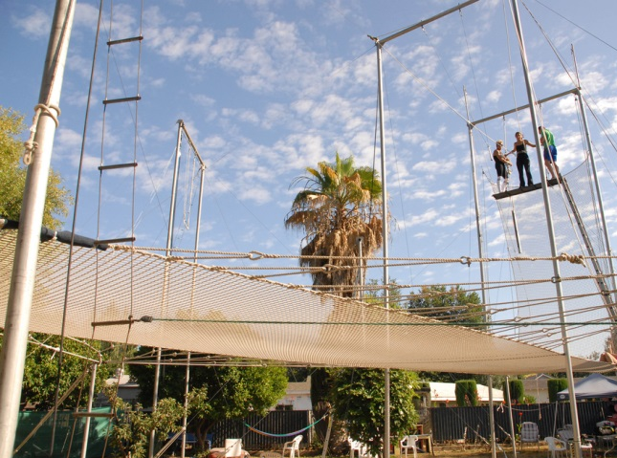
Transitions of Care Expand the Safety Net
Notes:
Transitions of Care
Expanding the safety net a metaphor for transitions
Looking at this image we have concerns about risk of harm. During transitions there are many risks for harm.
Transitions are a vulnerable time and place our patients at risk.
Ineffective Care Transitions adversely influence patient safety.
Effective Transitions of care have been identified as a high priority to ensure patient safety
The VA has joined with The Joint Commission, and other professional healthcare agencies, to improve patient safety during transitions of care.
The PACT Model of Care, with its patient centered, multidisciplinary team approach, expands the patients’ safety net along the continuum of care.
The RN Care manager has a pivotal role in assuring the Veteran receives coordinated quality care.
This module will provide information on specific measures RN Care Managers, Case Managers, and other members of the PACT interdisciplinary team can perform to maintain high standards of care to our Veterans as their healthcare needs change along the continuum of care.

Slide 3
Transitions of Care
The term “care transitions” refers to the movement patients make between health care practitioners and settings as their condition and care needs change during the course of a chronic or acute illness.
Eric Coleman MD, MPH
Notes:
The term “care transitions” refers to the movement patients make between healthcare practitioners and settings as their condition and care needs change during the course of a chronic or acute illness.

Slide 4
Patient Aligned Care Team (PACT)
Access
Offer same day appointments
Increase shared medical appointments
Increase non-appointment care
Care Management & Coordination
Focus on high-risk pts:
  Identify
  Manage
  Coordinate
Improve care for:
  Prevention
  Chronic disease
Improve transitions between PACT and:
  Inpatient
  Specialty
  Broader Team
Practice Redesign
Redesign team:
  Roles
  Tasks
Enhance:
  Communication
  Teamwork
Improve Processes:
  Visit work
  Non-visit work
Patient Centeredness: Mindset and Tools
Improvement: Systems Redesign, VA TAMMCS
Resources: Technology, Staff, Space, Community
Notes:
The RN Care Manager has a crucial role in improving transitions of care .
In the center, here we see Care Management and Coordination as one of the three PACT Pillars. Transitions of Care is a major part of the center pillar.
Smoothing transitions could result in
improving quality of care,
improving patient satisfaction,
Improving access to primary team and specialty care by minimizing the needs for post-hospitalization visits

Slide 5

Notes:
Patient Aligned Care team
PACT helps us to develop A partnership between healthcare team and Veterans
You can tell your patients, “This is our PACT with you —
to deliver excellence in every aspect of patient care”
Guiding and assisting our Veterans through Transitions of Care is an important part of our partnership.

Slide 6
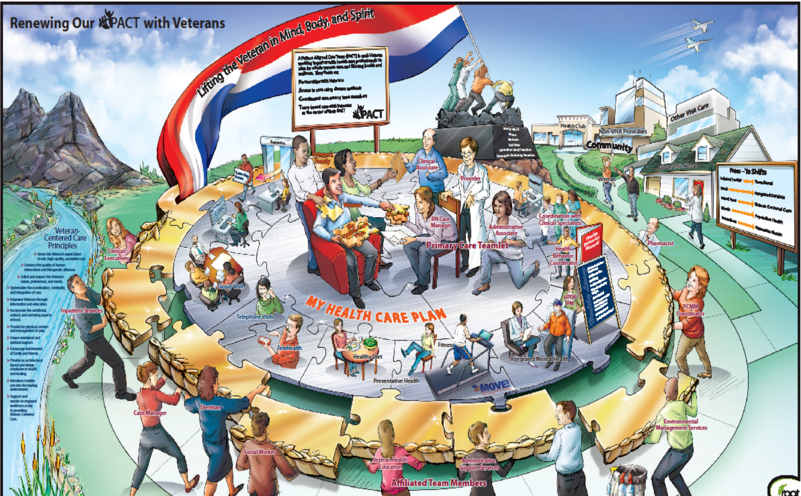
The PACT Team
Notes:
Here is the entire PACT team
The RN Care Manager and Primary Care Teamlet is shown in the center of this picture having direct contact with the patient and their personal support of caregivers. Encircling the PACT Teamlet and veteran are extended care team members who support and coordinate care to optimize the Veterans Health and well being.
The role of the RN Care Manager requires interactions between the PACT Team and the many resources that extends across the VA healthcare system and into the community.
Care Coordination is the overarching goal of PACT, in which all participants in the delivery of health services work cooperatively as a cohesive unit, facilitating access to care and improving each patient’s health by providing the right care in the right place at the right time. This is a shared responsibility of all involved to engage the patient in shared decision-making and the cooperative exchange of information, expertise and data to ensure smooth transitions and prevent that burden from being placed solely on the patient.
The role of the RN Care Manager requires interactions between the PACT Team and the variety of resources that extends across the VA healthcare system and into the community.
One of the first recommendations that I recommend to a new RN Care Manager is to know how to easily contact VA staff and community resources. Investigate your facility’s Intranet to discover easy online access to Staff directories, Translation Services, and local policies. Develop your own quick access tool for frequent contacts to include local community resources.

Slide 7

Poll Question
What is your role?
    RN Care Manager
    Provider
    LPN
    Case Manger
    Administrative
    Other
Notes:
Now I’d like to ask a poll question.
What is your role?
RN Care Manager
Provider
LPN
Case Manager
Administrative
Other
To answer this question, use the blue polling icon above my head. We’ll move on and come back to your results in just a moment.

Slide 8
PACT Teamlet
Notes:
Now, let’s focus in closer to the PACT Teamlet as the center of a very busy team that includes extended team members and community resources. The RN Care Manager will maintain a connection as patients’ condition and care needs change. To become informed partners in the health care plan, patient and caregivers need individualized support and education to provide them with the needed skills.
Relationship based care, as pictured, is repeated for each patient on the Team’s Primary Care Panel
The RN Care manager and PACT Teamlet will work to optimize the health and well being of all patients on their Primary Care Management Module or PCMM panel. Most people generally refer to the Teamlet ‘s assigned patients as “their panel” of patients.
Managing and planning the care of your panel of patients requires team work as well as the support and resources of the VA and local community..
Health Care planning …correlates with new strategic goals

Slide 9
A Partnership with Veterans
Personalized
Proactive
Patient Centered Health Care
Notes:
A goal as an RN Care Manager is to make a Partnership with the Veteran:
Personalized, Proactive, Patient driven health care
The Patient Aligned Care Team is part of the VA’s Transformational Initiatives to provide a coordinated system of care, based on relationships, where the tools and support are provided to patients and caregivers to optimize health and well being.
Think about the RN Care Manager’s role of safely guiding patients through transitions of care as we watch a short video from Dr. Tracy Gaudet, Director, VHA office of Patient Centered Care and Cultural Transformation.

Slide 10
Video Clip

Slide 11

Care that is based on relationships
Notes:
Key Take Away Points:
Know the Veteran’s Mission for life and health
Develop a personalized health plan
Provide Training and skill Building
Support is needed for success
Care based on relationships helps to establish the trust and open lines of communication for Veterans and caregivers to provide more information which results in a more personalized Care plan.
Know what is important to the Veteran.
As Dr. Gaudet has noted – “To be mission ready for their lives”
Personal needs are an important consideration in a personalized healthcare plan.
Ask - What really matters to the Veteran? What do they want their health for in their life plan
It is important to Personalized care also includes cultural and linguistic competency.
Use translators as per your facility policy.
Every transition is potentially a cultural exchange.
Knowledge of a patient’s cultural values is an important part of Care Planning especially during transitions.
Ask your patient if there are cultural consideration that the healthcare team needs to be aware of to optimize a personalized healthcare plan.
For instance In New York, a healthcare plan for a Puerto Rican patient had to consider the cultural importance of a diet of rice and beans. Some religions follow dietary restrictions. Ask
Ask the patient how they prefer to receive healthcare education.
When providing education to provide skill building and training it is important to note if English is a second language or if there are literacy concerns.

Slide 12
Poll Results
What is your role?
  RN Care Manager
  Provider
  LPN
  Case Manager
  Administrative
  Other
Notes:
Now let’s pause for a moment and take a look at your poll results.
Ad-lib to the audience results, then advance to move on.

Slide 13
Poll Results
  RN Care Manager
  Provider
  LPN
  Case Manager
  Administrative
  Other
Notes:
(Cue to Tech Team that you’re moving on) “Click” again to move on

Slide 14
Care Transitions
PACT Teamlet
ER
Other Hospital-Based Care
Long-Term Care
Specialty
Clinic
Non-VA Dual Care
Patient’s Care Needs
Within Settings
Between Settings
Across health states
Notes:
The patient is the center of the care transition
Inpatient to Outpatient
Collaborative working relationships
Communication
Outpatient to Specialty
Service agreements for consultation, including non face-to-face consultation
Education and partnering with specialists
communication
Outpatient and Dual Care
Accurate & timely communication with teamlet
Between Medical Centers contact VA Referral Case Manager or Travel Veteran coordinator
Clarify what patient wishes are – who will manage what

Slide 15
Care Transitions Between Healthcare Settings
Hospital
Sub Acute Facility
Ambulatory
Clinic
Senior Center
Hospital
Home
Notes:
This slide shows you examples of: Care Transitions Between Healthcare Settings
As patients move from setting and/or states of health care this is called the continuum of care.
Note that multi directions as patients can travel to multiple healthcare sites.
Each Transfer represents change and is opportunity for continuity of care or a threat to patient safety.
Example of what a PACT RN Care manager may be doing in ambulatory care setting will complete assessment and Geriatric Extended Care Consult (GECC) in CPRS. Adult Day care is a popular option in addition to assistance in the home. The RN Care manger will coordinate the transition of care with the SW.

Slide 16
Care Transitions Within Healthcare Settings
Primary Care
Specialty Care
Inpatient ICU
Ward
ED
Primary Care
Notes:
This slide shows examples of Transitions Within Healthcare Setting
The RN Care Manager will play a pivotal role as the patient transitions from Primary Care to Specialty Care
It is important to Review consults to check that the prerequisite tests are completed. For instance Most Cardiology consults include a recent ECG, Orthopedics specific X-Rays. Specific lab tests.
Mammography consults must have complete patient information.
Mammography may be completed outside of a VA facility.
Always follow –up on results
After consult to specialty care are completed review consult to update care plan
Emergency care may not be provided at a VA hospital—this may be a non VA ER visit
Follow-up on patients that require emergency care

Slide 17
Care Transitions Across Health States
Curative Care
Palliative Care/Hospice
Personal Residence
Assisted Living
Notes:
This slide shows Care transitions across health states
The RN Care manager continues to Care and modify Care plan.
The second half of this presentation will be specific information on coordinating complex medical care needs with a Case Manager

Slide 18
A Unique Transition…
Military Healthcare to VA
Notes:
A transition that goes to the heart of the VA’s mission. Military Healthcare to VA
Quote VA Mission.
VHA Mission
To honor America’s Veterans by providing exceptional healthcare that improves health and well being.
The RN care manger and members of the Patient Aligned Care Team (PACT) need to know how to care for the basic needs of post-deployed Veterans, as well as how to access more advanced resources and services for Veterans with more complex needs. Some facilities have PACT specialty teams for OEF/OIF/OND that can also offer resources. Some of our audience may work on these specialty PACT teams. Community Based Outpatient Clinics or CBOCs may provide primary care due to travel distance to main facility. RN Care Managers will need to know who to contact and coordinate care for OEF/OIF/OND Veterans on the Team panel.
The above logo for OEF/OIF/OND is the icon on our NJ VA Intranet that directly connects to the OEF/OIF/OND Program’s home page. Here we find immediate contact information to access the Program Manager, Case Managers, and all support staff. A full menu of resources is available – these include support groups, links to benefits and other information specific to our newest Veterans.
Know how to reference local community resources. State, county and local governments offer Veteran assistance programs. PACT Social Workers can also assist.
Make a “Favorites” list for easy reference.

Slide 19
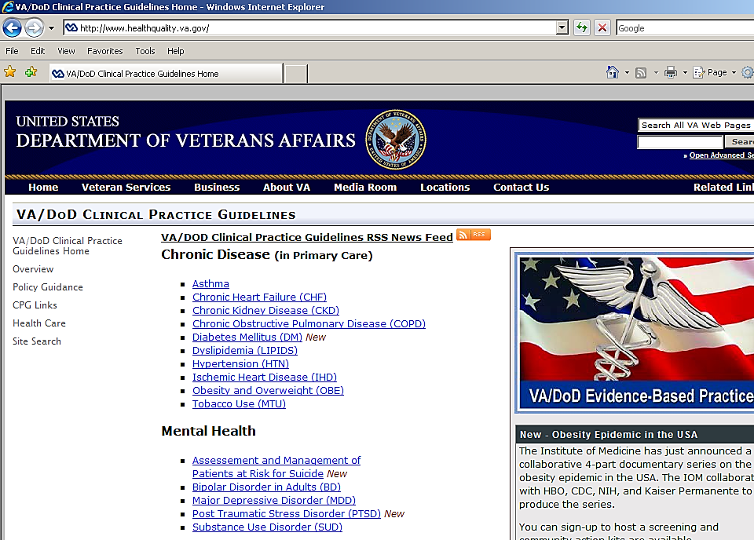
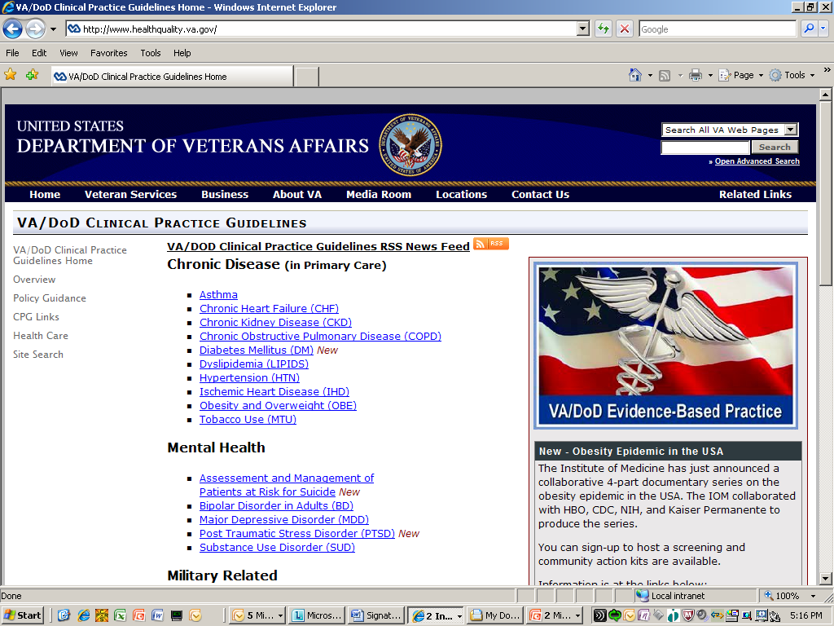
Notes:
Following VA/DOD Clinical Practice Guidelines improves transition from Military Health Care to VA healthcare. Awareness of the guidelines allows the RN to be informed and fully participate as a team members and patient advocate.

Slide 20
Notes:
Please use as a refer to this website for further information and use as a reference when planning care

Slide 21

Dual Care
Notes:
Dual Care is a unique aspect of VA health care and presents a continual need to monitor changes in the Veterans healthcare plan.
VA has national policies on Dual Care .
VA has national policies on Dual Care to coordinate health care for Veterans seen by both VA providers and community providers.
“ It is VHA policy to ensure that the care of Veterans receiving Dual Care is well coordinated, safe, documented, and appropriate, and the autonomy and responsibility of VA providers are respected.”
Many Veterans live in communities that are a distance from VA medical centers and need a local Non-VA health care provider.
Some Veterans prefer to only use VA prescription benefits
Every visit has the potential to be a transition within Primary Care setting..
The RN Care manager, aware of HIPAA compliance, can assist the patient in keeping all healthcare providers informed of the Care Plan.

Slide 22
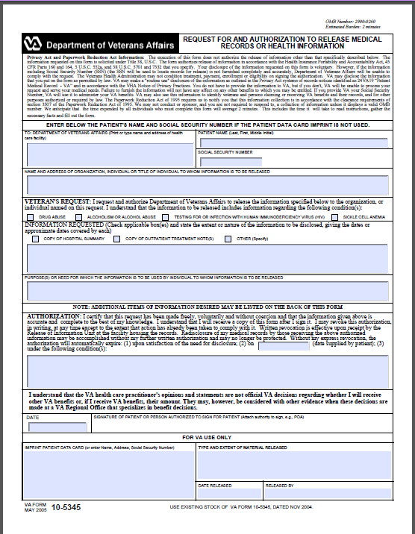
Notes:
VA Form 10-5345 Request for and Authorization to Release Medical Records or Health Information.
Highlighted areas must be completed to state purpose of request for medical records (Continuity of Care) and meet HIPAA requirements. Remember to add request for immunization history to update VA immunization records.
Available online at VA Forms and MyHealtheVet)
We will include pdf files in our reference section that you can keep on your desktop for ready access.
RN may delegate obtaining ROI to other members of the PACT team.
Follow Privacy policies
As a team, consider keeping a list of local non-VA health care facilities with telephone and fax numbers of the medical records department.
As an incentive, remind patients that community hospitals may charge the patient by the page for copies of healthcare notes. Agency to agency is no charge. So Veteran can have records sent directly to clinic or VA medical records.
Be sure to include your facility fax # for rapid response from medical records

Slide 23
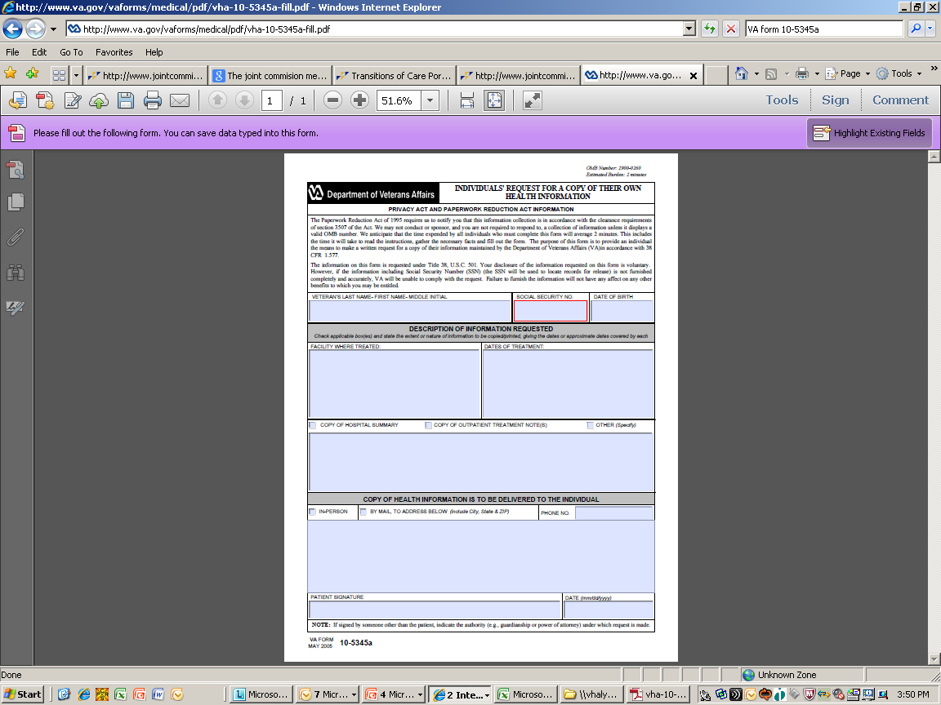
Notes:
VA Form 10-5345a Individuals' Request for A Copy OF Their Own Health information
Veteran can share VA information with their non-VA provider.
This release of information form is processed by the medical records department.
Check with your facility for contact information and local regulations. Add this information to your “Favorite Contacts”.
This form is part of the MyHealtheVet registration, In Person Authentification (IPA) packet.
This feature empowers the Veteran and streamlines the process of information sharing between providers!
You can access these from our reference handout by clicking on the green download button.

Slide 24


Access to personal health information
Notes:
MyHealtheVet improves Transitions of Care
Allows ACTIVE Veteran actively participate in Transitions of Care
The Veteran can click on the Blue button--
The VA Blue Button enhances Veteran access to personal health information from their own VA Electronic Health Record and other key data sources to foster patient engagement, encourage activation, and support patient-centered care.
Veterans who are registered and completed “In Person Authentication” may independently access some of their health records to improve transitions from VA to Non VA health care providers.
Open notes since January 2013, Problem list, Chemistry and Hematology, pathology and radiology reports, and admission/discharge summaries.

Slide 25
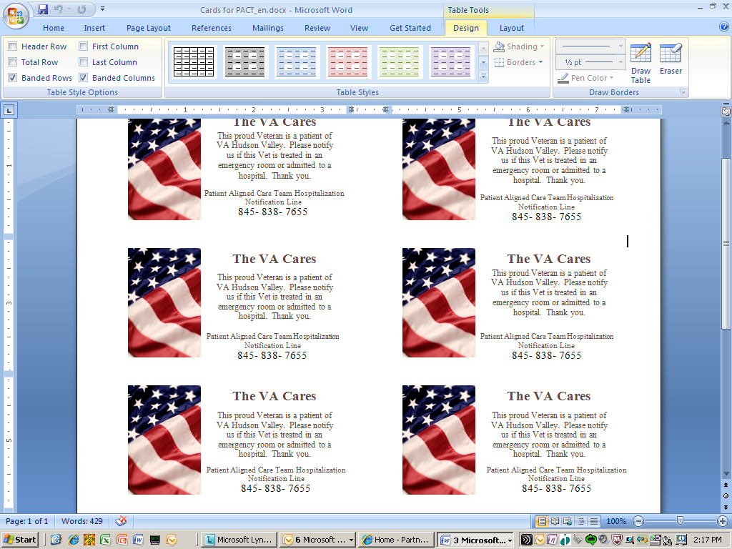
Notes:
The Veteran’s Active involvement in their healthcare plan helps to smooth Dual Care transitions.
Discuss the patient’s role in advance so that IF an unplanned transition of care such as Non-VA emergency care or hospitalization occurs the Veteran will be able to advise care providers at the Non-VA facility to contact VA healthcare.
Here is an example of an information card given to Veterans at VA Hudson Valley, New York that assists in keeping the PACT team informed of a patient's transition to a non-VA healthcare facility.
At our clinic all Veterans receive a tri-fold pamphlet about PACT that includes important telephone numbers and an open invitation to call their team.
Check to see if your facility has a standardized method of communication.

Slide 26
Elements of Safe Transitions
Medication Management/Reconciliation
Transition Planning
Information Transfer
Shared Accountability
Patient and Family Engagement/Education
Healthcare Provider Engagement
Follow-up Care
Notes:
Here are the 7 Elements of a safe transition – The safety net to keep our patients safe from harm
Every time a patient transitions these element must be addressed
1. Medications Management - Ensuring the safe use of medications by patients and their families and based on patients’ plans of care
Development and implementation of a plan for medications management as part of the patient’s overall plan of care
2. Transition Planning -A formal process that facilitates the safe transition of patients from one level of care to another including home or from one practitioner to another
3. Patient and Family Engagement / Education
Education and counseling of patients and families to enhance their active participation in their own care including informed decision making.
4. Information Transfer - Sharing of important care information among patient, family, caregiver and healthcare providers in a timely and effective manner.
5. Follow-Up Care - Facilitating the safe transition of patients from one level of care or provider to another through effective follow-up care activities.
6. Healthcare Provider Engagement -Demonstrating ownership, responsibility and accountability for the care of the patient and family/caregiver at all times.
7. Shared Accountability across Providers and Organizations - Both the healthcare provider (or organization) initiating the transition as the sender and the one receiving the patient have accountability for safe transitions.l

Slide 27
Medication Reconciliation Steps
1
Obtain medication information from patient, caregiver, and/family
2
Compare to medication information in medical record.
3
Communicate, provide education to patient, caregiver, and/or family on medication reconciliation
4
Communicate Medication Reconciliation with the healthcare team(s). Include pharmacist.
Address discrepancies, update chart
Notes:
Medication reconciliation is a National Patient Safety Goal “Accurately and completely reconcile medications across the continuum of care”. At VA NJ we carry a small copy of the NPSG’s on our ID holder.
Medication reconciliation is defined as “The process of identifying the most accurate list of all medications that the patient is taking, including name, dosage, frequency and route, but comparing the medical record to an external list of medications obtained from a patient, hospital or other provider.
Medication reconciliation is a multi-step process that requires teamwork!
-The patient’s list of medications is reviewed
-Patient or care giver participates in review ( This step checks to see if Patient may be taking a different dose than noted on list)
-Note any identified Medication discrepancies with CPRS/VistA
-Medication discrepancies are addressed Include the PACT Pharmacist when possible and remember it is the responsibility of the Provider to complete Reconciliation and update medication list
-The patient is provided with an updated list Discharge Summary = Patient Instructions Med List
-The RN and other team members help to develop list and review. Communication skills are used to assess patients’ proper medication administration and usage. Use open ended questions and interview skills. Follow the 5 rights – Right patient name (check name on prescription bottle, right drug, right dose, right time, and right route.
-Explain the importance of managing meds to the patient/caregiver.
Have patient verbalize medication instructions. Have the patient explain the parameters for PRN medication
Example: “Just to be clear, tell me how you will take your medications starting tomorrow”
Repeat education and verbalization until correct.

Slide 28

Include the Veteran and the Caregiver
Notes:
Remember to ask if the veteran has support with healthcare while at home.
“Caregiver” is a general term that takes into consideration that many people outside of a Veteran’s family may support the veteran’s healthcare needs at home.
They are an important link in assuring a smooth transition of care.
Many Veterans rely on friends, neighbors, or other relationships outside of their family to help with personal medical care.
Using the term caregiver opens up the conversation to include a important partner.

Slide 29

Use open-ended questions
Notes:
Previous episodes of RN Boot Camp encouraged the use of effective communication techniques through Motivational Interviewing and TEACH for Success. These communications skills can be used effectively in all aspects of patient care.
Open ended questions gives the patient an opportunity to provide more information that can assist with accurate medication reconciliation.
Many patients are not taking medications as ordered. Some may try to self manage side effects. Financial concerns may delay refills due to co-pay obligations.
Compare these two methods of interviewing a patient –
Do you have any questions about your medication (YES or NO question)
vs.
Can you please tell me about the medications you are taking? (OPEN ENDED question)
Using open ended questions allowed an RN Care manager to note that Insulin was not verbalized. Using open ended questioned allowed a non- judgmental atmosphere where the veteran admitted not taking insulin as prescribed due to problems with refrigeration when traveling. A teachable moment - found to be eligible for Flex pen

Slide 30
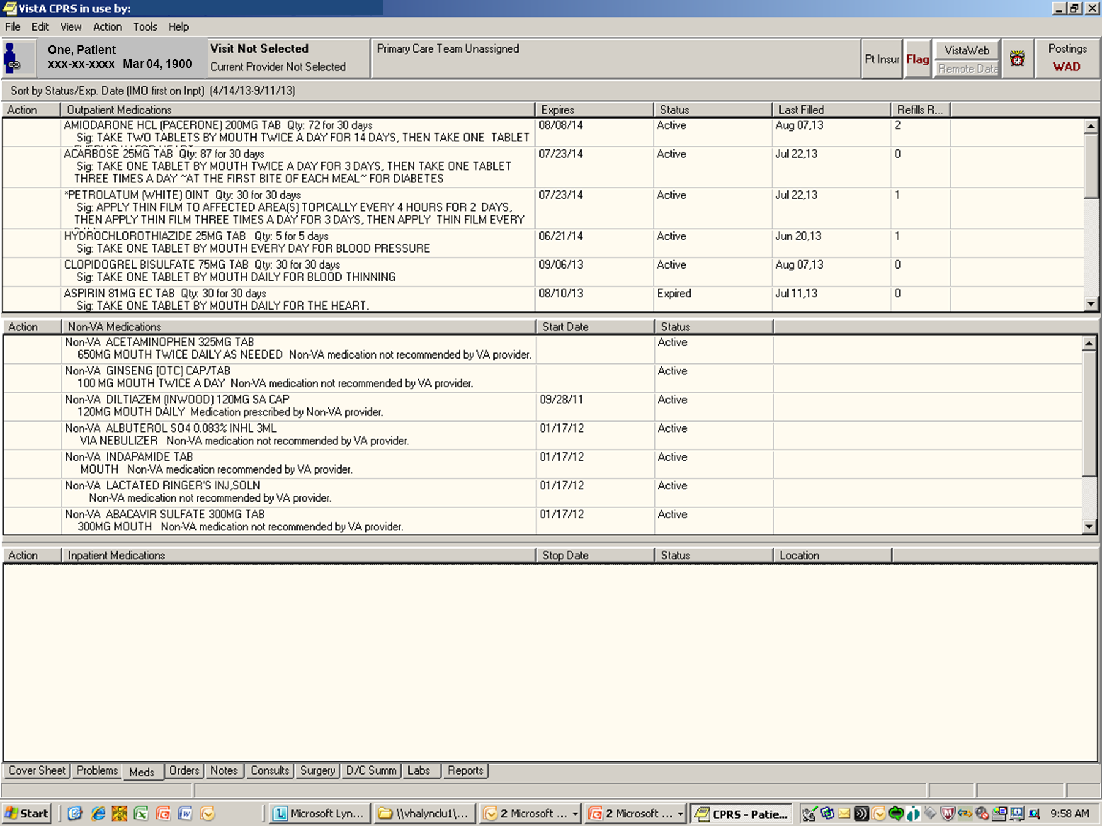
Notes:
Screen shot from CPRS medications tab
Review Non VA Medications
Use open ended questions to find out what OTC medications the patient uses for self care. Examples might be OTC pain relievers or antacids. Many of these medications can be contraindicated with their prescribed medications. Many Veterans may take Acetaminophen for pain then unknowingly take an OTC cold remedy that contains Acetaminophen causing a double dose.Many of these medications can be contraindicated with their prescribed medications.
Herbal or natural supplements are often considered to be harmless by patients but can have serious interactions.
Your PACT pharmacist is a great resource to assist with OTC and Natural supplements.
Note VistaWeb in upper right corner
Remember to check VistaWeb Remote Data for coordination of care between VA healthcare.

Slide 31
Notes:
Check all active and expired medications.
Use open ended questions to ask about expired medication
Check further on medications that have not been refilled on schedule.

Slide 32
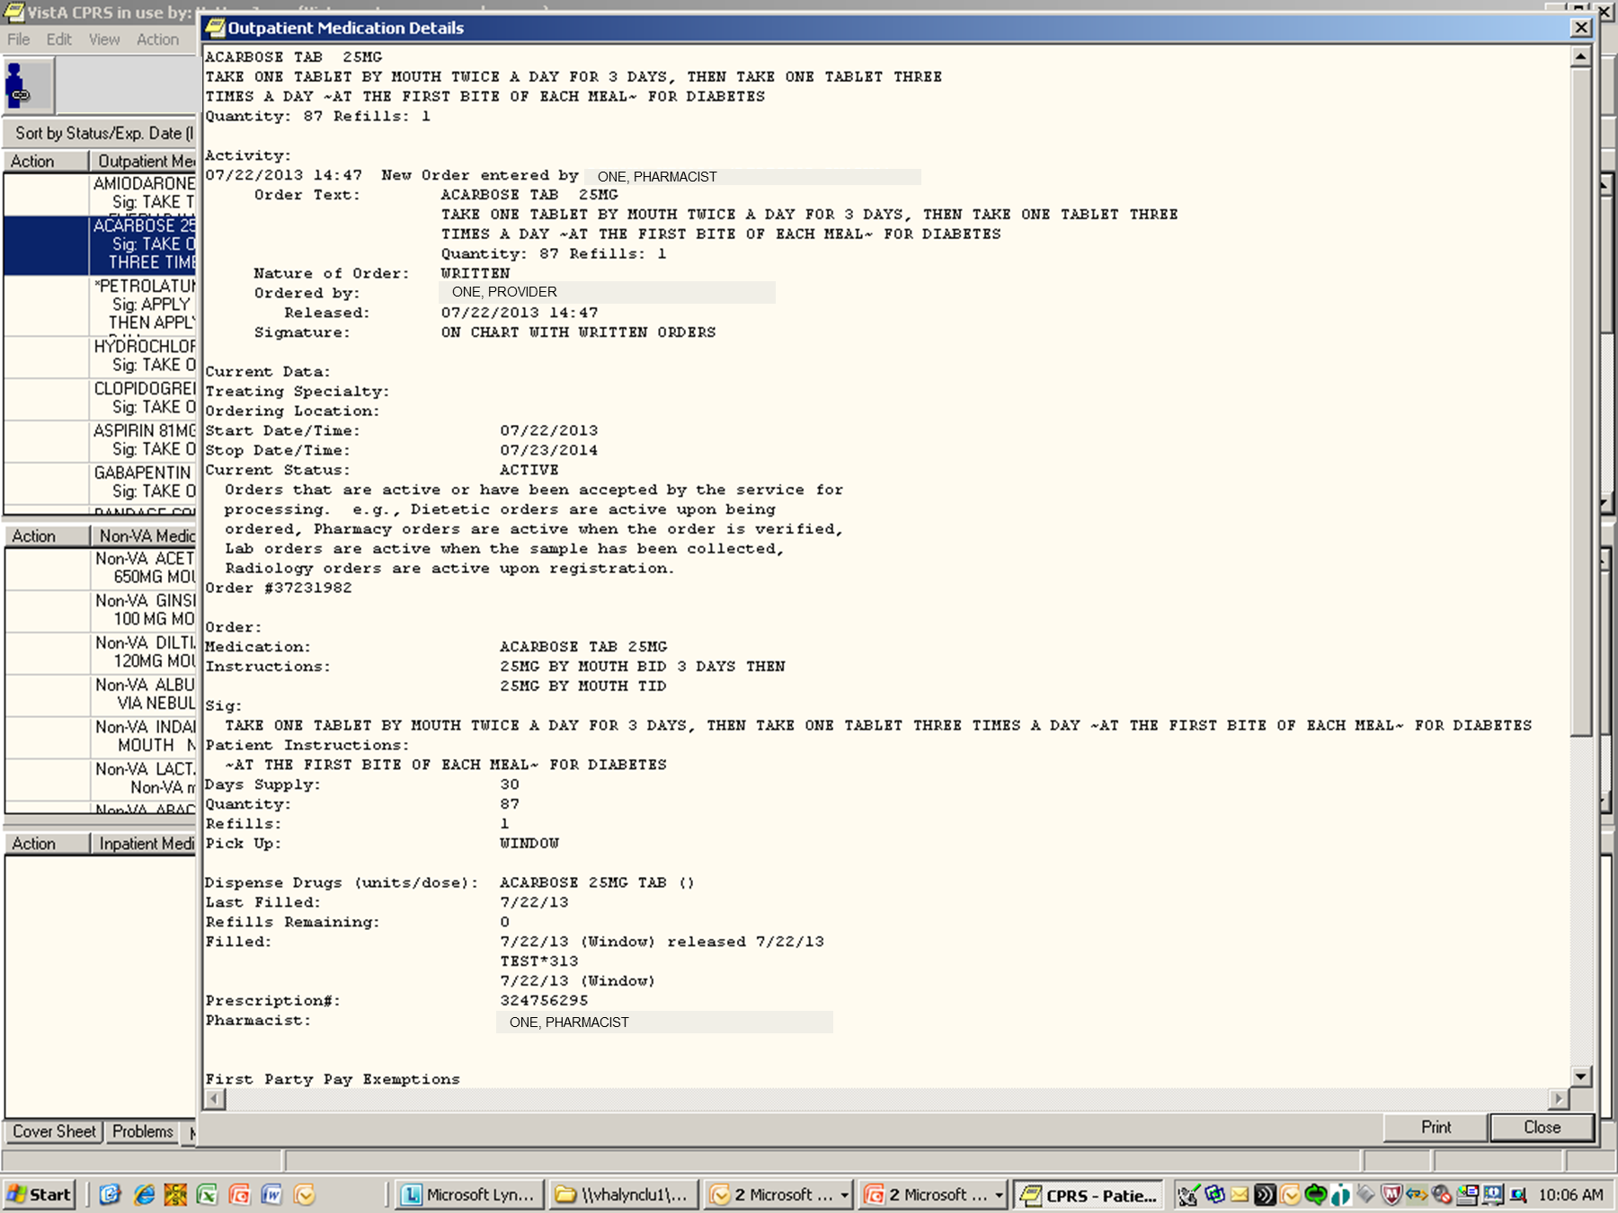
Notes:
Ask the patient how they are taking the medication to check if instructions are understood. Any discrepancy needs to be addressed and reconciled.
Some patients may only remember the first dose instructions and not increase after three days = wrong dose
Another example: An elderly patient took insulin at bedtime as directed but was found to take at irregular hours after late night TV. Reconciliation occurred after patient was instructed to take insulin at the same time every evening when the 10pm news came on.

Slide 33

Communicate updates and medication reconciliation to Healthcare team and Patient
Notes:
Effective Communication is Critical throughout the reconciliation process
Include the pharmacist in the reconciliation process
Provider will complete medication reconciliation.
Share the new updated information with other members of healthcare team, provide new medication list to patient and caregiver. Advise that new list with changes be shared by the veteran with Dual Care providers or obtain ROI

Slide 34

Communicate updated medication list with the patient and caregiver
Notes:
Consult with your PACT Pharmacist for assistance with medication management. Check if your facility has pocket medication cards for the veteran to carry to each medical appointment. Be sure that pocket cards are updated too. Check to see if you can order med minder pill boxes to assist Veterans with medication schedule.

Slide 35

80%
Notes:
Hand-off Communications
According to The Joint Commission Center for Transforming Healthcare
80 percent of serious medical errors involve miscommunication between caregivers when patients are transferred or handed-off.
Effective Communication is essential to maintain a safe and effective transition at all points of care.
Health care organizations have identified patient safety problems during the process of passing necessary and critical information about a patient from one caregiver to the next, or from one team of caregivers to another.
Safe and effective care is dependent upon effective communication between care givers. Hand off communication is part of a safe transition.

Slide 36

Hand off Communication
Complete
Clear
Brief
Timely
Notes:
Hand-Off Communication is Complete, Clear, Brief, and Timely
What remains is COMMUNICATION between a sender and a receiver
Sender communicates accurate, pertinent, critical information to receiver in a timely manner. Provide details of patient status . Identify and emphasize critical information
Receiver expects to get timely critical information to safely care for the patient. Use critical thinking to ask questions - note contact information of sender in case follow-up questions develop later.
Clear understanding of role & responsibilities ( i.e. who follow-ups on pending tests or post discharge needs)
The PACT model relies on the active participation of the RN Care manager.
For accurate and complete information - utilize tools of the electronic health record to include Medication list, problem list, progress note, lab and test results.
Use a standardized checklist - many facilities use SBAR

Slide 37
Hand off Communication
Situation
Background
Assessment
Recommendation
Notes:
SBAR is used in NJ and many other locations. Some use a facility approved check list.
Know what standardized communication tool your facility uses.
Situation – What is the situation?
Background – What is clinical background or circumstances leading to situation?
Assessment – What do I think is the problem
Recommendation – what do I recommend be done to correct problem?

Slide 38

Case Study
Situation, Background, Assessment, Recommendation
Notes:
Give example of how a case was presented when Emergency Services responded to a 911 call from the CBOC
Situation – While waiting for his 8:30 am appointment with Diabetic Educator, Veteran became lethargic, slumped in chair, responded with slow slurred speech. Too lethargic to give large oral glucose tabs. No IV available in CBOC
Background –Known Diabetic patient, family member reported he took insulin this morning but did not eat breakfast due to concerns about having high blood sugar at appointment. Vital signs - Finger stick glucose 32
Assessment – Critical Value Hypoglycemia Rapid response needed.
Recommendation – 911 Emergency Medical Services notified for emergency care to include IV therapy and transport to hospital.
I want to point out that National Patient Safety Goal “Improve the Effectiveness of Communication among Caregivers” requires a written procedure for reporting “Critical Values”. When communicating critical values Always ask for a read back!
Know your facility’s policy
I encourage you to think of an example from their own practice that they could place into the SBAR format for a safe and effective transfer

Slide 39

Hand off Communication
Notes:
Communication
Include information on Transitions of Care Team in Team Huddles and Care Planning Meetings.
By sharing information, everyone on the team assists in developing an optimal care plan.
Extended team members are included as appropriate to optimize healthcare.

Slide 40
Two Day Contact Post Discharge
Notes:
Once the Veteran returns home from the hospital, changes made to medications and treatment plans can be overwhelming to patients and care givers.
The RN Care manger will call within two days after discharge to re-establish communication with Primary Care Team and facilitate safe transition along the continuum of care. Many facilities have an approved template for the post discharge note. Follow local Policy and Procedures for guidance before delegating as this is an assessment and may not be in the LPN scope of practice.
Review discharge instructions, medication list, plan and coordinate follow-up appointment with primary care and specialty care. Does the discharge plan include any new medical equipment? As the RN Care manager you might consider if a home safety evaluation is indicated and initiate a consult. A telehealth consult can also be initiated as determined by the RN Care manager.
Be aware of language or literacy barriers that might limit understanding of written D/C instructions.
- Make sure the Veteran can verbalize - What symptoms need to be reported?
Who should they call if there is a problem?
Use open ended questions or teach back to assess Veteran’s understanding of instructions.
Effective communication tools can elicit important information from the Veteran or Care giver to include in the patient centered care plan.
A home telehealth consult can help to monitor BP, glucose, or weights. Patients and caregivers will appreciate the continuing connection to a healthcare professional from their home. Consider how much better a transition from Hospital to home would be if a small weight gain was detected by home telehealth before any symptoms of CHF exacerbation occurred.
Telehealth has a PCCM metrics: have 1.6% or more of your panel of patients participating in Home telehealth.

Slide 41
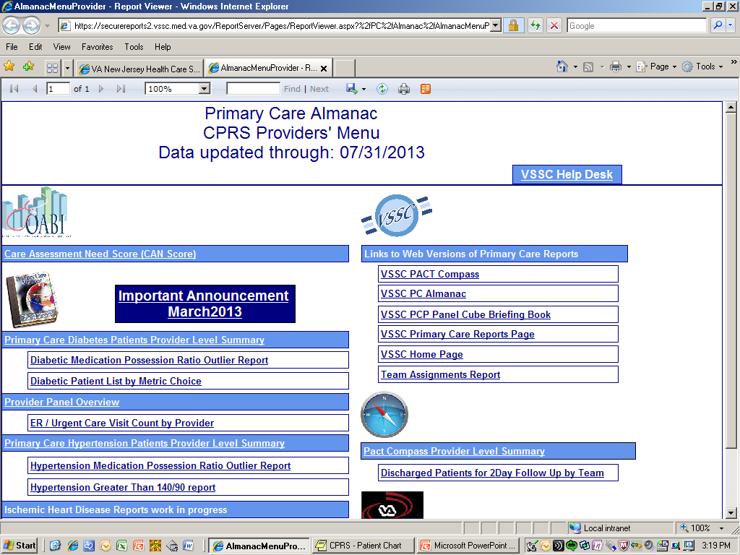
Notes:
In the CPRS under the Tools bar you can link to the PC Almanac
– Almanac notification of discharges from VA facility.
This should be Checked daily – May be a delegated task to other members of team
Update times vary by facility ask informatics or CAC contact
Vista also has discharge report by facility not specific to PACT team
CPRS alert also available
Encourage Dual Care patients to notify VA if admitted or discharged from a non-VA hospital. Educating the patient and caregiver and encouraging a contact with the PACT teamlet will help with transitions.
Follow your metrics in the PACT Compass. The Benchmark for the 2 day post discharge contact is ≥ 75% for 2 Day Contact post discharge ratio VHA d/c
A call made on the day of discharge will not be included in data for metric.

Slide 42

Notes:
Patients and caregivers need help to continue safe care at home
They will welcome your call and appreciate your assistance with care coordination. This post discharge contact is reassuring when patients and caregivers feel overwhelmed. A smooth transition from inpatient care to primary care can reduce hospital readmissions and improve post hospital care.
The PACT model of Care provides an ongoing relationship between the Primary Care team and the patient.

Slide 43

Case Manager
Some Transitions require a specialist
Notes:
As we discuss hospitalization and Community resources for specialized care the RN Care manager has a partner with the RN Case manger.
So let’s Hand -Over this discussion to Donna Vogel RN, a certified Case manger for the specific and specialized role of CaSe Managers.

Slide 44


Case Manager
The PACT Team
Notes:
As Erica explained, the Case Manager is part of the larger healthcare team. And it is the Case Manager that will coordinate the Veterans very complex and specialized needs with the appropriate VA and non-VA community programs and services.
Case Managers have a specialized role and specialized training. The Case Management Society of America (often referred to as CMSA), defines case management as “a collaborative process of assessment, planning, facilitation, care coordination, evaluation, and advocacy for options and services to meet an individual’s and family’s comprehensive health needs through communication and available resources to promote quality, cost-effective outcomes”.
In addition, there are established Standards of Practice for case management professionals. These can be found on the CMSA website – www.cmsa.org. You should visit the site if you do not already refer to it.

Slide 45
Team Huddle
Notes:
In the team huddle and Care Planning meeting, the RN Care Manager can delegate to other members of the team including the generalist or the specialist case manger.

Slide 46
CARE MANAGER
CASE MANAGER
Notes:
The care and case manager roles are separate and distinct but there is some overlap as they work together to ensure continuity of care and patient safety during transitions. It is only through good communication and understanding of each other’s distinct roles that they avoid duplication of services.
As mentioned earlier, the role of the care manger is unique to PACT nursing. But it takes the unique training, education, and expertise of the entire healthcare team to meet the Veterans comprehensive care needs.
During Transitions of Care, the Case manager has specialized training to collaborate with the Care Manager to ensure a timely and safe transition - and continuity of care.

Slide 47

Care Management
Notes:
It is important to understand Care Management. Care Management is the oversight and management of a comprehensive health care plan for an individual patient or cohort of patients. It is the process by which components of the patient’s health care (including their self-care needs, interactions with the healthcare team and the healthcare system), are assessed, analyzed, and coordinated to optimize patients’ well-being.
Care Management links patients with needed services, resources, and opportunities across the continuum - this includes linking patients to both both VA and non-VA services. It is when the continuing care needs are complex that the Care Manager will delegate to the Case Manager to develop or manage a Veteran’s comprehensive health care plan.

Slide 48
CARE MANAGER
PACT Teamlet RN
Continuous care
Intensity varies
May delegate to another team member
Generalist nursing care for all patients on team panel
Notes:
The Care Manager is responsible for (point to slide) working closely with the PACT teamlet and is the generalist nurse resource for all patients on the team panel. The care manager’s involvement is continuous – although the intensity of involvement will vary. And it is the care manager who delegates – as appropriate - to other team members.
So the care manager would be responsible for:
Day to day care coordination
Reporting Abnormal Findings and Patient Problems
Accepting phone calls from home health agencies
Coordinating uncomplicated transitions
Obtaining medical records from outside facilities and outside providers (remember, she or he may delegate this to other staff)
She or he is also responsible for:
Following up on Veterans discharged from the inpatient setting
Coordinating referrals to various clinics – for example Coumadin clinic
Completing uncomplicated referrals to home health agencies
Completing consults and referrals for DME, Home Oxygen, and to HBPC or HT
The Care Manager also coordinates appointments and can order medication refills

Slide 49
CASE MANAGER
RN or MSW Specialist
Follows a subset of more complex patients
Duration and Intensity of care varies
Does not delegate Communicates with RN Care Manager on regular basis
Notes:
The Case Manager is often an RN or social worker with specialized training and follows a subset of complex patients. The duration of time that they follow the patient and the intensity of case management services will vary depending on the patients needs. The case manager does not delegate to other members of the team. He or she is in close communicate with the Care Manager, and knows to hand-over care back to Care Manager once intensive case management services are no longer needed.
So the Case Manager would be responsible for managing:
The Veterans with complex medical or psychosocial needs – or both.
Veterans undergoing Complicated transitions – moving out of state, transitioning from DoD to VA
Veterans In Contract Nursing Homes
Veterans with a history of Non-Compliance
Veterans needing Palliative Care, Home or Community Hospice, and who have End of Life needs
Veterans who meet eligibility for services on alternative care programs - including Homemaker, Home Health Aide, ADC and Respite programs
The case manager would also manage Veterans requiring other community based services on Non VA Care Coordination program – (now referred to as ‘NVCC’ care; and previously referred to as ‘Fee services’).
The case manager is also often responsible for managing Veterans who require Home Infusion, those that have difficulty with transportation, and those that need Vocational Rehabilitation services.

Slide 50

Case Management
Notes:
Case Management can be viewed as a specialized component of Care Management.
It is needed when a Veterans continuing care needs require a more intensive level of support and monitoring. This includes when a Veterans continuing care needs involve complex medical, mental health or psychosocial factors that are beyond what the core team can provide.
Remember - Case Management is a specialized, collaborative service, to assist with highly complex situations beyond the level normally offered by the primary care core team.

Slide 51
Case Management
Practice Across the Continuum
Inpatient
Outpatient
Notes:
Case Management Practice spans the continuum of care.
When you consider Case Management practice across the continuum, there are differences between inpatient and outpatient processes and patient care needs. There are also differences in how the needs should be managed and who should manage the patient-specific care needs.
Some of the differences are:
Case Management practice and interventions can be either Episodic or Continuum-based.
Some case management requires a Specialist Case Manager. A specialist case manager covers a very specific population or episodic event such as managing a returning combat Veteran, a traveling Veteran, managing a Veteran with an exacerbation of their chronic disease, surgical case coordination, or a patient on HT.
At other times, the practice and interventions can be met by a generalist case manager in PC. This generalist case manager - who often follows the patient through the continuum - refers patients to home and community based programs, coordinates services on NVCC program, can provide telephonic case management for certain chronic disease states that need close monitoring and follow up, and may coordinate within state travel for the Veteran. The Generalist case manager refers to and collaborates with a Specialist case manager as needed.
And Case Management can be inpatient focused or outpatient focused.
Inpatient focused would include:
Acute care, sub-acute care, inpatient rehabilitation, and inpatient extended care and long term care.
Outpatient may include:
Case Management of Chronic Disease Populations
Primary Care, Specialty Care, Geriatric and Extended Care services, Mental Health and Special Populations
Specialty Care populations would include: cardiology, cancer care, liver and GI, ENT, Spinal Cord Injury and Diseases, TBI, Polytrauma, Visually Impaired; returning combat Veterans, Veterans with intensive mental health case management needs
It also includes the End-of-life and Hospice & Palliative Care population that I mentioned earlier
And patients on Home and Community Based Care at VA expense (which is the NVCC program that I mentioned).

Slide 52
Specialized Case Managers
Notes:
As experts in coordinating complex care needs, the Case Manager ensures coordination of care that is patient-centered and includes the patient and caregiver in addition to the interdisciplinary team.
The goal is to provide the right care, at the right time, in the right place and at the right cost – each and every time.
As mentioned earlier, case managers have specialized training that allows them to work as a Generalist (which I just spoke about), or as a Specialist case manager supporting a specialized area.
The Specialist Case Managers would be:
The Traveling Veteran Coordinator (often referred to as the TVC)
Operation Enduring Freedom/Operation Iraqi Freedom/ Operation New Dawn (usually referred to as OEF/OIF/OND) Case Managers
Cancer Care Coordinators
Home Telehealth Care Coordinators
NVCC Case Managers
ER Case Managers
Patient Flow/Bed Management Case Managers
Surgical Case Coordinators
Spinal Cord Injury and Disease Case Managers
Contract Nursing Home Program, Hospice & Palliative Care, and Home Based Primary Care Case Managers
And also Mental Health Intensive Case Management (most often referred to as ‘MHICM”) program staff

Slide 53

OEF/OIF/OND
Notes:
As mentioned, the OEF/OIF/OND population is a cohort of patients that requires specialized case managers that can best manage their care.
These specially trained case managers support the partnership between the VA and the Department of Defense (DOD) to transition the health care of severely ill and injured returning combat service members and Veterans from DOD to the VA health care system. These patients are eligible for various services not always available to other Veterans.
Many of these service members and Veterans suffer from multiple, complex health and mental health problems, including traumatic brain injury, amputations, burns, combat stress and post-traumatic stress disorder. The VA has dedicated programs and systems of care including Polytrauma/Traumatic Brain Injury, Spinal Cord Injury and Diseases, Visual Impairment, and Mental Health that provide specialized life-long clinical care and care management for these special cohorts of Veterans. Therefore, it is critical for each VA health care facility to have a process in place to ensure that the care of these service members and Veterans is well-coordinated, and that those who are severely injured and ill receive care management services from a specially trained nurse or social worker case manager.
In addition, some of these patients are followed in the Care Management Tracking and Reporting Application (this is referred to as CMTRA). This is an electronic database that provides the specially trained OEF-OIF-OND case managers a mechanism to identify and track severely injured and ill OEF/OIF/OND service members and Veterans.

Slide 54
Telehealth
Notes:
The VA is a leader in telehealth. The VA supports Home Telehealth, Clinical Store & Forward, and Clinical Video Teleconferencing technologies to provide Veterans the care they need - without having to travel long distances. For many Veterans, traveling is a hardship – for some Veterans it can be costly or painful; it can involve loss in work time, or it may be very inconvenient with our Veterans having to get someone to drive them to receive needed care.
Specialized Case Managers are responsible for managing patients on home telehealth technology.
Telehealth improves access to care and provides timely intervention; and telehealth can improve transitions in care.
In home messaging devices are available with disease management protocols to improve patients’ self-management of chronic disease states. Specially trained HT case managers can view patient data and responses to survey questions on a secure web site and are ‘alerted’ to out-of-range data. This allows for efficient and timely review of patients they are following.
Case Managers often arrange for Store and forward telehealth to prevent their patients from having to travel long distances. Store and Forward allows for storing of clinical information (including data, images, sound, and video). This is then forwarded to or retrieved by another site for clinical evaluation. The three areas where this is becoming commonplace in the VA are radiology, dermatology and teleretinal imaging for Veterans with diabetes.
And the 3rd modality, Video conferencing, allows for clinicians to have face-to-face encounters – clinicians can see facial expressions or can view the medication bottles that the Veteran is taking their medication from. In addition, video conferencing is very useful in providing patient education.

Slide 55
Non-VA Care Coordination
VA
Non-VA
Notes:
Veterans often require care on the NVCC program – the Non-VA Care Coordination program that I mentioned earlier.
We know that coordination of continuing care needs is essential to ensure safe and timely access to care. Often times NVCC care is needed to provide our Veterans with needed services. And as appropriate, the VA will pay.
After an inpatient hospital stay – whether in a VA or Non-VA facility, Veterans often require short term rehabilitation for skilled care including SN, Medical SW services, PT, OT, SP (this may include infusion therapy); or they transition to home with home care services for skilled care –again possibly infusion therapy, or for end of life or hospice care.
Veterans may also be at a community hospital at VA Pay – on NVCC program.
VA can pay for virtually anything a Veteran needs so long as it is related to a service-connected condition. This includes inpatient, outpatient, prescription, or long-term-care needs.
VA can pay for care for female Veterans who need inpatient care, services that are not available at the VA, or when receiving care at a VA facility is not feasible.
VA can also pay for non-service connected care under special circumstances.
The Veterans Millennium Health Care and Benefits Act was passed in November of 1999. This allows for reimbursement for emergency treatment and emergency inpatient care. The VA is authorized to pay reasonable emergency care costs for Veterans obtaining their principal health care from the VA – when:
The Veterans is enrolled in the VA; The Veteran was seen at a VA in the last 24 months; There is no third party liability; and Receiving care at a VA facility is not feasible.
In addition:
The ‘emergency’ needs to meet the prudent lay person’s definition of an emergency; and the Claim must be filed within (90) days including 90 days from death or after all attempts to collect from other insurance has been exhausted. The claim is paid to point the patient is stable unless transfer to the VA is requested.

Slide 56

Community Rehabilitation
Notes:
To transition Veterans to the most appropriate level of care, case managers refer to home and community based facilities and programs. This often includes referrals to rehabilitation facilities in the community when rehab services are not available at a VA facility.
These rehabilitation facilities may be for physical or behavioral health rehabilitation needs –including alcohol or drug addiction; and they may be inpatient or outpatient rehab centers.
The Care and Case Management teams collaborate and communicate to coordinate the Veteran’s care without the duplication of services.
Communication, Coordination, and Collaboration is key. This includes communicating, coordinating and collaborating with the patient and caregiver, with PACT and the interdisciplinary team, and with both VA and Non-VA providers.

Slide 57
Transportation
Notes:
Veterans may need to travel by ambulance, air ambulance, or chair car.
Coordinating transportation needs can be difficult – especially if trying to obtain a payer source.
Case Managers are often responsible for coordinating complex travel needs, and must adhere to VA travel regulations. This includes determining when VA is the payer and communicating travel responsibilities to both the referring and the accepting facilities.
Many Veterans are eligible for VA travel benefits. This would be for:
A Veteran who travels to or from a VA facility (or VA-authorized health care facility) in connection with treatment or care for a SC disability - this is regardless of the percent of their disability.
A Veteran with a SC disability that is rated at 30 percent or more and travels to or from a VA facility (or a VA-authorized facility), for examination, treatment, or care for any condition.
Also for Veterans who travels to a VA facility (or again, to a VA-authorized health care facility) for a scheduled compensation and pension examination.
Travel benefits would also be available to Veterans receiving VA pension, who travels to or from a VA facility (or VA-authorized facility) for examination, treatment, or care.

Slide 58

Traveling Veteran Coordinator
Notes:
VA has a directive and Coordinated Care Policy for Traveling Veterans.
In accordance with directive, every VA Facility has a TVC- a Traveling Veteran Coordinator.
The TVC position and the role are essential in transitioning complex care for Veterans who are traveling or moving out of state. Often these moves are over a great distance.
When a Veteran is planning travel or to relocate, the provider should notify the TVC at their facility. Then the TVC can contact the TVC at the future site of care to discuss the Veteran’s needs.
It is critical that appropriate members of the patient’s care team are included in the hand-over of care. The result will be a smooth transition to the new facility - with appointments and other services in place.

Slide 59

Hospice
Notes:
All enrolled Veterans are eligible for hospice care. This may be either inpatient hospice or home hospice services.
The VA utilizes community hospice agencies to provide the majority of hospice care for Veterans.
All VA facilities have a Palliative Care Consult Team as a resource for hospice and palliative care provided in the VA facility and coordinated in the community.
VA Hospice and Palliative Care is care in which the primary goal of treatment is comfort rather than cure in a person with an advanced disease that is life-limiting. (And a life-limiting illness is a disease or condition that is expected to significantly shorten an individuals’ life span).
VA Hospice Care can be provided to Veterans when:
The Veterans is diagnosed with a life-limiting illness, and
The Veteran has treatment goals focused on comfort rather than cure, and
The Veteran has a life expectancy (as deemed by a VA physician) to be 6 months or less if the disease runs its normal course. - And This requirement is consistent with the prognosis component of the Medicare hospice criteria.
And of course, the Veteran needs to accept hospice care.
Patients can and do stay on hospice longer than six months. As long as the hospice team continues to certify with supporting evidence that the patient is terminal, the VA – and also insurance companies will continue to pay for hospice care.
Patients can be on hospice for any diagnosis - if expected to be terminal. This includes cancer, end-stage heart - lung or liver disease, stroke, renal failure, Alzheimer’s or many other conditions.
Case Managers, in their role as strong patient advocates, may need to take a lead role in discussing hospice care with the provider. The literature shows that often times the medical team is slow to refer to hospice care – understandably, some are reluctant to document a prognosis of 6 months or less. And some may be overly optimistic that the treatment will be more effective than it is. As a result, patients may be referred to hospice in the very end-stages of their diseases - resulting in the hospice benefit being underutilized.

Slide 60

Team Work
Notes:
Teamwork is essential to ensure safe and timely transitions across the continuum for our Veterans.
We know that Teamwork improves communication and coordination of care; and this in turn improves provider efficiency and utilization of resources by avoiding duplication of services.
Remember to enjoy your team and celebrate the important work done in supporting our Veterans.

Slide 61

Notes:
Erica and I would like to make a special acknowledgement to our team members that worked on this presentation. Joan Vetter RN, MSN, ACRN PACT Educator and Gloria Satti-Langlois RN, CCM - Care Coordinator and Clinical Manager for NVCC Program. We want to thank them both for their expertise and contributions.

Slide 62

Ask the Presenter
Notes:
If you haven’t submitted your questions yet, there is still time to do so by clicking on the orange “Ask The Presenter” icon. We’re going to show a brief announcement and be right back to answer your questions.
(Stand still and smile until you see the video come up full screen)

