Slide 1
Care Management Prioritizing and Planning
Navigating the Data
Kathleen Beatty, RN, BSN
Tamara Box, PhD
Sheila Ford, MSN, RN, CNL
Notes:
Thank you Dawnell! I am happy to be here today to talk about using the data to help you be a great Care Manager.

Slide 2
VA Changing Roles
Pre-PACT | PACT
Reactive | Proactive
Unclear roles/responsibilities | Roles are clearly defined
No set goals/accountability | Set goals
No need to work to the top of one’s license/ability | A need to work to the top of one’s license/ability
Notes:
In the Spring of 2010, when PACT was rolled out, the roles of the new PACT teamlet became much more clearly defined. We all became much more proactive, and there were accountability measures – data endpoints - could be reviewed for the entire teamlet.
We were introduced to Dashboards and Compass Data; Almanacs and the Data Warehouse. We were all working together. I needed to rely on my “team” more than I ever had before-
Everyone took on new tasks in their new roles.

Slide 3

Staff Changes
Organized
Create New Policies & Agreements
Create electronic tools
Utilize available VA tools and data
Keep Focused
Notes:
At the VA NCHCS, where I work in a small outpatient clinic in Oakland, California – we’ve set up schedules to help us address all of the items we need to in a given day. Our AIM is to target the Veterans who need assistance the most, using new tools, providing input on clinic service and coordination agreements, and figuring out the best ways to work together with out coworkers to get everything done.
It’s been a busy, often challenging three years. We’ve had to learn to not only address the individual Veteran’s needs- but the needs of the entire 1200 Veteran panel.

Slide 4

Poll Question
How many PACT teamlet members who have created schedules to address their daily tasks find them helpful?
    I have created a schedule, and find it very helpful to keep on top of things.
    I have created a schedule, and find it somewhat helpful.
    I have created a schedule, but it’s impossible to stick to
    I have never created a schedule.
Notes:
Now I’d like to ask a poll question.
I’d like to ask this question of the audience- now, I’m not talking about a schedule of just Veteran appointments or calls, here- I’m talking about including tasks in the schedule- from data or chart reviews to meetings and follow ups- everything you try to get done during the day, the big picture-
How many PACT teamlet members who have created schedules to address their daily tasks find them helpful?
I have created a schedule, and find it very helpful to keep on top of things.
I have created a schedule, and find it somewhat helpful.
I have created a schedule, but it’s impossible to stick to
I have never created a schedule.
To answer this question, use the blue polling icon above my head. We’ll move on and come back to your results in just a moment.

Slide 5
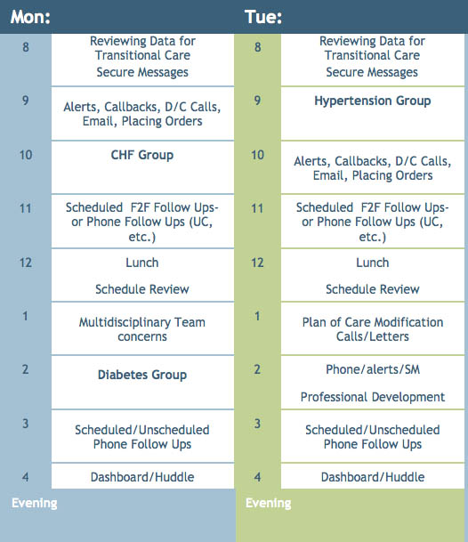
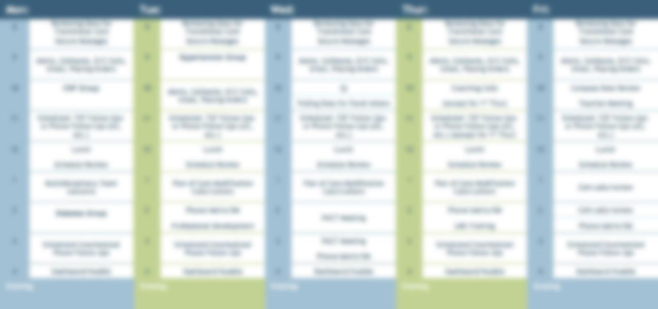
Schedule Example
Notes:
This is an example of my “current” schedule (it has gone through numerous revisions in the past couple of years!) It’s starts, in the morning, with a review of data from various sources – our “Morning Report”- the National 2 day Discharge List, an UC list of patients who were seen the previous day that we get from our CAC, and a list of patients in non-VA and a DoD partner facility that we get from our Fee Base department to see which of our patients may need follow up review, plans, or calls.
Do I stick to it everyday? No. Do things get switched around? Always. Do I modify it? At least every 2 months- but making that attempt to stick to it keeps me focused on the items I need to get done, and less likely to get sidetracked. Each day it gets a little bit easier.
By the way- the information that I mentioned- the data from Fee Basis, the ED list from the CAC – if you’d like to have items like this, the best thing to do is simply ask. I’ve found that most folks are more than happy to help!

Slide 6
Poll Results
How many PACT teamlet members who have created schedules to address their daily tasks find them helpful?
    I have created a schedule, and find it very helpful to keep on top of things.
    I have created a schedule, and find it somewhat helpful.
    I have created a schedule, but it’s impossible to stick to
    I have never created a schedule.
Notes:
Now let’s pause for a moment and take a look at your poll results.
If you have so many unplanned inputs in a day that you feel you could never stick to some sort of schedule, maybe it’s time to speak with the folks in your clinic and troubleshoot. Remember – proactively addressing your panel may take time away from small daily tasks you were used to doing – but often there are other teamlet members who can step in to help.

Slide 7
Poll Results
    I have created a schedule, and find it very helpful to keep on top of things.
    I have created a schedule, and find it somewhat helpful.
    I have created a schedule, but it’s impossible to stick to
    I have never created a schedule.
Notes:
(Cue to Tech Team that you’re moving on) “Click” again to move on

Slide 8
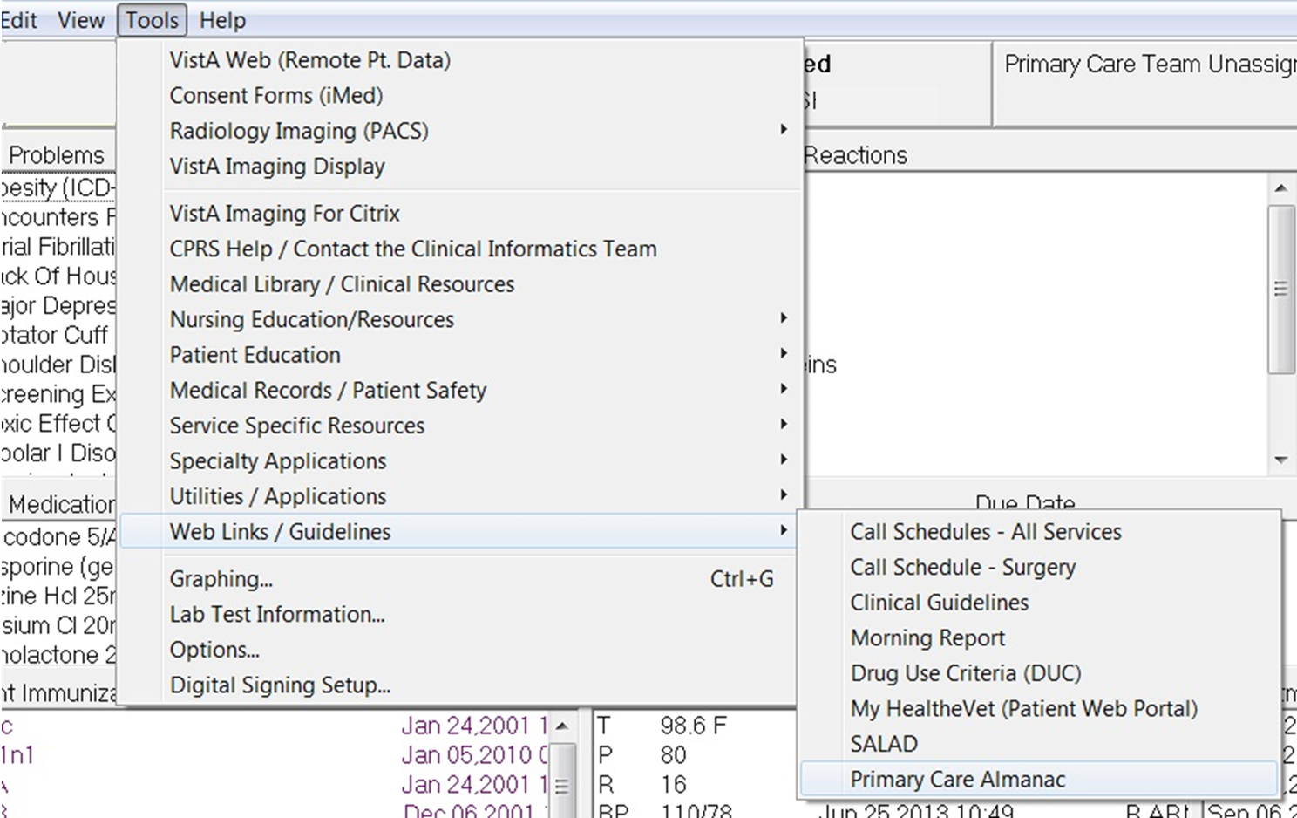
The Primary Care Almanac
Notes:
The first screen shot I want to show you is from CPRS, from the tools menu – that leads to the Almanac, the first data item we’ll discuss.
*You* can access the Almanac for information on your own panel(s) from CPRS –
No special access is needed. Available primary care provider/associate providers and PACT team members assigned in PCMM will all be able to view data from their teams.
If you don’t see the Almanac on your drop down, contact your CAC and ask them to call Freddy Kirkland in Clinical Informatics-
Freddy.Kirkland@va.gov
You can access his email and this presentation by clicking the green download button above my head.

Slide 9
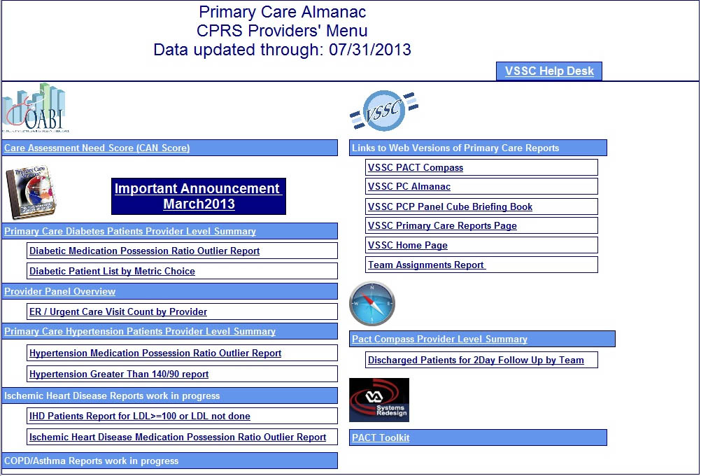
Notes:
Off of the main page of the Almanac, you can find links to the CAN Score, individual provider metric reports, ER reports, the 2 day discharge follow up lists, medication possession ratios, PCMM Team assignments, even a link to the PACT toolkit.
We’re going to start by looking at a simple Provider Level Summary-

Slide 10
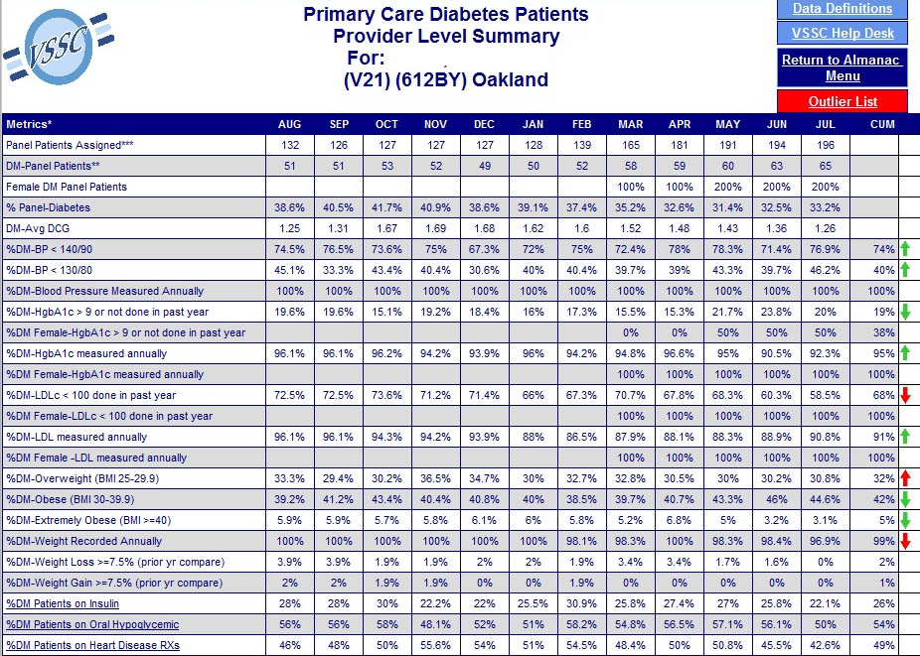
The Primary Care Almanac
Notes:
I know that this may be difficult to see so please remember that you can access this information in the hand out that we provided. Please click on the green download button above my head to download the handout.
This is a simple screenshot of a Primary Care “Provider Level Summary” for Diabetic patients, for one provider. It shows how your teamlet is doing with simple red or green arrows, month over month, on a host of metrics from blood pressures to A1c measurements to weight gain.
Our teamlet members have individual responsibilities related to these metrics, which makes this a very useful tool. It’s a great way to give kudos to, say, the Clinical Associate, who may be responsible (as in one of my teamlets) for getting folks in for those BP checks. Our clerical associate, who sends out templated CPRS letters and calls patients to get them in when labs haven’t been done, can take a bow for the green arrows with the labs.
Each month the team, working together, can review this summary to see how the whole teamlet is performing, as well as the individual members, and where next month’s focus needs to be.

Slide 11
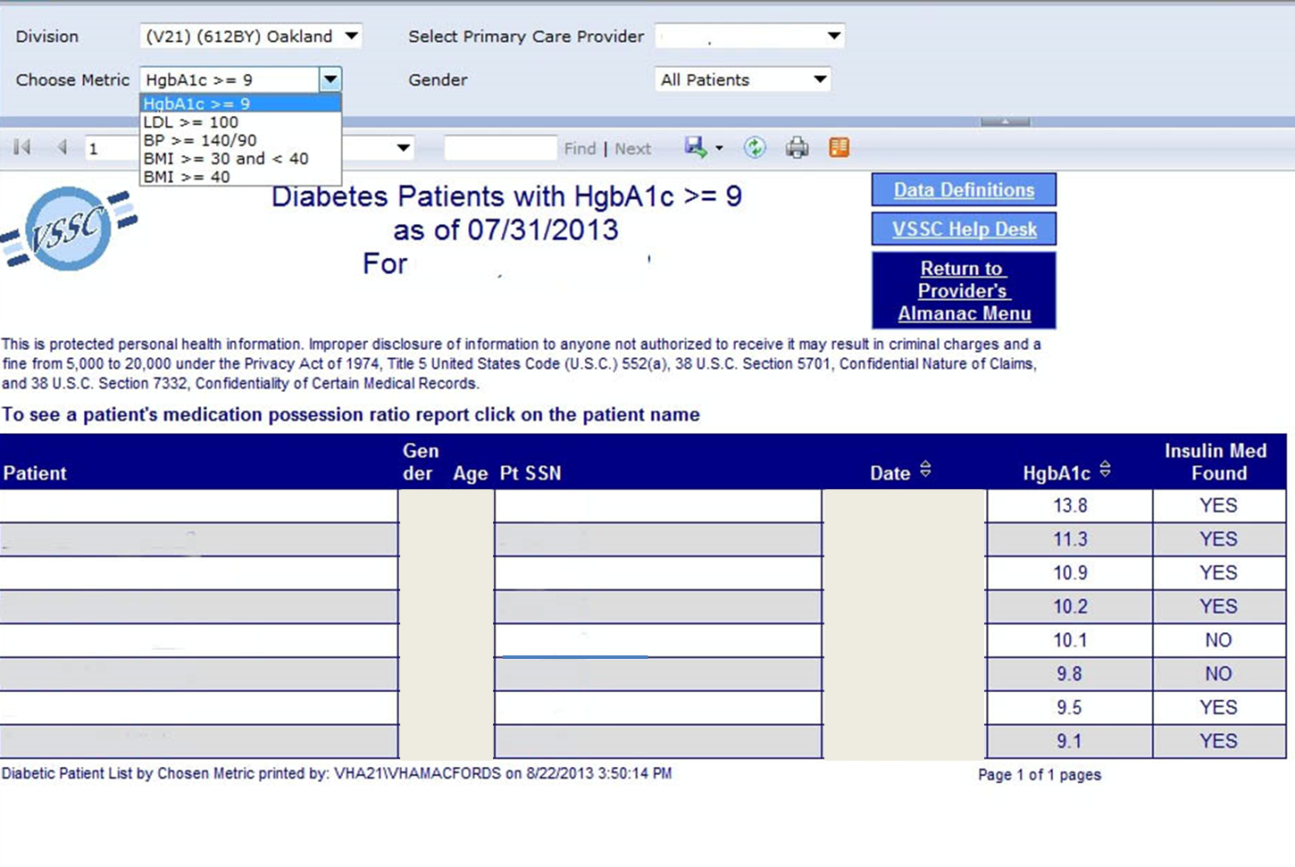
The Primary Care Almanac
Notes:
This is a simple screenshot of the lists of the Diabetic Patient List by Metric choice. You can easily pull up the names of veterans who are failing to meet certain metrics- as you can see on the top dropdown- for A1cs, LDLs, BP and even BMI. Your screen view will show the patient information that should be listed here- Veteran name, sex, age, the date of the last measurement, what it was- a lot of useful data all in one place when you’re talking with a veteran you have concerns about.

Slide 12
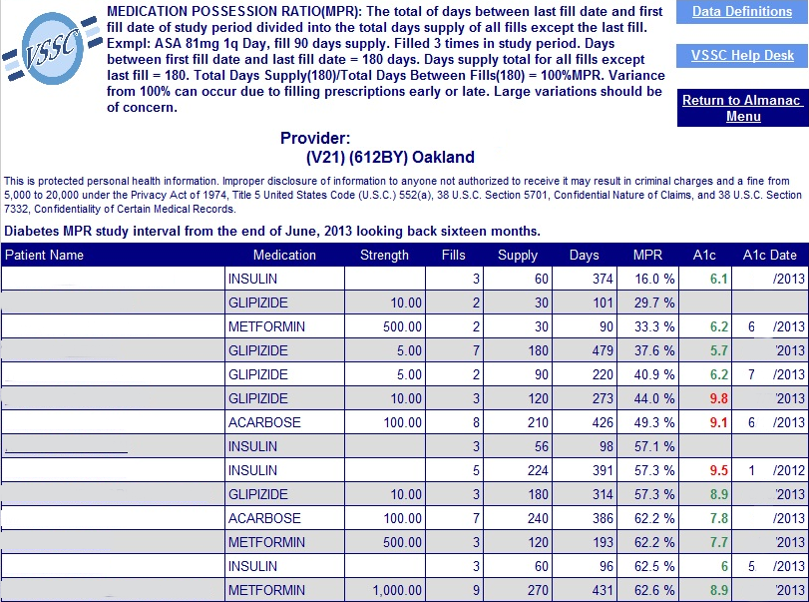
The Primary Care Almanac
Notes:
The almanac is a great tool even for the extended team. PACT pharmacists can help address concerns with Veterans who are listed here, on the Medication Possession Ratio - Veterans whose A1c is higher than you’d like and who appear, per the data, to not be picking up all of their diabetes medications can be scheduled in to speak with the PACT pharmacist to see what the problem is.
You are aware of these tools, and how to use them- make everyone on the team aware of them, and share the responsibility for addressing specific tasks related to them! It will help assure that the work is done.

Slide 13
Notes:
I want to take a second to talk about Social Security level access, which is not a necessity to review data- but it’s nice for one of two folks in the clinic to have it.
To get it, you fill out a form, have your supervisors sign, and submit it to your Information Security Officer. If you are granted this access- in using the Almanac, you’ll be able to get to the Cohort menus, which will give you more helpful data.
So- for those of you with SSL access - if you go back to the main page- and clinic on the “Primary Care Reports” link on the right-

Slide 14
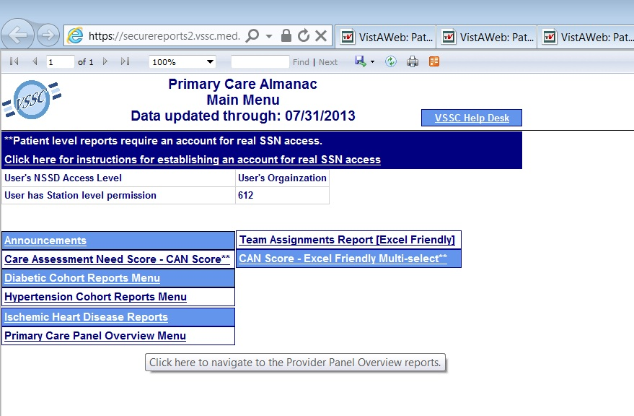
The Primary Care Almanac
Notes:
Then click on the Primary Care Panel Overview Menu-

Slide 15
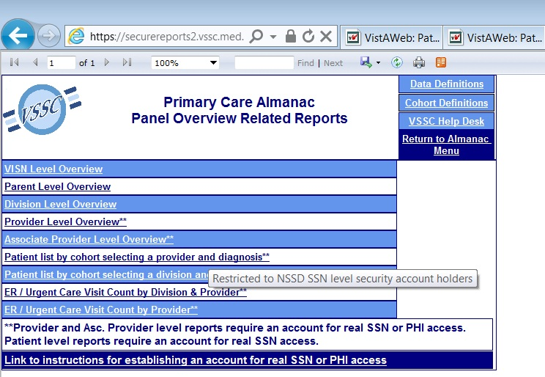
The Primary Care Almanac
Notes:
Then into the cohort menus.

Slide 16
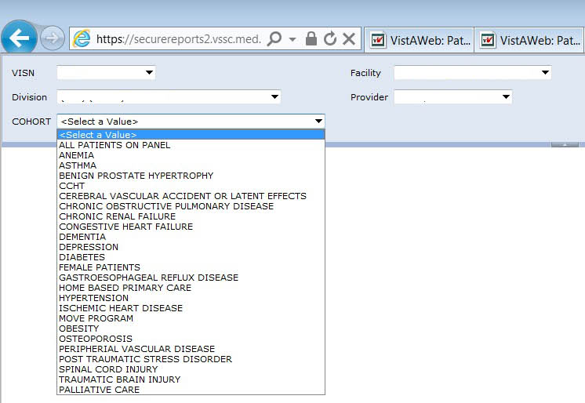
The Primary Care Almanac
Notes:
This is a view of the Provider and Diagnosis menu, with a drop down list.
I’m not going to pick any of the specific cohorts listed- rather, I’d like to give you an overview of everything that’s currently available for you to review by selecting “all patients on panel”
You can review Veterans with metrics related to all of these disease processes- great if you’re interested in beginning a disease registry, or if you’re looking for patients to start a Shared medical Appointment.

Slide 17
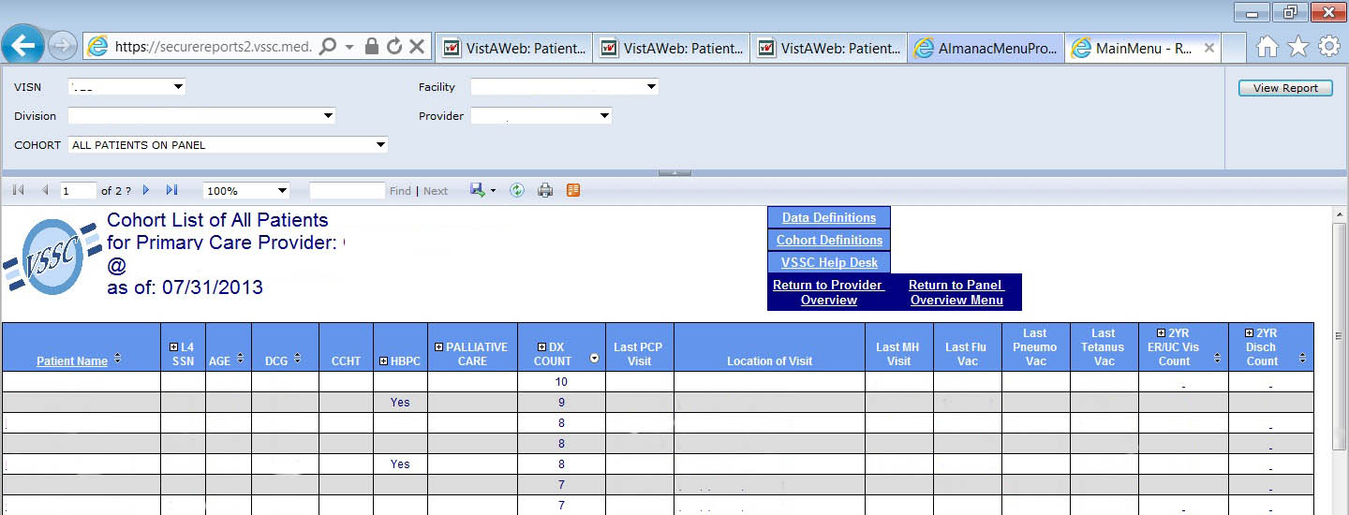
The Primary Care Almanac
Notes:
PHI has been removed- but you can see that I can review Veterans by their age, their numbers of – and types- of diagnoses (which is important because those Veterans with Multiple Chronic Conditions, or MCC’s, at at higher risk of needing higher levels of care – so those are folks you want to stay in close contact with, too). Just like with the CAN, you can see who – based on the number of those MCC’s- might be appropriate for extra resources like palliative care or Home Telehealth. You can even see items like whether or not folks have gotten their flu vaccines for the year.
Personally, I’d LOVE to see an interface that had even MORE data, all in one place. Vaccinations, like Zoster – or Hep C testing – and I’d love if we could review the entire VA system, not just one little site. The more data we have, the more we can tell what our Veterans need, at the direct care level, quickly and easily.

Slide 18
Poll Question
With Flu season coming up Nurse 1 would like to know which of her patients have not had their flu shot, where would she look for that information?
    The Primary Care Almanac Cohort report
    It’s in the Compass Facility Summary
    I’m not sure where it’s located
Notes:
Before we move on, I have one more question that I’d like to ask –
With Flu season coming up Nurse 1 would like to know which of her patients have not had their flu shot, where would she look for that information?
The Primary Care Almanac Cohort report
It’s in the Compass Facility Summary
I’m not sure where it’s located
To answer this question, use the blue polling icon above my head. We’ll move on and come back to your results in just a moment.

Slide 19
Notes:
I wanted to highlight another one of the DBs that we work with every week. It’s our CAN Score, and we are lucky enough to have Dr. Tami Box who will talk to us about everything CAN! You may have seen Dr. Box and Dr. Fihn’s presentation in April on Can – if not, you can access the full presentation by heading to MyVeHU Campus.com and clicking on the purple on demand button and searching for -13053 Tools for Care Management: Care Assessment Needs (CAN) Score and Patient Care Assessment System (PCAS).
So now I’d like to welcome Dr. Tami Box, remotely to the stage.
Hi Tami, how are you? We are so glad to have you here with us today all the way from Washington

Slide 20
Top 10 VHA Discharge Diagnoses 2008
Affective psychoses
Heart Failure
Chronic ischemic heart disease
Respiratory symptoms/other chest sx
Pneumonia
Cardiac dysrhythmias
Schizophrenic disorders
Chronic bronchitis
Alcohol dependence
General symptoms
Notes:
(Maynard and Fihn, Internet Journal Epi 2010)

Slide 21
Knowledge of a patient’s risk of adverse event can help target services
Home-based primary care
Case-management
Specialty clinics, e.g., heart failure
Telehealth
Palliative care
Providers can’t accurately
predict Veterans at highest risk of deterioration
PACT RN Care Managers charged to coordinate care
No systematic way to identify Veterans who might benefit most → predictive analytics using data from EHR
Broad range of clinical programs designed improve care for veterans with complex chronic illness
Notes:
VHA provides a broad range of programs for patients with chronic illness to improve outcomes and prevent hospitalizations:
Home-based primary care
Case-management
Specialty clinics, e.g., heart failure
Telehealth
Palliative care
However, no systematic way of targeting programs or identifying patients who might benefit most
Knowledge of a patient’s risk of adverse events could help to target delivery of intensive services to those with the potential to derive the most benefit
Doctors and nurses cannot accurately predict who is at highest risk of deteriorating or dying
Predictive analytics using data from many sources including EHR could help to identify highest risk patients and target services.

Slide 22
Modeling Strategy
Patient characteristics
Demographics – age, priority level
Coexisting conditions – Deyo/Charlson score, HCCs
Vital signs
Utilization – inpatient and outpatient
Pharmacy
Lab values

Slide 23
Modeling Strategy
Outcomes occurring in subsequent yr.
Readmissions, deaths, either at
30, 60, 90 days & 1 yr
Conjoint modeling admission and death using polytomous (multinomial) logistic regression

Slide 24
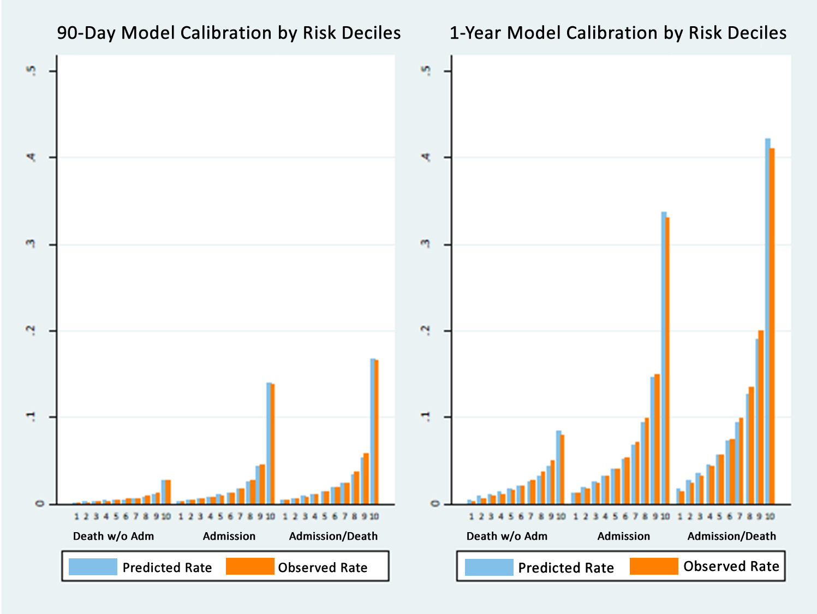
Predicted and Observed Likelihood of Death/Admission
4,505,501 primary care patients
Wang, et al. Med Care. 2013;51:368-73.
C=0.79
C=0.81
C=0.81
C=0.85
C=0.83
C=0.87

Slide 25
Care Assessment Need (CAN) Score
Reflects estimated probability of
admission or death
within a specified time period
(90 days or 1 year)
0%
(lowest risk)
99%
(highest risk)

Slide 26
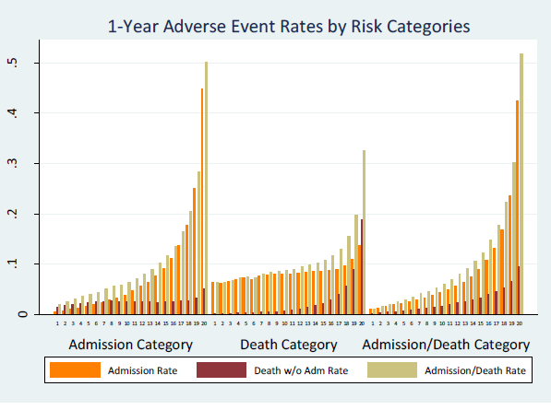
95th %ile – 39%
96th %ile – 42%
97th %ile -- 49%
98th %ile -- 57%
99th %ile -- 72%
Patients in highest percentile of risk have 62% probability of admission, 30% probability of death, and 72% probability of either event
Notes:
Encouraging Care Coordination
all participants in the delivery of health services work cooperatively
facilitating access to care
right care in the right place at the right time
shared responsibility
Encouraging Care Management
Linking patients with needed services, resources, and opportunities
Discouraging “misuse” of the score
The score is not a performance measure to try to “improve”
A high score does not indicate a pt is not receiving high quality of care
A low score is not an indication to ignore a pt

Slide 27
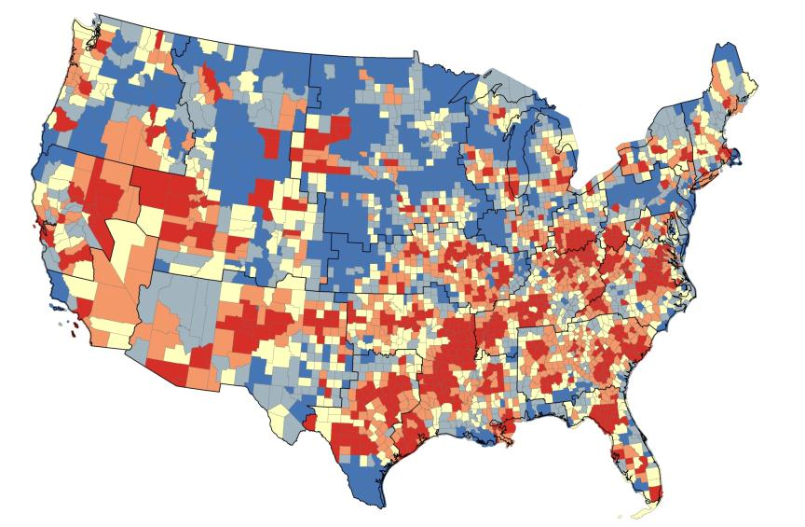
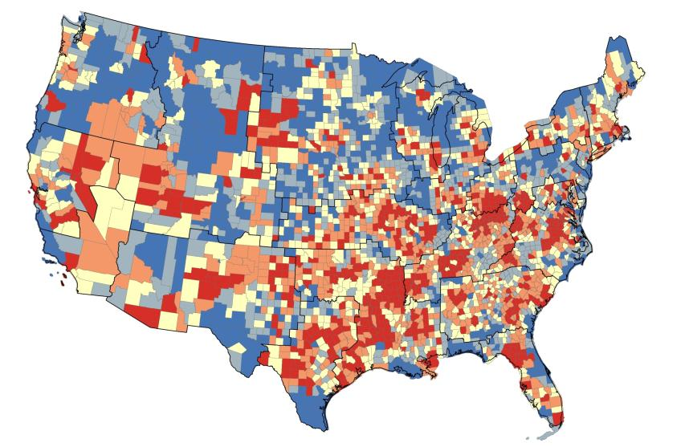
Use of High Level Analytic Data for Population
Management and Resource Planning
1-yr likelihood of admission or death
2.37% - 9.03%
9.04% - 10.01%
10.02% - 10.96%
10.97% - 12.18%
1-yr likelihood
of admission
12.19% - 19.34%
1.86% - 5.93%
5.94% - 7.00%
7.01% - 7.97%
Dynamic
Geospatial Mapping
7.98% - 9.21%
9.22% - 16.99%
Notes:
Data shown in quintiles. Probability of a patient being admitted within one year by county (patient’s probability aggregated to the county level). Dark red represents the counties with the highest probability (top 20%) and dark blue represents the counties with the lowest probability (bottom 20%). Counties with less than 5 patients are excluded. The county with the lowest probability is Aleutians West, AK (1.86%—not shown) and the highest is Roberts County, TX (17%). Average probability for all counties is 7.5%.

Slide 28
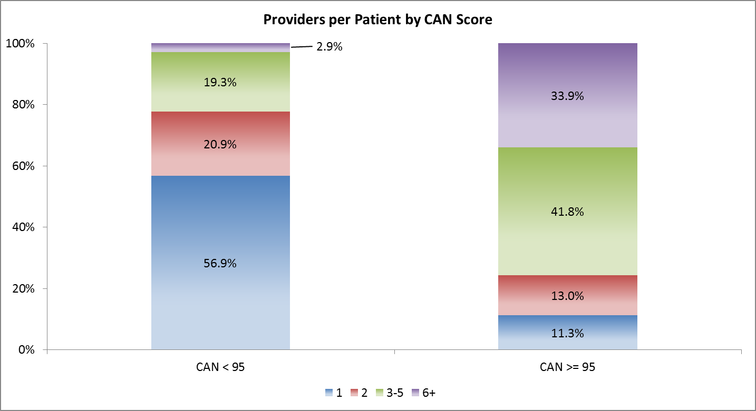
High Number of Health Care
Providers per Patient by CAN Score
Notes:
More than a third of patients with very high CAN scores have 6 or more providers

Slide 29
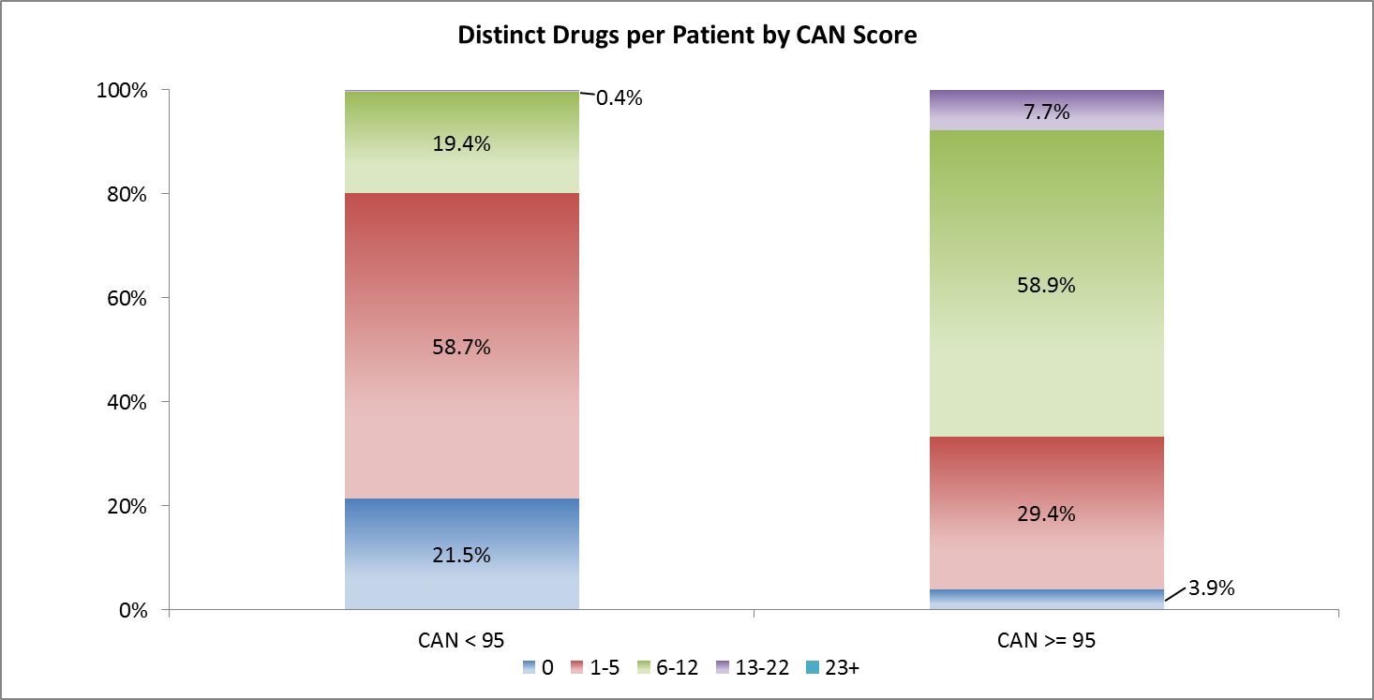
High Number of Different Drugs per Patient by CAN Score
Notes:
More than 2/3’s of patients with very high CAN scores are on 6 or more different drugs

Slide 30
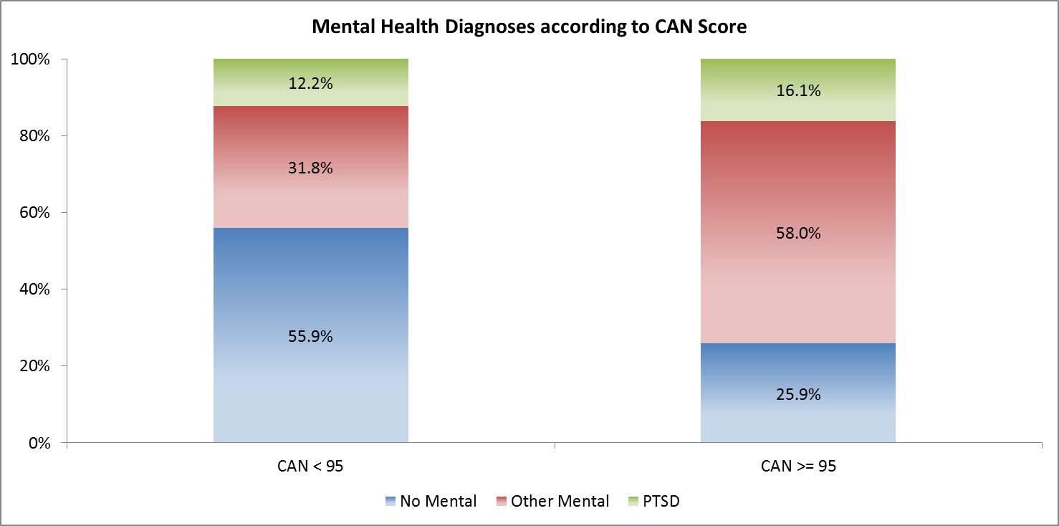
Mental Health Diagnoses according to CAN Score
Notes:
¾’s of patients with the highest CAN scores have at least one MH diagnosis

Slide 31
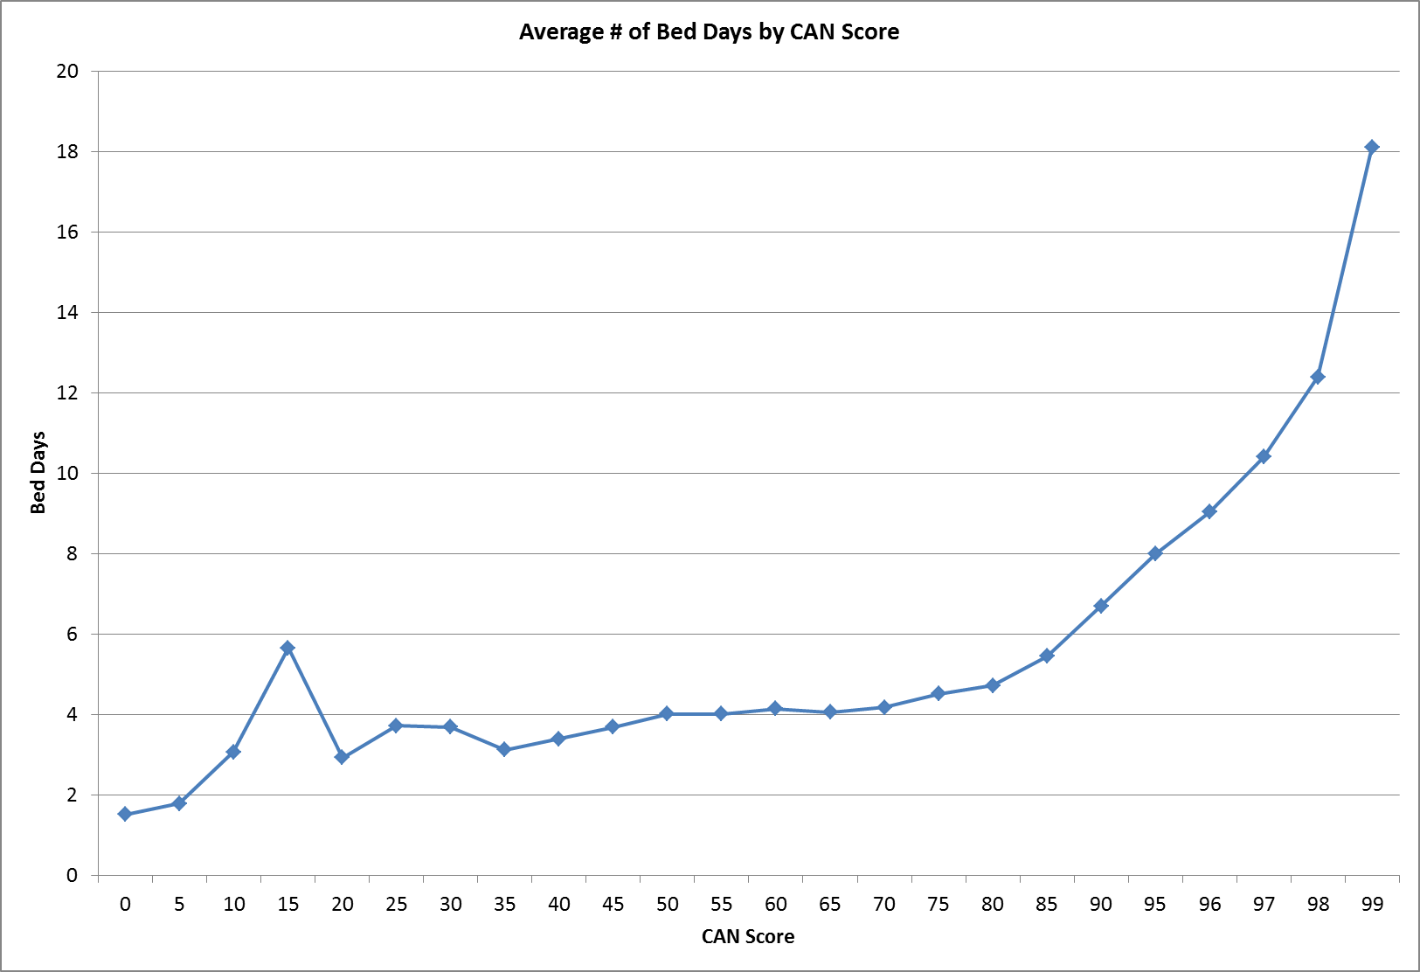
Bed Days - Per Patient, Average

Slide 32
Few Patients with High Scores Referred to Coordination Programs: Telehealth, HBPC, Palliative Care, and Hospice
PROGRAM | % Patients Referred with CAN ≥ 95
Telehealth | 10.7%
HBPC | 3.6%
Palliative Care | 0.6%
Hospice | 0.2%
Notes:
Comprehensive Listing of Telehealth patients reported as of 11/06/2012.
HBPC is defined as Stop Code (Credit or Clinic) of: 156,157,170,171,172,173,174,175,176, and 177.
Palliative Care
Score ≥ 95 --1,353 of 241,917 total patients (0.6%)
Hospice
Score ≥ 95 -- 569 of 241,917 total patients (0.2%)

Slide 33
Can CAN scores help?
Patients with highest 10% of CAN scores
who saw their PCP for >60% of visits
were 10% less likely to die or be hospitalized
[after adjustment for age, sex, comorbidity,
and mental health diagnoses and
versus similar risk patients who did not see their PCP]
Notes:
After adjusting for age, sex, comorbidity, and mental health diagnoses, patients with CAN scores in the highest 10% who saw their assigned PCP for >60% of visits, were 10% less likely to die or be hospitalized than similar risk patients who did not see their PCP during the year before PACT implementation. Similar, but less pronounced association for high risk patients who saw their assigned PCP up to 60% of the time.

Slide 34
How might a care manager or provider use the tool?
Scan list of pts weekly to identify those who may be at high risk
Call high risk patients to check in: are questions answered? are medications taken as prescribed?
Confirm that high risk pts have visits coming up soon
Ensure that high risk patients are on appropriate medical therapy
Review resources already in use, such as telehealth or specialty care
Notes:
Scan your list of patients each week to identify those who may be at high risk
Call your high risk patients to check in:
are medical questions answered?
are medications taken as prescribed?
Use – about 1,000 users/monthly (just a fraction of potential population)
Kathy will be giving live, practical, and real examples a little later. And now we’ll bring Shelia back to talk about her experience with CAN.

Slide 35
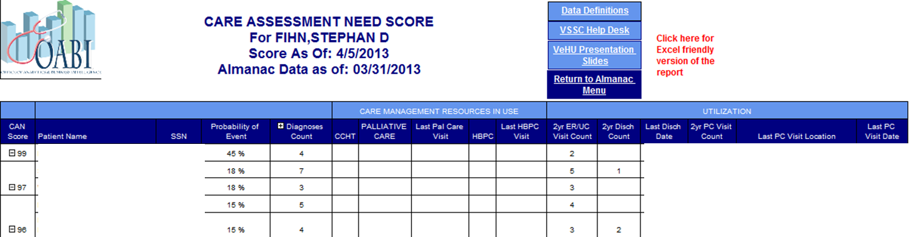
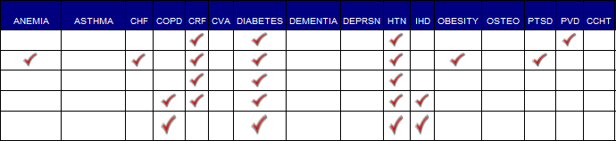
CAN Scores
Notes:
We found the CAN scores in the Spring of 2012. We had been looking, after hearing Dr. Finh give a presentation on this incredible risk stratification dashboard he was working on for Primary Care.
After we quickly verified that CAN was this tool, we created a plan- all of the RNs in Oakland would address their high CAN score patients weekly.
CAN gives you a score- 99 down, that correlates to risk for hospitalization or death. It will also tell you how many times the Veteran has been hospitalized or seen in the ED in the past 2 years, how many diagnoses they have, and whether or not they have been referred to other care resources like HT, Palliative Care or HBPC- services that, with their assistance- can make our lives easier in Primary Care, and the patient’s outcomes better!!!
We did it in different ways- some of us called the highest risk weekly, others called every other week- we all gave them contact numbers if they needed to get back to us-
The first week, the calls took awhile. I had to explain why I was calling – that due to their recent hospitalization, or number of diagnoses- they were at higher risk for admission or readmission. I never mentioned that they were also at higher risk for mortality, but that is something that I always kept in the back of MY head.
Within 3 mos our hospitalization rates had started to decrease- I’m going to show you a graph on those rates later- but we were seeing a difference! CAN – following up on those Veterans that the computer targets as being at highest risk- works!

Slide 36
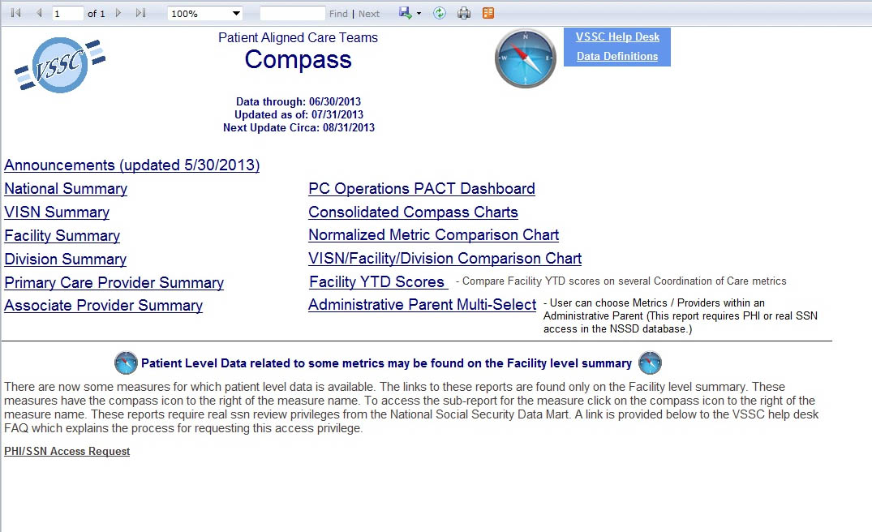
The PACT Compass
Notes:
Another quick data item- this is the main page of the PACT Compass, which you can get to from the Almanac. It’s a great tool because it can give you the big picture regarding your clinic, as well as allow you to evaluate how any new policies, procedures or tools that you start to use.

Slide 37
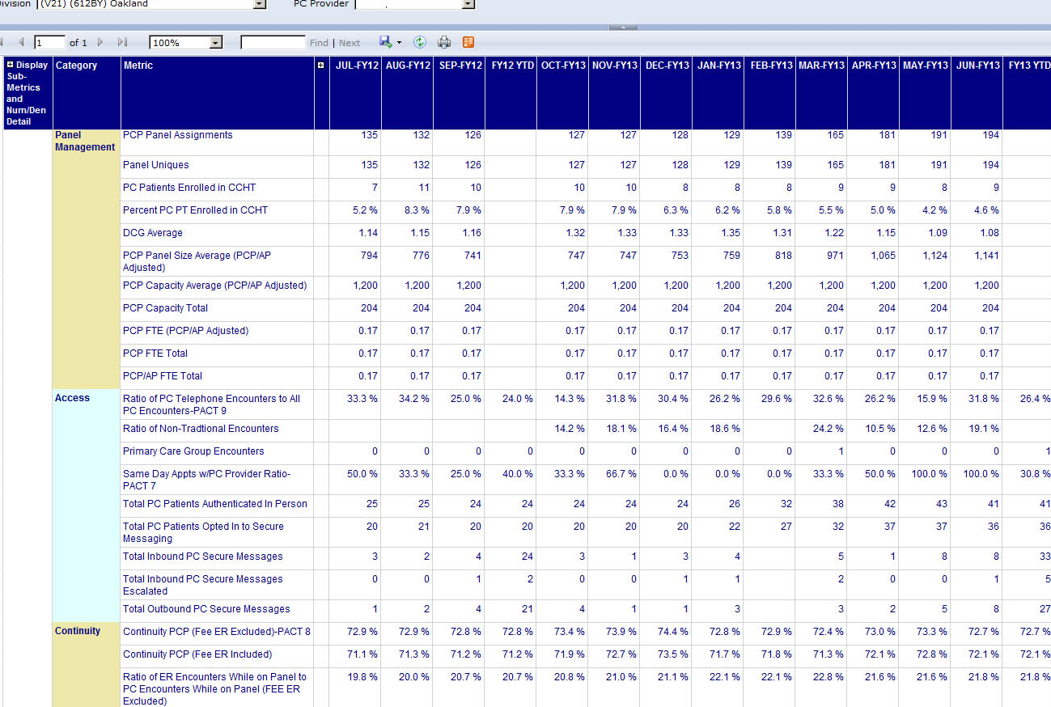
The PACT Compass
Notes:
This is a page from the Primary Care provider summary page from the PACT Compass. You can evaluate items like panel numbers, Home Telehealth use, non-traditional encounter use (Secure Messaging, Telephone visits) use, continuity data, coordination data, inpatient rates, and more.
Again - I wanted to remind you that you can view this document in more detail by downloading the handout. You can do this by clicking the green download button above my head.

Slide 38
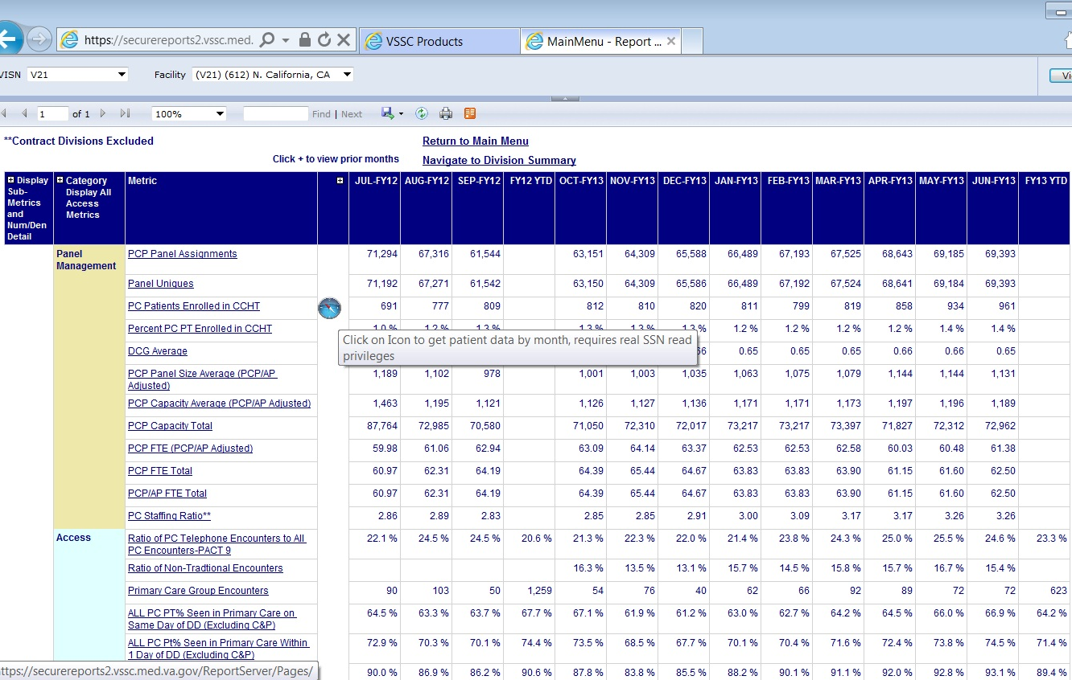
The PACT Compass
Notes:
This is a page from the facility summary page from the PACT Compass. At this level, a simple click on the “compass” icon that shows next to some metrics can provide a list of all Veterans, by provider, who are counted towards the individual facility metric- (you do need someone to have the Social Security Level access we spoke about earlier for these reports) but what that means is- say you only got a 75% on your 2 day post discharge contact metric last month? These reports will let you view every veteran who counted towards that metric, and you can see if the call was made. Sometimes, the calls were made, but the encounters weren’t entered correctly, and you can work with your Data management department to update the score.
An aside- starting soon, I understand that those 2 day calls will only “count” if the person who makes the call is listed on the PCMM staff list for that Veteran’s teamlet. Remember, if you have any concerns about who is on your PCMM teamlet list, you can find it off the almanac.

Slide 39
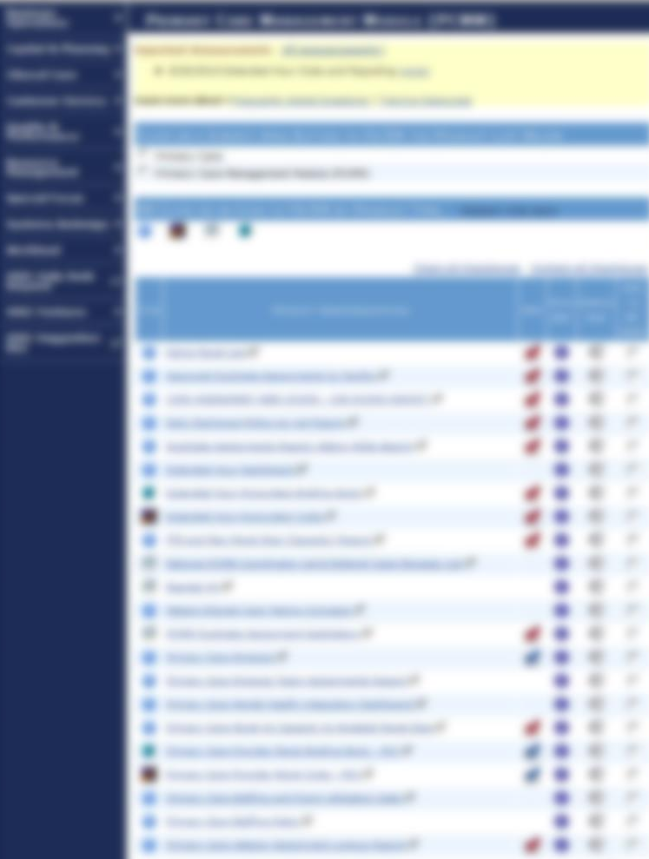
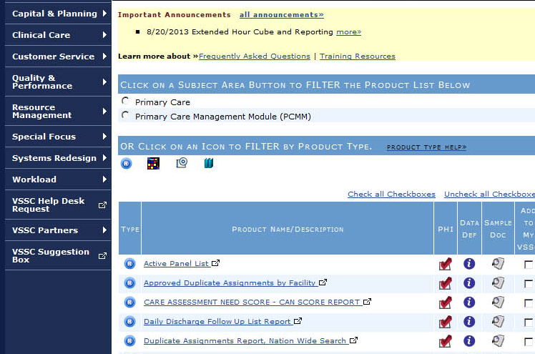
Notes:
Finally- VSSC is the main national VA data page. Again, it’s not necessary that everyone in the clinic have access to it, but it can give you some very important panel management tools.
In addition to links for the Compass and Almanac, VSSC provides links to complete panel data – including Veteran names, and when they were last seen, and if they have any upcoming appointments. Our clerical associates use this data to quickly send out templated letters and make calls if a patient has not been seen in 12 months or more, and has no upcoming appointments in Primary Care.
There is also a large database on patients who have more than one provider in the complete VA system, as well as the another smaller one that has patients who have been approved to have dual providers.
New data on extended hours clinics is also available through VSSC.

Slide 40
Poll Results
With Flu season coming up nurse 1 would like to know which of her patients have not had their flu shot, where would she look for that information?
    The Primary Care Almanac Cohort report
    It’s in the Compass Facility Summary
    I’m not sure where it’s located
Notes:
Now let’s pause for a moment and take a look at your poll results.
Ad-lib to the audience results, then advance to move on.

Slide 41
Poll Results
    The Primary Care Almanac Cohort report
    It’s in the Compass Facility Summary
    I’m not sure where it’s located
Notes:
(Cue to Tech Team that you’re moving on) “Click” again to move on

Slide 42
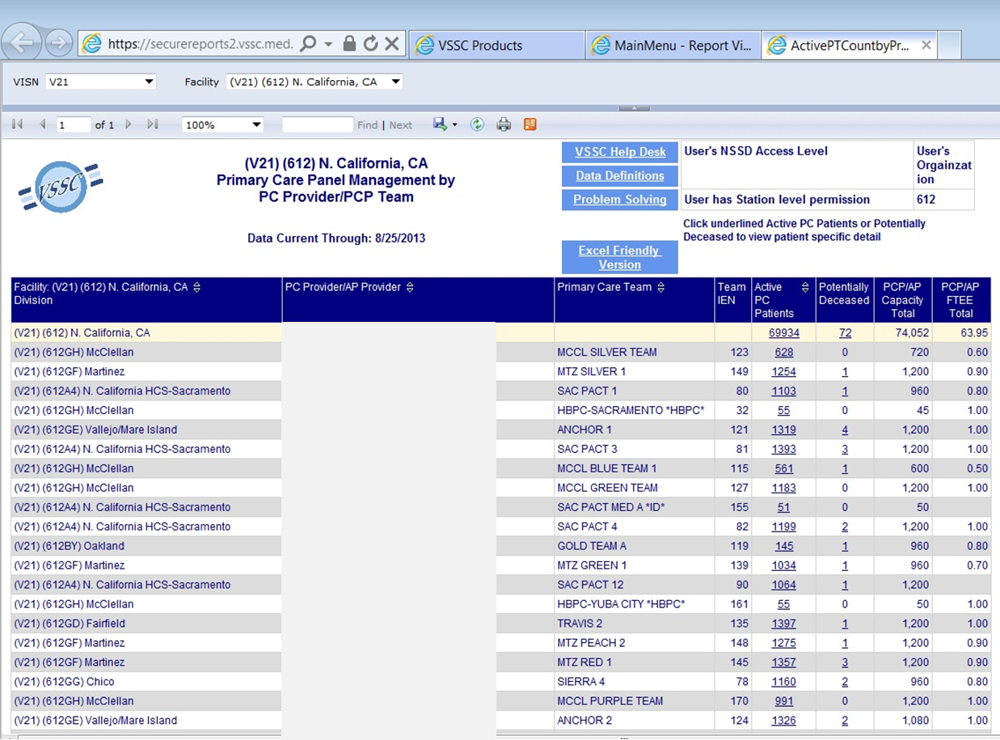
VSSC - http://vssc.med.va.gov
Notes:
This is the “Active Panel List” off of VSSC.
All providers are listed for a site. Clicking on the number to the right will bring up the data our clerks use to contact Veterans as soon as they’ve been absent from clinic 12 months or more-

Slide 43
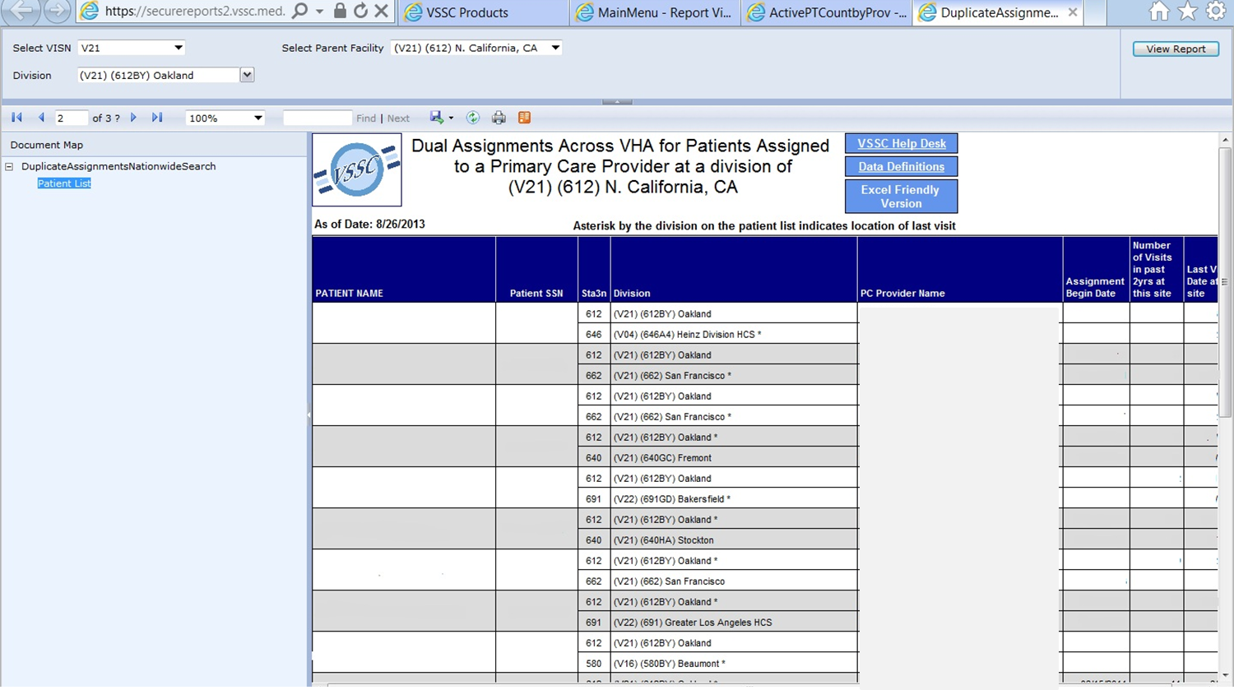
VSSC
Notes:
This is the database on patients who have more than one provider in the complete VA system, which we review every few months, along with another smaller database that has patients who have been approved to have dual providers (again, this image has been scrubbed of PHI and only provider names are visible).
Our clerks call the Veterans who have two providers listed and ask them to please choose one, reminding them of the VA regulations and explaining safety concerns.
Since our clinic is close to 3 VA systems, this database is very important for our panel management.

Slide 44
VA Oakland Outpatient Clinic
Notes:
I know all of this data – added on to all of the other new items that we’re doing- can be overwhelming-
I want to thank you for listening. I also really want to but I just wanted to let you know, that it works.
This is my slide showing Oakland’s hospitalization rate, and how it’s decreasing.
Through 2011 and early 2012, our inpatient admission rate hovered between.13-.14. Like most VA Primary Care clinics, throughout the nation, our early-on allocation of new PACT resources was often tempered by a loss of staff- as well as by inter-clinic “teamwork” concerns.
Moving from the Primary Care model to PACT was not without it’s challenges-
But in the last year and a half- thanks to a leadership sensitive to our needs, to great Veterans- and to my exceptional co-workers (who are covering my team right now, in addition to all of their own duties!) - who really want to make a difference- we’re doing well in Oakland.
I look at this chart (which I- and everyone in our clinic- is really very proud of) for - the last 15 months, there are certain items that I can pinpoint-
In May of 2012, we started using CAN to address our high risk patients
In November of 2012, we were able to try to contact all of our Veterans for a 2 day discharge call (situated with 3 VA Medical Centers within a 90 mile radius of our clinic- patients were often hospitalized and we were not aware of it) thanks to the national 2 day discharge contact list
In December of 2012 we had a huge push to get the Dashboards – the IHD, HTN and DM metrics- into better shape, with the clerical and clinical associates doing a lot of calls and letters- in May, we got new hires on board-
So- I can’t say with any certainty what items have had the biggest impact, because there have been so many- new resources, new tools, new tasks – but the use of all of them, together- working as a PACT- is having a real effect on our patient outcomes. What we’ve seen since last Spring is a slow but constant decrease in our inpatient admission rate that has been beautifully sustained. We’re saving Veterans admissions, and we’re saving the VA money- and we all feel as though we are making a huge difference.

Slide 45

Email
Notes:
If you would like to contact me, please click on the yellow presenter button above my head, you will find my email and biography in there.
You also still have time to ask me questions today by clicking the Orange Ask the Presenter button which is also above my head. We will answer those questions directly after the presentation.
Now let’s invite Ms. Kathy Beatty on to the stage.

Slide 46

Pact RN Can Plan
VA Sierra Foothills CBOC Case Study
Notes:
Thank you Sheila and hello everyone. I am happy to be here participating with the PACT RN Boot Camp Series and promote helpful care-management tools that can be applied successfully by PACT RNs.
Kathy: We are going to change gears for this part of the discussion and explore a scenario of RN’s having a discussion after hearing about care-management tools.
Shelia, in a moment we are going to take a look at a short video where we will check in with nurses that have appeared in a previous Boot Camp session – Improving Access to Care: Connecting the Dots #13092
Shelia: To watch the full broadcast of 13092 – Access, please go to myvehucampus.com click the purple on demand button and search for session 13092
Kathy: Are you ready to watch that video Shelia?
Shelia: sure
Kathy: Great, let’s watch it now!

Slide 47
Video Clip

Slide 48
Poll Question
Have you accessed the veteran patient panel on the Almanac?
    No, I have never used it
    Yes, just out of curiosity or interest
    Yes, on a weekly or monthly basis
    Yes, regularly or daily
Notes:
Does this sound familiar? I believe many nurses are motivated to use tools that would improve veteran care and outcomes.
Many of you have heard about the Almanac, the CAN Score Report, and other tools. For some of you this may be the first time you have seen this information – Sometimes taking the first steps to utilize new tools is the biggest challenge.
Before we continue, I’d like to ask a Poll Question : Have you accessed your veteran patient panel on the Almanac?
No, I have never used it
Yes, just out of curiosity or interest
Yes, on a weekly or monthly basis
Yes, regularly or daily
Please select your answer from the options listed by clicking the blue polling icon above my head. We will move on with the presentation and get back to your responses in a moment.

Slide 49

Our Purpose
The nurses at Auburn CBOC want to share their satisfaction and successful experience in using the CAN tool
Notes:
The systems Redesign pillar of the PACT implementation has led to training and new tools that assist PACT teams meet the goals to improve care access and care coordination. Many nurses have voiced concerns related to incorporating new tools into their already busy day.
By sharing our CAN journey so far, we hope nurses see the easy and efficient use of the Almanac CAN Score tool. And like the nurses in the video, you also can work with your fellow PACT RNs and develop your own plan.

Slide 50

First Steps following Sheila’s Call …
PACT RN follow-up discussion
Commitment to PACT can plan
Formulation of PDSA
Notes:
Our experience with the Can Score Report began in January 2013 when Auburn CBOC nurses heard a presentation given by Sheila. She described the use of the CAN Report at the Oakland CBOC and the resulting positive outcomes in a relatively short period of time.
Following the presentation we huddled and were all experiencing the same positive response! We were excited at the prospect of performing the type of proactive nursing that was resented. We also believed the tools discussed would provide the practical application needed to successfully achieve a positive change.
We agreed to commit to a CAN Plan that would focus on proactive outreach to high-risk veterans, with a goal to offer appropriate health support programs that are available through our VA system.
Because of the many variable of patient need and the numerous support programs, we agree to develop a focused plan that would be specific, realistic, and measureable. We chose to utilize the PDSA model. The Plan-Do-Study-Act is a useful tool for developing and documenting small tests of change.

Slide 51
Broad view of CAN Score
1-yr likelihood of admission or death
2.37% - 9.03%
9.04% - 10.01%
10.02% - 10.96%
10.97% - 12.18%
1-yr likelihood
of admission
12.19% - 19.34%
1.86% - 5.93%
5.94% - 7.00%
7.01% - 7.97%
Dynamic
Geospatial Mapping
7.98% - 9.21%
9.22% - 16.99%
Notes:
As you saw earlier, this slide shows a geographic distribution of patients by county according to CAN Score. The graphic reflects CAN Scores and their relation to percent risk of and event.
Red on the legend depicts high percent of risk in given counties; we identified areas in the VA SNHCS catchment that are high risk. This graphic allowed Auburn nurses to see the need for proactive outreach.

Slide 52
Poll Results
Have you accessed the veteran patient panel on the Almanac?
    No, I have never used it
    Yes, just out of curiosity or interest
    Yes, on a weekly or monthly basis
    Yes, regularly or daily
Notes:
Now let’s pause for a moment and take a look at your poll results.
Ad-lib to the audience results, then advance to move on.

Slide 53
Poll Results
    No, I have never used it
    Yes, just out of curiosity or interest
    Yes, on a weekly or monthly basis
    Yes, regularly or daily
Notes:
(Cue to Tech Team that you’re moving on) “Click” again to move on

Slide 54

High risk Veterans Care Manager’s selection
Notes:
We outlined our desired outcome for our veteran population - Use CAN Score to increase health care access to high-risk Veterans; Enhance quality and reduce unnecessary, unplanned care; Link Veterans with needed services, resources, and opportunities.
We agreed to target CHF as it is a particular focus in health care due to the high admission and readmission rates. We focused on veterans with a diagnosis of CHF and veterans at Risk of developing CHF due to diagnoses of IHD, HTN, DM.
We planned to offer Home Telehealth (formerly called CCHT) which facilitates home-monitoring of health data. HTH increases access to care, promotes veteran-centered care, and builds self-efficacy. This proactive, ongoing care management is a stark contrast to reactive care that only targets acute exacerbations or patients that are already in the hospital.
We couldn’t wait to get started!

Slide 55
What can CAN do?
CAN PLAN: Use CAN Score to identify high-risk Veterans (CHF); engage in proactive outreach to offer CCHT support.
CAN DO:
*Ensure RN access to Almanac and CAN Score data
*Target CCHT
*Meet with Key stakeholders
*Utilize RN phone appointments and templates
CAN STUDY: Measure outcome – access to CCHT over three month period.
CAN ACT: Adopt outcomes that have improved. Make adjustments on the outcomes that have made no change or not improved, then re-study after a set period of time.
Notes:
(Review slide) * PCMM

Slide 56

What did the report allow us to see for Auburn PACT Team D
CAN Score > 95 = 23 Veterans
15% - 45% probability of event in 90 days
CHF 8 CCHT = 0
IHD 9
HTN 18
Notes:
Each PACT RN Manager accessed their panel’s CAN Report and printed high-risk veterans with a can score of >95.
Here we see PACT Team D (Review Slide)
It was such a positive experience to be able to see this type of data for the panels we actually serve. We also noted that high risk veterans have high ER/UC and PC visit rates.
The diagnoses lists and visit rates indicate the need for proactive care management. Having access to this data provided what we needed to accomplish our goals on the PDSA.

Slide 57

Case Study#1
Notes:
Case study #1
The PACT RN Managers targeted veterans on the report and began the outreach. Here is our first case study involving a 88 y/o male WWII Veteran, Purple Heart recipient. He has a CAN Score of 98 and a 25% risk of an event within 90 days. He has 6 chronic conditions including CHF. His current health care support VA includes primary care and audiology. The veteran also has dual care in the community which creates challenges in continuity of care.
The veteran was contacted; the nurse did a needs assessment and discussed HTH. CAN outreach was well received by this veteran and his spouse who is his primary caregiver. The veteran agreed to HTH support. The extended support will no doubt help this senior couple to better navigate through day-to-day health management.

Slide 58
Case Study#1
CCHT Consult And Resulting Support
Additional Needs Met Through Occupational Therapy (OT)
Notes:
Since the outreach the veteran has been contacted by HTH nursing staff when the home health monitoring system flags out of range data. The veteran has also received additional Occupational Therapy support since the CAN outreach.
We know that this support is providing the veteran with increased confidence knowing that his daily data are being assessed by health care staff.
The PACT RN is able to review notes by HTH staff and plan appointments and additional care more effectively. The RN Care Manager knows he/she has facilitated proactive and ongoing follow up care that is geared to this veteran’s needs.

Slide 59

Case Study#2
Notes:
Case study 2 reviews a 68 y/o mail with a CAN Score of 96 and a 15 % risk of an event within 90n days. This veteran has CHF; CVA: HTN; Depression; and Demensia. CAN data reflected 26 PC visits in a 2/yr period; that averages to > one visit each month.
It was also noted that the veteran was receiving primary care and eye clinic services but no other VA health care support.
When the veteran was contacted he brought his wife on the line as she is primary support system. The veteran and his wife were very interested in HTH and the support it provides. The wife expressed gratitude for any extra support she could get.

Slide 60
Case Study#2
CCHT Consult and Resulting Support
Veteran was Enrolled in MyHealtheVet
SW Consult For Needs Assessment
Notes:
The extra HTH support for this veteran will allow him and his wife to monitor his chronic conditions and avoid or reduce acute exacerbation as well as improve quality of life. The veteran also agreed to enroll in MyHealtheVet.
In addition the veteran and his wife were referred to the CBOC Social Worker for assessment of psychosocial needs and available resources.

Slide 61

Case Study#3
Notes:
Though we originally focused on CHF and associated disease, we wanted to add this case study to demonstrate the variable needs of high risk veterans.
This 52 y/o female veteran has a CAN Score of 96 with a 15% probability of an event within 90 days. She has COPD, PTSD, Depression, history of substance abuse, and continued to smoke. Her current support through the VA included Primary Care and Mental Health.
CAN Data reflected 3 ER/UC/Admission count and 40 Primary Care visits in 2 years. For this 52 year old that is a hospital admission every 8 months as well as 10 primary care visits every 6 months. Do you see a pattern here? We all believed a driving force for this patient was the need to feel secure with her health care team.
The PACT RN Manager contacted this veteran to offer additional health connection and support. The veteran was very receptive to the extra support and attention from her health care team and turned out to be one of our best outcomes yet!

Slide 62
Case Study#3
Can Outreach And Resulting Support….
Loves MyHealtheVet!
Signed up for Telephone Life Style Coaching
Agreed to Pain Management Consult
Quit Smoking
Notes:
So here is what happened –
The veteran wanted to sign up for MyHealtheVet and Secure Messaging –
She stated that the secure messaging component helped her immensely because she received responses in a timely manner where in the past, calling the clinic and not getting through right away had caused her increased anxiety.
The veteran also signed up for TLC (Telephone Lifestyle Coaching) which is being piloted within VISN 21. The TLC program is a free telephone based pilot program designed to help patients achieve personal health goals, for example being tobacco free!
This veteran did stop smoking and reported that she started painting again! She has shown remarkable change in her communication with the clinic and her health care team is supportive and happy for her progress.
For this veteran and others like her we can look at data over time for a positive change in the data.
The PACT Care Manager can know that she is giving veteran-centered, whole-person nursing care.

Slide 63

Voice of the Veteran
Voice of the Veteran
That sounds great!
Definitely! Sign me up.
That sounds great!
Definitely! Sign me up.
I would be interested, have them call me with more details.
I would be interested, have them call me with more details.
That’s perfect! Just what I’ve been looking for.
Wow – the VA has really stepped up the care!
That’s perfect! Just what I’ve been looking for.
Wow – the VA has really stepped up the care!
Notes:
The feedback from the veterans was encouraging! Here are just a few of many responses.
One veteran said, “I had no idea the VA was doing all this!”
I say…Isn’t this what it’s all about?

Slide 64
Voice of the Nurse
I love giving even better care to high risk patients.
The veterans seem to feel like they have a “guardian angel” watching over them
The vets appreciate that I thought of them and called them personally
I appreciate the extended team support with my high risk patients.
Notes:
The nurses are happy with the outcome of this project. In a short time we have learned to use the CAN Score tool and improve our nursing care. Not only that, but we have begun to automatically integrate increased discussion with veterans about many of the VA services while they are in the clinic.
The Auburn RNs agree that the Almanac and the CAN Score are “PACT RN-Centered tools that facilitate veteran-centered care to our veterans.
We also have enjoyed meeting fellow VA nurses along the way. We have connected with nurses from different facilities, different VISNs, and even from the Dept of Analytics who are helping to develop the tools.

Slide 65

Voice of an extended team member PharmD
Notes:
We have received so much positive feedback from extended PACT Team members during this project – I wanted to share the thoughts of our clinic Pharmacist, she says :
**Read pharmD comment
Voice of the PharmD
“Coordinated use of the Dashboard and Primary Care Almanac has propelled our clinic forward with regard to our multidisciplinary approach to patient care. We collaborate on a regular basis using the above tools and this has created a team synergy that is likely unmatched. Our Veterans get the benefit of many eyes on the data and many hands working together to optimize their care. Most importantly, our veterans have noticed the benefits and regularly express gratitude for our close oversight and communication regarding their health care. And our Dashboard just keeps going “greener” -- so as a clinic we’re almost always meeting and/or exceeding VA benchmarks of care. “

Slide 66
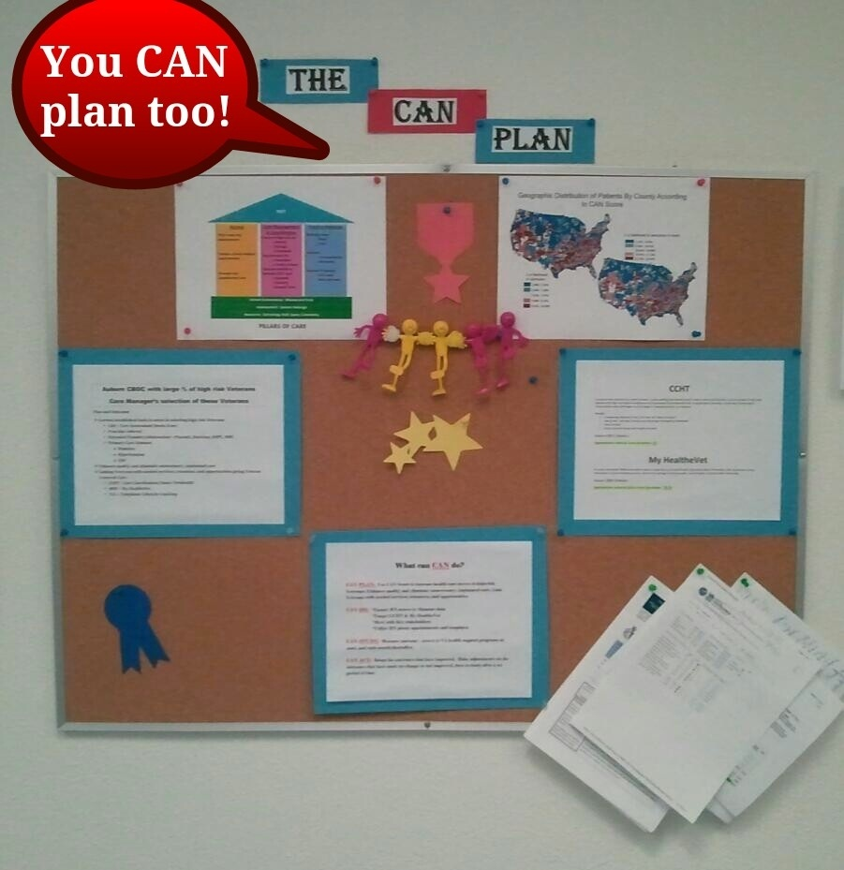
You CAN plan too!
From Jan 1 to March 31…
CCHT referrals 28
My HealtheVet IPAs > 100
2-day post discharge calls 100%
The CAN Score leads to a Win-Win for the veterans and the nurses
Notes:
The PACT RN’s developed a story board at the start of the project – Here is a snap shot of the board that hangs in the clinic’s main hallway. This provided the study piece of the PDSA at the 3 month mark. We achieved the original desired outcome of outreach and increase HTH utilization. In addition, we saw improvements in My HealtheVet use and we began to achieve 100% on our 2-day post discharge call measure.
I recommend nurses do their own story boards because it is a conversation starter, a reminder of what we do and how we are doing. In our clinic it has led to a dramatic culture change because rather than just a pilot project, we have naturally eased these practices in to our day-to-day veteran care.

Slide 67
Sustained
Notes:
So where are we today? Can our positive results be sustained? Absolutely! Auburn CBOC RN’s continue to monitor progress for their teams. Here you see the HTH enrollment since October 2012. Our percent utilization continued to increase after our March 13 measurement – We went from 0.3% use in January 2013 to 1.9% in June 2013 which is above the target measure of 1.5%.

Slide 68
Sustaining
Notes:
Here you see a graph showing improvement in the 2-day post discharge call measure.
This was a direct result of our project and our new awareness of the Almanac and CAN Report.
The nurses were so happy about these results because they are doing the work, providing great care, and…the workload is being captured.

Slide 69
MyHealtheVet
Notes:
Finally, here is a shot of the increased utilization of MyHealtheVet. It more than doubled in less than a year. Through these improved measures we see the power of planning and making changes to improve care.
PACT RNs are posed to be leaders in veteran health promotion and disease prevention. The VA is creating programs and tools to help us -
When we review nursing codes and standards of practice, we see that the goals of the VA and PACT are aligned with a nursing care model that is to treat the whole person by empowering them and partnering with them to achieve optimal health. We can achieve these goals by utilizing CAN!
We encourage PACT Nurse Managers across the VA to begin utilizing the wonderful tools that are tailored to provide the
“Best Care Anywhere”
Kathy: Now let’s check back in with Tami remotely. Hi Tami, I am really excited to learn about PCAS.
Tami: Thank you Kathy…

Slide 70
What CAN we do tomorrow?
PCAS- The Patient Care Assessment System
A new RN Dashboard, currently in development
Pulls data from multiple sources to save time
Manage not only ‘statistical high risk’ Veterans
Allows the RN to create and upload a plan of care
Notes:
Dr. Finh and his team – who brought us CAN- are currently working on another big thing- the PCAS Dashboard. We’ve seen a couple of presentations (and I’ve stolen a few screenshots) because we hope to be using this within the next year in Primary Care.
Right now, a big drawback of having so much data available is the time it takes to pull it down and review it. To obtain certain items- such as the actual names of Veterans who are counted each month towards the 2 day discharge follow up metric- the RN needs to obtain special VSSC Social Security level access. We move from the Dashboard to VSSC to the Almanac; from Discharge Lists to Fee Base pulls to UC and ED data, daily, and it can take time. What if it was all in one place, organized, so we could turn on our computers, pick up our phones and begin our day- making sure the Veterans we were targeting were the ones that needed it the most- not only statistically, as the data we obtain from CAN- but looking at Veterans who were at higher risk for other reasons: medication non-adherence; provider-placed risk flags; homeless or marginally housed veterans; those who utilize the ED more than Primary Care?
Best- what if in the course of our interactions with the Veteran, we were able to complete or to update an electronic Nursing Plan of care – something that I’d love to be able to easily do with my patients- that would detail their situation, background and goals - so that anyone could review that plan and- in an instant – understand their living arrangements, whether or not there was a caregiver involved; if they had transport – what the Veteran’s own wishes were– so that so many people didn’t spend so much time asking the same questions? We’d be able to follow our Veterans, and efficiently, within the system- make sure that anyone else who needed to, could do the same.

Slide 71

High Risk Patient Identification
Notes:
Overall Charge from PCS:
Construct risk prediction models for Veteran population using established risk factors and undiscovered factors from EHR
Use models to target specific care delivery
Evaluate effectiveness of case management of high risk patients in preventing adverse outcomes

Slide 72
OUR MISSION
The Patient Care Assessment System is a
web-based application
to provide
Patient Aligned Care Teams (PACT)
with
tools to
identify, manage, and coordinate care
for their paneled patients.
Special emphasis is given to high risk patients.

Slide 73
Patient Care Assessment System (PCAS)
PCAS
VISTA
CDW
CAN
ADMIN
OTHERS

Slide 74
Tools for Identifying and Coordinating Care
 |  | CAN | PCAS
PRIMARY AUDIENCE |  | PACT PROVIDERS | PACT RN CARE MANAGERS
ROLE |  | CAN Scores Key risk data Dashboard format | CAN Scores Key risk data PACT Team Management Patient and Team Notifications Clinical data Care planning

Slide 75

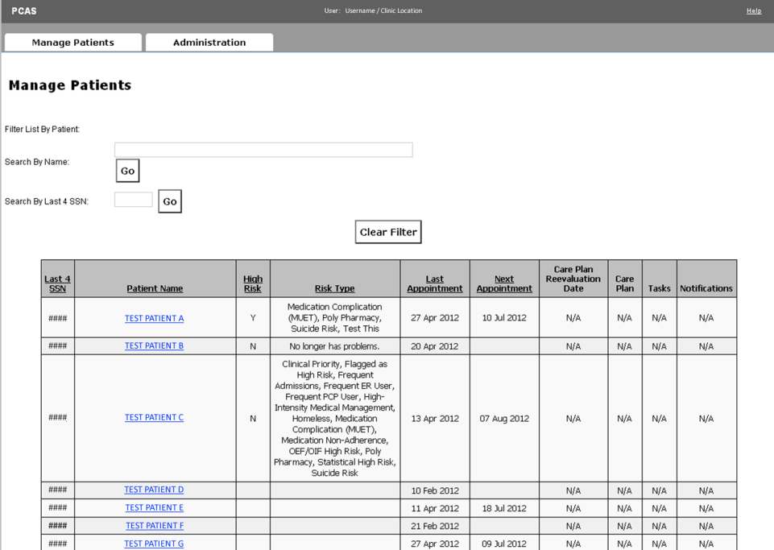
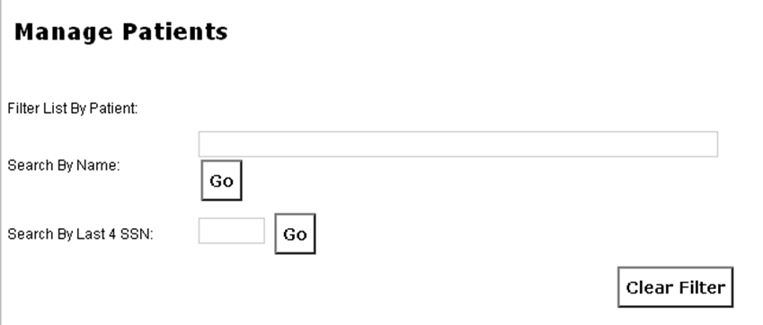
Patient Care Assessment System

Slide 76
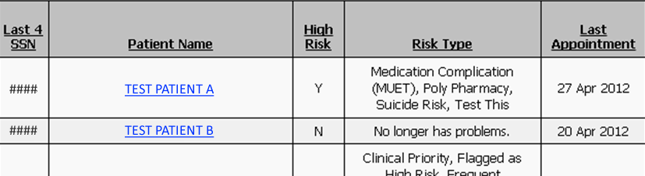
Patient Care Assessment System

Slide 77
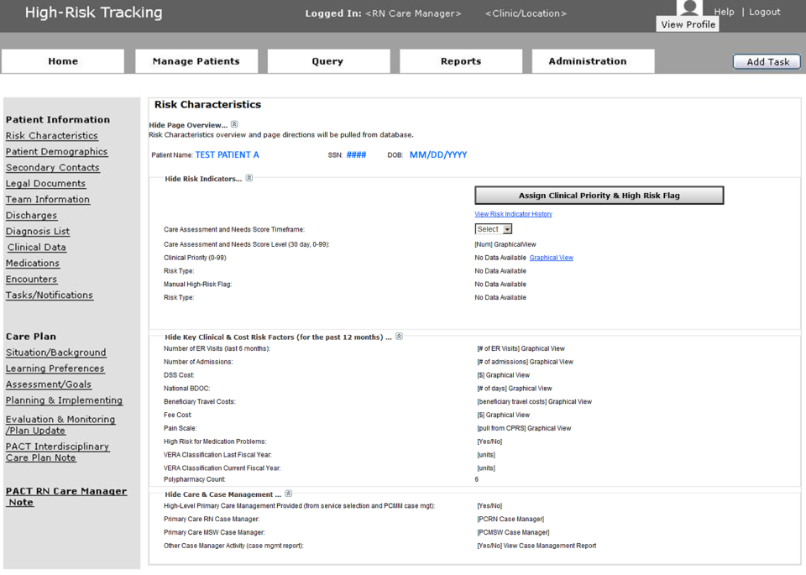

Patient Care Assessment System
Username / Clinic Location [ROLE]
Help
Risk Characteristics
Patient Demographics
Team Information
Discharges
Encounters
Diagnosis List
Clinical Data
Medications
Consults
Tasks/Notifications

Slide 78
Patient Care Assessment System
Username / Clinic Location [ROLE]
Help
RISK INDICATORS
CAN Scores (all models; 0-99)
CAN Score Graph Over Time
Clinical Priority (0-10)
Manual High Risk Flag
Risk Type
Statistical High Risk
High Intensity Medical Management
Suicide Risk
Homeless
Frequent ER User
Polypharmacy
Frequent PCP Visits
Frequent Admissions
Medication Non-Adherence (MUET)
OID/OIF/OND High Risk

Slide 79
Patient Care Assessment System
Username / Clinic Location [ROLE]
Help
KEY CLINICAL & COST RISK FACTORS
(past 12 mos)
Number of ER Visits
Number of Discharges
DSS Cost
National BDOC
Fee Cost
VERA Classifications
Polypharmacy
Pain Scale

Slide 80
Patient Care Assessment System
Username / Clinic Location [ROLE]
Help
CARE & CASE MANAGEMENT
High-Level Primary Care Management
Primary Care RN Case Manager
Primary Care MSW Case Manager
Other Case Manager Activity

Slide 81
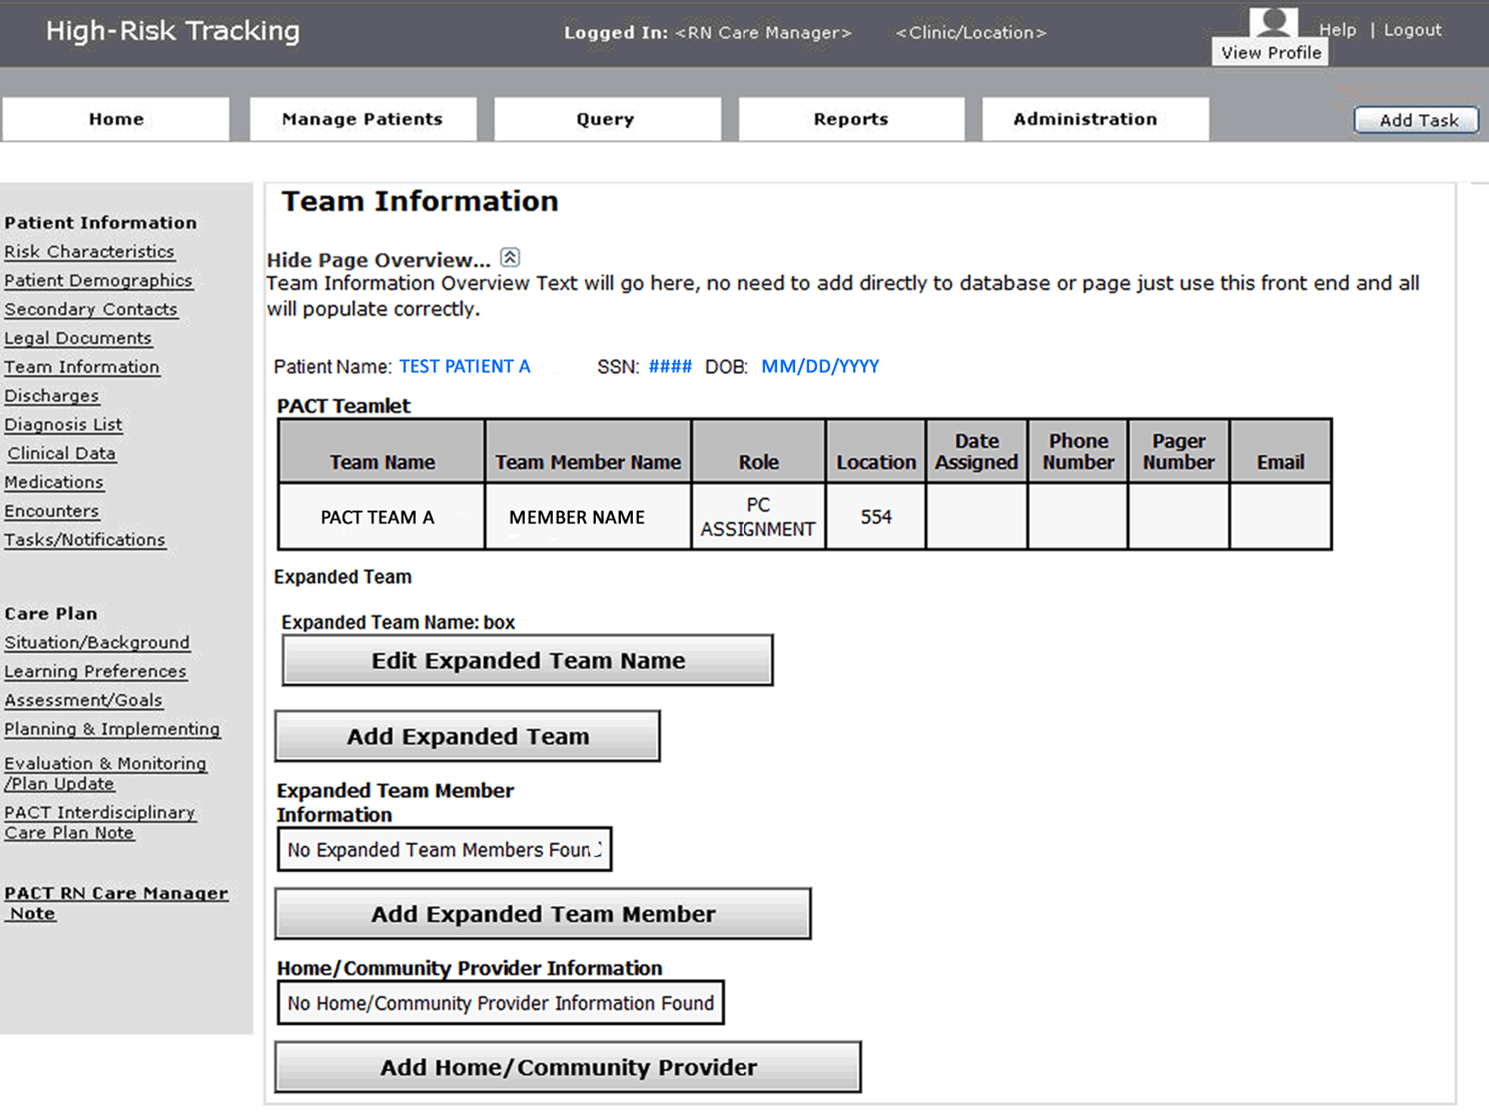
Patient Care Assessment System
Username / Clinic Location [ROLE]
Help
TEAM MANAGEMENT
All PCMM Team Members – any location
Expanded Team Members
Home/Community Providers

Slide 82
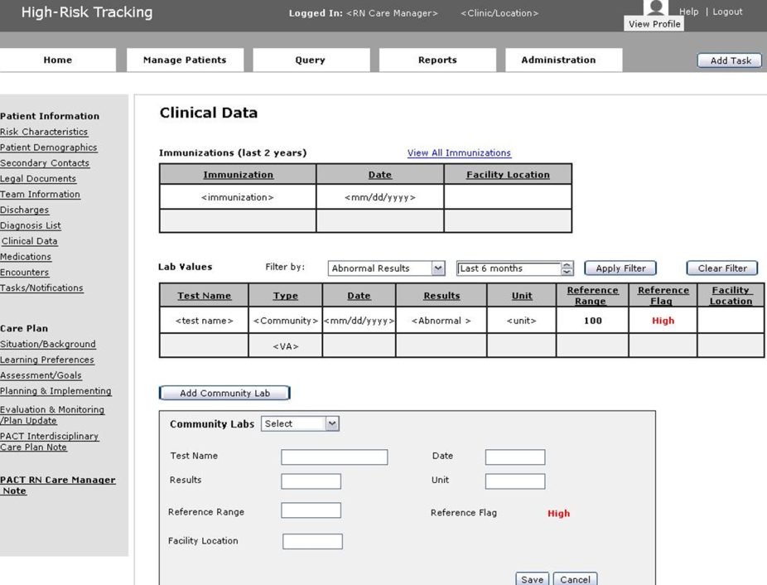
Patient Care Assessment System
Username / Clinic Location [ROLE]
Help
CLINICAL DATA
10 Most Recent Diagnoses (last 24 months)
Immunizations (last 2 years)
Lab Values (with extended filter capability)
Community Labs

Slide 83
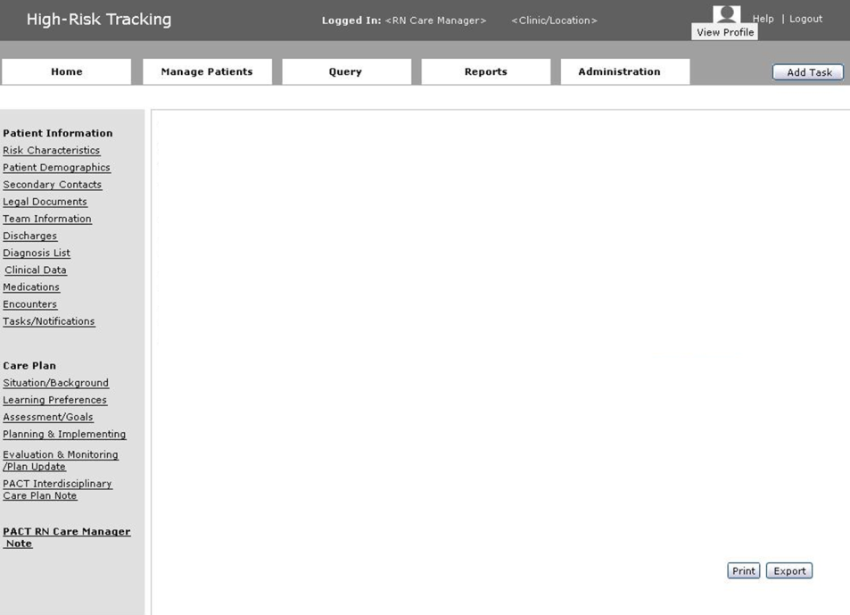
Patient Care Assessment System
Username / Clinic Location [ROLE]
Help
Encounters
10 Most Recent
Scheduled Date | Encounter With | Encounter Type | Facility | Clinic Name | Primary Stop Code | Diagnosis
ENCOUNTERS
Date
Provider Name
Type
Facility
Clinic Name
Stop Code
Diagnosis

Slide 84
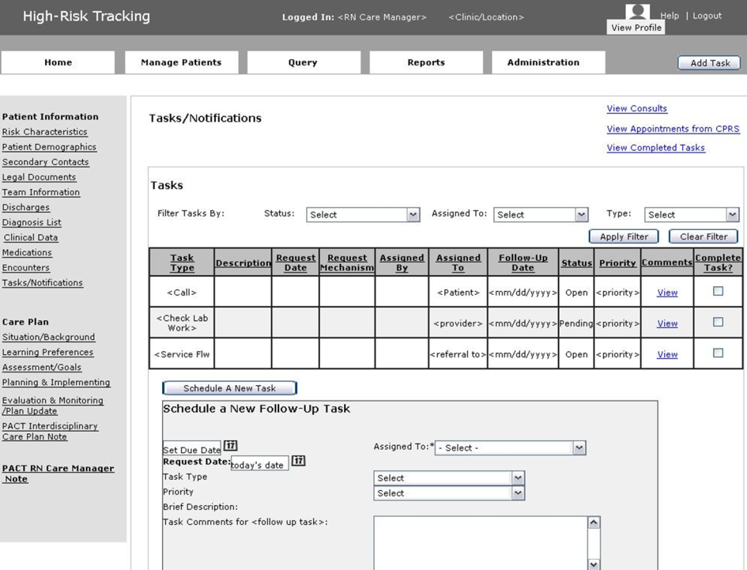
Patient Care Assessment System
Username / Clinic Location [ROLE]
Help
TASKS & NOTIFICATIONS
Team & patient-related
Scheduling
Reminders
Priorities
Historical Tracking

Slide 85
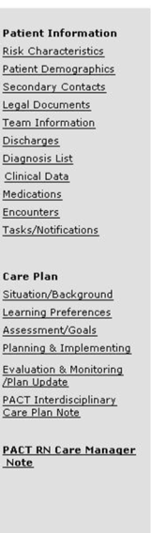
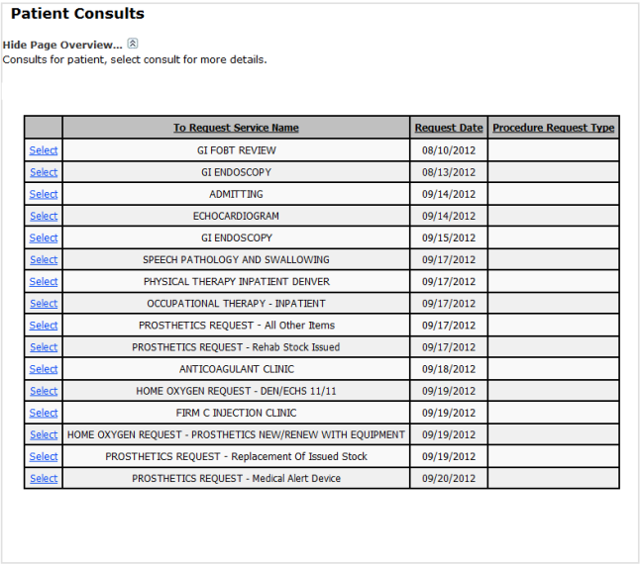
Patient Care Assessment System
Username / Clinic Location [ROLE]
Help
CONSULT TRACKING
Full Panel Overview
Search/filter – date range, patient, status
Per-Patient Consult Report
Per-Consult Details

Slide 86
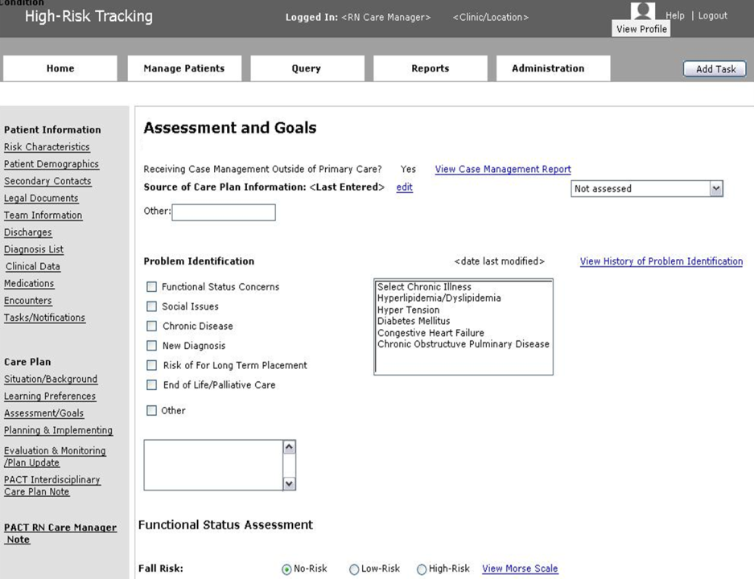
Patient Care Assessment System
Username / Clinic Location [ROLE]
Help
CARE PLANNING
Situation/Background
Learning Preferences
Assessment/Goals
Planning/Implementing
Evaluation & Monitoring/Plan Update
PACT Interdisciplinary Care Plan Note
PACT RN Care Manager Note

Slide 87
Patient Care Assessment System
Username / Clinic Location [ROLE]
Help
ASSESSMENT & GOALS
Case Management Report
Problem Identification
Functional Status Assessments

Slide 88
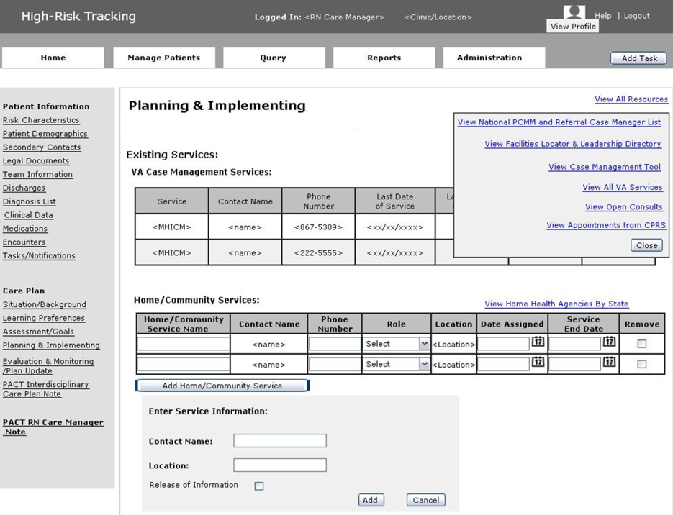
Patient Care Assessment System
Username / Clinic Location [ROLE]
Help
PLANNING & IMPLEMENTING
VA Case Management Services
Home/Community Services

Slide 89
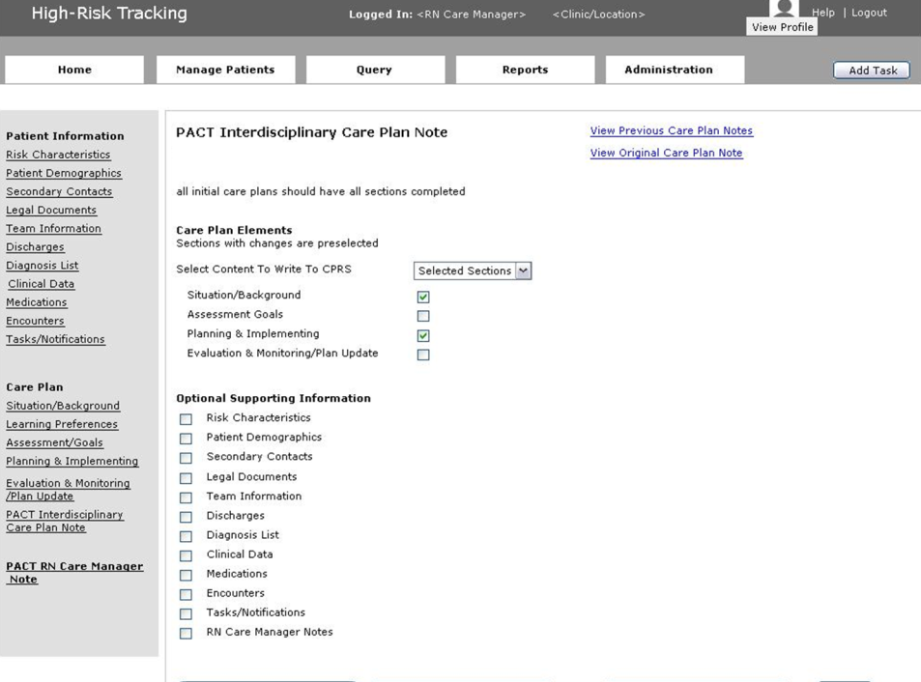
Patient Care Assessment System
Username / Clinic Location [ROLE]
Help
PACT Interdisciplinary Care Plan Note
Dynamically created
Include specific Care Plan sections if changed
Include any option patient information

Slide 90
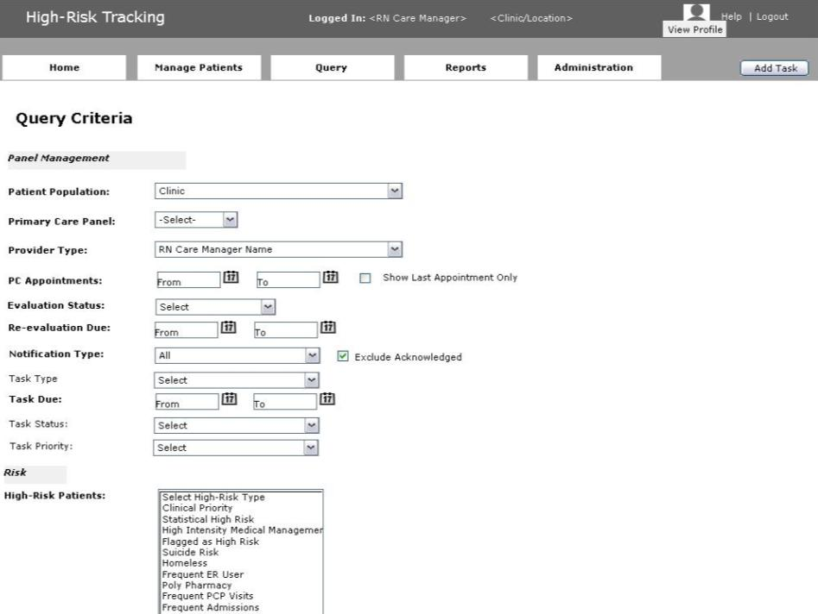
Patient Care Assessment System
Username / Clinic Location [ROLE]
Help
QUERY FUNCTIONALITY
Appointment Range
Risk Types
Risk Categories
Care Plan Evaluation

Slide 91
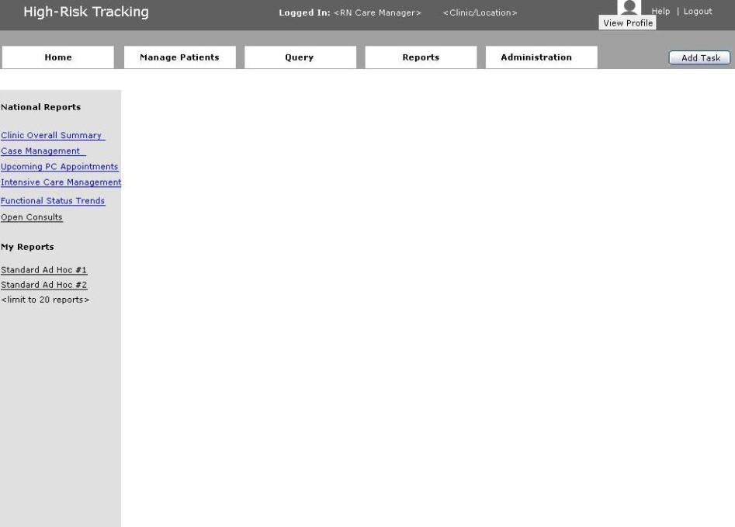
Patient Care Assessment System
Username / Clinic Location [ROLE]
Help
Nationally-Standardized Reports
Clinic Overall Summary
Case Management
Upcoming PC Appointments
Intensive Care Management
Functional Status Trends
Open Consults
MY REPORTS
Standardized Ad Hoc #1
Standardized Ad Hoc #2

Slide 92
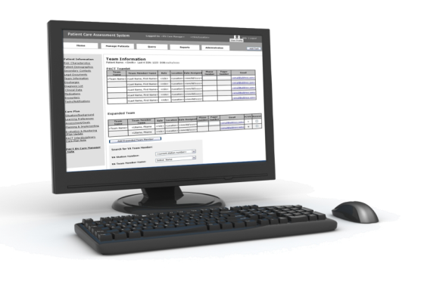
Ongoing Evaluation
Implementation
Standards of care
High risk ambulatory patient evaluation
Primary Care Services
Office of Nursing Services

Slide 93

Ask the Presenter
Notes:
(Tami will say all this) (This must be your last slide.)
If you haven’t submitted your questions yet, there is still time to do so by clicking on the orange “Ask The Presenter” icon. We’re going to show a brief announcement and be right back to answer your questions.
(Stand still and smile until you see the video come up full screen)
[erase these notes and add your own!]

