Slide 1
Partnering with Veterans and their Medications
Part Two: Patient Medication Information
Rosemary Grealish, RPh
&
Maureen Layden, MD, MPH

Slide 2


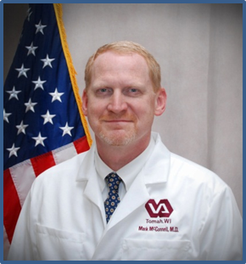
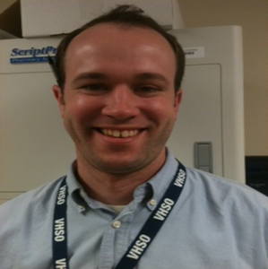
Who we are
Rosemary Grealish, RPh
Maureen Layden, MD, MPH
Mark McConnell, MD
Eric Spahn, PharmD
Notes:
Maureen & Rose
Rose, Maureen and Eric work for PBM Med Reconciliation, Mark represents the MedRecon Task Force.
Maureen: So lets start with viewing a clip from the MedRecon “The Right Prescription: Primary Care Kiosk” video. This will help us set the stage for our session here on partnering with our patients and their meds. Lets take a look.

Slide 3
VA Patient Medication Information & Medication Reconciliation Initiative
Workgroups
Resources
Cross Program & Federal Healthcare Agency Events
Notes:
Maureen:
Recap of Part 1
We are the Pt Med Information and MedRecon Initiative.
In our part 1 we talked about MedRecon History, why it is important, the barriers, the resources available to you to help improve your process.
We also talked about the Joint Commission, VA MedRecon Directive and the new MedRecon Quality Indicators EPRP or External Peer Review Program.
We have meetings every Tuesday and resources to share with you—pamphlets, posters, videos, policy tools, cases, links, and lots of examples of documentation and monitoring strategies—all on our Share Point.
You are also welcome to join our Cross Program & Federal Healthcare Agency Events
--The Med Use Crisis Conference, Interprofessional MedRecon & Med Info Mgt Education Module, We left off highlighting some innovations—the May is MedRecon Awareness Month winners, SLC’ s MedRecon Pharm Tech Program, and the Boston PILL Clinic .
Handoff to Rose—no verbiage

Slide 4
Objectives
Describe patient medication information (PMI)
Understand the relationship between PMI and medication reconciliation (MedRecon)
Explore ways to partner with patients and their medications
Define essential medication information standards
Outline 3 strong practices to partner with patients and their medications
Notes:
Rose:
Describe objectives:
Describe PMI
PMI/MedRecon
Essential Med Info Standards
Handoff: First Lets go over what medication information is----

Slide 5

What is Medication Information?
Notes:
Maureen:
-All the information regarding the medications the Veteran takes
-The medications the Veteran’s healthcare team(s) have ordered or recommended
-The Veteran’s medication history including effectiveness, allergies, and adverse effects & events
-The education materials and resources the Veteran/Caregiver uses to understand his/her medications
Handoff to Rose: Medication Information play a critical role in how we care for patients…….

Slide 6
Why is Medication Information Important?
Medication Treatment Planning
Transitions in Care
Adverse event mitigation
Patient Partnership
Education
Notes:
Rose:
This is very similar to the VALUE slide that we reviewed in the last presentation, but let’s expand that conversation
Medication Treatment Planning
Transitions in Care
Adverse event mitigation
Patient Partnership:
Customization
Overcoming Barriers
Self Management
Education…..
Handoff to Maureen: No verbiage

Slide 7
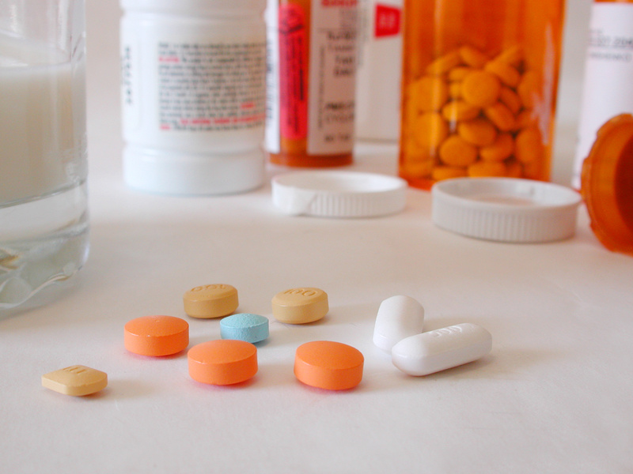

Medication Information and the
Patient Protection and Affordable Care Act
Notes:
Maureen:
We talked about The Joint Commission’s National Patient Safety Goal for medication management and the Health and Human Services (HHS) Office of National Coordinator Meaningful Use criteria on clinical reconciliation.
Medication Information Management is part of the quality metrics associated with both inpatient and outpatient processes underlying the Affordable Care Act. For example, inpatient clinical processes involve medications and discharge instructions as well as patient experience of care including staff communication and responsiveness, communication about meds, and discharge info
An Outpatient example is medication reconciliation after discharge.
CMS Partnership for Patients, is a collaborative of over 3,500 hospitals who’s goal is to reduce readmission and medical harm……..
Rose: Handoff no verbiage
http://www.cms.gov/Regulations-and-Guidance/HIPAA-Administrative-Simplification/Affordable-Care-Act/index.html?redirect=/Affordable-Care-Act/

Slide 8
The Trajectory of Medication Information
Before the Visit
Medical Visit
After the Visit
Ongoing Health Maintenance
Kim M. Nazi, PhD, FACHE
Notes:
Rose
Dr. Nazi has outlined the trajectory of medication information. Medication information drives care before, during and after the medical visit. While the healthcare team focuses on the medical visit, the patient spends most of the time outside the healthcare system using this information for self management.
Maureen Hand Off: Medication Reconciliation is part of Med Info Mgt and lets look first at how patients may view this overall process……

Slide 9
Patient
Medication Reconciliation
Medication Information Management
Collect
Compare
Collaborate
This is what I am doing with my meds
This is how I take my meds and why
How can we reduce the burden of my meds?
Notes:
Maureen:
To maintain medication information, both sides need to do a fair amount of work.
The first few steps is really preparing and performing medication review, and the review with the patient may have different implications than it does for the clinician.
Medication Reconciliation is part of Medication Information Management, patients, and their caregivers and families have different ways to maintain their med information.
MedInfo Mgt is a larger process. It’s beyond making sure the lists are the same.
READ SLIDE
Collect:This is what I am doing with my meds
Compare:This is how I take my meds and why
Collaborate:How can we reduce the burden of my meds?

Slide 10
Patient
Medication Reconciliation
Medication Information Management
Correct
Communicate
Counsel
Do these meds make sense for me now?
These are my healthcare team(s) that need an updating
How can I avoid problems like side effects or drug interactions?
Notes:
Maureen (continue)
READ SLIDE
Correct Do these meds make sense for me now?
Communicate These are my healthcare team(s) that need an updating
Counsel How can I avoid problems like side effects or drug interactions?
Rose: Hand off no verbiage

Slide 11
Staff
Medication Reconciliation
Medication Information Management
Collect
Compare
Collaborate
Is the patient able to give a medication history?
What are their barriers to adherence?
How can we negotiate the best plan?
Notes:
Rose:
Medication Reconciliation is part of
Medication Information Management: Healthcare team’s perspective
Continue next slide
Collect: Is the patient able to give a medication history?
Compare: What are their barriers to adherence leading to discrepancies?
Collaborate: How can we negotiate the best plan?

Slide 12
Staff
Medication Reconciliation
Medication Information Management
Correct
Communicate
Counsel
Have we updated the chart?
Are all the healthcare team(s) updated?
How can we improve your system of medication use?
Notes:
Rose:
Medication Reconciliation is part of
Medication Information Management: Healthcare team.
Correct: Have we updated the chart?
Communicate: How many healthcare team(s) are there complicating care?
Counsel: How can we improve the patient’s system of medication use?
Maureen: This is part of complex process….

Slide 13
Iterative Cycle of Reconciliation with permission of Dr. Blake Lesselroth
Lesselroth et al., Greenwald et al, Markowitz et al, Vermeire et al
Notes:
Lesselroth et al., Hum Fact Erg, 2011; 2. Greenwald et al, JHM, 2011
3. Markowitz et al, AMIA Pro, 2011; 4. Vermeire et al, J Clin Pham Ther, 2001
Maureen:
This slide is difficult to read, but you can download a copy of this presentation to have a closer look by clicking on the green download button above my head
True, Dr. Lesselroth has compiled this iterative cycle of medication reconciliation.
The cycle involves am effector arm and a receiver arm. It doesn’t have to happen in one visit, but often occurs over time and a series of visits. There’s a lot to do with collecting the information, sharing goals and iteratively modifying the goals to achieve the best results for the patient.
Rose: Lets share a case from Dr. McConnell to get an idea what we mean here….

Slide 14
Case
Dr. Mark McConnell from Tomah, Wisconsin
Notes:
Rose:
Dr. McConnell, our a key member of our MedRecon Task Force shared this patient story with us
A patient was added on at 7am because he needed a “form filled out”
=====================
57 y/o active male, non-smoker, non-drinker, very active who has bp of 160/90 and A1c of 9.4
Very busy with home remodeling business, here to get a commercial driving license physical. Mark noticed poor BP and glucose control and simply asked the patient if he'd been taking his meds. He admitted he hadn’t been taking any of them. Mark reviewed each medication with the patient, how they prevent diseases like heart attacks, strokes and about side effects and how he can be safe taking his meds. For instance, Mark explained about risk hypoglycemia in a worker using power tools. Finally we re-organized his meds so he can fit them in his busy life—so we cut down the number of medications he takes each day. We've designed a simple, evidence based regimen that fits HIS schedule.
He agreed to come back to work on the rest of his health maintenance plan.
“Every once in a while, you get to change a life if you simply do med reconciliation and CREATE an atmosphere where patients can tell you they aren’t taking their meds”. This really helped improved adherence in a way that fits with patients life and goals…..
Handoff to Maureen: No verbiage

Slide 15
Partnering with Patients
Med Use Crisis
Barriers to Adherence
Preference
Shared and Informed Clinical Decision making
Notes:
Maureen:
That is a great case and illustrates many of the common themes, how we partner with patients to manage their health information
Med Use Crisis: Overuse, underuse, misuse—missed opportunity to treat and prevent
Care Coordination
Preference
Barriers to Adherence
Shared and Informed Clinical Decision making which is the really the new frontier for healthcare……….
Handoff to Rose: No Verbiage

Slide 16
Minimally Disruptive Medicine
With permission of Dr. Victor Montori
Patient begins consultation with clinician
Clinician and patient discuss medication options
Patient leaves consultation with prescription
Patient makes decision about medication
Notes:
Rose:
Disruptive medication is where the disconnect is.
While we think that the patient agrees with the medication regimen we’ve prescribed for him/her, we don’t realize the burden that we place on patients and how the medication regimens can disrupt their lives.
Dr. Victor Montori from the Mayo Clinic, in his presentation “Minimally Disruptive Medicine” eloquently presented the problem for us at our October 2012 Medication Use Crisis conference. The patient makes the decision as to whether to actually take the medication or not, and how do we work together to come up with the best, evidence-based plan that works for the patient.
Maureen: This is a huge issue as many of you know…..

Slide 17
Medication Harm
2000: IOM estimated that 98,000 people die every year
2006: 1.5 million harmed Americans each year, $3.5 billion in medical costs
ADEs are the single largest contributor to hospital-related complications
2013: may actually be as high as 440,000
Notes:
Maureen
In 2000, The Institute of Medicine’s (IOM) seminal study estimated that as many as 98,000 people die every year from preventable medical errors at a cost of $29 billion¹
A new study this year suggests that deaths may be as high as 440,000²
If the Centers for Disease Control were to include preventable medical errors as a category, this would make it the third leading cause of death in America²
In 2006, the IOM reported medication errors harm an estimated 1.5 million Americans each year, resulting in upward of $3.5 billion in extra medical costs³
ADEs are the single largest contributor to hospital-related complications ⁴ , accounting for over 3.5 million physician office visits, approximately 1 million emergency department (ED) visits, and an estimated 125,000 hospital admissions every year.⁵
1. IOM (Institute of Medicine). To Err is Human—Building a Safer Health System, 2000
2. James, J. Journal of Patient Safety, 2013
3. IOM (Institute of Medicine). Preventing Medication Errors, 2006
4. Classen et al, Health Aff, 2011
5. Budnitz et al JAMA, 2006
Rose Handoff: And there's more…
(In 2000, IOM estimated that 98,000 people die every year
2013 – may actually be as high as 440,000²
If the Centers for Disease Control were to include preventable medical errors as a category, this would make it the third leading cause of death in America²
In 2006, the IOM reported medication errors harm an estimated 1.5 million Americans each year, resulting in upward of $3.5 billion in extra medical costs³
ADEs are the single largest contributor to hospital-related complications ⁴ , accounting for over 3.5 million physician office visits, approximately 1 million emergency department (ED) visits, and an estimated 125,000 hospital admissions every year.⁵)

Slide 18
Adherence
20% -30% med never filled
50% patients discontinue treatment
$100 billion -$289 billion in direct cost
$2000 per patient visit
59% understand the purpose of their meds
Notes:
Rose: Studies show:
20% to 30% of medication prescriptions are never filled consistently
Patients do not continue treatment as prescribed in about 50% of cases, particularly in the case of long-term therapies
Direct cost estimated at $100 billion to $289 billion annually
Costs $2000 per patient in physician visits, associated with 30% to 50% of treatment failures and 125,000 deaths annually
In the VA*, only 59% of inpatients strongly agree that they understand the purpose of taking each of all of their meds when they are discharged. Unfortunately, that leaves about 40% that are going home NOT understanding their medications and greatly decreasing their buy in to adherence…
Handoff to Maureen (no verbiage)
1. Peterson et al, PMID, 2003
2. Sabate et al, Adherence to Long-Term Therapies: Evidence for Action, WHO 2003
3. Brown et al, Mayo, 2011
4. Osterberg et al, NEJM, 2005
5. Levine et al, Annals of Neuro, 2013
6. Ho et al, Circulation, 2009
7. FY2013 VA inpatient SHEP (Survey of Healthcare Experiences of Patients) question 25
http://www.cdc.gov/primarycare/materials/medication/
http://www.who.int/chp/knowledge/publications/adherence_full_report.pdf
In data being collected for FY ‘13 the new VA inpatient SHEP (Survey of Healthcare Experiences of Patients) question 25 (understands med purpose) reveal that only 59% of inpatients strongly agree that they understood the purpose of taking each one of their medication upon discharge. For Question 17, how well do you understand side effects of your new medication? Of the patients who receive medications at discharge, about 55% of discharged patients, only 50% answered ‘always’.
We need to improve on that.
(45% response for SHEP surveys, sometimes they don’t answer all the questions.)
Preliminary data from the HCAPS (Hospital CAHPS (Consumer Assessment of Healthcare Providers and Systems) Survey nationally tied to hospital reimbursement by the ACA).

Slide 19
Adherence
Health care system/team factors
Patient-related factors
Therapy-related factors
Condition-related factors
Social and economic factors
World Health Organization. Adherence to long-term therapies: evidence for action, 2003.
Notes:
Maureen:
Adherence is a cluster of behaviors—not a single one—and is simultaneously affected by multiple factors,
such as patient factors—like healthcare literacy, provider factors like communication skills to help patients understand their regimen and possible side effects, and health-care system factors like the information we give to patients to help them understand their medications.
Compliance is a passive following of recommendations.
Persistence is a measure of how successful patients are at continuing medications after starting, also a complex process
Handoff to Rose: no verbiage
http://www.who.int/chp/knowledge/publications/adherence_full_report.pdf

Slide 20
What can you do for the Veteran and Caregiver?
Engage
Observe
Ask
Assess
Understand
Target
Coach the driver
With permission of Katharina Echt, PhD
Notes:
Rose:
We need to help our Veterans and their caregivers manage their own medication information. Dr Katharina Echt suggests that we
Engage our patients to take ownership
Observe how they manage their medications
Ask them if they know why they are taking each one
Assess their understanding
Understand the barriers to adherence
Target specific barriers that can be improved
Our aim is to support patient driven care—we need to coach the driver to success
Handoff to Maureen: no verbiage

Slide 21

Poll Question
Non adherence to medications can be due to which factor or factors?
    Health Literacy
    Unpleasant side effects
    Number of medications per day
    Unclear medication information
    All of the above
Notes:
Maureen:
Non adherence to medications can be due to which factor or factors?
To answer the poll question, please click on the blue polling icon above my head. We’ll get back to your results in just a minute
While you’re answering the pole… (advance to The Same Page).

Slide 22


The Same Page
Sergeant First Class William Fraas, retired and his wife Mrs. Marie Fraas
OEF/OIF/OND Team
VA Pittsburgh Healthcare System
Notes:
Maureen:
The goal is to be on the same page as the patient, making it possible for them to get the most out of their medication, aligning with their preferences, and addressing barriers to adherence they may have. A major barrier is confusion. What is the medication list they are to go home on? Sometimes we don’t know, we’re not sure which is the correct medication list.
Which medication list that is best for the patient to take home that will enable the Veteran and caregiver to report any problems?
What can we do to create tools to help Veterans explain what medications they are on to help them communicate with their healthcare teams outside VA to coordinate care?
This takes defining the page and addressing unclear medication information.
Handoff to Rose: What are the poll results

Slide 23
Poll Results
Non adherence to medications can be due to which factor or factors?
    Health Literacy
    Unpleasant side effects
    Number of medications per day
    Unclear medication information
    All of the above
Notes:
Rose:
Non adherence to medications can be due to which factor or factors?
If you answered ‘all of the above’, you’ ve been listening. The Healthcare team, organization, Caregiver, as well as the Patient all contribute to success in adherence to the medication treatment plan that we came up with together.
Now lets focus on decreasing the confusion Patients and Teams may have over medication lists and medication information by Defining the Page.
Handoff to Maureen: Maureen, let’s get started…

Slide 24
Poll Results
    Health Literacy
    Unpleasant side effects
    Number of medications per day
    Unclear medication information
    All of the above
Notes:
(Cue to Tech Team that you’re moving on) “Click” again to move on

Slide 25
Defining the Page: Essential Med Info Standards Directive
Med List
Web
Mobile
Point of Service
Paper
Notes:
Maureen:
There are a lot of ways to present medication information. To define the page is a challenge, especially given all the different kinds of tools that our Veterans can use to access their health information.
We need to define medication list standards so that it will be the same across all these tools our Veterans use, so that the information will be the same no matter where they go or how they get it. If not, they’ll have to reenter information in the tools, or the information will be different.
Handoff to Rose: no verbiage

Slide 26
National Alliance of Patient Medication Information Standardization “NAPMIS”
Started as grass roots VA, DoD, and IHS
Produced the Essential Medication Information Standards Directive
Published a Patient Medication Information Standardization White Paper
Notes:
Rose:
You’re right. The National Alliance for Patient Medication Information Standardization Workgroup was started by VA, DoD, and IHS as a joint effort concerned with the variation in medication information content, duplication of IT tools in development, & lack of unified strategy. The group wrote and disseminated a white paper in 2012, and in 2013, wrote the Essential Medication Information Standardization Directive, to define the content, authoritative source and standards for display of medication information.
Let’s go over the Medication Information Standardization Directive…
Handoff to Maureen: no verbiage

Slide 27
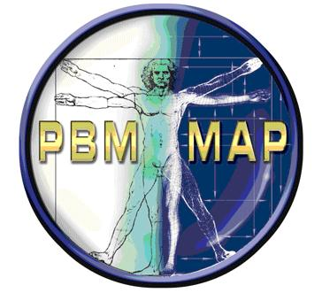
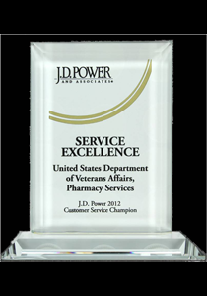
VA Pharmacy Benefits Management
Your Guide to Essential Medication Information
Notes:
Maureen:
PBM is the guide for all things pharmacy related including medication data.
Pharmacy Distribution-Facilities Consolidated Mail Outpt Pharmacy
CMOP is winner of the JD Power and Associates Service Excellence for the fourth straight year!
Pharmacy Operations: VISN and Facility support
Pharmacy Informatics
Clinical Pharmacy Services
Formulary Management
MedSafe/Adverse Event Reporting
Medication Information Management
Medication Reconciliation
Patient Medication Information Management
Handoff to Rose: no verbiage

Slide 28
Essential Med Info Standardization Directive
Medication Information
Content
Notes:
Maureen
What are the essential elements of Medication Information?
No handoff

Slide 29
Medication | Instructions | Provider | Pharmacy | Notes
Lisinopril 10mg | 1 tab daily | Jones (VA) | VA | Heart
Simvastatin 80mg | ½ tab daily | Jones (VA) | VA | Chol.
Lasix 80mg | ½ tab Daily | Carlton (VA heart Doc) | VA | Water pill
Tylenol 200mg | 2 caps bed time |  | Walmart | Back Pain
Celexa 20mg | 1 tab daily | Hernandez (St. Marks Psych Doc) | Samples | Happy Pill
Drug Name, Strength
How the Veteran takes the med
Who prescribed it
Where they got it
What’s important to the Veteran
Notes:
Rose:
Let’s look at a typical list that a patient might write to keep track of their medications.
There’s the name and strength of the drug
How to take it
Who prescribed it (remember, about half of our patients receive care outside of VA and have providers in the community)
Where it was filled
And most importantly, notes that the patient keeps of information important to them, what the med is for, what it looks like, a nickname for the drug.
Hand off to Maureen: Where does all that information come from?

Slide 30
Med Info: VA
Remote (other VA Facilities)
Progress notes
Other
Local
Notes:
Maureen:
Our medication information comes from the pharmacy (dispensary) package.
Sources for medication information include medications we’ve ordered in the local electronic medical record (from the medical center that the patient is visiting now), information from remote electronic medical records (other VA medical centers that the patient may have visited for care). Remember, we can’t change the dose of a prescription without dispensing it, so don’t forget to look at the progress notes for most recent doses. This is really important for high risk drugs like anticoagulants and opioids. We also need to consider other relevant information in the electronic medical record like medications that have recently expired or been discontinued, or were written today but waiting for pharmacy to complete them (pending meds), and the ‘fugitive’ medications, those administered in clinic or ED, given once a year, in infusion clinics, etc. that don’t always show up in the medication record.
Handoff to Rose: But there are other sources of medication information that patients may be taking.

Slide 31
Med Info: Non VA
Non-VA provider prescribed medications filled at non-VA pharmacies.
VA provider prescribed medication filled at non-VA pharmacies.
Other medications, such as sample prescription medications provided from a non-VA provider’s office.
Medications obtained from family or friends.
Herbals, over-the counter-medications, nutraceuticals, and alternative medications not dispensed through VA.
Notes:
Rose:
That’s right, we can’t forget that our Veterans have a choice of where they receive care, and at least 50% of them receive dual care, both from VA and in the community.
A non VA provider may have written prescriptions and the Veteran can purchase them at a non VA pharmacy.
Likewise, a VA provider may write a prescription for the patient, but that medication may be available at a community pharmacy for $4, instead of the $8-9 for a 30 day supply that VA charges.
The patient may have received sample medications or may be sharing medications with friends or family.
And we can’t forget that they may be purchasing other medications over the counter that they may not think of as “medications”. We need to remind them of those and document them.
Handoff to Maureen: no verbiage

Slide 32
For Review
Recently Discontinued
Expired
Pending, where relevant
Medication Management
Name of Drug
Strength/Dosage
Instruction/Directions
Notes
Sharing
Name, another identifier, ALL/ADR, Facility Contact, Date Printed, Instructions
Notes:
Maureen:
We need to review all the sources of medication for active meds, for recently discontinued, expired or pending medications so that we make sure we have everything the Veteran is supposed to take.
We need to provide usable information, including the name, strength/dosage, instructions/directions and any relevent notes to help the Veteran manage the medications once they return home.
We need to have the information in a format that is easily shared with both the Veteran/caregiver and the veteran’s healthcare teams.
Handoff to Rose: no verbiage

Slide 33
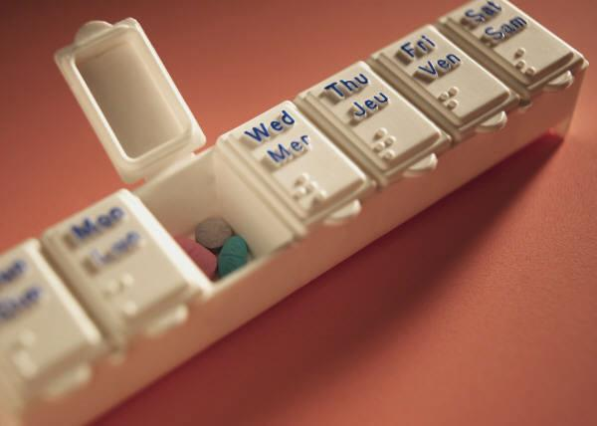
Non VA
VA
Other
Notes:
Rose:
So essentially we need to funnel all this information into a cohesive medication list that is meaningful to both the healthcare team and the Veteran.
Handoff to Maureen: But sometimes, it’s not the Veteran who is the source of errors in medication management…

Slide 34
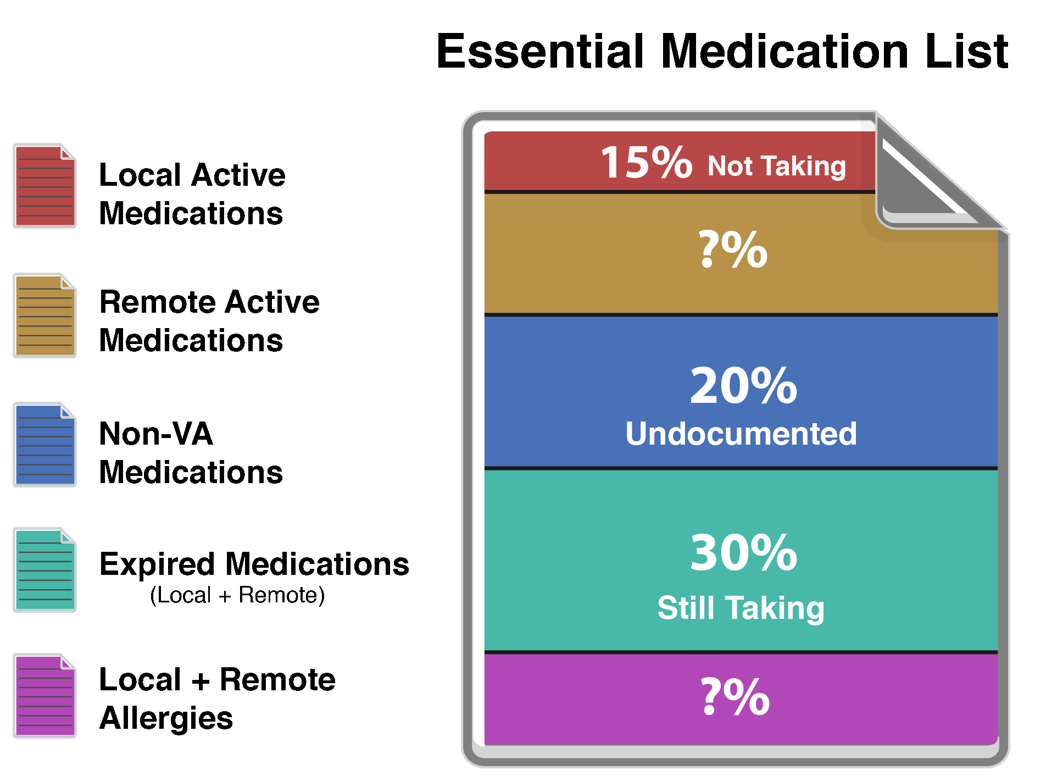
With permission of Dr. Lesselroth
Notes:
Maureen:
Dr. Lesselroth and the PIC had evaluated the number and types of discrepancies identified during a study period and found that many of the discrepancies are due to errors in the electronic record.
He’s found that 15% of the time, the patient is not taking a medication that we have listed as active, 20% of non VA meds remain undocumented in the electronic record, 30% of the patients are still taking medications that have ‘dropped off’ our electronic record because they expired (were not renewed) and the number of errors in capturing remote medication and allergy information is really still an unknown.
Handoff to Rose: We need to develop better tools to help the HCT help the Veteran.

Slide 35
Medication Review: Innovation
Medication review that makes it easier to identify the most important current and historical data.
Includes embedded infobuttons and decision support.
Search tool that allows a user to search across a patient’s chart
Used with permission from hi2 – HMP development, Thomas Heller, RPh.
Notes:
Rose:
The VA has created the Health Informatics Initiative (hi2), tasked with innovating and improving the electronic tools we use in caring for our Veterans. One of their current projects involves improved Medication review that will make it easier to identify the most important current and historical data related to the Veterans medications. The software will include embedded infobuttons to access more information and decision support to assist the clinician with medication selection. Search tools will allow a user to search across a patient’s chart in order to quickly identify specific information that may otherwise be difficult to find.
http://hi2.med.va.gov/
No Handoff

Slide 36
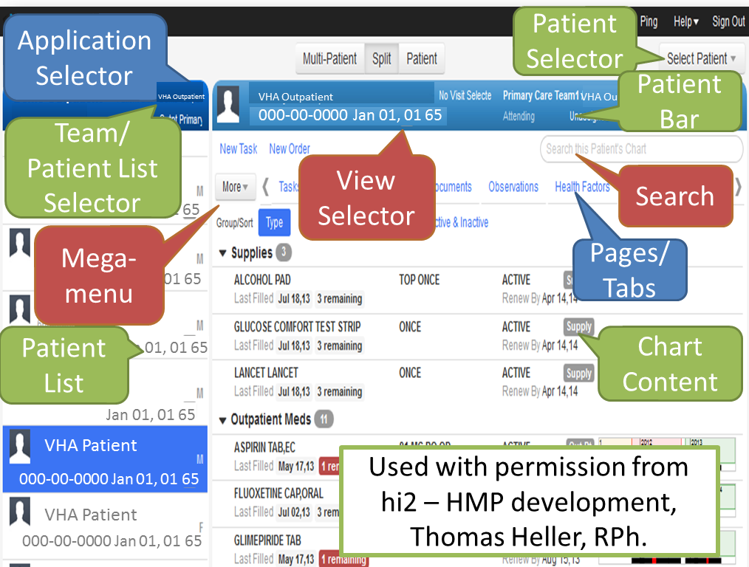
VHA Outpatient
Notes:
Rose
There’s a lot on this slide, but Health Management Platform (HMP) will contain a lot of options that we don’t have now, like the search function, a mega menu to select from, and various ways to filter the information to match the provider’s needs.
Let’s continue our discussion about the Essential Med Standardization Directive by looking at the display standards.
Handoff to Maureen: No Verbiage

Slide 37
Essential Med Info Standardization Directive
Medication Information
Display Standards
Notes:
Maureen
Let’s recap how we’re going to stay on the same page by defining the page. We talked about what goes on a med list (content), what the med list can be used for (use cases) and the innovation to help us to do medication review.
Now let’s talk about the Display standards, that’s a joint effort with NAPMIS and the Human Factors group. Let’s take a look.
No handoff

Slide 38
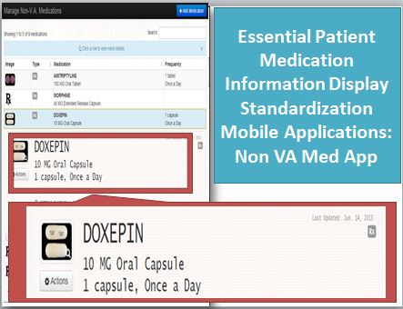
Used with permission from hi2 – non VA Med App
development, Thomas Heller, RPh
Notes:
Maureen:
Exemplars of human factors engineering for patient display
Here’s another example of an hi2 innovation, called the nov VA mobile app. It’s easy to see what medication the veteran is taking, including the image, the directions for use and the ability to get more information.
The goal is to have every medication list have the same look and feel to avoid confusion. This is a work in progress.
Handoff to Rose: So now we’ve defined the content and how it looks, Rose, where does the information come from?

Slide 39
Essential Med Info Standardization Directive
Medication Information Authoritative Source Standards
Notes:
Rose:
In the Essential Med Info Standards Directive we have defined the Medication Information Authoritative Source Standards we use in medication lists.
No handoff go to next slide

Slide 40

The Authoritative Source of Medication Information:
  PBM
  The Pharmacy Files
  Example: Medication Name “Lisinopril”
Medication | Instructions | Provider | Pharmacy | Notes
Lisinopril 10mg | 1 tab daily | Jones (VA) | VA | Heart
Notes:
Rose
PBM manages all the pharmacy files and is these files serve as the authoritative source for all medication information. The pharmacy files have been evolving over the past 30 years. Something as simple as which file to pull the medication name from can be very confusing for the developer since the same or similar data may be found in multiple drug files that are used for different purposes within the pharmacy package. Developers need to understand which specific file is to be used so that we can ensure to standardization for Veterans and Staff. To that end, PBM had catalogued the appropriate drug files to be used in all mobile, web based and point of service apps being developed and has made that information available within the Essential Medication Information Standardization Directive. This is very important in “defining the page”.
Handoff to Maureen: Let’s move on to a poll question…

Slide 41
Poll Question
The Essential Med Info Standards Directive defines:
Medication List Content
Sources for Medication Information
Medication Information Display
All of the Above
Notes:
Maureen:
Now I’d like to ask a poll question.
The Essential Med Info Standards Directive defines
Medication List Content
Sources for Medication Information
Medication Information Display
All of the Above
To answer this question, use the blue polling icon above my head. We’ll move on and come back to your results in just a moment. In the meantime, I’d like to share another innovation that we’re particularly proud of.
No transition, Maureen will cover both MIL slides

Slide 42
Medication Image Library
With permission of Bob Gale, RPh, MBA
Pharmacist Verified High Quality Image Library
Developed for Veterans
Centralized
Up to Date
Total VA NDC’s With Images: +15,000
Total Images: +40,000
MIL Users, not just the VA!
Notes:
Maureen:
Pharmacist Verified High Quality Image Library
Developed for Veterans
Centralized library, not 7 different ones with different image standards
Up to Date, constantly adding new images
Total VA NDC’s With Images: +15,000
Total Images: +40,000
MIL Users include Kiosk, MHV, Blue Button, but it’s not just the VA
NON-VA:
NIH/NLM Pillbox, a medication identification application, is currently using MIL data and images. In fact, of the 5000 images contained on the Pillbox application, over 3000 are from the MIL!

Slide 43
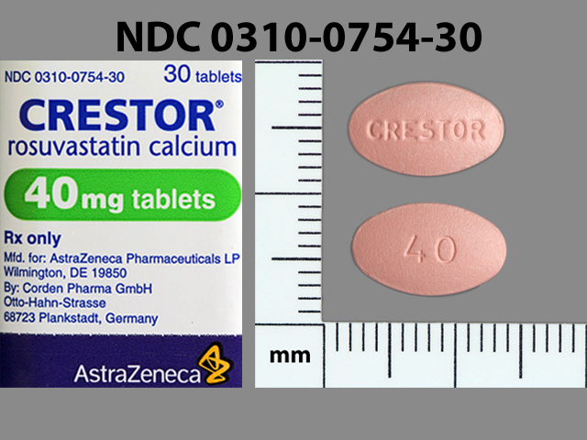
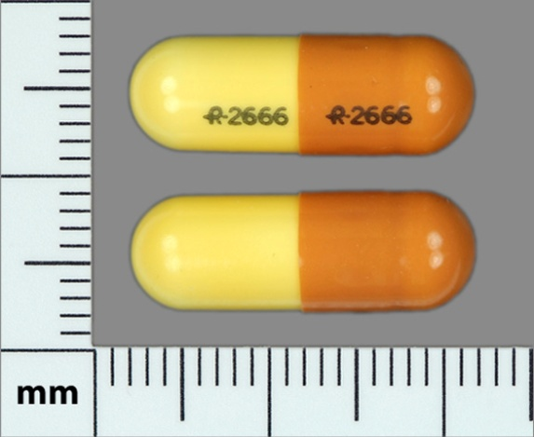
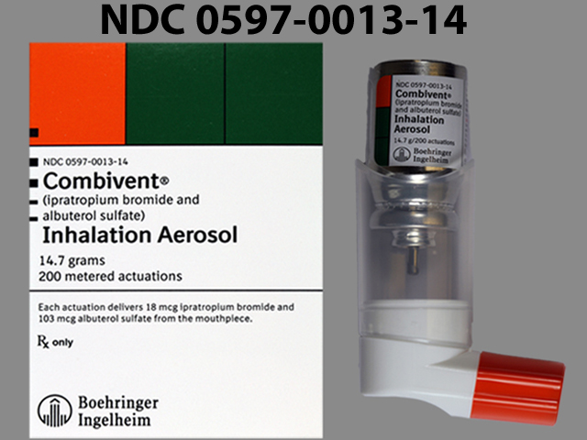
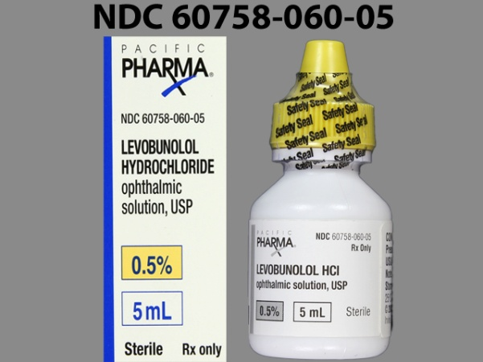
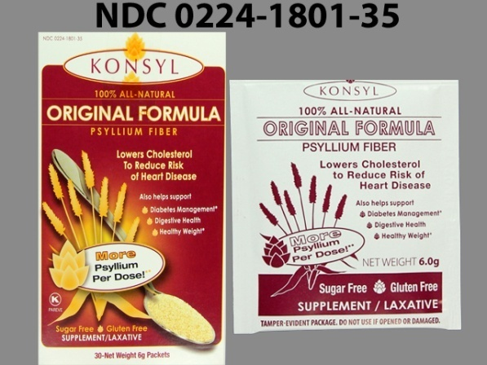
Medication Image Library
With permission of Bob Gale, RPh, MBA
Notes:
Maureen:
Take a look at these images, they are crystal clear. Patients tend to understand their meds by what they do and how they appear, “My little red pill for my heart” Another great way we can partner by standardization.
Handoff to Rose: Let’s look at the poll results…

Slide 44
Poll Results
The Essential Med Info Standards Directive defines:
Medication List Content
Sources for Medication Information
Medication Information Display
All of the Above
Notes:
Rose:
The Essential Med Info Standards Directive defines
Medication List Content
Sources for Medication Information
Medication Information Display
All of the Above
If you’ve answered D, you’re correct. The Essential Med Info Standardization Directive defines content, sources and display of medication information so patients have information that is clear to them, that looks and feels the same in whatever tool they are using whether it’s paper, web, mobile or Point of Service--like Kiosk.
Handoff to Maureen: no verbiage

Slide 45
Poll Results
Medication List Content
Sources for Medication Information
Medication Information Display
All of the Above
Notes:
(Cue to Tech Team that you’re moving on) “Click” again to move on

Slide 46
Patient’s Data
My Meds/My Recovery Plan on MHV
VPS Kiosk
Medication Mobile Apps
Reconciliation
Healthcare Organization Data
Non-VA
DoD
IHS
VA
Notes:
Maureen:
So this is what it could look like from an operations stand point:
Med Info from patients via all sources so they can manage and communicate
Data will be reconciled with the healthcare data across VA, DoD, IHS and amongst non VA Data
How can we all be on the same page?
Connected Health Office to do this work and exemplars from the field and program offices are also contributing to make this happen with the exciting Patient Generated Database
Handoff to Rose: no verbiage

Slide 47
Exemplars
My Meds/My Recovery Plan
VA Point of Service Kiosk/Automated Patient History Intake Device
Ask A Pharmacist
Daily Plan
Notes:
Rose
My HealteVet’s MyMeds/MyRecovery Plan, NCPS’ Daily Plan, PBM’s Ask a Pharmacist and Portland’s POS Kiosk and APHID are all examples of wonderful innovations both in development and currently deployed.
Handoff to Maureen: Let’s start with MyMeds

Slide 48

List of ALL Medications
Medication Images (VA only)
Self-Enter Medication Effects
Self-Enter and Monitor Medication Doses
Medication Reference Material
Access to MHV Features
* My Medications National Release with MHV 12.7 (limited release and field testing in December 2013.)
With permission of
Kenneth Weingardt, PhD
Notes:
Maureen
My Medications is a new feature of My HealtheVet that is currently available to limited users with limited national release planned for December 2013.
MyMeds will include a list of ALL medications with medication images displayed for VA medications. The Veteran can contribute to the record by self-entering medications and medication effects.
Medication reference material will be available, as well as access to other MHV Features including Secure Messaging (SM), Rx Refills, FAQs, Learn More and Quick Guide.
Handoff to Rose: No verbiage

Slide 49
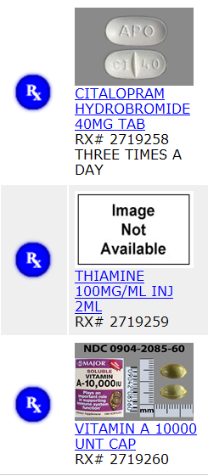
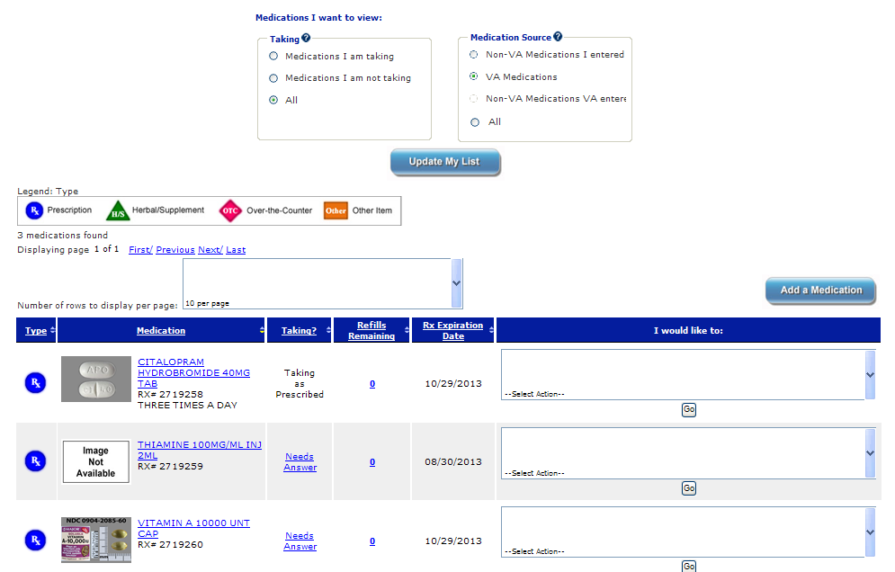
My Medications Functionality Overview
With permission of
Kenneth Weingardt, PhD
Notes:
Rose:
This is a display of what the Veteran will see---A complete list of all medications in a single location
Veteran will be able to self enter Non-VA Medications including Herbals/Supplements (H/S), Over-the-Counter (OTC) items, and Prescriptions (Rx) prescribed by a Non-VA prescriber.
Images for Medication Image Library (MIL)
MyMeds will also allow the Veteran to document any medication effects, wanted or unwanted, that they experience and to track and record medication doses using the Medication Journal.
Handoff to Maureen: No verbiage

Slide 50
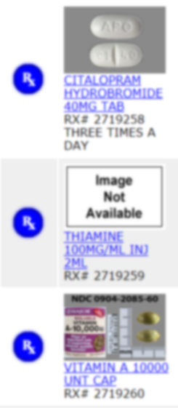
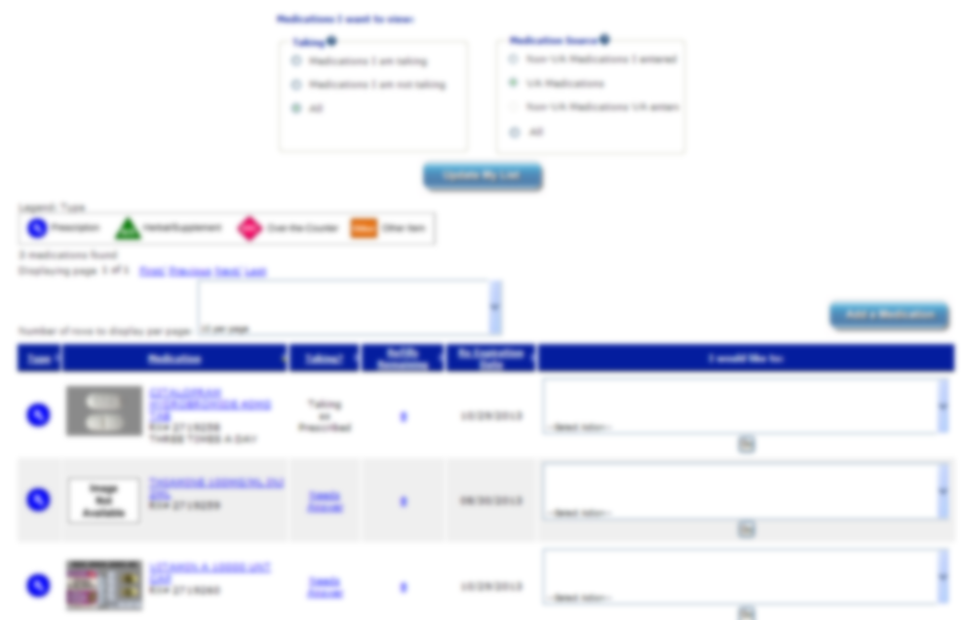
Maintains a complete list of your medications in a single location
Displays medication images for VA medications
With permission of
Kenneth Weingarten, PhD
Notes:
Maureen:
This is really going to help patients and their caregivers maintain their meds and partner with their healthcare teams.
Work is continuing on the MyMeds project. Future functionality will also include the incorporation of My Medications into the MHV Blue Button. Users will be able to view/print/save or download medication information via printer friendly pages throughout My Medications or located within Blue Button.
To learn more register for 3 sessions MHV is presenting on 1/31/2014
Handoff to Rose: Another way patients will be able to learn more is Ask A Pharmacist, an innovation led by our own Eric Spahn who started this effort in Fayetteville VAMC

Slide 51



With permission of
Eric Spahn, Pharm D
Notes:
Rose
Ask a Pharmacist is both an innovation in development and a Secure Messaging Strategy currently in use in many facilities
For the innovation: Veterans will be able search for answers to general questions about health and medications any time, day or night.
VA pharmacists will prepare answers to FAQS.
Currently, Veterans who have completed the In-Person Authentication Process (IPA) can submit specific questions for a prompt, personal response from pharmacists through secure messaging in 51 facilities. More facilities are being added.
No Handoff to Maureen

Slide 52
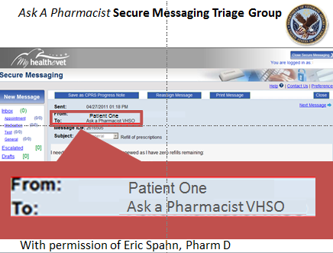
Notes:
Maureen
Ask A Pharmacist Secure Messaging Triage Group looks like this now in participating facilities
In these facilities, a Veteran is able to send specific questions to pharmacy staff. A three day response window will allow staff to respond in a secure, efficient, documented manner.
No Handoff to Rose

Slide 53

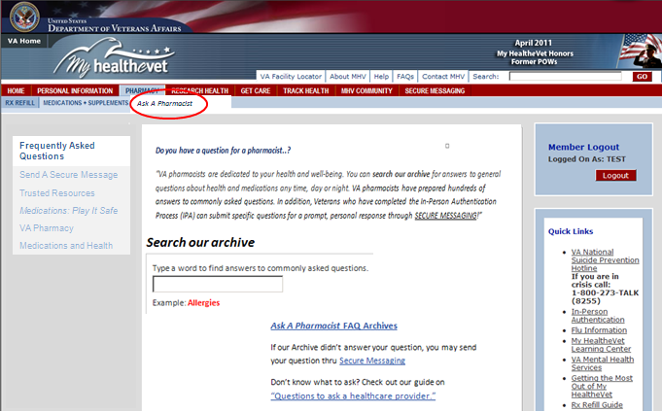
  Ask A Pharmacist Clinical Content Addition to Pharmacy Section of MHV.
Ask A Pharmacist
With permission of
Eric Spahn, Pharm D
Notes:
Rose:
Here is a mock up of the Innovation for Ask A Pharmacist in development
Its a website within the pharmacy section of MHV, includes
links to vetted internal and external medication resources, providing more resources for medication information for Veterans.
For more info on Ask a Pharmacist, see Eric Spahn’s ON DEMAND VeHU presentation.
Also at the end of the month MHV is presenting 3 sessions on 1/31/2014
Handoff to Maureen: the Daily Plan is another great innovation.

Slide 54

Patient Safety & Quality Tool
Patient-specific
Encourages “speak up”
Prevention
Improves the patient safety culture.
Provides an opportunity for patient education and identification of patient education needs.
VA National Center for Patient Safety
With permission of
Cheryl Mitchell, RN, , BSN, MSA, VHA-CM
Notes:
Maureen:
The Daily Plan, developed by the NCPS
Patient Safety & Quality Tool- “Empowers” patients and families to be involved in their plan of care.
Patient-specific document reviewed with patients each day of their hospital visit.
Encourages patients and/or their caregivers to “speak up” and be involved in their care.
Helps prevent possible medical errors.
Improves the patient safety culture.
Provides an opportunity for patient education and identification of patient education needs.
https://vaww.cmopnational.va.gov/CR/ncpsoit/TDP/default.aspx
No handoff: go to next slide

Slide 55
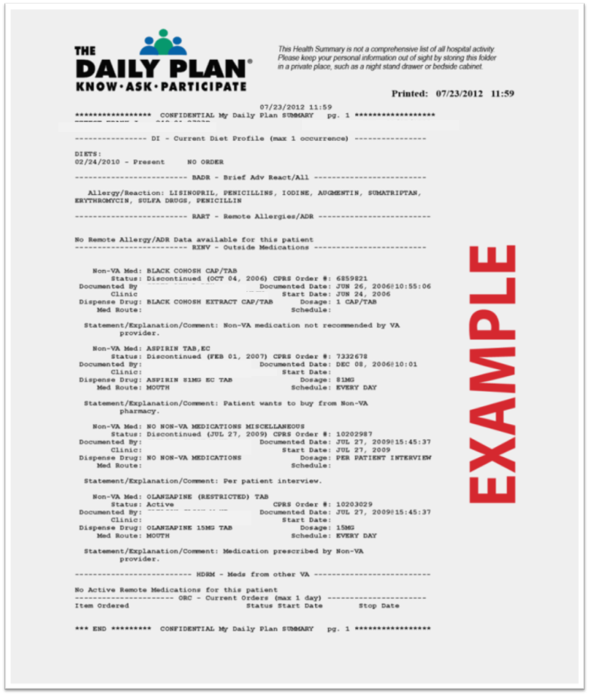
The Daily Plan
Patient specific printed document
Reviewed by patient, nurse, and provider
Patient involvement
Enhanced patient safety
“Getting Started” booklet pg. 9-15 has CAC step by step set up
With permission of
Cheryl Mitchell, RN, BSN, MSA, VHA-CM
Notes:
Maureen:
Here is what the Daily Plan looks like.
Patients are encouraged to go over the Daily Plan and ask their healthcare team about any of the features to facilitate patient decision-making regarding their medical care.
To get started, you can find the Getting Started booklet on the site in the presentation notes
https://vaww.cmopnational.va.gov/CR/ncpsoit/TDP/default.aspx
Handoff to Rose: no verbiage…

Slide 56
Reported Results
Medication Reconciliation
Discharge Planning
Positive Communication
Staff dialogue with patient
Decreasing hospital readmissions
With permission of
Cheryl Mitchell, RN, BSN, MSA, VHA-CM
Notes:
Rose
More than 85 facilities have implemented the Daily Plan in IP, OP, PACT, even ED.
Current facilities using Daily Plan report shown that it helps with medication reconciliation, discharge planning, encourages staff dialogue with patients, resulting in positive communication and decreased hospital readmission.
For more info contact Cheryl Mitchell and Beth King or view their VEHU presentation on Daily Plan.
Handoff to Maureen: Up next, we want to introduce you to another great innovation group.

Slide 57


Portland Patient Safety Center of Inquiry
PSCI
Operations
Development
Citizenship
Scholarship
Dissemination
With permission of
Dr. Blake Lesselroth
Notes:
Maureen:
Portland Informatics Center/Patient Safety Center of Inquiry - The PIC/PSCI is dedicated not only to support Veterans Health Information Systems and Technology Architecture (VistA). Their research has enhanced our knowledge of enterprise medication reconciliation through development of novel tools and processes, but they have also contributed to medication reconciliation research for the entire healthcare industry. Efforts are framed in five domains: 1) product development, 2) operations and implementation, 3) research, quality, and evaluation, 4) service and citizenship, and 5) dissemination activities.
There’s a link in the chart notes where you can learn more.
http://www.portland.va.gov/Portland_Informatics_Center.asp
Handoff to Rose: No verbiage

Slide 58
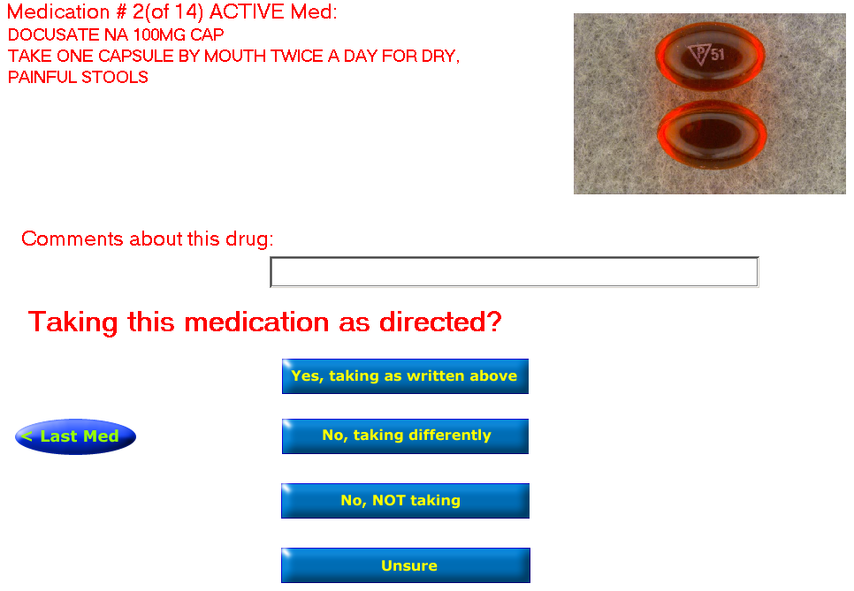
Portland: Automated Patient History Intake Device (APHID)
With permission of
Dr. Blake Lesselroth
Notes:
Rose
One of the my first experiences with Portland was at the 2008 VeHU, when I co-presented with Blake Lesselroth and Rob Silverman, another med reconciliation innovator. Blake was demonstrating Portland’s Unified Action Profile and the beginning work on the APHID. The APHID allows the veteran to actually see an image of the medication that has been dispensed and allow the veteran to verify whether they are or are not taking the medication…
Maureen: Handoff no verbiage
APHID, Lesselroth et al, JAMIA, 2009

Slide 59
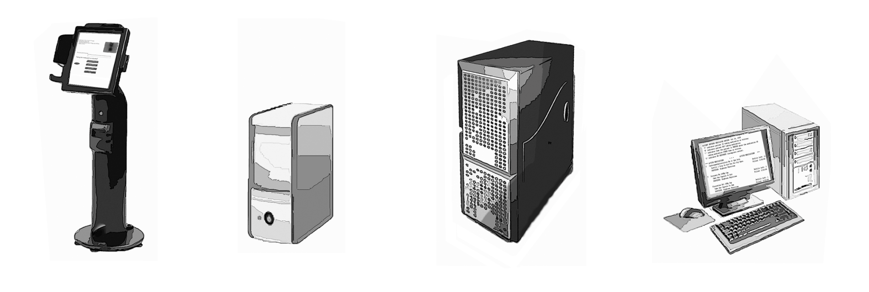
Portland: Automated Patient History Intake Device (APHID)
With permission of
Dr. Blake Lesselroth
Notes:
Maureen
Here is how it works, the Veteran or Caregiver spends time at the Kiosk—this can be a standing device, wall mounted—even a tablet. The information is then sent to the provider who will be seeing the patient
No Handoff-Maureen will do next slide

Slide 60
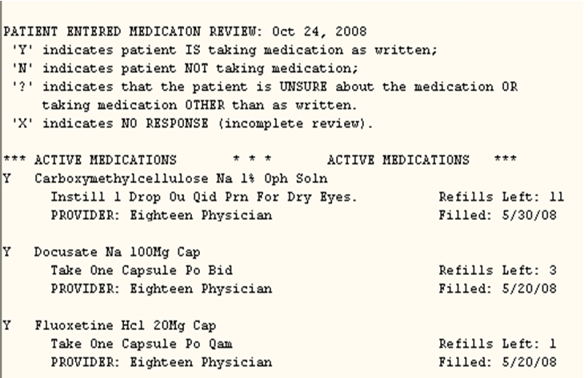
With permission of
Dr. Blake Lesselroth
Notes:
Maureen
This may be difficult for you to read, but this is what the provider will see when he sees the patient in the exam room.
Handoff to Rose: It really helps getting to the truth, getting to what the patient is taking.

Slide 61
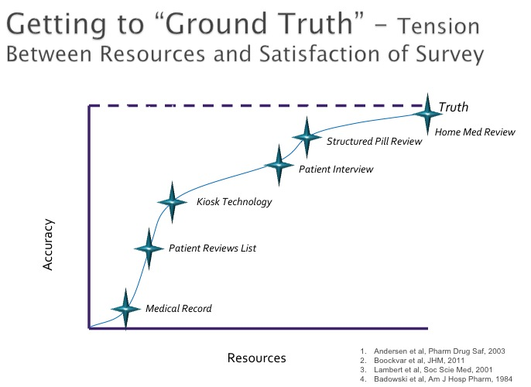
Truth
Home Med Review
Structured Pill Review
Patient Interview
Accuracy
Kiosk Technology
Patient Reviews List
With permission of
Dr. Blake Lesselroth
Medical Record
Resources
Notes:
Rose:
In research conducted at the Portland informatics Center, increasing our resources increases the accuracy of the medication list, helping it come closer to the truth. Asking the Veteran to view the med list before an appointment is better than just assuming that everything in the medical record is correct. Introducing kiosk technology, increases the accuracy of the patient’s med review med review because we’re showing them a picture and asking if they are still taking it. But unless we talk to the patient, and ask specific questions, we’re still only mimicking a home med review which is the gold standard.
Handoff to Maureen: All this enables to empower the Veteran.

Slide 62

Empowering the Veteran
Anthony Correia / Shutterstock.com
Notes:
Maureen
This is what it’s all about, empowering the Veteran to maintain, update and take ownership of their medication information
Create a medication use system that works for the Veteran
Pill reminders, calendars, and med lists
Foster a safe place for the Veteran to raise concerns
Employ shared and informed decision making including consideration of the Veteran’s
Goals of care
Personal medication use
Barriers or preferences that affect medication adherence
Reports of any problems with medications
Help all the members of their healthcare team stay connected
Handoff to Rose: Rose, we’ve talked about empowering the Veteran. What do we do as a healthcare organization to make this happen?

Slide 63
Our Responsibilities
Deploy
Standardize
Synchronize
Synergize
Measure
Make
an enterprise strategy for seamless experience with medication information
data, tools, and processes
through every platform & type of tool
our communities
to ensure value, usability, safety, and ongoing improvement
seamless, even delightful care
Notes:
Rose:
The Essential Medication Information Standardization Directive helps us to define the page so we can really partner with patients.
We need to deploy an enterprise strategy for a seamless experience with medication information through all settings of care to standardize data, tools, and processes.
We need to synchronize work through every platform and type of tool by synergizing our communities.
We need to continuously measure to ensure value, usability, safety, and ongoing improvement.
Handoff to Maureen: The goal is to make care seamless…,

Slide 64
The Challenge for 2014
Improving Medication Management at Discharge: Join Us!!!
MedUseCrisis Conference
January 28, 2014
Notes:
Maureen:
…even delightful, for our Veterans.
The challenge for 2014. Improving Medication Reconciliation and Medication Reconciliation at Discharge: Join Us!!!
4 hour virtual Medication Use Crisis conference on Jan. 28, 2014. which will address Medication Information at Discharge.
You will see opportunities for your facility to support all the activities around improving discharge for our Veterans. Do you have any improvement programs in place for improving discharge now? Any lessons learned you would like to share? Innovations? Quality Improvement? System Redesign? Research? ---please let us know!
Handoff to Rose: No verbiage.

Slide 65

Ask the Presenter
Notes:
Rose: We can’t and we haven’t done this alone. You are a vital part of our Med Recon and Patient Medication Information Management community. We need you. It will take all of us, working together, to get this work done.
If you haven’t submitted your questions yet, there is still time to do so by clicking on the orange “Ask The Presenter” icon. We’re going to show a brief announcement and be right back to answer your questions.
(Stand still and smile until you see the video come up full screen)

