Slide 1
Back to Basics: Notifications
Melissa Eggink
Notes:
Thank you (moderator name)!
-Talk about Notifications-for some, new material; for some, review and ideas on how to set new notifications OR edit settings on existing notifications
-Setting by user, service, division, system
-Troubleshoot situations in daily CPRS life-why didn’t user get notification, if they did get it, when; why didn’t the correct person get a notification; why did I get this notification? (provider)

Slide 2
Phone calls
Pagers
Hall Talk
Papers
Post it Notes
Notes:
Why CPRS notifications are important
Other options/past options: phone,pager,hall talk,paper,post it (why each can be unreliable)

Slide 3
A person can only remember so much!
Notes:
To create safer, more reliable communication between members of the healthcare team and the patient’s record, we use electronic notifications
-real time actions
-customization
-easy availability
-quicker, more efficient processing

Slide 4
Types Of Notifications
Lab
Consults
Imaging
Dietetics
Orders
Pharmacy
Notes:
First, talk about the different types of notifications
talk about set up and also how to use notifications to trouble shoot and solve problems relating to “notification overload”
want the right notification to go to the right person
Lab: abnormal info, abnormal action, critical info, critical action, *lab threshold exceeded*, lab order cancelled, stat lab results
Imaging: patient examined, imaging results, abnormal imaging results, imaging request cancel/held, stat imaging request, urgent imaging request, imaging request amended, imaging request changed
Orders: flag order for clarification, order req elec signature, order requires chart signature, flagged OI order (inpt, opt) flagged OI expiring (inpt,opt)
Stat order, new order, dc order, expiring order, dnr expiring
Consults: consult/request resolution, new service consult/request, consult/request cancel/hold, consult request updated, consult/proc interpretation
Pharmacy: meds expiring (inpt, opt), unverified med order
Dietetics: npo diet more than 72 hours-providers need to know if patient is not being nourished

Slide 5
Patient Info/ Movement
Results
Flags
TIU Alerts
Notes:
Patient info: admission, discharge, transfer, deceased
Results: lab, imaging, consult, mammo, pap smear, pathology
Flags: flagged OI to user, team, device. Flag orders on Orders tab for clarification
TIU alerts: unsigned, uncosigned, addl signature. Will regenerate until action resolved.
Often hear users-and other Health Informatics Specialists-use the term notif and alert interchangeably. Technically only TIU documents send alerts-hardcoded into the kernel software. Not editable. The diff=CPRS notifications are editable. However, since alerts become CPRS notifications, its understandable why we use both terms so comfortably.

Slide 6
Notifications
Parameters
Setup
Notes:
Going to talk about Notification set up parameters
Many different ways CPRS can electronically alert individual providers, teams of providers, clerical support for all of the items we just mentioned
You may have never heard of some of these, or you may have heard or even seen these options on your screen in performing daily duties as HIS and not known what they were for or what they could do-who has time to play around and test them? A lot could have been set up years ago, before you ever began your job and so you have never had to address them before anyway-today look at what each one can do and think about how you can edit them at your facility to improve efficiency for all of your customers

Slide 7
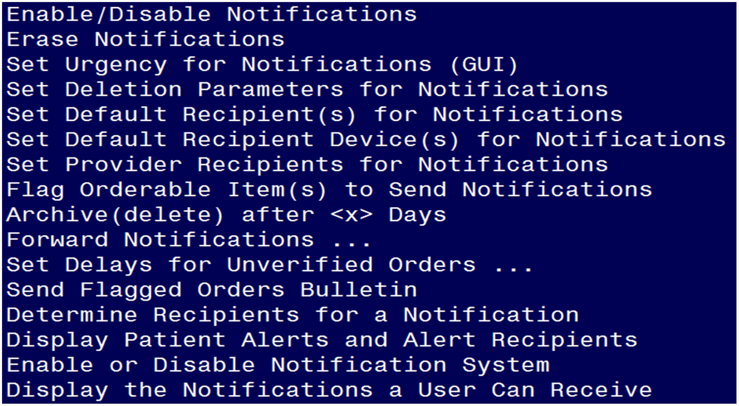
Notification Mgmt Menu
Notes:
Notification set up done in Vista
We will go over each setting in turn today

Slide 8
Enable
Disable
Notes:
Enable/Disable notifications

Slide 9
User
Location
Team
Division
Service
System
Designations
Notes:
Can be set by any of these designations.
Choose one, enter a question mark to open an expanded list of notifications available
Use division or system to set important or mandatory notifications, users cannot disable a mandatory (more on that in a moment)
-story about disabling consult/request updated in Omaha at division level, users having to enable if they want the comments

Slide 10
Erase Notifications

Slide 11
Erase
User
Specific
Patient
All
Notes:
1. Erase all notifications for a User
2. Erase all notifications for a Patient
3. Erase all instances of a notification (regardless of Patient or User)
4. Erase specific notifications for a User (NOIS calls, task error-user cannot delete)
5. Edit Erase All Notifications parameter for a User
#5 expand: Set User's Ability to Erase All His Notifications/Alerts
Access to erase all my alerts option may be set for the following: be wary of authorizing users to be able to erase their own alerts!
1 User USR [choose from NEW PERSON]
2 Division DIV [choose from INSTITUTION]
3 System SYS [CENTRAL-PLAINS.MED.VA.GOV]

Slide 12
Set Urgency for Notifications

Slide 13
Moderate
Low
High
Notes:
Set URGENCY Parameters for Notifications
Notification Urgency may be set for the following:
1 User USR [choose from NEW PERSON]
2 Service SRV [choose from SERVICE/SECTION]
3 Division DIV [choose from INSTITUTION]
4 System SYS [CENTRAL-PLAINS.MED.VA.GOV]
-Set to High, Moderate, Low
-Helps provider to categorize and sort notifications easier

Slide 14
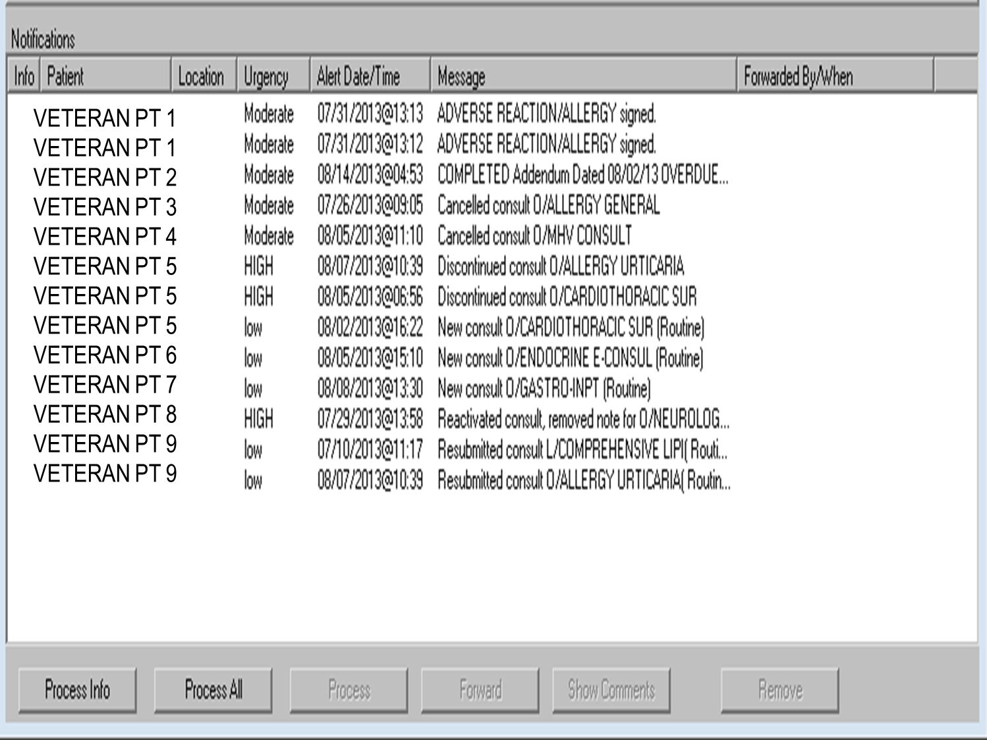
Notes:
User’s view, discuss clicking the Urgency button to sort

Slide 15
Set Deletion Parameters for Notifications

Slide 16
Individual
All Recipients
Notes:
-Deletion set by division or system
-value is individual or all recipients
-relates to notification resolution
Individual: tells the system to delete the notification for an individual when the person has either reviewed or completed the actions associated with the notification (depending on if it is an action or informational)
All: delete the notification for all recipients when any individual recipient has reviewed or taken the action

Slide 17
Set Default Recipient(s)
*OR*
Set Default Recipient(s)
Device

Slide 18
Default Recipient(s)
User
Team
Notes:
Can be a single person, or a team of people
Useful if a user, or team should ALWAYS receive a notification, regardless if the notification was determined mandatory, enabled, or disabled under another parameter, regardless if the patient “belongs” to them or not.
Select user or team, enter name. Enter a ? to see list of available notifications, select by number the one desired, enter value “Yes” to set.

Slide 19
Default Recipient(s)
Device
Division or System
Notes:
Useful if a device should ALWAYS print a hard copy of the notification (backup, contingency plan) regardless if the notification was determined m
mandatory, enabled, or disabled under another parameter, regardless of patient.
Select division or system, enter name of device/printer. Enter a ? to see list of available notifications, select by number the one desired, enter value “Yes” to set.

Slide 20
Set Provider Recipients for Notifications

Slide 21
Provider Recipients
Division or System
Notes:
This parameter controls a set of codes indicating the default provider recipients of a notification by their title or relationship to the patient. Notifications can be set up with any or all of the following codes: PATOMERSC

Slide 22
P (Primary Provider)
A (Attending Physician)
T (Patient Care Team)
O (Ordering Provider)
M (PCMM Team)
E (Entering User)
R (PCMM Primary Care Practitioner)
S (PCMM Associate Provider)
C (PCMM Mental Health Treatment Coordinator)
Notes:
Go into more detail:
P (Primary Provider): deliver notification to the patient's Primary
Provider. (inpatient)
A (Attending Physician): deliver notification to the patient's Attending
Physician.-inpatient
T (Patient Care Teams): deliver notification to the patient's OE/RR
Teams (personal patient and team lists are evaluated for potential
recipients) and to devices on an OE/RR team.
O (Ordering Provider): deliver notification to the provider
who placed the order which trigger the notification.
M (PCMM Team): deliver notification to users/providers linked to the
patient via PCMM Team Position assignments.
E (Entering User): deliver notification to the user/provider who entered
the order's most recent activity. (nurse, clerk)
R (PCMM Primary Care Practitioner): deliver notification to the
patient's PCMM Primary Care Practitioner. (outpatient)
S (PCMM Associate Provider): deliver notification to the patient's PCMM
Associate Provider. (resident)
C (PCMM Mental Health Treatment Coordinator): deliver notification to
the patient's PCMM Mental Health Treatment Coordinator.
Enter the desired values for each notification, one letter after another. enter ? to access list
This list may seem really long and difficult to remember, but memorizing it and learning how to apply it will take you from notifications novice to notifications expert. Try and think of a way to help yourself remember this acronym-use the memory tool that I myself use! When I look at
P A T O M E R S C, hm-PATOMERSC=Pat O’Merscky. Sounds like a good old fashioned Irish name. I have a bit of Irish heritage myself-this trick helps me to remember how to set my notifications like a pro.
Not too long ago had an instance in Omaha where patient care became an issue when an attending neglected to place an order on a chart. When the previous order was getting ready to expire, it triggered a notification to 7 providers in all-all of whom deleted it without taking action. In this case, we determined quickly that the notification was obviously being sent to the wrong recipients, and change was needed.

Slide 23
Poll Question
Provider calls, he didn’t receive a notification for a comment entered on a consult that he had ordered. Where do we troubleshoot?
Check Enable/Disable Notifications
Look up PATOMERSC settings
Look at Deletion Parameters
They must have missed/erased it
Notes:
Now I’d like to ask a poll question. Test your knowledge!
Ask question-”where would you look?” Only one answer!
(usually presenters read the poll question and acknowledge that the possible answers are on the screen)
To answer this question, use the blue polling icon above my head. We’ll move on and come back to your results in just a moment.

Slide 24
Flag Orderable Item(s) to Send Notifications

Slide 25
Flag INPATIENT orders/results/expiring orders
Flag OUTPATIENT orders/results/expiring orders
Flag Lab tests for Threshold Exceeded alerts
Notes:
-can flag orders, results, expiring orders
-inpt or opt
-lab tests can be flagged to a user to send a notification if the lab result is less than or greater than a specified value.

Slide 26
Flag Inpatient ORDERS.
Flag Inpatient ORDERS for PROVIDER RECIPIENTS.
Flag Inpatient RESULTS.
Flag Inpatient RESULTS for PROVIDER RECIPIENTS.
Flag Inpatient EXPIRING orders.
Flag Inpatient EXPIRING orders for PROVIDER RECIPIENTS.
Notes:
As example, inpt options
A look at the options for inpt/opt flagging (opt options will look exactly the same as this. The options will be numbered, enter the number associated with the item you want flagged for notification: order, test result, expiring order.
*Results can only be flagged for lab, imaging and consults

Slide 27
Flag Items to Send INPT ORDER Notifs may be set for the following:
User
Team
Device
Notes:
Orders can be flagged to individual users, a team of users (create team list in Team List Mgmt menu option), or a hard copy of the notification can be queued to print on a selected device. System will ask if you want to add the name you chose as a new orderable item, confirm with “yes”.
When I say orders, I mean orderable items. Orderable item must first be created and built into a generic order of your choosing. Keep in mind, and educate users- a flagged orderable item notification does not display/print a copy of the order itself; only a one liner notification with the patients name/location, date, and up to 63 characters of your best description of the order. Use your characters wisely, it should serve mainly as a notice to send the recipient into that patients cprs chart for the details, and to take any related actions necessary.
Before we move on, let’s take a look at your poll results.

Slide 28
Poll Results
Provider calls, he didn’t receive a notification for a comment entered on a consult that he had ordered. Where do we troubleshoot?
Check Enable/Disable Notifications
Look up PATOMERSC settings
Look at Deletion Parameters
They must have missed/erased it
Notes:
“Provider calls, didn’t receive a notification for a comment entered on a consult he had ordered”
The answer is A, check enable/disable notifications. While it is plausible that the provider accidentally missed or deleted the alert, be sure to check the enable/disable notifications parameter-if the notification for “Consult/request updated” is disabled, the provider would never have seen the notification in his queue. If it was enable, go into trouble shooting mode to determine when it was processed/deleted

Slide 29
Poll Results
Provider calls, he didn’t receive a notification for a comment entered on a consult that he had ordered. Where do we troubleshoot?
Check Enable/Disable Notifications
Look up PATOMERSC settings
Look at Deletion Parameters
They must have missed/erased it
Notes:
Click to move on

Slide 30
Flag Items for INPT ORDER Providr Recip may be set for the following:
Division
System
Notes:
Using this option, send notifications for orderable items to provider recipients based on the patomersc settings
P (Primary Provider): deliver notification to the patient's Primary
Provider.
A (Attending Physician): deliver notification to the patient's Attending
Physician.
T (Patient Care Teams): deliver notification to the patient's OE/RR
Teams (personal patient and team lists are evaluated for potential
recipients) and to devices on an OE/RR team.
O (Ordering Provider): deliver notification to the provider
who placed the order which trigger the notification.
M (PCMM Team): deliver notification to users/providers linked to the
patient via PCMM Team Position assignments.
E (Entering User): deliver notification to the user/provider who entered
the order's most recent activity.
R (PCMM Primary Care Practitioner): deliver notification to the
patient's PCMM Primary Care Practitioner.
S (PCMM Associate Provider): deliver notification to the patient's PCMM
Associate Provider.
C (PCMM Mental Health Treatment Coordinator): deliver notification to
the patient's PCMM Mental Health Treatment Coordinator.
Enter the desired values for each notification, enter ? to access list, separate values with commas.

Slide 31
Flag Items to Send INPT RESULT Notifs may be set for the following:
User
Team
Device
Notes:
Results can be flagged to individual users, a team of users (create team list in Team List Mgmt menu option), or a hard copy of the notification can be queued to print on a selected device. Results=lab,imaging,consults only. Enter the name of the test or consult at the prompt that says” select orderable item”. System will ask if you want to add the name you chose as a new orderable item, confirm with “yes”.
-Informational alert only

Slide 32
Flag Items for INPT RESULTS Providr Recip may be set for the following:
Division
System
Notes:
Using this option, send notifications for results to provider recipients based on the patomersc settings
P (Primary Provider): deliver notification to the patient's Primary
Provider.
A (Attending Physician): deliver notification to the patient's Attending
Physician.
T (Patient Care Teams): deliver notification to the patient's OE/RR
Teams (personal patient and team lists are evaluated for potential
recipients) and to devices on an OE/RR team.
O (Ordering Provider): deliver notification to the provider
who placed the order which trigger the notification.
M (PCMM Team): deliver notification to users/providers linked to the
patient via PCMM Team Position assignments.
E (Entering User): deliver notification to the user/provider who entered
the order's most recent activity.
R (PCMM Primary Care Practitioner): deliver notification to the
patient's PCMM Primary Care Practitioner.
S (PCMM Associate Provider): deliver notification to the patient's PCMM
Associate Provider.
C (PCMM Mental Health Treatment Coordinator): deliver notification to
the patient's PCMM Mental Health Treatment Coordinator.
Enter the desired values for each notification, enter ? to access list, separate values with commas.

Slide 33
Do you want to add, modify or remove lab thresholds? Yes// (Yes)
Enter user's name ("^" to exit): EGGINK,MELISSA
Current > lab thresholds for EGGINK,MELISSA A:
CBC (... TO 05/11/91)*O BLOOD 60
Notes:
Flag Lab tests for threshold exceeded alerts
Lab tests only
Enter user name, lab test name, greater than/less than, and numerical value exceeded to be notified of

Slide 34
Archive (Delete) After <x> Days

Slide 35
Division
System
Notes:
This param tells the system how many days to archive, or hold for retrieval, notifications before automatically deleting them. Any notification that does not have a # of days listed will default to 30 days. Max# days=100,000 or 220 years
-will have to touch each individual notification (lab results, abn lab results, admission, etc) and set the number of days manually if you want anything older than 30days.
-set at Omaha: 120days, after a couple of RCAs relating to question of whether or not, and when, resident provider received a notification in his queue. If date in question older than the #days set here in this param, unable to tell.

Slide 36
Forward Notifications

Slide 37
Surrogates
Backup
Reviewer
Supervisor
Notes:
All 3 designees that notif can be forwarded to are set at the division or system level. Choose the type of user to receive the backup notification
Supr-supervisor/section chief
Surrogate-will only work if user has a surrogate assigned
Bkup reviewer-could be chief of service, even chief of staff
After choosing type of user, you will again have to set each notification individually, by entering the name of the notification and the value=number of days that you want the system to wait before automatically sending another copy of the notification. The maximum is 30 days.
If no value is entered or the number is zero, notification will not be forwarded. Must be bw 1-30.
For example, if a notification
has a value of 14 for this parameter, it will be forwarded to the backup
reviewer of each recipient who hasn't processed the notification after 14
days.

Slide 38
Set Delays for Unverified Orders

Slide 39
All
Unverified Orders
Medication
Unverified Orders
Notes:
Set delays for all unverified orders or unverfied med orders
Set by division or system
Enter the # of hours to pass before system send an alert to ordering provider that the order (any order) or medication order has gone unverified (and thus potentially unseen-ordering provider must alert a member of the patients healthcare team more directly)

Slide 40
Send Flagged Orders Bulletin
Notes:
May be set by:
User
Service
Division
System
Setting this parameter by one of these designations will send a vista mailman message when an order is flagged for clarification on the orders tab
The mailman msg will go into the IN basket of the ordering provider whenever the order that they entered is flagged for clarification, regardless of why it is flagged or who it is flagged to

Slide 41
Subj: Order flagged for clarification 08/15/13@15:01
From: EGGINK,MELISSA A
In 'IN' basket.
---------------------------------------------------------------------
The following order has been flagged for
clarification:
Patient: VA, PATIENT 1 000000000
Order Date: Aug 15, 2013@15:01
Start Time: Aug 15, 2013@15:01
Notes:
example

Slide 42
Trouble-shooting
Notifications
Notes:
These next params good for trouble shooting notifications-who received what notif and when, or why they did not receive

Slide 43
Notes:
Members of healthcare team need to work synergistically with the pt record to provide the best, safest care
Our job to help make that happen
Sometimes things go wrong with notifications-talk about some ways to figure out what might have gone wrong, and how to fix it

Slide 44
Determine Recipients for a Notification

Slide 45
Processing notification: LAB RESULTS
for patient: VA, PATIENT 1
for order: 0RDER0001
Recipients determined by Provider Recipient:
Ordering provider:
EGGINK,MELISSA A: ON because
Division VA NWIHS, OMAHA DIVISION is
MANDATORY
Notes:
This report is very specific-you must enter the name of the patient, the notification in question, and the order number. Double click on the order itself on the cprs orders tab and in the order details under current status you will see “Order # _____”. Entering all three pieces of information here in this parameter will tell you exactly who the notification recipients are, and why-in example above, because the notif lab results is set to mandatory at the division level in omaha
Recipient determined by provider recipient was set under: Set provider recipients for notifications

Slide 46
Display Patient Alert and Alert Recipients

Slide 47
Alerts for
VA, PATIENT 1
Alert Alert Date/Time
6 Order requires electronic signature. [00000000] 8/15/13@09:57
Notes:
Choose this option to see exactly who received a specific alert on a patient and when.
Enter patient name and give a date range
For that date range list of alerts will display
Enter the number associated with the notification (to the left) to see more details
This is an unsigned order alert, date/time the notification was sent to the right, order# on the left in parantheses
Good for troubleshooting also!

Slide 48
Enable or Disable Notification System
Notes:
Pretty self explanatory
Set at division or system level
Parameter determines if any notification processing will occur. 'E' or 'Enable' indicates the notifications system is enabled and running. 'D‘ or 'Disabled' indicates the notifications system is disabled and not running.
Lets leave this one enabled!

Slide 49
Display the Notifications a User Can Receive
Notes:
Enter the users name
A list of notifications will appear on the left, a column will display showing if the notification is on/off and why

Slide 50
Notification List for EGGINK,MELISSA
Notification ON/OFF For This User and Why
----------------------------------------------------------------
ADMISSION ON User value is Enabled
Notes:
Enter the users name
A list of notifications will appear on the left, a column will display showing if the notification is on/off and why
Report is display only, you cant edit the value of the notification here, return to enable/disable to set the values.

Slide 51
Poll Question
Patient Safety wants to ensure all Resident Providers are receiving lab test results for their clinic patients. What parameter to check?
Set Default Recipients for Notifications
Determine Recipients for a Notification
Set Provider Recipients for Notifications
Send Flagged Orders Bulletin
Notes:
Now I’d like to ask another poll question.
(usually presenters read the poll question and acknowledge that the possible answers are on the screen)
To answer this question, use the blue polling icon above my head. We’ll move on and come back to your results in just a moment.

Slide 52
Report Menu for Alerts
Notes:
Want to talk now about how to use this particular menu, “Report Menu for Alerts”
This may be a menu that you as a HIS do not have access to currently-after listening to the next part of our session together today, you may find it useful to request this menu option : XQAL Reports Menu

Slide 53
Critical Alerts Count Report

Slide 54
Display users whose
CRITICAL ALERT
count is at least: 10//
START DATE: T END DATE: T
Notes:
Use this report to check for users who might have critical alert notifications pending/unprocessed
Choose number of alerts
Can break out report for more than one division, if desired
Choose a date range
Can list users by name or service
Will tell you when that user last signed on, how many critical alerts are pending, and the date of the oldest alert.
*use of the Forward Notifications parameter, forwarding to surrogate, supr and/or backup reviewers can help ensure that these critical notifications don’t negatively affect patient safety and care!

Slide 55
List Alerts For A User From a Specified Date

Slide 56
Found 4 Alerts for User
EGGINK,MELISSA A
For Aug 10,2013 through Aug 10, 2013
@08:56:48
Notes:
Nice report to show exactly what alerts and when they were received for an individual user.
Can filter the alerts by entering a keyword if desired “consult”
Will also automatically tally all of the alerts received within the date range selected-see if user could be a victim of “notifications overload”
Also-check to see if the doctor received that consult alert on the Veteran’s consult
Now let’s take a look at our poll results.

Slide 57
Poll Results
Patient Safety wants to ensure all Resident Providers are receiving lab test results for their clinic patients. What parameter to check?
Set Default Recipients for Notifications
Determine Recipients for a Notification
Set Provider Recipients for Notifications
Send Flagged Orders Bulletin
Notes:
“Patient Safety office wants to ensure all resident providers are receiving all lab notifications. How can you ensure this is set up correctly?”
The answer is C , Set provider recipients for a notification. They key word here is “resident” provider-to ensure that this specific type of provider is receiving the notification, you must use set provider recipients for the lab results notification to the S (remember PATOMERSC) for associate provider, which is how resident providers are identified in PCMM for their patient panel.

Slide 58
Poll Results
Patient Safety wants to ensure all Resident Providers are receiving lab test results for their clinic patients. What parameter to check?
Set Default Recipients for Notifications
Determine Recipients for a Notification
Set Provider Recipients for Notifications
Send Flagged Orders Bulletin
Notes:
Click to move on

Slide 59
Patient Alert List For a Specified Date
Notes:
Use this report to view a list of notifications generated for a specific patient, within a specific date range
Don’t have a specific user or provider in mind, but you have the patient name (search in opposite way from List Alerts for a user from a Specified date”
Can also filter for key words “critical” “unsigned”
Will also automatically tally number of alerts generated within date range

Slide 60
Found 2 Alerts for Patient
VA, PATIENT 1 (V0000)
Notes:
-enter patients name
System will guide you: “The quick scan method used here will not pick up some alerts,
but should give an indication of when alerts might be found.
Do you want to scan for a list of dates that have at least some alerts for this
patient? Y or N”
-enter date range
“*** WARNING ***: Do not specify too many days - each entry in the Alert Tracking
file must be checked for the date range specified.”
-filter by keyword if desired
-list of notifications will display, type of alert, date
-automatically tally the number of notifications the patient had within the date range specified
-

Slide 61
User Alerts Count Report

Slide 62
User Alerts Count Report
Do you want to count only alerts containing
specific words or phrase(s)? NO
Display users whose ALERT count is at least: 10
START DATE: T END DATE: T
Notes:
Use report to track users who have more than a designated amount of unprocessed alerts in their queue.
You set the number, set the date range
Can filter by keyword “Critical” “Consult” “Imaging”
Can break out by division if desired
List report by name of user

Slide 63
View Data For an Alert Tracking File Entry

Slide 64
New consult O/NON VA CARE PHYSIC (Routine) 08/16/2013@08:37:46 [ROU] ien=0000IEN00
Notes:
Very specific report to track a notification by the ien number, internal entry number, get details regarding a specific notification sent to a person
Go to reports option “List alerts for user from a specified date”
Enter name of user
Enter date or date range in question
When the alerts display in a list, look for the ien number, it is the very last item after the date (seen here highlighted in red)
Copy this number
Go back to reports menu for alerts
View data for an alert tracking file entry
Very technical details-date and time alert was generated-by who-who it was delivered to-when they first saw it, whether it was forwarded or deleted, and by whom when they processed it-even the retention date-the date until the alert details will no longer be archived.
Most specific report-if you need to determine whether a not a user ever received an alert, and if they did, when they processed it, this is where to go (RCA, Patient Safety office)

Slide 65
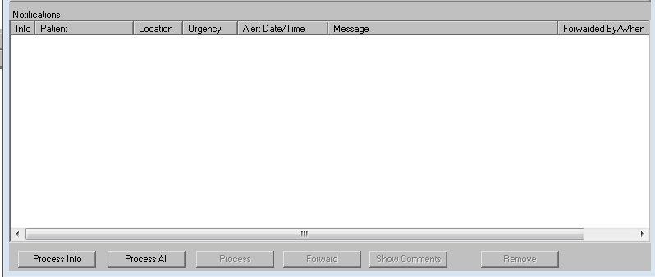
CPRS GUI
Notes:
Lastly, no presentation on Notifications would be complete without taking a look at Notifications from the other side-how our users process them in the CPRS GUI.
A look at the notifications screen on the patient selection page. A blank one, at that!
Important tips to pass on to our providers
-click on columns across top to sort-sort by urgency is popular, maybe alphabetized
-tiu alerts will remain in queue until signed-no other way to process. If erased, they will regenerate
-note the forwarded by/when column-direct users attention here especially if they have a notif and have no idea why or where it came from, it could have been forwarded
-informational vs. action alerts
-process info and process all buttons on the bottom-process info will delete all notifications with the “I” designation in the far left column without any further processing
-no, process all button does not just delete everything and clear the notifications box (as many a provider at my own site has assumed, or maybe wished for) it will actually allow the user seamless processing by taking them to each notification in turn, without having to return to the patient selection screen in between each one. User simply clicks on the “Next” button on the far lower right hand of the CPRS chart to continue.

Slide 66
Notes:
-speaking of the “Next button”, a handy trick to remind your providers of is that if they right click on that button, a menu will appear where they can select “Continue”, “Forward” and “Renew”.
Continue-return to patient selection screen to continue processing notifications
Forward-send to another user
Renew-my favorite-even though the user is currently viewing and thereby “processing” the notification (which will often resolve it and remove it from the queue) selecting Renew will place the notification right back into the list. (user doesn’t always have time to complete the necessary actions at that time-they get paged, after viewing the alert they realize that the actions they need to take are much more complex than originally thought). Now the notif can be processed again at a later time when the user can devote the time and attention required.

Slide 67
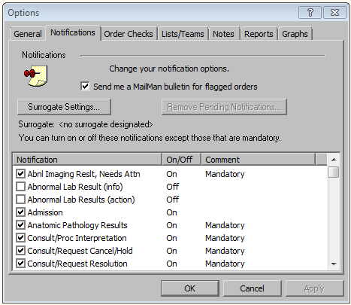
Notes:
Remember, users also have some degree of control over their notifs under Tools Menu
Notice the check box for “send me a mailman bulletin for flagged orders” we talked about that parameter

Slide 68
Notes:
Surrogate settings: we didn’t talk about these much today, im sure you all know to go into vista option “Alerts-set/remove surrogate for user”
Users can and should be educated on how to set a surrogate for themselves in the GUI, empowering the user to customize CPRS for themselves engages them more
Choose name and date range-however, can only set one surrogate
For more than one, you should set for them in vista using your own set/remove surrogates option

Slide 69
Notes:
Speaking of empowering and engaging your users in the world of informatics, be sure they know how to turn on/off notifications for themselves.
You still control what is mandatory or optional under param: Enable/Disable notifications-you can select the notifications, and set the value to M for mandatory if you want to ensure users cannot disable it for themselves.
Other than what is determined mandatory, give them some leeway. Show how to uncheck a particular notification if they don’t think it’s helpful or efficient for them to receive it
Show users they can be proactive in preventing their own notifications overload!

Slide 70
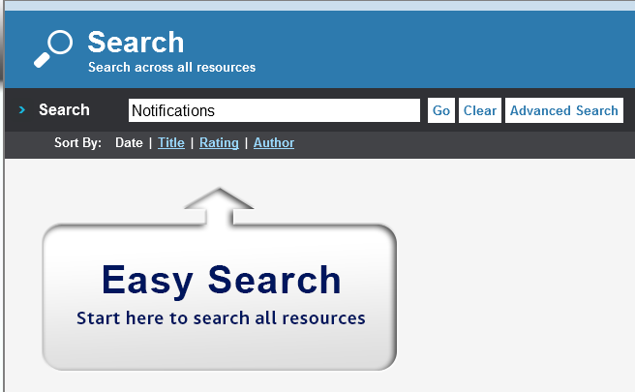
Notes:
Want more information about Notifications in CPRS? Log in at myvehucampus.com and look for the “search” button in the lower middle part of the screen, you’ll see an icon that looks like a magnifying glass
Enter search term notifications
More than a dozen other classes and poster presentations on the subject of notifications will appear-check them out and before you know it, you will be a Notifications expert too!

Slide 71
Ask the Presenter
Notes:
If you haven’t submitted your questions yet, there is still time to do so by clicking on the orange “Ask The Presenter” icon. We’re going to show a brief announcement and be right back to answer your questions.
(Stand still and smile until you see the video come up full screen)

