Slide 1
Creative Use of Reminders
Joseph (Gus) O’Neil
Philip VanCamp
Notes:
Thank you (moderator name)! I am happy to be here today to talk about Creative Use of Reminders.

Slide 2

Notes:
Did you know that Reminder Dialogs can randomly assign patients to different research protocols?
Just a reminder (Pun intended) – If you have any questions, don’t be afraid to use the “Ask the Presenter” button!
Depiction of ”Random Motion” of molecules (particles)
This example: Project – Find a means to have CPRS Randomly select/assign Veterans, to 2 different Research Protocols.

Slide 3

Why?
Notes:
Why? Why do this?
No evidence of any Electronic Medical Record, anywhere, that was capable of randomizing patients to different protocols.
Proof of concept – To our knowledge, CPRS is the 1st EMR to do so.

Slide 4


Who?
Notes:
Who – Who was involved?
MAVERIC Research group at Boston VAMC; (Louis Fiore, MD, Leonard D’Avolio, PhD) - Requestors
Chester Conrad, MD – Cardiologist Boston VAMC - Medicine Service Line Liaison to IT –
Gus O’Neil, VISN 1 CR Manager;
Gina Donofrio – Programmer/Applications Supervisor Providence VAMC
Mike Fournier, Region 4 Application Service Line Manager
Patrick Redington, National Clinical Reminders Programmer
Suzi Boudreau, Northampton CAC
Jessica Drabkin, Former Northampton CAC

Slide 5
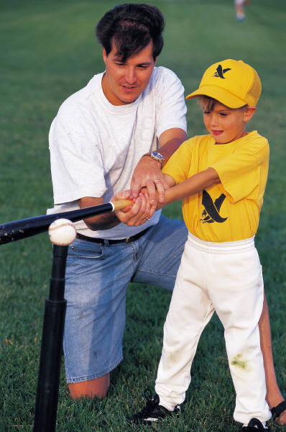
How
was
this
done?
Notes:
How? How was this done? Just like the Father shown here teaching his son how to hit a baseball, Chester Conrad and I spent many hours on teleconferences, over several months, just discussing how this might be done. The use of Branching Logic in Reminder Dialogs held the solution. Using the Computed Finding, “Last Service Separation Date” in a Reminder Term was the INITIAL solution. (I should mention that I kept telling Chester that it could NOT be done, but he kept asking me to find a way! )

Slide 6
Storing a Date in “M”umps:
August 27, 2013 = 3130827
$E(V,6,7)= 27
Notes:
I originally used this method to RANDOMIZE patients – using the Last Service Separation Date:
If the date returned was 8/27/2013, then V = 27 (Value of the Extracted #).
If V<16 was the TRUE statement, this would evaluate to FALSE (22 is > 16), so Dialog Group B would appear
It worked…BUT

Slide 7

Poll Question
Have you ever used the Computed Finding, “VA-RANDOM NUMBER”?
      Yes
      No
Notes:
Now I’d like to ask a poll question.
(READ QUESTION)
To answer this question, use the blue polling icon above my head. We’ll move on and come back to your results in just a moment.

Slide 8

How was this created?
Notes:
How was this created?
Originally done using Class I Mumps Function $EXTRACT of a Date (Extract last 2 digits - DAY of month) from Service Separation Date. (Or DOB, or DOD, etc.)
WORKED, but not ok – too small a # - (31) introduced statistical anomaly – need a larger number like 1000
Creation of Class III Routine on Providence’s system – pass in 1000 #s – return one random number between 0 and 999;
Approved by Mike Fournier, Region 4 ASLM as Class II
Export Class II Routine to Boston; POC-01 Study – Comparing Sliding-Scale to Weight-Based Insulin Protocols.
National CF Created by Patrick Redington & Exported in PXRM patch to all sites.
Now let’s pause for a moment and take a look at your poll results.

Slide 9
Poll Results
Have you ever used the Computed Finding, “VA-RANDOM NUMBER”?
  Yes
  No
Notes:
Ad-lib to poll results

Slide 10
Poll Results
Have you ever used the Computed Finding, “VA-RANDOM NUMBER”?
  Yes
  No
Notes:
(Cue to Tech Team that you’re moving on) “Click” again to move on

Slide 11
VA-RANDOM NUMBER:
(Uses $RANDOM “M” function)
Set Occurrence Count: 1
Set Computed Finding Parameter: 0^1000
Set Condition: I V<500
Notes:
Computed Finding used as a Finding in a Reminder Term (RT),that returns a number randomly, between the low and high number set in the RT.
Example: Setting to “0^1000” – will return an integer in the range 0 to 999.
- Set Occurrence Count: 1
- Set Computed Finding Parameter: 0^1000
- Set Condition: I V<500

Slide 12
Poll Question
How often have you used Branching Logic?
      Never
      Once
      Occasionally
      Frequently
Notes:
Now I’d like to ask a poll question.
(READ QUESTION)
To answer this question, use the blue polling icon above my head. We’ll move on and come back to your results in just a moment.

Slide 13

Methylprednisolone
vs. Prednisone
Notes:
Any research project could use this process, to randomly COMPARE drug protocols, treatment plans, radiology procedures, medical procedures, lab tests, or other research protocols. The POC-01 MAVERIC study compares Sliding Scale Insulin to Weigh Based Insulin protocols.
For this discussion, I’m using a simple example of randomly assigning patients to either methylprednisolone or prednisone – potentially for contact dermatitis??
Now let’s pause for a moment and take a look at your poll results.

Slide 14
Poll Results
How often have you used Branching Logic?
  Never
  Once
  Occasionally
  Frequently
Notes:
Ad-lib to poll results

Slide 15
Poll Results
How often have you used Branching Logic?
  Never
  Once
  Occasionally
  Frequently
Notes:
(Cue to Tech Team that you’re moving on) “Click” again to move on

Slide 16

4. Shared Templates??
3. Dialog
2. Dialog Groups
1. Reminder Term
Notes:
Steps to creating this process:
Create Reminder Term
Create 2 Dialog Groups
Create the Dialog using just the “A” Group (with branching logic on Term replacing Group “A” with “B”)
Make Available in CPRS as either Shared Template or associated with TIU Note Title

Slide 17
Step 1: Create Reminder Term
Select Reminder Term: PRO-RANDOM NUMBER
(Skipping unimportant fields)
Reminder Term has no findings!
Select Finding: CF.VA-RAND
VA-RANDOM NUMBER NATIONAL
...OK? Yes// (Yes)
FINDING ITEM: VA-RANDOM NUMBER//
Notes:
Simple setup of Reminder Term – only a few important fields.

Slide 18
Step 1: Continued…
BEGINNING DATE/TIME:
ENDING DATE/TIME:
OCCURRENCE COUNT: 1
COMPUTED FINDING PARAMETER: 0^1000
CONDITION: I V<500
CONDITION CASE SENSITIVE:
USE STATUS/COND IN SEARCH:

Slide 19

A
B
Twin
Dialog
Groups
Notes:
Twin Dialog Groups:
1. Group A has:
An order element for methylprednisolone; and
A patient refusal element;
2. Group B has:
What looks like the EXACT SAME ordering element but it orders prednisone; and
A patient refusal element, except they are named differently and have different Health Factors for tracking

Slide 20
GROUP NAME: GP PRO-BRANCHING DIALOG A
1 Group: GP PRO-BRANCHING DIALOG A
Replaced by GP PRO-BRANCHING DIALOG B if Reminder Term PRO-RANDOM NUMBER TERM evaluates as FALSE (I V>500)
2 5 Element: OI PRO-BRANCHING ORDER
ELEMENT – METHYLPREDNISOLONE
Finding: Methylprednisolone 4mg
[5076] (QUICK ORDER)
Resolution: ORDERED
3 10 Element: HF PRO-BRANCHING
ELEMENT A - PATIENT REFUSED
Finding: PATIENT REFUSED STUDY
- A [651257] (HEALTH FACTOR)
Resolution: PATIENT REFUSED

Slide 21

Setting-up the
branching logic…
REMINDER TERM: PRO-RANDOM NUMBER TERM//
REMINDER TERM STATUS: FALSE//
REPLACEMENT ELEMENT/GROUP:
GP PRO-BRANCHING DIALOG B
Notes:
I’ve just shown the key fields that must be populated in the Reminder Term, to get branching logic to work.

Slide 22
GROUP NAME: GP PRO-BRANCHING DIALOG B
1 Group: GP PRO-BRANCHING DIALOG B
2 5 Element: OI PRO-BRANCHING ORDER
ELEMENT – PREDNISONE
Finding: Prednisone 5mg [5077]
(QUICK ORDER)
Resolution: ORDERED
3 10 Element: HF PRO-BRANCHING
ELEMENT B - PATIENT REFUSED
Finding: PATIENT REFUSED STUDY
- B [651258] (HEALTH FACTOR)
Resolution: PATIENT REFUSED

Slide 23
Step 3: Create Reminder Dialog
Select Item: Next Screen// ad Add Reminder Dialog
GENERATE DIALOG AUTOMATICALLY: N// n NO
Select DIALOG to add: PRO-RANDOM STUDY MEDROL/ PREDNISONE
Are you adding 'PRO-RANDOM STUDY
MEDROL/PREDNISONE' as a new REMINDER DIALOG
(the 10849TH)? No// Y (Yes)

Slide 24
Step 3: Continued
NAME: PRO-RANDOM STUDY MEDROL/PREDNISONE Replace(Skipped several fields)
Select SEQUENCE: 5
DIALOG ELEMENT/GROUP: GP PRO-BRANCH
1 GP PRO-BRANCHING DIALOG A dialog group
LOCAL
Select SEQUENCE:
PATIENT SPECIFIC: 1 TRUE
Select DIALOG to add:

Slide 25
Step 4: Make Reminder Dialog Available in CPRS – Set GUI Parameter
EP Edit Parameter Values
-- Edit Parameter Values ---
Select PARAMETER DEFINITION NAME: TIU TEMPLATE REMINDER DIALOGS Reminder Dialogs allowed as Templates

Slide 26
Step 4: Continued
TIU TEMPLATE REMINDER DIALOGS may be set for the following:
1 User USR [choose from NEW PERSON]
3 Service SRV [choose from SERVICE/SECTION]
4 Division DIV [choose from INSTITUTION]
5 System SYS [PROVIDENCE.MED.VA.GOV]
Enter selection: Enter selection: 5 System
PROVIDENCE.MED.VA.GOV

Slide 27
Step 4: Continued
Setting TIU TEMPLATE REMINDER DIALOGS for System:
PROVIDENCE.MED.VA.GOV --
Select Display Sequence: 796 ← Pick a sequence # not in use
Are you adding 796 as a new Display Sequence? Yes// y YES
Display Sequence: 796// 796
Clinical Reminder Dialog: PRO-RANDOM STUDY MEDROL/PREDNISONE
reminder dialog LOCAL
...OK? Yes// (Yes)
Select Display Sequence:

Slide 28

Choices
Notes:
Choices – like in Life, there are always choices to be made! Set this Dialog up either:
As selectable from the Shared Templates folder; or
Associating it with a specific Note Title, so dialog comes up automatically when title is selected. (What the POC-01 Insulin Study uses.)
Either way, randomly, one of the two (2) Dialog Groups will appear:

Slide 29
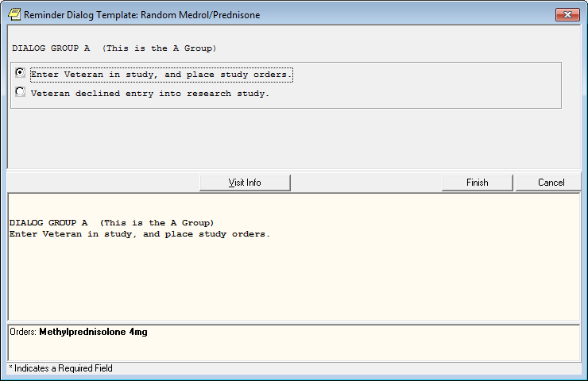
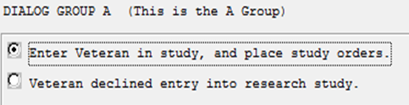

Notes:
Dialog Group A: With 1st option checked.
Note the methylprednisolone order - DO NOT include text at top – “DIALOG A , ETC.”

Slide 30
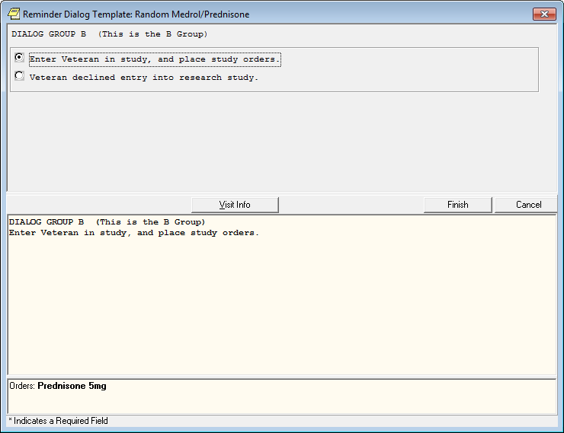
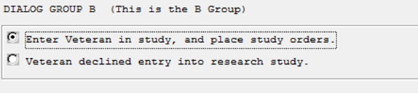

Notes:
Dialog Group B: With 1st option checked:
Note Prednisone Order:
http://ctj.sagepub.com/content/8/2/1833
Again, just a reminder to use the “Ask the Presenter” button if you have any questions throughout the presentation.

Slide 31
GIANT
Reminder Dialog
RESOLVE
Multiple Reminders
Notes:
Did you know that a GIANT reminder Dialog could be used to resolve multiple reminders?

Slide 32
Poll Question
What is the largest reminder dialog you have ever created?
      1-50 Checkboxes (Elements)
      51-100 Checkboxes (Elements)
      101-200 Checkboxes (Elements)
      > 200 Checkboxes (Elements)
Notes:
Now I’d like to ask a poll question.
(READ QUESTION)
To answer this question, use the blue polling icon above my head. We’ll move on and come back to your results in just a moment.

Slide 33

Problem? IT Need?
Notes:
What was the problem and the IT need?
CBOC realignment: Framingham CBOC from Bedford VAMC to Northampton VAMC
Worcester CBOC from Boston VAMC to Northampton VAMC
Only Patient Demographics moved from original VAMC System to Northampton’s System
Now let’s pause for a moment and take a look at your poll results.

Slide 34
Poll Results
What is the largest reminder dialog you have ever created?
  1-50 Checkboxes (Elements)
  51-100 Checkboxes (Elements)
  101-200 Checkboxes (Elements)
  > 200 Checkboxes (Elements)
Notes:
Ad-lib to poll results

Slide 35
Poll Results
What is the largest reminder dialog you have ever created?
  1-50 Checkboxes (Elements)
  51-100 Checkboxes (Elements)
  101-200 Checkboxes (Elements)
  > 200 Checkboxes (Elements)
Notes:
(Cue to Tech Team that you’re moving on) “Click” again to move on

Slide 36
Notes:
Why was there a problem? NO Lab Test Results, NO Medications, NO Specialty Consults, and NO Radiology Procedure Results - NOT MIGRATED to Northampton’s system. NO Health Factors, immunizations, or exams either!

Slide 37

Everything
Is Due
…Don’t Forget!
Notes:
What did this mean for Veterans and Providers? – All the Clinical Reminders were DUE!
Even those processed last month were DUE AGAIN! FRUSTRATION for Veterans and Providers!

Slide 38

Support Staff $$$
Providers
$$$$$$$$$$$
Frustration
Notes:
What to do? Weigh the benefits and pitfalls of two approaches!
Providers process with Veterans = MORE $$$$$$ (SALARY) & frustration for Provider and Veteran; OR
Support staff process them all, (without Veterans) before system change = LESS $$ (SALARY) & no Provider or Veteran frustration.

Slide 39



Think Tank
Staff from VISN 1 & 3 VAMC’s
Notes:
Staff from VISN 1 and three (3) VAMC’s formed a think tank:
Solution must be something that will be:
Cost efficient;
Easily processed – as little thought as possible involved; and
QUICK – only 60 day window: patient demographics were loaded to Northampton’s system 60 days prior to system change at the CBOCs - ~ 10,000 + Records!

Slide 40
GIANT
Dialogs
that include
VISN 1 Reminders
Notes:
The outcome from our meetings? Create a GIANT Dialog that contains all the options from all of the VISN 1 reminders, that:
Document Patient Received clinical intervention outside the VAMC;
Document Patient Refusal;
Document any contraindications; or
Document Life Expectancy < 6 Months

Slide 41

What are the
Pitfalls?
Notes:
What were the PITFALLS ?
MH Instrument Reminders – can’t use HFs for Done Elsewhere – would require reprocessing – can’t be included;
EVERY Option (Except done at encounter) for each reminder needs to be included – HUGE # dialog elements;
Funding the project (Salaries/overtime);

Slide 42

SUCCESS
Notes:
BIG Planning steps to ensure success:
Get approval from HIMS allowing support staff to do this documentation; Create Dialog; Test Dialog; Fix Dialog problems; Retest Dialog; Selection of staff to do the processing; Provide them with CPRS Access to three systems; Provide Dual Monitors for those staff members (Sign into Veteran’s CPRS Record on BOTH systems); Training staff; and selecting start date.

Slide 43

Patient A
Bedford
VAMC
SYSTEM
Patient A
Northampton VAMC
SYSTEM
Notes:
Process with Dual Monitors:
Look up all reminders on Patient A on Bedford (or Boston) system, and 1 at a time;
Find Date of resolution for each;
Find Resolution Finding for each – Refusal, Done at VAMC, Done Elsewhere, Contraindication, Short Lifespan;
Write progress note on Northampton’s system, and process the reminder (All Done at VAMC are processed as Done Elsewhere on Northampton’s System)
All elements have Date Prompt;
Reminders are Resolved for the appropriate time frame.

Slide 44
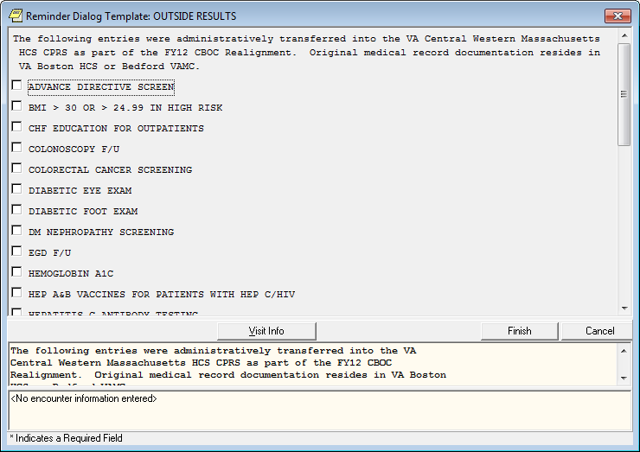
Notes:
GIANT Reminder Dialog (just a small piece of it!)

Slide 45
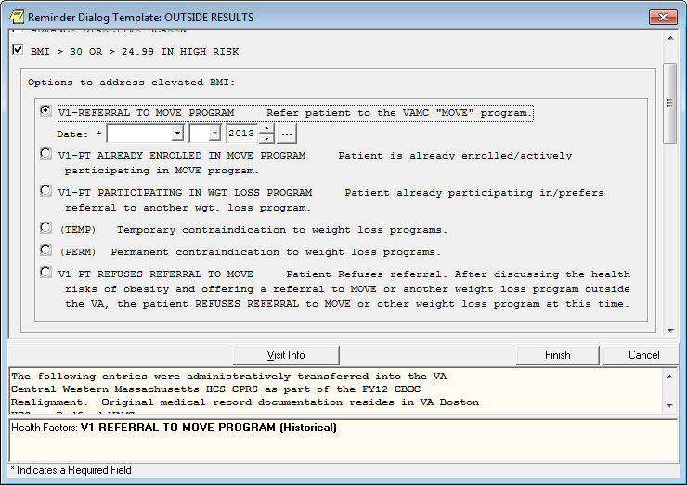
Notes:
What one of the 33 reminders in the GIANT Reminder Dialog looks like. Note the REQUIRED Date Prompt – found on EVERY option – 208 elements!

Slide 46

CELEBRATE
SUCCESS
Notes:
Celebrate Success! The project was successful – reminders processed on most Veterans BEFORE they were seen again at the CBOC. Providers and Veterans saved from frustration of asking and answering the reminder questions AGAIN! Not too many reminders DUE for Providers to process – just the MH-Instrument-related reminders (AUD-C, Depression Screen, PTSD Screen, AIMS, GAF, etc.), and those that just came due again.

Slide 47

Questions?
Notes:
Thank you for your attention. If you have any questions, don’t forget to use the “Ask the Presenter” Button. Philip & I will do our best to answer all of them during the time allotted at the end of this presentation. Speaking of Philip – let’s welcome Philip VanCamp to the podium for part 2 of our “Did you know” presentation.

Slide 48

Notes:
Thank you Gus, I will have to think of a use of that VA-Random item. One of the unique opportunities I have with being on the national support team for Clinical Reminders, I am often pulled in to work with sites having issues with these unique uses. Or often called upon to see if clinical reminders is able to do XYZ, based a sites local project or request. So I get to enjoy seeing how far we can stretch the functionality. So I would like to take the opportunity to present a few items based on sites requests and continue with the theme of Did You Know.
Did you know you could do some Trending in Clinical reminders.

Slide 49

Trending
Notes:
Coversheet reminder or Report Reminder Look for upward or downward trend
Examples A1Cs Lipids BPs Pain Score
Above in relationship with a medication
Process Finding item with Occurrence Count set Series of Function Findings (FF)

Slide 50
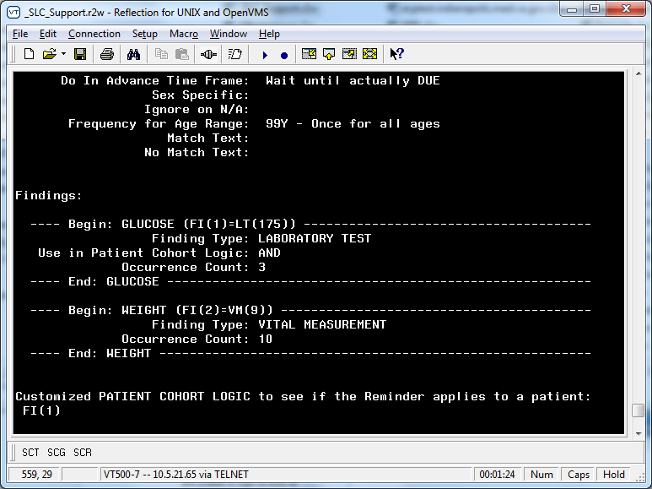
FINDING ITEM
Notes:
Say we want to trend Glucose values upward. First thing we need to Add is the finding item that you want to trend. Your occurrence count has to be high enough to encompass the number of results you want to trend. That is if you want to trend the last 3 results, your occurrence account has to be at least 3 or higher.

Slide 51
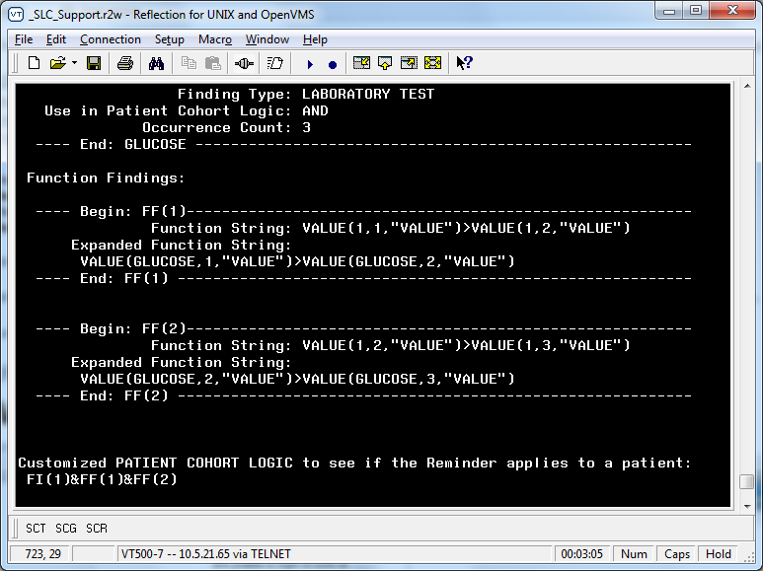
FF1
Notes:
FF string to look at value of finding 1, instance 1, most recent value to see if it is Greater Than the value of the 2nd most recent instance of the same finding. The syntax for the Function finding looks confusing so let me break it down for you.

Slide 52
VALUE (1, 1, “VALUE”)
VALUE (1, 1, “VALUE”) – FINDING Number
VALUE (1, 1, “VALUE”) - Occurrence
VALUE (1, 1, “VALUE”) - CSUB
Notes:
Function Finding syntax for Value. The first position is the finding number. That is the number assigned to the finding when you add to the definition. The 2nd piece is the Instance of the finding. So if you want the 1st, most recent instance, then the value is a 1, if you want the 2nd instance, then a 2 and so forth. The third piece is the Csub, Condition Subscript. Each finding has some defined CSUBs that we can use in evaluations. In this example we are going to look at the Value of the Value of the finding. The first value in the syntax is the Reminder FF function. The second word Value is the CSUB, referencing the field of the finding. Value being measurement of the glucose value.

Slide 53
FF1
Notes:
FF string to look at value of finding 1, instance 1, most recent value to see if it is Greater Than the value of the 2nd most recent instance of the same finding.

Slide 54
FF2
Notes:
A second FF looks at the 2nd most recent instance of the glucose value to see if it is greater than the 3rd most recent value.

Slide 55
Glucose 3
Glucose 2
Glucose 1
Notes:
Glucose 3 < Glucose 2 < Glucose 1
So the most recent value is higher than the 2nd most recent which is higher than the 3rd most recent.
Let me provide a more visual example.

Slide 56
Laboratory test: GLUCOSE; specimen: SERUM
06/11/2013@08:26:26 value - 85
06/09/2013@08:00 value - 75
06/03/2013@11:57:26 value - 70
Notes:
Laboratory test: GLUCOSE; specimen: SERUM
06/11/2013@08:26:26 value - 85
06/09/2013@08:00 value - 75
06/03/2013@11:57:26 value – 70
Now let me plug in the values into the previous graphic.

Slide 57
Glucose 3
6/3/13
70
Glucose 2
6/9/13
75
Glucose 1
6/11/13
85
Notes:
Glucose 3 (70) < Glucose 2 (75) < Glucose 1 (85)
06/11/2013@08:26:26 value - 85
06/09/2013@08:00 value - 75
06/03/2013@11:57:26 value - 70

Slide 58
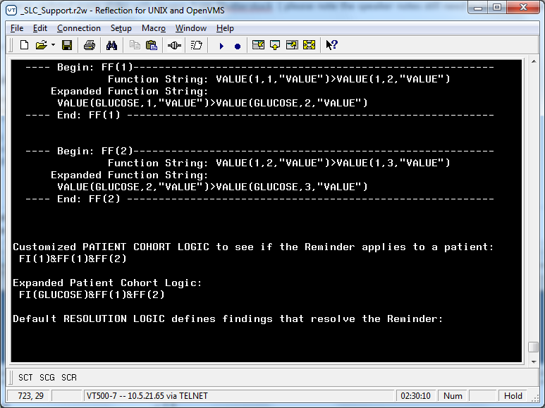
Reminder Definition Logic
--STATUS-- --DUE DATE-- --LAST DONE--
GLUCOSE TREND UP DUE NOW DUE NOW unknown
Cohort:
Laboratory test: GLUCOSE; specimen: SERUM
06/11/2013@08:26:26 value - 85
06/09/2013@08:00 value - 75
06/03/2013@11:57:26 value - 70
Notes:
Customized logic to look at the Glucose finding being present, and FF1 and FF2 both being TRUE
That is that the most recent glucose is higher than the 2nd and the 2nd glucose is higher than the third.
The upward and downward trends in these examples require the values to be specifically higher or lower than its previous ones. A true statistical trending, would require new functionality, because you could have ups and downs in values, but still an upward or downward trend. However, using current functioning, you can do a pretty good job at an attempt.

Slide 59
Poll Question
  Can you see a use at your site for using Trending?
    Yes, clinical coversheet reminder
    Yes, reporting/research
    Yes, other
    No
Notes:
Now I’d like to ask a poll question.
To answer this question, use the blue polling icon above my head. Also if you any questions, please use the Orange Ask the Presenter icon above my head.
We’ll move on and come back to your results at the end of the presentation.

Slide 60
Branching Logic
Notes:
Branching Logic

Slide 61

BRANCHING LOGIC
Branch more than
2 ways?
Notes:
Did you know Clinical Reminders could: BRANCHING LOGIC
Branch more than 2 ways
In a dialog, a reminder group can have a reminder term associated. If the reminder term evaluates true, you can go one dialog pathway. IF the term is false you can use an alternate dialog pathway.
Like in Gus’s earlier example for VA-RANDOM, he had branching logic to take them down 1 of 2 different medication pathways.

Slide 62
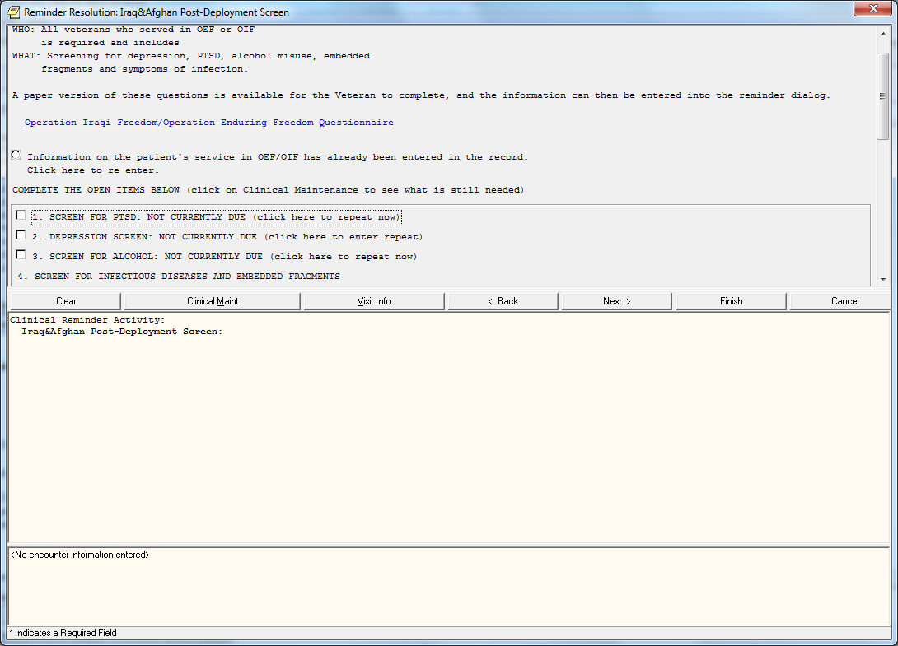
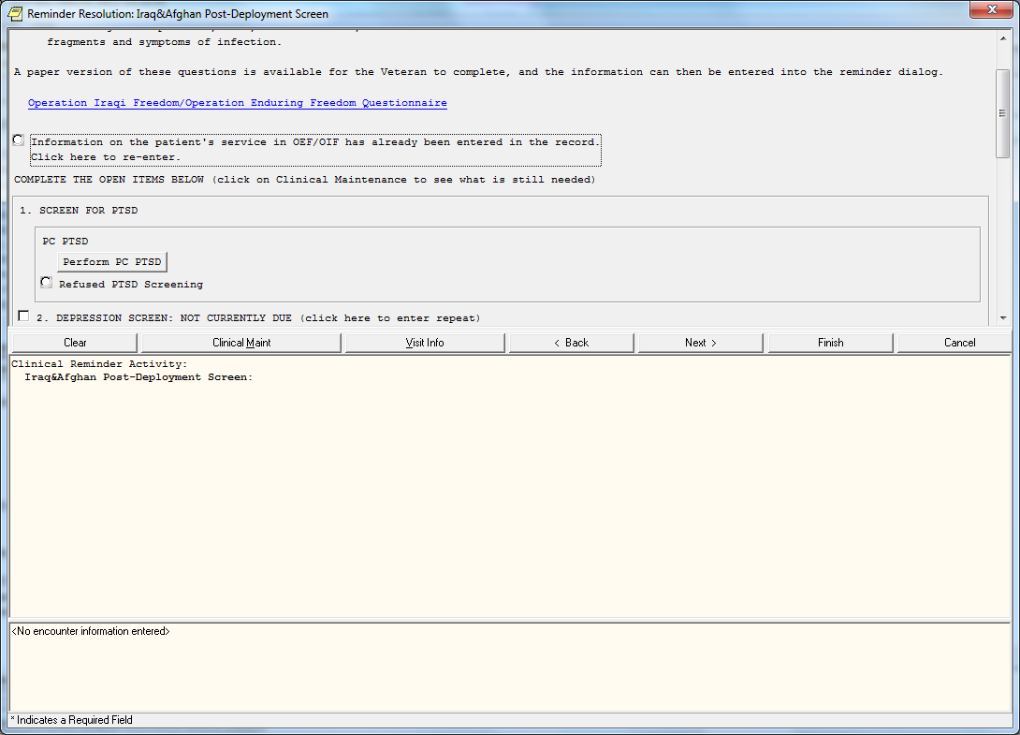
Notes:
Oldest use of branching logic and most recognized is probably the National Iraq-Afghan Post deployment reminder. Where branching is used to determine if MH screening is completed after deployment. This example shows the 2 possible items (branches). Based on a reminder term for a MH instrument being done after the last service sep date. If done, then the option displays that the screening is not due. But if the term evaluates false, (not done) then the prompt displays for the user to administer the MH instrument screen.

Slide 63

Notes:
What if you wanted to branch 3 or more ways?
Age 30-40 Dialog 1 Age 41-50 Dialog 2 Age 51-60 Dialog 3 Age 61-70 Dialog 4
Current functionality only allows one Reminder Term and one alternate Pathway

Slide 64
Dialog
Reminder Term
True
Dialog 1
False
Dialog 2
Notes:
Branching logic pathway review again.
Using that existing functionality, in a “unique” way.
For 4 branches we will use 4 groups
Each with its own term and alternate group

Slide 65
DIALOG
RT1
T
D1
F
DB
RT2
T
D2
F
DB
RT3
T
D3
F
DB
RT4
T
D4
F
DB
Notes:
Complex branching path
This is what we are trying to accomplish. 4 different pathways ages. So a reminder term for each age grouping.
1 PVC AGE 30-40 LOCAL
2 PVC AGE 41-50 LOCAL
3 PVC AGE 51-60 LOCAL
4 PVC AGE 61-70 LOCAL
Where each pathway will evaluate and will lead to either a dialog, or will return a “blank” entry on the screen.

Slide 66
4 Reminder Terms
4 Dialogs for True findings
4 “Blank” dialogs for False
Notes:
This example requires
4 Reminder Term 4 Dialogs for each of the True Findings 4 Dialog elements (BLANKS) for the False Findings
The 4 reminder terms need to use a Computed finding of VA-AGE with a condition to set 30-40 , 41-50 , 51-60 , and 61-70
Finding Item: VA-AGE (FI(1)=CF(24)) Condition: I V>30&(V<41)
Dialogs for the True findings would be the pathways you want to show for a specific age group.
Create “blank” elements for FALSE Term evaluations
The blank elements will have NO dialog text or alternate text and most importantly, the SUPPRESS CHECKBOX needs to be marked as SUPPRESSED

Slide 67
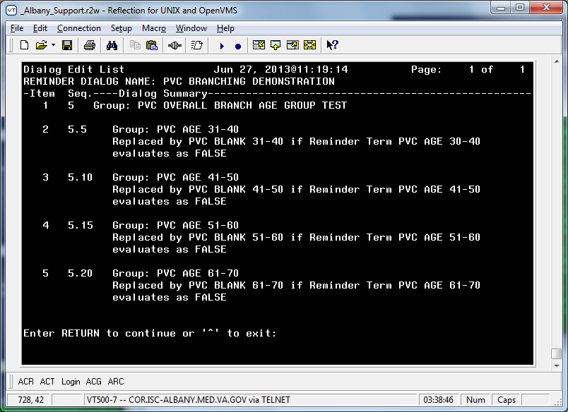
Build The Dialog
Notes:
So let me show you our example of the dialog set up, here we have 4 dialog groups, each with its reminder term for its respective age grouping. Then the Dialog for the true pathway and the replacement dialog if the term evaluates false.
With having 4 branches and in this example using Age, we know only one pathway can be true. So lets test it. Lets open the dialog in CPRS for a 33 year old.

Slide 68
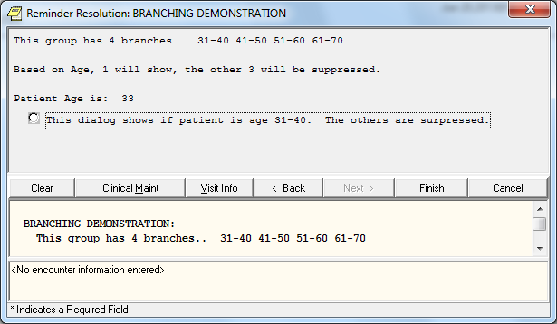
Notes:
Branching logic example for an aged 33 year old. So the reminder term that had the condition for age 30-40 evaluates as true and thus shows me the dialog I have assigned for that age. The other 3 reminder terms evaluate as false and thus use their respective replacement “blank” dialogs, with the blank dialogs having no text and again having the button suppressed, it hides those 3 items.
Lets try another, lets choose a 55 year old.

Slide 69
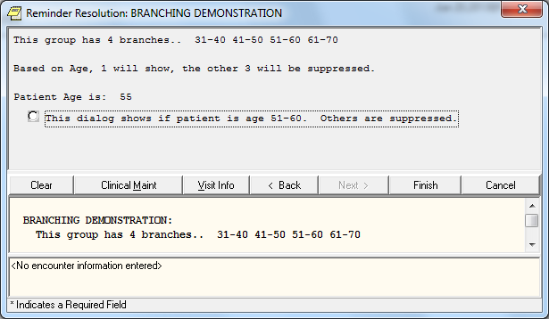
Notes:
Branching logic example for a 55 year old Again, this time the reminder term with the 51-60 age evaluates as true and shows its respective dialog, the others are blank and suppressed.
This was a simple example using a finding that will only have one value so the terms, built properly will work fine. You could be more complex and use findings that could possibly cause 2 or more of the branches to show. So proper planning and development of your terms and dialogs will minimize this and provide you with a complex dialog that will benefit your site.
So lets move on to our next poll question.

Slide 70
Poll Question
  Do you have or foresee needing to have 3 or more branches at a single level for a dialog?
    Yes, Current need
    Yes, Can Foresee
    No, Not at this time
Notes:
Now I’d like to ask a poll question.
(usually presenters read the poll question and acknowledge that the possible answers are on the screen)
To answer this question, use the blue polling icon above my head. Also if you any questions, please use the Orange Ask the Presenter icon above my head.
We’ll move on and come back to your results at the end of the presentation.

Slide 71

USE NEGATIVE OCCURRENCE COUNT ON FINDINGS
Notes:
USE NEGATIVE OCCURRENCE COUNT ON FINDINGS
In my first section on Trending, I spoke about having a finding with an occurrence count high enough to look at the number of values you want to review.
OCCURRENCE COUNT:
This is the maximum number of occurrences of the finding in the date range to return. If the OCCURRENCE COUNT is input as a positive number, N, up to N of the most recent occurrences will be returned and the finding will take the value of the most recent occurrence.
If the OCCURRENCE COUNT is input as a negative number then this behavior is reversed. Up to N of the oldest occurrences will be returned and the finding will take the value of the oldest occurrence in the list.

Slide 72
Laboratory test: GLUCOSE; specimen: SERUM
06/11/2013@08:26:26 value - 85
06/09/2013@08:00 value - 75
06/03/2013@11:57:26 value – 70
---- Begin: GLUCOSE (FI(1)=LT(175)) ----------------------------
Finding Type: LABORATORY TEST
Use in Patient Cohort Logic: AND
Beginning Date/Time:
Occurrence Count:
Notes:
So using our lab value examples from earlier, if our occurrence count is blank on a finding in a reminder definition, the default is a 1, thus returns the most recent value for the date range identified.
So in this example, what value should we get returned?

Slide 73
Laboratory test: GLUCOSE; specimen: SERUM
06/11/2013@08:26:26 value - 85
06/09/2013@08:00 value - 75
06/03/2013@11:57:26 value – 70
---- Begin: GLUCOSE (FI(1)=LT(175)) ----------------------------- Finding Type: LABORATORY TEST
Use in Patient Cohort Logic: AND
Beginning Date/Time:
Occurrence Count:
Cohort:
Laboratory test: GLUCOSE; specimen: SERUM
06/11/2013@08:26:26 value - 85
Notes:
85, the 6/11 date is the most recent finding.
Cohort:
Laboratory test: GLUCOSE; specimen: SERUM
06/11/2013@08:26:26 value - 85

Slide 74
Laboratory test: GLUCOSE; specimen: SERUM
06/11/2013@08:26:26 value - 85
06/09/2013@08:00 value - 75
06/03/2013@11:57:26 value – 70
---- Begin: GLUCOSE (FI(1)=LT(175)) --------------------
Finding Type: LABORATORY TEST
Use in Patient Cohort Logic: AND
Beginning Date/Time:
Occurrence Count: -1
Notes:
So lets set the occurrence count to a negative 1 again from the earlier definition, it should pull the oldest value for the date range identified.
Using our values and dates, which value will get returned from this evaluation using the negative 1 occurrence.

Slide 75
Laboratory test: GLUCOSE; specimen: SERUM
06/11/2013@08:26:26 value - 85
06/09/2013@08:00 value - 75
06/03/2013@11:57:26 value – 70
---- Begin: GLUCOSE (FI(1)=LT(175)) ----------------------------
Finding Type: LABORATORY TEST
Use in Patient Cohort Logic: AND
Beginning Date/Time:
Occurrence Count: -1
Cohort:
Laboratory test: GLUCOSE; specimen: SERUM
06/03/2013@11:57:26 value – 70
Notes:
Right, the 6/3 date value of 70, that is the oldest value of our returns. Please note this was just a test patient with only 3 values, so in your personal examples, you will have values dating back much further.

Slide 76
Laboratory test: GLUCOSE; specimen: SERUM
06/11/2013@08:26:26 value - 85
06/09/2013@08:00 value - 75
06/03/2013@11:57:26 value – 70
---- Begin: GLUCOSE (FI(1)=LT(175)) ---------------------
Finding Type: LABORATORY TEST
Use in Patient Cohort Logic: AND
Beginning Date/Time: 6/5/2013
Occurrence Count: - 1
Notes:
So lets change things up a bit. Continuing to use our negative 1 occurrence count, it will pull the oldest value for the date range identified. So in this example we are throwing in a Beginning date for the finding. That is we are saying ignore all values prior to that date. So what date/value from our list should we get returned now?

Slide 77
Laboratory test: GLUCOSE; specimen: SERUM
06/11/2013@08:26:26 value - 85
06/09/2013@08:00 value - 75
06/03/2013@11:57:26 value – 70
---- Begin: GLUCOSE (FI(1)=LT(175)) ----------------------------
Finding Type: LABORATORY TEST
Use in Patient Cohort Logic: AND
Beginning Date/Time: 6/5/2013
Occurrence Count: -1
Cohort:
Laboratory test: GLUCOSE; specimen: SERUM
06/09/2013@08:00 value - 75
Notes:
Right, the 6/9 value of 75. With the beginning date of 6/5 set, it says ignore everything prior to 6/5. Thus it throws out the 6/3 date. Leaving 2 values. With the occurrence count set to negative 1 it will find the oldest value in the date range.
Lets move to some national examples that use negative occurrence counts

Slide 78
VA-Alcohol Audit-C Positive F/U Eval
VA-MH High Risk No-Show Follow-Up
VA-PTSD Reassessment (PCL)
VA-MH High Risk No-Show AdHoc Report
Notes:
Some National Clinical Reminder Definitions that use Negative Occurrences
VA-ALCOHOL AUDIT-C POSITIVE F/U EVAL
VA-MH HIGH RISK NO-SHOW ADHOC RPT
VA-MH HIGH RISK NO-SHOW FOLLOW-UP
VA-PTSD REASSESSMENT (PCL)

Slide 79
VA-PTSD Reassessment (PCL)
Notes:
VA-PTSD REASSESSMENT (PCL)
2 Instances of a visit to a MH Stop during a specified time frame.
Comparing 1st (oldest) visit to a specified set of MH stop codes with most recent visit to a specified set of mh stop codes to ensure there is a space of X days
And we are doing this with a function finding where Difference in dates between the 2 findings are more than a set number of days desired.
Function String: DIFF_DATE(2,10)>0
Expanded Function String:
DIFF_DATE(VA-MH STOP CODES FOR PTSD EVALUATION,
VA-MH STOP CODES FOR PTSD EVALUATION)>0

Slide 80
Ability to find the oldest occurrence of a finding in a specified time frame
Generally used in combination/comparison with other findings
Notes:
Basically using Negative Occurrence count gives you the ability to find the oldest occurrence of a finding in a specified time frame.
Generally used in combination/comparison with other findings Like the first application of an antidepressant after the first diagnosis of depression. Or the presence of a Health factor after the earliest instance of another finding.
So lets change things up a bit with this next polling question, going to challenge you.

Slide 81
Poll Question
06/01/2013 - 129.85
05/29/2013 - 121.7
04/18/2013 - 116.5
03/08/2013– 120
Begin: WEIGHT (FI(1)=VM(9))
Beginning Date/Time: T-4M
Occurrence Count: -1
If you have the above definition, what weight value will be returned?
A. 129.85 C. 116.5
B. 121.7 D. 120
Notes:
Now I’d like to ask a poll question. To answer this question, use the blue polling icon above my head. With the given set of weights and the finding having a Beginning date/time and occurrence count set. What weight value will be returned.
We’ll move on and come back to your results at the end of the presentation.
Also if you any questions, please use the Orange Ask the Presenter icon above my head.

Slide 82
USE THE DATE OF ONE FINDING TO SET DATE RANGE OF ANOTHER FINDING
Notes:
USE THE DATE OF ONE FINDING TO SET DATE RANGE OF ANOTHER FINDING

Slide 83
FIEVAL(M,”DATE”)
FIEVAL(M,N,”DATE”)
Notes:
Using some syntax for the BDT or EDT, we can accomplish this.
FIEVAL(M,”DATE”) or FIEVAL(M,N,”DATE”)
Where M is the finding number of the item you want and N is the Occurrence of that finding.
Lets use an example of weight. There are usually lots of weight values in a record. But you want to look at only weights that occurred AFTER another item occurred.

Slide 84
---- Begin: WEIGHT (FI(1)=VM(9)) ----------------- Finding Type: VITAL MEASUREMENT
Beginning Date/Time: FIEVAL(3,1,"DATE")
Notes:
FIEVAL(M,”DATE”) or FIEVAL(M,N,”DATE”)
---- Begin: WEIGHT (FI(1)=VM(9)) ----------------- Finding Type: VITAL MEASUREMENT
Beginning Date/Time: FIEVAL(3,1,"DATE")

Slide 85

A site wants to see if a Veteran has weight gain of 5lbs or more after admission
Notes:
So I get this question, a site wants to see if a Veteran has weight gain of 5lbs or more after admission
With this puzzle, what pieces will I need. Well, I will need 4 pieces. First, we need to know the admission date,
Then we need to know the first weight after admission and then finally what their current weight is. So we can then compare the 2 weights to see if there is a difference of 5 lbs or greater.

Slide 86

---- Begin: VA-WAS INPATIENT (FI(3)=CF(67)) ------------------------------
Finding Type: REMINDER COMPUTED FINDING
Occurrence Count: 1
---- End: VA-WAS INPATIENT -----------------
Notes:
So our first puzzle piece is the Admission date, we will use a computed finding VA-WAS INPATIENT to pull the date of admission. This is because the “date” CSUB for this finding returns the admission date. If we used the VA-IS inpatient, it will pull the current date.
Please notice this finding was assigned finding #3 in the reminder definition.

Slide 87

--- Begin: WEIGHT (FI(1)=VM(9)) ---------------------
Finding Type: VITAL MEASUREMENT
Beginning Date/Time: FIEVAL(3,1,"DATE")
Occurrence Count: -1
---- End: WEIGHT ----------------------------------
Notes:
Our second piece of the puzzle is the first weight after admission. So we will use the syntax for using finding 3 ( the admission date) to set the beginning search date of weights. That is to ignore ALL the weights prior to the admission date. But we have to remember to set the occurrence count to -1, so that it finds the OLDEST value within the date range otherwise we get the most recent value after that date. Note this is assigned as Finding #1

Slide 88

--- Begin: WEIGHT (FI(2)=VM(9)) -------------------
Finding Type: VITAL MEASUREMENT
Beginning Date/Time:
Occurrence Count:
---- End: WEIGHT ----------------------------------
Notes:
Our third piece is the current weight. So just a normal entry with null occurrence count pulls the most recent value. Since we have our 3 puzzle pieces, we can move onto our final puzzle piece a Function Finding. Again, note that in this example, the reminder definition assigned #2 as the finding number.

Slide 89
Then use a Function Finding to compare
---- Begin: FF(1)-----------------------------------------------
Function String: NUMERIC(2,1,"VALUE”)>(NUMERIC(1,1,"VALUE")+4.9)
Expanded Function String:
NUMERIC(WEIGHT,1,"VALUE")>(NUMERIC(WEIGHT,1,"VALUE")+4.9)
---- End: FF(1) -----------------------------------------------
Notes:
Our 4th piece is using a Function Finding to compare the 2 weights. So in our function string we will see if the numeric value of the current weight (finding 2) is greater than that of the numeric weight (finding 1) after admission and adding 4.9 lbs. Mumps evaluates Left to Right after items in parentheses are evaluated. So the second numeric value is evaluated and 4.9 added, before it is compared to the most recent. So that will give us 5 or more lb weight gain if the FF evaluates as true.
So lets test this on a patient.

Slide 90
--STATUS-- --DUE DATE-- --LAST DONE--
PVC INPATIENT WEIGHT GAIN DUE NOW DUE NOW
Cohort:
Vital Measurement: WEIGHT
05/03/2013@10:35; rate - 121.47
Information:
Vital Measurement: WEIGHT
04/26/2013@10:53:04; rate - 115.1
Computed Finding: VA-Was Inpatient
04/24/2013@10:02:39; Inpatient from: 04/24/2013@10:02:39 to 6/21/2013@09:04:25
Notes:
Here is a section from a reminder test on the patient showing us our findings.
We see our admission date is 4/24 The first weight after admission is 115.1 lbs The current weight is 121.47
So we can see why this is then true (or Due). The admission weight plus 4.9 lbs would be 120lbs (115.1 +4.9) and the current weight is higher than that at 121.47. So this example the patient has a weight gain of 6.3 lbs since admission.
You could use this example in combination with specific medications or Diagnoses the patient may have. So to summarize, we used the finding date of Admission to set the starting date of searches for all the weights after that date and exclude those prior.

Slide 91
Poll Question
  Do you have or foresee using the date of one finding to set the search dates of another finding?
    Yes, Current need
    Yes, Can Foresee
    No, Not at this time
Notes:
Now I’d like to ask a poll question. (Note: This is the last poll question before the review)
To answer this question, use the blue polling icon above my head. Also if you any questions, please use the Orange Ask the Presenter icon above my head.
While the bean counters are tallying this final poll question, I would like to go back and start reviewing the poll question results from my earlier topics.
Trending
Branching Logic
Negative Occurrence Count
Finding setting date of another finding.

Slide 92
Poll Question
  Can you see a use at your site for using Trending?
    Yes, clinical coversheet reminder
    Yes, reporting/research
    Yes, other
    No
Notes:
Trending Results

Slide 93
Poll Results
Can you see a use at your site for using Trending?
  Yes, clinical coversheet reminder
  Yes, reporting/research
  Yes, other
  No
Notes:
Ad lib to poll results

Slide 94
Poll Results
Can you see a use at your site for using Trending?
  Yes, clinical coversheet reminder
  Yes, reporting/research
  Yes, other
  No
Notes:
(Cue to Tech Team that you’re moving on) “Click” again to move on

Slide 95
Poll Question
  Do you have or foresee needing to have 3 or more branches at a single level for a dialog?
    Yes, Current need
    Yes, Can Foresee
    No, Not at this time
Notes:
Branching Logis

Slide 96
Poll Results
Do you have or foresee needing to have 3 or more branches at a single level for a dialog?
  Yes, Current need
  Yes, Can Foresee
  No, Not at this time
Notes:
Ad lib to poll results

Slide 97
Poll Results
Do you have or foresee needing to have 3 or more branches at a single level for a dialog?
  Yes, Current need
  Yes, Can Foresee
  No, Not at this time
Notes:
(Cue to Tech Team that you’re moving on) “Click” again to move on

Slide 98
Poll Question
06/01/2013 - 129.85
05/29/2013 - 121.7
04/18/2013 - 116.5
03/08/2013– 120
Begin: WEIGHT (FI(1)=VM(9))
Beginning Date/Time: T-4M
Occurrence Count: -1
If you have the above definition, what weight value will be returned?
    129.85
    121.7
    116.5
    120
Notes:
Negative occurrence count results
Correct answer is B 121.7 The Beginning Date/Time of T-4 months, means since today is August 25th, that 4 months prior is is April 25th, and thus ignores values prior to April 25th. With the occurrence account set to -1, the oldest of the remaining is returned, which is 5/29 value of 121.7

Slide 99
Poll Results
If you have the BDT= T-4M and OCC = -1, what weight value will be returned?
  129.85 – 06/01/2013
  121.7 – 05/29/2013
  116.5 – 04/18/2013
  120 – 03/08/2013
Notes:
Correct answer is B 121.7 The Beginning Date/Time of T-4 months, means since today is August 25th, that 4 months prior is April 25th, and thus ignores values prior to April 25th. With the occurrence account set to -1, the oldest of the remaining is returned, which is 5/29 value of 121.7

Slide 100
Poll Results
If you have the BDT= T-4M and OCC = -1, what weight value will be returned?
  129.85 – 06/01/2013
  121.7 – 05/29/2013
  116.5 – 04/18/2013
  120 – 03/08/2013
Notes:
(Cue to Tech Team that you’re moving on) “Click” again to move on

Slide 101
Poll Question
  Do you have or foresee using the date of one finding to set the search dates of another finding?
    Yes, Current need
    Yes, Can Foresee
    No, Not at this time
Notes:
Finding Date controlling date of another.

Slide 102
Poll Results
Do you have or foresee using the date of one finding to set the search dates of another finding?
  Yes, Current need
  Yes, Can Foresee
  No, Not at this time
Notes:
Ad lib to poll results

Slide 103
Poll Results
Do you have or foresee using the date of one finding to set the search dates of another finding?
  Yes, Current need
  Yes, Can Foresee
  No, Not at this time
Notes:
(Cue to Tech Team that you’re moving on) “Click” again to move on

Slide 104
Ask the Presenter
Notes:
If you haven’t submitted your questions yet, there is still time to do so by clicking on the orange “Ask The Presenter” icon. We’re going to show a brief announcement and be right back to answer your questions.
(Stand still and smile until you see the video come up full screen)
[erase these notes and add your own!]

