Slide 1
Regional Data Warehouses
Clinton Daniel, IT Specialist (Data Management) – OI&T Business Intelligence Service Line
Notes:
Thank you (moderator name)! I am happy to be here today to talk about Regional Data Warehouses.

Slide 2
Notes:
What is the Data Warehouse?
From Stephen Anderson Draft (3/11/2013): “Manual for Data Warehouse Customers Policies, Guidelines and Best Practices”:
The Business Intelligence Service Line (BISL) is the section of the Office of Information and Technology (OI&T) that maintains a set of servers and other IT resources that provide clinical and other data to VA for analytical purposes. Each server contains a national data set (CDW), a regional data set (RDW) or a VISN data set (VDW). The servers contain the same data model (same table structures), are loaded by the same processes and the regional and national environments have the same permissions model. Therefore the term “Corporate Data Warehouse” is often used to mean the system overall as the metadata and other documentation apply to all environments.
The data maintained on the servers are in large relational databases organized by logical data domain, e.g. pharmacy, lab chemistry, etc. The data comes from the source systems (mostly Vista) without “scrubbing”, filtering and without business logic applied. The data is not optimized for any particular use but rather it is fairly normalized to allow its use by varied types of queries for analyses and reports.

Slide 3
Poll Question
What is your experience with the Data Warehouse?
Never used it
Very little
Moderate experience
Advanced experience
Notes:
Now I’d like to ask a poll question.
What is your experience with the Data Warehouse?
Never used it
Very Little
Moderate experience
Advanced experience
To answer this question, use the blue polling icon above my head. We’ll move on and come back to your results a bit later.
I am trying to get a broad idea of the experience the audience has with the data warehouse.

Slide 4
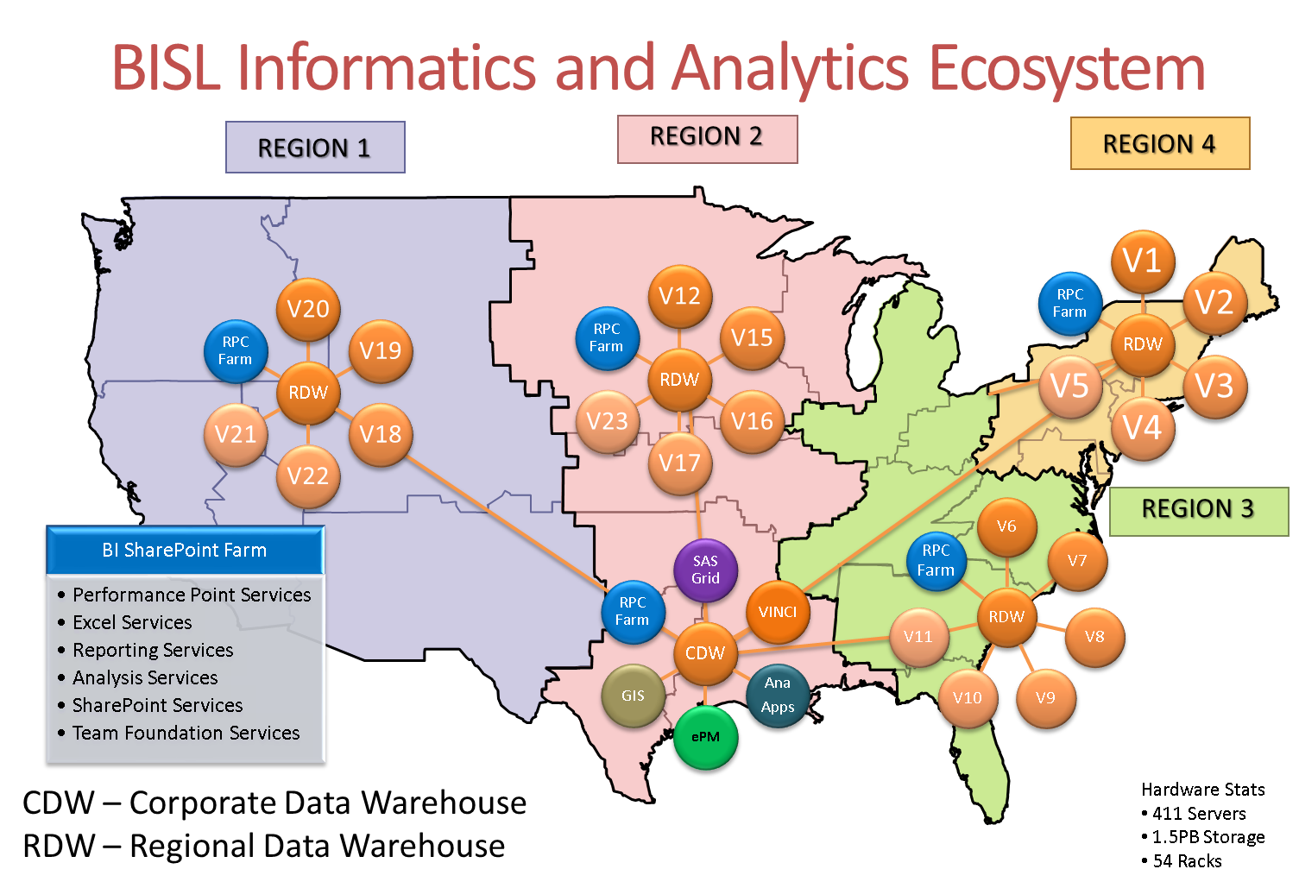
Hardware Stats
411 Servers
1.5 PB Storage
54 Racks
CDW – Corporate Data Warehouse
RDW – Regional Data Warehouse
Notes:
Provide a general overview of our BISL infrastructure
From Jim Malpass (Director, Region 3 Data Warehouse) slide presentation given 6/24/2013 titled, “VA Data Warehousing & Business Intelligence”:
Business Intelligence Service Line (BISL) – OIT component
Design, develop, deploy & maintain the database and infrastructure
Technical support
Training
Collaboration
Office of Informatics and Analytics (OIA) – VHA component
Business knowledge and insight
Identify business needs
Define terms and business rules
Design reports
Ad hoc queries
Field-level VHA Staff
Data analyst
DSS staff
Etc.

Slide 5
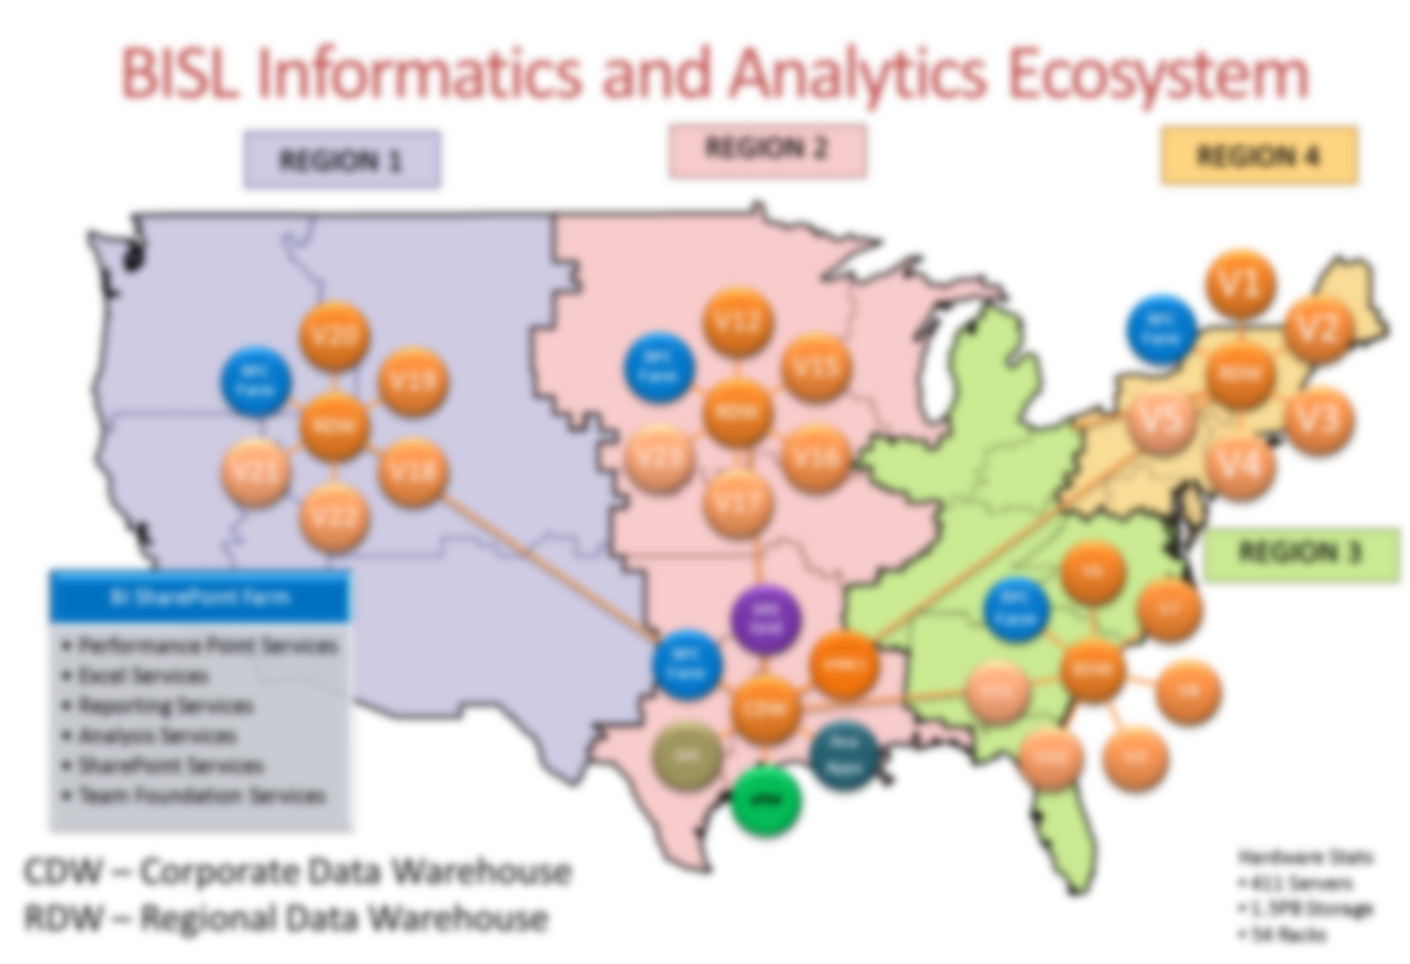
Hardware Stats
411 Servers
1.5 PB Storage
54 Racks
CDW – Corporate Data Warehouse
RDW – Regional Data Warehouse
Notes:
Provide a general overview of our BISL infrastructure
From Jim Malpass (Director, Region 3 Data Warehouse) slide presentation given 6/24/2013 titled, “VA Data Warehousing & Business Intelligence”:
Business Intelligence Service Line (BISL) – OIT component
Design, develop, deploy & maintain the database and infrastructure
Technical support
Training
Collaboration
Office of Informatics and Analytics (OIA) – VHA component
Business knowledge and insight
Identify business needs
Define terms and business rules
Design reports
Ad hoc queries
Field-level VHA Staff
Data analyst
DSS staff
Etc.

Slide 6
Hardware Stats
411 Servers
1.5 PB Storage
54 Racks
CDW – Corporate Data Warehouse
RDW – Regional Data Warehouse
Notes:
Provide a general overview of our BISL infrastructure
From Jim Malpass (Director, Region 3 Data Warehouse) slide presentation given 6/24/2013 titled, “VA Data Warehousing & Business Intelligence”:
Business Intelligence Service Line (BISL) – OIT component
Design, develop, deploy & maintain the database and infrastructure
Technical support
Training
Collaboration
Office of Informatics and Analytics (OIA) – VHA component
Business knowledge and insight
Identify business needs
Define terms and business rules
Design reports
Ad hoc queries
Field-level VHA Staff
Data analyst
DSS staff
Etc.

Slide 7
Hardware Stats
411 Servers
1.5 PB Storage
54 Racks
CDW – Corporate Data Warehouse
RDW – Regional Data Warehouse
Notes:
Provide a general overview of our BISL infrastructure
From Jim Malpass (Director, Region 3 Data Warehouse) slide presentation given 6/24/2013 titled, “VA Data Warehousing & Business Intelligence”:
Business Intelligence Service Line (BISL) – OIT component
Design, develop, deploy & maintain the database and infrastructure
Technical support
Training
Collaboration
Office of Informatics and Analytics (OIA) – VHA component
Business knowledge and insight
Identify business needs
Define terms and business rules
Design reports
Ad hoc queries
Field-level VHA Staff
Data analyst
DSS staff
Etc.

Slide 8
Poll Results
What is your experience with the Data Warehouse?
Never used it
Very Little
Moderate experience
Advanced experience
Notes:
Now let’s pause for a moment and take a look at your poll results.
Question was…What is your experience with the Data Warehouse?
Never used it
Very Little
Moderate experience
Advanced experience
Ad-lib to the audience results, then advance to move on.

Slide 9
Poll Results
What is your experience with the Data Warehouse?
Never used it
Very Little
Moderate experience
Advanced experience
Notes:
(Cue to Tech Team that you’re moving on) “Click” again to move on

Slide 10
VistA
DW Layers
VDW
RDW
CDW
Notes:
How does the DW get the Data?
Provide a general overview of how the data warehouse can be populated at the RDW, CDW, and VDW levels

Slide 11
Shadow Servers and Cache Shadows
Notes:
How does the data warehouse get it data and what are the data warehouse layers?
Detailed overview of the Data Warehouse layers.
From Dave Fackler’s blog post (5/7/2013):
Shadow Servers and Cache Shadows. This is technically the bottom layer of our data warehouse environment and is a fundamental cog in the gears that provide data to the various data warehouse servers. We maintain our own set of shadow servers and Vista shadow databases in each region.

Slide 12
Journal Readers and Filers
Notes:
Journal Readers and Filers. This application layer consists of a set of applications that run on our shadow servers. The Journal Readers cull through the journal files supporting each of our Vista shadow databases and look for “transactions” of interest (i.e., something that changed with regards to a Vista file we are monitoring for data). Changes that we find are queued and then the Filers move through that queue and copy the changes to the next layer up (next bullet point).

Slide 13
Feeder Data Warehouse (FDW) Databases
Notes:
Feeder Data Warehouse (FDW) Databases. These databases exist as SQL Server databases and are housed on our primary regional data warehouse servers. The Filers that find queued up changes handle the insert or update of records in the FDW databases. In general, we have an FDW database in each region that houses dimension tables and several FDW databases in each region that house fact tables. We spread the fact tables out into multiple databases to keep the size of any given database manageable (backups, files and filegroup sizes, and the like).

Slide 14
ETL Process
Notes:
ETL Process. This application layer consists of a (large) set of SSIS packages that are responsible for taking data from the FDW databases and loading that data into the next layer of our data warehouse environment. Our ETL process currently runs on a nightly basis and issues incremental queries against each of the tables in the FDW databases (it knows what data was returned the prior night, so it knows how to construct a query that only returns newly inserted or updated records). The process then does any transformations required – sometimes very little (such as assigning surrogate keys and filling in foreign keys) and sometimes a whole lot (such as un-pivoting data or completely changing its structure as with the PCMM tables) – and loads the data into the next layer up (next bullet point).

Slide 15
Data Distribution System (DDS)
VISN Data Warehouse Databases (VDW)
Regional Data Warehouse Databases (RDW)
LSV Database and Views
SPV Database and Views
Corporate Data Warehouse Databases (CDW)
xDW Work Databases and Views
Notes:
Data Warehouse Layers cont.:
Regional Data Warehouse (RDW) Databases. This set of databases also exist as SQL Server databases and are housed on the same primary regional data warehouse servers as the FDW databases (although the FDW databases might move at some point in the near future). On a nightly basis, an ETL process (mentioned above) loads data into these databases in an incremental, batched fashion. As with the FDW databases, we have an RDW database in each region that houses dimension tables and several RDW databases in each region that house fact tables. Again, we spread the fact tables out into multiple databases to keep the size of any given database manageable. As records are loaded into the RDW databases, each is assigned a surrogate key (the SID column) based on an identity column value with specific seed values so that no records in any RDW table (regardless of origin) will ever have the same SID value.
Data Distribution System (DDS). This application layer consists of a set of stored procedures and automatically generated SQL Server Agent jobs on each of the primary regional data warehouse servers. As a batch of data gets loaded into any given RDW table, a SQL Server Agent job is spawned that is responsible for distributing that batch of data from the RDW environment to the other data warehouse environments at the corporate and VISN levels (next bullet points). The DDS process simply copies and merges batches of data from a given RDW table to all destinations that are registered and required in each region.
Corporate Data Warehouse (CDW) Databases. This set of SQL Server databases contain the consolidation of data from each regional set of RDW databases. At present, we maintain two copies of CDW databases – one for operational use (for VHA users, project teams, national program offices, etc.) and one for research use (for VINCI clientele). Both copies contain all data from each region as the DDS process in each region pushes batches of data to each CDW copy.
VISN Data Warehouse (VDW) Databases. Each VISN within each region has a specific data warehouse server provisioned for them by the BISL teams. On each of these servers, a VDW database exists within SQL Server that houses that particular VISN’s “slice” of the data from that region’s RDW databases. The VDW databases are different from the RDW databases in that a single database houses all dimension and fact tables. Beyond that, the structures of the tables themselves are the same. Thus, the DDS process splits the data from each RDW table into the slice belonging to each VISN (based on Sta3n) and pushes that slice to each VDW database within the region.
xDWWork Databases and Views. At the RDW, CDW, and VDW levels, we maintain a database generically referred to as the xDWWork database. At the RDW level, the database is named RDWWork, at the CDW level it is named CDWWork, and at the VDW level it is named VDWWork. These databases house views that correspond to all of our dimension and fact tables (housed in either the RDW, CDW, or VDW databases accordingly). These views filter the dimension and fact data so that records marked as deleted are not shown. Thus, the xDWWork databases provide somewhat of a WYSIWYG view of the data similar to what you might see within Vista (i.e., if a record is deleted from Vista and marked as deleted within the data warehouse environment, you won’t see that record via the xDWWork database views).
SPV Database and Views. Alongside the xDWWork databases, we also maintain an SPV database with views that correspond to all of the dimension and fact tables. These views act exactly like the views in the xDWWork databases except that they do not filter out deleted records. All records are shown. Thus, while report developers may or may not want to refer to these views, ETL developers maintaining downstream data marts or other reporting databases may want to use these views so that they can know about and handle records that are marked as deleted (I’ll explain how we do that in a future post on OpCode values).
LSV Database and Views. Finally, alongside the xDWWork databases, we also maintain another database named LSV with views that correspond to all of the dimension and fact tables. These views, however, filter based on the set of Sta3n values that any given user is authorized to see. An application available within the CDW SharePoint environment allows regional and VISN resources to request and be authorized access to specific Sta3n’s. As these authorizations are made, data related to those Sta3n’s can then be viewed by the given authorized user through the LSV database views.

Slide 16
Translate VistA Logic into SQL Logic
Notes:
Translate VistA Logic into SQL Logic
Explain the difference between how VistA uses Business logic and stores its data via Transactions from the Electronic Healthcare Record System (CPRS, VistA packages, etc.) . Explain how developers must translate business logic from the transaction system to analytical logic using SQL in the data warehouse. This knowledge is needed for all phases of the data warehouse – ETL for domains and analytical SQL for customer products.

Slide 17
Communicates Organizational Priorities
Sets/Monitors Domain, Work Priorities & Completion
Organizes SMEs & Data Stewards
Provides Business Logic Documentation/Clarification
Notes:
VHA Business Owners/SMEs
CDW Governance:
What Kind of Data?
Provide a general overview of the data warehouse governance. Meet the needs of the organization. Get together with our business partners to prioritize domains and resources.
CDW Governance Board
Determines priorities for new data domains in CDW
Establishes business rules and definitions for processing data
Regional Data Warehouse Steering Committees
Determines priorities for regional projects
Establishes business rules and definitions not addressed by CDWGB
VISNs have governance boards based on specific needs of VISN. Example VISN 8:
The VA Sunshine Healthcare Network (VISN 8) Data Warehouse (VDW) Subcommittee will have the authority to establish processes and prioritize projects and reports to ensure that the VISN 8 Data Warehouse, and Business Intelligence Service Line is responsive to the clinical and administrative business needs of Veterans Health Administration end users in VISN 8.
CURRENT DATA DOMAINS (partial list):
Patient
Staff
Consults
Health Factors
Immunizations
Lab, Chemistry
Primary Care Assignments
Pharmacy, Outpatient
Vital Signs
Appointments
Mental Health Assessment
Outpatient Encounters
Clinical Orders
Inpatient Admissions
Barcode Med Administration
Inpatient Unit Dose
Intravenous Medications
Microbiology
Clinical Text Notes
Accounts Receivable
Purchased Care
Radiology
Beneficiary Travel
Compensation & Pension Exams
Non VA Meds
MyHealtheVet Secure Messaging
Surgical procedures
Prosthetics
Equipment Inventory
Engineering work orders
Emergency Department
Allergies

Slide 18
Communicates Organizational Priorities
Sets/Monitors Domain, Work Priorities & Completion
Organizes SMEs & Data Stewards
Provides Business Logic Documentation/Clarification
Notes:
CDW Governance Board
CDW Governance:
What Kind of Data?
Provide a general overview of the data warehouse governance. Meet the needs of the organization. Get together with our business partners to prioritize domains and resources.
CDW Governance Board
Determines priorities for new data domains in CDW
Establishes business rules and definitions for processing data
Regional Data Warehouse Steering Committees
Determines priorities for regional projects
Establishes business rules and definitions not addressed by CDWGB
VISNs have governance boards based on specific needs of VISN. Example VISN 8:
The VA Sunshine Healthcare Network (VISN 8) Data Warehouse (VDW) Subcommittee will have the authority to establish processes and prioritize projects and reports to ensure that the VISN 8 Data Warehouse, and Business Intelligence Service Line is responsive to the clinical and administrative business needs of Veterans Health Administration end users in VISN 8.
CURRENT DATA DOMAINS (partial list):
Patient
Staff
Consults
Health Factors
Immunizations
Lab, Chemistry
Primary Care Assignments
Pharmacy, Outpatient
Vital Signs
Appointments
Mental Health Assessment
Outpatient Encounters
Clinical Orders
Inpatient Admissions
Barcode Med Administration
Inpatient Unit Dose
Intravenous Medications
Microbiology
Clinical Text Notes
Accounts Receivable
Purchased Care
Radiology
Beneficiary Travel
Compensation & Pension Exams
Non VA Meds
MyHealtheVet Secure Messaging
Surgical procedures
Prosthetics
Equipment Inventory
Engineering work orders
Emergency Department
Allergies

Slide 19
Communicates Organizational Priorities
Sets/Monitors Domain, Work Priorities & Completion
Organizes SMEs & Data Stewards
Provides Business Logic Documentation/Clarification
Notes:
OI&T Corporate Data Warehouse
CDW Governance:
What Kind of Data?
Provide a general overview of the data warehouse governance. Meet the needs of the organization. Get together with our business partners to prioritize domains and resources.
CDW Governance Board
Determines priorities for new data domains in CDW
Establishes business rules and definitions for processing data
Regional Data Warehouse Steering Committees
Determines priorities for regional projects
Establishes business rules and definitions not addressed by CDWGB
VISNs have governance boards based on specific needs of VISN. Example VISN 8:
The VA Sunshine Healthcare Network (VISN 8) Data Warehouse (VDW) Subcommittee will have the authority to establish processes and prioritize projects and reports to ensure that the VISN 8 Data Warehouse, and Business Intelligence Service Line is responsive to the clinical and administrative business needs of Veterans Health Administration end users in VISN 8.
CURRENT DATA DOMAINS (partial list):
Patient
Staff
Consults
Health Factors
Immunizations
Lab, Chemistry
Primary Care Assignments
Pharmacy, Outpatient
Vital Signs
Appointments
Mental Health Assessment
Outpatient Encounters
Clinical Orders
Inpatient Admissions
Barcode Med Administration
Inpatient Unit Dose
Intravenous Medications
Microbiology
Clinical Text Notes
Accounts Receivable
Purchased Care
Radiology
Beneficiary Travel
Compensation & Pension Exams
Non VA Meds
MyHealtheVet Secure Messaging
Surgical procedures
Prosthetics
Equipment Inventory
Engineering work orders
Emergency Department
Allergies

Slide 20
Communicates Organizational Priorities
Sets/Monitors Domain, Work Priorities & Completion
Organizes SMEs & Data Stewards
Provides Business Logic Documentation/Clarification
Notes:
Data Quality
CDW Governance:
What Kind of Data?
Provide a general overview of the data warehouse governance. Meet the needs of the organization. Get together with our business partners to prioritize domains and resources.
CDW Governance Board
Determines priorities for new data domains in CDW
Establishes business rules and definitions for processing data
Regional Data Warehouse Steering Committees
Determines priorities for regional projects
Establishes business rules and definitions not addressed by CDWGB
VISNs have governance boards based on specific needs of VISN. Example VISN 8:
The VA Sunshine Healthcare Network (VISN 8) Data Warehouse (VDW) Subcommittee will have the authority to establish processes and prioritize projects and reports to ensure that the VISN 8 Data Warehouse, and Business Intelligence Service Line is responsive to the clinical and administrative business needs of Veterans Health Administration end users in VISN 8.
CURRENT DATA DOMAINS (partial list):
Patient
Staff
Consults
Health Factors
Immunizations
Lab, Chemistry
Primary Care Assignments
Pharmacy, Outpatient
Vital Signs
Appointments
Mental Health Assessment
Outpatient Encounters
Clinical Orders
Inpatient Admissions
Barcode Med Administration
Inpatient Unit Dose
Intravenous Medications
Microbiology
Clinical Text Notes
Accounts Receivable
Purchased Care
Radiology
Beneficiary Travel
Compensation & Pension Exams
Non VA Meds
MyHealtheVet Secure Messaging
Surgical procedures
Prosthetics
Equipment Inventory
Engineering work orders
Emergency Department
Allergies

Slide 21
Access and Use the DW
Notes:
Access and Use the DW:
Explain the access controls and tools required to use the data warehouse. Emphasize information security. VA s response to security. We are fully aware of the sensitivity of this data.

Slide 22
How can the DW Benefit the Customers?
Notes:
How can the DW Benefit the Customers?
Overview of how the data warehouse can be used to benefit all VA customers. Examples would include Reports, Dashboards, etc.

Slide 23
Business Question
Gather Requirements
Develop Product
Deploy Product
Manage Product
Notes:
Typical Business Intelligence Product Life Cycle
Use the following as an example:
Natural and Structured example (can easily build relationships based on documentation):
Developing a product to meet the "Mental Health Care Transitions (mht1, mht11)"
Mental Health Inpatient 7 Day Follow-Up Monitor" per Documentation – VA Performance Measure Manual
Unnatural example – cannot easily relate to documentation:
Appointments associated with CPRS Orders – fabricate a relationship.

Slide 24
Code SQL
Build Report
Publish to SharePoint
Notes:
Describe the process of developing and publishing a product in the data warehouse
Code SQL
Validate
Test
Build Report
Customer Review
Modify if needed
Publish to SharePoint
Inform Customer
Customer Markets Product

Slide 25
Notes:
Shareable VISN Products

Slide 26
Ask the Presenter
Notes:
Address questions at this time.
If you haven’t submitted your questions yet, there is still time to do so by clicking on the orange “Ask The Presenter” icon. We’re going to show a brief announcement and be right back to answer your questions.
(Stand still and smile until you see the video come up full screen)
[erase these notes and add your own!]

