Slide 1
CPRS tools and resources for the PACT RN Care Manager
Patricia Akerly MSHSA, MSN, CRNP
Charles J. Zeilman, III, PhD, ARNP, ANP-BC
Notes:
Thank you (moderator name)! Welcome to today’s presentation of CPRS Strategies to Improve Efficiency

Slide 2
CPRS
CPRS Tips & Time savers
Notifications
Clinical Reminders
Reports Tab
Progress Notes
Combination List
Orders
Notes:
During this presentation we will present a few tricks and tips to assist you with navigating in CPRS and customizing CPRS to more efficiently meet your needs.

Slide 3

Poll Question
What is your role on the team?
Provider
RN Care Manager
LPN
HCT
Other
Notes:
Before we begin, We would like to know which PACT team members are listening to today’s presentation.
What is your role on the team?
Provider
RN Care Manager
LPN
HCT
Other
To answer this question, use the blue polling icon located on the top of your screen. For now, we will move on and come back to your results in just a moment.

Slide 4

Keyboard Commands
ESC
Tab
Ctrl
Enter
Shift
Left Click
Right Click
Notes:
In the work setting there is so much work to do and so little time. Every second counts. To save time while working in CPRS, in addition to saving wear and tear on your wrist from using the mouse, the next few slides provide a few ideas to help you navigate more efficiently within CPRS . This is accomplished by using keyboard commands instead of the mouse. Keyboard commands allow for completion of an action in less time with less effort.

Slide 5

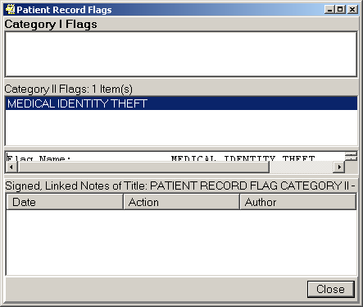
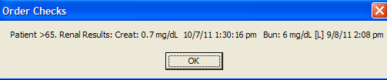
Notes:
We will start with the Escape key. The Escape key (which may be abbreviated as ESC) can be used to clear a pop-up window or to back out of a view. To close a pop up window, instead of using the mouse to select “close” or “ok” , hitting the Esc key will close the window. For example, to close a patient record flag or order check, press the escape key and the window will go away without having to use the mouse to select an action.

Slide 6

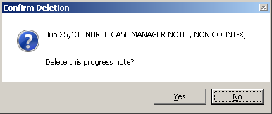
Press ENTER key to select highlighted button
Notes:
The enter key can function the same as a mouse click. Note the highlighting of the “No” button in the grey area on this slide. Pressing the enter key will “click” the highlighted button without having to use a mouse click.

Slide 7

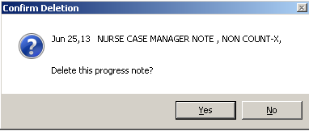
Press TAB key
to select a different choice
Notes:
Pressing the Tab Key will switch button selections. In this case the “Yes” button is highlighted, pressing the TAB key will change the selection from No to Yes. Once the Yes button is highlighted, press the enter key to continue.

Slide 8
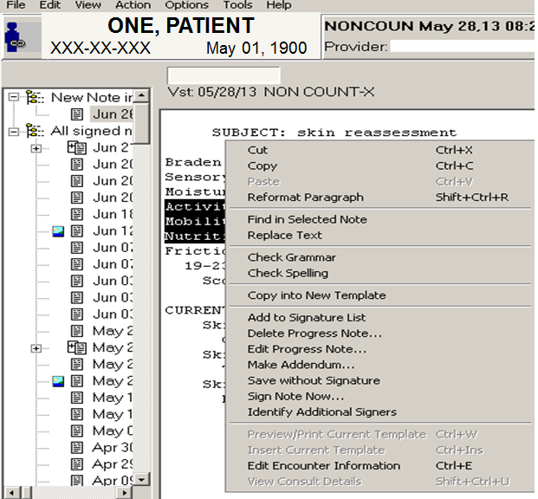
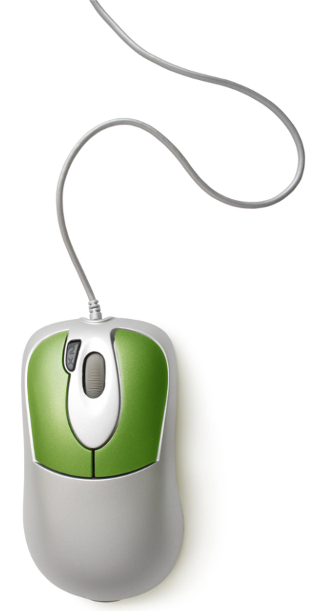
Shortcuts
Right Click
Notes:
Here is another way to save time and use less effort while working in CPRS. To edit or complete an action in the notes section, instead of using the mouse to move the cursor to select EDIT

Slide 9
Shortcuts
Right Click
Notes:
Or to select ACTION, leave the cursor in the note text section and right click on the mouse. A window will display with actions that can be completed without clicking the EDIT or ACTION from the menu bar.

Slide 10
Shortcuts
Right Click
Notes:
Other keys can be used to complete actions instead of moving the cursor with the mouse. Pressing one of the command keys along with one of the letter keys will give you the same action as clicking on the command. For example pressing the Control key and the letter C will copy highlighted text. The Control key and the letter V will paste the text.

Slide 11
Shortcuts
Right Click
Notes:
There is no need to remember all of the shortcut commands. Shortcut commands that are available are listed next to the requested action, as illustrated in the green box on this slide.
This presentation provides a glimpse of a few CPRS shortcuts using the keyboard. To learn more about keyboard shortcuts, take a look at the on demand VeHu class by Dr. Neil Evans : Class 101: Saving Time with Keyboard Shortcuts.

Slide 12
Poll Results
What is your role on the team?
Provider
RN Care Manager
LPN
HCT
Other
Notes:
Now let’s pause for a moment and take a look at the poll results.
Ad-lib to the audience results, then advance to move on.

Slide 13
Poll Results
What is your role on the team?
Provider
RN Care Manager
LPN
HCT
Other
Notes:
(Cue to Tech Team that you’re moving on) “Click” again to move on

Slide 14

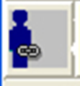

The CCOW Icon
Linked
Notes:
Have you ever experienced times when Vista Web, Vista Imaging or IMED consent would not open.
The problem could be that a link is broken between the patient’s chart and programs which should link with the patient once the chart is opened. The correct linking of programs is a function of the CCOW application.
CCOW stands for Clinical Context Object Workgroup
On this slide, the blue man with the paper clip intact indicates the chart is linked with CCOW. This function synchronizes all the “compliant” programs and links them to the patient’s chart.

Slide 15

The CCOW Icon
Broken Link
Notes:
A group of people with a broken paper clip means the chart is not linked. If the link is broken, you will not be able to proceed with the program. In other words, Vista Web, Vista Imaging or Imed Consent will not open.

Slide 16
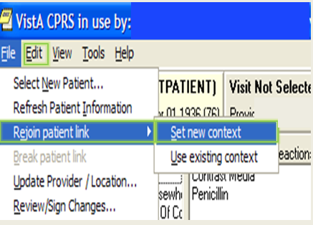
Fix a broken link
Notes:
In the past if a broken link was displayed I would close CPRS and reopen it to rejoin the link.
That was a waste of valuable time. To rejoin the link without exiting CPRS -
Select “FILE” from the menu bar
then select “Rejoin patient link” and “Set new context”.
The links in CPRS will re-synchronize and previously unlinked programs will open.

Slide 17
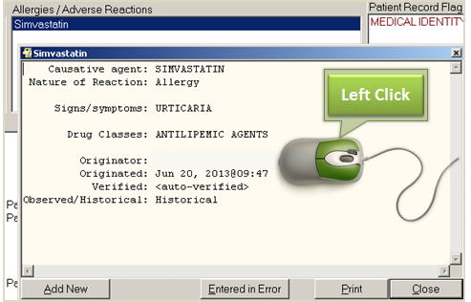
Additional Information from the cover sheet
Notes:
Would you like to access quick information about the patient without opening multiple tabs in CPRS? The items on the cover sheet include a lot of background information.
To view additional information, position the cursor over the item on the cover sheet.
Left click on the mouse and detailed information will display.
In this example by left clicking on one of the listed allergies, the signs/symptoms that occurred related to this allergy and the date the allergy was documented will display.
Another example of information to view from the cover sheet, are the progress notes written during a clinic visit. Follow the same process mentioned earlier: Place the cursor on the clinic visit date and left click with the mouse. All of the notes linked to that visit will display.
Viewing a note from the cover sheet can save valuable time by skipping the steps of searching for a note in the notes tab.

Slide 18

Tools Tab
Notes:
The next menu item we will look at is the Tools Tab.
If you have not had a chance to explore the tools tab in CPRS, I highly encourage you to take a few minutes the next time you are in CPRS and review the information included in the Tools tab for your site.

Slide 19
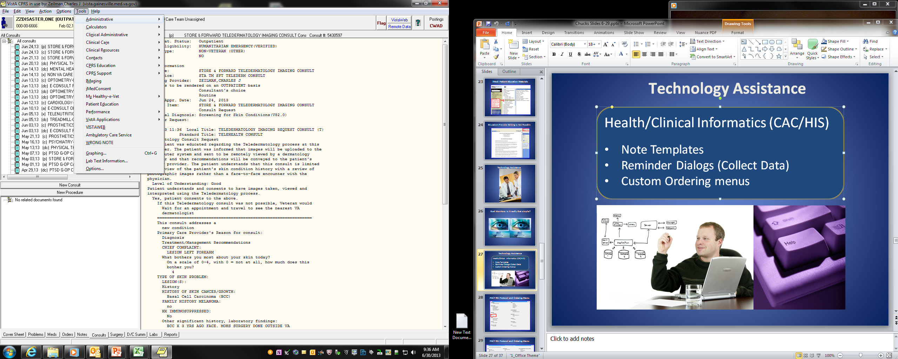

Links on
Tools Tab
Notes:
The tools tab is located at the top of the CPRS screen. It can be accessed from any tab within CPRS.
You may already be familiar with several of the items on the tools tab such as Secure messaging, Vista imaging, and Imed consent.
Real estate is limited on the tools tab. Each site customizes their tools tab to best meet the users needs.
The tools tab contains many links to clinical resources and educational material that can be used in your day to day practice.
A few examples of items that can be placed on the Tools Tab include: nursing reference materials, the VA Library web site, PACT Toolkit, the VSSC to review PACT reports and the WiKI website for additional CPRS help.
On this slide, notice the arrows in the green box to the right of the items.
An arrow indicates there are additional items available for that selection.
Click on the arrow to expand the available tools .

Slide 20
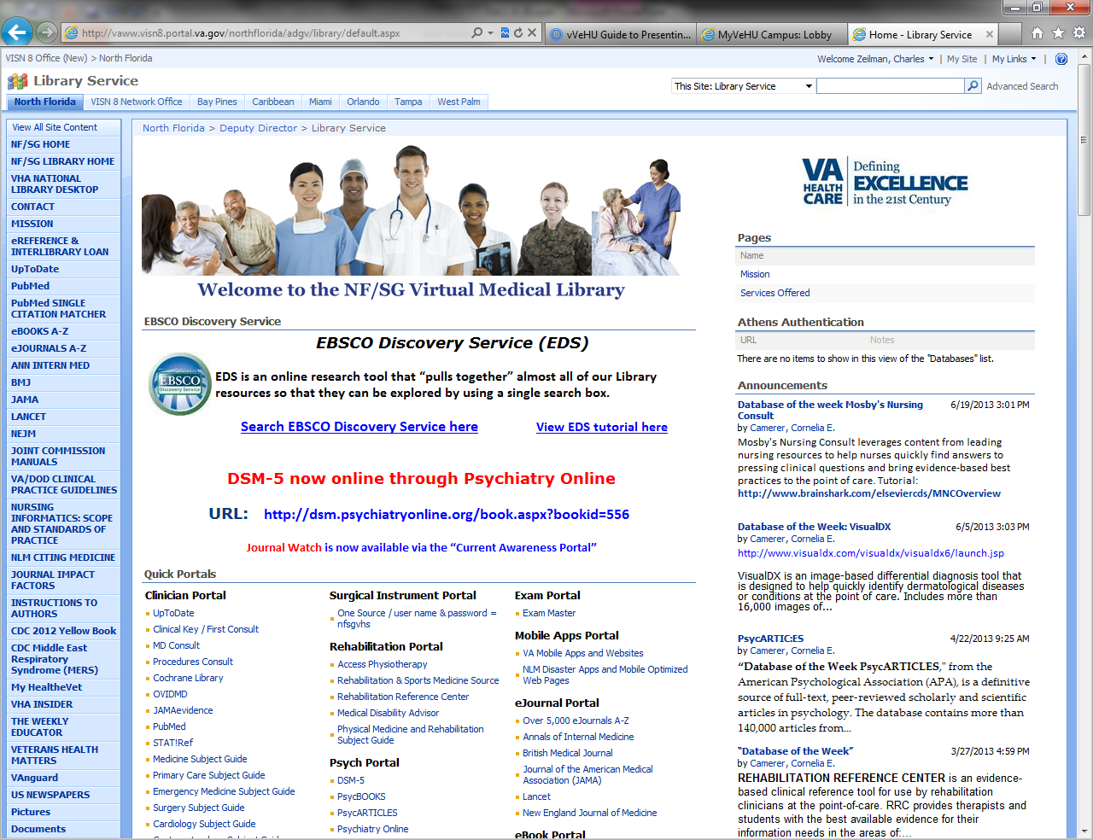
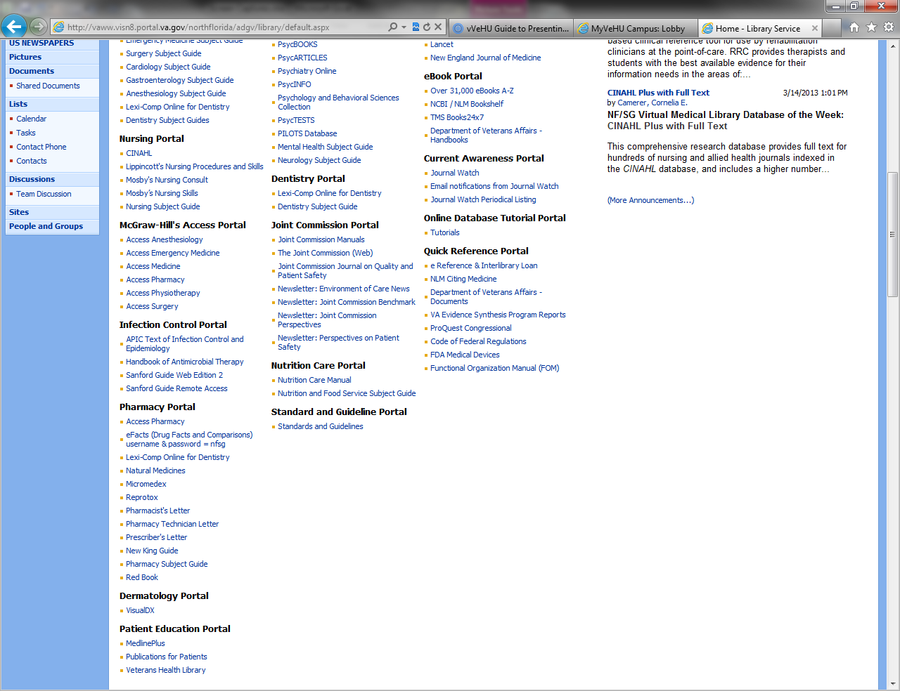
Resources
Notes:
This slide is an example of one sites link to their local resource share point.
As you can see, on this share point there is a section specific to Nursing resources.
Remember the information located on the tools menu is customized at each site.
If links to common resources are not included on your tools menu, talk with your CAC to find out the process to have items added. Many clinical resources are available from national and local share points. Other helpful links that can be included on the tools tab include links to the local library and the online Veterans Health Library. The weblinks for the library sites are included in the notes section for this slide.
Remember, take a few minutes and navigate around your TOOLS tab to become familiar with all of the great tools available to you at the touch of your fingers.
Link to the National VA on line library:
http://vaww.vhaco.va.gov/library/default.htm
online Veterans Health Library (VHL) :
http://www.veteranshealthlibrary.org

Slide 21
Standard items on Tools Menu
Notes:
The Tools menu has 3 items which are standard for all sites:
Graphing
Lab test information
Options for customizing CPRS
These items are located at the bottom of the Tools Tab.
During this presentation we will not be reviewing the graphing options. However there are excellent on demand presentation from VeHU that can be viewed at another time.
One is class # 115: CPRS Tips and Timesavers by Dr. Neil Evans and Dr. Donald Weinshenker. This class not only reviews the graphing tools, it also expands on many of the tips and tricks mentioned in today’s presentation.
The lab test information menu provides a way to view how different lab test and panels are set up in the lab package.
Information about the lab test include: Listing of individual test a panel
Reference ranges for results
Specimen collection information such as the volume of blood required and type of collection tube needed.

Slide 22
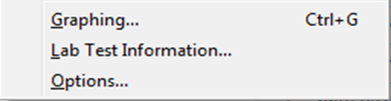
Standard items on Tools Menu
Notes:
As mentioned on the previous slides, there are many valuable items on the Tools menu. But the most important item to help you save time while surfing in CPRS is the very last item, the OPTIONS menu.

Slide 23
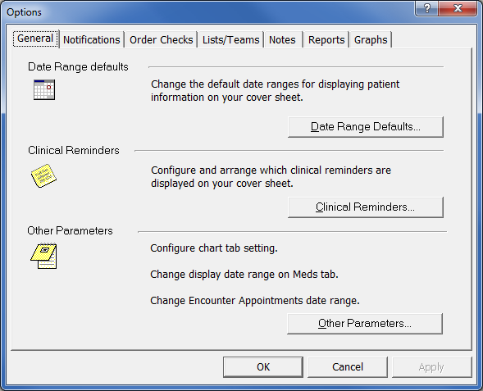
General tab
Notes:
We are going to take a few minutes and review some of the tips and tricks available in the different tabs on the options menu. Each tab under the options section provides additional ways to configure CPRS to meet your needs.
During the 2nd ½ of this presentation Chuck will explain different functionality available in the Lists/teams section.
This current slide presents a view of the General tab.
The General tab includes options to change the display of date ranges on the cover sheet and meds tab.
From within this tab, you can designate which section of the chart to open each time a patient is selected. This function is helpful for chart reviews. For instance, if you will be reviewing only the notes tab, select the “Other Parameters” button
And set the chart tab to notes.
Each time a different patient is selected, CPRS will open to the Notes section, without first going to the cover sheet. I do not recommend leaving the setting on the notes tab for day to day use, as you may miss valuable information which is included on the cover sheet.

Slide 24
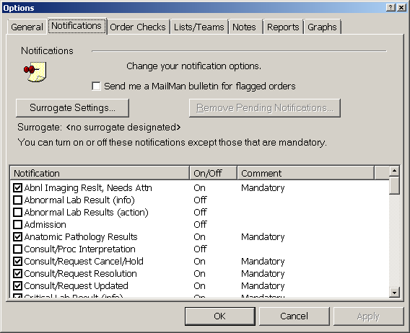
Notification Preferences
Notes:
How could we have a class on improving CPRS efficiency without mentioning alerts and notifications.
Are you receiving alerts you do not want?
Are there alerts you are NOT getting that you want to receive?
Which notifications go to which people in which location is set up locally. Notifications can be set to go to different providers, users, devices and teams. Currently alerts can not be set up to display to the entire PCMM team without creating a special team list. Other alerts requiring additional set up are the consults. Teams and individuals to receive consult alerts must first be set up within the consult package.
Take a look at the middle column on this slide. Notice some of the alerts are turned on and others are turned off. In order to receive an alert it MUST be turned on. Non-mandatory notifications can be turned on or off. The comment section for each alert displays if the alert is mandatory. Mandatory alerts can not be turned off by the user.
It is a good idea for local Informatics committees and CAC’s to periodically review the alert set ups at their facility.
To help prevent alert overload, adjust notifications according to your preferences. For instance there is no need to have both the Abnormal Lab result (info) and Abnormal Lab Results (action) alerts turned on. The information alert will display the result of the individual lab test, but if both notifications are turned on you will be alerted twice for the abnormal lab result.
Personally I prefer to use the action notification instead of the Informational ones. The action alerts take me directly to the panel of lab results. The information alerts are nice for a quick glance, but when you click on the alert it goes away.

Slide 25
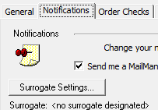
Surrogate
Notes:
To prevent important patient information from being missed while you are away, use the Surrogate Settings button to assign a surrogate to receive your alerts.
When assigning a surrogate there are a few guidelines to keep in mind:
Before designating a surrogate, consider turning off some of the non-critical alerts to decrease the volume of alerts going to your surrogate.
For example do not leave on the informational and action notifications for the same type of alert.
2. Never assign a surrogate without the surrogate being aware of the
dates and times they will be covering for you
3. Make sure the dates and times for surrogacy are set to coincide with the times
you will be away.

Slide 26
Setting Multiple Surrogates
VISTA option
1. ONE, PATIENT Discontinued consult GU
2. ONE, PATIENT : Order requires electronic signature.
Select from 1 to 2
or enter ?, A, F, S, P, M, R, or ^ to exit:
Current Surrogate(s): START DATE END DATE
1 ONE, NURSE Aug 21, 2013@16:00 Aug 22, 2013@16:00
TWO, NURSE Aug 22, 2013@16:01 Aug 25, 2013@16:00
3 THREE, NURSE Aug 25, 2013@16:01 Aug 27, 2013@16:00
Notes:
There may be times when more than one person will be assigned to cover leave.
Some sites designate ADPAC’s or individuals within their service to set up the multiple surrogates for the person who will be away for an extended period of time.
You can set up your own list for multiple surrogates. First sign into Vista and select View Alerts or ^VA .
Current alerts will display along with a prompt to enter a number for the alert or enter a letter for a command.
Enter the letter “S” and a menu will display to select multiple surrogates.
BE VERY CAREFUL: Make sure all times when you will be away are accounted for. Also make sure the surrogate will be available during the designated times. DO NOT overlap time periods. The end date of the first surrogate should be set for one minute before the start of the 2nd surrogate. There is a bug in the system and if the times are set to overlap, the alert MAY loop around and not go to anyone.

Slide 27
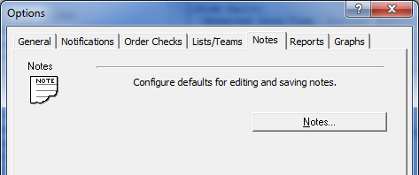
Preferred List of Note Titles
Notes:
In a few minutes we will review ways to simplify processing of alerts, but for now we will stay in the options setting of the Tools Tab to review the process for setting up personalized list of Document titles. This option is located at the bottom of the notes tab in the Options section of the Tools tab.

Slide 28
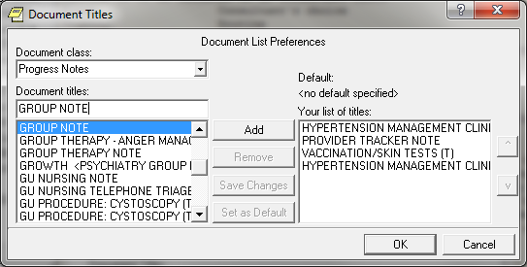
Preferred List of Note Titles
Notes:
Use this section to set up a list of frequently used note titles.
First Select the Note title
Then Select Add to move the title to your personalized list of titles

Slide 29
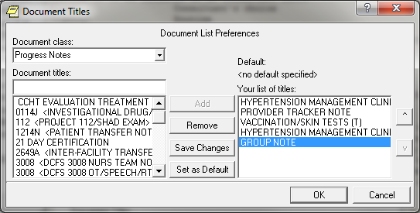
Preferred List of Note Titles
Select Note Title
Select Up or Down
Notes:
Once the note is added to your list, use the up and down arrows to arrange the list in order of preference.

Slide 30
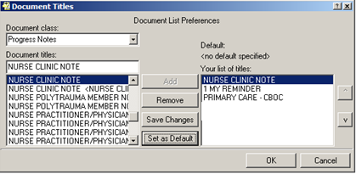
Default titles
Notes:
After creating a list of titles frequently used, select a title to use as your default. Once selected click the “Set as Default” button.
Once changes are made, Always, Always remember to select the “Save Changes” button before exiting.

Slide 31
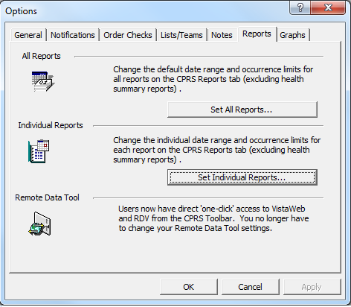
Report Dates
Notes:
While still in the tools tab under options, lets move on to the reports tab.
CPRS is set at a system level to display a designated number of reports within a specified time frame. This conserves network Bandwidth and make the system run faster.

Slide 32
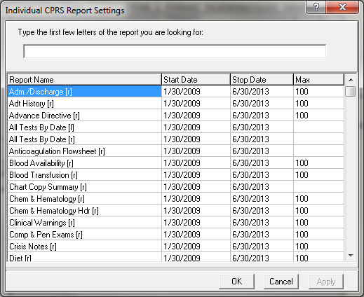
Report Dates
Set your report search range in any field
Notes:
There are times when you need to find a report that is out of the date range set at the system level.
Maybe there was a CT scan from 2007 that you can not find in the system. If this occurs, the date range for the imaging reports should be changed.
To change the date range select the report, highlight the date range, enter desired date, then select OK.
Now go back to view imaging reports and the CT from 2007 will display.
If it still does not display then change the number under “Max” to increase the number of reports to return for the designated date range.
CAUTION: Setting these ranges very large will slow down your computer !!!
WE recommend changing the ranges temporarily only when you need to view specific reports.

Slide 33
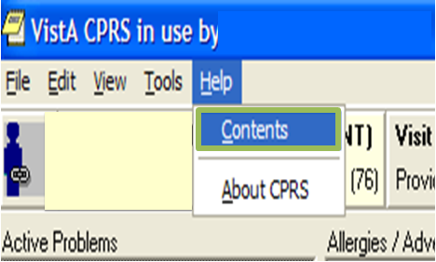
Notes:
We have now left the Tools tab but there is SO much to remember and more to learn. Additional help is available from any tab in CPRS by selecting the HELP menu which is the last item on the tool bar in CPRS
When you go back to your work station, take a few minutes and look at some of the items under Help.
Select the HELP menu and click “Contents”.

Slide 34
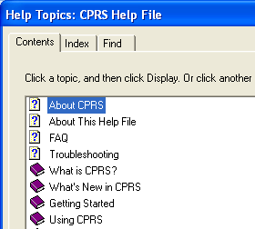
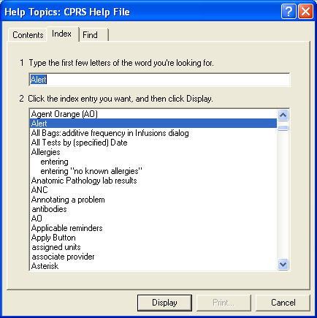
Select “About CPRS”
Type topic to search
Notes:
Then choose “About CPRS”.
A Search box will appear. Type the name of the topic you want to search.
For this example I entered the word Alert.

Slide 35
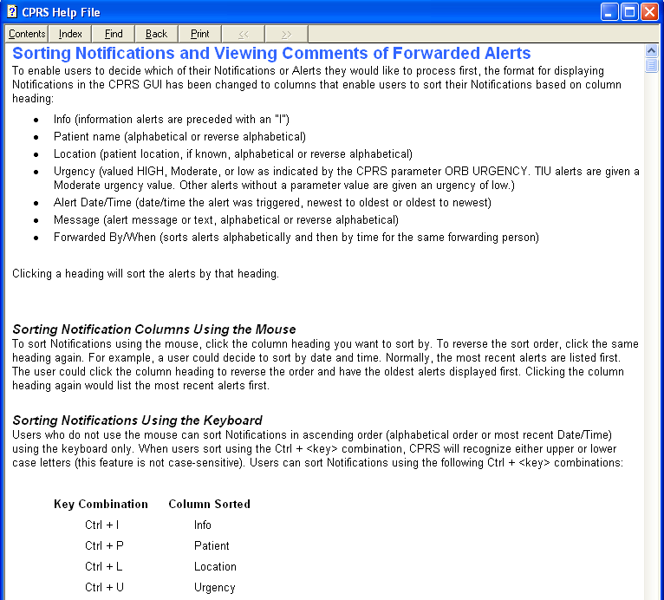
Notes:
This information on this slide is an example of the material contained in the HELP menu for notifications/alerts.
This slide is just an example and not meant to be read in depth from this presentation.
To read more about notifications, alerts or any topic in CPRS use the HELP menu.
Everything you need to be a CPRS expert is at your fingertips.

Slide 36
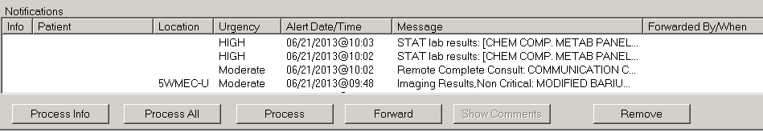
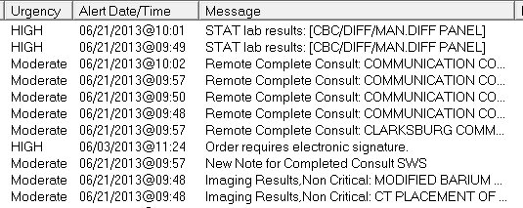
Notifications/Alerts
Sorting
Notes:
Since we just looked at the HELP menu for Alerts/notifications,
lets discuss how to more efficiently process the volume of alerts you receive.
Processing alerts can be more efficient when the alerts are sorted by categories.
From the Notifications section on the patient selection screen you can change how alerts are displayed.
Depending on personal preferences, sort the notifications by clicking any of the headings in the View Alert window.
For example if the Message heading is selected, the notifications will display alphabetically by message. This is a nice way to look at alerts you need to review at this time and save less important alerts to view later.
Other ways to sort include:
urgent alerts at the top
date of alerts
patient location

Slide 37

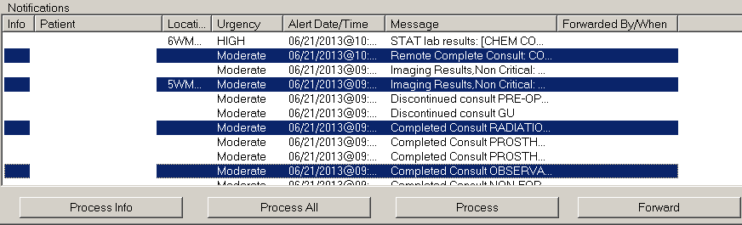
Processing Notifications
Notes:
Processing alerts can be simplified by selecting multiple notifications at a time.
Notifications displaying randomly on your list, can be selected by pressing and holding the Control(CTRL) key, then click on each notification you want to process.
After the notifications are highlighted, click the process button at the bottom of the alert screen or hit the enter key to review the highlighted alerts.

Slide 38
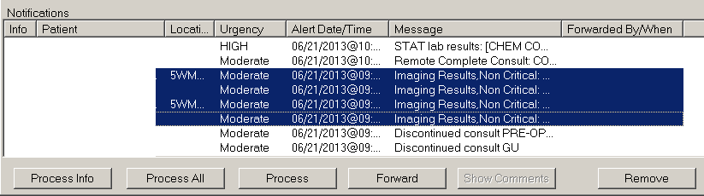
Processing Notifications
Notes:
If you group notifications by category as mentioned earlier, The group of notifications will display in a sequence. To highlight these alerts press the SHIFT key and then click on the first alert and the last alert in the sequence.
Once the notifications are highlighted press the enter key or the Process button to process the highlighted notifications.

Slide 39
Processing Alerts
Notes:
When processing a range of alerts, use the NEXT button in the lower right corner to move to the next alert.

Slide 40
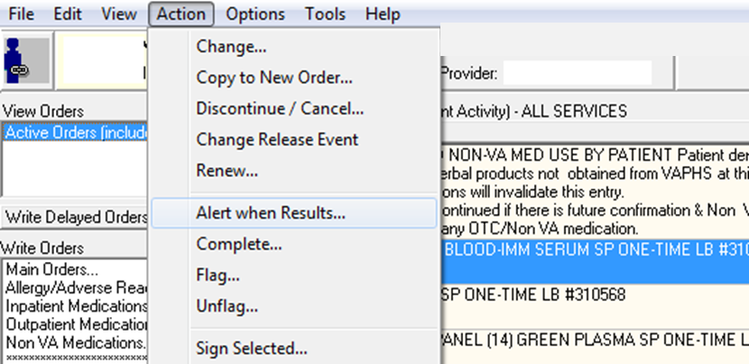
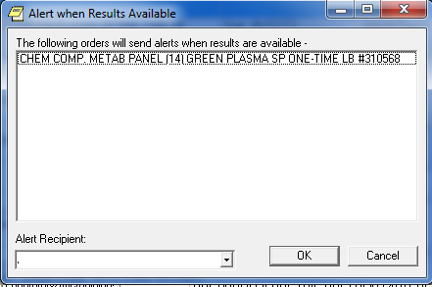
Alert when results
Highlight Order
Select Action
Alert when Results
Select Recipient
Notes:
There are times you may want to review results of a test or a completed consult ordered by a specialist or other PACT team member.
The Alert When Results feature allows you to notify another provider (or yourself) when results are available.
Follow these steps to receive the alert :
Highlight the original order —Select Action—Alert when Results – Select the recipient to receive the alert and then click on OK.

Slide 41
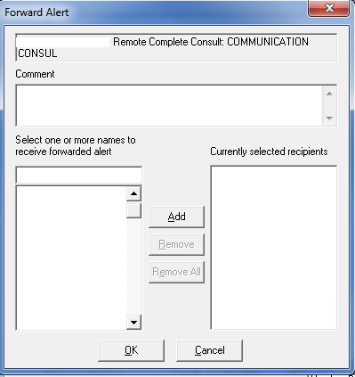
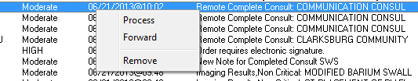
Forward Alert
  You may also Forward an alert you have received to one or more other providers.
Notes:
You may also Forward an alert you have received to one or more CPRS users by selecting the forward button and enter the name of the person to forward the alert to. A comment may also be added to the forwarded alert.

Slide 42

Lost Alerts
  Right Click & Select Renew
Notes:
After viewing an alert, if you want to save it to view later, the alert can be renewed. Renewing an alert prevents it from disappearing after you view the alert.
To save the alert once it is processed, look for the pointing finger with the word NEXT. The finger is located on the bottom of the
CPRS screen.
With your mouse, right click the word NEXT
This will bring up a pop up menu as displayed on this slide.
Select Renew and the alert will stay active until you process it again.
Informational alerts can not be saved using this feature. Once you select an information alert it is removed from your notification list.

Slide 43

Clinical
Reminders
Due in Advance
Finding Terms
Age Gender
Finding Conditions
End Date
Time
Frequency for Age
Boolean Logic
Begin Date
Baseline Frequency
Findings
Notes:
Clinical Reminders can be puzzling.
What is the purpose of the clinical reminders?
Why are certain reminders due on some patients but not on others?
Lets take a few minutes and look at the mystery behind reminders.

Slide 44
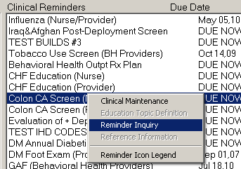
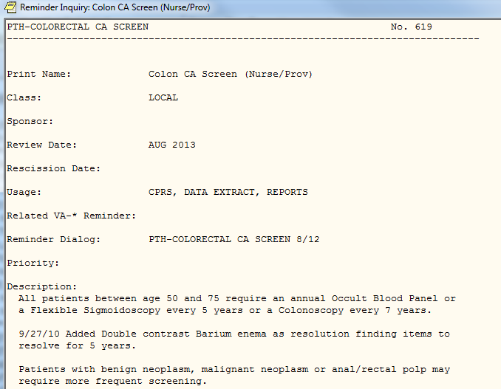
Reminder Inquiry
  Left click a reminder on the coversheet to see a description of the reminder.
Notes:
To find the purpose of a reminder, position the cursor on the reminder and LEFT click on the mouse.
Select reminder Inquiry and a description of the reminder will display.
Most of the descriptions are created locally so they will vary from site to site.

Slide 45
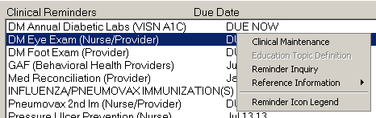
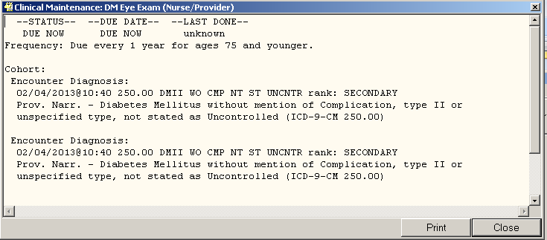
One Click Clinical Maintenance
Left Click
Notes:
Why are reminders displaying for your patient when they do not apply?
Left Click a reminder on the coversheet or from the reminders folder.
Select clinical maintenance to see why it is due.
For instance if a reminder is displaying for a diabetic eye exam and the patient is not a diabetic,
The clinical maintenance will show you that the patient was previously coded as a diabetic.

Slide 46
Divide Reminders
WHO?
Provider
RN
HOW?
Clinic visit
Phone call
LPN
Clerical Associate
Questionnaire
Notes:
At times it seems there are too many reminders and not enough time during the visit to complete all of them.
Work with your services and the informatics team to review the reminders.
Who should get the reminder? The provider, RN, LPN, HCT or clerical associate.
Can the reminder be resolved by a clinic visit, phone call or even a questionnaire?

Slide 47
Clinical Reminder Reports
Recent ER visit or Multiple ER Visits
Admissions
Discharges
Disease specific reports
Clinical performance measures
Notes:
Clinical Reminders can also be used to create reports.
A few examples include: Recent ER visits, multiple ER visits, Admissions, Discharges, Disease specific reports, and performance measure reports.
CAC’s generally create the reminder reports. Many sites are now using local or VISN data warehouses to run reports instead of using reminder reports.

Slide 48

Reports Tab
Notes:
We are now going to move to the Reports tab in CPRS to look at additional ways to simplify viewing patient information.

Slide 49
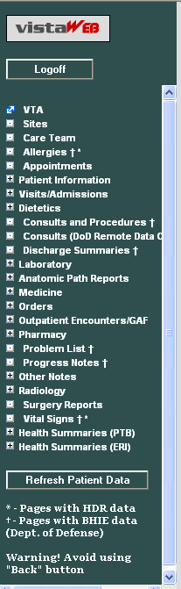
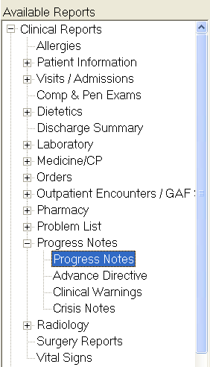

Remote Data
Notes:
You can determine if a patient was seen at other VA’s by looking for the VISTA Web and Remote data buttons to display with Blue Text. These buttons are located on the upper right of your CPRS screen.
Vista Web information can be accessed from any tab in CPRS. You must be in the Reports tab to view most of the information from the Classic Remote Data view.
Next we will look at the Pharmacy section which is located under Clinical Reports on the Reports tab

Slide 50
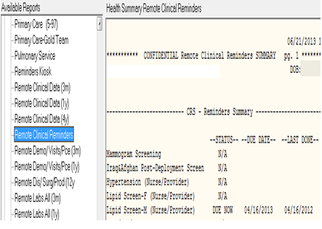
Health Summary
Remote Clinical Reminders
Cardiology
Surgery
Dietetics
Social Work
AdHoc report
Etc…
Notes:
Health summaries are included in the reports tab. Originally these were created prior to having the chart tabs in CPRS.
Health summaries can be built to pull information specific to a clinical service or to view specific information using Ad Hoc Reports.
Viewing remote data or VISTA Web can be used to view the status of clinical reminders from other facilities the patient may have visited.
For instance, when you select the Remote Clinical Reminders health summary, you can see the results of common reminders that were resolved at other stations.
Your patient may have previously been screened at another site for TBI, Mammogram, colonoscopy or other procedures. Viewing the Remote Clinical Reminders health summary may prevent duplication of ordering test or completing additional reminders.

Slide 51
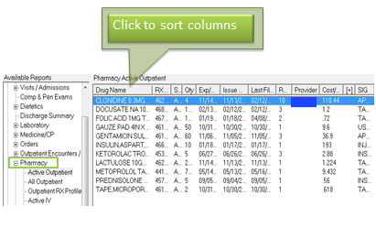
Medication View – Reports tab
Notes:
The pharmacy section is helpful for sorting information regarding a patient’s prescription history. Items in this section can be sorted for easier viewing by clicking the column heading.
For example, if you click the Drug name heading, the medication list will sort alphabetically .
The pharmacy reports section is also available when viewing remote data. Using remote pharmacy reports can be a great timesaver to retrieve medication information if the patient recently transferred to your VA from another VA.

Slide 52

Viewing Notes Options
Notes:
How can time be saved while searching for information in progress notes.
Some patients have hundreds of notes to view.
We will take a look at a few ways to simplify searching in notes tab.

Slide 53
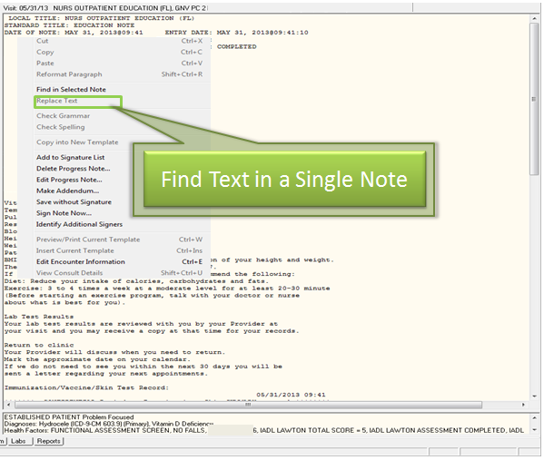
Notes:
To search for specific text in a single note, from within the body of the note right click and select Find Text in a single note.

Slide 54
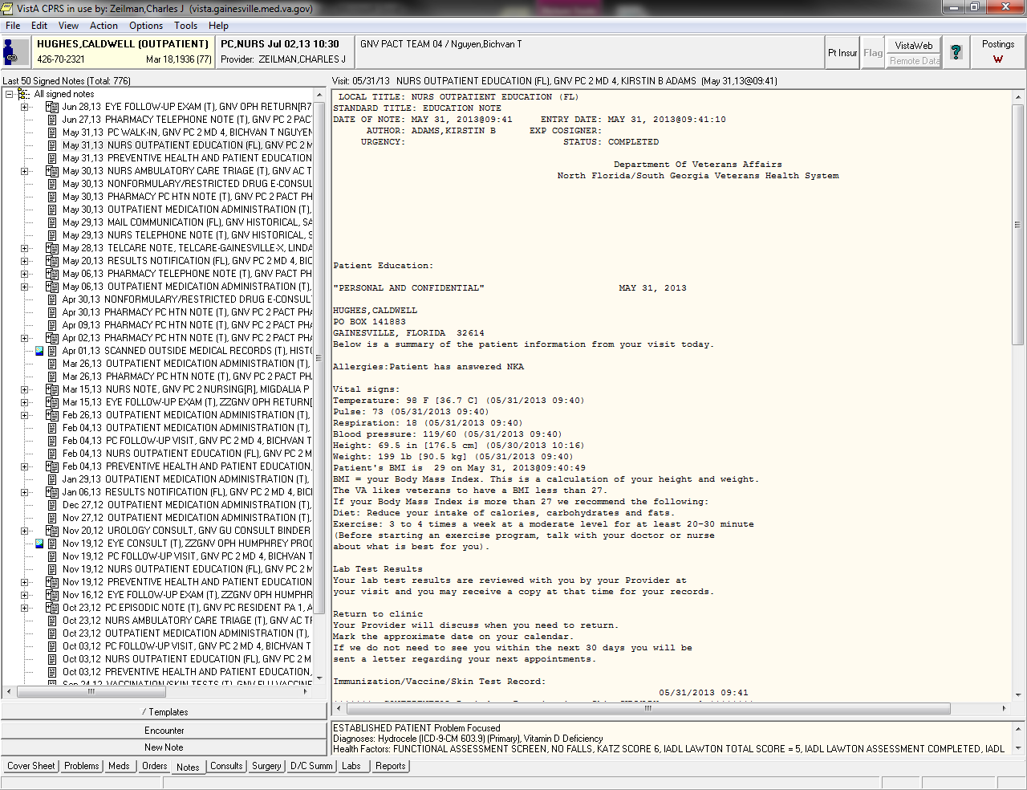
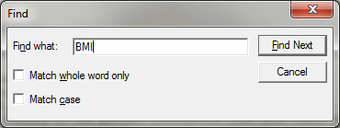
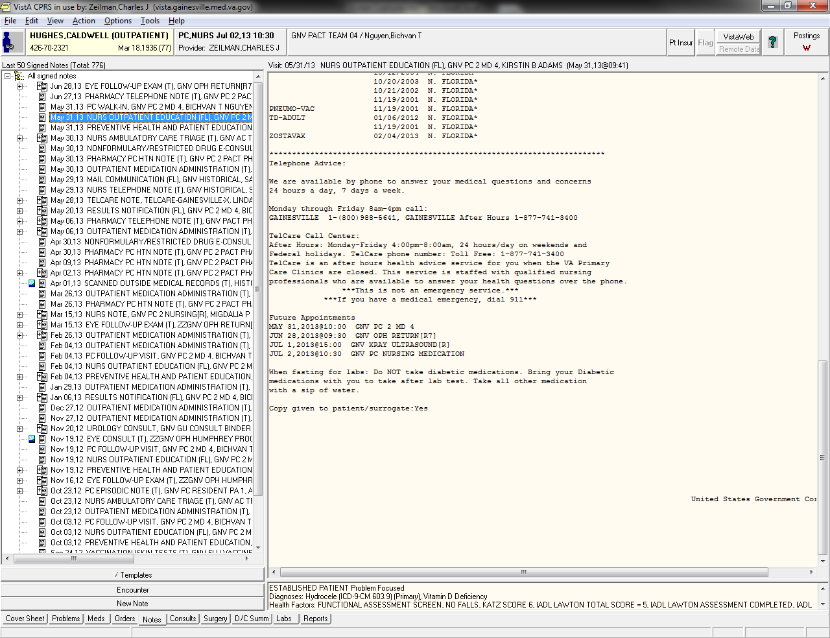
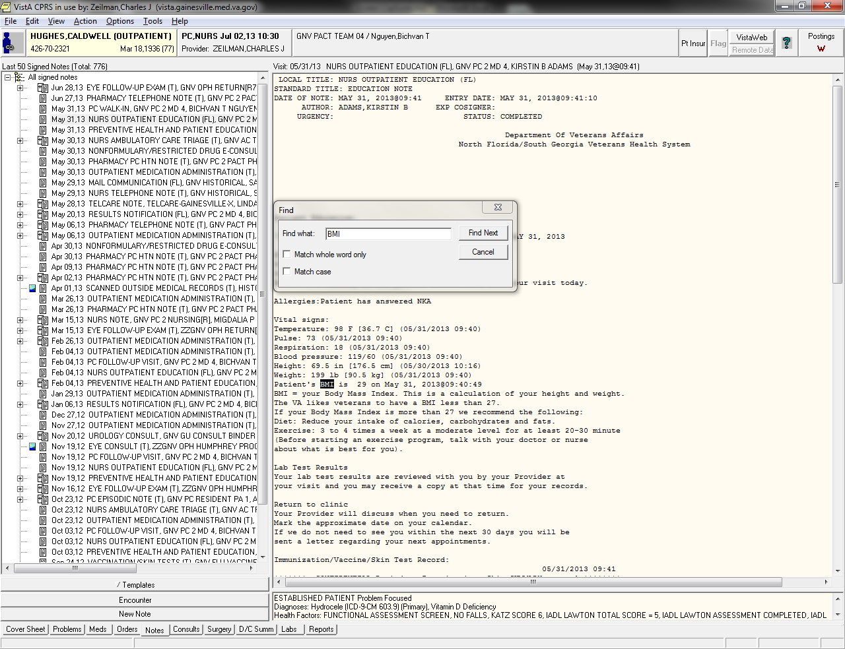
  Enter Text
  Text will be highlighted
  Select “Find Next” to find more in document.
Notes:
Enter the text in the search box . As shown on this slide, the text will be highlighted. Select “Find Next” to find more instances of the word within that document.

Slide 55
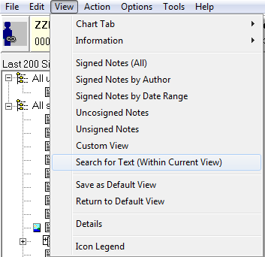
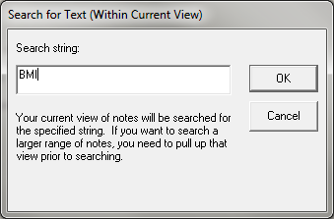
Find Text In Multiple Notes
Notes:
Text in multiple notes can be found by selecting View from the Menu and then Search for Text.
Enter the text you are searching for and select OK.

Slide 56
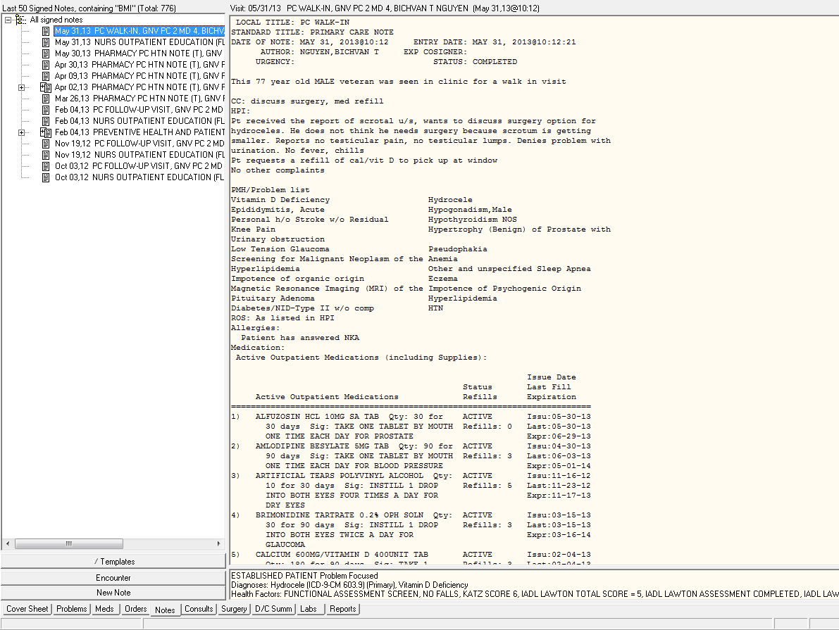
  The search will display all notes that have the text. Please note may need to change default settings to expand search.
Notes:
The search will display all notes that have the text. Please note the default setting of your note view may need changed to expand the search.

Slide 57

Viewing Notes
  Custom Views:
  Sorting Notes
  Number of Notes Displayed
  Bolded Notes
Notes:
There are numerous ways to sort the list of progress notes displayed.
Within the Notes tab, select VIEW from the top menu and then select
Custom View.

Slide 58




Sorting Notes
  Number of Notes Displayed
300
Notes:
For example, if a patient has many notes, you may not be able to see an older note you are searching for.
The top of the notes list displays how many notes are being viewed and the total number of notes available for that patient.
If the system level is set to pull in 200 notes and the note you are looking for is note #250, the “Max Number to Return” will need
changed by entering a larger number on the upper right corner of the custom view window.
Other examples of different views include viewing the note by author, date range, title, and location.
To search for a particular title, change the “Group By” choices to “title” and all of the notes for the titles within the Maximum number to return, will be placed in a file cabinet as demonstrated on the left of this slide.
CAUTION: The more notes you have pull in the longer it will take CPRS to display the note titles.

Slide 59


Bolded Note Titles
  Bolded Notes Displayed
Notes:
Another option I find helpful is to bold words in note titles I frequently pull up .
In this example I selected to view either the title or subject if it contains the text Primary Care.
As demonstrated on this slide, all notes listed with the word Primary Care now display as Bolded text.

Slide 60

Save Changes
Notes:
To save changes, go back to VIEW and then select “Save as Default View”
At this time I will turn the presentation over to Chuck for additional tips/timesavers to use while working with CPRS.

Slide 61

Combination Patient List
Notes:
There are multiple ways to configure a default view.
A Combination Patient List is great for having multiple clinic profile showing for same day, Example Nurse clinic and Provider Clinic.

Slide 62

How to Save a Combination Patient List
Notes:
Now I am going to show you to set a Combination Patient List using the Example of a Nurse clinic and Provider Clinic
Remember for setting these defaults go to TOOLS and Options!!!

Slide 63

The Options Screen
Select “Lists/Teams”
Select “Patient Selection Defaults…”
Notes:
From the options screen select Lists/Teams tab at the top, then select the Patient Selection Defaults Button.

Slide 64

Patient Selection Defaults
Select “Combination”
Select “Appointment Date”
Select Date Range
Select OK.
Notes:
Again, this is where you would find multiple options for defaults view, now to make a combination list
Select the “Combination” radio button under List Source.
Then under Sort Order Select your desired display, in this example we will select the “Appointment date” which sorts by date and time.
Next you will need to select Start and Stop date, recommend “Today Only” for default view.
Select OK to proceed to next step.

Slide 65
The Options Screen
Select “Lists/Teams”
Select “Source Combinations…”
Notes:
From the options screen select Lists/Teams tab at the top, then select the Source Combinations… Button.

Slide 66


Source Combinations
Select your clinic profile
Select all clinics to display
Select “Add”
Select OK.
Notes:
Under the Source combination box,
Select all desired clinics to display in appointment list then select “Add”.
Your “Combinations” list appears on the right.
The examples utilized here consist of an RN and Provider Clinic
Then select OK.

Slide 67

Your Default Patient Combination List
Notes:
This will give you a default view for all patients under the RN clinic and Provider Clinic in order of Appointment date and time.

Slide 68

Consults

Slide 69
What is the status of my consults ordered?
DIABETIC TELERETINAL IMAGING
NUTRITION
SMOKING CESSATION
OPTOMETRY EYE
COLONOSCOPY
Notes:
I am going to talk about an option for consults that a Registered Nurse ask me.
“They asked is there a way to find pending consults for a provider?”
So have you ever wondered what is the status of my PACT Team Consults?

Slide 70

Consult Reports
PL: Print Consults by Provider, Location, or Procedure
There are several formats for the print outs
Notes:
The is a report in Vista to view consults by Provider, Location or Procedure.
This example is by Provider, in a specified date range and with a status of All pending consults, All pending examples include pending, Active, Schedule….
PRIVACY - Charles Zeilman is the presenter and the provider

Slide 71
Orders Tab
Notes:
Now I am going to show a few options under the Orders tab in CPRS.

Slide 72

Custom View in Orders Tab
Custom view option
Notes:
Now with many sites implementing Nursing orders, you can customize the order view.
While on the orders tab in CPRS select View then Custom Order View.

Slide 73


Custom Views of Orders
Select Active
Select Type of Order
Notes:
The example I am utilizing is for a clinic visit. You need to view all pending orders for a clinic visit in order to complete for visit.
Select Active then Nursing.

Slide 74

Custom Views of Orders
Notes:
This will give you a view of all active Nursing orders only. This makes it easier to locate the orders.

Slide 75
Personal Quick Orders (Orders Tab)
Medications
Labs
Consults
Notes:
Remember we are still under the Orders tab in CPRS.
**You have to Save all Quick Orders from the Orders Tab.**
There are 3 packages that let you create Personal Quick Orders: Medications, Labs, and Consults. Please note, depending on how your consults are set up, example templates you may not be able to save as quick order.
Personal Quick Orders can help organize and save time!

Slide 76

Medications
Notes:
I am only briefly showing the medication option since most RN would not complete these but may want to discuss with the Provider on team.
Once you complete all the fields of the order, “DO NOT ACCEPT ORDER AT THIS TIME” select the Orders tab, then at the top select Options and Save as Quick Order.

Slide 77

Labs
Notes:
You can do the same thing for Labs:
Once you complete all the fields of the order, “DO NOT ACCEPT ORDER AT THIS TIME” select the Orders tab, then at the top select Options and Save as Quick Order.
These are great for Frequent or uncommon orders.

Slide 78


Organize and Save
Notes:
When you select Save as Quick Order, you can place in any order you wish.

Slide 79

Lab Order Screen
  Personal Quick Orders
Notes:
When you go to order a lab, your personal quick orders will display in the window for selection. As you can see I have some common labs and an Uncommon lab “copper” (for Wilson’s Disease) that may not be on any menu. This will save time trying to find if you may be ordering intermittently.

Slide 80
Personal (Customized) Templates
Text Template
Dialog Template
Notes:
Did you know you can create your templates? Please note some sites may have turn this option off, but I do not recommend turning off. I will discuss additional options later that may help with this issue.
There are multiple types of templates but I am going to discuss 2 common types: Text and Dialog templates.

Slide 81


Basic Text Template
Notes:
The “Text Template” is just what it states, Only text is saved for the template.
These are great for enter statements that you enter frequently and are standardized such as education.

Slide 82
Dialog Template
Template Fields Include (access can be issue):
Buttons (change with each click)
Radio buttons (e.g. yes/no, positive/negative)
Drop down lists
Check boxes
Edit boxes
Date selectors
Web Links
Notes:
Dialog templates provide a lot of flexibility. if you have documentation where there can be multiple answers or selections this format is typically preferred.
Dialog Templates can include the following components:
Template Fields Include (access can be issue):
Buttons (change with each click)
Radio buttons (e.g. yes/no, positive/negative)
Drop down lists
Check boxes
Edit boxes
Date selectors
Web Links
*Access may be limited by your site.

Slide 83

Template Issues
Component examples:
Data Objects (caution when utilizing)
Medications, Labs, Imaging
Dates can be an issue!
Notes:
I would Caution utilizing some components.
Please note it pulls last date entered, can pull old data!
Do you really need it in the note if it is in the record?

Slide 84

Dialog Template
Notes:
Here is an example of a Dialog Template.

Slide 85

iMed: Patient Education Materials
Notes:
Now I am going to discuss some possible resources to help save time.
First, iMed consent. Many users do not realize that there is nationally approved “Patient Education” within iMed. They are available in 2 educational levels, Easy (6th grade) and Standard (8th Grade).

Slide 86

Education-Provider Editing is Not Possible
Notes:
Once you select the education topic,
You can Print for patient and Save it to chart.

Slide 87

Technology Assistance
Notes:
Technology is moving so fast, I am not going to discuss all the options currently available or in testing, but what readily accessible. Even though I say readily accessible, it can vary by site.

Slide 88

Dual Monitors: Is it really that simple?
Notes:
First, Dual monitors. I became very quick with one monitor with many keyboard short cuts but once I obtained dual monitors it truly increased my speed and efficiency. Helps tremendously when using multiple programs: CPRS, Imaging, iMed, VSSC, Excel, MHV, Up to Date…..

Slide 89

Technology Assistance
Health/Clinical Informatics (CAC/HIS)
Note Templates
Reminder Dialogs (Collect Data)
Custom Ordering menus
Notes:
Is the a live person that can help me?
Yes, Clinical Application Coordinators (CACs, HIS,)., Maybe Clinical Informatics Service, Section…
They can build customized Notes, Reminders to collect data, Orders and Ordering Menus.
I am now going to show you some examples of items we built for our system.

Slide 90

PACT RN Protocol and Ordering Menu
Notes:
We created a Standardized PACT RN menu for the entire system based on a Protocol.

Slide 91

PACT RN Protocol and Ordering Menu
Notes:
This is the menu based on that protocol.
Additionally, if you cant remember what is related to the protocol we have a link built in the menu the will take you to the protocol.

Slide 92

PACT RN Protocol and Ordering Menu
Notes:
This is the link to the protocol.

Slide 93

Results Notification Form Letter
Notes:
We created some Note titles and templates (Reminder Dialogs) for the system.
The next 2 are related to results notification. Both collect data for our system to monitor.
These template is a form letter to send to patient.

Slide 94

Results Notification Telephone Note
Notes:
This is also a results notification template but for a phone call to patient.
These are just some options for menus, orders, notes and templates. We continually create and edit items for our system.

Slide 95

Ask the Presenter
Notes:
(This must be your last slide.)
If you haven’t submitted your questions yet, there is still time to do so by clicking on the orange “Ask The Presenter” icon. We’re going to show a brief announcement and be right back to answer your questions.
(Stand still and smile until you see the video come up full screen)
[erase these notes and add your own!]

