Slide 1

Michael Rubin, MD, PhD
Clinical Lead, System-Facing HMP
Notes:
Thanks for the opportunity to talk today about the work we're doing in the area of population analytics for what is called the System-facing Health Management Platform, which is part of the overall VA initiative called hi2, or the Health Informatics Initiative. My name is Michael Rubin, and I'm a physician trained in infectious diseases, epidemiology, and biomedical informatics. My role is the Clinical Lead of the System-facing HMP, and I'll be telling you a bit about what the Health Management Platform is, and more specifically, what the System-facing component of the HMP is all about.

Slide 2
Goals
Agenda
  Communicate our vision and plan for the System-facing Health Management Platform
  Describe our current and future strategic partnerships
  Part I: Vision & Plan
  Part II: Tools & Partnerships
Notes:
Before I get into that, I want to clarify the Goals of this talk, as well as the agenda. In terms of the goals, I have two in mind.
As for the agenda, I've divided this talk into two parts: in the first part, I'll talk about what the System-facing HMP is, what our vision for it is, and the plan we have in place to achieve it. In part 2, I'll talk more specifically about some of the tools we're developing, and the partnerships we have in place to help make this all happen.

Slide 3

Vision
& Plan
Part I

Slide 4
hi² Organizational Chart
Senior Program Manager
Marcia Pickard
Workstream B
Curtis Anderson
Peter Koutsovitis
Team-Facing
Jessica Murphy
Kristian Johnson
Patient-Facing
John Hixon
System-Facing
Michael Rubin
Health Management Platform (HMP)
Notes:
This slide helps illustrate who we are and how we fit into the hi2 organization. The goal of the Health Informatics Initiative, or hi2, is to transform healthcare delivery at the VA through informatics, in part through the development of the next-generation electronic health record that we call the Health Management Platform, or the HMP.

Slide 5
System-Facing Platform Team Structure
Core Team
Role
Michael Rubin Clinical Lead
Jennifer Garvin Perform Msmt/CHF Lead
Johnny Childress Program Lead
Dale Ryan Inform Nurse Specialist
Lois Hooper HIM Specialist
Steve Eaton OIT Project Manager
Developer Team
Role
Chris Palmer Program Manager
Joshua Dinerstein Development Lead
Ian Parish Sr. Software Engineer
Andy Barrett Data Architect
Christopher Hall Web Developer
Stephanie Bollinger Scrum Master
Notes:
Who we are more specifically. The SF HMP consists basically of two teams, a core team and a developer team. The core team is led by me and consists of a number of individuals with various clinical and informatics backgrounds, and the goal of this team is to manage the project, work with our stakeholders, and set development priorities. The developer team is the group responsible for software development, and consists of individuals with primarily IT backgrounds, such as computer programmers and data architects. By no means does this represent all of the individuals working in the SF HMP, and I won’t go through each of them individually, but I wanted to give you a sense of how the team is structured and what kinds of skills and expertise we utilize.

Slide 6
System-Facing Platform
Create a Healthcare System-Facing HMP
"Addresses the need to look
across VA’s IT systems and populations to improve health"
"Develops a platform to support research, registries, predictive modeling, decision support, etc."
"Facilitate population health and achieve a healthy health system"
Notes:
So now that I've introduced you to the Health Management Platform and who we are in the System-facing HMP, I'll talk a bit about what it is we are trying to create. Shown here are our stated objectives as laid out in the initial hi2 FY11 Operating Plan from October 2010. (read)
This is the highest level view of the System-facing HMP. The description is quite broad, however, leaving considerable room for creativity and innovation on our part.

Slide 7
System-Facing Platform
What is Population Health?
Individuals
Populations
Notes:
Before we go into what we decided to create that fits this description, I thought this would be a good time to talk a little bit about what population health and population analytics are.
In the broadest sense, population health is about “what we as a society do collectively to assure the conditions in which people can be healthy.”
Population health is basically an approach to health that aims to improve the health of an entire population – in our case, we focus on the US Veteran population.
In order to understand the health of a population, we need to understand the health of the individual members of that population, which means that we need to collect, analyze, and summarize the health of all of the individual members of that population.
In order to improve the health of a population, we need to focus on policies, interventions, and tools that target the health of each individual member of that population.
Our goal with the SF HMP is to transform healthcare delivery and improve population health using innovative health information technology.

Slide 8
System-Facing Platform
HIT interface with Population Health
Public Health
Surveillance/Response
Health Status
and Disease Monitoring
Health Education
& Communication
HIT
Population-based
Clinical Care
Population-based
Research
Notes:
The interface of health information technology with population health is shown here. This figure shows the five interrelated and overlapping domains of population health:
1. Public health surveillance and response -- which, in the healthcare setting, is often the role of the infection prevention and control group, including detection of disease outbreaks, and surveillance for disease or unexplained deaths
2. Health status and disease monitoring -- including identification of health risks and needs, including monitoring of chronic conditions such as obesity and diabetes, and identifying the needs of vulnerable populations
3. Population-based research -- for new insights and innovative solutions to health problems on a population level to ensure that all people achieve optimal health outcomes
4. Population-based clinical care -- assuring health and functional status for populations of people, including evidence-based clinical care and quality improvement efforts, and
5. Health education/communication -- informing, educating, and empowering providers and patients to reduce risk, promote better health, and maintain health and functional status.
Health information technology (HIT) is represented by the rectangular box in the middle of the diagram, and it supports, interacts with, and underlies the other five areas, and the key to doing this is through electronic clinical data and the tools that use these data. Electronic data can help support health and healthcare improvements including public health interventions, disease management, quality improvement, provider performance measurement, epidemiologic surveillance, research, and more. The process of collating, analyzing, and using these data to benefit the entire population can support improvements in the way we prevent illness and injury, provide patient care, and manage care systems – all important areas of focus if we're to assure the conditions in which people can be healthy.

Slide 9
System-Facing Platform
The Interpretation
Improve population/system health and healthcare delivery
Create tools for population/system-level analytics
Move toward active, dynamic data tools
Integrate tools into provider workflows
Notes:
With this background, and the initial description of the SF HMP I described earlier, we asked outselves, "what do we want to create that fits this description?" We want to create a system that:
1. Improved health and healthcare delivery at the level of our Veteran population and the healthcare system itself
2. Supports tools that generate and deliver population/system-level data analyses
3. Moves beyond passive information displays to active, dynamic tools for exploration, discovery, support, and intervention, even at the individual patient level
4. Integrates these tools into provider workflows to make peopl more efficient

Slide 10
System-Facing Platform – Strategic Goals
Build a system that:
Harnesses the power of population-level data
Improves and monitors population/system health
Integrates large-scale population/system analyses into the workflow of the electronic health record
Performs functions that would not otherwise be possible without data spanning large populations
Serves the needs of a wide variety of stakeholders & end-users, not just clinicians
Promotes the operationalization of research work
Notes:
To create this, we need to build a system that does all of the following things.

Slide 11
System-Facing Platform – Strategic Goals
Create a Healthcare System-Facing HMP
…How to do this?
1
Create new informatics tools and functionalities
2
Leverage existing/developing tools and services
3
Act as a pipeline between research and operations
Notes:
This is an enormous task, of course, and so the question then is, how are we going to do this? We're doing this by focusing our efforts in three areas.
1. Create new informatics tools and functionalities where currently none exist but are needed;
2. Leverage tools and services that currently exist or are in development at the local level, but which would benefit from expanded, national exposure; and
3. Act as a pipeline between research and operations, to get innovative new products of informatics research into the hands of our providers at the point of care,
To do all of this means connecting with various groups and stakeholders throughout the VA who are connected with research and operations and who know what activities are ongoing and what activities are needed. We're interested in the really innovative stuff going on at the VA.

Slide 12
Public/Occ Health
Genomics
Infection Control
HSR
System-Facing
Platform
Care Providers
Registries
Population Informatics
Biosurveillance
Notes:
To begin to get a handle on all that this represents, we needed to get a sense of all of the different stakeholders throughout the VA that would have various needs addressed by population analytics and represented in the SF HMP. We started by identifying many of the different clinical stakeholders; that is, stakeholders that often provide direct patient care -- for instance.

Slide 13
Systems Analysis
PM
UM
OQP
Data
Quality
System-Facing
Platform
VBA
HIM
Privacy &
Security
CBO
Patient Safety
Notes:
We also looked to identify many of what we call our "business" stakeholders; that is, groups that more indirectly provide aspects of health care delivery, but still have needs addressed by population analytics, or have an important role in population-level data and analytics.

Slide 14
Genomics
OQP
HSR
Systems Analysis
Public/Occ Health
Data Quality
Infection Control
VBA
System-Facing
Platform
Care Providers
HIM
Population Informatics
CBO
Biosurveillance
Patient Safety
Privacy &
Security
Registries
Data
Stakeholders
Notes:
In addition to all of these clinical and business use stakeholders, we also had to identify all of the various data stakeholders that would play an important role in providing the electronic data needed for population analytics. So as a whole, this represents an enormous number of groups, and the needs of each of these groups potentially represents an infinite space. In order to accomplish our goals, we needed to get an understanding of what the various needs are of these groups, to take that infinite space and make it more finite. Our plan then was to engage each of these groups and identify a stakeholder representative from each to help us get a sense of what tools and functionalities are already out there, and what are still needed.

Slide 15
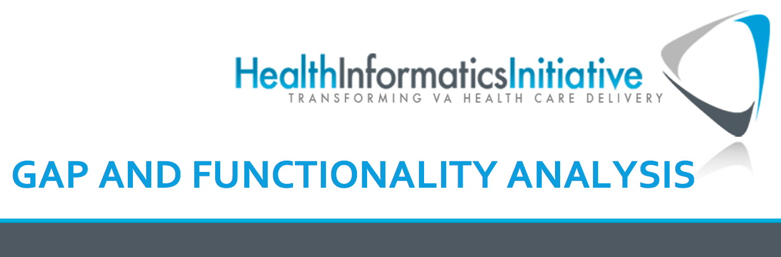
Gaps in Existing Functionalities for System
& Population-Level Analysis,
Monitoring & Decision-Making
Version 9.0
Notes:
The result of our initial work with these stakeholders is a gap analysis that we completed and published back in the fall of 2011. Within this document, we essentially review each of the various clinical and business domains I just discussed, and cover all of the various clinical functionalities, based on population analytics, that they feel are needed for optimal health care delivery, but which currently are not available or don’t exist within the current implementation of the electronic health record.

Slide 16
SFP Gap
Analysis
Decision-Support
Economics
Genomics
Health Information Management
Human Resources
Mathematical & Predictive Modeling
Population Health
Quality Performance Measurement
Research
Surveillance &
Monitoring
Systems Analysis & Redesign
Notes:
This slide shows some of the main clinical areas that were identified by our stakeholders as key for future development. This certainly doesn’t represent all of the important areas, but it’s to give you a sense of some of the areas they found to be critical for the development of a population analytic platform. (read)
To do all of this would take a large team of developers many years. So, how do we make all of this possible?

Slide 17

Partnerships
We need to leverage existing or developing technologies, projects, and expertise to create collaborative partnerships
Notes:
The key to everything is partnerships. The System-Facing Platform consists primarily of individuals with clinical and technological expertise. What we don't really have is an army of epidemiologic/data/statistical analysts at our disposal to make everything that we want to make. Nor would we want to do this. There are already many groups out there doing these kinds of things; rather than repeating or replacing this, we need to partner with them and leverage existing/developing technologies and projects. We want to create collaborative partnerships that are advantageous for each of us. We also need to create a clear pathway for future partnerships and a framework for incorporating new ideas, technologies, and partners as they arise.

Slide 18
Motivating Factors
Developers
Business Owner
Epidemiologists
Informaticians
SMEs
User-Centered Design
Collaboration
Workflow Assessment
Translation of Innovation
Stakeholders
Clinicians
End Users
Notes:
In working with these various stakeholder partners, we’re motivated by several factors to create the kind of useful informatics tools that fit user workflows and improve efficiency, and these factors operate at all stages of the design and development process.

Slide 19

Part II
Tools & Partnerships

Slide 20
System-Facing Platform – Strategic Goals
ecosystem
1
Create new informatics tools and functionalities
2
Leverage existing/developing
tools and services
3
Act as a pipeline between research and operations
Notes:
So as I said before, we are focusing our efforts in three general areas: (1) creation of new tools, (2) working with teams to extend and generalize existing tools beyond the local level, and (3) forming collaborative partnerships with research/development groups to integrate existing tools into our platform. We're pursuing partnerships at each of these levels; this gives us the opportunity to maximize the involvement of the larger VA community in the creation of an ecosystem of tools to serve the various needs of all of the different stakeholders. I’ll begin now by discussing some of the tools and partnerships that address the first area, creating new tools and functionalities.

Slide 21

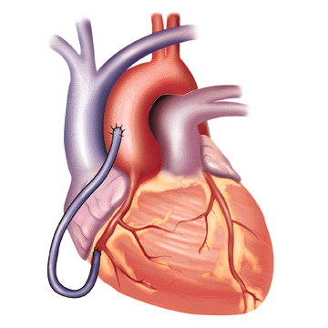
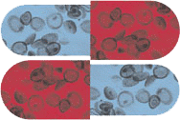
System-Facing Strategic Goals
Antimicrobial
Stewardship
C. difficile
Surveillance
Congestive
Heart Failure
Research &
Operations
(SLC-IDEAS &
PBM/NIDS)
Operations &
OIT
(MDRO & IPEC)
Research &
Operations
(ADAHF &
OABI/SCS)
Notes:
This slide gives a few examples of some of our current strategic partnerships targeting different areas of clinical care. We have partnerships addressing antimicrobial stewardship (which monitors and improves the use of antibiotics), partnerships addressing C. difficile surveillance (which helps to monitor and control the spread of this organism in VA facilities), and partnerships addressing the management of congestive heart failure patients. Each of these represents a partnership between hi2 and various groups with research and operations who are responsible for those clinical areas. So for instance…
In each case, these stakeholder groups have identified datasets and epidemiologic analyses that support their various clinical activities, and our goal is to translate that work and provide a pathway for integrating it into the workflow of the electronic health record.

Slide 22

Antimicrobial Stewardship
IV to PO Interchange: Needs and Workflow
Identification
Validation
Action
Reporting
Notes:
I wanted to focus first on a tool that we’re creating for antimicrobial stewardship called IV to PO Interchange. The purpose of this tool is to identify those situations where a patient in the hospital is being given intravenously one of a particular set of antibiotics (like 6) that are equivalent in the IV form and the oral form, and to make sure they are switched to the oral form whenever possible. The reason for this…
In order to create this type of tool, we had to work with the stewards to understand the actual workflow involved in this process, so that the tool could be designed to fit their workflow.
Identification: Identify a set of candidate patients for conversion from IV to oral antibiotics (criteria)
Validation: Validate the candidates should be converted based on review of information in their health records
Action: Perform the appropriate steps to convert the patients from IV to oral antibiotics (order, notes)
Reporting: Analyze data on IV to PO conversion rates

Slide 23
Antimicrobial Stewardship
Goal: Develop tools to manage antibiotic prescribing that integrate with the EHR & facilitate workflow
Tools that will:
Assess patients and create lists
Allow interaction between views
Enable users to take action
Create visualizations of data
Notes:
So our goal was to…
Assess patients and create lists of those who qualify for intervention
Allow interaction between population-level and patient-level views
Enable users to intervene/take action on patients
Create visualizations of population-level data for reports, evaluation, etc.
Note, however, that what is described here is actually a fairly generic template for potentially many different tools, not just tools for antimicrobial stewardship.

Slide 24
IV to PO Interchange
Business logic provided by ASTF
Antimicrobials
Azithromycin
Fluoroquinolones
Clindamycin
etc.
Inclusion Criteria
Afebrile x 24h
Oral meds last 24h
Stable vital signs
Exclusion Criteria
TPN in last 72h
ANC<500 in last 48h
Report Format
Patient Name
Ward/Room
Drug, Route, Dose
Next dose due
Notes:
The nice thing about this process is that the stakeholders (ASTF) work out all the details and requirements; then it’s our job to work out how to implement it using electronic data.
Antimicrobials
Azithromycin
Fluoroquinolones
Clindamycin
Fluconazole
Linezolid
Metronidazole
Inclusion Criteria
Afebrile x 24h
Any oral med in last 24h (not anti-emetics)
Hemodynamically stable
Exclusion Criteria
TPN in last 72h
ANC <500 in last 48h
Report Format
Patient Name
Ward
Drug, route, dose
Date started
Next dose due

Slide 25
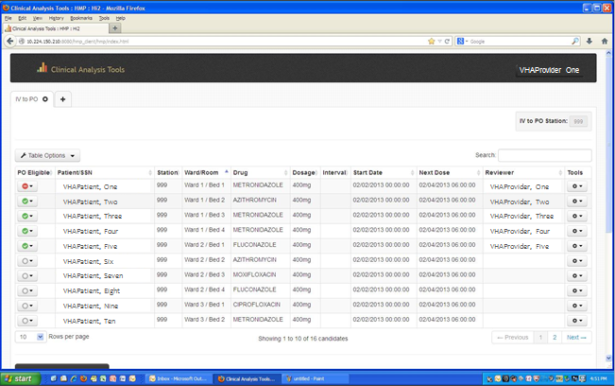

Slide 26
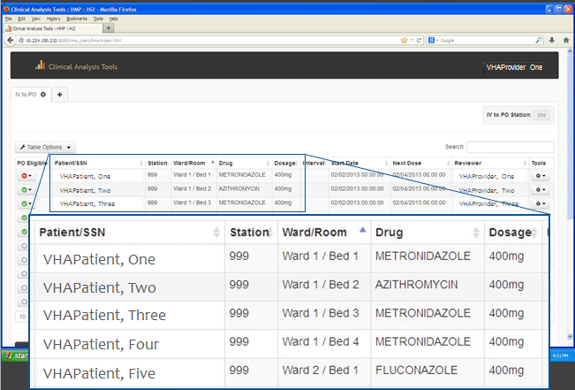
VHAProvider One

Slide 27
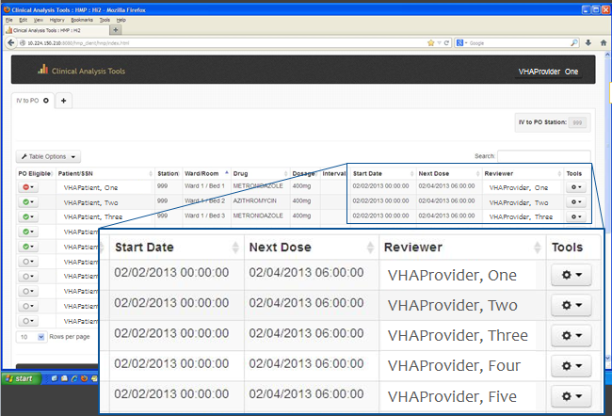

Slide 28
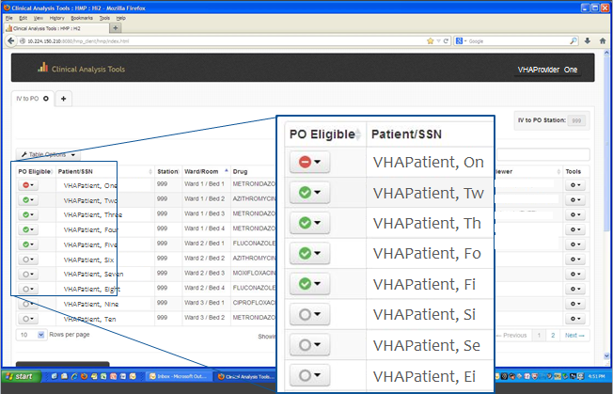
VHAProvider One

Slide 29
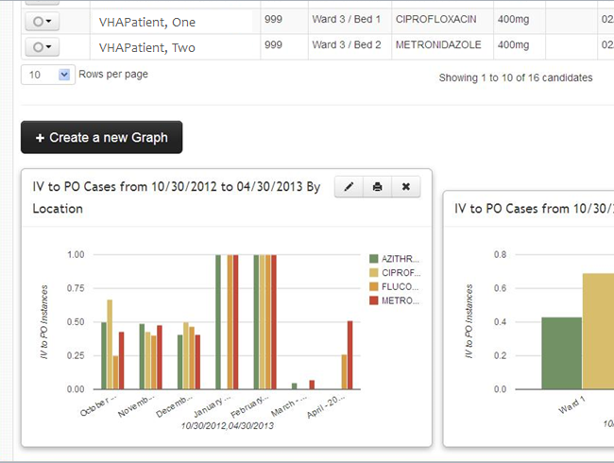

Slide 30
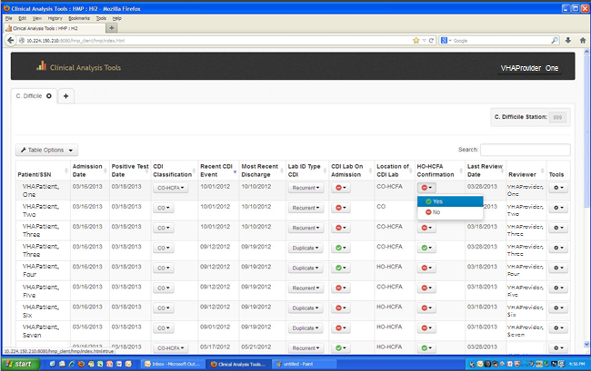

Slide 31
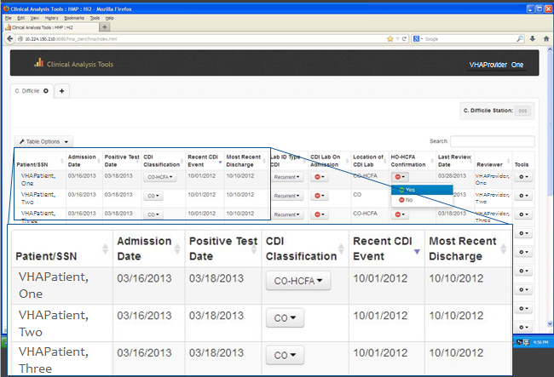

Slide 32
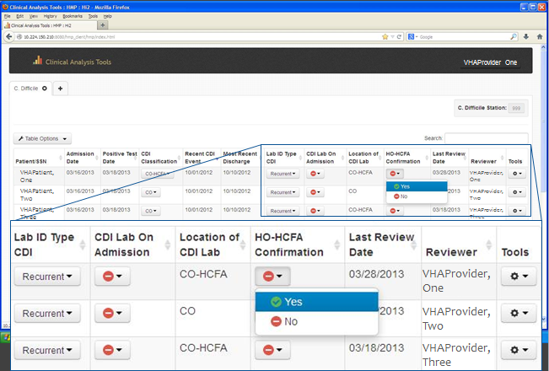

Slide 33
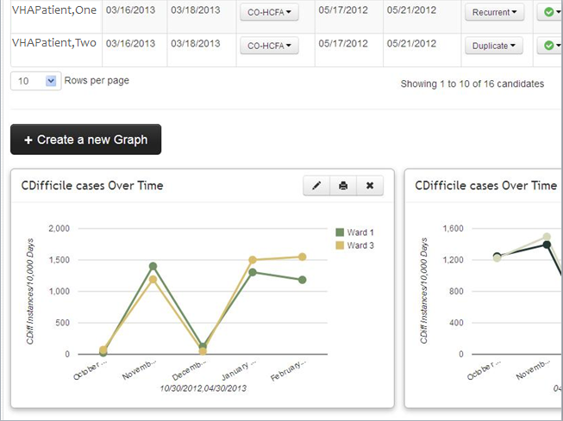

Slide 34
System-Facing Platform
The framework components
Data services
Analytic/ Business Layer
Outputs
Workspace Environment
Notes:
In order to implement a platform that supports this kind of reusable tool development and deployment, we wanted to focus on creating a framework to define and support the four key components of the platform:
Data services providing access to various data sources (CDW)
Analytic/Business Layer to manipulate/aggregate/analyze data
Outputs of analysis formatted and delivered as services for consumption by clients
Workspace Environment for web-based creation/deployment of apps (modules) addressing particular use cases

Slide 35
System-Facing HMP
Notes:
This slide shows a schematic representation of the system-facing HMP architecture and framework.

Slide 36
System-Facing HMP
Notes:
(No notes)

Slide 37
System-Facing Platform
ecosystem
1
Create new informatics tools and functionalities
2
Leverage existing/developing tools and services
3
Act as a pipeline between research and operations
Notes:
(No notes)

Slide 38

Future Partnerships & Directions
Innovative tools that harness the power of emerging informatics research and population-level data…
  “Tools that utilize visual analytics to facilitate pattern discovery and identify actionable interventions”
  Kaleid
  Len D'Avolio
  MAVERIC
Notes:
This is a really creative and innovative tool that uses a unique, visual interface and approach to data analysis related to any one of a number of clinical domains, such as C. difficile surveillance.
Automatically extracts all relevant variables from VistA (structured and unstructured)
Graphical data exploration / comparison
"Learns" which variables are most influential
Models different interventions effects on outcomes
Ongoing monitoring of interventions

Slide 39
System-Facing HMP
Notes:
Kaleid is being developed as a software package with its own back-end analytic engine, and its own web-based front end interface. This diagram shows how the Kaleid system will be integrated into the SF HMP, and should serve as a model for the integration of other packages developed by other groups.

Slide 40
System-Facing Platform
ecosystem
1
Create new informatics tools and functionalities
2
Leverage existing/developing
tools and services
3
Act as a pipeline between research and operations
Notes:
(No notes)

Slide 41
Future Partnerships & Directions
Innovative tools that harness the power of emerging informatics research and population-level data…
  "Tools that use data to manage uncertainty and support clinical decision-making"
  Veterans Like Mine
  Matthew Samore
  SLC IDEAS
Notes:
Helps providers make decisions in the absence of applicable recommendations from clinical trials or practice guidelines
Helps unlock evidence about best practice that is currently latent within VA data
Performs case-matched population queries to retrieve information on Veterans who are similar to the patient at hand based on features deemed relevant by the user
Explore previous decisions and outcomes

Slide 42
System-Facing HMP
Notes:
(No notes)

Slide 43

Pathways Forward
Shared/Distributed Development
Development Pathways
Domain Modules
Module Repository
Notes:
So that summarizes some of the specific tools and partnerships that we have focused on thus far, and in terms of where we’re going from here and some of the pathways forward to achieving our goals, these are the main areas we are concentrating on:
- Shared/distributed development – SDK (parameters, criteria, instructions)
- Three specific development pathways:
The System-facing HMP workspace
Prototype modules for specific domains and use cases
Developin a platform that is scalable, extensible, and meets the needs of the short and long term growth of HMP
- Encourage external development of domain modules (by groups outside of hi2)
Democratization of IT
- Module Repository (centralized area for submitting and deploying modules)

Slide 44

System
Facing
Platform
Summary
Points
Innovation
Collaboration
Democratization
Notes:
So for the main summary points, if there are three words that summarize the goals of the SF HMP, they would be innovation, collaboration, and democratization.
Our goal is to create innovative tools that harness the power of population data
Collaborative partnerships and leveraging existing or developing technologies are the keys to our success
We want to democratize the development process to make it straightforward for others to operationalize their work and incorporate it into workflow

Slide 45

Ask the Presenter
Notes:
Pause now for a brief video, after which we’ll be back for questions & answers (use the orange ATP icon)

