Slide 1

Primary Care Almanac Opioid Therapy Tool
Robby C. Riddle. MD, FAAFP, MBA/HCM
William J. Sanders, RN
Julie S. Horne, PharmD, BCPS
Fred Kirkland, RN, MSN
Gordon Schectman, MD, MS

Slide 2
Opioid Therapy Risk Report
Purpose & Update Frequency
Identify higher risk patients receiving Opioid Therapy (OT)
View key variables that influence patient risk
aligns w/Clinical Practice Guidelines (CPG)
Track patient response to therapy over time
Determine patients to contact regarding signed consent
aligns w/ Directive 1005
PCPs, APs & PAC Teams Quickly
  Patient-Focused Provider-Specific Actionable

Slide 3
Transforming VA Pain Care:
The Six Essential Elements of Good Pain Care
Educate Veterans/families
Educate/train all team members
Develop and integrate non-pharmacological modalities
Institute rational medication prescribing
Implement approach for bringing the Veteran's whole team together
Establish metrics to monitor pain care and outcomes
Notes:
Educate Veterans/families to promote self-efficacy and shared decision making; provide access to all relevant resources.
Educate/train all team members to their discipline-specific competencies, including team-based care.
Develop and integrate non-pharmacological modalities into care plans.
Institute rational medication prescribing, use of pain procedures, and safe opioid use (universal precautions).
Implement approach for bringing the Veteran's whole team together (e.g. SCAN-ECHO, e-consults, telehealth) and for maintaining ongoing communication between team members.
Establish metrics to monitor pain care and outcomes at both the individual and population level.

Slide 4
What is a Substance Use Disorder?
DSM-5 Criteria (abbreviated)
Taking more than intended
Persistent desire or unsuccessful efforts to cut down
Great deal of time spent obtaining, using or recovering
Craving or strong desire
Failure to fulfill major role obligations
Continued use despite psychosocial problems
Important activities given up or reduced in order to use
Recurrent use in hazardous situations
Continued use despite knowledge of medical problems
Tolerance
Withdrawal
DSM-5 Substance Use Disorder (2013)
  “A cluster of cognitive, behavioral, and physiological symptoms indicating that the individual continues using the substance despite significant substance-related problems.”
Notes:
Addiction is a disease just like diabetes and hypertension. There is an organ or organ system whose normal physiology goes awry.
The organ in the case of addiction (substance use disorders) is the brain, specifically pathways that help us make split-second, preconscious decisions that prioritize behaviors important for survival (motivation, “incentive salience”). Addicting drugs hijack these pathways such that we gradually prioritize the addicting drug over other, truly more important activities.
The specifics of how the brain physiology goes awry could be an entire presentation or course. For those who want to know more details, see brief summary below or read Volkow and Li (2004).
The specific pathway involved is the mesocorticolimbic (reward) pathway comprised of the Ventral Tegmental Area (VTA) in the midbrain, the Nucleus Accumbens in the Ventral Striatum, and the Amygdala in the medial temporal lobe. The normal function of this neural system is to motivate behaviors that are important for survival such as drinking water, eating food, reproducing (sex), and escape from danger (fear). This pathway assigns priorities for attending to certain stimuli such as signals that food is available or that a threat is present.
Because these decisions must be made quickly, they happen automatically, outside of conscious awareness. This explains why addiction seems cunning and baffling; the pathway affected operates largely outside of conscious awareness.
Addicting drugs activate this pathway more powerfully than natural rewards, sending the false signal that the drug is more important than food, water, and shelter from danger. This explains why those who are addicted continue to use the drug despite conscious knowledge that it causes significant problems. This baffling part comes from the fact that our brains are designed to prioritize signals from the primitive reward pathway (essential for survival) over signals from the rational cortex. So behavior driven by a false prioritization of the drug in the preconscious reward pathway seems irrational.
As you can appreciate, addicting drugs have the potential to impair our ability to make large and small decisions that are essential for survival, so we should embark on using these substances with full knowledge of their potential to cause a significant and long-lasting decision-making impairment.

Slide 5
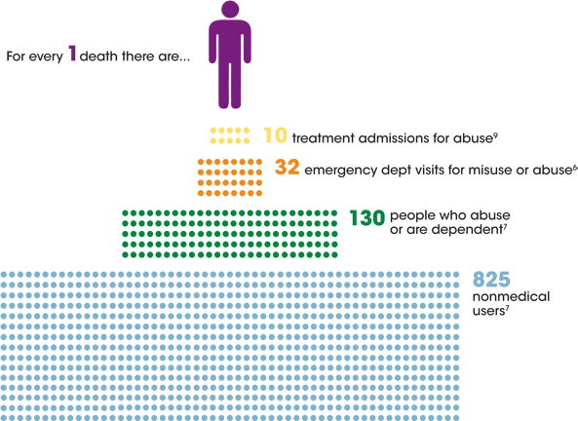
Notes:
CDC. Vital Signs: Overdoses of Prescription Opioid Pain Relievers—United States, 1999-2008. MMWR 2011; 60: 1-6In addition to the risk of overdose death, there is a significant risk of becoming addicted to these medications.
The risk of addiction increases for those who use the medications non-medically, and the risk of non-medical use and addiction increases with the use of other addicting drugs.
There are no other reliable predictors of taking non-prescribed drugs*, therefore, I test everyone who takes LTOT.
Urine drug testing helps me to determine when a patient is using other addicting drugs and, therefore, increasing his/her risk of addiction and overdose death.
* From Michna et al, 2007-Objective: To examine the incidence of abnormal urine toxicology screening among chronic pain patients prescribed opioids for their pain and to relate these results to patient descriptors and type, number, and dose of prescribed opioids.
Methods: A retrospective analysis of data from 470 patients who had urine screening at a pain management program in an urban teaching hospital was performed. Urine samples were analyzed using gas chromatography-mass spectrometry. Patients were categorized as having urine screens that were “normal” (expected findings based on their prescribed drugs) or abnormal. Abnormal findings were those of (1) absence of a prescribed opioid, (2) presence of an additional nonprescribed controlled substance, (3) detection of an illicit substance, and (4) an adulterated urine sample.
Results: Forty-five percent of the patients were found to have abnormal urine screens. Twenty percent were categorized as having an illicit substance in their urine. Illicit substances and additional drugs were found more frequently in younger patients than in older patients (P<0.001). No other variables were found to predict abnormal urine screen results.
Discussion: These results confirm past findings that random urine toxicology screens among patients prescribed opioids for pain reveal a high incidence of abnormal findings. Common patient descriptors, and number, type, and dose of prescribed opioids were found to be poor predictors of abnormal results.
http://www.cdc.gov/homeandrecreationalsafety/rxbrief/

Slide 6

Opioid Therapy Risk Report
Purpose & Update Frequency
Updated Monthly
Processing complete & data available by
No later than 10th Business day of month
‘As Of’ date alerts you to data freshness
PCMM Assignment
‘As Of’ date also used to determine date assignment processing occurred
Provider Selection Field
Lists PCPs, Attendings & APs
APs are grouped w/ their Attending

Slide 7
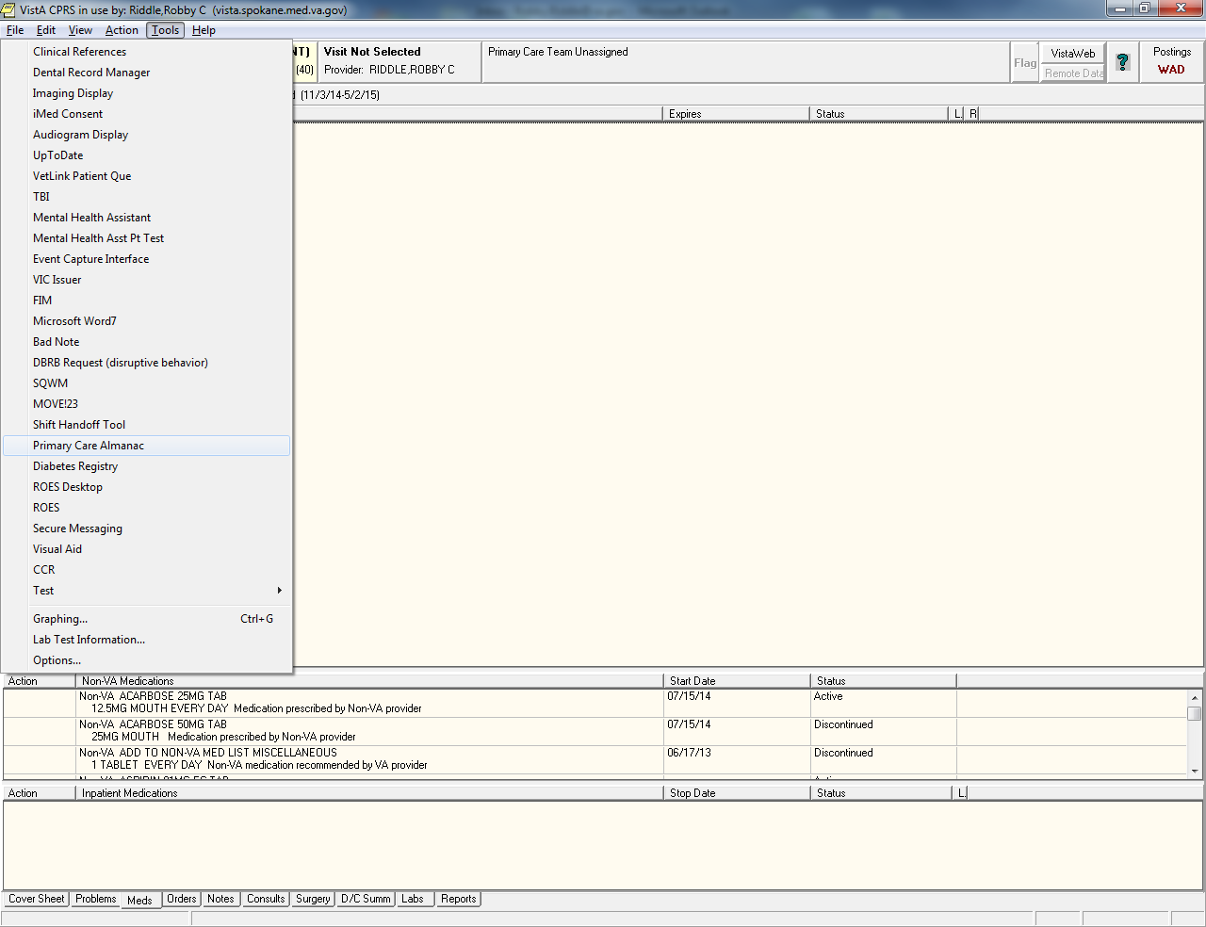
Accessing the Tool
Primary Care Almanac

Slide 8

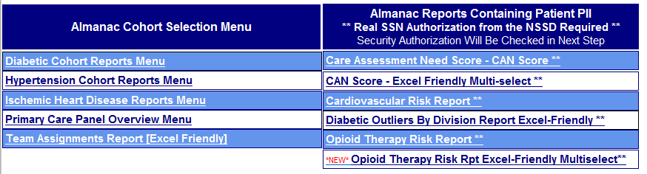
Security & Access
Viewing Reports w/ Patient PII/PHI
Notes:
Primary Care Almanac Home Page Menu
Use the Home Page Menu using either NSSD or CPRS access paths
A security check will be performed when you click on the report name
https://securereports2.vssc.med.va.gov/ReportServer/Pages/ReportViewer.aspx?%2fPC%2fAlmanac%2fMainMenu&rs%3aCommand=Render

Slide 9
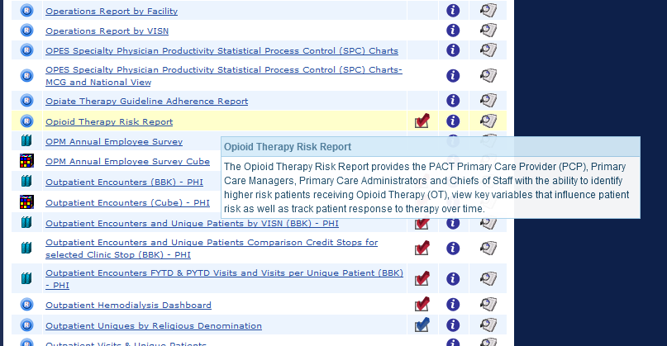
Notes:
http://vssc.med.va.gov/AlphaIndex.asp?Ltr=O

Slide 10
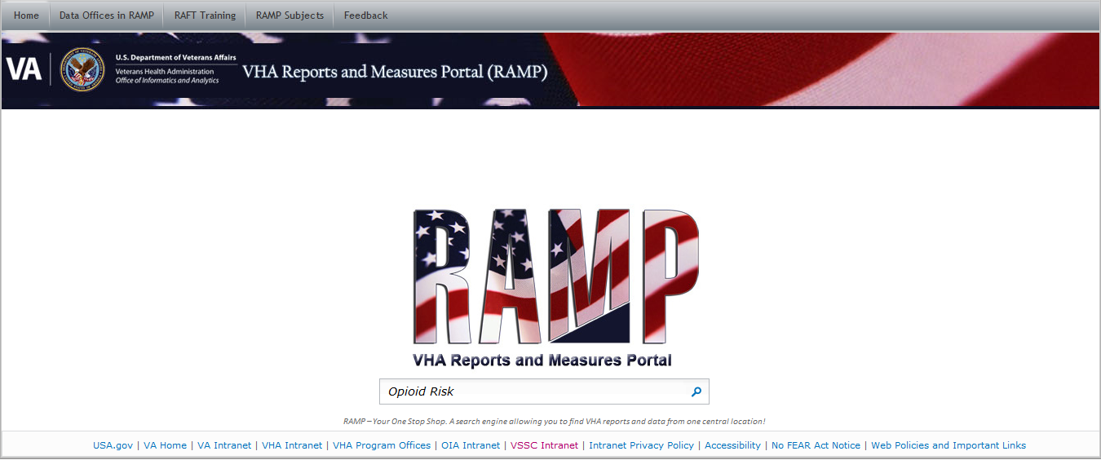

Slide 11
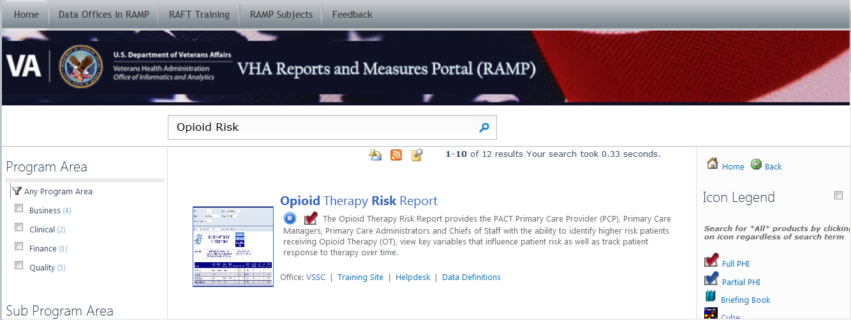

Slide 12
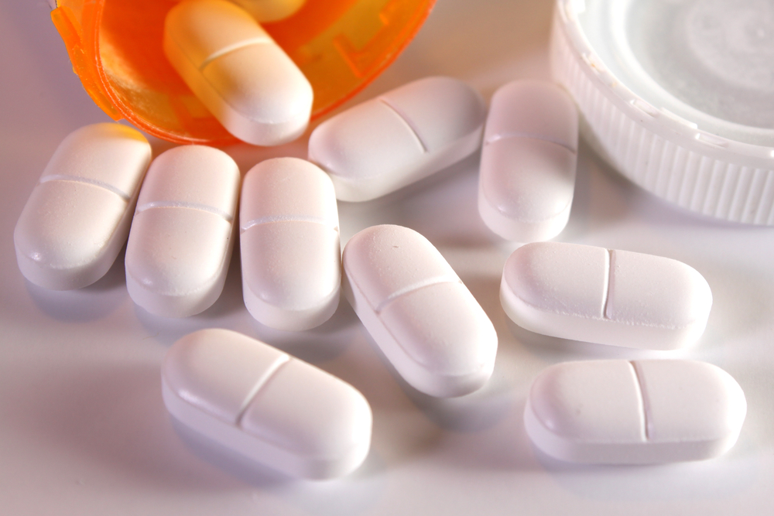
Opioid Therapy Risk Report
Long-term Opioid Use Definition
Long-term Opioid Use*
90 day Intended Coverage
  at least 75 days of therapy available within the most recent 120 days
*historically known as Chronic Opioid Use

Slide 13
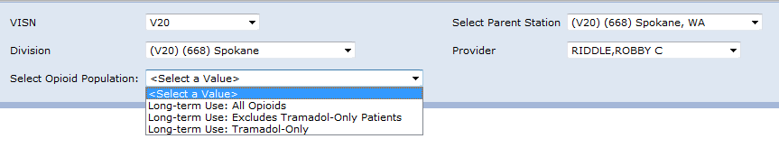
Opioid Therapy Risk Report
FAQ: OT Patient Populations
Q: Why have the ability to exclude Tramadol-Only Patients?

Slide 14
Opioid Therapy Risk Report
FAQ: OT Patient Populations
Q: Why have the ability to exclude Tramadol-Only Patients?
A: Allows teams to identify which patients require a signed consent & the concomitant training

Slide 15
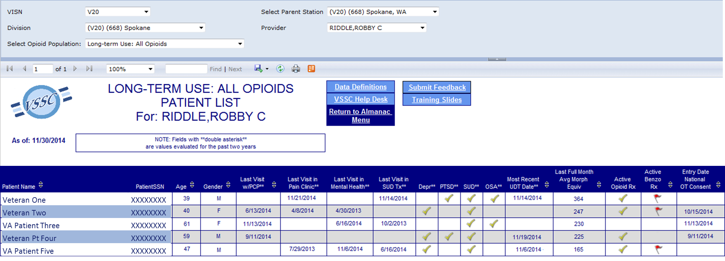
Opioid Therapy Risk Report
Patient List
Patient List Enables the Clinician to Quickly View Status of Key Risk Factors & Treatment Milestones

Slide 16
Initial Use
Team Huddle
Preplanning for upcoming patients
Determine who needs I-med consent, UDS, and face to face Visit
Also quick glance to determine if patient should be considered for possible BHS or SUD tx

Slide 17
Other Important Points
Quick glance at diagnosis which can contribute to a higher complication rate of patients on opioids depression, PTSD, SUD substance use disorder, OSA
As important is the benzodiazepine column which also increase possible risk of complication

Slide 18
Opioid Therapy Risk Report
Patient List
Documented diagnoses that increase patient risk
  Depression** PTSD** Substance Use Disorder(SUD)** DSM-IV
  Obstructive Sleep Apnea (OSA)**

Slide 19
Opioid Therapy Risk Report
Patient List
Most Recent Urine Drug Test (UDT) date**
Regardless of Location Where Testing Occurred

Slide 20
Opioid Therapy Risk Report
Patient List
Morphine Equivalents
Default Presentation Order for Patient List

Slide 21
Opioid Therapy Risk Report
Patient List
Active Rx Indicator Flags
Opioid &/or Benzodiazepine

Slide 22

Opioid Therapy Risk Report
Patient List
  Date OT Tx Consent Signed
  In iMedConsentTM
  Helps meet VHA Directive 1005 – Deadline: May 6, 2015

Slide 23
Opioid Therapy Risk Report
FAQ: Opioid Consent
Q: How can I quickly identify which patients do not have a signed Opioid Consent?

Slide 24

Opioid Therapy Risk Report
FAQ: Opioid Consent
Q: How can I quickly identify which patients do not have a signed Opioid Consent?
A: On the Patient List Page…
Click the sort arrows in the column header labeled
  “Entry Date National OT Consent”
  All the Patients w/ no National OT Consent rise to the top
  Click the sort arrows again to reverse the sort
    Patients with a signed consent rise to the top
  Either way, all the patients remain on the list
  Data Source: TIU Document Title:
    Consent for Long-Term Opioid Therapy for Pain
Sorting on a data column allows you to
prioritize how the information is viewed

Slide 25
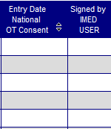
Opioid Therapy Risk Report
FAQ: iMedConsentTM
Q: What is the purpose of the column titled:
‘Signed by IMED USER’?

Slide 26
Opioid Therapy Risk Report
FAQ: iMedConsentTM
Q: What is the purpose of the column titled:
‘Signed by IMED USER’?
A: Green Checkmark indicates process completed
using iMedConsentTM
Red X Indicates activity outside of iMedConsentTM
  Paper document signed, then scanned
  Something else?
    Local Team must determine validity
Date Opioid Therapy Tx Consent
Signed In iMedConsentTM
Helps meet VHA Directive 1005 – Deadline: May 6, 2015

Slide 27

Opioid Therapy Risk Report
Patient List Page – More Features
Patients with the highest average Morphine equivalents float to the top the list
Click patient name to go to the patient detail page
Sort results by data columns using the arrows

Slide 28
Opioid Therapy Risk Report
Patient List
Click on Patient Name to
Open a Details Report for that Patient

Slide 29
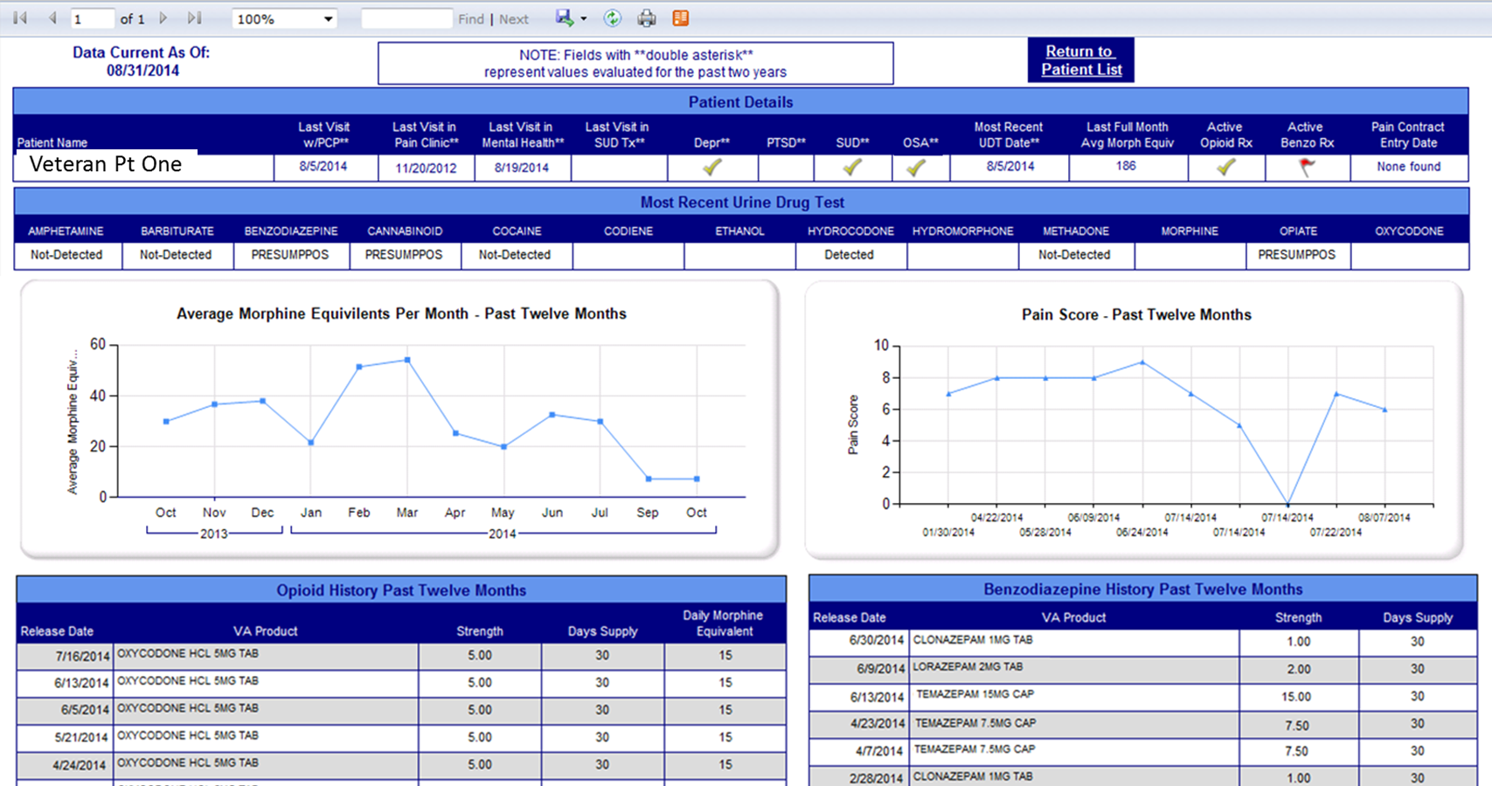
Opioid Therapy Risk Report
Patient Detail

Slide 30
Face to Face Visit Use
Print off before the visit
Re-enforces to the patient the doses of current meds
Allows conversation concerning early refills
Patients other contributing diagnosis i.e. PTSD, depression, OSA
Can be used as a recurrent tracking tool as adjustments or tapers are being made
Tremendous visual of the relationship between doses of opioids and benzodiazapines

Slide 31
Opioid Therapy Risk Report
Patient Detail

Slide 32

Formalized training for providers through TMS and other venues to include practical applications and use.
Continued refinement of tool based on provider input
Will explore ability to place direct link on desktop or shortcut on tools in CPRS
Ability for chiefs to review complete list of entire clinic

Slide 33
Thank You for Your Time,
Attention & Service to Our Veterans!
http://www.va.gov/painmanagement/
http://vaww.infoshare.va.gov/sites/primarycare/resources/pcedresourcesforPACT/pain_management_/default.aspx
http://www.healthquality.va.gov/guidelines/Pain/cot/

Slide 34
There is an authorization on file for the use of names in the screenshots of this presentation
Please send comments and feedback to:
William.Sanders@va.gov
Freddy.Kirkland@va.gov
Office of Analytics and Business Intelligence
VSSC Clinical Analytic Reporting

