Slide 1

Building 508 Compliant Apps
Shawn Hardenbrook
Director, Web and Mobile Solutions, Connected Health,
Office of Informatics and Analytics,
Veterans Health Administration
Ellen Crowe
Competency Manager,
Product Development, Application Development Competency
Office of Information & Technology,
Department of Veterans Affairs
Notes:
Becky Monroe will provide introductions.

Slide 2

About VA Mobile Health
Leverages wireless/mobile technologies to improve the health of Veterans
Expands care for Veterans beyond the traditional office visits
Notes:
SHAWN
Mobile Program started about 3 years ago
Now part of connected health office
Also includes Innovations and My Health e Vet
Main mission is to build apps for VA staff and Veterans
Apps for all type of users clinical to administrative
Also have process for other Program Offices to publish apps
VA has around 15 apps on the public app store – Apple App Store and Google Play
There are other VEHU sessions on the app certification process – Brian Olinger
Developer information is on http://mobile.va.gov
Today, we’re going to talk accessibility. Accessibility is one of the approximately 15 criteria we look at during the app certification process.
*** STOP HERE *************************

Slide 3
About VA Mobile Health (cont’d)
Helps Veterans, Caregivers and VA health care team securely coordinate all aspects of care
Provides Veterans and their Caregivers with tools to help lead healthier lives
Notes:
SHAWN
Mobile Program started about 3 years ago
Now part of connected health office
Also includes Innovations and My Health e Vet
Main mission is to build apps for VA staff and Veterans
Apps for all type of users clinical to administrative
Also have process for other Program Offices to publish apps
VA has around 15 apps on the public app store – Apple App Store and Google Play
There are other VEHU sessions on the app certification process – Brian Olinger
Developer information is on http://mobile.va.gov
Today, we’re going to talk accessibility. Accessibility is one of the approximately 15 criteria we look at during the app certification process.
*** STOP HERE *************************

Slide 4

Why I Care About Accessible Software
Notes:
SHAWN
Was in glasses by 6 months.
Walked into walls when learning to walk.
Went through about 3 years of physical therapy 2-3 days a week for eyes.
Have problems with central vision in left eye
Can’t see 3d.
So I have some challenges.
Because of this, Accessibility is really important to me.
So what about you Ellen? What’s your story?
*** STOP HERE *************************

Slide 5

Why I Care About Accessible Software
Notes:
ELLEN
Ellen Crowe and Allie. She’s been blind since birth. Ellen has learned to live with her disability. She had more vision earlier in life and it has gotten worse in life due to a medical disability. When accessibility is done right, she gets the same information as others from apps. Mobile technology has brought a lot of convenience to her.
*** STOP HERE *************************

Slide 6

Why Accessibility is Important
Makes apps accessible to the widest audience possible
Particularly beneficial to Veterans with disabilities
It’s the law
Notes:
ELLEN
Talking points, from Ellen:
Stress that they really do have to this. But do you really want to be designing apps that AREN’T accessible by Veterans with disabilities? They’re the ones that can really benefit. Apps should be made available to the widest possible audience.
The apps are tools that have great potential to make a difference in the lives and care of Veterans with disabilities. To do this, they must be fully accessible to that population. Lack of accessibility makes them less valuable tools that can only be used by a limited segment of the population VA is trying to reach.
Additionally, accessibility is the law, and legally accessibility regulations must be adhered to
*** STOP HERE *************************

Slide 7

Before The Americans With Disabilities Act “Accessible Design Standards” (1990)
Notes:
SHAWN
The focus of this slide is about reducing barriers to people with disabilities.
This is also a prime example of why developers should build in accessibility from the beginning.
Metaphor
It’d be a lot harder to go back once the staircase is built and reconstruct it as a ramp. Not to mention, others might have benefitted from a ramp, like moms with strollers and people pulling luggage.
Software is the same concept except dealing with electronic interfaces data instead of boards and bricks.
*** STOP HERE *************************
citation: http://redbridgeweb.com.au/2014/07/digital-accessibility-resources/

Slide 8
What Does “508” Mean?
Applies to software procurements and development in government
Officially referred to as Section 508 of the Rehabilitation Act of 1973
Added in 1987
Abbreviated as “508” or “Section508”
Amended in 1998 to match modern technology and add further clarifications.
Notes:
ELLEN
The law is undergoing a refresh because of the same reasons that it needed a refresh in 1998.
It’s not a secret Craigs List code.
US Law that applies to software procurements and development in government.
Officially referred to as Section 508 of the Rehabilitation Act of 1973, but was added in 1987.
Abbreviated as “508” or “Section508” (no space)
Later amended in 1998 to match modern technology and add further clarifications.
*** STOP HERE *************************
http://www.section508.gov/summary-section508-standards

Slide 9

Poll Question
Do you or someone you know have any traits of colorblindness?
    Yes
    No
    I’m not sure
Notes:
SHAWN
Now I’d like to ask a poll question.
Do you or someone you know have any traits of colorblindness?
Yes
No
I’m not sure
To answer this question, use the blue polling icon above my head. We’ll move on and come back to your results in just a few minutes.
*** STOP HERE *************************

Slide 10

Why Does 508 Matter?
508 describes the requirements for creating accessible software, telecommunications and web content.
http://www.section508.gov/summary-section508-standards
Notes:
SHAWN
Even if there were no government regulations requiring accessible software, it’s still the right thing to do.
VA should be making our software as available as possible to as many people as possible. And we know that a large portion of our Veterans and employees have disabilities.
So by following basic design rules and parameters, we can ensure that everyone is able to use VA software.
If looking at it from a regulation standpoint, it matters because these requirements are US law.
If a product is rushed out the door without considering accessibility and manages to get published, it risks being taken off-line later. It’s much easier, cheaper and less frustrating to work accessibility into software during development than to go back later and try to fix it.
During VA mobile app certification, accessibility is one of the criteria that can become a show stopper. No one likes to spend 6 months developing a new mobile app only to find out they can’t get their app approved because they forgot about accessibility.
*** STOP HERE *************************

Slide 11
Disability: By the Numbers
Approximately 54 million Americans are living with a disability.
In July 2010, President Obama signed an executive order to hire 100,000 people with disabilities in the Federal workforce.
In FY2013, the Federal government employed 1.8 million Schedule A employees, including more than 230,000 Veterans with a disability of 30% or greater.
Notes:
SHAWN/ELLEN:
Over the past three years, the Federal government has added nearly 58,000 people with disabilities.
*** STOP HERE *************************
Source: Office of Personnel Management http://www.opm.gov/policy-data-oversight/diversity-and-inclusion/reports/disability-report-fy2013.pdf

Slide 12

Veterans and Disabilities
More than 5.5 million individuals with disabilities
More than 21 million Veterans
Notes:
SHAWN:
*** STOP HERE *************************
Source: Annual Disability Statistics Compendium http://disabilitycompendium.org/compendium-statistics/veterans

Slide 13

508 Key Fact
508 applies directly to information & technology purchased, developed, maintained or used by the Federal government. It does not apply to people.
Notes:
SHAWN:
We tend to throw the terms “508” or “Section 508” around a lot. This refers to specific legislation and regulations that apply to information technology.
And the regulations only apply to the Federal government. So if Microsoft wants to create a new tool or game, they don’t have to necessarily worry about whether it would work with a screen reader.
However, if Microsoft wants to sell that tool to the VA, they do have to worry about it. Because when the government goes to buy that tool, the regulations will be applied. If it’s not accessible, then the government can contract or buy that tool until it is made accessible.
It’s important to pay special attention to new contractors who are hired who may have never worked with the Federal government.
They may not be aware of accessibility requirements. Most of them want to do the right thing. They simply don’t know the criteria which will be applied. So if someone is the COR or PM, especially involving a new contractor, it may take extra effort to be sure accessibility isn’t missed and becomes a problem at the end of the project.
*** STOP HERE *************************

Slide 14

What about other accommodations?
There is another law (504) that applies to the government’s responsibilities to accommodate people with disabilities. When 508 is done correctly, 504 is easier to implement.
Notes:
SHAWN:
Here’s a slide referring to 504. Ellen was just talking about that a few slides back.
ELLEN:
Section 504 includes language which describes reasonable accommodations for employees with disabilities.
So what the law actually states is:
“No otherwise qualified individual with a disability in the United States, as defined in section 705 [paragraph 20] of this title, shall, solely by reason of her or his disability, be excluded from the participation in, be denied the benefits of, or be subjected to discrimination under any program or activity receiving Federal financial assistance or under any program or activity conducted by any Executive agency or by the United States Postal Service.”
Further, it goes on to state.
"For purposes of employment, Qualified Individuals with Disabilities are persons who, with Reasonable Accommodation, can perform the essential functions of the job for which they have applied or have been hired to perform. “
As an example, let’s assume there were no 508 requirements and VA built apps that used only audible alerts with no visual or other indicators. We’d have a difficult time making accommodations for someone deaf who couldn’t hear those alerts. If the only reason they couldn’t perform a job function is due to that app, the VA would have to make accommodations to work around the audible alerts. It’d be a lot easier to just build in other features in the software from the beginning. And if we follow good design principles, we can do that cheaper and easier at the start of an app project than at the end.
*** STOP HERE *************************

Slide 15
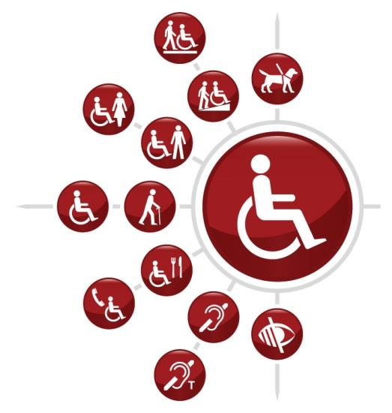
Who Benefits When Accessibility is Considered?
People with:
Low Vision / Blindness
Colorblindness
Hearing disabilities
Limited motion disabilities
Notes:
ELLEN/SHAWN:
HAROLD – Stay at top while Ellen is talking because need to read some of this.
People with:
Low Vision / Blindness
Accommodation: Screen Reader
Compatibility: JAWS, Window- Eyes, Operating-System API’s
Colorblindness
Accommodation: Alternate text/symbols when color is used as an indicator Green may mean “ok” and red may mean “high on a lab.” But we need to also include labels such as “H” or an arrow pointing up to indicate “high”.
Hearing disabilities
Accommodation: Closed Captioning when text is being spoken, such as video within an app.
Limited motion disabilities
Accommodation: Mouthstick combined with designing simple navigation using minimal keystrokes. We wouldn’t want to design an app with a complex key sequence to get back to the home screen, for example.
*** STOP HERE *************************

Slide 16

Color and Contrast
Notes:
SHAWN: So let’s look at 3 best practices
One is color and contrast
The second is input and navigation
The third is images and user interface control
Let’s start with color and contrast
*** STOP HERE *************************
**Tube TV – test pattern
Let’s look at a few of the design principles behind accessible apps.
One of these has to do with color and contrast within an application.

Slide 17
Poll Results
Do you or someone you know have any traits of colorblindness?
  Yes
  No
  I’m not sure
Notes:
Now let’s take a look at the poll results. I asked
Do you or someone you know have any traits of colorblindness?
Yes
No
I’m not sure

Slide 18

Poll Results
Do you or someone you know have any traits of colorblindness?
  Yes
  No
  I’m not sure
Notes:
Click to move on “cue for tech team”

Slide 19
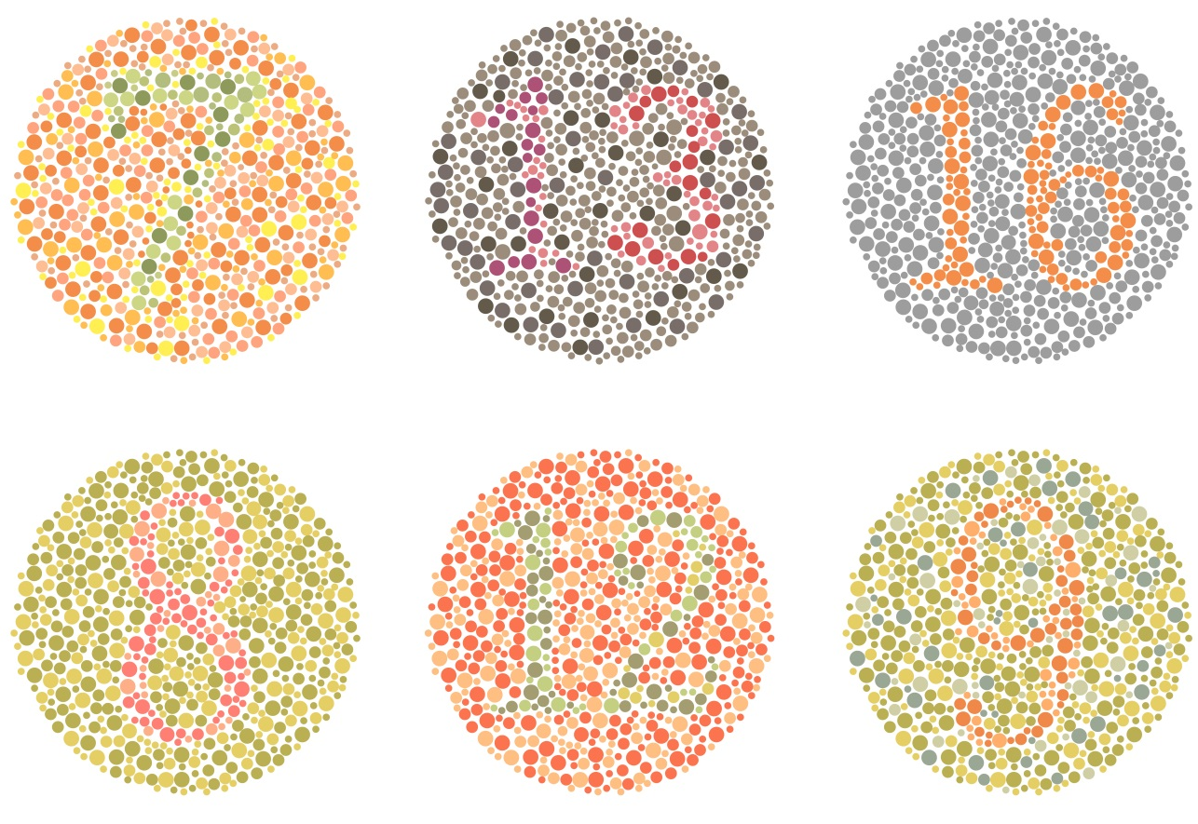
Think About How Users Perceive Color
All information must be presented so that it is accessible to users who cannot see or differentiate color.
Notes:
SHAWN:
I’m probably the worst one to be talking about this slide because I have some green colorblindness.
Here we see 6 ishihara color blindness test plates.
All of these have numbers in them.
Someone with green colorblindness may not be able to see the “7” in the plate in the upper left, or the 9 in the lower right, for example.
If an app were designed with a similar color scheme, a green colorblind user would have a lot of trouble distinguishing data in the app.
This would potentially put others and risk and make it hard for them to do their job.
Could be dangerous to patients.
*** STOP HERE *************************

Slide 20
508 Requirements for Color and Contrast
Information cannot be provided using color only.
There must be contrasting colors/shades at a ratio of 4.5:1 to discern between background and foreground content.
Notes:
ELLEN:
What are the requirements in 508 for color and contrast?
We can’t indicate something by color alone. So using RED for that high lab value would need to also have some other visual indicator for the user who can’t see shades of red.
Apps must not override user-selected color and contrast settings. If an app provides users the option to change the look of the screens, a variety of background and foreground colors should be provided.
*** STOP HERE *************************

Slide 21
Color Barriers
Screen-readers don’t pick up color.
Users who can see but have color perception deficiencies may not be able to differentiate between different colors.
Notes:
SHAWN
So Ellen, what happens to you when you’re using your screen reading and someone indicates something about color.
ELLEN…
----
Remember too that someone using a screen reader will potentially miss color-related information. That’s why the text labels and other indicators become so important. A screen reader or braille terminal isn’t going to tell the user the color of the text that it’s reading.
We take color for granted in our daily lives. So it’s easy to miss this. But this is one of the criteria that will be evaluated during the accessibility portion of the mobile certification process.
*** STOP HERE *************************

Slide 22
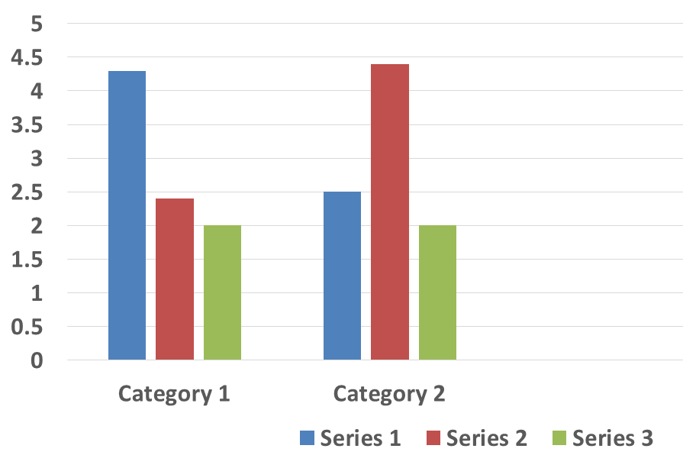
Non-Compliant Example
Notes:
SHAWN:
So here we have an example of a poorly constructed, non-compliant graph.
What’s wrong with this graph?
If two bars in a bar chart use different colors but use no patterns and no text labels, a person who is color blind may be unable to tell them apart.
It may be obvious to most people that blue is on the left, series one.
Red is in the middle as series 2
Green is on the right at series 3.
But imagine if someone had trouble with any of these colors.
*** STOP HERE *************************

Slide 23
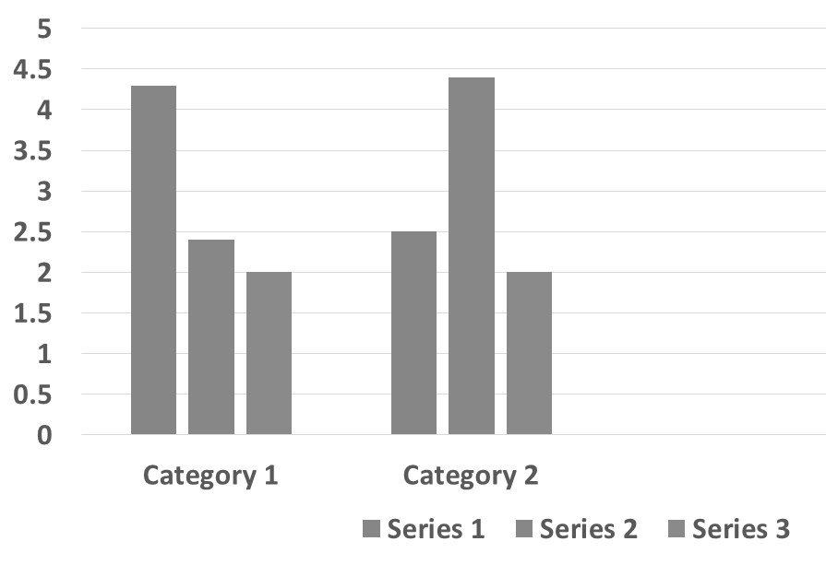
Non-Compliant Example
Notes:
SHAWN:
Without color as an indicator, how do you tell which bar represents which series?
This graph would be made compliant using alternate text or patterned areas to explain the visual and differentiate which bar corresponds to which series.
*** STOP HERE *************************

Slide 24
Non-Compliant Example
When sufficient contrast is not provided between the color of the text and the background color, people with color perception deficiencies may not be able to read the screen.
Notes:
SHAWN:
Here we have an example of the contrast ratio requirement mentioned on a previous slide. Sometimes a user may be able to see a particular color. But when it’s next to certain other colors, they may have problems telling the difference between the colors. Even someone without color vision issues may have difficulty with this example, especially if they were rapidly using an app and didn’t have time to stop and focus.
When sufficient contrast is not provided between the color of the text and the background color, people with color perception deficiencies may not be able to read the screen.
*** STOP HERE *************************

Slide 25
Compliant Example
When sufficient contrast is not provided between the color of the text and the background color, people with color perception deficiencies may not be able to read the screen.
Notes:
SHAWN:
And now here’s an example of how to fix the contrast ratio problem. Whether someone has issues distinguishing colors or not, they’ll clearly be able to read this screen because of the difference between the dark black text and the light grey background.
Usability testing, user acceptance testing, and field testing or pilots are all ways you can work through accessibility problems prior to pushing out an app to production.
In VA Web & Mobile, we’ll require an accessibility certification prior to publishing an app. But we don’t necessarily require this step to be complete for limited field testing or pilots prior to production releases. That’s because we know some of the accessibility issues won’t be discovered until users are actually in and working with an app.
This is also really important because it’s come up quite a few times.
When developing an app, always ensure you still have a developer available, either internally or contracted, to deal with any issues that you might discover when you go to field testing. Otherwise, you may hit a show stopper and have a problem that needs remediation with no developer to do the work.
TO ELLEN: Ellen, what’s your experience with screen reader and color … does it have any impact because you use a screen reader…
*** STOP HERE *************************

Slide 26
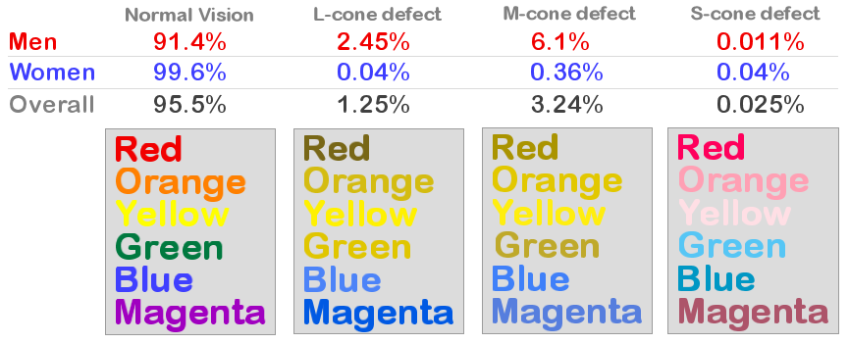
Why color-only indicators are a problem…
Notes:
SHAWN:
Here we have an image demonstrating common types of color blindness.
Note that almost all women have normal color vision. But a large portion of men, nearly 9%, don’t. So about 5% of app users, both men and women, may run into issues using software where color alone was used for conveying certain pieces of information.
And also realize that even if someone doesn’t have an obvious problem with their color perception, the defects mentioned here can be present in various levels. So someone may have no issue with dark green but may start to have problems detecting lighter shades of green. They may not even realize it.
The only color that’s visible virtually the same across the types of color blindness is Blue, with yellow a close second. But we also can’t use just blue and yellow text in all of our apps. And someone with an S-cone defect may have trouble distinguishing green from blue.
*** STOP HERE *************************
Image is of stats describing normal vision, l-cone defect, m-cone defect, s-cone defect.
Men are 8.6% likely to have some form of colorblindness. Women are .4% likely to have colorblindness. Red, Orange, Green, Yellow, Green, Blue, and Magenta are all affected by colorblindness.
*****
https://community.devexpress.com/blogs/markmiller/archive/2009/02/26/great-ui-clarity-and-color-on-the-presentation-layer.aspx
---Harold will get Kimberly icons

Slide 27

Non-Compliant Example
VITAL SIGNS:
Heart Rate: 72bpm
BP: 150/88
Notes:
ELLEN:
Here we’re using a blood pressure example that would be displayed in a mobile or web app. The 150 over 88 blood pressure is in red to indicate there’s a problem with that value.
But we know from the chart on the previous slide that about 8 ½ percent of users would have a problem knowing the text is in red.
---
Explain: The issues with the BP reading are indicated in red. This is not accessible by itself because the red will not necessarily be visible to someone with a vision impairment.
*** STOP HERE *************************

Slide 28
Compliant Example
VITAL SIGNS:
Heart Rate: 72bpm
BP: (HIGH RISK) 150/88
Notes:
ELLEN:
So to fix this, we simply add a label next to the red text.
We’re not going to require the red be removed, because it’s a great way to highlight the information for the majority of users. But the requirement will be to include the extra text for the percentage of users who don’t get any meaning from the red color.
--
Explain: To make the slide compliant, it is necessary to indicate that the blood pressure reading is high risk in text, rather than just through the use of color
*** STOP HERE *************************

Slide 29
Accessibility Management Platform (AMP) Resources on Color and Contrast
iOS:
https://va.ssbbartgroup.com/public/standards/view_violations.php?media_type_id=223
Android:
https://va.ssbbartgroup.com/public/standards/view_violations.php?media_type_id=288
Notes:
ELLEN:
There’s specific reference material available on-line related to color and contrast within apps. We’d recommend you download this presentation and take a look at the links included on this slide. We’ve also included the email address of the section 508 team in VA in the speakers notes. You can contact this program office to help answer any additional questions you may run into.
Also in TMS, there is additional accessibility training which includes information on color and contrast within apps and websites.
Please remember that the slides are available by using the green download icon above my head. There are helpful links in the speaker notes.
Find out more from the Accessibility Management Platform (AMP) courses Navigation and Input on both the iOS and Android platforms.
Color contrast checkers can also be found at: http://www.section508.va.gov/support/resources_508.html
If your content is a mobile app please send an email to section508mobile@va.gov. Please include your name, email address, and phone number.
If the content you produce is e-learning please send an email to section508elearning@va.gov. Please include your name, your email address, and your phone number.
*** STOP HERE *************************

Slide 30
Poll Question
Have you been responsible for incorporating 508 standards into a VA product?
  Yes
  No
  Not sure
Notes:
ELLEN:
I have another poll question for you
Have you been responsible for incorporating 508 standards into a VA product?
Yes
No
Not sure
To answer this question, use the blue polling icon above my head. We’ll move on and come back to your results in just a few minutes.

Slide 31

Navigation and Input
Notes:
ELLEN:
Next, we’re going talk about moving around inside apps along with inputting information into them.
*** STOP HERE *************************

Slide 32

Think About How Users Access Information
All information, and all functionality MUST be accessible via a keyboard.
Notes:
ELLEN:
Think about how important a keyboard is to you every day. You probably press 1000’s, if not 10’s of 1000’s or even 100’s of thousands of keys a week.
The keyboard was one of the first tools created for computers. Even computers without keyboard, like smartphones, have virtual keyboards. And most desktop operating systems today have ways of doing virtually everything by keyboard. And that’s one of the core things you should think about when building or designing a web app. Not everyone is going to be able to use a mouse. Most accessibility tools have focused on either using or simulating keyboards.
One of the very first requirements in 508 law is that all application features must be accessible via keyboard.
*** STOP HERE *************************

Slide 33
508 Requirements for Navigation and Input
All components must be accessible by a keyboard and touch gesture with the use of Assistive Technology.
No keyboard traps.
Provide alternatives to touch gestures that need multiple touch points or direct touch access.
Document non-standard or alternative touch gestures for access.
Touch events must respond to touch up events rather than touch down events.
Notes:
SHAWN:
Here we have a list of the 508 requirements for navigation and input.
There are a number of things to consider.
The basic requirement is that everything must be accessible by a keyboard and touch gesture. There should be nothing on the screen that a user couldn’t tab or otherwise move the input to without a keyboard.
Then there’s a special situation called a keyboard trap.
To Ellen -> So Ellen, I you’ve had issues sometimes with keyboard traps. Tell us about that.
Then there are some specific requirements for mobile that have to do with gestures and touch. Most touch-based operating systems like iOS and Android have accessibility built-in. But there are some requirements specifically on touch and gestures that developers may not be thinking of but that they’ll need to account for.
*** STOP HERE *************************
---
Any interactive element or function must be able to be accessed or activated by a keyboard and touch gesture with the use of Assistive Technology.
There can be no keyboard traps.
Touch gestures that require multiple touch points or direct touch access must provide alternatives.
Non-standard or alternative touch gestures for access must be documented.
Touch events must respond to touch up events rather than touch down events.

Slide 34

Avoid Keyboard Traps
A keyboard trap occurs when a user cannot move focus away from an interactive element or control using the keyboard alone.
Notes:
SHAWN: Even though mobile apps don’t necessarily have a physical keyboard, keyboard traps can still come up in a way in mobile apps. This is normally not an issue with standard components provided by the OS. But it’s important to ensure that custom components provide the same access as the standard components.
*** STOP HERE *************************
---
Keyboard focus should never become trapped within an app. Keyboard traps prevent keyboard-only users from accessing the rest of the app content.
Important: The importance of navigation by people with disabilities cannot be overstated. Keyboard and accessible touch access is fundamental to accessibility, and gaps in navigation create extreme accessibility challenges for people with visual, motor, and cognitive disabilities. Where an app supports keyboard access, it is essential that keyboard access is indicated visually and programmatically.

Slide 35
Navigation Barriers
Standard touch gestures are not possible for a blind user, as touching a control in order to discover its identity will activate it.
Touch gestures may not be possible when the user does not have the physical abilities to use multiple touch points.
Notes:
SHAWN PROMPTS ELLEN: This slide is about touch gestures. Now Ellen, explain what we’re talking about when it says standard gestures aren’t available for a blind user.
Flip to next slide while Ellen is talking…
*** STOP HERE *************************
---
When accessible navigation and input is not provided to all interactive controls, people who cannot use the standard touch gestures will not be able to use or complete all functions in an app. This denies them access and provides an unequal experience. For example, people may not be able to complete forms, perform a search, or log-in to a system. Interactive controls include navigation controls (links, buttons and such as those used to close, move, or drag an interface element. Other examples of barriers include editable content (selectable text and data input. Wherever people are expected to interact with controls, it must be possible to do so using accessible navigation and input techniques.
When equivalent alternatives have not been provided for all gesture actions, users with disabilities may not have access to custom controls such as those used in feature-rich apps.
When custom gestures or keystrokes are created but not documented, users with disabilities do not know they exist and may not be able to access all the features in your app.
Some apps require direct touch access or custom gestures such as drawing a circle around a correct answer. When alternatives to these direct touch gestures are not available, users with limited dexterity may not be able to make those gestures and will not be able to access the feature.

Slide 36
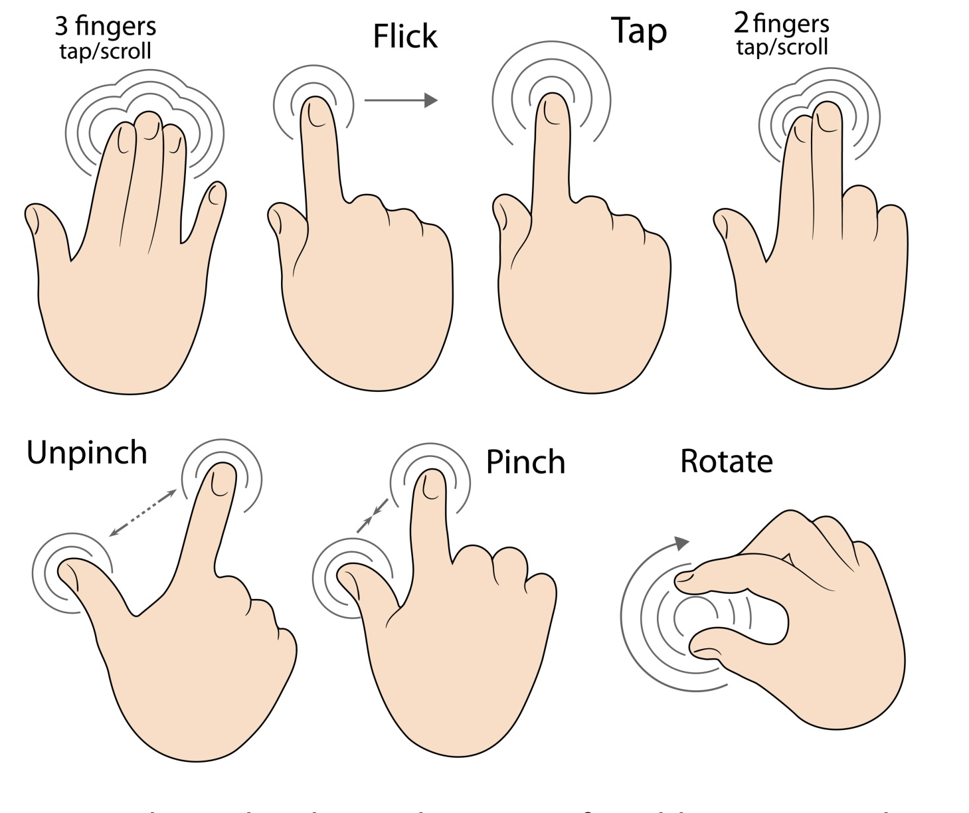
Provide Touch Gesture Access
Notes:
ELLEN:
“Hey, I’ve got a video from yesterday where I was showing Becky how to use touch gestures.”
*** STOP HERE *************************

Slide 37
Document Alternative Methods
Standard touch gestures for an interactive element must function as expected. If not, documentation of alternative methods must be provided to people who cannot perform that touch gesture.

Slide 38

Ensure Appropriate Sequence
Arrange all interactive content in an appropriate sequence on the screen.
Notes:
SHAWN:
What this is referring to is ensuring the order in which the users encounters each element makes sense.
All interactive content must be placed in an appropriate sequence on the screen.
We used to call it Tab Order in Windows apps.
You might call it focus order in a mobile app.
So you might want to test this with voiceover running, maybe in a unit test and definitely with some users who may have accessibility turned on.
*** STOP HERE *************************

Slide 39
Poll Results
Have you been responsible for incorporating 508 standards into a VA product?
  Yes
  No
  Not sure
Notes:
SHAWN:
Let’s take a look at the latest poll results
Have you been responsible for incorporating 508 standards into a document and/or presentation?
Yes
No
Not sure

Slide 40
Poll Results
Have you been responsible for incorporating 508 standards into a product?
  Yes
  No
  Not sure
Notes:
Click to move “cue for tech team”

Slide 41

What if your user’s mouse works like this?
Notes:
SHAWN:
These next couple of slides are some examples of alternate access.
So here we have a mouse controlled with a mouthstick.
Image: Image from DC VAMC Website
*** STOP HERE *************************

Slide 42

What if your user types like this?
http://blog.knowbility.org/wp-content/uploads/2014/09/AccessU-2012-usingMouthStick.jpg
Notes:
Here we have man typing on keyboard with sip-and-puff accessory.
*** STOP HERE *************************
http://blog.knowbility.org/wp-content/uploads/2014/09/AccessU-2012-usingMouthStick.jpg

Slide 43
Accessibility Management Platform (AMP) Resources on Navigation and Input
iOS:
https://va.ssbbartgroup.com/public/standards/view_violations.php?media_type_id=233
Android:
https://va.ssbbartgroup.com/public/standards/view_violations.php?media_type_id=296
Notes:
ELLEN: So here we have a couple of URL’s to the Accessibility Management Platform (AMP) resources regarding Navigation and Input on both the iOS and Android platforms.
In the speaker notes we also have some email addresses for the 508 program office if you have questions.
*** STOP HERE *************************
If your content is a mobile app please send an email to section508mobile@va.gov. Please include your name, email address, and phone number.
If the content you produce is e-learning please send an email to section508elearning@va.gov. Please include your name, your email address, and your phone number.

Slide 44

Images and Interface Controls
Notes:
ELLEN: Now we’re going to talk about one of the other best practices, images and controls
*** STOP HERE *************************

Slide 45
Images
For people who can’t see an image or can’t interpret it, that image must have a textual equivalent.
Pictures
Icons
Complex graphics (including charts, graphs and diagrams)
Notes:
SHAWN:
Some say, “a picture is worth a thousand words,” <<ELLEN CUTS IN: Yeah. But it takes up 3x the memory.>> but for people who can’t see the picture or can’t interpret it, that image must have a textual equivalent.
We call this alt text. And really, alt text is really just a text description of images and pictures that are used in an app or presentation. So it’s fine to use images because people respond well to that. But just be sure to have a text description that a screen reader would be able to read to someone who can’t see the image.
*** STOP HERE *************************

Slide 46
508 Requirements for Images
All images must have associated text describing the purpose and/or function of the image. Decorative images do not require a description.
Descriptive text for text rendered as an image must match exactly.
Notes:
Shawn: So this is kind of dry but pretty important. You don’t have to describe a decorative image like a separator or something decorative..
If you have an image of text, just be sure the alt text matches the text that’s in the image.
*** STOP HERE *************************

Slide 47
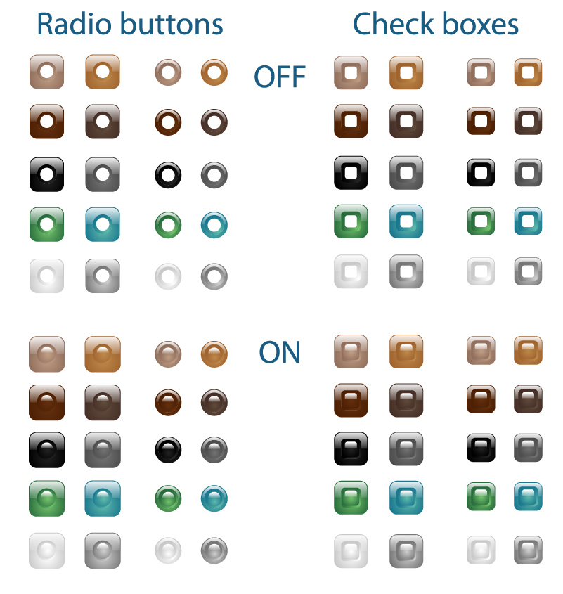
Interface Controls
Buttons (including toggle buttons).
Check boxes.
Radio buttons.
Drop-down lists (combo boxes).
Page tabs and accordions.
Text entry areas sliders and controls for making adjustments.
Controls for moving, resizing, or closing screens.
Notes:
ELLEN:
These are the types of graphic interface controls you really need to pay attention to and make them accessible.
These are critical controls. If for some reason someone using accessibility software can’t interact with them, then they can’t use your app.
The list, and you can read them yourself, are some of the most common types of controls in mobile.
*** STOP HERE *************************

Slide 48
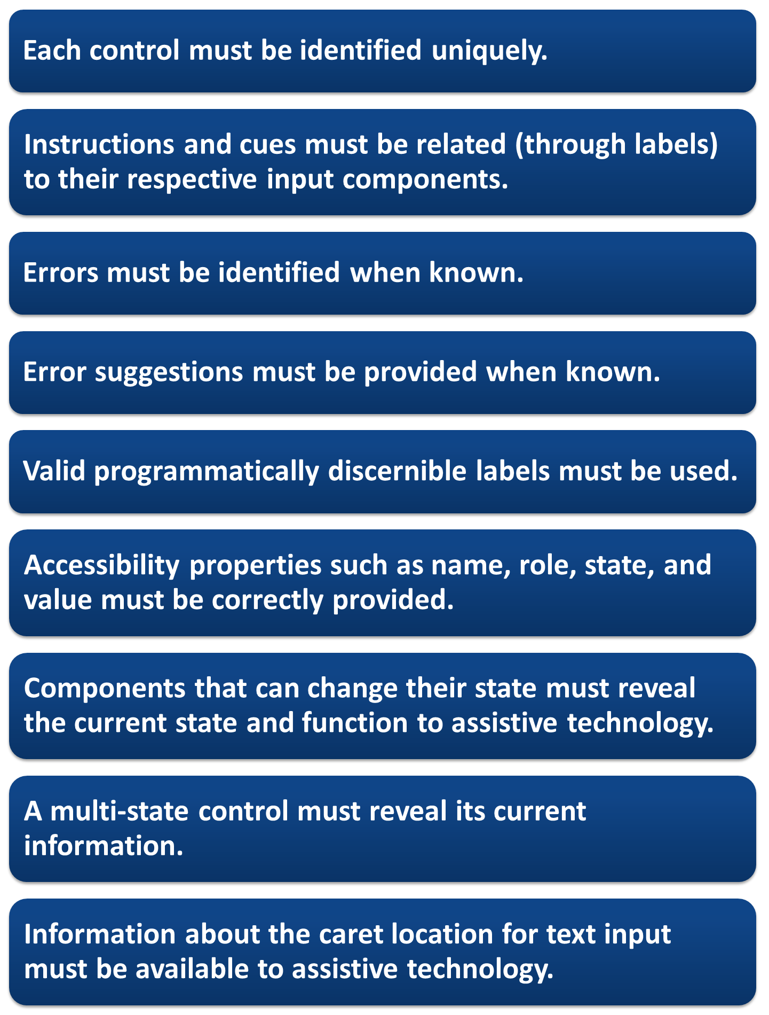
508 Requirements for Interface Controls
Each control must be identified uniquely.
Instructions and cues must be related (through labels) to their respective input components.
Errors must be identified when known.
Error suggestions must be provided when known.
Valid programmatically discernible labels must be used.
Accessibility properties such as name, role, state, and value must be correctly provided.
Components that can change their state must reveal the current state and function to assistive technology.
A multi-state control must reveal its current information.
Information about the caret location for text input must be available to assistive technology.
Notes:
ELLEN:
These are some the best practices regarding user interface controls.
Typically, these controls are used on forms – very busy forms which are collecting a lot of information.
Make sure each control is specifically labeled or named.
Make sure an errors are clear and specific, moving focus to the field with he error – if it’s possible to do that.
*** STOP HERE *************************

Slide 49
508 Requirements for Interface Controls (cont’d)
Each control must be identified uniquely.
Instructions and cues must be related (through labels) to their respective input components.
Errors must be identified when known.
Error suggestions must be provided when known.
Valid programmatically discernible labels must be used.
Accessibility properties such as name, role, state, and value must be correctly provided.
Components that can change their state must reveal the current state and function to assistive technology.
A multi-state control must reveal its current information.
Information about the caret location for text input must be available to assistive technology.
Notes:
Shawn:

Slide 50
508 Requirements for Interface Controls (cont’d)
Each control must be identified uniquely.
Instructions and cues must be related (through labels) to their respective input components.
Errors must be identified when known.
Error suggestions must be provided when known.
Valid programmatically discernible labels must be used.
Accessibility properties such as name, role, state, and value must be correctly provided.
Components that can change their state must reveal the current state and function to assistive technology.
A multi-state control must reveal its current information.
Information about the caret location for text input must be available to assistive technology.
Notes:
Shawn:
So what this is referring to is making sure all controls are labeled in a way a human could understand them.
Just as an example, when coding, the tool may add checkbox 1, checkbox 2, checkbox 3 to a form, which may be perfectly ok from a programming standpoint. But it doesn’t help someone using a screen reader And actually, even programmers looking at the code later would find this helpful.
Again, just more best practices. This is basically saying that an app needs to expose as much information as possible to the end user who may be using some sort of assistive technology.
It may not mean testing every single control by the developer when they’re developing. But they definitely should periodically spot test and make sure the user interface controls are acting properly.
Like we said earlier, if this is caught at the end, it’ll mean re-working the app until it passed the 508 certification criteria. So it’s better to do it now than later.
*** STOP HERE *************************

Slide 51
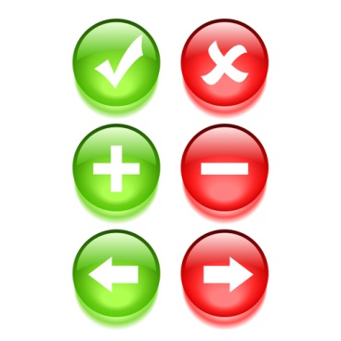

Images and Interface Do’s
Do ensure all controls are implemented correctly to be speech activated.
Do clearly associate form fields with labels so screenreaders can identify them.
Do provide alternative text for all images and controls.
Notes:
SHAWN: Here are some general do’s. This is a bit like what we’ve already discussed.
There is something here we may here we may not have mentioned. It’s generally a good idea to have labels to explain what’s on the screen, like for a form input control.
As an example, you might have a label that says “First Name” next to the editbox that’s associated with that prompt.
*** STOP HERE *************************
Accessibility properties are the pieces of information that help assistive technology identify elements like controls. The key types of information about UI controls (name, role, value, and state) make up much of the data that assistive technology conveys to a user about a control.
When controls are implemented correctly, people dependent on speech recognition software can activate the control by speaking its visual label.
When form fields are associated with labels, someone who uses a screen reader will know which label goes with which form field.
When image buttons provide alternative text, someone who uses a screen reader can navigate an app effectively.
When a text equivalent is missing from a chart, users who can’t see the chart won’t know what it represents.

Slide 52
Images and Interface Don’ts
Don’t place radio button or check box labels to the left of a radio button or check box.
Don’t convey information by sound alone.
Don’t update content on the screen based on a users’ interaction with the content, without clearly informing the user how the content as changed
Yes
No
Notes:
Shawn: Now we have some donts. There’s one in particular we haven’t talked about yet that has to do with sound. It’s the same concept as color. If you have an alarm, or beep, or some other sound, you can still use it. Just be sure to have a visual indicator to go with it.
*** STOP HERE *************************
Accessibility properties are the pieces of information that help assistive technology identify elements like controls. The key types of information about UI controls (name, role, value, and state) make up much of the data that assistive technology conveys to a user about a control.
When controls are implemented correctly, people dependent on speech recognition software can activate the control by speaking its visual label.
When form fields are associated with labels, someone who uses a screen reader will know which label goes with which form field.
When image buttons provide alternative text, someone who uses a screen reader can navigate an app effectively.
When a text equivalent is missing from a chart, users who can’t see the chart won’t know what it represents.

Slide 53
Accessibility Management Platform (AMP) Resources on Images and Interface Controls
iOS:
Forms and Controls: https://va.ssbbartgroup.com/public/standards/view_violations.php?media_type_id=224
Nontext Elements: https://va.ssbbartgroup.com/public/standards/view_violations.php?media_type_id=231
Structure and Reading Order: https://va.ssbbartgroup.com/public/standards/view_violations.php?media_type_id=230
Notes:
Ellen: So here are more AMP resources. We’re promoting the Accessibility Management platform where all of these resources exist. There’s no way we could get into all of this content today. But you definitely should go and check these resources after the presentation.
*** STOP HERE *************************
Find out more from the Accessibility Management Platform (AMP) courses Navigation and Input on both the iOS and Android platforms.
If your content is a mobile app please send an email to section508mobile@va.gov. Please include your name, email address, and phone number.
If the content you produce is e-learning please send an email to section508elearning@va.gov. Please include your name, your email address, and your phone number.

Slide 54
Accessibility Management Platform (AMP) Resources on Images and Interface Controls
Android:
Forms and Controls: https://va.ssbbartgroup.com/public/standards/view_violations.php?media_type_id=292
Nontext Elements: https://va.ssbbartgroup.com/public/standards/view_violations.php?media_type_id=294
Notes:
Shawn: The last slide had the iOS references. This slide has the Android references.
*** STOP HERE *************************
Find out more from the Accessibility Management Platform (AMP) courses Navigation and Input on both the iOS and Android platforms.
If your content is a mobile app please send an email to section508mobile@va.gov. Please include your name, email address, and phone number.
If the content you produce is e-learning please send an email to section508elearning@va.gov. Please include your name, your email address, and your phone number.

Slide 55
VA Learning University (VALU) Talent Management System (TMS) Courses
Section 508: What is It and Why is It Important to You?
Testing HTML for Section 508 Compliance
Developing Section 508 Compliant Web Content
Testing Software for Section 508 Compliance
Purchasing Section 508 Information and Communication Technology
Testing Mobile Apps for Section 508 Compliance
Notes:
Ellen:
This slide lists the TMS courses that are related to 508. There’s a testing mobile apps course now available. But coming soon is an iOS Developer course, all about the iOS operating system. This should be released around May 2015. We’ll be sure this gets advertised on our mobile.va.gov website once it’s available.
There’s specific reference material available on-line related to color and contrast within apps. We’d recommend you download this presentation and take a look at the links included on this slide. We’ve also included the email address of the section 508 team in VA in the speakers notes. You can contact this program office to help answer any additional questions you may run into.
Also in TMS, there is additional accessibility training which includes information on color and contrast within apps and websites.
Note: Log in to TMS at https://www.tms.va.gov/learning/user/login.jsp and search for the course you would like to take.
*** STOP HERE *************************
Find out more from the Accessibility Management Platform (AMP) courses Navigation and Input on both the iOS and Android platforms.
If your content is a mobile app please send an email to section508mobile@va.gov. Please include your name, email address, and phone number.
If the content you produce is e-learning please send an email to section508elearning@va.gov. Please include your name, your email address, and your phone number.

Slide 56
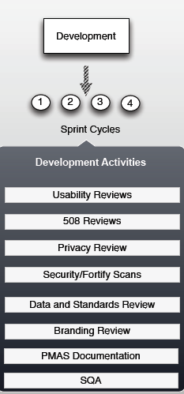
Mobile Development
IMPORTANT!!!
Development teams are required to engage the compliance teams to ensure the App will pass the final compliance reviews.
Notes:
Shawn:
I wanted to talk about an important point. Development teams must engage with Compliance bodies through the development process. If development wait till the end to determine if their app is meeting the VA requirements it will most likely fail the final review. This will require the team to be removed from the Compliance and Release process.
*** STOP HERE *************************

Slide 57


Mobile Development
CONCEPT DEFINITION
PLANNING
DEVELOPMENT
O&M
MS0
MS1
MS2
ORR/IOC Entry
IMPLEMENTATION
Multiple Apps
Multiple Apps
IOC Exit
7.8 SQA
7.13 VA Branding
7.9 Enterprise Security
7.10 Data Security
7.11Privacy
7.12 Independent V&V
MAGB
1 Request New App
2
Approve Request
3 Business Requirements Document (BRD)
4
Fund Effort
5
Assign/ Contract Agile Team
6
Concept Paper Scope
7
Agile Development
8
Field Testing
9
Release
10 Product Support
Sprint 0
Sprint 1
Sprint 2
Sprint 3
Sprint 4
Sprint 5
WMS PM
VA OI&T PM
7.4 508
7.3 Data & Terminology
7.2 Enterprise Architecture
7.5 Clinical Assessment
7.7 OAP/ Sustainment Plan
7.1 Human Factors
7.6 Patient Safety
Notes:
Shawn:
This is our evolving process or lifecycle of a mobile app.
It’s pretty common to not worry about 508 until it comes time to certify an app. But in the Development phase, we recommend that 508, as well as the other certifications be an active part of the development process, seeking feedback while the apps are being built. This reduces the likelihood of a problem later.
Detailed information on the process is available at mobile.va.gov under the developers resources section of the website.
*** STOP HERE *************************

Slide 58
Mobile App Compliance
Mobile Application Classification | 1 - Very Low | 2 - Low | 3 - Medium | 4 - High
Certifying Body | Does not utilize VA resource | Read only access to VA resources | Write access to VA resources | Read and/or write access to VA sensitive resources
Software Quality Assurance | Assessment | Assessment | Testing | Testing
Patient Safety Assessment (OIA) | REQUIRED | REQUIRED | REQUIRED | REQUIRED
508 Accessibility (OIT) | REQUIRED | REQUIRED | REQUIRED | REQUIRED
Code Review | REQUIRED | REQUIRED | REQUIRED | REQUIRED
Usability Testing (OIA) | REQUIRED | REQUIRED | REQUIRED | REQUIRED
User Interface (OIA) | REQUIRED | REQUIRED | REQUIRED | REQUIRED
VA Branding (OPIA) | REQUIRED | REQUIRED | REQUIRED | REQUIRED
Sustainment Plan | REQUIRED | REQUIRED | REQUIRED | REQUIRED
System Performance Impact Assessment (OIT) |  | REQUIRED | REQUIRED | REQUIRED
IV&V | REQUIRED | REQUIRED | REQUIRED | REQUIRED
Data and Terminology Standards Compliance |  |  | REQUIRED | REQUIRED
Privacy and Application Data Security (OIA) |  |  |  | REQUIRED
Enterprise Security |  |  |  | REQUIRED
Certifying Bodies
Notes:
Shawn:
This chart is difficult to see, it’s available in the handout in the Downloads section. But I want to call your attention to the PURPOSE/USE of the chart. The left hand column has list of key certifying bodes. The remaining columns are different “categories” that apps falls into. And so depending on the level of access the app requires, this chart tells you WHICH certifying bodes are required to complete a compliance review. And so now we’re going to take a closer look at each of these certifying bodies and talk about what they each are responsible for assessing/reviewing
*** STOP HERE *************************

Slide 59
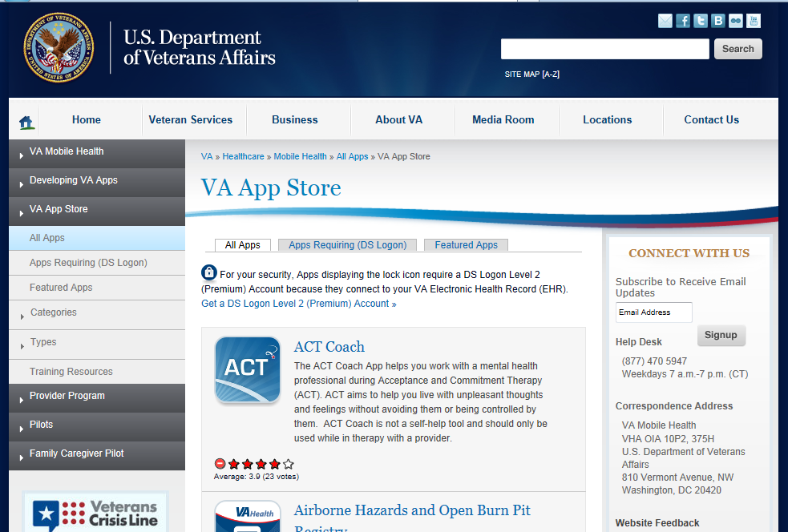
http://mobile.va.gov/appstore
Notes:
Accessibility properties are the pieces of information that help assistive technology identify elements like controls. The key types of information about UI controls (name, role, value, and state) make up much of the data that assistive technology conveys to a user about a control.
http://mobile.va.gov/appstore
*** STOP HERE *************************

Slide 60

Ask the Presenter
Notes:
SHAWN:
If you haven’t submitted your questions yet, there is still time to do so by clicking on the orange “Ask The Presenter” icon. We’re going to show a brief announcement and then Shawn will join me back onstage to answer your questions.
(Sit still and smile until you see the video come up full screen)
*** STOP HERE *************************

