Slide 1
Using Data From the Encoder Product Suite - Central Reporting (EPS-CR). A Tiered Approach
Jennifer Rollins, RHIA, CCS
Jacki Bebb, MA, RHIT, CCS, CCS-P
Notes:
Jacki: Thank you Becki! We are happy to be here today. I want to extend a special thanks to Jennifer for being here with me today and for all of her help collaborating on the presentation . Todays topic is using the data from the encoder product suite – central reporting – or as you will hear us shorten this throughout the presentation to EPS-CR.
I asked Jennifer to work with me to provide the levels of this presentation, in essence the tiers and that’s what we mean by EPS-CR a tiered approach. I will provide the national level perspective and Jennifer will bring the VISN and Medical Center perspectives. So, let’s get to it!

Slide 2

Learning Objectives
Define
available Health Information Management (HIM) dashboard data
Discuss
why they are important to monitor
Provide
practical examples of data use at the VISN and Medical Center Level
Notes:
Jennifer: Our learning objectives for today are:
Define the available data on the HIM dashboards
Discuss why the data is important to monitor
And provide practical examples of data uses at the VISN and Medical center
I would also like to mention that all of the data in the reports that we will discuss today is the direct result of processes occurring at your facility. (For Example: Coders entering the POA status or bypassing VERA edits). So the output from these reports really can help you identify weak areas in your processes.

Slide 3

Data Overload
Notes:
Jacki: Are you experiencing data over load? Do you feel like there is data out there but you are feeling over whelmed by the sheer amount of it?
Jennifer: Yes, absolutely, that’s why I was interested in co-presenting with you today. Even though I was on the original workgroup that developed these reports, I know there are more ways we could utilize the information to improve our processes in VISN 2.
Jacki: That’s great to hear! One of our objectives here today it to help you understand the data that is currently available on the HIM dashboard. In the daily operations of a HIM Department, we know all too well that time is very precious and there are many competing priorities. The HIM program office modified the Nuance contract to include a monthly output of key HIM operational metrics. These metrics are meant to assist HIM departments with data gathering and reporting and to free up your time to focus on the analysis of the data and what it means to your facility and how it can be used to drive improvements.
Now Jennifer is going to ask the audience an interactive poll question.

Slide 4

Poll Question
Do you know where the HIM Dashboards are located?
    Yes, I use them all the time.
    Yes, but I want to learn more.
    No, but I want to learn more.
    What’s a HIM Dashboard?
Notes:
Jennifer: To find out a little more about what our audience knows about the EPS-CR dashboard, we would like to ask a poll question. Do you know where the HIM Dashboards are located? Please respond with one of the following:
Yes, I use them all the time.
Yes, but I want to learn more.
No, but I want to learn more.
What’s a HIM Dashboard?
Please indicate your answer by clicking on the blue polling icon above my head. We’ll move on and come back to your results in just a moment.

Slide 5

Where is the Dashboard?
No special permissions required
Link on the HIM Website
http://vaww.vhahim.va.gov/index.php?option=com_content&view=featured&Itemid=101
Notes:
Jennifer: While the poll results are collecting – The dashboard can be accessed at this link, which is located on the VHA HIM website.
There are no special accesses or permissions required.
If you have a NT logon and password, you can access the dashboard.
Also, if you have any questions regarding the dashboard content, you can post a question to the HIM Question and Answer section on the HIM site.

Slide 6
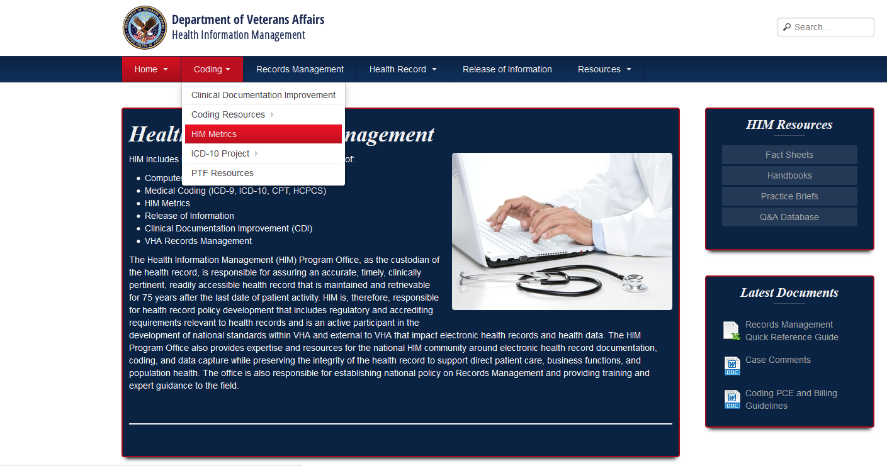

Notes:
Jennifer: When you get to the HIM website, just click on the coding tab and choose “HIM Metrics”.

Slide 7
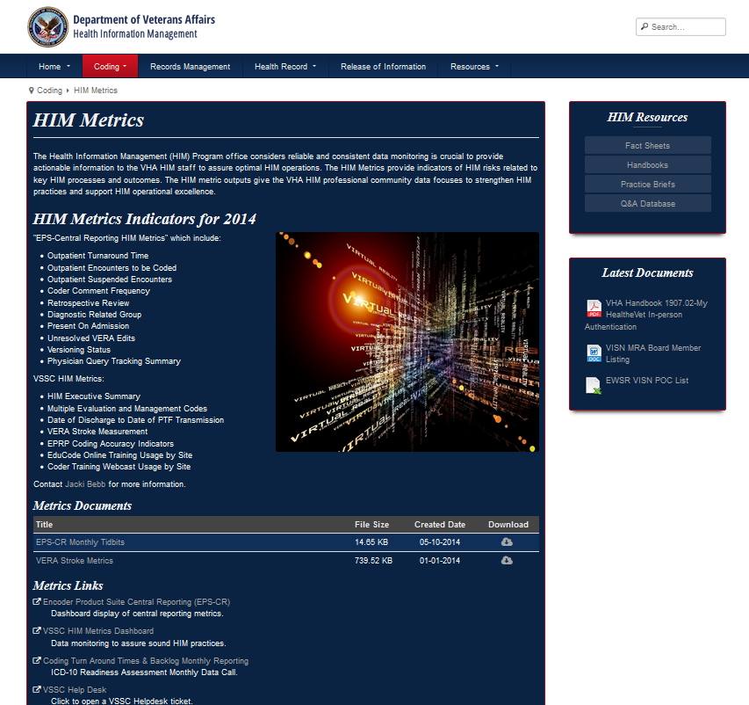
Notes:
Jennifer: To access the dashboard click on the Metrics Links for Encoder Product Suite Central Reporting.
Now that you know how to get to the reports, Jacki is going to go over what the dashboard looks like and the data source of it’s contents.

Slide 8
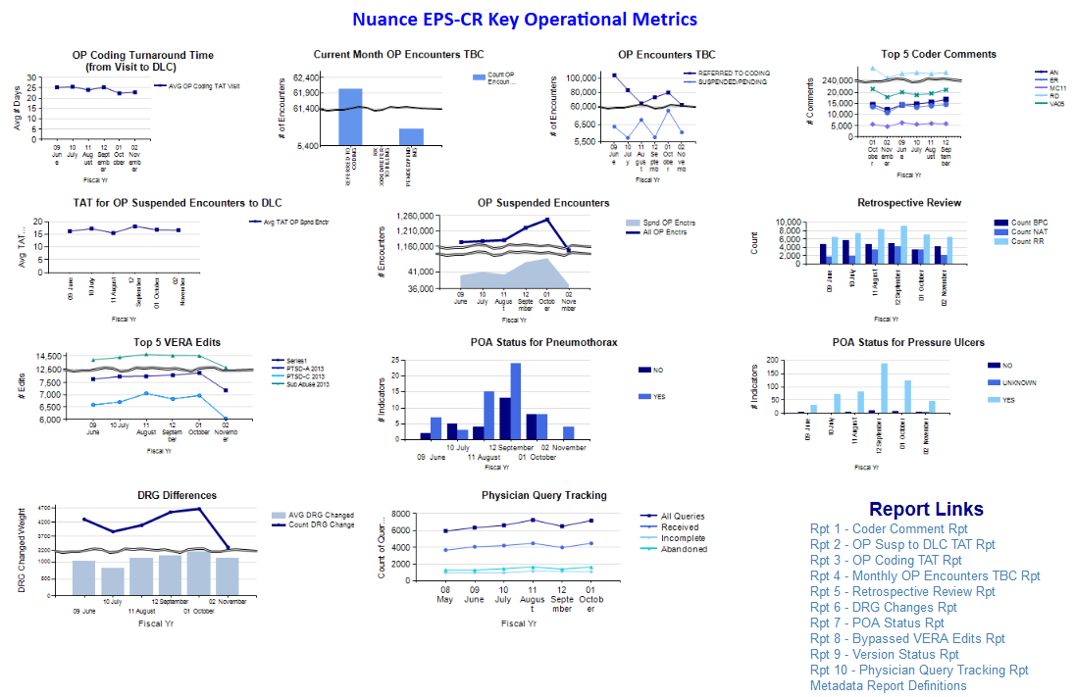

Notes:
Jacki: As you can see this is a lot of information, the dashboard was designed to be a one stop shop at this view. From here it functions by drilling down to each level of the organization.
Many of the details on these slides will be difficult to read. We’re going to go through each one of these reports and have called out the details we’d like you to focus on, but if you’d like to see this in more detail, you can always click on the green download icon above my head to download the presentation. You can also go to the dashboard after this presentation to check it out yourself. It would be nice to be able to move through the dashboard live today, but unfortunately we are unable to, so we have provided screen shots of the dashboard and the reports.
Please note that we prepared these slides in advance, to see the most up to date data, please visit the dashboard.
In addition to the design of a one stop shop view with drill down capability, the dashboard is populated monthly. Jennifer can you talk about that a bit, how does it work?
Jennifer: All of the data is provided in a extract form from each medical center or VISN (depending on the local set up). The snapshot of the data is taken on the 15th of the month for the previous month’s data, but sometimes the extracts are missing or incomplete. When this happens the vendor works with the local IT staff to trouble shoot the problems. And so they have until the 30th to do this.
So looking at the dashboard, this is the national level data for the defined reports. It is “drillable” to all levels of the organization.

Slide 9
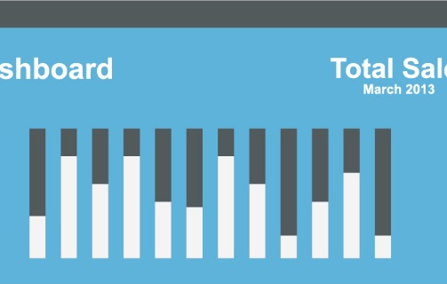
Data Source
  Clintegrity 360
  and
  Encoder Product Suite (VIP Workplace, Coder Compliance Module, Audit Compliance Module).
Nuance Product Suite
Notes:
Jacki: We are going to spend the majority of our time talking about the EPS-CR dashboard. it’s data source is the Nuance Encoder Product Suite, which includes: Clintegrity 360
and
Encoder Product Suite (VIP Workplace, Coder Compliance Module, Audit Compliance Module).
Jennifer: Jacki, I have a quick question, why is the data on the dashboard specific to Nuance?
Jacki:
Good question. The overall goal or vision of the project was to provide timely, consistent actionable data. Our office,
the Health Information Management (HIM) Program office considers reliable and consistent data monitoring crucial to strengthen practices and support operational excellence.
Initially the national contract supplied the software but there was no way to determine outputs at a national level prior to the dashboard project . Since, the national level data was not available, we had to ask for the data to be collected, by manual data calls to each medical center – and as you can imagine there are a lot of pitfalls when working with self reported data, and we wanted to eliminate these pitfalls and make the data clean, consistent, and readily accessible.

Slide 10

Dashboard History
Log into the Nuance Support Center: http://www.nuance.com/support/clintegrity360-government/index.htm
Navigate to Quick Links area
Complete EPS Enhancement Request Form with as much detail as possible; including checking the “EPS-CR” box
E-mail the completed form to epsenhancements@dssinc.com
Notes:
Jacki: The dashboard is 3 years old and like us, aging. ☺ Jennifer can you believe it was almost 4 years ago when we brought the workgroup together to build this dashboard?
Jennifer: Time sure does fly. It’s hard to remember what some of the original reports even looked like, but the original concepts remains the same, and that is to provide key data to drive process improvement in the domains of quality and timeliness.
We continue to refine the information contained on the dashboard via input from the field. I would like to mention, any input for new reports or enhancements to current reports can be made by following the steps on the slide. We do value your ideas and monitor these requests as they are submitted.

Slide 11
Poll Results
Do you know where the HIM Dashboards are located?
    Yes, I use them all the time
    Yes, but I want to learn more
    No, but I want to learn more.
    What’s a HIM Dashboard?
Notes:
Jennifer: So – how did the poll go? The question was: Do you know where the HIM Dashboards are located?
Ad lib to audience results then move on

Slide 12

Poll Results
Do you know where the HIM Dashboards are located?
    Yes, I use them all the time
    Yes, but I want to learn more
    No, but I want to learn more.
    What’s a HIM Dashboard?
Notes:
Jennifer: Now that we have a better understanding of what the audience knows, Jacki is going to go over some more specifics regarding the dashboard.

Slide 13
What it contains
Outpatient Turnaround Time*
Outpatient Encounters to be Coded*
Outpatient Suspended Encounters*
  Turnaround Time for Outpatient Suspended Encounters*
Coder Comment Frequency*
Retrospective Review*
DRG Differences*
Present On Admission (Pneumothorax and Pressure Ulcers)
Top 5 Unresolved VERA Edits
Physician Query Tracking Summary
Notes:
Jacki: The EPS-CR dashboard contains these listed reports. The asterisk next to the report on this slide indicates reports that are drillable to the Internal entry number, which we commonly refer to as the IEN – The IEN is specific to the patient and to the encounter. The IEN is provided to “work” that specific patient encounter. For example on the outpatient TAT report you can drill down to the IEN level which can be used to identify the specific encounter at your facility.
Also, the underlined reports on this slide (read reports) are reports that are going to be replaced. This is why we really need your help defining what you feel would be of value. We are going to have a live opportunity to do just that coming up. So be thinking of general ideas regarding Nuance reports that you would like to see on the dashboard.

Slide 14

CBO Focus
Outpatient Coding Turnaround Time
< 14 days
Notes:
Jennifer: We talked about the data source which is Nuance, and why the dashboard is important. I also wanted to mention that we don’t work in a vacuum. We engage our business partners within VHA such as the Chief Business Office. All of the efforts were vetted with CBO and as you can imagine, CBO is very interested in the coding process, as it is an integral part of the revenue timeline.
The goal for Outpatient Coding Turnaround time is 14 days or less.

Slide 15

Outpatient (OP) Turnaround Time (TAT) Workgroup
Notes:
Jacki: The Outpatient Coding turnaround time workgroup is an excellent example of how field suggestions were received and used to enhance the dashboard.
This group was comprised of subject matter experts from coding, billing, revenue utilization review, non-MCCF staff ( Tricare and ChampVA). The group identified all data gaps in the original calculation of the turn around time. And wrote software enhancement requests that addressed these gaps.
The group suggested that VERA, Referred to UR, Referred to Legal/Tort, Inpatient Professional fees and the ENHANCEMENT YOU HAVE ALL BEEN WAITING FOR - THE New Insurance Late Check Out encounters be excluded from the calculation. This enhancement will be in the Nuance 2nd Quarter release which is due out in April 2015.
Jennifer: This is a very desired enhancement the field has been waiting for, in fact the first test extract excluding this data was just pulled from the VISN 2 data base. We are anxious to see how it impacts our TAT.

Slide 16
Features of the Dashboard
Visual graphic view of national key metrics
National, CPAC, VISN, Medical Center, CBOC
Individual actionable encounter data*
Drillable to Internal Entry Number (IEN)
Metadata definitions for each report
Export each report to many different file extensions
Notes:
The dashboard is a visual graphic view of key metrics, it is drillable to the CPAC, VISN, Medical center and CBOC level, and some reports even drill down to the internal entry number, the IEN, which allows you to translate into the patient specific encounter for action. The IEN is used to designate a unique record within the VistA database. It is provided on the lowest level of the drill-through report to allow a user to conduct research by pulling up the individual encounter to view additional details if they wish. It should be noted that the user must have SSN access to view the related encounter details. You can request SSN access via the VSSC website. The link is provided at the end of this presentation.
There is also metadata which is the definition of each report and what they contain.
And you can export the reports to a bunch of different formats for use outside of the dashboard. So, if you had a meeting to present data, you could export it.

Slide 17
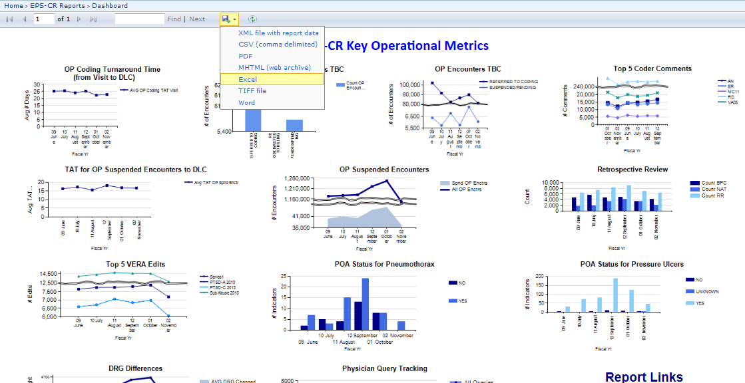
EXL, CSV,PDF, MHTML, Excel, TIFF, or Word file
Insert a graphic – drop down will all of the choices
Notes:
Here is a screen shot of all the file types you can use to export.
So Jennifer. –Which files types do you typically use?
Jennifer: Most of the time we just abstract the numbers from the dashboard to populate our reports, but if we do need to export them, we use the Excel or CSV format.
Jacki: Now let’s move on to a VISN example of not only the mechanics of how you use the export feature on the dashboard, but how you actually use the data.

Slide 18
VISN 2 Example TAT
Notes:
Jennifer: As Jacki previously mentioned, you may remember that prior to EPS-CR we were required to run the outpatient TAT report in ACM, manipulate the data and report our numbers each month. This process was time consuming, so it’s great that this information is easily accessible on the dashboard. In VISN 2, we use it to populate our VISN and facility dashboards.
I also like the fact that the data is pulled using the same criteria for all facilities which truly allows us to compare ourselves to other VISNs and medical centers.

Slide 19
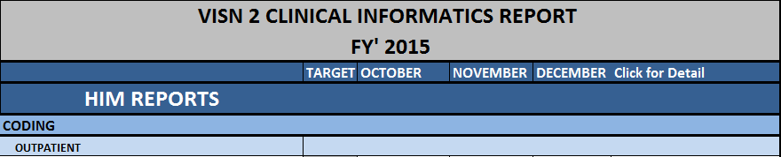
Notes:
Jennifer: this is an example of how we use the data to populate our VISN 2 Clinical Informatics Dashboard.
We display the target for this metric which is 14 days or less, and then we populate the actual turnaround time averages by obtaining them from the national dashboard.
As you can see we are very close to making the 14 day TAT in VISN 2.

Slide 20
Poll Question
Do you use the HIM Dashboard to monitor compliance with key HIM metrics in your department?
    Yes
    No, because it’s not applicable to my position
    No, but I want to learn more
Notes:
Jennifer: So the previous slide was an example of how we use the national dashboard data in VISN 2. Jacki and I would like to get a sense of how our audience uses the dashboard data.
To do so, I would like to ask you a poll question. Please indicate your answer by clicking on the blue polling icon above my head.
Do you use the HIM Dashboard to monitor compliance with key HIM metrics in your department?
Yes
No, because it’s not applicable to my position
No, but I want to learn more
While the poll is open Jacki is going to discuss another data source that may be of interest to you.

Slide 21
VSSC Dashboard
https://securereports2.vssc.med.va.gov/Reports/Pages/Report.aspx?ItemPath=%2fMgmtReports%2fHIMS%2fProductionHIMS%2fHIM+Metrics+Report&rs:Command=Render
Notes:
Jacki: I just wanted to point out that there is another dashboard on the HIM site. The link on the slide will take you to the VSSC Dashboard.

Slide 22
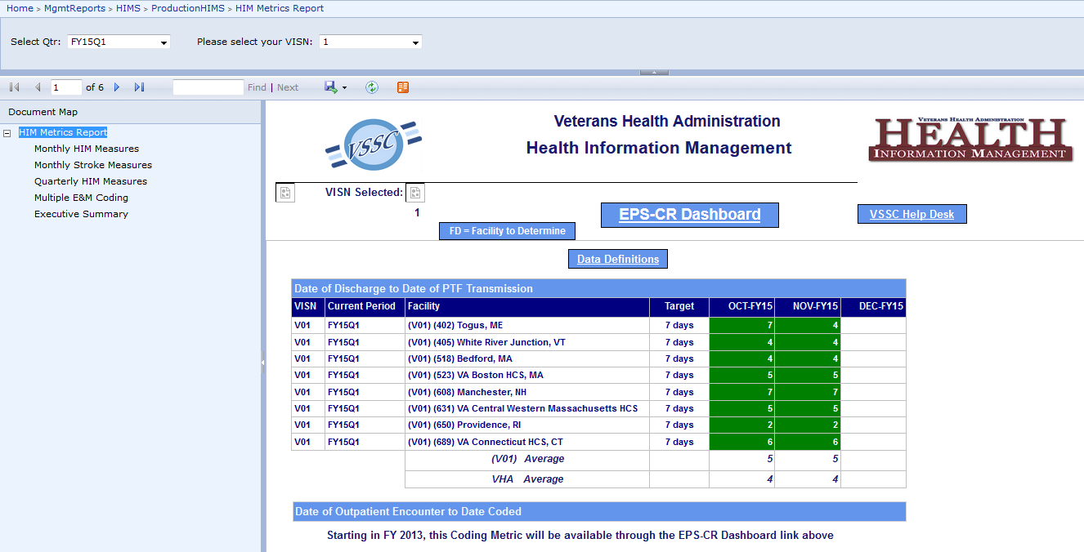
VSSC Dashboard
Notes:
Jacki: Here is the VSSC Dashboard. As you can see it has a very different look than the EPS-CR dashboard.

Slide 23
Notes:
Jacki: The VSSC dashboard contains Monthly HIM Measure such as PTF Timeliness, Monthly Stroke Measures, Multiple E&M Coding, and an Executive Summary. On the executive summary there is a good graphical representation of outpatient coding turnaround time at the National, VISN, and CPAC level. It’s worth a look!

Slide 24
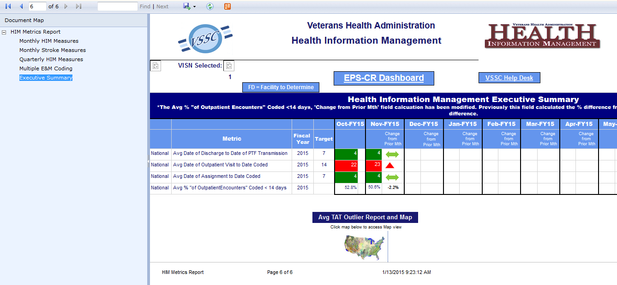
Notes:
Jacki: on the Executive Summary, you can get some detailed information regarding Outpatient TAT by clicking on the map of the US.

Slide 25
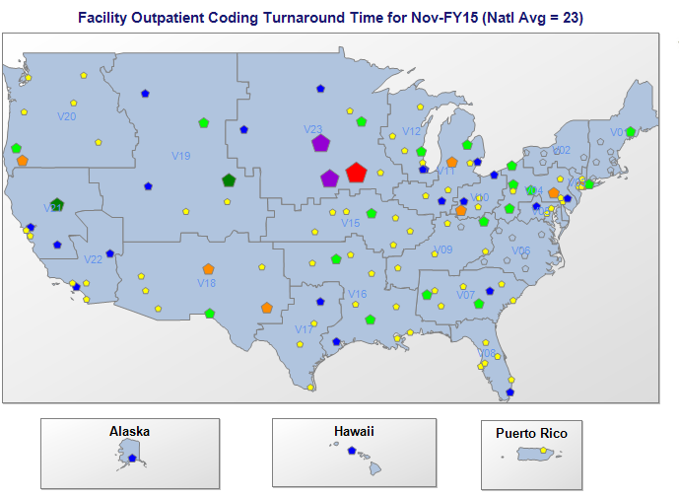

Notes:
Jacki: Here you will find a national map of outpatient turn around time by Medical center. The overall goal is 14 days or less and the medical centers are each represented by their individual performance. So at a national glance, we have a handful of medical centers who are meeting the turn around time goal, but it looks to me like there is a big army of yellow sites – which indicate they are very close to meeting the goal – they are at 15-23 days.

Slide 26
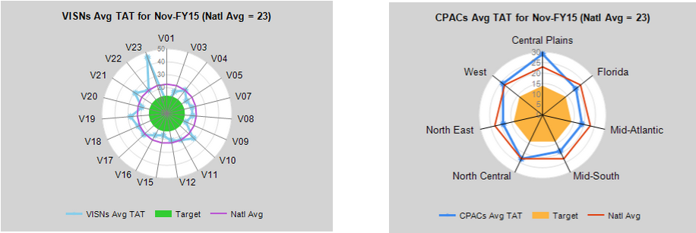
Notes:
Jacki: In addition, there are some “spider graphs” that display VISN and CPAC performance as compared to the goal. The goal of 14 days is in the center of the target.
Just as a reminder these are illustrated to show the content and purpose of the outpatient TAT reports. This display data is not up to date, be sure to access the dashboard to view your current performance.
Jennifer: Well Jacki, learning about where these graphs are located is great information, as I wasn’t aware of them before.
Now I’m going to take a look at the poll results.

Slide 27
Poll Results
Do you use the HIM Dashboard to monitor compliance with key HIM metrics in your department?
Yes
No, because it’s not applicable to my position
No, but I want to learn more
Notes:
Jennifer:
Poll results : Do you use the HIM Dashboard to monitor compliance with key HIM metrics in your department?
Look like…..ad lib.

Slide 28
Poll Results
Do you use the HIM Dashboard to monitor compliance with key HIM metrics in your department?
Yes
No, because it’s not applicable to my position
No, but I want to learn more

Slide 29

Key HIM Metrics – Definitions on the EPS-CR Dashboard
Notes:
Jennifer: Now let’s really dive deeper into the presentation. Jacki is going to get us started with the Outpatient Coding Turn Around Time Report.

Slide 30
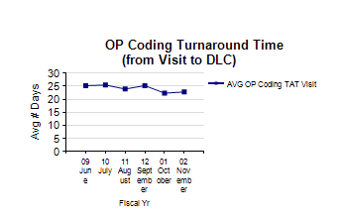
Notes:
Jacki: I just want to mention once again, that all of the reports that I will define today are extracted monthly and their data source is the Nuance Product Suite.
Outpatient coding turnaround time is an average of the date of the encounter to the date last coded within the reporting period.
-There are some data exclusions in the calculation (thanks to the Outpatient turnaround time workgroup).
The calculation excludes:
encounters re-assigned after coding is complete and result in a negative number.
• encounters covered by ChampVA or Tricare insurance to align with Central Business Office reporting.
• Inpatient Professional Encounters and encounters in a “Legal Referred to Coding” status
• encounters sent for VERA Validation.
• and prosthetics encounters.

Slide 31
Notes:
Jacki stand to start interacting with slides here
To drill down into the data, since we can’t do that on the fly in the studio, I will show you screen shots of the steps. This should be pretty quick and only a little bit painful, but I wanted to show you, so you have it for future reference.
To drill down, click on any data point on the report. In this example, you are going to drill down into the month of Novembers’ data.

Slide 32
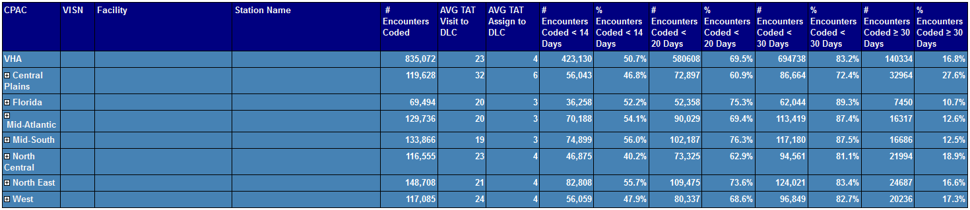
CPAC Level
Notes:
Next you will see the CPAC level; it displays the number of encounters, the average turn around time from the visit to the date last coded, the average turn around time from the date of assignment to the date last coded, the number of encounters coded less than 14 days, and the % of those encounters (the goal is 100% of encounters to be coded under 14 days). The report breaks down into time increments to show you how many encounters are in goal, how many are close to goal and how many are really far from meeting the goal.
In this example: in VHA we code about half (50%) of our encounters within 14 days, 69% within 20 days, 83% within 30 days, and 16 % greater than thirty days. So this report not only give you the average, but it provides some basic data analysis about what is contained in the total average, providing some more meaning.

Slide 33
Notes:
Once you select the CPAC, (here we will select the North East CPAC) to drill down to the VISNs contained within that cpac.

Slide 34
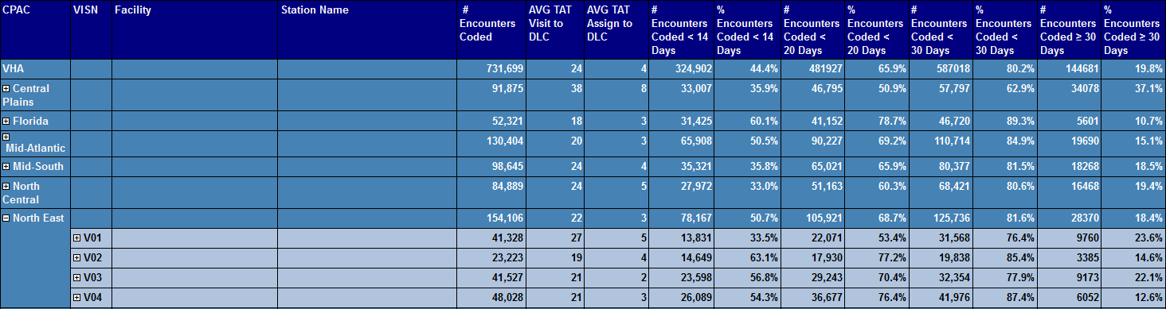
VISN Drill Down
Notes:
So this is the view of the North East cpac, and included in it is visn’s 1, 2, 3, and 4.

Slide 35
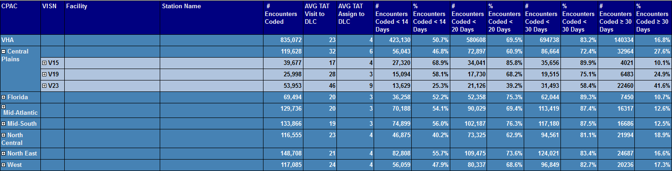
Notes:
Since Jennifer is here with me today, I am going to select her VISN, VISN 2.

Slide 36
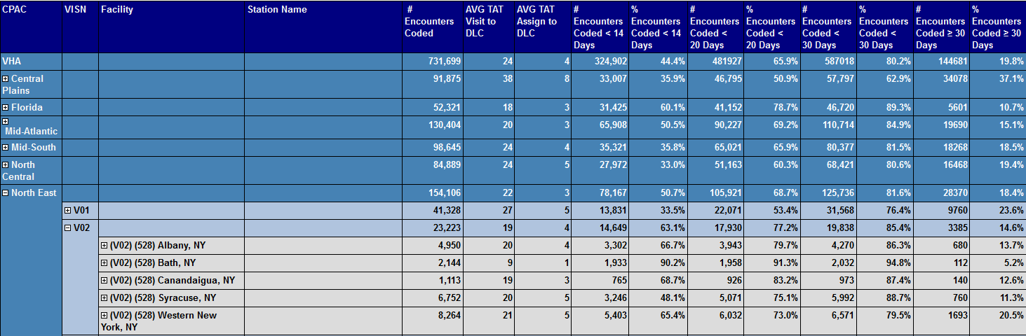
Medical Center Drill Down
Notes:
And here you will see all of the medical centers within VISN 2. For this example we select Albany.

Slide 37
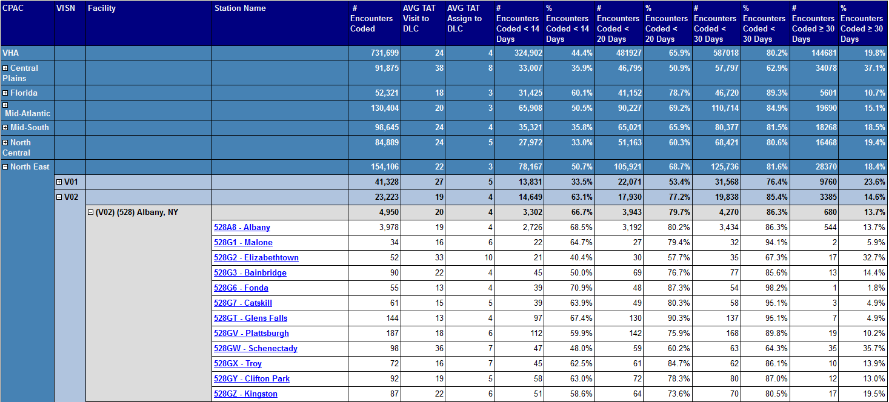
CBOC Drill Down
Notes:
Within the selected Medical Center in this example, you can drill down into a CBOC (Community Based Outpatient Clinic) and in this example we will select Malone.

Slide 38
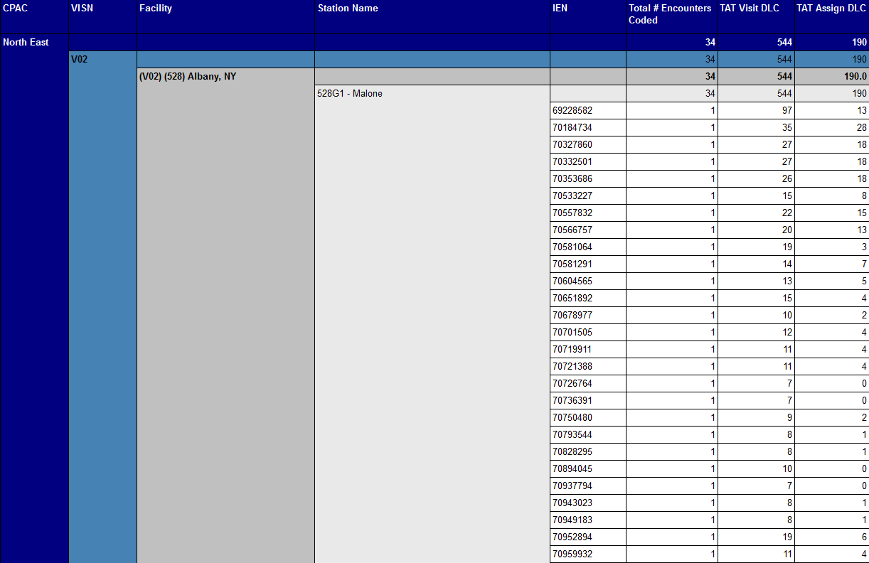
Internal Entry Number (IEN)
Notes:
Here you can see the total number of encounters and the turnaround times. In this example, the site might want to research the IEN associated with the encounter that is 97 days after the encounter date.

Slide 39
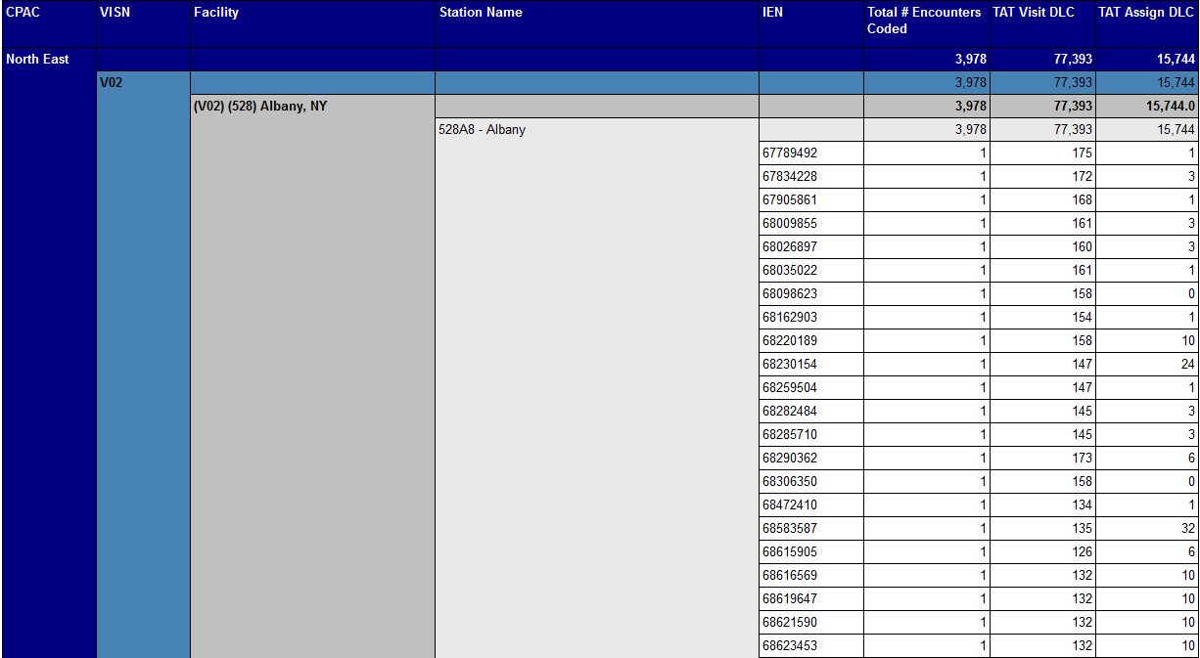
Notes:
And they can do this by entering the IEN into any Nuance software product and it will translate the IEN into the patient encounter.
So I talked about the definition of the report and it’s purpose and the functionality of the report. Now I’m going to hand it over to let Jennifer talk about how the report is used at the Medical Center Level.
Jacki can sit back down here and transition to Jennifer

Slide 40
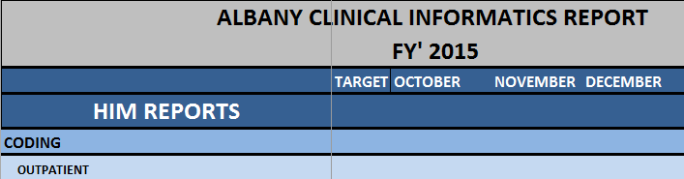
Medical Center Outpatient (OP) Turnaround Time (TAT) use
Notes:
Jennifer - Earlier in the presentation, I showed you how the OP TAT information is used in our VISN Dashboard to keep VISN leadership apprised of key HIM Metrics on a monthly basis. We also prepare a monthly dashboard for each medical enter in our VISN which is distributed to leadership and key staff at the facility.
For example when this report is received, Albany leadership will be able to see Albany’s performance over time and if they are in compliance or not.
As a VISN we continue to struggle with the tat metric of 14 days. We are looking forward to seeing how the NILCO encounters being excluded will impact our numbers.
Now back to Jacki who will walk you through the Outpatient Encounters To Be Coded report.

Slide 41
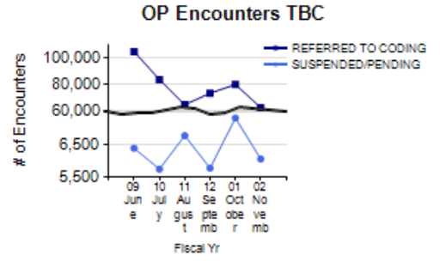
Notes:
This report the outpatient encounters to be coded report is essentially what is in your queue to be coded.
It includes encounters with a status of referred to coding and it includes the status of suspended/pending encounters. Since these are encounters that include Referred to coding and suspended encounters statuses, Jennifer, how do the coders use the suspended status?
Jennifer –
Some examples of why a coder would suspend an encounter are because they need to send a query to the provider or because the code sets have changed. This report will help you monitor the encounters which have been suspended to ensure your coders are addressing these suspended encounters in a timely manner (your facility should have a SOP which defines your process and time line for working suspended encounters), as you do not want encounters to remain suspended indefinitely.
Jacki: Thanks Jennifer that makes sense.
This report also provides a comparison of total encounters to be coded and the ones that are suspended or pending. You would expect to see those lines trending in the same direction, but look at the month of August. Even though less encounters were referred to coding, more encounters were suspended. There may be an explanation for the increase (such as a policy change that required more encounters to be suspended). And in fact when we looked into this data anomaly, we found, this was around time when there was a change in how prosthetic encounters were being processed and during this month they were all required to be suspended. Which did increase the suspended numbers.

Slide 42
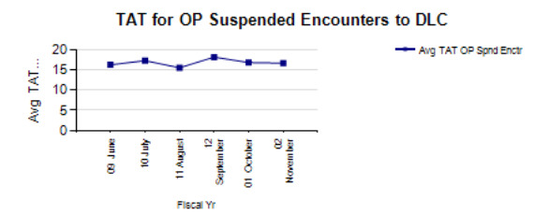
Notes:
Jacki: The Turnaround Time for outpatient Suspended Encounters to Date Last Coded report shows the percentage of encounters which are suspended on a monthly, quarterly and annual basis and provides a point in time view of the monthly snap shots at a national, VISN, CPAC and local level. This report specifically identifies the average turnaround time from the suspended date to date last coded within the reporting period.
Jacki – so Jennifer, what would you be most concerned with on the report?
Jennifer: I would be concerned if there are a lot of encounters suspended over 30 days because The CPAC SLA states an encounter will not be suspended for more than 30 days. So if your facility is over 30 days, you need to look at your process for working your suspended encounters.

Slide 43
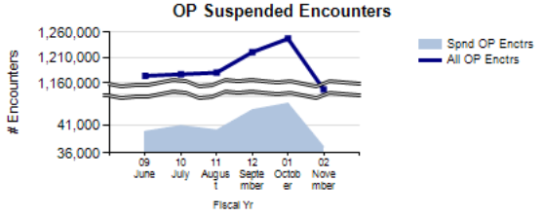
Notes:
Jacki:– The Outpatient Suspended Encounters Report displays the percentage of encounters which are suspended, this report specifically identifies the average turnaround time from suspend date to date last coded within the reporting period.
As you can see this is a report where we took two data points of interest that could have a cause and effect relationship. For example: the top line displays all of suspended encounters. And the bottom blue filled space is the percentage of suspended encounters. You would expect if more encounters are processed, there may be more of a need to suspend them.
And the black broken lines in the middle represent a data break, this is simply a way to fit all of the data points on the graph. On this example, if there was not a data break we would not be able to view the top line.
Now I’m going to turn it over to Jennifer to discuss the Coder comment report.

Slide 44
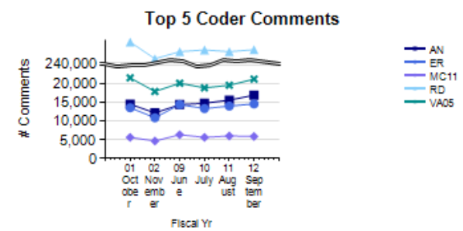
Notes:
Jennifer - interact with slide
At the highest level of the dashboard this report is limited to display the top five coder comments. But you can move into the dashboard for a display of all the case comments and the number of times they were used by clicking anywhere on the graph.
Because all medical centers are different, the information that will be most valuable to you will be the individual comments specific to your medical center.

Slide 45
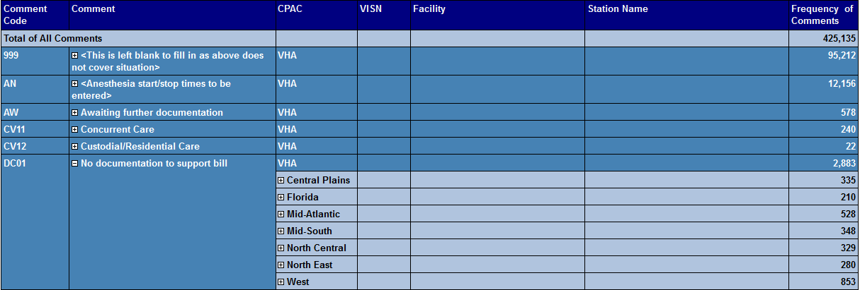
Notes:
Once you click into the report here is where you can look at specific case comments and the frequency that they are being used. In this example, if you want to look at the case comment of DC01 which represents “no documentation to support bill”, you will see it was selected “2,883” times VHA wide. To start the drill down click on the case comment.
Before we go on, just as a reminder to see all of these screen shots in more detail, click on the green download icon above my head to download the presentation, or go to the dashboard after the presentation!
Now back to the drill down.

Slide 46
Notes:
For my VISN I would select the North East CPAC. In this example – there are a total of 280 case comments for the reporting period.

Slide 47
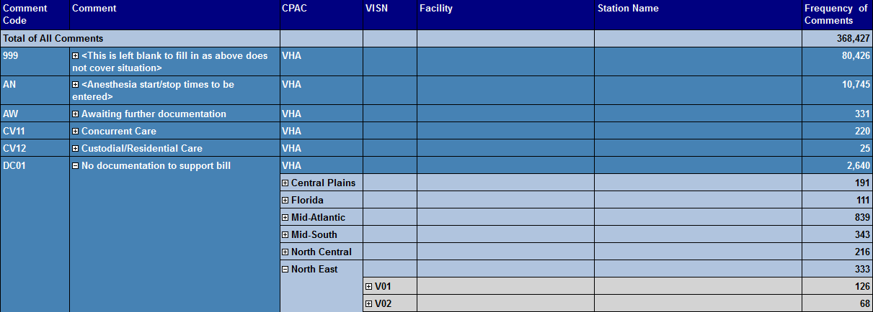
Notes:
Then I would select VISN 2.

Slide 48
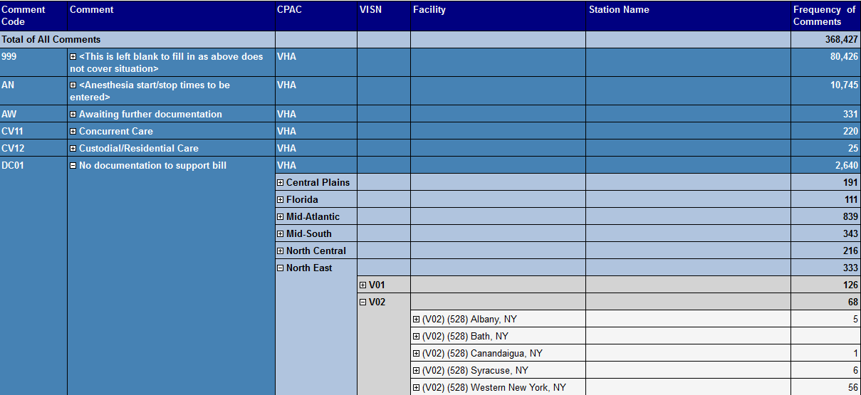
Notes:
For this example I want to look at the case comments for Albany.

Slide 49
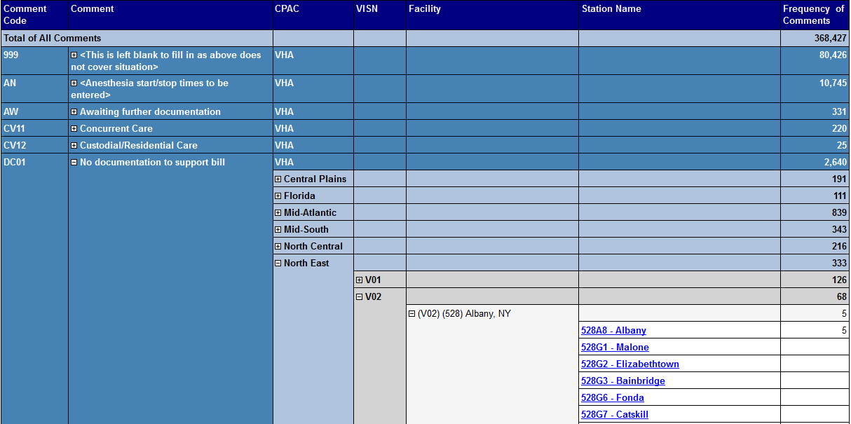
Notes:
Next I can drill down to Albany, or if I just want to look at a CBOC I will select it here.

Slide 50
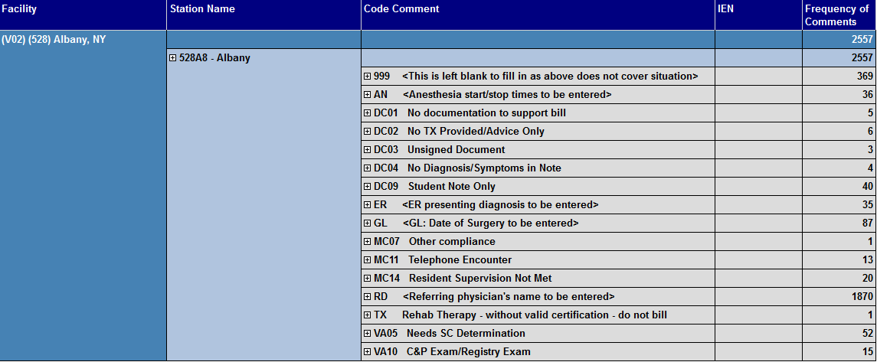
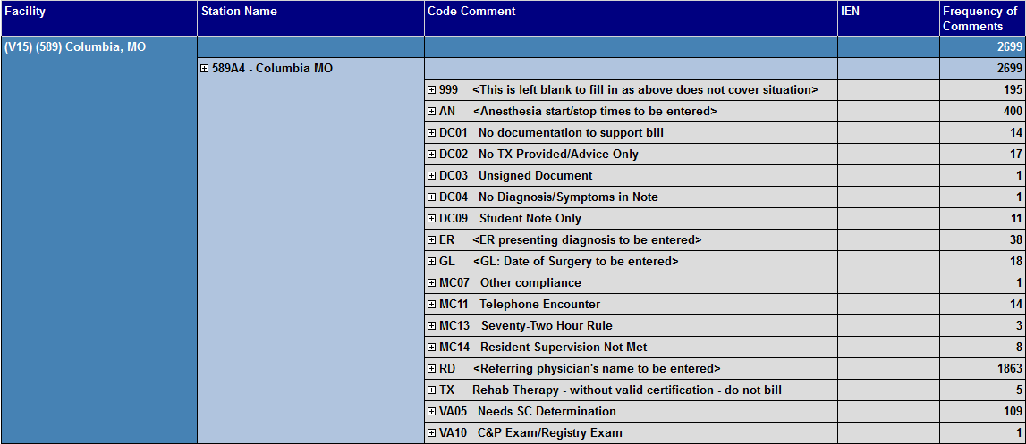
Notes:
As you can see, Albany does not have a large number that were commented to have no documentation. But, if there was a bigger issue, you would want to drill down to the IEN, to check to see if a query was sent or if there is a provider pattern. Both of these examples will provide documentation improvement opportunities.
Jacki: Thanks for going over the case comment report, and as we all know the case comments are then passed to the billers to place a “reason not billable” in the billing package which can result in a cancelled bill, so by monitoring this report, you can get a quick snap shot of the types of comments that are being selected by coding.

Slide 51
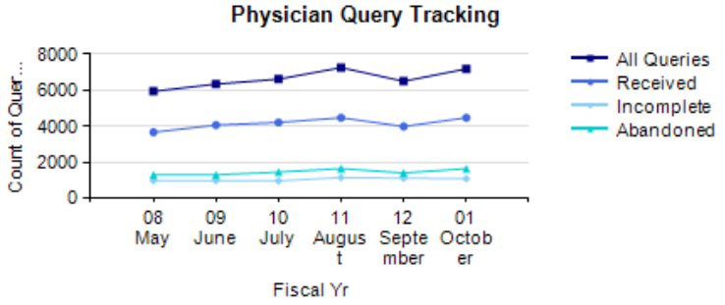
Notes:
Jacki: The Physician Query Tracking report is used to determine the impact of the use of the Physician Query Tracking (PQT) tool on clinical documentation. It includes all queries received, completed and abandoned.
Unfortunately It doesn’t drill down to the IEN – because it’s pulling out of Clintegrity 360, not VistA, but you can run a report locally out of Clinterity 360 at that level of specificity.
Jennifer will you please give us an example of how this report can be used at the VISN and facility level?
Jennifer:
From the VISN and facility level you want to pay close attention to the number of queries which are incomplete or abandoned. In VISN 2, we have a VISN SOP which defines specific time frames and actions the coders should be taking in regards to these statuses.
Jacki- What is the maxim days you allow?
Jennifer – Our standard is 30 days. If the coder is unable to get a response from the provider in 30 days, the query is marked as abandoned. This is important because in our opinion documentation provided 30 days past the encounter is may not be reliable.

Slide 52
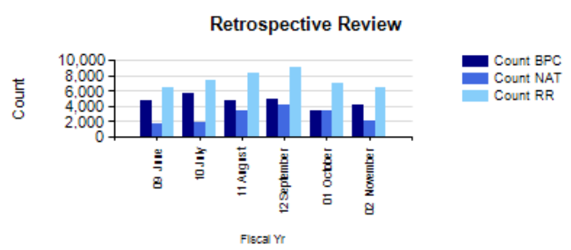
Notes:
Jacki: The Retrospective Review report is meant to record the number of encounters required to be changed post-review and the number of those encounters that subsequently had billing changes performed. This report supports VHA Directive 2010-013, Monitoring "Reasons Not Billable".
We are looking at sun setting this report, because it doesn’t have all of the components that are required to comply with the reasons not billable directive.
Jennifer – It’s too bad that we were not able to get this report to do what we needed it to do. But because the Nuance package is not able to pull the billing action out of the IB package a manual process is still required.
Jacki – knowing this now is a good time to do some live chatting with the audience out there today.

Slide 53

Chat Question
We are looking at discontinuing this report. What types of reports would you find valuable going forward to replace it?
Notes:
Jacki: We are looking at discontinuing this report, and other reports as business needs change. What types of reports would you find valuable going forward?
To answer this question, use the red chat icon above my head.
To get you thinking – think of reports that you continually have to run that you would like to see automated at the National, CPAC, VISN and mc level.
Also think of components of existing reports that could be added.
We’ll move on and come back to your ideas in just a moment. Now let’s talk a bit about the Present of Admission Reports.

Slide 54
Present on Admission (POA):
Y
Yes
N
No
1
Exempt
U
Undetermined
W
Clinically Undetermined
Notes:
Jacki: These reports pull in the indicators that the coders answer in the Patient Treatment File when they are coding inpatient discharges. They include the indicators of Yes, No, Exempt (for example, NHCU stays are exempt from POA indicators), undetermined, and clinically undetermined.

Slide 55
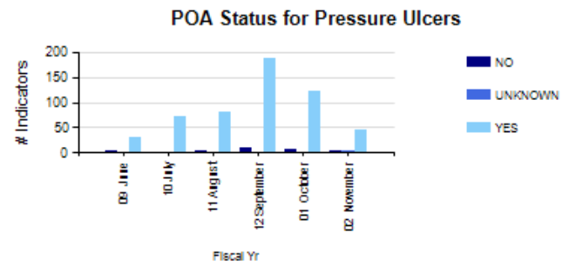
Notes:
The POA reports on the dashboard are limited to two diagnostic cohorts (Pressure Ulcers and I-ah-tro-genic Pneumothorax)
Displayed here is the first cohort – Pressure Ulcers and the diagnostic code range is : 707.0 – 707.09.
This report does not have the ability to display “nulls” or zeros. So you can see – no cases were indicated as “undetermined’ or clinically undetermined” or exempt.
Only No, Unknown, and Yes were selected during this reporting period for Pressure Ulcers.

Slide 56
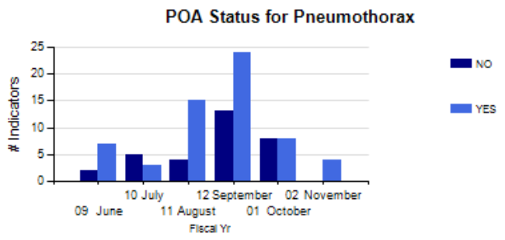
Notes:
The second cohort is for the diagnosis code 512.1, I-ah-tro-genic pneumothorax.
So in this cohort, for this reporting period ONLY Y= Yes, N = No were selected.
This is another report that will be discontinued in the future due to business process changes, Jennifer can you talk about this change in POA reporting?

Slide 57

POA Example
Notes:
Jennifer: With the full implementation of ICD-10 we won’t be limited to two diagnostic cohorts, as the data will be available in VistA for all Hospital Acquired conditions that require a POA status once we transition to ICD-10.
Specifically, PTF file 45 will be updated to contain the POA field on the 701 and 501 screens.
Jacki: ICD-10!! Now there is an example of a business process that is changing. Post – ICD-10 we will work with VSSC to define reporting for all hospital acquired conditions and they won’t be a part of the EPS-CR dashboard any longer. They will display on the HIM VSSC Dashboard, hence opening up some real estate on the EPS-CR display.

Slide 58
Chat Responses
Notes:
Jacki: So, do you have any ideas for what we might replace the POA reports with? Let’s see if we’ve received any ideas from chat. Ad lib.
Plant some chat responses – Exclude New Insurance Late Check Out Encounters from the OP Turnaround
Now let’s move on to the VERA Edits report.

Slide 59
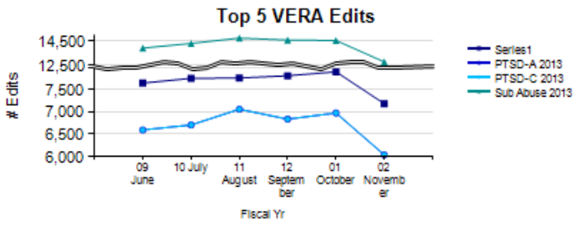
Notes:
Jacki:
This report provides the number of bypassed edits for each Veterans Equitable Resource Allocation (VERA) edit category after the Patient Treatment File (PTF) record is transmitted. This metric assesses the usefulness of the VERA edits and potentially identifies educational opportunities for inpatient coders. It’s like the Top 5 coder case comment report that we discussed – it doesn’t all “fit” on the display – so the top five are listed at the national level on the dashboard, but you can drill down to each specific VERA edit that was bypassed and see how many times during the reporting period it was used.
As a final reminder, to see all of these screen shots in more detail, click on the green download icon above my head to download the presentation, or go to the dashboard after the presentation!
Now, Jennifer is going to go over a specific example in her VISN of how they use the VERA edit report -

Slide 60
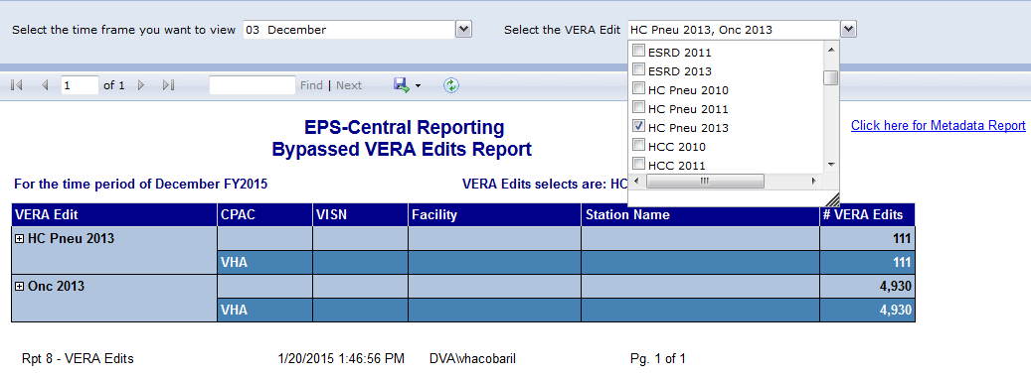
Notes:
Jennifer interact with slide:
I’m going to discuss the VERA edit - High cost pneumonia. To access the report I would select that edit here, by checking the box.

Slide 61
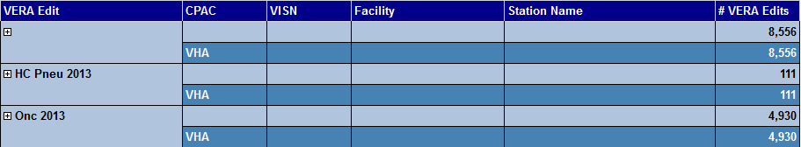
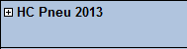
Notes:
And to display more detail I would click on the plus sign.

Slide 62
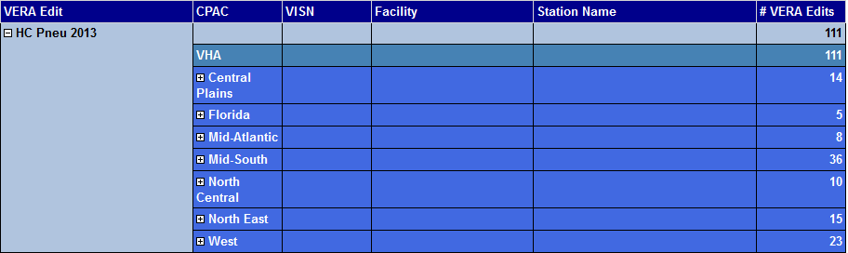
Notes:
I would then select my CPAC – North East.

Slide 63
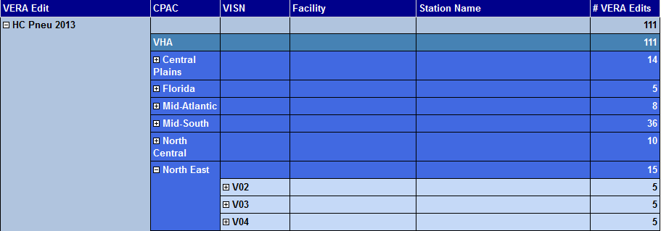
Notes:
And then I would select VISN 2.

Slide 64
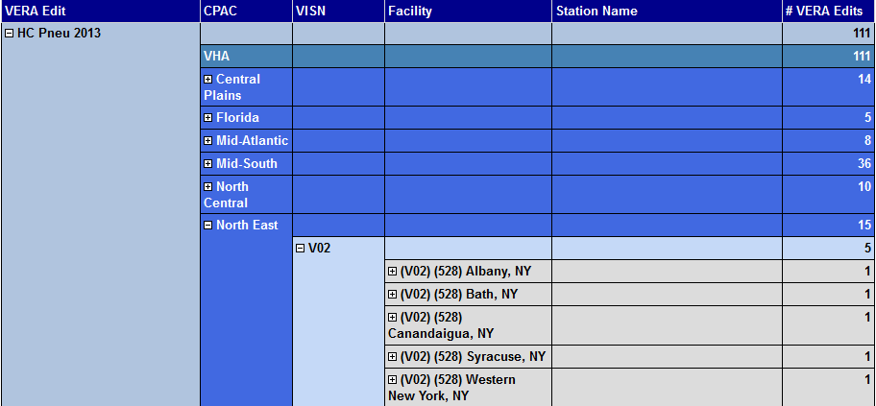
Notes:
We will look at one of the facilities in my VISN – Albany, NY.

Slide 65
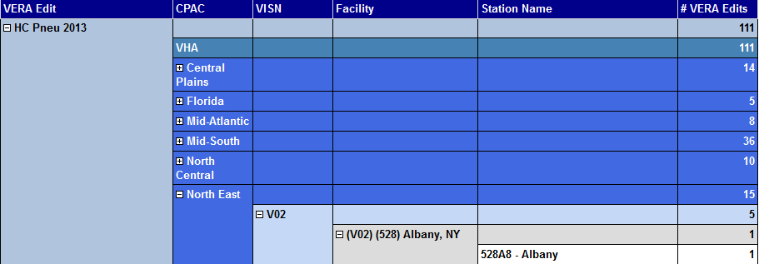
Notes:
Jennifer: We had one case where the coder bypassed the high cost pneumonia VERA edit.
Unfortunately this report does not drill down to IEN, to find out how to identify individual cases, please refer to VehU session 15051, HIMS Role in VERA for specifics.

Slide 66
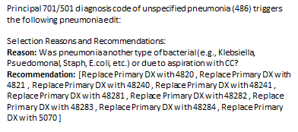
Notes:
At the facility level this is the edit that the coder would see prior to closing the PTF. If the PTF is transmitted with the VERA edit, it will show on the EPS report. At the VISN and facility level the report can be reviewed to ensure the code assignment and sequencing are accurate and if the edit was appropriately bypassed by the coder.
Jacki: That is a really good point Jennifer – this report shows “bypassed” edits. It isn’t a collection of all edits applied. And as you know sometimes it is appropriate to bypass the edit and It is at the coders discretion to accept or bypass the edit, using their judgment.

Slide 67
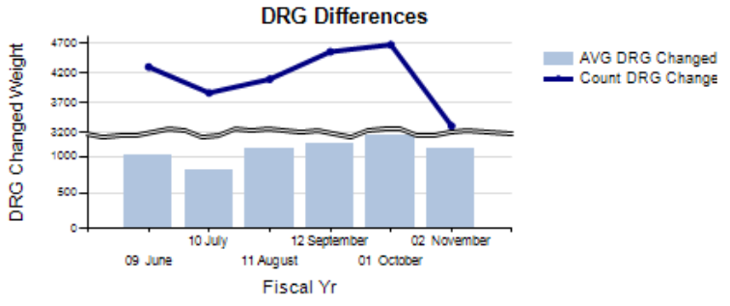
Notes:
Jacki: The DRG Differences report displays the number of DRG (Diagnosis-Related Group) changes made by the coders after initial transmission and calculates the average weight change difference.
This report displays the DRG changes in isolation and the total number of DRG’s coded (so think of this as the denominator of the equation). You may want to use this report to monitor trends in your DRG assignments, which may help you identify areas for documentation improvement opportunities. For example, if you have a Clinical Documentation Improvement program, your CDI Specialist may want to target improvement of unspecified pneumonia documentation. You would expect to see some DRGs changed if queries sent resulted in more specific documentation.
Again the black broken line down the middle – is the data break. If you see it on any of the reports, it just means the totals were too large to show graphically, so there is a date break in the middle of the graph, that shrinks the higher numbers down, so both data points can be displayed. In this example: a data break had to be inserted, because there were far more total drg’s coded than DRG’s changed. But we want to display both sets of data on the report.
Guess what??? This was out last report to discuss today!

Slide 68

Conclusion
Notes:
Jacki: The dashboards continues to be a work in progress – we will be refining existing reports and creating new reports as the software evolves and new business needs surface. In essence, the dashboard reports will continue to evolve.
We hope the time you gave us today gave you more knowledge regarding what is contained on the dashboards and maybe some ideas about how you can use the data to improve processes wherever you work within VHA. Thanks so much for your time and attention.

Slide 69

Ask the Presenter
Notes:
If you haven’t submitted your questions yet, there is still time to do so by clicking on the orange “Ask The Presenter” icon. We’re going to show a brief announcement and be right back to answer your questions.
(Stand still and smile until you see the video come up full screen)

Slide 70
Helpful Links
HIM Website
http://vaww.vhahim.va.gov/index.php?option=com_content&view=featured&Itemid=101
VSSC HIM Dashboard
https://securereports2.vssc.med.va.gov/Reports/Pages/Report.aspx?ItemPath=%2fMgmtReports%2fHIMS%2fProductionHIMS%2fHIM+Metrics+Report&rs:Command=Render
EPS CR Dashboard
http://r01scrappepscr1.r01.med.va.gov/Reports/Pages/Report.aspx?ItemPath=/EPS-CR+Reports/Dashboard
Nuance Support Center
http://www.nuance.com/support/clintegrity360-government/index.htm
VSSC Request for SSN Access
https://help.vssc.med.va.gov/cgi-bin/VSSCHelpDesk/wonderdesk.cgi?do=faq_view_record&faq=1&view_detail=1&faq_id=4

